Slide 1
Exercise 5: Mutation Testing
Gregory Gay
DIT636/DAT560 - February 25, 2026

Slide 2
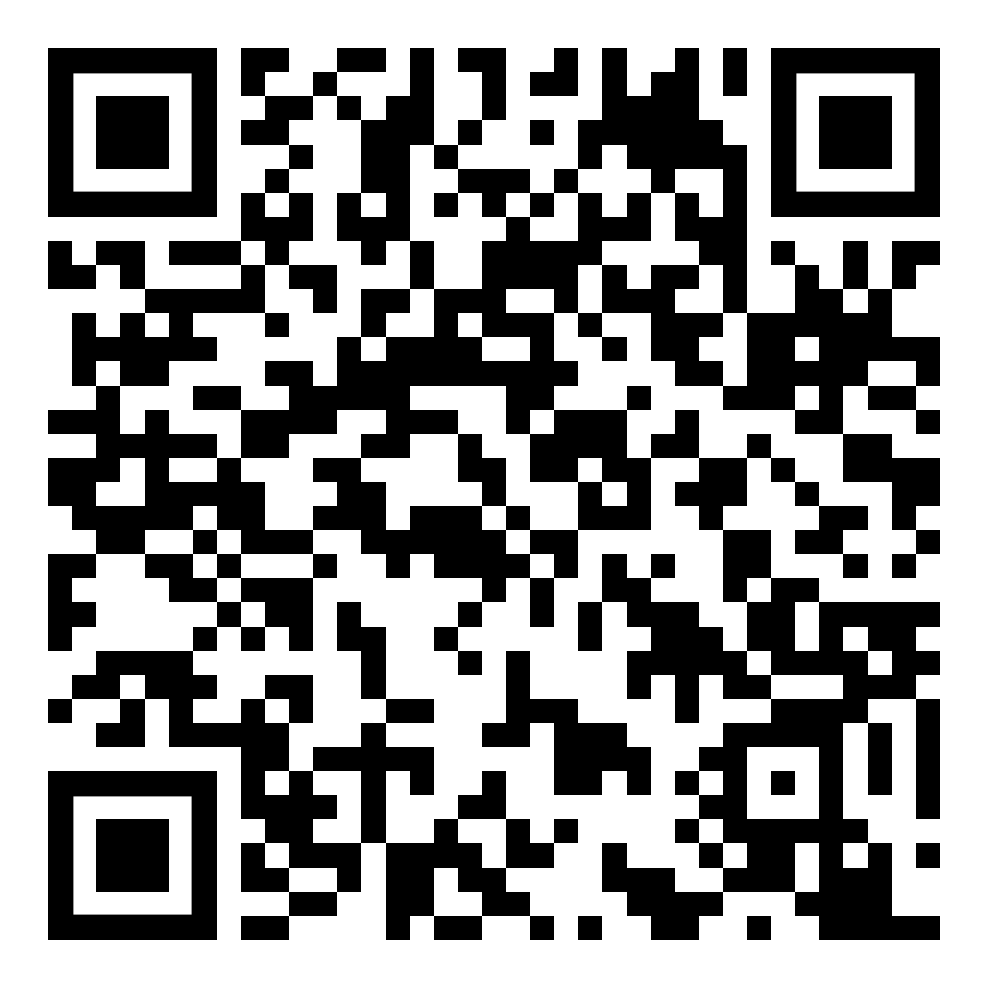
The Planning System Returns
Everybody likes meetings.
  Not true - but we need to book them.
We don’t want to double-book rooms or employees for meetings.
System to manage schedules and meetings.
Notes:
(read)

Slide 3
Mutate the Meeting Planner
Create at least three mutants for classes from the MeetingPlanner system.
  Try to create at least one from each category:
    invalid (does not compile)
    valid-but-not-useful (fails for almost any test case)
    useful (requires specific input or input ranges to detect)
  Use different operators for each mutant
    See handout and lecture 11 slides.
  Try mutating different parts of the code.
Notes:
In particular, look at the difference between valid-but-not-useful (almost any test applied to that method will show different results between the original method and the mutated version) and useful (more subtle mutations that require particular input or input ranges to detect). It is easy to create mutants that almost always fail. It is much harder to create actual useful ones.

Slide 4
Assess Your Test Cases
Run the tests you created in previous exercises. Do they detect the non-equivalent mutants?
  (Pass on original code, fail for mutated code)
  If not, create new test cases that will detect them.
  If equivalent, make sure you understand why the mutant will never be detected.
Can use PITest to measure mutation score.
  Real-world mutation testing tool.

Slide 5
Example 1
Valid, but not useful: constant-for-constant replacement
public boolean isBusy(int month, int day, int start, int end) throws TimeConflictException{
boolean busy = false; BECOMES
boolean busy = true;
checkTimes(month,day,start,end);
for(Meeting toCheck : occupied.get(month).get(day)){
if(start >= toCheck.getStartTime() && start <= toCheck.getEndTime()){
busy=true;
}else if(end >= toCheck.getStartTime() && end <= toCheck.getEndTime()){
busy=true;
}
}
return busy;
}
Notes:
Now, the easiest class to modify is Calendar, so let’s create a useful mutant and a valid, but not useful. Let’s start with valid, but not useful. For both examples, we’ll use isBusy. Here’ we’re going to apply a constant for constant replacement. Rather than initializing busy to false, it is initialized to true. What effect does this have? Well, now, this method can only return true. busy can never be false. If we only have tests that indicate the person is busy at this time, then we’ll miss this mutant. However, this is pretty unlikely. Any test where the person should not be busy will detect this mutant - which will likely be a lot of the tests you will write. This is a very easy mutant to detect. Let’s look at a test case that exposes this.

Slide 6
@Test
public void testIsBusy_NotBusy() {
// Meeting with no conflict with our dates.
Meeting noConflict = new Meeting(1,13,1,3);
Calendar calendar = new Calendar();
// Add meeting to calendar
try {
calendar.addMeeting(noConflict);
// Enter a time that has no conflict.
boolean result = calendar.isBusy(1, 13, 14, 16);
assertFalse(result, "Should cause no conflict");
} catch(TimeConflictException e) {
fail("Should not throw exception: " + e.getMessage());
}
}
ANY test where the person is not busy will fail for this mutant!

Slide 7
Example 2
Useful: Statement Deletion
public boolean isBusy(int month, int day, int start, int end) throws TimeConflictException{
boolean busy = false;
checkTimes(month,day,start,end);
for(Meeting toCheck : occupied.get(month).get(day)){
if(start >= toCheck.getStartTime() && start <= toCheck.getEndTime()){
busy=true;
}else if(end >= toCheck.getStartTime() && end <= toCheck.getEndTime()){
busy=true;
}
}
return busy;
}
Notes:
Now, for a useful one, we’ll use checkTimes, and we’ll apply statement deletion. Statement deletion often results in useless mutants because it can very easily make something not compile. Here, however, it will still compile and run - we’ve just introduced the possibility of an issue because we no longer check to see if the entered meeting time is illegal. This mutant will only be detected if we try an illegal time and don’t get the expected exception. However, it would be very easy not to have a test already checking this. If you’re unit testing and focused on the isBusy method, your first instinct is probably to set up certain calendar meetings and then see if times conflict with those - in other words, you’re focused on the logic in that for loop right after the checkTimes method. However, before we spend time checking our meetings for conflicts, we should absolutely have the code check whether the provided time is even valid! It would be easy as a programmer to have left out a check like this. So, this mutation is essentially checking to see if our tests would be robust to this kind of change. Let’s look at a unit test that would expose this mutant.

Slide 8
Example 2
Test passes in invalid date and expects a TimeConflictException to be thrown.
@Test
public void testIsBusy_invalid_date() {
Calendar calendar = new Calendar();
Throwable exception = assertThrows(
TimeConflictException.class, () -> {
boolean result = calendar.isBusy(14, 13, 14, 16);
});
}

