Slide 1
Proving the Shalls:
Requirements Analysis
CSCE 740 - Lecture 10 - 09/28/2015

Slide 2
How do we know that the software will work?
(AKA: How do we know that our specification is correct?)
(Also… free of contradictions and complete)
Notes:
This is essentially the same question we started with last class. There, we talked about how you need to ensure that your domain assumptions are both stated and accurate. You can’t just claim that the software will operate under any conditions - you need to state your assumptions. That’s not the whole picture, though. That helps us know whether the software will work - whether our specifications are correct- if we are clear about our assumptions and attempt to confirm or refute them, then we’ll at least think more, but that’s just a first step. What else should we do?
(discuss)

Slide 3
Requirement & Specification Correctness
Stating domain assumptions helps with manual inspection…
… But manual inspection can vary in effectiveness.
Writing tests helps refine requirements…
… But they cannot be run until you have software.
If mistakes are missed by writing tests and manual inspection, you won’t find them until it is too late.
Modeling and Automated Verification
Gregory Gay CSCE 740 - Fall 2015 3
Notes:
(read, read). It’s a human process. Humans make mistakes and get distracted. Rigorous manual inspection is normal, it’s something you should do, but it isn’t perfect, it takes a lot of time, and how well it works depends on who looks at it.
(read, read) - Before that, they’re just a brainstorming exercise. That helps. Something that can’t be tested is not a good requirement.
(read)
So, what can you do? Today, we’ll talk about a powerful, largely automated, method of analyzing your requirements - modeling software behavior and performing verification over that model.

Slide 4
Today’s Goals
Building behavioral models.
Finite state machines.
Formulating specification statements as formal logical expressions.
Introduction to temporal logic.
Performing finite-state verification over the model.
Exhaustive search algorithms.
Gregory Gay CSCE 740 - Fall 2015 4
Notes:
(read)

Slide 5
Behavior Modeling
Abstraction - simplifying a problem by identifying important aspects, focusing on those, and pretending other details don’t exist.
The key to solving many computing problems.
Solve a simpler version, then apply to the big problem.
Don’t have code? A design? Hardware? Ignore those and focus on the core behavior.
Gregory Gay CSCE 740 - Fall 2015 5
Notes:
Remember those principles back in the first class? One of those was abstraction - (read).
This idea has been the key to solving many, many, MANY computing problems over the years. Start cutting away at unnecessary complexity. Find a simpler, related problem to solve, figure it out, then see if your solution holds on the big problem.
The final software is going to be big and complex and scary. You haven’t built it yet, you don’t have code, you don’t even have a design laid out. Those are big things that will take a lot of time, but if you just want to analyze your functional requirements, then those details don’t matter just yet. Ignore them and focus on the core behavior of the software. Focus on its functionality.

Slide 6
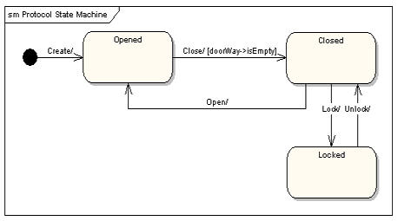
Finite State Machines
A common method of modeling behavior of a system.
A directed graph: nodes represent states, edges represent transitions.
Not a substitute for a program, but a way to explore and understand a program.
Can even build a model for each function.
Gregory Gay CSCE 740 - Fall 2015 6
Notes:
The most common way to model system behavior before building it for read is as a finite state machine.
These are directed graphs where nodes represent snapshots of the system and edges represent events and conditions that change what the system is doing.\
(read) - extremely simple, not enough information to execute for real - but (read). (read)

Slide 7
Some Terminology
Event - Something that happens at a point in time.
Operator presses a self-test button on the device.
The alarm goes off.
Condition - Describes a property that can be true or false and has duration.
The fuel level is high.
The alarm is on.
State - An abstract description of the current value of an entity’s attributes.
The controller is in the “self-test” state after the self-test button has been pressed, and leaves it when the rest button has been pressed.
The tank is in the “too-low” state when the fuel level is below the set threshold for N seconds.
Gregory Gay CSCE 740 - Fall 2015 7
Notes:
First, let’s cover some terminology. We commonly talk about the behavior of software in terms of events and conditions, then reflect on the state of the software. What does that actually mean, though?
(read) - things that occur that trigger a response from the software. Something went wrong, an alarm is raised. A human starts the self-test, which causes the software to enter a self-test mode. These are interactions that occur at some point in time.
(read). Describe the environment or software over a period of time. An event happens and it is over, a condition is something that is true over a period of time. It can be triggered by an event, but is not an event.
(read). The state of an object or of the software is some description of what it is currently doing. What mode is it in? What is guiding its behavior?

Slide 8
States, Transitions, and Guards
State - An abstract description of the current value of an entity’s attributes.
States change in response to events.
A state change is called a transition.
When multiple responses to an event (transitions triggered by that event) are possible, the choice is guided by the current conditions.
These conditions are also called the guards on a transition.
Gregory Gay CSCE 740 - Fall 2015 8
Notes:
(read)

Slide 9
State Transitions
Transitions are labeled in the form:
event [guard] / activity
event: The event that triggered the transition.
guard: Conditions that must be true to choose this transition.
activity: Behavior exhibited by the object when this transition is taken.
All three are optional.
Missing Activity: No output from this transition.
Missing Guard: Always take this transition if the event occurs.
Missing Event: Take this transition immediately.
Gregory Gay CSCE 740 - Fall 2015 9
Notes:
(read)

Slide 10
State Transition Examples
Transitions are labeled in the form:
event [guard] / activity
The controller is in the “self-test” state after the self-test button has been pressed, and leaves it when the rest button has been pressed.
Pressing self-test button is an event.
The tank is in the “too-low” state when the fuel level is below the set threshold for N seconds.
Fuel level below threshold for N seconds is a guard.
Gregory Gay CSCE 740 - Fall 2015 10
Notes:
(read)

Slide 11
Example: Gumball Machine
[gumballs > 0]
Waiting for Quarter
user ejects quarter
user inserts quarter
Quarter Inserted
user turns crank
[gumballs -1 > 0] / dispense gumball
Out of Gumballs
[gumballs -1 = 0] / dispense gumball
Gumball Sold
Gregory Gay CSCE 740 - Fall 2015 11
Notes:
Old school mechanical devices are dead. Today, people are building software into everything from refridgerators to cars. Now, we want to bring gumball machines into the modern day. By putting CPUs in our machine, we can increase sales, monitor inventory, and add new features. How do we do this? We start by modeling the behavior of our gumball machine as a state machine. (walk through)
initial state
point out transitions and guards
Now, this isn’t detailed enough to serve as source code directly - there are a lot of actions unaccounted for - what should happen if a person tries to eject a quarter then there isn’t one in the machine? what if they insert two quarters? Those decisions need to be made during implementation, and should have been covered in the requirements, but this gives us an abstracted overview of what happens then the system operates - how the system reacts to events and what conditions guide those actions.

Slide 12
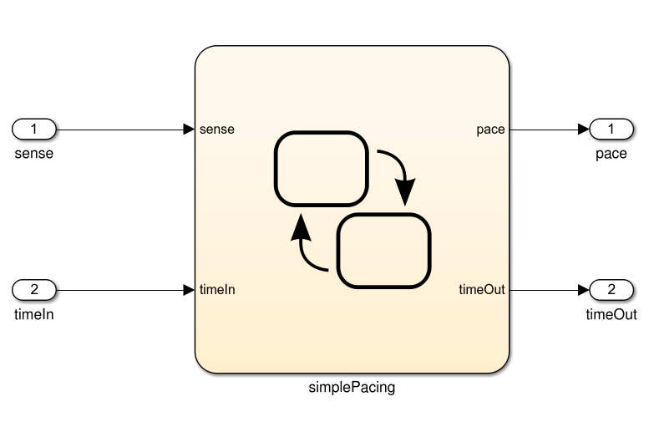
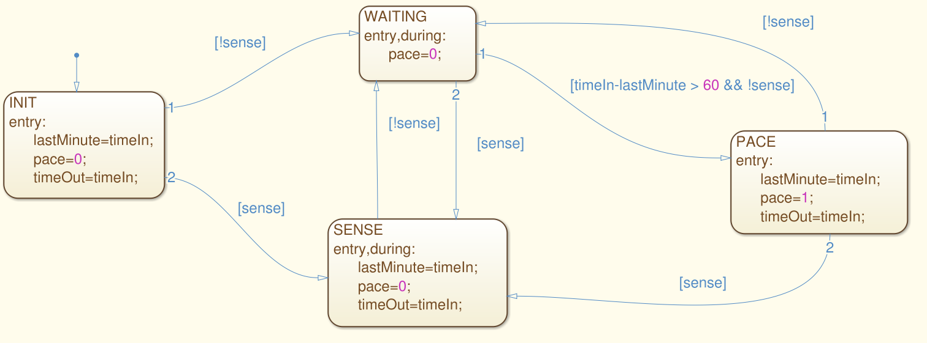
Creating Models - Graphical
Most common industrial framework: Stateflow
Gregory Gay CSCE 740 - Fall 2015 12
Notes:
If you actually want to build some of these models, there are a lot of ways to do so. The most common framework used in industry - especially when building embedded systems - is called Stateflow. It’s a visual modeling language from Mathworks, the people who make Matlab. The stateflow language looks a lot like the generic state machines we were just looking at. This state machine models the behavior of the software for a simplified pacemaker. The model listens to timestamped sensor readings, and if a minute passes without a sensed natural heartbeat, it issues a timestamped command to shock the heart.

Slide 13
Creating Models - Written Language
MODULE main
VAR
request: boolean;
state: {ready, busy};
ASSIGN
init(state) := ready;
next(state) :=
case
state=ready & request: busy;
state=ready & !request : ready;
1: {ready, busy};
esac;
NuSMV modeling language
Part of a framework for model analysis.
Gregory Gay CSCE 740 - Fall 2015 13
Notes:
There are also numerous textual languages for describing models. One of the most well-known is NuSMV. NuSMV is actually an entire framework for analyzing models, and this language expresses the state machine in a form that can be easily processed. (go over code).

Slide 14
What Can We Do With This Model?
Now that we have a model, we can reason about our requirements and specifications.
Specification
public static void Main(){
System.out.println(“Hello world!”);
}
And If the model is well-formed, consistent, and complete.
And If the model accurately represents the program.
If the model satisfies the specification...
Gregory Gay CSCE 740 - Fall 2015 14
Notes:
Ultimately, we need to make the argument that the the system we built fulfills the specification - make the argument for verification. The model represents the first step in making that argument. If we take the specification and formulate it as a series of logical properties, we can check whether those properties hold by analyzing the model. As the model comes directly from our requirements and our understanding of the system, if there are violations, there is an issue with our plans - somewhere, our requirements and specifications are wrong. They might be contradictory, incomplete, or just have a mistake. By verifying properties over the model, we can find out if there are issues and fix them. So, the train of thought is that if the model satisfies the properties, AND if the model is well-formed, consistent, and complete, AND if the model actually represents the final program, then proving properties over the model is an argument that your specifications are correct and that the final product will actually meet them.
Where do you think you can get in the most trouble here?
(discuss - last one)

Slide 15
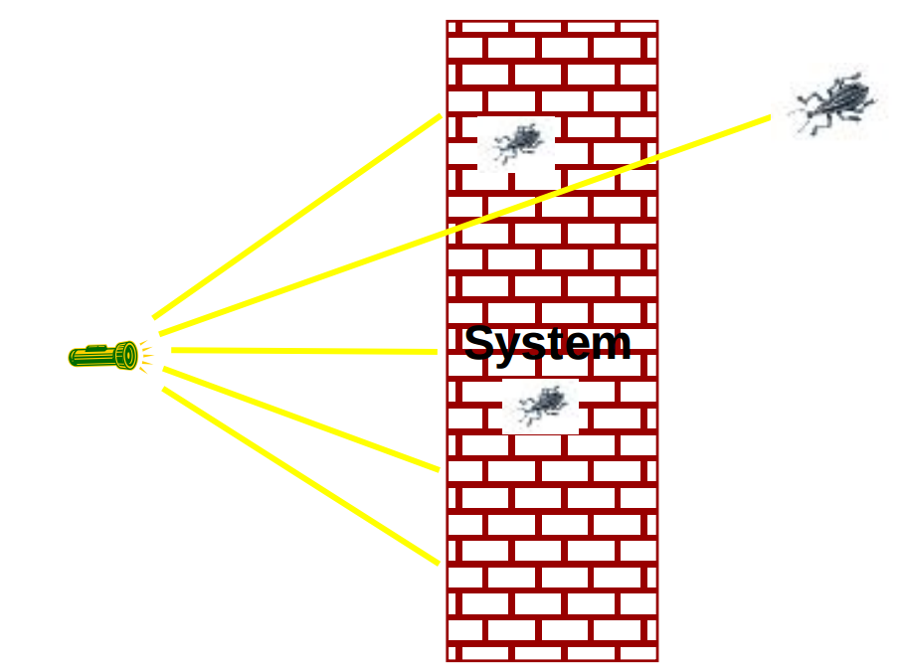
Requirements-Based Tests
If you have requirements-based tests, you can “run” them on the model to demonstrate that the model passes the tests.
But even a model can have trillions of inputs...
Gregory Gay CSCE 740 - Fall 2015 15
Notes:
In practice, how does that work? Well, if we have requirements-based tests, we can try them on the model to see if it passes. The model isn’t the full program, but it is something you can pass input into - either manually or in many cases in a controlled form of execution - and get output from. That’s enough to test.
But (read) - it’s like finding a needle in a haystack still, finding every little cocoroach with a flashlight.

Slide 16
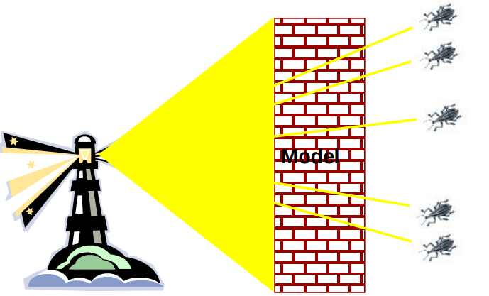
Finite-State Verification
Express specification as a set of logical properties, written as Boolean formulae.
Exhaustively search the state space of the model for violations of those properties.
If the property holds - proof that the model is correct.
Contrast with testing - no violation might just mean bad tests.
Gregory Gay CSCE 740 - Fall 2015 16
Notes:
Often, on a real program, testing is the best you can do. You can’t cover the input space, but you do enough to feel confident. In this case, however, we’ve simplified things dramatically by building a model. A model is much, much simpler than the real system. So, we can perform a more thorough analysis. This is a process called finite state verification.
(read)

Slide 17
Expressing Properties
Properties expressed in a formal logic.
Temporal logic ensures that properties hold over execution paths, not just at a single point in time.
Safety Properties
System never reaches bad state.
Always in some good state.
Liveness Properties
Eventually useful things happen.
Fairness criteria.
Gregory Gay CSCE 740 - Fall 2015 17
Notes:
To ensure that the requirements hold, we need to express them in a form that can be logically assessed, as a boolean expression written in a formal logic. Now, if we just write out a property as an if expression, we can check whether it holds at
a particular point in time - over a model, we could check whether something is always true, but that’s usually not quite expressive enough - many requirements are properties over paths of execution. So typically, we use a form of what is called temporal logic. Temporal logics contain a set of operators that can be used to express properties over execution paths, allowing you to ensure that complex properties hold over any possible execution of the system.
Typically, we can break down these properties into two forms - safety properties and liveness properties.
Safey properties divide the system into good states and bad states, where good states satisfy properties and bad states violate them. Most properties are written this way - we say that the system never will do something or that it will always do something. These can be specified over sequences of events too, where we treat the history of events preceeding a state as an attribute of that state. Think about a traffic light, we could write properties asserting that the order must always be green, then yellow, then red. If there is a situation where these could go out of order, then we’re in trouble. There is a violation of that property.
Liveness properties deal with eventualities - they say that at some point, a thing must happen. We don’t know when - that’s what differentiates liveness from safety. Safety properties are exact - this sequence must happen, this property must never
be violated. Liveness is something we want to eventually be true. A safety property says that nothing bad will ever happen- the light will always turn green within five seconds - while liveness properties say that something good will eventually happen - if the light is red, it will eventually be green. Liveness properties are used to reason over paths of unknown length.

Slide 18
Temporal Logic
Sets of rules and symbolism for representing propositions qualified over time.
Linear Time Logic (LTL)
Reason about events over a timeline.
Computation Tree Logic (CTL)
Branching logic that can reason about multiple timelines.
We need both forms of logic - each can express properties that the other cannot.
Gregory Gay CSCE 740 - Fall 2015 18
Notes:
temporal logic is any system of rules and symbolism for representing, and reasoning about, propositions qualified in terms of time. Consider the statement: "I am hungry." Though its meaning is constant in time, the truth value of the statement can vary in time. Sometimes the statement is true, and sometimes the statement is false, but the statement is never true and false simultaneously. In traditional logic, you can only discuss statements whose truth value is constant in time. We’d be limited severly in what we could
verify over the program - and many requirements actually ask for sequences of events over types of paths - there are a lot of qualifiers. We can address this in temporal logic, where statements can have a truth value which can vary in time. In a temporal logic we can then express statements like "I am always hungry", "I will eventually be hungry", or "I will be hungry until I eat something".
Typically, two types of temporal logic are used to express properties.
Linear time logic, or LTL, has the ability to reason about a time line. One can encode formulae about the future of paths, for instance, that a condition will eventually be true or that a condition will be true until another fact becomes true,
Branching logics, such as computation tree logic or CTL, however, can reason about multiple time lines. In a branching logic we may state that "there is a timeline in which that I will stay hungry forever." Or, in terms of liveness, "there is a possibility that eventually I am no longer hungry." If we do not know whether or not I will ever get fed, these statements are both true some times.
(read)

Slide 19
Linear Time Logic Formulae
Formulae written with propositional variables (boolean properties), logical operators (and, or, not, implication), and a set of modal operators:
X (next) | X hunger | In the next state, I will be hungry.
G (globally) | G hunger | In all future states, I will be hungry.
F (finally) | F hunger | Eventually, there will be a state where I am hungry.
U (until) | hunger U burger | I will be hungry until I start to eat a burger.
R (release) | hunger R burger | I will cease to be hungry after I eat a burger.
Gregory Gay CSCE 740 - Fall 2015 19
Notes:
(go over)
U and R are very similar, the difference is that U means that the first property can stop being true in the same state that the latter becomes true.
R is stronger, R requires that both be true for at least one state, then in the next state, the first property can become false. If the latter property never becomes true, then the former can never be false.

Slide 20
LTL Examples
X (next) - This operator provides a constraint on the next moment in time.
(sad && !rich) -> X(sad)
((x==0) && (add3)) -> X(x == 3)
F (finally) - At some point in the future, this property will be true.
(funny && ownCamera) -> F(famous)
sad -> F(happy)
send -> F(receive)
Gregory Gay CSCE 740 - Fall 2015 20
Notes:
read, ask them to explain formulae

Slide 21
LTL Examples
G (globally) - This property must always be true.
winLottery -> G(rich)
U (until) - One property must be true until the second becomes true.
startLecture -> (talk U endLecture)
born -> (alive U dead)
request -> (!reply U acknowledgement)
Gregory Gay CSCE 740 - Fall 2015 21
Notes:
read, ask them to explain formulae

Slide 22
More LTL Examples
G (requested -> F (received))
G (received -> X (processed))
G (processed -> F (G (done)))
If the above are true, can this be true?
G requested && G (!done)
Gregory Gay CSCE 740 - Fall 2015 22
Notes:
read, ask them to explain formulae
F G done = final state, once done it can’t be undone
(discuss - no )if it’s requested, it will eventually be received, then processed, then eventually done

Slide 23
Computation Tree Logic Formulae
Combines quantifiers over all paths and path-specific quantifiers:
A (all) | A hunger | Starting from the current state, I must be hungry on all paths.
E (exists) | E hunger | There must be some path, starting from the current state, where I am hungry.
X (next) | X hunger | In the next state on this path, I will be hungry.
G (globally) | G hunger | In all future states on this path, I will be hungry.
F (finally) | F hunger | Eventually on this path, there will be a state where I am hungry.
U (until) | hunger U burger | On this path, I will be hungry until I start to eat a burger. (I must eventually eat a burger)
W (weak until) | hunger W burger | On this path, I will be hungry until I start to eat a burger. (There is no guarantee that I eat a burger)
Gregory Gay CSCE 740 - Fall 2015 23
Notes:
As computation tree logic poses properties over all possible paths, not just over a specific path, there quantifiers get a little more complex. CTL has two quantifiers over all paths, and several over specific paths
(go over)
U and W are similar - the difference is that W is a weaker property - it never guarantees that the latter property will be verified. I could always be hungry and hunger W burger would be considered true. For hunger U burger to be verified, you must eventually eat a burger and you must be hungry until then.
The path specific and all path quantifiers are alwayscombined, so that you specify properties saying things like, along all path, something will happen next, or there exists some path where this becomes true.

Slide 24
CTL Examples
chocolate = “I like chocolate.”
warm = “It is warm outside.”
AG chocolate
EF chocolate
AF (EG chocolate)
EG (AF chocolate)
AG (chocolate U warm)
EF ((EX chocolate) U (AG warm))
Gregory Gay CSCE 740 - Fall 2015 24
Notes:
read, ask them to explain formulae
AG.P "I will like chocolate from now on, no matter what happens."
EF.P"It's possible I may like chocolate some day, at least for one day."
AF.EG. "It's always possible (AF) that I will suddenly start liking chocolate for the rest of time."
EG.AF.P "This is a critical time in my life. Depending on what happens next (E), it's possible that for the rest of time (G), there will always be some time in the future (AF) when I will like chocolate. However, if the wrong thing happens next, then all bets are off and there's no guarantee about whether I'll ever like chocolate."
AG(PUQ)"From now until it's warm outside, I will like chocolate every single day. Once it's warm outside, all bets are off as to whether I'll like chocolate anymore. Oh, and it's guaranteed to be warm outside eventually, even if only for a single day."
EF((EX.P)U(AG.Q)) "It's possible that: there will eventually come a time when it will be warm forever (AG.Q) and that before that time there will always be some way to get me to like chocolate the next day (EX.P)."

Slide 25

Examples
It is always possible to reach a reset state.
AG (EF reset)
Is the LTL formula G (F reset) the same expression?
Eventually, the system will reach a good state and remain there.
F (G good)
Is the CTL formula AF (AG good) the same?
Gregory Gay CSCE 740 - Fall 2015 24
Notes:
read, ask them to explain formulae
ask about LTL - what the CTL formula says that along all paths, it is always true that there is some possible continuation where we could eventually reset. The LTL formula here is not the same -it says that we MUST eventually reset, the CTL formula just allows the possibility. This is a formula that is not possible in LTL
read
ask about CTL - The CTL formula says that on all paths, at some point, it will become permanently true along all extensions that things are good. This is trickier - this statement is too strong. Consider this diagram, where p is good. F( G good) holds on this - eventually, we get to a point where good is always true, on the right. The CTL formula is not true because we have this good state closer to the front - we can’t differentiate the two p nodes. the all paths part is what kills us. We can’t swap the A to an E either, as that is too weak. The LTL statement has no equivalent CTL statement in this case - this is why we need both logics

Slide 26
Proving Properties
To perform verification, we take properties and exhaustively search the state space for violations.
Violations give us counter-examples
A path that demonstrates how the property has been violated.
Implications:
Property is incorrect.
Model does not reflect expected behavior.
Real issue found in the system being designed.
Gregory Gay CSCE 740 - Fall 2015 26
Notes:
(read)
(read) - (read). This is really helpful, as we don’t just know that something is wrong, we can trace our way through the model to see exactly what is wrong.
If you get a violation, this can mean three things
(read) - you made a mistake when you translated specification to the temporal logic
(read) - the model is wrong, and needs to be fixed
or, and this is what we want to find - (read) - identified something that you left out, or that is contradictory, or that is just plain wrong. This is what we want to see, if we get violations, we can fix our specification before we design and code the system.

Slide 27
Test Generation from Models
We can also take properties and negate them.
Called a “trap property” - we assert that a property can never be met.
The counter-example shows one way the property can be met.
This can be used as a test for the real system - to demonstrate that the final system meets its specification.
Gregory Gay CSCE 740 - Fall 2015 27
Notes:
Now, this same process isn’t just useful for analyzing our requirements, but is useful for verification of the final system as well. You can (read)
(read) - we can take that, extract inputs from it, then run those inputs as a test for the final system (read)

Slide 28
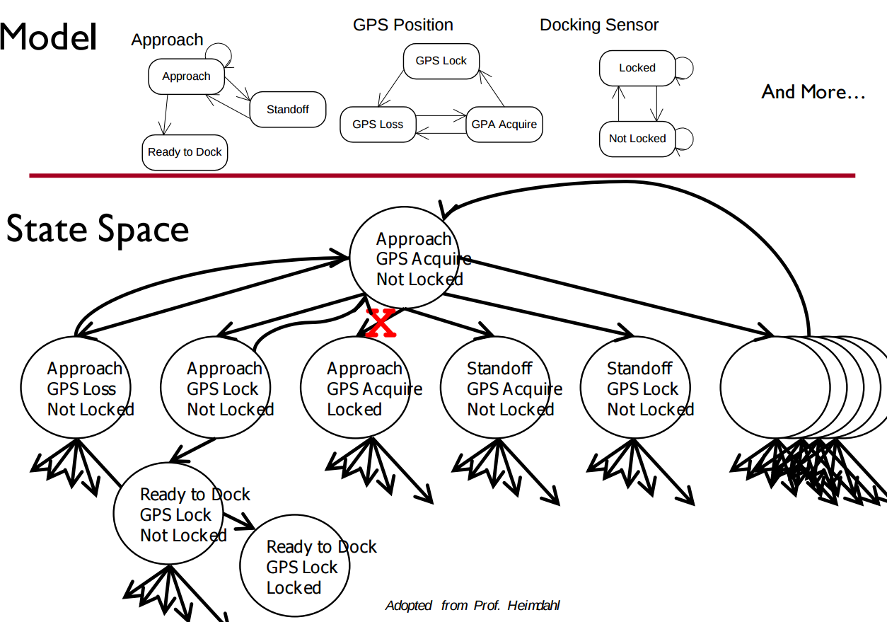
Exhaustive Search
Algorithms exhaustively comb through the possible execution paths through the model.
Major limitation - state space explosion.
Gregory Gay CSCE 740 - Fall 2015 28
Notes:
This form of verification depends on a family of techniques that exhaustively search the state space - the set of all possible paths of execution over the model - at each state, examining all reachable states, then from there, examine all possible reachable states, and so on.
very quickly, the problem that we run into is that the number of possible states and paths through those states explodes. Let’s say we define three variables - approach, GPS position, and Docking Sensor - and we define how those variables can
change values. The state of the system describes the combination of assignments to those three variables. Even if the number of possible values is small, the number of possible states is massive, and the number of reachable states at any given time can be quite large. Quickly, an exhaustive search of the state space becomes extremely difficult.

Slide 29
Exhaustive Search - Dining Philosophers
Problem - X philosophers sit at a table with Y forks between them. Philosophers may think or eat. When they eat, they need two forks.
Goal is to avoid deadlock - a state where no progress is possible.
5 philosophers/forks - deadlock found after exploring 145 states
10 philosophers/forks - deadlock found after exploring 18,313 states
15 philosophers/forks - deadlock found after exploring 148,897 states
9 philosophers/10 forks - deadlock found after exploring 404,796 states
Gregory Gay CSCE 740 - Fall 2015 29
Notes:
To give an example, say we built a model of the dining philosophers problem (read)
(read)
What we can see from this is that the limits of verification are reached pretty quickly as the complexity of the model grows. All of these algorithms have tricks to prune the state space, but even still, models cannot be too complex - if so, they must be simplified further to be verified in this way. This is why we can’t just use these techniques on real code. Real code almost always has a massive state space.

Slide 30
Search Based on SAT
Express properties as conjunctive normal form expressions:
f = (!x2 || x5) && (x1 || !x3 || x4) && (x4 || ! x5) && (x1|| x2)
Examine reachable states and choose a transition based on how it affects the CNF expression.
If we want x2 to be false, choose a transition that imposes that change.
Continue until CNF expression is satisfied.
Gregory Gay CSCE 740 - Fall 2015 30
Notes:
This search is based on satisfaction of what is called a SAT problem - or boolean satisfiability - the problem of determining if there exists a solution that satisfies a boolean formula. To check these properties, (read) - a conjunction of clauses - AND statement -, where each clause is a disjunction of boolean variables - OR statements.
(read rest)

Slide 31
Branch & Bound Algorithm
Set a variable to a particular value (true/false).
Apply that value to the CNF expression.
See whether that value satisfies all of the clauses that it appears in.
If so, assign a value to the next variable.
If not, backtrack (bound) and apply the other value.
Prune branches of the boolean decision tree as values are applies.
Gregory Gay CSCE 740 - Fall 2015 31
Notes:
One example of an exhaustive search algorithm is the branch-and-bound algorithm. This algorithm is conceptually simple: set a literal in the boolean formula to a particular value, apply that value to the formula, and check to see if the value satisfies all of the clauses that it appears in. If so, assign a value to the next variable. However, if setting a value unsatisfies a clause, then a backtracking step (a bound) is initiated and the other possible value is applied. This process prunes branches of the formed boolean decision tree

Slide 32
Branch & Bound Algorithm
f = (!x2 || x5) && (x1 || !x3 || x4) && (x4 || ! x5) && (x1|| x2)
Set x1 to false. f = (!x2 || x5) && (0 || !x3 || x4) && (x4 || ! x5) && (0 || x2)
Set x2 to false. f = (1 || x5) && (0 || !x3 || x4) && (x4 || ! x5) && (0 || 0)
Backtrack and set x1 to true. f = (0 || x5) && (0 || !x3 || x4) && (x4 || ! x5) && (0 || 1)
Gregory Gay CSCE 740 - Fall 2015 32
Notes:
-We first set a value of zero to x1. This inserts a zero into clauses two and four, but does not satisfy or unsatisfy either clause yet.
-Next, we insert a value of zero for x2. This satisfies the first clause, but unsatisifies the fourth clause (as both x1 and x2 are set to zero).
-Therefore, we stop and backtrack, assigning a new value of one to x2. This satisifies the fourth clause. We can continue this process with all variables until the complete formula is satisified.

Slide 33
DPLL Algorithm
Set a variable to a particular value (true/false).
Apply that value to the CNF expression.
If the value satisfies a clause, that clause is removed from the formula.
If the variable is negated, but does not satisfy a clause, then the variable is removed from that clause.
Repeat until a solution is found.
Gregory Gay CSCE 740 - Fall 2015 33
Notes:
Another common complete method is the Davis-PutnamLogemann-Loveland, or DPLL, algorithm [13]. DPLL is conceptually similar to the branch-and-bound method, but a few key differences give it an edge on a number of SAT problems. Like with branch-and-bound, DPLL begins by selecting a variable and applying a value to it. If this value satisifies the clause, then that clause is removed from the formula. If the variable is made false due to negation, the algorithm instead remove that variable from any cause that it is negated in. This process is repeated recursively until a solution is found. This induces a domino effect—as more variables are removed from clauses, more clauses turn into unit clauses

Slide 34
DPLL Algorithm
f = (!x2 || x5) && (x1 || !x3 || x4) && (x4 || ! x5) && (x1|| x2)
Set x2 to false. f = (1 || x5) && (x1 || !x3 || x4) && (x4 || ! x5) && (x1|| 0) f = (x1 || !x3 || x4) && (x4 || ! x5) && (x1)
Set x1 to true. f = (1 || !x3 || x4) && (x4 || ! x5) && (1) f = (x4 || ! x5)
Set x4 to false, then x5 to false.
Gregory Gay CSCE 740 - Fall 2015 34
Notes:
-If we assign a value of zero to x2, the first clause is rendered true (¬x2 = ¬0 = 1). We can eliminate the first cause from the formula and x2 from clause four. This leaves the following: (read)
- As the third clause is now a unit clause, we assign x1 = 1. We can now remove both clauses one and three from the formula:(read)
- From this point, the example is trivially solved with x4 = 0 and x5 = 0 so that we have assigned everything.

Slide 35
Challenge - Does the Model Match the Program?
Models require abstraction. Useful for requirements analysis, but may not reflect operating conditions.
In the model:
Binary input
In the implementation:
Voltage reading compared to calculated threshold
SimplePacing
sense
Voltage Sensor
Other Subsystems
In the model:
input time = output time
Operations take place instantly.
In the implementation:
Operations take time to compute.
Clock drift may impact time.
timeIn / timeOut
Clock Module
Gregory Gay CSCE 740 - Fall 2015 35
Notes:
A big challenge in using models to perform verification is that models must be representative of the actual program. To make a model, we make simplifications. These models - while prescribing behavior - operate at an abstracted level. They need to be useful for automated verification, and if you model every detail down to the hardware level, you’re just building the final system. It’ll be just as complex, the state space will be too large, and it’ll take you months to build. Unfortunately, abstraction can get you in trouble - especially when working with embedded or real-time systems, where the execution of the system is highly dependent on the timing of input - when it arrives, when output is released, how much time computation takes - many details that are often abstracted from the models.
-Consider the actual operating environment of the implementation of the SimplePacing software. A number of abstractions have been made in the interest of better analyzing the core requirements, or because the final details were not yet known.
-For example, the model receives a simple binary sense. In the real world, the electrical impulses being sensed in the heart are complex analog readings, prone to noise.
-The time stamps used as both input and output from SimplePacing will be taken by polling a clock module in the software platform. In the model, the input and output timestamps are the same, but in the real software differences from computation time, clock drift, and the difficulty of synchronizing the parallel components of the software. Furthermore, clock issues are commonly non-deterministic. Repeated application of the same test stimulus may not result in the same output if, say, processing time varies.
These kind of behaviors are hard to predict until you implement, and you often end up with a model that is a little too optimistic, that is simple enough that properties that hold over it are not guaranteed over the real program.

Slide 36
Model Properties
To be useful, a model must be:
Compact
Models must be simplified enough to be analyzed.
Depends on how it will be used.
Predictive
Represent the real system well enough to distinguish between good and bad outcomes of analyses.
No single model usually represents all characteristics of the system well enough.
Gregory Gay CSCE 740 - Fall 2015 36
Notes:
(read)
(read) - this depends on how it will be used. For human inspection, a model must be relatively simple. Otherwise, you’ll get lost. For automated verification, it can be more complex, but must not fall prey to state space explosion.
(read, read)
For instance, you’d build seperate models to analyze airflow over an aircraft fusulage and to analyze the internal layout for efficient passenger loading.

Slide 37
Model Properties
To be useful, a model must be:
Meaningful
Must provide more information than success and failure.
General
Models must be practical for use in the domain of interest.
An analysis of C programs is not useful if it only works for programs without pointers.
Gregory Gay CSCE 740 - Fall 2015 37
Notes:
(read, read) If a property is violated, we must be able to tell why it was violated.
(read) - don’t adapt them to be so specific to a simplified version of your problem that they fail to be useful for use on the un-abstracted problem. (read).

Slide 38
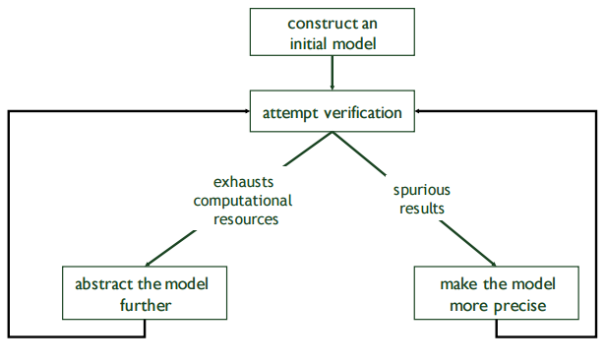
Model Refinement
Models have to balance precision with efficiency.
Abstractions that are too simple may introduce spurious failure paths that may not be in the real system.
Models that are too complex may render model checking infeasible due to resource exhaustion.
Gregory Gay CSCE 740 - Fall 2015 38
Notes:
(read all).
So, you often find that your first attempt at a model is not good enough. You need to get into a loop of iterative refinement. If it’s too complex, simplify it. It it’s too simple, add detail. Continue until you are able to perform verification.

Slide 39
We Have Learned
We can analyze our specifications by creating simplified models of the system and proving that the specification properties hold over the model.
To do so, we must express specifications as sets of logical formulae written in a temporal logic.
Finite state verification exhaustively searches the state space for violations of properties.
Gregory Gay CSCE 740 - Fall 2015 39
Notes:
(read, read) If a property is violated, we must be able to tell why it was violated.
(read) - don’t adapt them to be so specific to a simplified version of your problem that they fail to be useful for use on the un-abstracted problem. (read).

Slide 40
We Have Learned
By performing this process, we can gain confidence that the specifications are correct (or fix them if they are not).
We can also generate test cases from the model to demonstrate that properties still hold over the final system.
Gregory Gay CSCE 740 - Fall 2015 40
Notes:
(read, read) If a property is violated, we must be able to tell why it was violated.
(read) - don’t adapt them to be so specific to a simplified version of your problem that they fail to be useful for use on the un-abstracted problem. (read).

Slide 41
Next Time
Design and Architecture
Readings:
Sommerville, chapter 6
Homework:
Revised requirements and tests due soon.
Any questions?
Gregory Gay CSCE 740 - Fall 2015 41
Notes:
(read, read) If a property is violated, we must be able to tell why it was violated.
(read) - don’t adapt them to be so specific to a simplified version of your problem that they fail to be useful for use on the un-abstracted problem. (read).

