Slide 1
Object Modeling
CSCE 740 - Lecture 16 - 10/26/2015

Slide 2
Objectives for Today
Introduce methods for starting an object model.
Identifying classes, their attributes, and their operations.
Identifying associations between classes.
Get some experience with OO design.
Gregory Gay CSCE 740 - Fall 2015 2
Notes:
Last time, we talked about the basics of OO design - how you break your system down into interacting entities and how to depict them and their relationships in a class diagram. Today, we’re going to get some hands-on experience with a couple of different ways to take an initial problem statement and some requirements and come up with a reasonable design. Today is going to be a very hands-on sort of class, so I expect participation.

Slide 3
An Approach for Object Modeling
Start with a problem statement.
High-level requirements
Identify potential objects.
Look for nouns.
A library has books, videos, and CDs that it loans to its users. All library material has an ID number and a title. Book 101.1 is The Wee Free Men by Terry Prachett.
Library
Book
Video
CD
Library Material
ID Number
Title
Book 101.1
Wee Free Men
Terry Prachett
Gregory Gay CSCE 740 - Fall 2015 3
Notes:
Approaching object modeling starts by taking a hard look at your problem. What are you trying to solve? Write a bit about your problem domain and see if anything pops out. A good start is to look for nouns. What are our nouns?
Those usually make sense as classes.
(discuss - what are some potential classes that we see here?)
bring in and list

Slide 4
Object Modeling Approach
Refine and remove bad classes
Redundant, vague, or irrelevant.
Abstract objects to classes.
Prepare data dictionary
Describe each class and its purpose.
Library
Book
Video
Library Material
ID Number
CD
Title
Author
CD
Book 101.1
Wee Free Men
Terry Prachett
Library Material: An abstract class representing a generic library item that can be checked out. Has an ID and title.
Book: A class representing a book that can be checked out. Has an author in addition to inherited attributes ID and title.
Gregory Gay CSCE 740 - Fall 2015 4
Notes:
Next, you want to take that big list of nouns and refine it. Get rid of any vague, redundant, or irrelevant classes.
If you aren’t sure what it represents, get rid of it. If you have multiple nouns that mean the same thing, keep the one that has the clearest meaning and ditch the rest. If there are nouns that are too insignificant to keep as classes, get rid of them. Look for nouns that are clearly object instantiations and see if you can abstract them to a class.
What can we get rid of here? (discuss)
-ID number and title sound like attributes of any of these library items - they sound simple enough that they don’t need classes - probably just an float and a string, right? (click)
-Book 101.1 is just the ID number of a book object, and Wee Free Men is the title of that object. (click)
-Now, that does leave us with Terry Prachett, which rather than removing a class, hints at one we’re missing. We don’t need a Terry Prachett class, but what does he represent? He’s an author - we might want an Author class. (click)
-What about library material? Should we keep that?
Next, (read). This is where you take each remaining class and ascribe meaning to it. What is a Book? What is a Video? What meaning do they have in this system? What job do they perform? If you can’t come up with this, then it has no purpose in this system.

Slide 5
Object Modeling Approach
Identify associations and aggregations.
Identify the attributes and operations of classes.
Organize and simplify using inheritance.
Library
Book
Video
1
0..*
Library Material
Library Material
CD
Author
Book
CD
Video
1..*
1..*
1..*
1..*
1..*
1..*
Author
Performer
Director
Creator
Gregory Gay CSCE 740 - Fall 2015 5
Notes:
Now, we need to know how these classes relate to each other. We need to identify the associations and aggregations between classes. How do they relate to each other? What are their dependencies?
At the same time, we need to identify the attributes of the classes and their links - what kind of information is being stored in each class? What defines a Book or an Author?
Finally, see if you can organize and simplify this diagram using inheritance - are there any classes that share common attributes or operations? Can we form a parent with those shared attributes and operations and then create specialized children that inherit those?
(discussion - ask them to suggest associations, aggregations, inheritance)
-library has materials
-inheritance
-leaves author - books clearly have authors, but what about videos or CDs? This gives another opportunity for inheritance - maybe movies have directors and CDs performers, and authors/directors/performers all could come from a common creator class.
-Then, we link these up. Books have authors, CDs have performers, Videos have Directors. This might be considered an aggregation - authors are part of a book. explain 1..*I on multiplicity

Slide 6
Define Attributes and Operations
What are the responsibilities of the class?
Use tools such as data dictionaries to define responsibilities of a class - what services must they perform or allow others to perform.
Classes were nouns, now look for verbs.
General guidelines:
Responsibilities should be evenly distributed between classes.
Information related to a responsibility should be stored in the class responsible for that service.
Those are the attributes.
Gregory Gay CSCE 740 - Fall 2015 6
Notes:
(read)
-In particular, look at the requirements and problem description, use your data dictionary, to (read)
-We told you to look for nouns to come up with the list of classes, now look for verbs. What does the class do? Those are its operations.
-There are some good guidelines to follow in this.
-(read)- don’t allow one class to do too many things. This implies weak cohesion, and it will be harder to isolate faults or change in the future. If one class if doing most of the work, it’s probably too big - see if you cna split it up. beware of long lists of responsibilities here - if a class is starting to accumulate a huge number of methods, it’s probably too long.
(read) - as much as possible, information needed to perform a service should be stored in the class that offers that service. This is impossible to always do. The same information is often needed by multiple classes, and it often isn’t smart to store the information in multiple places, but try to minimize that overhead.

Slide 7
Identify Associations
Classes fulfill responsibilities in one of two ways:
It can use its own methods to modify its own attributes.
It can collaborate with other classes.
If a class cannot fulfill its responsibilities alone, identify and document the associations.
is-part-of (aggregation)
has-knowledge-of (association)
depends-upon (association)
Gregory Gay CSCE 740 - Fall 2015 7
Notes:
(read 1-4)
In particular, look for these three types of relationships:
(read 5) Membership, cases where a complex class is part of another class. Wheels and a transmission that belong to a car.
(read 6) If they share data
(read 7) If they need a service from the other class

Slide 8
Object Modeling Approach
Iterate and refine the model.
You will almost always go through multiple iterations of a design.
Group classes into subsystems.
Which classes can combine to form an independent grouping?
Library
1
0..*
Library Material
Book
CD
Video
1..*
1..*
1..*
1..*
1..*
1..*
Author
Performer
Director
Creator
Gregory Gay CSCE 740 - Fall 2015 8
Notes:
Now, you will rarely finish this first design and call it quits. The first crack at the design is usually missing something - we might need more classes - and even if it isn’t, it probably isn’t the most efficient way to implement the system. There might be more communication overhead than you need, there might be redundant associations, the control structure might be suboptimal. So, refine and improve the model. Look for better representations ,ways to cut down dependencies, how you store and access information.
While you do this, pay attention to how you group classes. Are you starting to see the system break down into independent packages or subsystems, libraries of classes and methods that can stand alone and be reused down the line?

Slide 9
Refinement
The software design is often not optimal. Before implementation, consider how it can be improved.
Watch for:
Redundant associations.
Attributes that can be derived at runtime.
Remove redundant associations
Student
name
course
teacher
Teacher
name
1 1
*
1
1
Course
students
teacher
1
Gregory Gay CSCE 740 - Fall 2015 9
Notes:
Many designs are not optimal. That’s a natural consequence of the complexity of software. There are many ways to solve a problem, and our first stab, or our second, or our fifth are usually not perfect. In fact, the more intuitive the design is to the reader, the less optimal is often is. Optimizing a design involves balancing competing goals - are you aiming for maintainability? readability? efficiency? security? Decide on your goals and work towards those when refining your design.
Two common things to watch for are redundant associations and attributes that can just be derived rather than explicitly stored.
remove redundant associations to cut storage costs and limit coupling issues - that assists speed and maintainability. For instance, in this design, we associate teacher, student, and course with all of the others. We could cut a link between either student and teacher or course and teacher and decrease the coupling between these classes, increase security by better controlling data access

Slide 10
Derived Links and Attributes
Derived entities can be calculated from other entities. Indicated by a slash. They are potentially redundant.
Person
birthDate
/age
Calendar
currentDate
Organization
Works For
{age = currentDate - birthDate}
Department
Employee
Gregory Gay CSCE 740 - Fall 2015 10
Notes:
(read)
A person might have both a birthdate and an age, but if we have a calendar with the current date, you can always derive the person’s age. So, we might not need the age attribute in there. These derived associations can be redundant. We could ditch that as an attribute and instead calculate it when needed. If the calculation is relatively rare, then it may be cheaper to calculate it when needed rather than adding another stored attribute. That said, sometimes you want to fogure out what can be derived so that you can actually add permanent new attributes - if a calculation is performed often, you might want to add an attribute so that you can perform the calculation once, store the result, and just pull that value when needed.
-Similarly, You can also derive associations. For instance, if an organization has departments, and a department has employees, you can derive that an employee works for the organization. We don’t necessarily need that explicit association, we don’t need a pointer in the program.
Since these attributes and associations can be derived, their existence might make the program more efficient or open up cohesion and coupling issues. You could figure out which associatioins and attributes are redundant and ditch them in the implementation in an attempt to optimize your program.

Slide 11
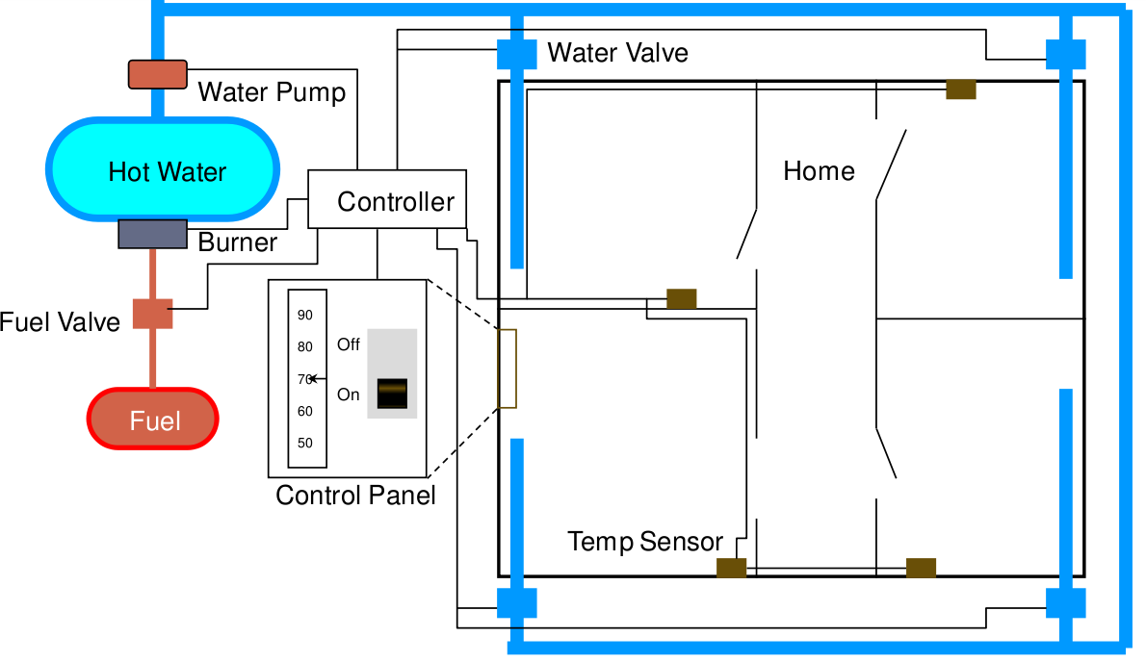
The Home Heating System
Gregory Gay CSCE 740 - Fall 2015 11
Notes:
Let’s go through a more complicated example together. Our good friend, the home heating system.
It controls the level of heat in each of the rooms of a house. The software maintains the temperature of each room within a specified range by controlling the heat flow to individual rooms. We have a central thermostat that a human can use to turn the system on or off and set the desired temperature.
Simple enough, right? Let’s work together to design the software.

Slide 12
Home Heating Requirements
The purpose of the software for the Home Heating System is to control the heating system that heats the rooms of a house. The software shall maintain the temperature of each room within a specified range by controlling the heat flow to individual rooms.
The software shall control the heat in each room
The room shall be heated when the temperature is 2F below desired temp
The room shall no longer be heated when the temperature is 2F above desired temp
The flow of heat to each room shall be individually controlled by opening and closing its water valve
The valve shall be open when the room needs heat and closed otherwise
The user shall set the desired temperature on the thermostat
The operator shall be able to turn the heating system on and off
The furnace must not run when the system is off
When the furnace is not running and a room needs heat, the software shall turn the furnace on
To turn the furnace on the software shall follow these steps
open the fuel valve
turn the burner on
The software shall turn the furnace off when heat is no longer needed in any room
To turn the furnace off the software shall follow these steps
close fuel valve
turn burner off
Gregory Gay CSCE 740 - Fall 2015 12
Notes:
Let’s take a look at some of our requirements. Read through together.
(read)
Ok, let’s look for classes. Tell me some candidates. Look at those nouns. Jot them down on your activity as well. (discuss)

Slide 13
Identify Object Classes
Requirements Statements
Extract Nouns
Tentative Classes
Eliminate Classes
Final Class List
Water Pump House Water Valve
Hot Water Room Controller
Burner Temperature Software
Furnace Home User
Fuel Valve Thermostat Heat
Fuel Range Operator
Desired Temperature Control Panel
On-Off Switch Heat Flow
Heating System Home Heating System
Gregory Gay CSCE 740 - Fall 2015 13
Notes:
go through list
Any others that you had written down?

Slide 14
Eliminate Bad Classes
Redundant Classes
Classes that represent the same thing with different words.
Irrelevant Classes
Classes we simply do not care about.
Vague Classes
Classes with ill-defined boundaries.
Attributes
Things that describe or make up other classes.
Gregory Gay CSCE 740 - Fall 2015 14
Notes:
Now, we have this list, and already, I’m sure you saw a few that were questionable. That’s fine. We just want to come up with a big list of possibilities at first, and try to refine it. So, the next step is to eliminate the bad classes.
(read)
1 - controller and control panel
2 - we had one just called software. That’s not really needed.
3 - classes that don’t have a clear role, or could be encompased by something else
4 - simple items that could just be data stored by other classes.

Slide 15
Eliminate Bad Classes (Continued)
Operations
Sequences of actions are often mistaken for classes.
Roles
The name of a class should reflect what it is, not the role it plays.
Implementation Details
Save those for the implementation.
Gregory Gay CSCE 740 - Fall 2015 15
Notes:
5 - you might have pulled out a potential class that is actually just a term for a sequence of actions that the system needs to take. For instance, you might have pulled out a class that you were calling “heat”. That’s more something that the system does. Those aren’t necessarily good classes, but could be broken down as operations in another class or in a set of classes.
6 - (read). This is less applicable to the heating example, but for your GRADS system, you might have written down User, Admin, and Student as classes. You could make an argument for having all of those, but rather than having a Student and Admin class, it might be better to just have a User class. Both are users, and you could potentially use the data attributes to control the operations they can access.
7 - you might have a noun that reflects some ultra-detailed aspect of the implementation. Say, you picked out an Oracle Database or Hashmap. That isn’t needed for the software design, better to leave that for the implementation. You’d just want something like Database Handler object, and leave the Oracle part out for now unless the software design really depends on this detail.

Slide 16
Identify Object Classes
Requirements Statements
Extract Nouns
Tentative Classes
Eliminate Classes
Final Class List
Water Pump House Water Valve
Hot Water Room Controller
Burner Temperature Software
Furnace Home User
Fuel Valve Thermostat Heat
Fuel Range Operator
Desired Temperature Control Panel
On-Off Switch Heat Flow
Heating System Home Heating System
Gregory Gay CSCE 740 - Fall 2015 16
Notes:
(give them time to remove some)
redundant
irrelevant
vague
Attributes
Operations - none
Roles - none
Implementation - none

Slide 17
Classes After Elimination
Requirements Statements
Extract Nouns
Tentative Classes
Eliminate Classes
Final Class List
Water Pump Water Valve
Room Controller
Burner Thermostat
Furnace
Fuel Valve
Operator
Control Panel
On-Off Switch
Home Heating System
Gregory Gay CSCE 740 - Fall 2015 17
Notes:
walk through what is left. Did we miss anything? Any arguments for getting rid any of these?

Slide 18
Prepare Data Dictionary
Water Pump
The pump that transfers water from the tank to the radiators in the rooms.
Room
An enclosed location in the house. Has a thermometer and a radiator.
Radiator
A device that can increase the temperature of a room when the valve is open. It consists of a valve and a radiator element.
… etc...
Describe each class and its purpose.
What are the classes’ responsibilities? What information does it need to perform those services?
Gregory Gay CSCE 740 - Fall 2015 18
Notes:
Next, we need to take each class and make sure we know what it does - what purpose it serves and what defines it. To do this, we prepare a data dictionary where we define - at a high level - what each class’s purpose is in the system. This helps make sure that the class belongs and suggests operations and attributes
(time to work, click)
(read through examples)
This helps give you your associations, attributes, and operations. You get an idea of what makes up each class, what it can do, and what classes it relies on. We see that the pump connects to the radiator, which connects to a room.

Slide 19
Derive Possible Associations
Not much information from the prose requirements.
… but, a lot of information from the data dictionary and physical design.
A room consists of a thermometer and a radiator
A radiator consists of a valve and a radiator element
The home heating system consists of a furnace, rooms, a water pump, a control panel, and a controller
The furnace consists of a fuel pump and a burner
The control panel consists of an on-off switch and a thermostat
The controller controls the fuel pump, the burner, and the water pump. It monitors the temperature in each room, and opens and closes the valves in the rooms
The operator sets the desired temperature, and turns the system on and off
The controller gets notified of the new desired temperature
Gregory Gay CSCE 740 - Fall 2015 19
Notes:
Using our data dictionary, we can formally define the associations between the classes. Now, the requirements may not actually be all that helpful here. They largely talked about the properties of individual classes. However, this is a system that controls a lot of physical hardware, and the information we have on the physical design of the system might end up being quite helpful. These tell us a lot about how classes communicate.
(walk through)

Slide 20
Add Associations to Complete the Class Diagram
Home Heating System
Temp Sensor
Water Valve
Fuel Valve
Control Panel
Room
Burner
Water Pump
On-Off Switch
Thermostat
Operator
Furnace
Controller
Gregory Gay CSCE 740 - Fall 2015 20
Notes:
(interactive - have two come to the board)

Slide 21
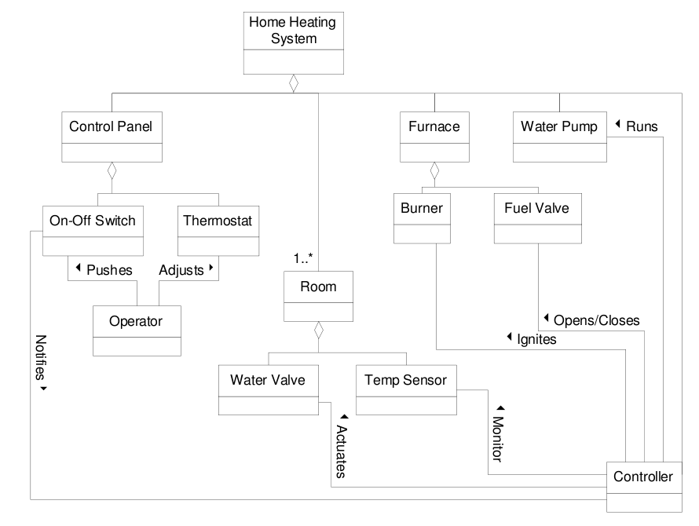
Class Diagram
Gregory Gay CSCE 740 - Fall 2015 21
Notes:
Don’t worry if yours looks different. MAny ways to design this system, but here is one take.
(walk through)

Slide 22
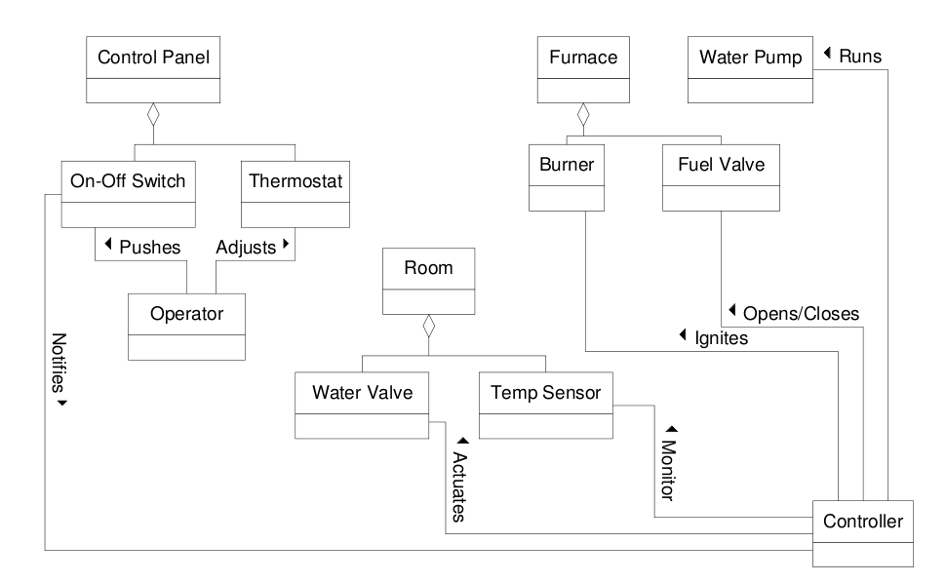
Refinement 1 - Better?
Gregory Gay CSCE 740 - Fall 2015 22
Notes:
As we said before, the first stab isn’t always the best design,so we want to take a long look at what we have and see where we can refine it. Where is the design inefficient? Where can we get rid of communication overhead or unnecessary associations?
- So, if we look at this, one thing pops out that we might want to get rid of - this Home Heating System class. It just looks like a container to connect to everything in the system - do we use that for anything? Will those extra connections hurt efficiency by making us route control through that central point?
- bring in, discuss. Is this better? It’s a question of flow of data through the system.We can pretty clearly see the subsystems in this - the control structures - The control panel, rooms, and furnace represent bottleneck points. These are subsystems that bring together multiple classes to perform different functions. HomeHeatingSystem doesn’t do anything by itself right now, but it gives a centralized access point - it brings together the furnace, rooms, and control panel. However, the controller also already brings them together through its associations - it defines a control dependency - onoff notifies the controller of changes, the controller turns on and off valves in the rooms, and sends commands to the furnace. The Controller defines control flow between the subsystems, so it could do the same thing that the HHS does. Even if HHS did not hurt efficiency, but it might only be useful from an organizational standpoint.
-But… We need to be careful when we start chopping out classes. Point out link to the temp sensor/water valve. Before, we could get the list of rooms from the HomeHeatingSystem class, now we can’t. We have a link to each water valve and temperature sensor, but you’ve now complicated the task of heating a room. Before, you could grab the list of rooms, check its temperature, then turned on its water valve if the temp was too low. Now, you need to check temperature sensors, figure out what room a sensor belongs to, go through all of the water valves, find the one matchin the right room, and turn it on.
Even if it was inefficient having that central HomeHeatingSystem class, what wev’e done now is worse because there is no longer an easy way to iterate through a list of rooms.
The moral of this is to be careful. When you refine, you need to be careful that the darn thing still works - can this design still function? But, this does help us notice an inefficiency in our design. The controller has no direct knowledge of the rooms in the house. It needs to go through the link to the top-level HomeHeatingSystem class. We can try this refinement again - get something thay both works and is more efficient

Slide 23
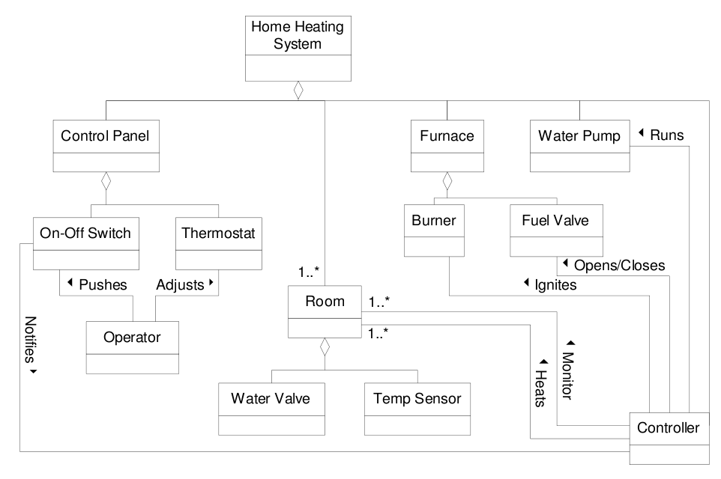
Class Diagram - Round 2
Gregory Gay CSCE 740 - Fall 2015 23
Notes:
(walk through) - point out difference
Now, we’ve fixed one inefficiency. The controller directly keeps track of the rooms. It can monitor and heat the rooms directly through the Room objects. It maintains its own list of rooms and influences the water valve and temp sensor by goiung through a room object. This is more efficient - we don’t need to get a list of rooms from another object - and more secure - for that same reason, we can lock down the HomeHeatingSystem object, lock down the Controller, and use Room to control access to the Water Valve and Temp Sensor. The controller now effectively structures the individual subsystems and defines the control flow between them.

Slide 24
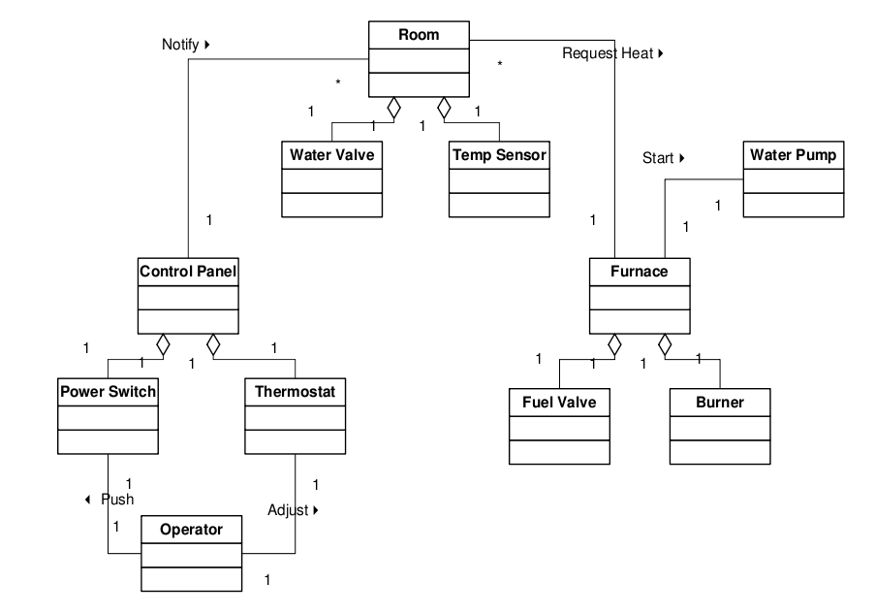
Class Diagram - Alternate
Gregory Gay CSCE 740 - Fall 2015 24
Notes:
Now, there are many ways to design the system given these classes, and it all comes down to those associations, how you link the classes. How do you define the flow of control through the system? How does data get passed around? In that the first design, the subsystems - furnace, rooms, and control panel, communicated through two classes - the overall HomeHeatingSystem, which gave structure and organization to the system, and the Controller class, which was used to route control and command between the three subsystems. This version is more decentralized.
(walk through)
The previous version was a bit easier to follow - how I’d expect most people to approach the design from the start - and has a more well-defined structure, but this version is likely to be more efficient. In the last one, the different subsystems - the furnace, rooms, and control panel communicated through those central structures - the Controller in particular - but here, tthings are laid out with more independent subsystems, working through a process in more of an assembly line style.
Neither design is *right* or *wrong*, but each emphasizes different design priorities. The first will be clearer to the developers and easier to explain to the customers, probably easier to implement. This version will probably be more efficient and facilitates code reuse.

Slide 25
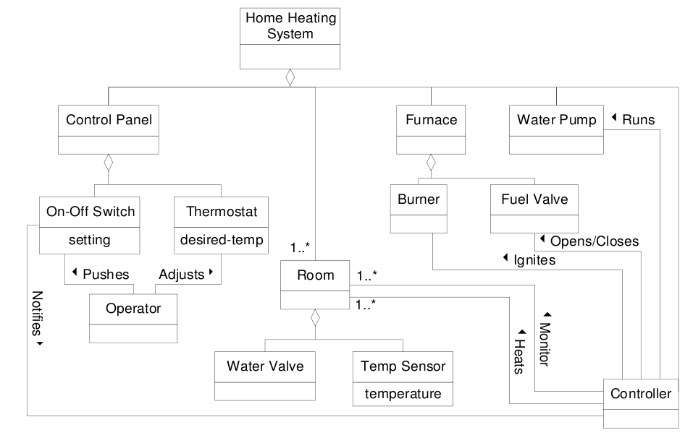
What about Attributes?
Gregory Gay CSCE 740 - Fall 2015 25
Notes:
Now, we have a class diagram, but we’re missing some information. There are a few more items that we need to make this work, but they weren’t complicated enough to include as classes. Remember any of those? What are some attributes we can add to these classes to make this system work?
(discussion)
bring in and point out. Any others?

Slide 26
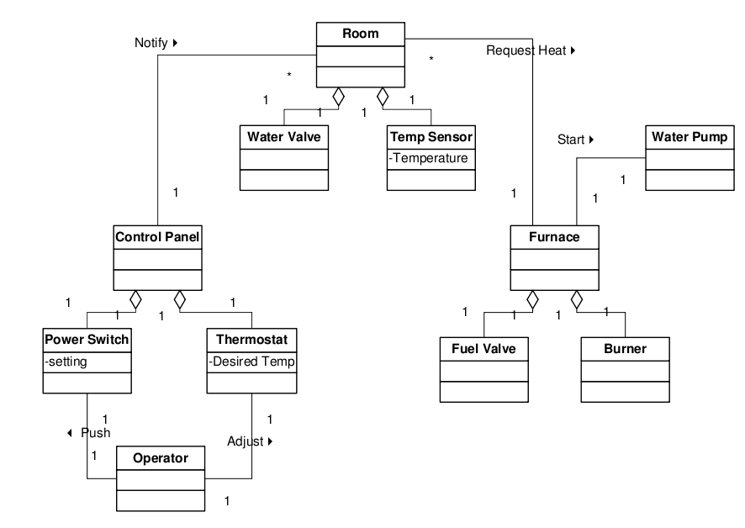
Attributes - Alternate
Gregory Gay CSCE 740 - Fall 2015 26
Notes:
We can do the same with the alternate view - point out
Anything that makes sense to include here?

Slide 27

Iterate the Model
Keep on iterating until you, your customers, and your engineers are happy with the design.
Any questions on class diagrams?
Gregory Gay CSCE 740 - Fall 2015 27
Notes:
Now, you have a pretty good class diagram. We can work on iterating this model - try to make it more efficient, fix errors, make sure it can acocmplish all of your goald. (read)
Do you guys feel confident about this? Think you could come up with a diagram for your GRADS system? Any questions?

Slide 28
We Have Learned
How to approach an OO modeling effort
Identify objects (nouns)
Identify operations and associations (verbs)
Identify attributes.
Refine, refine, refine!
The model will need a lot of iteration.
And often requires a dynamic view of the system as well (we’ll get to that soon).
Gregory Gay CSCE 740 - Fall 2015 28
Notes:
(discussion)

Slide 29
Next Time
Design Patterns
Design advice for certain types of systems.
Reading
Sommerville, chapter 7
Start working on class diagrams for GRADS.
Questions?
Gregory Gay CSCE 740 - Fall 2015 29
Notes:
(discussion)

Slide 30
Preparing for Implementation
Notes:
(backup slides - probably will not get to today)
Basic considerations to keep in mind as your design the system to get the design ready for programming

Slide 31
Choosing Data Structures
Design documents detail what is being stored, but not how to store it.
Choice of data structure matters:
Storage and operation costs
Suitability to problem (and what data is being stored)
Many guidelines out there - key is to think through the problem and your priorities (ease-of-use vs efficiency)
Gregory Gay CSCE 740 - Fall 2015 29
Notes:
Your program contains data, and that data needs to go somewhere. (read)
That choice of data structure - how you store data and collections of data within your system - matters. Each type of data structure out there, whther you use language objects like arrays or maps or trees or roll your own specialized structure - takes up different amounts of memory, has different time-bounds for performing operations, and has its own guidelines for usage.
- some may be more suitable for the problem you’re trying to solve than others or may emohasize different priorities. Like with many other problems in this class, there is a trade-off game here. Is efficiency the most important attribute of the project? Then, choose data structures with fast operation time. Is memory limited? Focus on low storage cost and simplicity. Is maintainability important? Then choose something that makes sense for the data being stored, something explicitly clear to use, even if it isn’t the most efficient storage mechanism.
There are whole classes and books of advice on this topic, so I’m not going to spend much time on this, but key is to think and make the judgement call based on your project priorities.

Slide 32
Choosing Algorithms
Design gives you what a method should do, implementation concerns how to code it to do that.
Many ways to solve a problem, think carefully about choice.
Good design may suggest certain realization.
Be prepared to trade efficiency for maintainability or understandability.
Gregory Gay CSCE 740 - Fall 2015 30
Notes:
On the same note, (read) When implementing the functionality of the system and the operations that each class provides, there may be dozens of ways to implement the solution. The obvious example is search. There are as many search algorithms as there are planets in our galaxy. Design gives you behavior description, but how do you actually realize that in code?
(read). Start filling in these details early. Even include pseudocode with your design description. Design patterns may make this easier by giving class structure that suggests certain realization. As with data structures, watch for inefficient algorithms, watch storage and memory costs. Learn from previous experience on similar topics - make use of other solutions.
- (read) Trade-offs will occur here too. Something that is easy to understand is often not the most efficient realization, and the most efficient code is often hard to comprehend. You can always combat that through clear coding standards and good documentation, but plan ahead and realize that you may need to make the judgement between competing solutions.

Slide 33
Error-Prone Constructs
Should NOT always be avoided, but must be
used with great care.
Floating-point numbers
Inherently imprecise. The imprecision may lead to invalid comparisons.
Pointers
Pointers referring to the wrong memory areas can corrupt data.
Aliasing can make programs difficult to understand and change.
Gregory Gay CSCE 740 - Fall 2015 31
Notes:
However, when deciding how to implement the system, you should be mindful of the pitfalls of relying on certain language constructs. There may be features - data structures, algorithms, code structuring styles - that are more error-prone than others. Doesn’t mean you should avoid them, may be needed to realize the design, BUT be careful, mindful.

Slide 34
Error-Prone Constructs
Dynamic memory allocation
Run-time allocation can cause memory overflow and garbage collection issues.
Parallelism
Can result in subtle timing errors because of unforeseen interaction between parallel processes.
Recursion
Errors in recursion can cause memory overflow.
Interrupts
Can cause a critical operation to be terminated and make a program difficult to understand.
Gregory Gay CSCE 740 - Fall 2015 32
Notes:
do not actually avoid parallelism these days

Slide 35
Code Reuse
Most modern software is constructed, in part, by reusing existing components or systems.
When developing software, consider how to make use of existing code.
Possible at many levels of development.
Be careful - many problems and costs associated with reuse.
Gregory Gay CSCE 740 - Fall 2015 33
Notes:
Until relatively recently, most new software was developed completely from scratch. The only significant example of reuse was the limited set of library functions in languages such as C.
However, with the increasing complexity of modern software, the lack of increase in time to develop, and the ease of sharing code, many modern projects are based, at least in part, on reusing existing systems or components.
(read) - reuse should be one of the first things you consider when designing the implementation.
(read) - abstract, object level, component level, or system level
(read)

Slide 36
Code Reuse Levels
Abstraction Level Use knowledge from similar projects in your system design (design/architectural patterns)
Object Level Import individual objects and functions from libraries and use them in your project.
Component Level Incorporate collections of objects and adapt them to your needs.
System Level Reuse complete applications, wired together with scripting code.
Gregory Gay CSCE 740 - Fall 2015 34
Notes:
(read)
- at this level, you don’t reuse software directly but rather use knowledge of successful solutions to similar problems in the design of your software. Design patterns and the architectural styles we discussed a few weeks back are major examples of this. Learn from the experience of others.
- at the object level, you directly reuse objects from a library rather than writing the code yourself. To do this, you need to find libraries of objects and functions that offer functionality you need. In most modern languages, such as Java or Python, yuo do this all the time, and the languages offer hundreds of libraries and packages to import small pieces of functionality from.
- Components are collections of objects that operate together to provide functions and services. You often have to adapt and extend these components for ytour needs by adding code of your own. For instance, you might build your user interface in a particular GUI framework. This framework offers a set of general classes for event handling, display management, etc. You add in connections to display the data calculated in your system and write code to define specific display details.
- At the system level, you reuse entire complete applications. to help your system perform services. You’ll sometimes see entire systems created by grabbing off-the-shelf systems and adapt them by writing scripting to tie them all together and give the result you need.

Slide 37
Costs of Code Reuse
The time spent looking for software to reuse and addressing whether it fits your needs can be high.
Buying and licensing software for reuse can be expensive.
Cost of adapting and configuring the reusable components to fit your requirements can be more expensive than coding yourself.
Integrating reused systems with each other and with your new code can result in new defects.
Gregory Gay CSCE 740 - Fall 2015 35
Notes:
By reusing software, you can theoretically develop systems more quickly, with fewer development risks, and lower costs. Theoretically, that software has already been tested and should be more reliable than new software. Notice that I said theoretically. The practice is generally messier. There are several problems and costs to watch out for when reusing code. As long as you temper your expectations and work to reduce these risks, code reuse may benefit your project.
- (read), You may need to test the software to see if it will even work in your environment.
- (read), especially if you buy it and find it doesn’t fit your needs.
-(read)
-(read) and even if not, it can be time consuming to figure out.
What it comes down to is that you are using software for purposes it may not have been intended for. Remember that talk about environmental assumptions? The developers of the original code made certain domain assumptions when you put those systems together. Your new project might undermine those assumptions, and lead to poor results. Be careful, and do your research.

Slide 38
Host-Target Development
Most software is developed on one type of computer (the host) and deployed on different types of computers (targets).
For embedded systems, the target is very different from the host.
For desktop applications, still need to consider a wide variety of target environments.
Gregory Gay CSCE 740 - Fall 2015 36
Notes:
(read). Sometimes, the development and execution platforms are the same, but generally, software must be packaged, installed, and executed on many different forms of hardware, operating a variety of operating system versions, and potentially with software installed that may conflict with the new software.
- for embedded systems, the target will be very different from the host. You’re moving from a fully-featured desktop to a tiny system with limited execution power and all sorts of special-purpose hardware such as sensors. In that case, it’s normal to test using a simulation of the target system that runs on your desktop. In that case, how you simulate the target platform becomes hugely important to actually finding and fixing defects.
- Most of you will not be working in embedded systems, but for desktop applications, there are some important decisions to make in order to ensure that your application works across the staggering variety of hardware builds, OS types, and execution environments out there.

Slide 39
Target Support Issues
The hardware and software requirements of a component.
If a component is designed for a specific hardware architecture, requires certain CPU/RAM/GPU, or requires special software, then make sure those assumptions are clearly stated.
The availability requirements of the system.
Components may be deployed on multiple platforms. Make sure an alternative implementation of the component is available if one fails.
Component Communications
If distributed components must communicate, try to install them on a single system or ensure geographically close servers exist.
Gregory Gay CSCE 740 - Fall 2015 37
Notes:
(read)
(read) - in a high availability system, components need to be deployed on multiple machines and platforms.. (Read)
(read) reduce communication latency

Slide 40
Managing Change
Change happens all the time, so managing change is essential.
When teams work together, their work must not conflict.
Changes must be coordinated. Otherwise, one programmer may overwrite the other’s work.
Everybody must have access to the most up-to-date versions of all project components.
If something is broken, we should be able to go back to the working version.
Gregory Gay CSCE 740 - Fall 2015 38
Notes:
(read)
How many of you keep your code in source control? IF not all, do it. What do you use? Git? SVN? BZR?

Slide 41
Configuration Management
The process of managing a changing system. Three fundamental activities:
Version Management Different versions of system components are tracked. Coordinates development by several programmers. Prevents overwriting of code.
System Integration Support is provided to help developers define what versions of a component are used to create a system build. Supports automated builds by linking components.
Problem Tracking Allow users to report bugs and other problems, and allow developers to see who is working on these problems.
Gregory Gay CSCE 740 - Fall 2015 39
Notes:
(read). The aim of configuration manage it to support the development process such that developers can access the project code and documents in a controlled way, find out what changes have been made, and compile and link components to create a system.
(read)

