Slide 1
Dynamic Modeling
CSCE 740 - Lecture 19 - 11/04/2015

Slide 2
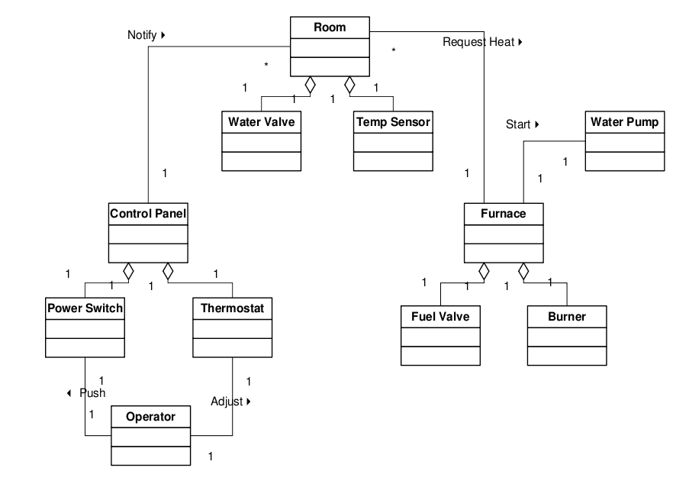
Class Diagram
Gregory Gay CSCE 740 - Fall 2015 2
Notes:
We’ve been talking about how you design object oriented systems a whole lot lately, and you’ve gotten quite familiar with our friend, the class diagram.
You remember our pal, the home heating system - (walk through)
We’ve talked a lot about class diagrams, as they are essentially the closest analogue that we have in software to blueprints, but they just represent one view of the system - the static structure of the source code, the abstract classes that may or may not be instantiated and used by the system during runtime. This doesn’t give us the complete picture.

Slide 3
Overview
Static models describe the structure of the classes (attributes, operations) and their relationships.
Dynamic models describe how objects interact and change state, including the ordering of interactions.
Today, we will discuss using sequence diagrams to examine dynamic behavior.
Gregory Gay CSCE 740 - Fall 2015 3
Notes:
- Structural models, such as class diagrams, (read). class diagrams are a “flat” view - they tell you about the structure of the code, but don’t give the complete picture of how the system will work when it executes. They tell us what, say, a Control Panel or a Furnace can do - the full set of operations that *might* be invoked - but not what the instantiated objects will do during any one concrete execution of the system. Class diagrams define the universe of behaviors, but during runtime, we take one of an infinite number of strolls through that universe.
- (read)

Slide 4
Why Model Dynamic Behavior?
Static models tells us that Rooms request heat from a Furnace.
But not when
Or how
Or how often
… and that a Furnace can start a Water Pump
But not under what circumstances
Dynamic models add context.
Gregory Gay CSCE 740 - Fall 2015 4
Notes:
(read)
Dynamic models give us the context for associations. They tell us how the objects actually interact during a set of chosen scenarios. They let us construct sequences of events, and tie multiple objects together as they perform the functions of the system. With just a class diagram, our view of the system is too vague, it only tells us what might happen. We need that context to fill in the details for implementation, to construct the sequence of interactions that take place between objects.

Slide 5
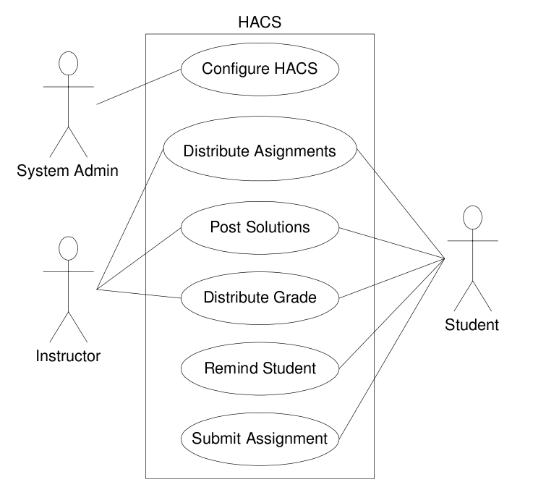
Start With The Use-Cases
Use-cases describe functions the system can accomplish.
Functions can be decomposed into series of actions performed internally by system classes.
Gregory Gay CSCE 740 - Fall 2015 5
Notes:
Start with use cases - these are an external view of system behavior - what does the user feed in and what does the system pop back out - but they are a good starting place. They give us scenarios to analyze. During these, what does the system do to generate that output? What interactions need to take place internally?
(read, bring in example)

Slide 6
Sequence Diagrams
Capture how the system fulfills a use case.
Sequence of interactions between objects within the system.
Highlight the order and sequencing of interactions.
ord1: Order
items: Catalog
calculatePrice
calculatePrice
Gregory Gay CSCE 740 - Fall 2015 6
Notes:
Sequence diagrams describe how objects collaborate and the behaviors and state of those objects during the execution of the system. They capture a detailed sequence of object interactions during a scenario.
(read 3). This provides context to the static class diagram. From the sequence diagrams, we can figure out when and how objects should interact, not just a drawing of all of the ways that the abstract classes might collaborate.

Slide 7
Sequence Diagram Syntax
ord1: Order
items: Catalog
Naming: name : Class or, informally, “A Class”.
Lifeline: dashed line indicates life of the object.
calculatePrice
lookup(item)
Found Message: Commands from an unmodeled source.
Activation Box: A method is being executed.
price
Message: One object calls a method offered by another object.
Return: Information that the object returns to the calling object.
Gregory Gay CSCE 740 - Fall 2015 7
Notes:
- In the box, you name the object. These are object instances, rather than classes, so you give the instance a name, then indicate its class, just like you would do in the code.
- (read lifeline). It should end either when the object is destroyed, or when the system stops execution
- The sequence of events is kicked off by some event, usually a call to a method in the object that then calls into other objects. If the actor or object that starts the sequence is not important - or can be a number of different sources - we just indicate the start of a sequence with what is called a found message. We got a command from some unmodled source. Indicated by the circle with an arrow.
- A box on the lifeline indicated that the object is currently active - that a method performed by this object is on the stack. The box should end when that method is done executing. So, the external source called the calculatePrice method in this Order instance.
- Now we bring in a second object, a line on the order form. The arrow is called a message. It activates a method on the object. So, this Order is calling the process method in the OrderLine object.

Slide 8
Sequence Diagram Syntax (2)
ord1: Order
Actors: external users/systems can be modeled as objects
A Customer
calculatePrice
new
items: Catalog
New: When an object is created, a “new” message should point to the box naming the new object.
close
sumPrices
Close: When an object is destroyed, end its lifeline with an X.
Self-Call: Objects can call their own methods.
totalPrice
Gregory Gay CSCE 740 - Fall 2015 8
Notes:
- Actors - either users or external systems such as databases can also be modeled as objects in sequence diagrams. They are indicated by the stick figures, and should be given unique names like the object instances. This is needed if user interactions need to be modeled, or if information needs to be returned to some external user or system.
- New - Previously, we had the actor and this Order object lined up. That’s because they began to exist at the same time. But, not all objects are present from the time that the software turns on. We create objects all the time. So, when that happens, you start that onject’s lifeline from the point of creation, with a message labeled new pointing at that name box.
- (read close)
- (read self-call) - this is indicated by an message arrow pointing at themself. Notice the second box over the first. That’s because the first method is still executing on the stack. This Order calls one of its own methods while performing the calculatePrice method.

Slide 9
Ordering Example
ord1: Order
line: OrderLine
item: Product
user: Customer
calculatePrice
priceLine()
getPrice(quantity)
price
price
getDiscountedValue(ord1)
getCurrentTotal
current total
discounted total
Gregory Gay CSCE 740 - Fall 2015 9
Notes:
(walk through example)
order is made up of a series of order lines, each line of order has a product and a quantity
we would want to go through each line of the order. This example technically only shows us going through a single line, we’ll go over how ytou handle repeated operations shortly.

Slide 10
Conditional Behavior
When capturing complex scenarios, you will commonly encounter conditional behavior:
The user does something, if this is X, do this… If Y, do this… If Z, do something else…
For each item, do this...
Use “frames” to highlight branches in the diagram.
Gregory Gay CSCE 740 - Fall 2015 10
Notes:
(read 1) - right? this is programming 101, you encounter loops, you repeat actions over a collection of items, you hit if-then-else blocks
The question is - how do you depict these in a sequence diagram? There is a construct known as a frame to convey this kind of situation - loops, conditional statements, and optional events.

Slide 11
Loops and Conditions
ord1: Order
careful: Distributor
regular: Distributos
emails: Messenger
procedure dispatch
foreach(line item)
if (item.value > 10000)
careful.dispatch
else
regular.dispatch
if (needsConfirmation)
emails.confirm
dispatch
loop
[for each line item]
alt
[value > 10000]
dispatch
[else]
dispatch
opt
[needsConfirmation]
confirm
Gregory Gay CSCE 740 - Fall 2015 11
Notes:
go over procedure
- first, we need to go through each item in the order and decide how to ship it, this requires a loop. This takes the form of a frame, a box around an area of the sequence diagram. In the corner, we apply a keyword to describe the frame - in this case, it is a loop. Next to that, we place a condiitonal statement in the brackets that defines the loop condition. In this, we say it loops over all line items
- now, we have an if-then-else block, if the product is worth more than 10k, we use careful shipping, else we use normal shipping. We bring in another frame. This one is labeled with alt - that means that multiple scenarios can occur. You can use this anytime you have multiple possible actions. You cut the frame into portions for each outcome. The first here is if the value > 10000, the second covers the else branch
- This last if statement just has one outcome, so we don’t use alt for that - there’s one outcome. Instead, we use opt for optional - this is an optional block of code. We use the opt keyword and define the condition - if it needs confirmation, we send confirmation.

Slide 12
Frame Operators
alt: Alternative paths, only one of which will execute.
opt: Optional set of interactions.
loop: Set of interactions may execute multiple times.
par: Each indicated set of interactions will execute in parallel.
region: Critical region, only one thread can execute this interaction sequence at once.
neg: This set of interactions can never legally happen.
ref: Used to refer to a set of interactions depicted on another diagram.
Gregory Gay CSCE 740 - Fall 2015 12
Notes:
Those tags that we place on frames - opt, alt, loop - are called frame operators. They indicate why you’ve carved out that special block of the interaction diagram. There are several frame operators that we can make use of.

Slide 13
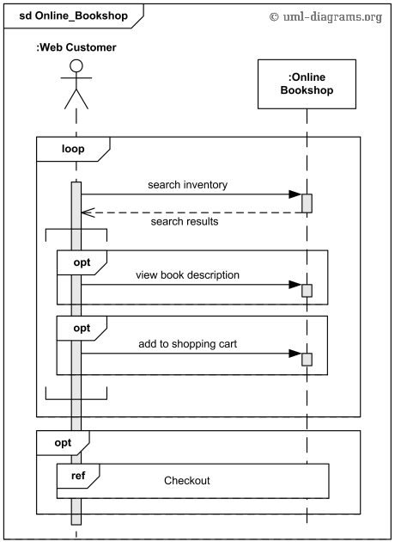
Online Bookstore Example
store: Bookstore
A Customer
Gregory Gay CSCE 740 - Fall 2015 13
Notes:
Here is another example, showing off some of these frames. (walk through)
Now, there is a loop here with no condition. That is used to indicate that this is a set of events that can occur multiple times - it isn’t necessarily a loop in the program, rather, you’re just saying that a customer is not required to check out as soon as they add one item to the cart.

Slide 14
Home Heating Use Case
Use Case: Power Up
Actors: Home Owner
Description:
The Home Owner moves the power switch to the “on” position.
The system responds with a “system ready” status message if it starts successfully.
Gregory Gay CSCE 740 - Fall 2015 14
Notes:
Remember the Home Heating System from last week? We designed a couple of class diagrams for it, right? Let’s see if we can take those diagrams and a use case and sketch out a sequence diagram.
Here is our use case (read)
This doesn’t give us much yet.

Slide 15
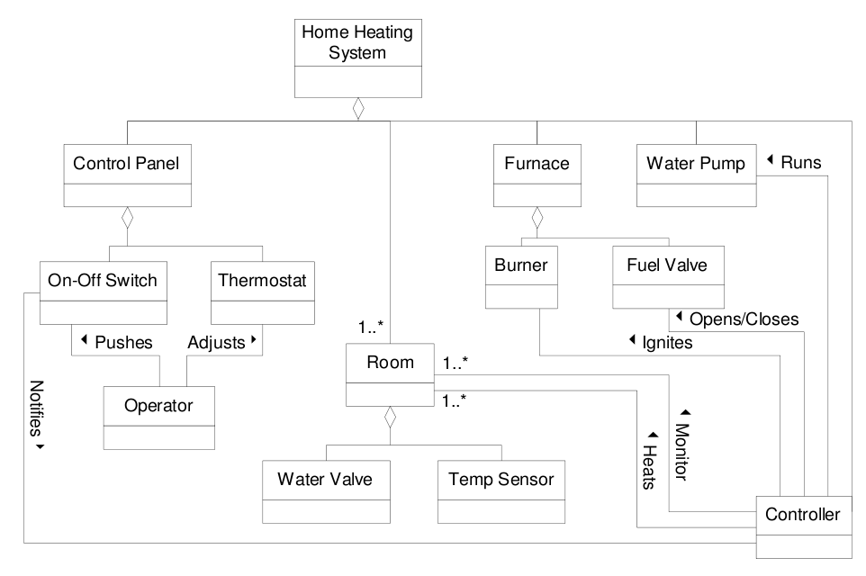
Class Diagram - v1
Use Case: Power Up
Actors: Home Owner
The Home Owner moves the power switch to the “on” position.
The system responds with a “system ready” status message if it starts successfully.
Related Requirement:
An operator class processes input signals. When the power is turned on, each room is temperature checked. If a room is below the desired temperature, the valve for the room is opened, the water pump started, the fuel valve opened, and the burner ignited.
Gregory Gay CSCE 740 - Fall 2015 15
Notes:
The use case gives us the external events - we know that the home owner starts heating by flipping the power button and that the system tries to start up, returning that status message when its done. Now, we need to fill in what happens between request and return. If we look over our requirements and our class diagram, we can do that. Now, we don’t have operations listed in this class diagram yet. This is a good way to figure some of those out, right? We have down how classes are associated, let’s use that to fill in operations, then sketch out our diagram. This is pretty straightforward
(discussion, walk through)
owner - on-off switch, system on
oos - controller, power on
controller - check temperature of all rooms (loop)
if status low - controller turns on pump, opens valve, starts burner

Slide 16
Sequence Diagram - v1
ioProc: Operator
switch: On-Off Switch
con: Controller
: Room
pump: Water Pump
fv: Fuel Valve
bur: Burner
An Owner
turnon
activate
loop
[for all rooms]
power on
get temperature
temperature
opt
[tempStatus==low]
pump on
open valve
result message
status
start burner
Gregory Gay CSCE 740 - Fall 2015 16
Notes:
(walk through example)

Slide 17
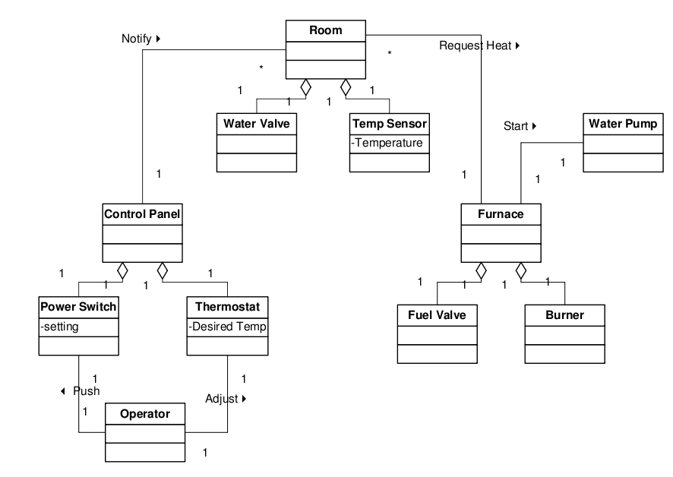
Class Diagram - v2
Use Case: Power Up
Actors: Home Owner
The Home Owner moves the power switch to the “on” position.
The system responds with a “system ready” status message if it starts successfully.
Related Requirement:
An operator class processes input signals. When the power is turned on, each room is temperature checked. If a room is below the desired temperature, the valve for the room is opened, the water pump started, the fuel valve opened, and the burner ignited.
Gregory Gay CSCE 740 - Fall 2015 17
Notes:
second class diagram, more decentralized structure. On the static side, we don’t change things all that much - the class diagram is pretty similar - but it does change the sequence diagram a bit - we’ve overhauled how objects are allowed to communicate with this architecture. Let’s see what this might look like
(discussion) owner - power stich, system on
power switch - control panel, power on
control panel - notify all rooms, loop, rooms check their temp
if status is low, room requests heat from the furnace.
furnace, turns on pump, opens valve, and ignite burner

Slide 18
Sequence Diagram - v2
ioProc: Operator
switch: Power Switch
cp: Control Panel
: Room
furn: Furnace
pump: Water Pump
fv: Fuel Valve
bur: Burner
An Owner
turnon
activate
loop
[for all rooms]
power on
notify
check temp
opt
[tempStatus==low]
request heat
pump on
open valve
result message
status
start burner
Gregory Gay CSCE 740 - Fall 2015 18
Notes:
(walk through example)

Slide 19
Example - Poker Hand
Starting a New Game Round
The scenario begins when a request for a new round is sent to the UI.
All players' hands are emptied into the deck, which is then shuffled.
The player left of the dealer supplies an ante bet of the proper amount.
Next each player is dealt a hand of two cards from the deck in a round-robin fashion; one card to each player, then the second card.
If the player left of the dealer doesn't have enough money to ante, he/she is removed from the game, and the next player supplies the ante.
If that player also cannot afford the ante, this cycle continues until such a player is found or all players are removed.
Gregory Gay CSCE 740 - Fall 2015 19
Notes:
Now, we don’t always have to start from use cases. Once you have an idea of the classes in your system, you can model any execution scenario. So, here’s another example, based on a poker system. We’ve talked to our stakeholders, and they tell us that this is what should happen (read)
Not giving you the class diagram here, but we can pick out objects and classes from the text. What are our classes? Think you could draw this? Give me some interactions.

Slide 20
Example - Poker Hand
interface: UI
table: Table
: Player
cards: Deck
leftmost: Player
newRound()
newGame()
loop
[for all players]
emptyHand()
addCards()
shuffle()
loop
[players remain and leftmost cannot ante]
removePlayer(leftmost)
Gregory Gay CSCE 740 - Fall 2015 20
Notes:
(point out - no name on Player object because we’re looping over several)
The scenario begins when someone chooses to start a new round in the UI. An actor wasn’t named, so we use the “found message” starting point.
All players' hands are emptied into the deck, which is then shuffled.
If the player left of the dealer doesn't have enough money to ante, he/she is removed from the game, and the next player supplies the ante.
If that player also cannot afford the ante, this cycle continues until such a player is found or all players are removed
not quite enough room on the slide, so we’ll continue on the next

Slide 21
Example - Poker Hand
interface: UI
table: Table
: Player
cards: Deck
leftmost: Player
alt
[players remain]
ante()
bet
loop
[for each player, twice]
drawCard()
getCard()
a card
[else]
endGame()
Gregory Gay CSCE 740 - Fall 2015 21
Notes:
The player left of the dealer supplies an ante bet of the proper amount.
Next each player is dealt a hand of two cards from the deck in a round-robin fashion; one card to each player, then the second card.

Slide 22
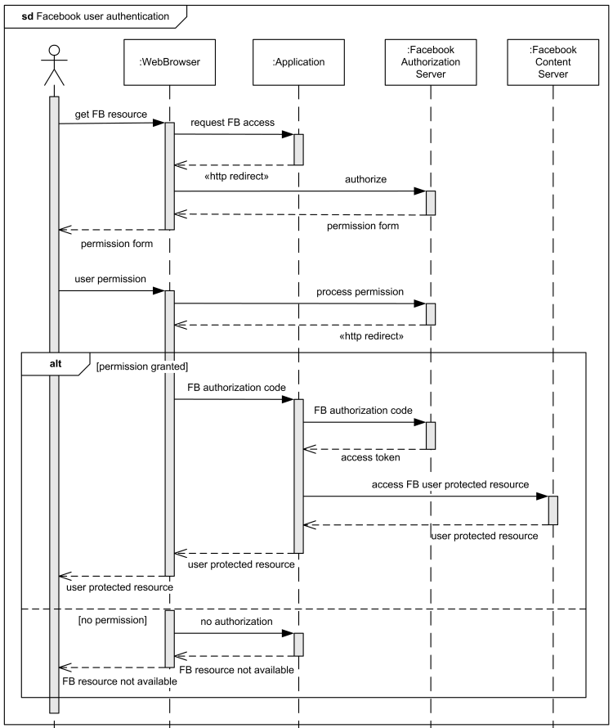
Facebook Web User Authentication
browser: WebBrowser
app: Application
fbAuth: AuthorizationServer
fbContent: ContentServer
A User
Gregory Gay CSCE 740 - Fall 2015 22
Notes:
walk through

Slide 23
Sequence Diagram Activity
A local television station opens a communication link to the SatComms module, identifies itself, and requests a link to the WeatherStation instance for a particular location. It then requests a weather report from the WeatherStation. The WeatherStation requests a summary from that location’s WeatherData instance. If new readings have not been take in the last five minutes, then the WeatherData will gather new values for its attributes. WeatherData will then return its summary.
Draw a sequence diagram for this scenario using these classes.
WeatherStation
identifier
testLink()
reportWeather() reportStatus()
restart(instruments)
shutdown(instruments)
reconfigure(commands)
WeatherData
temperature
windSpeed
windDirection
pressure
lastReadingTime
collect()
summarize(time)
Thermometer
ther_identifier
temperature
get()
shutdown()
restart()
Barometer
bar_identifier
pressure
get()
shutdown()
restart()
Anemometer
an_identifier
windSpeed
windDirection
get()
shutdown()
restart()
SatComms
linkedStation
stationList[]
openLink(identifier)
closeLink(identifier)
identify(userID)
requestReport()
Gregory Gay CSCE 740 - Fall 2015 23

Slide 24
Activity Solution
comms: SatComms
s1: Weather Station
wD: WeatherData
ther: Thermometer
bar: Barometer
an: Anemometer
A TV Station
identify(userID)
openLink (location)
testLink()
acknowledgement
requestReport()
reportWeather()
summarize(time)
opt
[time - lastReading > 5 minutes]
collect()
get(temperature)
get(pressure)
get(speed)
report
report
report
Gregory Gay CSCE 740 - Fall 2015 24
Notes:
(walk through example)
anything different?
One thing I didn’t add here was error scenarios - this is easier to read, but when coming up with these, you should think about including error checking in here. What if we couldn’t establish a communication link? You should think about and try to include these things. If there are alternative or exception scenarios, then you should try to model and incorporate those to make implementation easier.

Slide 25
When to Use Sequence Diagrams
Use sequence diagrams when you want to look at the interaction between objects during a single use-case of the system.
Diagrams show what information is passed between objects…
and, more importantly, in what order.
Allows for concurrency, process creation, and process destruction.
Clarity is the goal - use comments.
Gregory Gay CSCE 740 - Fall 2015 25

Slide 26
Why Not Just Code It?
Sequence diagrams can be close to the code level, so why not take the class diagram and start coding it?
A sequence of steps != code for those steps.
Sequence diagrams are language-agnostic.
Non-coders can still draw sequence diagrams.
Easier to come up with sequence diagrams as a team.
Can see many objects/classes at a time on same page.
Gregory Gay CSCE 740 - Fall 2015 26
Notes:
read
- (read)better to have the high level picture before filling in the details.
- (read) thus more portable than code. Say, we need to develop a new version of the software in a different language. Having a set of sequence diagrams is often more useful than having the existing code, often clearer
- (read), they are even a good way to communicate between the developers and other project members or customers
- (read) - wasier than coding as a group
- (read) - better visualization than trying to read through all of the code.

Slide 27
We Have Learned
Dynamic modeling allows us to design how the system acts during execution.
Sequence diagrams allow modeling of detailed object interactions.
These provide context to the static structural diagrams.
Gregory Gay CSCE 740 - Fall 2015 27
Notes:
read

Slide 28
Next Time
Testing Fundamentals.
Reading:
Sommerville, ch. 8
Homework due Friday.
Any questions?
Gregory Gay CSCE 740 - Fall 2015 28
Notes:
read

Slide 29
backup slides

Slide 30
Modeling Dynamic Behavior
Several model formats used to examine dynamic behavior, at differing levels of detail:
Use Case Diagrams
Externally visible behavior of system.
Activity Diagrams
Flow of events during execution.
Sequence Diagrams
Interactions between objects.
State Diagrams
Detailed behavior of a single object.
Low Detail
High Detail
Gregory Gay CSCE 740 - Fall 2015 5
Notes:
(read).
(read). Use-Cases are at the most minimal level of detail. From an external perspective, what is the system doing during different execution scenarios.
(read). These broadly model a sequence of actions taken during execution. We tend to group objects or reason at the subsystem level and just sketch out the ordering of major system functions.
(read). Here, we look at a concrete series of interactions over the execution of one scenario at the object level. We look at the exact method calls and passing of data conducted between all of the active objects within the system.
(read). Model the behavior of a single object in terms of events and states. These are the most detailed way to look at all of the things that one object can accomplish.

Slide 31
Activity Diagrams
Show how system and user actions are connected together:
Shows order of processing.
Captures parallelism.
Allows analysis of:
Processing
Synchronization
Conditional selection of activities
Receive Order
Fill Order
Send Invoice
[priority order]
[else]
Overnight Deliery
Regular Delivery
Receive Payment
Close Order
Gregory Gay CSCE 740 - Fall 2015 7
Notes:
The next step is to construct activity diagrams. Activity diagrams are a technique for describing the procedural logic and workflow of the system. They show how the actions the system can perform and actions the user can perform are connected together. They show sequences of events within and external to the system and capture the order of processing. They can also capture parallel behavior in the system, and allow the analysis of information processing, synchronization of system activities, and the conditional selection of activities.
These are an in-between step between use cases and full blown dynamic design diagrams. They let us look inside of the system, but still at a higher level - we can look at what either individual objects or groups of objects are accomplishing in parallel when performing the scenarios we’ve chosen to examine.

Slide 32
Activity Diagram Syntax
Initial Node: Where execution begins.
Receive Order
Action: Something that the system does.
Fill Order
Send Invoice
Fork: Split into concurrent activities.
[priority order]
[else]
Join: Combine event flow back into one stream.
Overnight Deliery
Regular Delivery
Receive Payment
Decision: Perform different activities based on result.
Merge: Resume execution after a decision split.
Close Order
Gregory Gay CSCE 740 - Fall 2015 8
Notes:
- initial node, where execution is considered to begin for this diagram.
- bubbles are actions - these are things that the system can do. This can be something one object is responsible for, or something accomplished by a group of classes, depending on the level of detail.
- Forks are where we split into concurrent processing streams. Several objects or groups of objects might be performing activities in parallel.
- These are succeeded by a join where the streams come back together to form a single activity stream. This is where we synchronize all of our information and continue execution.
- Decisions let us perform different activities for different situations. This allows us to model alternate event sequences or exception handling.
- a second diamond is used to indicate where we resume execution after the split.
- (explain)

Slide 33
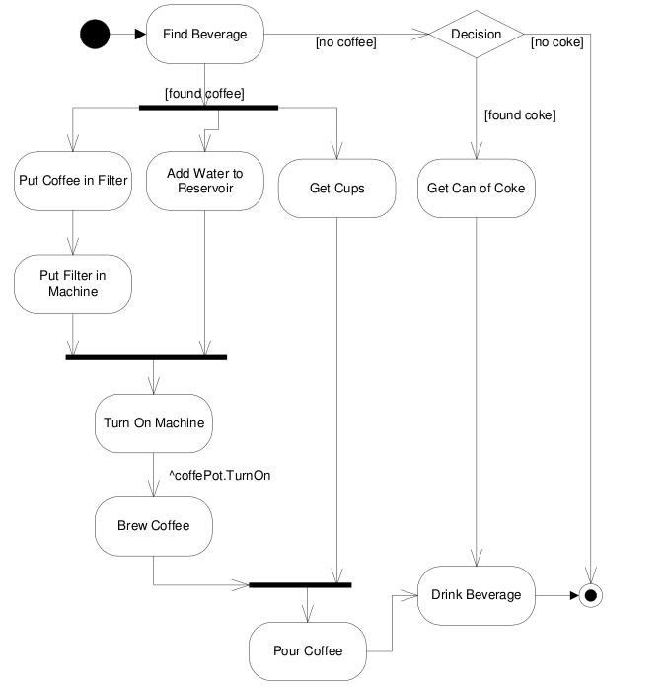
Drink Dispenser Example
Dispense Drink
Gregory Gay CSCE 740 - Fall 2015 9
Notes:
I’m tired, I want coffee. (walk through)

Slide 34
HACS Example
Use Case: Distribute Assignments
Actors: Instructor, Student
Description: The Instructor completes an assignment and submits it to the system. The Instructor will also submit the delivery date, due date, and the class the assignment is assigned for. The system will, at the due date, mail the assignment to the student.
Gregory Gay CSCE 740 - Fall 2015 10
Notes:
If we want to look at the dynamic behavior of the system, we can start with our use case diagram and descriptions. Say we have this homework distribution system (go through description).
Can we start to fill in the sequence of events? What does the system need to do?
(discuss)

Slide 35
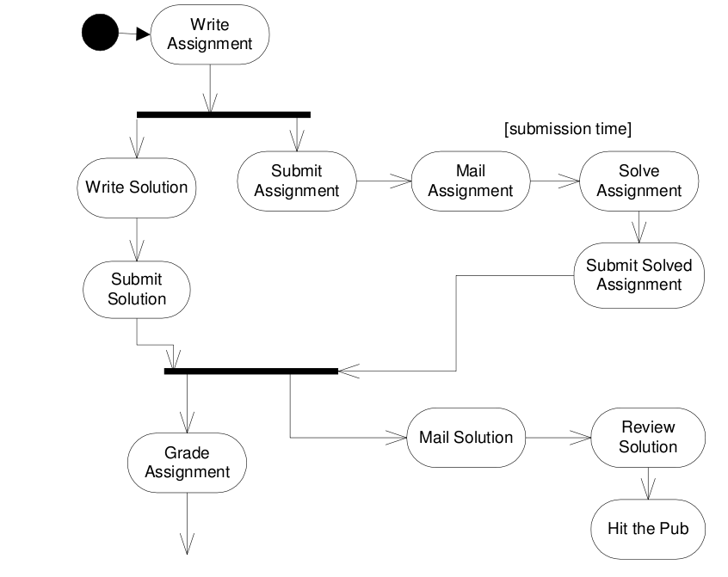
HACS Example
Gregory Gay CSCE 740 - Fall 2015 11
Notes:
Here’s an initial stab at the activity diagram. This is still very focused on externally visible behavior of the system, but we can begin to understand how the system should work internally from this.
As we walk through this, think about how you could refine it to be more in terms of what is going on within the system. See if we can fill in more details as we go.
walk through - link from user actions to how the system would handle them

Slide 36
Subactivities
Describe complex actions using subactivity diagrams.
Receive Order
Fill Order
Send Invoice
Deliver Order
Regular Delivery
Deliver Order
Receive Payment
[else]
Order
Order
[priority order]
Overnight Deliery
Close Order
Gregory Gay CSCI 5801 - Spring 2015 12
Notes:
Sometimes, you will put an activity into one of these diagrams, and it’s actually quite complex - something you may want to sketch out the logic of. It may be useful to break that down into a more detailed set of subactions. We can do this through by splitting out into a side-diagram, called subactivity diagrams.
(explain syntax)
name, input and output, fork

Slide 37
Partitions
Shipping
Order
Controller
Billing
Divide diagram into actions performed by one entity (object or subsystem) or actor.
Receive Order
Fill Order
Send Invoice
[priority order]
[else]
Overnight Deliery
Regular Delivery
Receive Payment
Close Order
Gregory Gay CSCE 740 - Fall 2015 13
Notes:
Activity diagrams tell you what is happening, but where they often fall short is that they don’t tell you WHO does what. This doesn’t tell you which actor or object or subsystem or whatever is responsible for an action. This might be fine when you start figuring out how to design your system- you need to know what gets done, but don’t need to know who does it yet - but is eventually going to be a problem. If you want to start making that distinction, you can divide your diagram using partitions. Each partition shows which actions one entity carries out. These are also called swimlanes, because they divide the diagram into different lanes for each entity.
(explain example)

Slide 38
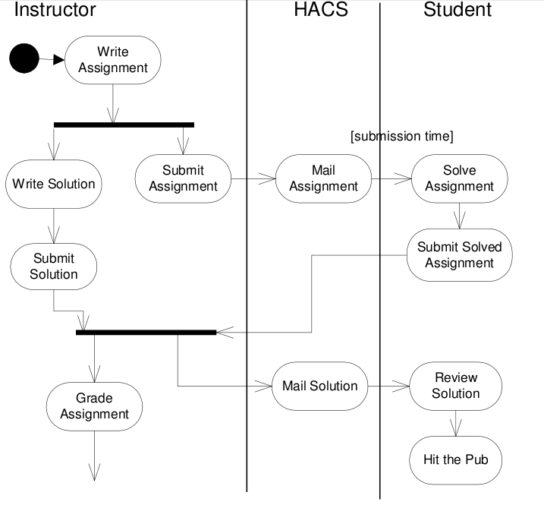
HACS Partitions Example
Gregory Gay CSCE 740 - Fall 2015 14
Notes:
HACS does very little right now - but as we add actions performed internally, this diagram will be reshaped a good bit. For instance, the Instructor submits an assignment, well, HACS will need to do something with that, so we might add activities like save assignment or auto-grade solutions for multiple-choice assignments. Eventually, we wouldn’t want a HACS partition here at all, but split it into objects or subsystems within HACS.
But, you can see how this partitioning is limited from a visual standpoint - this can easily get cluttered and hard to read. There is a limit to how much detail you can go into with these diagrams. They’re intended for high-level modeling or sequences of activities, but don’t give you the most detailed idea of object interactions.

Slide 39
Problems with Activity Diagrams
They are glorified flowcharts.
Very easy to make a traditional data-flow oriented design, but not well-suited to OO design.
Hard to isolate behavior of a single object.
Do not show how objects collaborate to perform an action.
Do not show how individual objects behave over time.
However...
They can be very powerful when you know how to use them correctly.
Gregory Gay CSCE 740 - Fall 2015 15
Notes:
(read) - These worked pretty well for simple C programs, or things where you pass data from one transformer to the next, as we saw in some of those architectural designs, but they aren’t well-suited to complex object-oriented design. They aren’t great when you’re looking at back and forth interaction between dozens of classes.
(read 3). Often - an action of the software isn’t performed by a single object, but by several working together, and these diagrams do not do a very good job of showing that. They also do not look at how the state of an object changes over time.
(read 6-7)

Slide 40
When to use Activity Diagrams
Useful when:
Analyzing a use case (or collection of use cases).
Great stepping stone from use cases to dynamic design models.
Understanding flow of information or control through a system.
Working with parallel applications.
Gregory Gay CSCE 740 - Fall 2015 16
Notes:
They are very useful early on in the design process, even before you have a class diagram sketched out, as a way to start filling in the internal details of the system.
(read 2 - 4)
(read 5) - looking at what actions occur at the same time.

Slide 41
Preparing for Implementation
Notes:
(backup slides - probably will not get to today)
Basic considerations to keep in mind as your design the system to get the design ready for programming

Slide 42
Choosing Data Structures
Design documents detail what is being stored, but not how to store it.
Choice of data structure matters:
Storage and operation costs
Suitability to problem (and what data is being stored)
Many guidelines out there - key is to think through the problem and your priorities (ease-of-use vs efficiency)
Gregory Gay CSCE 740 - Fall 2015 29
Notes:
Your program contains data, and that data needs to go somewhere. (read)
That choice of data structure - how you store data and collections of data within your system - matters. Each type of data structure out there, whther you use language objects like arrays or maps or trees or roll your own specialized structure - takes up different amounts of memory, has different time-bounds for performing operations, and has its own guidelines for usage.
- some may be more suitable for the problem you’re trying to solve than others or may emohasize different priorities. Like with many other problems in this class, there is a trade-off game here. Is efficiency the most important attribute of the project? Then, choose data structures with fast operation time. Is memory limited? Focus on low storage cost and simplicity. Is maintainability important? Then choose something that makes sense for the data being stored, something explicitly clear to use, even if it isn’t the most efficient storage mechanism.
There are whole classes and books of advice on this topic, so I’m not going to spend much time on this, but key is to think and make the judgement call based on your project priorities.

Slide 43
Choosing Algorithms
Design gives you what a method should do, implementation concerns how to code it to do that.
Many ways to solve a problem, think carefully about choice.
Good design may suggest certain realization.
Be prepared to trade efficiency for maintainability or understandability.
Gregory Gay CSCE 740 - Fall 2015 30
Notes:
On the same note, (read) When implementing the functionality of the system and the operations that each class provides, there may be dozens of ways to implement the solution. The obvious example is search. There are as many search algorithms as there are planets in our galaxy. Design gives you behavior description, but how do you actually realize that in code?
(read). Start filling in these details early. Even include pseudocode with your design description. Design patterns may make this easier by giving class structure that suggests certain realization. As with data structures, watch for inefficient algorithms, watch storage and memory costs. Learn from previous experience on similar topics - make use of other solutions.
- (read) Trade-offs will occur here too. Something that is easy to understand is often not the most efficient realization, and the most efficient code is often hard to comprehend. You can always combat that through clear coding standards and good documentation, but plan ahead and realize that you may need to make the judgement between competing solutions.

Slide 44
Error-Prone Constructs
Should NOT always be avoided, but must be
used with great care.
Floating-point numbers
Inherently imprecise. The imprecision may lead to invalid comparisons.
Pointers
Pointers referring to the wrong memory areas can corrupt data.
Aliasing can make programs difficult to understand and change.
Gregory Gay CSCE 740 - Fall 2015 31
Notes:
However, when deciding how to implement the system, you should be mindful of the pitfalls of relying on certain language constructs. There may be features - data structures, algorithms, code structuring styles - that are more error-prone than others. Doesn’t mean you should avoid them, may be needed to realize the design, BUT be careful, mindful.

Slide 45
Error-Prone Constructs
Dynamic memory allocation
Run-time allocation can cause memory overflow and garbage collection issues.
Parallelism
Can result in subtle timing errors because of unforeseen interaction between parallel processes.
Recursion
Errors in recursion can cause memory overflow.
Interrupts
Can cause a critical operation to be terminated and make a program difficult to understand.
Gregory Gay CSCE 740 - Fall 2015 32
Notes:
do not actually avoid parallelism these days

Slide 46
Code Reuse
Most modern software is constructed, in part, by reusing existing components or systems.
When developing software, consider how to make use of existing code.
Possible at many levels of development.
Be careful - many problems and costs associated with reuse.
Gregory Gay CSCE 740 - Fall 2015 33
Notes:
Until relatively recently, most new software was developed completely from scratch. The only significant example of reuse was the limited set of library functions in languages such as C.
However, with the increasing complexity of modern software, the lack of increase in time to develop, and the ease of sharing code, many modern projects are based, at least in part, on reusing existing systems or components.
(read) - reuse should be one of the first things you consider when designing the implementation.
(read) - abstract, object level, component level, or system level
(read)

Slide 47
Code Reuse Levels
Abstraction Level Use knowledge from similar projects in your system design (design/architectural patterns)
Object Level Import individual objects and functions from libraries and use them in your project.
Component Level Incorporate collections of objects and adapt them to your needs.
System Level Reuse complete applications, wired together with scripting code.
Gregory Gay CSCE 740 - Fall 2015 34
Notes:
(read)
- at this level, you don’t reuse software directly but rather use knowledge of successful solutions to similar problems in the design of your software. Design patterns and the architectural styles we discussed a few weeks back are major examples of this. Learn from the experience of others.
- at the object level, you directly reuse objects from a library rather than writing the code yourself. To do this, you need to find libraries of objects and functions that offer functionality you need. In most modern languages, such as Java or Python, yuo do this all the time, and the languages offer hundreds of libraries and packages to import small pieces of functionality from.
- Components are collections of objects that operate together to provide functions and services. You often have to adapt and extend these components for ytour needs by adding code of your own. For instance, you might build your user interface in a particular GUI framework. This framework offers a set of general classes for event handling, display management, etc. You add in connections to display the data calculated in your system and write code to define specific display details.
- At the system level, you reuse entire complete applications. to help your system perform services. You’ll sometimes see entire systems created by grabbing off-the-shelf systems and adapt them by writing scripting to tie them all together and give the result you need.

Slide 48
Costs of Code Reuse
The time spent looking for software to reuse and addressing whether it fits your needs can be high.
Buying and licensing software for reuse can be expensive.
Cost of adapting and configuring the reusable components to fit your requirements can be more expensive than coding yourself.
Integrating reused systems with each other and with your new code can result in new defects.
Gregory Gay CSCE 740 - Fall 2015 35
Notes:
By reusing software, you can theoretically develop systems more quickly, with fewer development risks, and lower costs. Theoretically, that software has already been tested and should be more reliable than new software. Notice that I said theoretically. The practice is generally messier. There are several problems and costs to watch out for when reusing code. As long as you temper your expectations and work to reduce these risks, code reuse may benefit your project.
- (read), You may need to test the software to see if it will even work in your environment.
- (read), especially if you buy it and find it doesn’t fit your needs.
-(read)
-(read) and even if not, it can be time consuming to figure out.
What it comes down to is that you are using software for purposes it may not have been intended for. Remember that talk about environmental assumptions? The developers of the original code made certain domain assumptions when you put those systems together. Your new project might undermine those assumptions, and lead to poor results. Be careful, and do your research.

Slide 49
Host-Target Development
Most software is developed on one type of computer (the host) and deployed on different types of computers (targets).
For embedded systems, the target is very different from the host.
For desktop applications, still need to consider a wide variety of target environments.
Gregory Gay CSCE 740 - Fall 2015 36
Notes:
(read). Sometimes, the development and execution platforms are the same, but generally, software must be packaged, installed, and executed on many different forms of hardware, operating a variety of operating system versions, and potentially with software installed that may conflict with the new software.
- for embedded systems, the target will be very different from the host. You’re moving from a fully-featured desktop to a tiny system with limited execution power and all sorts of special-purpose hardware such as sensors. In that case, it’s normal to test using a simulation of the target system that runs on your desktop. In that case, how you simulate the target platform becomes hugely important to actually finding and fixing defects.
- Most of you will not be working in embedded systems, but for desktop applications, there are some important decisions to make in order to ensure that your application works across the staggering variety of hardware builds, OS types, and execution environments out there.

Slide 50
Target Support Issues
The hardware and software requirements of a component.
If a component is designed for a specific hardware architecture, requires certain CPU/RAM/GPU, or requires special software, then make sure those assumptions are clearly stated.
The availability requirements of the system.
Components may be deployed on multiple platforms. Make sure an alternative implementation of the component is available if one fails.
Component Communications
If distributed components must communicate, try to install them on a single system or ensure geographically close servers exist.
Gregory Gay CSCE 740 - Fall 2015 37
Notes:
(read)
(read) - in a high availability system, components need to be deployed on multiple machines and platforms.. (Read)
(read) reduce communication latency

Slide 51
Managing Change
Change happens all the time, so managing change is essential.
When teams work together, their work must not conflict.
Changes must be coordinated. Otherwise, one programmer may overwrite the other’s work.
Everybody must have access to the most up-to-date versions of all project components.
If something is broken, we should be able to go back to the working version.
Gregory Gay CSCE 740 - Fall 2015 38
Notes:
(read)
How many of you keep your code in source control? IF not all, do it. What do you use? Git? SVN? BZR?

Slide 52
Configuration Management
The process of managing a changing system. Three fundamental activities:
Version Management Different versions of system components are tracked. Coordinates development by several programmers. Prevents overwriting of code.
System Integration Support is provided to help developers define what versions of a component are used to create a system build. Supports automated builds by linking components.
Problem Tracking Allow users to report bugs and other problems, and allow developers to see who is working on these problems.
Gregory Gay CSCE 740 - Fall 2015 39
Notes:
(read). The aim of configuration manage it to support the development process such that developers can access the project code and documents in a controlled way, find out what changes have been made, and compile and link components to create a system.
(read)

