Slide 1
Testing Strategies and Automation
CSCE 740 - Lecture 22 - 11/16/2015

Slide 2
We Will Cover
Additional structural testing strategies
Test automation
Testing requires programming!
Automated Testing Strategies
Gregory Gay CSCE 740 - Fall 2015 2
Notes:
You’ve got the basics down, but today we’re going to cover a couple of additional testing topics (read)

Slide 3
Path Coverage
Path coverage requires that all possible execution paths be covered by tests.
Theoretically, the strongest coverage metric.
But… Generally impossible to achieve.
Loops result in an infinite number of path variations.
Gregory Gay CSCE 740 - Fall 2015 3
Notes:
Many failures result from faults formed by the interactions between statements in the code, so (read point)
Loops are a big issue. You see, program execution can actually change pretty dramatically depending on the number of times you execute a loop, so executing a loop 19 times is considered to be a different path from executing 20 times, especially if you have things like nested loops or if-statements within that loop. As a result, unless bounded, loops result in an infinite number of paths, making path coverage impossible.
A couple lectures ago, I showed a relatively simple CFG. Even if we bounded the loop in that program to a small number of iterations, we still ended up with something like 3 quadrillion possible paths. Even at 1000 tests per second, running those would take over a hundred thousand years. So, what do we do? Can we somehow get the benefits of path coverage without the insane requirements?

Slide 4
Dealing With Loops
To make path coverage practical, constrain the number of loop iterations to representative scenarios.
For simple loops, write tests that:
Skip the loop entirely.
Take one pass through the loop.
Take two passes through the loop.
Choose an upper bound N, and:
M passes, where 2 < M < N
(N-1), N, and (N+1) passes
Gregory Gay CSCE 740 - Fall 2015 4
Notes:
To constrain path coverage to the point that it is reasonable, we need to somehow turn this infinite set of paths into a finite number of path types and cover those representations. In practice, this is quite possible - there is often little difference between running a loop 19 times and 20 times. So, rather than running all of those iterations, choose tests that will cause a certain number of loop cycles that cover certain important scenarios.
Now, there are some good general strategies for dealing with loops (read)

Slide 5
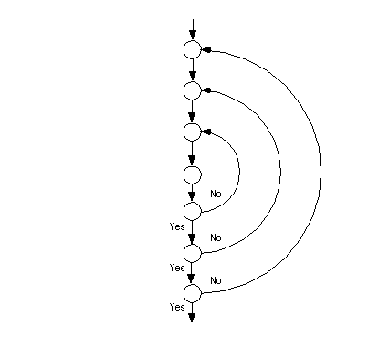
Nested Loops
Often, loops are nested within other loops.
For each level, you should execute similar strategies to simple loops.
In addition:
Test innermost loop first with all outer loops executed the minimum number of times.
Move one loops out, keep the inner loop at “typical” iteration numbers, and test this layer as you did the previous layer.
Continue until the outermost loop tested.
Gregory Gay CSCE 740 - Fall 2015 5
Notes:
(read)

Slide 6
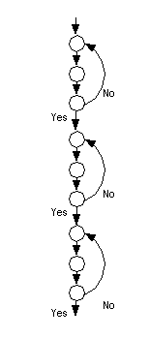
Concatenated Loops
One loop executes. The next line of code starts a new loop.
These are generally independent.
Most of the time...
If not, follow a similar strategy to nested loops.
Start with bottom loop, hold higher loops at minimal iteration numbers.
Work up towards the top, holding lower loops at “typical” iteration numbers.
Gregory Gay CSCE 740 - Fall 2015 6
Notes:
Another scenario to pay attention to are when you have concatenated loops - when one loop ends, another one starts on the next line of code.
These are generally independent, and if they are, they can be tested independently. But, that isn't always the case. How the program executes up the current point in execution will always - obviously - impact how the rest of the execution proceeds. So, how the previous loop executed might have an impact on what happens when the new loop executes.
(read)

Slide 7
Why These Loop Strategies?
Why do these loop values make sense?
In proving formal correctness of a loop, we would establish preconditions, postconditions, and invariants that are true on each execution of the loop, then prove that these hold.
The loop executes zero times when the postconditions are true in advance.
The loop invariant is true on loop entry (one), then each loop iteration maintains the invariant (many).
(invariant and !(loop condition) implies postconditions)
Loop testing strategies echo these cases.
Gregory Gay CSCE 740 - Fall 2015 7
Notes:
It is easy enough to define a bunch of loop iteration values, but why do these make sense? Running the loop zero, one, and more than once? Why are these more likely to reveal faults? (discuss)
Well, the intuition is that these values reflect the structure of the program design. You guys have probably taken an algorithms course. Well, if we wanted to write a proof of correctness for that loop, the base case would show that the loop is executed zero times when its postconditions are true in advance of the loop.
Then, we would show that the loop invariant is true on entry to the loop, then each iteration of the loop maintains a this invariant. Then, that the invariant and the negation of the looping condition implies that the postconditions are true.
These loop strategies force us to exercise the same cases that we would analyze in a proof. Even if you’re not formally writing a proof, when we write tests that hit those conditions, we state the expected outputs for each of those tests. Whether you realize it or not, you’ve performed a form of a proof - we have some idea that the loop behavior of the program is correct.

Slide 8
Identifying the Subpaths
Number of paths can be limited by identifying a set of subpaths that can be combined to form all paths.
A control-flow graph has a number of basis subpaths equal to: number of edges - number of nodes + 2
This is known as the “cyclomatic complexity” of the control flow graph.
Gregory Gay CSCE 740 - Fall 2015 8
Notes:
Now, those strategies help you test loops in a reasonable manner, but it’s a situation like with the input partitioning that we talked about earlier in the class. You try some basic cases, but it’s still easy to miss something by not running the exact number of loop iterations that will raise a fault.
But, if we look at these paths, we could break these paths down into subpaths - partial paths through the program - and we’ll see a lot of commonalities between the full paths. Perhaps we can avoid that repetition. What are all of the independent subpaths - those that don’t cross other subpaths? We can try to find a set of the tests that covers all of the independent subpaths. If we can do that, we can argue that we could form any path from this set of tests. These subpaths are called a basis set - a set of subpaths that can be combined together to form any path.
(read)
We can get the benefits of path coverage by identifying a basis set and covering them in our test cases.

Slide 9
The Subpaths
The number of paths through this code is exponential.
N non-loop branches results in 2^{N} paths.
However, there are many overlapping subpaths.
number of edges - number of nodes + 2
or… number of decision points +1
We can combine these subpaths to form any path.
if (a) S1;
if (b) S2;
if (c) S3;
…
if (x) SN;
1 | False | False | False | False
2 | True | False | False | Dalse
3 | False | True | False | False
4 | False | False | True | False
5 | False | False | False | True
Gregory Gay CSCE 740 - Fall 2015 9
Notes:
The number of paths, even in a non-looping program can be immense. Consider the code on the right here, we have a series of N if statements in sequence. Well, for N non-looping branches, there are 2^N possible paths. This is nuts. But, if we start looking at the possible paths, we can quickly see that most of these are covering similar portions of the code. So, what we need to do is to identify a set of basis subpaths and cover those when we test.
In this code, the number of subpaths is equal to that complexity value - edges - nodes + 2
Or, as it turns out, this is the number of decision points + 1. So, if we have four if statements, there are going to be five relevant subpaths through those statements - one where all if-statements are false, then one where each is true.. We can then combine these subpaths to form any possible path through those four if statements.

Slide 10
Cyclomatic Testing
Generally, there are many options for the set of basis subpaths.
When testing, count the number of independent paths that have already been covered, and add any new subpaths covered by the new test.
You are done testing when the number of independent subpaths covered = the cyclomatic complexity.
Gregory Gay CSCE 740 - Fall 2015 10
Notes:
(read)
it doesn’t matter which set of basis subpaths you’ve covered, as long as they can combine to form any path in the system. So, when testing, what you want to do is (read)
So, you only count a new execution path as progress towards your coverage goal if it is independent of all paths explored in previous tests.

Slide 11
Uses of Cyclomatic Complexity
A way to guess “how much testing is enough”.
Upper bound on number of tests for branch coverage.
Lower bound on number of tests for path coverage.
Used to refactor code.
Components with a complexity > some threshold should be split into smaller modules.
Based on the belief that more complex code is more fault-prone.
Gregory Gay CSCE 740 - Fall 2015 11
Notes:
This value - the cyclomatic complexity of the control flow graph - is useful for a number of tasks in the engineering and testing of systems.
In general, it is a quick way to judge whether you need to add more tests. Cyclomatic complexity is an upper bound on the number of tests needed for branch coverage. You need to measure the actual coverage achieved to see if your tests are any good, but if your complexity is 10, you’ll need at more 10 tests to achieve branch coverage - assuming that your tests hit the rigfht branches.
It’s also a lower bound on path coverage - you’ll need at least 10 tests for path coverage. More if loops get involved.
The complexist is also used to indicate when you need to refactor code. You can pick some threshold, and any component with a complexy > that threshold should be split into smaller modules. In practice, this value was at one point 10, now it’s usually around 30, as time passes, that has a tendency to rise upward. This idea is based on the belief that complex code is more fault-prone. If it does more, if it’s harder to parse, then we’re more likely to make mistakes.

Slide 12
Which Coverage Metric Should I Use?
Path Coverage
Path Coverage (With Loop Constraints)
Compound Condition Coverage
Generally Impractical
Cover All Loops Using Listed Strategies
MC/DC Coverage
Cyclomatic Path Coverage
Branch and Condition Coverage
Branch Coverage
Basic Condition Coverage
Power, Cost
Statement Coverage
Gregory Gay CSCE 740 - Fall 2015 12
Notes:
We’ve gone over a few different structural coverage metrics now, and the natural question is which one I should use?
Well, these criteria can be arranged in terms of their power. Many of these criteria subsume others. For instance, if you achieve branch coverage, then you have also achieved statement coverage. However, the more powerful a criterion, the more expensive it is to fulfill. It will require more tests, and those tests must fulfill very specific conditions, so they will be harder to come up with.
In this, any criterion on a higher level subsumes anything it is connected to on a lower level. Those are higher levels are both more expensive, but are considered more powerful than ones on a lower level. Criteria on the same level are considered equally powerful.
(go over)
Now, there are many other forms of coverage, and if you take the testing class next semester, we will be going into more complex metrics, but this gives you a taste of the ideas behind structural testing. These metrics are a way to enforce our testing efforts, to guide us towards writing better tests, but the thing to be careful about, is that you don’t...

Slide 13
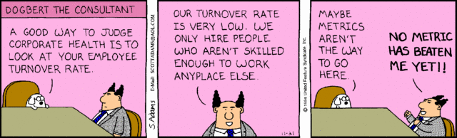
Don’t Rely on Metrics
There is a small benefit from using coverage as a stopping criterion.
But, auto-generating tests with coverage as the goal produces poor tests.
Two key problems - sensitivity to how code is written, and whether infected program state is noticed by oracle.
Gregory Gay CSCE 740 - Fall 2015 13
Notes:
Coverage metrics shouldn’t be relied on as a crutch for “good testing”. A recent study found that:
(read)
(read)
Now, other studies have found happier results - better correlations between fault finding and coverage, but Given the important role of structural coverage criteria in development, especially given that certain forms of coverage are mandated for safety certification of aircraft systems, we found these results kind of scary. These coverage metrics aren’t always a particularly great indicator of test adequacy, and we’re getting junk tests from automated generation, so what can we do? Well, we should start by figuring out what is wrong with coverage metrics, and there were two key issues that kept popping up with, even with “strong” coverage metrics like MC/DC (read)
Both of these issues relate to the idea of masking - in an expression, especially boolean expressions, the value of one variable can determine the result of the whole expression regardless of the value of the other variables. In that case, say that a fault corrupted one expression, well, we might not notice that fault if we monitor another expression where the faulty state is masked by another variable.

Slide 14
Sensitivity to Structure
expr_1 = in_1 || in_2;
out_1 = expr_1 && in_3;
out_1 = (in_1 || in_2) && in_3;
Both pieces of code do the same thing.
How code is written impacts the number and type of tests needed.
Simpler statements result in simpler tests.
Gregory Gay CSCE 740 - Fall 2015 14
Notes:
First, there is the idea of masking. Sometimes, the effect of executing code is negated by other other code - we don’t notice because one calculation overrules another for this combination of input. Due to masking, it is possible to change the number and structure of test obligations - we’ve changed how the code was written, so what the tests need to execute changes.
So, here, these two program fragments have different structures but are functionally equivalent. Version 1 is written with an intermediate variable
\texttt{expr\_1}, and Version 2 inlines this variable. To give a masking example, given a decision like {in\_1 or in\_2}, the truth value of \texttt{in\_1} is irrelevant if \texttt{in\_2} is true, so we state that \texttt{in\_1} is masked out.
Based on the form of coverage we’re working with, we will get different test goals and, as a result, different tests from these two fragments.
One of these coverage metrics is called MCDC, and it requires tests that overcome the masking effect at the expression level, so we would need a test where in_1 is not masked by in_2. \mcdc\ over the inlined version requires a test suite to take the masking effect of \texttt{in\_3} into consideration as well, so the tests are going to need to satisfy slightly more complicated test goals. Those differences can have significant ramifications when it comes to fault finding.
Restructuring the program with additional intermediate variables makes it significantly easier to achieve the desired coverage (\mcdc\ tests are easier to find
if the decisions are simple). This restructuring can significantly impact the number and quality of the tests required to satisfy the coverage goals.

Slide 15
Sensitivity to Oracle
The oracle judges test correctness.
We need to choose what results we check when writing an oracle.
Typically, we check certain output variables.
However, masking can prevent us from noticing a fault if we do not check the right variables.
We can’t monitor and check all variables.
But, we can carefully choose a small number of bottleneck points and check those.
Some techniques for choosing these, but still more research to be done.
Gregory Gay CSCE 740 - Fall 2015 15
Notes:
So, remember those testing artifacts. We had the oracle, which is what we use to check the behavior of the program, maybe some assertions we write or we take some variables and state what their values should be. Well, of course, when we write an oracle, we choose which variables to check the behavior of. Typically, we take a look at the output of a function. The problem is that, through masking, some expressions in the systems can easily be prevented from influencing the outputs. So, if we don’t check the right variables, we might not notice that there is a fault in the program.
This reduces the effectiveness of any testing process based on structural coverage, as we can easily satisfy coverage obligations without allowing resulting errors to propagate to an observed variable. This is a problem where automated test generation is concerned. We have found that test inputs generated tend to be short, kind of lazy - they only do the bare minimum to exercise the system. The longer you run the code - the more loop cycles, longer path, more statements executed - the more likely the problems reach the outputs. This is, in some sense, a problem with the test generation technique, but the blame can be shared by the coverage metric. The generation algorithm did exactly what it was told to do.
Now, of course, we can always add more variables and expected values for those to the oracle, but there are often so many options to choose from that we just can’t write an oracle for every variable. You’d get one test done a day. That’s just not going to work out. But, by being smart and choosing the right variables, we can do pretty well. We have a couple of techniques for estimating those variables -those chokepoints in control in the system, but there is still research to do in coming up with efficient ways of identifying those variables.

Slide 16
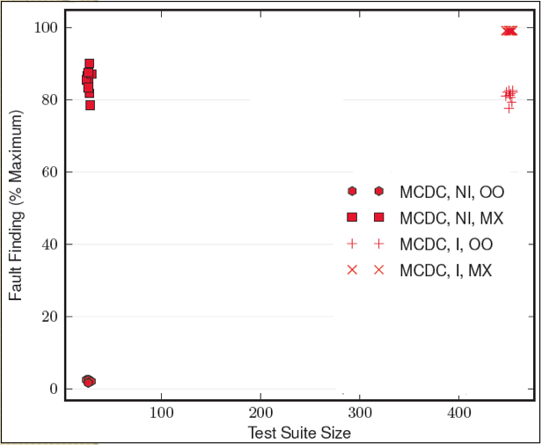
Coverage Effectiveness
Still sensitive to choice of oracle.
Sensitive to choice of oracle.
Sensitive to structuring of the system.
Gregory Gay CSCE 740 - Fall 2015 16
Notes:
How bad is it? Well, here we go. Here we plot the fault finding effectiveness against the test suite size of test suites for one system where we vary the program structure and oracle.
1) MC/DC considered strong, but has a couple of important weaknesses wrt propagation - it is formulated assuming that decisions are independent, as a result, you can actually satisfy it with only a small number of tests. However, short length/don’t propagate. effectiveness is Sensitive.
2) by simply changing the oracle so that we observe all of the internal variables, we see a massive increase in effectiveness. If oracle can monitor everything/specify behaviors for all of those variables , this propagation weakness doesn’t matter.
3) MC/DC is also sensitive to the choice of program structure. If we have an expression that uses the result of another expression, we can inline that used expression. Simple syntactic change - type of optimization compilers often make. As a result, the effectiveness of MC/DC tests jumps quite a bit - but it also requires many more tests to achieve coverage (some of benefit from better tests or more tests)
4) despite this restructuring, there are still propagation issues. Effects of faults masked out.

Slide 17
Masking
Why do we care about faults in masked expressions?
Effect of fault is only masked out for this test. It is still a fault. In another execution scenario, it might not be masked.
We just haven’t noticed it yet.
The fault isn’t gone, we just have bad tests.
Gregory Gay CSCE 740 - Fall 2015 17
Notes:
(read). If the effect of that fault is masked, then we’re still getting the right output, right?
(click)
(read). It’ll bite us in the butt eventually.
(read)

Slide 18
What Can Be Done?
Take masking into account.
Find where masking can take place, and write tests that offer a masking-clear path to monitored variable.
Write oracles that check values of variables likely to being masked.
Don’t forget about the requirements and input/output partitions.
Require both code coverage and coverage of function outcomes and input partitions.
More complex tests - input that results in particular outputs while exercising targeted code structures.
Gregory Gay CSCE 740 - Fall 2015 18
Notes:
So, what can be done to alleviate this?
First is to take masking into account when writing tests. Don’t just look at individual elements of code, but look at how that element can effect the variables that we do check the correctness of.
(read 2) - a path where the element we’re targeting won’t get masked out before potentially corrupting the variable we do check the value of.
You can also expand the oracle - (read 3)
The other strategy is to not forget about the requirements - those input and output partitions.
(read 5,6)

Slide 19
Activity: Writing Structure-Based Tests
For the binary-search code:
Draw the control-flow graph for the method.
Identify the cyclomatic complexity. number of edges - number of nodes + 2 number of decision points + 1
Develop a test suite that exercises the loops using the guidelines presented earlier.
Gregory Gay CSCE 740 - Fall 2015 19

Slide 20
Activity: Writing Structure-Based Tests
int bott, top, mid;
bott=0; top=size-1;
L = (top+bott)/2;
bott<=top && !found
F
EXIT
T
T[L] == key
mid=top+bott/2;
T
F
T[mid] == key
F
found=true;
found=false;
T
T
T[mid] < key
bott=mid+1;
found=true;
L= mid;
top=mid-1;
F
Gregory Gay CSCE 740 - Fall 2015 20
Notes:
What is the complexity of this CFG?
18 - 15 + 2 = 5
4+1 = 5
Tests - how many did you need for branch? What loop conditions did you cover?

Slide 21
Executing Tests
Once you have tests, how do you execute them?
You could run them and check results by hand
Don’t do this. Please.
Test Automation is the use of software to separate repetitive tasks from the creative aspects of testing.
Control the execution of tests,
Compare predicted and actual output,
Control the environment and preconditions.
Gregory Gay CSCE 740 - Fall 2015 21
Notes:
(read 1-3)
Test case design generally requires human input, but test execution should not. Test execution is mechanical, repetitive. Humans good at big picture, not at tedious repetition. If humans have to sit down and run tests, that introduces more room for failure. We want to make testing as easy as possible for humans. Test automation is how we do this
(read 4-end)

Slide 22
Anatomy of a Test Case
Test Input
Any required input data.
Expected Output (Test Oracle)
What should happen, i.e., values or exceptions.
Initialization
Any steps that must be taken before test execution.
Test Steps
Interactions with the system (such as method calls) , and output comparisons.
Tear Down
Any steps that must be taken after test execution to prepare for the next test.
Gregory Gay CSCE 740 - Fall 2015 22
Notes:
So, to automate testing, we need a little bit more info than just the inputs and expected outputs. We also need to know
(read initialization on down).
Now that we have this, we need to make it happen - we need to run the test, and many others, on the code

Slide 23
Testing Requires Writing Code
Test scaffolding is a set of programs written to support test automation.
Not part of the product
Often temporary
Allows for:
Testing before all components complete.
Testing independent components.
Control over testing environment.
Gregory Gay CSCE 740 - Fall 2015 23
Notes:
So, to make this happen, testing often involves wriitng a surprising amount of code.
(read)
That said, scaffolding has been estimated to be up to half of the code written for a number of large-scale projects
(more reading)
last point - the ability to set up the system in the state needed for running a test, to control how components are tested, and to then tear it down and prepare the system for the next test.

Slide 24
Test Scaffolding
A driver is a substitute for a main or calling program.
Test cases are drivers.
A harness is a substitute for all or part of the deployment environment.
A stub (or mock object) is a substitute for system functionality that has not been completed.
Gregory Gay CSCE 740 - Fall 2015 24
Notes:
Some of the common pieces of code written as test scaffolding include:
(read). Called this because this is how you interact with the software and make it do something. Each test is generally a driver. It initializes objects and calls them, sets up the oracle, and initiaes the result comparison once the test runs.
(read) - This usually comes into play when testing embedded systems - you might simulate the platform it is running on and the environment it’ll be used in if it needs to work with some particular environment - for instance, a pacemaker might need a simulated heart to react to. When testing a program with a networking component, you might simulate the network and try out different copnnection conditions.
(read)

Slide 25
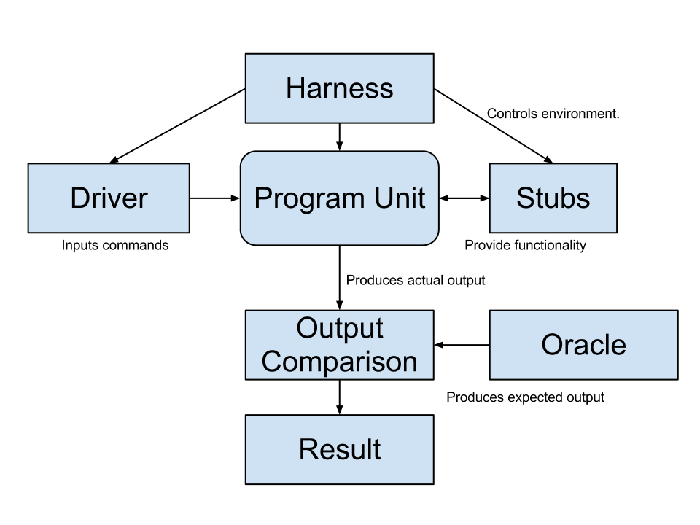
Test Scaffolding
Simulates the execution environment.
Can control network conditions, environmental factors, operating systems.
Initializes objects
Initializes parameter variables
Performs the test
Performs any necessary cleanup steps.
Templates that provide functionality and allow testing in isolation
Checks the correspondence between the produced and expected output and renders a test verdict.
Gregory Gay CSCE 740 - Fall 2015 25
Notes:
- Driver: instantiates system objects, performs setup - initializes the non-local variables, initializes parameters, activates the test, then tears everything down when done
- The harness simulates the execution environment, controlling factors such as environment simumations for embedded systems or networking conditions for systems with communication components.
- Stubs are templates that represent unimplemented system components or external entities and allow you to test part of a system in isolation from the rest.
- The oracle checks the produced output against an expected output and renders a test verdict - pass or fail.

Slide 26
Generic vs Specific Scaffolding
Simplest driver - one that runs a single specific test case.
More complex:
Common scaffolding for a set of similar tests cases,
Scaffolding that can run multiple test suites for the same software (i.e., load a spreadsheet of inputs and run then).
Scaffolding that can vary a number of parameters (product family, OS, language).
Balance of quality, scope, and cost.
Gregory Gay CSCE 740 - Fall 2015 26
Notes:
Your test scaffolding can range a good bit in complexity. The most common, and most straightforward is (read) - that’ll be easy to build, but you’ll quickly notice that time adding up. There are more complex forms of scaffolding that may save you more time long-term, (read)
As usual, the trade-off game comes in...

Slide 27
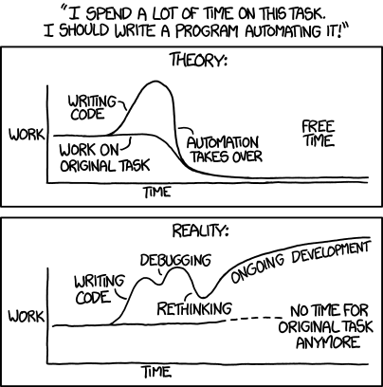
Automation Trade-Offs
Some common strategies help guide automation.
Gregory Gay CSCE 740 - Fall 2015 27
Notes:
I have to look back at this comic from time to time in my own work. It’s fun to code up automation, but it can get a little out of hand. We’ll cover some strategies to help systematically test a system.

Slide 28
Incremental Testing
T1
Test pieces of the system as they are completed. Use scaffolding (stubs, drivers) to test in isolation, then swap out for real components to test integration.
Advantages:
Easily test components in isolation.
Discover faults earlier.
Disadvantage:
Expensive to develop scaffolding.
T1
A
A
T2
T2
B
B
T3
T3
C
T4
T1
A
T2
B
T3
C
T4
D
T5
Gregory Gay CSCE 740 - Fall 2015 28
Notes:
One of the most powerful things made possible by all of this automation is the concept of incremental testing. Rather than waiting for the complete system to be built, we can start testing what we have completed. Piece by piece, we test components of the system. When we start, almost everything is stubbed out, but we can add in the real components and test their integration as we complete them.
As a result, we can easily test components in isolation, which means that not only we can more easily discover faults, we can discover faults earlier in development because we don’t need the rest of the system and fix them before they become a problem.
The downside is that it is expensive to develop all of that scaffolding. The earlier you start, or the more you want to isolate components, the more work you will have to pour into writing stubs. That can add up.

Slide 29
Top-Down Testing
Testing Sequence
Level 1
Level1
Level 2 Stubs
Level 2
Level 2
Level 2
Level 3 Stubs
Gregory Gay CSCE 740 - Fall 2015 29
Notes:
How you test can follow a style similar to how you are design your system. Earlier, we talked a little about top-down vs bottom-up development. How you incrementally test relates to how you work through building the code. In top-down testing, testing takes place from top to bottom in the system hierarchy, following the control flow dependencies. You take a higher-level component, something that calls into low level code, and you test it in isolation. To do so, lower level components or systems are substituted by stubs that fake their results. This lets you see whether the higher-level component and how it brings together those stubs can corrupt results.

Slide 30
Top-Down Testing
Start with the high levels of a system (based on control-flow, data-flow, or architecture) and work your way downwards.
Use in conjunction with top-down development.
Very good for finding architectural or integration errors.
May need system infrastructure in place before testing is possible.
Requires large effort in developing stubs.
Gregory Gay CSCE 740 - Fall 2015 30
Notes:
(read)
(read) - if the interaction between components is an issue, it’s easier to spot if the top level is already working pretty well. If there is a problem with how the architecure comes together in practice. you’ll spot that more quickly.
The trade-off is that top-down testing requires simulating the lower components. You will need to put effort into building stubs, and may need a great deal of system architecture in place before you can do much testing at all.

Slide 31
Bottom-Up Testing
Level N-1 Drivers
Testing Sequence
Level N-1
Level N-1
Level N-1
Level N Drivers
Level N
Level N
Level N
Level N
Gregory Gay CSCE 740 - Fall 2015 31
Notes:
Bottom-Up testing comes in from the opposite direction. You start at the bottom of the system hierarchy - small units that perform tasks independently of calling components. Test each individual component at that level in isolation, then work your way up the hierarchy, bringing together already-tested components. Here, you don’t need as many stubs. You have the lower components. When you develop something that brings together lower-level units, that has dependencies, most of its dependencies should already exist as they will come in at the lower level. However, most of the testing code will be in the drivers. You will need to develop more complex drivers to instantiate, set up, and test those components.

Slide 32
Bottom-Up Testing
Start with the lower levels of a system (based on control-flow, data-flow, or architecture) and work your way upwards.
Use in conjunction with bottom-up development.
Appropriate for object-oriented systems.
Necessary for testing critical infrastructure.
Does not find major design problems, but very good at testing individual components.
Requires high effort in developing drivers.
Gregory Gay CSCE 740 - Fall 2015 32
Notes:
(read)
(read 3) - the best way to test components in isolation. It won’t find architectural issues as easily, but it allows you to effectively test and find faults in those individual objects or methods.
The trade off is that it (read 5).

Slide 33
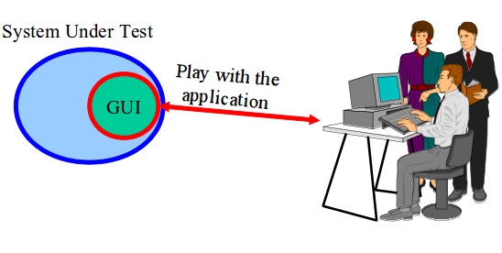
What About Graphical Interfaces?
Graphical components of projects often tested manually by real users.
Heavily tested during alpha/beta testing.
Gregory Gay CSCE 740 - Fall 2015 33
Notes:
Now, there are aspects of most programs that aren’t exactly amenable to passing in a few command line parameters and running. The graphical components of applications - GUIs, video games - take input from mouse motions and clicks. testing whether those work can be complex - dealing with overlapping visual widgets, it’s hard to define boundary regions, and every click can set off a series of under-the-surface interactions How do we test those?
Well, those are often tested by hand. First by the developers, of course, but most heavily during alpha and beta testing. Get a few hundred users clicking around and sort out the problems that crop up.

Slide 34
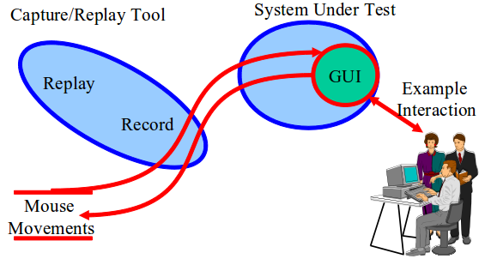
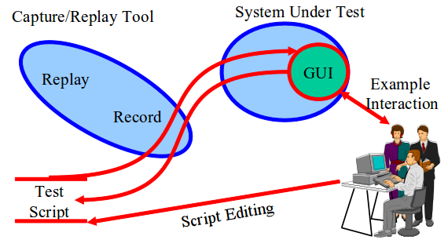
Capture and Replay
Have a human interact with the system, walking through several different scenarios.
Record their mouse motions and clicks during these scenarios.
Take these test cases and modify them to create additional tests.
Gregory Gay CSCE 740 - Fall 2015 34
Notes:
The thing is - this stinks. It’s something that should have some human involvement eventually, as graphical interactions - especially in games - need to be tuned until they feel right. But, if we’re just on the hunt for bugs, we should be able to automate interactions. How can we do that without a person? Well, a common idea in automation is the concept of taking a little bit of human feedback as a seed and building automation off of that. This is a concept that comes in to play heavily in testing GUIs. What we can do is get a human in to play with the program. We can record the actions they take during some sample scenarios - based on our different use cases. Those are called captures. We can then use those - we can replay them - to repeat the same scenarios and the same mouse motions and clicks without needing the human sitting there. These captures - these sets of actions - become an initial set of test cases. We can then edit those to turn them into new test cases - modifying the actions slightly or taking the individual actions and combining them to form entirely new tests. This lets us automate GUI testing. Cuts repetition. Capture a few manual executions, and reuse them or alter them. More productive use of human effort.

Slide 35
Six Essentials of Testing
Adapted from Software Testing in the Real World, Edward Kit; Addison-Wesley, 1995
The quality of the test process determines the success of the test effort.
Prevent defect migration by using early life-cycle testing techniques.
Start testing early.
The time for software testing tools is now.
Gregory Gay CSCE 740 - Fall 2015 35
Notes:
Automation and structural or requirements-based testing alone isn’t enough to guarantee testing. No matter what, you need to put the work in. Effective testing is about not just tools or techniques, but about the working environment, and the pressures and incentives for developers. There are a few essentials to help ensure effective testing.
1. - Just as the quality of a software product depends on the quality of the process that produced it, the quality of the testing done depends on the quality of the process that produced it. Organization, setting the right expectations, establishing quality standards. Those are all important. It’s important to decide on the activities that you’re going to perform - what test types you need, artifacts you need to produce - and set a schedule for producing those.
2. - This is just a fancy way of saying that you should start testing early. Half the errors are introduced in the requirements.
- The cost of errors is minimized if they're found where they're introduced. Write tests as soon as you can, and use those to refine your requirements, design, or code.
3. - You don’t need to create testing infrastructure from scratch. Coverage tools, Capture/Playback. Have a strategy!

Slide 36
Six Essentials of Testing
A real person must take responsibility for improving the testing process.
Testing is a professional discipline requiring trained, skilled people.
Cultivate a positive team attitude of creative destruction.
Gregory Gay CSCE 740 - Fall 2015 36
Notes:
4. - Somebody has to drive improvement. That starts with you, the developers! - Must have management support. - Don't just buy tools. Must have a process in place first.
5. - Testing is a discipline requiring trained professionals. Too often, companies will hire testers and treat them as second-class citizens. Testing should be conducted by engineers who have the right technical background. Even if they aren’t directly responsible for writing the system, testing has a hugely important role in the quality of the final product. So, testers should be engineers too, who look at the system in informed, rigorous ways. - Testing is not an entry level job to other things. - Don't let testing become subservient to development.
6. - Good testing requires real ingenuity and can be viewed as destructive. Destroying something in a controlled, systematic way isn't easy! - Objective: Show that it does what it shouldn't do and doesn't do what it should. That's testing!

Slide 37
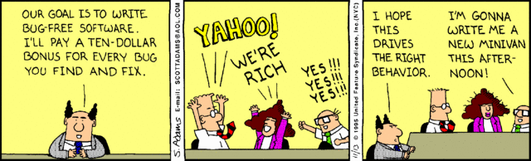
The Key to Effective Testing: Offering the Right Incentives
Gregory Gay CSCE 740 - Fall 2015 37
Notes:
Really, the key to effective testing is setting the right incentives. Creating an environment where quality is essential, developers and testers are given the time and incentive to focus on creating a robust system.
And - this isn’t the right way to do it - but create an environment where it is worth taking pride in your system and where it is worth putting in the effort to test effectively.

Slide 38
We Have Learned
Loop strategies to make path coverage more realistic.
How coverage criteria relate in terms of cost and power.
Test automation can be used to lower the cost and improve the quality of testing.
Automation involves creating drivers, harnesses, stubs, and oracles.
Systems can be tested in a top-down or bottom-up style.
Gregory Gay CSCE 740 - Fall 2015 38

Slide 39
Next Time
We’ve looked at developing test inputs…
What about the expected output?
Writing Test Oracles
Homework - questions?
Gregory Gay CSCE 740 - Fall 2015 39

