Slide 1
Test Oracles and Mutation Testing
CSCE 740 - Lecture 23 - 11/18/2015

Slide 2
Software Testing - Back to the Basics
Tests are sequences of stimuli and observations. We care about input and output.
(I₁ O₁) (I₂ O₂ ) (I₃ O₃)
Gregory Gay CSCE 740 - Fall 2015 2
Notes:
At this point, testing is nothing new to you. But, let’s go back to the basics for a second. When we talk about testing, we’re talking about an investigation - a search for problems. There are a ton of components to the testing process, but really, for an investigation, there are two things we can do. We poke the system, and we see what happens. So, the problem at the core of testing is coming up with interesting inputs and making sense of the results.

Slide 3
What Do We Need For Testing?
(I₁ O₁) (I₂ O₂ ) (I₃ O₃)
Test Inputs
How we “stimulate” the system.
if O_{n} = Expected(O_{n})
then… Pass
else… Fail
Test Oracle
How we check the correctness of the resulting observation.
Gregory Gay CSCE 740 - Fall 2015 3
Notes:
To test a system, to conduct that investigation, you really need two things.
You need to come up with inputs. You need a plan on how you’re going to draw out issues. You’re experts on this now.
The second half is today’s class - you need some way to tell if the observed behavior was the right behavior. To know that there is a problem, you need to know what good behavior looks like. That’s where the oracle comes in.

Slide 4
We Will Cover
Software Test Oracles
Where do they come from?
How do we create them?
Why are they important for testing?
Gregory Gay CSCE 740 - Fall 2015 4
Notes:
So, we’ve spent time talking about the input side of the equation, but today, I want to go over the output side of the testing equation. How do we know there are problems? How do we create these oracles? How do we make use of them?

Slide 5
Test Oracle - Definition
If a software test is a sequence of activities (stimuli and observations), an oracle is a predicate that determines whether a given sequence is acceptable or not.
An oracle will respond with a pass or a fail verdict on the acceptability of any test sequence for which it is defined.
Gregory Gay CSCE 740 - Fall 2015 5
Notes:
A test can be considered as a sequence of activities - a set of stimuli and observations, recorded in their order of occurrence. Any time we poke the system- whether it is concrete input provided by the tester, or some environmental factor - an event or condition that the system must respond to - you can watch how the system reacts. You can make observations of how the system behaves after receiving that input. You can keep track of all sorts of things - monitor anything that can be produced by or affected by the system - concrete output values, temporal properties of the execution, power and heat profiles of the software ,exceptions, data downloads and uploads, and so on. You can take down observations and use those to figure out whether there are problems.
The oracle is what does this. The oracle is a predicate that takes in these sequences and determines whether a given sequence is acceptable or not, given some built-in data on what constitutes correct behavior. The oracle looks at these observations and answers a simple question - did the system pass or fail the test? Was that sequence acceptable?

Slide 6
Test Oracle - Definition
An oracle, as an artifact, can be broken into:
Oracle Information
The information used by the oracle to judge the correctness of the observed behavior, given the set of inputs.
Oracle Procedure
How that information is used to arrive at a verdict.
Commonly... (value(system output) == value(expected output))
Gregory Gay CSCE 740 - Fall 2015 6
Notes:
Now, that’s a little vague, an oracle is *anything* that we can use to judge a test. Oracles come in a surprising variety of forms. From a direct statement of, given input x, the result should be y to So, to a state machine or a set of properties. In a general sense. When we talk about oracles, we talk about two components, the
(read) - set of facts known by the oracle. This might be an explicit input to output table, or a set of assertions about behavior, or even a model that executes in its own right.
(read) - this is the code portion - how we take the sequences, compare them to our expectations, and arrive at a verdict. commonly this is a boolean proposition - do these variables have the expected values?

Slide 7
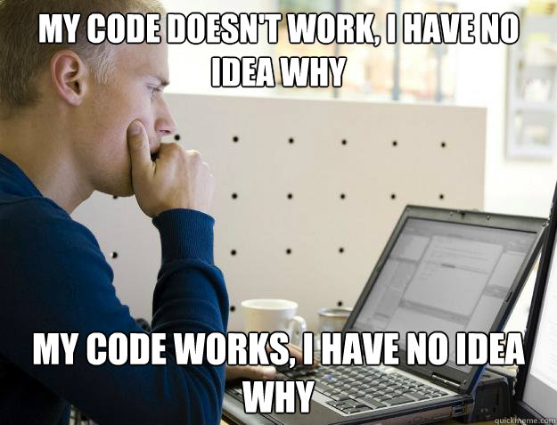
Where Do We Get Test Oracles?
Most commonly:
Developers write inputs
and oracles by hand.
Large amount of manual effort and time required to create tests
Will not be able to run many tests. Did you choose the right inputs?
Gregory Gay CSCE 740 - Fall 2015 7
Notes:
So, where do we get these inputs and oracles from? In the majority of cases, they come down to one process. A few developers sit down and write test cases by hand, specifying both the inputs and exact expected outputs.
Here’s the thing. This sucks.
It take a lot of work to create these tests and it takes a lot of time to write them. So, in practice, you end up writing one or two unit tests per method, and you don’t spend a lot of time varying inputs.
You won’t be able to create that many tests,even if you want to, which limits the scenarios you can examine, which means that it is crucial to choose the right things to check for. You will almost certainly miss some corner cases, and might not find potentially major faults in your system until the product is out the door.
We can do better.

Slide 8
The “Test Oracle Problem”
We are good at coming up with new input...
But, it is much harder to automatically check results.
f(int)
f(0) f(6) f(1123)
f(0) = ?
f(6) = ?
f(1123) = ?
Gregory Gay CSCE 740 - Fall 2015 8
Notes:
Here’s the thing, Given the limitations of manual efforts, we’d like to do better. We want smart ways of coming up with tests, and we want to automate so that we can hit a larger variety of scenarios. There is a huge quality component to testing - never forget that. You could write thousands or millions of tests and never find issues without smart techniques, but there is a quantity component too. We need both. We need good tests, and we need a way to come up with a bunch of good tests. That question is.. how?
On the input side of the equation, we’ve gotten… not great, but alright, at coming up with smart ways to poke systems. There are some great techniques for automated input generation. But, the oracle side of the equation is incredibly challenging. Automatically checking behavior is still very hard. Even inventing oracles that work for more than one test isn’t easy. There is even a term for it. This is is what we call test oracle problem - the challenge of automatically deriving the oracle or, at least, streamlining the process of creating one and crafting oracles that work for a wider variety of testing scenarios

Slide 9
Can We Design Better Test Oracles?
Notes:
Can we build more universal oracles? Ones that give accurate verdicts for more than one or two test cases?

Slide 10
Judging the Judge
What properties do we want out of an oracle?
Cost to Build (Per Test and Overall)
How much effort goes into building it?
Want low cost.
Accuracy of Verdicts
Can it give the wrong answer?
Want high accuracy.
Completeness
Can it offer verdicts for multiple test cases?
What kind of situations is it useful for?
Want high completeness.
Gregory Gay CSCE 740 - Fall 2015 10
Notes:
(read), (discussion)
(read) - when thinking about cost, we need to consider two dimensions - how much does this end up costing us on a per test basis and for all tests - for instance, some oracles are expensive to build if you’re just going to use them on one test, but they work for a large number of tests, so overall, it’s quite cheap - you only have to build it once.
(read) - accuracy, if it says the test failed, did it actually fail?
(read) - or is it just good for one test?
So, as we go through these oracle types, keep in mind these properties. How expensive are they to either build, how accurate are they, and how widely applicable is their use?

Slide 11
Types of Oracles
Specified Oracles
Developers, using the requirements, formally specify properties that correct behavior should follow.
Derived Oracles
An oracle is derived from development artifacts or system executions.
Implicit Oracles
An oracle judges correctness using properties expected of many programs.
Human Oracles
How do you handle the lack of an oracle?
Gregory Gay CSCE 740 - Fall 2015 11
Notes:
(read)

Slide 12
Specified Oracles

Slide 13
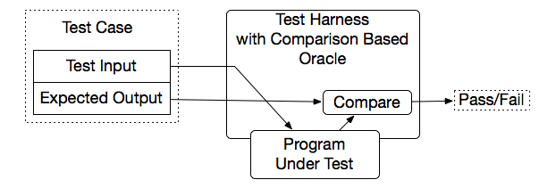
Specified Oracles
Specified Oracles judge behavior using a human-created specification of correctness.
Any manually-created test case has a specified oracle (expected-value oracle: what is the expected value given this input?)
How can we extend this to multiple tests?
Gregory Gay CSCE 740 - Fall 2015 13
Notes:
Specified oracles are called that simply because (read). Somewhere, we’ve written down what the correct behavior is, and we pull from that knowledge to judge test cases.
So, most simple example - (read). Now, how would you place that in terms of cost, accuracy, and completeness? (discuss) - low per test cost, high overall cost since there is no reuse.high accuracy, pretty absolute. low completeness.
How could we extend this to multiple tests? (discuss)

Slide 14
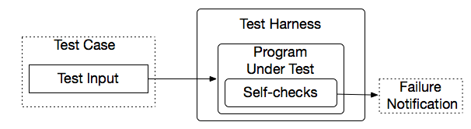
Self-Checks as Oracles
Rather than comparing actual values, use properties about results to judge sequences.
Take the form of assertions, contracts, and other logical properties.
@Test public void multiplicationOfZeroIntegersShouldReturnZero() { // Tests assertEquals("10 x 0 must be 0", 0, tester.multiply(10, 0)); assertEquals("0 x 10 must be 0", 0, tester.multiply(0, 10)); assertEquals("0 x 0 must be 0", 0, tester.multiply(0, 0)); }
@Test public void propertiesOfSort (String[] input) { // Tests String[] sorted = quickSort(input);
assert(sorted.size >= 1, "This array can’t be empty.")
}
Gregory Gay CSCE 740 - Fall 2015 14
Notes:
(read) - Make assertions about properties that should never be violated, then see if the output - in whatever form it takes - obeys those properties.
Often take the form of assertions - I assert that X is always less than Y - and many languages actually support the ability to assert a property and see if it holds at the point in execution where it is asserted. In Java, JUnit tests are built on executable assertions. If they are violated, test execution stops.
Some libraries also add contracts, pre and post conditions that you define for methods, loops, or other conditional statements that must never be violated. Similar idea - throughout the code, or in test cases, you can sprinkle these check statements. You can use those to issue a test failure, or even put them in the real system code and use them to gracefully stop execution if something goes wrong.
These are a little more general than expected value oracles - they tend to work for multiple tests. The downside is that they only tell us if the behavior is wrong if we wrote in a property that gets violated. (cost - relatively low per test, medium overall - assertions tend to be tied to specific parts of the code - so you get multiple tests out of them, but still not that many tests usually, accuracy - high, completeness - better, but still restricted to the exact properties we’ve written)

Slide 15
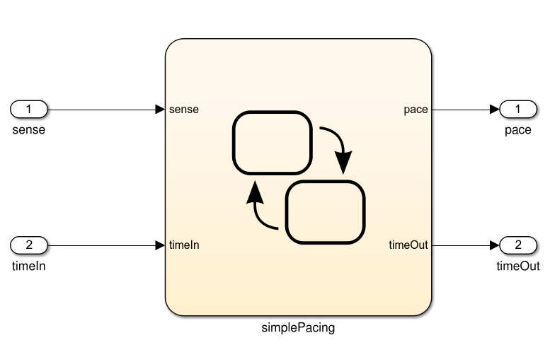
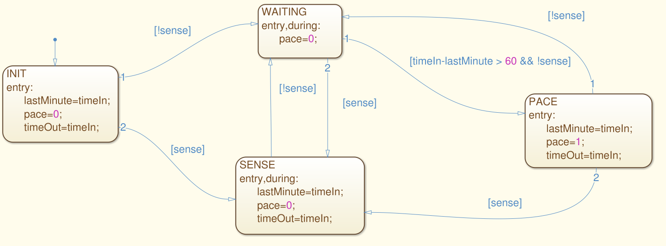
System Models as Oracles
Models could potentially serve as a “universal” test oracle
Model
Test Input
Compare Results
Implementation
Gregory Gay CSCE 740 - Fall 2015 15
Notes:
One form of specified oracle is a model of the system. Models are great - often, in industrial development, teams build models of the system in order to analyze and look for problems in the requirements specification. We talked about this a little before the midterm.
These models give some idea of how aspects of the system should behave in a variety of situations.
Take this model - built in the Stateflow notation. It models the behavior of the software for a simplified pacemaker.
This software listens to timestamped sensor readings, and if a minute passes without a sensed natural heartbeat, it issues a timestamped command to shock the heart.
-This is a model that can, in a way, be executed. It’s not a substitute for the real system - it abstracts away a lot of the details - but can serve as a source of oracle information - tells us how the system should behave.
Can gen tests, apply to both, compare results to model
(cost - high per test/low overall, can be high completeness - depends on the scale of the model - but usually a whole family of tests) - what about accuracy? What do you think?

Slide 16
Problem: Abstraction
Models require abstraction. Useful for requirements analysis, but may not reflect operating conditions.
In the model:
Binary input
In the implementation:
Voltage reading compared to calculated threshold
SimplePacing
sense
Voltage Sensor
Other Subsystems
In the model:
input time = output time
Operations take place instantly.
In the implementation:
Operations take time to compute.
Clock drift may impact time.
timeIn / timeOut
Clock Module
Gregory Gay CSCE 740 - Fall 2015 16
Notes:
go make a sandwich while they execute.
We don’t live in an ideal world. These models - while prescribing behavior - operate at an abstracted level. They need to be useful for design or requirements analysis, and if you model every detail down to the hardware level, you’re just building the final system. That isn’t useful from a design perspective. So, you at least abstract
This makes conformance testing particularly challenging for many systems - especially embedded or real-time systems, where the execution of the system is highly dependent on the timing of input - when it arrives, when output is released, how much time computation takes - many details that are often abstracted from the models.
-Consider the actual operating environment of the implementation of the SimplePacing software. A number of abstractions have been made in the interest of better analyzing the core requirements, or because the final details were not yet known.
-For example, the model receives a simple binary sense. In the real world, the electrical impulses being sensed in the heart are complex analog readings, prone to noise.
-The time stamps used as both input and output from SimplePacing will be taken by polling a clock module in the software platform. In the model, the input and output timestamps are the same, but in the real software differences from computation time, clock drift, and the difficulty of synchronizing the parallel components of the software. Furthermore, clock issues are commonly non-deterministic. Repeated application of the same test stimulus may not result in the same output if, say, processing time varies.
All of these issues can lead to behavior that is very different from the one produced by a model. So, what happens is that the model and the system start to disagree, and that doesn’t always mean the implementation is wrong. It becomes hard to seperate fault-indicative behavior from false failure verdicts - where the execution of model and system diverge - that a developer must investigate, potentially negating the benefits of MBO. So, model-based oracles offer a lot of promise - potentially being useful for almost any testing scenario, but abstraction can be a problem. Correctness isn’t always assured.

Slide 17
Derived Oracles

Slide 18
Derived Oracles
In the absence of a specified oracle, oracles can be derived from existing sources of information:
Project Artifacts
Documentation
Existing tests
Other versions of the system
Program Executions
Invariant detection
Specification mining
Often lowers costs significantly, but may suffer from accuracy issues.
Gregory Gay CSCE 740 - Fall 2015 18
Notes:
In the past few years, there has been more interest in the idea of somehow automatically synthesizing an oracle. Recent research has shown that you may be able to derive an oracle from either project artifacts - data mining of documentation or requirements spec, or using older versions of the system, or taking existing test cases and from observing executions of the system and detecting properties from executions that you know to be correct.
These methods vary in terms of cost and completeness, but they are often cheaper on an overall basis than coming up with tests yourself and often work for multiple test cases. So, that’s promising. The main caveat with automatically learning oracles is that since all of these are guesses made from learning processes - and aren’t the product of human specification - they potentially suffer from accuracy issues. The learned oracle may be incorrect. To help, many of these methods also can make use of some form of human feedback as a sanity check.

Slide 19
Pseudo Oracles
(N-Version Programming)
An alternate version of the program as an oracle.
Does output(V1) = output(V2)?
Pseudo Oracle because we know the two don’t agree, but don’t know which is wrong or why.
Also called N-Version programming, where multiple designs are implemented, or same design is implemented by independent teams.
Genetic programming can use search (through genetic algorithms) to automatically produce multiple implementations.
Gregory Gay CSCE 740 - Fall 2015 19
Notes:
(read) - we take both, run them, and see if they agree.
Called a (read)
(read) This sounds unlikely. Why on earth would you build two copies of a program? (discuss)
(might be different designs and you don’t know which would be more efficient)
You don’t do this often at all, and never for your whole system, but with some critical methods, you might have two independent teams create their own implementation of that method, then at runtime, you compare the results of both to see if they line up - it’s a software extension of the idea of triple redundancy - where you have multiple copies of the same hardware running.
Now, this is uncommon due to the cost of double implementation, but there is some exploration of automated versions of this where a search algorithm - powered by a genetic algorithm uses a set of common transformations to automatically create different versions of a program for testing purposes. You can see if those all produce the same results.
(cost - high if you’re writing code manually and weren’t planning on doing this for non-testing purposes, but low if you were or if you use genetic programming, accuracy - that depents… both might be wrong and you don’t know which is right, completeness - depends on level of duplication, but for the parts you duplicate, high)

Slide 20
Regression Testing
When changes are made to a system, rerun your tests. Any existing tests that passed previously should still pass.
An older version of your program can be the oracle.
Do new features break working features?
Do bug fixes break working features?
If requirements have changed, you do NOT want the output to match for features related to the requirement.
Gregory Gay CSCE 740 - Fall 2015 20
Notes:
Now, you wouldn’t generally produce multiple implementations at the same time for testing, but a common, closely related, practice is regression testing - read. That’s normal, you want to know if any modifications you’ve made have interfered with functions that you know work. If it passed before, it should pass now. You older system is the oracle. Anything that passed on the old system should still pass. That seems like it shouldn’t be a huge problem, but you’d be surprised how fragile systems can be. For functionality that you were confident worked correctly, you could see if the old and new versions produce the same output. This helps solve certain testing questions
(read)

Slide 21
Metamorphic Relations
If you have a set of test cases, you can generate partial oracles for follow-up tests by deriving metamorphic relations between tests.
A metamorphic relation is a necessary property of a function:
A property of a sin function is that sin(x) = sin (pi - x).
Thus, sin(x) and sin(pi - x) have the same expected output.
If these relationships are violated, then there is a bug.
Can be an equation or more general properties specified between inputs.
Gregory Gay CSCE 740 - Fall 2015 21
Notes:
(read)
A metamorphic relation (MR) is anecessary property of the function, such as “sin x = sin (π − x)”. Hence, the program under test should have the same expected output for an original test case “0.1234” and a follow-up test case “π − 0.1234”. If the actual outputs from the program under test for these two test cases are different, it indicates a failure.
(read) - for instance, these have been used to test search engines like Google, where you can’t come up with expected output, but you know general properties of how the pagerank algorithm works and how similar searches will get relate to each other. So, you could come up with similarity properties between two different searches and see if those hold on the output side.
(discuss cost - can be hard to come up with these properties, but once you have them, it’s similar to self-checks - the more applicable they are, the lower the overall cost, accuracy - tends to be higher if you come up with them by hand, completeness - works for multiple tests, but tends to be function specific, so medium)

Slide 22
Invariant Detection
Invariants (pre/post-conditions) can be specified as a form of test oracle. If they are not known in advance, there are algorithms that can detect them from program executions.
Testers take a set of tests that the program is known to produce correct behavior for.
Properties true of all observed executions are extracted for methods, loops, and conditional statements.
Gregory Gay CSCE 740 - Fall 2015 22
Notes:
(read). We talked about these as a form of self-check oracle.
This is pretty exciting - we take observations from what happens when we execute and state that these things should always hold out, regardless of the input. If they don’t, then you’ve found a bug.
(discussion - cost - quite low since you can do this automatically, accuracy - depends on how good the extracted properties are - the problem is that you’re learning from a potentially bad program and it depends on how much data you feed it, completeness - medium, specific to parts of the code again)

Slide 23
Model Inference
From system executions, we can derive a state machine model of system execution. As we observe more executions, we refine the model.
Major problem of both invariant and model detection: Accuracy!
The more executions observed, the more accurate, but requires much more effort.
What do we do about this?
Gregory Gay CSCE 740 - Fall 2015 23
Notes:
Just as we had invariants as a form of specified oracle, we also talked about using system models as an oracle. And, just as we can learn invariants, we can learn models. (read)
(read) - a recent study found that for complex systems, over half of the learned invariants were wrong.
(read) - but, we need to know that those executions are correct, which requires a lot of effort. We need to make sure we get more out of this than we put in, otherwise there is no point.
(discussion)
human feedback can help, but again, requires effort. How can we automatically tune this process?

Slide 24
Interlude:
Mutation Testing

Slide 25
Fault-Based Testing
Many testing techniques based on what we think should happen. We can also test based on what we think could go wrong.
Deliberately seed faults into a system, and see if you can distinguish the faulty system from the existing system.
Gregory Gay CSCE 740 - Fall 2015 25
Notes:
So, if we want to work on the accuracy, get some more information to work with, one idea is to build our own faults in to the sysem (read)
We don’t know if our system is working, but what if we break our system on purpose? Could we get some more information by doing that? (read)
We can use that knowledge, from the deliberately seeded faults, to improve our testing - to refine these oracles - and find the real faults in the system. Once we seed faults, we can see if our derived oracles catch those fake faults - that gives us evidence that we’re on the right track.

Slide 26
Mutation Testing
Select mutation operators - code transformations that represent classes of faults that we are interested in.
Generate mutants by applying mutation operators to the program.
Execute tests against the program and mutants to kill mutants.
Mutation testing can judge adequacy of a test suite and can help tune metamorphic relations, invariants, and inferred models.
Gregory Gay CSCE 740 - Fall 2015 26
Notes:
(read)

Slide 27
Mutation Operators
Operand Modifications
Replace scalar with constant, alter constants in expressions (+1 changes to +X), negate booleans, etc.
Expression Modifications
Replace arithmetic (+,-,*,/,%) operator, logical (&&, ||, !=, ==) operator, remove operator and an operand.
Statement Modifications
Delete statement, switch case label, shift end of block.
Gregory Gay CSCE 740 - Fall 2015 27
Notes:
The basic idea is that there are types of faults we might expect in the system, and we can go through and insert those by taking a block of code and transforming it so that it is now broken. There are a lot of different faults we could model, and these code transformations get pretty complex, but to give some basic examples, we could
(read - mess with variable values)
(read - mess with expressions)
(read - make more serious statement modifications)
Just try to go in ane make little mistakes on purpose to muck things up

Slide 28
Does Mutation Testing Make Sense?
Mutation testing is valid if seeded faults are representative of real faults.
Competent Programmer Hypothesis
System under test is close to correct.
Coupling Effect
Complex changes are a combination of smaller changes.
Gregory Gay CSCE 740 - Fall 2015 28
Notes:
The goal is that we can use these fake faults to provide evidence that we found real faults, but that does rely on a key assumption - that those fake faults are representative of the kind of faults that would be in our system. That’s a potential weakness with mutation testing. The argument lies on two key points
-(read), that programmers aren’t stupid - they’ve made something that is almost right, and the fault is a fixable mistake that doesn’t underlie the entire program - not always true, but most of the time, this seems reasonable.
- (Read) - that by making small changes to the code, we’ll create a realistic enough fault. Even little mistakes will cascade into issues that we’ll notice.

Slide 29
Mutant Quality
To be used in testing, mutants must be:
Syntactically correct (valid)
Plausible (useful)
Can a mutant be valid, but not useful?
Gregory Gay CSCE 740 - Fall 2015 29
Notes:
Not all mutants are created equally - and when we go in and make automated changed to the code, we’l lget a few duds. If you want to use mutants to help you test, those mutants must be (read)
that is, they need to be code that compiles and runs. If it can’t compile, it’s not valid to begin with. Every test fails automatically.
that is, it can’t constantly crash - it can’t be the kind of fault that is always picked up on. We need to learn something from it. If it crashes for any test, it isn’t going to tell us much about how our system works.
(read, discuss)

Slide 30
Mutant Quality
Mutants that are valid, but not useful might remain live if:
They are equivalent to the original program.
for(i=0; i < 10; i++)
for(i=0; i != 10; i++)
Identifying equivalency is NP-hard.
Test suite is inadequate for that mutation.
(a <= b) and (a >= b) cannot be differentiated if a==b in the test case.
Gregory Gay CSCE 740 - Fall 2015 30
Notes:
(read)

Slide 31
Mutation Coverage
Adequacy of the suite can be measured as:
(# mutants killed)
(total mutants)
(Note - mutants can be equivalent when both the original and the mutant are wrong.)
Mutation can subsume other coverage:
Statement: apply statement deletion to all statements.
Branch: Replace all predicates with constants T/F.
Gregory Gay CSCE 740 - Fall 2015 31
Notes:
Now, we’ve talked about code coverage metrics at this point - branch coverage, condition coverage, and the like. Mutation coverage can also be thought of as another way to judge the adequacy of a test suite. This is unrelated to the oracle problem, but can be another way to ensure that you have a good set of test inputs - another piece of evidence that our tests are doing their job.
(read)

Slide 32
Practical Considerations
Mutation testing is expensive.
Must run all tests against all mutants.
Many mutants typically generated.
If cost is an issue, can use “weak” mutation testing:
Apply multiple mutation operators per mutant.
Trade lower inference quality for fewer mutants.
Gregory Gay CSCE 740 - Fall 2015 32
Notes:
(read) - really expensive
(read, read), so the time investment in running the tests increases exponentially.
(weak mutation - trade-off involved. You get fewer mutants, but in exchange, you get more noise in the data. Those mutants are often easier to kill, and when you catch them, it’s harder to tell why they failed - what the exact fault was that caused the failure.

Slide 33
Implicit Oracles

Slide 34
Implicit Oracles
Implicit oracles require no domain knowledge or specification, but instead can be applied to check properties that are expected of any runnable program.
Implicit oracles often detect particular anomalies, such as network irregularities or deadlock. These are faults that do not require expected output to detect.
Gregory Gay CSCE 740 - Fall 2015 34
Notes:
Our third category or oracle are called implicit oracles. (read). You don’t need to sit down and write out the expected output or assertions when using one of these - instead, you’re checking for a particular type of problem, something you can ensure the program never does.
These oracles can be very useful for specific types of anomalies and certain testing scenarios - for instance, they may be built to detect security issues like buffer overrun or as part of performance testing to detect network problems, slow response time, data upload or download problems, power consumption problems, those kind of non-functional properties.

Slide 35
Uses of Implicit Oracles
Implicit oracles can be built to detect:
Concurrency Issues
Deadlock, livelock, and race detection
Violations of properties related to non-functional attributes of the system
Performance properties
Robustness
Memory access and leaks
Gregory Gay CSCE 740 - Fall 2015 35
Notes:
(read)
non-functional - where we don’t need to know what output came out - these oracles aren’t checking whether f(a) = b, but whether the expected non-functional properties were maintained.
(cost, accuracy, completeness)
cost is often very low - you don’t need much program knowledge to create them
accuracy tends to be high. But, there is something to watch out for here - some of these properties might not show up on every execution of a test - the performance of a system is often non-deterministic. So, detection might be hard. If it detects it, the oracle is accurate, but you might run a test 10 times before it fails.
Completeness is low - sure, they work regardless of the test input, but they only work for the properties they are built to detect. The scope of an implicit oracle is very narrow.

Slide 36
Fuzzing
Fuzzing is a way to find implicit anomalies.
Generate random (or fuzz inputs).
Attack the system with these inputs.
Generation and attacks guided by “attack profiles” that reflect certain malicious use scenarios.
Report anomalies with the test sequence that caused them.
Commonly used to detect security vulnerabilities, such as buffer overruns, memory leaks, unhandled exceptions, and denial of service.
Gregory Gay CSCE 740 - Fall 2015 36
Notes:
Implicit oracles are usually used as part of a process called fuzzing or fuzz testing (read)

Slide 37
Human Oracles

Slide 38

The Human Oracle
If no automation is possible or no specification exists, a human can always judge output manually.
Not ideal, but surprisingly common in practice.
Gregory Gay CSCE 740 - Fall 2015 38
Notes:
(read). Surprisingly common, especially in embedded systems domains. You see very little automation, just a human sitting there pressing buttons.
Is this a bad thing? Why is this bad? Why not have humans judge tests
(cost - very high, accuracy - high, but depends, completeness - low, time cost per test too high)

Slide 39
Handling the Lack of Oracles
Even if there is no oracle, there are techniques that can reduce the human oracle cost through:
Quantitative reduction in the amount of work the tester has to do for the same amount of fault-detection potential.
Qualitative increase in the ease of evaluating testing results.
Gregory Gay CSCE 740 - Fall 2015 39
Notes:
Now, a human oracle is fairly common. Even if test generation is automated, it’s still common to hand human testers a stack of inputs and ask them to either specify output or give the ok on what thw software spits out as output. In this case, there is still a lot that can be done to reduce the high cost associated with using a human as the oracle
This reduction can come from either (read)

Slide 40
Quantitative Cost Reduction
Test suites can be unnecessarily large:
Tests that cover too few testing goals or scenarios.
Tests that are unnecessarily long, with redundant method calls.
Human oracle cost can be reduced by cutting out either of these.
Test suite reduction techniques cut tests that cover redundant code structure or do not penetrate deeply into the code.
Test case reduction techniques attempt to remove unnecessary test steps.
Gregory Gay CSCE 740 - Fall 2015 40
Notes:
(read) - quantity can be good, but quality is important, and you might have situations where you have
(read), (read)
(read)

Slide 41
Qualitative Cost Reduction
Not all test cases are equally understandable by human testers. Automated test generation often produces test inputs that do not match the expected usage of a program, and humans have trouble judging the results of such tests.
Some test generation approaches allow the seeding of human knowledge or use usage profiles to help generate input.
Gregory Gay CSCE 740 - Fall 2015 41
Notes:
(read)
The idea then, is to make sure that test inputs are realistic - do they make sense to the human tester, can the tester produce the expected output for them? (read)
usage profiles or natural language profiles

Slide 42
Crowdsourcing the Oracle
Recent development - outsource the oracle problem to many different human oracles.
Several services exist for this now - Amazon Mechanical Turk, Mob4Hire, MobTest, uTest.
Users cannot be expected to have much domain knowledge, so understandability of test inputs and documentation are very important.
Gregory Gay CSCE 740 - Fall 2015 42
Notes:
(read) - ask a large number of people to help judge the results of test cases.
(read) Many of these have popped up specifically to help test mobile apps, where getting to market quickly is often considered so important that testing is not a priority.
(Read)

Slide 43
Placing the Oracles
Manual Specification
Behavioral Model
Self-Checks
N-Version Programming
Metamorphic Testing
Invariant Detection
Implicit Oracles
Cost(T/O), Accuracy, Completeness
L/H H L
H/L M-H H
L/M H M
L-H/L L-H M-H
L/M H M
L/L L-H M
L/L H L
Gregory Gay CSCE 740 - Fall 2015 43
Notes:
(go through and discuss)
which of these do you think are most useful? Which would you use?

Slide 44
We Have Learned
Test Oracles judge the correctness of sequences of stimuli and observations.
Oracles can be:
specified (expected values, models, assertions)
derived from correct executions or project artifacts
built to detect implicit properties
humans asked to check results
Mutation testing can help improve testing efforts by using fake faults to learn about how our system works.
Gregory Gay CSCE 740 - Fall 2015 44

Slide 45
Next Time
When to stop testing.
Statistical testing and some wrap-up testing topics.
Reading:
Sommerville, ch. 11
Any homework questions?
No office hours on 11/24
Makeup hours 11/23, 3:30 - 4:30 PM
Gregory Gay CSCE 740 - Fall 2015 45

