Slide 1
Course Overview:
The Product and the Principles
CSCE 740 - Lecture 1 - 08/18/2016

Slide 2
Today’s Goals
Introduce Software Engineering
What the heck is going on in this class?
What you should already know
Course expectations
Assignments/grading
Answer any questions
Cover the basics:
What is software?
What are the principles governing software engineering?
Gregory Gay CSCE 740 - Fall 2016 2

Slide 3
What is Software Engineering?
The development and evolution of high-quality (large) software systems in a systematic, controlled, and efficient manner.
Gregory Gay CSCE 740 - Fall 2016 3
Notes:
Software engineering is concerned with the development - design, building, and testing - and evolution of high-quality software systems in a systematic, controlled, and efficient manner.
Pay attention to bolded part.
Software engineers are concerned with safety and reliability of the product as well as the cost and schedule of the development process.

Slide 4
How does this differ from CS?
Most CS courses teach you how to solve particular types of problems.
SE is the study of software.
Building those solutions in a rigorous manner.
Solutions should be reliable, functionally complete, and usable.
Gregory Gay CSCE 740 - Fall 2016 4
Notes:
Whereas many computer science classes deal with taking complex domain-specific problems and deriving solutions from the appropriate mathematical and computational theories. For example, in an AI course, you learn to reason about intelligence problems and design software that solves such problems. SE is the study of software itself. The study of what software is, and how it can be build in a rigorous, controlled manner. In software engineering, you will learn to reason about software itself, and will learn lessons that apply to any program you design in the future.
focused around designing, developing, and documenting reliable, functionally complete, and usable software.

Slide 5
Software is Important
The economies of all developed nations are dependent on software.
Software development expenditure represents a significant fraction of GNP of all developed countries.
Gregory Gay CSCE 740 - Fall 2016 5
Notes:
Why software? It’s important. A concept that we’ll return to a lot is cost. Money is both the greatest human motivator and our greatest demotivator all at once - we assign importance to money - and we are not happy to be parted from it. So, why is software engineering important? Because software is expensive.
Software is ubiquitous. Everything is a computer now, and computers need software. The developed world relies on software to power every single industry, and our economy depends on it.
And, the fact is that what we spend on software development is a significant fraction of the GNP. Software costs a lot to make.

Slide 6
The Scope
Software is expensive to develop and maintain.
$542 Billion spent each year on software projects (2013, Forrester Research)
Software costs often dominate system costs.
The costs of software often exceed the costs of hardware.
For systems with a long life, maintenance costs may be several times development costs.
Gregory Gay CSCE 740 - Fall 2016 6
Notes:
This is a little of date, but still gives an idea of the scope. That figure is, at least, 10% low - maybe 25% low. Software is everywhere. Your car is a computer - Ford is one of the biggest software companies in the US - your phone, your refridgerator. Software is ubiquitous!
If it’s around for awhile, it only gets more expensive - might spend way more fixing issues, adding features, keeping up compatibility. Can be a nightmare.

Slide 7

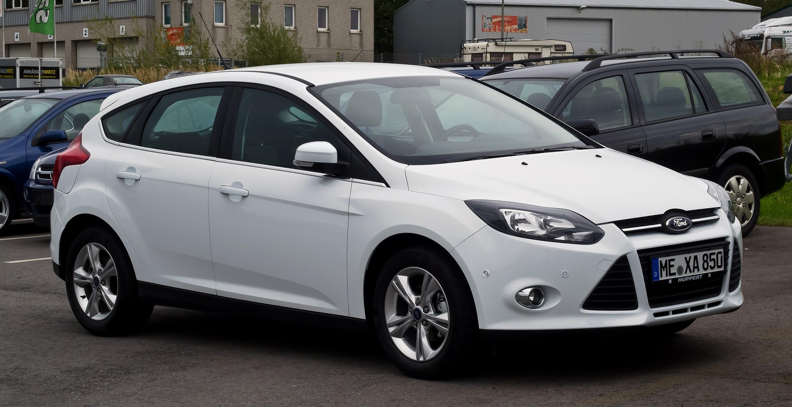
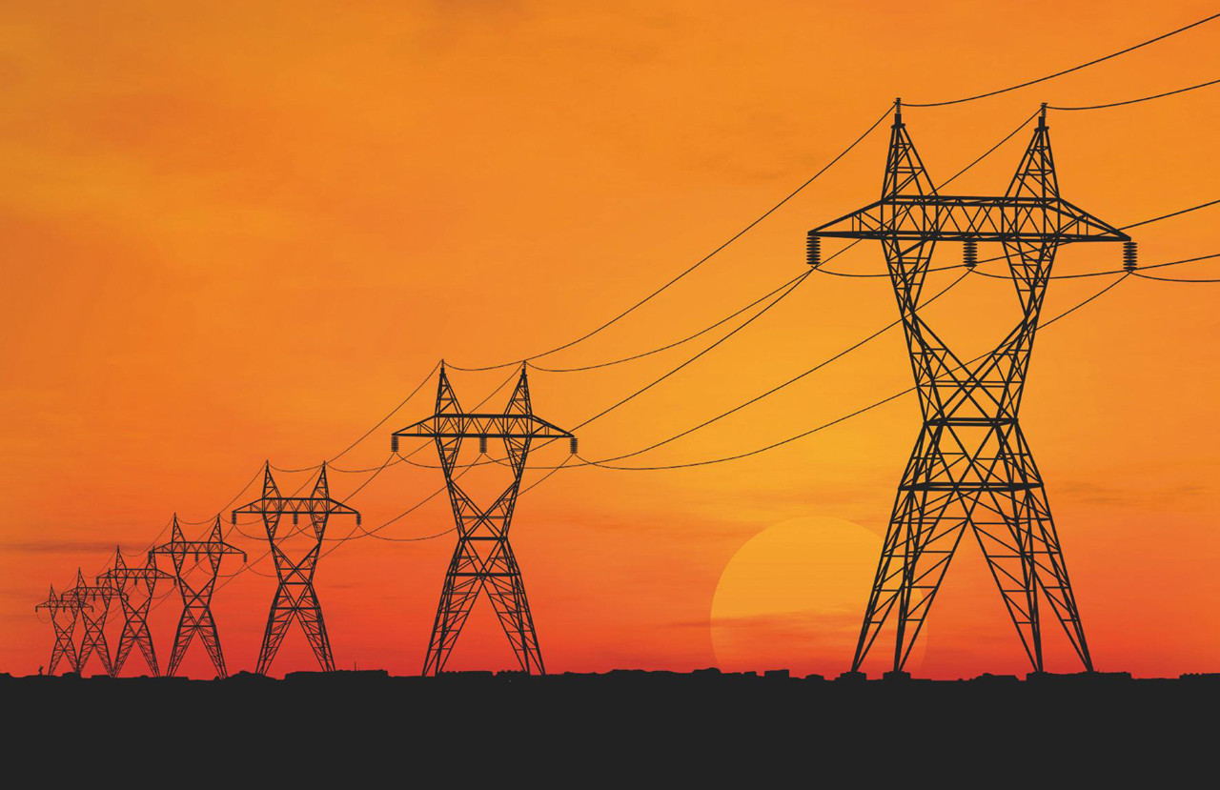
Our Society Depends on Software
This is software: So is this:
Also, this:
Gregory Gay CSCE 740 - Fall 2016 7
Notes:
Amazon, of course, is software. No one disputes that. If I ask you about software, you’d mention something like this - a web app, a video game, a word processor. That’s not all that is software though - Our society is built on software. It powers our homes, it manages our private information, it controls our cars, it automates our factories and it even regulates our bodies. Ford is one of the largest software makers in the country. Ford employs more software engineers than Apple. It is incredibly important that we construct good software. We need robust, operational systems, especially given growing demand for features, limited development budgets and strict time constraints.

Slide 8
What if you mess up?
If you screw up during design, development, or testing…
Best Case: Software bugs hurt profits.
Worst Case: Software bugs hurt people.
Gregory Gay CSCE 740 - Fall 2016 8
Notes:
If you don’t nail development - don’t test enough, leave bugs in, there are nasty outcomes.

Slide 9
Software Bugs Hurt Profits
“Bugs cost the U.S. economy $60 billion annually… and testing would relieve one-third of the cost.”
- NIST
“Finding and ﬁxing a software problem after delivery is often 100 times more expensive than ﬁnding and ﬁxing it before.”
- Barry Boehm (TRW Emeritus Professor, USC)
Gregory Gay CSCE 740 - Fall 2016 9
Notes:
As a software developer, software bugs hurt your bottom line. They are expensive to fix, and only become more expensive the longer they remain active. The cost of fixing bugs, handling tech support, distributing the patched software, and addressing potential legal issues is not insignificant.
In 2002, a study commissioned by the US Department of Commerce' National Institute of Standards and Technology concluded that "software bugs, or errors, are so prevalent and so detrimental that they cost the US economy an estimated $59 billion annually, or about 0.6 percent of the gross domestic product"
The report estimated that minor improvements in software testing would relieve 1/3rd of that cost.

Slide 10
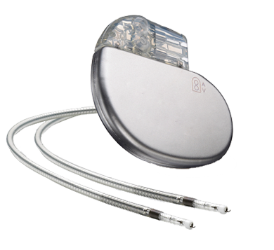
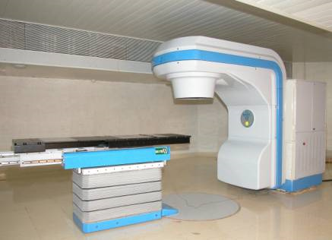
Software Bugs Hurt People
Software problems are responsible for 26% of medical device recalls in 2010.
“There is a reasonable probability that use of these products will cause serious adverse health consequences or death.”
US Food and Drug Administration
Gregory Gay CSCE 740 - Fall 2016 10
Notes:
More importantly than any hit to the bottom line, in the worst cases, software bugs can harm people, equipment, and the environment.
The Therac-25 was a radiation therapy machine that was involved in at least six accidents between 1985 and 1987, in which patients were given massive overdoses of radiation, roughly 100 times the intended dose, all due to a potential race condition.
This little device, fits in the palm of my hand, is a pacemaker. A little block of sensors, pulse generators, and a lot of complicated software, that regulates the beating of the heart. Just one example of the growing medical device industry - little complex combinations of hardware/software that are implanted in patients and used to improve their quality of life.
In 2010, software problems were responsible for 26% of medical device recalls. These were classified by FDA as class 1 recalls, meaning (quote).
To swap one of these devices, to remove a defective one, a patient must undergo surgery - a life-threatening operation in order to fix a software issue.

Slide 11
Are we any good at building software?
Notes:
discussion point
we’re awful - who here works in industry? interned?
worst thing you’ve seen?

Slide 12
The Problems
We don’t deliver finished products on time
Only 16.1% of projects delivered on time and within budget, with all planned features complete as specified.
31.1% of projects are cancelled before delivery.
$81 billion spent per year on cancelled projects
The rest were completed and operational,
over budget, behind schedule, poor quality
Gregory Gay CSCE 740 - Fall 2016 12
Notes:
What’s the problem?
Old figures - 1994 figures, but these problems have only gotten worse, if anything, as the complexity of software increases.
read this

Slide 13
Why Software Engineering?
Software engineering is concerned with theories, methods, and tools for professional software development.
Better engineering practices lead to better software, faster development, and cheaper production costs.
Gregory Gay CSCE 740 - Fall 2016 13
Notes:
Why is SE important? Well, it’s how we avoid these disasters.
The practice of software engineering is what takes you from being a programmer, a hobbyist, a hacker to being a professional - we’re concerned with developing and teaching theories, methods, and tools for professional software development.
Why is that important? That’s how we beat those numbers, that’s how we don’t end up on the evening news, how we push our society into a better future.
It costs a lot to develop good software, but much of that cost comes from fixing our screw-ups. By offering better methods of developing software, by offering tools to improve efficiency and streamline the development process, by teaching best practices, we get better software - robust to attack, unlikely to fail - and we do so faster and for less cost.

Slide 14
The Need for Disciplined Practices
The job of software engineers is to:
produce high-quality products
produce them on schedule
and do this within planned costs
In this class, we’ll learn some useful skills.
(You’ll want the practice)
Gregory Gay CSCE 740 - Fall 2016 14
Notes:
This is why we need to apply engineering principles to programming. Engineering is about rigor, about discipline.
Jobs is to
high quality - safe, reliable
In this class, I hope you’ll learn some useful skills.
you’ll need the practice - no judgement on your individual skills, but that’s the reality of large-scale sw dev

Slide 15
Developers in Demand
Developers Available
Demand for Software
Skilled Developers
Developers Available
Gregory Gay CSCE 740 - Fall 2016 15
Notes:
When I say that you’ll want the practice, I mean that there’s something in this for you.
When I started out, I saw graphs like these are motivation for doing a CS degree. Look at all of this demand for software! you’re guaranteed a job!
In practice, more like this. Anyone can build a computer program. More and more people are doing this.
But, the actual number of skilled developers is lower -more like that original plot. So, this is your incentive to become good engineers. The key to getting a well-paying job is to be good at your work. To demonstrate that you’re the best developer, the best engineer you can be. Software engineering skills are a really nice way to land that job at Google or Amazon. You’ll be able to show that you can deliver well-build, dependable, and well-documented software.
At least, that’s the goal. Lets see what we can do with you.

Slide 16
Desired Course Outcomes
Distinguish between different development processes and design techniques.
Be familiar with requirements elicitation and be able to create a requirements document.
Be familiar with the fundamentals of black-box (functional) and white-box (structural) testing and test selection methods.
Gregory Gay CSCE 740 - Fall 2016 16
Notes:
read off
and be familiar with the pros and cons of each
able to describe a software project - what its functionality is, what outcomes it should deliver, and what constraints need to be obeyed
how to test software

Slide 17

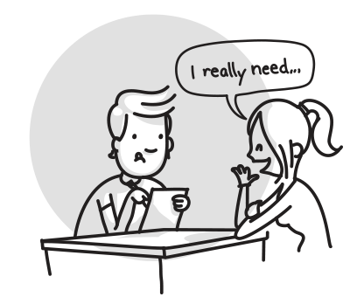
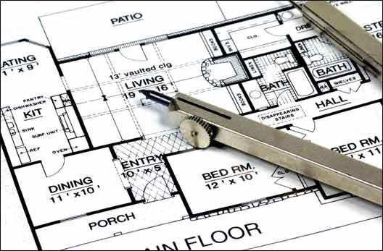
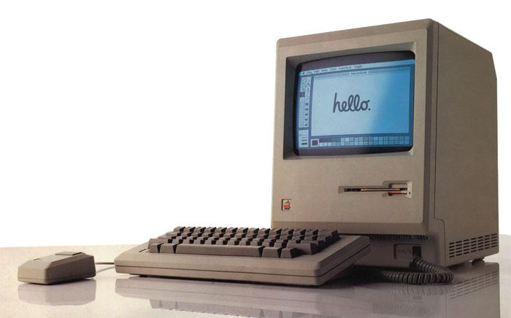
Typical Development Process
Concept Formation
Requirements Specification
Implementation
and Testing
Design
Gregory Gay CSCE 740 - Fall 2016 17
Notes:
Many ways to develop software, but roughly, real-world development follows typical stages, and we will look at these in a great deal of detail as the class goes on.
concept formation - you get an idea, someone comes to you and asks for something. investigate feasibility, figure out if it’s something you want to do and take care of the boring legal jumbo
figure out exactly what you’re building - features, results, interview the customer and grill them
take the requirements and figure out HOW to build it, what it should look like, how program should be structured
actually implement it, then make sure it works coirrectly
oh, and sometimes you go back to previous stages. this is pretty normal. in fact, you can pretty much count on it. This is a class about how the lifecycle of a software product, and the practices that take place at each stage of that lifecycle.

Slide 18
Lecture Plan (approximate)
Introduction and Processes (2 weeks)
Requirements Specification (3 weeks)
Design Fundamentals (1 week)
Software Architecture (1 week)
Design (OO) (2 weeks)
Implementation (1 week)
Testing (3 weeks)
Reliability and Maintenance (1 week)
Gregory Gay CSCE 740 - Fall 2016 18
Notes:
The lecture plan roughly follows this lifecycle.
read off

Slide 19
Contact Info
Instructor: Greg Gay (Dr, Professor, $#*%)
E-mail: greg@greggay.com
Office Hours: T/Th, 4:00-5:00 PM, 3A66 Swearingen Engineering Center
Website:
https://dropbox.cse.sc.edu/course/view.php?id=363
(Moodle - will be used for course material and assignment submission)
Gregory Gay CSCE 740 - Fall 2016 19
Notes:
read off

Slide 20

Textbook
Main Book:
Software Engineering, Ian Sommerville.
Ninth or Tenth Edition
Recommended:
UML Distilled: A Brief Guide to the Standard Object Modeling Language. Martin Fowler. Third Edition.
Head First Design Patterns. Eric Freeman, Bert Bates, Kathy Sierra, Elisabeth Robson.
Gregory Gay CSCE 740 - Fall 2016 20
Notes:
point out ninth edition
Don’t do homework questions from it, but I still recommend it so you can follow along with the course. Other two (go over). Again, not required, but may be useful. Especially design patterns.

Slide 21


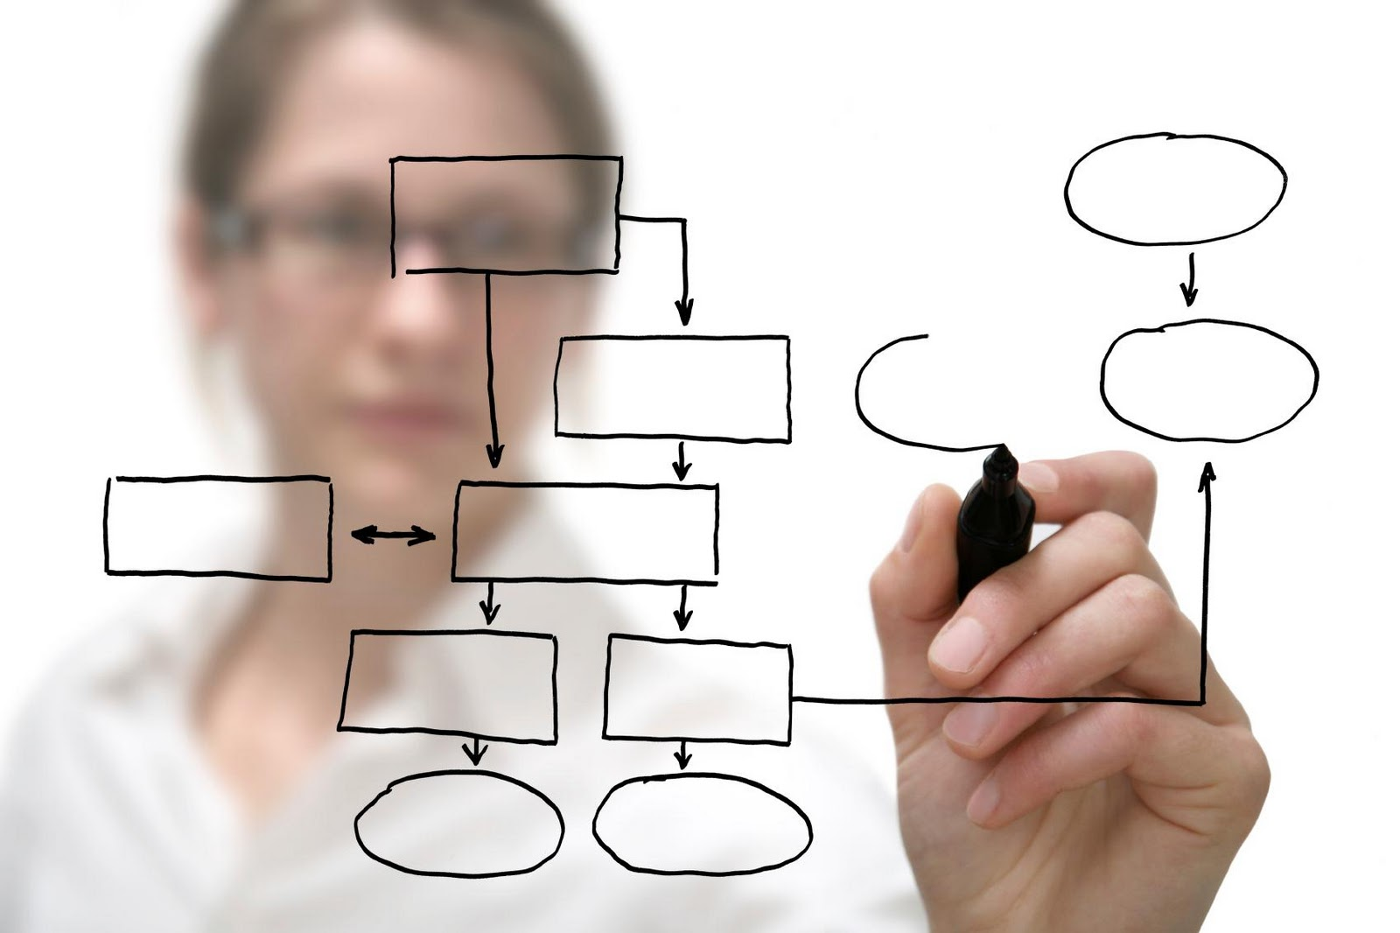
Learning Modes
Lectures/Textbook
Class Discussions
Group Project
Gregory Gay CSCE 740 - Fall 2016 21
Notes:
Most of the time, we’re in normal class mode. I will stand up here and drone at you, then toss in a joke to keep you awake
Then, because it’s boring to just listen to me talk. For me too. We’ll do alot of group discussion. I’ll ask questions,try to get you to answer them. We’ll work through problems and examples in a group. I expect you guys to respond. I’ll stand here until someone does. These discussions factor into your grade, where there is a 10% participation credit.
Project. Work in groups on a large-scale software project. You’ll go through each stage of development, and build a system. The idea is that you get to put the course content into practice.

Slide 22
Prerequisites
You need to be proficient in Java
(and, ideally, C or C++)
You should be able to read and write programs without additional instruction.
This is not a programming language class.
You need a basic understanding of algorithms, logic, and sets.
Gregory Gay CSCE 740 - Fall 2016 22
Notes:
read off

Slide 23
Assignments and Grading
Midterm (20%) and Final (30%)
Closed book
Midterm: In-class, October 4th.
Final: December 6th.
Check this independently!
Projects (40% in total)
Groups of three-four.
Frequent peer evaluations.
Participation (10%)
Many in-class activities.
Group participation.
Answering questions.
Gregory Gay CSCE 740 - Fall 2016 23
Notes:
read off
APOGEE - can work alone on project, but are recommended to join a group.

Slide 24
Expected Workload
This class can be time consuming.
Do not underestimate the project work.
Project work requires team coordination
Good engineering is hard.
Planning and scheduling your time is essential.
Do NOT delay getting started.
Gregory Gay CSCE 740 - Fall 2016 24
Notes:
project -
We’re not trying to make things arbitrairly hard to justify teamworks, but good engineering is hard - it takes time adn work
planning/scheduling is essential. most issues come from people starting too late and trying to cram. That doesn’t work here. Especially given the need for teamwork. Working together takes planning.
You can’t slack off - we do use peer evaluations in grading, and if you don’t take part, you won’t get the grade.

Slide 25
Feedback
Problems with assignments, course questions, feedback?
Contact me!
Problem with instructor
Also contact me
Contact CS front office
Gregory Gay CSCE 740 - Fall 2016 25
Notes:
(read). I’m new. I’m going to make mistakes. I’ll forget things, try things that don’t work out, and will change things as we go along. Don’t hesitate to contact me at any time. I want your feedback. If something isn’t working, don’t wait until the end to tell me - let me know and we’ll see what we can do about it.

Slide 26
Other Policies
Integrity and Ethics:
The homework and programs you submit for this class must be entirely your own. If this policy is not absolutely clear, then please contact me. Any other collaboration of any type on any assignment is not permitted. It is your responsibility to protect your work from unauthorized access.
Classroom Climate:
All students are expected to behave as scholars at a leading institute of technology. This includes arriving on time, not talking during lecture (unless addressing the instructor), and not leaving the classroom before the end of lecture. Disruptive students will be warned and potentially dismissed from the classroom.
Gregory Gay CSCE 740 - Fall 2016 26

Slide 27
Other Policies
Make-Up and Late Homework
The midterm and final are required.
If a test fall on a religious holiday, they will be rescheduled.
Make-ups for graded activities may be arranged if your absence is caused by a documented illness or personal emergency.
Homework assignments are due at the time noted on the assignment handout. Late work is not accepted without prior approval. Any assignment turned in after the due date will be considered late and will be subject to a penalty of 10% per day, including weekends and holidays.
Gregory Gay CSCE 740 - Fall 2016 27
Notes:
(read 1-3) - A written explanation (including supporting documentation) must be submitted.
Make-up arrangements should be completed prior to the scheduled activity.
(read 4)

Slide 28
Other Policies
Diversity
Students in this class are expected to respectfully work with all other students, regardless of gender, race, sexuality, religion, or any other protected criteria. There is a zero-tolerance policy for any student that discriminates against other students.
Special Needs
We will provide, on a flexible and individual basis, reasonable accommodations to students that have disabilities that may affect their ability to participate in course activities or to meet course requirements Students with disabilities should contact their instructor early in the semester to discuss their individual needs.
Gregory Gay CSCE 740 - Fall 2016 28
Notes:
Someday you will graduate, and in the real world, you will have to work with a wide variety of people. Now is the time to abandon preconceived prejudices about others. Students in this class are expected to respectfully work with all other students, regardless of gender, race, sexuality, religion, number of tentacles, whether they pick their nose, or any other possible criteria. Real talk here - we’re a bunch of nerds, and nerds have a reputation for not knowing what to do when women are in the room. Don’t be that stereotype. There is a zero-tolerance policy for any student that discriminates against other students, regardless of the reason. Be a professional adult.
(read)

Slide 29
Why is software development so %$##% hard?
Notes:
discussion point - why so flipping hard?
guesses? who here works in industry? interned?
how much time do you spend designing? testing? challenges?
(expensive, so incentive to half-ass), intangible/hard to visualize, look for good answers from audience

Slide 30
software = computer program
?
Notes:
how about a different question - when we say software, do we just mean a computer program.
What is software? What do you need to consider when developing software?

Slide 31
Software As Product
Software is more than the executable
Also any legal documents, installation manual, user manual, requirement documentation, design documentation, source code documentation, testing code, regulations and laws that must be followed.
Software interacts with other software, hardware, people.
We must consider and discuss all of these.
Gregory Gay CSCE 740 - Fall 2016 31
Notes:
One view is to look at software as the product being sold. Software isn’t just the executable, but everything that comes with it and everything that goes into its develppment.
A software project is a potentially huge collection of artifacts:
(read these)
Software is also part of a broader environment (3) In building software, (4)

Slide 32
Development is Human-Intensive
Creation of software is labor-intensive
Trivial manufacturing process (copying)
But, difficult building process:
May involve more than just programmers:
Designers
Management
Testers
Customers
Legal/Government Entities
Gregory Gay CSCE 740 - Fall 2016 32
Notes:
Software development is an insanely human-intensive effort. You might not think that - the manufacturing process is trivial. It’s relatively hard to build 1000 phones, but that’s because each part needs to be built in a factory somewhere by teams of people performing physical processes. Manufacturing copies of the software product is easy, right click, copy, paste.
But, it’s hard to build the original unit - the product. In many ways, harder than any engineered physical artifact. Software involves a lot of people in very specialized positions. Not just a programmer, but (read off and elaborate a bit)

Slide 33
Development is Human-Intensive
Software is complex and intangible.
Can’t see it, touch it, hear it, or smell it.
Hard to see mistakes until it is done.
(and you still might miss them)
Components highly interconnected, hard to visualize the “structure” of a system.
Gregory Gay CSCE 740 - Fall 2016 33
Notes:
More importantly, software is both complex and intangible. This is an important idea that we’ll come back to from time to time. Software is intangible. You can’t see it, touch it, or smell it. If you’re building a bridge, and you screw up, you’ll find out pretty quickly. It might fall over before you’re done. It’s harder to make a mistake because most mistakes are obvious. That isn’t the case in software. There’s no clear way to see that a part doesn’t fit correctly. If you’re lucky, when you run it, you’ll notice an issue, but that requires that you can actually run it. Sometimes that doesn’t happen until later in the process. Even then, that’s only the obvious mistakes. Some mistakes only emerge when you hook every component together and look at their interaction, and even then, you still might not notice a problem unless you feed in the right inputs. Software is insanely complex, code is highly interconnected, and mistakes are not easy to see.

Slide 34
Software Product Attributes
High-quality software doesn’t “just” function, but fulfills certain attributes and goals.
Maintainability: Should be possible for the software to evolve to meet changing requirements.
Dependability: Software should not cause physical or economic damage in the event of failure.
Efficiency: Software should not make wasteful use of system resources.
Usability: Software should have an appropriate user interface and documentation.
Gregory Gay CSCE 740 - Fall 2016 34
Notes:
When building software, there are a lot of different considerations to make. It’s not just a question of whether it works. You aren’t going to just make sure it gives the answer to 1+1, but you’ll want to shoot for the fulfillment of certain attributes and goals that make your product better, that let you compete with others on the market, make your customers happy.
Not going to go through everything you could aim for, but a few key ones include maintainability:
(read off), add new features, change functionality, fix problems, and ensure that customers can continue to make use of your work
(read off). Shouldn’t blow up an airplane, shouldn’t overload a medical device, it shouldn’t erase your harddrive or cause legal liability issues.
(read off) Don’t be a memory hog, don’t take hours to do a task that can be done in minutes with a little bit of optimization.
(read off) Don’t make your program too confusing. Can your mom sit down with it and launch a missile? No? Then redesign it?

Slide 35
Expensive to Maximize Attributes
Costs rise exponentially if very high levels of an attribute are required.
Cost
Dependability
(Efficiency)
(Maintainability)
(etc.)
Gregory Gay CSCE 740 - Fall 2016 35
Notes:
Remember, making a high quality product is expensive, and the more of each of these attributes you want, the more it costs you. You can’t build software that works, that is dependable, that is highly efficient, and is highly maintainable all at the same time.There is a trade-off game here - if you need to be highly dependible, you might have to sacrifice some level of efficiency, or you must be prepared to pay for both - increased budget to hire people, increased development time to refine and optimzie.

Slide 36
Quality is in the Eyes of Beholders
Maintainer
Good Documentation
Readable Code
Good Design
Reusability
Reliability
Correctness
Efficiency
Functionality
Ease of Use
Ease of Learning
Low Cost
Portability
Increased Productivity
Customer
User
Gregory Gay CSCE 740 - Fall 2016 36
Notes:
And, it isn’t easy to choose these attributes. You have to balance the needs of the people that are involved in every aspect of your software. What makes your software high-quality depends on who you ask.
(read off a bit)
You’re going to have to prioritize. You’ll have to look at what everybody finds important and put that first, then figure out who to appease and who to piss off.
And in some domains, what people want doesn’t matter, certain attributes must dominate: for instance, in a safety-critical system - an airplane autopilot system for instance, dependability and efficiency are more important than anything.

Slide 37
Typical Development Process
Concept Formation
Requirements Specification
Implementation
and Testing
Design
Gregory Gay CSCE 740 - Fall 2016 37
Notes:
Even then, how you organize the development cycle itself matters. Organization and planning are king. WE’ll follow something that looks a bit like this (quick recap)

Slide 38
Typical Development Process
Concept Formation
(Ok, I had an idea, and I think it’s a good one.)
Implementation
and Testing
Gregory Gay CSCE 740 - Fall 2016 38
Notes:
But, if we want to be honest, it often looks more like this. Come up with an idea, then sit down and tap it out. Then stick there for awhile as you find out about mistakes.
This is clearly a problem, and this is why development is so expensive and the products we get out of it so terrible still.

Slide 39
The Trade-Off Game
Software engineering is the process of designing, constructing and maintaining the best software possible given the available resources.
We are always trading off between what we want, what we need, and what we've got. As a NASA engineer put it,
“Better, faster, or cheaper - pick any two”
Gregory Gay CSCE 740 - Fall 2016 39
Notes:
So, here’s the honest answer to what is software engineering and the role of the successful software engineer.
- (read).
That point - the best we can do given what we have means there is always a trade-off game. As a NASA engineer put it, “we want products to be better, faster to develop, and cheaper to develop - you aren’t getting all three. Best you can do is pick two.” It can be created on a short schedule without a big budget, but that comes at a cost to quality. It can be developed quickly and quality can be maintained, but that will cost you. This semester, you will hear me say several times that the right answer depends on your product, your budget, your resources. It depends is frustrating, but it is the honest answer. What we’ll do is prepare you to make that judgement call.

Slide 40
The Role of Software Engineers
Software engineers, therefore, aren’t just responsible for designing, constructing, and maintaining software.
They are the people we look to plan, make, and justify well-informed decisions about trade-offs throughout the development process.
Gregory Gay CSCE 740 - Fall 2016 40
Notes:
Your

Slide 41
Principles of SE
Software Engineering is based on a collection of fundamental principles.
These principles guide the development of all aspects of software development:
Languages
Methods
Tools
Processes
Project Management
Gregory Gay CSCE 740 - Fall 2016 41

Slide 42
1: Rigor and Formality
Proper engineering requires professionalism, rigorous practices, and a formal approach.
But… software development is a creative process. Creativity often implies informality and chaos.
Do rigor and formality contradict creativity?
Gregory Gay CSCE 740 - Fall 2016 42
Notes:
The first of these principles is that (read). Basically, engineering is serious. Failure can have consequences, so we must approach development from a serious perspective.But… (read)
I never question this, software development is a creative process. It requires clever thinking, ingenuity. Software development can’t be boiled down to a recipe book that can be applied by rote.
But, when you think of creativity, you think of the opposite of formality, you think of beautiful chaos. The breaking of rules. Isn’t this a contradiction?
(discuss some)

Slide 43
Rigor and Formality
Do rigor and formality contradict creativity?
Not necessarily so:
Provides structure to the process.
Increases skill.
Increases confidence in the creative results.
Gregory Gay CSCE 740 - Fall 2016 43
Notes:
I don’t think they do. By applying rigor and formality to the development process, we increase the confidence in our results without sitfling the creativity of our approach. We provide structure to the process of getting from conception to product. We increase the skill of the developer. Think of your favorite artist. Did they start out as a great artist? They practiced, they built skill. They were technically proficient. That is the aim of this idea of structuring and formalizing the development process and the activities performed - to provide developers with a solid base of skill proficiency, and to ensure that the creative product is sound and safe to use.
This is evident in the programming languages we use - they have restrictions, maybe a defined type structure to protect users and developers alike, but these constraints don’t destroy the freedom of the developer. They help avert disaster and teach the developer about the pitfalls that could await them. Instead, having structure frees them from certain tedious aspects of development - for instance, by providing automatic garbage collection, we protect the users, we free up the focus of the developer, and we get better software as a result.

Slide 44
2: Separation of Concerns
We cannot deal with all aspects of a problem simultaneously.
So, separate issues and tasks:
Functional design from efficiency goals.
Requirements specification before design.
Implement behaviors one feature at a time.
Gregory Gay CSCE 740 - Fall 2016 44
Notes:
Software is complex. We cannot deal with all aspects of a problem simultaneously. We’ll just muck it up.
So, this is a simple idea that will seep into all aspects of design, development, and testing - divide and conquer, separate your issues and tasks.
(read issues and tasks)
Can separate in terms of time - figure out what will take the most or least amount of time and look at it first
can separate in terms of qualities - how can we best increase efficiency? now, let’s look at reliability?
in terms of views of an artifact - maybe we can break our requirements into chapters based on types of functionality. Great. Let’s work on refining detailing this feature first, now this one, now this one.

Slide 45
Separation of Concerns
By separating concerns, won’t we miss out on optimizations?
Sure, but if we solely take the global view, we may fail entirely!
Separation of concerns allows separation of responsibilities.
Separation of managerial and technical issues.
Separation of requirements and design.
Separation of functionality between developers.
Gregory Gay CSCE 740 - Fall 2016 45
Notes:
The worry here is that if we separate too much, if we focus on one thing at a time, we’ll miss out on the global picture. We won’t end up with an optimized system because we didn't spend enough time on how things will fit together.
The answer is sure, that’s a risk, but if we focus entirely on the global view, we might screw up entirely. We might get the functionality wrong, we might make unfixable mistakes, or miss something, or be clueless as to how to properly implement something. We don’t want to get lost in the weeds, but we also don’t want to trip over the alligator hiding in those weeds.
The thing is, separation of concerns also allows separation of responsibilities. By planning a project in discrete, clear stages, we allow teams to efficiently work in parallel, focusing on their responsibilities and tasks - keep management focused on management, let requirements and design teams work concurrently and feed off of each other, let someone worry about optimization and someone to worry about correctness.

Slide 46
3: Modularity
A complex system must be broken down into smaller modules.
Three goals:
Decomposability
Break the system into understandable modules.
Composability
Construct the system from smaller pieces.
Ease of Understanding
System will change. We must understand it.
Gregory Gay CSCE 740 - Fall 2016 46
Notes:
Modularity is closely related to separation of concerns - they appear to be the same thing at first. Separation of concerns is more how you approach everything in life - don’t try to solve a big problem at once, but split it into tasks. Modularity is a concrete design principle along the same lines. Architect a system as a series of cooperating, but otherwise independent subsystems. If we’re building a calculator, let’s separate multiplication functions from trigonometric functions. In your word processor, spell check functions independently of font styling. Modularity applies at the program level - you don’t want to stick too much of your code in one location - a single class or function - but you want to group code logically and carefully control how parts of the program communicate, ideally in such a way that parts of your program could stand alone and be reused in other products.
By breaking programs into smaller, independent modules, we have three goals in mind.
- Decomposability. You want to be able to take the system and break it into understandable modules. The understandable is important here. You want to be able to look at a module, and know that it does one thing, and you want to understand what that is any why that module does it. It’s a pain to look at a class that does 32 different things. Why is it doing so much? Where is the code I need for the one thing I want to do? How do I understand something so complicated?
- Composability. You want to be able to take these small modules and be able to construct a working system out of the building blocks.
- This makes reuse easier - can take those blocks and make something else by adding a few new modules.
- It makes maintenance easier - if something is wrong, you find the block responsible and fix it. You don’t have to fix other things too.
- Foundation of OO frameworks. Slip in the right object and talk to it.
- Ease of understanding. At some point, the system will change. To facilitate change, we must understand the system. We need to understand the whole, sure, but through modularity, we can understand the pieces. We can both see the whole picture and the weeds.

Slide 47
Modularity Properties
Cohesion = The degree to which modules are compatible.
Coupling = The degree of interdependence between modules.
We want high cohesion and low coupling.
Gregory Gay CSCE 740 - Fall 2016 47
Notes:
We can measure modularity through two metrics. We’ll talk about these a lot when we talk about design.
(read definitions)
We want high cohesion. If we have a class, made up of several methods, we want those methods to be similar - to be related through some common purpose. If we’re building a calculator, we might want a class that collects all functions related to multiplication, and a separate class that collects all methods related to addition. This improves maintainabilty - we know where to look for particular modules. It reduces complexity - we could get rid of some modules by not repeating functionality. We can facilitate reuse by simply making it obvious where everything is.
And we want low coupling. We want modules that are independent. If coupling is too high, a bug in one module will cause a rippling effect where it spills over into other modules, requiring potentially many changes to the system. This interdependence makes testing harder, as you can’t test modules independently. Your final system might be harder to assemble, as you have to understand how more modules work and how they communicate.
Keep these in mind - you’ll get tired of hearing about them by the end of the semester.

Slide 48
4: Abstraction
Simplify a problem by identify the important aspects, focusing on those, and pretending that the other details don’t exist.
Examples of abstraction:
Behavior analysis
By modeling a system function and analyzing that model, we can understand whether the full system performs correctly.
Design notations
Visualize static structure to identify dependencies, but abstract runtime method calls
Gregory Gay CSCE 740 - Fall 2016 48
Notes:
Abstraction is something you find throughout all of CS- the principle of taking a problem that is hard to solve, simplify it by identifying the important aspects, and ignoring the rest of the little details. The idea is that hard problems can be solved if we streamline them - remove the details we don’t care about and focus on the key factors. This is something that will also come up often.
- this is key in ensuring that your software functions as it should. Software is complex, and to make sure it works, we need ways to isolate features or behaviors and verify that they work as intended. One way to do that is to model a system function - perhaps as a state machine - and analyze this model outside of the complexities of the real system. This simplified model can help us understand whether the real system works as intended.
- this comes up in design notations - we have all of these ways to try to visualize this intangible product we’re building, different diagrams, class structure, ways to plot out interaction sequences - let us look at the software from every angle, but each view is simplified to one aspect at a time so we can analyze in isolation. For insntance, a class diagram is a great way to see the class structure of the system. This allows us to identify undesired dependencies. However, this is a static diagram that doesn’t reveal the full picture of runtime behavior. Sequence diagrams can help with that.
- You should keep in mind that an abstraction does hide certain details of reality, so you eventually want to look at those details too - have multiple abstractions, so you can combine them to still solve the whole problem. Almost a form of separation of concerns, right? Multiple abstractions provide different views of the whole picture, and you can piece together a solution from there.

Slide 49
5: Anticipation of Change
Change is inevitable. Plan for it.
Make sure artifacts are easy to change.
Maintain many versions of all artifacts.
Plan for personnel turnover.
Plan for a rapidly changing market.
Plan for rapidly changing technology.
Gregory Gay CSCE 740 - Fall 2016 49
Notes:
Simple principle - change is inevitable in a software project. We should plan for it. This principle effects all aspects of SE
make sure your artifacts - requirements, design, code - are easy to change. Modularity and separation of conerns are crucial in enabling this
Version control systems are your friends
Programmers will leave, management will leave, this happens. don’t let it cripple your project
Especially with as fast as the mobile market moves these days. you might not be first to market with a new product, or you might find there is no longera need for the tool you’re building. Have a backup plan.
Same deal. Plan for rapidly changing tech. Make sure an OS update or fancy new hardware platform doesn’t leave you obsolete.

Slide 50
6: Generality
In every problem, attempt to find a more general solution.
A general problem is often easier to solve.
A generalized solution may be reusable.
If you are lucky, you may be able to buy instead of build.
Gregory Gay CSCE 740 - Fall 2016 50
Notes:
In every problem, try to find a general solution. This is where hardware and manufacturing have an edge. Computers are built using roughly similar and compatible parts. Even more so, buildings are constructed from standard parts. In physical inustries, you can generally solve your problem using off-the-shelf parts, then reuse your method and parts in building other items. This is uncommon in software.
Sometimes, a purpose-built solution is more optimized and efficient, but a general problem may be easier to solve - address the core problem, then tune it to your domain. Might be easier than trying to hit your particular corner case. Your generalized solution is likely more reusable.
If you’re really lucky, you may be able to grab some other software to help provide certain functionality in your system - videogames are good at this one, licence physics engines, animation frameworks, graphic pipelines.

Slide 51
7: Incrementality
Move towards the goal in increments.
Separation of concerns and modularity facilitate incrementality.
Process of software development is focused on incrementality (requirements, then design, etc.).
Gregory Gay CSCE 740 - Fall 2016 51
Notes:
Simple principle - Move towards your goal in increments. It’s hard to take the big bang approach - boom, a complete product. Instead, it’s better to set intermediate goals - we’ll have this piece of functionality done in two weeks, then the next two weeks later, and so on.
(read)
(read) specification, design, implementation, testing
Still, too often see planning go wrong and focus go astray, then developers try to do much at once. The idea here is to have a plan. To stay focused on one thing at a time, so you are constantly adjusting and refining your schedule. As a result, you have some prayer of staying on schedule.

Slide 52
We Have Learned
Software engineering is concerned with the theories, methods, and tools for developing, managing, and maintaining software products.
Software engineers do all of this while planning for and making trade-offs given the resources they have.
Seven principles guide all aspects of software development. Keep them in mind this course (and in the future).
Gregory Gay CSCE 740 - Fall 2016 52
Notes:
(read)
(read) - keep these in mind during this class and in the future when you plan a new software project, design the software, evaluate new tools, or look at new methodologies. Remember that even though development - tools, frameworks, languages - evolve, these principles remain the same. They won’t steer you in the wrong direction.

Slide 53
Next Time
Plan your team selection.
The earlier, the better!
Speaking of planning…
Project planning, risk management, and software development processes.
Reading: Sommerville, chapters 2 and 3.
Gregory Gay CSCE 740 - Fall 2016 53

