Slide 1
Object-Oriented Design
CSCE 740 - Lecture 15 - 10/06/2016

Slide 2
Objectives for Today
Introduce object-oriented design.
Design the system based on interactions between entities.
UML Class Diagrams
Visualization of the static structure of the classes and their relationships.
Gregory Gay CSCE 740 - Fall 2016 2
Notes:
(read)

Slide 3
Common Problems
The requirements are wrong.
Incomplete, ambiguous, inconsistent
Developer and customer had different interpretations.
Requirements drift
Requirements tend to change often.
Leads to late design changes.
The result - continual change
Functionality changes often.
Many of these changes come late in the project.
Many changes during maintenance.
Gregory Gay CSCE 740 - Fall 2016 3
Notes:
During development, there are a few problems that we can almost count on showing up, starting with requirements that are just plain wrong. You might have some that are (read 2) or maybe the developers and customers just had different ideas or read the wrong message into something being said, but now, we’re in this boat where the requirements are wrong and we’re scrambling to fix them, often at great cost. Now, as a result, poor requirements has this domino effect that cascades into a situation where the requirements need to be updated often and we end up having to work overtime to change the design to deal with fixing a misunderstanding or a bad requirement. The end result is that everything has to change. We need to change the functionality the software offers throughout development, often late into development, and we need to keep changing it even after the software is released into the world. Change is often a huge problem. To a fair extent, software is malleable - you can always add or edit code - but not as much as we’d like to think it is, and the further you get into development, the more problems you’ll have changing the project without making the whole thing fall apart. These problems just keep rolling into each other

Slide 4
The Solution
Good: Rigorous requirements and planning stages.
Make sure stakeholders and developers are on the same page.
Better: Structure the system to accommodate change.
Isolate parts that are likely to change.
Modularize so changes are contained.
Attempt to not compromise the system structure during change.
Gregory Gay CSCE 740 - Fall 2016 4
Notes:
The big theme here is change. Change is hard - changing requirements will require fundamental rethinking of the project, and even minor feature changes require care to not break what is working. A good start is (read, read), make sure you end up with decent starting requirements, make sure you get feedback. But, all of the planning in the world won’t protect you from all change. Some level of change is inevitable. The better solution is to design your system to accommodate change.
(read 4)
Build your system out of small, independent blocks to better contain changes
and design the system so that changes do not require large modifications to the fundamental architecture of the system
The key to achieving this is to follow the principles of object-oriented design - OO design is all about supporting change, swapping out components, isolating entities, minimizing coupling. This is what we’re going to start diving into today.

Slide 5
The Object-Oriented Solution
The problem domain is relatively consistent.
Creating ID Cards
Assemble data based on selected options, place in correct position on card layout.
Autopilot System
Get the plane from point A to point B using available control options.
Word Processor
Style text using user-selected options, render the document as it would appear once printed.
Gregory Gay CSCE 740 - Fall 2016 5
Notes:
In many areas, your problem domain is relatively consistent. Your exact feature set might vary a bit, but fundamentally,
if you’re building software to generate ID cards, you (read)
If you’re designing an autopilot system, your fundamental task is to (read)
If you’re designing a word processor, you want to (read)
Even if your requirements change, these facts remain constant. You can count on those.

Slide 6
The Object-Oriented Solution
What changes is functionality and how data is represented.
Creating ID Cards
Type of information and where it is placed changes.
New types of ID may need to be added.
Autopilot System
Hardware interfaces need to adapt to new airplanes.
Operation options may evolve over time.
Word Processor
New style options and templates added over time.
New document types supported (HTML, XML, etc.)
Gregory Gay CSCE 740 - Fall 2016 6
Notes:
The problem domain is consistent, but what might change over time is what features you offer and how you represent data.
With your ID card software, you might change the type of information that goes on an ID, you might add new types of ID, but you’ll still be making ID cards the whole time
With the autopilot system, you might have to change how you interface with the plane’s hardware, you might add or refine control optons, but you’ll still be working with planes and routes
With the word processor, you might add (read), you might add in new types of documents (read), but you’re still styling text in a wysiwyg format.
This is a powerful concept - we can reason about the entities that exist in this problem domain, we can separate what changes from what doesn’t, and then design around the principles of encapsulating change and protecting the inherant concepts that do not change

Slide 7
The OO Approach:
Structure the system based on the abstract concepts of the problem domain, not the concrete instantiations.
Notes:
read - problem domain - entities that make up any solution and how they relate - read
ID Card: Think about what makes up an ID card - layout, photo, personal information - regardless of the type of card - reason about IDs in the abstract and the operations that are performed to create them rather than worrying about the particulars of a driver’s licence vs a learner’s permit, then be able to slot in what you need for those.
Autopilot: You have a plane - doesn’t matter what type of hardware it has right now - you have a plane, a destination point on a map, routes to get there, and different control options. They might vary per plane, not all routes are the same, but reason in the abstract - what can you universally assume about any autopilot system?
Word processor: You have documents, you have style options, you have printing options. You could hundreds of individual style options, but plan around the abstract concepts and don’t design the system around the exact options you have in mind right now. Be able to add or remove options at any time.
Even the MEAT system - you want employees to be able to manage various kinds of meetings. Now, you’re going to support two types - a generic meeting and vacation time, but in designing the system, you don’t really want to design it based on what exact types of meetings you support now - or worse - sround one particular building plan, but in more abstract terms - you want to support meetings, and rooms, and employees. Those representations can change, if employee type starts to matter, or meeting type.

Slide 8
What is OO Design?
OO design is a way of thinking about a problem based on abstractions of concepts (entities) that exist in the real world.
OO design is not the same as programming in an OO language.
Can reason about entities and relationships even when programming in C, Fortran, etc.
OO languages do not ensure OO design.
Gregory Gay CSCE 740 - Fall 2016 8
Notes:
(read, read)
(read)
And even though OO is the natural paradigm of a language like Python or Java, (read) - just because you call something a class doesn’t mean it *should* be one.

Slide 9
Viewpoints of OO Analysis
Static Models:
Describe the structure of the entities in the system.
Individual entities (attributes and operations).
Relationships between entities (association and inheritance).
Clustering of entities into logical subsystems.
Dynamic (Behavioral) Models:
Describe sequences of interactions between object instantiations during execution.
Show changes to attributes.
Model the control aspects of the system.
Gregory Gay CSCE 740 - Fall 2016 9
Notes:
Over the next couple of weeks, will look at different ways of analyzing OO solutions from two primary viewpoints - starting today with static models of the structure of the system - this is your abstract look at what the system looks like, what are the individual entities, or classes, that make up the system and what defines them? What data do they contain and what actions can they take? How can we take them and organize them into little cooperative clusters? This is your blueprint, what classes and methods do you need to write code for, conceptually, how do they relate?
Then, dynamic models of the system behavior at runtime. What sequences of events occur when using the system? How do the instantiated objects actually communicate in practice? What does the chain of control look like?

Slide 10
The OO Solution
The design should be organized as a collection of objects that model concepts in the problem domain.
Concrete concepts in the real world
A driver’s license, an aircraft, a document…
Logical concepts
A scheduling policy, conflict resolution rules...
What defines an object:
Data representation
Characteristics that define an object (attributes).
Functionality
What the object can do (operations).
Gregory Gay CSCE 740 - Fall 2016 10
Notes:
- (read), can either reflect concrete entities or logical concepts of the problem domain
- (read, read)
- When we reason about Objects, we need to be able to define what makes up that object. When we talk about me, there are things that define me. You know some information about me - I have attributes that define me - I have a name, an age, a job, hobbies. And there are things I can do - operations I can perform - I can teach (well, that’s arguable), but I can talk, I can program, I can walk or swim, not so great at running. So, in modeling a domain, you need to come up with the entities that make up that domain, and for each, define what attributes and operations those entities have.

Slide 11
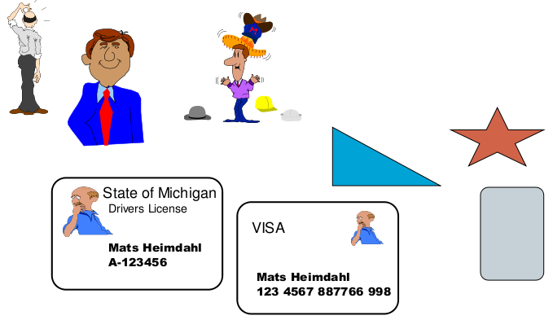
Card Entities
You are building a system that can print different types of card (ID, license, credit cards).
What are some of the entities that make up this problem domain?
How do these entities relate?
Gregory Gay CSCE 740 - Fall 2016 11
Notes:
(read, discussion)
different types of cards
layout - might come in different shapes and sizes, have text and picture fields in different locations
people own cards - need info about them
login for people who print cards, not just anyone can print up a drivers licence
-Can we define what makes up a card, then use that to differentiate credit cards from drivers licenses? Can we define what represents a person and what they can do with a card - whether they are an admin or an end user?

Slide 12


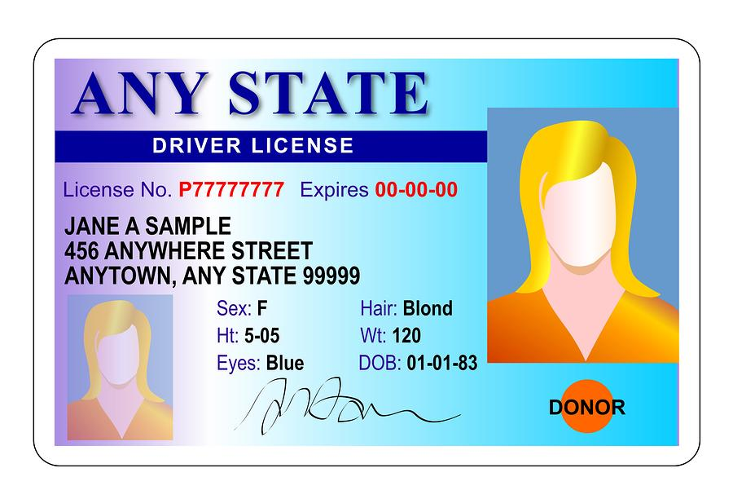
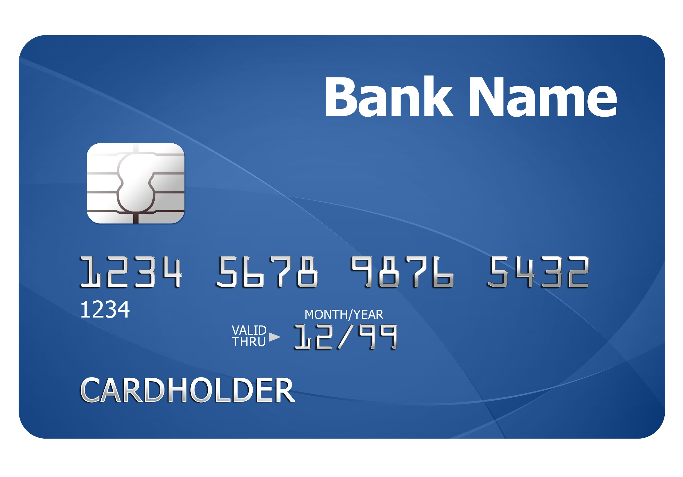
Attributes and Operations
Person Objects
Card Objects
Attributes
Name
Age
Height
Weight
Address
Role
Operations
Edit Information
Change Role
abstracts to
Attributes
Owner
Layout
ID Number
Expiration Date
Operations
Issue
Edit Information
Renew
Retract
Gregory Gay CSCE 740 - Fall 2016 12
Notes:
So, let’s say that for this card system, we want to reason about people and cards. What defines these?
(discussion)
what defines a person? a card?

Slide 13
Objects vs Classes
Objects are concrete entities that make sense in the application domain:
Greg Gay
Greg’s credit card
Greg’s driver's license
All objects have an identity and are distinguishable
Greg’s credit card vs Jason’s credit card
Not an object:
Person
Driver’s License
Gregory Gay CSCE 740 - Fall 2016 13
Notes:
Two words that you hear a lot in the design portion of the class are objects and classes. These are not the same thing - this is, I imagine, review, but quickly
- (read), things that we can reason about - in our card system, we might reason about (read examples)
- (read) can tell Greg’s credit card from Jason’s credit card
- now, although we might talk about Greg, Greg is a person. A Person, then, would be a class - a description of a generic object. Greg is the object, a person is what Greg is an example of. Greg’s driver license is a particular instance of a generic driver’s license.

Slide 14
Classes
Describes a type of object.
Objects are instances of classes.
Each instance has the same attributes and behaviors, the same relationships to other classes, and common meaning.
Each instance may have different values for those attributes.
Person instances:
Greg Gay, Jason Biatek
Credit Card instances:
Greg’s credit card, Jason’s credit card
Gregory Gay CSCE 740 - Fall 2016 14
Notes:
A class is an abstraction of an object, a type (read).
Objects are instances of classes (read)
(3-4)
So, Greg Gay is an object, an instance of the Person class. Jason is an instance of the Person class. They both have names, addresses, ages, and so on, but are differentiated by the values for those attributes. (read credit cards)

Slide 15

Objects Characteristics
Objects have a classification.
Objects are instances of classes.
Each instance has the same structure and behavior.
Objects have identity.
Discrete and distinguishable entities.
!=
Gregory Gay CSCE 740 - Fall 2016 15
Notes:
(read) - (read), and (read) - All People have the same attributes and same operations. The values of the attributes and results of the operations might vary, but they offer the same operations and offer values for the same information.
That said, (read). They are (read).Two objects might be instances of the same class, but you can tell them apart. You can tell Jason apart from me using the differing values of those attributes.

Slide 16
Objects vs Classes
Classes are used in static views of a domain or system.
Classes are defined in the source code.
When we design the system structure, we don’t care about Greg. We care about what defines any abstract Person.
Objects are used in dynamic views of a domain or system.
Objects represent the system state during runtime.
When the system is running, we care about Greg’s state and behavior, not an abstract Person.
Gregory Gay CSCE 740 - Fall 2016 16
Notes:
(1-2) - When we sit down to design the structure of the source code, we obviously don’t care about Greg or Jason. The system might not always load up a Greg object - I don’t exist everywhere at once. WE care about the concept of a Person, what makes up every possible instance of a Person. In static situations, we just want to know what is true of all instances of a class, not any one particular instance.
(4-5) - When we run the system - or model what will happen when it is run - we look at concrete scenarios - Greg owns a credit card. What does that mean? Greg edtis his information, he orders a driver’s license, he renews his credit card. When we map out these specific scenarios, we can’t just look at any possible Person or driver’s license, we create specific instantiations and map out how they interact. (6)

Slide 17
Inheritance
Card
id-number: integer
height: integer
width: integer
issue()
revoke()
Child classes share attributes and operations based on a hierarchical relationship.
Allows the creation of specialized subclasses without reimplementing functionality or including attributes and operations where they aren’t needed.
Objects instantiated from a child are instances of that class and of the parent class.
Drivers Licence
class: Vehicle
issued: Date
expires: Date
restrictions: String[]
renew()
ID Card
issued: Date
expires: Date
renew()
Gregory Gay CSCE 740 - Fall 2016 17
Notes:
An important aspect of OO design is the idea of Inheritance - this is the concept that you can define a hierarchy of related classes where the children all inherit the attributes and operations of their parents. This is really useful in creating specialized new classes.
For instance, our card system might need to be able to issue both drivers licences and plain ID cards. Both are special forms of cards with their own unique attributes and operations. We can define the card class that captures information and behavior relevant to all cards, then refine from there to create subclasses for special types of cards with their own needs and behaviors. This averts two big design no-nos - reimplementing functionality in multiple places - no need for that, we inherit those from the parents. If we need to change those, we just change the parent. Second, we avoid including attributes or operations that are only used in very specific scenarios. We never want to create a class with attributes that aren’t always set. Instead, we create these specialized children and encapsulate those attributes and operations to the subclass that actually makes use of them.
- Also of relevance is that (read). So, Greg’s Drivers License is both an instance of a Drivers License and an instance of a Card. This is very useful, as we can write code that can work with any type of child rather than explicitly checking what kind of child object it is. We can write code that works for any Card without worrying that it is an ID card or a Drivers license.

Slide 18
Polymorphism
The same operation may behave differently when used on different classes.
Specifically, we can redefine operations in each related class.
Because Shape defines an area() method, we know all children offer that method.
But, we can redefine that method in each child to offer the right answer.
Shape
area()
Square
area()
Circle
area()
Triangle
area()
Because objects are instances of both their class and their parent class:
void getArea(Shape s){
System.out.println(s.area());
}
Gives the right answer if a square, circle, triangle, etc is passed in.
Gregory Gay CSCE 740 - Fall 2016 18
Notes:
Polymorphism is the ability of the same operation to behave differently when used on instances of different classes. Specifically. it is the ability to redefine the behavior of an operation to be relevant to the class it is operating on.
(read), (read)
(read right side)
This is a very powerful concept, allowing us to write code that does not need to change, even if we get rid of particular shapes, add new shapes, or change how the area of an existing shape is calculated. We can restrict change to a limited subset of the program.

Slide 19
Class Diagrams
Visualize system structure: classes and how they relate.
Notes:
So, now that we have the basics down about reasoning about objects and how they interact, lets talk about how to visualize the static structure of the system. Class diagrams are a fundamental design tool that we can use to view the structure of our system and understand how all of our classes relate to and depend on each other

Slide 20
Class Diagrams
Class Diagram:
Used to describe class with attributes.
Attributes are variables
That describe the instantiated object.
That are used by objects to perform operations.
Include the data type, and (optionally) a symbol to indicate visibility:
+ (public), - (private), # (protected), ~ (package-level)
Person
+name: String
age: integer
-currentMember: Boolean
Gregory Gay CSCE 740 - Fall 2016 20
Notes:
Class diagrams are used to discuss classes and their attributes in the abstract. This is a way to visualize the structure of the code and dependencies between classes. YOu dn’t care here about Jason or Greg, but how, in all clases, a Person relates to a Card and what attributes and operations makes up any Person object.
(go through UML syntax, fields, +/-/# for protected, and tilda for package-level visibility)

Slide 21
Operations
Operations are transformations that can be applied to or performed by an instance of a class.
Operations may have arguments.
Shape
height: integer
width: integer
rotate(angle: integer)
move(x: integer, y: integer)
Card
height: integer
thickness: integer
-id-number: integer
issue()
revoke()
Gregory Gay CSCE 740 - Fall 2016 21
Notes:
walk through, explain syntax

Slide 22
Associations
A conceptual connection between classes.
A credit card is issued by a bank.
A person works for a company.
Credit Card
Bank
Issued-by
Person
Company
Works-for
Gregory Gay CSCE 740 - Fall 2016 22
Notes:
Of course, classes don’t exist in isolation. They have to work with other classes to perform tasks. We can use associations to inform the reader about how these classes depend on each other and work together. These are just lines with text explaining at a high level how these classes link together. For instance, (read)
(syntax)
You should use descriptive verb phrases to label associations. Try not to just use “has”, but something more informative like “works for”. These phrases can be marked with an arrow to help indicate the direction of the relationship, a Person works for a company. Arrow so you don’t read it the other way.

Slide 23
Associations Can Have Direction
Direction on an association indicates control. Which object owns and calls on the other?
Associations can be bidirectional.
Person
credit: Card
Card
Owns
Person
employer: Company
Company
employees: Person[*]
Works-for
Gregory Gay CSCE 740 - Fall 2016 23
Notes:
In reality, many associations are actually directional, a Person owns a credit card. The credit card doesn’t own a person. Right? In the last slide, I put an arrow on the label to tell you to read it in a certain direction. That’s helpful when you go to implement, it gives you an idea of the control dependence. That said, in the code, we might need to use storage to link a Person and a Card. Well, we usually do this by storing instances of a class within the attributes of the class on the other end of the association, with at least a variable storing a pointer from, say, the Person to the cards they own. When designing the system, if we have a preference on where the pointer gets stored, we can use an arrow on that association line itself to indicate that direction. That’s a stronger statement than just putting an arrow on the label - you’re imposing a constraint on the source code.
Bidirectional associations are used when the relationship is mutual - they contain pointers to each other.
When dealing with operations related to the working relationship between employees and employers, we might use that bidirectional link. The company maintains a list of employees and each employee keeps track of their employer. Bidirectional links are tougher to implement because you need to keep both sides in sync, and they open up more securitry risk because you can trace either side of the association to the other information, but sometimes you need that two way link.
Now, this might end up being a programming decision that you can’t just make at design time, so these arrows are optional. A lack of arrows doesn’t mean we will never decide on the direction of pointers, but we just haven’t decided it yet or it isn’t important to the design.

Slide 24
Associations Have Multiplicity
Associations should be labeled with how many instances of a class are expected on each side.
One Person owns one Card
One Person can own zero or more cards
Person
credit: Card
Card
1
Owns
1
Person
credits: Card[0..*]
Card
Owns
1
0..*
Gregory Gay CSCE 740 - Fall 2016 24
Notes:
The multiplicity of an association is an indication of how many object instances are expected in a particular relationship. For example, (read, read)
(suntax - 0,1,*,range)

Slide 25
Multiplicity
Defined with a lower and upper bound.
One Person can own zero or more Cards.
Each Card is owned by zero to one Person.
Common terms that imply multiplicity:
Optional: implies lower bound of 0.
Mandatory: implies lower bound of 1 or more.
Single-Valued: implies upper bound of 1.
Multivalued: implies an upper bound > 1 (often *).
Person
credit: Card
Card
Owns
0..1
0..*
Gregory Gay CSCE 740 - Fall 2016 25
Notes:
Generally, multiplicities are defined with a lower and upper bound. These can be read on each side as: (read example)
The lower bound can be any positive number or zero. The upper bound can be any positive number of a * for unlimited instances. If the lower and upper are the same, you can just use one number - like the 1 in the previous slide for the one person to one card associaiton.
If no multiplicity is listed, one is assumed.
(read)

Slide 26
Multiple Associations
Can have multiple associations between objects, each with their own multiplicities.
One Person can own zero or more Cards.
Each Card is owned by zero to one Person.
Each Card has one or more authorized users.
One Person can be authorized to use zero or more Cards.
Person
credit: Card
Card
authorized: Person[*]
Owns
0..1
0..*
1..*
Authorizes
0..*
Gregory Gay CSCE 740 - Fall 2016 26
Notes:
An association isn’t supposed to represent any link, but a particular working relationship. So, in practice, you might have multiple associations between two classes, each labeled with the context and multiplicities of that relationship. (read)

Slide 27
Link Attributes
Associations can have attributes just like classes can have attributes.
How do you represent salary and job title?
Person
name: String
age: integer
address: String
Company
name: String
address: String
0..*
Works-for
1
salary: integer
job-title: String
Gregory Gay CSCE 740 - Fall 2016 27
Notes:
(read) - in some cases, you might want to represent certain information that is related to the association - that defines that particular association- and these might not be attributes that map well to either of the linked classes. In the diagram, this can be represented using a link attribute (explain syntax)
Now, here’s a question, why not fold those attributes into the Person class?

Slide 28
Folding Link Attributes into Classes
Person
name: String
age: integer
address: String
salary: integer
job-title: String
Company
name: String
address: String
0..*
Works-for
1
Why not this?
Person
name: String
age: integer
address: String
Company
name: String
address: String
0..*
Works-for
1
salary: integer
job-title: String
Gregory Gay CSCE 740 - Fall 2016 28
Notes:
Why not fold that information into the Person class? (discuss)
Salary and job title are properties of a job, not of the person. Not all people have a salary of job title. Some people have multiple jobs. In this job system, a Person class might have uses unrelated to their particular job. That information is not part of what defines a person, but does define the link between a person and the company they work for. We will eventually have to store that information somewhere - the best solution might actually be a job class - but a link attribute is a good way - at design time - to indicate that we have special information that defines an association between two classes.

Slide 29
Association Constraints
General Constraints: On one association or between multiple. Plain English. Use dotted line to show dependency.
Ordering:
On one association. Implies that objects on the “many” side must be ordered.
Person
Class
Students
1 0..*
{ordered}
Account
Owner
{xor}
Corporation
Gregory Gay CSCE 740 - Fall 2016 29
Notes:
One of the refinements you can make is the idea of a constraint on the association - these constraints tell the programmer how to implement the association.
- We can place constraints on one association or between multiple associations to inform the implementation about how they need to be coded. Between two associations - person xor corporation (dotted line to show dependency).
Be clear and descriptive. Don’t clutter up your diagram with a million of these - use them only when necessary.
- Ordering is a common constraint on one association that implies an order to the objects on the many side. For instance, a class might have a list of students. We could place an ordering constraint to insist that the students be stored in alphabetical order.

Slide 30
Attribute Constraints
General Constraints: Plain English. Can be constraints on an attribute or on multiple related attributes.
BankAccount
owner: string
balance: number
CreditCard
number: int
{owner is not empty and balance >= 0}
{number is 16 digits}
Gregory Gay CSCE 740 - Fall 2016 30
Notes:
We can also place constraints on attributes to inform the implementation. These let the implementer know that certain properties must hold over these attributes.
Bank account has owner and balance attributes, and we state that there must be an owner and balance can’t be negative.
Credit card number is a 16 digit integer

Slide 31
Role Names
Attach names to the ends of an association to clarify its meaning.
Person
name: String
age: integer
address: String
Company
name: String
address: String
0..*
Works-for
1
employee
employer
Gregory Gay CSCE 740 - Fall 2016 31
Notes:
(read). This helps make the model clearer, as it informs the reader of the role of each object in the association.

Slide 32
Higher Order Associations
Associations can be between more than two classes.
Person
name: String
age: integer
address: String
Company
name: String
address: String
0..*
1
1..*
Project
name: String
language: String
Gregory Gay CSCE 740 - Fall 2016 32
Notes:
Some associations aren’t just between two classes, but might be between several at once. For instance, a person might work on a project as a company. Within the company, a person might work on multiple projects at the same time, and the company might own multiple projects at once. We can link all three with the same association to depict that particular relationship between them. We can do this by connecting them all with a diamond, and labeling the multiplicity on all ends.

Slide 33
Aggregation
A special type of association. Indicates membership.
A sentence is part of a paragraph.
(A paragraph consists of sentences.)
A paragraph is part of a document.
(A document consists of paragraphs.)
Document
Paragraph
Sentence
Gregory Gay CSCE 740 - Fall 2016 33
Notes:
(read). This is a strong association that indicates usage or membership. (read examples).
You want to use this any time that you have a class that is composed of other classes. It indicates that something is a building block of a greater structure.

Slide 34
Composition
A stronger type of aggregation.
Aggregation indicates membership. Member objects can exist outside of the owner.
Composition indicates dependence. The instance is destroyed if its owner is destroyed.
Car
Transmission
Wheel
Gregory Gay CSCE 740 - Fall 2015 34
Notes:
(read). This is a stronger form of aggregation (read).
(black vs white diamond)
Think about a car - it is composed of parts - it would have a transmission and wheels. Well, if it’s in a nasty wreck and gets totaled - you aren’t taking that transmission and putting it into a new car. It’s done. If the car is destroyed, the transmission isn’t something that will exist on its own - it also gets destroyed. It’s wheels however, are easier to salvage. They might be usable in another car if they survived the wreck, so those might merely be aggregation. The wheels are members, but they are allowed to continue to exist independently of the car.

Slide 35
Aggregation vs Association
When should you use a plain association versus an aggregation?
Can you use the phrase “is made of”?
Are operations automatically applied to the parts?
Then use aggregation. If not clear, use association.
Company
0..*
Division
0..*
Department
0..*
Person
Gregory Gay CSCE 740 - Fall 2016 35
Notes:
(read)
So, a company might logically be broken into a number of divisions, and those might be made up of departments. That makes sense - the company is made up of divisions, so we use an aggregation to depict that membership. We’re making a strong statement that anything that happens to a company happens to its divisions as well, that fundamentally, the divisions belong to the company. That’s a strong statement. People also work for the company, but that might be a weaker relationship. If something occurs to the company, it might not automatically happen to those people. The company is not fundamentally defined by the people it employs. So, if we can’t make as strong of an argument for membership, then we should use a regular association. Aggregation and Composition are very strong statements of relationship that should only be used when we mean it.

Slide 36
Inheritance
The is-a association.
Cards have many properties in common.
Generalize the common properties as a base class.
Let all card types inherit the common attributes and add their own (Drivers License is-a Card)
Card
id-number: integer
height: integer
width: integer
issue()
revoke()
Drivers Licence
class: Vehicle
issued: Date
expires: Date
renew()
ID Card
issued: Date
expires: Date
renew()
Gregory Gay CSCE 740 - Fall 2016 36
Notes:
(read)
We talked about this earlier, but this is how we depict it in a class diagram (syntax)

Slide 37
Aggregation Versus Inheritance
Do not confuse “is-a” (inheritance) with “is-part-of” (aggregation).
Use inheritance for different special versions of a general concept.
Use aggregation to indicate components of a whole.
Wheel
Car
Body
Engine
Station Wagon
Compact
Gregory Gay CSCE 740 - Fall 2016 37
Notes:
(read)
(read) - There is no direct association - a station wagon does not contain a car, it is a special form of a car.
(read)

Slide 38
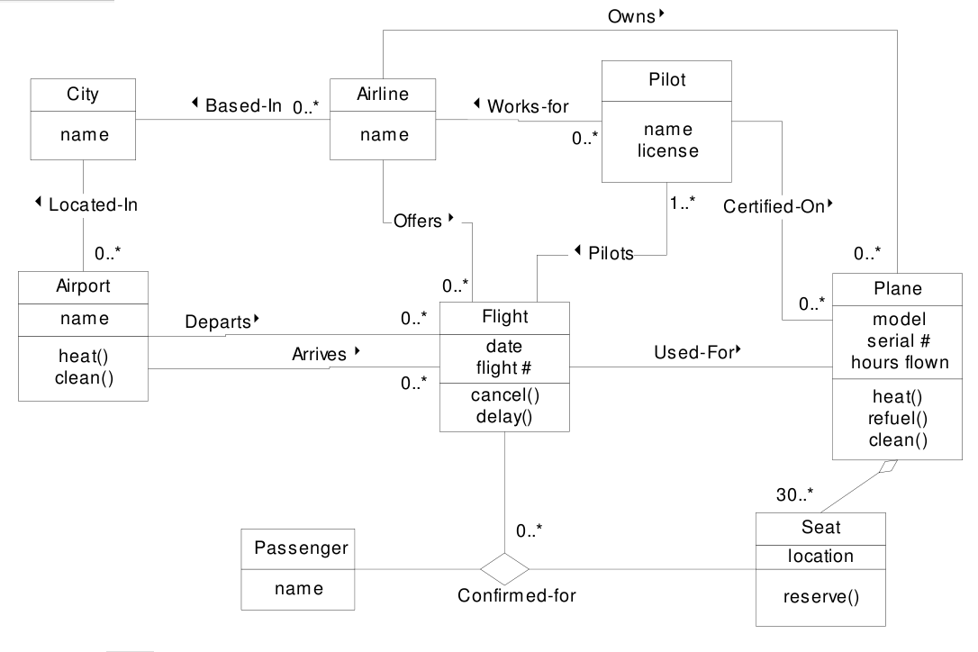
Example
Gregory Gay CSCE 740 - Fall 2015 38
Notes:
Let’s bring it all together now. Here is a class diagram for an aircraft reservation system
(walk through)

Slide 39
Examples
Draw a class diagram for a book chapter.
A chapter comprises several sections, each of which comprises several paragraphs and/or figures. A paragraph comprises several sentences, each of which contains several words.
Draw a class diagram (using inheritance) that captures two categories of a company’s customers: external customers, which are other companies buying goods from this company, and internal customers, which are the divisions of the company.
Gregory Gay CSCE 740 - Fall 2016 39

Slide 40
Suggested Solution 1
Draw a class diagram for a book chapter.
A chapter comprises several sections, each of which comprises several paragraphs and/or figures. A paragraph comprises several sentences, each of which contains several words.
Chapter
Section
Component
1
1..*
1
1..*
Word
Sentence
Paragraph
Picture
1..*
1
1..*
1
Gregory Gay CSCE 740 - Fall 2016 40

Slide 41
Suggested Solution 2
Draw a class diagram (using inheritance) that captures two categories of a company’s customers: external customers, which are other companies buying goods from this company, and internal customers, which are the divisions of the company.
Company
External Customer
Corporate Division
Internal Customer
Customer
Gregory Gay CSCE 740 - Fall 2016 41
Notes:
(explain, good example of aggregation vs inhertiance)
Multiple inheritance - not possible in some languages - could make an argument for either or both.

Slide 42
We Have Learned
An object is an entity in the problem domain.
An object is an instantiation of a class (a type of object).
Classes have attributes and operations.
Classes are related through associations:
Regular association, aggregation, composition, inheritance
Associations have multiplicity and may have direction.
Gregory Gay CSCE 740 - Fall 2016 42
Notes:
(read)

Slide 43
Next Time
Coming up with the classes and associations.
Reading:
Sommerville, chapter 7
Fowler UML, chapter 3 and 5
Gregory Gay CSCE 740 - Fall 2016 43
Notes:
(read)

