Slide 1
Design Patterns
CSCE 740 - Lecture 17 - 10/20/2016
(Partially adapted from Head First Design Patterns by Freeman, Bates, Sierra, and Robson)

Slide 2
OO Design Exercise:
Building a Better Duck
Duck
quack()
swim()
fly()
display()
// Other Methods
MallardDuck
display() { .. }
RedheadDuck
display() { .. }
…
Gregory Gay CSCE 740 - Fall 2016 2
Notes:
I don’t know why you’re programming virtual ducks. Maybe the next Elder Scrolls game will focus on realistic duck behavior. So, anyway, ducks. Ducks quack, they swim, they fly. So, based on what we talked about last week, it seems reasonable that you might want to do is use inheritance so that you can add dozens of duck types and just inherit those common attributes and operations from the parent. Is that ok? Could this get you into trouble?

Slide 3
Adding new ducks
Duck
quack()
swim()
fly()
display()
// Other Methods
MallardDuck
display() { .. }
RedheadDuck
display() { .. }
RubberDuck
display() { .. }
Gregory Gay CSCE 740 - Fall 2016 3
Notes:
Good reuse of operations in the initial design, but it isn’t always the answer, and might end up getting you into trouble when you go to change the system later. What if you add new ducks? What if it’s a rubber duck? They quack, in a sense, you can even argue that they swim - they certainly float at least - but they certainly don’t swim in the same way that others do, and unless you throw them, they aren’t flying around.

Slide 4
Why not override?
Duck
quack()
swim()
fly()
display()
// Other Methods
WoodenDuck
display() { .. }
@Override quack() { .. }
@Override fly() {.. }
MallardDuck
display() { .. }
RedheadDuck
display() { .. }
RubberDuck
display() { .. }
@Override fly() {.. }
Gregory Gay CSCE 740 - Fall 2016 4
Notes:
One option is to override a method that you inherit with your own version. That’s often a useful trick - you inherit these methods, but the behavior isn’t the same, so you could override their behavior with your own local version of flying or swimming. How about that?
(discuss, bring in)
Now we add a wooden duck. That might float if it’s light, but it doesn’t quack and it doesn’t fly. It would make sense to group it with ducks still, but we’re reaching a breaking point with the behavior overrides.
Defeats the point of inheritance - why bother inheriting behaviors if you’re not going to use them at all? If not shared? The point is to localize functionality to that parent so a change in one place changes it everywhere. It isn’t much use if we just override everything.

Slide 5
Why not interfaces?
<<interface>>
Flyable
fly()
<<interface>>
Quackable
quack()
Duck
swim()
display()
// Other Methods
MallardDuck
display() { .. }
fly() { .. }
quack() { .. }
RedheadDuck
display() { .. }
fly() { .. }
quack { .. }
RubberDuck
display() { .. }
quack() {... }
WoodenDuck
display() { .. }
Gregory Gay CSCE 740 - Fall 2016 6
Notes:
One option are interfaces - Here, we don’t actually implement a shared behavior, but we define a contract that states that anything that implements the interface will - at least - offer these methods with these parameters.
So, we could define interfaces for some of these behaviors - anything that implements flyable can fly. Anything that implements quackable can quack.
(click) Strip out flying and quacking and add those as interfaces.
(click) implement our ducks - they still all swim and they might share data attributes
(click) when appropriate, have them implement the right interfaces.
- this provides assurance that if an object can fly or quack, you know how to call that behavior. Good. Is this actually a better design, though?
(discuss)
we know not all ducks fly, so inheritance isn’t the right answer, but this - interfaces - just solves part of the problem. A bug point of inheritance is the idea that we don’t implement the same code in multiple places. With just an interface, we have to implement the behavior each time, and that likely means the same flying or quacking behavior appears in multiple places in the code. Maintenance, bug fixes are still going to be a nightmare.

Slide 6
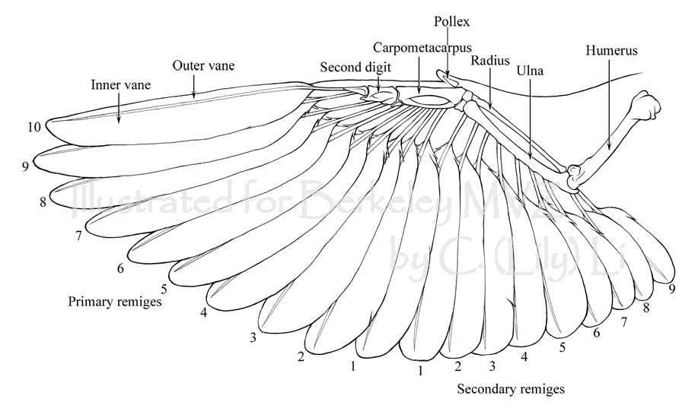

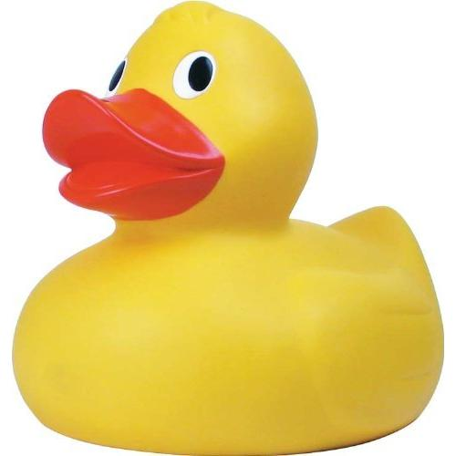
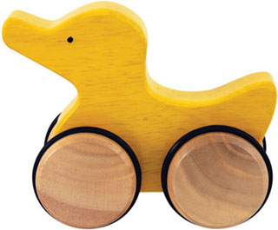
How do we fix this mess?
Apply good OO design principles!
Step 1: Identify the aspects that vary and encapsulate them.
Duck Flying
class behaviors
Gregory Gay CSCE 740 - Fall 2016 6
Notes:
(read)
So, let’s ignore these fancy tools for a second - interfaces, inheritance. Let’s focus on the core reason these tools exist - one of the biggest advantages of OO design is that we can think of the system as a bunch of independent blocks that connect together, so let’s do that. This was the first lesson we talked about after the midterm - Let’s identify what changes and isolate that from what doesn’t
So, we have ducks. What never changes? Let’s take that and put that into our duck class, the basis for all other ducks. What does change between these variants? Well, for one thing, how they fly (or don’t fly) - so, let’s separate what never changes about ducks from the changing behaviors so that later you can alter or extend the parts that might change without affecting those parts that never change.

Slide 7
Step 2:
Implement behaviors as classes
Principle - Program to an interface, not an implementation.
<<interface>>
FlyBehavior
fly()
(GOOD)
Programming to an interface:
Duck d = new MallardDuck()
d.performFly();
Flying/Quacking behavior called in the same way for all ducks. Only implement specific version of behavior once.
(BAD)
Programming to an implementation:
MallardDuck d = new MallardDuck();
d.flyWithWings();
Requires knowing what type of duck you’re using, and what methods it has.
(BETTER… BUT NOT GREAT)
Inherit and override.
Duck d = new MallardDuck();
d.fly();
Still requires reimplementing the same behaviors multiple times.
Duck
swim()
display()
Duck
swim()
fly()
quack()
display()
FlyWithWings
fly() { .. }
FlyNotAllowed
fly() { .. }
Duck
FlyBehavior flyB
QuackBehavior quackB
performQuack()
performFly()
swim()
display()
MallardDuck
flyWithWings()
quackLoudly()
swim()
display()
MallardDuck
fly();
quack();
performFly() {
flyB.fly();
}
Gregory Gay CSCE 740 - Fall 2016 7
Notes:
So, we want to separate what never changes from what does. Our first inclination might be to do something like this. Create children, and just program in flying and quacking when needed, implementing whatever behavior we need independently of the parent. This isn’t quite there yet - this means that when we want a duck to fly, we need to know what duck we’re working with and how to call the right method.
- Now, of course, we could go back to stating that duck has fly and quack methods and overwriting them. This is better - we know that all ducks have the same methods, so we don’t need to know which duck we’re working with. Call the fly method and you’ll get the appropriate behavior. But, as we talked about earlier, this isn’t great either, as we need to reimplement the same behavior multiple times. That said, there is an important lesson here.
- Program to an interface, not an implementation. Even if the result varies, always offer the same way to access the appropriate version of the same type of behavior. Offer that assurance that no matter what type of duck we have, we can call fly() or quack() and get the right result. Now, how do we do this right?
- So, what we want to do is to take those flying behaviors and program them once. We can give them each their own class and, since the behavior varies, we don’t want to inherit, but we can create an interface that says that any type of flying behavior will offer a method call fly(); We provide a contract - here is how you fly.
- Now, in the duck, we state that there will be a FlyBehavior and a QuackBehavior. All children inherit those attributes, but in those children, we can assign the appropriate instance of Flying or Quacking. Now, we have separated what changes from what doesn’t. Flying behavior is implemented separately from the duck, in one place, and no matter what duck we’re dealing with, we can access the right behavior in the same way without needing to know which duck it is or which version of flying it is. We will get the right result. That’s good OO design. Any questions?

Slide 8
HAS-A can be better than IS-A
Principle: Favor composition over inheritance.
Duck
FlyBehavior flyB
QuackBehavior quackB
performQuack()
performFly()
swim()
display()
setFlyBehavior()
setQuackBehavior()
<<interface>>
FlyBehavior
fly()
FlyWithWings
fly() { .. }
FlyNotAllowed
fly() { .. }
<<interface>>
QuackBehavior
quack()
MallardDuck
display() { .. }
RedheadDuck
display() { .. }
RubberDuck
display() { .. }
NormalQuack
quack() { .. }
Squeek
quack() { .. }
Gregory Gay CSCE 740 - Fall 2016 8
Notes:
This leads to another principle of OO programming. Inheritance is useful, but not always the answer. Often, we should favor composition over inheritance. Now, a duck has a flying behavior, it has a quacking behavior. But, instead of inheriting behavior from parent classes and making overrides, we have implemented the behaviors once and composd new versions of a class from the right building blocks.
We restrict a duck to what is true of all ducks, then build a new duck from the right set of behaviors.
This is the principle of composition - building a class from small independent blocks. Inheritance can be great, but only for those things that are shared between a parent and all children. Composition is better for those aspects that vary. Often has-a can be better than is-a.

Slide 9

Challenge - Duck Call
A duck call is a device that hunters use to mimic the sound of a duck. How would you implement a duck call in this framework?
Gregory Gay CSCE 740 - Fall 2016 9
Notes:
(discussion)
Is a duck call a duck? It certainly quacks. Probably not though
but, since quack behaviors are now implemented in their own classes, you can just create a DuckCall object and assign it a quack behavior. No need for it to be a duck, now you can reuse some duck code in something that isn’t a duck. That’s good design - take what can change - how something flies or quacks - separate it from what doesn’t - but define a standard method of calling that behavior no matter which specific instantiation you’re dealing with. As a bonus, you have these fundamental building blocks, flying/quacking behaviors that you can use as part of new classes - taking pieces of software and extending their lives beyond their original purposes.

Slide 10
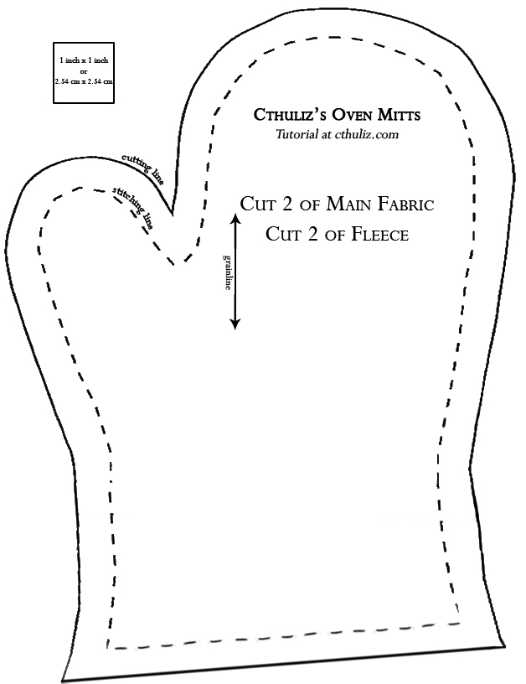
Enter... Design patterns
Don’t just describe classes, describe problems.
Patterns prescribe design
guidelines for common
problem types.
Gregory Gay CSCE 740 - Fall 2016 10
Notes:
Now, those are some of the fundamental lessons of OO development, but they can take some work to apply in practice. Fortunately, we can learn from the expereince of others. Don’t start design by listing a set of classes. Start by describing the problem you are addressing. Someone has probably solved it before. Some of these experience have been summarized as what we call design patterns. These patterns serve as a reference guide for design - for particular types of systems or development situations, they offer design guidelines.

Slide 11
Guidelines, not solutions
“Each pattern describes a problem which occurs over and over again in our environment, and then describes the core of the solution to that problem in such a way that you can use this solution a million times over, without ever doing it the same way twice.”
- Christopher Alexander
Gregory Gay CSCE 740 - Fall 2016 11
Notes:
Quote from Christopher Alexander, who popularized the concept of design patterns. (read)
Nice quote that really describes what a design pattern is. These patterns offer a head start to design - the core of a solution to a problem. They aren’t libraries of code that you can plug in. You won’t find patterns that replace your system. But they offer structure and guidance, a set of instructions, that will ideally result in a better design for your particular problem.

Slide 12
Categories of design patterns
Behavioral Describe how objects interact.
Creational Decouple a client from objects it instantiates.
Structural Clean organization into subsystems.
Gregory Gay CSCE 740 - Fall 2016 12
Notes:
1 - What we’ll spend the most time on - describe how a group of objects can interact to efficiently produce system functionality. Example is the observer pattern. A group of objects watch for changes in a common object of interest and react to those changes.
2 - patterns that parametrize the behavior of a system based on the classes of objects it creates. for dynamically selecting the class of created objects. Let you decouple a client from the objects it instantiates. Useful for systems with many subtypes of classes where you decide on a type situationally - say we need to create pizzas from a set of user-selected options. These patterns can help you create the right subclass instance at the right time without
much overhead or code changes when you add new subclasses or remove subclasses in the future.
3 - Uses language objects - interfaces, aggregates - to structure code - to compose classes or objects into larger structures. These help you create an efficient system architecture - let you create and organize those independent subsystems and modules and get them to work together with less overhead. Example is facade pattern - interface to interfaces, defines a higher-level interface that lets you plug in new subsystems without rewriting what you have to work with their interface. Another is Iterator pattern - defines an aggregator over a collection that makes no assumptions about what is being aggregated.
- These patterns aren’t mutually exclusive - you might apply multiple patterns to a project, and the same class might have a role in multiple patterns. These just help you structure parts of your system more efficiently.

Slide 13
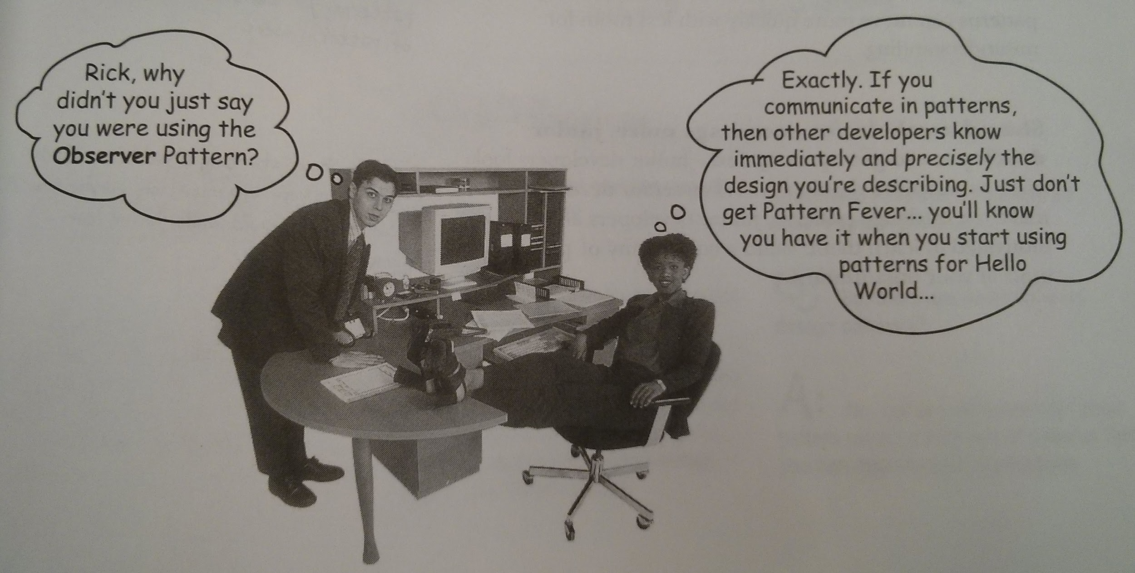
Why use design patterns?
Good examples of OO principles.
Faster design phase.
Evidence that system will support change.
Offers shared vocabulary between designers.
Gregory Gay CSCE 740 - Fall 2016 13
Notes:
1. As a learning tool. Offer clear lessons in OO design. Studying them will improve your design chops.
2. Start with most of a design figured out. Take a pattern where it applies, fill in the details of your particular system, and be in business.
3. Better than a bad design - most patterns provide ways to let some part of the system vary independently of the parts that will remain relatively static. Easier maintenance, improvement, defect fixes, expansion.
4. Elevates thinking about architecture, reason at design level, not at object level. Lets independent design/implementation teams discuss problems without worrying about low-level details.

Slide 14
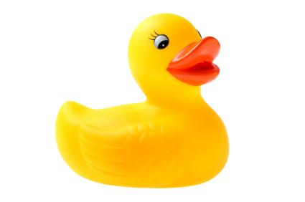


You already applied one pattern
Strategy Pattern
Defines a family of algorithms, encapsulates them, makes them interchangeable.
Gregory Gay CSCE 740 - Fall 2016 14
Notes:
Behavioral pattern. Algorithms describe behaviors. You take those, implement them, and make them interchangable by ensuring they all offer the same interface. Can swap one form of flying for another at runtime, don’t need to know specifics.

Slide 15
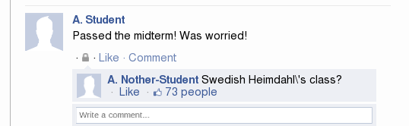

Observer Pattern - Motivation
Gregory Gay CSCE 740 - Fall 2016 15
Notes:
The observer pattern is the embodiment of the common idea of a publisher and subscriber model. Humans are social creatures, we like to share. We like to update our friends on what is going on and we like to know when there’s an update to something we’re interested in. You put out a status update on Facebook, your friends react - some comment, others simply make a note and move on. If you get too annoying, they might unfriend you. There are many situations where we want to encode the same kind of model in our software. Have objects subscribe to events of interest, and when those events occur, they leap into action.

Slide 16
Observer Pattern - Definition
(When data changes, subscribers are notifed)
Subscriber Objects
Change Request
Object
(These objects have subscribed to the Subject to receive updates when data changes)
Updated Data
Subject Object
Updated Data
update(){
// do something
}
Object
Updated Data
Subscribe
Object
update(){
// do something
}
update(){
// do something
}
Gregory Gay CSCE 740 - Fall 2016 16
Notes:
It is common that you have some software functionality that is performed over and over, activated each time you make a change to some central object.
- The observer pattern enables a publisher/subscriber relationship where observers register interest
- then when a change comes in
- the observers are alerted that the observed object was updated,
- then they perform operations using the changed data. It defines a one-to-many dependency between objects so that when one object changes state, all of its dependents are notified and updated automatically.

Slide 17
Observer Pattern Example
Pet Feeding
update(){
if (bowl.getFood() ==
“puppy chow”)
eat();
}
fillBowl(“puppy chow”);
Dog
addObserver();
Food Bowl
update();
Cat
removeObserver(Mouse);
Mouse
update(){
if (bowl.getFood() !=
“ahi tuna”)
angryMeow();
}
fillBowl(String food){
notify();
// ....
}
notify(){
for o in observers{
o.update();
}
}
update(){
if (bowl.GetObservers()
contains Cat)
removeObserver(this);
else
eat();
}
Gregory Gay CSCE 740 - Fall 2016 17
Notes:
Let’s say you have a pet simulator, and part of that is a food bowl. You have a number of animal objects lurking around the house who might be interested. A dog, a cat, and a mouse are all interested in being alerted in when that food bowl is filled, so they subscribe and set up observation of that object.
(seven clicks)

Slide 18
Observer Pattern - In Practice
<<interface>>
Observable
addObserver(Observer)
removeObserver(Observer)
notify()
<<interface>>
Observer
update()
notify() {
for observer in observers{
observer.update()
}
}
1
observers
*
ConcreteObserver
ConcreteObservable subject
update()
setSubject(ConcreteObservable)
// Action methods
ConcreteObservable
State state
List<ConcreteObserver> observers
addObserver(ConcreteObserver)
removeObserver(ConcreteObserver)
notify()
getState()
setState()
1
subject
1
update(){
state= subject.getState()
}
Gregory Gay CSCE 740 - Fall 2016 18
Notes:
So, what does this actually look like in terms of our class diagram? In the abstract, this is what we get.
As usual, we start with some interfaces - we need to define a blueprint for objects that are observable and objects that observe. You may have all sorts of functionality in your actual observable objects, but at minimum, you need a subscription method, a removal method, and some way of notifying your subscribers of changes. You might also have methods of getting and setting your current state - that is, some way of updating your data values.
Each observable object may have many observers (one to many relationship). This is a case of aggregation, the observers are a part of the observable, and vice-versa - an observable is part of an observer, we have this idea of membership.
The update method will generally traverse the collection of subscribers and notify each of them
Similarly, your concrete observers must implement an update method to be informed of changes to the observable object. They will generally have other methods that are triggered by the update method. Each observer can have one observable subscription (a one to one relationship)

Slide 19

Benefits of Observer Pattern
When objects are loosely coupled, they can interact while lacking knowledge of each other.
Can add new observers at any time.
Never need to modify subject.
Easy code reuse.
Easy change.
Gregory Gay CSCE 740 - Fall 2016 19
Notes:
(discuss)
The observer pattern is powerful because it provides loose coupling. When two objects are loosely coupled, they can interact while having little detailed knowledge on each other. The only thing the subject knows is that the observer implements a certain interface. It doesn’t need the concrete class, what it does, or anything else. Why is this good? (participation)
1 - we can add new observers at any time. We can replace one observer with another at runtime and the subject can keep running without any issues. We can add new types of observers to our code without reqriting anything. We can remove or add observers interchangably, knowing that they subscribe and get alerted in the same manner.
2 - We never need to modify the subject to accommodate new observer types. The new class just need to implement the Observer interface and register as a subscriber.
3- We can reuse subject or observer classes in other projects independently of each other.
4 - changes to either subject or observer will not affect the other, because both offer the same interface, we isolate changes and keep the system loosely coupled.

Slide 20


Visitor Pattern - Motivation
Gregory Gay CSCE 740 - Fall 2016 20
Notes:
The visitor pattern is another example of a behavioral pattern. The motivation behind this pattern is simply that we need information to perform operations, and to do that efficiently ,we need a good way to go out and gather that information regardless of what type of class we’re getting it from. That information is stored somewhere, so we need to go out and get it. Situations like this are common - we want to ring up the total on our groceries, we want to find particular books. It is similar in many ways to the observer approach, but while observer is passive - you wait for updates and then act, the visitor is active - you go out and get information when you need it.

Slide 21
Visitor Pattern - Definition
Collection
accept(Visitor)
(The items tell the visitor what they are, and the visitor acts accordingly)
visit(Collection)
Visitor
Client
accept(Visitor)
accept(Visitor)
visit(Item)
ItemSet
Item
(Visitors can traverse the data structure and gather information.)
(The client wants to perform actions using data from some structure)
accept(Visitor)
accept(Visitor)
Item
Item
(Items are instructed to tell the visitor
who they are.)
Gregory Gay CSCE 740 - Fall 2016 21
Notes:
Essentially, Visitor patterns are used to iterate over composite structures and perform operations given the information gathered during that traversal. They allow you to separate an algorithm from the data that it operates on and update the data structure without changing the operation. The visitor gathers information, performs actions, and returns the results.
- Program goes out and tells the Visitor to go look at the collection.
- Visitor goes to that collection and asks it to accept a visit
- Each item then has its own Accept method that looks at the visitor and tells it what it is
- The visitor has a set of methods, called visit, that take in the type of an object. When those collection items tell the visitor who they are, the Visitor knows what to do when it sees an item of that type.

Slide 22
Visitor Pattern Example
Grocery Checkout
accept(visitor){
for(item in Items())
item.accept(visitor);
}
Cart
accept(TagScanner);
Cashier
accept(visitor);
visit(Cart);
Dairy Products
Ramen
Tag Scanner
accept(visitor);
accept(visitor);
Cheese
Milk
visit(Cheese c){
price+= c.getPrice();
}
visit(Cheese);
accept(visitor){
visitor.visit(this);
}
Gregory Gay CSCE 740 - Fall 2016 22
Notes:
Let’s say that you’re building a checkout for an online grocery store. Like a real cashier, your virtual cashier’s primary responsibility is to check over the items to be purchased and ring up the total. The items to be purchased are contained in a data collection called, as you might guess, a cart. A cart can contain different classes representing the different items. It can even contain sub-collections, like for collecting the dairy products. Now, how do you ring up these purchases?
(click)We could build code directly into the cashier for ringing up purchases, specifically written to read the cart structure, but that isn’t the design pattern way. Instead we’ll use a special visitor class to iterate over the structure. Let’s call this a Scanner.
(click) The scanner, having been given the instruction to iterate over the structure, now need to gather the information needed. (click) It then visits each element, triggering a specific form of acceptance method in each item. So, first it goes to the collection and asks to visit (click) - the Cart is a top-level container, it defines a type of collection, so it triggers the acceptance in each of its items. DairyProducts is a subcollection, so it will do the same - (click) sets off a cascading series of accept calls to the individual cart items.
(click) Now, rather than build code into the groceries to deal with any form of visitor - scanner, inventory, etc - we instead keep that code in the visitor.
(click) So, what the acceptance method does is calls to the scanner and says “hey - I’m cheese” “hey - I’m ramen” We call back to the visitor, telling it what it is visiting.
(click) The scanner, the visitor, has logic built in for dealing with cheese, or ramen, or milk.
if that behavior changes, we don’t have to change every item we keep in the store, we just have to change the appropriate visitor. This is, again, all about restricitng the impact of changes to the system and enabling us to keep adapting the system for years to come

Slide 23
Visitor Pattern - In Practice
Client
<<interface>>
Element
accept(ConcreteVisitor)
<<interface>>
Visitor
visit(ConcreteElementA)
visit(ConcreteElementB)
ConcreteElementA
List<ConcreteElementB> members
accept(ConcreteVisitor)
getMembers()
ConcreteElementB
accept(ConcreteVisitor)
ConcreteVisitor
visit(ConcreteElementA)
visit(ConcreteElementB)
accept(ConcreteVisitor visitor){
for element in this.getMembers(){
element.accept(visitor)
}
accept(ConcreteVisitor visitor){
visitor.visit(this)
}
Gregory Gay CSCE 740 - Fall 2016 23
Notes:
In practice, this pattern also involves implementing two interfaces. A main client class calls into these visitors, which traverse over the elements. The accept method can either trigger a further traversal of a substructure, or it can call into the appropriate visit method of the visitor.
The visitor has, for each data type it can iterate over, a method with the logic for what to do when we visit it.

Slide 24

Benefits of Visitor Pattern
Can add operations to a collection without changing the collection structure.
Thus, adding new functionality and operations is easy.
Operation code is centralized.
Gregory Gay CSCE 740 - Fall 2016 24
Notes:
(participation) Visitor patterns are extremely useful when you want to add operations to a collection structure without changing the structure itself. That is, we have a bunch of data that we can use, we want to do things with that data, and we eventually might want to add new ways to use that data or change how we use it now. Thus, adding new operations is easy - you just write a new visitor implementation. We never have to change the data being examined.
Third, your operation code is encapsulated into a centralized location. fixing issues with those operations is easy. You don’t need to change every possible item in a collection that can be iterated over, you change the visitor. Again, this is all a nice way of encapsulating what changes and separating it from what doesn’t - that central tenet of OO design.

Slide 25
Activity
Building a weather monitoring application.
Generates three displays: current conditions, weather statistics, simple forecast.
Design system using either visitor or observer pattern.
Provided: To Implement:
Pulls data from.
Weather Data System
Displays
to
Display Hardware
Humidity Sensor
Physical Hardware
Temperature Sensor
Pressure Sensor
Gregory Gay CSCE 740 - Fall 2016 25
Notes:
System that can take readings from a set of sensors
Uses readings to display three screens - current cond, weather stats, simple forecast

Slide 26
Activity Solution - Observer Pattern
<<interface>>
Observable
addObserver(observer)
removeObserver(observer)
notify()
<<interface>>
Observer
update()
<<interface>>
Display
display()
WeatherData
List<Observer> Displays
addObserver(Observer)
removeObserver(Observer)
notify()
getTemperature()
getHumidity()
getPressure()
measurementsChanged()
CurrentConditionsDisplay
WeatherData data
update()
display()
ForecastDisplay
WeatherData data
update()
display()
StatisticsDisplay
WeatherData data
update()
display()
Gregory Gay CSCE 740 - Fall 2016 26

Slide 27
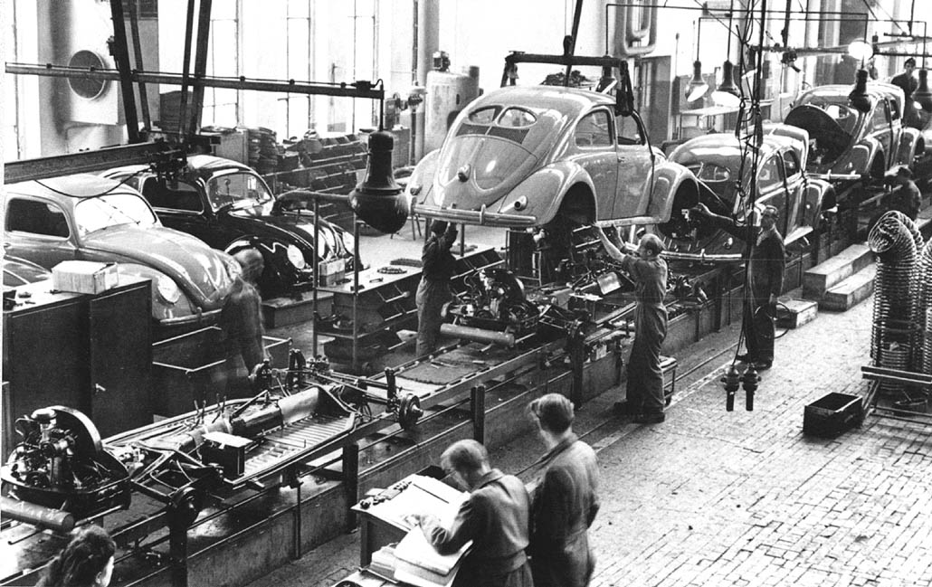
Factory Pattern - Motivation
Gregory Gay CSCE 740 - Fall 2016 27
Notes:
In manufacturing, you often end up creating multiple versions of the same produce. Say you’re building a new laptop. The process is the same for each instance of the laptop that you build, but the individual parts might differ - different RAM sticks, different hard drive capacities. You often see this same thing in restaurants - two customer might order pizza or a hamburger, but with different toppings. Same fundamental type of object - a pizza, a burger - but the details differ deoending on the options chosen. These same situations happen often in software as well, and that is where the factory pattern - a creational pattern - comes in, allowing us to exploit polymorphism to create the right type of object and change what options we offer without rewriting code in several parts of the program.

Slide 28
Factory Pattern - Motivation
Pizza orderPizza(){
Pizza pizza = new Pizza();
pizza.prepare();
pizza.bake();
pizza.cut();
pizza.box();
return pizza;
}
Gregory Gay CSCE 740 - Fall 2016 28
Notes:
So, let’s say we’re running a virtual pizza store. Ordering a pizza sets up a sequence of events where you prepare, bake, cut, box, and finally ship out the pizza. Regardless of the type of pizza we order, those steps remain the same (though the specifics of what happens when you call those methods will vary by class). This is like what we talked about earlier with the ducks, right? Now, there’s something missing here - deciding on the type of pizza.

Slide 29
Factory Pattern - Motivation
Pizza orderPizza(String type){
Pizza pizza;
if (type.equals(“cheese”)){
pizza = new CheesePizza();
else if(type.equals(“pepperoni”)){
pizza = new PepperoniPizza();
}
// Prep methods
}
Gregory Gay CSCE 740 - Fall 2016 29
Notes:
So, first stab at this - we add an argument for setting the pizza type, and use conditional statements to filter and instantiate the right type. Each type has to follow the pizza interface and implement those prep methods in the last slide.
Is this going to be a problem? Why (discuss)

Slide 30
Factory Pattern - Motivation
Pizza orderPizza(String type){
Pizza pizza;
if (type.equals(“cheese”)){
pizza = new CheesePizza();
else if(type.equals(“pepperoni”)){
pizza = new PepperoniPizza();
} else if(type.equals(“veggie”)){
pizza = new VeggiePizza();
}
// Prep methods
}
Gregory Gay CSCE 740 - Fall 2016 30
Notes:
Now, your menu will never remain static forever. You’ll need to add new pizza types, remove old ones. This can be a problemn, as this code is not entirely friendly to change. You’ll have to modify it over and over, while the rest of this order pizza method, namely the prep methods, will likely stay the same. This if-then-else block, this pizza selection code is likely to appear elsewhere in your system, and you’ll need to change it there as well. This isn’t a design conducive to change.

Slide 31
Factory Pattern - Motivation
Pizza orderPizza(String type){
Pizza pizza;
pizza.prepare();
pizza.bake();
pizza.cut();
pizza.box();
return pizza;
}
SimplePizzaFactory
Gregory Gay CSCE 740 - Fall 2016 31
Notes:
So, we are going to take that pizza instantiation code from every place it appears in the system, strip it out, and encapsulate the pizza instantiation code into a special type of object that we call a factory. Factories handle the details of object creation. In the visitor pattern, we had a client ask the visitor for information. Similarly, here, the orderPizza method is a client of the PizzaFactory. Now, we preserve loose coupling. The orderPizza method does not need to know the differences between pizza types. It just cares that it gets a valid pizza, which implements the pizza interface so we can call the prep methods. So, the factory gives us a pizza object, and we cook that pizza. We don’t need to know what’s on it, what type of pizza it is, what dough it uses. We don’t care - it just needs to act as we promised that a pizza will act, provide the right set of methods.

Slide 32
The Simple Factory
PizzaStore
SimplePizzaFactory factory
orderPizza(String)
SimplePizzaFactory
createPizza(String)
<<interface>>
Pizza
prepare()
bake()
cut()
box()
Pizza createPizza(String s){
if(s.equals(“Pepperoni”))
return new PepperoniPizza();
// Other pizza types
}
VeggiePizza
prepare()
bake()
cut()
box()
CheesePizza
prepare()
bake()
cut()
box()
PepperoniPizza
prepare()
bake()
cut()
box()
Gregory Gay CSCE 740 - Fall 2016 32
Notes:
Now, we’re not quite to the pattern yet - the full factory pattern has a couple more quirks - but here is what our pizza shop looks like now that we’ve stripped out object creation. The pizza store contains a factory, which is called when we need to instantiate a pizza. So, we call the PizzaStore a client of the SimplePizzaFactory. We have several types of pizza that all implement the pizza interface. We still have that if statement I showed you before, but the important part is that we have put that list in ONE place. If it changes, we only need to change it once. Thus, the factory can create any of these pizza types, and the client knows how to use them. So far, so good.

Slide 33
Franchising the Factory
PizzaStore
PizzaFactory factory
orderPizza(String)
<<interface>>
PizzaFactory
createPizza(String)
<<interface>>
Pizza
prepare()
bake()
cut()
box()
NewYorkPizzaFactory
createPizza(String)
ChicagoPizzaFactory
createPizza(String)
NYVeggiePizza
prepare()
bake()
cut()
box()
NYPepperoniPizza
prepare()
bake()
cut()
box()
ChicagoPepperoniPizza
prepare()
bake()
cut()
box()
ChicagoVeggiePizza
prepare()
bake()
cut()
box()
Gregory Gay CSCE 740 - Fall 2016 33
Notes:
Not all pizza are created equal. A pepperoni pizza from chicago is not the same as one from New York. Right? So, we might want to offer different hierarchies of options. We might want to let the user select a pizza type - NY or Chicago - then the toppings. In that case, we might not just want one Pizza Factory, we might want multiple- some of the details of creation might differ, or the options offered by each might differ, in either case, we provide an extra layer of organization. We can create a set of factories, each responsible for the creation of a subset of the items.
This means that we want to create a factory interface and spin that off into concrete factories that offer the same contract to other methods, but differ in the implementation details - each responsible for their own products. From this, we begin to see that what we are really dealing with in the factory pattern are products and creators, both of which have interfaces - contracts that they agree to follow in order to present a common interface.

Slide 34
Factory Pattern - Definition
Defines an interface for creating an object, but lets subclasses decide which object to instantiate.
Allows reasoning about creators and products.
<<interface>>
Pizza
prepare()
bake()
cut()
box()
<<interface>>
PizzaFactory
createPizza(String)
NYVeggiePizza
prepare()
bake()
cut()
box()
ChicagoVeggiePizza
prepare()
bake()
cut()
box()
NewYorkPizzaFactory
createPizza(String)
ChicagoPizzaFactory
createPizza(String)
Gregory Gay CSCE 740 - Fall 2016 34
Notes:
The factory pattern gives us a way to encapsulate the instantiations of concrete types. Lets us reason in terms of two parallel class hierarchies - creators and products - factories encapsulate object creation by letting subsclasses decide which objects to create.
All creators let us pass in options, use those to instantiate an object, then pass the right object back. The object we create - the products - may differ in the result of the methods they offer, but all offer a common set of methods.

Slide 35
Factory Pattern - In Practice
Client
<<interface>>
ProductB
// methods
<<interface>>
ProductA
// methods
Concrete
ProductA1
ConcreteFactory1
createProductA()
createProductB()
Concrete
ProductA2
<<interface>>
Factory
createProductA()
createProductB()
Concrete
ProductB1
ConcreteFactory2
createProductA()
createProductB()
Concrete
ProductB2
Gregory Gay CSCE 740 - Fall 2016 35
Notes:
So, what does this look like in a more abstract form? We have a client, who is concerned with both factories and products.
For each product type we build, we have an interface that states operations that can be assumed of that type of product. So, we have an interface for harddrives, for RAM, for graphics cards. Then, we have concrete product classes for each type that implement those methods.
A factory interface defines creation methods for each product type, be that hard disc or ram or graphics card. So, each factory is responsible for creating certain combinations of concrete products, and links to the products it creates.

Slide 36
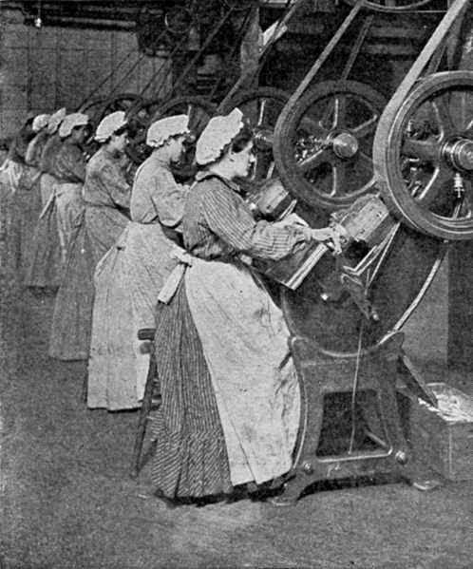
Benefits of Factory Pattern
Loose coupling.
Creation code is centralized.
Easy to add new classes.
Lowered class dependency (can depend on abstractions, not concrete classes).
Gregory Gay CSCE 740 - Fall 2016 36
Notes:
(participation) By pattern three, these should be easy.
1 - This is a reason we also like the observer pattern - we have loose coupling. We can create and interact with objects without knowing exactly which concrete class we instantiated. We program to an interface rather than to an implementation.
2/3 - Class instantiation code is in one centralized place, can change it more easily. Can more easily incorporate new classes - like new versions of pizza. That’s that idea of encapsulating what changes, and only changing it once. Same ideas, different ways of realizing it in your system, right?
4 - this last one is very much related to #1 - If we put our creation code in our pizza shop code, we have a high dependency on all of the different product classes, we directly reference each product that can be created, we need to know about all of the products that we create, we call their constructors directly. If we use factories, we lower that class dependency and can depend on abstractions, and not concrete classes - high level components should not depend on low level components, instead both levels should depend on abstractions and not need to know the details of each other. Both the high level pizza store and the low level pepperoni pizza need to interact, but they don’t need to know more than what a pizza is and how it can be interfaces with

Slide 37
Why not use a design pattern?
What are the drawbacks to using patterns?
Potentially over-engineered solution.
Increased system complexity.
Design inefficiency.
How can we avoid these pitfalls?
Gregory Gay CSCE 740 - Fall 2016 37
Notes:
(participation) Patterns aren’t a magic bullet. You can’t just plug one in, compile, and go out for coffee. You need to consider the consequences of patterns on your design.
To avoid - consider when to use and when not to use patterns. Better to be a good OO designer. Don’t overcomplicate is a simpler soution will work.

Slide 38
Resources
Web:
oodesign.com
c2.com/cgi/wiki?PatternIndex
Book:
Head First Design Patterns, by Eric Freeman, Bert Bates, Kathy Sierra, and Elisabeth Robson.
Design Patterns: Elements of Reusable Object Oriented Software, by Erich Gamma, Richard Helm, Ralph Johnson and John Vlissides (Gang of Four)
Gregory Gay CSCE 740 - Fall 2016 38

Slide 39
We Have Learned
When in doubt:
Reason about the problem, then the objects.
Patterns provide templates for OO design.
Patterns come in many flavors.
Think about patterns and MEAT (hint, hint).
Gregory Gay CSCE 740 - Fall 2016 39
Notes:
When in doubt about design, think about the problem before worrying about the individual objects. Abstract to the general problem you’re trying to solve. There might be a pattern for it.
Design patterns aren’t a cure-all, but they are a good start- they provide templates for certain types of problems.
Patterns can be used for organizing behavior - like in the observer pattern, for use in object creation - like factory, or used for structural purposes - like the adapter pattern, which ties together disparate interfaces.
Think about how patterns like visitor or factory can be used in the GRADS system. You don’t need to use design patterns in your assignment, but they may provide good ideas for approaching the design of the system.

Slide 40
Next Time
Design Patterns, round 2
Homework
Questions on class diagrams?
Gregory Gay CSCE 740 - Fall 2016 40

