Slide 1
Planning and the Software Lifecycle
CSCE 740 - Lecture 2 - 08/23/2016

Slide 2
Today’s Goals
Understand risk factors in software development.
Introduce software development processes
Definitions - processes and process models
Choosing a process
AKA: planning and risk management
Discuss the Waterfall Model
Gregory Gay CSCE 740 - Fall 2016 2
Notes:
This week is essentially the management portion of the course - we know that software is hard to build,and as a result, there are a lot of risks involved in the software development lifecycle. This week we’re going to lay out how to organize and manage the process to mitigate some of the risks.

Slide 3
Development is %S##% Hard
Complexity
More complex than a skyscraper.
Changeability
Software is “easy” to change.
Invisibility
We cannot see the progress of development.
Conformity
Software must be molded to fit external constraints.
Gregory Gay CSCE 740 - Fall 2016 3
Notes:
Software systems are the most complex artifacts ever created, with more moving parts and things that can go wrong than the most complex skyscraper
There is the perception that software is easy to change. You can just change a few lines of code, right? It’s deceptive. We even fool oursevles. It’s always tempting to go in and add more to it, or redesign a component. If you’re building a skyscraper - you don’t strip apart and rebuild the elevator just because you can build a faster one. You just don’t. We do that regularly in software
Invisiblity - you can’t necessarily see progress in development. It’s hard to say you’re 60% done until you’ve built everything. It might not work, and it’s hard to tell if it will during progress.. even after - might miss bugs
Conformity - you need to make people happy - meet the client and customer’s ever-changing desires and needs - meet legal standards - adapt to better fit the market conditions.

Slide 4
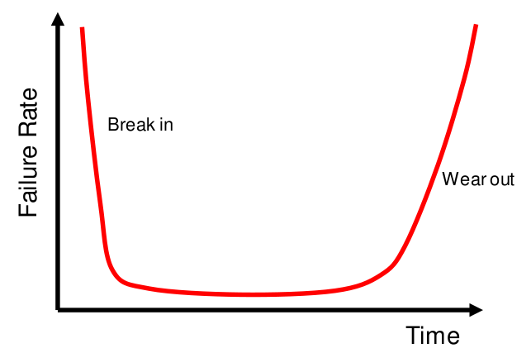
Hardware Failure
Gregory Gay CSCE 740 - Fall 2016 4
Notes:
All of these things have ramifications on the software we build, and you can really see it when we look at failure rates. Now, let’s start with hardware. Look at failure rates, where you plot failure rates on y axis and time on the x axis.
If you buy a piece of hardware. you kind of expect this kind of average failure rate - a bunch die right away - high failure rate at low values of time- then that dies down - low failure rates for some time - then a bunch die a few years later once they wear out - again, high failure rate at the end. Do you think the same thing happens with software? (discuss)
A software product is just not the same thing as a hardware product. It doesn’t work in the same manner. Failure rate expectations just don’t work in the same way.

Slide 5
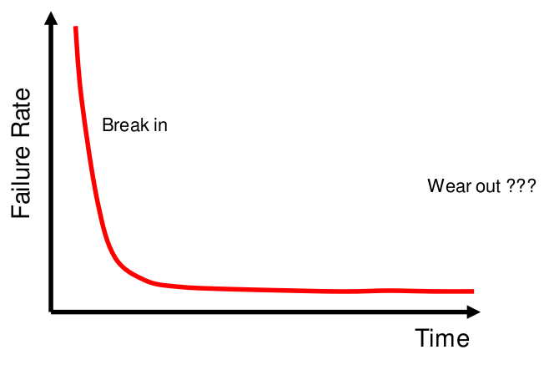
Software Failure
Gregory Gay CSCE 740 - Fall 2016 5
Notes:
Software is a bit different. With software, you kind of expect a similar starting failure rate - a lot of issues right away - high failure rate at low values of time- then that dies down and stays down once bugs are fixed. It’s software - it won’t wear down, right? Does this seem reasonable?

Slide 6
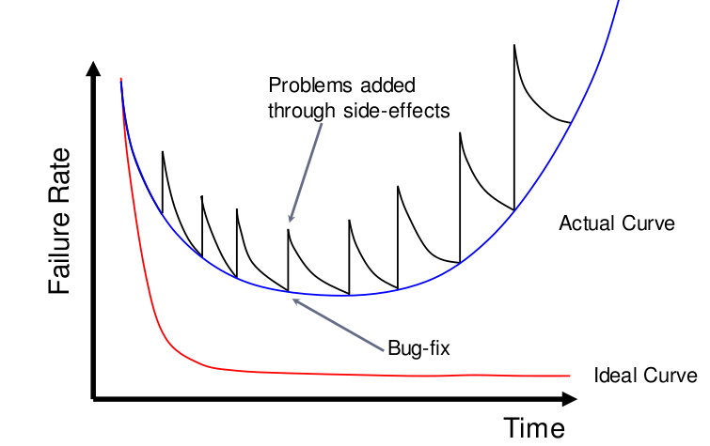
Software Failure
Gregory Gay CSCE 740 - Fall 2016 6
Notes:
Wrong. A more common - kind of a worst-case scenario - curve appears here in blue, and.. this tells you everything, doesn’t it? If you aren’t careful, software doesn’t gracefully curve, it yo-yos. You make changes, you break something, you fix bugs, and you inevitably break something else. It’s a never ending cycle of coding and fixing. Heck, even if you are careful, the world is out to get you - the OS will change, hardware will change. No matter what, it seems that the world is out to kill your software. In practice, software will break down over time as surely over hardware, and the ride to that point will be far from east. The actual failure rate curve is always escalating higher and higher as time passes. Now, this is obviously not ideal.

Slide 7
Prevailing Paradigm:
Code and Fix
Notes:
But that’s what we’re dealing with in all too many cases. The code and fix paradigm - build something, see what goes wrong, fix that, then see that something else has gone wrong. It’s a vicious cycle. WE need to escape from that. Now, this entire course is an overview of how you prevent this at each and every stage of development, but escaping this cycle starts before you write a single line of code, before you decide what features the software will have. Let’s begin at the beginning.

Slide 8
Life Cycle of Software
Any product - software included - has a life cycle: a timeline that can be split into the required phases of existence.
What are the phases of the software lifecycle?
Project Planning
Requirements Definition
Software Design
Implementation
Testing
Release
Operation and Maintenance
Gregory Gay CSCE 740 - Fall 2016 8
Notes:
To do that, we need to take a good look at the lifecycle of software
Any product - software included - has a life cycle - a timeline from conception to retirement that can be broken into several necessary phases. The things we need to do to bring the software to the public and things we need to do once it is out there.
(Discussion) - what are some of these phases? what is the life cycle of software?
can be broken down, but broadly: reqs, design, implementation, testing, release, operation/maintenance
Something is missing here - and this is part of the reason we often get in trouble.

Slide 9
The Need for Planning
Why do we get stuck in the code & fix loop?
We know the phases of the lifecycle. We know there are activities that must be performed:
Specification, Design, Coding, Testing, Evolution
Lack structure and guidance:
When are we done? When do we move on?
Activities must be planned and modeled if they are to be managed.
Gregory Gay CSCE 740 - Fall 2016 9
Notes:
Why do we get stuck?
We know the phases conceptually. We know there are activites that must be performed. These vary by domain and organization, but we know that at some point, we need to specify, design, validate or test, and evolve the system post-release. At some level we get this, but...
We lack structure - management often lacks technical chops - understanding of software - and aren’t sure how to guide the team. Developers not sure when they’re done - not sure when or how to move forward. Without answers to these questions, of course projects go off-track. Of course projects are late and over budget, of course they fail. We need structure.
Activities need to be modeled if they are to be managed - We need to follow a to-do list, a set of sets. Need organization and feedback.

Slide 10
Asking Questions
Development begins by asking questions.
Why is the system being developed?
What will be done?
When will it be accomplished?
Who is responsible?
Where are they located within the organization?
How will the job be completed (technically and managerially)?
How much of each resource is needed?
Gregory Gay CSCE 740 - Fall 2016 10
Notes:
(read). Before you start writing a design document, before you create a prototype, before you sign a contract, ask yourself and your team questions. Be able to answer those questions.
(read)
(read) What exactly are we delivering?
(read) What is our deadline?
(read)
(read) Where are you drawing employees from?
(read)
(read) Do you have the human resources to spare? The monetary budget?
Until you have a plan, unless you can answer these questions clearly and convincingly, you are at risk. Your project may go off the rails.

Slide 11
Risk Management
The principle task of a manager is to minimize (avoid or mitigate) risk.
The “risk” in an activity is a measure of the uncertainty of the outcome of that activity.
Risk is related to the amount and quality of available information.
What are the risk factors? What will be their impact? How likely are they to arise?
Gregory Gay CSCE 740 - Fall 2016 11
Notes:
The principle task of a manager - what almost every organizational activity works towards - is to minimize risk, either by avoiding or mitigating risk factors.
Risk in an activity is a measure of the uncertainty of the outcome of that activity. How much information do you have? The less information, the higher the risk.
When planning, you need to think about what risk factors you have, how likely they are to be an issue, and how severe of an impact those factors can have.
If you can’t answer those questions on the last slide, you introduce risk. You add another risk factor.

Slide 12
Defining a Process
Process: a flow of events that describes how something works.
In our case - defines a timeline of activities required to build software.
Structures who is doing what, when, and how.
Gregory Gay CSCE 740 - Fall 2016 12
Notes:
To mitigate risks, we need a process that we can use to structure the entire development of our product.
(Read)
(read)
Defines roles and responsibilities - (read)
Provide the organization we need, give guidelines on how to manage a project, ensure that schedule is met, and make sure that team members can communicate and know their responsibilities.

Slide 13

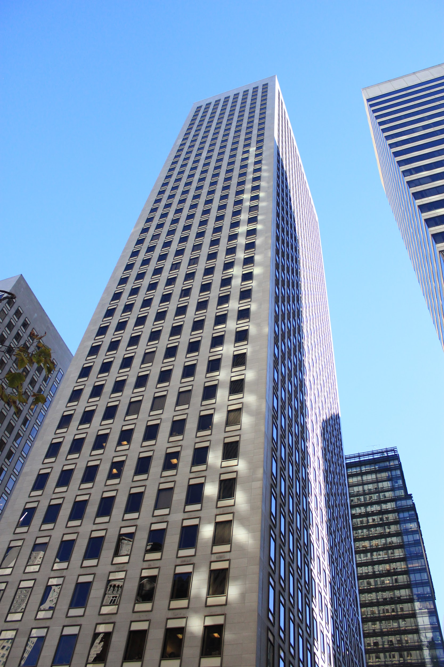
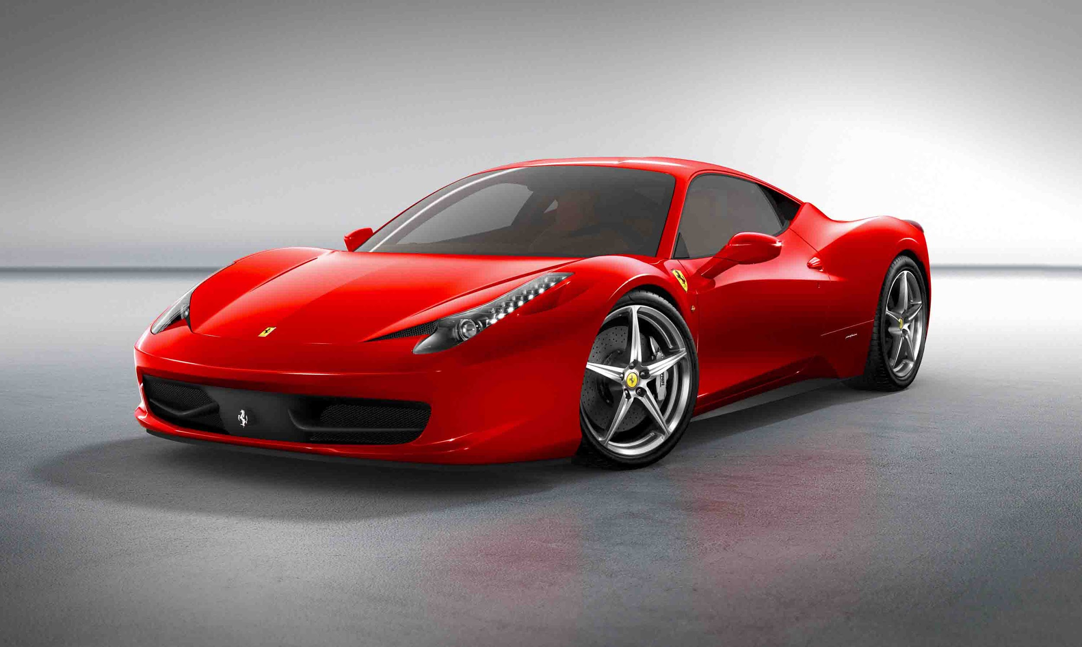
Typical Engineered Systems
What do these have in common?
Gregory Gay CSCE 740 - Fall 2016 13
Notes:
These are typical engineered systems. What do they have in common?
Built differently - different purposes, but they have a relatively similar lifecycle. They are planned - that is key. Before they are built, someone - maybe a team of people - sit down and plan out the whole life of the product - what blueprints will be followed, what it will look like, how it will be constructed, how we make sure it works properly, how it will be maintained once out in the world, and when and how it will be retired. These products are as different as they can be, but how they are built starts to look similar in the abstract, and there’s a reason for that. When we plan out engineered products, a failry natural lifecylce starts to appear. The design and manufacturing of each of these follows a process, and if you want to complete them sucessfully - with sound construction, on time, on budget - you need a process, you need to plan and manage development. Same for software, which is an engineered product just like these.

Slide 14
Risk Management
High-risk activities cause schedule and cost overruns.
A visible process provides the means to track, assess, and mitigate risk.
Processes provide quality and predictability by removing risk.
Gregory Gay CSCE 740 - Fall 2016 14
Notes:
bad stuff - read
This is key. A process gives you the tools to track, assess, and mitigate risk. Gives you knowledge of where you are in development, lets you plan and adjust your schedule, gives you foresight. There’s a bit of a who cares here - almost all of you will be developers/engineers, not managers, why does this matter? Well, this also empowers the engineer. You know what you’re doing, where you are in the timeline, what needs to be done, when you can expect feedback. That’s all really important stuff. No matter how good you are at coding or wriitng tests, unless you are proactive at organizing the development lifecycle - at planning for risks and understanding how to avoid them - the whole project can still go off the rails.

Slide 15
Engineering Process Model
Set of sequential, discrete phases:
Specification
Set out the requirements and constraints.
Design
Produce a paper model of the system.
Manufacture
Build the system.
Test
Check the system meets the specifications.
Install
Deliver the system to the customer.
Maintain
Repair faults over time.
Gregory Gay CSCE 740 - Fall 2016 15
Notes:
Most engineered products follow a sequential process, a series of discrete phases, where you define a set of tasks that must be completed before you move on.
Read these
Because of this structure, it is pretty easy to know where you are in the lifecycle, what comes next. As we’ll discuss, software can get a little more complicated, but this gives us a point of comparison. If you want to sucessfully engineer a car, you’ll define what it needs to do, design its physical structure, build a sample model, make sure it works, deliver more to stores, and fix issues that come up once they’re out in the wild. During each of these phases, you define tasks, you analyze risk factors, and you manage your budget and schedule. We can and should think about how to develop software following a similar set of activities and phases.

Slide 16
Software Process Models
Why is software different from other engineered products?
Specifications are often incomplete and vague (complex functionality, intangibility)
Blurred distinction between specification, design, and manufacture phases.
No physical realization of the system for testing.
Software does not wear out.
Gregory Gay CSCE 740 - Fall 2016 16
Notes:
At the same time, software is a little different, and we need to understand that to create software sucessfully. Why is software different?
-Specifications are often incomplete and anomalous (complex functionality, intangibility)
-Blurred distinction between spec, design, and manufacturing - in physical products, there is a very clear distinction between the specification of what you’re building, and a prototype or blueprint for the device, and then a prototype, then the actual device. Same for manufacturing - it’s pretty clear before you build whether you can build something. Software isn’t as clear at all for, again, reasons of complexity and even more - intangibility. It is hard to tell if you;ve laid out the right specifications until you have a clear blueprint of the system you’re going to build. You might do to design something, and figure out that you need to adjust the specs. Once you sit down to code the thing, you might again figure out that the design wasn’t quite optimal, or is infeasible, or that you forgot a constraint on the functionality or missed some crucial detail. Many of the phases of the lifecycle are not quite as distinct.
-There is no physical system to test. You might even want to weave testing into the manufacturing process and test modules as they are completed. You might start testing what you think is the final system only to discover that it isn’t as complete as you thought it was.
-Software doesn’t wear out in a traditional sense - maintenance doesn’t man component replacement, but generally is a continuation of testing, or revisiting manufacturing. Often software needs even more maintenance than physical goods - with a bridge, you generally don’t have to worry about the land it is connected to turning into water or lava. With software, you might find that the entire operating environment has changed.

Slide 17
Choosing a Process - Characteristics
What are characteristics of a good process?
Understandability
Is the process defined and understandable?
Visibility
Is the progress of the process externally visible?
Supportability
Can the process be supported by tools?
Acceptability
Is the process acceptable to those involved in it?
Gregory Gay CSCE 740 - Fall 2016 17
Notes:
Before we define some of these processes, let’s talk about what you should look for in one. One thing to consider are the characteristics of the process and how important those characteristics are to your organization.
What are some? (discussion, mention for software.. maintainability/readability/etc)
Is the process defined and understandable? Do you understand how to use it? how to apply it? the phases of it?
Is your progress externally visible. If the point is to mitigate risk by removing uncertainty about project completion, will we actually gain that certainty?
Are there tools that can help implement and track this process?
Do the developers want to use this process? If people aren’t on board, then it isn’t going to work

Slide 18
Process Characteristics
Reliability
Are process errors discovered before resulting in product errors?
Robustness
Can the process continue in spite of unexpected problems?
Maintainability
Can the process evolve to meet organizational needs?
Rapidity
How fast can the system be produced?
Gregory Gay CSCE 740 - Fall 2016 18
Notes:
if there is a problem in our process, can we ideintify and fix it before it causes product issues?
If there are problems in our process, can the process continue anyways?
If the needs of our organization change, can we evolve the process? What if we get an assignment that doesn’t exactly match the prescribed lifecycle of the process?
Does this process allow us to produce a system efficiently?

Slide 19
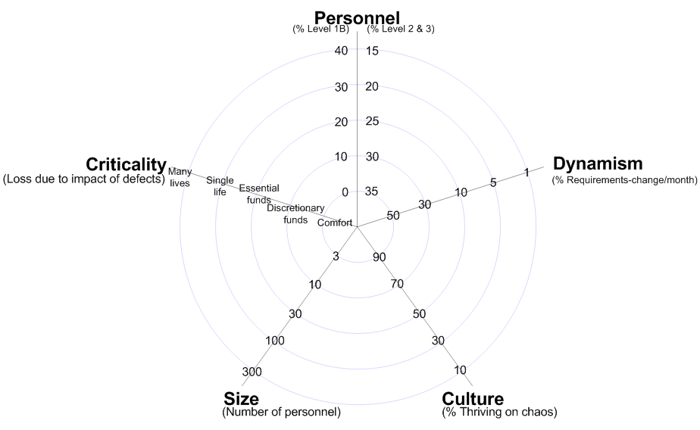
Considering Developmental Factors
Personnel
(% Junior, % Senior)
Plan-Driven Adaptable
Requirements Change
(% per month)
Criticality
(Loss due to defects)
Close to center = Adaptable
Code & Fix
Far from center = Plan-Driven
Team Size
(Number of Personnel)
Culture
(% Thrive on Chaos)
Gregory Gay CSCE 740 - Fall 2016 19
Notes:
Most processes can be plotted on a continuum between being heavily plan-driven - requiring long periods of planning - and being extremely adaptable - adjustable on the fly. Where your project falls on this continuum depends on the reality of your organization. Processes are not one-size-fits all, and Management needs to take into account both what your project is, but also what kind of team you’re working with.
In reality, this continuum isn’t a straight-line. This is often broken down into a five (or sometimes seven)-dimensional diagram where each access follows that continuum. The closer you are to the center, the more adaptable you can be, the further out, the more plan driven) Factors you need to consider include, clockwise from the top:
personnel makeup - how many are junior employees do you have, how many senior - the more junior, the more plan-driven you need to be. If you’re less experienced, it’s often harder to adapt to rapid change. You don’t have the domain knowledge, the mastery over the existing codebase.
requirments change - how much will the needs of the project change over time - if customers will come to you frequently and demand changes, you can’t spend more time planning - you need to adapt to meet the needs of the project. IF they don’t change often, you can spend time making sure you get the specs right
Culture - this one is a little more open to interpretation, but it essentially asks how well your employees perform pressure? if they do, you can be more adaptable
Team size - how many people are on the team? If it’s huge, you need to plan more, or people can’t communicate well - it’s hard to know who is working on what or where people stand.
Criticality - how bad will it be if something goes wrong? Will someone die? If so, you need a more plan-driven process. Could they lose money? Then you need to put some time into planning. If they might lose some replacable data, then that is less of a problem.
Your choice of process depends on where you stand on these factors. Code and fix is the ultimate adaptable choice - you don’t spend any real time on planning. This can work for small projects, small team sizes, low criticality, it really only works if you’re in the very center of this diagram. If any dimension is high, you need to consider a more plan-driven process.

Slide 20
Risk Identification
What are some risk factors to consider?
Technical Requirements
Are the requirements stable?
Design
Does the design depend on unrealistic assumptions?
Schedule
Do we depend on the completion of other projects?
Budget
How reliable are the cost estimates?
Gregory Gay CSCE 740 - Fall 2016 20
Notes:
A big factor to deal with when planning any process, but especially software, is risk. What can bring the whole ship down? How can we make that not happen? This is a huge part of the job of management in a company. They are there to guide the project, to figure out what the risks are, and to find ways to avoid them. Still, this is something worth discussing, because it impacts the engineers. Your life, as a developer, can be made easier or much, much harder depending on how well these risks are identified and averted, and as the pointy-haired manager doesn’t always have a technical background, you have a role to play in making him understand these risks. This is a factor to consider, too, in picking a process. How you develop the software should be one of the things that is tuned to the risks you expect to see while developing that software. So, what are some of the risk factors to consider and watch out for?
(discussion)
are the requirements stable? likely to change? how fickle is the client? are we sure we’re meeting their needs?
are we making sane assumptions?
how much time can we devote to the project? can we delay if we need to?
did we make a good estimation?

Slide 21
Risk Identification
What are some risk factors to consider?
Quality
Are quality considerations built into the design?
Work Environment
Do people cooperate and communicate?
Staff
Are we understaffed? Experience? Contractors?
Customer
Does the customer have realistic expectations?
Gregory Gay CSCE 740 - Fall 2016 21
Notes:
have we planned for maintainability, efficiency, and the like?
do people get along?
are we understaffed? do we have enough experienced staff? can we rely on any contractors?
does the customer understand what it will take to complete the project? will they allow delayed delivery?

Slide 22
Understanding Risk
Quantify the impact of risk factors:
What are the risk factors?
When will they occur?
(Ranked from 1 -Very Low - to 5 - Very High)
How likely are they to occur?
What is their impact?
How difficult are they to detect?
Gregory Gay CSCE 740 - Fall 2016 22
Notes:
To plan - to decide on a process or even set a budget or timeline, You need to identify and understand your risk factors, and you need to quantify their impact. You need to understand:
How likely they are
How much of an impact they will have
How difficult they will be to detect
When they can occur

Slide 23
Risk Factor Example
Nintendo has hired us to build Super Mario Bros 26. What are some of the risk factors?
Risk Factor | Likelihood | Impact | Phase
Level Design Breaks From Tradition | 3 | 2 | Design
Licensed Physics Engine Must Be Completed | 4 | 4 | Implementation
Client Requires November Release | 4 | 5 | All pre-release phases
User Backlash | 3 | 1 | Post-Release
Gregory Gay CSCE 740 - Fall 2016 23
Notes:
To give an example, let’s say we’re building Super Mario 26. What are some of the risk factors
explain table

Slide 24
Risk Severity Matrix
Likelihood
5
4
3
2
1
 |  |  | Physics Engine Incomplete | November Deadline
User Backlash | Level Design Breaks From Tradition
1 2 3 4 5
Impact
Gregory Gay CSCE 740 - Fall 2016 24
Notes:
To help you plan out the software lifecycle, you can take those risk factors and plot them on a risk severity matrix - a table where the cell chosen depends on the likelihood and the impact - with the row being chosen by the likelihood, and the column coming from the impact. You can then visualize the worst threats as those in the upper right corner, transitioning into moderate risk in the middle, and low risk on the lower left corner. This lets you prioritize risks by their severity. This kind of chart helps you mitigate risk throughout the entire process, but can also form the basis on which you choose a process. Is there a process that can help mitigate these risks?

Slide 25
Dealing With Risk
How can you deal with risk?
Mitigate risk
Reduce the likelihood or impact of an event.
Avoid risk
Change the plan to eliminate the risk entirely.
Transfer risk
Employ an external firm on a fixed-price contract.
Accept risk
Take a chance that a risk will not occur.
Gregory Gay CSCE 740 - Fall 2016 25
Notes:
We know the risks? How do you deal with these. For that, there are four basic courses of action.
Mitigate the risk. Either reduce the likelihood that it will occur or reduce the impact that will happen if it occurs. Most teams go for the first of those - try to make it unlikely that an event can occur. If you can’t, you need to look at how to reduce the impact. That can be very costly, but may be the only option
Change what you’re doing to avoid a risk altogether. Use proven technology, pay more to get supplies from stable companies.
Make someone else take on the risk. Employ a testing firm on a fixed-price contract. Downside is loss of control.
In some cases, the best repsonse is to simply accept a risk. For instance, it might be too expensive to eliminate certain risks - that a flood or earthquake will occur, so you just hope for the best
Your choice of process should tell you how to react to risks, or guide you towards certain options.

Slide 26
Choosing a Process
How do we choose a process?
Consider project characteristics.
Consider project risks and how they can be mitigated.
Determine the degree of rigor required.
Define a task set for each development phase.
Task set = {engineering tasks, work products that will be produced, quality assurance, schedule of project milestones}
Gregory Gay CSCE 740 - Fall 2016 26
Notes:
(read)
quality assurance - how we measure quality, when we check it

Slide 27
There is no one-size-fits-all software process.
Notes:
Engineered products generally follow a clearly-structured planned development process from conception to retirement. There is variation, but the phases of development have clearer separation, and the phases of lifecycle are very similar. The intangibility and complexity of software make it harder to structure the process. That said, we’re going to try. There are a bunch of software process models, and we’re going to discuss a few of them, along with the pros and cons of each. That said - this is your first case where the right answer isn’t always obvious, and you’re going to have to consider a bunch of factors before you decide what works for your project.

Slide 28
Code and Fix Model
Short, interleaved specification and design phases.
Interleaved implementation, testing, and maintenance phases.
Applicability
Useful for small, simple projects.
Allows faster time-to-market.
Potential Problems
Quality
Maintainability
Gregory Gay CSCE 740 - Fall 2016 28
Notes:
The typical code and fix paradigm is, in itself, a process. An informal one, absolutely, but the absence of a formal structure can, in itself, be talked about as an approach to development. It can be characterized by
- a short interleaved phase that combines specification and design
- Then, a long phase where you cycle through implementation, testing, and patching. Release generally occurs once you know the main functionality is in place - possibly after some amount of testing - but often makes use of extensive beta testing.
We’ve talked about how bad it can be, but it does have its place. Where is it applicable? What pros does it offer?
-useful for small, simple projects. you might not need extensive overhead from formality - don’t get much out of all of this planning. Faster time-to-market. Can respond faster to a changing market.
What are some problems?
-quality - if you don’t spend much time planning, you’re adding risk to the implementation phase - you might make more mistakes, miss important details. Might build something that isn’t what the customer wants
-maintainability - if you don’t plan for the ability to maintain your system, you’re at risk of building something that is hard to add new features to, and hard to fix. After several cycles of fixing bugs and bolting things on, this only gets worse.
Don’t recommend for most projects, but has its uses

Slide 29
The Waterfall Model
Adaptation of engineering process to software.
Only move on to another phase when the current phase is complete.
Requirements Definition
System Design
Implementation and Unit Testing
Integration and System Testing
Release and Maintenance
Gregory Gay CSCE 740 - Fall 2016 29
Notes:
The waterfall model is a sequential design process originates from the engineering process we talked about earlier, adapted to software. Each phase flows sequentially -progress is seen as flowing steadily downthe waterfall through the phases (read)
You only move to a new phase once another phase is done. In engineering, after-the-fact changes are prohibitively costly, if not impossible. Changes are never impossible in software, but the reasoning behind waterfall is that after-the-fact changes are bad - they are costly, they will cause problems. You need to make sure you have finished the current activity before starting the next. You must finish requirements, then design, then implementation, then integration. If not, you will make mistakes, you will end up with a poorly-developed system.

Slide 30
The Waterfall Model
Plan-Driven Adaptable
Benefits of Waterfall?
Spending more time on earlier phases prevents problems from being discovered later.
Brings discipline and structure.
Clear understanding of project progress.
Places emphasis on documentation.
Gregory Gay CSCE 740 - Fall 2016 30
Notes:
Waterfall is basically the ultimate plan-driven process
(discussion) where would waterfall be good?
problems are easier and cheaper to fix earlier in the development process.Spending more time in earlier phases like requirements elicitation allows you to discover issues earlier - problems with your planned requirements, mistakes in how you plan to implement functionality, poor design decisions. You can have more assurance that your system will operate safely.
Clearly structured, brings discipline to development - must work in a certain manner - you have clear milestones and development progresses linearly.
You know, fir instance, that you’ve devoted 50% of your time to requirements, 40% to design, and 10% so far on implementation. You know what phase you’re in.
Requirements will be detailed and understandable. Your design will have gone through several iterations, been well documented, and be clear to the whole team. This helps with personnel turnover too, as new team members can read the completed documents and quickly get up to speed.

Slide 31
Waterfall Model Task Set
Phase | Output Document
Product Conception | Feasibility Study
Requirements Definition | Requirements Document
System Specification | Functionality specification, acceptance test plan, draft of user manual
Architectural, Interface, and Detailed Design | Architectural, Interface, and Detailed Design Specifications. System, Integration, and Unit test plans
Coding | Source Code
Unit, Module, Integration, and System Testing | Testing Reports
Acceptance Testing | Final system and documentation
Gregory Gay CSCE 740 - Fall 2016 31
Notes:
The reason that I say that waterfall is the ultimate plan-driven process is because of the sheer amount of documentation it tends to produce. In its purest form, the Waterfall model calls for you to produce a series of reports - blueprints, documentation, plans - at each step of development. Each of these documents are inspected, and if they pass, then the development process can move on to the next stage. Some may see this as too much, but for certain types of projects, you want this level of insight, this level of planning and documentation.

Slide 32
Applicability
What type of projects should use Waterfall?
Projects where the requirements are stable.
Projects where impact of failure is severe.
Projects with high turnover or inexperienced developers.
Gregory Gay CSCE 740 - Fall 2016 32
Notes:
Where the requirements are unlikely to change. You have a clear goal, the functionality will not be expanded, and the legal environment will remain the same. Can you realistically produce a complete, verifiable requirements specification before design? correct design before implementation?
If the impact of failure is severe, you need a plan-driven process. If people could be hurt by your software, if there is serious financial risk, then waterfall is a safe process.
If you have many inexperienced developers, or expect a high turnover rate.

Slide 33
Problems
What are some problems with Waterfall?
It is hard to know when you are done with a phase.
Inflexible model that does not accommodate change.
Hard to respond to unexpected risk.
You rarely know all requirements that early.
Implementation details often emerge only during implementation.
Gregory Gay CSCE 740 - Fall 2016 33
Notes:
(discuss)
In practice, it’s hard to know when you are done with a development phase. Are the requirements truly done? No matter how much time you devote to a phase, you might still miss something.
You have little freedom to make changes to the project. Change is difficult at best. If you make a mistake and move on, it will be expensive and difficult to go back and change it.
If you don’t plan for something, you will have trouble responding a risk if it occurs
You rarely know your requirements for sure that early. Customers might change their mind,they might not know all of their needs yet.
Similarly, details and problems with implementation are almost impossible to know for sure until you try to implement the software.

Slide 34
Some Other Process Models
Evolutionary Development
Specification and development are interleaved in evolving series of prototype builds.
Spiral Model
Based on cycles where you identify objectives, alternatives, and constraints.
Incremental Development
Deliver your system in small, planned increments (one working feature per release).
Gregory Gay CSCE 740 - Fall 2016 34
Notes:
Some other models that we’ll talk about include (read)

Slide 35
Activity
You are involved in the development of a new software product. The product is an insurance application intended to determine what insurance products a potential customer is eligible for. The eligibility requirements are captured in various laws and regulations. You have a team of 15 developers, about 33% of which were newly hired for this project. Half of the team members have experience with projects that required adaptability. Your organization has hired a contractor to perform all levels of testing - the contractor has retained the ability to request additional funds to license additional testing tools.
Your organization has chosen the waterfall model as their development process. The product will be long-lived and good documentation is a must. In addition, the existing laws and regulations were thought to constitute a good start for the requirements of the project.
Gregory Gay CSCE 740 - Fall 2016 35

Slide 36
Activity - Risk Severity Matrix
Likelihood
5
4
3
2
1
 |  | Contractor requires more funds
 |  | Inexperience leads to defects |  | Testing misses defects
 |  |  |  | Laws are incomplete or ambiguous
 |  |  | Laws change
1 2 3 4 5
Impact
Gregory Gay CSCE 740 - Fall 2016 36
Notes:
Don’t worry if yours doesn’t match mine - this is your judgement at work

Slide 37
Activity - Developmental Factors
Personnel
(% Junior, % Senior)
Criticality
(Loss due to defects)
Requirements Change
(% per month)
Team Size
(Number of Personnel)
Culture
(% Thrive on Chaos)
Gregory Gay CSCE 740 - Fall 2016 37
Notes:
some of these I gave you, some were up to your intuition.
also discuss whether good to use waterfall here?

Slide 38
We Have Learned
Understanding and mitigating risk factors.
What is a process?
How we choose a process:
Desired Qualities
Organizational Factors
Risk Mitigation Potential
The Waterfall Model
Separate and distinct phases of specification and development.
Gregory Gay CSCE 740 - Fall 2016 38

Slide 39
Next Time
Agile processes
Plan your team selection!
Reading:
Paper: Embracing Change with Extreme Programming (on Moodle)
Gregory Gay CSCE 740 - Fall 2016 39

