Slide 1
Developing Requirements-Based Tests
CSCE 740 - Lecture 8 - 09/13/2016

Slide 2
Partitioning
Functional testing is based on the idea of partitioning.
You can’t actually test individual requirements in isolation.
First, we need to partition the specification and software into features that can be tested.
Not all inputs have the same effect.
We can partition the outputs of a feature into the possible outcomes.
and the inputs, by what outcomes they cause (or other potential groupings).
Requirement Specification
?
Test Cases
Gregory Gay CSCE 740 - Fall 2016 2
Notes:
Ultimately, we need to arrive at are concrete test cases that we can execute on the software. So, to arrive at test cases, we need to solve two problems, which we do through the idea of partitioning the option space.
The first is that (read). A requirement isn’t necessarily a function you can call - it’s just something the software needs to do while operating. So, our test cases need to actually be expressed in terms of features of the software.
We need to identify what features of the software we can test in isolation and in combination, link those features back to the requirements, and assign inputs and formulate expected outputs.
That leads to the second problem- not all inputs have the same effect. Some might draw out faults, others won’t. Some will lead to different outcomes than others. So, that’s the second layer of partitioning.
(read 5-6)

Slide 3
Creating Requirements-Based Tests
Write Testable Specifications
Produce clear, detailed, and testable requirements.
Identify Independently Testable Features
Figure out what functions can be tested in (relative) isolation.
Identify Representative Input Values
What are the outcomes of the feature, and which input classes will trigger them?
Generate Test Case Specifications
Identify abstract classes of test cases.
Instantiate concrete input/output pairs.
Generate Test Cases
Gregory Gay CSCE 740 - Fall 2016 3
Notes:
Last time, we started talking about how you take the requirements, derive test cases, and use those to both refine the requirements and test the actual software. I flashed this process. Last time, we talked about how you had to
Write and refine your requirements until they are testable. Make sure they are quantified and clear.
You can’t usually test the requirements directly. There isn’t a requirement 1 button in your software in most cases. So, to actually test, we need to use the features that the software offers. You need to figure out what the independently testable features of your system are. What features or functions can be tested in isolation, what their parameters are, and how those parameters are used. That will get you in good shape for crafting the actual test cases. That’s where we left off. Today, we’ll look at
For each of those features, what are the possible outcomes - good, alternative, and exception paths - and what kind of input will trigger them.
Usually, requirements-based testing techniques produce abstract test case specifications that identify classes of test cases.
Then, instantiate the specifications to produce individual test cases with concrete input and expected output pairings.

Slide 4
Today’s Goals
How to define and select requirements-based tests
Choosing representative input values.
Creating abstract test case “specifications”
Filling in the concrete input values.
Gregory Gay CSCE 740 - Fall 2016 4
Notes:
Today, we’re going to go more in-depth on how you define requirements-based tests that you can use now to refine the requirements, and later to test the system - to ensure it works and provide evidence for verification. (read)

Slide 5
Calculator Requirement
Requirement 7.63: Divide-By-Zero
When a 0 is provided as input, it should be intercepted. Division-by-zero indicates an unsolvable expression.
Any problems?
Input to what? Anything?
Intercepted?
Gregory Gay CSCE 740 - Fall 2016 5
Notes:
Let’s review a little. Say we have this requirement. (read and discuss)

Slide 6
Calculator Requirement (Take 2)
Requirement 7.63: Divide-By-Zero
When a 0 is provided as input as the divisor in any use of the division function, the software shall issue an error message indicating that this is an unsolvable expression.
What are the independently testable features of a calculator?
What are the parameters of the division feature? Their characteristics?
How would you test that this requirement is fulfilled?
Gregory Gay CSCE 740 - Fall 2016 6
Notes:
walk through requirement, better?
go through and discuss questions.
characteristics - dividend and divisor

Slide 7
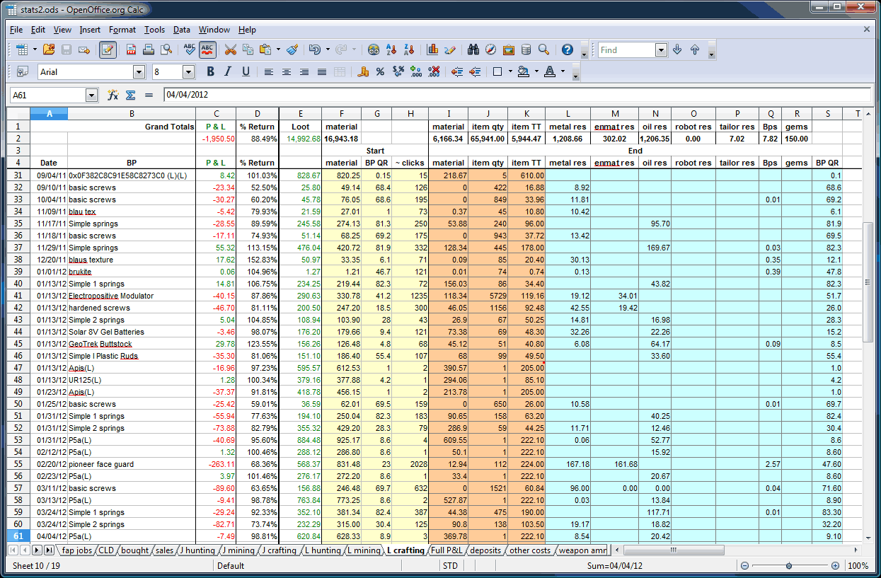
Independently Testable Features
What are three independently testable features of a spreadsheet?
Gregory Gay CSCE 740 - Fall 2016 7
Notes:
Let’s try a slightly less obvious one. Take a spreadsheet. What are three independently testable features of a spreadsheet? (discuss)

Slide 8
Identifying Representative Values
We know the features. We know their parameters.
What input values should we pick?
What about exhaustively trying all inputs?
Test Input Data
Program
Test Output Results
Gregory Gay CSCE 740 - Fall 2016 8
Notes:
(read) The next step, obviously, is to come up with the input to those parameters. If we want to test the software, we should prod the system so we can see what it does.
What values should we pass in? What would you do? (discussion)
How about we try every input? (discuss)

Slide 9
Exhaustive Testing
Take the arithmetic function for the calculator:
add(int a, int b)
How long would it take to exhaustively test this function?
2³² possible integer values for each parameter.
= 2³² x 2³² = 2⁶⁴ combinations = 10¹³ tests.
Test Input Data
Program
1 test per nanosecond
= 10⁵ tests per second
= 10¹⁰ seconds
Test Output Results
or… about 600 years!
Gregory Gay CSCE 740 - Fall 2016 9
Notes:
Let’s take that calculator again and just look at addition. Let’s just restrict the numbers to integers. If we wanted to exhaustively test this, how long would it take? How many inputs are we talking about?
- (read) That’s a lot right, how long we talking about time wise?
- let’s be generous and say we can run a test per nanosecond. That works out to about 10^5 tests per second, or 10^10 seconds overall. That doesn’t sound bad in seconds, but how long is that?
- (read). That’s for something as simple as addition of two integers. That’s insane, right?

Slide 10
Not all Inputs are Created Equal
We can’t exhaustively test any real program.
We don’t need to!
Some inputs are better than others at revealing faults, but we can’t know which in advance.
Tests with different input than others are better than tests with similar input.
Test Input Data
Ie
Program
Test Output Results
Oe
Gregory Gay CSCE 740 - Fall 2016 10
Notes:
We can’t exhaustively test any real program. You just can’t. Addition is the bottom of the barrel in terms of complexity. Most individual features will have quadrillions of inputs at least. Exhaustive testing just isn’t going to work out. Fortunately, you don’t need to. The fact is that not all inputs are as useful as others.
Purely from the verification perspective, there are only so many outcomes of a function, and you’ll have a lot of inputs that lead to the same outcomes. Why use all of them? We can cut that down some.
Then, fundamentally, testing is really something we do to find problems, and some inputs are going to be better than others and revealing those problems. We want those inputs.
Sadly, we don’t know which tests will reveal faults until we run them. At this point, we may not even have code, just our requirements if we start coming up with tests early. But, as a start, we know that two tests with inputs that are very different from each other are more likely to reveal faults than two tests with very similar input.
- Say you can select three tests for a program that breaks a text buffer into lines of 60 characters each. We select tests with a 40 character string and a 30 character string. Then, for a final test, we use a 100 character string. We can’t prove the 100 character buffer is a better test, but we would be more suspicious of a set of tests that is biased towards lengths less than 60. That’s a start, we’re covering a wider range of the input space. You’re more likely to hit a different outcome of a function or some weird corner case that is likely to break the whole thing..

Slide 11
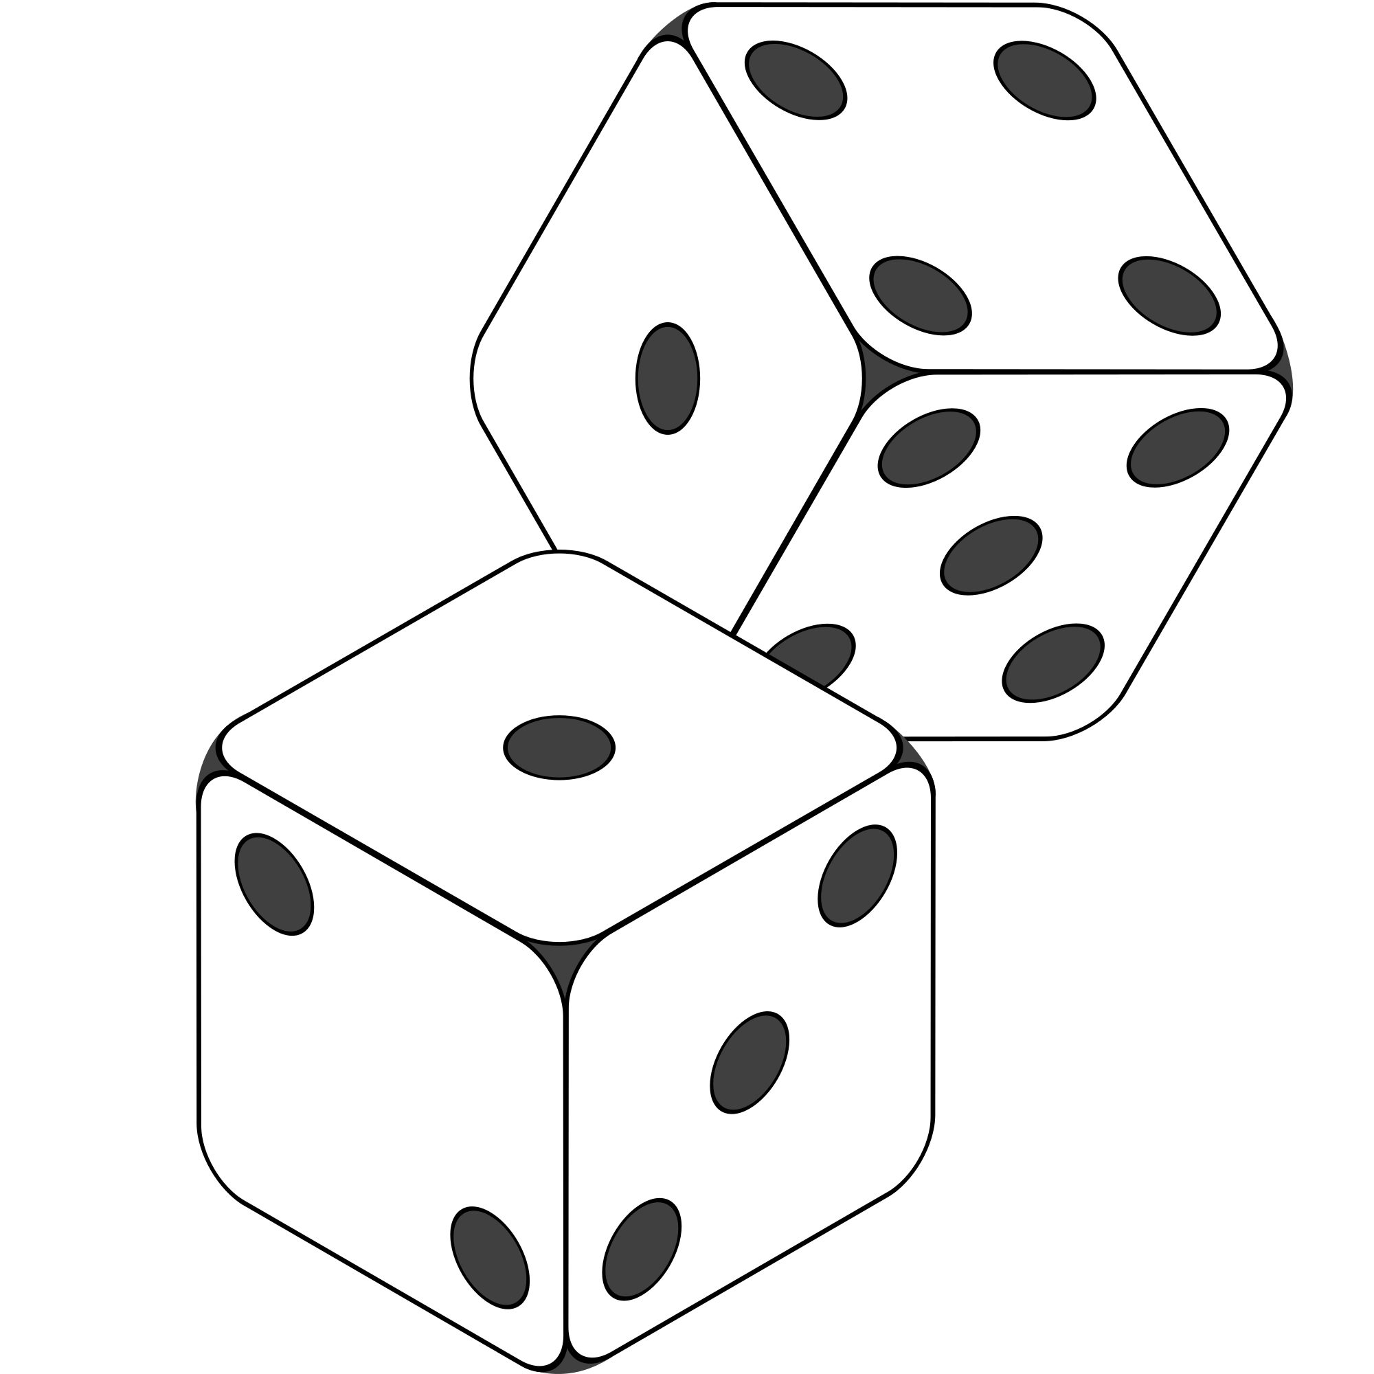
Random Testing
Pick inputs uniformly from the distribution of all inputs.
All inputs considered equal.
Keep trying until you run out of time.
No designer bias.
Removes manual tedium.
Gregory Gay CSCE 740 - Fall 2016 11
Notes:
- So, we don’t want to test exhaustively, but we do want to hit a good span of the input space. How about we try a random sampling?
- Let’s just consider all inputs equal and try different ones until we run our of time. This avoids bias, and is cheap - we don’t need to spend all of this time coming up with tests by hand - just spam the system with input. If it’s cheap to run tests, than we can just keep trying until we uncover bugs or run out of time.

Slide 12
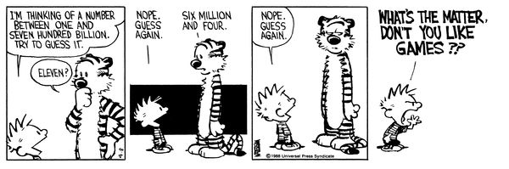
Why Not Random?
Gregory Gay CSCE 740 - Fall 2016 12
Notes:
(discuss)
*can be* useful doesn’t mean it usually is. Random testing is way too naive for the kind of input space you see in most software. You’re basically hoping to get lucky. Even if you generate thousands of random tests, you’ve only covered a tiny set of those possible inputs, and even worse, you’re likely repeating work. There’s no guarantee that you have chosen different inputs, you mgiht have hundreds clustered in a small corner of that space. Best case scenario is that we have a decent randomization strategy. If we can ensure enough diversity in input, we can at least try a lot of different things. But, still. this is what you do in the absence of a plan, pray and try something.
So, how do we find those faults, those needles in the haystack?

Slide 13
Input Partitioning
Faults are sparse in the space of all inputs, but dense in some parts of the space where they appear.
Test Input Data
Ie
Program
By systematically trying input from each partition, we will hit the dense fault space.
Test Output Results
Oe
Gregory Gay CSCE 740 - Fall 2016 13
Notes:
-The next step is to take a good, long look at that input space.
- In truth, faults are pretty sparse in the input space as a whole, but they are dense in the part of the input space in which they appear.
- In practice, you can almost always divide the input space into partitions - into logical group of inputs based on some criteria - maybe based on the outcome they’ll trigger. The thing is, if we do a good job of partitioning, and we come up with an input that lands in a space dense with faults, then we’re in good shape.
-This goes back to something I touched on a few minutes ago. We should - a a general strategy - favor different input over similar input. That’s a key idea. Try two very different things and you’re more likely to trigger a fault than trying two very similar things. Even more so if we put some thought into where those inputs come from. if we systematically go through and try a few inputs from each of those partitions, we are more likely to hit a a larger range of different results than just randomly trying input. If a feature can result in different outcomes, we’re more likely to hit all of those by braking the input space down along the lines of which outcomes are triggered, and as a result, we’re way more likely to hit that space where faults are dense and trigger a few of them. By incorporating human knowledge, you can make sure that the tests actually cover a representative portion of that input space.

Slide 14
Equivalence Class
We want to divide the input domain into equivalence classes.
Inputs from a group can be treated as the same thing (trigger the same outcome, result in the same behavior, etc.).
If one test reveals a fault, others in this class (probably) will too. In one test does not reveal a fault, the other ones (probably) will not either.
Perfect partitioning is difficult, so grouping based largely on intuition, experience, and common sense.
Gregory Gay CSCE 740 - Fall 2016 14
Notes:
So, by partitioning the input domain, we can then form a set of equivalence classes - tests that are essentially interchangeable. An equivalence class of tests essentially test the same scenario - they give you the same outcome, they trigger the same behavioral pattern, same usage of a feature.
-(read reveal)
-So, we want to come up with tests from each of the possible classes. Perfect partitioning of tests is hard, but we try our best with a combination of intuition, experience, and common sense.

Slide 15
Example
substr(string str, int index)
What are some possible partitions?
index < 0
index = 0
index > 0
str with length < index
str with length = index
str with length > index
...
Gregory Gay CSCE 740 - Fall 2016 15
Notes:
(discuss), both variables
think about the outcomes, and how the variables work together to influence the outcome.
-bring in and walk through
Let’s go over some strategies.

Slide 16
Choosing Input Partitions
Look for equivalent output events.
Look for ranges of numbers or values.
Look for membership in a logical group.
Look for time-dependent equivalence classes.
Look for equivalent operating environments.
Look at the data structures involved.
Remember invalid inputs and boundary conditions.
Gregory Gay CSCE 740 - Fall 2016 16
Notes:
A few of these include:
-Look for ranges of numbers or values - what are the different discrete ranges of input values that can be provided?
-Look for membership in a logical group - Can we group these inputs based on how their used, what context the method uses them in, do member of this group trigger similar behavior?
-Look for time-dependent classes - does the timing of input matter to particular groupings?
- (read) - some data structures, such as arrays, can be broken down into common groupings of input.
- (read) Can you group based on the output event that occurs?
- (read) the operating environment might influence system behavior
-(read)

Slide 17
Look for Equivalent Outcomes
It is often easier to find good tests by looking at the outputs and working backwards.
Look at the outcomes of a feature and group input by the outcomes they trigger.
Example: A graphics routine that draws lines on a canvas. Outcomes include:
No line
Thin, short line
Thin, long line
Thick, short line
… etc.
Gregory Gay CSCE 740 - Fall 2016 17
Notes:
First thing to do is start from the output, divide the output into the different outcomes I can get - then try to come up with input that produces those outcomes.
(read rest)

Slide 18
Look for Ranges of Values
If an input is intended to be a 5-digit integer between 10000 and 99999, you want partitions:
<10000, 10000-99999, >100000
Other options: < 0, max int, real-valued numbers
You may want to consider non-numeric values as a special partition.
Gregory Gay CSCE 740 - Fall 2016 18
Notes:
When dividing input into input partitions, it is natural to look for how you could split the values of inputs into discrete ranges. Any value from a particular input range should have the same effect.
(read)
You want to hit a typical value, something from the expected range, then hit cases that fall outside of the expected range
(read partitions)
Some other options to consider include those weird corner cases likely to trigger issues - a negative value - those can have strange effects, the maximum sized integer, or a real-valued number. Something with a decimal in it. See how that gets rounded (or if it breaks something, or if error handling code kicks in)
May also want to consider non-numeric values as a special partition. Can you pass in a string, character, array, pointer? What happens when you do?

Slide 19
Look for Membership in a Group
Consider the following inputs to a program:
The name of a valid Java data type.
A letter of the alphabet.
A country name.
All make up input partitions.
All groups can be subdivided further.
Look for context that an input is used in.
Gregory Gay CSCE 740 - Fall 2016 19
Notes:
(read) - idea is that there is context behind how a program uses inputs. Often ,you have different logical groups in mind when you come up with a feature. Why not break up inputs into these logical groupings?
(read rest - these groupings are often too broad at first, but can we break those into smaller subgroups?
data type - what about into numeric primitives and text-based ones? ints, float, double, etc and character, string.
alphabet - letter a-f, g-p, q-z.. or usage frequency in the english language
country name - groupings of countries - by continent or membership in US/EU/other political bodies.
(Depends on the needs of your program, but you can almost always break an input or output into logical groupings based on what it represents)

Slide 20
Timing Partitions
The timing and duration of an input may be as important as the value of the input.
Very hard and very crucial to get right.
Trigger an electrical pulse 5ms before a deadline, 1ms before the deadline, exactly at the deadline, and 1ms after the deadline.
Push the “Esc” key before, during, and after the program is writing to (or reading from) a disc.
Gregory Gay CSCE 740 - Fall 2016 20
Notes:
(read)
(read) very hard, but also something that can be very important. For many systems, the timing of an input is an unstated input. If timing matters, you need to remember that it is part of the input, and partition it accordingly.
For example, consider a pacemaker - looking for electrical impulses from the heart. (read)
Or, in a more common scenario, even on a personal computer, strange behaviors can happen when reading from a file or writing out to a file, try (read)

Slide 21
Equivalent Operating Environments
The environment may affect the behavior of the program. Thus, environmental factors can be partitioned and varied when testing.
Available memory may affect the program.
Processor speed and architecture.
Try with different machine specs.
Client-Server Environment
No clients, some clients, many clients
Network latency
Protocols (SSH vs FTP, HTTP vs HTTPS)
Gregory Gay CSCE 740 - Fall 2016 21
Notes:
Similar to timing, the environment that the program operates in can easily impact the behavior of the program. Thus, the environment can also be considered when forming behavior partitions. Consider the environment you’re operating in, how it can influence the input or output of the system, and how the combination of both program inputs and environmental variation can be partitioned.
Memory may cause problems. What if you don’t have enough? What if you have enough physical memory, but not enough free (or not enough birtual memory)
Same for processor speed or architecture. Could see race conditions, deadlock between processes, unexpected slowdown.
Try using different machine specs and vary both the processor and memory. Those choices suggest different partitionings.
Client-server environment can have huge impacts on the operation of the system.
try with different numbers of connections to clients - none, some, many (DDOS conditions)
network latency - can vary network equipment or speed
communication protocols - options for a file uploads, server requests , try each that you might support.

Slide 22
Data Structure Can Suggest Partitions
Certain data structures are prone to certain types of errors. Use those to suggest equivalence classes.
For sequences, arrays, or lists:
Sequences that have only a single value.
Different sequences of different sizes.
Derive tests so the first, middle, and last elements of the sequence are accessed.
Gregory Gay CSCE 740 - Fall 2016 22
Notes:
(read)
(read) Programmers naturally think of sequences as made of up several values and it’s common to embed this assumption into the program. If presented with a single-value sequence,the program might fail.
(read) Decreases the chances that a bad program will accidentally give you a good output because of a particular input choice.
(read) This will reveal problems at partition boundaries.

Slide 23
Do Not Forget Invalid Inputs!
Likely to cause problems. Do not forget to incorporate them as input partitions.
Exception handling is a well-known problem area.
People tend to think about what the program should do, not what it should protect itself against.
Take these into account with all of the other selection criteria already discussed.
Gregory Gay CSCE 740 - Fall 2016 23
Notes:
Situational, but.. (read)
read, even if you’ve included some error-handling code, test all possibilities - you’ve probably forgot some corner case
(read). We try to nail the functionality - it must perform this function, if everything goes to plan. We don’t spend as much time on the exceptional cases - on protecting the program from bad input.
so, in addition to the other criteria - group membership, timing, operating environment, take invalid input into account. Make sure you pass in malformed input when testing, and consider different types of bad input as additional equivalence classes on top of your partitioning of the valid input domain.

Slide 24
Input Partition Example
What are the input partitions for:
max(int a, int b) returns (int c)
We could consider a or b in isolation:
a < 0, a = 0, a > 0
We should also consider the combinations of a and b that influence the outcome of c:
a > b, a < b, a = b
Gregory Gay CSCE 740 - Fall 2016 24
Notes:
(discussion) (read)

Slide 25
Creating Requirements-Based Tests
For each independently testable feature, we want to:
Identify the representative value partitions for each input or output.
Use the partitions to form abstract test specifications for the combination of inputs.
Then, create concrete test cases by assigning concrete values from the set of input partitions chosen for each possible test specification.
Identify Representative Values
Generate Test Case Specifications
Generate Test Cases
Gregory Gay CSCE 740 - Fall 2016 25
Notes:
So, for each independently testable feature, we want to:
identify the representative values for each input. For each input, we want to be able to chop up the input space into different groupings.
So, we have each individual input partitioned. For tests, we feed in a combination of inputs. Not just a value for one, but a value for all inputs of a function. So, you form all of the possible combinations of partitions for the set of inputs to get your set of abstract test specifications.
(read)

Slide 26
Equivalence Partitioning
Feature insert(int N, list A).
Partition inputs into equivalence classes.
int N is a 5-digit integer between 10000 and 99999. Possible partitions:
<10000, 10000-99999, >100000
list A is a list of length 1-10. Possible partitions:
Empty List, List of Length 1, List of Length 2-10,
List of Length > 10
Gregory Gay CSCE 740 - Fall 2016 26
Notes:
So, in coming up with equivalence partitions for inputs or outputs, you need to think about what exemplifies the space of inputs. You want to make sure you hit the types of input that can be passed in.
For example (read)

Slide 27
From Partition to Test Case
Choose concrete values for each combination of input partitions: insert(int N, list A)
int N
list A
Test Specifications:
insert(< 10000, Empty List)
insert(10000 - 99999, list[1])
insert(> 99999, list[2-10])
etc
Test Cases:
insert(5000, {})
insert(96521, {11123})
insert(150000, {11123, 98765})
etc
< 10000
10000 - 99999
> 99999
Empty List
List[1]
List[2-10]
List[>10]
Gregory Gay CSCE 740 - Fall 2016 27
Notes:
Now, we have the representative values for the individual inputs. For our test, we want to combine those. We don’t just pass in values to a single input. We pass in values to all inputs at once. To form our test specifications, our list of test types, we need to list out all of the possible combinations of input partitions for all inputs. For example,
(read)
then, we can create concrete test cases by assigning values to each abstract specification
(read)

Slide 28
Identify Constraints Among Choices
Test specifications are formed by combining partitions for all inputs of a feature.
Number of possible combinations may be impractically large, so:
Eliminate impossible pairings.
Identify constraints that can remove unnecessary options.
From the remainder, choose a practical subset.
(called “category partition testing”)
Gregory Gay CSCE 740 - Fall 2016 28
Notes:
-(read). So, at the base level, the number of possible test specifications is the cartesian product of representative values for all variables.
-Now, the number of combinations grows exponentially as the number of variables and equivalence classes grows. For a simple system with five inputs and six values for each, the raw number of test specifications is 6^5, or 7776. Which, is an insane number of tests for a simple system. That’s still not going to happen.
- That said, we still don’t need all of those. Many of those combinations may not even be possible, so you want to eliminate any combinations that are impossible
- identify constraints that can be used to remove unnecessary combinations
- and from the remainder, choose a practical subset to examine the system.
- (read)

Slide 29
Identify Constraints Among Choices
Three types of constraint:
IF
This partition only needs to be considered if another property is true.
ERROR
This partition should cause a problem no matter what value the other input variables have.
SINGLE
Only a single test with this partition is needed.
Gregory Gay CSCE 740 - Fall 2016 29
Notes:
There are three types of constraints that we can define to reduce the number of pairings.
-read - for instance, you might inlcude input from one partition only if a particular partition is used for another input variable.
-read, so we don’t need every combination of other partition for the other variables with this one. Just one test with this error-inducing partition should do for us.
- Single is similar to error, but more general purpose. A partition is special, unusual, or irrelevant, so we only want to bother with it once. We don’t need every combination of other inputs with this partition. We just need one test that uses this particular partition and we can move on.

Slide 30
Constraint Example - Split
substr(string str, int index)
Str length Input index
length 0 value <0
length 1 value = 0
length >= 2 value = 1
Str contents
contains special characters value > 1
contains lower case only value = MAXINT
contains mixed case
PROPERTY zeroLen
ERROR
if !zeroLen
if !zeroLen
SINGLE
if !zeroLen
Gregory Gay CSCE 740 - Fall 2016 30
Notes:
Let’s take split again, and for each input, we have some partitions (read through). str - combine from the length constraints and contents choices.
What are some of the constraints we can try applying? (discuss)
- prop/if read
- error
- single - this one is unusual, but shouldn’t result in an error. We only really need to try it out once. It should execute and work, maybe slowly, but it should still work out. So, let’s jsut try it once

Slide 31
Constraints Example - Computer Customization
Model
Model number
malformed [error]
not in database [error]
valid
Number of required slots
0 [single]
1 [property RSNE] [single]
many [property RSNE], [property RSMANY]
Number of optional slots
0 [single]
1 [property OSNE][single]
many [property OSNE], [property OSMANY]
Product Database
Number of models in database
0 [error]
1 [single]
many
Number of components in database
0 [error]
1 [single]
many
Components
Correspondence of selection with model slots
omitted slots [error]
extra slots [error]
mismatched slots [error]
complete correspondence
Number of required components with non-empty selections
0 [if RSNE] [error]
< number required [if RSNE] [error]
= number required [if RSMANY]
Number of optional components with non-empty selections
0
< number optional [if OSNE]
= number optional [if OSMANY]
Selected components for required (optional) slots
some default [single]
all valid
>= 1 incompatible with slot
>= 1 incompatible with another component
>= 1 not in database [error]
Gregory Gay CSCE 740 - Fall 2016 31
Notes:
let’s walk through these
- So, the label error means that this is a value that only needs to be tried once when combined with the other non-error values of other parameters. No matter the combination, if you have this choice set, you get an error - so that right off the bat wipes out a lot of combinations. (walk through these). With these error labels, we get down to 2711 test specifications from 314928. Huge impact right there.
This still leaves a large number of test specifications to try, more than we may need or have budget for, so let’s see if we can get this down further. Some combinations might not be erroneous, but might only be useful or valid in combination with certain other choices. For example, the number of non-empty choices of required components > 0 doesn’t make sense if the number of required components is 0.
-So, that’s where properties and if-constraints come in. The property identifies a constraint. In this case, RSNE indicates that there is one or more required slots. Any situation where 0 isn’t the number of required slots.
-Similarly, we can mark properties on the number of optional slots.
- Now, the if-property contraints state that if a choice is only valid if that property is true. So, the choice of having fewer non-empty required slots than is required is only valid if there are 1 or more required slots. That just makes sense. These if-properties can be used to eliminate invalid combinations (point at rest). These if-properties reduce us again down to 1811 possible test specifications.
- Then, the single constraint acts like the error constraint. This is a situation that isn’t meant to be an error case, but is something rare that doesn’t need to be tried in every configuration - you just want to cover it once to make sure nothing is weird with it. This is how you normally treat boundary value conditions - they shuldn’t fail, but you need to try them - like a database with a single model in it or 0 required slots or a configuration that mixes default and non-default components. You want to try them, but don’t need to try every combination, so any one test will do. These single constraints take us from 1811 tests down to 67 - a very reasonable number to create. Our next technique can drop that even further.

Slide 32
Generate Test Cases
substr(string str, int index)
Specification:
str: length >=2, contains special characters
index: value > 0
Test Case:
str = “ABCC!\n\t7”
index= 5
Generate Test Case Specifications
Generate Test Cases
Gregory Gay CSCE 740 - Fall 2016 32
Notes:
Now, we have our set of test case specifications. We have all these abstract combinations of input types we want to try. Now, we need to transition to concrete test cases, where we feed in actual values. This is a simple instantiation of these test specifications. There are still a few things to keep in mind, though. For one - there is a reason we do both the specifications and concrete cases, which is that if you feed in multiple tests with the same specification, only one of them might still actually trigger a fault in the code.

Slide 33
Boundary Values
Basic Idea:
Errors tend to occur at the boundary of a partition.
Remember to select inputs from those boundaries.
Gregory Gay CSCE 740 - Fall 2016 33
Notes:
Now, no matter how you chop up the input partitions, the most errors tend to occur at the boundaries of those divisions. So, in choosing concrete values, don’t forget to try out those wrird corner cases.

Slide 34
Choosing Test Case Values
Choose test case values at the boundary (and typical) values for each partition.
If an input is intended to be a 5-digit integer between 10000 and 99999, you want partitions:
<10000, 10000-99999, >100000
0
5000
9999
100000
150000
max int
10000
50000
99999
Gregory Gay CSCE 740 - Fall 2016 34
Notes:
(read)

Slide 35
Activity: MEAT Partitioning
Consider the MEAT system you are designing for your homework.
What are the independently testable features of MEAT?
Choose one - how would you partition the input domain? Define the inputs and outputs for at least one of the independently testable features and identify partitions for each input.
Gregory Gay CSCE 740 - Fall 2016 35
Notes:
(read)
read, even if you’ve included some error-handling code, test all possibilities - you’ve probably forgot some corner case
(read). We try to nail the functionality - it must perform this function, if everything goes to plan. We don’t spend as much time on the exceptional cases - on protecting the program from bad input.
so, in addition to the other criteria - group membership, timing, operating environment, take invalid input into account. Make sure you pass in malformed input when testing, and consider different types of bad input as additional equivalence classes on top of your partitioning of the valid input domain.

Slide 36
Activity: MEAT Partitioning
How would you partition the MEAT functionality? What are the independently testable features?
Schedule a meeting
Edit a meeting
Schedule vacation time
View agenda
...
Gregory Gay CSCE 740 - Fall 2016 36

Slide 37
Activity: MEAT Partitioning
Choose one - how would you partition the input domain? Define the inputs and outputs and identify partitions for each input.
Schedule a Meeting
Inputs: Date, starting time, ending time, room, list of people, schedule database, room database, employee database.
How would we partition these?
Gregory Gay CSCE 740 - Fall 2016 37

Slide 38
We Have Learned
Requirements-based tests are derived by
identifying independently testable features
partitioning their input/output to identify equivalence partitions
combining inputs into test specifications
and removing impossible combinations
then choosing concrete test values for each specification
Gregory Gay CSCE 740 - Fall 2016 38
Notes:
(discussion) (read)

Slide 39
Next Time
Arguing for the correctness of our specifications.
The World and Machine Model
Reading:
Paper: “Will it Work?”
Available on Moodle
Homework
Due 09/18
Any questions?
Gregory Gay CSCE 740 - Fall 2016 39
Notes:
(discussion) (read)

