Slide 1
Architectural Style: Representational State Transfer (REST)
CSCE 742 - Lecture 10 - 10/04/2018

Slide 2
The Parts Depot Web Store
Parts Depot, Inc wants to deploy a web service to enable its customers to:
Get a list of parts.
Get detailed information about a particular part.
Submit a Purchase Order (PO).
How would you architect this?
Notes:
(go over, discuss)

Slide 3
RESTful Services
REST is an architectural style for implementing web-based systems.
RESTful services provide resources (as web pages) designed to be consumed by programs rather than by people.
Design Principles:
Stateless
Resource-Based (URI)
Uniform Interface (GET, PUT, POST, DELETE)
Links describe relationships
Cacheable and monitorable using standard internet tools
Notes:
Today’s class is centered around Representational State Transfer, or REST, (1). Systems based on REST, what we call RESTful services, (2 - rest)

Slide 4
Today’s Class
Introduce HTTP requests.
“The API of the Web”
Introduce the REST architectural style.
Design principles
Fulfillment of quality properties
Implementation of RESTful services

Slide 5
The Interface of the Web
Notes:
(discussion) Point is - there are a lot of different answers to this question

Slide 6
HTTP
The Hypertext Transfer Protocol is an communication protocol used for distributed networked systems.
Defines how to exchange or transfer hypertext between nodes in a network.
AKA, how your computer can access a webpage.
Defines an API based on requests.
Requests are performed using verbs.
I get a page, I post an update, I delete a photo, I put up my information.
Notes:
Much of the internet, as we know it today, is built on the HTTP - the hypertext transfer protocol. (1) (2-3). Now, HTTP defines all aspects of how information is moved around the web, but importantly, it defined a simple API based on requests.

Slide 7
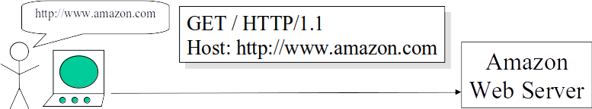
Retrieving Information (GET)
User types into the browser: http://www.amazon.com
The browser creates an HTTP request (no body)
The HTTP request identifies:
The desired action: GET ("get me resource")
The target machine (www.amazon.com)
Slide from: REST by Roger Costello and Timothy Kehoe http://www.xfront.com/REST-full.ppt

Slide 8
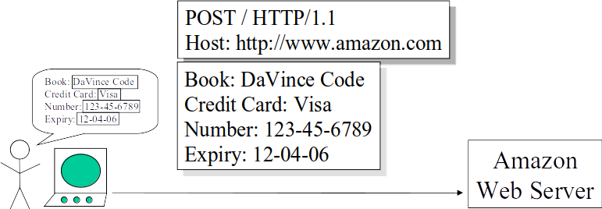
Updating Information (POST)
The user fills in a form on a webpage.
The browser creates an HTTP request with a body comprised of the form data
The HTTP request identifies:
The action: POST ("here is some updated info")
The target machine (amazon.com)
The body contains:
The data being POSTed (the form data)
Slide from: REST by Roger Costello and Timothy Kehoe http://www.xfront.com/REST-full.ppt

Slide 9
The HTTP API
HTTP provides a simple set of operations.
Amazingly, all Web exchanges are done using this simple HTTP API.
Based on the idea of CRUD (Create, Retrieve, Update, and Delete)
PUT: “Here is some new info” (Create)
GET: “Give me some info” (Retrieve)
POST: “Here is some updated info” (Update)
DELETE: “Get rid of this info” (Delete)
Slide from: REST by Roger Costello and Timothy Kehoe http://www.xfront.com/REST-full.ppt
Notes:
(1-3)
(4) The PUT method requests that the enclosed entity be stored under the supplied URI. If the URI refers to an already existing resource, it is modified; if the URI does not point to an existing resource, then the server can create the resource with that URI.
(5) The GET method requests a representation of the specified resource. Requests using GET should only retrieve data and should have no other effect.
(6) The POST method requests that the server accept the entity enclosed in the request as a new subordinate of the web resource identified by the URI. The data POSTed might be, for example, an annotation for existing resources; a message for a bulletin board, newsgroup, mailing list, or comment thread; a block of data that is the result of submitting a web form to a data-handling process; or an item to add to a database
(7)

Slide 10
Additional Verbs
HEAD
“Give me the metadata”
TRACE
“Show me what changes have been made”
OPTIONS
“Tell me what verbs you have implemented for this resource.”
PATCH
“Apply partial resource modification”
Notes:
Also some (title)
(1-2) The HEAD method asks for a response identical to that of a GET request, but without the response body. This is useful for retrieving meta-information written in response headers, without having to transport the entire content.
(3-4) The TRACE method echoes the received request so that a client can see what (if any) changes or additions have been made by intermediate servers.
(5-6) The OPTIONS method returns the HTTP methods that the server supports for the specified URL. This can be used to check the functionality of a web server by requesting '*' instead of a specific resource.
(7-8)The existing PUT method only allows a complete replacement of a document. PATCH can partially modify an existing HTTP resource.

Slide 11
Anatomy of an HTTP Request
VERB
URI
HTTP Version
Request Header
Request Body
<VERB> is one of the HTTP verbs
<URI> is the URI of the resource
<HTTP Version> is the version of HTTP
<Request Header> contains metadata
Collection of key-value pairs of headers and their values.
Information about the message and its sender like client type, the formats client supports, format type of the message body, cache settings for the response, and more.
<Request Body> is the actual message content.

Slide 12
HTTP Request Examples
VERB
URI
HTTP Version
Request Header
Request Body
GET:
POST:
GET http://www.w3.org/Protocols/rfc2616/rfc2616.html HTTP/1.1
Host: www.w3.org, Accept: text/html,application/xhtml+xml,application/xml; …, User-Agent: Mozilla/5.0 (Windows NT 6.3; WOW64) AppleWebKit/537.36 …, Accept-Encoding: gzip,deflate,sdch, Accept-Language: en-US,en;q=0.8,hi;q=0.6
POST http://MyService/Person/ HTTP/1.1
Host: MyService, Content-Type: text/xml; charset=utf-8, Content-Length: 123
<?xml version="1.0" encoding="utf-8"?>
<Person><ID>1</ID><Name>M Vaqqas</Name> <Email>m.vaqqas@gmail.com</Email><Country>India</Country></Person>
Notes:
Go over, point out that GET has no body but POST does, go over key/value pairings in header

Slide 13
Anatomy of an HTTP Response
HTTP Version
Response Code
Response Header
Response Body
<Response code> contains the status of the request. It is almost always a 3-digit HTTP status code from a pre-defined list.
<Response Header> contains the metadata and settings about the response message.
<Response Body> contains the representation if the request was successful.
Notes:
Requests are followed by replies - HTTP responses - in a similar packet format.

Slide 14
HTTP Response Example
HTTP Version
Response Code
Response Header
Response Body
GET Response:
HTTP/1.1 200 OK
Date: Sat, 23 Aug 2014 18:31:04 GMT, Server: Apache/2, Last-Modified: Wed, 01 Sep 2004 13:24:52 GMT, Accept-Ranges: bytes, Content-Length: 32859, Cache-Control: max-age=21600, must-revalidate, Expires: Sun, 24 Aug 2014 00:31:04 GMT, Content-Type: text/html; charset=iso-8859-1
<!DOCTYPE html PUBLIC "-//W3C//DTD XHTML 1.0 Strict//EN" "http://www.w3.org/TR/xhtml1/DTD/xhtml1-strict.dtd"> <html xmlns='http://www.w3.org/1999/xhtml'> <head><title>Hypertext Transfer Protocol -- HTTP/1.1</title></head> <body> …
Notes:
Requests are followed by replies - HTTP responses - in a similar packet format.

Slide 15
HTTP Status Codes
Common Responses:
200 Ok (succeeded)
201 Created (a new resource)
202 Accepted (not completed)
204 No Content (fulfilled request, nothing to return)
205 Reset content (reload page)
206 Partial content
301 Redirection: moved permanently
302 Redirection: found (temporary move)
400 Bad request
401 Unauthorized
402 Payment Required
404 Not found
Notes:
HTTP status code is primarily divided into five groups for better explanation of request and responses between client and server as named:
Informational 1XX
Successful 2XX
Redirection 3XX
Client Error 4XX
Server Error 5XX

Slide 16
Representational State Transfer (REST)
Notes:
(discussion) Point is - there are a lot of different answers to this question

Slide 17
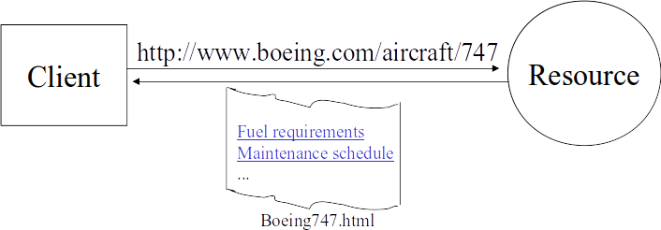
Representational State Transfer
A Client references a resource using a URI.
A representation of the resource is returned.
Receiving the representation places the client in a new state.
When the client selects a hyperlink in Boeing747.html, it accesses another resource.
The new representation places the client into yet another state.
Thus, the client application transfers state with each resource representation.
Slide from: REST by Roger Costello and Timothy Kehoe http://www.xfront.com/REST-full.ppt
Notes:
REST, short for representational state transfer, is an architectural pattern for implementing networked systems. In this architecture, (1). (2) (in this case as an HTML document). Receiving the representation (Boeing747.html) (3) (4) (5) (6)

Slide 18
The Core Idea
REST is modeled after the natural workflow of the Internet.
Motivation: Create a design pattern for how the web should work, such that it could serve as a guiding framework for designing web services.
A well-designed web application behaves as a network of web pages (a virtual state-machine).
The user progresses through an application by selecting links (state transitions).
Resulting in the next page (the next state of the application) being transferred to the user and rendered for their use.
Notes:
(1) - and was developed alongside HTTP version 1.1 itself. (rest)

Slide 19
REST - Not a Standard
REST is not a standard.
W3C will not put out a REST specification.
Microsoft does not sell a REST developer's toolkit.
REST is just an architectural pattern.
You can't bottle up a pattern.
You can only understand it and design your web services based on it.
REST does prescribe the use of standards:
HTTP, URL
XML/HTML/JPEG/etc. (Resource Representations)
text/xml, text/html, image/gif, image/jpeg, etc. (Resource Types, MIME Types)
Slide from: REST by Roger Costello and Timothy Kehoe http://www.xfront.com/REST-full.ppt

Slide 20
Verbs in REST
Verbs (loosely) describe actions that are applicable to nouns
Using different verbs for every noun would make widespread communication impossible
Some verbs only apply to a few nouns
In programming we call this “polymorphism”
In REST, we use universal verbs
All RESTful services offer the same interface.
Based on HTTP requests and responses.
Notes:
In a language, (1). One from the last slide - “I get a page”. The verb is “get”, the noun it is applied to is “the page”. If we had to come up with unique verbs (2).

Slide 21
REST Fundamentals
Services offer resources that can be interacted with.
All resources have a unique URI.
Often web addresses (blah.com/form.html)
Not necessarily HTML - resources are just concepts.
URIs tell a client that there's a concept somewhere.
Clients can then request a specific representation of the concept from the representations the server makes available.
HTTP verbs are used to retrieve or manipulate resources in a clear, universal manner.
Notes:
(1-4). A web page is a representation of a resource. (rest)

Slide 22
Representation Formats
Both client and server should be able to comprehend the format.
Structured content is often JSON or XML
JSON = Javascript Object Notation
A representation should completely represent a resource.
If there is a need to partially represent a resource, break the resource into child resources.
Smaller representation = easier to transfer = less time required to create representation = faster services.
The representation should be capable of linking resources to each other via URIs.

Slide 23
Verb Guarantees
GET, OPTIONS, TRACE, and HEAD are safe operations.
They should not change the resource in any way.
Be careful - no technical limitations ensuring safety.
A service may allow deletion of a resource by accessing a URL. A GET request to that URL would cause deletion.
PUT and DELETE are idempotent.
Repeated requests should have the same effect as a single request.
Safe operations are also idempotent.
POST is not idempotent.
Notes:
Some of the methods (for example, HEAD, GET, OPTIONS and TRACE) are defined as safe, which means they are intended only for information retrieval and should not change the state of the server. In other words, they should not have side effects, beyond harmless effects such as logging, caching, the serving of banner advertisements or incrementing a web counter. Making arbitrary GET requests without regard to the context of the application's state should therefore be considered safe. By contrast, methods such as POST, PUT, DELETE and PATCH are intended for actions that may cause side effects either on the server, or external side effects such as financial transactions or transmission of email.
Despite the prescribed safety of GET requests, in practice their handling by the server is not technically limited in any way, just limited by convention. Careless or deliberate programming can cause non-trivial changes on the server. For example, a website might allow deletion of a resource through a URL such as http://example.com/article/1234/delete, which, if arbitrarily fetched, even using GET, would simply delete the article.One example of this occurring in practice was during the short-lived Google Web Accelerator beta, which prefetched arbitrary URLs on the page a user was viewing, causing records to be automatically altered or deleted en masse. The beta was suspended only weeks after its first release, following widespread criticism
Methods PUT and DELETE are defined to be idempotent, meaning that multiple identical requests should have the same effect as a single request. This allows us to redeliver a request in event of a failure. GET, HEAD, OPTIONS and TRACE, being prescribed as safe, should also be idempotent, as HTTP is a stateless protocol In contrast, the POST method is not necessarily idempotent, and therefore sending an identical POST request multiple times may further affect state or cause further side effects (such as financial transactions). In some cases this may be desirable, but in other cases this could be due to an accident, such as when a user does not realize that their action will result in sending another request, or they did not receive adequate feedback that their first request was successful.

Slide 24
Elements of Web Architecture
Firewalls decide which HTTP messages get out, and which get in.
These components enforce web security.
Routers decide where to send HTTP messages.
These components manage web scalability.
Caches decide if a saved copy of a resource can be used.
These components increase web performance.
Slide from: REST by Roger Costello and Timothy Kehoe http://www.xfront.com/REST-full.ppt
Notes:
A major reason for the use of HTTP requests is not just that they offer a universal interface, but also because three fundamental components of all web architectures are already built around the exchange of HTTP messages and collectively determine many of the quality attributes of a web-based system.

Slide 25
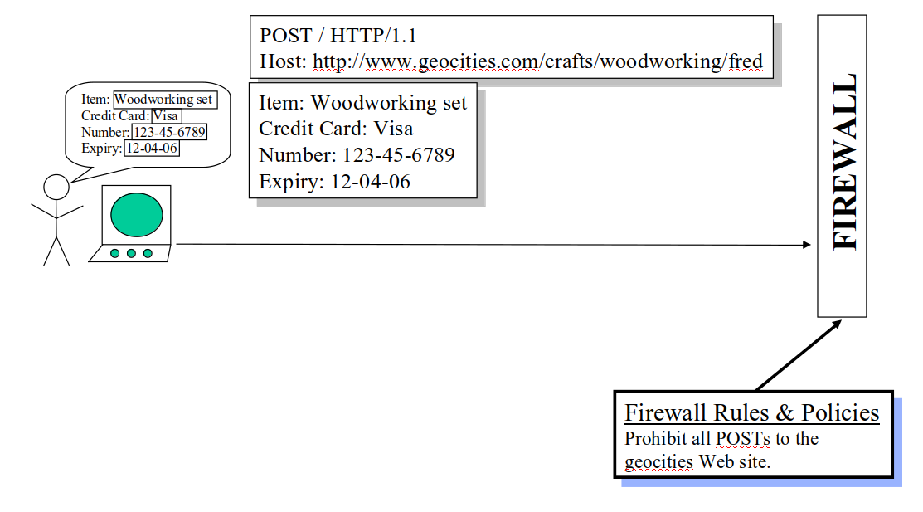
Firewalls
The firewall decides whether an HTTP message should pass through.
All decisions are based purely on the HTTP header. The firewall never looks in the payload.
This is fundamental!
This message is rejected.
Slide from: REST by Roger Costello and Timothy Kehoe http://www.xfront.com/REST-full.ppt
Notes:
Firewalls play a fundamental role in determining the outcome of requests by establishing rules and policies for services.

Slide 26
Privacy of Content
All three components base decisions and actions purely upon information in the HTTP header.
They should never examine the request body.
Letter analogy: The postal service doesn’t look inside your letter (this is illegal), they just act based on addressing on the outside.
REST enforces a similar idea - the content should not matter, just the metadata.
Protects privacy of data.

Slide 27
The Parts Depot Web Store
Parts Depot, Inc wants to deploy a web service to enable its customers to:
Get a list of parts.
Get detailed information about a particular part.
Submit a Purchase Order (PO).
How would you architect this?
Let’s discuss the RESTful way to design this.
Notes:
(go over, discuss)

Slide 28
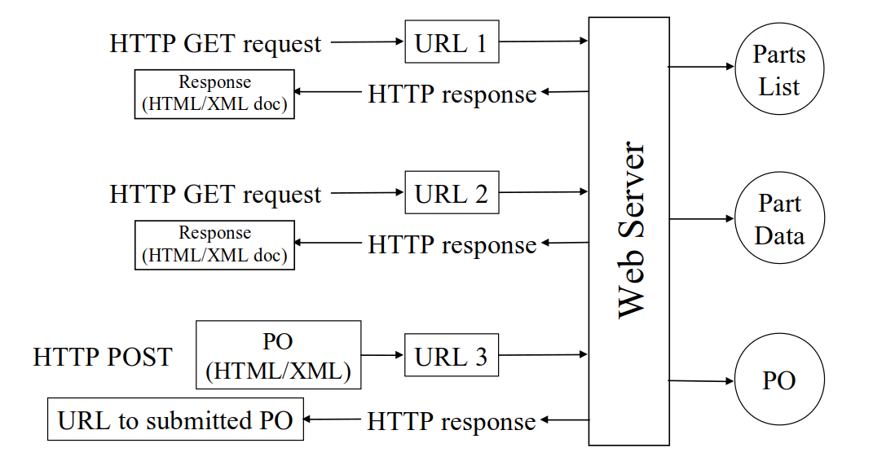
The RESTful Way of Designing the Web Services
Slide from: REST by Roger Costello and Timothy Kehoe http://www.xfront.com/REST-full.ppt
Notes:
Through HTTP requests and responses

Slide 29
Retrieving a List of Parts
Service: Get a list of parts
The web service makes available a URL to a parts list resource.
A client posts a GET request to this URL to get the parts list:
http://www.parts-depot.com/parts
How the web service generates the parts list is completely transparent to the client.
This enforces loose coupling.
Slide from: REST by Roger Costello and Timothy Kehoe http://www.xfront.com/REST-full.ppt
Notes:
(go over)

Slide 30
REST Fundamentals:
Create a resource for every service.
Identify each resource using a URI.
Notes:
Two fundamentals of REST are reflected here: Create a resource for every service. Identify each resource using a URL.

Slide 31
Data Returned: Parts List
<?xml version="1.0"?> <Parts> <Part id="00345" href="http://www.parts-depot.com/parts/00345"/> <Part id="00346" href="http://www.parts-depot.com/parts/00346"/> <Part id="00347" href="http://www.parts-depot.com/parts/00347"/> <Part id="00348" href="http://www.parts-depot.com/parts/00348"/> </Parts>
The parts list contains links to get detailed information about each part.
This is a key feature of the REST pattern.
The client transfers from one state to the next by examining and choosing from among the alternative URLs in the response document.
Slide from: REST by Roger Costello and Timothy Kehoe http://www.xfront.com/REST-full.ppt

Slide 32
REST Fundamental:
The data that a service returns should link to other data.
Thus, design your data as a network of information.
Contrast with OO design, which says to encapsulate information.
Notes:
one more fundamentals of REST is reflected here:

Slide 33
Retrieving Details on a Part
Service: Get detailed information about a particular part
The web service makes available a URL to each part resource.
For example, a client can request information on a specific part by posting a GET request to http://www.parts-depot.com/parts/00345
Slide from: REST by Roger Costello and Timothy Kehoe http://www.xfront.com/REST-full.ppt

Slide 34
Data Returned: Part 00345
<?xml version="1.0"?>
<Part>
<Part-ID>00345</Part-ID>
<Name>Widget-A</Name>
<Description>This part is used within the frap assembly</Description>
<Specification href="http://www.parts-depot.com/parts/00345/specification"/>
<UnitCost currency="USD">0.10</UnitCost>
<Quantity>10</Quantity>
</Part>
Again, data is linked to still more data
The specification for this part may be found by traversing the hyperlink.
Each response document allows the client to drill down to get more detailed information.

Slide 35
Designing Services with REST
Notes:
(discussion) Point is - there are a lot of different answers to this question

Slide 36
Designing Services With REST
Destination URL must be placed in the HTTP header for Web components to operate effectively.
Web components (firewalls, routers, caches) make their decisions based upon information in the HTTP Header.
Infrastructure will not work correctly if destination not in URL!
It is anti-REST if the HTTP header just identifies an intermediate destination and the payload identifies the final destination.

Slide 37
Designing Services With REST
Client requests should be idempotent – multiple calls should lead to the “same” response.
Server responses are “idempotent”, but only in terms of the meaning of information and not necessarily the content.
Think of a URL that always returns the current time…
Notes:
(1) This allows the client to retry if something goes wrong during transmission, which is VERY common

Slide 38
PUT and POST
PUT is idempotent, POST is not.
No matter how many times PUT request is made (>=1), server state will be the same.
Multiple POSTs may create multiple resources.
PUT requires a full resource ID path.
Client creates resource.
POST does not require full resource ID path.
Server notifies client of resource location.
Post can still be used for resource updates.
Notes:
Which brings us back to POST

Slide 39
PUT and POST
PUT http://MyService/Persons/
Won't work. PUT requires a complete URI.
PUT http://MyService/Persons/1
Insert a new person with PersonID=1 if it does not already exist, or else update the existing resource with the payload.
POST http://MyService/Persons/
Insert a new person every time this request is made (using the payload) and generate a new PersonID.
POST http://MyService/Persons/1
Update the existing person where PersonID=1

Slide 40
Handling POSTs
Other methods are idempotent, but POST creates new resources.
Multiple POSTs of the same data must be made harmless.
Put message ID in a header or in the message body.
This renders multiple posts harmless.
Prevents “multiple charge” issue with web stores.

Slide 41
Handling POSTs
Many ways to do this:
Exact: client or server-side unique transaction ID.
Heuristic: check for and remove “likely duplicates” from POST stream.
Wasted IDs are irrelevant.
Duplicated POSTs are not acted on by the server
The server must send back the same response the original POST got, in case the application is retrying because it lost the response.

Slide 42
Idempotence
What does this mean, strictly speaking?
Call to server must return the same thing each time?
No side effects?
What about changing data?
Time-of-day service.
Each GET call returns a new time.
Is this still RESTful?
As long as the resource is constant.
The value does not need to be constant, just how we access it.

Slide 43
Statelessness
Each request contains all information needed to service the request.
No client state is held on the server.
Benefits in terms of scale and availability.
Negatives:
Development is harder.
Performance may be worse (multiple requests may be needed to get information).
Notes:
REST is considered to be a stateless style, in the sense that The client–server communication is constrained by no client context being stored on the server between requests. Each request from any client contains all the information necessary to service the request, and session state is held in the client.

Slide 44
Caching
An important part of scaling services is caching generated results.
Clients and servers can cache responses.
Responses must be defined as cacheable or not to prevent clients from getting out-of-date information.
Well-managed caching removes some client-server interactions, improving scalability and performance.
Notes:
(1) As a result, the idea of caching is built into the REST style. clients and intermediaries can cache responses. Responses must therefore, implicitly or explicitly, define themselves as cacheable or not to prevent clients from getting stale or inappropriate data in response to further requests. Well-managed caching partially or completely eliminates some client–server interactions, further improving scalability and performance.

Slide 45
Caching
Controlled through HTTP header metadata.
Date
Date and time when this representation was generated.
Last Modified
Date and time when the server last modified this representation.
Cache-Control
Used to control caching. Allows specification of max or min time, can prevent storage.
Expires
Expiration date and time for this representation.
Age
Duration passed in seconds since this was fetched from the server. Can be inserted by an intermediary component.

Slide 46
Cache-Control Response Directives
Public: Indicates any component can cache this representation.
Private: Intermediary components cannot cache this representation, only client or server can do so.
no-cache/no-store: Caching turned off.
Max-age: Duration in seconds after the date-time marked in the Date header for which this representation is valid.
S-maxage: Similar to max-age but only meant for the intermediary caching.
Must-revalidate: Indicates that the representation must be revalidated by the server if max-age has passed.
Proxy-validate: Similar to max-validate but only meant for the intermediary caching.

Slide 47
Well-Structured URIs
Avoid using spaces. Use an _ (underscore) or – (hyphen) instead.
Remember that URIs are case insensitive.
Stay consistent with naming conventions throughout the service..
URIs are long lasting.
If you need to change the location of a resource, do not discard the old URI. If a request comes for the old URI, use status code 300 and redirect the client to the new location.
Notes:
(4) think before naming them

Slide 48
Well-Structured URIs
Avoid verbs for your resource names unless your resource is actually an operation or a process.
Bad URIs:
http://MyService/FetchPerson/Mike
http://MyService/DeletePerson?id=Mike
Good URI:
http://MyService/Persons/Mike
You can apply verbs to this resource.

Slide 49
Food For Thought
What if Parts Depot has a million parts, will there be a million static pages?
http://www.parts-depot/parts/000000
http://www.parts-depot/parts/000001
...
http://www.parts-depot/parts/999999
Slide from: REST by Roger Costello and Timothy Kehoe http://www.xfront.com/REST-full.ppt

Slide 50
Food For Thought
Distinguish between logical and physical entities.
The URLs are logical.
They express what resource is desired.
They do not identify a physical object.
The advantage of using a logical identifier (URL) is that changes to the implementation of the resource will be transparent to clients (loose coupling!).
Parts Depot will store all parts data in a database. Code at the Parts Depot website will receive each logical URL request, parse it to determine which part is being requested, query the database, and generate the part response document to return to the client.
Slide from: REST by Roger Costello and Timothy Kehoe http://www.xfront.com/REST-full.ppt

Slide 51
Food For Thought
Physical URLs
http://www.parts-depot/parts/000000.html
http://www.parts-depot/parts/000001.html
...
http://www.parts-depot/parts/999999.html
Logical URLs
http://www.parts-depot/parts/000000
http://www.parts-depot/parts/000001
...
http://www.parts-depot/parts/999999
Physical URLs are pointing to HTML pages.
If there are a million parts, it will not be very attractive to have a million static pages.
Furthermore, changes to how these parts data is represented will effect all clients that were using the old representation.
Slide from: REST by Roger Costello and Timothy Kehoe http://www.xfront.com/REST-full.ppt
Notes:
Contrast (go over). Instead, you use logical URLs that do not represent actual HTML pages, but are parsed by the server and elicit a response inside of an HTTP packet

Slide 52
Food For Thought
What if I have a complex query?
Show me all parts whose unit cost is under $0.50 and for which the quantity is less than 10
How would you do that with a simple URL?
Slide from: REST by Roger Costello and Timothy Kehoe http://www.xfront.com/REST-full.ppt

Slide 53
Food For Thought
For complex queries, you can provide a service (resource) for a client to retrieve a form that the client then fills in.
When the client hits "Submit", the browser will gather up the client’s responses (form data) and generate a URL based on the responses.
Often, the client doesn't generate the URL (think about using Amazon - you start by entering the URL to amazon.com; from then on you simply fill in forms, and the URLs are automatically created for you).
Slide from: REST by Roger Costello and Timothy Kehoe http://www.xfront.com/REST-full.ppt

Slide 54
Activity - Let’s Make a Deal
Game where contestants are presented with three doors.
One leads to a great prize, the other leads to nothing.
Users select one door.
Host opens one of the other doors.
Users can then choose to open their door or the remaining unopened door.

Slide 55
Activity - Let’s Make a Deal
You have been asked to implement Let’s Make a Deal as a web service. You must support:
Creation of games.
User selection of a door.
The game will open one of the other doors.
User opening of a door.
Querying of the current state of the game and outcome (if complete) by user.
Deletion of a game.
Determine the appropriate resources, verbs, and response messages.

Slide 56
Sample API
Resource | Verb
/games | get – status of games server post – create new game
/games/{gid} | get – status of game (in_play, won, lost) delete – delete the game resource
/games/{gid}/doors | get – status of all doors
/games/{gid}/doors/{1..3} | get – door status {closed, selected, opened} put – update door status
Use status codes to determine whether an operation is reasonable.
Once game is finished (won/lost), only GET requests are allowed.

Slide 57
Key Points
REST is an architectural style for implementing web-based systems.
RESTful services provide resources (as web pages) designed to be consumed by programs rather than by people.
Design Principles:
Stateless
Resource-Based (URI)
Uniform Interface (GET, PUT, POST, DELETE)
Links describe relationships
Cacheable and monitorable using standard internet tools
Notes:
Today’s class is centered around Representational State Transfer, or REST, (1). Systems based on REST, what we call RESTful services, (2 - rest)

Slide 58
Next Time
The Information Viewpoint
Sources: Rozanski and Woods, Ch: 18
Midterm coming up soon
Practice midterm on site, with no answers.
In Lec 12 (10/11), we will go over answers
Homework:
Project 2 - 10/11
Assignment 2 - 10/25

