Slide 1
Viewpoint: Information
CSCE 742 - Lecture 11 - 10/09/2018

Slide 2
Data Manipulation
Most software manipulates data.
Most organizations possess massive amounts of data on customers and products.
The architecture requires a summary view of static information structure and dynamic information flow.
Answers questions around ownership, latency, relationships, identifiers, and more.
The Information View details how the system will manipulate, manage, and distribute information.
Notes:
The ultimate purpose of most software is to manipulate data in some form. This data may be stored persistently in a database management system, in ordinary files, or in some other storage medium such as flash memory; or it may be transiently manipulated in memory while a program executes. In any case, Nowadays, many organizations possess massive amounts of information on their customers, their products or services, and their competitors. This information represents a substantial asset—one that, if correctly used, can bring substantial benefits. We see this often in large systems integration projects that attempt to bring together information from a variety of sources to produce a consolidated customer view, an integrated view of the supply chain, or an accurate financial picture.
Formal data modeling and design can be a long and complex process. As an architect, you can do data modeling only at an architecturally significant level of detail. You need to focus on those aspects of the data model where getting it wrong would affect the system as a whole rather than just a part of it. Your task is to develop a summary view of static information structure and dynamic information flow, with the objective of answering the architecturally significant questions around ownership, latency, relationships and identifiers, and so forth. You use the Information view to answer, at an architectural level, questions about how your system will store, manipulate, manage, and distribute information.

Slide 3
Information View
Describes the way the system stores, manipulates, manages, and distributes information.
Modeled through static information structure models, information lifecycle models, information ownership models, information quality analysis, metadata models, and volumetric models.
Addresses concerns around information structure, ownership, data usage, volatility, storage models, flow, consistency, quality, timeliness, latency, age.
Notes:
(1) Required for any system that has more than trivial information management needs.

Slide 4
Information Concerns
Notes:
(discussion) Point is - there are a lot of different answers to this question

Slide 5
Information Structure and Content
Find the elements of information structure that have system-wide impact, and leave the rest to data designers.
Focus on a small number of items core to primary system responsibilities.
Focus on information-rich items that:
Are fundamental to stakeholder concerns.
Are significant to the users.
Have complex internal structure.
Can impact quality properties.
Are heavily used or are expected to change frequently.
Notes:
The structure and content of the information that your system manages are clearly significant concerns. Your challenge as an architect is to focus on the most important aspects of information structure, those that have system-wide impact, and to leave most of the modeling and decision making to the data modelers and data designers.
You should focus on a relatively small number of data items (entities, classes, and so on) and the relationships among them. Deciding which data items are important depends on the problems you are trying to solve and the concerns of your stakeholders. However, you should bear the following in mind when selecting the data items of interest.
- Focus on a small number of data items that are core to the primary responsibilities of your system or that your stakeholders view as particularly significant or meaningful. When considering the interests of the stakeholders, primarily consider your users, but also take into account the concerns of other stakeholder types such as maintainers.
• Focus on information-rich data items, rather than ones that have few attributes (e.g., type entities are typically less important in architectural information models). Choose data items that are fundamental to the nature of the concerns being addressed, Are significant to the users or other stakeholders, Have a complex or poorly understood internal structure, Can have a significant impact on the system’s quality properties,
depending on how they are represented Are heavily used or volatile (the contents are expected to change frequently)

Slide 6
Information Structure and Content
Early in the project, focus on abstract - not physical - information.
Data implementation will change, important to start controlling guiding ideas.
Focus on system functionality. Model data so that it supports functionality.
Later, worry about physical considerations.
Location, ownership.
Notes:
In the early stages of developing your models, try to focus on abstract rather than physical information, and keep the models simple. Don’t worry too much about formal modeling techniques such as relational normalization at
this point. (2)
• Your early models should typically align with and be driven by your system’s functionality, and you should be concerned less with physical considerations such as location or ownership (although we address these
issues and others in this chapter).

Slide 7
Information Purpose and Usage
The same information can be used to support operational processes, present operational status, analyze historical trends.
How it is used is important. Different usage patterns often have different ownership rules and may require architectural variation.
Many systems have a transaction store.
Manages information required to support operations.
Highly volatile.
System must process a large number of concurrent read/write operations.
Notes:
Information can be used in different ways—to support operational processes, such as taking an order or making a payment; to present current operational status, such as stock levels or production rates; or to analyze historical information and uncover trends and patterns. While it is the same information in each case, how it is used is important. The distinction is important in the design of information systems, since the different usage patterns often have significantly different information ownership rules and may require significantly different architectural solutions..
Most information systems have at their heart a transaction store or transactional processing database. The transaction store manages the information required to support day-to-day operational processes. This information is highly volatile, and the system needs to be able to process a large number of concurrent read and write operations with short latency and high reliability.

Slide 8
Information Purpose and Usage
Significant reporting requirements strain the transaction store.
Long-running queries disrupt access by users.
Increases response time and lowers throughput.
Use a separate reporting database to service complex queries, fed from transaction store.
Optimize for compex ad hoc queries, not updates.
Transaction store biased to current activity.
Historic information usually managed in a analytical processing (OLAP) database.
Specialized data stores may manage information from a specific domain or time period.
Notes:
If the system has significant reporting requirements, this can put a strain on the transaction store. A long-running or complex query can disrupt access by operational users, leading to increased response times and lower throughput. For this reason, some systems implement a separate reporting database to service these large queries, which is fed in batch or real time from the transaction store. The reporting database is essentially read-only
(apart from the incoming information feeds) and is optimized for complex ad hoc queries rather than updates, with many indexes and significant denormalization.
• The transaction store and reporting database usually store only information related to current activity, such as open orders, current stock levels, or today’s prices. Some users require access to historical information, to look at
individual transactions or to analyze and summarize the information in different ways. Historical information is usually managed in a separate data
warehouse, sometimes called an online analytical processing (OLAP) data store. The data warehouse may in turn feed into more specialized data stores, which manage information from a specific domain or time period.
The data warehouse holds a record of all activity going back many years and can be used to retrieve specific historical information or to analyze trends over time.

Slide 9
Information Purpose and Usage
Most systems rely on reference data.
Information on people, places, things that classify system transactions.
Varies by organization, but changes infrequently and is lower in volume than transactional or operational information.
Important to be able to split data across multiple databases and data warehouses.
Architecture must control for impact of partitioning, speed of data read/write, data duplication.
Notes:
Most systems rely heavily on reference data (sometimes known as static, master, or lookup data), which is the information on people, places, and things that classifies the system’s transactional information. It
includes a wide range of business entities, such as calendars, customers, products, parts and supplies, prices, locations, employees, and external organizations. It also includes the “type” information (such as product type or employee role) that characterizes other information. Basically, this data offers context to transactions.
Every organization has its own definition of what it classes as reference data, but it is almost always fairly static, changing relatively infrequently, and there is usually much less of it compared with transactional and operational information. Reference data also may not be owned by your system, which can be a significant architectural challenge.
While the distinction here may not be important in the early days of an information system, over time the system will amass larger and larger volumes of data. It will be much easier to hive off a separate reporting database, data warehouse, or enterprise data store in the future if the initial architectural design has taken this possibility into account and allowed for the impact of partitioning, speeds of different stores, data duplication between stores, and so on.

Slide 10
Information Ownership
Information is often distributed across multiple locations.
Which copy of a data item is the most up-to-date?
How do you keep information synchronized in multiple places?
How do you deal with information derived from information managed and owned elsewhere?
What validation should be applied to data modification, and what assumptions can be made about data that has been validated elsewhere?
If the same data item can be modified in several places, how are conflicts reconciled?
Notes:
In many architectures, particularly those that involve the integration of new and/or existing systems, information is physically distributed across multiple data stores and accessed in different ways. This situation, while often unavoidable, creates all sorts of problems. (2-4) , such as account balances derived from account activity (5-6)

Slide 11
Information Ownership
Insurance company sends workers to customer homes.
Customer information is updated on a laptop, sent to central database when they return to the office.
Customers can also update information and make purchases online.
What if an online update is made before the laptop update is made?
What if a laptop update fails strict validation on the central database?
Requires rules on how to deal with update conflicts and failures.
Notes:
For example - An insurance company sends workers to customers at home to sell them financial products. The company maintains a central database of customers and prospects, part of which is downloaded to each salesperson’s laptop when visiting the office. Whenever a sale is closed at a customer’s home, the information is stored in a holding area on that laptop until it can be uploaded to the central database later.
Customers can also update their details and also purchase products online. However, what if they update data online before the data from the laptop has been uploaded? Sometimes, details stored on laptops overwrite more recent data on the central database, and vice versa. In other cases, updates to the central database are rejected because they fail the central system’s more stringent validation.
In order to address these problems, the architect first has to agree with the business stakeholders on some general rules about how to deal with update conflicts and failures (e.g., recent updates always override older ones). These rules are then coded into the central system and laptop applications.

Slide 12
Information Ownership
Develop a model of information ownership.
An owner of an item is the system or data store that contains the definitive version of that item.
Always has the “correct” value for that information.
Defining data owners helps ensure that consumers have the right data and that producers write to correct location.
Also clarifies interfaces - interfaces are required between data owners and consumers.
Notes:
A useful way to analyze these problems and develop architectural strategies to handle them is to develop a model of information ownership. The information owner of a data item is the system or data store that contains the
definitive, up-to-date, validated value of that data item. The information owner always has the correct value for that information and can act as the final arbiter when any disputes over accuracy occur.
By defining the owner of each data item, you can ensure that your information consumers are always working with the right information and that your information producers write it only to the correct place. When this is not possible in practice, you can analyze potential conflicts and inconsistencies and then deal with them.
For example, a national system for registering motor vehicles operates from a number of regional centers. Each center is responsible for registering vehicles purchased in that region. Each vehicle must be allocated a unique number, but conflicts could arise because there is no real-time communication between the regional centers. The problem is resolved by partitioning the information ownership, that is, by allocating to each center a separate, distinct range of numbers to assign to vehicles purchased in its area. Care must be taken to ensure that the ranges will never overlap. This is done by making each range far larger than the anticipated number of cars to be registered: The North center is given the range 1 to 100 million, the West center 101 million to 200 million, and so on.
A by-product, of information ownership analysis will be a high-level definition of some of your system’s interfaces. Where one system is an information owner and another is an information consumer (or maintains a copy of that information), some sort of interface is required between them. You can use the interface definitions to cross-check the models in your Information view against the models in your Functional view.

Slide 13
Identifiers and Mappings
All data items need unique identifiers distinguishing them from other items.
Customer number, serial number, ISBN.
The primary key, object ID, identifier.
If different systems use different means to identify items, these mechanisms must be reconciled when data exchange occurs.
Key assignment can be volatile.
Reconciliation must be kept up to date with new information as it arrives.
Notes:
Whether information is managed by using relational entities or objects and classes, each data item needs a unique identifier or key that distinguishes it from others of similar type (e.g., customer number, machine serial number, or ISBN). In relational database terminology, this is called a primary key; in object-oriented programming, the term object ID is often used; a more useful general term (which does not assume any underlying information model) is identifier. When information is spread over multiple repositories, identifiers often become an issue. Different systems may use different mechanisms to identify the same data item, and these mechanisms will need to be reconciled at points where data exchanges occur. Because key assignment can be a volatile activity (a sales system where many new orders are created per second), you will need to keep this reconciliation process up-to-date with new information as it arrives.

Slide 14
Identifiers and Mappings
Identifiers should be invariant.
Not always possible. Mechanisms for creating and changing identifiers must be carefully designed.
Ex: Financial derivatives are assigned temporary ID while going through approval. Once approved, they are given a permanent ID. Link must be established between the two.
Difficult to decide if two items are the same.
Ex: New edition of a book. Could only have minor corrections, or could be entirely new.
Should it have the same ISBN identifier?
Should identifiers be user-visible?
Ex: Credit card numbers are unique, but may not be shown to protect privacy.
Notes:
There are many architectural challenges associated with the use of identifiers. For example, identifiers are normally invariant, that is, they never change over the lifetime of the data entity that they identify. However, it is not always possible to enforce this rule. In such cases, the mechanisms for creating and changing identifiers must be very carefully specified and designed. For example - derivatives are financial products whose value is derived from the value of some other underlying asset. When a new derivative product is created, it goes through an approval process to ensure that it is sound, that it is compliant with regulations, and that its financial parameters are clear. This process can take a long time, and in the interim it is common for the product to be allocated a temporary identifier so that a provisional price can be quoted and measures of value and risk can be
calculated. Once the product is formally approved, it is given a permanent identifier, which may be different from the temporary one since it is allocated by a different part of the organization. A link must be established between the two identifiers, so that the provisional quote can be turned into a firm quote and a sale made with a clear audit trail.
There can also be some subtleties around the question of whether two data entities actually represent the same thing and should therefore have the same identifier. For example, every book is allocated an ISBN (International Standard Book Number) when it is published. A second edition of the book may contain only minor revisions and corrections, or may be substantially different, with a new structure and a substantial amount of new content. Should such a major revision be allocated a new ISBN? If so, how can it be linked to the ISBN of the first edition? If not, how are the two editions distinguished from one another? In this example, there are agreed-upon rules about allocating ISBNs, but in many cases it will be down to the architect to decide (or at least capture and agree on the requirements from users).
Another important consideration is whether your identifiers are going to be user- visible or not. For example, every debit and credit card has a unique 16-digit card number (last point). On the other hand, although each individual purchase on a credit card statement has its own identifier, this is not usually printed. If a transaction needs to be queried or confirmed, it is identified by the transaction date, the merchant name, and the amount (which is usually unique enough for this purpose).

Slide 15
Information Semantics Volatility
Information changes frequently.
New fields, constraints, relationships, or entities may be added to existing data.
Small changes can have implications for systems that use changing data.
New mandatory field added to a database requires every process that creates or updates data to provide a value for that field.
Managed through formal process of data model change control.
Data change only implemented once all parties have implemented required code changes.
Notes:
It is common for the syntax, semantics, and interrelationships of information to undergo frequent and unpredictable change. New fields may need to be added to existing entities, new constraints and relationships may
arise, or new types of entities may be needed to meet changing business needs. Although there are mitigation strategies to make such changes less painful (including abstract database access libraries, tools for impact analysis, and designing interfaces to allow for variation and change), even small changes to an information model can have wide-ranging implications for the systems that use
that information. For example, if a new mandatory field is added to a database table, every process that creates or updates rows in that table needs to be changed so that it can provide a value for that field. This process needs some form of control, traditionally managed through a formal process of data model change control: The impact of a change on every module in the system is assessed, and only when all parties have implemented the required functional changes is the database change rolled out.

Slide 16
Information Semantics Volatility
Decouple information semantics from the physical structure used to store it.
Store information structure in a structured text format (JSON, XML, YAML).
XML data management standards allow definition of a schema for XML documents.
Changes to schema can be implemented quickly.
Trade-off: XML-based systems can be less scalable due to XML management overhead and lack of database optimization support.
Notes:
This approach is established and effective, but it drastically slows down the rate at which systems can be changed, and in practice change control often ends up being subverted or bypassed altogether. An alternative approach, which is more flexible while still retaining a level of control, is to decouple the information semantics from the physical structures used to store it. A common way of doing this is to store complex information structures in structured text forms such as XML, JSON, or YAML, either within a database or in external data files. The XML family of data management standards includes mechanisms for defining the schemas of XML documents and accessing their contents. While changes to the schema still need management and oversight, they can often be implemented more quickly with less effort. The downside of this approach is that XML-based systems tend to be less performant and scalable, due to the XML management overhead and the fact that most database optimizers don’t work very well with XML data.

Slide 17
Information Flow
How does information move around the system? How is it accessed and modified by system elements?
Where is data created and destroyed?
Where is data accessed, modified, and enriched?
How do individual data items change as they move around the system?
Architecture must identify the most important information flows.
May be part of functional view.
Notes:
Just as important as the static information structure is the way that information moves around the system and is accessed and modified by its elements. (2-4)
As with information structure, it is usually necessary to consider only the most important information flows as part of architecture definition, that is, those that are crucial to the system’s primary responsibilities or those that will have a material impact on its quality properties. In any case, because you will have only a high-level data model to work with, you won’t be able to drill down into too much detail here. Because the main purpose of most systems is to process information, information flow is often analyzed within Functional rather than Information views. This works well as long as you don’t end up with a small number of
complex, overloaded models that are hard to understand—and as long as you make sure that the data-specific concerns discussed here are also addressed.

Slide 18
Information Consistency
Information held in different parts of the system must be compatible, congruent, and not in conflict.
Transactions are updates that occur as an atomic unit (all updates accepted or none).
Transaction management ensures right outcome by committing updates only if all updates can be applied.
Ex: Customer transfers $500 from CHECKING to SAVINGS. Implemented as two updates. Important that either both updates work or neither do.
Notes:
Information consistency means that information held in different parts of the system, or in different but related data items, should be compatible, congruent - in harmony - , and not in conflict. This may be as simple as a referential integrity constraint (e.g., if a customer is recorded as owning several products of specific types,these products should all exist) or may be more complex (e.g., a summary financial position should always match the underlying data used to calculate it). Information consistency is so fundamental to the operation of modern relational databases that its significance in the architectural context can easily be forgotten.
A transaction is a sequence of data updates that occur as an atomic unit—that is, either all updates are accepted and written to permanent storage or none of them are. Transaction management ensures the right outcome by committing updates (writing them permanently to disk) only if all updates can be successfully applied. Transaction management will roll back (undo) all of the updates if one of them fails.
For example, a bank customer uses an ATM to transfer $500 from her checking account to her savings account. The bank uses two data stores to manage these two different types of accounts. The transfer is implemented as two updates: a withdrawal of $500 from CHECKING, and a corresponding deposit of $500 into SAVINGS. It’s essential that either both of these updates complete successfully or neither of them do. For example, the transaction might not go ahead if the customer doesn’t have sufficient funds in her checking account. If only one of the transactions completes, either the customer or the bank would lose money.

Slide 19
Information Consistency
Transaction management across systems or processes is complicated to build or operate.
Compensating Transactions:
Each data update is committed individually.
If a later update fails, each committed update is reversed with a new transaction with an equal and opposite effect.
If withdrawal succeeds and deposit fails, a compensating deposit of $500 to the checking account will restore the original state.
Do not require locks over separate data stores at the same time.
Problem: what if the compensating transaction fails?
Notes:
Transaction management features are provided by all modern relational database systems, and their use is nowadays almost automatic (although care must be taken to avoid pitfalls such as deadlocking). Transaction management across multiple systems or processes is much more complicated to design, build, and operate.
An approach that avoids some of the difficulties with distributed transactions is to use compensating transactions to maintain data integrity. In this model, each data update is committed individually, and if a later update fails, each committed update is reversed by a transaction with an equal and opposite effect to the original one. In the preceding example, if the withdrawal was successful but the deposit failed, a compensating deposit of $500 to the checking account could be applied to bring everything back to a consistent state.
Compensating transactions often work well in practice since they do not require database locks to be held over separate data stores at the same time. However, they have problems of their own, particularly if
changes cannot easily be reversed or if a compensating transaction itself fails.

Slide 20
Information Consistency
Eventual Consistency:
Favor high availability over consistency.
Guarantees that all instances of the same data will eventually be updated to a value, without guarantee of when this will occur.
Used by DNS system, NoSQL databases
BASE principles:
Basic Availability: Data should be available in the presence of multiple failures. Instead of a central data store, spread data across many systems with high replication.
Soft State: Data consistency is left to developer, not the database.
Eventual Consistency: Data will converge to consistency.
Notes:
Another approach is known as eventual consistency. In this model, distributed applications favor high availability over consistency and are designed to be able to cope with data that is out of synch for a period of time. Such a system guarantees that after an update, all instances of the same data will eventually be updated to this value, without guaranteeing how long this will take.
Eventual consistency is used for infrastructure software such as DNS (the Internet’s Domain Name Service) and for some Internet-scale applications such as search engines, shopping sites, and social networking sites, but the
principles may also be useful to smaller-scale applications. The model is sometimes referred to as following BASE principles (Basically Available, Soft state, Eventual consistency).
Basic Availability. The NoSQL database approach focuses on the availability of data even in the presence of multiple failures. It achieves this by using a highly distributed approach to database management. Instead of maintaining a single large data store and focusing on the fault tolerance of that store, NoSQL databases spread data across many storage systems with a high degree of replication. In the unlikely event that a failure disrupts access to a segment of data, this does not necessarily result in a complete database outage.
Soft State. BASE databases abandon the consistency requirements of the ACID model pretty much completely. One of the basic concepts behind BASE is that data consistency is the developer's problem and should not be handled by the database. Eventual Consistency. The only requirement that NoSQL databases have regarding consistency is to require that at some point in the future, data will converge to a consistent state. No guarantees are made, however, about when this will occur. That is a complete departure from the immediate consistency requirement of ACID that prohibits a transaction from executing until the prior transaction has completed and the database has converged to a consistent state.

Slide 21
Information Quality
Are data values in your system accurate?
Affects the architecture of systems that use information from a variety of sources.
How will data quality be assessed and monitored?
What minimum quality criteria must be met?
How will these criteria be enforced?
How will poor-quality information be improved?
Can good-quality information be corrupted by information of lesser quality?
If so, should this be prevented or checked?
Is it possible for information quality to degrade as it flows around the system?
Notes:
The quality of a particular data item is the extent to which the current value of that data item agrees with the correct value in the real world. Poor-quality information can have a significant impact on an organization’s ability to carry out its operations. If you don’t have accurate information about your customers, for example, you risk annoying them, losing them, or even being sued by them. Information quality becomes an issue for you as an architect in cases where the system makes use of information from a variety of sources, particularly when some of these are external to your sphere of influence. If your information quality is variable, you must consider such issues as:
(3) (especially when information is frequently updated) (4 - 6) Will this be done in an automated way, or will it require manual intervention? (7) (For example, a customer address is updated, but the postal code is omitted.) (8-9)

Slide 22
Information Quality
May be necessary to develop tools for monitoring or assessing information quality.
Data may need to be held in a “holding” state for human repair.
Often managed through workflow.
List of tasks (i.e., correct customer names) is managed in a central database.
Tasks are assigned to workers and the system tracks status.
Tasks can be standard or ad hoc.
Company sets target service level.
Notes:
The answers to these questions are likely to have implications for your architecture. For example, it may be necessary to develop or deploy automated tools for monitoring or assessing information quality or for repairing poor- quality data. If repairing data needs some human intervention, you may have to set up a holding area where data can sit until it has been manually repaired. It is becoming more common to use workflow to address information quality problems when repair processes cannot easily be automated. In this model, a list of tasks, such as correcting a customer’s name or address or dealing with a suspect transaction, is managed in a central database. Tasks are assigned to users and the system tracks their status to completion. Tasks can either be standardized (defined at design time) or, in the most sophisticated workflow systems, ad hoc (created by someone at runtime). Service levels may be defined that commit the company to fixing problems within a certain time or at a certain rate. If well designed, this approach can be an effective way of improving information quality and customer satisfaction.

Slide 23
Information Timeliness
In distributed environments, information can be out of date.
Commodity brokerage system accepts information feeds and filters through a central gateway.
After returning from downtime, the gateway floods subscribers with messages that contain old price information.
Gateway should be modified so that, after a failure, it discards cached messages older than a threshold. Will enable faster recovery.
Notes:
In many systems, real time, timeliness, latency, and age are significant issues. I nmany systems, it is inevitable that some scenarios involve information that is old or out-of-date, if only by a few minutes.
For example, a commodity brokerage accepts feeds from information sources that provide up-to-date pricing and volume information, as well as news stories relevant to the commodities being
traded. The feeds are all channeled through a single gateway application that sorts, filters, and distributes the information to appropriate subscribers. A catastrophic hardware failure renders the gateway unavailable for several days. When it comes back online, the subscribers are flooded with several thousand cached price messages that, because they are several days old, are of no interest to the recipients. The gateway is modified so that after a failure, it discards cached price messages that are older than a certain configurable age. Another failure occurs (a change of hardware supplier is called for), and recovery is much faster.

Slide 24
Information Timeliness
Information transfer from producers to consumers takes time.
If lag cannot be reduced to near-zero, architecture must deal with impact of inconsistent information.
Time lag measured in terms of length of time between data update at source and the updated value being available throughout system.
Take into account age of data items (since last update by data source).
Discard information that is older than a threshold to prevent misuse.
Notes:
In this example we have separate information providers (the external systems that provide pricing and volume information) and information consumers (the internal users who make use of it). Because the process of information transfer from provider to consumer takes a finite (and possibly long) time, discrepancies can occur. If the time lag cannot be reduced to close to zero, you need to work with stakeholders to develop solutions to the problems that may arise from inconsistent information. The time lag between the visibility of information to providers and to consumers is expressed by means of latency, the length of time between a data item being updated at the data source and the updated value being available to all parts of the system.
You may also need to take into account the age of some data items (the time since the data item was last updated by its data source). A system that disseminates information on volatile stock prices, or the physical location of trucks, for example, may not be interested in information that is hours or even minutes old. You may be able to discard this information because it is no longer needed.

Slide 25
Information Timeliness
Identify when time-based inconsistency can occur and handle them:
Tag important data items with a “last updated” date and time.
Define “currency windows” for significant data items.
Warn users when information may be outdated.
Hide or discard information that may be too old.
Reduce latency by means of faster interfaces or direct access to data sources.
Notes:
You should identify key points where time-based inconsistencies can arise and, with the help of your stakeholders, develop strategies to handle them, such as (go over)

Slide 26
Information Archival and Retention
Information is often retained for legal and historical analysis.
Eventually, older and less-useful information should be transferred to offline storage.
Scope of archived information must be carefully defined.
Cannot be information needed to support production activities or used in regular analysis.
Selected on basis of age and usefulness.
Notes:
In many systems, it is becoming rare for information to be deleted; it may be kept for legal reasons or for historical analysis. Although disk storage is relatively inexpensive, managing large databases is a complex process and even enterprise disk architectures cannot expand indefinitely, so sooner or later your information will grow to a point where it is not desirable to keep it all online. Then you will need to archive older, less useful information to some other storage medium such as high-capacity offline storage.
You must define carefully the scope of information to archive. It obviously can’t be information that is still needed to support any production activities, nor should it be information that is likely to be useful for regular analysis.
Information is usually selected on the basis of age combined with business rules to determine its usefulness.

Slide 27
Information Archival and Retention
Archival strategy impacts architecture.
Archiving large volumes of information may make some systems fully or partly unavailable for significant periods of time.
Physical disk sizing needs to take into account the length of time information will be retained.
Need to define the processes that move production information to archive media,
Need to take special actions to ensure the integrity and consistency of production and archive storage.
There may be an impact on the network infrastructure if archive storage is remote.
Notes:
Your archiving strategy can have a significant impact on your architecture. Don’t try to add archival capabilities as an afterthought. Design your architecture
from the beginning in such a way that archiving is a natural part of the information lifecycle

Slide 28
Information Modeling
Notes:
(discussion) Point is - there are a lot of different answers to this question

Slide 29
Information Models
Static Information Models
Analyze the static structure of information.
Information Flow Models
Analyze the dynamic movement of information between elements of the system and the world.
Information Lifecycle Models
Analyze the way information changes over time.
Notes:
The three most important types of models are the following: (go over)
We discuss these models in this section—particularly how they are used in the
architectural context

Slide 30
Static Information Structure Models
Analyze the static structure of the data.
The important data elements and the relationships among them.
Entity-relationship modeling
Important data items are entities.
Their parts are called attributes.
We define relations between entities based on information semantics.
Relations have cardinality based on how many of an entity can be related to an instance of the other.
Similar to class diagrams, but omitting methods.
Notes:
(1)
Entity-relationship modeling is an common technique of data analysis. Data items of interest are referred to as entities, and their constituent parts are called attributes. The information semantics defines the static relationships among entities. Each relationship has a cardinality, which defines how many instances of one of the entities can be related to an instance of the other. If this sounds familiar, think about class diagrams. Class models can also document the behavioral aspects of a system, such as interfaces and methods, and inheritance, but the UML class model is sometimes used to model data as well.

Slide 31
Entity-Relationship Example
Publisher
name: string
address: string
location: string
1
1..*
Author
name: string
account: int
Book
title: string
isbn: string
Member
name: string
memberID: int
1..*
1..*
1
CheckOut
DueDate: Date
0..*
Notes:
A library stores a number of books for its members. Members check out books for a period of time, after which they are renewed or returned. Each book has one or more authors, who receive a fee each time a book is checked out. The fee is paid to the author via the book’s publisher. Each of the italicized terms in this description is represented as an entity in the entity-relationship model. Attributes of the model include book title, author name, ISBN number, and publisher name and address.

Slide 32
Star Schema
Data model used in data warehouses.
Facts hold measurable, quantitative data.
Sale price, sale quantity, sale time
Dimensions are descriptive attributes related to fact data.
Product models, product colors, product sizes
Fact tables contain facts at different levels.
Generally consist of numeric values and foreign keys to dimensional data where descriptive information is kept.
Notes:
Data warehouses and data marts are usually modeled using more specialized semantics called a star schema (also known as a multidimensional schema or cube). The star schema separates business process data into facts, which hold the measurable, quantitative data about a business, and dimensions which are descriptive attributes related to fact data. Examples of fact data include sales price, sale quantity, and time, distance, speed and weight measurements. Related dimension attribute examples include product models, product colors, product sizes, geographic locations, and salesperson names.
A star schema consists of fact tables, which contain numerical data or other “facts” aggregated at many different levels and have large compound keys. Fact tables record measurements or metrics for a specific event. Fact tables generally consist of numeric values, and foreign keys to dimensional data where descriptive information is kept

Slide 33
Star Schema
Dimensional tables model different levels at which information can be aggregated.
Usually contain fewer records than fact tables, but each record may have a large number of attributes.
Describe the fact data.
An aggregated value can be retrieved in a single database read, rather than querying and summarizing all underlying transactions.
Simplified queries - join logic is simpler than in highly normalized schema.
Improved query performance
Notes:
Clustered around each fact table are a number of dimension tables, which model the different levels at which information can be aggregated. Dimension tables usually have a relatively small number of records compared to fact tables, but each record may have a very large number of attributes to describe the fact data.
The chief advantage of using a star schema is that an aggregated value can be retrieved in a single database read, rather than querying and summing all the underlying transactions. Simpler queries - star schema join logic is generally simpler than the join logic required to retrieve data from a highly normalized transactional schema. Simplified business reporting logic - when compared to highly normalized schemas, the star schema simplifies common business reporting logic, such as period-over-period and as-of reporting. Query performance gains - star schemas can provide performance enhancements for read-only reporting applications when compared to highly normalized schemas.

Slide 34
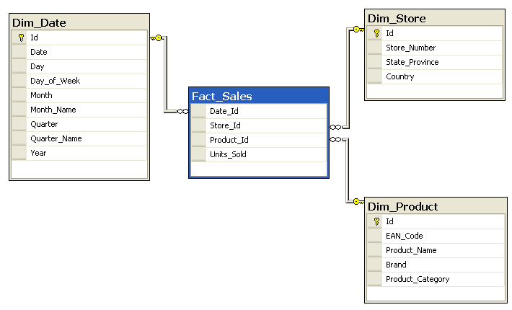
Star Schema Example
SELECT P.Brand, S.Country AS Countries, SUM(F.Units_Sold) FROM Fact_Sales F INNER JOIN Dim_Date D ON (F.Date_Id = D.Id) INNER JOIN Dim_Store S ON (F.Store_Id = S.Id) INNER JOIN Dim_Product P ON (F.Product_Id = P.Id) WHERE D.Year = 1997 AND P.Product_Category = 'tv' GROUP BY P.Brand, S.Country
From https://en.wikipedia.org/wiki/Star_schema
Notes:
Consider a database of sales, perhaps from a store chain, classified by date, store and product.
Fact_Sales is the fact table and there are three dimension tables Dim_Date, Dim_Store and Dim_Product.
Each dimension table has a primary key on its Id column, relating to one of the columns (viewed as rows in the example schema) of the Fact_Sales table's three-column (compound) primary key (Date_Id, Store_Id, Product_Id). The non-primary key Units_Sold column of the fact table in this example represents a measure or metric that can be used in calculations and analysis. The non-primary key columns of the dimension tables represent additional attributes of the dimensions (such as the Year of the Dim_Date dimension).
For example, the following query answers how many TV sets have been sold, for each brand and country, in 1997:

Slide 35
Structure Modeling Activities
Identify the important data entities.
Inspect the use cases and scenarios for nouns.
Normalization reduces model to purest form.
No repeated, redundant, duplicated information.
Sometimes helpful to leave data unnormalized in architecture so that you don’t miss anything.
Perform domain analysis to define legal value ranges for data attributes.
Not performed rigorously at architectural level, but a basic pass can inform your model.
Notes:
Formal information modeling includes a wide range of activities.
• The first step is to identify the important data entities. This is usually done by inspecting the scenarios and use cases for nouns such as customer, product, payment, or event. In an architectural description, you should focus on a small number of important entities.
• A process called normalization reduces the model to its purest form, in which there is no repeated, redundant, or duplicated information. It is rare for relational models to be taken beyond third-normal form, and from the architect’s perspective it is often more useful (although less rigorous) to model some information unnormalized.
• Domain analysis looks at attributes (fields) of data items and the rules that define their permissible values. For example, a customer number may always be a ten-digit integer with the last digit being a check digit, or a
telephone number is always a country code followed by a dialing code and a number. Domain analysis is important in schema design. Rigorous domain analysis may be too detailed for an AD, but you want to perform a basic pass over the data to inform your approach.

Slide 36
Information Flow Models
Analyze dynamic movement of information between elements of the system and the outside world.
Flows represent information transferred from one component to another.
Associated with a direction, scope of information transferred, volumetric information.
In a physical model, also includes how the information is transferred (flat files, JSON, XML messages).
Notes:
(1) These models identify the main architectural elements and the information flows between them.
Each flow represents some information transferred from one component to another—in other words, an information interface. Associated with each flow is a direction, the scope of the information transferred, volumetric information, and (in a physical model) the means whereby information is exchanged, whether it is a transfer of flat files or a real-time exchange of XML messages.

Slide 37
Information Flow Models
Bookseller
Member
Librarian
Check Out
Return
Book
Acquire Book
Dispose Of
Notes:
Ovals represent processes that manipulate information.
• Store also Narrow open rectangles represent data stores (logical or physical collections
of information).
• Arrows represent information flows.
• rectangles represent external entities (people or other systems that interact with this system).
Things to look at: Where is data created and destroyed? How do data items change as they flow through the system?
The diagram conveys several pieces of information.
• Members and the librarian provide information to the checkout and return
processes.
• A bookseller provides information to the acquire book process.
• The librarian provides information to the dispose of process.
• All this information is written to the BOOKS data store.

Slide 38
Information Lifecycle Models
Lifecycle models analyze the way information values change over time.
Entity Life Models
Model transitions data items undergo in response to external events, from creation to final deletion.
Can be a useful cross-check to ensure there is processing to deal with all of the life events for that entity.
Helps ensure entities are created in a controlled manner, and that all entities can be deleted.
Notes:
(1) Entity life histories model the transitions that data items undergo in response to external events, from creation through one or more updates to final deletion. A life history can be a useful cross-check to ensure that there is processing to deal with all of the life events associated with an entity. In particular, it can help you ensure that entities are created in a controlled manner and that all entities have a means of deletion.

Slide 39
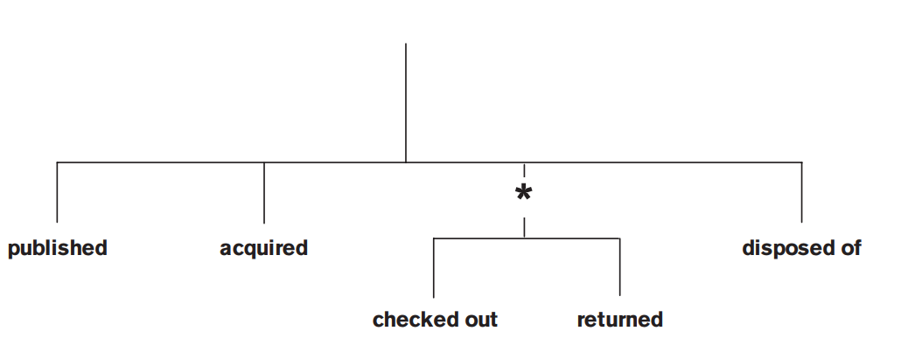
Entity Life Model
A book is initially published
It is then acquired by the library
Once on the shelves it alternates between available and checked out…
Until it is disposed of.

Slide 40
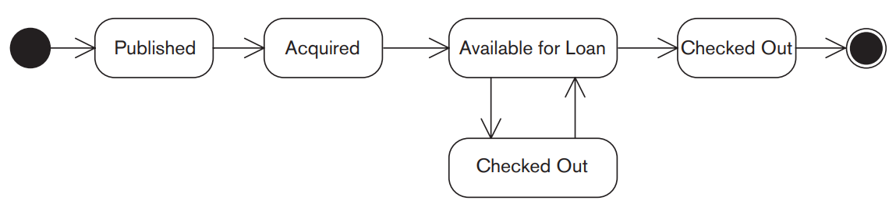
UML State Diagram
Model overall changes in an element’s state in response to stimuli.
Often used to model systems. Can also model state of a data entity.
Notes:
State transition models (or statecharts in UML terminology) model the overall changes in a system element’s state in response to external stimuli. This is a
useful way to model systems whose interactions with the outside world cause their internal state to go through many transitions in seemingly unpredictable ways. A statechart models a system element as a finite state machine (FSM). An FSM always has a current state, which is the sum total of the information it holds. When an external event occurs, the FSM changes deterministically to another state and may also instigate some special processing as a result of the change. (2)
A book is initially published; it is then acquired by the library, and once on the shelves it alternates
between being available for loan and checked out, until it is disposed of.

Slide 41
Information Ownership Model
Define the system that is the “owner” of each data item in the architecture.
A data item being a table or field.
Classes of ownership:
Owners hold definitive value for an item.
Creators create new instances of the item.
Updaters modify existing instances of the item.
Deleters delete instances of the item.
Readers can read, but not change, the item.
Copiers hold a read-only copy of the item.
Validaters perform validation of the item.
Combination of the above.
Notes:
Information ownership models define the owner for each data item in the architecture. In this context, “data item” typically means entity (table) or, occasionally, attribute (field), although more complex partitions can be modeled.
Of course, in practice, life is never this simple, and you may have to model a number of different classes of information ownership, such as:
• Owner or master, which holds the definitive value for that data item
• Creator, which creates new instances of that data item
• Updater, which modifies existing instances of that data item
• Deleter, which deletes existing instances of that data item
• Reader, which can read but not change instances of that data item
• Copy, which holds a read-only copy of that data item
• Validater, which performs validation on the data item to ensure that it meets
business rules
• A combination of these

Slide 42
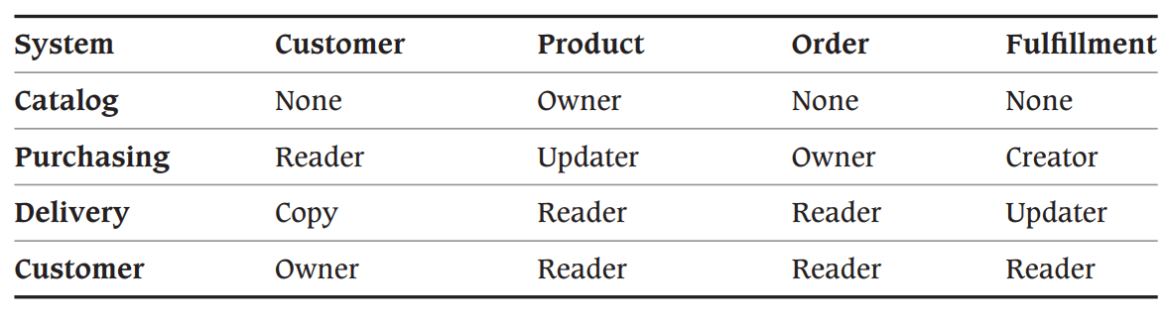
Information Ownership Model
Modeled using a grid, with systems and data stores on one axis and data items on other.
Shows conflicts in data ownership.
Notes:
Catalog and purchasing can both modify product

Slide 43
Problems and Pitfalls
Notes:
(discussion) Point is - there are a lot of different answers to this question

Slide 44
Representation Incompatibility
Simple: Different systems represent field-level information in different ways.
Different models (polar vs cartesian coordinates)
Different encoding (metric vs imperial)
Difficult: Different business models
Ex: Architecture integrates phone and sales systems
Phone customers may have multiple or shared numbers, each number has a “phone account”.
Sales system requires “customer accounts”.
These two are not compatible.
Notes:
At their simplest, data incompatibilities arise because different systems represent field-level information in different ways, either by using different models for the
information (e.g., polar versus Cartesian coordinates) or simply different encoding schemes (e.g., metric or imperial lengths). For example:
• One system may use Y and N for Boolean values, while another uses 1 and 0,
• One system may use standard ISO abbreviations such as FR or DE for countries, while another has its own numeric encoding.
• One system may record monetary amounts in euros, while another uses the local currency in which the transaction took place.
These sorts of problems are usually fairly easy to resolve. Much more problematic, however, are incompatibilities between business models.
For example, an architecture is required to integrate a telephone billing system with another system used to manage sales. A telephone customer may have several phone lines; for this reason, the billing system is based on the concept of a telephone account. some accounts may be held jointly by several customers (especially business accounts). The sales system is concerned solely with customers. However, the system needs to know about these customers’ existing accounts, as well as other details such as payment history and usage, in order to avoid trying to sell customers something they already have. The business models for these systems are fundamentally incompatible, and a lot of work is going to be needed to develop an architecture that successfully brings them together.

Slide 45
Representation Incompatibility
Reconciling business models requires complex processing.
Service that links customers and accounts.
Manages and stores links itself.
Would sit at center of architecture, require high performance, scalability, availability.
Risk reduction:
Develop a common high-level data structure model.
Include external entities in modeling efforts.
Develop a data abstraction layer to hide incompatibilities from other parts of architecture.
Notes:
Incompatible business models can usually be reconciled only by using what may turn out to be fairly complex processing. In the example, you would probably have to develop a service that was responsible for maintaining the links between customers and their accounts. This service would have to be updated when customers or accounts were created, deleted, or updated, or when the links between them were changed. It would own and manage the information itself and provide that data on demand to any other architectural element that required it. Such a service would sit at the core of the architecture, being accessed by many other architectural elements, with ambitious targets for performance, scalability, and availability. This service would need to be very carefully designed, built, and tested. Not an easy task.
Risk reduction:
Develop a common, high-level model of the data structure, the key data attributes, and their domains, and validate it against all parts of the system.
• Don’t forget to include external entities in your model (e.g., if you exchange data with other organizations).
• Consider developing a data abstraction layer on top of data sources to hide the incompatibilities from other parts of the architecture.

Slide 46
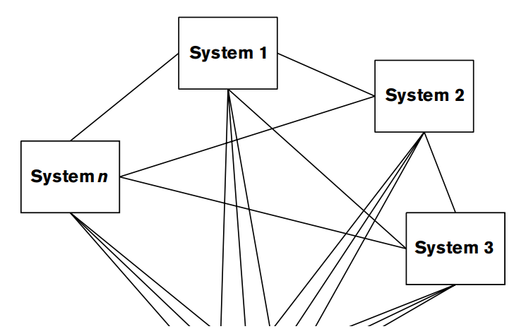
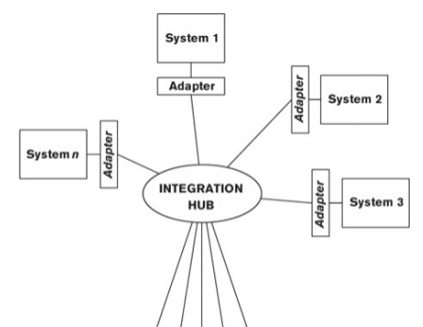
Interface Complexity
Integrating n data-sharing systems requires n (n - 1) / 2 interfaces.
Change to a system require changes to all interfaces accessing that system.
Can be fixed by applying an integration hub.
Adapter performs system-specific translation.
Hub handles message routing, resilience.
If a system changes, only the adapter needs to change.
Notes:
If two systems need to transfer information between themselves, one bidirectional interface needs to be built. For three systems, three interfaces are needed; for four systems, six. In the worst-case situation, if your architecture comprises n systems, each of which needs to exchange information with every other, you need to build n(n – 1)/2 interfaces. Change the interface definition for any one of your n systems, and n – 1 interfaces need to be redesigned, recoded, tested, and deployed. This represents a significant burden for developers and often acts as a barrier to change.
When interface requirements are complex, consider applying an integration hub. In this model, all systems are linked once via a specialized adapter to one central integration hub. The adapter performs system-specific translation, and the hub handles message routing, resilience, and more specialized functions such as publish and subscribe, acknowledgment, and guaranteed delivery. The advantage of this approach is that if a system changes, often only the adapter for that system needs to be modified. Furthermore, specialized code for routing, resilience, and so forth has to be implemented only once, in the central hub.

Slide 47
Overloaded Central Database
Central databases are simpler, cleaner. Do not need update reconciliation or complex interfaces.
Single point of failure, performance bottleneck, imposes geographical constraints.
Can cause data model to be overloaded.
Can impose design and runtime constraints.
Risk Reduction:
Consider likely growth rate.
Develop strategies for later data partitioning.
Plan for scalability.
Notes:
Many problems can be eliminated by storing all information in a single central database. This approach is much simpler and cleaner, since there is no need for key mappings, update reconciliation, or complex interfaces, and all data is immediately available
However, a single central database is a single point of failure and will eventually become a performance bottleneck. For geographically distributed systems, a central database will give poor latency for remote users, and they may find that system availability is constrained due to limitations of the global network. Managing all data in a single central database can cause the data model to become overloaded or unworkable and can cause design-time and runtime contention. For these reasons, care must be taken when designing a system based on a single central database.
Risk Reduction
• Carefully consider the likely growth of your system in terms of data volumes, numbers of users, and their locations.
• Be aware of the need to partition data in the future and design a strategy for it now (even if it is not yet implemented).
• If you do opt for a single central database, make sure that there are some scalability options available in case the system is more successful than expected.
• Look into the use of database clustering technologies and other mechanisms for improving availability and performance

Slide 48
Inconsistent Distributed Databases
Many problems are eliminated by replicating data in different locations.
Bring data close to where it is needed. Reduces latency and improves availability.
Often lead to information inconsistency due to replication delay.
Updates are hard to manage.
Risk Reduction:
Have strategies in place for dealing with inconsistency.
Ensure there are tools and processes for detecting data inconsistency.
Notes:
Conversely, some of the problems described today can be eliminated by replicating information between multiple databases in different locations or even geographical regions. This approach brings data near to where it is needed - physically or logically- , with a consequent reduction in latency and improvement in availability.
However, distributed information architectures are harder to design and build and often lead to information inconsistency due to the replication delay. Furthermore, updates are harder to manage in cases where replicate copies are not read-only. While these problems are not insurmountable, they require careful design and a solid implementation.
Risk reduction:
• If you adopt a distributed model, ensure that you have effective strategies in place for dealing with inconsistency and that these are agreed upon with your key stakeholders, especially users.
• Ensure that there are effective operational tools and processes in place for detecting and dealing with problems that can’t be dealt with automatically.

Slide 49
Excessive Information Latency
Overly complex architectures or architectures not designed for information volume can lead to excessive latency.
Latency issues from external systems are out of your control.
Identify expected latency early.
Can identify problem areas and address.
Close distance between providers and consumers.
Obtain agreement on latency requirements from stakeholders and validate that you meet them.
Notes:
Excessive latency typically arises from overly complex architectures or architectures that are not designed to handle the volumes of information they are presented with. You may also have latency issues that are outside your control. For example, information may arrive from an external source only once a week, or updates may need to be applied in batches overnight because of the
limitations of a legacy system. As with information quality, poor latency becomes an issue only if it is unexpectedly poor. By identifying expected latency early, you can identify problem areas and develop strategies to deal with them. When there is distance or complexity between information providers and information consumers, ensure that you predict, as best you can, what the information latency will be.
• When latency is significant, review this with your stakeholders to determine
whether it is a concern.
• Better still, obtain agreement on realistic latency requirements for all data
items up front, and validate your model against these.

Slide 50
Food for Thought
Do you have an appropriate level of detail in your data models?
(e.g., no more than 20–30 entities)
Does the data model support processing requirements now and in the future?
Are keys clearly identified for all entities?
When an entity is distributed across multiple systems or locations with different keys, are the mappings between these keys defined?
Do you have processes for maintaining these mappings when data items are created?

Slide 51
Food for Thought
Have you taken account of data that is derived from data managed elsewhere?
Have you defined strategies for resolving data ownership conflicts?
Are latency requirements clearly identified, and are mechanisms in place to ensure that these are achieved?
Do you have clear strategies for transactional consistency across distributed data stores?

Slide 52
Food for Thought
Have you considered which data storage models to use for the data stores?
Do you have mechanisms in place for validating migrated data?
Have you defined sufficient storage and processing capacity for archiving?
For restoring archived data?

Slide 53
Key Points
The Information View describes the way the system stores, manipulates, manages, and distributes information.
Modeled through static information structure models, information lifecycle models, information ownership models, information quality analysis, metadata models, and volumetric models.
Addresses concerns around information structure, ownership, data usage, volatility, storage models, flow, consistency, quality, timeliness, latency, age.

Slide 54
Next Time
Midterm Review
Practice midterm on site.
We will go over answers next time.
Homework:
Project Part 2 - Due on the 11th
Assignment 2 - Due on the 25th

