Slide 1
Viewpoints: Development, Deployment, and Operational
CSCE 742 - Lecture 15 - 16 -
10/30 and 11/01/2018

Slide 2
The Viewpoints
The Context, Functional, Information, and Concurrency Views define what you are building.
The static and runtime structure of the system.
The Development, Deployment, and Operational Views define how you will build the system.

Slide 3
The Viewpoints
This class and next…
The Development View defines how to implement the system.
The Deployment View defines how to transition the system to live operation.
The Operational View defines how to keep the system alive in the field.

Slide 4
Development Viewpoint
Notes:
(discussion) Point is - there are a lot of different answers to this question

Slide 5
Designing Development Environments
Supporting design, development, and testing of complex systems requires the right environment.
Code structure, dependencies, build management, design constraints, design standards.
The Development View addresses the concerns of developers and testers.
All software projects involve some amount of new code being written.
This view provides a stable environment for more detailed design work.
Notes:
A considerable amount of planning and design of the software development environment is often required to support the design, build, and testing of software for complex systems. Things to think about include code structure and dependencies, build and configuration management of deliverables, system-wide design constraints, and system-wide standards to ensure technical integrity.
It is the role of the Development view to address these aspects of the system development process. The development view addresses the specific concerns of the software developers and testers.This viewpoint is relevant to nearly all large system projects because almost all of them have some element of software development, whether it is configuring and scripting off-the-shelf software, writing a system from scratch, or something between these extremes.
The importance of this view depends on the complexity of the system being built, the expertise of the software developers, the maturity of the technologies used, and the familiarity that the whole team has with these technologies.You should view your work as providing a stable environment for more detailed design work that will be performed as part of software development.

Slide 6
Concern: Structure Organization
Software is often organized into groups of related classes or functions.
Some languages have built-in support for this: Packages in Java, Namespaces in C#.
We will refer to them generically as packages.
Packages are groupings of functionality
Classes in Java, groups of functions in C.
Packages are not functional elements.
Elements may contain packages (for organizing source code).
Packages may depend on component interfaces.
Notes:
The large systems you are likely to encounter may be built from hundreds of thousands of lines of source code spread over thousands of files. How you organize that code matters.
Source files are normally organized into larger units that contain related code - (1) called various things in different languages (2-3).
Arranging code in a logical structure like this helps to manage dependencies and helps developers to understand code and work on it without affecting other collections of code in unexpected ways. (4-8)
When working with a complex package structure, you need to identify and thoroughly understand and manage the dependencies between the packages to avoid ending up with a system that is difficult and error-prone to maintain, build, and release.

Slide 7
Package Diagrams
Packages can be specified in design phase using UML Package Diagrams
Folders indicate packages.
Classes are often listed inside the folder (omitted to save space).
Arrows indicate dependencies.
Can be annotated with <<import>> (one package imports from another) or <<merge>> (a package is composed of multiple subpackages).
Unlabeled arrow can be interpreted as an <<import>>
Data Model
Business Rules
<<import>>
<<import>>
Core Interface
Notes:
The package model defines the organization of the system’s source code, in terms of the packages into which the individual source files will be collected and the dependencies among these packages. Now, keep in mind that you don’t need to have a clear idea of what those files are at the start. You may not have even designed individual classes. Rather, these are conceptual units that may change - but you can lay out guidelines. Now, at times, this view is not constructed until later in design when you do have classes in mind. In any case.. (go over)

Slide 8
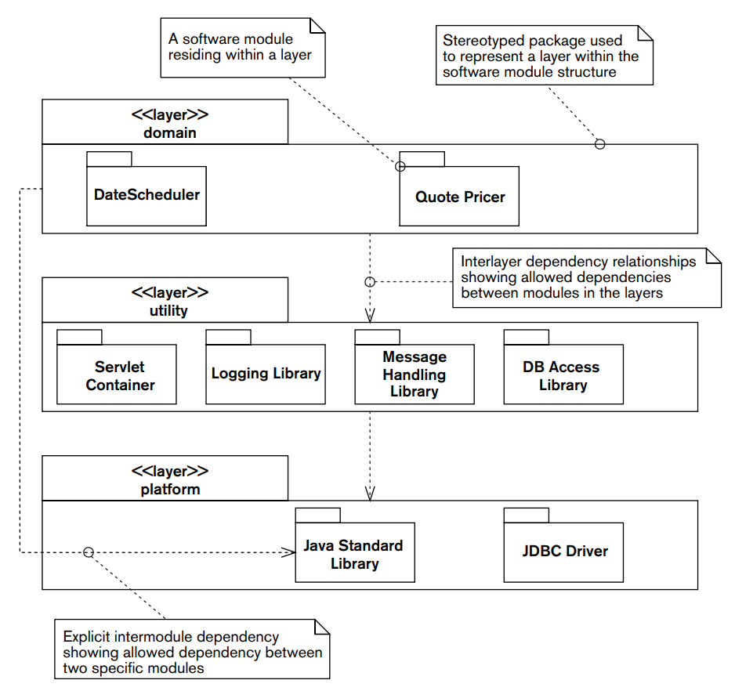
Layered Package Diagrams
Notes:
It is also common to impose some degree of higher-level organization on the modules themselves to avoid having to enumerate many individual dependencies.
Once you have identified a set of packages into which you can organize the source files, you can use the common architectural approach of grouping packages at similar abstraction levels into layers. You can then organize these layers into a dependency stack from the most abstract or highly functional (conceptually at the top) down to the least (at the bottom). You can then define interlayer dependency rules to avoid unwanted dependencies between packages at different abstraction levels. Typically, software in a package communicates only with other pakages at the same layer or in the layers directly above and below it (although there are often exceptions to this rule for performance or efficiency reasons).
This layer model shows a module organization with three layers, each layer being represented by a stereotyped package. The system’s modules are shown as UML packages within the layers. The model shows that the domain layer depends on the utility layer, which in turn depends on the platform layer (i.e., the domain-layer components can access only the utility-layer components, and so on). However, you can also see that nonstrict layering has been used in this system because all of the domain-layer components depend on facilities provided by the Java Standard Library component rather than accessing its facilities via intermediate utility components. (In contrast, the domain-level components cannot access the JDBC Driver component.)

Slide 9
Package Design Activities
Identify and classify the packages
Group source code files or packages (if they exist) or logical element subdivisions into packages.
Group package when it makes sense.
Identify the package dependencies
Identifies impact of making changes.
Identify layering rules
Can packages call packages only in their layer and one above/below, or throughout structure?
How do you preserve performance and flexibility?
Notes:
Identify and Classify the Modules. Group the source code for the system - files or packages (if they exist), logical elements- into a set of packages, and (optionally) classify them—by abstraction or other criteria— into a higher-level organization.
Identify the Module Dependencies. Identify a clear set of dependencies between the packages (or the higher-level groups) so that everyone involved in the design and construction of the system can understand the impact of making changes.
Identify the Layering Rules. If a layered approach is to be used, you need to
design a set of rules to be followed with respect to the layers. Can packages call packages only in their own layer and the one above or below, or do you want a less rigid rule in order to meet system quality properties such as performance and flexibility?

Slide 10
Package Cohesion Principles
Packages are a source code management and a release management idea.
Source management: grouping related classes.
Release management: for use, packages are often distributed as libraries
Jar files in Java; Assemblies in C#, .lib / .dll / .a files for C code.
Package design follows principles:
Reuse-release equivalence principle
Common reuse principle
Common closure principle
Acyclic dependencies principle
Notes:
It is important to remember that (1) - (2), making it easier to identify code of interest and change the code. (3) In service of both ideas (4-7)

Slide 11
Reuse-Release Equivalence Principle
Granule of reuse is the granule of release.
To reuse code, it must arrive in a complete, black-box, package that can be used but not changed.
Packages should be tracked using change-control system.
Package should be understood in terms of public functions / classes / interfaces.
No need to look at all the source code.
Each package is treated like a product.
Notes:
The granule of reuse is the granule of release. Only components that are released through a tracking system can effectively be reused. This granule is the package. This means that in order to effectively reuse code it must arrive in a complete, black-box, package that is to be used but not changed. Code should not be reused by copying it from one class and pasting it into another. If the original author fixes any bugs in the code, or adds any features, you will not automatically get the benefit. You will have to find out what's changed, then alter your copy. Your code and the original code will gradually diverge. Instead, code should be reused by including a released library in your code. The original author retains responsibility for maintaining it; you should not even need to see the source code. Effective reuse requires tracking of releases from a change control system The author of a library needs to identify releases with an identifier - numbers or names of some sort. This allows users of the package to identify different versions. This requires the use of some kind of release tracking system. The package is the effective unit of reuse and release It might be possible to use a class as the unit of reuse and release, however there are so many classes in a typical application, it would be hard for the release tracking system to keep track of them all. A larger-scale entity is required, and the package fits this need well.
(4-6)

Slide 12
Common Reuse Principle
Improper grouping of classes creates unwanted dependencies.
Classes that tend to be reused together belong in the same package.
If not, then perhaps they should be in separate packages.
The classes in a package are reused together. If you reuse one of the classes, you reuse them all.
All classes in the package should be reusable in the same context.
Notes:
it is very important to decide which classes should be bound together by a package. Improper selection of classes can create unwanted dependencies and turn usage of that package into a nightmare. Common Reuse Principle (CRP) lays down a good foundation to determine which classes should be packaged together: (2-4) This says that only cohesive classes should be packaged together. As with everything, the packaging of classes and the cohesiveness should be defined from the user’s perspective. If a user uses a package, all the classes in that package should be reusable in the same context. A rule that can be a derivative of this is that all the classes related to a functionality should be packaged together. For example, if I am using a package for matrix calculations, it better have only those classes related to matrices and not trigonometric functions. As specified by Reuse/Release Equivalency Principle (REP), even if one or two classes are being used, the granularity to be considered is the entire package. This dependency means that with every revision or release of that package, the software has to be tested and revalidated, whether the modified class is being used or not. Hence, only those classes should be packaged together which will be reused together.

Slide 13
Common Closure Principle
If one class needs to be changed, they all are likely to need to be changed.
Conversely, all classes within a package are closed to the same kinds of changes.
Helps pull tightly-coupled classes together in one package.
To enable easy distribution, updates, release, maintainability, localize all changes to a package.
A change will affect a minimal number of packages.
Notes:
Classes within a released component should share common closure. That is, if one needs to be changed, they all are likely to need to be changed. What affects one, affects all. The principle advises on which classes should be packaged together from a change and distribution point of view. (2). Even though most of the class design principles advocate loose coupling between classes, so that they can change without affecting the other, dependencies between classes cannot be avoided. This principle tries to look at classes that are dependent on each other from a code change perspective. (3) To enable easy distribution/update/release and maintainability, it is advisable to localise the changes to a package. Only the modified package can then be released, making the update easier. Even if the changes cannot be restricted to a single package, minimal packages should be required to be changed.

Slide 14
Acyclic Dependencies Principle
The dependency graph between packages must be acyclic.
That is, if package A depends on package B, then B must not depend on A.
Packages are units of work and reuse.
Versioned; clients can decide when to upgrade.
Changes to one package should not require an immediate update by other teams.
Graph makes the dependencies of packages explicit.
Cycles in the graph would break versioning.

Slide 15
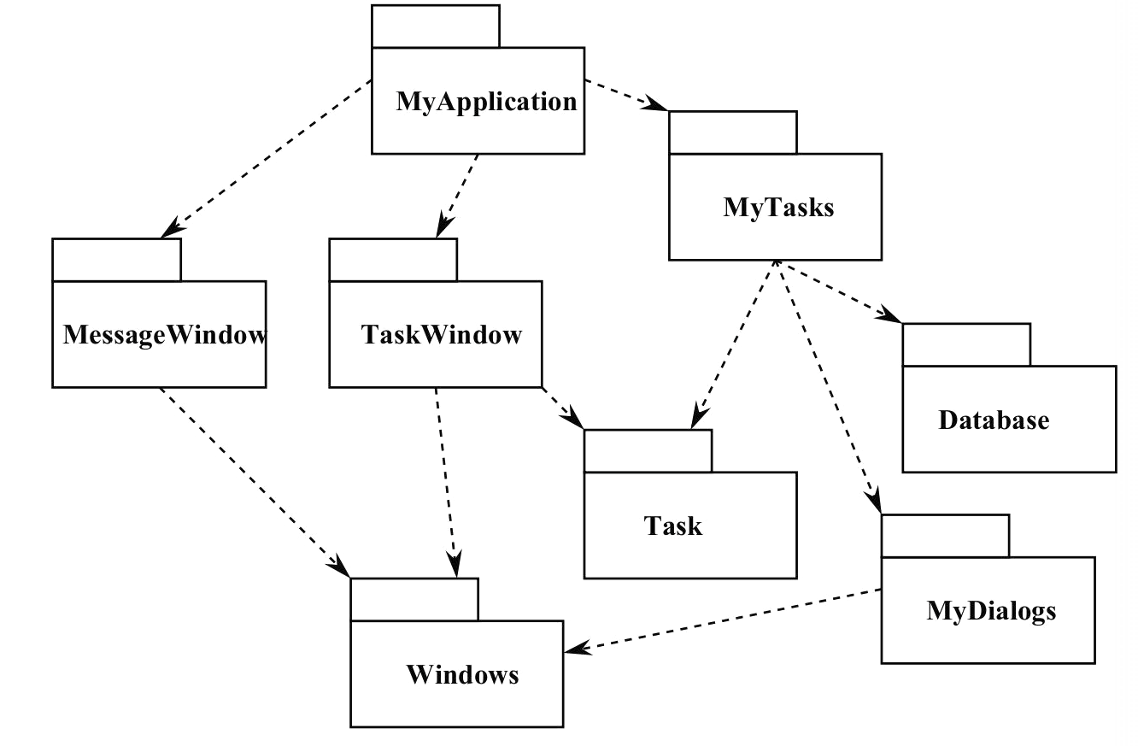
Acyclic Example (Good)
Modification Effect:
Changes to MyDialogs affect MyTasks and MyApplication.
Notification dependency between teams.
Dependency
Testing MyDialogs requires the Windows package (or a mock version).
Notes:
Ragardless of which package you begin at, it is impossible to follow the dependency relationship and come back to that package. Notice what happens if you make a change to MyDialogs (2) The teams responsible for those packages can decide when to integrate with a new release of MyDialogs. When MyDialogs is released, it has no effect on many other packages in the system. They don’t know about it and don’t care when it changes. This is great. The impact of a release is small.
If the engineers developing the MyDialogs package would like to test their package, they only rely on the Windows package (or a mock version of it). None of the other packages need to be involved. This is also great, as the engineers responsible have little work to do in terms of setup, and there are fewer problems that can spill over.
When it is time to release the whole system, this is done from the bottom up - (walk through structure) This process is very clear and easy to deal with. We know how to build this because we understand dependency between the parts.

Slide 16
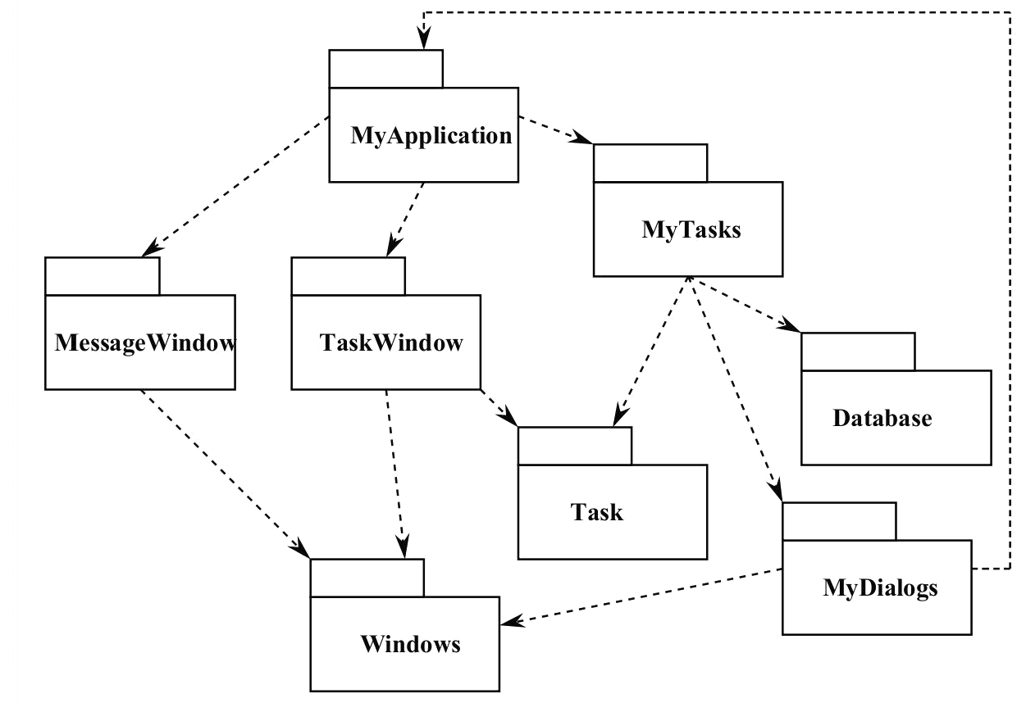
Cyclic Example (Bad)
Release:
Must be simultaneous with MyApplication.
But this means MyTasks must also be coordinated (it is a dependency of MyApplication and depends on MyDialogs).
This means that it must also be coordinated with Task and Database (dependencies of MyTasks).
Testing:
MyDialogs requires MyApplication, so…
MyDialogs is dependent on all packages(!) for testing!
Notes:
Now, let’s say we updated MyDialog with a change that requires the MyApplication package. We’ve introduced a cycle in this graph. What does this mean? It causes some immediate problems. (go over) In effect, this system has become one huge package.

Slide 17
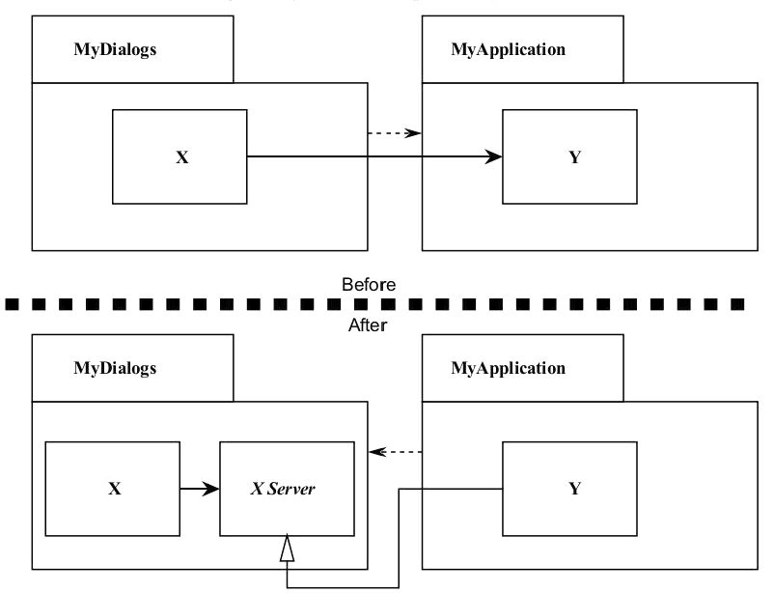
Fixing Circular Dependencies
Apply the Dependency Inversion Principle.
Create an abstract class with the interface MyDialogs needs.
Put the class into MyDialogs
Inherit into MyApplication.
Reverses the dependency, breaking the cycle.
Notes:
It is always possible to break a cycle of packages and get an acyclic graph. There are two primary mechanisms. (1) We can crate an abstract base class that has the interface MyDialogs needs. Then, put that into MyDialogs and inherit it into MyApplication. This inverts the dependency. - breaking the cycle.

Slide 18
Package Refactoring
Can also create third package with class(es) that both MyApplication and MyDialog depend on.
Package contents and dependency hierarchy must be actively managed and refactored.
Dependencies will change as system expands.
Circular dependencies must be pruned out.
Coordinating this movement is important job for architect.

Slide 19
Concern:
Standardizing Common Processing
Isolate common processing into separate code packages.
Logging in a single package.
Error Management in a single package.
...
Identify and specify areas of common processing.
Define design guidelines, patterns, and packages for these features
Notes:
A second concern is (title)
Any large system will benefit from identifying and isolating common processing into separate code packages. For example, standardizing how the system logs messages and handles configuration parameters can significantly simplify its administration. The Development view helps ensure that the areas of common processing are identified and clearly specified. You will typically start this only in outline form, adding further refinement and detail as development progresses. (6)

Slide 20
Establishing Design Constraints
Establish design principles and constraints.
Reduces risk and effort duplication by defining a standard approach to problem solving.
Commonality in system elements increases overall technical coherence and makes it easier to understand, maintain, and use.
Requires definition of:
Common processing
Standard design approaches
Common external software elements
Notes:
To maximize commonality across element implementations, it is desirable to define a set of design constraints that apply when designing the software elements. Such design constraints are valuable for two principal reasons.
• You can reduce risk and duplication of effort by identifying standardapproaches to be used when solving certain types of problems.
• Commonality among system elements helps increase the system’s overall technical coherence and makes it easier to understand, operate, and maintain.

Slide 21
Common Processing
How do we perform…
Initialization and recover
Termination and restart
Message logging and instrumentation
Internationalization
Processing configuration parameters
Security (authentication, encryption)
These aspects of element design benefit greatly from using a common approach.
Even if we can’t just define a single package containing this type of processing.

Slide 22
Example: Message Logging
All components must log human-readable messages that clearly state what has occurred and any corrective action that is expected in response.
Messages must be logged at one of the following levels: Fatal, Error, Warning, Information, Debug.
Elements should log messages at all five possible logging levels.
Logging should be achieved via a standard library (as defined later) to standardize destination, format, configuration, and so on.
Notes:
(1-2) Fatal should be used to indicate an unrecoverable error, where the component will stop immediately; Error indicates an unrecoverable error, where the component can reset itself and continue execution; Warning indicates a possible error or unexpected condition that may need operator intervention to review and address; Information is used to report conditions that occur during normal operation and require no operator intervention; Debug should be used to indicate internal details of the component’s operation.

Slide 23
Design Constraints
Define standard design approaches.
Look for situations where common processing is performed orr where implementation of an element has system-wide impact.
Define the approach, where it will be used, and why it should be used.
Design patterns - recipes for solving design problems.
Define common external elements
Identify external software that can be reused to save development time or effort.
Identify where and how it will be used.
Notes:
A definition of standard design approaches that should be used when designing the system’s elements. These start to emerge when (having defined the functional structure) you think ahead a little about how the subsystems might be implemented. When you see situations where the same sort of processing is performed by different elements, or where you know that the implementation of a certain aspect of an element will have a system-wide impact, you should consider whether you need a standard design approach. When identifying such an approach, you must define what the approach is, where it should be used, and why it should be used. In other
words, it is a special sort of design pattern.
A definition of what common software should be used and how it should be used. This may be the result of making other higher-level decisions (e.g., selecting an access library for your chosen database) or identifying a
reusable component (e.g., a third-party message-logging library or a locally developed graphical user interface element) that can save you development time and reduce risk. In either case, your common design model needs to
clearly identify what common elements should be used, where they should be used, and how they should be used.

Slide 24
Example: Standard Design for Internationalization
For internationalization of locale-sensitive resources, use an external resource catalog to store resources outside the source code files.
This means that all strings must be extracted from a message catalog before they can be used in a program (e.g., to write a log message).
As the server software is being written entirely in Java, the internationalization implementation will use the Java Platform’s native internationalization facilities: the resource bundle, the formatting classes in the java.text package, and the Locale class.
The relationships between these different elements of the internationalization technology are as follows. [. . .]
[You would place a definition of a design pattern for using the Java internationalization facilities here.]
Notes:
(internationalization - process of adapting the software to be used in multiple languages or locations)

Slide 25
Example: Standard External Elements for Logging
All message logging must be performed using the standard CCJLog package, which is part of the standard build environment.
The CCJLog package must be used in a standard way, which is documented as a code sample in the src/server/sample/logging/CCJLog source directory.

Slide 26
Concern:
Design and Testing Standardization
Design
Software is developed by teams.
Try to ensure common approaches to architectural design, class design, use of patterns, and interface design.
Establish clear guiding principles, based on quality.
Testing
Define common approaches, tool use, and testing conventions to ensure consistent testing efforts.
Requires reasonable tool chain and workflow, standard test data, and automation.
Notes:
Standardization of Design
Most systems are developed by teams of software developers rather than individuals. Standardizing key aspects of design provides critical benefits to the maintainability, reliability, and technical cohesion of the system (and saves time, too). You can achieve design standardization by using design patterns and off-the-shelf software elements, and establishing clear architectural principles.
Standardization of Testing
Standardization of test approaches, technologies, and conventions helps ensure a consistent approach to testing and speeds up the testing process. Key concerns include test tools and infrastructure, standard test data, standard test approaches, and test automation.

Slide 27
Concern: Codeline Organization
Code must be stored in directories, managed in source control, built and tested regularly, and released into production.
Managed through the codeline structure.
Source control files with a well-defined structure.
Stored in version management.
With a associated automated system to build, test, and release the system.
Should be defined as part of the development view.
Notes:
The system’s source code needs to be stored in a directory structure, managed via a configuration management system, built and tested regularly (ideally every
time the software changes—“continuous integration”), and released as tested binaries for further testing and use. The way that all of this is achieved is normally termed the codeline organization for a system. The codeline is a
particular version of a set of source code files with a well-defined organizational structure, usually with an associated automated system to build, test, and release the system.
Ensuring that the system’s code can be managed, built, tested, and released is crucial to achieving a reliable system—particularly when you’re using iterative development and many releases are necessary. As an architect, you may wish to specify how this is to be done, or better still, work with the development team to define the approach and design its implementation.

Slide 28
Codeline Organization
Codeline organization captures:
How code will be organized into source files.
How the files will be grouped into modules.
What directory structure will be used to hold the files.
How the source will be automatically built and tested.
What type of tests will be run and when they are run.
How the binaries will be released into a test or production environment for testing and use.
How the source will be controlled using configuration management to coordinate multiple developers.
What automated tools will be used for the build, test, and release process and how they will work together.
Notes:
(1-5) to form candidate releasable binaries
(6-8) working on it concurrently
(9) in order to form a complete continuous integration and delivery system

Slide 29
For any system of substantial size, continuous integration should be the goal Every time a commit occurs on stable or development branch System is automatically rebuilt Tests are run in increasing scope: unit / subsystem / system Failures are reported to interested stakeholders Goal: always have a shippable product.

Slide 30
Continuous Integration
Development practice that requires code be frequently checked into a shared repository.
Each check-in is then verified by an automated build.
The system is compiled and subjected to an automated test suite, then packaged into a new executable.
By integrating regularly, developers can detect errors quickly, and locate them more easily.
Goal: always have a shippable product!
Notes:
One area where test automation is essential - and has made possible - is continuous integration.
Continuous Integration is a development practice that requires developers to integrate code into a shared repository several times a day. Each check-in is then verified by an automated build (3)
By integrating regularly, you can detect errors quickly, and locate them more easily. CI requires significantly less back-tracking to discover where things went wrong, so you can more efficiently build the system. (5)

Slide 31
CI Practices
Maintain a code repository.
Automate the build.
Make the build self-testing.
Every commit should be built.
Keep the build fast.
Test in a clone of the production environment.
Make it easy to get the latest executable.
Everyone can see build results.
Automate deployment.
Notes:
(1) The first practice advocates the use of a revision control system for the project's source code. All artifacts required to build the project should be placed in the repository. the system should be buildable from a fresh checkout and not require additional dependencies. Everybody should be actively using source control, and committing code changes at least once - if not several times per day.
(2) A single command should have the capability of building the system. Think of something like Make in Unix - a script you write that builds the system. Maven is a more modern concept for Java that lets you define a series of actions used to compile, test, and package the code. Automation of the build should include automating the integration of program components, which often includes deployment into a production-like environment. In many cases, the build script not only compiles binaries, but also generates documentation, website pages, statistics and distribution media
(3) Once the code is built, all tests should run to confirm that it behaves as the developers expect it to behave. This requires test automation.
(4) The system should build commits to the current working version to verify that they integrate correctly. A common practice is to use Automated Continuous Integration, where a continuous integration server or daemon monitors the revision control system for changes, then automatically runs the build process.
(5) The build needs to complete rapidly, so that if there is a problem with integration, it is quickly identified.
(6) Having a test environment can lead to failures in tested systems when they deploy in the production environment, because the production environment may differ from the test environment in a significant way. The test environment should be built to be a scalable version of the actual production environment.
(7) Making builds readily available to stakeholders and testers can reduce the amount of rework necessary when rebuilding a feature that doesn't meet requirements. Additionally, early testing reduces the chances that defects survive until deployment. Finding errors earlier also, in some cases, reduces the amount of work necessary to resolve them.
All programmers should start the day by updating the project from the repository. That way, they will all stay up to date.
(8) It should be easy to find out whether the build breaks and, if so, who made the relevant change.
(9) Most CI systems allow the running of scripts after a build finishes. In most situations, it is possible to write a script to deploy the application to a live server that everyone can look at. Sometimes, the software is deployed directly into production, often with additional automation to prevent defects or regressions.

Slide 32
How Integration is Performed
Developers check out code to their machine.
Changes are committed to the repository.
The CI server:
Monitors the repository and checks out changes when they occur.
Builds the system and runs unit/integration tests.
Releases deployable artefacts for testing.
Assigns a build label to the version of the code.
Informs the team of the successful build.
Notes:
(go over)

Slide 33
How Integration is Performed
If the build or tests fail, the CI server alerts the team.
The team fixes the issue at the earliest opportunity.
Developers are expected not to check in code they know is broken.
Developers are expected to write and run tests on all code before checking it in.
No one is allowed to check in while a build is broken.
Continue to continually integrate and test throughout the project.
Notes:
(go over)

Slide 34
Common Approaches
Build environment
Machine configuration can be problematic
https://travis-ci.org/
Build from bare-bones linux platform
Ensures build works on clean install
Deployment as Virtual Machine
Application is packaged up as part of an image
Can easily be “spun up” on many machines
Deployment as container
https://www.docker.com/
Like a “lightweight VM”
Allows isolated “microcomponents” to be easily deployed.

Slide 35
Food for Thought
Have you defined a clear strategy for organizing the source code packages?
Have you defined a set of rules governing the dependencies that can exist between packages at different abstraction levels?
Have you identified all of the aspects of element implementation that need to be standardized across the system?
Have you clearly defined how any standard processing should be performed?

Slide 36
Food for Thought
Have you identified standard approaches to design that you need all element designers and implementers to follow?
If so, do your software developers accept and understand these approaches?
Will a clear set of standard third-party software elements be used across all element implementations?
Have you defined the way they should be used?

Slide 37
Food for Thought
Will the development and test environments work reliably and be usable and efficient for developers and testers to work in?
Have you defined a set of tools to automate the build, integration, test, and release processes?
Does the set of tools include internal or third-party tools that you require to deploy to the test and production environments that you are using?

Slide 38
Deployment Viewpoint
Notes:
(discussion) Point is - there are a lot of different answers to this question

Slide 39
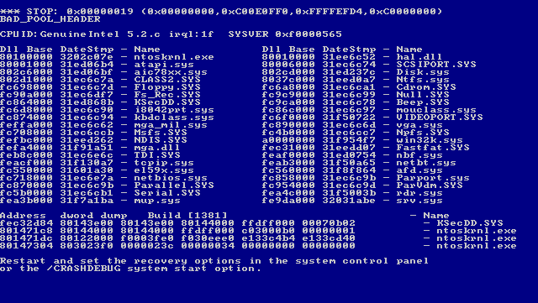
… But it worked when I tested it?!?!
Planning and documenting deployment is a key (and overlooked) part of successful development.

Slide 40
The Deployment View
Focuses on aspects of the system important after the system has been built and is ready to be put into live operation.
Defines:
The physical environment it will run in.
Hardware and hosting environment (processing nodes, network interconnections, disk storage).
Technical environment requirements for each processing node.
Mapping of elements to the runtime environment that will execute them.
Notes:
The Deployment view focuses on aspects of the system that are important after the system has been built and needs to be validation tested and transitioned to
live operation. This view defines the physical environment in which the system is intended to run, including the hardware or hosting environment (e.g.,
processing nodes, network interconnections, and disk storage facilities), the
technical environment requirements for each type of processing node in the
system, and the mapping of your software elements to the runtime environment
that will execute them.

Slide 41
When do I need this?
When the system has…
Complex runtime dependencies.
Third party libraries, network services.
Complex runtime environments.
Elements distributed across many machines.
Dependencies on unfamiliar HW/SW.
Deployed on cloud hardware.
When the system will be deployed in…
Wildly varying software environments.
Commercial software run on a PC.
Wildly varying physical environments.
Specialist or unfamiliar hardware.
Notes:
Deployment view is useful for any information system with a required deployment environment that is not immediately obvious to all of the interested stakeholders. This includes situations where:
• Systems have complex runtime dependencies (e.g., specific third-party software packages or particular network services are needed to support the system)
• Systems with complex runtime environments (e.g., elements are distributed over a large number of machines)
• Systems hosted in third-party environments, such as hosting services or public clouds, in order to allow a clear definition of the environment required and how the system will deploy into it
Or when the system will be deployed in
• a number of different environments and the essential characteristics of the required environments need to be clearly illustrated (which is typically the case with packaged software products)
• a number of physical environemtns - Systems that need specialist or unfamiliar hardware or software in order to run

Slide 42
Concern: Runtime Platform Required
Must identify the runtime platform and role of each part.
Compute nodes, special-purpose nodes for databases, storage, print and input devices, network services (firewalls), specialist hardware, etc.
Must define how the platform is provided.
In-house physical hardware, virtual servers in the cloud from a third party, public cloud, etc.
Define physical location of each part of the platform.
Define types of processing elements, dependencies between them, and mapping of functional elements to processing.
Notes:
The Deployment view must clearly identify the type of runtime platform that the system needs and the role that each part of it plays. This includes general-purpose compute nodes to host servers and computational logic, special-purpose compute nodes to host database engines, storage for databases and file systems, devices that allow users to access the system or print information, network services required to meet certain quality properties (such as firewalls for security), specialist hardware (such as cryptographic accelerators), and so on.
The manner in which the platform is provided, whether it be physical hardware commissioned in-house, virtual servers and storage provided by a third-party hosting company, the use of a public cloud computing environment, or some other option, needs to be clearly defined too, as does the location of each part of the platform.
Defining the runtime platform involves identifying the general types of processing elements required (such as compute server node, application server node, storage array, and so on), defining the dependencies between them, and mapping each of your functional elements to one of these types. In effect, this is a logical model of the runtime platform that your system requires. Then, when you have defined what each piece of the platform is used for, you can think about the details of exactly what hardware elements you need to provide it.

Slide 43
Concern: Specification and Quantity of Hardware or Hosting
Physical model of the hardware needed.
Can specify hardware you will purchase or for abstract virtual machines.
Developers are interested in:
Intel or Sun CPUs, Linux or Windows, resources
System admins are interested in:
What hardware and how much.
What service level will you maintain?
Do you need specific hardware, or general purpose?
Notes:
This concern, which follows from the previous one, addresses the specific details of the hardware that will need to be procured and commissioned in order to deploy the system—in effect, a physical model of the hardware your system needs. This hardware may need to be ordered and commissioned in-house or via a third party or may be specifications for a virtual computing environment, such as ordering capacity from a cloud computing supplier.
This is a separate concern from the previous one because it is much more specific and of interest to different stakeholders. For example, developers are interested in whether the deployment platform will use Intel or Sun SPARC servers; whether the servers will run Linux, HP-UX, or Windows; and what general processing resources will be available to them. However, system administrators are interested in the detailed specification and quantity of the hardware elements or specification of the hosting environment that needs to be acquired to create your runtime environment. The service-level agreements
(SLAs) for each part of the runtime environment will also need to be agreed to and validated as acceptable for the level of service your system needs to provide.
Be specific when considering the specification, quantity, and service level of the hardware and services that you need. If specific models of equipment or specifications of hosted environment services are required, you need to clearly identify and record them for easy reference. If specific models or services aren’t required, you should still be precise where needed.

Slide 44
Concern: 3rd Party Software
Most systems rely on 3rd party OS, libraries, messaging, application servers, databases.
Make clear all dependencies between your system and any 3rd party products.
Are there hardware requirements for these?
Tells developers what they can make use of.
Tells sys admins what they need to install and maintain.
Analysis shows gaps in context and functional views.
Notes:
All modern systems make use of third-party software as part of their deployment environment—even if only an operating system. Many systems make use of dozens of third-party software products, including operating systems, programming libraries, messaging systems, application servers, databases, data movement products, Web servers, and so on. If you are deploying your system to a platform-as-a-service environment, there is probably a specific set of platform services and options that you need in order for your system to run successfully.
Your Deployment view should make clear all of the dependencies between your system and any third-party software products.(3)
This ensures that the developers know what software will be available for them to use and that the system administrators know exactly what needs to be installed and managed on each piece of hardware. It also helps you to spot any gaps in your analysis as early as possible.

Slide 45
Concern: Network Environments
Elements may be deployed on multiple machines. Some interelement interactions are actually network interactions.
What services are required on the network?
How are machines linked?
What communication protocols are used?
Do we require load balancing, firewalls, encryption?
What is the required capacity, latency, and reliability of the links?
How much traffic will be carried over each intermachine link?
Notes:
Your Functional and Concurrency views define the functional structure of your architecture and make it clear how its elements interact. Part of the process of creating the Deployment view is to decide which hardware elements host each of these functional elements. Because elements that need to communicate often end up on different machines, some of the interelement interactions can be identified as network interactions.
One of the concerns the Deployment view addresses is the set of services that the system requires of its underlying network as a result of these network interactions. This view needs to clearly identify the required links between machines; the communications protocols used; any special network functions the system requires (load balancing, firewalls, encryption, and so on). And the required capacity, latency, and reliability of the links;
You need to know how much network capacity your system requires and the type of traffic you need to carry over the network. In order to provide this information, you must estimate and record the amount and type of network traffic that needs to be carried over each intermachine link in the proposed network topology.

Slide 46
Runtime Platform Elements
Runtime model defines the set of hardware nodes, how nodes connect via interfaces, which software elements are on which hardware nodes.
Processing nodes
Each computer is represented by a processing node.
Allows estimation of the resources needed for deploying the system.
Where similar machines are required (server farms), can summarize as groups of nodes.
Notes:
The runtime platform model is the core of this view. This description defines the set of hardware nodes that are required, which nodes need to be connected to
which other nodes via network (or other) interfaces, and which software
elements are hosted on which hardware nodes.
A runtime platform model has the following main elements.
• Processing nodes: Each computer in your system is represented by one processing node in the runtime platform model. This allows you and other stakeholders to see what processing resources are required for the system. For situations where many similar machines are required (e.g., Web server farms), you can use a summary notation to simplify the diagram, but make sure that the number of nodes required is still clear.

Slide 47
Runtime Platform Elements
Client Nodes
Also represent client hardware (in less detail).
Less control, but can note type and quantity.
Speciality hardware is considered a “client node” (printers, touch screens).
Runtime Containers
Special virtual machines that provide a sandboxed runtime environment for deployed elements.
Online Storage Hardware
How much storage, what type, how partitioned.
Required reliability and speed.
Where does processing take place.
Notes:
• Client nodes: You also need to represent client hardware, but probably in less detail than the main processing hardware. You may have less control over client hardware than server hardware, and if this is the case, you need
only represent the types and quantities of client machines required rather than the precise details of each. If you have special needs for presentation or user interaction hardware (e.g., touch screens, printers), this is specified as part of the client hardware.
• Runtime containers: Client and server nodes may need to provide a runtime container (such as a software application server or a client virtual machine) to provide a suitable runtime environment for the functional elements deployed onto them.
- Online storage hardware: This defines how much storage is needed, of what type, how it is partitioned, what it is used for, the assumptions you are
making about its reliability and speed, and whether or not processing takes place close to its associated stored data. The storage hardware could be disk devices within a processing node or dedicated storage nodes such as disk arrays. Make the distinction between the two types clear so that the physical impact of separate storage nodes on the deployment environment is understood. You need to include the capacity (and possibly speed) of each type of storage hardware in the model.

Slide 48
Runtime Platform Elements
Offline Storage Hardware
Archival and backup of data.
Ensure capacity, sufficient hardware speed, and network bandwidth.
Network Links
Links between hardware nodes.
Network model captures more detail.
Other Hardware Components
Network security, user authentication, special interfacing with systems, specialist processing.
Notes:
• Offline storage hardware: many systems that deal with a lot of information require offline storage (archives) as well. Offline storage will also probably be required to allow backup of information held online. You need to ensure that there is sufficient capacity, that the hardware is fast enough to complete archive and retrieval in an acceptable time, and that there is sufficient network bandwidth between it and the online storage. The requirements for the type, capacity, speed, and location of your offline storage hardware all need to be defined here.
• Network links: Your model needs to capture the essential connections required by your system (rather than your ideas on how the network will be built from specific network elements). It is sufficient at this point to show the links between your hardware nodes; you’ll capture more details about the network, such as internode bandwidth requirements, in the network model (described next in this chapter).
- Other hardware components: You may need to consider specialist hardware for network security, user authentication, special interfacing to other systems, or specialist processing (e.g., for automated teller machines).

Slide 49
Mapping Elements to Nodes
Need to map functional elements to the processing nodes where they execute.
Processes from Concurrency View can be mapped to processing nodes.
If not concurrent, map elements directly to nodes.
Captured as a UML deployment diagram showing nodes, storage, interconnections, and software elements.
Notes:
The final element of this model is a mapping of the system’s functional elements to the processing nodes where
they execute. How to go about defining this mapping depends on how complex your concurrency structure is. If you have a Concurrency view, you can map the operating system processes identified in that view to the processing nodes. If you don’t have a Concurrency view, you can map
functional elements from the Functional view directly to processing nodes
(and in this case, presumably the details of the operating system processes in
use aren’t architecturally significant).
This runtime platform model is typically captured as a network node diagram
that shows nodes, storage, the interconnections required between the nodes, and
the allocation of the software elements between the nodes.

Slide 50
Runtime Platform Model
Nodes represent computational resources.
Execution environments (VM, containers) run on nodes.
Artifacts represent software elements.
Nodes connected through communication paths.
<<processing node>>
Database Server
{model = HP SD2-8,
OS = “Ubuntu 18.04”
CPU = 4 x 2.7 GHz
Mem = 256 GB}
<<processing node>>
Primary Server
{model = HP BL87,
OS = “Ubuntu 18.04”
CPU = 24 x 2.8 GHz
Mem = 256 GB}
<<execution environment>>
Oracle 11.1 DBMS
<<artifact>>
CalcDB Schema
<<artifact>>
Data Capture Service
<<artifact>>
Data Access Service
Notes:
You can use a UML deployment diagram to document a runtime platform model. This diagram shows computing “nodes,” and optionally “execution environments” (such as runtime containers), with “artifacts” representing the software elements deployed to them and the “communication paths” between the nodes (the communication path being a specialization of a UML association). Interelement dependencies can also be indicated on the diagram using regular or stereotyped UML dependencies.

Slide 51
Runtime Platform Model
Online and Offline Storage
Specialized Hardware
Production Line Interface
<<disk>>
Disk Array
{size = 2 TB, type = L1 storage}
<<disk>>
Tape Storage
{size = 16 TB, model = StorageTek SL300}
<<processing node>>
Primary Server
{model = HP BL87,
OS = “Ubuntu 18.04”
CPU = 24 x 2.8 GHz
Mem = 256 GB}
<<processing node>>
Database Server
{model = HP SD2-8,
OS = “Ubuntu 18.04”
CPU = 4 x 2.7 GHz
Mem = 256 GB}
Client Node
<<artifact>>
Data Capture Service
Production Planner PC
{CPU = 1 x 3.5 GHz
Mem = 512 MB}
<<execution environment>>
Oracle 11.1 DBMS
<<artifact>>
Data Access Service
<<execution environment>>
JRE 1.8_20
<<artifact>>
CalcDB Schema
<<artifact>>
PlannerClient.jar
Notes:
Few things to point out.
- specialized hw
- online and offline storage
- client node - note that artifacts can be conceptual or very clear - execution environment is the JVM. When using the UML “artifact” to represent the software being deployed, it
may be useful to show the actual binary files that are deployed. Artifacts can also be used to represent entire system elements from the Functional view, which can be clearer and simpler. Both are here - JAR vs element

Slide 52
Runtime Modeling Activities
Design the deployment environment
Identify key servers
Identify important client hardware requirements
Identify network links between nodes
Add special-purpose hardware, specify hardware and software configurations for each node.
Map elements to hardware
May suggest changes to deployment environment.
Manage dependencies.
Ensure machine capacity is available.
Make quality trade-offs (security vs performance)
Notes:
Design the Deployment Environment. You typically start by identifying the key servers in the system, any important client hardware requirements, and the network links necessary between the nodes. With this done, you have the backbone of your deployment environment. The rest of the process is normally elaboration, adding any special-purpose hardware required (e.g., cryptographic accelerators, or nodes for redundant capacity) and specifying the hardware and software configurations for each node along with any interconnections.
Map the Elements to the Hardware. Once you have a proposed deployment environment, you need to find a home in it for each of your functional (software) elements. In reality, this is an iterative process where mapping the software elements to hardware resources may suggest changes in the deployment environment design (or newly identified deployment environment options may suggest new alternatives for software element locations). The main challenges here relate to managing dependencies, ensuring that enough machine capacity is available, and trading off the advantages of separated versus colocated elements (e.g., security versus performance).

Slide 53
Runtime Modeling Activities
Estimate the Hardware Requirements
Perform an initial estimation, then revise as the architecture and design progress.
Processing power, memory, disk space, bandwidth.
Conduct a Technical Evaluation
Prototype element development, perform benchmarks, perform compatibility tests.
Create mock systems to test integration and throughput.
Assess Constraints
Formal standards, informal guidelines, assumptions.
Review your design to ensure all are met.
Notes:
Estimate the Hardware Requirements. This activity normally starts with some initial estimation before initial deployment environment design, followed by an iterative process of refinement as architecture and design progress. The resources you need to estimate include processing power, memory, disk space, and I/O bandwidth for each processing node.
Conduct a Technical Evaluation. In order to design and estimate the deployment environment, you may need to perform a number of technical evaluation exercises such as prototype element development, benchmarks, and compatibility tests. For example, you may wish to create a representative prototype system to ensure that your application server, object persistence library, and database all work smoothly together and to check the transaction throughput you can achieve.
To ensure a representative test, identify the key attributes of your application (size, type of processing, and so on) and make sure you include all of this in your technical evaluation. Obtaining time and resources for technical evaluation is often a problem. We have found that arguing for evaluation resources in terms of risk management is
often the most effective way to deal with this.
Assess the Constraints. It is rare for architects to be left to define a Deployment view without any external constraints. The constraints you encounter may be formal standards, informal guidelines, or simply implicit constraints that you know exist. However the constraints are expressed, you need to review your proposed deployment environment design to ensure that they are met.

Slide 54
Network Models
If networking environment is complex, you may need a network model detailing:
Which nodes need to be connected.
Specific network services required (firewalls, compression, packet encryption)
Bandwidth requirements and quality properties.
Logical model, not a physical one.
Service-based view of the network.
Valuable for customers planning to deploy your software in their organization.
Notes:
Tthe runtime platform description does not usually define the network in any detail. If the underlying network is complex, it is usually described in a separate network model. However, it is important that you provide the networking specialists with a clear specification of the capabilities of the network you are expecting. This description must indicate which nodes need to be connected, any specific network services that you require (such as firewalls or compression), and the bandwidth requirements and quality properties required from each part of the network. This model is normally a logical or service-based view of what you require of the network, rather than a physical view that specifies its individual elements. Such a model is a valuable specification for customers planning the deployment of your software.

Slide 55
Network Model Elements
Processing Nodes
Elements that use the network to transport data.
Should match set from runtime platform model.
Network Nodes
New nodes added that represent network services you expect to be available.
Firewall security, load balancing, encryption.
Network Connections
Links between network and processing nodes.
Should describe service you expect link to provide.
Bandwidth, latency, quality of service, reliability, or other network qualities.
Notes:
The primary elements of a network model are as follows.
• Processing nodes: The processing nodes represent your system elements that use the network to transport data. This set of nodes should match the set from the runtime platform model, but here they are abstracted to simple elements with network interfaces.
• Network nodes: Additional network nodes can be added to represent network services that you expect to be available (such as firewall security, load balancing, or encryption).
• Network connections: The network connections are the links between the network and processing nodes. They are elaborated to include the characteristics of the service you expect the link to provide (most typically bandwidth and latency, but perhaps also quality of service, reliability, or other network qualities).

Slide 56
Network Models
<<network node>>
Production Operator PC
Production Line Interface
<<network link>>
{ type - ethernet}
<<network link>>
{ type - ethernet 100 MB}
<<network node>>
Primary Server
{network = 3 x 1 GB,
lines = leased}
<<network node>>
Production Planner PC
Firewall
Traffic from WAN filtered by host address at this point
Corporate WAN
Firewall
<<network node>>
Database Server
{network = 2 x 1 GB}
Notes:
This description is typically represented as an annotated network diagram, which is really a network-oriented specialization of the runtime environment diagram. In cases where your network requirements are very simple, you can describe the network sufficiently by elaborating the runtime platform model, rather than creating a separate network model. However, given the critical dependency that most of today’s systems have on the underlying network, a separate network model is a useful tool to focus attention on this aspect of the system.
(go over, point out:
Annotations, tagged values filling in required network details and link characteristics
Production line interface is specialized hardware from platform model, but is plugged into network so applies here
Firewalls are special network services, not a single piece of hardware
Paths show required network links, detailed link characteristics
Embedded comments on firewall to define required network services

Slide 57
Network Modeling Activities
Design the Network
Establish connections, capacity, quality of service, and security.
Logical design, which is handed to specialist network designers for physical design.
Estimate Capacity and Latency
Realistic estimation of the magnitude of traffic to be carried and expected round-trip time.
Capacity: Peak transaction throughput and a rough approximation of the size of messages required.
Latency: Standard metrics, distance between nodes.
Plan for scalability.
Notes:
Design the Network. The network design is typically handled separately from that of the computer hardware because different specialists are involved. From your point of view, this is a process of sketching what you need from the network (in terms of connections, capacity, quality of service, and security). This results in what is effectively a logical rather than a physical network design, which then becomes a specification for a specialist network designer to take further.
Estimate the Capacity and Latency. Part of designing your logical network is to estimate the capacity and latency that you are expecting between each node. Precision isn’t that important at this stage, but a realistic estimation of the magnitude of the traffic to be carried and expected round-trip time is important. You can estimate the capacity figures by combining peak transaction throughput and a rough approximation of the size of messages required to carry the transaction’s information. The latency is normally estimated using a combination of standard metrics for the type of network in use (combined with the distance between nodes) and some measurement of the existing network. Both results are normally combined with judicious scaling factors to allow for inevitable overheads and prediction inaccuracies.

Slide 58
Technology Dependency Models
When possible, it is ideal to bundle software and dependencies into one executable.
Not always possible due to efficiency, cost, licensing, flexibility.
Deployment view should document the dependencies on a node-by-node basis.
Can be captured in a simple table.
SW dependencies may have already been captured in Development View.
HW dependencies can be derived from test and development environment, manufacturer specs, testing you conduct.
Notes:
In some cases, you can manage the dependencies within your development or test environment by bundling your software and its dependencies into one deployment unit. However, in many cases this simply won’t be possible for reasons such as efficiency, cost, licensing, or flexibility. If this is the case, you need to manage the dependencies in your deployment environment. Technology dependencies are usually captured on a node-by-node basis in simple tabular form. The software dependencies are typically derived from the Development view, where you define the environment used by the software developers. You can also derive hardware dependencies from test or development environments, but in many cases you have to rely on manufacturer specifications and some judicious testing to confirm them

Slide 59
Technology Dependence Model
Component | Requires
Data Access Service | HP-UX 64-bit 11.23+ patch bundle B.11.23.0703 HP aCC C++ runtime A.03.73
Data Capture Service | HP-UX 64-bit 11.23+ patch bundle B.11.23.0703 HP aCC C++ runtime A.03.73 Oracle OCI libraries 11.1.0.7
HP aCC C++ Compiler & Runtime | HP patch PHSS_35102 HP patch PHSS_35103
Oracle OCI 11.1.0.7 | HP-UX optional package X11MotifDevKit.MOTIF21 HP-UX patch PHSS_37958
Notes:
From this table it is possible to see that this node in the system needs a particular version of HP-UX with a patch bundle, a couple of specific operating system patches, a set of C++ libraries, and one optional module installed, as well as a particular version of an Oracle product.
This is usually a manual exercise to work through your system elements, identifying the dependencies they have and then repeating this process for each of the third-party elements. You normally derive the runtime dependencies from documentation supplied with each piece of thirdparty technology you are using and your own build and test environment requirements. With this done, you can clearly define the third-party elements you need for each processing node in the system.In order to correctly document dependencies, you may need to do some prototyping or technical investigation.

Slide 60
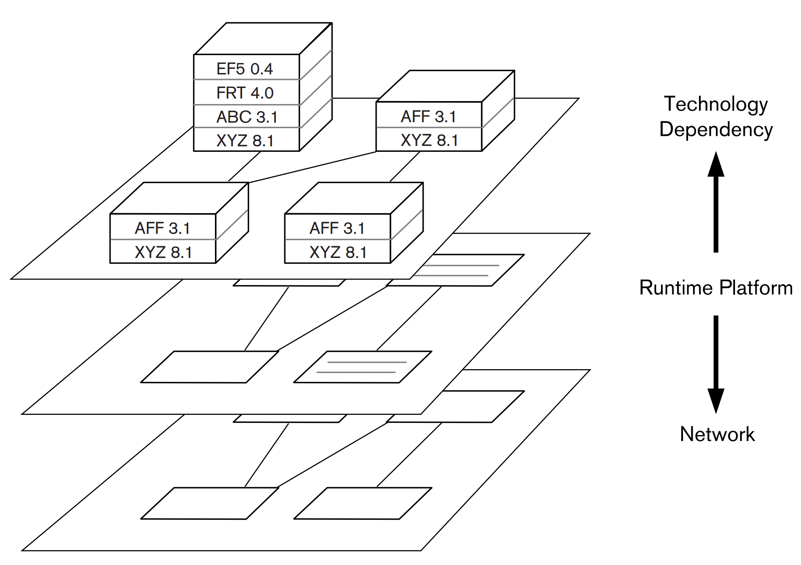
Intermodel Relationships
Runtime Platform Model: Used by group responsible for deployment early in the project.
Network Model: Used by specialist networking group
Technology Dependency Model: Used by system administrators during installation planning.
Notes:
For complex systems, a Deployment view contains two or three closely related models rather than a single model. the three models tend to be used by different stakeholders at different times. People in the groups responsible for deployment refer to the runtime platform model early in the project, a specialist networking group consults the network model, and system administrators use the technology dependency model during more detailed installation planning close to deployment.
A good way to think about these models is as a set of informal layers, with the core of the view being the runtime platform model. You can think of the network model as a lower layer supporting the runtime platform by defining details of the network required. The technology dependency model can be thought of as a more detailed layer on top of the runtime platform that defines the software and hardware installation requirements on each machine in the deployment environment.

Slide 61
Pitfall:
Missing or Inaccurate Dependencies
“You need Oracle and Linux”
Too vague to allow safe deployment.
Which versions? What patches? Optional updates?
Capture clear, detailed dependencies between SW, runtime environment, HW.
Capture dependencies between 3rd party SW and the runtime environment.
Perform compatibility testing.
Use existing, proven combinations of technologies with well-understood relations.
Notes:
Large-scale computing technology tends to be fairly complex, and it often has many explicit and implicit dependencies on its runtime environment that will cause problems if not satisfied. This difficulty is compounded by the fact that most of these dependencies are invisible and can’t be checked easily—you may not discover that you have the wrong version of a utility library until your database server fails to start. “You need Oracle and Linux” or “It uses Intel hardware” are pretty common dependency statements. For all but the smallest systems, these are too vague to allow safe deployment of the system. You should specify which versions are required, whether any optional parts of the products are needed, whether any patches are required, and so on. With the complexity and flexibility of enterprise software products today, you need to be very clear about what is required and what isn’t.
Risk Reduction • Capture clear, accurate, detailed dependencies between your software elements and the runtime environment in the Deployment view. • Capture dependencies between third-party software and the runtime environment it needs. • Perform compatibility testing to ensure that the dependencies between the elements are correct. • Use existing, proven combinations of technologies where the dependencies are well understood.

Slide 62
Risk: Unproven Technology
New tech can bring great benefits...
Often more features, improved performance.
Or great risk…
Functional shortcomings, poor performance, availability, security.
Use existing hardware and software that you can test before committing to.
Get advice from people who have used a technology before.
Create prototypes and benchmarks.
Perform compatibility testing.
Notes:
Everyone wants to use the newest and coolest technology—and understandably so, as it often has the potential to bring great benefits. However, because its characteristics are unknown, using technology with which you don’t have experience brings significant risks: functional shortcomings, for example, or inadequate performance, availability, or security. Risk Reduction • As much as possible, use existing software and hardware that you can test before committing to its use. • When you must use new technology (or technology new to you), get advice from people who have used the technology before, or if this is not possible, test it thoroughly. • Create realistic, practical prototypes and benchmarks to make sure that technologies work as advertised. • Perform compatibility testing to ensure that new technologies work well with existing technologies.

Slide 63
Risk: Lack of Specialist Knowledge
System design requires significant knowledge about many subjects.
Teams of people specializing in different technologies and aspects of the system.
Can easily end up in a situation where you lack detailed knowledge of a technology and must rely on vendor claims.
Bring in new specialists when needed.
Obtain external review of your architecture.
Obtain binding contracts from suppliers.
Notes:
Designing a large information system is a complex undertaking that requires a huge amount of specialist knowledge about many different subjects. No one person can possibly be an expert on all of the technologies you may need to use. This is why we use teams of people to develop systems and why some people specialize in particular technologies, allowing them to advise others. Given the number of technologies used in many systems, it can be difficult to assemble a project team with expertise in all of the technologies required. This can lead to a situation where you end up relying on vendor claims for products rather than proven knowledge and experience. Risk Reduction • Bring specialist knowledge into your team so that you have mastery of all of the key technologies you need to use to deliver your system. If you don’t need the knowledge full-time, hire trusted and experienced part-time experts. • Obtain external expert review of your architecture to validate your assumptions and decisions. • Obtain binding contractual commitments from your technology suppliers when possible.

Slide 64
Risk: Late Consideration of Deployment Environment
Problems occur when you consider system purely from a software-oriented perspective.
Can make a system unusable.
Impacts how software is designed and implemented.
Can be expensive to change.
I.e., if you need a group of small machines instead of one large machine, architecture differs.
Design deployment as part of architecture design, not after system has been developed.
Obtain external review to get early feedback.
Notes:
The deployment environment is where your system hits reality. We’ve seen problems in some projects when the system is designed from a purely softwareoriented perspective and the deployment environment is considered only when the software is complete. Remember that an inappropriate deployment environment can make an otherwise good system totally unusable. The deployment environment also often affects how the software is designed and implemented, and this can be expensive to change. For example, if plans change and you need to use a group of small machines rather than a single large machine to host your server elements, this could have a significant impact on the architecture of your server software, a change that would be expensive to make late in a project. Risk Reduction • Design your deployment environment as part of architecture definition rather than as part of a separate exercise performed after the system has been developed. • Obtain external expert review of your architecture to get early feedback before you spend too much time or money.

Slide 65
Risk: Ignoring Intersite Complexity
Many systems “live” in multiple locations.
Cloud computing environment, servers in different geographic locations.
Important to consider impact early.
Impacts security, performance, scalability.
Network latency, increased security burden, synchronization between sites.
Consider impact on system qualities.
Work with infrastructure team.
Test representative aspects as soon as possible “in the field”.
Notes:
Many systems are deployed to an environment involving more than one physical site, and this is becoming ever more prevalent as organizations move to use third-party hosting providers and cloud computing environments to augment their own data centers. Even when the entire environment is hosted in-house, concerns such as resiliency, disaster recovery, geographical location of the business, and data movement restrictions can result in systems being hosted across a number of geographically distant sites.
If you do have a multisite deployment environment, it is important to consider the impact of this quite early in your architectural design work as it can have a major impact on the quality properties of the system, particularly its security, performance, and scalability. Network latency between sites is the most obvious problem (meaning that interelement interactions across these links need to be considered carefully), but the need to keep the system secure across multiple sites and the possible scalability limitations of needing to synchronize information across sites are some of the other areas of concern that need to be addressed.
Risk Reduction • Understand any requirements for multisite deployment as early as possible in your design work, and if it looks likely that multisite deployment is going to be required, consider its impact on all of your system qualities. • Work with your infrastructure teams to understand the implications of distributing your system to multiple sites and the restrictions that the infrastructure may impose on this. • Try to test various representative aspects of multisite deployment as soon as you can so that you are confident that you understand its implications.

Slide 66
Risk:
Not Specifying Disaster Recovery
How can the system be kept operational in the event of a significant failure.
Power loss
Storage failure
Natural disasters
Often involves deployment of a special operational environment in a different location.
May have lower specification than production environment.
Should be considered as part of Deployment View.
Notes:
Disaster recovery is the means whereby systems can be kept operational in the event of a significant failure, such as loss of electric power, widespread storage failure, or a natural disaster such as fire or flood. Many disaster recovery strategies require the deployment of a separate operational environment at a different location (for example, a standby or alternate data center). To keep costs down, the standby environment may have a lower specification than the production environment. In any case, as it is usually the responsibility of a development project to specify, implement, and pay for the standby hardware, this must form part of your architectural description.

Slide 67
Food for Thought
Have you mapped functional elements to a type of element in your runtime platform?
Have you mapped them to specific hardware devices if appropriate?
Is the role of each piece of your runtime platform fully understood?
Is the hardware or service suitable for the role?
Have you established detailed specifications for hardware devices or hosted services?
Do you know exactly how many of each device or how much of each service is required?

Slide 68
Food for Thought
Have you identified third-party software and documented dependencies?
Are the network topology and services understood and documented?
Have you estimated and validated the required network capacity?
Can the proposed network topology be built to support this capacity?
Have you performed compatibility testing to ensure that the elements can be combined as desired?

Slide 69
Food for Thought
Have you used prototypes, benchmarks, and other practical tests when evaluating?
Can you create a realistic test environment?
Are you confident that the deployment environment will work as designed?
Have you obtained external review?
Can physical constraints (floor space, power, cooling) can be met?
Do you have a specification of a disaster recovery environment, if required?

Slide 70
Operational Viewpoint
Notes:
(discussion) Point is - there are a lot of different answers to this question

Slide 71
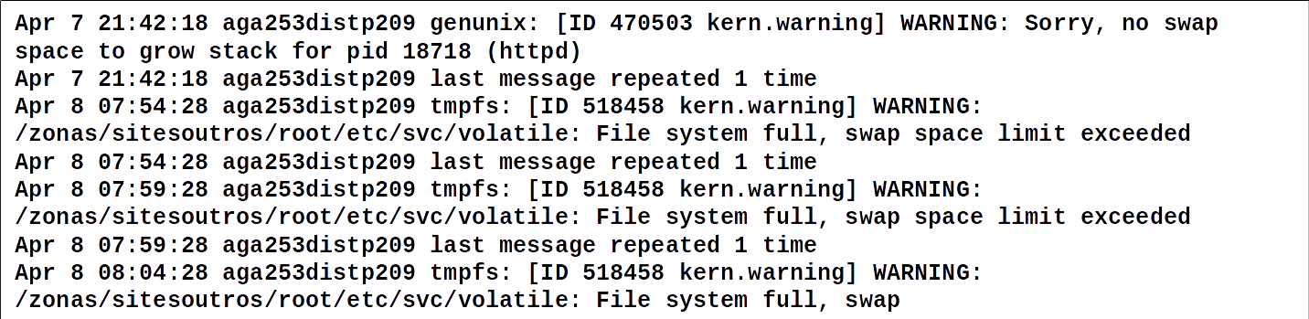
What does it mean when the swap file is full?
Operational aspects of systems are often ignored during design.
This is a significant contributor to unexpected system down time.
Notes:
1-2
Considerable effort is spent defining the architecture and design of today’s large systems. However, it is rare to find a system for which comparable consideration is given to how the system will be controlled, managed, and monitored once it is in the field.

Slide 72
The Operational Viewpoint
Identifies a system-wide strategy for addressing operational concerns.
Helps to ensure system is a reliable and effective part of its environment.
For packaged software, helps illustrate the types of issues that could occur once installed.
Documents how the system can be architected to reduce or address these concerns.
Often least well-defined view, as many of the details are not fully-defined until construction is underway.
Notes:
The aim of the Operational viewpoint is to identify a system-wide strategy for addressing the operational concerns of the system’s stakeholders and to identify solutions that address these. For a large information system, the Operational view focuses on concerns that help ensure that the system is a reliable and effective part of its technology environment, whether it is hosted within an organization or externally by a third-party provider.
For projects that will be sold in a package to consumers, the Operational view is more generic and illustrates the operational concerns that customers of the product are likely to encounter, rather than the concerns of a specific site. This view also identifies the solutions to be applied throughout the product implementation to reduce of resolve these concerns. Of all of the views you create for your AD, the Operational view is often the one that is least well defined and needs the most refinement and elaboration during the system’s construction. This is because many of the details that the Operational view considers are not fully defined until design and construction are well under way. However, considering the issues described in this chapter as early as possible will save you a lot of time and effort later.

Slide 73
Concern: Installation and Upgrade
[Insert your own installation horror story]
How is installation performed?
Your team performs the install.
Users install and configure themselves.
Resources allocated to a cloud environment.
Is this a pure installation or an upgrade?
Upgrades can be more complex.
Must respect existing data and settings, state of running elements.
Can you keep the system running during update?
Ensure the system can be installed or updated successfully.
Notes:
Installation and upgrade can range from the development team installing and configuring software elements on customer-specific hardware; to the ultimate users of the system obtaining hardware and software and performing installation, integration, and configuration themselves; to allocating resources in a public cloud computing environment and uploading software to it. The other major area of variability is whether this is a pure installation or whether a previous version of your system is already installed. Upgrade can be significantly more complex than installation, due to the need to respect existing data, configuration settings, the state of running elements, and so on, and in some cases to keep the system in operation during the upgrade. However, the use of iterative development approaches means that upgrade, rather than installation, is the norm, so you need to master it. As an architectural concern, installation is less about the design of detailed procedures and plans and more about ensuring that the system can be installed or upgraded in a way that is acceptable. What happens if something goes wrong? Can you prevent major harm?
This involves working with technical specialists to understand the installation processes, software developers to ensure that their elements can be easily and reliably installed, and production engineers to assure a practical, low-risk installation approach

Slide 74
Documenting Installation and Upgrade
Help the reader understand:
What needs to be installed or upgraded to move the system into production.
What dependencies exist between groups of items to be installed or upgraded (determines event order).
What constraints exist on the installation process.
What needs to be done to abandon and undo the installation/upgrade if there is a problem.
Do not need a complete guide.
Instead, constraints the architecture imposes on installation and upgrade.
Notes:
Moving a system from its development environment to its production environment is a critical part of the system’s lifecycle. Your AD needs to demonstrate that it is possible for a system built using this architecture to be installed (and upgraded) in a practical way. The installation model should discuss installation and/or upgrade as needed for your system. This model needs to help the reader understand: • What needs to be installed or upgraded to move the system into production • What dependencies exist between the various groups of items to be installed and upgraded • What constraints exist on the process to perform the installation and/or upgrade for the system • What would need to be done to abandon and undo the installation and/or upgrade if something goes seriously wrong
The AD doesn’t need to include a complete installation and upgrade plan—that information goes into a different document produced when needed. Instead, the installation model provides your view of the requirements and constraints the architecture imposes on installation and upgrade.

Slide 75
Installation Documentation Activities
Identify the Installation Groups
Group related elements. For each group, define what elements it contains and how they will be installed or ugraded.
Identify Dependencies
Identify dependencies between groups to identify order elements must be installed in.
Identify Constraints
Do you need to start an element immediately after installation? Do you need to restart machines?
Identify Backout Approach
What do you need to do to undo any tasks?
Notes:
Identify the Installation Groups. Start by considering what elements of your architecture need to be installed and/or upgraded, and identify groups of them that can be handled together. For each group, define which elements it contains and the approach that will be used to install or upgrade that group.
Identify Any Dependencies. Dependencies often exist between different parts of a system during installation, so that the installation process has to proceed in a specific order. Identify the dependencies that exist between your installation groups to reveal these constraints.
Identify Any Constraints. Consider the overall installation process and the different ways it could be achieved. Other than the ordering dependencies, does your architecture or deployment environment impose any further constraints on the process? (For example, do you need to start one element after it is installed so it can generate code or data needed to install the next one? Do you need to follow any particular environment-specific procedure when installing particular elements of the system? Do you need to restart one of the machines during installation?)
Design the Backout Approach. Consider what would need to be done to undo any of the installation tasks you have identified. In particular, identify anything that would be complex or time-consuming to undo.
[EXAMPLE: Page 412, bring up, go over]

Slide 76
Concern: Functional Migration
Process of replacing existing capabilities with your new capabilities.
Migrating users of an older system to your system
Big bang: Migration at a single point in time.
Parallel: New and old versions of a system used side-by-side until buy-in.
Staged: Parts of a process of system swapped over time to manage risk.
Problems: risk and cost
Big bang is cheapest, but no recovery route.
Others reduce risk, but more expensive.
Notes:
Functional migration is the process of replacing existing capabilities with the ones provided by your system. This usually means migrating users of an older system to use your new system. Your migration approach may comprise one or more of the following:
• A big bang where the migration occurs in a single step at a single point in time (often over a weekend)
• A parallel run where new and old versions of a system are used side by side until confidence in the new system is high enough to allow switching off the old one
• A staged migration where parts of a process or an organization are moved to a new system, one by one, to manage the risk and cost of the migration activity
Like many architectural concerns, migration is centered on two issues—risk and cost. The big bang approach, for example, can be the cheapest because it requires no replication of resources, but it can be extremely risky because there is no easy recovery route if the migration goes wrong. Other approaches can be much more expensive (because they require duplication of resources and the implementation of costly processes to ensure that systems run together in lockstep) but reduce risk.

Slide 77
Concern: Data Migration
Loading data from existing systems into the new ones.
Should be automated as much as possible.
May change format of GB - TB of data.
Data may not match new format exactly, may require conversion in parallel with live updates.
Moving data between locations may add security and performance concerns.
Notes:
Most system development involves data migration— that is, loading data from existing systems into the new one(s). A goal of a data migration exercise is almost always to automate as much as posible, particularly when large volumes of data are involved. When migrated data is very old, of variable quality, or poorly modeled, data migration may be extremely complex. Nowadays, systems that manage hundreds of gigabytes or terabytes of data are not uncommon, and this presents its own migration challenges. Massive data stores are far more likely to include data that does not conform to business rules and therefore requires exceptional processing (possibly manual intervention). It can take days or weeks to extract data from or load data into massive data stores, and it is important that you do not underestimate the time required to reorganize databases, create indexes, and so on. (4)
If you need to migrate data between geographical locations (for example, into a data center in a different region of the world, or into an externally hosted location), additional security and performance concerns can complicate things further.

Slide 78
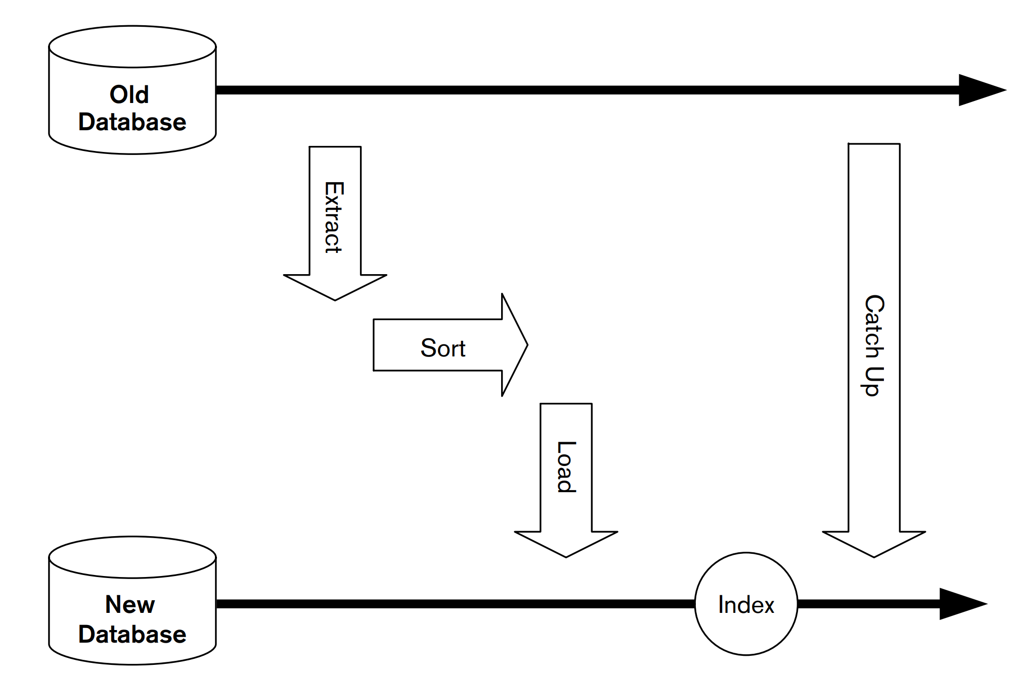
Concern: Data Migration
Migrating taxpayer database to new system.
Extraction - 3-5 days.
Sorting - 1 day.
Loading - 10 days.
100K updates expected.
Cannot stop tax collection for two weeks.
Capture updates and apply in bulk once data migration is complete.
Notes:
A government tax office has a very large database of taxpayers that it is migrating into a new system. The database is updated through end-user screens in tax offices throughout the country. The architect predicts that extracting all of the data from the database will take between three and five days. The data must be sorted, which will take another day, and will then be loaded into the new system, which will take ten days. Finally, indexes must be created on the new system, which will take another day. The overall elapsed time to migrate is over two weeks, during which time the original system is estimated to have received 100,000 updates, It will not be possible to halt the country’s tax-collection activities for two weeks while the data is migrated. Special code therefore has to be written to capture these updates as they occur and to apply them to the new system once the bulk of the data has been migrated into it, so that the extract is complete.
In short, data migration may be a significant piece of work in its own right, and you should manage it the same way as any other development project, with requirements, design, build and test, and acceptance—and, of course, architecture.

Slide 79
Documenting Migration
Does not require a complete plan, but defines overall strategy and constraints.
Allow reader to understand:
What strategies can be employed to migrate information and users to the system.
How the system will be populated with information from the existing environment.
How information in new and old environments can be kept synchronized.
How to revert to the old system if problems emerge.
Notes:
Again, a complete plan is not called for in the AD, but rather a succinct definition of the strategies to be employed. This model should allow its reader to understand: • What overall strategies can (or will) be employed to migrate information and users to the system • How the new system will be populated with information from the existing environment • How information in the new and old environments will be kept synchronized (if required) • How operation could revert to the old system if serious problems emerge with the new one
As with the installation model, the migration model should focus on the requirements and constraints that the current architecture places on the detailed migration process that will be developed later.

Slide 80
Migration Documentation Activities
Define the Migration Strategy
Big bang vs parallel vs staged.
How would this work?
What are the tradeoffs?
How long will this process takes?
Will it disrupt business?
Does this meet stakeholder needs?
Design the Data Migration Approach
How to populate the system with the existing information.
How long will it require?
What resources are needed?
Notes:
Establish Possible Strategies. Assess your architecture and the existing system(s), and establish which migration strategies (i.e., big bang, parallel run, staged migration) are possible, how each would work, and the tradeoffs among them. you will be tasked with the responsibility of defining which strategy best meets the needs of your stakeholders and making it happen. If migration is going to take more than a short period of time, you will need to consult with your stakeholders, particularly users, to define an approach that minimizes any business disruption.
Design the Data Migration Approach. Having identified a strategy to use, you need to decide how to populate the system with all of the information in the existing system(s). This doesn’t mean you need to spend days mapping fields between databases, but it does mean you have to understand the problem well enough to choose an appropriate approach for the data migration and determine how long it is likely to take and what tasks and resources might be required.

Slide 81

Migration Documentation Activities
Design Information Synch Approach
Especially in parallel run.
Unidirectional (into new system) or bidirectional?
Identify the Backout Strategy
Can you back out to the existing system?
Reverse data migration may not be practical.
Notes:
Design the Information Synchronization Approach. Some situations call for information to be synchronized between the old system(s) and the new one. This is particularly the case when using the parallel run migration strategy because information in the old system(s) may continue to be updated after the new system goes live. If synchronization is required, it may be unidirectional (just into the new system) or bidirectional (information changes need to be migrated from new to old as well as old to new). Your task is to identify an overall approach that will allow the required degree of synchronization to be performed within the operational constraints of your environment.
Identify the Backout Strategy. Being able to back out to an existing system (if available) is an attractive risk-reduction option for live operation. The problem is that it isn’t always clear how such a backout would work, or if it is even possible (e.g., reverse data migration may not be practical due to the design of the new system). You need to decide whether a backout strategy involving the old system(s) is required and, if so, how it could work.

Slide 82
Concern:
Operational Monitoring and Control
Systems require routine monitoring.
Control operations can be used to keep the system running correctly.
Startup, shutdown, transaction resubmission.
How much is required depends on how many unexpected operational conditions are likely to occur.
Balance against cost and time.
Consider deployment environment to identify solutions.
Notes:
Once a system is running in its production environment, it will require some amount of routine monitoring, to ensure that it is working correctly, and some routine control operations, to keep it working that way (startup, shutdown, transaction resubmission, and so on). Some systems need little monitoring or control—for example, a file server that needs only direct operational control when it fails or fills up. Others may need quite a lot—for example, a large financial reconciliation system that accepts data feeds from a variety of sources and may need routine monitoring and control to identify and rectify communication link and data reconciliation failures. The amount of monitoring and control needed depends on the likely number and variety of unexpected operational conditions the system is likely to encounter in production. However, the development and integration of monitoring and control facilities can be a major effort in itself, so you may have to balance stakeholder needs in this area against cost and time. You also need to consider the system’s deployment environment to make sure that the solutions you identify are appropriate.

Slide 83
Concern: Alerting
A system should send notifications when something bad happens.
Technical: Unable to connect to database.
Functional: Bad data on an automated input.
Significant non-error conditions (startup, shutdown)
Active function of a system.
Sent to appropriate humans for action.
Define which events require alerts, what information should be included, and where it should be sent.
Avoid sending too many alerts.
Notes:
An alert is a notification from the system that something has gone wrong that requires human intervention in order to fix. This may be a technical alert, such as the system is unable to connect to a database server, or a functional alert, such as bad data has been received on an automated input. Some significant nonfailure events, such as startup or shutdown of a service, also should be alerted (for information rather than action). Unlike operational monitoring (in which systems are largely passive), alerting is an active system function. The system sends alerts to a central console or alert management tool, where they are displayed to support staff so they can take appropriate action. For example, a server may need to be restarted or reset, a batch job may need to be resubmitted, or in some cases the alert may need to be handed over to development teams for diagnosis and repair.
define things such as which events must be alerted, the information that should be included in the alert, and where the alert should go.
avoid alert flooding.

Slide 84
Concern: Backup and Restore
Data must be protected and insured.
Backup processes should be designed, built, and tested regularly.
It must be possible to restore data from a backup in a transactionally consistent state.
All updates committed to the restored database or not recovered at all.
Consider data lost as part of restoring (at least any transactions active during failure).
Failure in one element could corrupt system.
Recover or recreate lost data.
Revert system to older state.
Notes:
data is an extremely valuable asset to any organization and should be protected and “insured” the same way that its other assets are. Processes to do this should be carefully designed, built, and executed and should also be regularly tested to ensure that they are still working correctly.
You shouldn’t forget the restore side of the equation, either. At a minimum, restoring data should leave it in a transactionally consistent state (i.e., with all updates entirely committed to the restored database or not recovered at all). You will need to consider the amount of data lost as a result of the restore; at a minimum, this will be any transactions that are active at the time of failure but may include a lot more, particularly if backups can be done only when the system is offline. If your data is distributed, this problem becomes much harder to solve.
Although a failure in any one program will affect only that program’s data, the data may then become inconsistent with the rest of the system; you need to develop strategies to deal with this. Typically, the solution involves recovering or recreating the lost data, either manually or (preferably) automatically. In some cases, it may be more appropriate to revert the rest of the system to the older state.

Slide 85
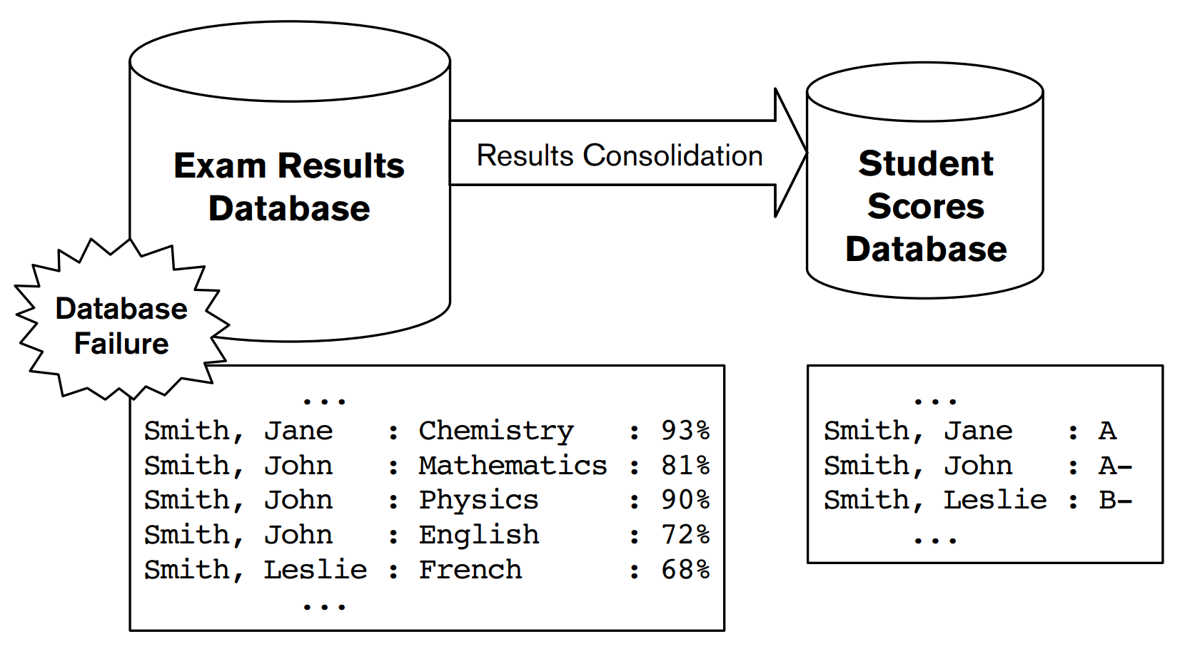
Concern: Backup and Restore
Academic records in databases.
Exam results database.
Scores database transforms data into a overall score.
Corruption requires restoration of exam database.
Over three months old.
Results from those months will need to be reentered.
However, student scores already reflect that data. Must prevent reentered data from changing scores.
Notes:
A significant complication for backup and restore planning is the fact that, in many situations, transactional consistency must extend across a system’s entire distributed data set. A university maintains academic records for all of its students in a number of databases. The main database stores results for each exam taken by each student, and a consolidated database turns these into an overall score for each student based on exam success. A database corruption means that the Exam Results Database has to be restored from its latest clean backup, which is almost three months old, and the results for the last three months rekeyed into it. Although the Student Scores Database is unaffected by the corruption, special actions must be taken to prevent this manually recovered data from filtering into the Student Scores Database and corrupting its data. As a result, it could take several weeks to repair the damage due to the corruption of one database.

Slide 86
Documenting System Administration
Monitoring and control facilities
How to monitor and adjust the system.
Custom utilities, existing management environments.
Basic message log to full-blown infrastructure.
Define what features you will offer, how to use them, and any limitations.
Required routine procedures
What needs to be performed regularly?
Backup and health check procedures.
Define purpose of each procedure, when performed, who performs it, and the steps involved.
Notes:
The administration model is the section of your AD where you define the operational requirements and constraints of your architecture and the facilities it provides for administrative users. The administration model must define the following items.
• Monitoring and control facilities: In order to support your system’s administrators, you may need to provide or use some monitoring and control facilities as part of your architecture. This may involve custom utilities or integration into existing management environments. It can be as simple as a basic message log or as complex as a full-blown integration with a management or monitoring infrastructure. You need to define the facilities you are going to provide, use, or integrate into; how these address the problem; and whether any limitations in these facilities could constrain their applicability or usefulness.
• Required routine procedures: You should also review the architecture you have designed and identify any administrative work that needs to be performed on a regular basis or that may be required in exceptional circumstances. Depending on the system, this can be as basic as a weekly backup and a monthly health check, or it can be a set of complex procedures performed on a round-the-clock basis to keep a critical high-volume system running at peak efficiency. For each procedure, you need to define its purpose, when it is performed, who performs it, and what is involved in performing it.

Slide 87
Documenting System Administration
Likely error conditions
Error conditions may require administrative intervention (disk full, network failure).
What is unique about your architecture?
Explain error conditions, when they occur, how to recognize them, and HOW to correct them.
Performance monitoring facilities
Watch the system for performance problems.
Extracted and analyzed routinely.
Explain measures taken, how they can be extracted and analyzed.
Notes:
• Likely error conditions: From simple situations such as disks filling up to sudden failures of the underlying network causing a cascade of problems, many error conditions that occur can require administrative intervention to rectify them. Some of these conditions are independent of your architecture and are caused by underlying platform failures. You need to understand the possible error conditions that are unique to your architecture, and you need to explain these carefully to help administrators understand the conditions they may need to recover from. Your description should include when the condition can occur, how to recognize it , how to rectify it, and possible further failures the condition could trigger.
• Performance monitoring facilities: A specialist subset of system monitoring is the ability to monitor the performance of the system. The difference between operational monitoring and performance monitoring tends to be how the data is used. Operational monitoring usually reports by exception and produces little or no output data when everything is going well. In contrast, performance monitoring is usually designed so that performance information can be extracted and analyzed routinely to allow system performance to be tracked over time. you need to explain the types of performance measures you will make available and how administrators or developers will extract and analyze the information when required.
[EXAMPLE page 420]

Slide 88
Do not use operations documentation as an excuse for bad software!
Examples:
Los Angeles air traffic control: reboot system every 30 days to prevent a timer overflow or system will crash
Patriot missile system: reboot system every 12 hours or it won’t track incoming missles correctly
Therac 25: don’t press keys too quickly or use backspace key or system will give incorrect radiation dose
Operations documents can become a CYA tool for bad software
Notes:
CYA (cover your ass)

Slide 89
Food for Thought
Do you know how to install your system?
Can you back out a failed installation?
Can you upgrade an existing version of the system (if required)?
Do you understand the facilities and constraints of the production environment?
Can you live with or mitigate these if not ideal?
Do you know how information will be moved from the existing environment into the new system?

Slide 90
Food for Thought
Do you have a clear migration strategy to move workload to the new system?
Can you reverse the migration if you need to?
How will you deal with data synchronization?
How will the system be backed up?
Will the approach identified allow reliable restoration in an acceptable time period?
Can the administrators monitor and control the system in production?
Do the administrators understand the procedures they need to perform?

Slide 91
Food for Thought
How will performance metrics be captured for the system’s elements?
Can you manage configuration of all of the system’s elements?
Is there consistency between the admin model and Development view?
Is the data migration architecture compatible with the amount of time available to perform the data migration?
Are there catch-up mechanisms in place where the source data is volatile during the data migration?

Slide 92
Key Points
Context/Functional/Information/Concurrency Views define what you are building.
The Development, Deployment, and Operational Views define how you will build the system.
The Development View defines how to implement the system.
The Deployment View defines how to transition the system to live operation.
The Operational View defines how to keep the system alive in the field.

Slide 93
Next Time
No class November 6th
Election Day!
Perspective: Performance & Scalability
R&W: Ch. 26
Bass, Clements, Kazman: Ch. 8
Homework:
Reading Assignment 2 - Tonight!
Project, Part 3 - Due on Nov 18
Assignment 3 - Nov 29

