Slide 1
Perspective: Security
CSCE 742 - Lecture 18 - 11/13/2018

Slide 2
“Your personal identity isn’t worth quite as much as it used to be - at least to thieves willing to swipe it. According to experts who monitor such markets, the value of stolen credit card data may range from $3 to as little as 40 cents.
That’s down tenfold from a decade ago - even though the cost to an individual who has a credit card stolen can soar into the hundreds of dollars.”
Taylor Buley, Forbes.com
Notes:
(discussion) Point is - there are a lot of different answers to this question

Slide 3
Security
The ability of the software to protect data and information from unauthorized access.
While still providing access to people and systems that are authorized.
Can we protect software from attacks?
Any action taken against a computer system with the intent of causing harm.
Unauthorized access attempts.
Attempts to deny service to legitimate users.
Notes:
Security is a measure of the system’s ability to protect data and information from unauthorized access while still providing access to people and systems that are authorized. (3) An action taken against a computer system with the intention of doing harm is called an attack and can take a number of forms. It may be an unauthorized attempt to access data or services or to modify data, or it may be intended to deny services to legitimate users.

Slide 4
Security
Processes that allow owners of resources to control access.
Actors (systems or users).
Resources are sensitive elements, operations, and data of the system.
Policies define legitimate access to resourced.
Enforced by security mechanisms used by actors to gain access to resources.
Actors
Mechanisms
Policies
Resources
Notes:
We define security as the set of processes and technologies that allow the owners of resources in the system to reliably control who can access which resources.
The “who” refers to the people, pieces of software, and so on that form the set of actors in the system who have a security identity; security specialists normally refer to such actors as principals.
The resources are the parts of the system considered sensitive (i.e., those to which access must be controlled) such as subsystems, data elements, and operations. The access to the resources refers to the operations that the principals in the system will want to legitimately perform on the resources (e.g., read them, change them, execute them, and so on), and the fact that access must be limited to principals known to the system.
Resources are at the core of the system’s security. Policies define the legitimate access allowed to them, which is enforced by security mechanisms, which are used by the principals of the system to gain access to the resources that they need.
The resources, principals, and policies that need to be considered are often very specific to the system. An Internet service provider is likely to have a totally different set of security concerns from those of a military intelligence organization, which will be different again from those of an enterprise implementing an internal information system that allows remote access to its employees. However, in all of these cases, security is still the business of allowing the right levels of access to the right resources to the right people.

Slide 5
Security Characterization (CIA)
Confidentiality
Data and services are protected from unauthorized access.
A hacker cannot access your tax returns on an IRS server.
Integrity
Data and services are not subject to unauthorized manipulation.
Your grade has not changed since assigned.
Availability
The system will be available for legitimate use.
A DDOS attack will not prevent your purchase.
Notes:
The simplest approach to characterizing security has three characteristics: confidentiality, integrity, and availability (CIA): 1. Confidentiality is the property that data or services are protected from unauthorized access. For example, a hacker cannot access your income tax returns on a government computer. 2. Integrity is the property that data or services are not subject to unauthorized manipulation. For example, your grade has not been changed since your instructor assigned it. 3. Availability is the property that the system will be available for legitimate use. For example, a denial-of-service attack won’t prevent you from ordering book from Amazon

Slide 6
Supporting CIA
Authentication
Verifies identities of all parties to a transaction.
Did the e-mail really come from the bank?
Nonrepudiation
Guarantees that the sender of a message cannot deny sending the message, and the recipient cannot deny receiving the message.
You cannot deny ordering the book, and Amazon cannot claim you never ordered.
Authorization
Grants user the privilege of performing a task.
The bank authorizes you to check balances.
Notes:
characteristics that are used to support CIA are these: 4. Authentication verifies the identities of the parties to a transaction and checks if they are truly who they claim to be. For example, when you get an email purporting to come from a bank, authentication guarantees that it actually comes from the bank. 5. Nonrepudiation guarantees that the sender of a message cannot later deny having sent the message, and that the recipient cannot deny having received the message. For example, you cannot deny ordering something from the Internet, or the merchant cannot disclaim getting your order. 6. Authorization grants a user the privileges to perform a task. For example, an online banking system authorizes a legitimate user to access his account. We will use these characteristics in our general scenarios for security.

Slide 7
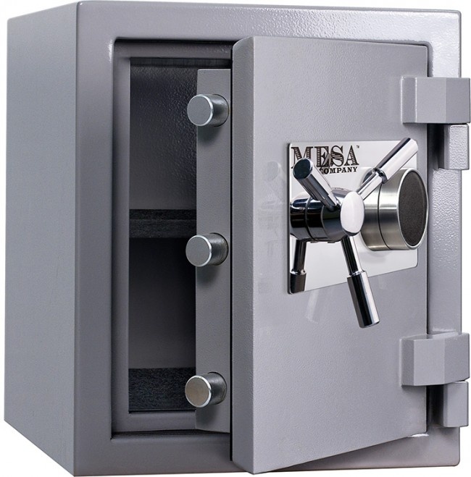
Security Approaches
Achieving security relies on:
Detecting attacks.
Resisting attacks.
Reacting to attacks.
Recovering from attacks.
Objects being protected are:
Data at rest.
Data in transit.
Computational processes.
Notes:
Approaches to achieving security can be characterized as those that detect attacks, those that resist attacks, those that react to attacks, and those that recover from successful attacks. The objects that are being protected from attacks are data at rest, data in transit, and computational processes.

Slide 8
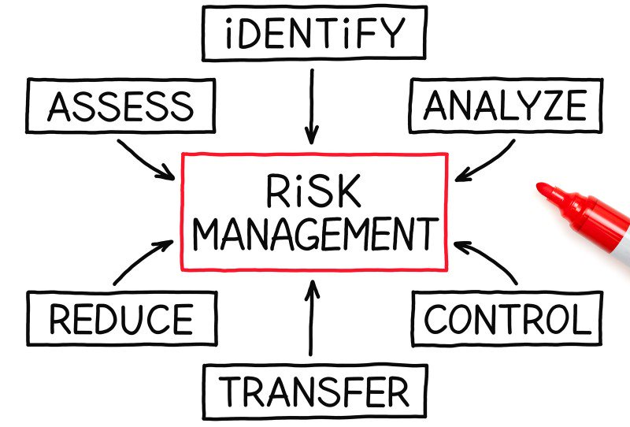
Security is Risk Management
Not a binary quality.
All systems will be compromised.
Try to avoid attack, prevent damage, and quickly recover.
Balance risks against cost of guarding against them.
Set realistic expectations!
Notes:
It is also important to recognize that security is not a simple process of “being secure” or not. Rather than being a binary state, security is really a process of
risk management. (2-3)
Balance likely security risks against the costs of guarding against them. Bear this in mind to help you set realistic expectations in the minds of your stakeholders and to make intelligent tradeoffs that address the realsecurity risks your system faces.

Slide 9
Impact on Views
Context:
Identify external connections that could have vulnerabilities, and protect them from malicious use.
Functional:
Identify which functional elements need to be protected. The functional structure may be impacted by the need to implement security policies.
Information:
Helps you see what sensitive data needs to be protected. Information models are modified as a result of security design (e.g., partitioning information by sensitivity).

Slide 10
Impact on Views
Concurrency:
May need to isolate elements into processes. This will affect the system’s concurrency structure.
Development:
Identify constraints that developers need to be aware of to ensure that security policy is enforced.
Deployment:
May need special hardware or software, or to change deployment arrangements to address risks.
Operational:
Make responsibilities clear, so security can be reflected in operational processes.

Slide 11
Security Scenarios
Notes:
(discussion) Point is - there are a lot of different answers to this question

Slide 12
Security Quality Scenarios
Measure of the system’s ability to protect data from unauthorized access while still providing service to authorized users.
Scenarios measure response to attack.
Stimuli are attacks from external systems/users or demonstrations of policies (log-in, authorization).
Responses include auditing, logging, reporting, analyzing.
Response measures include amount of data loss/compromise, time to detect/mitigate, % of attacks resisted, etc.
Notes:
(1) An attack is an attempt to break CIA. The response to the attack is to preserve CIA or deter attackers through monitoring of their activities. (2)

Slide 13
Generic Security Scenario
Overview: Description of the scenario.
System/environment state: The attack can come when the system is either online or offline, either connected to or disconnected from a network, either behind a firewall or open to a network, fully operational, partially operational, or not operational.
External Stimulus: The source of the attack may be either a human or another system. It may have been previously identified or may be currently unknown. A human attacker may be from outside the organization or from inside the organization. The stimulus is an attack (unauthorized attempt to display data, change or delete data, access services, change the system’s behavior, or reduce availability).
Notes:
Environment. The attack can come when the system is either online or offline, either connected to or disconnected from a network, either behind a firewall or open to a network, fully operational, partially operational, or not operational.
Source of stimulus. The source of the attack may be either a human or another system. It may have been previously identified (either correctly or incorrectly) or may be currently unknown. A human attacker may be from outside the organization or from inside the organization.
■ Stimulus. The stimulus is an attack. We characterize this as an unauthorized attempt to display data, change or delete data, access system services, change the system’s behavior, or reduce availability

Slide 14
Generic Security Scenario
Required system behavior: The system should ensure that transactions are such that:
Data/services are protected from unauthorized access
Data/services are not manipulated without authorization
Parties to a transaction are identified and cannot repudiate their involvement
Data, resources, and system services will be available for legitimate use.
The system should also track activities by
Recording access or modification and attempts to access data, resources, or services
Notifying appropriate entities (people or systems) when an apparent attack is occurring.
Notes:
Response. The system should ensure that transactions are carried out in a fashion such that data or services are protected from unauthorized access; data or services are not being manipulated without authorization; parties to a transaction are identified with assurance; the parties to the transaction cannot repudiate their involvements; and the data, resources, and system services will be available for legitimate use. The system should also track activities within it by recording access or modification; attempts to access data, resources, or services; and notifying appropriate entities (people or systems) when an apparent attack is occurring.

Slide 15
Generic Security Scenario
Response Measure: Measures of a system’s response include:
How much of a system is compromised when a particular component or data value is compromised.
How much time passed before an attack was detected
How many attacks were resisted
How long it took to recover from a successful attack
How much data was vulnerable to a particular attack.
Notes:
Response measure. Measures of a system’s response include how much of a system is compromised when a particular component or data value is compromised, how much time passed before an attack was detected, how many attacks were resisted, how long it took to recover from a successful attack, and how much data was vulnerable to a particular attack.

Slide 16
Example Security Scenario
Unsuccessful Modification Attempt
Overview: A disgruntled employee at a remote location attempts to change their pay rate.
System/environment state: The system is operating normally, without problems. 100 active users are logged into the system.
External Stimulus: An employee has discovered the location of a configuration file storing all employee pay rates. They log in (using their credentials) and use a stolen passkey to open the locked file. They modify the file with a new rate and save changes.
Required system behavior: The system maintains an audit trail. The user is able to modify the file, as they have the passkey. However, the log records the date, time, identify of user, and modification made. System administrators are informed of the modification.
Response measure: The correct data is restored within a day and the source of tampering has been identified and reported.

Slide 17
Example Security Scenario
Unsuccessful Authentication
Overview: A user attempts to authenticate but the authentication fails due to unrecognized auth token or due to system unavailability.
System/environment state: There is a valve installed on the tap. There is a flow meter installed on the tap. There is a piezo buzzer installed on the Kegboard. Authentication hardware (RFID or one-wire) is installed on the Kegboard. There is no pour in progress. The system is operating normally, without problems.
External Stimulus: A user presents an auth token to the authentication hardware on the Kegboard.
Required system behavior: The auth token is unrecognized, and the valve is not opened. An audible sound is played from the piezo buzzer, indicating authentication failure.
Response measure: No beer is dispensed.
Notes:
Why are these good examples?
They are specific and they describe both reasonable system responses and reasonable measures that
can determine whether the system is behaving as intended.

Slide 18
Security Tactics
Notes:
(discussion) Point is - there are a lot of different answers to this question

Slide 19
Consider Physical Security
Secure buildings have:
Limited access.
Security checkpoints, locked doors.
Means of detecting intruders.
RFID badges.
Deterrence mechanisms.
Armed guards.
Reaction mechanisms.
Automatic locking of doors.
Recover mechanisms
Off-site backup.
Notes:
One method for thinking about how to achieve security in a system is to think about physical security. Secure installations have limited access (e.g., by using security checkpoints), have means of detecting intruders (e.g., by requiring legitimate visitors to wear badges), have deterrence mechanisms such as armed guards, have reaction mechanisms such as automatic locking of doors, and have recovery mechanisms such as off-site backup. These same ideas can inform security as part of architecture.

Slide 20
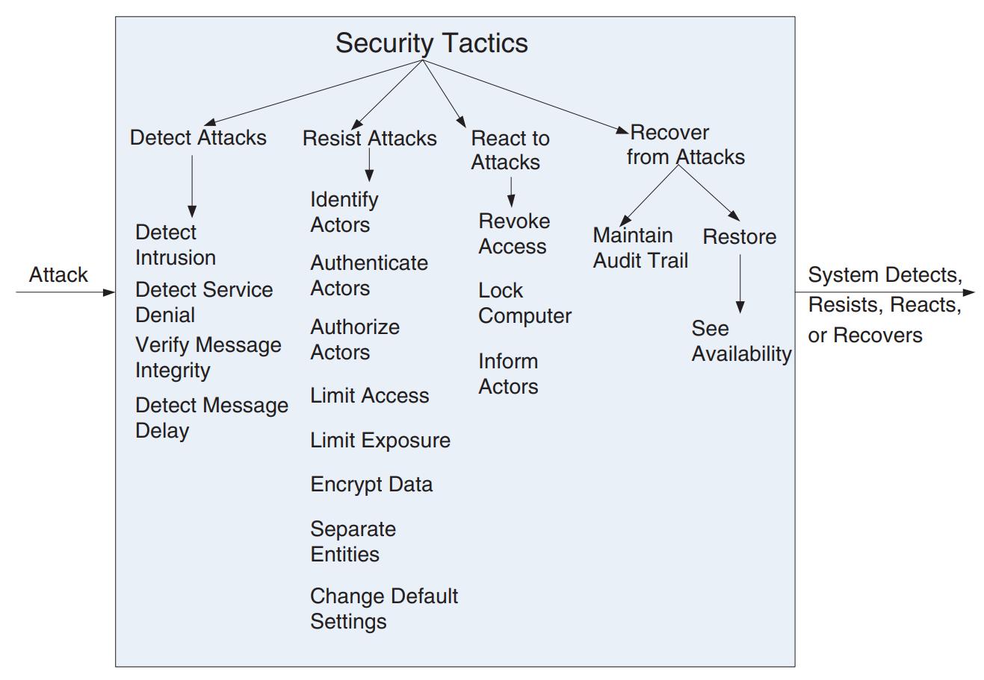
Security Tactics
Notes:
These lead to our four categories of tactics: detect, resist, react, and recover. (go over)

Slide 21
Detect Attacks
Detect intrusion:
Comparison of network traffic or service request patterns to known patterns of malicious behavior.
Can be based on protocol, TCP flags, payload sizes, applications, source/destination address, or port number.
Detect service denial:
System is flooded with too many requests or carefully timed requests to prevent others from accessing data or services.
Comparison of pattern or signature of network traffic coming into a system to historic profiles of known denial-of-service attacks.
Notes:
The detect attacks category consists of four tactics: detect intrusion, detect service denial, verify message integrity, and detect message delay.
■ Detect intrusion is the comparison of network traffic or service request patterns within a system to a set of signatures or known patterns of malicious behavior stored in a database. The signatures can be based on protocol - how did we get the request? , TCP flags, payload sizes - what is in the packet?- applications, source or destination address - is this part of a known botnet or an unusual access point?, or port number- how is this being directed? Some ports are monitored and restricted more heavily than others, (talk about blocking ports).
■ (5) Detect service denial is the comparison of the pattern or signature of network traffic coming into a system to historic profiles of known denial-ofservice attacks.

Slide 22
Detect Attacks
Verify message integrity:
Use checksums or hash values to verify the integrity of messages or files.
Checksum: Maintain a piece of information about a file, check whether the file matches the stored information when used.
The checksum is often a hash, a unique string generated based on a piece of content.
Any change to the files or messages will cause a major change in the hash value.
Notes:
■ Verify message integrity. This tactic employs techniques such as checksums or hash values to verify the integrity of messages, resource files, deployment files, and configuration files. A checksum is a validation mechanism wherein the system maintains redundant information for configuration files and messages, and uses this redundant information to verify the configuration file or message when it is used. (4)
A hash value is a unique string generated by a hashing function whose input could be configuration files or messages. Even a slight change in the original files or messages results in a significant change in the hash value.

Slide 23
Detect Attacks
Detect message delay:
Detects man-in-the-middle attacks, where someone intercepts and modifies messages.
By checking the time it takes to deliver a message, we can detect suspicious timing behavior.
Too long of a delay: messages may be being intercepted or modified.
Variable timing: some messages may have been intercepted. Timestamps could have been edited.
Notes:
■ Detect message delay is intended to detect potential man-in-the-middle attacks, where a malicious party is intercepting (and possibly modifying) messages. By checking the time that it takes to deliver a message, it is possible to detect suspicious timing behavior. Some red flags include (go over)
where the time it takes to deliver a message is highly variable.

Slide 24
Identifying Threats
Threat models identify the threats you feel the system is subject to, their impact, and their likelihood.
Who is likely to try to infringe the security policy?
How will they try to do so?
What are the attacker’s main characteristics?
Sophistication, motivation, resources.
What are the consequences of the policy being breached in this way?
Have security specialists review the model.
Notes:
we need to identify the possible threats to the security policy. Identifying threats provides a clear definition of what in the system needs to be protected and what it needs to be protected from. This makes it clear which threats you are aware of and can try to guard against and also (implicitly) the threats you have not considered.
a threat model provides a thorough analysis of the threats you think the system is subject to, the impact of the threat being realized, and the likelihood of the threat occurring. To create a threat model, you ask a number of key questions about your proposed system. (2-6)
Explicitly identifying threats allows specialists from outside your project to provide assistance by reviewing the model and advising you about potential threats that have not been considered at all or threats that may have been incorrectly characterized in the model. Be sure to have it widely reviewed so that you can be confident you have considered all likely threats. The threat model also allows you to systematically consider the set of security facilities your system needs.

Slide 25
Attack Trees
Structured notation for categorizing threats and their probability.
Represented visually as a tree as a nested list.
Root of the tree shows the goal of the attack.
Branches classify the different types of attacks that could be attempted.
Create a tree for each goal an attacker may have. Can be used to analyze security policies.
Goal: Obtain customer credit card details.
Extract details from database.
Access database directly.
Crack/guess database passwords.
Crack/guess OS passwords that bypass database security.
Access via a member of the administration staff.
Bribe a database administrator (DBA).
Conduct social engineering by e-mail to trick the DBA into revealing details
Notes:
attack trees provide a structured, graphical notation to categorize and illustrate the threats a system faces and the likely probability of each occurring.
An attack tree represents the possible attacks your system may face in order for an attacker to achieve a particular goal. The root of the tree is the goal the attacker is trying to obtain, and the branches of the tree classify the different types of attacks the intruder could attempt in order to obtain the goal. Attack trees can be represented graphically (as a tree structure with nodes and links) or textually as a nested list. An attack tree should be created for each of the possible goals that an attacker may have for breaching your system’s security. Once you have an attack tree, you can analyze each threat it contains to establish whether the system’s security neutralizes the threat.
Here is a possible attack tree for the goal of extracting customer credit card details from an e-commerce Web site.

Slide 26
Attack Tree Example
Extract details from Web interface.
Set up a dummy Web site and e-mail users the URL to trick them into entering credit card details.
Crack/guess passwords for user accounts and extract details from the GUI.
Send users a program by e-mail to record keystrokes.
Attack the domain name server to hijack domain name and attack 2.1.
Attack the server software directly to try to find loopholes in its security.
Find details outside the system.
Conduct social engineering by phone/e-mail to get customer services staff to reveal card details.
Direct a social-engineering attack on users by using public details from the site to make contact.

Slide 27
Designing Security Implementation
In considering security design, identify system-wide policies and infrastructure to enforce policies.
Single-sign-on, firewalls, SSL encryption, policy management systems.
For the attack tree:
Isolate databases and security-sensitive elements from public networks using firewalls.
Analyze paths into your system to check them for possible vulnerabilities.
Arranging penetration testing to see if experts can find ways into your system.
Notes:
Once you understand the sensitive resources and threats, you can consider the technical security design for the system. The goal of this step is to design a system-wide security infrastructure that can enforce the system’s security policy in the face of the risks identified in the threat model. In this step, you consider using specific security technologies such as single-sign-on systems, network firewalls, SSL communication link security, cryptographic technology, policy management systems, and so on.

Slide 28
Security Implementation
For the attack tree:
Identify an intrusion detection strategy that would allow security breaches to be recognized.
Train staff to avoid social-engineering attacks and to abide by strict privacy protection procedures.
Design site so that a minimal amount of user information (ideally, none) is publicly viewable.
Design site so sensitive information is never shown in full (e.g., display just the last four digits of a card number to allow legitimate users to identify their cards in lists).
Apply security-related software updates to all third-party software used in the system.
Remind users of security precautions they should take (e.g., not revealing passwords to anyone, including your staff; checking URLs before entering information)
Notes:
It is interesting to note how much of a typical security implementation does not involve security
technology directly but is about making sure that people act in a secure manner.

Slide 29
Resist Attacks
Identify actors:
What are the sources of external input?
(users, programs)
Can identify through ID of users, IP addresses of requests, protocols, ports.
Can restrict access to known IDs (white list).
Can at least log actions and associate with IDs.
Authenticate actors:
Ensure any actor is actually who they say they are.
Passwords, one-time codes, certificates, biometrics.
Two-factor authentication pairs a password with a physical item or one-time code.
Notes:
There are a number of well-known means of resisting an attack:
■ Identify actors. Identifying “actors” is really about identifying the source of any external input to the system (3). Users are typically identified through user IDs. Other systems may be “identified” through access codes, IP addresses, protocols, ports, and so on. (5-6)
■ Authenticate actors. Authentication means ensuring that an actor (a user or a remote computer) is actually who or what it purports to be. Passwords, one-time passwords, digital certificates, and biometric identification, two-factor systems where you need both a password and a physical artifact or one-time code- provide a means for authentication.

Slide 30
Resist Attacks
Authorize actors:
Only authenticated actors have the right to access and modify data and services.
Provide an access control mechanism, based on actors, classes of actors, and actor roles.
Limit access:
Control what and who may access the system.
White list (only those on the list can access)
Black list (those on the list cannot access)
Can limit access to CPUs, memory, network.
Achieved through process management, memory protection, blocking hosts, closing ports, rejecting protocols.
Notes:
■ Authorize actors. Authorization means ensuring that an authenticated actor has the rights to access and modify either data or services. This mechanism is usually enabled by providing some access control mechanisms within a system. Access control can be by an actor or by an actor class. Classes of actors can be defined by actor groups, by actor roles, or by lists of individuals.
■ Limit access. Limiting access involves controlling what and who may access which parts of a system. (white/black).
This may include limiting access to resources such as processors, memory, and network connections, which may be achieved by using process management, memory protection, blocking a host, closing a port, or rejecting a protocol.

Slide 31
Limit Access
Grant least privilege possible:
Only give users what they absolutely need.
Vary set of privileges over time.
Firewalls:
Firewall is a single point of access to intranet.
A demilitarized zone is a subnet between internet and intranet, protected with firewalls on each side.
Used to let external users access services outside of the intranet.
Minimizes open ports in the internal firewall.
Limits access by identifying, authenticating, and authorizing all users.
Notes:
Always grant security principals the smallest set of privileges they require in order to perform their
tasks. Consider varying the set of privileges a principal has over time if
certain sensitive tasks are executed only intermittently.
A firewall is a single point of access to an organization’s intranet. A demilitarized zone (DMZ) is a subnet between the Internet and an intranet, protected by two firewalls: one facing the Internet and the other the intranet. A DMZ is used when an organization wants to let external users access services that should be publicly available outside the intranet. This way the number of open ports in the internal firewall can be minimized. This tactic also limits access for actors (by identifying, authenticating, and authorizing them).

Slide 32
Resist Attacks
Limit exposure:
Concealing facts about a system.
(security by obscurity)
Ex: Hide how many entry points a system has.
Distributing critical resources so one exploit cannot fully compromise a resources.
Ex: Store data in multiple data centers.
Encrypt data:
“Scramble” both data and communication.
Implemented by a virtual private network (VPN) or Secure Sockets Layer (SSL).
Can be symmetric (both parties use same key) or asymmetric (public/private keys).
Notes:
■ Limit exposure. Limiting exposure refers to ultimately and indirectly reducing the probability of a successful attack, or restricting the amount of potential damage. This can be achieved by concealing facts about a system to be protected (“security by obscurity”). For example, a design decision to hide how many entry points a system has is a way of limiting exposure. Don’t rely on obscurity. The weaknesses in this approach are that it assumes the
attackers aren’t smart enough to work past the obscurity and that it may prevent external experts from assessing the real level of security provided.
Another way to limit exposure is by dividing and distributing critical resources so that the exploitation of a single weakness cannot fully compromise any resource (“don’t put all your eggs in one basket”). A decision to distribute servers amongst several geographically dispersed data centers is also a way of limiting exposure.
■ Encrypt data. Data should be protected from unauthorized access. Confidentiality is usually achieved by applying some form of encryption to data and to communication. Encryption provides extra protection to persistently maintained data beyond that available from authorization. Communication links, on the other hand, may not have authorization controls. In such cases, encryption is the only protection for passing data over publicly accessible communication links. The link can be implemented by a virtual private network (VPN) or by a Secure Sockets Layer (SSL) for a web-based link. Encryption can be symmetric (both parties use the same key) or asymmetric (public and private keys).

Slide 33
Resist Attacks
Separate entities:
Store elements and data on different physical machines (physical separation).
Virtual machines provide a sandboxed environment (software separation).
Keep elements as independent as possible.
Separate sensitive from nonsensitive data.
Change default settings:
Do not use default passwords, port settings, IP addresses!
These are all public pieces of information.
Notes:
■ Separate entities. Separating different entities within the system can be done through physical separation on different servers that are attached to different networks; the use of virtual machines (see Chapter 26 for a discussion of virtual machines); or an “air gap,” that is, by having no connection between different portions of a system. Finally, sensitive data is frequently separated from nonsensitive data to reduce the attack possibilities from those who have access to nonsensitive data.
■ Change default settings. Many systems have default settings assigned when the system is delivered (7). Forcing the user to change those settings will prevent attackers from gaining access to the system through settings that are, generally, publicly available.

Slide 34
Resist Attacks
Defend in depth:
Use more than one security measure!
A series of defenses provides a greater level of security than a single one could.
Layer defenses in case any one fails.
Keep security design simple:
The best security design is one you have analyzed for flaws.
Complex designs are hard to verify.
Make sure you can verify all security requirements.
Notes:
Defend in depth: If you examine physical security systems, you’ll find that they rarely rely on just one security measure. Just as medieval castles had moats, drawbridges, and strong walls, banks have alarms, vaults, security guards, surveillance systems, and multiple locks on important doors. These are examples of the principle of defense in depth, where a series of defenses provides a greater level of security than a single one could. Defense in depth is particularly relevant to computer systems, given that many of the security technologies we use may themselves have hidden flaws and that we are also susceptible to human and procedural failures. Rather than relying on one security measure to counter each threat to your system, consider possibilities for layering defenses to provide greater protection.
Keep security designs simple: Security engineers often say that complexity is the enemy of security. Complexity in a system is difficult to deal with and makes it very difficult to analyze the system to assess its security. This
makes it difficult to know whether the system will be secure or not, and it increases the likelihood of vulnerabilities creeping into the system. Systems with stringent security requirements need to be simple enough to make it possible for them to be secured and verified.

Slide 35
React to Attacks
Revoke access.
Lock access to sensitive resources for all users, legitimate or not.
Revoke rights for suspected user until cleared.
Lock account or CPU.
If repeated failed login attempts, limit access to that machine or the account.
Can be time-based or until manual intervention.
Inform actors.
Ongoing attacks may require action from administrators or systems.
Notify them of a detected attack.
Notes:
Several tactics are intended to respond to a potential attack:
■ Revoke access. If the system or a system administrator believes that an attack is underway, then access can be severely limited to sensitive resources, even for normally legitimate users and uses. For example, if your desktop has been compromised by a virus, your access to certain resources may be limited until the virus is removed from your system.
■ Lock computer. Repeated failed login attempts may indicate a potential attack. Many systems limit access from a particular computer if there are repeated failed attempts to access an account from that computer. Legitimate users may make mistakes in attempting to log in. Therefore, the limited access may only be for a certain time period.
■ Inform actors. Ongoing attacks may require action by operators, other personnel, or cooperating systems. Such personnel or systems—the set of relevant actors—must be notified when the system has detected an attack.

Slide 36
Recover from Attacks
If a system has been attacked, it needs to recover (restoration of data or services).
Additional servers or network connections may be kept in reserve for this purpose.
Need to maintain an audit trail.
Record of user and system actions and effects.
Helps trace actions of attacker.
Helps identify and prosecute the attacker.
Helps identify what data needs to be restored.
Helps build better defenses in the future.
Notes:
Once a system has detected and attempted to resist an attack, it needs to recover. Part of recovery is restoration of services. For example, additional servers or network connections may be kept in reserve for such a purpose. We need to maintain an audit trail. We audit—that is, keep a record of user and system actions and their effects—to help trace the actions of, and to identify, an attacker. We may analyze audit trails to attempt to prosecute attackers, Helps identify what data needs to be restored. or to create better defenses in the future.

Slide 37
Security Design
Notes:
(discussion) Point is - there are a lot of different answers to this question

Slide 38
Allocation of Responsibilities
Determine which system responsibilities need to be secure. For each, ensure that capability exists to:
Identify, authenticate, and authorize the actor.
Grant or deny access to data or services.
Record attempts to access/modify data or services.
Encrypt data.
Recognize reduced availability and inform appropriate personnel and restrict access.
Recover from an attack.
Verify checksums and hash values

Slide 39
Coordination Model
Determine mechanisms required to communicate and coordinate with other systems or users.
For these, ensure that mechanisms are in place for authenticating and authorizing the actor or system, and encrypting data for transmission.
Ensure that demand for resources or services can be monitored and that unexpectedly high demands result in restricting or terminating the connection.

Slide 40
Data Model
Determine the sensitivity of data fields.
Ensure that data of different sensitivity is separated.
Ensure that data of different sensitivity has different access rights and that access rights are checked prior to access.
Ensure that access to sensitive data is logged and that the log file is suitably protected.
Ensure that data is suitably encrypted and that keys are separated from the encrypted data.
Ensure that data can be restored if it is inappropriately modified.

Slide 41
Mapping Across Elements
Determine how alternative mappings of elements could change:
How a user or system reads, writes, or modifies data
How services or resources are accessed.
How availability changes.
How logging and auditing is performed
For all mappings, ensure that we can:
Identify, authenticate, and authorize an actor.
Grant or deny access to data or services.
Record attempts to access/modify data or services.
Encrypt data.
Recognize and recover from an attack.
Notes:
Determine how alternative mappings of architectural elements that are under consideration may change how an individual or system may read, write, or modify data; access system services or resources; or reduce availability to system services or resources. Determine how alternative mappings may affect (5), how we record access to data, services or resources and the recognition of unexpectedly high demands for resources.
For each such mapping, ensure that the system can (rest)

Slide 42
Resource Management
Determine how to identify and monitor a system or user.
(internal or external, authorized or not, with access to some or all resources).
Determine how to authenticate, grant or deny access, notify entities, record actions, encrypt data, recognize and act on attacks.
Notes:
Determine the system resources required to identify and monitor a system or an individual who is internal or external, authorized or not authorized, with access to specific resources or all resources.
Determine the resources required to authenticate the actor, grant or deny access to data or resources, notify appropriate entities (people or systems), record attempts to access data or resources, encrypt data, recognize inexplicably high demand for resources, inform users or systems, and restrict access.

Slide 43
Resource Management
For each resource:
Can an external entity access or exhaust it?
Can we manage and log resource utilization?
Can we ensure that there are sufficient resources to perform the necessary security operations?
Can we ensure that contaminated elements can be prevented from contaminating other elements?
Can we ensure that shared resources are not used for passing sensitive data from an actor with access rights to that data to an actor without access rights?
Notes:
For these resources consider whether an external entity can access a critical resource or exhaust a critical resource; how to monitor the resource; how to manage resource utilization; how to log resource utilization; and ensure that there are sufficient resources to perform the necessary security operations. Ensure that a contaminated element can be prevented from contaminating other elements. Ensure that shared resources are not used for passing sensitive data from an actor with access rights to that data to an actor without access rights to that data

Slide 44
Food for Thought
Have you identified the sensitive resources contained in the system?
Have you identified the actors who need access to the resources?
Have you identified the system’s needs for information integrity guarantees?
Have you identified the system’s availability needs?
Have you established a security policy to define the security needs for the system, including which actors are allowed to perform which operations on which resources and where information integrity needs to be enforced?

Slide 45
Food for Thought
Is the security policy as simple as possible?
Have you worked through a formal threat model to identify the security risks your system faces?
Have you considered insider as well as outsider threats to the system?
Have you considered how the system’s deployment environment will alter the threats to the system?
Have you worked through example scenarios with your stakeholders so that they understand the planned security policy and the security risks the system runs?
Have you reviewed your security requirements and design with external experts?

Slide 46
Food for Thought
Have you addressed each threat identified in the threat model to the extent required?
Have you considered all standard security principles when designing your security infrastructure?
Is your security infrastructure as simple as possible?
Have you defined how security breaches will be identified and how to recover from them?
Have you applied the results of the Security perspective to all of the affected views?

Slide 47
Key Points
Attacks against a system are attacks against the confidentiality, integrity, or availability of a system or its data.
Confidentiality: Keeping data away from those who shouldn’t have it.
Integrity: No unauthorized modifications or deletion of data.
Availability: System is accessible to authorized users.
Notes:
Attacks against a system can be characterized as attacks against the confidentiality, integrity, or availability of a system or its data. Confidentiality means keeping data away from those who should not have access while granting access to those who should. Integrity means that there are no unauthorized modifications to or deletion of data, and availability means that the system is accessible to those who are entitled to use it.

Slide 48
Key Points
Identifying, authenticating, and authorizing actors are how we determine who is entitled to access the system.
No tactic is foolproof. Systems will be compromised.
Tactics detect attacks, limit their spread, react, and recover from attacks.
Notes:
The emphasis of distinguishing various classes of actors in the characterization leads to many of the tactics used to achieve security. Identifying, authenticating, and authorizing actors are tactics intended to determine which users or systems are entitled to what kind of access to a system. An assumption is made that no security tactic is foolproof and that systems will be compromised. Hence, tactics exist to detect an attack, limit the spread of any attack, and to react and recover from an attack. Recovering from an attack involves many of the same tactics as availability and, in general, involves returning the system to a consistent state prior to any attack.

Slide 49
Key Points
Security is important!
Cannot cover it in one class. A whole semester may not cut it!
CSCE 548: Secure Software Development
A good start!
Also, classes on penetration testing, data security, etc.
You can get a whole degree in security.
Pay attention, take precautions, fix bugs, keep up to date.

Slide 50
Next Time
Perspective: Availability
Sources: Rozanski & Woods, Ch. 27
Bass, Clements, & Kazman, Ch. 5
Homework:
Project, Part 3 - Due on Nov 18
Reading Assignment 3 - November 27th
Beaver et. al, “Finding a needle in Haystack: Facebook’s photo storage”
Summarize the system being developed.
Summarize the quality properties of interest to the developers, and how the design achieves them.
Identify two viewpoints that would be of interest for the stakeholders, and explain their importance.

