Slide 1
Perspective: Availability
CSCE 742 - Lecture 19 - 11/15/2018

Slide 2
Availability
Is the software there and ready to carry out its task when you need it to be?
Encompasses reliability and repair.
Reliability: Does the system tend to demonstrate correct behavior?
Repair: Can the system recover from an error?
Availability refers to the ability of a system to mask or repair faults such that the cumulative service outage does not exceed a required value over a time interval.
Notes:
Availability refers to a property of software that it is there and ready to carry out its task when you need it to be. This is a broad perspective and encompasses what is normally called reliability (3) (although it may encompass additional considerations such as downtime due to periodic maintenance). In fact, availability builds upon the concept of reliability by adding the notion of recovery—that is, when the system breaks, it repairs itself.
To define it formally: “Availability refers to the ability of a system to mask or repair faults such that the cumulative service outage period does not exceed a required value over a specified time interval.” This definition make the concept of failure subject to the judgment of an external agent, possibly a human - what is a failure?. This also subsumes concepts of reliability, confidentiality, integrity, and any other quality attribute that involves a concept of unacceptable failure - what are we willing to accept?

Slide 3
Availability
Closely related to security and performance.
Security: A DDOS attack is designed to make the system unavailable.
Performance: Has the system failed, or is it recovering or limiting the damage from a hazard?
Availability is about minimizing outage time by mitigating faults.
A failure is a visible deviation from expected behavior (crash, incorrect output).
Failures are caused by faults - a mistake in the source code.
Notes:
Availability is closely related to security. A denial-of-service attack is explicitly designed to make a system fail—that is, to make it unavailable. Availability is also closely related to performance, because it may be difficult to tell when a system has failed and when it is simply the system entering a hazardous state and recovering or limiting the damage when it does.
Fundamentally, availability is about minimizing service outage time by mitigating faults. A failure is the deviation of the system from its specification, where the deviation is externally visible to a system or human observer in the environment. A failure’s cause is called a fault - a mistake in the source code. A fault can be either internal or external to the system under consideration, that is, caused by a mistake in our code or a mistake in someone else’s code.

Slide 4
Availability
Achieving availability requires understanding the nature of the failures that can arise.
Faults and failures can be prevented, tolerated, removed, or forecasted.
How are faults detected?
How frequently do failures occur?
What happens when a failure occurs?
How long can the system be out of operation?
When can faults or failures occur safely?
Can faults or failures be prevented?
What notifications are required when failure occurs?
Notes:
One of the most demanding tasks in building a high-availability, fault-tolerant system is to understand the nature of the failures that can arise during operation. Once those are understood, mitigation strategies can be designed into the software.Faults can be prevented, tolerated, removed, or forecast. In this way a system becomes “resilient” to faults. Among the areas with which we are concerned are how system faults are detected, how frequently failures may occur, what happens when a failure occurs, how long a system is allowed to be out of operation, when faults or failures may occur safely, how faults or failures can be prevented, and what kinds of notifications are required when a failure occurs

Slide 5
Measuring Availability
Time to repair is the time until failure is no longer observable.
“Observability” can be hard to define.
Stuxnet caused problems for months before being noticed. How does that impact availability?
Software can remain partially available more easily than hardware.
“Degraded operating modes”
If code containing a fault is executed, but the system is able to recover, there was no failure.
Notes:
Because a system failure is observable by users, the time to repair is the time until the failure is no longer observable. This may be a brief delay in the response time or it may be the time it takes someone to fly to a remote location in the Andes to repair a piece of mining machinery (as was recounted to us by a person responsible for repairing the software in a mining machine engine). The notion of “observability” can be a tricky one: the Stuxnet virus, as an example, went unobserved for a very long time even though it was doing damage. In addition, unlike hardware, we are often concerned with the level of capability that remains when a failure has occurred—a degraded operating mode.
The distinction between faults and failures allows discussion of automatic repair strategies. That is, if code containing a fault is executed but the system is able to recover from the fault without any deviation from specified behavior being observable, there is no failure.

Slide 6
Measuring Availability
Availability is the probability that the system will provide a service within required bounds over a specified time interval.
Availability = MTBF / (MTBF + MTTR)
MTBF: Mean time between failures.
MTTR: Mean time to repair
Scheduled downtime often does not count.
Pay attention to the significant figures!
0.99999 = down for 5 minutes per year (high avail.)
0.9999 = down for 52 minutes per year
0.99 = down for 3 days per year
Notes:
The availability of a system can be calculated as the probability that it will provide the specified services within required bounds over a specified time interval. When referring to hardware, there is a well-known expression used to derive steady-state availability
There is a well-known formula for this from the hardware world, but it applies to software as well (2-4)
In the software world, this formula should be interpreted to mean that when thinking about availability, you should think about what will make your system fail, how likely that is to occur, and that there will be some time required to repair it
From this formula it is possible to calculate probabilities and make claims like “99.999 percent availability,” or a 0.001 percent probability that the system will not be operational when needed. Scheduled downtimes (when the system is intentionally taken out of service) may not be considered when calculating availability, because the system is deemed “not needed” then. This arrangement may lead to seemingly odd situations where the system is down and users are waiting for it, but the downtime is scheduled and so is not counted against any availability requirements.
(6-end).
The term high availability typically refers to designs targeting availability of 99.999 percent (“5 nines”) or greater.

Slide 7
Impact on Views
Context:
Consider how your system’s availability is impacted by availability of external systems.
Functional:
Availability is a key concern to user and acquirer stakeholders.
Functional changes may be needed to support availability requirements, such as the ability to operate in an offline mode when a network is unavailable.
Notes:
Functional: Availability is a key concern to user and acquirer stakeholders because it may impact the business’s ability to operate effectively. Functional changes may sometimes be needed to support availability requirements, such as the ability to operate in an offline mode when a communications network is unavailable.

Slide 8
Impact on Views
Information:
Consider the set of processes and systems for backup and recovery.
Systems must be backed up in such a way that they can be recovered in a reasonable amount of time if a disaster occurs.
Backups should not impact online availability, or if they do, they may need to be scheduled to occur outside the online day
Concurrency:
Features such as hardware replication and failover may imply changes to your concurrency model.
Notes:
Inf; A key availability consideration is the set of processes and systems for backup and recovery. Systems must be backed up in such a way that they can be recovered in a reasonable amount of time if a disaster occurs. Backups should not impact online availability, or if they do, they may need to be scheduled to occur outside the online day

Slide 9
Impact on Views
Development:
Achieving availability may impose constraints on software development.
All elements may have to support start, stop, pause, and restart commands.
Deployment:
Availability has major impact on deployment.
Requirements may mandate environment where hardware is duplicated or a recovery site that can be activated if production environment goes down.
May need special software to support hardware redundancy and clustering.
Notes:
Dev: Your approach to achieving availability may impose design constraints on the software modules. For example, all subsystems may have to support start, stop, pause, and restart commands to align with your failover strategy
Deploy: Availability and resilience can have a big impact on the deployment environment. Availability requirements may mandate a fault-tolerant production environment (i.e., one in which each hardware component is duplicated and failover is automatic) or a separate disaster recovery site that can be quickly activated if the production site goes down. You may also need special software to support hardware redundancy or clustering.

Slide 10
Impact on Views
Operational:
Processes to identify and recover from problems may be required.
May be a need for geographically-separate disaster recovery facilities.
Processes for main site failover, network failover, data recovery must be designed, tested, and built.
If standby site is physically separate from production site, processes are needed to move staff between locations.
Notes:
Processes and mechanisms to allow the identification and recovery of problems in the production environment may be required. There may also be a need for geographically separate disaster recovery facilities. Processes for main site failover, network failover, and data recovery must be designed, tested, and implemented. If the standby site is physically remote from the production site—as it usually is—processes are also required to move production staff from one location to the other or to deploy suitably trained staff at the standby site.

Slide 11
Planning for Failure
Notes:
(discussion) Point is - there are a lot of different answers to this question

Slide 12
“Failure is not an Option”
Failure is absolutely an option.
Failure is inevitable.
Making a system safe and available requires planning for and handling failures.
First step - understanding what kinds of failures the system is prone to and the consequences.
Techniques:
Hazard Analysis
Fault Tree Analysis
Notes:
When designing a high-availability or safety-critical system, it’s tempting to say that failure is not an option. It’s a catchy phrase, but it’s a lousy design philosophy. In fact, failure is not only an option, it’s almost inevitable. What will make your system safe and available is planning for the occurrence of failure or (more likely) failures, and handling them with aplomb. The first step is to understand what kinds of failures your system is prone to, and what the consequences of each will be. Here are three well-known techniques for getting a handle on this.

Slide 13
Hazard Analysis
Catalog the hazards that can occur, classified by severity.
Example from Aeronautics:
Catastrophic: Represents the loss of critical function required to safely fly and land aircraft.
Hazardous: Failure has a large negative impact on safety, performance, or ability to operate the aircraft.
Major: Leads to passenger discomfort or increases crew workload to the point where safety is affected.
Minor: Causes passenger inconvenience or a routine flight plan change.
No Effect: No impact on safety, crew, or operation.
Notes:
Hazard analysis is a technique that attempts to catalog the hazards that can occur during the operation of a system. It categorizes each hazard according to its severity. For example, the DO-178B standard used in the aeronautics industry defines these failure condition levels in terms of their effects on the aircraft, crew, and passengers: ■ Catastrophic. This kind of failure may cause a crash. This failure represents the loss of critical function required to safely fly and land aircraft. ■ Hazardous. This kind of failure has a large negative impact on safety or performance, or reduces the ability of the crew to operate the aircraft due to physical distress or a higher workload, or causes serious or fatal injuries among the passengers. ■ Major. This kind of failure is significant, but has a lesser impact than a Hazardous failure (for example, leads to passenger discomfort rather than injuries) or significantly increases crew workload to the point where safety is affected. ■ Minor. This kind of failure is noticeable, but has a lesser impact than a Major failure (for example, causing passenger inconvenience or a routine flight plan change). ■ No effect. This kind of failure has no impact on safety, aircraft operation, or crew workload. Other domains have their own categories and definitions.

Slide 14
Hazard Analysis
Requires assessment of probability a hazard will occur.
If (cost * probability) > threshold, we must develop a way to mitigate the hazard.
Common Thresholds
Probable: Probability of occurrence per operational hour is greater than 1 * 10⁻⁵
Remote: Probability of occurrence per operational hour is less than 1 * 10⁻⁵ and greater than 1 * 10⁻⁷
Extremely Remote: Probability per operational hour is less than 1 * 10⁻⁷ and greater than 1 * 10⁻⁹
Extremely Improbable: Probability of occurrence per operational hour is less than 1 * 10⁻⁹
Notes:
Hazard analysis also assesses the probability of each hazard occurring. Hazards for which the product of cost and probability exceed some threshold are then made the subject of mitigation activities.

Slide 15
Fault Tree Analysis
Specifies a state of the system that impacts safety or reliability, then analyzes operation to find all ways that the state could occur.
Fault tree identifies all sequential and parallel sequences of contributing faults that could result in the failure.
Can be hardware, human, or software faults.
Can be events that drive the system out of normal operating conditions.
Notes:
Fault tree analysis is an analytical technique that specifies a state of the system that negatively impacts safety or reliability, and then analyzes the system’s context and operation to find all the ways that the undesired state could occur. The technique uses a graphic construct (the fault tree) that helps identify all sequential and parallel sequences of contributing faults that will result in the occurrence of the undesired state, which is listed at the top of the tree (the “top event”). The contributing faults might be hardware failures, human errors, software errors, or any other pertinent events that can lead to the undesired state.

Slide 16
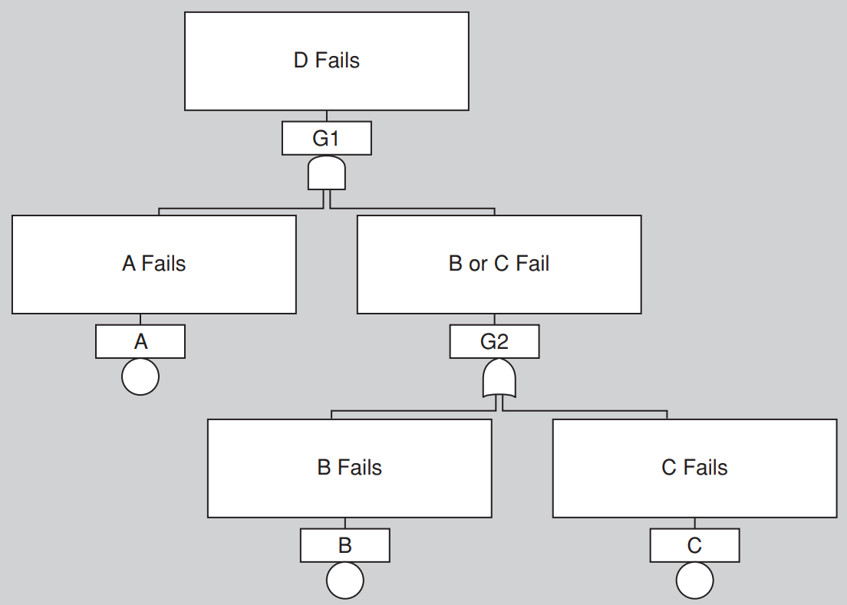
Fault Tree Notation
Basic Event (generally an environmental factor or input)
Intermediate Event (generally a failure)
Undeveloped Event (we are not modeling it or digging into it)
Notes:
A simple fault tree. D fails if A fails and either B or C fails.

Slide 17
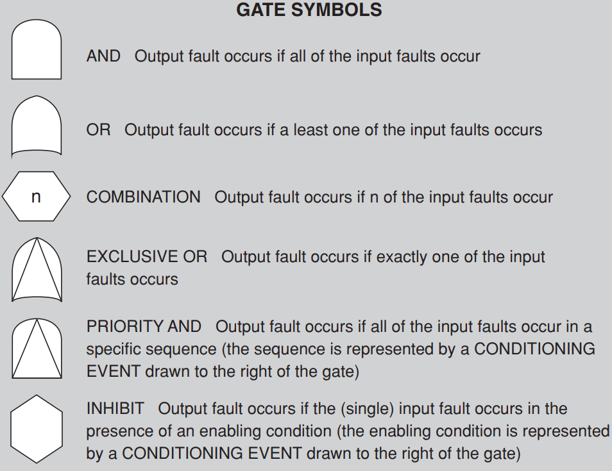
Fault Tree Notation

Slide 18
Fault Tree Example
Car Accident
2.15 * 10⁻⁴
OR
3.12 * 10⁻⁶
2.12 * 10⁻⁴
AND
Non-Deer Accident
Deer in Road
Car Fails to Stop
0.0026
0.0012
Each event assigned a probability.
If events are independent, we propagate using:
P(X or Y) = P(X) + P(Y) - (P(X) * P(Y))
P(X and Y) = P(X) * P(Y)
OR
Driver Distracted
Brakes Fail
0.001
0.0002
Brakes Applied
0.999

Slide 19
Availability Scenarios
Notes:
(discussion) Point is - there are a lot of different answers to this question

Slide 20
Availability Quality Scenarios
The ability of the system to mask or repair faults such that the outage period does not exceed a required value over a time period.
Measure how the system responds to failure.
When the system breaks, how long does it take to resume normal operation?
Stimuli should always be a failure.
Response measures should always include a measure of availability:
availability percentage, time to detect or repair fault, time system in degraded mode, no down time, etc.
Notes:
Availability is (1). Availability scenarios (rest)

Slide 21
Availability Quality Scenarios
Scenarios must distinguish physical failures in the system and the software’s perception of the failure.
Do not assume software is omniscient.
Scenarios tend to deal with:
Failure of a physical component or external system.
Reconfiguration of the physical system.
Maintenance or reconfiguration of the software.
Notes:
(1) For example, given a network connection failure, if there is no traffic from the system over the link, then the software may not perceive the network failure until it attempts to use the network. Do not assume the software is omniscient, that is, all-knowing; there must be a mechanism in the architecture to perceive failures before the system can respond to them.
The kinds of scenarios that are managed by availability fall into three types: failure of an existing
physical component or external system that is used by the software, reconfiguration of the physical
system (e.g., adding or removing additional hardware resources), or maintenance or reconfiguration of
the software: for example, loading new versions of the software onto hardware, especially if it requires
restarting different processes that are part of the system, or entering a “maintenance mode” that
requires that the software is offline or functions in a reduced capacity.

Slide 22
Generic Availability Scenario
Overview: Description of the scenario.
System/environment state: The state of the system when the fault or failure occurs may also affect the desired system response. If the system has already failed and is not in normal mode, it may be desirable to shut it down. If this is the first failure, degradation of response time or functions may be preferred.
External Stimulus: Differentiate between internal and external origins of failure because desired system response may be different. Stimuli is an omission (a component fails to respond to an input), a crash (component repeatedly suffers omission faults), timing (a component responds but the response is early or late) or response (a component responds with an incorrect value).
Notes:
■ Artifact. We need to specify the resource that is required to be highly available, such as a processor, communication channel, process, or storage.
■ Environment. The state of the system when the fault or failure occurs may also affect the desired system response. For example, if the system has already seen some faults and is operating in other than normal mode, it may be desirable to shut it down totally. However, if this is the first fault observed, some degradation of response time or function may be preferred.
■ Source of stimulus. We differentiate between internal and external origins of faults or failure because the desired system response may be different.
■ Stimulus. A fault of one of the following classes occurs: ■ Omission. A component fails to respond to an input. ■ Crash. The component repeatedly suffers omission faults. ■ Timing. A component responds but the response is early or late. ■ Response. A component responds with an incorrect value.

Slide 23
Generic Availability Scenario
Required system behavior: There are a number of possible reactions to a failure. Fault must be detected and isolated before any other response is possible. After the fault is detected, the system must recover from it. Actions include logging the failure, notifying selected users or other systems, taking actions to limit the damage caused by the fault, switching to a degraded mode with either less capacity or less function, shutting down external systems, or becoming unavailable during repair.
Response measure: Can specify an availability percentage, or it can specify a time to detect the fault, time to repair the fault, times or time intervals where system must be available, or duration for which the system must be available.
Notes:
■ Response. There are a number of possible reactions to a system fault. First, the fault must be detected and isolated (correlated) before any other response is possible. (One exception to this is when the fault is prevented before it occurs.) After the fault is detected, the system must recover from it. Actions associated with these possibilities include logging the failure, notifying selected users or other systems, taking actions to limit the damage caused by the fault, switching to a degraded mode with either less capacity or less function, shutting down external systems, or becoming unavailable during repair.
■ Response measure. The response measure can specify an availability percentage, or it can specify a time to detect the fault, time to repair the fault, times or time intervals during which the system must be available, or the duration for which the system must be available.

Slide 24
Availability Scenario
Availability while adding new taps
Overview: How the system handles additional taps being added to the system.
System/environment state: The system is operating normally, without problems.
External Stimulus: A user powers up a new Kegboard on the network with six additional taps.
Required system behavior: The kegboards send init messages to the central Kegbot server. The server interrogates the kegboards and adds the additional taps to the inventory of taps. The system continues to service the existing taps without interruption.
Response measure: There is no interruption of service to existing taps. Within 1 second, the new kegboard is added to the administrative interface on the KegBot web server for administraton configuration.
Notes:
(from a beer inventory management system)
Why are these good examples? They are specific and have a reasonable and testable response measure.
A possible critique is that both scenarios have aspects of both availability and performance, but occurs
fairly often. Note that we have combined the system state and environment; for both of these “good”
examples, they are essentially stating that everything is normal.

Slide 25
Availability Scenario 2
Web server failure at e-commerce site
Overview: One of the client-facing web servers fails during transmission of client page update.
System/environment state: System is working correctly under normal load. Customer has generated a “add item to shopping cart” post, which was routed to web server <X> in transaction pool.
External Stimulus: Web server <X> crashes during response generation.
Required system behavior: Response page may be corrupted on client browser. Load balancer component no longer receives heartbeat message from web server and so removes it from the pool of available servers after 2s of missed messages, or upon next request sent to the server. Load balancer will remove the server from the pool of available servers. From client’s perspective, a page reload will be automatically routed to alternate server by load balancer and page will be correctly displayed.
Response measure: Upon client-side page refresh, client state and display contains state after last transaction. Time for re-routed refresh is equivalent to “standard” refresh (<1 second 95% of the time).
Notes:
Why are these good examples? They are specific and have a reasonable and testable response measure.
A possible critique is that both scenarios have aspects of both availability and performance, but occurs
fairly often. Note that we have combined the system state and environment; for both of these “good”
examples, they are essentially stating that everything is normal.

Slide 26
Availability Tactics
Notes:
(discussion) Point is - there are a lot of different answers to this question

Slide 27
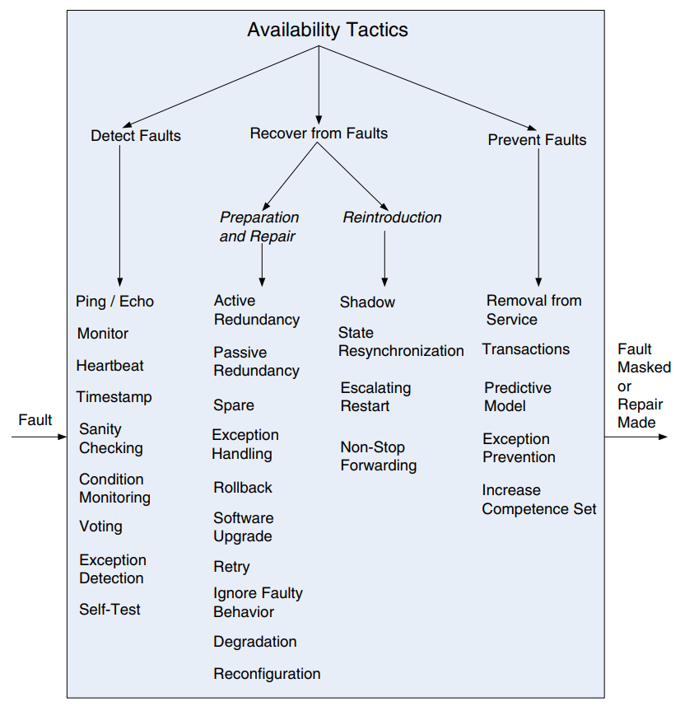
Availability Tactics
Notes:
A failure occurs when the system no longer delivers a service that is consistent with its specification; this failure is observable by the system’s actors. A fault (or combination of faults) has the potential to cause a failure. Availability tactics, therefore, are designed to enable a system to endure system faults so that a service being delivered by the system remains compliant with its specification. The tactics we can apply will keep faults from becoming failures or at least bound the effects of the fault and make repair possible. Availability tactics may be categorized as addressing one of three categories: fault detection, fault recovery, and fault prevention.

Slide 28
Detect Faults
Before we can take action, the presence of a fault must be detected or anticipated.
Ping/Echo:
Asynchronous request/response message exchanged between nodes to determine reachability and round-trip delay.
Echo determines that a pinged element is alive.
Ping often sent be a system monitor.
Time threshold determines how long to wait for the echo before timing out.
Standard implementations available through IP.
Notes:
Before any system can take action regarding a fault, the presence of the fault must be detected or anticipated. Tactics in this category include the following:
■ Ping/echo refers to an asynchronous request/response message pair exchanged between nodes, used to determine reachability and the round-trip delay through the associated network path. But the echo also determines that the pinged element is alive and responding correctly. The ping is often sent by a system monitor. Ping/echo requires a time threshold to be set; this threshold tells the pinging component how long to wait for the echo before considering the pinged component to have failed (“timed out”). Standard implementations of ping/echo are available for nodes interconnected via IP

Slide 29
Detect Faults
Monitor:
Element that monitors the health of processes, CPUs, I/O, memory, etc.
Can detect failure or congestion in network and shared resources,initiate system self-tests, and detect timing issues.
“Watchdog” that monitors overall system.
Heartbeat:
Message exchange between monitor and a process.
Process resets watchdog timer in monitor.
Often merged with other control messages to avoid performance or scalability issues.
Difference with ping: process has the responsibility.
Notes:
■ Monitor. A monitor is a component that is used to monitor the state of health of various other parts of the system: processors, processes, I/O, memory, and so on. A system monitor can detect failure or congestion in the network or other shared resources, such as from a denial-of-service attack. It orchestrates software using other tactics in this category to detect malfunctioning elements. For example, the system monitor can initiate self-tests, or be the element that detects faulty time stamps or missed heartbeats. When the detection mechanism is implemented using a counter or timer that is periodically reset, this specialization of system monitor is referred to as a “watchdog.” During nominal operation, the process being monitored will periodically reset the watchdog counter/timer as part of its signal that it’s working correctly; this is sometimes referred to as “petting the watchdog.”
■ Heartbeat is a fault detection mechanism that employs a periodic message exchange between a system monitor and a process being monitored. A special case of heartbeat is when the process being monitored periodically resets the watchdog timer in its monitor to prevent it from expiring and thus signaling a fault. For systems where scalability is a concern, transport and processing overhead can be reduced by piggybacking heartbeat messages on to other control messages being exchanged between the process being monitored and the distributed system controller. The big difference between heartbeat and ping/echo is who holds the responsibility for initiating the health check—the monitor or the component itself.

Slide 30
Detect Faults
Time Stamp:
Detect incorrect sequences of events.
Time stamps established using local clocks.
Can use a sequence number of time is not important
Sanity Check/Condition Monitoring:
Checks validity or reasonableness of specific operations or outputs of a component.
Requires well-specified properties.
Employed at interfaces to examine information flow.
Monitor must be simple to avoid introducing new errors through the overhead of monitoring.
Notes:
■ Time stamp. This tactic is used to detect incorrect sequences of events, primarily in distributed message-passing systems. A time stamp of an event can be established by assigning the state of a local clock to the event immediately after the event occurs. Simple sequence numbers can also be used for this purpose, if time information is not important.
■ Sanity checking checks the validity or reasonableness of specific operations or outputs of a component. (2) This tactic is typically based on a knowledge of the internal design, the state of the system, or the nature of the information under scrutiny. By monitoring conditions, this tactic prevents a system from producing faulty behavior.
It is most often employed at interfaces, to examine a specific information flow.
However, the monitor must itself be simple (and, ideally, provable) to ensure that it does not introduce new software errors.

Slide 31
Detect Faults
Voting:
Run three elements that “do the same job”, apply same input to each, then compare the output.
Often three copies of the same process.
Detect inconsistency among the three output states.
If there are disagreements, report a fault.
Use majority as the “official” output.
Notes:
■ Voting. The most common realization of this tactic is referred to as triple modular redundancy (TMR), which employs three components that do the same thing - usually three copies of the same process- each of which receives identical inputs, and forwards their output to voting logic, used to detect any inconsistency among the three output states. Faced with an inconsistency, the voter reports a fault. It must also decide what output to use. It can let the majority rule, or choose some computed average of the disparate outputs. This tactic depends critically on the voting logic, which is usually realized as a simple, rigorously reviewed and tested singleton so that the probability of error is low.

Slide 32
Failure Recovery
Prevention-and-repair tactics attempt to retry computations or introduce redundancy.
Active Redundancy (Hot Spare):
A protection group is a group of processing nodes where one or more nodes are “active,” with the remaining nodes serving as redundant spares.
In this configuration, all nodes (active or redundant) process input in parallel, allowing redundant spares to synchronize with active nodes.
Because redundant nodes has identical state, it can take over from a failed element in milliseconds.
Notes:
Recover-from-faults tactics are refined into preparation-and-repair tactics and reintroduction tactics. The latter are concerned with reintroducing a failed (but rehabilitated) element back into normal operation. Preparation-and-repair tactics are based on a variety of combinations of retrying a computation or introducing redundancy. They include:
■ Active redundancy (hot spare). A protection group is a group of processing nodes where one or more nodes are “active,” with the remaining nodes in the protection group serving as redundant spares .This refers to a configuration where all of the nodes (active or redundant spare) in a protection group receive and process identical inputs in parallel, allowing the redundant spare(s) to maintain synchronous state with the active node(s). Because the redundant spare possesses an identical state to the active processor, it can take over from a failed component in a matter of milliseconds. The simple case of one active node and one redundant spare node is commonly referred to as 1+1 (“one plus one”) redundancy. Active redundancy can also be used for facilities protection, where active and standby network links are used to ensure highly available network connectivity

Slide 33
Failure Recovery
Passive Redundancy (Warm Spare):
Only active members of a production group process input, and provide redundant spares with status updates.
State of redundant nodes is only loosely coupled to active nodes.
Enables availability with lower performance cost.
Spare (Cold Spare):
Redundant nodes remain out of service until a failure occurs, then they replace the active nodes.
Poor recovery performance, but improves reliability.
Notes:
■ Passive redundancy (warm spare). This refers to a configuration where only the active members of the protection group process input traffic; one of their duties is to provide the redundant spare(s) with periodic state updates. Because the state maintained by the redundant spares is only loosely coupled with that of the active node(s) in the protection group, the redundant nodes are referred to as warm spares. Depending on a system’s availability requirements, passive redundancy provides a solution that achieves a balance between the more highly available but more compute-intensive (and expensive) active redundancy tactic and the less available but significantly less complex cold spare tactic (which is also significantly cheaper).
■ Spare (cold spare). Cold sparing refers to a configuration where the redundant spares of a protection group remain out of service until a fail-over occurs, at which point a power-on-reset procedure is initiated on the redundant spare prior to its being placed in service. Due to its poor recovery performance, cold sparing is better suited for systems having only high-reliability (MTBF) requirements as opposed to those also having high-availability requirements.

Slide 34
Failure Recovery
Exception Handling:
Once an exception is detected, the system must handle it.
Easiest thing to do is crash, but this is not desirable.
Offer error messages, details on why the program failed (cause and location of the failure).
Mask the fault and restore the program to a usable state or retry an operation.
Rollback:
Revert to a known good state (“rollback line”).
Continue from restored state.
Often paired with redundancy.
Can update stored state when convenient.
Notes:
■ Exception handling. Once an exception has been detected, the system must handle it in some fashion. The easiest thing it can do is simply to crash, but of course that’s a terrible idea from the point of availability, usability, testability, and plain good sense. There are much more productive possibilities. The mechanism employed for exception handling depends largely on the programming environment employed, ranging from simple function return codes (error codes) to the use of exception classes that contain information helpful in fault correlation, such as the name of the exception thrown, the origin of the exception, and the cause of the exception thrown. Software can then use this information to mask the fault, usually by correcting the cause of the exception and retrying the operation.
■ Rollback. This tactic permits the system to revert to a previous known good state, referred to as the “rollback line”—rolling back time—upon the detection of a failure. Once the good state is reached, then execution can continue. This tactic is often combined with active or passive redundancy tactics so that after a rollback has occurred, a standby version of the failed component is promoted to active status. Rollback depends on a copy of a previous good state (a checkpoint) being available to the components that are rolling back. Checkpoints can be stored in a fixed location and updated at regular intervals, or at convenient or significant times in the processing, such as at the completion of a complex operation.

Slide 35
Failure Recovery
Retry:
Assumes fault is transient. Retries the failed operation. Often used in networked environments.
Limit number of retries.
Ignore Faulty Behavior:
Block all messages from a source known to be faulty
Common tactic for avoiding DDOS attacks.
Degradation:
Drop non-critical functions after a failure and maintain the functioning critical services.
Reconfiguration:
Reassign responsibilities to remaining resources.
Notes:
■ Retry. The retry tactic assumes that the fault that caused a failure is transient and retrying the operation may lead to success. This tactic is used in networks and in server farms where failures are expected and common. There should be a limit on the number of retries that are attempted before a permanent failure is declared.
■ Ignore faulty behavior. This tactic calls for ignoring messages sent from a particular source when we determine that those messages are spurious. For example, we would like to ignore the messages of an external component launching a denial-of-service attack by establishing Access Control List filters, for example.
■ The degradation tactic maintains the most critical system functions in the presence of component failures, dropping less critical functions. This is done in circumstances where individual component failures gracefully reduce system functionality rather than causing a complete system failure.
■ Reconfiguration attempts to recover from component failures by reassigning responsibilities to the (potentially restricted) resources left functioning, while maintaining as much functionality as possible.

Slide 36
Failure Recovery
Reintroduction restores failed elements after correction.
Shadow:
Operate a failed or in-service component in a “shadow” mode for a period of time before restoring to active service.
During this time, its behavior is monitored for correctness and state is re-populated incrementally.
State Resynchronization:
With active redundancy: States of active and passive elements are compared to ensure synchronization.
With passive redundancy: State of passive elements is periodically updated by active elements.
Notes:
Reintroduction is where a failed component is reintroduced after it has been corrected. Reintroduction tactics include the following:
■ The shadow tactic refers to operating a previously failed or in-service upgraded component in a “shadow mode” for a predefined duration of time prior to reverting the component back to an active role. During this duration its behavior can be monitored for correctness and it can repopulate its state incrementally.
■ State resynchronization is a reintroduction partner to the active redundancy and passive redundancy preparation-and-repair tactics. When used alongside the active redundancy tactic, the state resynchronization occurs organically, because the active and standby components each receive and process identical inputs in parallel. In practice, the states of the active and standby components are periodically compared to ensure synchronization.
When used alongside the passive redundancy (warm spare) tactic, state resynchronization is based solely on periodic state information transmitted from the active component(s) to the standby component(s), typically via checkpointing.

Slide 37
Failure Recovery
Escalating Restart:
Allows the system to recover from failures by varying the granularity of the elements restarted and minimizing level of service affected.
Level 0: Employ a warm spare. All child threads of the faulty element are killed and recreated.
Level 1: Frees and reinitializes all unprotected memory.
Level 2: Frees and reinitializes all memory, forcing all elements to reload and reinitialize.
Level 3: Completely reload and reinitialize the executable image and associated data.
Useful for enabling graceful degradation.
Notes:
■ Escalating restart is a reintroduction tactic that allows the system to recover from faults by varying the granularity of the component(s) restarted and minimizing the level of service affected. For example, consider a system that supports four levels of restart, as follows. The lowest level of restart (call it Level 0), and hence having the least impact on services, employs passive redundancy (warm spare), where all child threads of the faulty component are killed and recreated. In this way, only data associated with the child threads is freed and reinitialized. The next level of restart (Level 1) frees and reinitializes all unprotected memory (protected memory would remain untouched). The next level of restart (Level 2) frees and reinitializes all memory, both protected and unprotected, forcing all applications to reload and reinitialize. And the final level of restart (Level 3) would involve completely reloading and reinitializing the executable image and associated data segments. Support for the escalating restart tactic is particularly useful for the concept of graceful degradation, where a system is able to degrade the services it provides while maintaining support for mission-critical or safety-critical applications.

Slide 38
Failure Prevention
Removal from Service:
Temporarily place elements in out-of-service states to mitigate potential system failures.
Take an element out of service and reset it to scrub latent faults (memory leaks, fragmentation, caching errors) before they cause a failure.
Transactions:
Ensure that all asynchronous messages are:
Atomic (each transaction treated as a single unit, and either succeeds or fails completely)
Consistent (data changes must be valid)
Isolated (concurrent updates have same effect as sequential)
Durable (once completed, a transaction remains committed even in case of a failure).
Notes:
Instead of detecting faults and then trying to recover from them, what if your system could prevent them from occurring in the first place? Although this sounds like some measure of clairvoyance might be required, it turns out that in many cases it is possible to do just that.
■ Removal from service. This tactic refers to temporarily placing a system component in an out-of-service state for the purpose of mitigating potential system failures. One example involves taking a component of a system out of service and resetting the component in order to scrub latent faults (such as memory leaks, fragmentation, or soft errors in an unprotected cache) before the accumulation of faults affects service (resulting in system failure). Another term for this tactic is software rejuvenation.
■ Transactions. Systems targeting high-availability services leverage transactional semantics to ensure that asynchronous messages exchanged between distributed components are atomic, consistent, isolated, and durable. These four properties are called the “ACID properties.” (go over)

Slide 39
Failure Prevention
Transactions:
Usually implemented through two-phase commit.
All processes in the transaction asked whether to commit or abort the transaction.
Then, a manager decided whether to commit based on process votes.
Prevents race conditions from processes attempting to update at the same time.
Notes:
The most common realization of the transactions tactic is “two-phase commit” (a.k.a. 2PC) protocol. (3-4) This tactic prevents race conditions caused by two processes attempting to update the same data item.

Slide 40
Failure Prevention
Predictive Model
A monitor uses a model to predict when the system has stepped outside of normal operating parameters, and takes action.
Uses performance metrics to predict failure.
Session establishment rate (for a server).
Process state (in-service, out-of-service, under maintenance, idle).
Message queue length.
Task completion speed.
Notes:
■ Predictive model. A predictive model, when combined with a monitor, is employed to monitor the state of health of a system process to ensure that the system is operating within its nominal operating parameters, and to take corrective action when conditions are detected that are predictive of likely future faults. The operational performance metrics monitored are used to predict the onset of faults; examples include session establishment rate (in an HTTP server), maintaining statistics for process state (in service, out of service, under maintenance, idle), message queue length statistics, and so on.

Slide 41
Failure Prevention
Exception Prevention
Prevent exceptions from occuring.
Use “wrappers” around common datatypes to prevent misuse of that type.
Prevent dangling pointers, semaphore access violations, null pointers, out-of-bounds access.
Use smart pointers to do bounds-checking on pointers and ensure that resources are automatically deallocated when no data refers to it.
Avoids resource leaks.
Notes:
■ Exception prevention. This tactic refers to techniques employed for the purpose of preventing system exceptions from occurring. A common example of exception prevention include abstract data types, such as smart pointers, and the use of wrappers to prevent faults, such as dangling pointers and semaphore access violations, null pointers, out-of-bounds access from occurring. Smart pointers prevent exceptions by doing bounds checking on pointers, and by ensuring that resources are automatically deallocated when no data refers to it. In this way resource leaks are avoided.

Slide 42
Availability Design Guidelines
Notes:
(discussion) Point is - there are a lot of different answers to this question

Slide 43
Allocation of Responsibilities
Determine system responsibilities that need to be highly available.
For each, ensure that the system can:
Detect an omission, crash, incorrect timing, or incorrect response.
Log the failure and details on underlying fault.
Notify appropriate people or systems.
Disable the source of events causing the failure.
Be temporarily unavailable.
Fix or mask the fault or failure.
Operate in a degraded mode.
Notes:
Determine the system responsibilities that need to be highly available. Within those responsibilities, ensure that additional responsibilities have been allocated to detect an omission, crash, incorrect timing, or incorrect response. Additionally, ensure that there are responsibilities to do the following: ■ Log the fault ■ Notify appropriate entities (people or systems) ■ Disable the source of events causing the fault ■ Be temporarily unavailable ■ Fix or mask the fault/failure ■ Operate in a degraded mode

Slide 44
Coordination Model
For each responsibility that must remain highly available:
Can coordination mechanisms detect the failure?
Is guaranteed delivery of messages necessary?
Will coordination work under degraded communication?
Can the coordination mechanism replace the failed element?
Does replacement of a server allow the system to still operate?
Can coordination still function under degraded conditions?
How much lost information can the model withstand?
Notes:
Determine the system responsibilities that need to be highly available. With respect to those responsibilities, do the following: ■ Ensure that coordination mechanisms can detect an omission, crash, incorrect timing, or incorrect response. Consider, for example, whether guaranteed delivery is necessary. Will the coordination work under conditions of degraded communication? ■ Ensure that coordination mechanisms enable the logging of the fault, notification of appropriate entities, disabling of the source of the events causing the fault, fixing or masking the fault, or operating in a degraded mode. ■ Ensure that the coordination model supports the replacement of the failed element (processors, communications channels, persistent storage, and processes). For example, does replacement of a server allow the system to continue to operate? ■ Determine if the coordination will work under conditions of degraded communication, at startup/shutdown, in repair mode, or under overloaded operation. For example, how much lost information can the coordination model withstand and with what consequences?

Slide 45
Data Model
For each element that must be highly available:
Which data abstractions, operations, or properties could cause a failure?
For each data abstraction, operation, or property, can it be disabled, temporarily unavailable, fixed, or masked?
Can write requests be cached if a server is temporarily down, then performed once it is returned to service?
Notes:
Determine which portions of the system need to be highly available. Within those portions, determine which data abstractions, along with their operations or their properties, could cause a fault of omission, a crash, incorrect timing behavior, or an incorrect response. For those data abstractions, operations, and properties, ensure that they can be disabled, be temporarily unavailable, or be fixed or masked in the event of a fault. For example, ensure that write requests are cached if a server is temporarily unavailable and performed when the server is returned to service

Slide 46
Mapping Among Elements
What processes, CPUs, persistent storage, etc. can produce a failure?
Ensure that mapping of elements to runtime elements is flexible enough to permit recovery.
Which processes need to be reassigned at runtime?
Which CPUs, data stores, etc. can be activated or reassigned at runtime?
How can data on failed CPUs or storage be replaced?
How quickly can the system be reinstalled?
Notes:
Determine which artifacts (processors, communication channels, persistent storage, or processes) may produce a fault: omission, crash, incorrect timing, or incorrect response. Ensure that the mapping (or remapping) of architectural elements is flexible enough to permit the recovery from the fault. This may involve a consideration of the following: ■ Which processes on failed processors need to be reassigned at runtime ■ Which processors, data stores, or communication channels can be activated or reassigned at runtime ■ How data on failed processors or storage can be served by replacement units ■ How quickly the system can be reinstalled

Slide 47
Resource Management
What critical resources are needed to continue operating in the presence of a fault?
Ensure sufficient resources to log the fault, notify people and systems, disable the events causing the fault, fix or mask the fault, and operate in a degraded mode.
Determine availability time for critical resources, what resources must be available at specified time intervals, and repair time.
Ensure critical resources are available during these intervals. (i.e., make sure input queues are large enough to buffer if a server fails).
Notes:
Determine what critical resources are necessary to continue operating in the presence of a fault. Ensure there are sufficient remaining resources in the event of a fault to log the fault; notify appropriate entities (people or systems); disable the source of events causing the fault; fix or mask the fault/failure; operate normally, in startup, shutdown, repair mode, degraded operation, and overloaded operation. Determine the availability time for critical resources, what critical resources must be available during specified time intervals, time intervals during which the critical resources may be in a degraded mode, and repair time for critical resources. Ensure that the critical resources are available during these time intervals. For example, ensure that input queues are large enough to buffer anticipated messages if a server fails so that the messages are not permanently lost.

Slide 48
Key Points
Availability is the ability of the system to be available for use, especially after a failure.
Failures must be recognized or prevented.
System response can range from “ignore it” to “keep on going as if it didn’t occur”.
Availability tactics detect faults, recover from failures, and prevent failures.
Detection depends on signs of life.
Recovery involves retrying operations or maintaining redundant data or computations.
Prevention depends on removing elements from service or limiting scope of failures.
Notes:
Availability refers to the ability of the system to be available for use, especially after a fault occurs. The fault must be recognized (or prevented) and then the system must respond in some fashion. The response desired will depend on the criticality of the application and the type of fault and can range from “ignore it” to “keep on going as if it didn’t occur.” Tactics for availability are categorized into detect faults, recover from faults and prevent faults. Detection tactics depend, essentially, on detecting signs of life from various components. Recovery tactics are some combination of retrying an operation or maintaining redundant data or computations. Prevention tactics depend either on removing elements from service or utilizing mechanisms to limit the scope of faults.

Slide 49
Next Time
Embedded System Architecture and Architecture Design Languages
Sources:
Medvidovic and Taylor, “A classification and comparison framework for Architecture Description Languages”
“Architecture Analysis with AADL”
Homework:
Project, Part 3 - Due on Nov 18
Reading Assignment 3 - Due on Nov 27

