Slide 1
Architectural Style: Service-Oriented Architectures
CSCE 742 - Lecture 22 - 11/29/2018

Slide 2

In the Beginning...
Notes:
In the beginning….

Slide 3
Early Business Software
Business and Government discovered the value of computing.
Business requirements were captured and programmed.
Applications were designed for specific departments / business needs.
Applications were monolithic.
Designed as one entity, combining the logic of user interface, business processing, and data access.
Notes:
Early on, (1-4).

Slide 4
Problem: “Silo Apps”
Each application is self contained.
One view of user interaction.
Difficult to find clean integration points
Because of monolithic design, updates of one kind of logic require testing multiple kinds of behavior.
Monolithic applications are harder to understand, as logic is generally patched rather than rewritten.
Rewrites are risky, “house of cards” effect.
Notes:
This creates this problem, these monolithic, or silo, apps. (1), which means that we have (2) - of how user would work with this application. This makes it (3). Worse, (4). The system was not necessarily designed as a set of independent subsystems, but as a whole. (5) (6) Updates take extra time as developers try to decipher the logic, and as the complexity grows, additional errors accompany updates.

Slide 5
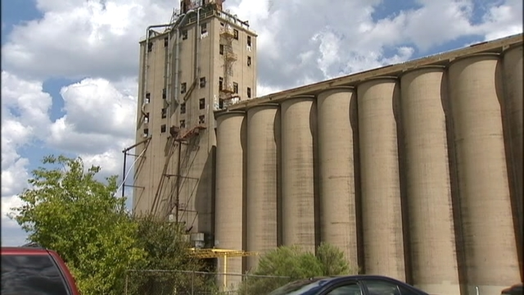
Problem: “Silo Apps”
Lack of standards makes it difficult to integrate with or to other applications.
Leads to duplication:
If we don’t plan for reuse, reuse will not happen.
Applications contain nearly-duplicate functionality:
Authentication, business logic, storage management, logging.
Business units have nearly-duplicate applications.
Notes:
Worse, (4) - we may not have a clearly defined API, or any real way to export functionality other than the user interface. As a result (2-3) Then, you get (rest)

Slide 6
The Times, They Are Changing.
Reuse of existing software assets.
Integration between separately developed business applications.
…Using different languages.
…Using heterogeneous hardware.
Easily support corporate change:
Mergers / acquisitions.
Reorganization.
AKA - can we continue to support and use this application after employee turnover.
Notes:
Over time, things have changed. Partly as a result of these problems, partially because of evolving technology. Now, we want (1) - we don’t want to reinvent the wheel each time we start a project. We want to code once, and use endlessly. Duplication leads to wasted effort. We also want (2-4), a variety of hardware platforms. This is not possible in a siloed environment, where the system must use one language, and often is not intended to be used outside of a small context. From the business side, we also want to be able to (5-7). Why does this matter from the software development side? (8) - can we understand this code? Can we execute and get business value from this system? This is hard when using a monolithic application, as we have to understand the whole system and not a small number of valuable pieces.

Slide 7
Services and Service-Oriented Architecture (SOA)
Notes:
This is where services come in.

Slide 8
What is a Service?
From the dictionary:
A facility supplying some public demand.
The work performed by one that serves.
See also: help, use, benefit
In economics, a service is the non-material equivalent of a good.
Service provision is an economic activity that does not result in ownership.
It is claimed to be a process that creates benefits by facilitating either a change in customers, a change in their physical possessions, or a change in their intangible assets.
Notes:
(go over). This hasn’t said much about software yet, but the ideas matter. In the software realm, services is a design concept - an attempt to capture the same ideas of processes that create benefits, that supply a public demand, rather than serving a single consumer.

Slide 9
What is a Service?
A service handles a business process, a technical task, or provides business data.
Process: Calculating an insurance quote.
Task: Accessing a database.
Data: Details needed to construct a GUI.
A service can access another service and respond to different kinds of requesters.
A service is relatively independent.
Changes to a requester require few or no changes to the service.
Changes to the internal logic of a service require few or no changes to the requester.
Notes:
A service • handles a business process such as calculating an insurance quote or distributing email, or handles a relatively technical task such as accessing a database, or provides business data and the technical details needed to construct a graphical interface • can access another service and, with the appropriate runtime technology, can access a traditional program and respond to different kinds of requesters — for example, to Web applications • is relatively independent of other software so that changes to a requester require few or no changes to the service, while changes to the internal logic of a service require few or no changes to the requester

Slide 10
Properties of Services
A service logically represents a business activity with a specified outcome.
A service is self-contained.
Designed to maintain loose coupling.
A service is a black box for its consumers.
Only its interface needs to be understood.
Can handle interactions within and outside your company, geographically distributed across the world.
A service may consist of other underlying services.
Notes:
A service has four properties according to one of many definitions of SOA (1) - a small, independent unit of functionality. (2-3), where changes to one service do not spill over into other services. The flexibility offered by loose coupling protects your company from excessive costs when business or technical requirements change. (4) - they do not need to know what is inside, just how to access it. (5) When you invoke a function, you aren’t concerned with the internal logic of the invoked code or with how the function receives arguments or returns a value. Similarly, when you code a service request, you care only about the syntax for requesting the service. At best, service requests are as easy as function invocations.
A service can handle interactions within your company, as well as between your company and its suppliers, partners, and customers. The location of service requesters can extend worldwide, depending on security issues and on the runtime software used to access a particular service. In most cases, the requesting code has no details on the service location. Like the requester, the service can be almost anywhere. The location is set when the network is configured, and changes to the location are sometimes possible at network run time. (last point) - services are composable, and as long as their interfaces are respected, we can build a system from a collection of underlying services and connection code.

Slide 11
Service-Oriented Architecture (SOA)
A way of organizing software so that companies can respond quickly to the changing requirements of the marketplace.
The architecture of a system links services.
Small, customized units of software that run in a network.
Developers make services available over a network to allow users to combine and reuse them.
Services communicate by passing data in a well-defined, shared format, or by coordinating activity between other services.
Notes:
That last point leads to the concept of (title). SOA is (1), in practice, SOA separates functions into distinct units, or services,^{[6]} - (3) - which developers make accessible over a network in order to allow users to combine and reuse them in the production of applications. These services and their corresponding consumers communicate with each other by passing data in a well-defined, shared format, or by coordinating an activity between two or more services.

Slide 12
SOA Manifesto
Business value over technical strategy.
Strategic goals over project-specific benefits.
Intrinsic interoperability over custom integration.
Shared services over specific-purpose implementations.
Flexibility over optimization.
Evolutionary refinement over initial perfection.
Notes:
A manifesto was published for service-oriented architecture in October, 2009. This came up with six core values which are listed as follows:^{[8]}
Business value is given more importance than technical strategy. Does this offer meaning and value to our business, and what maximizes its value? Value can come from reuse, ease of use, ease of integration.
Strategic goals are given more importance than project-specific benefits. Think of the long-term, can we continue to get value from this?
Intrinsic inter-operability is given more importance than custom integration. Design from the first place to be easy to use and extend, rather than being designed for use in one specific project.
Shared services are given more importance than specific-purpose implementations. Again, can we reuse this? Can we derive a general representation of output and input formats, rather then fitting this current project perfectly.
Flexibility is given more importance than optimization. This is a tradeoff you will have to make. Make the service easy to integrate, easy to use - this is more important than perfect performance.
Evolutionary refinement is given more importance than pursuit of initial perfection - can we get something working that we improve over time? Get the service out there and usable.

Slide 13
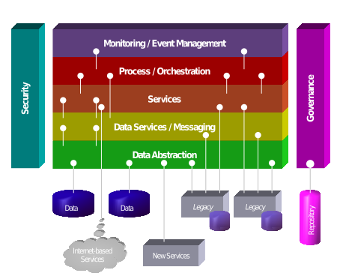
Service Hierarchy
Services tend to naturally form a layered architecture.
Data abstraction layer retrieves and writes to underlying databases.
Data services transform that data and provide messaging queues.
Services offer low-level business tasks, may be combined to perform “high-level” tasks by the process/orchestration layer.
Top levels perform integration and monitoring of the whole system.
Security and governance services work across the layers.
Notes:
(1) The bottom levels consist of data-access services, each of which handles the relatively technical task of reading from and writing to data-storage areas such as databases and message queues. A data-access service is most often invoked from the business layer.
The middle level is composed of services that each fulfill a relatively low-level business task. For example, an integration service might invoke such business services to verify the details provided by an insurance-policy applicant. If the business services return values that are judged to mean “issue a policy,” the integration service invokes yet another business service, which calculates a quote and returns the quote to other parts of the software or other systems (for example, a Web application) that invoked the service-oriented application.
The topmost levels contain one or more integration services, each of which controls a flow of activities such as processing an applicant’s request for insurance coverage. Each integration service invokes one or more business services.
(last point)
Great complexity is possible. Some integration services, for example, provide different operations to different requesters, and some invoke other integration services and are said to be composed of those services.

Slide 14
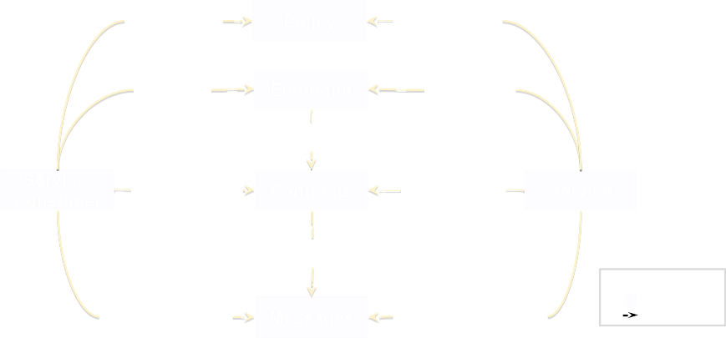
Service Interactions
Slide by Arnon Rotem-Gal-Oz
Notes:
Technical and non-technical components
End-point, interface and connector

Slide 15
Standardized Service Contract
Services within the same service inventory should be in compliance with the same contract design standards.
Services share schema and contract, not class.
Service compatibility is based on policy
A service contract is a promise of the purpose and capabilities of a service.
Its public interface.
The nature and quantity of content that it will publish.
How do services express functionality?
How are data types/models defined?
How are policies asserted and attached?
Notes:
(1) (2) Services express their purpose and capabilities via a service contract. (3) The Standardized Service Contract design principle essentially requires that specific considerations be taken into account when designing a service's public technical interface
and assessing the nature and quantity of content that will be published as part of a service's official contract.
A great deal of emphasis is placed on specific aspects of contract design, including the manner in which services express functionality, how data types and data models are defined, and how policies are asserted and attached.

Slide 16
Standardized Service Contract
The service contract should govern all services that you offer in one “inventory”.
Consists of a functional expression standardization - defining the interface, input, and output (WSDL).
A data model (XML schema) - defining formats.
A policy document - defining terms of use.
Service contracts ensure services are consistent, reliable, and governable.
Standards must be applied correctly. Service contracts avoid ambiguity.
Notes:
(1), (2). This is usually a WSDL document, a language for describing web interfaces using XML. This helps to increase the service contract's correct interpretation, which in turn increases service’s reuse and interoperability. When service contracts clearly express their capabilities, the chance of service duplication is also reduced. (3) Two services exchanging messages based on the same type of data—e.g., a purchase order—might model that data according to different schemas, which requires data model transformation. This clearly adds overhead, and stands in the way of service interoperability and reuse. To avoid this transformation, the standardized service contract principle requires standardized data models, which further helps create a standardized data representation architecture that can be reused across the enterprise to define standardized service capabilities. (4) Service policies represent terms of use for a service. So, for a service to be reusable, its behavioral requirements must be expressed consistently using standardized policy expressions based on industry standard vocabularies.
There is a constant focus on ensuring that service contracts are both optimized, appropriately granular, and standardized to ensure that the endpoints established by services are consistent, reliable, and governable.
the use of standards guarantees the interoperability and reusability of services. But the use of standards must be a correct use, which implies precision. Ambiguity is one of the enemies of the definition of Service Contracts, and is a very slippery enemy. - a good service contract avoids ambiguity and ensures that the project is governable.

Slide 17
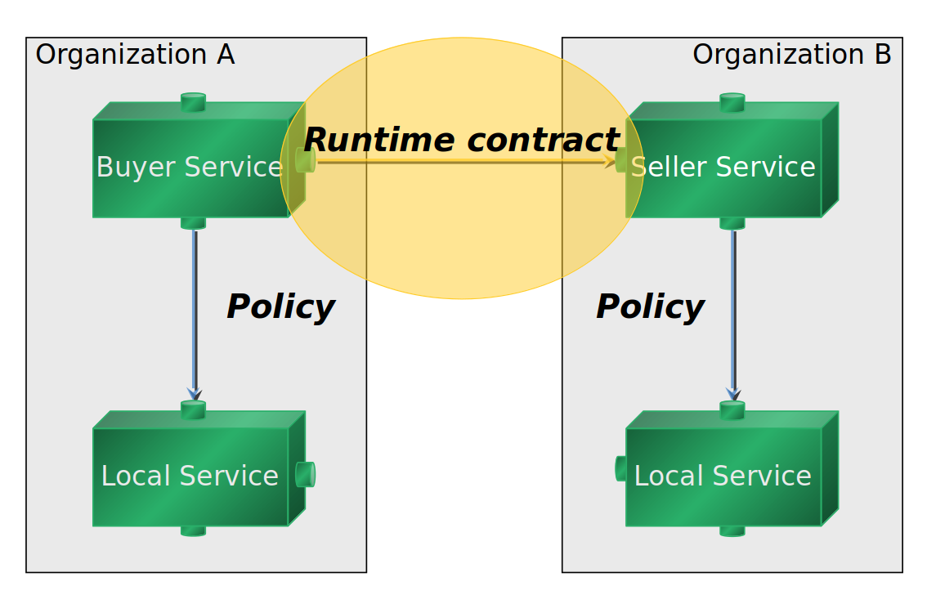
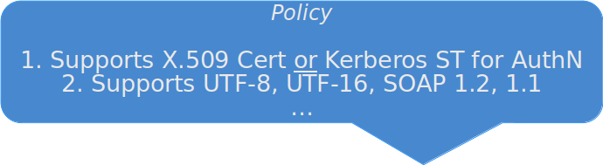
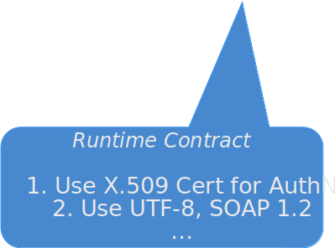
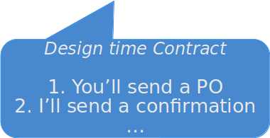
Contracts and Policies
Contacts can be established at design and run-time. Policies are constraints that ensure contracts are met.
Slide by Arnon Rotem-Gal-Oz
Notes:
Contacts can be established at design and run-time. Policies are constraints that ensure contracts are met.
(three click)

Slide 18
Principles of Services and SOA
Notes:
This is where services come in.

Slide 19
Service Abstraction
Public information on a service should be limited to what it required for use.
Too much knowledge of the inner workings of a service leads to increased coupling to a particular implementation.
Functional abstraction: How much of the service logic is exposed to the public?
Public vs private functionality - what logic can consumers access?
In the service contract, do not discuss inner details of business rules and validation logic.
Notes:
Service abstraction is a design principle that is applied so that the information published in a service contract is limited to what is required to effectively utilize the service. The service contract should not contain any superfluous information that is not required for its invocation. In the case of service-orientation, more knowledge is not necessarily better. There is a chance that additional information could impede the reusability of the service as the service consumer designer may streamline their design based on this knowledge. However, doing so would affect the evolution of the service as now the consumer is indirectly coupled to the service implementation, which may need to be replaced in the future.
Func: This form of abstraction is dependent upon how much of the service logic is exposed as service capabilities. An example would be of a class whereby some of its methods are private while others are public. A class would only expose those methods as public that it deems to be important to other objects, any helper methods that are not relevant to the objects are kept hidden. Here, limit functionality is exposed to the public, and what is listed in the contract- a 'detailed contract' reveals too much of business rules and the validation logic

Slide 20
Service Abstraction
Technology information abstraction:
Do not tell consumers how the service logic and implementation are designed.
Logic abstraction:
Do not provide too much detail on how service performs functionality, as consumers may be designed around that knowledge.
Risks hampering logic refactoring.
Quality abstraction:
Only provide details that help in determining reliability and availability, not on other quality attributes.
Notes:
Tech: Any information about the underlying technology used within the service would result in a low technology information abstraction as the service contract explicitly tells the service consumers how the service logic and its implementation are designed. This extra information might result in service consumers being designed in a way that specifically targets that particular implementation
Logic: The programmatic details about the service logic need to be abstracted^{[3]} as knowledge about how the service actually performs its functionality can result in service consumers that factor in this information and are consequently designed under these assumptions. This can seriously hamper service logic refactoring efforts
Qual: (last point) - this is mainly to avoid confusing readers, as these details are often not relevant. In the case of security, this also assists in information hiding.

Slide 21
Service Granularity
How much does a service do?
Business Function:
Each service operation maps to a single business function. Can be violated if combination does not add design complexity or increase message size.
Performance:
The service should use a minimal number of service requests.
Message Size:
Services should only transmit data required. Try to reduce message sizes.
Quality of service characteristics:
Each operation should perform a single system transaction and leave cross-border data integrity to the consumer.
Notes:
The service granularity principle essentially asks, (1) - this is not a trivial question, and debate over it will determine everything you do when designing a service. Service granularity is both an application domain concern (business granularity), as well as a software interface design issue (technical granularity).
Bus: Ideally, each service operation maps to a single business function, although if a single operation can provide multiple functions without adding design complexity or increasing message sizes, this generality can reduce implementation and usage costs.
Perf: Web services are accessed remotely and calls to web service operation create more network overhead. Reducing the number of service requests reduces that overhead.
Mess: Coarse-grained services may pass more data than fine-grained services, including data that is not specifically required for the task. This complicates message processing in the endpoint and might in turn harm performance. Reducing message size may require adding a more fine-grained operation.
Qual: For conceptual clarity each service operation should perform a single system-level transaction and leave data integrity across service boundaries to the business logic in the service consumer. This also simplifies error recovery, and typically eases design.

Slide 22
Loose Coupling
Services must be as independent as possible from other services.
Run-time coupling:
Other services may not always be available.
Resend messages.
Cache results when:
The known interval for service updates,
Client uptime requirements stricter than service uptime requirements,
There are bandwidth problems in distribution.

Slide 23
Loose Coupling
Interface coupling:
Should be able to exchange services with compatible interfaces. Data should be published in standard formats.
Interfaces need to evolve over time. Support multiple versions to allow client migration
Multiple types of interface coupling:
Logic-to-contract: Behavior dictated by contract.
Contract-to-logic: Contract dictated by existing logic.
Contract-to-implementation/technology: Contract dictated by implementation details or technology.
Contract-to-consumer: Contract written for a client.
Notes:
2- XML, JSON
5- this is desirable
6 - less desireable, but pretty common
7 - like a data model of the underlying database. This is bad.
8 - Very bad

Slide 24
Loose Coupling
Service reference autonomy:
Services should only be aware of the existence of other services.
Only all services through their public API.
Any services offering the same interface can be swapped.
Service location transparency:
Services can be called from anywhere in the network, no matter where it is present.
Online, or on a local network.
Services can be located anywhere in the world, as long as they are accessible on the network.
Notes:
Two other principles comes from the idea of loose coupling - of service independency. (go over)

Slide 25
Service Autonomy
Services should exercise a high level of control over their execution environment.
A service should not contain logic dependent on anything external to the service - data models, information systems, shared resources.
A service cannot be reusable if its logic is coupled to external artifacts.
Design-time autonomy: Can the service be evolved without impacting consumers?
Enabled by loose coupling and abstraction.
Shields contract from logic and implementation, allowing redesign.
Notes:
For services to carry out their capabilities consistently and reliably, their underlying solution logic needs to have a significant degree of control over its environment and resources. The principle of Service Autonomy fosters design characteristics that increase a service's reliability and behavioral predictability. Broadly speaking, this principle states that a service can not contain logic that depends on anything external to the service itself, be it a data model, shared resources, an information system, or anything else. The need for this autonomy is largely imposed by reuse. We can not expect a service to be reusable if its logic is coupled in some way to some other artifact external to the service.
Design-time autonomy refers to the independence with which the services could be evolved without impacting their service consumers. This type of autonomy is required as the service’s underlying legacy resources might need an overhaul or the service’s logic might need refactoring in order to make it more efficient. The application of the service loose coupling and the service abstraction principles helps in attaining design-time autonomy as their application results in services whose contracts are shielded from their logic and implementation and hence, the services could be redesigned without affecting their service consumers.

Slide 26
Service Autonomy
Run-time autonomy:
Can a service control how their logic is processed by the runtime environment?
More control = more reliable behavior.
If the service is memory-intensive, deploy to a server with reserved resources.
Provide locally cached copies of data to reduce dependency on a shared database.
Increasing design-time autonomy increases run-time control over the environment.
May require customized environments.
Notes:
Run-time autonomy refers to the extent of the control that a service has over the way its solution logic^{[3]} is processed by the run-time environment. The more control a service has over its run-time environment, the more predictable is its behavior. Run-time autonomy is achieved by providing dedicated processing resources to the service. For example, if the service logic performs memory intensive tasks then the service could be deployed to a server with reserved or conserved resources. Similarly, by providing locally cached copies of data, where applicable, the service’s dependency on a remote shared database can be reduced. As a result, the overall autonomy of the service is increased...
There is a direct relationship between run-time autonomy and the design-time autonomy. Increasing the design-time autonomy automatically increases the ability to evolve service’s implementation environment.
The provisioning of service autonomy may require additional infrastructure and needs to be applied on a per-need, prioritized basis. On some occasions, services may need to be isolated and deployed in a customized and dedicated environment, with emphasis on designing the correct functional context since making fundamental changes to such a service is likely to be difficult.

Slide 27
Service Statelessness
Scalability requires separating services from their state data whenever possible.
Reduces the resources consumed by a service, as state management is delegated to the consumer.
Increases the number of requests that can be handled by the service.
Core tenant of REST (a form of SOA), other SOA styles may relax to varying degrees.
May need to retain some business data (i.e., customer records) or session data between tasks.
Still, must allow multiple concurrent connections with no side effects.
Notes:
(1) his results in reduction of the resources consumed by a service as the actual state data management is delegated to an external component or to an architectural extension. By reducing resource consumption, the service can handle more requests in a reliable manner (rest)

Slide 28
Service Discoverability
Services should be supplemented with meta-data that can be used to allow discovery by other services.
Supports reuse and composability.
Allows developers to identify existing services that fulfill generic requirements of the process being automated.
Services are registered to a service registry.
Java - Maven Repository
Bluetooth Service Discovery Protocol
Notes:
(go over - bluetooth: Used to allow devices to discover what services each other support, and what parameters to use to connect to them. For example, when connecting a mobile phone to a Bluetooth headset, SDP will be used to determine which Bluetooth profiles are supported by the headset (headset profile, hands free profile, advanced audio distribution profile, etc.) and the protocol multiplexer settings needed to connect to each of them. Each service is identified by a Universally Unique Identifier (UUID), with official services (Bluetooth profiles) assigned a short form UUID (16 bits rather than the full 128).

Slide 29
Service Boundaries are Explicit
A service edge is a natural boundary.
Services should not cross those boundaries when performing computations or working with data.
Crossing boundaries is costly:
Location of targeted service may be unknown.
Security models are likely to differ.
Data representations differ publicly and privately.
Services evolve and are reconfigured.
Consumers are unaware of how internal processes are implemented, and have limited control.
Notes:
1-2. Crossing service boundaries may be costly, depending upon geographic, trust, or execution factors. This is mainly due to
The physical location of the targeted service may be an unknown factor.
Security and trust models are likely to change with each boundary crossing.
(6) Marshalling and casting of data between a service’s public and private representations may require reliance upon additional resources—some of which may be external to the service itself.
While services are built to last, service configurations are built to change. This fact implies that a reliable service may suddenly experience performance degradations due to network reconfigurations or migration to another physical location.
Service consumers are generally unaware of how private, internal processes have been implemented. The consumer of a given service has limited control over the performance of the service being consumed.

Slide 30
Service Boundaries are Explicit
Do not use RPCs when crossing borders. Instead, use messages.
RPCs trick us into thinking there is no substantial difference between local and remote objects.
Messages will be lost. Design them to be retransmitted.
Idempotence - as long as request is processed at least once, we will see correct behavior.
Multiple instances of a request should do the same thing. No side effects.
Modern systems must be designed to be idempotent.
Notes:
Since crossing service boundaries is explicit, services should make this explicit by using messages for communication instead of trying to hide the boudary crossing by imitating a distributed RPC. (rest)

Slide 31


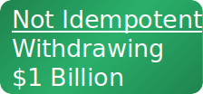
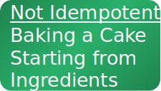
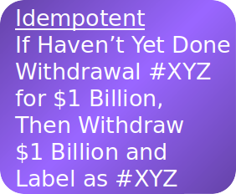
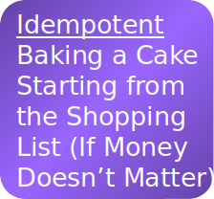
Idempotence
Slide by Pat Helland

Slide 32
Service Composability
Services should be designed to be reused as part of systems-of-services.
All software should be reusable. We should be able to build a system by webbing together existing parts.
Services should be designed to be used either as a service that controls other services, or as a service that provides a function to other services.
Service contract must present functionality based on varying levels of input and output.
If a composition member, input is more fine-grained than when it is a controller.
Services must be as stateless as possible.
Notes:
(1) - services and systems that are built from other services - think of services as LEGO. Natural outcome of the core design philosophy (2)
his is the underlying concept within object-orientation where the end product is composed of several interlinked objects that have the ability to become part of multiple software solutions, no matter how complex the solution is. As a result of this emphasis, some guidelines are required to develop services that can be effectively aggregated into multiple solutions. The application of the service composability principle requires designing services so that they can be used in a service composition either as a service that controls other services, i.e. a controller service, or as a service that provides functionality to other services in the composition without further composing other services, i.e. a composition member.
For the service to provide this dual functionality, the service contract^{[3]} must be designed so that it presents functionality based on varying levels of input and output data. In case if it is required to participate as a composition member, then usually the input parameters to the service would be more fine grained as compared to the situation when it is required to participate as a composition controller. A heavily reused service must be as stateless as possible (service statelessness principle) so that it can provide optimum performance when composed within multiple service compositions.

Slide 33
Service Composability
Factors determining composability include:
Ability to provide functionality at different levels within a process.
Surfacing proper interfaces.
Message exchange pattern.
One-way (request/reaction) versus duplex (request/reply)?
Whether the service supports transactions and rollback/compensation features.
Support for exception handling.
Availability of meta-data about service capabilities and behavior.
(discoverability)
Notes:
Some of the factors that determine the composability potential of a service include:^{[7]}
Ability to provide functionality at different levels within a business process.
Message Exchange pattern
Whether the service supports transactions and rollback/compensation features. - do we keep a record of actions/data writes, can we reverse them if needed?
Support for exception handling.
The availability of meta-data about service capabilities and behavior.

Slide 34
SOAP and REST
Notes:
This is where services come in.

Slide 35
Creating a Web Service
Online services can be used by external organizations and systems.
Services communicate through message passing. Therefore, we need standardized means of sending messages across networks.
Most common: REST and SOAP.
We already discussed REST.
Now, for SOAP.

Slide 36
Simple Object Access Protocol (SOAP)
Lightweight protocol used for exchange of messages in a decentralized, distributed environment.
Used to perform Remote Procedure Calls.
By default, uses XML as payload message format and HTTP or SMTP as transport.
Facilitates interoperability in a platform-independent manner.
XML and HTTP are open standard, running on all operating systems.
Notes:
SOAP (originally Simple Object Access Protocol) is a messaging protocol specification for exchanging structured information in the implementation of web services in computer networks. Its purpose is to induce extensibility, neutrality and independence. It uses XML Information Set for its message format, and relies on application layer protocols, most often Hypertext Transfer Protocol (HTTP) or Simple Mail Transfer Protocol (SMTP), for message negotiation and transmission.
SOAP allows processes running on disparate operating systems (such as Windows and Linux) to communicate using Extensible Markup Language (XML). Since Web protocols like HTTP are installed and running on all operating systems, SOAP allows clients to invoke web services and receive responses independent of language and platforms.

Slide 37
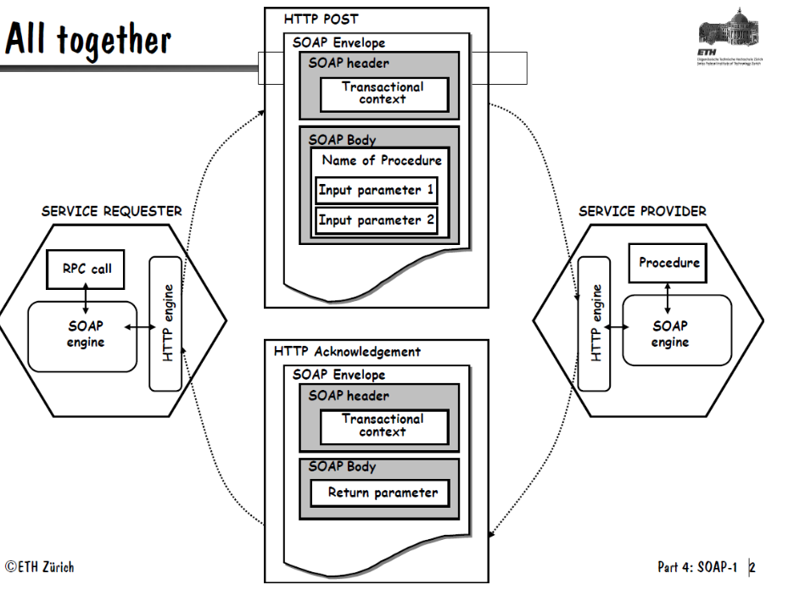
SOAP Ecosystem
Notes:
SOAP provides the Messaging Protocol layer of a web services protocol stack for web services. It is an XML-based protocol consisting of three parts:
an envelope, which defines the message structure^{[1]} and how to process it
a set of encoding rules for expressing instances of application-defined datatypes
a convention for representing procedure calls and responses
Messages are sent as POST in HTTP, and acknolwedgement packets are returned containing the response

Slide 38
SOAP Elements
Envelope (mandatory)
Top element of the XML document.
Defines message structure and how to process it.
Header (optional)
Determines how a recipient of a SOAP message should process the message.
Adds features to the SOAP message such as authentication, transaction management, payment, message routes, etc.
Body (mandatory)
Includes information for the recipient of the message
Typical use is for RPC calls and error reporting.

Slide 39
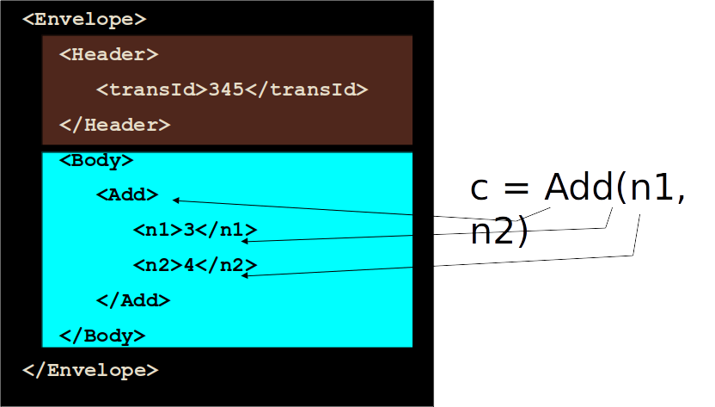
Simple Example
Slide from: www.cs.columbia.edu/~knarig/SOAP.ppt
Notes:
Go over

Slide 40
SOAP Request
<SOAP-ENV:Envelope
xmlns:SOAP-ENV=“http://schemas.xmlsoap.org/soap/envelope/”
SOAP-ENV:encodingStyle="http://schemas.xmlsoap.org/soap/encoding/”>
</SOAP-ENV:Envelope>
<SOAP-ENV:Header>
<t:transId xmlns:t=“http://a.com/trans”>345</t:transId>
</SOAP-ENV:Header>
<SOAP-ENV:Body>
<m:Add xmlns:m=“http://a.com/Calculator”>
<n1>3</n1>
<n2>4</n2>
</m:Add>
</SOAP-ENV:Body>
Slide from: www.cs.columbia.edu/~knarig/SOAP.ppt
Notes:
Here is the same thing, in a full SOAP XML style
Xmlns - XML Namespaces provide a method to avoid element name conflicts. Link to schema with information on the element name

Slide 41
SOAP Request
Scopes the message to the SOAP namespace describing the SOAP envelope
<SOAP-ENV:Envelope
xmlns:SOAP-ENV=“http://schemas.xmlsoap.org/soap/envelope/”
SOAP-ENV:encodingStyle="http://schemas.xmlsoap.org/soap/encoding/”>
…
</SOAP-ENV:Envelope>
Establishes the type of encoding that is used within the message (the different data types supported)
Slide from: www.cs.columbia.edu/~knarig/SOAP.ppt

Slide 42
SOAP Request
Qualifies the transaction ID
<SOAP-ENV:Header>
<t:transId xmlns:t=“http://a.com/trans”>345</t:transId>
</SOAP-ENV:Header>
Defines the procedure to call
<SOAP-ENV:Body>
<m:Add xmlns:m=“http://a.com/Calculator”>
<n1>3</n1>
<n2>4</n2>
</m:Add>
</SOAP-ENV:Body>
Slide from: www.cs.columbia.edu/~knarig/SOAP.ppt
Notes:
Here is the same thing, in a full SOAP XML style
Xmlns - XML Namespaces provide a method to avoid element name conflicts. Link to schema with information on the element name

Slide 43
SOAP Response
<SOAP-ENV:Envelope
xmlns:SOAP-ENV=“http://schemas.xmlsoap.org/soap/envelope/”
SOAP-ENV:encodingStyle="http://schemas.xmlsoap.org/soap/encoding/”>
</SOAP-ENV:Envelope>
<SOAP-ENV:Header>
<t:transId xmlns:t=“http://a.com/trans”>345</t:transId>
</SOAP-ENV:Header>
<SOAP-ENV:Body>
<m:AddResponse xmlns:m=“http://a.com/Calculator”>
<result>7</result>
</m:AddResponse>
</SOAP-ENV:Body>
Slide from: www.cs.columbia.edu/~knarig/SOAP.ppt
Notes:
Response now, envelope/header the same - body differs
Response typically uses method name with “Response” appended

Slide 44
SOAP Encoding
Based on a simple type system that has common features with programming languages and databases.
Types are either simple (scalar) or a composite of several parts.
An XML schema which is consistent with this type system can be constructed.
Use of schemas is encouraged but NOT required.
Slide from: www.cs.columbia.edu/~knarig/SOAP.ppt

Slide 45
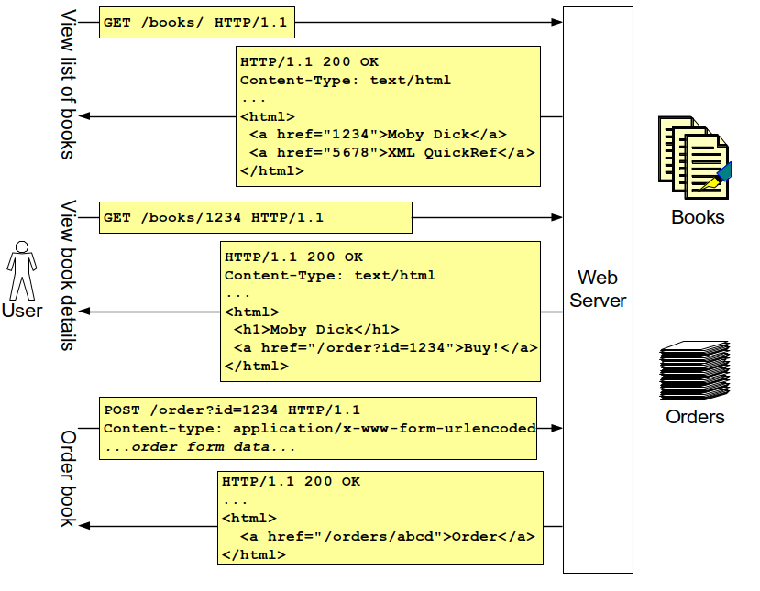
REST Bookstore
Slide from DevelopMentor: REST and SOAP
Notes:
GET
GET based on the URI of a particular book
POST to URI of a order service with book id appended.

Slide 46
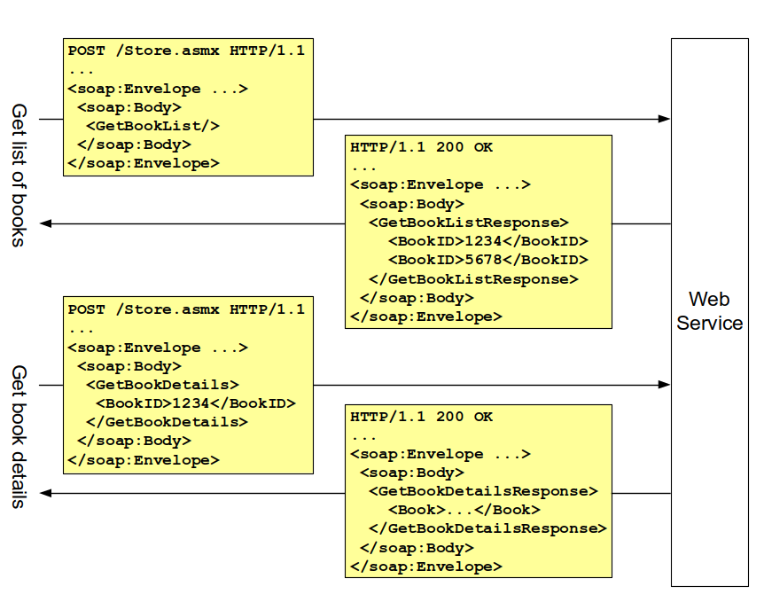
SOAP Bookstore
Slide from DevelopMentor: REST and SOAP
Notes:
All POSTs to a service with a SOAP interpretation layer, with XML bodies defining RPCs and parameters

Slide 47
SOAP from a REST Viewpoint: Addressing
REST architectures utilize the existing web addressing model:
Standard URI schemes subsume protocols (http, ftp)
Standardized distributed naming authorities (DNS).
Standardized way of discovering, referring to resources (URIs).
SOAP applications define their own addressing schemes
Web service entrypoints have URIs.
Resources have custom, service-specific addresses.
No standardized way of discovering, referring to resources.
Slide from DevelopMentor: REST and SOAP

Slide 48
SOAP from a REST Viewpoint: Addressing Issues in SOAP
Intermediaries (proxies, caching) cannot operate solely on URI.
Simple URI-based technologies (XSLT, XInclude) hampered.
Integrating disparate applications requires custom logic.
"Deep linking" into applications not generally possible.
Slide from DevelopMentor: REST and SOAP
Notes:
2- we just have a single entrypoint URI

Slide 49
SOAP from a REST Viewpoint: Generic Interfaces
REST emphasizes standardized, generic operations:
HTTP provides PUT, GET, POST, DELETE.
Allows for uniform manipulation of URI-identified resources.
SOAP does not provide for generic operations:
Each application defines its own set of operations
Creates need for description, discovery mechanisms
Knowledge of semantics of operation is out-of-band.
Slide from DevelopMentor: REST and SOAP

Slide 50
SOAP from a REST Viewpoint: Generic Interface Issues
Clients need knowledge of description, discovery mechanisms.
Clients need foreknowledge of specific service semantics.
Generic clients not universally feasible (local standardization).
Slide from DevelopMentor: REST and SOAP

Slide 51
SOAP from a REST Viewpoint: State Management
REST apps have explicit state transitions:
Servers & intermediaries are inherently stateless.
Resources contain data, links to valid state transitions.
Clients maintain state, traverse links in generic manner.
SOAP apps have implicit state transitions:
Servers & intermediaries may (should!) be stateless.
Messages contain only data (not valid state transitions).
Clients maintain state, require knowledge of state machine.
Slide from DevelopMentor: REST and SOAP

Slide 52
SOAP from a REST Viewpoint: State Management Issues
Clients need foreknowledge of service's state machine.
Generic clients not universally feasible (local standardization).
Limits independent evolution of client/server state machine.
State machine description needed for automated discovery.
Slide from DevelopMentor: REST and SOAP

Slide 53
REST from a SOAP Viewpoint
SOAP & related technologies have broad industry support.
Client & server toolkits are widely deployed.
Tool support on client & server matters.
SOAP headers provide a widely adopted extensibility model
Despite presence of HTTP extension mechanisms.
SOAP can be bound to non-HTTP transports
Important for richer XML messaging in the future.
SOAP 1.2 can be used in a RESTful manner
"Can't we all just get along?"

Slide 54
Key Points
Services are small programs that do “a single job” and encapsulate their own data.
Services can be reused endlessly.
Changes to services should not affect the rest of the system.
Service-oriented architectures create systems from a collection of services.
Services “talk” by exchanging messages.
Often performed using REST or SOAP.
SOAP offers richer implementations, but lacks standardization of REST.

Slide 55
Next Time
Machine Learning for Software Architects
Guest speaker - Dr. Jamshidi
(This will be on the final, so don’t skip!)
Practice Final
On site, without answers.
We will go over on December 6
Homework:
Project, Part 4 - Due on December 6
Assignment 3 - Due on December 9

