Slide 1
Final Review
CSCE 742 - Lecture 24 - 12/06/2018

Slide 2
The Final...
150 minutes: December 11, 9:00 - 11:30
In this room!
Closed book, no notes!
Graded on quality of answers, not how much you wrote.
Very similar in format to the practice final and midterm.
Not cumulative!
Study your homework.

Slide 3
The Final
Topics:
Concurrency Viewpoint
Development Viewpoint
Deployment Viewpoint
Operational Viewpoint
Performance and Scalability Perspective
Security Perspective
Availability Perspective
Real-time systems
Architectural Description Languages
Services and Service-Oriented Architecture
REST/SOAP
ML Systems

Slide 4
General Questions
Today: Go over practice final questions.
First - any general questions on course content or homework?
Notes:
(read)

Slide 5
Question 1
Speculate as to why none of the architecture description languages other than UML have achieved widespread use.
Notes:
Early on, (1-4).

Slide 6
Question 1
Speculate as to why none of the architecture description languages other than UML have achieved widespread use.
Many possible answers here. Some starting points:
Difficult to create critical mass to attract tool builders.
Most notations only capture a small portion of architectural concerns.
Lack of communication between “academic” software engineering and commercial SE.
Too domain specific; have not evolved to describe new kinds of architectures (e.g. web services).
Too hard to use / not understandable to developers.
Notes:
Early on, (1-4).

Slide 7
Question 2
Create an attack tree describing how an attacker might attempt to steal money from an Automated Teller Machine (ATM).

Slide 8
Attack Trees
Structured notation for categorizing threats and their probability.
Represented visually as a tree as a nested list.
Root of the tree shows the goal of the attack.
Branches classify the different types of attacks that could be attempted.
Create a tree for each goal an attacker may have. Can be used to analyze security policies.
Goal: Obtain customer credit card details.
Extract details from database.
Access database directly.
Crack/guess database passwords.
Crack/guess OS passwords that bypass database security.
Access via a member of the administration staff.
Bribe a database administrator (DBA).
Conduct social engineering by e-mail to trick the DBA into revealing details
Notes:
attack trees provide a structured, graphical notation to categorize and illustrate the threats a system faces and the likely probability of each occurring.
An attack tree represents the possible attacks your system may face in order for an attacker to achieve a particular goal. The root of the tree is the goal the attacker is trying to obtain, and the branches of the tree classify the different types of attacks the intruder could attempt in order to obtain the goal. Attack trees can be represented graphically (as a tree structure with nodes and links) or textually as a nested list. An attack tree should be created for each of the possible goals that an attacker may have for breaching your system’s security. Once you have an attack tree, you can analyze each threat it contains to establish whether the system’s security neutralizes the threat.
Here is a possible attack tree for the goal of extracting customer credit card details from an e-commerce Web site.

Slide 9
Attack Tree Example
Extract details from Web interface.
Set up a dummy Web site and e-mail users the URL to trick them into entering credit card details.
Crack/guess passwords for user accounts and extract details from the GUI.
Send users a program by e-mail to record keystrokes.
Attack the domain name server to hijack domain name and attack 2.1.
Attack the server software directly to try to find loopholes in its security.
Find details outside the system.
Conduct social engineering by phone/e-mail to get customer services staff to reveal card details.
Direct a social-engineering attack on users by using public details from the site to make contact.

Slide 10
Question 2
Create an attack tree describing how an attacker might attempt to steal money from an Automated Teller Machine (ATM).
Goal: Steal money from ATM
Physical attack
Break ATM casing and steal money
[AND]
Steal entire ATM for later dismantling
Procure vehicle capable of transporting ATM
Card-data stealing attack
Card-based attack using new cards
[AND]
Buy/steal card producing device
Buy/steal card stock for new ATM cards
Data capture for ATM spoofing
Capture ATM track 1&2 data and valid PIN using a skimming device
Buy data and PINs from black market
Capture/guess ATM data from online banking site
Capture/guess ATM data through ATM software vulnerability
Get valid card in someone else’s name (id theft)
...
Notes:
If you create an attack tree over multiple pages with things I have not thought about then I will get nervous and ask you about your past employment …

Slide 11
Question 3
What difficulties do cyclic component dependencies lead to in an architecture?
What can be done to break cyclic dependencies?

Slide 12
Question 3
What difficulties do cyclic component dependencies lead to in an architecture?
Components that contain circular dependencies are much more difficult to test and maintain.
They are tightly coupled to the interface of the others.
For testing, a usual strategy is to use “leveling” to test.
Test components that have no dependencies first, then once you have confidence in them, test components that depend only on those components.
If you have circular dependencies, it is much more difficult to test in this way. We have to examine the behavior of all of these components simultaneously.
Notes:
Sets of components that contain circular dependencies are much more difficult to test and maintain than components that do not have circular dependencies. They are tightly coupled, they each depend on the interface of the others. For testing, a usual strategy is to use “leveling” to test. That is, you test components that have no dependencies first, then once you have confidence in them, you test components that depend only on those components, etc. If you have circular dependencies, then it is much more difficult to test in this way, and we have to examine the behavior of all of these components simultaneously.

Slide 13
Question 3
What difficulties do cyclic component dependencies lead to in an architecture?
For maintenance, it is often difficult to modify one of the cyclically connected components without changing all of the components in the cycle.
This can be problematic if the components containing the cyclic references reside in multiple packages.
For versioning, if components mutually depend then they must be installed and updated simultaneously.
The same thing is true for compilation. A change in one triggers compilation of all others.
Notes:
Sets of components that contain circular dependencies are much more difficult to test and maintain than components that do not have circular dependencies. They are tightly coupled, they each depend on the interface of the others. For testing, a usual strategy is to use “leveling” to test. That is, you test components that have no dependencies first, then once you have confidence in them, you test components that depend only on those components, etc. If you have circular dependencies, then it is much more difficult to test in this way, and we have to examine the behavior of all of these components simultaneously.
Similarly, for maintenance, it is often difficult to modify one of the cyclically connected components without changing all of the components in the cycle. This can be especially problematic if the components containing the cyclic references reside in multiple packages. For versioning, if components mutually depend then they must be installed and updated simultaneously.
The same thing is true for compilation. A change in one triggers compilation of all others.

Slide 14
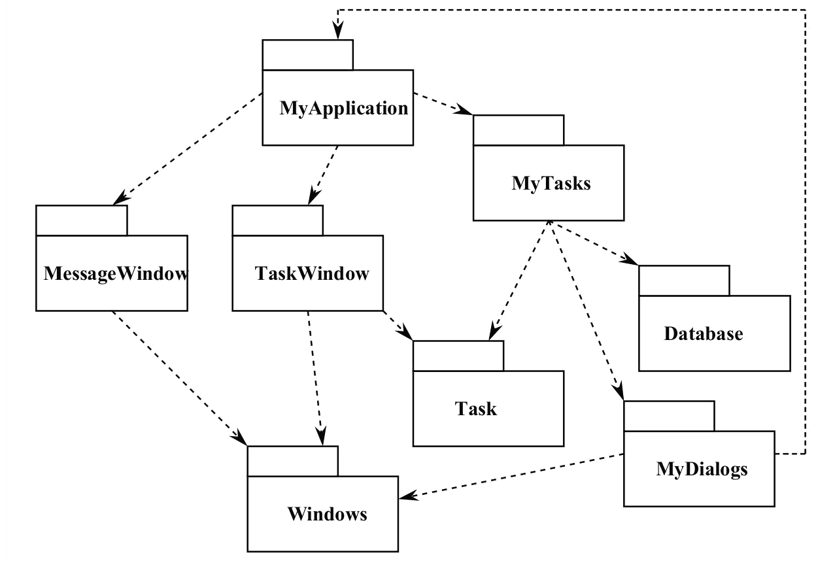
Cyclic Example (Bad)
Release:
Must be simultaneous with MyApplication.
But this means MyTasks must also be coordinated (it is a dependency of MyApplication and depends on MyDialogs).
This means that it must also be coordinated with Task and Database (dependencies of MyTasks).
Testing:
MyDialogs requires MyApplication, so…
MyDialogs is dependent on all packages(!) for testing!
Notes:
Now, let’s say we updated MyDialog with a change that requires the MyApplication package. We’ve introduced a cycle in this graph. What does this mean? It causes some immediate problems. (go over) In effect, this system has become one huge package.

Slide 15
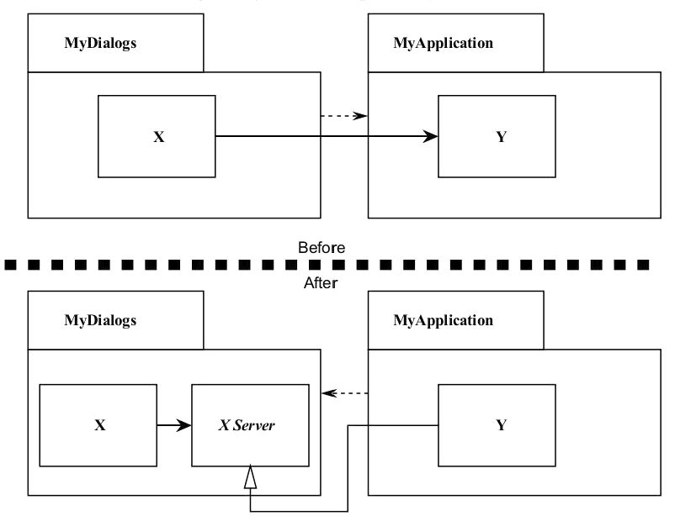
Fixing Circular Dependencies
Apply the Dependency Inversion Principle.
Create an abstract class with the interface MyDialogs needs.
Put the class into MyDialogs
Inherit into MyApplication.
Reverses the dependency, breaking the cycle.
Notes:
It is always possible to break a cycle of packages and get an acyclic graph. There are two primary mechanisms. (1) We can crate an abstract base class that has the interface MyDialogs needs. Then, put that into MyDialogs and inherit it into MyApplication. This inverts the dependency. - breaking the cycle.

Slide 16
Package Refactoring
Can also create third package with class(es) that both MyApplication and MyDialog depend on.
Package contents and dependency hierarchy must be actively managed and refactored.
Dependencies will change as system expands.
Circular dependencies must be pruned out.
Coordinating this movement is important job for architect.

Slide 17
Question 4
RPCs and messaging schemes are inter-process communication mechanisms.
For one process with multiple threads:
Are there analogous concepts to RPCs and messaging between threads?
Describe an additional means of communication that is available between threads.
Do the same benefits/drawbacks between RPCs and messaging schemes exist when considering inter-thread communication as interprocess communication?

Slide 18
Question 4
Are there analogous concepts to RPCs and messaging between threads?
Messaging:
Constructed from semaphores (limits number of consumers for a resource).
Threads communicate through event queues (send event to queue).
Delivery is guaranteed, as we act within one process.
RPC:
No immediately analogous concept.
Local procedure calls are similar, but not a means of cross-thread communication.
Notes:
Messaging concepts exist, but they are “manufactured” from lower level concepts such as semaphores. Event queues are used for threads as the analogue for messaging between threads. Threads communicate using these queues (which are themselves objects that are controlled by monitors or semaphores). Delivery is guaranteed because it is within process, as long as the process does not crash.
There is no immediately analogous concept to RPCs (except in the language Ada, which supports rendezvous). You could argue that local procedure calls act like RPCs; they are synchronous, after all. However, they do not really involve other threads at all.

Slide 19
Question 4
Describe an additional means of communication that is available between threads.
Shared memory
Threads can read and write from the same memory space. Form of message passing, indirectly causes changes to occur in other threads.
Monitors
In Java, objects have a monitor that ensures that only one thread can execute a critical section of code at a time.
wait() tells calling thread to give up monitor and go to sleep until some other thread enters the same monitor and call notify.
notify() wakes up a thread that called wait() on same object.
notifyAll() wakes up all the threads that called wait() on same object.

Slide 20
Question 4
Describe an additional means of communication that is available between threads.
Monitors
wait() tells calling thread to give up monitor and go to sleep until some other thread enters the same monitor and call notify.
notify() wakes up a thread that called wait() on same object.
notifyAll() wakes up all the threads that called wait() on same object.
Threads enter to acquire lock.
Lock is acquired by one thread.
Now, thread goes to waiting state if you call wait() method on the object. Otherwise it releases the lock and exits.
If you call notify() or notifyAll() method, thread moves to the notified state (runnable state).
Now thread is available to acquire lock.
After completion of the task, thread releases the lock and exits the monitor state of the object.

Slide 21
Question 4
Describe an additional means of communication that is available between threads.
Semaphores
Counter that acts as a permit for a shared resource.
When a thread gets a permit, the counter goes down.
Otherwise, the thread will be blocked until it can get a permit.
When finished, the thread releases the semaphore
(counter increments).
Semaphores can be used to control synchronization between threads.

Slide 22
Question 4
Do the same benefits/drawbacks between RPCs and messaging schemes exist when considering inter-thread communication as interprocess communication?
RPCs may not be useful between threads. They share an address space. Why not just use the active thread?
No performance benefit since RPCs are synchronous.
Messaging is still useful.
Allows decoupling of processes from UI, etc.
Allows a clean interface between threads, preventing deadlock/race conditions.
No guarantee of persistence (like inter-process communication), but no process lifecycle issues.
Notes:
It is questionable whether RPCs would be useful between threads; since the threads share an address space, why not just use the active thread to perform the task in question? In addition, RPCs are synchronous, so there is no performance benefit, just additional overhead.
Messaging is still useful, however. It allows decoupling of long running processes from (for example) the user interface. Also, it allows a clean interface between communicating threads that prevents many of the problems with deadlock and race conditions.On the one hand, you don’t get the same guarantees in terms of persistence that you get with IPC. On the other, you don’t have to worry about process lifecycle issues; if an application is running, then in all probability, its threads will be running too.

Slide 23
Question 4
Do the same benefits/drawbacks between RPCs and messaging schemes exist when considering inter-thread communication as interprocess communication?
Performance:
Threads communicate faster than processes, so lower cost of splitting tasks.
Isolation:
Threads are not isolated (like processes), so some benefits of IPC do not impact inter-thread communication.
IPCs allow processes to be spread across multiple machines. ITC does not.
No scalability benefit.
Notes:
In terms of performance, communication will be much faster between threads than between processes, so the cost of splitting up tasks is lower.
In terms of isolation, threads are not isolated from one another, so some of the benefits with IPC do not accrue with inter-thread communication.
Also, IPC allows processes to be spread across multiple machines potentially increasing scalability, where as ITC does not.

Slide 24
Question 5
What are the benefits and drawbacks of using XML vs. binary protocols for messaging between processes?

Slide 25
Question 5
What are the benefits and drawbacks of using XML vs. binary protocols for messaging between processes?
Custom binary protocol may require less network bandwidth than XML.
If processes can agree on format, binary protocol may require less translation and parsing at network boundaries.
For applications that are network intensive, this may lead to better performance and network utilization.
Notes:
On the plus side for a custom binary protocol, a custom binary protocol may require significantly less network bandwidth than XML, and, if processes agree on the format, require significantly less translation and parsing effort at the network boundaries. For applications that are network-intensive, and whose protocols do not require significant extensibility this may correspond to significantly better application performance and network utilization.
On the other hand, XML may be much easier to maintain because it is possible to use standard tools to snoop the message traffic and diagnose application errors. In addition, it supports transparent re-hosting, even if the new platform has different endian-ness, for example. (Endianness refers to the sequential order in which bytes are arranged into larger numerical values when stored in memory or when transmitted over digital links. Endianness is of interest in computer science because two conflicting and incompatible formats are in common use: words may be represented in big-endian or little-endian format, depending on whether bits or bytes or other components are ordered from the big end (most significant bit) or the little end (least significant bit).)
Also, it may actually lead to better performance given relatively static data because it is possible to easily insert pre-built caching applications into the network stream. XML is more likely to offer extensibility along multiple axes: it is fairly straightforward to add additional data to XML messages without disrupting existing clients, and there are several tools for manipulating and routing XML messages that could allow new applications to be easily integrated into the system. Also, many languages already have built-in support to generate and parse XML messages, so implementation might be easier than using a binary protocol.

Slide 26
Question 5
What are the benefits and drawbacks of using XML vs. binary protocols for messaging between processes?
XML will be easier to maintain. Can use standard tools to process message traffic and diagnose errors.
XML supports transparent re-hosting on different platforms.
XML may lead to better performance given static data. Can perform pre-built caching.
Can more easily add additional data to XML messages without disrupting existing clients.
Several tools for manipulating and routing XML messages, making it easier to allow new applications into a system.
Notes:
On the other hand, XML may be much easier to maintain because it is possible to use standard tools to snoop the message traffic and diagnose application errors. In addition, it supports transparent re-hosting, even if the new platform has different endian-ness, for example. (Endianness refers to the sequential order in which bytes are arranged into larger numerical values when stored in memory or when transmitted over digital links. Endianness is of interest in computer science because two conflicting and incompatible formats are in common use: words may be represented in big-endian or little-endian format, depending on whether bits or bytes or other components are ordered from the big end (most significant bit) or the little end (least significant bit).)
Also, it may actually lead to better performance given relatively static data because it is possible to easily insert pre-built caching applications into the network stream. XML is more likely to offer extensibility along multiple axes: it is fairly straightforward to add additional data to XML messages without disrupting existing clients, and there are several tools for manipulating and routing XML messages that could allow new applications to be easily integrated into the system. Also, many languages already have built-in support to generate and parse XML messages, so implementation might be easier than using a binary protocol.

Slide 27
Question 6
Big Bang, Parallel Run, and Staged Migration are techniques for upgrading existing software installations.
Briefly explain each technique.
Describe advantages and disadvantages for each technique in terms of data migration, complexity, and rollback in case of failure.
Describe installation scenarios where you might use each technique.

Slide 28
Question 6
Briefly explain each technique.
Big Bang: Pick a day, turn the old system off and the new system on.
Parallel Run: Choose a period in which the old and new systems run in parallel.
Staged Migration: Swap out pieces of the old system with pieces of the new system over an installation period or migrate portions of the organization over a period.

Slide 29
Question 6
Describe advantages and disadvantages for each technique in terms of data migration, complexity, and rollback in case of failure.
Big Bang:
Data migrates in one shot.
Simple in the sense that only one system runs at a time. Hard if systems do not have downtime.
How do you do “immediate switchover”?
Hard to recover from failure, may require reverse data migration.
Notes:
Big bang:
data migration: one shot. May not work for continuous operation system.
Complexity: simple in the sense of only one system running at a time. Lots of complexity if systems do not have downtime – how do you do “immediate switchover”?
Rollback: often difficult to recover from failure, may require reverse data migration
Parallel Run:
data migration: can be in parallel with old system running (new system will fail on certain queries so route to old system). Less risk. Need to have support for continuous migration as data is added to new system.
complexity: more complex than big bang in that policies have to be created for synchronizing and routing traffic between old and new system. How is new system validated? Voting? Split stream traffic? Also, need to maintain redundant copies of information
Rollback: can run in lockstep, in which case rollback is almost trivial. Can also run split stream traffic, in which case some capability of reverse migration of data is required.
Staged
data migration: need facades to allow new system component to work with old system components. These must translate back and forth.
complexity: Need facades for boundaries. If migrating parts of organization, may need policies for discrepencies between old/new system.

Slide 30
Question 6
Describe advantages and disadvantages for each technique in terms of data migration, complexity, and rollback in case of failure.
Parallel Run:
Data migration happens in parallel with older system running (if new system fails on certain queries, route to old system).
Less risk in data migration. Need to have support for continuous migration as data is added to new system.
More complex than big bang.
Policies needed for synchronizing and routing traffic between old/new system.
How is the new system validated?
Need to maintain redundant copies of data.
Rollback can be run in lockstep.
Can also run split-stream traffic, then reverse data migration may be required.
Notes:
Parallel Run:
data migration: can be in parallel with old system running (new system will fail on certain queries so route to old system). Less risk. Need to have support for continuous migration as data is added to new system.
complexity: more complex than big bang in that policies have to be created for synchronizing and routing traffic between old and new system. How is new system validated? Voting? Split stream traffic? Also, need to maintain redundant copies of information
Rollback: can run in lockstep, in which case rollback is almost trivial. Can also run split stream traffic, in which case some capability of reverse migration of data is required.

Slide 31
Question 6
Describe advantages and disadvantages for each technique in terms of data migration, complexity, and rollback in case of failure.
Staged:
Data migration needs facades to allow new system components to work with old system components.
These facades translate data back and forth.
Since you need facades, there is some complexity.
If migrating parts of organization, you may also need policies for handling discrepancies between the new/old system.
Notes:
Staged
data migration: need facades to allow new system component to work with old system components. These must translate back and forth.
complexity: Need facades for boundaries. If migrating parts of organization, may need policies for discrepencies between old/new system.

Slide 32
Question 6
Describe installation scenarios where you might use each technique.
Big bang: Home web server upgrade
Just move everything over and be done.
Only affects you.
Parallel run: Banking transaction software
Can test new system with a subset of users.
If any issues, use the existing reliable system.
Staged migration: Air traffic control
Hard to keep old and new synchronized, but want to control release of new system to ensure each component is reliable.

Slide 33
Question 7
What are the availability benefits and risks associated with the following architectural styles: Pipe and Filter, Repository, Event-based, Layered.

Slide 34
Question 7
What are the availability benefits and risks associated with the following architectural styles: Pipe and Filter.
Can duplicate streams of data to multiple CPUs transparently (from filter perspective).
If failure occurs, can redirect to a good stream.
Can easily introduce “voters” to look for disagreements in results from multiple filters.
Risks: On a single pipe & filter chain, any single failure will cause whole system to fail because filters do not know about each other.
Notes:
Pipe and Filter: for availability: you can duplicate streams of data to multiple boxes transparently (from the perspective of the filters); if failure occurs, you redirect to good stream. Also, you can easily introduce “voters” to check for discrepancies between results from multiple filters. This is perhaps the simplest architecture to make highly available. Risks: Along a single pipe-and-filter chain, any single failure will likely cause the whole system to fail, because the filters do not “know” about each other.

Slide 35
Question 7
What are the availability benefits and risks associated with the following architectural styles: Repository.
Risky for availability.
Central store, so consistency problems in presence of multiple readers/writers.
Central point of failure.
Consolidates critical data in a single location, so single-point logging & recovery.
Many schemes for high-availability repositories (database clusters).
Expensive, but work well in practice.
Notes:
Repository: this pattern can be risky for availability; it is a central store so problems in terms of consistency in the presence of multiple writers and readers/writers must be addressed. In addition, it is a central point of failure. On the other hand, it consolidates critical data in a single location, so supports single-point logging and recovery. Also, there are many schemes for making highly available repositories (e.g. database clusters). These tend to be technologically sophisticated (and expensive) but tend to work well in practice.

Slide 36
Question 7
What are the availability benefits and risks associated with the following architectural styles: Event-based.
If there is a centralized event broker, can be risky for availability (and performance) because it introduces a central point of failure.
Also, can be difficult to understand the composite behavior of event-based systems.
“Event storms” can occur if one event leads to a cascade of many events that can reduce system reliability and availability.
On the other hand, failover mechanisms when constructing highly-available systems are event-based.
A heartbeat event, sent at regular intervals, is the means by which system health is monitored. If a sibling system does not send a heartbeat, then failover is performed.
Notes:
Event-based: This depends somewhat on the implementation of the pattern. If there is a centralized event broker that routes events between components, this can be risky for availability (as well as performance) because it introduces a central point of failure. Also, it can be difficult to understand the composite behavior of event-based systems; “event storms” can occur in which one event leads to a cascade of many events that can reduce system reliability and availability. On the other hand, the mechanism for failover when constructing highly-available systems is usually event-based. A heartbeat event, sent at regular intervals, is the means by which system health is monitored. If a sibling system does not send a heartbeat, then failover is performed.

Slide 37
Question 7
What are the availability benefits and risks associated with the following architectural styles: Layered.
Layers help create highly available systems because they limit the kinds of failures that must be accounted for.
Web is reliable because of isolated handling of classes of failure by different layers. IP handles routing, TCP handles packet retransmission, load balancing handles server failures, etc.
Notes:
Layered: There are many possible answers here. In general, layering helps construct highly available systems because it limits the kinds of failures that must be accounted for. For example, one of the reasons that the web is reliable is because of the isolated handling of classes of failures by different layers: IP handles routing, TCP handles packet retransmission in case of loss, load balancing servers handle compute resource failures, etc. etc.

Slide 38
Question 8
Write the guarantees for the following AADL component describing a dishwasher mode controller:
system Dishwasher_Mode
features
door_closed: in data port Base_Types::Boolean;
time_remaining: in data port Base_Types::Integer;
pump_on: out data port Base_Types::Boolean;
dishwasher_mode: out data port Base_Types::Integer;
annex agree {**
const SETUP_MODE : int = 0;
const WASHING_MODE : int = 1;
const RINSE_MODE : int = 2;
const DRYING_MODE : int = 3;
guarantee "the pump shall be off if the door is open" : true;
guarantee "If the dishwasher was in WASHING_MODE and time
remaining is zero, it shall enter RINSE_MODE" : true;
guarantee "The dishwasher shall never transition directly from
WASHING_MODE to DRYING_MODE" : true;
guarantee "The dishwasher shall start in SETUP_MODE" : true;
**};
end Dishwasher_Mode;

Slide 39
Question 8
Write the guarantees for the following AADL component describing a dishwasher mode controller:
system Dishwasher_Mode
features
door_closed: in data port Base_Types::Boolean;
time_remaining: in data port Base_Types::Integer;
pump_on: out data port Base_Types::Boolean;
dishwasher_mode: out data port Base_Types::Integer;
annex agree {**
const SETUP_MODE : int = 0;
const WASHING_MODE : int = 1;
const RINSE_MODE : int = 2;
const DRYING_MODE : int = 3;
guarantee "the pump shall be off if the door is open" : pump_on => door_closed;
(alternate): (not door_closed) => (not pump_on);
**};
end Dishwasher_Mode;

Slide 40
Question 8
Write the guarantees for the following AADL component describing a dishwasher mode controller:
system Dishwasher_Mode
features
door_closed: in data port Base_Types::Boolean;
time_remaining: in data port Base_Types::Integer;
pump_on: out data port Base_Types::Boolean;
dishwasher_mode: out data port Base_Types::Integer;
annex agree {**
const SETUP_MODE : int = 0;
const WASHING_MODE : int = 1;
const RINSE_MODE : int = 2;
const DRYING_MODE : int = 3;
guarantee "If the dishwasher was in WASHING_MODE and time remaining is zero, it shall enter RINSE_MODE" : true -> ((pre(dishwasher_mode) = WASHING_MODE and time_remaining = 0) => dishwasher_mode = RINSE_MODE)
**};
end Dishwasher_Mode;

Slide 41
Question 8
Write the guarantees for the following AADL component describing a dishwasher mode controller:
system Dishwasher_Mode
features
door_closed: in data port Base_Types::Boolean;
time_remaining: in data port Base_Types::Integer;
pump_on: out data port Base_Types::Boolean;
dishwasher_mode: out data port Base_Types::Integer;
annex agree {**
const SETUP_MODE : int = 0;
const WASHING_MODE : int = 1;
const RINSE_MODE : int = 2;
const DRYING_MODE : int = 3;
guarantee "The dishwasher shall never transition directly from WASHING_MODE to DRYING_MODE" : true -> (pre(dishwasher_mode) = WASHING_MODE => (not dishwasher_mode = DRYING_MODE))
**};
end Dishwasher_Mode;

Slide 42
Question 8
Write the guarantees for the following AADL component describing a dishwasher mode controller:
system Dishwasher_Mode
features
door_closed: in data port Base_Types::Boolean;
time_remaining: in data port Base_Types::Integer;
pump_on: out data port Base_Types::Boolean;
dishwasher_mode: out data port Base_Types::Integer;
annex agree {**
const SETUP_MODE : int = 0;
const WASHING_MODE : int = 1;
const RINSE_MODE : int = 2;
const DRYING_MODE : int = 3;
guarantee "The dishwasher shall start in SETUP_MODE" : dishwasher_mode = SETUP_MODE -> true.
**};
end Dishwasher_Mode;

Slide 43
Question 9
What is the difference between response time and throughput?
Give an example of a system with excellent throughput but poor response time and vice versa.

Slide 44
Question 9
What is the difference between response time and throughput?
Response time is from the client’s perspective.
How long does it take to service my request?
Throughput is from the server’s perspective.
How many requests can be processed in a given time period?

Slide 45
Question 9
Give an example of a system with excellent throughput but poor response time and vice versa.
A pipelined system may involve several processors working in tandem to solve a particular problem.
It may be able to process very large volumes of transactions (high throughput) due to partitioning the problem into segments that are handled sequentially, while still exhibiting poor response time.
(each segment takes time t, with number of segments s, so the total response time is n*s).
Instead, imagine a single processor non-pipelined system that processes requests sequentially.
If there are few requests, it will have better response time than the pipelined system because there is no latency in servicing the request.
However, it will have very poor throughput under heavy load.
Notes:
A pipelined system may involve several processors working in tandem to solve a particular problem. It may therefore be able to process very large volumes of transactions (high throughput) due to partitioning the problem into segments that are handled sequentially, while still exhibiting poor response time (each segment takes time t, with number of segments s, so the total response time is n*s).
Instead, imagine a single processor non-pipelined system that processes requests sequentially. If there are few requests, it will have better response time than the pipelined system because there is no latency in servicing the request. However, it will have very poor throughput under heavy load.

Slide 46
Question 10
What is the distinguishing characteristic of a real time, as opposed to a non-real time system? What is the difference between hard and soft real time systems?

Slide 47
Question 10
What is the distinguishing characteristic of a real time, as opposed to a non-real time system? What is the difference between hard and soft real time systems?
For a real-time system, an operation’s correctness depends not only on logical correctness, but the time required to complete it.
In a hard real-time system, computation of an answer after its deadline is considered failure.
Soft real time systems can tolerate missed deadlines as long as there is a bound on the number of missed deadlines within some time scale.
Notes:
for real time systems, an operation’s correctness depends not only on its logical correctness but also in the time required to compute it.
In a hard real-time system, computation of an answer after its deadline is considered failure. Soft real time systems can tolerate missed deadlines as long as there is a bound on the number of missed deadlines within some time scale.

Slide 48
Thanks for a great semester!!!!!!!!!!!!!!!!!!!!
Notes:
This is where services come in.

Slide 49
Next Time
The Final
Please e-mail questions + office hours today.
Exam will be proctored by a student, so ask me questions before the day of the test.
Homework:
Project, Part 4 - Due tonight
Assignment 3 - Due on December 9

