Slide 1
Viewpoints and Perspectives
CSCE 742 - Lecture 3 - 08/30/2018

Slide 2
Three Pillars of Architectural Design
Stakeholders are the people impacted by the architecture, who have differing expectations and needs.
Viewpoints are used to structure architecture definition by focusing on aspects of the system being designed.
Perspectives focus on how a particular quality attribute impacts each viewpoint of the architecture.
Notes:
In the first lecture, I offered this framing device for the class - these three pillars of architectural design - structure I’m going to use this semester to present information.
Stakeholders are the people for whom we build systems. A key part of your role as an architect is knowing how to work with stakeholders in order to create an architecture that meets their complex, overlapping, and conflicting needs. Viewpoints are an approach to structuring the architecture process and description, based on the principle of separation of concerns. Viewpoints guide the creation of an architecture, by taking on a particular view and ignoring other elements until necessary. Perspectives are a complementary concept to viewpoints that focus on cross-viewpoint quality properties rather than architectural structures, and (3)

Slide 3
Today’s Goals
Closely examine the concepts of views and viewpoints of architecture.
How we look at different aspects of architecture.
How we explain elements to stakeholders.
Examine architectural perspectives.
Cross-cutting concerns based on non-functional quality properties.
Notes:
(read)

Slide 4
Views and Viewpoints
Notes:
(discussion) what entails a good design?

Slide 5
Starting Questions
How should the main system functions translate into architectural elements?
How will those elements interact?
With each other? With the outside world?
What information will be managed, stored, and presented?
What physical hardware and software elements will be required?
What operational features will be provided?
What development, test, support, and training environments will be provided?
Notes:
When you start designing the architecture of your system, you will find that you have a whole lot of difficult architectural questions to answer, and very few clear, provided answers. (go over) You eventually need to answer all of these, but how do you do this? Simultaneously? A common temptation—one you should strongly avoid—is to try to answer all of these questions by means of a single all-encompassing model.

Slide 6
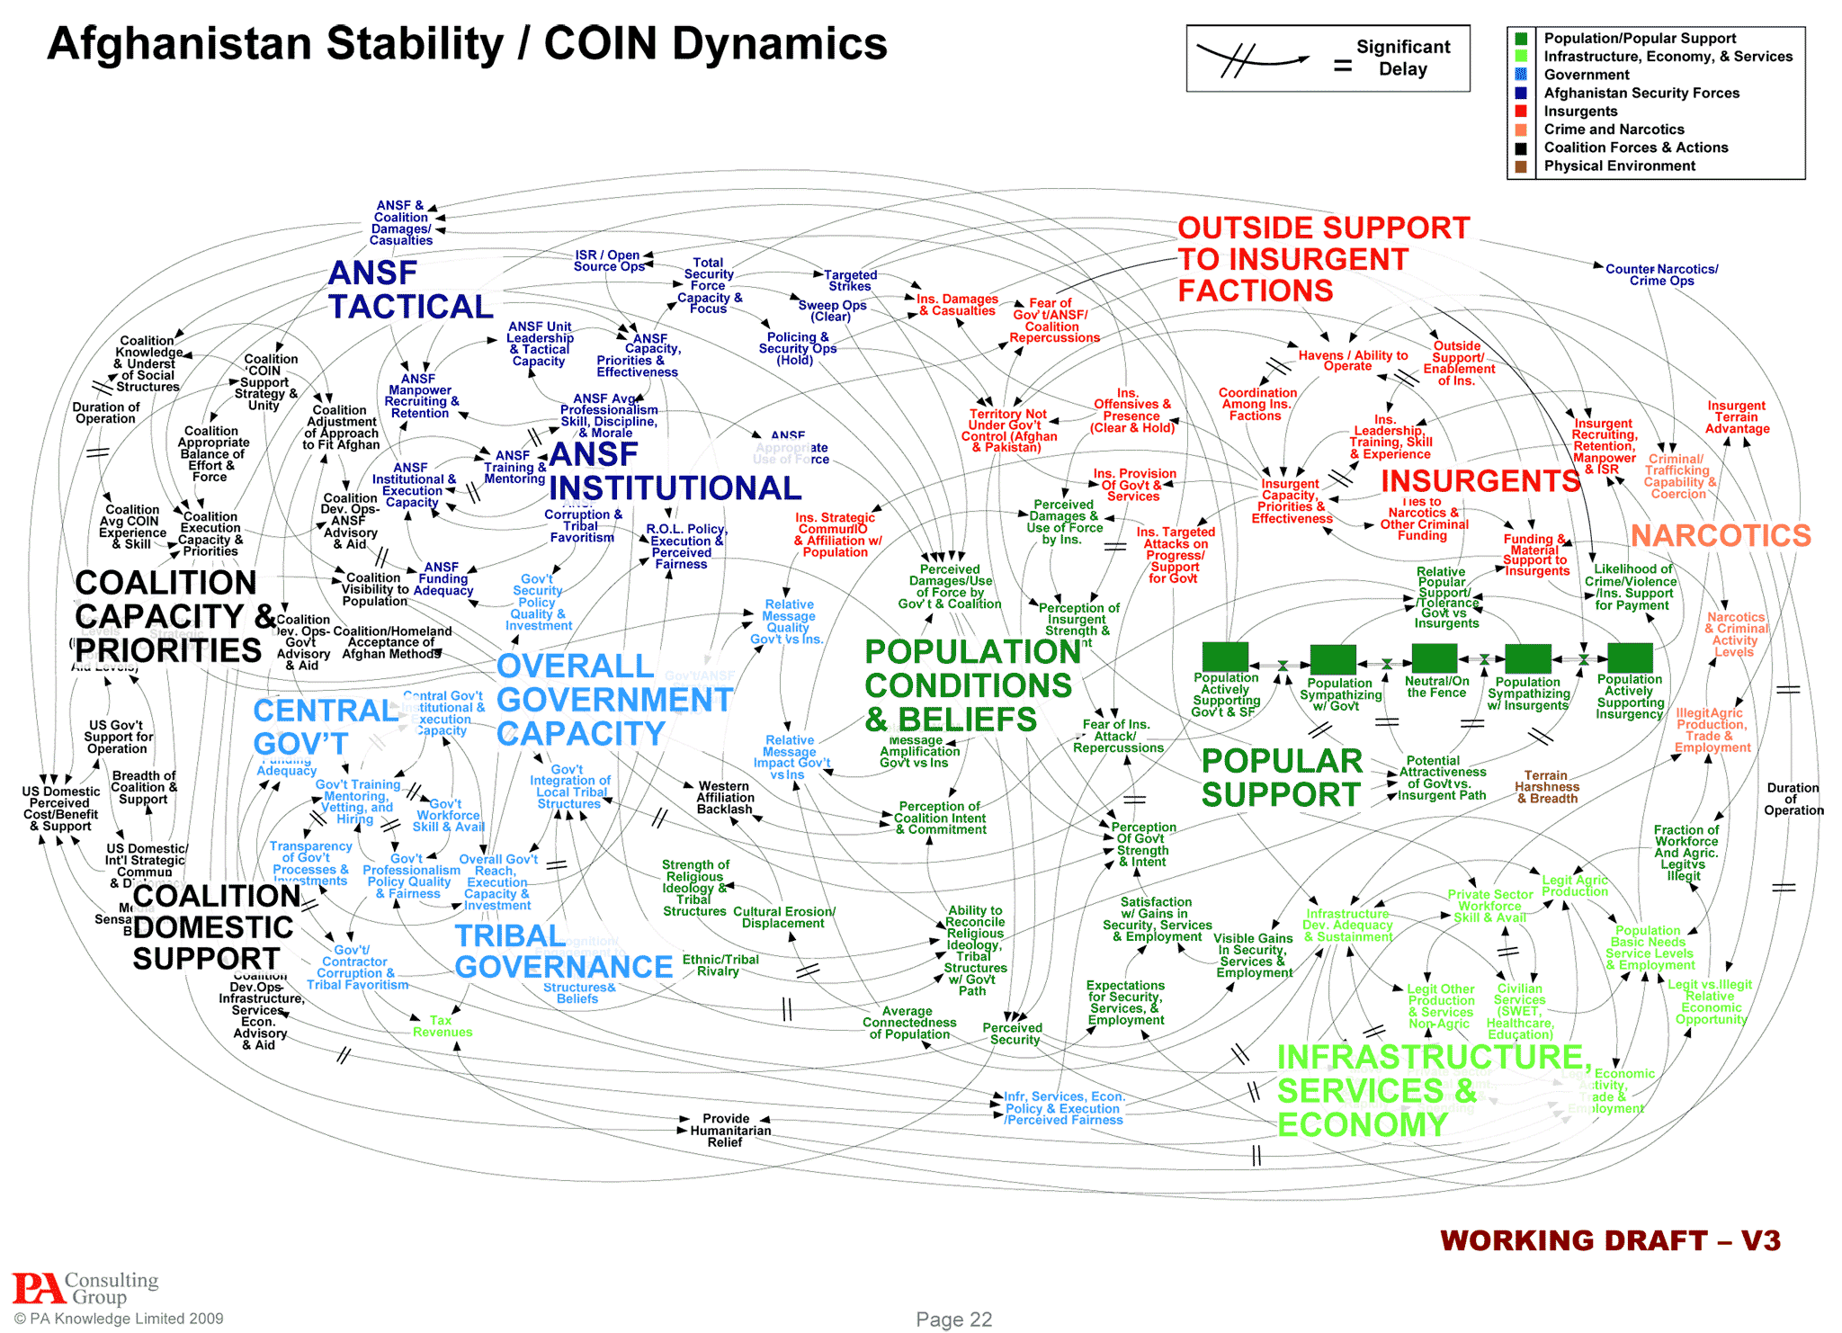
One Model to Rule Them All
Notes:
This sort of model is exactly what we want to avoid. Now, this isn’t an actual software architecture - this is actually a mapping of concepts from the military describing the Afghan operaition theater. But, this is pretty much what happens when you try to model too many concepts at once, where you will probably use a mixture of formal and informal notations to describe a number of aspects of the system on one huge sheet of paper: the functional structure, software layering, concurrency, intercomponent communication, physical deployment environment, etc and so forth.

Slide 7
The Airline Reservation System
Complicating Factors:
Data is distributed across a number of systems in different physical locations.
Different data entry devices must be supported.
The system must present some information in different languages.
The system must print documents on a wide range of printers.
International regulations must be obeyed.
The architect prepares a first draft of the architecture...
Notes:
This is an easy trap to fall into. Let’s go back to an example from the first class - an airline reservation system. Although the system is conceptually fairly simple, in practice some aspects of this system make it very complicated. (go over).
After some discussion, the architect draws up a first-cut architecture for the system, which attempts to represent all of its important aspects in a single diagram.

Slide 8
The Airline Reservation System
Model includes all data entry devices
Each physical system storing data is included.
PC
Phone
TV
Point of Sale Terminal
Data Server (US)
Missing details on network interfaces between components
Network
Data Server (UK)
Model is heavily annotated with
text explaining language and
regulation support.
Multilanguage support is needed here.
This element must audit data to fit EU regulation 103.542c.
Data Server (China)
Each supported printing device is included.
HP Laser Printer
Dell Laser Printer
HP InkJet Printer
Notes:
So, what went wrong here?
- This model includes the full range of data entry devices (including various dumb terminals, desktop PCs, and wireless devices)
- the multiple physical systems on which data is stored or replicated data is maintained are included
- some of the printing devices that must be supported (the model does not cover remote printing because it is done at a separate facility).
- . The model is heavily annotated with text to indicate, for example, where multilanguage support is required and where data must be audited, archived, or analyzed to support regulatory requirements.
- However, no details of the network interfaces between the different components are included—these are abstracted out into a network icon because these are so complex. (In fact, the network design is probably the most complicated aspect of the architecture, requiring support for a number of different and largely incompatible network protocols, routing over public and private networks, synchronous and asynchronous interactions, and varying levels of service reliability and availability.) Furthermore, the model does not address any of the implications of having the same data distributed around multiple systems.

Slide 9
Problems
Fails to please stakeholders.
Users find it too difficult, systems engineers ignore because it doesn’t address network details, legal needs more detail on regulatory compliance.
Difficult to update.
Each new data entry device or printer must be added.
Diagram will become obsolete.
Model will fail to inform development.
The complicating factors still exist, but this design failed to address them.
Notes:
Because it is so complex and tries to address a too many concerns in the same diagram, the model fails to please any of the stakeholders. The users find it too difficult to understand (particularly because of the large number of physical hardware components represented). The systems engineers, on the other hand, tend to disregard it because of the detail that is left out, such as the network topology. The legal team members can’t use it to satisfy themselves that the regulatory aspects will be adequately handled, and the sponsor finds it completely incomprehensible.
Furthermore, you are going to spend an inordinate amount of time keeping it up-to-date—every time a new type of data entry device or printer is discussed, the diagram needs to be updated. Because of these problems, the diagram soon becomes obsolete and is eventually forgotten. Unfortunately, the issues that the model fails to address do not disappear and thus cause many problems and delays during the implementation and the early stages of live operation.

Slide 10
Separation of Concerns
It is not possible to capture all features and quality properties of a complex system in a single model that is understandable and of value to all stakeholders.
Instead, consider separation of concerns.
Split into different aspects of the architecture.
Network view, printing view, device view, regulatory view, structural view, etc.
Notes:
The point here is that It is not possible to capture the functional features and quality properties of a complex system in a single comprehensible model that is understandable by and of value to all stakeholders. A monolithic model is hard to understand, unlikely to clearly identify important features, will poorly serve individual stakeholders, and will generally be incomplete, incorrect, and out-of-date. We need to represent complex systems in a way that is manageable and comprehensible, and this is where a tried and true principle comes into play (2-4). A complex system is much more effectively described by using a set of interrelated views, which collectively illustrate its functional features and quality properties and demonstrate that it meets its goals

Slide 11
Architectural Views
A view is a representation of one or more structural aspects of an architecture that illustrates how the architecture addresses concerns held by its stakeholders.
Can be arbitrarily narrow or general, depending on the stakeholder.
Are based on specific concerns, which map to various stakeholders.
Can be detailed or high-level.
Notes:
(1) An architectural view is a way to portray those aspects or elements of the architecture that are relevant to the concerns the view intends to address—and, by implication, the stakeholders for whom those concerns are important. (2) What class(es) of stakeholder is the view aimed at? A view may be narrowly focused on one class of stakeholder or even a specific individual, or it may be aimed at a larger group whose members have varying interests and levels of expertise. (3)What stakeholder concerns is the view intended to address? How much do the stakeholders know about the architectural context and background to these concerns? Those help you set the level and type of detail. (4) based on How much technical understanding these stakeholders have. Lawyers, for example, will be experts in their subject areas but are unlikely to know much about hardware or software, while the reverse may apply to developers. How much do these stakeholders need to know about this aspect of the architecture? For nontechnical stakeholders such as users, how competent are they in understanding its technical details?

Slide 12
Viewpoints
A viewpoint is a collection of patterns, templates, and conventions for constructing one type of view.
Framework for a “standard” view.
Defines the stakeholders and concerns are reflected in the viewpoint.
Defines guidelines, principles, and models for constructing a view.
Standardizes language and approach.
Notes:
Views, in practice, are informed by what we call “viewpoints”. It would be hard work if every time you were creating a view of your architecture you had to go back to first principles to define what should go into it. We don’t have to. (1), (2). making available a library of templates and patterns that can be used off the shelf to guide the creation of an architectural view . (3-5) Architectural viewpoints provide a framework for capturing reusable knowledge that can be used to guide the creation of a particular type of (partial) AD.

Slide 13
Viewpoints
Supports system construction
Describe software artifacts and the primary organization of the system.
Functional Viewpoint
Development Viewpoint
Information Viewpoint
Characterize the system once in a live environment.
Deployment Viewpoint
Concurrency Viewpoint
Operational Viewpoint
Notes:
At various times in this class, we are going to talk about six core viewpoints (list). These broadly fit into three categories
- The Functional, Information, and Concurrency viewpoints characterize the fundamental organization of the system, the software artifacts we are going to create.
- The Development viewpoint exists to support the system’s construction.
- The Deployment and Operational viewpoints characterize the system once in its live environment.
Not all of these will apply to all systems, and some are more important than others. These are also not an exhaustive list of viewpoints - you may need to identify and add others yourself. Let’s talk about each.

Slide 14
Artifact Viewpoints
Functional Viewpoint
Describes functional elements, responsibilities, and their interactions.
Information Viewpoint
How the architecture stores, manipulates, and distributes information.
Offers a view of static data structure and information flow between elements.
Concurrency Viewpoint
How concurrent processes are coordinated and controlled.
Notes:
(1) This is what many think of when discussing architecture. It describes the system’s functional elements, their responsibilities, interfaces, and primary interactions. A Functional view is the cornerstone of most ADs and is often the first part of the description that stakeholders try to read. It drives the shape of other system structures such as the information structure, concurrency structure, deployment structure, and so on. It also has a significant impact on the system’s quality properties such as its ability to change, its ability to be secured, and its runtime performance.
(3) Describes the way that the architecture stores, manipulates, manages, distributes, and protects information. The ultimate purpose of virtually any system is to manipulate information in some way, and this viewpoint is how you present a complete but high-level view of static data structure and information flow between elements. The objective of this viewpoint is to answer the big questions around content, structure, ownership, references, and data migration.
(5) Describes the concurrency structure of the system and maps functional elements to processes to identify the parts of the system that can execute concurrently and how this is coordinated and controlled. This requires the creation of models that show the process and thread structures that the system will use and the rprocess communication mechanisms used to coordinate their activities.

Slide 15
Environmental Viewpoints
Development Viewpoint
Details the architecture in place to support building, testing, and maintaining the system.
Deployment Viewpoint
Captures runtime software, hardware, and network dependencies of the system.
Operational Viewpoint
Describes how the system will be used, administered, and supported when running in production.
Notes:
(1) Describes the architecture that supports the software development process. This communicates the aspects of the architecture of interest to those stakeholders involved in building, testing, maintaining, and enhancing the system.
(3) Describes the environment the system will be deployed into, including capturing the dependencies the system has on its runtime environment. This view captures the hardware environment that your system needs (primarily the processing nodes, network interconnections, and disk storage facilities required), the technical environment requirements for each element, and the mapping of the software elements to the runtime environment that will execute them. Can be split into physical and software views.
(5) Describes how the system will be used, administered, and supported when it is running in its production environment. For all but the simplest systems, installing, managing, and operating the system is a significant task that must be considered and planned at design time. The goal of the this viewpoint is to address the operational concerns of the stakeholders and to identify solutions that address these.

Slide 16
Example: Statistics Processing
Raw data is loaded into a database.
Derived statistics are calculated automatically based on the data.
Statisticians view the data and make reports.
Clients access statistics and make deductions that are checked manually.
Notes:
We will talk about each of these in more detail as we go along, but let’s bring this together and show some examples. We have a statistics processing application. (go over) Not too complicated, but there are some places where we can get in trouble.

Slide 17
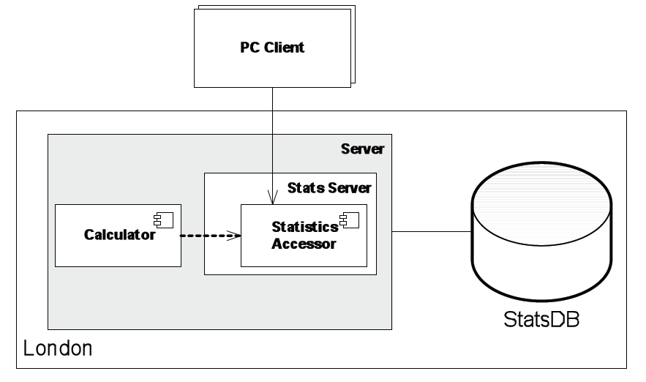

First Try...
Notes:
Here is our first stab at this. Now, this doesn’t look too bad, but it also doesn’t tell us a lot about how this is supposed to work. What information do we store? Are these all of the subsysytems in the code? Do any elements of this code operate in parallel? We need more information to build this system. This is where viewpoints come into play.

Slide 18
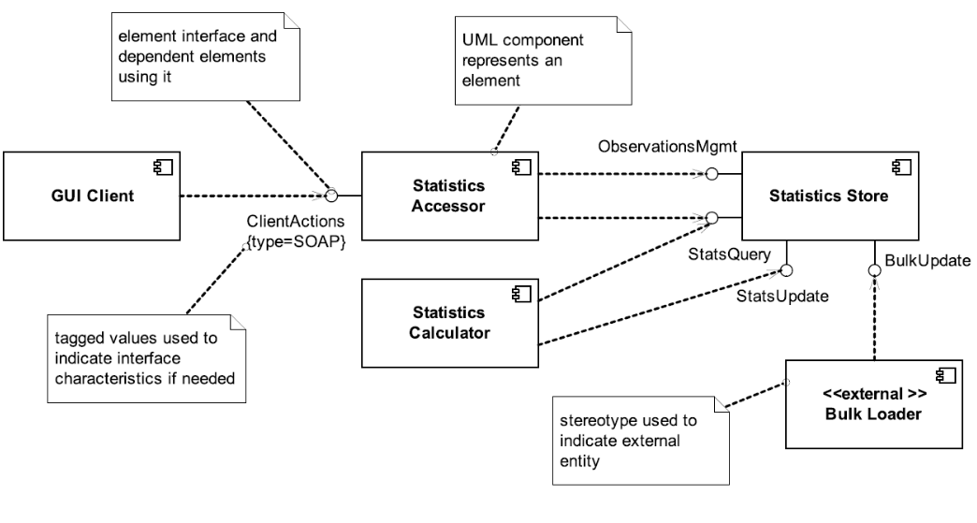
Functional View
Notes:
Now, we can get a deeper view of the code architecture itself (go over). We can add annotations to explain elements and how they relate (point out)

Slide 19
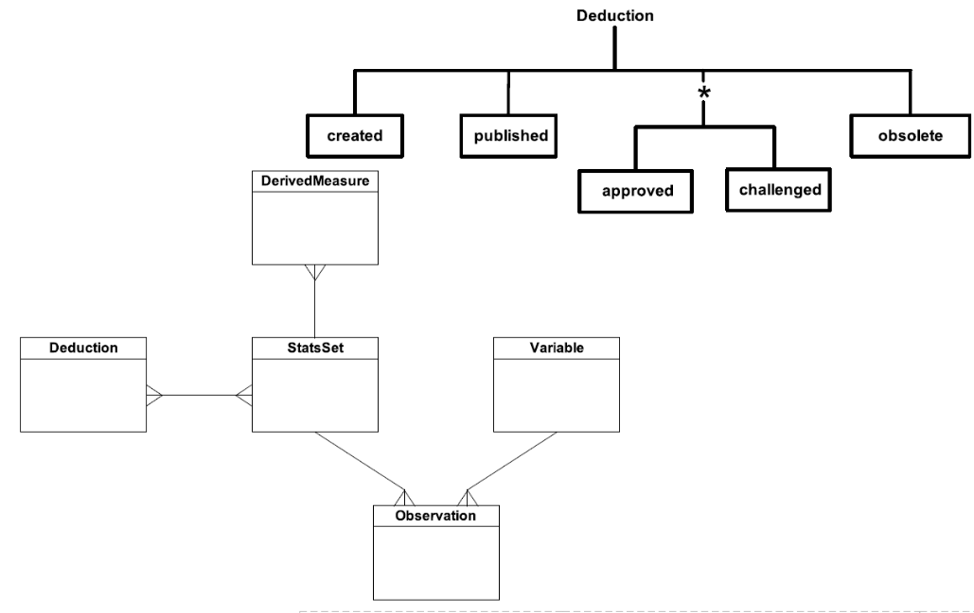
Information View
Notes:
Now, let’s look at the information being stored. (users can make deductions,these have different states, can divide up. Different stored info that relates (go over mapping)

Slide 20
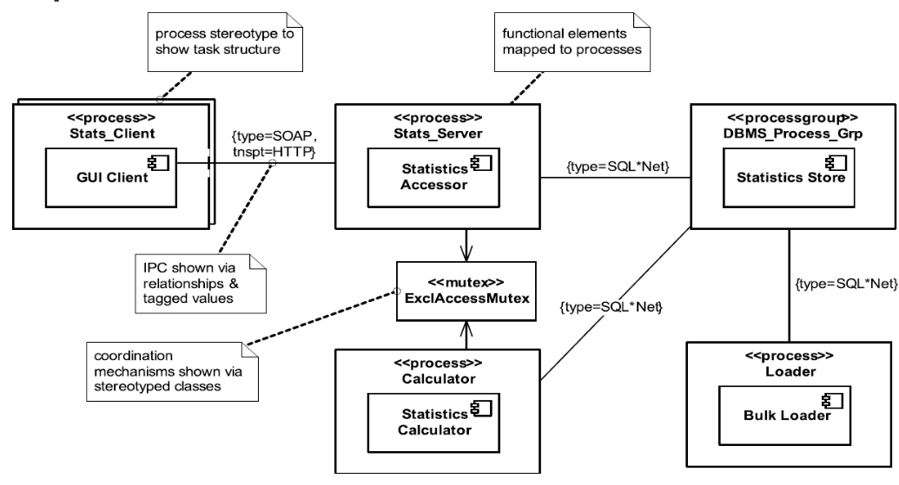
Concurrency View
Notes:
Fuctional diagram does not capture the whole picture of how these components interact during runtime, the concurrency view helps fill this in by illustrating what processes and threads interact and how. (go over) - see annotations again

Slide 21
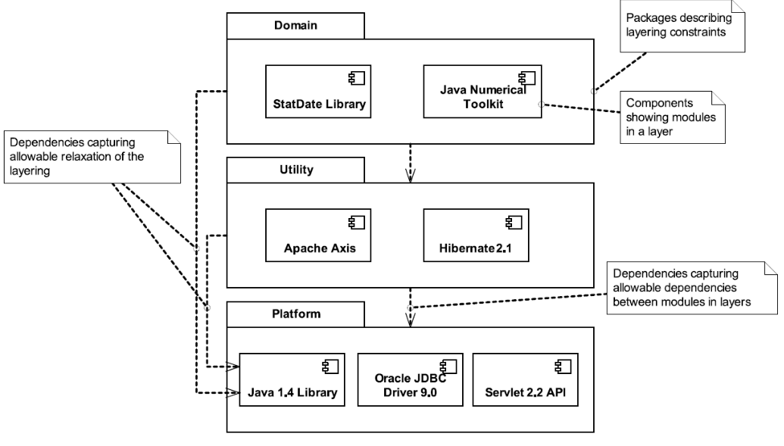
Development View
Notes:
Helps detail how we will build the system (go over) - libraries, platforms, how these help support the project

Slide 22
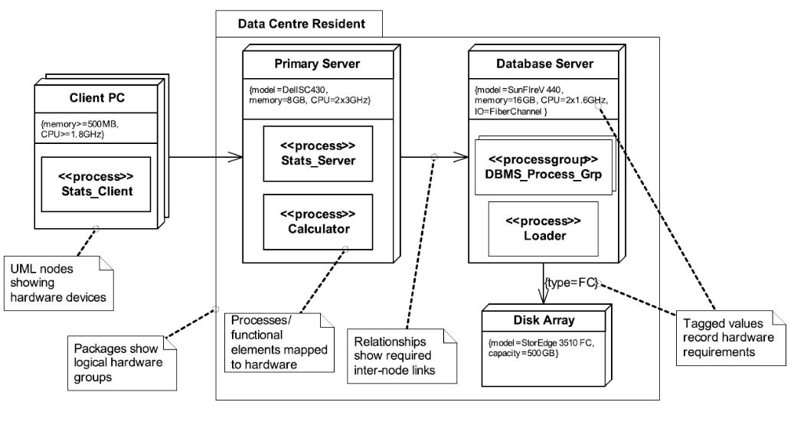
Deployment View
Notes:
What does the environment look like where we put the system out? The deployment view lays out hardware constraints, software constraints, and how entities interact in practice (go over)

Slide 23
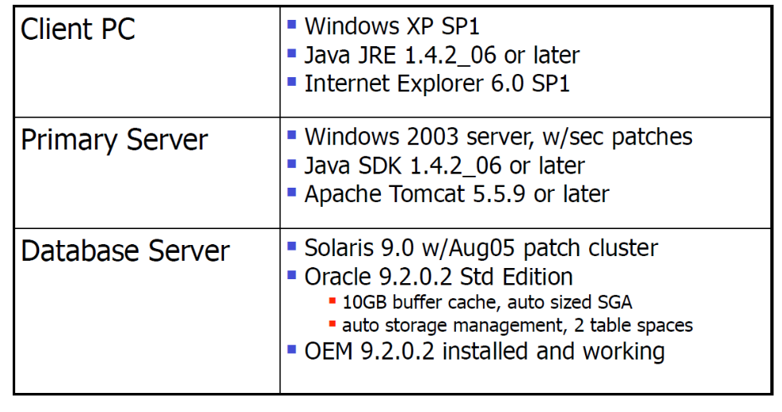
Deployment View (2)
Notes:
(go over) slides clearly old - internet explorer 6 - wow. Still get the idea.

Slide 24
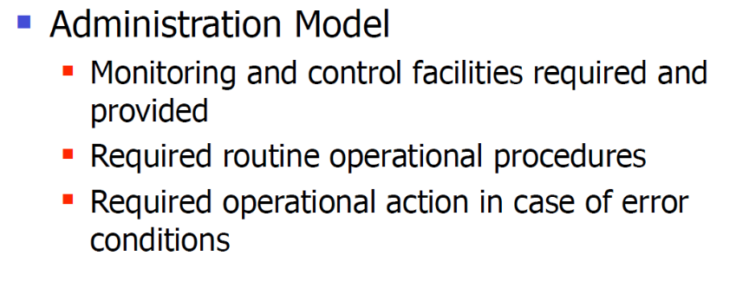
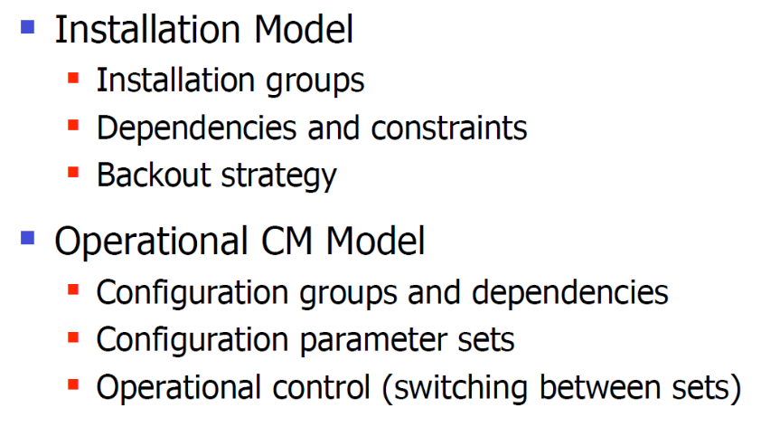
Operational View
Notes:
The operational view lays out how we plan to use, deploy, manage, and maintain the system. These fragments show aspects of that (go over)

Slide 25
Viewpoint Benefits
Helps structure architecture definition.
Usually a very unstructured activity.
Enables separation of concerns.
Helps design, analysis, and communication by abstracting unimportant details.
Allows communication with stakeholders.
Guide stakeholders to parts of the architecture description based on their concerns.
Improves developer focus
Ensures right system gets built, and that all details are captured.
Notes:
(1) In a relatively unstructured activity like architecture definition, the idea of the viewpoint is very appealing. If we can define a standard approach, a standard language, and even a standard metamodel for describing different aspects of a system, stakeholders can understand any AD that conforms to these standards once familiar with them.
(3) Describing many aspects of the system via a single representation can cloud communication and, more seriously, can result in independent aspects of the system becoming intertwined in the model. Separating different models of a system into distinct (but related) descriptions helps the design, analysis, and communication processes by allowing you to focus on each aspect separately and abstracting unimportant details. Dealing simultaneously with all of the aspects of a large system can result in overwhelming complexity that no one person can possibly handle. By treating each significant aspect of a system separately, the architect can focus on each in turn and so help conquer the complexity resulting from their combination.
(5) The concerns of each stakeholder are typically quite different, and communicating effectively with the various stakeholders is challenging. Viewpoints can help. Different stakeholder groups can be guided quickly to different parts of the AD based on their particular concerns, and each view can be presented using language and notation appropriate to the knowledge and concerns of the intended target.
(7) The AD is the foundation of the system design. By separating out into different views those aspects of the system that are particularly important to the development team, you help ensure that the right system gets built, that important details are captured, and that nothing from the requirements is forgotten.

Slide 26
Viewpoint Pitfalls
Inconsistency between views
Cross-checking is a tedious manual process.
Selection of the wrong views
Requires careful consideration of stakeholders and their concerns.
Fragmentation
Many views can make the “big picture” hard to follow.
Each view requires significant effort.
Eliminate views that do not address significant concerns for the system.
Notes:
Of course, these are not silver bullets. the use of views and viewpoints won’t solve all of your software architecture problems automatically. Although views make the problem manageable, there are issues you must account for. (1) Using a lot of views to describe a system inevitably brings consistency problems. There is no good way to automatically cross-check views either, achieving cross-view consistency is an inherently manual process. Later, we will talk about how to handle this. (3) : It is not always obvious which set of views is suitable for describing a particular system. This is influenced by a number of factors, such as the nature and complexity of the architecture, the skills and experience of the stakeholders (and of the architect), and the time available to produce the AD. There really isn’t an easy answer to this problem, other than your own experience and skill and an analysis of the most important concerns that affect your architecture. (5) When you start to describe your architecture, one temptation is to create a large number of views. This can lead to your architecture being described by many independent models, each in a separate view, making the overall architecture difficult to follow. Each separate view also involves a significant amount of effort to create and maintain. To avoid fragmentation and minimize the overhead of maintaining unnecessary descriptions, you should eliminate views that do not address significant concerns for the system you are building. In some cases, you may also consider creating hybrid views that combine models from a number of views in the viewpoint set. Beware, however, of the combined views becoming difficult to understand and maintain because they address a combination of concerns.

Slide 27
View Exercise
Notes:
(discussion) what entails a good design?

Slide 28
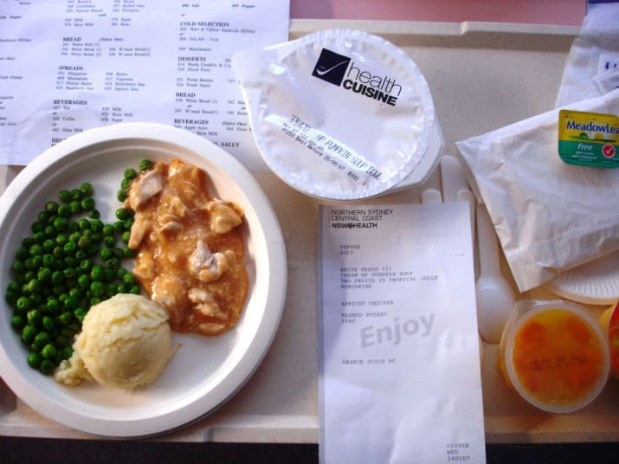
Hospital Food
A hospital has purchased a small clinic across the city.
The hospital will have to provide meals to the clinic.
The patients should be able to choose their meals using standard hospital meal tickets.
Notes:
A hospital has recently purchased a small clinic across the city where they will move lengthy outpatient procedures, such as dialysis. The hospital will have to provide meals (breakfast and lunch) to the clinic. The patients should be able to choose their meals using standard hospital meal tickets.

Slide 29
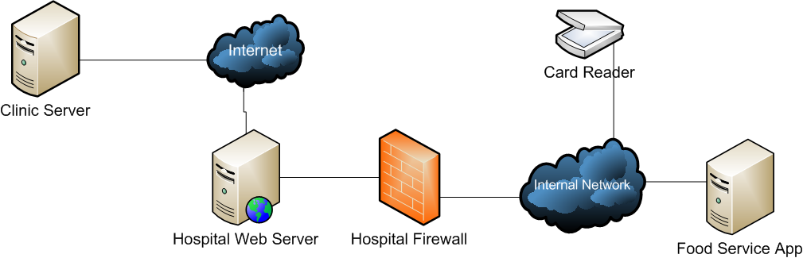
System Constraints
Hospital/clinic are connected to the internet.
Current meal system is antiquated; managed with ticket readers and is on the internal network (behind the firewall).
In the current system, no authentication or encryption.
The volume of traffic will likely be low
(anticipated top demand is 30-40 users).
System functionality: 1) Transmit menu to clinic 2) Allow patients to order food 3) Deliver food to clinic
Notes:
The hospital and clinic are both connected to the internet. However, the current meal system is antiquated; it is managed with ticket readers and is on the internal network (behind the firewall). In the current system, no authentication or encryption is performed. The volume of traffic will likely be low (anticipated top demand is 30-40 users).
System functionality:
Transmit menu to clinic
Allow patients to order food
Deliver food to clinic

Slide 30
How Would You Architect This?
Who are the stakeholders in this system?
What questions would you ask them?
What information is missing from the system description?
What are the relevant views? (This can include aspects not covered in this lecture)
What considerations belong to each view?

Slide 31

Many Possible Solutions
Webapp
Web-based food application. Need to add authentication and security.
VPN
Enter in meal tickets. Could duplicate card reader output over the VPN.

Slide 32
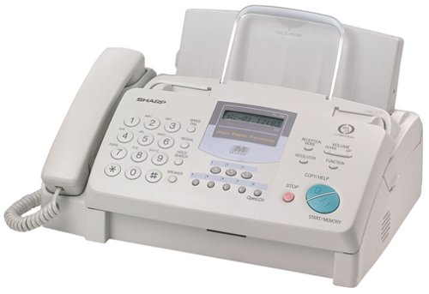
Think Outside of the Box
Use a fax machine.
Fax meal card in the morning.
Fax back completed card.
Read completed faxes into existing card readers.
Very inexpensive, and can be automated.
But doesn’t have to be...
Notes:
Here’s something you might not have considered. (go over) Always think outside of the box.

Slide 33
Architectural Perspectives
Notes:
(discussion) what entails a good design?

Slide 34
Quality Attributes
The architecture not only dictates what the system does, but how it does it.
How quickly it runs.
How secure it is.
How available its services are.
How easy it is to modify.
Quality attributes describe desired non-functional properties of systems.
An architect must prioritize quality attributes and design a system that meets thresholds.
Notes:
what a system does is only part of the story and that how the system provides its services often has a huge impact on the perceptions that stakeholders have of it. (rest) Designing a system that exhibits acceptable quality properties is a crucial part of your role as an architect.

Slide 35
What do you prioritize during development?
Notes:
(discussion) what entails a good design?

Slide 36
Examples of Qualities
Performance
Scalability
Security
Availability
Resilience
Modifiability
Supportability
Reliability
Safety
Portability
Development Efficiency
Time to Deliver
Tool Support
Geographic Distribution
Others?
Notes:
(read)

Slide 37
Qualities Impact Many Views
Security is a very important quality. It must be detailed in the architecture.
No security “viewpoint”, as it impacts all viewpoints.
Functional: System needs to identify/authenticate users.
Information: System must control classes of access to information at various levels of granularity.
Operational: System must maintain and distribute passwords, software dependencies must be patched.
Notes:
Security is clearly a vital aspect of most architectures. It has always been important to be able to restrict access to data or functionality to appropriate classes of users, and everything is online now. You need both good external and internal security. If some of your systems are exposed to the wider world, they are vulnerable to attack - they WILL be attacked- and the consequences of a breach can be disastrous. You may be surprised,then, that I didn’t list a Security viewpoint earlier. Well, this is because security impacts all viewpoints, and needs to be addressed at multiple levels. From the Functional viewpoint, the system needs the ability to identify and authenticate its users (internal and external, human and mechanical). Security processes should be effective but unobtrusive, and any external processes exposed to the outside world need to be resilient to attack. From the Information viewpoint, the system must be able to control different classes of access to information (read, insert, update, delete). The system may need to apply these controls at varying levels of granularity (e.g., defining object-level security within a database). From the Operational viewpoint, the system must be able to maintain and distribute secret information (e.g., keys and passwords) and must be up-to-date with the latest security updates and patches. When we consider the system from the Development, Concurrency, and Deployment viewpoints, we’ll probably also find aspects there as well that impact security. So our overall qualtiy goal - “the system must be secure” - actually breaks down across the viewpoints into more specific criteria.

Slide 38
Architectural Perspective
Architectural Perspectives are used to discuss how particular quality attributes affect each view of the overall architecture.
A perspective is a collection of activities, tactics, and guidelines used to ensure that a system exhibits the chosen set of quality attributes.
Systemizes what a good architect does: studies properties, assesses architectural choices, selects and applies tactics to ensure quality.
Notes:
Achieving quality goals is a cross-cutting aspect of the architecture definition process and is likely to impact all of the different structures that make up your architecture. This means that achieving your quality goals is likely to affect all of the viewpoints in your architectural description. We need a better way to ensure that our architecture exhibits the quality properties required of it and to organize our knowledge about quality properties when designing the architecture. In order to do this, we use architectural perspectives. A architectural perspective is analogous to a viewpoint, but rather than addressing a type of architectural structure, a perspective addresses a particular quality property (such as performance, security, or availability) and looks at how it affects each viewpoint. An architectural perspective is a collection of activities, tactics, and guidelines that are used to ensure that a system exhibits a particular set of related quality properties that require consideration across a number of the system’s architectural views. With perspectives, we are trying to systematize what a good architect does—understand the quality properties; assess the architectural models to ensure that the architecture exhibits the properties; identify, tests, and select architectural tactics to address cases when the architecture is lacking; and so on.

Slide 39
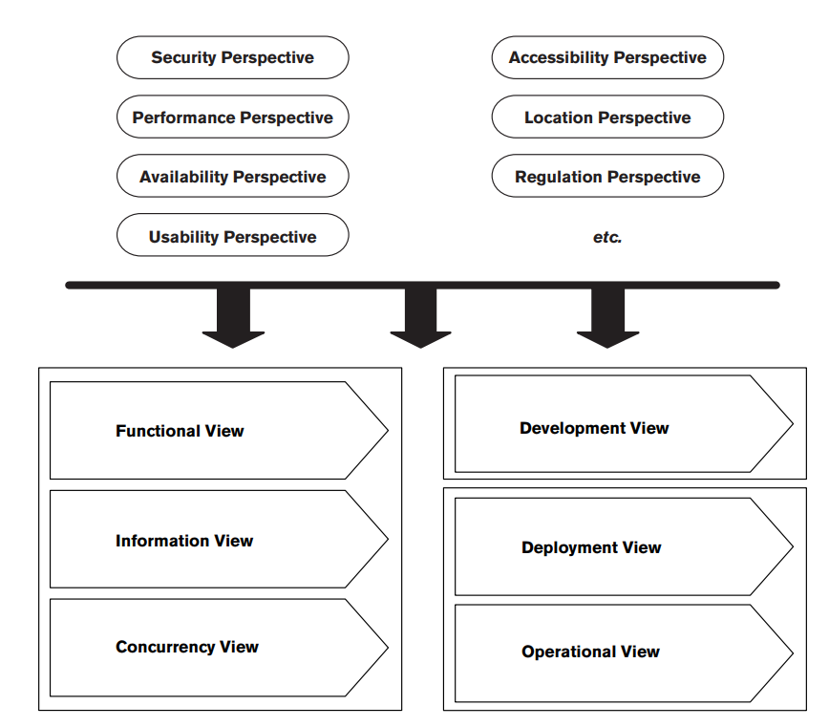
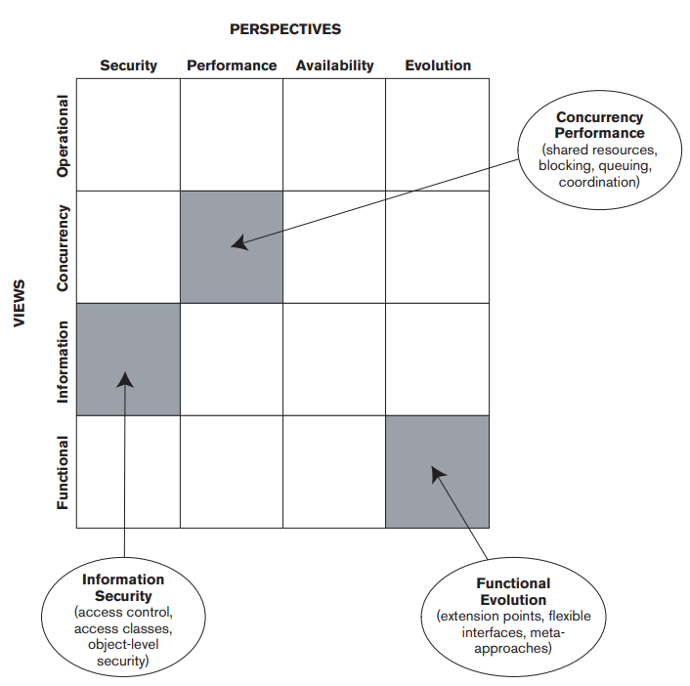
Applying Perspectives to Views
Notes:
The key point is that you apply each relevant perspective to some or all of the views in order to address that perspective’s system-wide quality property concerns. The architectural views contain the description of the architecture, while the perspectives guide you through the process of analyzing and modifying your architecture to make sure it exhibits a particular quality property. every perspective can be applied to every view (the relationship between perspectives and views is many-to-many), in practice, because of time constraints, you usually apply only some of the perspectives to some of the views.
- think of a two-dimensional grid, with views along one axis and perspectives along another. Each rectangle in the grid represents the application of a perspective to a view, and the contents of the rectangle define the important qualities and concerns at that intersection. When you apply the Security perspective to the Information view, it guides the design of your architecture so that, for example, it includes appropriate data access control and data ownership. When you apply the Security perspective to the Information view, it guides the design of your architecture so that, for example, it includes appropriate data access control and data ownership. When you apply the Evolution perspective to the Functional view, it guides the design of your architecture so that, for example, you consider the types of changes that will be required and build in the right level of flexibility.

Slide 40
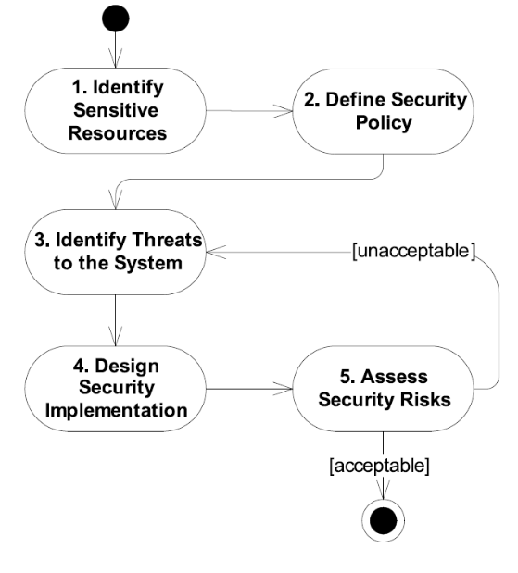
Example: Security Activity
Perform activities, based on viewpoint, to identify how the perspective impacts that viewpoint.
Suggests changes to the architecture.
Different partition to functional elements.
Introduce new hardware/software elements to deployment environment.
Identify new operational procedures to support secure operation.
Notes:
Going back to our example of security,if we’ve decided on a candidate architecture for your system and captured it as a set of views, we can then apply the Security perspective in order to ensure that the system meets its security requirements. To apply this perspective, you would perform a number of activities, as listed in the perspective’s definition, (go over). The result would typically be some changes to your candidate architecture. You might decide to partition the system differently in order to easily restrict access to parts of it. This would affect your Functional view. You might introduce new hardware and software to limit access or to add additional guarantees (such as encryption). You would need to add these new elements to your Deployment view to define where they fit, and you might need to update the Development view to define how these new elements should be used. You might identify new operational procedures to support certificate management or modify existing procedures to ensure security (e.g., handling backups of sensitive data). These procedural changes will modify the Operational view. Applying the Security perspective has not resulted in a new security view but has identified a number of modifications to your existing views that help address your stakeholder’s security concerns.

Slide 41
Example: Security Activity
Sensitive Resources
Security Threats
Data in the database
Operators stealing backups.
Admins querying data, seeing names.
Bribing investigating officers
Internal attack on database via network.
Notes:
Bring in, discuss

Slide 42
Example: Security Activity
Security Countermeasures
Backups: encrypt data in the database
Does this impact performance?
Does this impact the difficulty of maintaining availability?
Hiding names: use hash instead of names, protect names at a higher security level.
More complexity in development?
Possible performance impact?
Notes:
Backups, hiding names
Bring in, discuss

Slide 43
Example: Security Activity
Security Countermeasures
Bribery: add audit trail for data access
Does this impact performance?
Does this impact implementation complexity?
How do you protect the audit trail?
Network attacks: harden database, firewalls
Deployment and admin cost?
Hardware and operational cost?
Notes:
Bribery, network attacks
Bring in, discuss

Slide 44
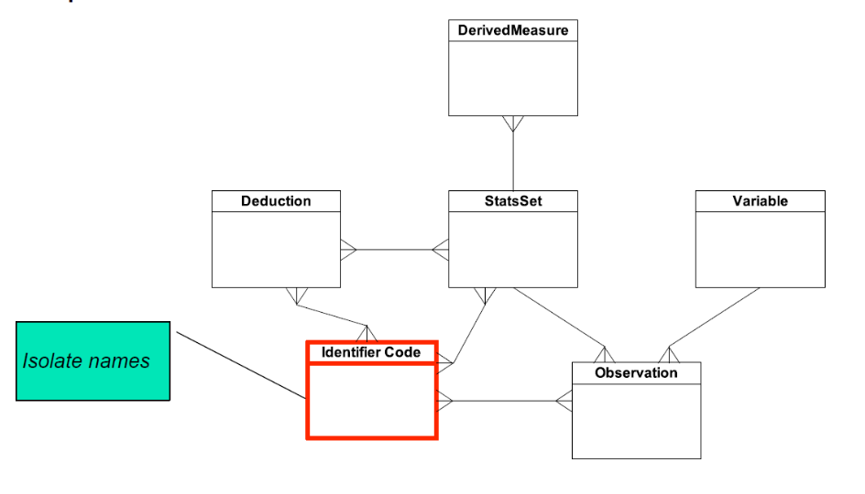
Impact on Information View
Notes:
(read)

Slide 45
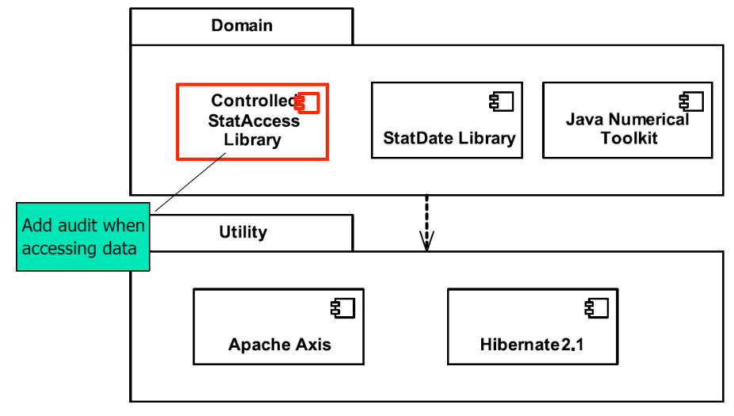
Impact on Development View
Notes:
(read)

Slide 46
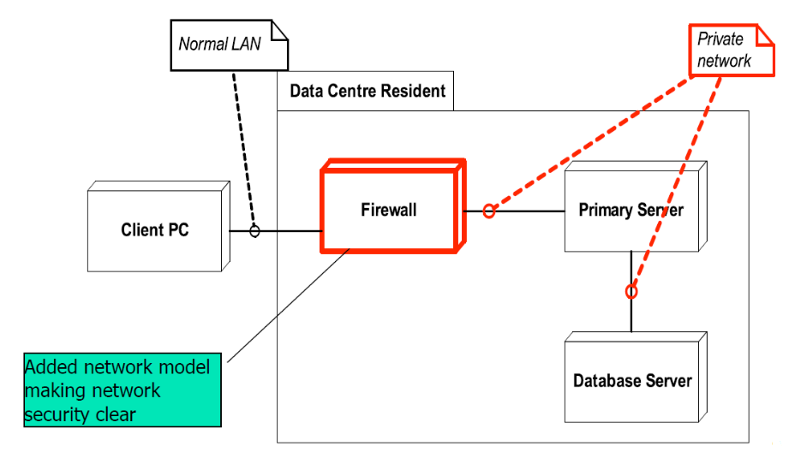
Impact on Deployment View
Notes:
(read)

Slide 47
Other Impacts
Revisions to information or deployment view with changes to database security.
Need to capture impact on operational view.
Consider impact on other quality attributes (performance, availability).
Need to alter performance models to allow for encryption, audit, etc.
Key point: perspectives cause changes to multiple views. Make sure you maintain consistency.
Notes:
(read)

Slide 48
Consequences of Perspectives
Insights into the system’s ability to meet a quality property.
Applying a perspective tends to lead to a model demonstrating that an architecture meets a quality property or misses it.
Improvements to the chosen architecture.
Leading to changes in models
Artifacts that offer supporting architectural information and significant lasting value.
Notes:
Applying a perspective to a view can lead to insights, improvements, and artifacts. (1-2) Applying the Security perspective - going through that activity on the last slide, for instance- might reveal the existence of significant security threats that are not countered by the system in its current form. You would then need to understand these threats, understand what the risks are, and understand the impact these risks have on your architecture.
If applying the perspective tells you that the architecture will not meet one of its quality properties, the architecture needs to be improved. In this case, you may need to change an existing model in the view, create additional models to further develop the content of the view, or perhaps do both of these. Take the performance property. Applying the Performance perspective to your Deployment view might demonstrate that you need to replicate the application servers to be capable of scaling to meet expected demand. This could lead to a change to the Deployment model to show several servers instead of one and possible changes to the Functional or Information views to support this load balancing.
Some of the models and other deliverables created as a result of applying a perspective will have significant lasting value and are important supporting architectural information. We call those artifacts. Applying the Location perspective to your Deployment view might result in a spreadsheet that models the physical network to show that there is sufficient bandwidth and capacity for the expected traffic. This is useful and is likely to be needed in the future to investigate the impact of changes to the system or the network. You should retain and reference this artifact from the AD.

Slide 49
Perspective Benefits
Offers conventions for describing qualities.
Performance perspective offers standardized measures and guidance for measuring them.
Defines concerns that guide decisions.
Performance perspective defines concerns, i.e., response time and predictability.
Describes how to validate quality.
Performance perspective offers advice for enacting simulations to predict performance.
Offers solutions common across systems.
Performance perspective describes how hardware can be multiplexed.
Notes:
Applying perspectives to a view benefits your AD in several ways. The perspective provides common conventions, measurements, or even a language you can use to describe the system’s qualities. For example, the Performance perspective defines standardized measures such as response time, throughput, latency, and so forth, as well as how they are specified and captured. The perspective defines concerns that guide architectural decision making to ensure that the architecture will exhibit the qualities considered by the perspective. For example, the Performance perspective defines standard concerns such as response time, throughput, and predictability. The perspective describes how you can validate the architecture to demonstrate that it meets its requirements across each view. For example, the Performance perspective describes how to construct simulations to predict expected performance under a given load. The perspective may offer recognized solutions to common problems, helping to share knowledge across projects. For example, the Performance perspective describes how hardware devices may be multiplexed to improve throughput

Slide 50
Perspective Pitfalls
Each perspective addresses a single set of concerns and will conflict with other perspectives.
Stakeholder concerns and priorities are different for every system. How much you need to consider each perspective varies.
Perspectives offer general advice. Your situation may differ.
Notes:
Each perspective addresses a single, closely related set of quality property concerns. There will often be conflicts between the solutions suggested by different perspectives (e.g., a highly evolvable system may be less efficient, and thus less performant, than a less flexible one). An important part of your role is to balance competing needs. The stakeholder concerns and priorities are different for every system, so the degree to which you should consider each perspective varies considerably. Perspectives contain established, general advice for ensuring a system exhibits certain quality properties. However, every situation is different, and it is important that you think about the advice and its relevance to your situation and then apply it appropriately.

Slide 51
Key Points
Viewpoints and perspectives offer a way to organize architectural information.
Allows detailed thinking about different aspects of design while abstracting other details (focus on the software structure, then on information format, etc.)
Describes expected activities and common pitfalls for each view of the system.
Must be tailored to your product.
Notes:
(read)

Slide 52
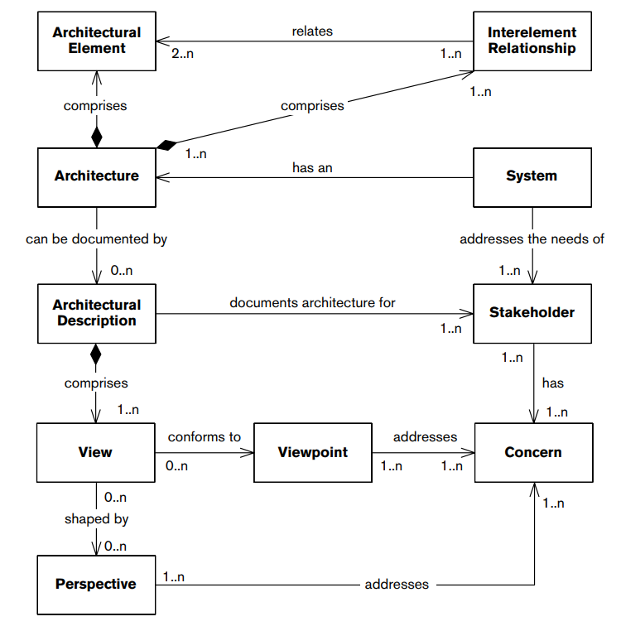
Bringing it Together
Notes:
(read)

Slide 53
Next Time
Architecture Definition
Sources: Rozanski & Woods: ch. 5-7
Homework: Team selections due next class. Instructions on course website.
Reading Assignment 1:
Whalen, Gacek, Cofer, Murugesan, Heimdahl, Rayadurgam. Your “What” is my “How”: Iteration and Hierarchy in System design
Due September 6th
Notes:
(read)

Slide 54
Reading Assignment
Whalen, Gacek, Cofer, Murugesan, Heimdahl, Rayadurgam. Your “What” is my “How”: Iteration and Hierarchy in System design
Individual assignment. Paper on website.
Read the paper and turn in a one-page write-up:
Summary of the paper.
Your opinion on the work.
Do the authors’ arguments make sense in the real world?
Where does their opinion fall short?
Your thoughts on how these ideas could be improved and extended.

