Slide 1
Architecture Definition
CSCE 742 - Lecture 4 - 09/04/2018

Slide 2
What is the role of the software architect?
Notes:
(discussion) Point is - there are a lot of different answers to this question

Slide 3
The Role of the Architect
Some write a lot of code, some hand jobs to the build and testing teams.
Some specialize in one area (networking, middleware, databases), others have no development background at all.
What does an architect do?
Notes:
If you gathered a group of software architects in a room and asked them to describe the jobs they do, you would probably end up with at least a dozen different definitions, even more if you ask the people they work with what they do.
On some projects, the architect has a very hands-on role - designing, coding, and testing. Alternatively, architects may hand down orders at intervals to the build and implementation teams. Architect is also often used as a generic title to denote a senior technical member of staff. Architects may specialize in one area, such as networking, middleware, or database design, to the exclusion of others; occasionally, the architect may not even have a system development background at all, having entered through business analysis. The title may also be qualified such as application architect, data architect, or even enterprise architect, without being clear what these roles involve. So before we consider how you perform your job as an architect - what your role is - we need to understand exactly what that job is—what your responsibilities are, where your boundaries are, what areas you should delegate to others, and how you work alongside the other members of the team to ensure a successful software delivery. (3)

Slide 4
Today’s Class
Discuss the architecture definition process.
How we discover the system architecture.
Explain the relationship between “architecture”, “design”, and “requirements”.
Your “what” is my “how”.
Define the role of the software architect.
Notes:
If you gathered a group of software architects in a room and asked them to describe the jobs they do, you would probably end up with at least a dozen different definitions, even more if you ask the people they work with what they do.
On some projects, the architect has a very hands-on role - designing, coding, and testing. Alternatively, architects may hand down orders at intervals to the build and implementation teams. Architect is also often used as a generic title to denote a senior technical member of staff. Architects may specialize in one area, such as networking, middleware, or database design, to the exclusion of others; occasionally, the architect may not even have a system development background at all, having entered through business analysis. The title may also be qualified such as application architect, data architect, or even enterprise architect, without being clear what these roles involve. So before we consider how you perform your job as an architect - what your role is - we need to understand exactly what that job is—what your responsibilities are, where your boundaries are, what areas you should delegate to others, and how you work alongside the other members of the team to ensure a successful software delivery. (3)

Slide 5
Introducing Architecture Definition
Notes:
(discussion) what entails a good design?

Slide 6
Architecture Definition
“Software architecture is the fundamental organization of a system, embodied in its components, their relationships to one another and the environment, and the principles governing its design and evolution.”
Architecture definition is the process of discovery of these components, relationships, and principles.
Notes:
Think back to the definition of software architecture we gave a couple of weeks ago (1). Well, (2)

Slide 7
Architecture Definition
Architecture definition is a process by which stakeholder needs and concerns are captured, an architecture to meet these needs is designed, and the architecture is clearly and unambiguously described via an architectural description.
Notes:
Formally, (read)

Slide 8
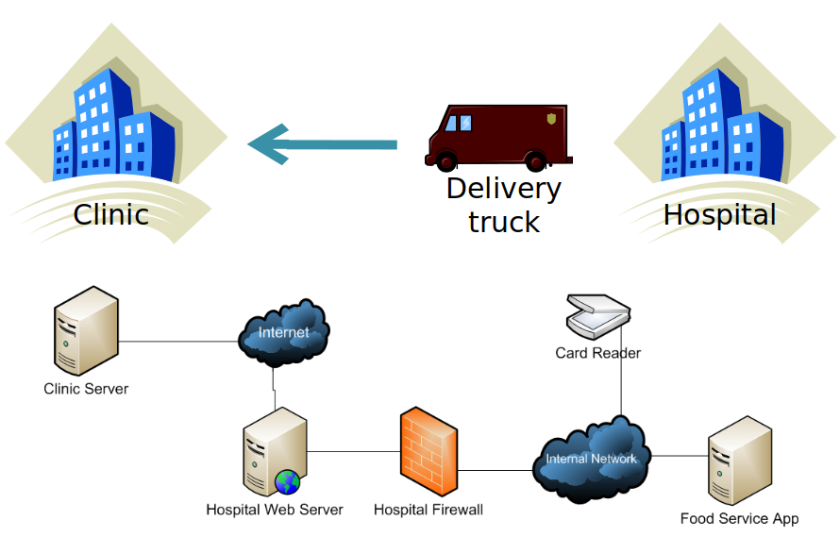
Hospital Food
Physical World
Infrastructure in Place
Notes:
If we think back to last class, we had this example of hospital food ordering that I asked you to think about. We had a real-world problem - we want to deliver meals to a remote clinic each day. We also looked at the infrastructure in place (go over). Then, I asked you to think about how you’d architect this system. You basically followed the definition process.

Slide 9
What Did We Do?
Examined the stakeholders.
Asked them about the expected behavior.
Looked at our options (our infrastructure).
Looked at the scope of the system.
Made decisions about how to architect it.
Repeat the cycle, using the current draft.
Notes:
(go over)

Slide 10
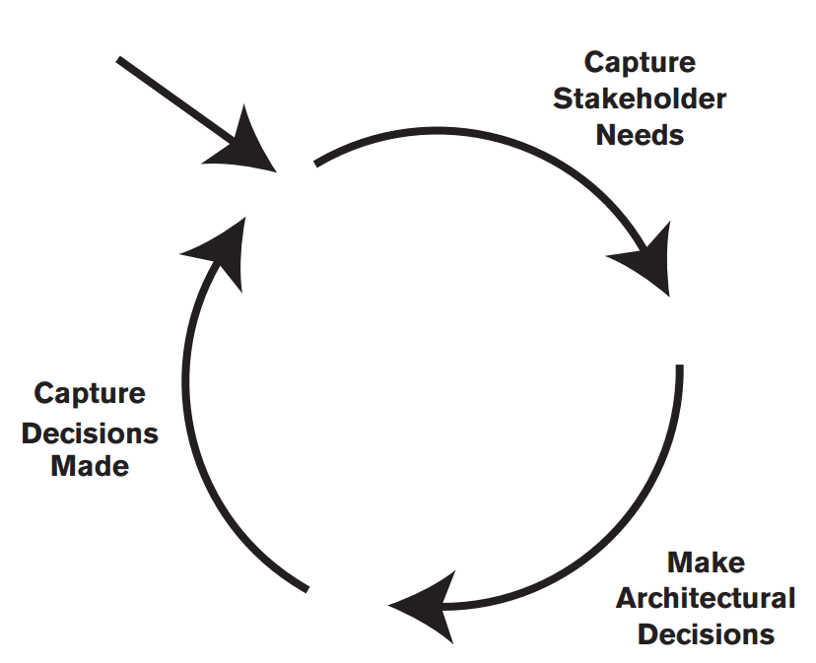
The Architecture Definition Process
Understand what is important to stakeholders, recording and agreeing on those needs.
Make decisions that fit those needs, refine until adequate.
Record decisions and rationale in a permanent document.
Notes:
In abstract, we completed the circular process of architecture definition. The goal of an architecture definition process is to design an architecture that meets the needs of its stakeholders. There are three aspects to this.
- Capturing stakeholder needs, that is, understanding what is important to stakeholders (possibly helping them reconcile conflicts such as functionality versus cost) and recording and agreeing on these needs
- Making a series of architectural design decisions that result in a solution that meets these needs, assessing it against the stakeholder needs, and refining this solution until it is adequate
- Capturing the architectural design decisions made - and their rationale and all supporting material, in the document that we call the architectural definition
These activities form the core of the architecture definition process and are normally performed iteratively. A good architecture definition process is one that leads to a good architecture, documented by an effective architectural description, which can be realized in a time-efficient and cost-effective manner

Slide 11
Architecture, Requirements,
and Design
Notes:
(discussion) what entails a good design?

Slide 12


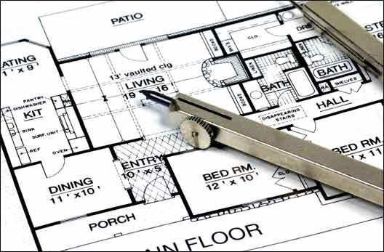

Typical Development Process
Concept Formation
Requirements Specification
Implementation
and Testing
Design
Notes:
Software development can be structured in a lot of different ways, but we usually have a breakdown that looks like this (go over each stage).

Slide 13
What is a requirement?
A requirement is a singular documented physical or functional need that a particular product must be able to perform.
“The software shall be able to calculate the sum of a column of integers.”
A statement that identifies a necessary attribute, capability, characteristic, or quality of a system for it to have value and utility to a stakeholder.
Notes:
Here’s a clear definition.
(read)
Essentially, the requirements for a system are a set of promises - here is what the system will do, here are the constraints it will follow, here are properties that must be met to release the product and consider it finished.

Slide 14
Requirement Specification Process
A requirement’s specification is a comprehensive technical description of how that requirement will be realized.
The set of specifications will fully describe what the software will do and how it will be expected to perform.
During the requirement specification process, we define what the system does.
Notes:
A requirement is a high-level statement of something the software must do. A property that must be met. Most requirements, then, are accompanied by what is called a specification - (1). Not requirements in themselves, but the details needed to successfully meet that requirement.
The terms requirement and specifications are often thrown around interchangeably, because they are often delivered in the same document, but keep that difference in mind. The requirement is what you are promising, and its accompanying specification is the explanation that makes it possible to implement. Anybody can understand the high-level requirements - those are a checklist of things that your software will offer, but specification is something the engineers need to actually realize those promises - the detailed definition of what the software needs to do, what conditions it will do it under, what the input should look like, and what will come out when you’re done.(read 2)
(3)

Slide 15
What is Design?
Design is the process of transforming a problem into a solution.
In our case, transforming a requirements specification into a detailed description of the software to be implemented.
Specification - what the system does.
Design - how the system does it. A description of the structure of the solution.
Notes:
(read)
(read).
We have the spec - which describes what the system should do - what its functions are and what the behavior should look like. That tells us nothing about how to implement it. That tells us what the machine should do, but not how to contruct it or what the structure of that solution looks like.
The design is our instruction book, our blueprint for how to build the solution. The design describes the structure of the solution.

Slide 16
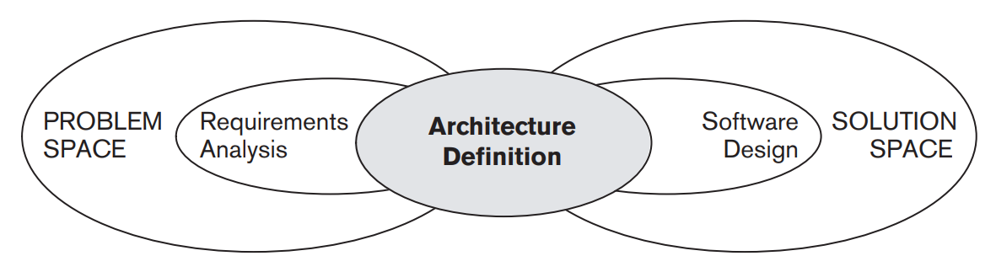
Where is Architecture Definition?
A bridge between specification and design.
Design focuses on solution space, targets developers. Focused on the classes that make up the codebase.
Requirement specification focuses on the problem space, ignores needs of developers.
Architecture bridges problem and solution spaces, balancing the needs of the stakeholders.
Notes:
Where does architecture definition fit into this process? In 740, I talked about architecure as part of design. A common question that arises is whether architecture definition is “just” part of design or whether there is something more to it. It’s true that architecture definition incorporates elements of design but also of requirements analysis. In practice, architecture is a distinct activity that sits in between the two.
Design is an activity focused on the solution space and targeted primarily at one group of stakeholders—the developers. It works within a clearly defined set of constraints (the system’s requirements) and is essentially a process of translating these into the blueprints for a system. Historically, design has tended not to focus as much on the needs of other stakeholders such as operations or support, assuming that their needs have been captured in the requirements.
Requirements analysis, on the other hand, is an activity focused on the problem space that (in its purest forms) ignores the needs and constraints of groups like developers and systems administrators because it focuses on what is desired rather than what is possible. It also works within a clearly defined set of constraints (the system’s required scope), although within these it tends to have much more freedom than the design process does.
Architecture definition resolves this tension by bridging the gap between the problem and solution spaces. Its focus is to understand the needs of everyone who has an interest in the architecture, to balance these needs, and to identify an acceptable set of tradeoffs between these.

Slide 17
Requirements v. Architecture:
Hospital Food
Many ideas in solution space
Delivery drivers
VPNs, Card readers, firewalls
These ideas constrain the problem space
(the requirements).
If delivery guy picks up food orders, patients have to choose meals earlier
If using delivery truck vs. car, we batch meals.
It is a mistake to consider requirements without also working in the solution space.
Notes:
If we go back to our hospital food example. (go over). This is what the architecture does. It checks our initial ideas - our requirements - against reality

Slide 18
Requirements v. Architecture
Architecture reconciles requirements against the real world.
By analyzing, understanding, prioritizing requirements.
What are the implementation options?
What is the value of a requirement?
What is the cost of implementing a requirement?
How do we implement a requirement given the options in the solution space?
Notes:
(1) Part of your role as an architect is to be involved in the process of analyzing, understanding, and prioritizing the system’s requirements. This also allows you to start assessing the difficulty involved in implementing each requirement. part of this process involves understanding the relative business value of requirements, it must also take into account the associated costs and risks, and answer the question of how we implement a requirement given the options in the solution space. Many of the requirements specified initially are likely to be difficult to implement because the requirements analysts have little or no insight into the implementation options. As an architect, you are ideally placed to provide this insight so that the importance of each requirement can be considered in the context of the likely cost of providing it.

Slide 19
Design v. Architecture:
Hospital Food
Careful examination of infrastructure is key
Physical items (delivery trucks), existing software base, available language/library/OS support, 3rd party solutions
These are all part of the solution space.
In this example, we could implement a system meeting the requirements with no new software.
Architecture defines the interfaces and constrains the range of solutions.
It is not about writing code.
We are defining the architecture, not the class list.
Notes:
However, architecture isn’t quire design either. (go over). Architecture often constrains the software we define - structures it into internal subsystems and decides how classes communicate, but by defining systems, subsystems, and interfaces - not the code units themselves.

Slide 20
Design v. Architecture
Is an element architecturally significant?
A concern, problem, or element is architecturally significant if it has a wide impact on the structure of the system or on its quality properties.
An architect must balance a high-level view and exploring the detail.
As architecture evolves, review the scope and add detail when appropriate.
Do not be afraid of constraining the design.
Notes:
One of the most important decisions you will have to make as an architect is whether something is important enough for you to worry about or whether it can safely and appropriately left until the detailed design phase - in other words, whether it is architecturally significant. A concern, problem, or system element is architecturally significant if it has a wide impact on the structure of the system or on its important quality properties such as performance, scalability, security, reliability, or evolvability.
Your job as an architect is to get the right balance between maintaining a high-level view and exploring the detail. Beware, however, of assuming that all architectural concerns are found at the abstract level; often, you need the details. You need to consider aspects of your architecture at all levels, from the strategy to the code. It is also important to keep considering whether your judgment is correct and to make sure that as your AD develops, you continue to review whether your scope is appropriate. (4-5)

Slide 21
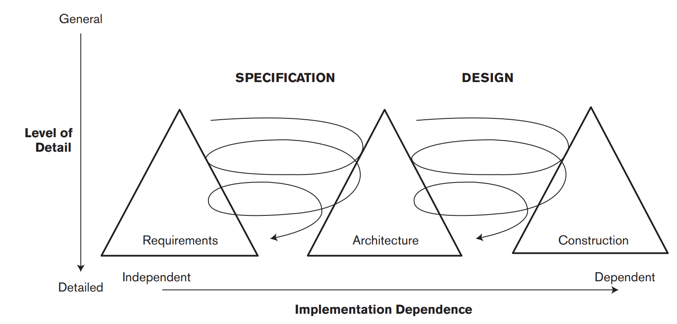
The Three Peaks Model
Notes:
Architecture forms the bridge between requirements and design, performing the tradeoffs necessary to satisfy the demands of both. A good model for the interaction between requirements, architecture, and construction is what is called the Three Peaks model. The three triangles (the peaks) in the diagram represent the major software development activities - requirements analysis, architecture definition, and construction; the widening of the shapes at their bases represent an increasing level of detail as time goes on while the system is developed. The curling arrows show how requirements and architecture as well as architecture and construction are intertwined at a progressively increasing level of detail during system development. Although the specification, architecture, and implementation of the system are quite distinct, they have effects on each other and so cannot be considered in isolation.

Slide 22
The Three Peaks
Requirements provide context for architecture definition by defining scope, functionality, and quality properties.
Architecture definition reveals requirement problems, helps stakeholders understand cost of meeting requirements. Allows refinement of requirements.
Architecture definition constricts design.
Design provides refinement to architecture.
Alterations to architecture further shape design.
Notes:
Requirements analysis provides the context for architecture definition by defining the scope and the system’s desired functionality and quality properties. Architecture definition often reveals inconsistent and missing requirements and also helps stakeholders understand the relative costs and complexities of meeting their concerns. This feeds back into requirements analysis to clarify and add requirements and to prioritize these when tradeoffs are made between stakeholders’ aspirations and what can be achieved given time and budget constraints.
(3) When architecture definition has resulted in an architecture that meets an acceptable set of requirements, the construction of the system can be planned - we can proceed with design. Design and implementation is often organized as a set of incremental deliveries, each of which aims to provide a useful set of functions and to leave the system in a stable, usable state (albeit an incomplete one). The construction of each increment provides further feedback to architecture definition, indicating problems with the architecture as currently specified; so, there is architecture definition activity throughout the lifecycle.

Slide 23

Requirements or Design Information?
The patient shall never be infused with a single air bubble more than 0.5ml volume.
When a single air bubble more than 0.5ml volume is detected, the system shall stop infusion within 0.2 seconds.
When a single air bubble more than 0.5ml volume is detected, the system shall issue an air-embolism command.
The system shall always stop the piston at the bottom or top of the cylinder.
When air-embolism command is received, the system shall stop piston movement within 0.1 second.
Notes:
(go over) (discuss)

Slide 24
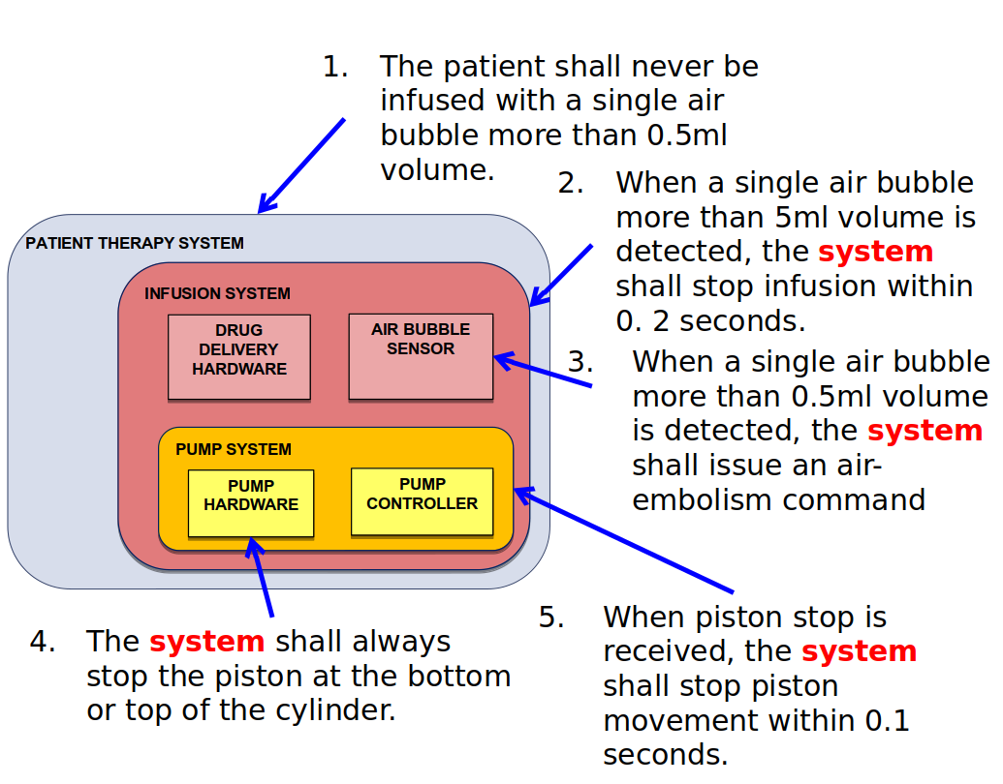
Both!
Notes:
The answer is both. The first is a real-world factor, but something you must control through the system you are architecting. The others describe constraints on the system and descriptions of what it does. These are requirements in pure form. That doesn’t mean that they sit purely in the realm of requirements.

Slide 25

Your “What” is my “How”
Systems are hierarchically architected as interacting subsystems
Design considerations at one level determine what happens at the next level in the hierarchy.
Requirements at one level are implemented as design decisions (an architecture), which imposes requirements on that architecture’s elements.
Requirements vs. architectural design is a matter of perspective
Notes:
Consider the Boeing 747. it’s an extraordinarily complex system containing more than 6 million parts, 171 miles of wiring, and five miles of tubing. More importantly, it’s a complex software and hardware infrastructure containing 6.5 MLOC distributed across dozens of different computing resources. You don’t sit down, sketch a class list, and write the code of something like that. To make design and construction possible, the components— physical and software—are necessarily architected as a hierarchicy of subsystems that interact to satisfy the aircraft’s safety, reliability, and performance requirements. This hierarchical aspect of design is crucial. Design considerations at one level of abstraction, such as in partitioning a system into subsystems and allocating functionality to each, determine what the subsystems should do at the next level of abstraction. Requirements at a particular level in the hierarchy are implemented in terms of a set of design decisions (an architecture), which in turn induces sets of requirements on that architecture’s components. By making architecture decisions, we create and reshape requirements on the elements of that architecture. (4)

Slide 26
Architecture Often Comes First
May have candidate architectures from previous systems
Designer familiarity
Cost amortization
Architecture may guide requirements discovery.
Program families
Certification or criticality requirements
Architectural choices often restrict set of achievable system requirements.
Notes:
We think of requirements specification as the first stage of development, but that’s not always true. Often (title). (1) Beneficial, because (2-3). (4) or be necessary to draft the requirements in the first place. You may have program families that exist that you are adding to. These programs may share common interfaces, networking environments, physical components - all elements of architecture - that will in turn determine many of the requirements. You have have certification or criticality requirements that require architectural knowledge. (7)

Slide 27
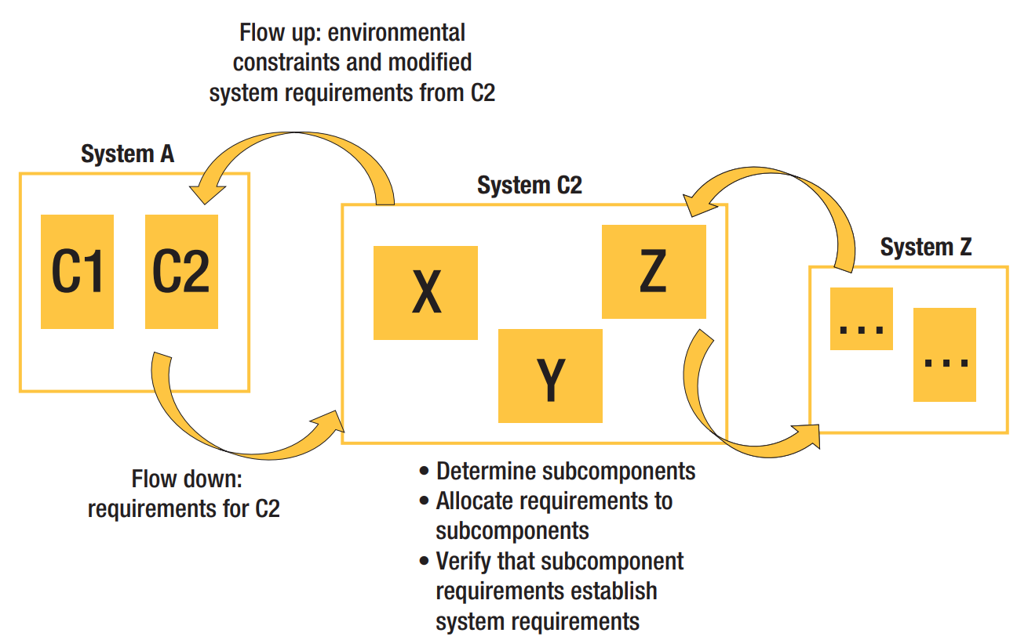
Flow is Bidirectional
Notes:
Once systems become sufficiently complex, they must be decomposed into subsystems - this is what our architecture does. Consequently, the requirements on the system as a whole must be decomposed and allocated to each of those subsystems. This decomposition affects both requirements and architecture because the decomposition’s structure will influence how requirements flow down to each subsystem. Requirements should be organized into hierarchies that follow the system’s architectural decomposition. This organization promotes a natural notion of refinement and traceability between layers of requirements. The act of decomposing a system into components (and then assembling the components into a system) creates a requirements analysis effort in which we must determine whether the requirements allocated to subcomponents in the architecture are sufficient to establish the system-level requirements. Of equal importance, we must determine whether any assumptions on a component’s environment made when allocating requirements to that component can be established. As we begin to allocate requirements to components, we might find that the architecture we’ve chosen simply can’t meet the system-level requirements. This might cause us to rearchitect the system. This flow is bidirectional - (go over flow up and flow down)

Slide 28
The Architecture Definition Process
Notes:
(discussion) what entails a good design?

Slide 29
Architecture Design Principles
Must be driven by stakeholder concerns.
Must encourage communication of decisions, principles, and the solution to stakeholders.
Must ensure decisions are adhered to throughout the product lifecycle.
Must be structured into a series of steps, with clear objectives, inputs, and outputs.
Notes:
For an architecture definition process to be successful, it must adhere to the following principles.
It must be driven by stakeholder concerns, and the process must balance these concerns effectively where they conflict or have incompatible implications. It must encourage the effective communication of architectural decisions, principles, and the solution itself to stakeholders. It must ensure, on an ongoing basis, that the architectural decisions and principles are adhered to throughout the lifecycle of development. It must (as much as possible) be structured. In other words, it must offer a series of steps or tasks, with a clear definition of the objectives, inputs, and outputs of each step. Typically, the outputs from one step are the inputs to subsequent steps.

Slide 30
Architecture Design Principles
Must be pragmatic, considering time and budget.
Must be flexible, tailorable to your context.
Must be technology-neutral, not dependent on one single technology or tool.
Must integrate with the chosen development lifecycle.
Must align with software engineering best practices to integrate with existing approaches.
Notes:
It must be pragmatic—that is, it must consider real-world issues such as lack of time or money, shortage of specific technical skills, unclear or changing requirements, the existing context, and environmental - market/political - considerations. It must be flexible so that it can be tailored to particular circumstances. (This is what we sometimes call a toolkit or framework approach, with the idea that you use those elements of the toolkit you need and ignore the rest.) It must be technology-neutral. That is - as much as possible- it must not mandate that the solution is based around any one specific technology - library, tool - , architectural pattern, or development style, nor should it dictate any particular modeling, diagramming, or documentation style. It must integrate with the chosen software development lifecycle - how your team has structured development.It must align with good software engineering practices and quality management standards (such as ISO 9001) so that it can integrate easily with existing approaches.

Slide 31
Outcomes of the Process
A sound architecture, also:
Clarification to requirements and other inputs.
Requirements and concerns may be revised.
Management of stakeholders’ expectations.
Explanation for compromises made.
Identification and evaluation of architectural options.
Rationale for the choices made.
Description of the architecture acceptance criteria.
What do stakeholders require to accept the proposed architecture?
Creation of a set of design inputs.
Ensures detailed design conforms to architecture
Notes:
Of course, the main goal of architecture definition is to develop a sound architecture. However, there are some secondary outcomes or consequences of this process, such as: Clarification of requirements and of other inputs to the process : Your stakeholders may not be absolutely clear what they want, and it may take some time to iron that out, or requirements may not be realistic- as we discussed. Management of stakeholders’ expectations: Your architecture will inevitably need to make compromises around your stakeholder concerns. It is better to make those clearly understood early in the life of the project. Identification and evaluation of architectural options: There is rarely just one solution to a problem. When there are several potential solutions, your analysis will reveal the strengths and weaknesses of each and justify the chosen solution. This should be recorded and maintained as the architecture evolves. Description of architectural acceptance criteria (indirectly): Architecture definition should lead to a clear understanding of the conditions that must be met before the stakeholders will accept the architecture (e.g., it must provide a particular function, achieve certain response times, or restart in less than a given time period). Creation of a set of design inputs (ideally): Such information as guidance for and constraints on the software design process will help ensure the integrity of your architecture.

Slide 32
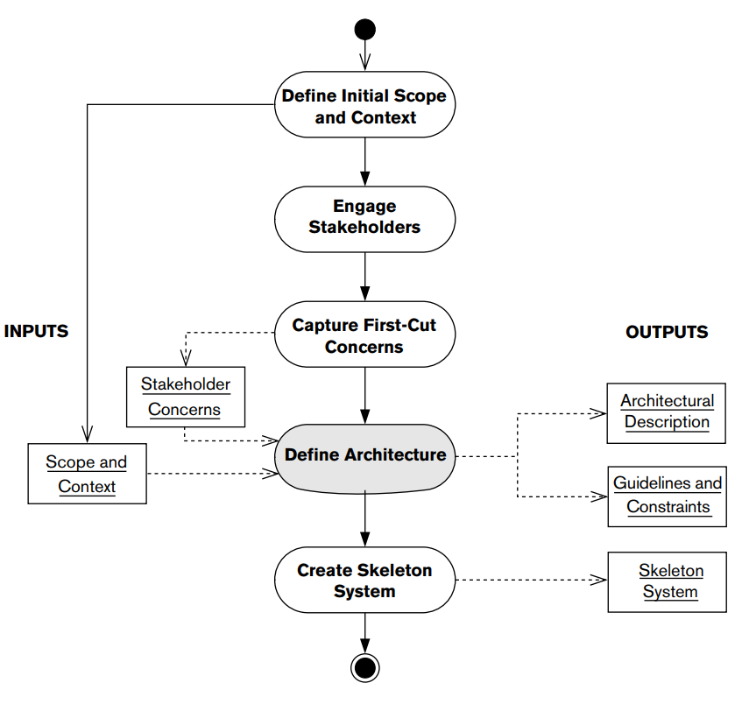
Outline of the Process
Clearly define the system objectives, behaviors, and boundaries.
Is this really a
linear process?
Identify and start discussions with stakeholders.
Interview stakeholders, identify their concerns, place priorities on concerns.
Create the architecture.
(optional) Create a working, incomplete prototype to illustrate correctness.
Notes:
- The goal of the first stage is pretty much in the name - To clearly define the boundaries of the system’s behavior and responsibilities and the operational and organizational context within which the system exists.
- To identify the system’s important stakeholders and to create a working relationship with them.
- (read)
- (read)
- Optional step to create a working (albeit limited) implementation of your architecture that can evolve into a delivered system during the system construction phase of the lifecycle.
- linear? Discuss? Do we really define scope before engaging the stakeholders? How do we know the scope before we know the stakeholder concerns? More of a cycle.

Slide 33
Define Initial Scope and Context
Aims: Define boundaries of behavior and responsibilities and the system context.
Inputs: Client needs, organizational strategy, IT architecture.
Outputs: List of goals, list of exclusions, system context definition.
Notes:
This step is primarily an initial step to understand strategic and organizational objectives and how the system helps meet them, along with some analysis to understand which other systems need to interact with this one. The scope as defined here may change (subject to stakeholder agreement) during architecture definition.
Aims: To clearly define the boundaries of the system’s behavior and responsibilities and the operational and organizational context within which the system exists.
Input: Start by looking at what you have to work with - you need Acquirer needs and vision; organizational strategy; also a good idea of what you have to work with - what is your enterprise IT architecture? What do you inherit and have to work with
Output: Initial statements of the goals of the system and what is included and excluded from its responsibilities; initial system context definition.

Slide 34
Engage the Stakeholders
Aims: Identify the key stakeholders, begin initial discussions of their concerns.
Inputs: Initial scope and context, organizational structure.
Outputs: Defined list of stakeholder groups, people who will represent each group.
Notes:
This step involves understanding the organizational context you are working in and identifying the key people who will be affected by the system. You can then start to get to know their representatives and begin building a working relationship with them.
Aims: To identify the system’s important stakeholders and to create a working relationship with them.
Input: initial Scope and context; organizational structure.
Output:Definition of each of the stakeholder groups, with one or more named, engaged people who will represent the group.

Slide 35
Capture First-Cut Concerns
Aims: Clearly understand and prioritize the concerns that each stakeholder group has.
Inputs: Initial scope and context, stakeholder list.
Outputs: Initial definition of the prioritized concerns for each stakeholder group.
Notes:
Aims: To clearly understand the concerns that each stakeholder group has about the system and the priorities they place on each concern.
This step often starts with your initial stakeholder meetings. It normally involves a series of presentations and meetings with representatives of each stakeholder group that allow you to explain what you aim to achieve and allow the stakeholders to explain their interests in the system. The concerns as defined here may change (subject to stakeholder agreement) during architecture definition, but this gives you an initial list.
Input: Stakeholder list; scope and context.
Output: Initial definition of a set of prioritized concerns for each stakeholder group.

Slide 36
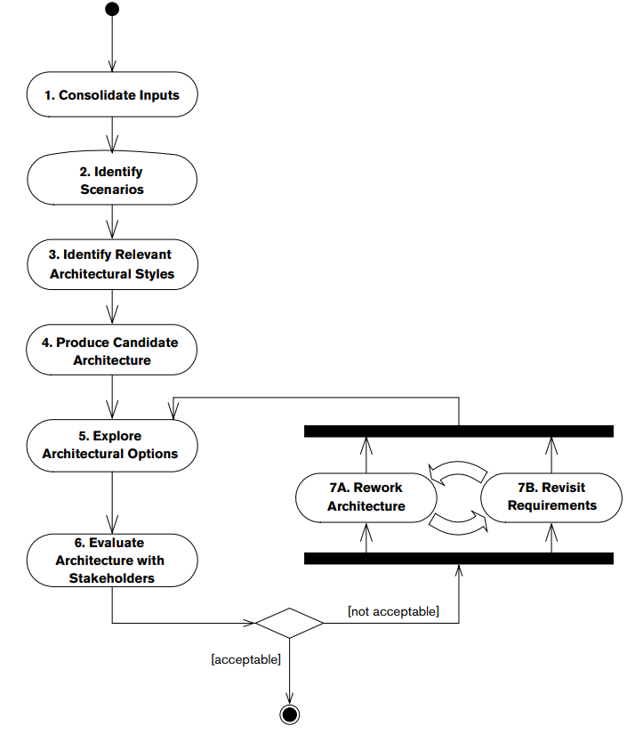
Architecture Definition
Assess, validate, and refine initial inputs.
Identify scenarios that illustrate the requirements.
Identify proven architectural styles that fit the problem.
Alter the architecture based on stakeholder feedback
See if requirements need to change based on architecture changes
Create a draft architecture that can be refined.
Explore possibilities and make key decisions.
Work with stakeholders to assess the draft.
Notes:
Now, within this broad process, architecture definition is its own separate subprocess.
- read
- read
- read
- read
- Now, this will not be complete, just a starting place. Next, we read
- read. If it’s acceptable, we’re done. It’s unlikely to be acceptable at this point. We tend to enter an iterative cylce of refinement after this, where we
- read
- then, we read
Now, we assess again - (5/6/done?)

Slide 37
Consolidate the Inputs
Aims: To understand, validate, and refine the initial inputs.
Inputs: Scope and context, stakeholder concerns
Activities: Take the inputs, resolve inconsistencies, answer open questions, and produce a baseline.
Outputs: Refined inputs
Notes:
First, we need to (title). It is rare for you to be provided with a consistent, accurate, and agreedupon set of process inputs. During this step you take the information available, fill in gaps, resolve inconsistencies, and obtain formal agreement from the key stakeholders.
Aims: To understand, validate, and refine the initial inputs.
Input: Raw process inputs (scope and context definition, stakeholder concerns).
Activities: Take the raw process inputs, resolve inconsistencies between them, answer open questions, and delve deeper where necessary, to produce a solid baseline
Output: Consolidated inputs, with major inconsistencies removed, open questions answered, and (at a minimum) areas requiring further exploration identified

Slide 38
Identify Scenarios
Aims: To identify a set of scenarios that illustrate the system’s requirements.
Inputs: Consolidated inputs.
Activities: Produce scenarios that characterize the most important attributes required of the architecture, that can be used to evaluate a proposed architecture.
Outputs: Architectural scenarios.
Notes:
Aims: To identify a set of scenarios that illustrates the system’s most important requirements.
A scenario is a description of a situation that the system is likely to encounter, which allows assessment of the effectiveness of the architecture in that situation. Scenarios can be identified for required functional behavior (“How does the system do X?”) and for desired quality properties (“How does the system cope with load Y?” or “How can the architecture support change Z?”).
Input: Consolidated inputs (as currently defined).
Activities: Produce a set of scenarios that characterize the most important attributes required of the architecture and can be used to evaluate how well a proposed architecture will meet the underlying functional and quality property requirements.
Output: Architectural scenarios.

Slide 39
Identify Relevant Styles
Aims: To identify proven architectural styles that could be used as a basis for the system.
Inputs: Consolidated inputs, scenarios.
Activities: Review existing catalogs of architectural styles, and consider system organizations that have worked before. Identify those that appear to be relevant.
Outputs: Architectural styles to consider.
Notes:
Using an architectural style is a way to reuse architectural knowledge that has proved effective in previous situations. This can help you arrive at a suitable system organization without having to design it from scratch and so reduces the risks involved in using new, unproven ideas.
Aims: To identify one or more proven architectural styles that could be used as a basis for the overall organization of the system
Input: Consolidated inputs (as currently defined); architectural scenarios.
Activities: Review existing catalogs of architectural styles, and consider system organizations that have worked well for you before. Identify those that appear to be relevant to the architecture as you currently understand it.
Output: Architectural styles to consider as the basis for the system’s main architectural structures.

Slide 40
Produce Candidate Architecture
Aims: To create a first-cut architecture for the system that reflects its primary architectural concerns.
Inputs: Consolidated inputs, relevant architectural styles, viewpoints, and perspectives.
Activities: Produce architectural views, define ideas, guided by best practice.
Outputs: Draft architectural views
Notes:
Aims: To create a first-cut architecture for the system that reflects its primary architectural concerns and that can act as a basis for further architectural evaluation and refinement. Although they may - and probably will - contain gaps, inconsistencies, or errors, the draft views form a starting point for the more detailed architecture work later.
Input: Consolidated inputs (as currently defined); relevant architectural styles, viewpoints, and perspectives.
Activities: Produce an initial set of architectural views to define your initial architectural ideas, using guidance from the viewpoints and perspectives and any relevant architectural styles.
Output: Draft architectural views

Slide 41
Explore Architectural Options
Aims: Explore possibilities for the system and make the key architectural decisions.
Inputs: Draft architectural views, scenarios, viewpoints, and perspectives.
Activities: Apply scenarios to the draft models. Take risk, concern, or uncertainty and further explore the requirements, problems, and issues.
Outputs: Refined architectural views
Notes:
Aims: To explore the various architectural possibilities for the system and make the key architectural decisions to choose among them. The aim of this step is to fill in gaps, remove inconsistencies in the models, and provide extra detail where needed.
Input: Consolidated inputs; draft architectural views; architectural scenarios, viewpoints, and perspectives.
Activities: Apply scenarios to the draft models to demonstrate that they are workable, that they meet requirements, and that there are no hidden problems. Take any areas of risk, concern, or uncertainty that are revealed and further explore the requirements, problems, and issues. Where there is more than one possible solution, evaluate the strengths and weaknesses of each and select the best one.
Output: More detailed or accurate architectural views for some parts of the architecture.

Slide 42
Evaluate Architecture
Aims: Evaluate with stakeholders, capture problems, and gain acceptance.
Inputs: Consolidated inputs, architectural views, and perspective outputs.
Activities: Evaluate architecture with representative stakeholders. Capture and agree on improvements or comments.
Outputs: Architectural review comments.
Notes:
Aims: To work through an evaluation of the architecture with your key stakeholders, capture any problems or deficiencies, and gain the stakeholders’ acceptance of the architecture.Although each group of stakeholders will have different interests, the overall objective is to confirm that stakeholder concerns are met and that the architecture is of good quality. You may have to work hard to obtain consensus if the concerns of different stakeholders conflict with one another.
Input: Consolidated inputs; architectural views and perspective outputs.
Activities: Evaluate your architecture with a representative collection of stakeholders. Capture and agree on any improvements to or comments on the models.
Output:Architectural review comments.

Slide 43
Rework the Architecture
Aims: Address any concerns that have emerged during the evaluation task.
Inputs: Views; review comments; relevant styles, viewpoints, and perspectives.
Activities: Take the results of the evaluation and address them. This involves functional analysis, the use of viewpoints and perspectives, and prototyping.
Outputs: Reworked architectural views.
Notes:
If the candidate architecture has not been accepted… (title)
Aims: To address any concerns that have emerged during the evaluation task.
Input: Architectural views; architectural review comments; relevant architectural styles, viewpoints, and perspectives.
Activities: Take the results of the architectural evaluation and address them in order to produce an architecture that better meets its objectives. This step normally involves functional analysis, the use of viewpoints and perspectives, and prototyping.
Output:Reworked architectural views; areas for further investigation (optional).

Slide 44
Revisit the Requirements
Aims: Consider changes to requirements in light of architectural evaluation.
Inputs: Architectural views, architectural review comments.
Activities: Work may reveal inadequate, inconsistent, infeasible requirements. Revisit requirements with stakeholders and obtain agreement to revisions.
Outputs: Revised requirements.
Notes:
This step is done concurrently and often quite collaboratively with (title)
Aims: To consider any changes to the system’s original requirements that may have to be made in light of architectural evaluation.
Input: Architectural views; architectural review comments
Activities: The work done so far may reveal inadequacies or inconsistencies in requirements or requirements that are infeasible or expensive to implement. In this case, you may need to revisit these requirements with stakeholders and obtain their agreement to the necessary revisions.
Output:Revised requirements if any

Slide 45
Create a Skeleton System
Aims: Create a working (but incomplete) implementation of the architecture that can evolve into a full system.
Inputs: Architectural definition, guidelines, constraints.
Outputs: A limited working system that illustrates that the architecture can address at least one of your scenarios.
Notes:
Now, the last step, an optional one, is to create a skeleton system.
Aims: Optional step to create a working (albeit limited) implementation of your architecture that can evolve into a delivered system during the system construction phase of the lifecycle
If you have the time and resources available to allow the creation of a skeleton system, it forms an effective bridge between architecture definition and software construction. This step allows the architect and the developers to build a working system that can execute at least a simple scenario the system is meant to address. The skeleton system acts as a proof of concept as well as a framework for the software construction phase.
Input: AD; associated guidelines and constraints
Output: A limited working system that illustrates that the system can address at least one of your scenarios.

Slide 46
What is the role of the software architect?
Notes:
(discussion) what entails a good design?

Slide 47
The Role of the Architect
The architect designs, documents, and leads the construction of a system that meets the needs of all its stakeholders.
An architect identifies and engages stakeholders.
An architect understands and captures the stakeholders’ concerns.
An architect creates and owns the definition of an architecture that addresses these concerns.
An architect takes a leading role in realizing the architecture as a final product.
Notes:
We can now define the role of the architect. The architect is responsible for designing, documenting, and leading the construction of a system that meets the needs of all its stakeholders. (2-5)

Slide 48
The Role of the Architect
The architect owns the big picture.
You develop and maintain a high-level view of the elements in a system.
This is translated into detailed design, coded, tested, and deployed.
You ensure the “big picture” is the right one.
All problems have multiple possible solutions. You identify the correct one.
Architects are involved at all stages of development, ensuring the product conforms to the architecture.
Notes:
“the architect owns the big picture” - bridging requirements and the blueprints for the source code. Your responsibility as an architect is to develop and maintain a high-level view of the main elements in the system, which is translated into a detailed design, coded, tested, and deployed. You need to ensure that the big picture you develop is right for your situation. As we have seen, every problem has a number of possible architectural solutions, and every architecture has a number of possible representations. You must select an architecture that is fit for purpose and then document that architecture in an appropriate way. (6) During the initial phases, your involvement is intense. You are fully occupied in defining and agreeing on scope, agreeing on and validating requirements, and providing the technical leadership to make the decisions that will shape the architecture. Your involvement typically lessens during the detailed design and code phases, while the product or system is being built, tested, and integrated. In practice, you may take a different role during this period, such as design authority or designer. If so, you are likely to be involved in mentoring, reviews, problem resolution, and technical leadership. In any case, if the architecture needs any changes, you must lead the change process. Your involvement peaks again prior to and during acceptance, as you provide support and guidance to help resolve the last-minute problems that inevitably occur and to ensure a smooth deployment.

Slide 49
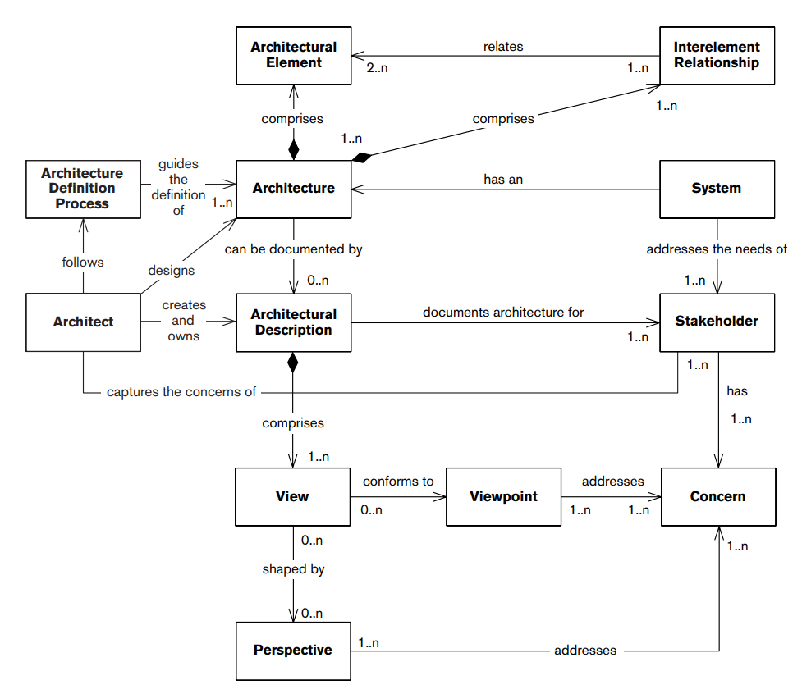
Bringing it Together
Notes:
We can now add two final pieces to our relationship diagram, namely, the process of architecture definition and the architect The architect captures and consolidates the concerns of the stakeholders. The architect designs an architecture that meets these concerns. The architect creates and owns the AD. An architecture definition process guides the definition of the architecture. The architect follows the architecture definition process to carry out all of these tasks. (go over)

Slide 50
Key Points
Process of architecture definition includes:
Defining scope and context, engaging stakeholders, capturing first-cut concerns, defining the architecture, and creating a skeleton system.
The activities involved in creating a architecture definition include:
Consolidating inputs, identifying scenarios, identifying relevant styles, producing a candidate, exploring options, evaluating the architecture, reworking the architecture, and revisiting the requirements.
Notes:
(read)

Slide 51
Key Points
Architecture bridges requirements analysis and detailed class design.
Architects “own the big picture”.
They design, document, and lead the construction of a system that meets the needs of all its stakeholders.
Notes:
(read)

Slide 52
Next Time
No class or office hours Thursday!
Next Tuesday: Setting Context and Identifying Stakeholders
Sources: Rozanski & Woods: ch. 9, 16
Homework: Reading Assignment 1 - Due Thursday
Project Part 1 is up! Due September 18.
Notes:
(read)

Slide 53
Project
Semester-long project intended to enable you to critique a software architecture.
What are the major components of the architecture?
What patterns or styles are used?
What architectural views are relevant for stakeholders?
How well does the architecture align with stakeholder interests?
How amenable is the architecture to change?
Enable you to extend or refactor architecture
Justify why this better meets stakeholder needs.
Notes:
(read)

Slide 54
Phase 1: Choosing a System
You will understand, document, and extend an existing architecture.
Phase 1 - choose a system
Must be a real system
Source code must be available
Open-source, or at least, available to your team and me.
Must be at least 10,000 source LOC.
Notes:
(read)

Slide 55
Phase 1: Choosing a System
Include a description of the system
Explain why it is architecturally interesting.
List the quality attributes relevant to the system and its stakeholders.
For each, explain why this attribute is important.
No minimum length. However, it is expected to be detailed and provide a complete treatment of the subject.
(Probably at least 5 pages)
Notes:
(read)

