Slide 1
Setting Context and Identifying Stakeholders
CSCE 742 - Lecture 5 - 09/11/2018

Slide 2
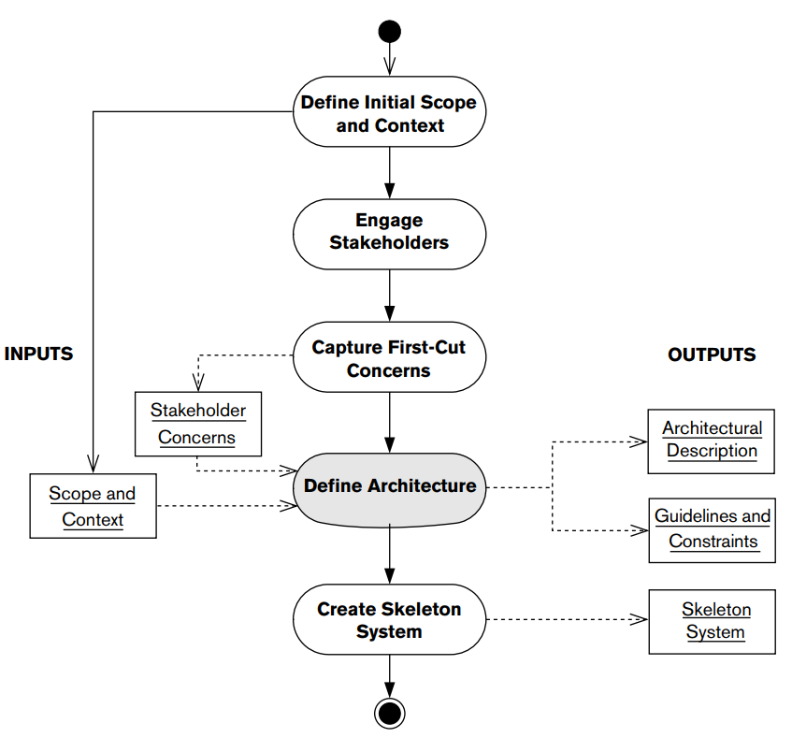
The Architecture Definition Process
Notes:
Last time, we walked through the process of defining the software architecture.
- This week, we’re going to look at the first three major stages of this process - go over

Slide 3
Today’s Class
Defining the system context.
The “Context View”
Establishing scope, understanding the external entities interacting with your system, and establishing boundaries.
Identifying and engaging stakeholders.
“Working with Difficult People”
What classes of people are interested in your system?
Notes:
Go over

Slide 4
Defining System Context
Notes:
(discussion) Point is - there are a lot of different answers to this question

Slide 5
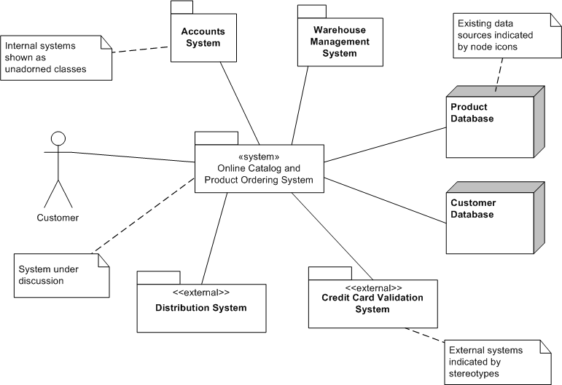
The Context View
System context should be a view in the architectural description.
Context is often implicit rather than being defined.
Context may be loosely defined during requirements analysis, but at too low of a level of detail.
You need to refer to elements of the system context elsewhere in your architectural description.
Notes:
Most architectural descriptions focus on views that model the system’s internal structures, data elements, interactions, and operation. “Outward facing” information - context, scope, requirements - is assumed to be defined elsewhere. This may not always be the case. As part of defining the architecture, you need to ensure that a definition of the system’s context is included as part of your architectural description - as the first view of the architecture. This is because the system context (2) explicitly defined as part of the project initiation or requirements capture. (3) (4), which makes it desirable to be a part of the architectural description and under your control.

Slide 6
The Context View
The context view defines the relationships, dependencies, and interactions between the system and its environment.
Defines what it does/does not do.
Defines boundaries between it and the world.
Defines how it interacts with other systems and people across these boundaries.
Focus is on the outside world, not the internal architecture of the system.
System is a “black box”.
Notes:
The Context view of a system defines the relationships, dependencies, and interactions between the system and its environment—the people, systems, and external entities with which it interacts. It defines what the system does and does not do; where the boundaries are between it and the outside world; and how the system interacts with other systems, organizations, and people across these boundaries. The Context view focuses on the outside world and usually represents the system itself as a “black box,” hiding all details of its functional elements, data, implementation, and so forth, since these are documented in one of the other views.

Slide 7
System Scope
What are the main responsibilities of the system? What is it required to do?
Can also define certain tasks it does not have to do.
Requirements should already be defined. Scope definition summarizes them for stakeholders.
Defined as a high-level list of system’s key capabilities or requirements.
Notes:
The first stage of setting context is considering the main responsibilities of the system, that is, what it is required to do. For clarity, it may also identify some specific exclusions, although by definition, anything not listed here is excluded. This does not extend to a complete definition of the system’s requirements - should be happening already - which is the responsibility of requirements analysis. (3) Scope definition should be brief, succinct, and easily understood by all stakeholders without going into a lot of detail. It is usually defined in the form of a high-level list of the system’s key capabilities or requirements, and it may also be useful to highlight some functional exclusions explicitly for the avoidance of doubt.

Slide 8
Example: Clothing Retailer
The online clothing store must:
Present the catalog to the user, including pictures and product details.
Provide a flexible search facility.
Accept orders for goods.
Accept payment by credit card .
Provide automated interfaces into back-end systems for fulfillment.
The system will not be required to:
Amend or cancel orders.
Allow payments by means other than credit card.
Display live stock levels.
Notes:
Go over (2) - (search on product name, type, keyword, size) (4) - (with asynchronous approval and notification to the customer)
(8) - (this will need to be done over the telephone but is planned to be automated in a subsequent release)
All reasonable exclusions. Generally abilities that a stakeholder might explicitly expect that you don’t plan to include.

Slide 9
External Entities
An external entity is any system, organization, or person with which this system interacts in some way.
A user or class of user.
Other systems (internal or external).
An interface to another ecosystem.
A data store external to the system.
A physical device external to the system.
Each external entity offers services to the system or uses services of the system.
Notes:
The next step is to idenfity the external entities that will interact with the system and the data they use. (1) A user, a class of user, or some other person or role, such as operational or support staff, Another system that runs in the same organization as the system being architected (“internal systems”) or another system that runs in another organization (“external systems”), An interface or other implementation component that has the effect of hiding other systems (which may themselves be internal or external), A data store that is external to the system (for example, a shared database or data warehouse), A peripheral or other physical device that is external to the system, such as environmental sensors or an enterprise search engine). Each external entity will implement and offer some services, and manage and provide some data, that are used by this system. Similarly, each external entity will use some services and/or data offered by this one.

Slide 10
External Entity Quality
Quality properties of external entities affect the architecture of your system.
Ex: travel booking system
Interacts with other systems around the world.
Systems in some locations may have low availability.
Travel system interface to external systems will need to account for this.
Retry interactions N times, log attempts.
Not just software.
Hardware in the loop may fail or have a delayed response.
Notes:
The quality properties of external entities, such as system stability and availability, performance and throughput capabilities, physical location, or data quality, may significantly affect the architecture of the system.
For example, A travel booking system exchanges information with many other systems located around the world. Some of these systems in certain locations may be only intermittently available, because of time zone differences or because they are more liable to failure. A failed communication with such a system might result in a booking being lost, which we want to avoid. The travel system’s interfaces with external systems will therefore need to be carefully designed. All failed interactions should be automatically retried a configurable number of times, and these retry attempts should be logged to a database so that operational staff can monitor trends. Interactions will need to be designed so that they can potentially be submitted multiple times. It should be possible to restart very large transfers that fail partway through from the point of failure rather than having to retransmit the whole file.
It may be necessary to consider the “nature” of external entities that are not systems. For example, a hardware peripheral may have performance characteristics that need to be taken into consideration, and could fail or have a delayed response.

Slide 11
External Entity Identification
Data provider or consumer
Supplies data or receives data.
Identify the content, scope, and meaning of data.
Service provider or consumer
Performs some action or requests an action.
Identify what is being requested and its parameters, actions to be taken, data to be returned, error information, exception actions.
Event provider or consumer
Subscribes and watches for events of interest.
Identify events of interest, meaning and content, timing of occurence.
Notes:
For each external entity, the nature of how it interfaces with this system should be identified.
Data provider or consumer: The external system supplies data directly to this system or receives data directly from it. We should identify the content, scope, and meaning of the data to be transferred.
Service provider or consumer: The external system is requested to perform some action by this system or requests some action of this system (e.g., a service call), and the service may return data and/or status information in response to the request. We need to identify the semantics of the request (the nature of what is being requested and any parameters); the actions to be taken by the system fulfilling the request; any data to be returned; any acknowledgment, status, or error information that may be returned; and any exception actions to be taken by either side.
Event provider or consumer: The external system publishes events that this system wishes to be notified of, or this system publishes events that the external system wishes to be notified of. Identify the events of interest, their meaning and content, and the volume and likely timing of their occurrence.

Slide 12
External Interface Characteristics
Quality properties of external interfaces may differ from the systems they interface.
The interface is the constraining factor on your architecture.
Characterize interfaces as part of planning.
Expected number of requests or transfers, size of data, expected growth over time.
Are interactions scheduled, occur in response to events, or are ad-hoc.
Are interactions automated, manual, or a combination?
Notes:
The quality properties of external interfaces may differ significantly from the quality properties of the systems at the other end. For example, there may be a low-bandwidth, relatively unreliable data link to a highly resilient system in another country. The system is fine, the interface is the constraining factor in this case and again will have a significant effect on the architecture of the system. We can use characteristics of that interface to plan.
• The expected volumes—number of requests or transfers, size of data, seasonal fluctuations, and expected growth over time • Whether interactions are scheduled (occurring at predefined times), occur in response to events, or are ad hoc • Whether interactions are completely automated, completely manual (e.g., a user saves a file or sends an e-mail), or somewhere in between

Slide 13
External Interface Characteristics
Characterize interfaces as part of planning.
Do interactions need to complete fully or partially?
What is the criticality and timeliness of interactions?
Are interactions performed using individual calls or in batch?
What level of security is required?
What is the service level of the interface? (response time, scalability, availability)
What protocols are used by the interface?
What data and file formats are used?
Notes:
• Whether interactions are transactional—that is, they are required to complete fully or not at all •
Criticality and timeliness—for example, a particular interaction that may be required to complete before the end of the business day in order to be captured by an auditing or accounting system •
Whether interactions are batch (large data sets transferred as a “unit”), message-based, or streaming - API calls between processes - in nature •
What level of security is required (authentication, authorization, confidentiality, and so on) •
The service level that can be expected of the interface (in terms of response time, latency, scalability, availability, and so on)
• The technical nature of the interface and what protocols are used (open standards or proprietary) •
Data and file formats

Slide 14
External Interdependencies
There may be interdependencies between your system and external entities.
Online shopping system
Must interact with a payment system, a customer account system, and a fulfillment system.
Normally independent, but data dependency:
Fulfillment system contains a list of addresses for each customer. Maintained by replicating data from account system.
Updates to addresses within the shopping system must take this dependency into account.
Notes:
There may be interdependencies between your system and external entities. These interdependencies may act in either direction—the system may be dependent on an external entity or vice versa. Such dependencies can be subtle and are sometimes hard to find. You must identify the nature of the dependency and its architectural impact—what capabilities or features need to be built into the architecture in order for the dependency to be dealt with properly.
Back to our online shopping system: to fulfill an order, this system has to interact with a separate payment system to collect payments, a customer account details system to make any updates to the customer’s account (such as shipping addresses), and a fulfillment system that dispatches the goods. These are three independent systems, and can usually be treated as such. However, there is a data dependency between two of them that in certain situations must be taken into account. The Fulfillment system in this organization contains its own list of verified dispatch addresses for each customer, and it will reject orders that are not being sent to these addresses. However, this list is maintained by data replication from the Customer Accounts System. When the customer wants to update their address, the shopping system must take this dependency, and the latency of the replication, into account. Otherwise, orders may be rejected by the Fulfillment System because their dispatch addresses are not listed in its database.

Slide 15
External Interdependencies
Online shopping system
Architecture must handle this external system dependency.
Allow resubmission to fulfillment system after a delay if a request is rejected.
Delay orders with address updates.
Resubmitting failed orders will be easier if the fulfillment system interface returns reason for failure.
Customer
<<system>>
Shopping System
Payment Confirmation
Payment requests
Dispatch Updates
<<external>>
Payment System
Dispatch Requests
Account updates
<<external>>
Fulfillment System
<<external>>
Account System
Verified dispatch address (data replication)
Notes:
The architectural impact in the case of this system might be to allow for resubmission to the Fulfillment System after a delay if a fulfillment request is rejected or to delay orders that have associated address updates to allow data replication to occur.Back to the need to understand the details of external interfaces, this is an example that bears this out: resubmitting failed orders can be made much more efficient if the interface to the Fulfillment System allows the reason for failure to be reliably discerned from the dispatch status returned by that system.) We can document the relations in a graph like this - called a context diagram - we’ll talk more about that in a second. (go over)

Slide 16
Context Model
Places the system in its environment and details relationships with external entities.
The system itself, with internal structure hidden.
External entities, with name, nature (system, data store, person), owner, and responsibilities (services, functions, data).
Interfaces between system and external entities, with interactions, data exchanged, exception processing details, and quality properties..
Should be kept relatively simple, with detail presented alongside.
Notes:
The context model is the main architectural model within the Context view and often the only one produced. The idea is that it places the system clearly in its environment and relates it to the external entities with which it interacts, via explicit relationships that represent the interfaces to and from it. The purpose of the context model is to explain what the system does and does not do, to present an overall picture of the system’s interactions with the outside world, and to summarize the roles and responsibilities of the participants in these interactions. The context model is usually fairly high-level and abstract, answering the important “why” and “what” questions about the architecture. It does not specify in any detail how the system or its interfaces will be built; these questions are answered in the other architectural views. Typically includes these elements:
The system itself, represented as a black box, with its internal structure hidden, since the Context view is not concerned with how the system is built
• The external entities, represented as black boxes for the same reason. (Indeed, it is likely that the internal details of external entities are not visible or known.) For each external entity, it is important to capture some key information, namely, the name of the entity, the nature of the entity (e.g., system, data store, person, group), the owner of the entity, and the responsibilities of the entity from the perspective of this system (the services, functions, and data upon which this system relies).
The interfaces between the system and the external entities, presented at a summary level, highlighting the key data items or function invocations across the interface. Often all of the individual interfaces between the system and each external entity are “rolled up” into a single interface, to make the diagram easier to follow. For each external interface it is important to capture an overview of the interactions expected over the interface, the semantics of the interface (i.e., the data exchanged and its meaning), the exception processing approach that will be used when unexpected things happen, and the key quality properties of the interface upon which this system is relying. In many cases, you will just capture a short summary of this information in the context model and reference external sources of information for fuller descriptions.
(5)

Slide 17
Context Model
Notes:
- The system is represented as a UML component, stereotyped as a system.
- • External entities that cause human interactions with the system are represented as UML actors
- internal systems - owned by company, but not part of your system - shown as classes without a stereotype
• External entities that are systems are represented as either further subsystem components or actors
. data sources external to the system are also depicted.
Lines can be marked with text annotations to explain relationships, arrows if interaction is directional

Slide 18
Example - Risk Assessment
Sends Alerts
Data Analytic Engine
Sends summary statistics
Risk Monitor
Risk Manager
Source Processing Engine
<<external>> Business Information Service
Events
Risk Determination Rules
Sends summary statistics
<<system>>
Risk Assessment System
Rule Updates
Records
Rule Database
Historical Statistics
Notes:
Go over
System to looks over data, and determine rules for assessing risk as an insurance manager.

Slide 19
Pitfalls
Missing or incorrect external entities
To avoid, work with stakeholders:
Is all functionality required part of system scope, provided by external entity, or excluded?
Involve domain experts.
Ensure context model is under version control.
Missing implicit dependencies
I.e., falsely assuming data is available in two external systems when there is actually data transfer.
Assume nothing, work with external organizations to uncover implicit dependencies.
Notes:
(1) It is therefore easier than you might think to accidentally leave something out of the context model, include something that is not needed, or put the system boundaries in the wrong place - something external inside or more commonly, an internal subsystem that starts out outside. Getting the context wrong can have a huge impact later on, may require significant changes to work with a missing external interface or entity. To avoid: Work with a wide range of stakeholders. For example, you should ensure that any functionality they require either is part of the system scope, is provided by an external entity, or is excluded entirely with the agreement of the people who need it. • Involve a domain expert in this analysis as early as you can, and make sure that person is involved in review and sign-off of this part of the AD. • Ensure that once the context model has stabilized,is under version control and subsequent changes to it are reviewed and agreed upon.
It is easy to miss the subtle dependencies between external entities. For example, you may assume that a particular business entity or data item is instantaneously available in two external systems, when there is actually a significant latency due to data transfer. Or you could assume that the availability of an external system will affect only one part of your system,when everything depends on it. • Assume nothing, work with your stakeholders and the external orgs to uncover and understand implicit dependencies, and ensure that they are documented in the Context view

Slide 20
Pitfalls
Inaccurate interface descriptions
Important to capture architectural implications.
Can you confidently use an interface? Characterize the effect on the architecture?
Do not gloss over complicated issues.
Inappropriate level of detail
Look for vague scope and requirements.
If context diagram too cluttered, move detail to appendices or secondary views.
Group external entities by type.
Notes:
It’s tempting to get the basic idea of an external interface and leave it at that. In fact, you have to do this to some extent as you can’t understand every detail of every interface. However, it is important that you capture enough detail so that the architectural implications can be understood. • Ensure that you understand your external interfaces in sufficient detail to use them confidently, and capture enough information about them in the Context view to characterize the effect they have on your architecture. • Avoid the temptation to gloss over things that are complex in the expectation that problems will be resolved later.
Getting the level of detail right is a challenge everywhere in the AD but is especially important in the Context view. If you provide too much detail, stakeholders, may fail to understand the big picture.I you gloss over some aspects of the context or scope, expecting them to be fleshed out later, you may miss something important, mislead your stakeholders, or allow incorrect assumptions to be made. • Look out for scope or requirements that appear vague because nobody understands what they mean (or people assume different meanings) • If the Context view becomes too detailed, move some of the information either into appendices in the document or into secondary views in the AD (either subdiagrams or typically the Functional or Information view). If there are more than, say, 10 to 20 external entities, consider whether they can be grouped by type (for example, a large number of suppliers of the same type of goods), or whether you really have a single system at all, rather than a collection of systems.

Slide 21
Pitfalls
Scope creep
Increase in expectations on system responsibilities without consideration of what is achievable.
Challenge additions to scope.
Work with stakeholders to understand effect of added requirements.
Ensure scope changes are version-managed.
Assumed context or scope
State the obvious to avoid misunderstanding.
Do not assume stakeholders know something.
Notes:
Scope creep is when you have uncontrolled changes to system scope, which often occur gradually. These changes increase what the system is expected to do, often without due consideration of whether this is sensible or achievable. For example, when interviewing users about required functionality, it is easy for each user to add a few more requirements to the mix that really are “nice-to-haves” rather than truly essential. By the time this process is completed, the scope is significantly larger and more ambitious, possibly fatally so. • Challenge additions or changes to scope to confirm that they really are necessary and make sure their implications are understood. • Work to help stakeholders understand the consequences of adding requirements, such as increased time to market, development and operational cost, or system complexity and stability. • Ensure that scope changes are change-managed once the scope has stabilized.
More than in any other part of the AD, the scope definition is where you should state the obvious when there is any chance of misunderstanding. Don’t be tempted to leave things out because “everybody knows that”—the odds are that there are some stakeholders who don’t.

Slide 22
Pitfalls
Overcomplicated interactions
Interacting with legacy systems can be more complicated than expected.
Take time to understand interfaces early.
Prototype interactions and test thoroughly.
Overuse of jargon
Be careful not to use terms unfamiliar to stakeholders.
If you need to use jargon, provide a glossary.
Notes:
Interactions with some external entities (particularly older systems) can be a lot more complicated than expected, so it’s easy to end up with unexpected problems when you come to build the interfaces. For example, some of the problems we have encountered when dealing with interfaces to long-established systems have included unusual data encodings, poorly understood conversation protocols, and complex and proprietary interface technologies. • Take the time to understand interfaces to external systems early in the architectural design process, and don’t assume that they’re necessarily the same as the interfaces you’ve met before. • prototype interactions with them, and test them thoroughly in order to understand how they behave in different situations.
Inputs to the Context view come from a wide variety of sources. It is easy to make careless use of business and technology terminology that may not be well understood by the majority of your stakeholders. Since people are often reluctant to question things they do not understand, you risk confusion and misunderstanding. If you need to use jargon and there is any risk of confusion, provide a glossary.

Slide 23
Activity - Airport Parking
You will develop a new automated parking system at the CAE airport.
In this new system:
A user can insert their card into the card reader at the ramp entrance.
This will record the time they entered airport parking.
They then can use the same credit or debit card to pay at an exit lane.
The system should be fully automated.
The system should also support ticketed parking
User receives a ticket and pays either by credit card or cash on exiting.
Notes:
You have been asked to develop a new automated parking system at the CAE airport.
In this new system, a user can simply insert their credit or debit card into the card reader at the ramp entrance. This will record the time they entered airport parking. They then can use the same credit or debit card to pay at an exit lane. The system should be fully automated; there is no waiting in line for a cashier. The system should also support ticketed parking: where the user receives a ticket and pays either by credit card or cash on exiting.

Slide 24
Activity - Airport Parking
The system needs to interact with a number of entities and systems, including:
Customers parking in the ramp
Airport police and emergency responders
Ramp managers
External systems for validating credit card details and submitting payments
The airport’s accounting system
External physical gate systems with basic controllers (raise / lower)
External physical systems for signage
An existing personnel system for staffing exit kiosks

Slide 25
Activity - Airport Parking
Develop a context view diagram for the airport parking system.
Think about the physical devices, stakeholders, and internal and external software systems.
Customer
<<system>>
Shopping System
Payment Confirmation
Payment requests
Dispatch Updates
<<external>>
Payment System
Dispatch Requests
Account updates
<<external>>
Fulfillment System
<<external>>
Account System
Verified dispatch address (data replication)

Slide 26
Activity - Airport Parking
<<external>>
Card Processing
Airport Police
Customer
Inserts card or ticket
Sends payment request
Issues alerts
Card Reader
Issues status update
Issues status update
Police Alert System
Sends status update
<<system>>
Parking System
Issues alerts
Gate
Hardware
Sends space availability data
Issues raise/lower commands
Sends reports
<<external>> Signage System
Accounting System
Administer system
Ramp Managers

Slide 27
Identifying and Engaging Stakeholders
Notes:
(discussion) Point is - there are a lot of different answers to this question

Slide 28

The Stakeholders
Ops manager: How do I back up system data for disaster recovery?
Security and compliance: How data is logically and physically secured?
Management: What is the business case for the system? How much will it cost?
Developer: What are the system interfaces I need to respect?
User: How is this going to make my life better?
Notes:
Systems are not just used. Systems are designed and built.Systems are operated.Systems have to be repaired.Systems are enhanced.Systems are paid for. Each of these activities involves a number—possibly a significant number—of people distinct from the users. Each of these groups of people has its own goals - own requirements - its own interests, and its own needs from the system. These are our stakeholders. The people with an interest in our software (go over) and you in the middle screaming at these people to stop

Slide 29
The Stakeholders
Architecture definition requires identifying and engaging the stakeholders.
People, groups, or entities with an interest in or concerns about the realization of the architecture.
Identifying stakeholders and gaining commitment is key to project success.
Need to cast net widely early in the project.
Need to draw up and maintain a list of potential stakeholders.
May need proxy stakeholders who can speak for future stakeholders.
Notes:
Go over

Slide 30
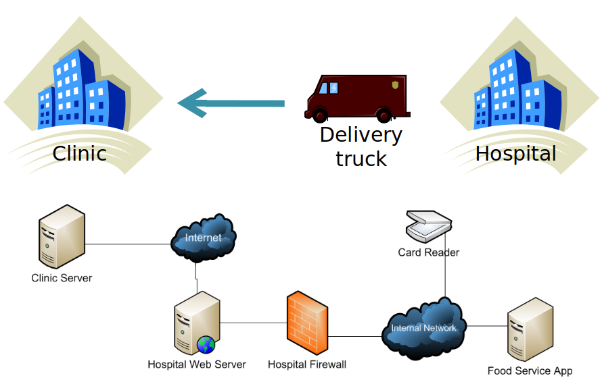
Who are the Stakeholders?
Hospital Food Ordering
Who are the stakeholders of this system?
Notes:
(discuss)

Slide 31
Who are the Stakeholders?
A subjective choice.
There are no purely objective criteria for whether you chose “correct” stakeholders.
Selection depends on system goals, organization considerations, politics, resources, cost, timescale.
Cast your net widely early in the project.
Reconcile differences while you still can.
Notes:
It is a subjective choice whom you select to populate your community of stakeholders (hospital example). Unfortunately, there are no purely objective criteria for determining whether you have correctly identified your stakeholders. Who you select depends on a range of factors including the goals of the system, organizational and political considerations, availability of resources, and cost and timescale constraints.
We have found, however, that casting your net more widely at the beginning is important in the long term (although in the short term, it may make your life more difficult because you will have more potentially conflicting requirements to reconcile). . If you don’t take stakeholders’ concerns into consideration at the beginning of your development project, you can be sure that they will complain at the end, when making changes is much harder—and making architectural changes may be practically impossible.

Slide 32
Effective Stakeholders Are...
Informed
Have information, background, understanding needed to offer feedback.
Committed
Willing to be available and to make decisions.
Authorized
Allowed to make binding decisions.
Representative
Do you have someone who can represent a group of stakeholders with authority?
Notes:
That said, there are criteria you can use to identify good stakeholders, those who will be effecitve. These effective stakeholders are:
Informed: Do your stakeholders have the information, the experience, and the understanding needed to offer feedback on the project or make informed decisions?
Committed: Are your stakeholders willing and able to make themselves available to participate in the process, and are they prepared to make some possibly difficult decisions?
Atuhorized: Do they have power? Can you be sure that decisions made now by your stakeholders will not be reversed later (at potentially high cost)?
Representative: If a stakeholder is a group rather than a person, have suitable representatives been selected from the group? That can speak for that group with authority? Do those representatives meet the above criteria for individual stakeholders?

Slide 33
Stakeholder Responsibilities
Ensure that all concerns are communicated.
Representative stakeholders must convey concerns of the people they represent.
Make decisions in a timely and authoritative manner.
And stick with them!
If they lack authority, they must escalate to those who do have that power.
Review the architecture definition to ensure system meets their concerns.
Notes:
Effective stakeholders fulfill the following responsibilities.
They ensure that all of their concerns are clearly communicated to the architect. Representative or proxy stakeholders clearly convey to the architect all of the concerns of the people they represent.
They make decisions in a timely and authoritative manner and stick to them.
If the stakeholders do not have the authority to make a decision, they escalate it appropriately and obtain a decision from someone who has that power.
They review the AD to ensure that the system meets their concerns and is—as far as they can tell—functionally correct.

Slide 34
Common Classes of Stakeholders
Acquirers oversee system procurement.
Typically senior management, legal, purchasing.
Make monetary decisions.
Concerns center around alignment with corporate objectives, return on investment, cost/timescale of project, resources needed to build and run system.
Assessors oversee system conformance to legal regulations and standards.
Concerns center around formal, demonstrable compliance to any relevant regulations.
Notes:
Every project is different, and its stakeholders will be different. That said, there are some common classes of stakeholders that we often end up needing to consider.
Acquirers oversee the procurement of the system or product. Acquirers typically include senior management, which authorizes funding for system development, and may also include the purchasing and legal departments, which represent commercial interests of users in negotiations with suppliers. There may also be investor representation in this group if specific external investment is required to fund the project. In seniority terms, acquirers are usually your most important stakeholders, because they make the monitary decisions. Acquirers’ concerns typically center around issues such as alignment with strategic objectives, return on investment, and the costs, timescales, plans, and resources involved in building and running the system. Their goals are usually value for money and efficient expenditure of resources during delivery and operation.
Assessors oversee the system’s conformance to standards and legal regulations. Assessors may come from the organization’s own internal quality control or conformance departments, or they may be legal entities. Assessors’ concerns are focused around testing (to demonstrate conformance to requirements) and on formal, demonstrable compliance.

Slide 35
Common Classes of Stakeholders
Communicators explain the system to others through documentation and training.
Concerns lie in understanding the architecture and explaining it to audiences with varying backgrounds.
Developers write the code, using specifications and architecture.
Concerns around understanding architecture, build standards, choice of platform, language, tool support, maintainability, flexibility, preservation of knowledge over time.
Notes:
Communicators explain the system to other stakeholders. Internal or public trainers provide training for support staff, developers, maintainers, and so on, and technical authors create manuals for the users and administrators of the system. Communicators’ interests lie in understanding the rationale and details behind the architecture and explaining it to audiences with different technical backgrounds.
Developers construct and deploy the system using the specifications and architecture. they take it from design, code, and test to acceptance. Developers need to understand the overall architecture but also have specific concerns that focus on development issues such as build standards, choice of platform, language, and tools as well as other issues such as maintainability, flexibility, and the preservation of knowledge over time.

Slide 36
Common Classes of Stakeholders
Maintainers will manage system evolution after release.
Concerns focus on maintainability documentation, system monitoring, debugging environment, source control, knowledge preservation.
Suppliers build the hardware, software, or infrastructure on which the system will run.
Not usually part of building, running, or using system
Still impose constraints due to requirements of products they supply.
Concerns around whether your system can work with their product ecosystem.
Notes:
Maintainers manage the evolution of the system once it is operational. Maintainers’ concerns focus on issues such as maintainability - ability to change and refactor the code - development documentation, instrumentation (facilities for operational system monitoring), debug environments, source control and tracking, and the preservation of knowledge over time.
Suppliers build and/or supply the hardware, software, or infrastructure on which the system will run, or possibly they provide specialized staff for system development or operation. Suppliers are a slightly special class of stakeholder: They are not usually involved in building, running, or using the system, but they may impose constraints due to the limitations or requirements of the products they supply. For example, an application may mandate a particular version of the operating system to run, or may run only on certain hardware configurations, or may impose limitations on the number of concurrent connections or maximum data size. You must factor such constraints into the design of the architecture.

Slide 37
Common Classes of Stakeholders
Support staff provide support to users for the product or system when it is running.
Concerns around having information required to solve problems with users.
System administrators ensure the operation of the system once deployed.
Concerns around system monitoring and management, business continuity, disaster recovery, availability, resilience, scalability.
Notes:
Support staff (help desk, technical support, customer service departments, and so on) provide support to users of the product or system when it is running. Support staff concerns revolve around having the information required to solve problems with users who may be communicating via telephone, e-mail, or the Internet—or in person.
System administrators ensure the operation and configuration of the system once it has been deployed. In largescale commercial environments, system administrators play a key role because operation of the system is essential to the business.System administrators may focus on a wide range of concerns, such as system monitoring and management, business continuity, disaster recovery, availability, resilience, and scalability.

Slide 38
Common Classes of Stakeholders
Testers verify system correctness before and after release.
Often independent from developers. Can perform a more thorough job of evaluating the system than other stakeholders.
Concerns around refinement of requirements, ability to prove requirements are met, building testing infrastructure
Users interact with system functionality.
Concerns around scope, functionality, performance, security. Ultimate judges of your success.
Notes:
Testers systematically verify the system in order to establish whether or not it is suitable for deployment and use, and generally continue to work post-release. Although developers also perform testing, testers should be independent and do not have the same sense of ownership of the system’s implementation. This, along with their specialist knowledge and experience, means that they can perform a more thorough and objective job of evaluating the system than the other stakeholders can. Testers may be part of the same team as the developers or may be in a separate organizational unit or even a distinct organization. concerned with establishing and refining requirements, designing tests to prove whether requirements have been met, and building infrastructure on which to run their tests that works within your architecture.
Users define the system’s functionality and will ultimately be the ones to interact with it. In the case of internal systems, users are internal staff who may be dealing with customers or performing back-office functions. In the case of a software product, users are the eventual purchasers of the product; here it is necessary for the product manager to represent their interests in some way, for example, by market testing. In some scenarios users may be members of the public; again, it is necessary to represent their interests secondhand. Users’ concerns obviously center around scope and functionality; however, they have operational concerns too, such as performance and security, although the architect may need to bring these to the users’ attention.

Slide 39
Example: Traditional Development
An educational software supplier has partnered with a college to develop a course content management system.
Who are our stakeholders?
Think about the groups discussed earlier, and who fits each group.
Stakeholders can belong to either organization.
Notes:
Company B, an educational software supplier, wants to develop a product that will be used by college lecturers to manage their schedules of classes. Company B has formed a partnership with a local college for the product. (discuss)

Slide 40

Example: Traditional Development
Acquirers:
Senior management at software company. Purchasing department at college.
Users:
Lecturers and admin staff at college.
Developers, maintainers from software company.
System admins from college.
Communicators:
From company. Provide training and user manuals.

Slide 41
Example: Off-The-Shelf Deployment
Selecting, tailoring, and implementing an existing software package within your overall system.
A hardware manufacturer wants a resource planning system to manage its supply chain from ordering to delivery.
Who are our stakeholders?
Think about the groups discussed earlier, and who fits each group.
Notes:
An off-the-shelf deployment project involves the selection, tailoring, and implementation of an existing software package and so involves the development of less software than a traditional system development project. However, many of the stakeholders from a traditional software project are still relevant to an off-the shelf deployment project.
(2-4) (discuss)

Slide 42

Example: Off-The-Shelf Deployment
Acquirers:
Senior management, purchasing department, IT management
Users:
Internal staff (working in order entry, purchasing, finance, manufacturing, distribution)
Developers, system admins, maintainers:
Internal staff
Communicators:
Internal trainers, internal help desk, system supplier
Notes:
An off-the-shelf deployment project involves the selection, tailoring, and implementation of an existing software package and so involves the development of less software than a traditional system development project. However, many of the stakeholders from a traditional software project are still relevant to an off-the shelf deployment project.
(2-4) (discuss)

Slide 43
Proxy Stakeholders
May not be possible to identify all stakeholders until system is developed.
Must identify proxy stakeholders - individuals or groups that predict the concerns of the real stakeholders.
Offer feedback and concerns on behalf of potential stakeholders who can’t be interviewed.
I.e., you can’t interview customers that don’t exist.
Notes:
We can see from the examples in the previous section that it may not be possible to identify all stakeholders until the system is developed. While some stakeholders will almost always be identifiable—particularly the acquirers and probably the users—others may not physically exist as a group. . In these situations, you must identify proxy stakeholders. The proxy is an individual or group who predicts the concerns of the real stakeholders and ensures that they are given as much weight as other concerns. (3) For a new product, for example, the user stakeholders are potential customers. You don’t have those yet. You can’t interview them. Your proxy user stakeholders might be the product managers from the marketing group, armed with the results of market testing, or members of the target user population willing to be involved in the product’s inception, alpha, beta tests.

Slide 44
Checklist (Food for Thought)
Have you identified stakeholders from each class? If not, is the omission justified?
Have you informed stakeholders of their responsibilities, have they agreed to these?
Does each stakeholder understand the level of commitment involved?
Is each stakeholder aware of the particular role to fulfill?
Notes:
1-3 , in terms of attending meetings, reviewing documents, and making decisions?
(4) (acquirer, user, and so on)?

Slide 45
Checklist (Food for Thought)
For each group of stakeholders, have you identified a suitable representative?
Does this proxy have the knowledge and authority to speak on behalf of the group?
For each stakeholder group that does not yet exist, have you identified and engaged a suitable proxy?
If suppliers are included as stakeholders, are their responsibilities and contractual obligations understood by both sides?
Notes:
1-4

Slide 46
Key Points
The context view defines the relationships, dependencies, and interactions between the system and its environment.
Defines what it does/does not do.
Defines boundaries between it and the world.
Defines how it interacts with other systems and people across these boundaries.
Focus is on the outside world, not the internal architecture of the system.
Notes:
(read)

Slide 47
Key Points
Architecture definition requires identifying and engaging the stakeholders.
People, groups, or entities with an interest in or concerns about the realization of the architecture.
Identifying stakeholders and gaining commitment is key to project success.
The stakeholders help set the context.
Notes:
(read)

Slide 48
Next Time
Concerns, Principles, and Decisions
Source: Rozanski & Woods: ch. 8
Homework:
Project 1, due 9/18
Assignment 1, due 9/25
Questions?
Notes:
(read)

