Slide 1
Concerns, Principles, and Decisions
CSCE 742 - Lecture 6 - 09/13/2018

Slide 2
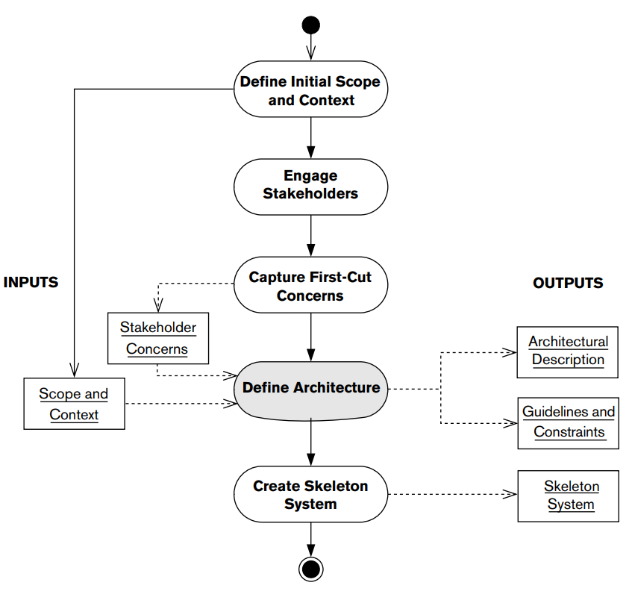
The Architecture Definition Process
Notes:
Last time, we walked through the first two stages of this process. Today, we’re on to stage 3 - capturing the concerns of the stakeholders - the input to the architectural definition process.

Slide 3
Today’s Class
Capturing concerns.
What policies, goals, and constraints must guide architecture definition?
Establishing architectural principles.
How should stakeholder interests and priorities be applied over the entire architecture?
Making and documenting decisions.
Using principles to link concerns to decisions.
Notes:
Go over

Slide 4
Capturing Concerns
Notes:
(discussion) Point is - there are a lot of different answers to this question

Slide 5
Input to the Architectural Definition
Business and IT strategies set organizational priorities and establish a roadmap.
Goals and drivers are the issues that drive stakeholders to initiate the project.
Standards and policies mandate aspects of how the organization does business.
Real-world constraints such as time, budget, and knowledge dictate project limitations.
Notes:
As we talked about last time, the most obvious things that shape and define your architectural solution are the scope and requirements of the system - what goes into your context view. However, these are not the only inputs, other things can be just as important as inputs to your architectural decision making.
• Business and IT strategies set the long-term business and technology priorities and direction for the organization and may also include a roadmap to get from today to the “target state.” •
Goals and drivers are the fundamental issues and problems that prompted your stakeholders, especially the acquirers and users, to initiate the project. •
Standards and policies mandate certain aspects of how the organization does business or operates internally. •
There are also many other real-world constraints that you need to take into account, such as time and money, availability of skills, or technology pitfalls and limitations.

Slide 6
Concerns
A concern about an architecture is a requirement, an objective, a constraint, an intention, or an aspiration a stakeholder has for that architecture
The desires of the stakeholders (concerns)
Specific, unambiguous, measureable concerns (requirements)
Notes:
We collectively refer to these inputs as “concerns”. Formally, (1). This definition of concern is wide-ranging. A concern may be specific, unambiguous, and measurable, in which case we call it a “requirement” and can use the techniques of traditional systems analysis to capture it, document it, and use it to shape the architecture. On the other hand, a concern may be vague and loosely stated but still extremely important to your stakeholders.

Slide 7
Concerns
Architectural goals: the “non-requirements” that are left.
Notes:
Indeed, it might be more important to them than the specific requirements. The requirements shape our solution, but so do the goals of the stakeholders.

Slide 8
Online Shopping Concerns
The values, ethos, and reputation of the retailer must be reflected in the appearance and operation of the online store and its supporting processes.
At all times, the Web site should try to present a “human” face to the customer (even those portions of it that are fully automated).
The online store must be easy to use by customers who have limited experience with computers and e-commerce.
The online store must be responsive (quick to load and respond to customer actions) whether or not the customer has a fast Internet connection.
The online store must cover all aspects of the shopping experience, including an up-to-date, browseable catalog; a secure online purchasing system; order tracking; and returns handling.
Notes:
We might have a retailer with a strong reputation for quality of service and customer responsiveness, which must be reflected in every interaction with the customer. This translates into a number of goals and aspirations for a new online store that the retailer wants to build. (1-5) How many of these are actual requirements? That we can measure, that have a single meaning?
Apart from the last item, none of these can be considered formal and measurable requirements, and the last one is really a statement of scope. However, if the system does not meet these goals and aspirations, it will probably be viewed as a failure.

Slide 9
Goal Characteristics
Often expressed using imprecise language.
Unlikely to be quantifiable or measurable.
No objective criteria for judging whether or not they have been met.
Because of strong business focus, unclear how to translate into an architectural solution
You cannot ignore goals and drivers.
Notes:
Unfortunately, these goals and drivers typically exhibit a number of characteristics that make them hard to translate into specific architectural features.(1)—indeed, the stakeholders may not really be clear about what they mean. • (2-3). It all comes down to gut feelings and the subjective assessments of the stakeholders. • (4)
You cannot afford to ignore goals and drivers, they have a major influence on the nature of the architecture and what it is supposed to achieve

Slide 10
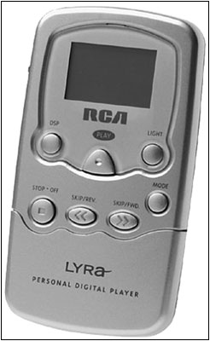
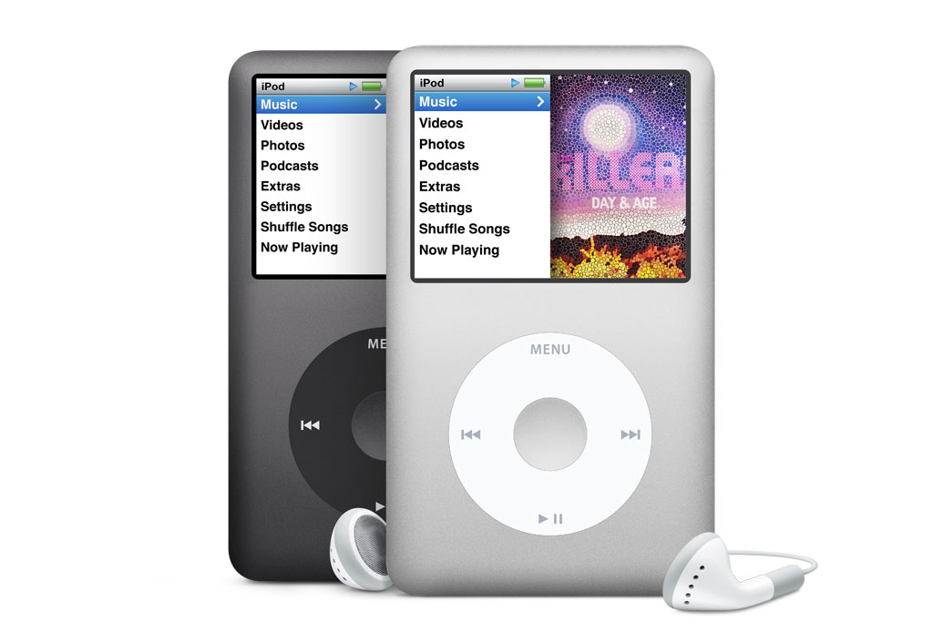
Importance of Goals
Instead Of
Notes:
This is what happens when you take these goals into account. Two products - same basic idea, probably more or less the same formal requirements. Play music stored on an internal harddrive. Worlds apart in execution. I’m not a huge apple fan, but intuitive interface, better software platform, faster response time, more physically attrative. The result of a lot of driving organizational forces

Slide 11
How to Work With Goals
Try to turn them into requirements.
“System should be responsive”
Quantifiable response time, throughput, etc.
“System should be easy to use”
XX% of users can complete a transaction within YY time.
Manage stakeholder expectations.
Develop architectural principles that translate goals into features and qualities of the architecture.
“Ease of use” translates to common look and feel, common exception handling procedures, interface standards.
Notes:
How, then, do we deal with these goals?
(1) For example, a goal about growing market share might translate into some sizing and performance requirements (2-5). • Manage your stakeholders’ expectations of success, especially when goals are vague or unachievable. For example, a system developed under tight budgetary constraints that has ambitious goals for 24/7 availability is unlikely to succeed. You need to make the stakeholders understand why this is the case and work with them to develop more realistic goals. • (7) - we’ll talk more about this in a bit but -. For example, a goal related to ease of use might be translated into principles around a common look and feel, exception handling, and interfaces between automated and manual processes.

Slide 12
Concern Categories
Problem-Focused Concerns: constrain the problem the system is solving.
Solution-Focused Concerns: constrain solutions to that problem.
Business Strategy
IT Strategy
Influence
Business Goals and Drivers
Technology Goals and Drivers
System Scope and Requirements
Business Standards and Policies
Technology Standards and Policies
Constrain
Real-World Constraints
Notes:
As we can see, there is a broad range of concerns that shape the architecture. We can group these into two categories: problemfocused concerns, which influence or constrain the problem that the system is trying to solve; and solution-focused concerns, which influence or constrain the possible solutions to that problem.
Solution-focused concerns are often derived, directly or indirectly, from problem-focused concerns—for example, an organization’s IT strategy is usually driven pretty explicitly from its business strategy. In some instances, there is also a flow in the other direction, with technology driving a change in business behavior or priorities - you saw a lot of this when smartphones became a driving force. (go over grouping)
As you can see, we have further grouped the concerns into ones that have influence and drive decision making in a certain direction (for example, a business or technology goal), and ones that impose constraints and therefore restrict the decisions you can make (such as a standard or policy that you have to follow). Figure 8–1. Problem-Focused

Slide 13
Problem-Focused Concerns
Influence or constrain the problem the system is trying to solve.
May mandate a capability of the system.
May shape the nature and details of capabilities.
May constrain how the system behaves in certain circumstances.
Address “why” and “what” questions.
Include business strategy, business goals and drivers, scope and requirements, and business standards and policies.
Notes:
Problem-focused concerns are those concerns that influence or constrain the problem that the system is trying to solve. A problem-focused concern may influence the architecture by suggesting or mandating a capability of the system, or by shaping or clarifying the nature and specific details of that capability. It may constrain the architecture by allowing the system to behave only in certain ways in certain circumstances, or by prohibiting the system from doing something altogether.
Problem-focused concerns address the “why” and “what” questions about the system: Why does it need to do something, or what does it need to do? They include business strategy, business goals and drivers, system scope and requirements, and business standards and policies

Slide 14
Business Strategy
Defines the direction for the business as a whole or for some part of it.
What goods and services does it provide?
Who are its customers?
How is this organization different from competitors?
How does it structure and organize itself?
Establishes a roadmap for future business.
Drives requirements.
Understanding strategy enables prioritization.
Enables justification of architecture decisions
Notes:
A business strategy defines the direction for the business as a whole or for some part of it. It looks at questions such as (2-5) It may also include a roadmap that describes how the business is planning to transform itself into the desired future state. While you are unlikely to have to refer to it directly, understanding the business strategy is a useful way of understanding the concerns of your more business-focused stakeholders and ensuring that your architectural is aligned with the priorities of the organization. In particular, the business strategy will have driven at least some of your requirements, so understanding the strategy will help you understand why these requirements are important. You may also find that the business strategy is a useful way of justifying some of your architectural decisions or priorities. For example, if the business strategy is to move toward a customer self-service model (whether in-store or on the Internet), the customer-facing aspects of your architecture become very significant.

Slide 15
Business Goals and Drivers
A goal is a specific aim the organization has.
“Achieve 85% of sales through online purchases”
A driver is a force acting on the organization that requires it to behave in a particular way.
“Losing market share to a competitor with a better web presence”
Work with stakeholders to translate goals and drivers into concrete requirements or architectural principles.
Notes:
The business goals and drivers set the business context for the project and are the fundamental reason the project exists. (1-2) in order to grow and protect the business. A retailer may have a specific business goal to achieve 15% of its sales via online purchases made through its Web site. A business driver acting on the organization could be the fact that it is losing market share to a competitor with a much better and easier-to-use shopping Web site.
In some cases, you may be given a formal statement of business goals and drivers, probably written on behalf of the acquirers of the system. In other cases, you will need to work with the stakeholders to understnad their goals. This normally involves asking your key stakeholders a large number of questions to help them and you understand the goals, the drivers, and their implications. (5)

Slide 16
Business Standards and Policies
Mandate how the organization does business or operates internally.
Driven by regulation, best practices, or by the organization’s ethos and ways of working.
Constrain aspects of the architecture.
Data retention policies, security policies.
Translate into architectural features such as archiving capabilities and security controls.
Influence requirements, but aspects are often forgotten.
Notes:
Business standards and policies(1). They may be (2). You may need to refer to some business standards and policies directly, but even when this isn’t the case, you may need to have an awareness of them as they may constrain some aspects of your architecture in significant ways. For example, most businesses have a data retention policy that defines in what circumstances data on their customers can be retained, for how long, and how the data must be protected from unauthorized access. These will ultimately translate into architectural features such as archiving capabilities and security controls. Ideally you should find that business standards and policies are reflected in the system’s requirements. However, this may not always be the case—in particular, things like data retention policies are often forgotten—and so standards and policies can be a useful source of information. As with business strategy, you can also use them to help justify your architectural decisions or influence principles.

Slide 17
Solution-Focused Concerns
Constrain the solution to the problems defined in the problem-focused concerns.
Influences architecture by suggesting or mandating a specific approach to building the system.
Address “how” and “with what” questions.
“How should it be built?”
“What components or technology should be used?”
Includes IT strategy, technology goals and drivers, technology standards and policies.
Notes:
Solution-focused concerns are those that influence or (1). A solution-focused concern may (2), or by shaping and clarifying how it is built. It may constrain the architecture by requiring that the system be constructed in a certain way. Solution-focused concerns address the “how” and “with what” questions about the system: How should it be built to make sure it works in the right way, and with what components and technologies? They include IT strategy, technology goals and drivers, and technology standards and policies.

Slide 18
IT Strategy
Defines long-term direction for IT.
IT as a business unit, providing services to the rest of the organization and to customers.
Concepts and ideas have implications on the architecture.
May drive technology requirements and constraints.
For example, systems may need to use central services or data stores.
Notes:
Like business strategy, an organization’s IT strategy (1). It can be viewed as the “business strategy for IT,” which considers IT to be a business unit in its own right, providing services to the rest of the organization, and possibly to customers and third parties as well. As with the business strategy, you may not need to have to refer to the IT strategy directly, but it is important that you understand its main concepts and ideas so that you are aware of any implications for your architecture. It may drive some technology requirements or constraints (for example, to build systems in a loosely coupled, multitier way, or to use central services or data stores).

Slide 19
Technology Goals and Drivers
Goals are aims the IT department has.
Retailer has a technology goal to be able to scale its customer-facing systems at short notice.
Drivers are forces acting on the project or IT department that requires particular behaviors
Retailer is driven by unpredictable and volatile patterns of online system usage.
Should be translated into requirements and principles when possible.
Notes:
Technology goals and drivers set out the relevant technology objectives, intentions, or aspirations of the project. As with business goals and drivers, a technology goal is a specific aim the IT department has, while a technology driver is some force acting on the project or IT department that requires people to behave in a particular way. For example, The retailer mentioned previously may have a specific technology goal to be able to scale its customer-facing systems at short notice to meet fluctuating spikes in demand. A technology driver might be the unpredictable and volatile usage patterns of its Internet systems.
As with business goals, technology goals and drivers are often imprecise way, and you may find it hard to turn these into more quantitative influences or constraints.

Slide 20
Technology Standards and Policies
Standards may have a technology or business focus.
How computers are networked versus syntax of internal messages.
Adopting standards may ease design and make it easier to integrate the system.
Policies define processes that must be followed to meet stakeholder needs.
Often preexisting policies (security).
Notes:
Technology standards may have a very strong technology focus, such as those that define the physical mechanisms for linking computers together; or they may have more of a business focus, such as those that define the syntax and semantics of a certain class of business messages. Adopting standards can ease the design and development process and make it easier to integrate the system with others, now and in the future. Technology (4). You may need to comply with preexisting policies (security policies are a common example), or alternatively your architectural analysis may identify the need to produce some policies of your own.

Slide 21
Technology Standards and Policies
Open standards (ISO, IEEE, W3C) accepted by community and apply to range of HW/SW.
Proprietary standards imposed by client or dominating companies.
Organizational standards dictate certain HW/SW or infrastructure components.
Ad-hoc “best practices”
Must ensure compliance can be tested.
Notes:
There are certain common types of standards.
Open standards are defined bodies such as the International Organization for Standardization (ISO), the Institute of Electrical and Electronics Engineers (IEEE), and the World Wide Web Consortium (W3C). They are generally accepted by the community at large and typically apply across a range of hardware and software environments. Proprietary standards are created and managed by commercial companies. These usually apply only to a particular manufacturer’s products, but may influence your system if it incorporates or must be compatible with their products. Organizational standards are developed for use by your organization. These may mandate the use of certain hardware or software suppliers or define standard ways to use infrastructure components such as messaging frameworks or data warehouses. There are also ad-hoc “best practices” that may dictate certain design choices - for instance, API definiition standards.
You should ensure that compliance with standards can be tested in some way. Some standards are accompanied by programs or test suites that will demonstrate a system’s compliance; if not, you may want to derive tests of your own

Slide 22
Other Constraints
Web shop may use a third party service to validate credit cards.
Could impose a wait time when using your system.
Could cause customers to accidentally submit an order twice or to give up.
Need to ensure your site can work around this delay and prevent issues.
Perform authorization in the background. Send e-mail once payment confirmed.
“Customers should not be left waiting while slow background processes complete”
Notes:
In addition to requirements, standards, and the other documentation we have already described, you will have to deal with numerous real-world constraints of one sort or another. You need to understand these constraints up front, document the key ones in your AD, and discuss them with your stakeholders. For example, Online retailers usually use third parties to validate credit cards and take payments from customers. However, this process can sometimes be slow, especially at peak periods. The implication of this constraint is that customers may be faced with unacceptably long wait times while making a purchase, which may lead to their attempting to pay twice or even abandoning their purchase. You need to ensure that the Web site works around this issue. Rather than make a customer wait for a payment to be authorized, you might perform the authorization in the background. The customer is presented with a message saying that the purchase has gone through and may then receive an e-mail a few minutes later confirming the payment. This approach might be encapsulated in a general principle that customers should not be left waiting while slow background processes complete. This principle affects the system’s functionality and the way it stores and manages data,

Slide 23
Other Constraints
Technical constraints
Limits in functionality, scale, security.
Time
Deadlines constrain scope of solution, testing cycle, deployment windows, design time.
Cost
Limit ability to hire staff, tool support, hardware choice, complexity of solution.
Skills
Do your staff/users know a technology, know a development approach, or have domain expertise?
Notes:
Go over. At a minimum it may be necessary to spend time and money on training them, which will take budget from development activities. You may also have to take the skills of users into consideration, particularly for systems used by members of the public.

Slide 24
Other Constraints
Operational Constraints
Need to provide service at particular times.
Need to operate system in compliance with organizational standards.
Need to fit existing operational schedules (backups, network maintenance).
Physical Constraints
Distance between clients and servers, time zones.
Organizational Constraints
Preferred development approaches, outsourcing.
Notes:
Go over

Slide 25
“Good” Concerns
Should be clearly stated and lack jargon.
Quantified and measurable (as much as possible).
Testable in a way that demonstrates whether it has been achieved.
Traceable back to strategy or goals and can be traced forward to architectural or design features.
Notes:
Concerns should be clearly stated and avoid jargon that is not understood. They are usually numbered or otherwise uniquely identified. A well-expressed concern also is (2) Avoid statements like “The system must respond quickly” or “The interface must be easy to use.” (3) (4)

Slide 26
Establishing Principles
Notes:
(discussion) Point is - there are a lot of different answers to this question

Slide 27
Relationship Between Concepts
Problem-Focused Concerns
Concerns expose other concerns.
Solution-Focused Concerns
Concerns restrict design approaches
Concerns restrict capabilities.
Scope and Requirements
Architecture
Requirements shape the architecture
Notes:
Concerns can affect the requirements and architecture—and each other—in different ways. We have seen that solution-focused concerns influence or constrain the architecture directly, by defining or restricting the candidate architectures you can use. Problem-focused concerns influence or constrain the architecture more indirectly, by defining requirements or mandating behaviors s that suggest suitable candidate architectures that meet those requirements. Sometimes the influences and constraints work in the other direction—that is, from the solution space back to the problem space. For example, an IT department might mandate certain security features to protect the confidentiality and integrity of its information, which could significantly change the business interacyions that users and customers have with the company’s systems.
(go over, dash lines represent the reverse from solution back to problem space)

Slide 28
Principles
An architectural principle is a fundamental statement of belief, approach, or intent that guides the definition of an architecture.
It may refer to current circumstances or to a desired future state.
Provide a decision-making framework for the architecture, define rules of design, and are derived from the needs and priorities of stakeholders.
Notes:
A useful technique for dealing with such a jumble of cause and effect is to establish some principles about the construction of the architecture, and to use these to help make important decisions. (1-3) establish a baseline or framework for architecture definition. Principles expose stakeholders’ underlying assumptions and bring them out—they make the implicit assumptions and desires explicit.

Slide 29
Example - Weather Data
Weather monitoring service for mobile apps.
Data captured around the world.
Published over XML and HTTP.
Architecture must effectively manage and distribute captured data.
Several solutions that meet the requirements
A: Collect data locally and transfer to a central managed database. Simple and easy, but central point of failure and limited scalability.
B: Copy data to three locations, direct requests to closest.
C: Three locations, but each only hosts local data. Requests routed to location with the requested data.
Notes:
An organization that monitors weather conditions around the world wants to make this information available through an API to developers of applications for mobile devices. Most data is captured automatically from weather stations. The data will be published over the Internet in real time using XML- and HTTP. The architect comes up with several different approaches to managing and distributing the captured data. All of these meet the functional requirements as expressed by the users but are architecturally very different and make different tradeoffs
Option A, has data collected locally and transferred to a single, central database that would manage all of the weather data and respond to all requests. This solution is architecturally simple and cheapest and quickest to implement. However, it has a single point of failure limited scalability. She therefore comes up with two more candidate architectures. Option B involves having a copy of all of the data at three different locations around the world: North America, Europe, and China.. All data would be distributed to all locations, and requesters would be directed to the one that is physically nearest to them. In Option C, there would still be three locations, but each location would host data only for that region. Requests would be routed to the location that holds the data requested.
Which would you choose? (discuss)

Slide 30
Example - Weather Data
Each option meets functional requirements.
Each has advantages and disadvantages in flexibility, performance, scalability, time, cost.
Each has important implications for users in timeliness, consistency, and completeness of data.
Which is correct? Talk to the stakeholders.
In this case, leads to a principle:
“Data required for processing a request should be held as close to that user as possible, even if this means it has to be replicated or redistributed.”
Rules our A and C, argues for B.
Notes:
1-4. How do you pick? Let’s think about our discussion. In practice, you’d conduct a similatr discussion with stakeholders. After further discussion, the architect agrees on a principle with key stakeholders, which states that data required for processing a user’s request should be held as “close” to that user as possible, even if this means it has to be replicated or redistributed. The rationale for this principle is that users might be interested in weather forecasts for anywhere in the world, not just their own area, and that the data needs to be easily available near the point at which it is accessed to achieve a good user experience (by minimizing latency) and to improve availability. This rules out A - data is held in a central location that may not be close - and C - data for far locations must travel far - and argues for B. This is not a universal principle, but is something that the stakeholders and architect think makes sense in this specific project.

Slide 31
Example - Customer Care
Retailer wants new customer care center.
Hardware-sizing exercise reveals that cost is way over budget.
High availability attained via clustering, hardware replication, online backup.
How can we reduce cost?
Talk to the stakeholders.
Reveals that different parts of the system are of varying importance to the business.
This can be taken into account in planning.
Notes:
Principles can be a great way of ensuring that concerns are addressed consistently throughout the architecture and explaining why the architecture needs to be built in a certain way. For example, A retailer wants to develop a new customer care system to deal with postal, telephone, and e-mail questions from its customers. However, when the hardware-sizing exercise is completed, it is discovered that the cost is way over budget because high-availability technologies such as clustering, hardware replication, and high-speed online backup have been used to provide a very high level of system availability. (4-5) Discussion with the sponsor and users reveals that, in fact, different parts of the system are considered to be of varying levels of importance to the business, and this can be taken into account when planning the high-availability design.

Slide 32
Example - Customer Care
Principle: “While availability of the customer care system is of paramount importance, parts of the system that support customer-facing staff should be prioritized over parts such as workflow monitoring and management reporting. If tradeoffs need to be made, the parts that support the customer-facing workflow should always take precedence.”
Use high-availability technology in the parts of the system supporting customer interactions. Reduce use of that technology in the rest of the system.
Notes:
While the availability of the contact center system is of paramount importance to the operation of the business, the parts of the system that support the customer-facing staff should be prioritized over other parts of the system (such as workflow monitoring and management reporting). If tradeoffs need to be made relating to the performance, availability, or resilience of different parts of the system, the parts that support the customer-facing workflow should always take precedence.
We can make use of this princuple. , the hardware architecture can b considerably simplified by focusing the high-availability technology on the parts of the system that support customer interactions and reducing the amount of such technology used in other parts of the system. Again, not a general principle to apply in all projects, but something you can apply throughout this system based on the priorities of the stakeholder and the organization.

Slide 33
“Good” Principles
Constructive
Highlights issues, drives decisions, and establishes the right architectural framework.
Reasoned
Motivated by business drivers and goals.
Well Articulated
Can be understood by all stakeholders and is not open to misinterpretation.
Testable
Must be possible to determine objectively whether they are being adhered to.
Significant
Can the opposite meaning ever be applied?
Notes:
• It is constructive(2). • It is reasoned. It is strongly motivated by business drivers, goals, and other principles. • It is well articulated. More than for any other artifact, it is important that your principles can be understood by all stakeholders and are not open to misinterpretation (accidental or willful). • It is testable. Principles are (usually) valid over the entire lifetime of the architecture, and it must be possible to determine objectively whether they are being adhered to. • It is significant. ask whether the opposite statement could ever be true. If the statement opposing the principle is still meaningful (although obviously wrong for your circumstances), the principle is probably significant.

Slide 34
Fixing a Bad Principle
“The online store must be easy to use by customers who have limited experience with computers and e-commerce”
Significance test: “The store must be hard to use” will never be true, so this fails significance test.
Ease of use is still clearly important.
Break down into:
“We should minimize the amount of data that is collected from customers during early interactions. This minimizes data protection concerns and avoids slowing down browsing and product selection. ”
Notes:
Let’s take an example (1). Now, this is not a great principle. applying the test for significance, it is clear that the opposite statement, “The online store will be hard to use,” is not one that would ever make sense. As it stands, this first attempt at a principle is a truism and not of much value.
Ease of use is clearly important to the stakeholders, and further discussion reveals that this is particularly important for new customers because it is so easy for potential customers to click away to another site if they are having problems. So, we can break the principle nto several more specific ones, including (5)

Slide 35
Fixing a Bad Principle
“We should minimize the amount of data that is collected from customers during early interactions. This minimizes data protection concerns and avoids slowing down browsing and product selection. ”
More reasoned (rationale), constructive (highlights a specific need), and signficant (a sign-up that requires more data may be necessary).
Still not testable. Correct by setting a target (less data than competitors’ sites)
Notes:
This principle is now more reasoned (because it is supported by the rationale to avoid inconveniencing customers and to avoid data protection concerns around personal data) and more constructive because it highlights the specific need for ease of use in initial customer interactions. It is also more significant because requiring a sign-up process that captures a lot of data might be necessary in some other situations. However, it is still not particularly testable: How do the stakeholders know whether they have achieved their objectives for ease of use? Can fix by setting a target - competitors sites. Now we also have a target for developers to aim for.

Slide 36
Defining Principles
Often seem obvious, but can cause huge arguments.
Get differences out in the open and resolve them early in the process.
State clear principles to stakeholders, argue with them, and revise until consensus is reached.
Do not make principles too specific.
Should be overarching, capture spirit and motivation.
Do not write too many principles.
Need to be memorable and to the point.
Notes:
When you first start to use them, principles may come across to you and your stakeholders as an overblown way to state the obvious, but you will recognize their usefulness the first time you start having trouble reaching consensus over one. Because principles reach right down to core beliefs, disagreement over the wording or meaning of a principle is a sure sign of some fundamental differences among your stakeholders. It is good to get these differences out in the open and resolve them early in the process. It can take a lot of effort to obtain consensus on your principles, so try to get them right the first time. Revising a principle later consumes valuable time and can lead to a significant amount of architectural rework. Don’t make your principles too specific. That’s what requirements are for: Your aim at this point is to capture the spirit and motivation of your stakeholders, rather than the details (which you will capture later). How many principles should we define?” There is no right answer to this question; you should define as many as the stakeholders need.Keep that number small, though—if you have hundreds of principles, no one will remember them

Slide 37
Making and Documenting Decisions
Notes:
(discussion) Point is - there are a lot of different answers to this question

Slide 38
Decisions
Very important to get decisions right. May be impossible to fix once code is written.
Decisions should be made explicit (documented and discussed).
Engages stakeholders.
Ensures developers understand the architecture.
Provides traceability back to business drivers and goals. Gives visibility into implications of decisions.
Notes:
Getting the big “architectural” decisions right is vitally important because they are usually difficult, expensive, and time-consuming to change later. If the architecture prioritizes one quality property over another, such as performance over flexibility, it can be very hard, if not impossible, to change this balance once software has been written. It’s not only the explicit decisions—those that have been discussed, agreed upon, and documents—that you have to worry about. many architectural decisions are implicit and are not documented anywhere or even discussed. Making your architectural decisions explicit is a good way of engaging stakeholders who might not otherwise have the time to participate in architectural definition. It also helps to “embed” the fundamentals of the architecture into everyone’s thinking, so that decisions are not reversed later without due consideration of the consequences. it also provides traceability of decisions back to fundamental business drivers, which helps you get stakeholder buy-in and gives early visibility to the implications of your decisions.

Slide 39
Architectural Significance
Does this decision answer a “what”, “how”, or “with what” question?
“What”: Map out functional components of the architecture, data stores, concurrency, deployment platforms, operational tools, and element relations.
“How”: Drive how elements are constructed.
I.e., which database schema to use.
“With what”: What software and hardware will be used to build the decision?
Notes:
Obviously you can’t document and review every decision you make about your architecture. However, you can apply the idea of architectural significance to help you determine which decisions need review and oversight. Architecturally significant decisions usually answer the important “what,” “how,” and “with what” questions about the architecture and are the decisions that are critical to ensuring that the system achieves its key goals.
(2) . “What” decisions often have significant stakeholder impact and need to be made in consultation with key stakeholders and usually require their ratification.
(3) They often make use of standard patterns or approaches, such as a decision to design a multithreaded server using pools of stateless components, or a reporting database using a star schema database. “How” questions usually have more impact on the solution space than on the problem space.
(5). These are aimed at the solution space.

Slide 40
Example - Event Booking
Event booking service offers online ticket sales. There is concern that card authorization could be slow.
“What” decision: include a service to collect payment after the order is accepted, and issue a notification if there is an issue.
“How” decision: credit card payments will be authorized using the service operated by Chase.
“With What” decision: service call to Chase using their standard API over HTTPS.
Notes:
(go over) These are decisions with implications on the architecture, and should be documented. For instance, the “what” decision implies that in some cases, a customer who thought her order had been accepted would need to be notified that an alternative means of payment was required. That must be accounted for in the architecture and resulting software.

Slide 41
Linking Concerns and Decisions
Principles provide traceability for architectural decisions by associating rationale and its implications.
Use business drivers to develop business principles.
Principles that focus on “why” questions, with drivers as rationale.
Use business principles to develop technology principles.
Focus on “how” and “with what” questions, with business principles as rationale.
Use technology principles as rationale for developing architectural decisions.
Notes:
One of the most powerful uses of principles is to provide traceability for your architectural decisions. In other words, you can use principles to help justify and explain particular elements or features of your architecture. This approach relies on associating two additional pieces of information with each of your principles: its rationale (why it is an appropriate and valuable principle for your architecture) and its implications (what needs to happen in order for the principle to become reality).Traceability comes about by linking principles together using implications and rationales.
• Start with the business drivers and goals for the architecture.
• Use the business drivers to develop a set of business principles, many of which have as their rationale one or more business drivers. A business principle generally focuses on the “why” and “what” questions rather than on how the architecture will be built or deployed.
• Use the business principles to develop a set of technology principles, many of which have as their rationale one or more business principles. Technology principles usually focus on the “how” and “with what” questions.
• Finally, use the technology principles to develop a set of architectural decisions, many of which have as their rationale one or more technology principles

Slide 42
Example - Online Shopping
Business Principles:
All customers will gain access to any information, service, or catalog via a single point of entry
Customer data items (name, address, e-mail address) should be replicated across all sites.
Goal: To interact with customers in a “joined-up” manner, making it easy to browse our entire portfolio.
Technology Principles:
Each item of customer data will be held only once, updated in real time, and used as the authoritative source of the truth.
Any system that requires access to a core data item will retrieve it from the central data store at the time of use.
Noncore data (i.e., data that applies only to a specific service or catalog) will be managed by the system to which it pertains.
Rationale: G1
Decisions:
A central consolidated data store will be used that manages all core customer data
A messaging framework will be used to synchronously retrieve or update all core data
Rationale: BP1, BP2
Rationale: TP1, TP2, TP3
Notes:
Our online store now has a number of separate online catalogs in its portfolio. Each catalog fronts a separate shopping system, with its own ways of ordering goods and managing accounts.This is obviously a pain for people who would make purchases from multiple shops.
- The business strategy now has this goal (read)
- As a result of this, a number of business principles are accepted, including (read), with the goal as the rationale
- After some discussion, these are driven down into the a set of technology principles (read), with B1 and B2 as the rationale
- An architecture is developed from these principles and we make two decisions (read). These are based on the tech princuiples T1-T3.
You can see from this simple example that the decision to deploy a central data store can be justified and traced from business goal G1, through business principles B1 and B2, and through technology principles T1, T2, and T3.

Slide 43
Activity - Airport Parking
You will develop a new automated parking system at the CAE airport.
In this new system:
A user can insert their card into the card reader at the ramp entrance.
This will record the time they entered airport parking.
They then can use the same credit or debit card to pay at an exit lane.
The system should be fully automated.
The system should also support ticketed parking
User receives a ticket and pays either by credit card or cash on exiting.
Notes:
You have been asked to develop a new automated parking system at the CAE airport.
In this new system, a user can simply insert their credit or debit card into the card reader at the ramp entrance. This will record the time they entered airport parking. They then can use the same credit or debit card to pay at an exit lane. The system should be fully automated; there is no waiting in line for a cashier. The system should also support ticketed parking: where the user receives a ticket and pays either by credit card or cash on exiting.

Slide 44
Activity - Airport Parking
The system needs to interact with a number of entities and systems, including:
Customers parking in the ramp
Airport police and emergency responders
Ramp managers
External systems for validating credit card details and submitting payments
The airport’s accounting system
External physical gate systems with basic controllers (raise / lower)
External physical systems for signage
An existing personnel system for staffing exit kiosks

Slide 45
Activity - Airport Parking
Who are the stakeholders?
What questions should you ask them?
What information is missing?
What are their architectural concerns?
Notes:
Talk over

Slide 46
Activity - Airport Parking
Who are the stakeholders?
Customers, Police, Managers, Accountants, Personnel Managers. Anyone else?
What are their architectural concerns?
Customer: Types of credit cards supported, ease of use, availability of service, speed of service
Airport Police: Predictability of alarms, speed of alarms, information captured in alerts
Could these concerns contradict?

Slide 47
Key Points
A wide range of factors shape architecture.
Business and IT strategy, goals and drivers, scope and requirements, standards and policies, and real-world constraints.
We call these concerns
Problem-focused concerns guide the problem that the system is trying to solve.
Solution-focused concerns guide the possible solutions to that problem.
Notes:
(read)

Slide 48
Key Points
Architectural principles are statements of belief, approach, or intent that guide architecture definition.
These principles provide a framework for the architecture and link concerns to the final decisions.

Slide 49
Next Time
Identifying and Using Scenarios
Sources:
Rozanski & Woods: ch. 10
Bass, Clements, and Kazman: ch. 4, pg. 79-86, 131-134, 147-150, 175-176
Homework:
Project 1, due 9/18
Assignment 1, due 9/25
Questions?
Notes:
(read)

