Slide 1
Identifying and Using Scenarios
CSCE 742 - Lecture 7 - 09/25/2018

Slide 2
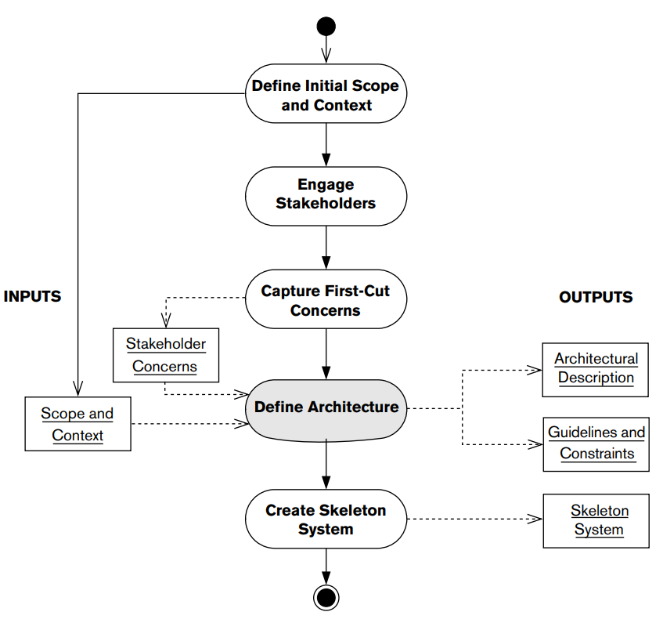
The Architecture Definition Process
Notes:
Now that we’re through the preliminaries, today, we’re getting into part of the architecture definition process itself. Specifically...

Slide 3
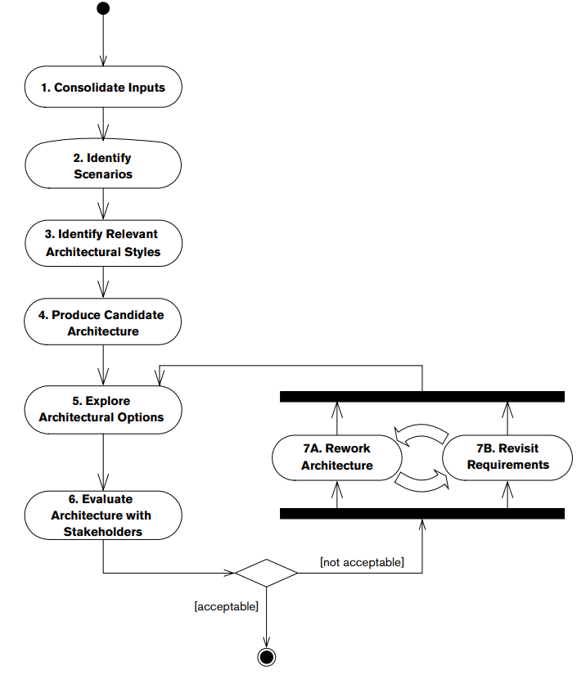
The Architecture Definition Process
Notes:
Specifically, here. Where we identify and learn how to make use of scenarios.

Slide 4
Scenarios
To ensure you meet stakeholder demands, continually consider how your ideas will work in practice.
An architectural scenario is a well-defined description of an interaction between an external entity and the system.
It defines the event that triggers the scenario, the interaction initiated by the external entity, and the response required of the system.
Similar to use cases or user stories, but examines both quality and functionality.
Notes:
As we’ve said time and time again, the most important goal of your software architecture is that it meets the needs of your stakeholders. In practical terms, this means that the system built based on your architectural design must be able to perform certain tasks while exhibiting the specific properties - performance and such - that are important to the stakeholders. A good way to stay grounded when developing your architecture is to continually consider how the ideas you are developing will actually work in practice. We can do this by defining and applying scenarios to your architecture. (2-4), but rooted in checking the compliance of your architecture and examining quality as well as functionality.

Slide 5
Scenarios
Capture a range of architectural requirements:
A set of interactions with users to which a system must respond.
Processing in response to timed events.
Peak load situations that could occur.
Regulator demands.
Failure response.
A change that a maintainer might make.
Any situation that the design must handle.
Notes:
Architectural scenarios can be used to capture a wide range of architectural
requirements, such as:
• A particular set of interactions with its users to which the system must be
able to respond
• The processing that must happen automatically at a particular point in time,
such as month end
• A particular peak load situation that could occur
• A demand that an external regulator might make of a system
• How the system must respond to a particular type of failure
• A change that a maintainer might need to be made to the system
• Any other situation with which the design of the system must be able to cope

Slide 6
Scenario Types
Functional Scenarios define how the system responds to external stimuli.
Users initiate transactions, AIR call or data sent through an interface, timed events.
System Quality Scenarios define how the system should react in order to exhibit quality properties.
Ability to be modified to provide new functionality, to cope with peak load, to protect critical information.
Notes:
We can divide the scenarios for a system into two groups: those concerned with what the system does and those concerned with how it does it. In other words, just as with requirements, scenarios can be divided into functional scenarios and quality scenarios.
Functional scenarios are defined in terms of a sequence of external events (normally derived from a system use case) to which the system must respond in a particular way. Examples include users initiating
transactions, data arriving at external interfaces, temporal events (such as the end of the day) occurring, and so on.
The new wrinkle that we don’t tend to see in use cases or user stories are system quality scenarios. In contrast, system quality scenarios are defined in terms of how the system should react to a change in its environment in order to exhibit one or more quality properties. How does the system handle events that would impact security, performance, availability, and evolution? Examples of system quality scenarios include the ability of the system to be modified to provide a new function, to cope with a particular type of peak load, to protect critical information even under a denial of service attack, and so on.

Slide 7
Scenario Usage
Provide input to architecture definition.
Help flesh out and find missing requirements.
Evaluate the architecture
Force description of execution paths through system
Find missing/incompatible interfaces.
Communicate with stakeholders
Concrete, easy to understand.
Drive the testing process
Help prioritize testing efforts.
Notes:
You can use scenarios in a number of ways within the architecture definition process.
(1) Scenarios can provide part of this input and keep the process grounded in reality by challenging you to design solutions to specific problems the scenarios pose. it is common for scope and requirements to be ill defined in the early stages of development, and scenarios (2) Considering how the system behaves in one scenario often leads stakeholders to realize that another situation they hadn’t previously considered was omitted from the requirements analysis.
(3) Scenarios are a primary input into almost any process of architectural evaluation, which can range from simple credibility checks to heavyweight reviews using a formal process like the Architecture Tradeoff Analysis Method (ATAM). Scenarios force you to consider how well the system can respond to a specific situation, (4-5)
(6) Scenarios are (7). Discussion of a scenario, and how the system will respond to the situation described in it, is a very useful vehicle for communicating with stakeholders and is often much more effective than using traditional design documentation, particularly for less technical stakeholders. Indeed, for nontechnical stakeholders, scenarios may be the only way to communicate the implications of the proposed architecture in a way that they really understand.
(8) Scenarios help highlight the things that are important to your stakeholders, providing a useful guide for where to focus testing activity. After identifying your scenarios, use them to plan the sort of testing you will require, and make sure that the system’s testers have a copy of the scenarios as a basis for their initial test plans.

Slide 8
Identifying Scenarios
Another format for requirements.
Useful for “task-focused” requirements.
Less useful for all-purpose invariants.
Shall statement: “System shall tolerate any single component failure without loss of service”
Scenario: “What if component X fails? What if component Y fails?”
Require some effort to think about and write.
Start from overview and fill in most important scenarios.
Notes:
Can the thought of as (1). Most (2). They are (3) - by which I mean encompassing shall statements like (4). How do you walk through that? Instead, they are more purpose-build (5)
(6). You have to foresee certain events, but the thing is - you eventually need to flesh this out anyways - it just might be in development, where you lack control over how it is handled. (7)

Slide 9
Functional Scenarios
Notes:
(discussion) Point is - there are a lot of different answers to this question

Slide 10
Functional Scenario Format
Overview
Brief description of what the scenario illustrates.
System State
State of system before the scenario starts.
System Environment
Significant observations about the environment that the system is running in.
External Stimulus
The event that sets off the scenario.
Required System Response
How should the system respond?
Notes:
For a functional scenario, you usually need to define five pieces of information: (1-2) (3) the state of the system before the scenario occurs (if
significant). This is usually an explanation of any information that should already be stored in the system for the scenario to be meaningful. For instance, we might already have a user logged in and a database connection established.
(5) any significant observations about the environment that the system is running in, such as the unavailability of external systems, particular infrastructure behavior, time-based constraints, and so on.
(7) a definition of what causes the scenario to occur, such as data arriving at an interface, user input, the passage of time, or any other event of significance to the system.
(9) an explanation, from an external observer’s point of view, of how the system should respond to the scenario.

Slide 11
Functional Scenario Format
External stimulus should describe both the actor making a request and action.
Actor: the user, environmental stimulus such as a failure or timer, or external system.
Action: the request, event, or activity.
Required system response should describe both how the system responds and a response measure.
Success or failure criterion for the response.

Slide 12
Example: Statistics Processing
Raw data is loaded into a database.
Derived statistics are calculated automatically based on the data.
Statisticians view the data and make reports.
Clients access statistics and make deductions that are checked manually.
Notes:
Let’s talk over an example. We have a statistics processing application. (go over)

Slide 13
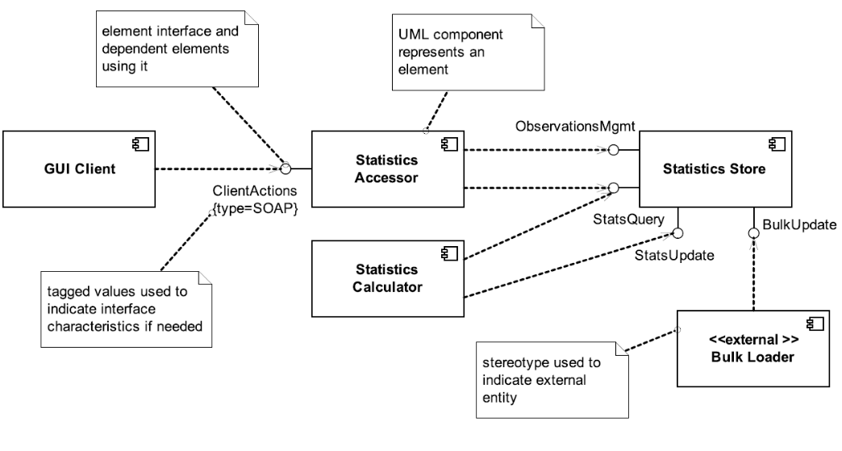
Functional View
Notes:
Now, we need a bit of information to proceed. Here is the functional view of this system - the internal structural elements and their relationships. (go over)

Slide 14
Functional Scenario
Incremental Statistics Update
Overview: How the system deals with a change to the existing base data.
System State: Summary statistics already exist for the sales quarter that the incremental statistics refer to. The system’s databases have enough space to cope with the processing required for this update.
System Environment: The deployment environment is operating normally, without problems.
External Stimulus: Update to sales transactions for the previous quarter arrives via the Bulk Data Load external interface.
Required System Response: The incoming data should automatically trigger background statistical processing to update the summary statistics for the affected quarter to reflect the updated sales transaction data. The old summary statistics should stay available until the new ones are ready.
Notes:
A functional scenario for a system that summarizes incoming data - the incremental statistics update - in other words, as laid out in the overview (2).
Go over

Slide 15
Quality Scenarios
Notes:
(discussion) Point is - there are a lot of different answers to this question

Slide 16
Quality Scenario Format
Overview
Brief description of what the scenario illustrates.
System State
Aspects of the state that affect quality
(i.e., information stored in the system)
System Environment
Significant observations about the environment that the system is running in.
External Stimulus
Environmental factors that initiate the scenario.
(i.e., infrastructure changes or failures, security attacks, etc.)
Required System Response
How should it respond (from a quantifiable point of view)?
(i.e., how should it handle a defined increase in requests)?
Notes:
the stimulus–response approach works less well when trying to capture system quality scenarios. Quality scenarios try to illustrate characteristics that vary widely; in general, they try to show how the system
responds to a change it its environment. Sometimes this change can be seen as a stimulus (e.g., being attacked), whereas in other cases (e.g., an external system slowing down or data volume increasing), viewing the change as a stimulus is rather artificial. And so, we change our approach just slightly when establishing system quality scenarios. You usually need to define five pieces of information for a system quality scenario.
(1-2) (3) the state of the system before the scenario occurs (if
significant). For quality scenarios, this may need to define aspects of the system-wide state (such as a level of load across the system) rather than the information stored in the system
(5) - same as before - any significant observations about the environment that the system is running in, such as the unavailability of external systems, particular infrastructure behavior, time-based constraints, and so on.
(7) an explanation of what has changed in the system’s environment that causes the scenario to occur. This could be infrastructure changes or failures, changes in external system behavior, security attacks, required modifications, or any of the other environment changes that require the system to possess a particular quality property in order to deal with them.
(9) a definition of how the system must behave in response to the change in its environment (e.g., how the system should respond, from a quantifiable performance point of view, to a defined increase in the number of requests arriving per minute).

Slide 17
Examples - Statistics Processing
Failure in Summary Database Instance
Overview: How system behaves when database writes fail.
System state: N/A
System environment: The deployment environment is working correctly.
External Stimulus: While writing summary statistics to the database, the system receives an exception indicating that the write failed (e.g., the database is full).
Required system behavior: The system should immediately stop processing the statistics set it is working on and leave any work in progress behind. The system should log a fatal message to the operational console monitoring system and shut down.
Notes:
Let’s do a couple of examples based on our statistics summarization system.

Slide 18
Examples - Statistics Processing
Daily Data Update Increases in Size
Overview: How the system’s end-of-day processing behaves when regular data volumes are suddenly greatly exceeded.
System state: The system has summary statistics in its database for data that has been processed, and the system’s processing elements are lightly loaded at the current rate of system load.
System environment: The deployment environment is working correctly, and data is arriving at a steady rate of 1,000 to 1,500 items per hour.
External Stimulus: The data update rate on a particular day suddenly increases to 4,000 items per hour.
Required system behavior: When the end-of-day processing starts, the system should process that day’s data set for a period until the processing time exceeds a system-configurable limit. At that point, the system should stop processing the data set, discard work in process, leave the previous set of summary statistics in place, and log a diagnostic message (including cause and action taken) to the operational console monitoring system.
Notes:
Let’s do a couple of examples based on our statistics summarization system.

Slide 19
Examples - Statistics Processing
Additional Summary Dimension Required
Overview: How the system can cope with the need to extend the statistical processing provided.
System state: N/A
System environment: The deployment environment is operating normally, as initially delivered.
External Stimulus: The need arises to support a new statistical dimension in the summary statistics to summarize sales by type of payment option used.
Required system behavior: The development team should be able to add the required processing to provide the new statistical dimension without making any changes to the overall system structure (i.e., changing any interelement interfaces or interactions) and with a total effort of fewer than 4 person-weeks.
Notes:
Let’s do a couple of examples based on our statistics summarization system.
Development scenario, not a in-the-field scenario - however, keep in mind that many quality properties are based on development factors like testability and modifiability - in this case. (go over) Still measurable and testable.
A point worth noting from these examples is that a scenario doesn’t always indicate good news, and when you create a scenario you may not have all the answers. The required failure behavior outlined in the examples isn’t particularly robust or detailed, and this may not be acceptable. However, by writing this scenario, you now have a concrete case to discuss with stakeholders to help you learn what the
phrase “must cope with failure conditions” in the requirements document actually means. Similarly, it isn’t clear yet how the architecture would cope with the need for a new summary dimension, but you can now discuss the need for different types of evolution in a more concrete way.

Slide 20
Performance Quality Scenarios
Measure system performance (as opposed to user performance).
Begins with an event arriving at the system.
Responding requires resources (including time) to be consumed.
Arrival pattern for events can be:
Periodic (at regular time intervals)
Stochastic (events arrive according to a distribution)
Sporadic (unknown timing, but known properties)
“No more than 600 per minute”
“At least 200 ms between arrival of two events”
Notes:
A performance scenario begins with an event arriving at the system. Responding correctly to the event requires resources (including time) to be consumed. While this is happening, the system may be simultaneously servicing other events. Events can arrive in predictable patterns or mathematical distributions, or be unpredictable. An arrival pattern for events is characterized as periodic, stochastic, or sporadic:
Periodic events arrive predictably at regular time intervals. For instance, an event may arrive every 10 milliseconds. Periodic event arrival is most often seen in real-time systems.
Stochastic arrival means that events arrive according to some probabilistic distribution.
Sporadic events arrive according to a pattern that is neither periodic nor stochastic. Even these can be characterized, however, in certain circumstances. For example, we might know that at most 600 events will occur in a minute, or that there will be at least 200 milliseconds between the arrival of any two events. (This might describe a system in which events correspond to keyboard strokes from a human user.) These are helpful characterizations, even though we don’t know when any single event will arrive.

Slide 21
Performance Quality Scenarios
Response measurements include:
Latency: The time between the arrival of the stimulus and the system’s response to it.
Deadlines in processing: Points where processing must have reached a particular stage.
Throughput: Usually number of transactions the system can process in a unit of time.
Response Jitter: The allowable variation in latency.
Number of events not processed because the system was too busy to respond.
Notes:
The response of the system to a stimulus can be measured by the following: (go over)
(2) In the engine controller, for example, the fuel should ignite when the cylinder is in a particular position, thus introducing a processing deadline.

Slide 22
Performance Quality Scenarios
For real-time systems (i.e., embedded devices), measurements are absolute.
Look at worst-case scenario.
For non-real-time systems, measurements should be probabilistic.
95% of the time, the response should be N.
99% of the time, the response should be M.

Slide 23
Generic Performance Scenario
Overview: Description of the scenario.
System/environment state: The system can be in various operational modes, such as normal, emergency, peak load, or overload.
External Stimulus: Stimuli arrive from external or internal sources. The stimuli are event arrivals. The arrival pattern can be periodic, stochastic, or sporadic, characterized by numeric parameters.
Required system behavior: The system must process the arriving events. This may cause a change in the system environment (e.g., from normal to overload mode).
Response measure: The response measures are the time it takes to process the arriving events (latency or a deadline), the variation in this time (jitter), the number of events that can be processed within a particular time interval (throughput), or a characterization of the events that cannot be processed (miss rate).

Slide 24
Bad Performance Scenario
Overview: How the server handles concurrent requests with graceful response times.
System/environment state: Application is packaged and deployed on the server. The server process is up and ready to serve requests.
External Stimulus: Concurrent requests arrive in high volume.
Required system behavior: Server spawns new threads and handle each request concurrently based on resources configured (like available memory, CPU speed etc.)
Response measure: Server successfully handles all requests.
Notes:
(go over - discuss. What’s wrong?)
It is very vague in all aspects. What is “high volume”? How quickly does the system have to respond
to requests? For some volume of requests, it is not possible to service them, so it is not actually
implementable. The scenario tells you very, very little about the architecture and how it is built to
concretely respond to high load.

Slide 25
Good Performance Scenario
Overview: Check system responsiveness for adding items to shopping cart under normal operating conditions.
System/environment state: Normal load is defined as deployment environment with no failures and less than 20 customer requests per second. System is communicating over good internet connection to acceptable client (see glossary for expected internet / client specifications).
External Stimulus: Customer adds product to shopping cart.
Required system behavior: Web page refreshes. Icon on right side of web page displays last item added to cart. If item is out of stock, cart icon has exclamation point overlay on top of cart icon.
Response measure: In 95% of requests, web page is loaded and displayed to user within 1 second. In 99.9% of requests, web page is loaded and displayed to user within 5 seconds.
Notes:
(go over - discuss. Why good?)
It is specific; it talks about response under a specific user action. It gives enough context
information to be reasonable (granted, some of it is defined elsewhere in a glossary). Also, it gives a
probabilistic guarantee, which is usually the correct way to talk about performance for non-real-
time systems, and provides a testable bound for the scenario

Slide 26
Usability Quality Scenarios
Measure user performance (as opposed to system). Scenarios center around:
Learning system features: What can the system do to make learning easier?
Using a system effectively: What can the system do to make the user more efficient?
Minimizing impact of errors: What can the system do so a user error has minimal impact?
Adapting to user needs: Can the system adapt to make a task easier?
Increasing confidence and satisfaction: What does the system do to provide feedback?
Notes:
Usability is concerned with how easy it is for the user to accomplish a desired task and the kind of user support the system provides. Usability comprises the following areas: (2-3)
For instance, this might include the ability for the user to suspend one task, perform operations, then resume that task.
(4). For instance, a user may wish to cancel a command they performed incorrectly.
(5). For instance, a system might fill in URLs from the user history
(6)

Slide 27
Generic Usability Scenario
Overview: Description of the scenario.
System/environment state: The user actions with which usability is concerned occur at runtime or at system configuration time.
External Stimulus: The end user is the source of the stimulus for usability. The stimulus is that the end user wishes to use a system efficiently, learn to use the system, minimize the impact of errors, adapt the system, or configure the system.
Required system behavior: The system should either provide the user with the features needed or anticipate the user’s needs.
Response measure: The response is measured by task time, number of errors, number of tasks accomplished, user satisfaction, gain of user knowledge, ratio of successful operations to total operations, or amount of time or data lost when an error occurs.

Slide 28
Bad Usability Scenario
Overview: The developer creates a working application (using Rails) that meets simple data storage and retrieval requirements.
System/environment state: Rails is installed and working properly. No such application already exists to meet the data storage requirements.
External Stimulus: The user identifies the requirements of the application and begins development.
Required system behavior: Rails automatically generates and configures the majority of files necessary for the application to run and encapsulates commonly performed web development tasks.
Response measure: Files are created in standard location.
Notes:
What’s wrong?
What does this have to do with usability? Response behavior and measure is purely something the framework is doing, not the user. Does not suggest anything about usability. Same for environment state
Too general - all applications basically

Slide 29
Good Usability Scenario
Overview: Developer adds RESTful access to domain object that previously did not support it.
System/environment state: Ruby and Ruby on Rails installed. Developer has 2 weeks experience with RoR.
External Stimulus: Developer adds RESTful access to Ruby domain object.
Required system behavior: Developer successfully adds URIs for object using both RoR and vanilla Ruby, performing RoR task first. GET on URI displays current value of domain object and PUT on URI correctly modifies object.
Response measure: In 95% of all instances, RoR solution requires less effort (across all of the following measures: SLOC manually written / time to write / count of files manually modified) than "vanilla" Ruby solution.
Notes:
What’s good?
About devveloper and relationship with rails

Slide 30
Availability Quality Scenarios
The ability of the system to mask or repair faults such that the outage period does not exceed a required value over a time period.
Measure how the system responds to failure.
When the system breaks, how long does it take to resume normal operation?
Stimuli should always be a failure.
Response measures should always include a measure of availability:
availability percentage, time to detect or repair fault, time system in degraded mode, no down time, etc.
Notes:
Availability is (1). Availability scenarios (rest)

Slide 31
Availability Quality Scenarios
Scenarios must distinguish physical failures in the system and the software’s perception of the failure.
Do not assume software is omniscient.
Scenarios tend to deal with:
Failure of a physical component or external system.
Reconfiguration of the physical system.
Maintenance or reconfiguration of the software.
Notes:
(1) For example, given a network connection failure, if there is no traffic from the system over the link, then the software may not perceive the network failure until it attempts to use the network. Do not assume the software is omniscient, that is, all-knowing; there must be a mechanism in the architecture to perceive failures before the system can respond to them.
The kinds of scenarios that are managed by availability fall into three types: failure of an existing
physical component or external system that is used by the software, reconfiguration of the physical
system (e.g., adding or removing additional hardware resources), or maintenance or reconfiguration of
the software: for example, loading new versions of the software onto hardware, especially if it requires
restarting different processes that are part of the system, or entering a “maintenance mode” that
requires that the software is offline or functions in a reduced capacity.

Slide 32
Generic Availability Scenario
Overview: Description of the scenario.
System/environment state: The state of the system when the fault or failure occurs may also affect the desired system response. If the system has already failed and is not in normal mode, it may be desirable to shut it down. If this is the first failure, degradation of response time or functions may be preferred.
External Stimulus: Differentiate between internal and external origins of failure because desired system response may be different. Stimuli is an omission (a component fails to respond to an input), a crash (component repeatedly suffers omission faults), timing (a component responds but the response is early or late) or response (a component responds with an incorrect value).

Slide 33
Generic Availability Scenario
Required system behavior: There are a number of possible reactions to a failure. Fault must be detected and isolated before any other response is possible. After the fault is detected, the system must recover from it. Actions include logging the failure, notifying selected users or other systems, taking actions to limit the damage caused by the fault, switching to a degraded mode with either less capacity or less function, shutting down external systems, or becoming unavailable during repair.
Response measure: Can specify an availability percentage, or it can specify a time to detect the fault, time to repair the fault, times or time intervals where system must be available, or duration for which the system must be available.

Slide 34
Bad Availability Scenario
Handling Isolation
Overview: How the server manages multiple applications with desired isolation.
System/environment state: Multiple applications (unrelated) are deployed on the server. The server is up and running.
External Stimulus: User(s) establishes session with each of these applications.
Required system behavior: Server deploys each application in its own context which can be configured to share or not share any application specific data between them.
Response measure: Applications are isolated.
Notes:
Why is this scenario a bad example?
First, we don’t have an idea of why this isolation matters (it could be that it improves availability
because given proper configuration, a crash of a low-quality component will not impact a high-
quality component). Second, we don’t know what “contexts” are. Are these address spaces? Is this
something enforced by the operating system or Java? What guarantees do we get here? The
response measure is not meaningful, because we don’t know what isolation means. Can we shut
down an application without affecting the other applications?

Slide 35
Good Availability Scenario
Availability while adding new taps
Overview: How the system handles additional taps being added to the system.
System/environment state: The system is operating normally, without problems.
External Stimulus: A user powers up a new Kegboard on the network with six additional taps.
Required system behavior: The kegboards send init messages to the central Kegbot server. The server interrogates the kegboards and adds the additional taps to the inventory of taps. The system continues to service the existing taps without interruption.
Response measure: There is no interruption of service to existing taps. Within 1 second, the new kegboard is added to the administrative interface on the KegBot web server for administraton configuration.
Notes:
(from a beer inventory management system)
Why are these good examples? They are specific and have a reasonable and testable response measure.
A possible critique is that both scenarios have aspects of both availability and performance, but occurs
fairly often. Note that we have combined the system state and environment; for both of these “good”
examples, they are essentially stating that everything is normal.

Slide 36
Good Availability Scenario 2
Web server failure at e-commerce site
Overview: One of the client-facing web servers fails during transmission of client page update.
System/environment state: System is working correctly under normal load. Customer has generated a “add item to shopping cart” post, which was routed to web server <X> in transaction pool.
External Stimulus: Web server <X> crashes during response generation.
Required system behavior: Response page may be corrupted on client browser. Load balancer component no longer receives heartbeat message from web server and so removes it from the pool of available servers after 2s of missed messages, or upon next request sent to the server. Load balancer will remove the server from the pool of available servers. From client’s perspective, a page reload will be automatically routed to alternate server by load balancer and page will be correctly displayed.
Response measure: Upon client-side page refresh, client state and display contains state after last transaction. Time for re-routed refresh is equivalent to “standard” refresh (<1 second 95% of the time).
Notes:
Why are these good examples? They are specific and have a reasonable and testable response measure.
A possible critique is that both scenarios have aspects of both availability and performance, but occurs
fairly often. Note that we have combined the system state and environment; for both of these “good”
examples, they are essentially stating that everything is normal.

Slide 37
Security Quality Scenarios
Measure of the system’s ability to protect data from unauthorized access while still providing service to authorized users.
Scenarios measure response to attack.
Stimuli are attacks from external systems/users or demonstrations of policies (log-in, authorization).
Responses include auditing, logging, reporting, analyzing.
Response measures include amount of data loss/compromise, time to detect/mitigate, % of attacks resisted, etc.

Slide 38
Generic Security Scenario
Overview: Description of the scenario.
System/environment state: The attack can come when the system is either online or offline, either connected to or disconnected from a network, either behind a firewall or open to a network, fully operational, partially operational, or not operational.
External Stimulus: The source of the attack may be either a human or another system. It may have been previously identified or may be currently unknown. A human attacker may be from outside the organization or from inside the organization. The stimulus is an attack (unauthorized attempt to display data, change or delete data, access services, change the system’s behavior, or reduce availability).

Slide 39
Generic Security Scenario
Required system behavior: The system should ensure that transactions are such that:
Data/services are protected from unauthorized access
Data/services are not manipulated without authorization
Parties to a transaction are identified and cannot repudiate their involvement
Data, resources, and system services will be available for legitimate use.
The system should also track activities by
Recording access or modification and attempts to access data, resources, or services
Notifying appropriate entities (people or systems) when an apparent attack is occurring.

Slide 40
Generic Security Scenario
Response Measure: Measures of a system’s response include:
How much of a system is compromised when a particular component or data value is compromised.
How much time passed before an attack was detected
How many attacks were resisted
How long it took to recover from a successful attack
How much data was vulnerable to a particular attack.

Slide 41
Bad Security Scenario
Malicious Control
Overview: How the server restricts damage when someone maliciously gains control over it.
System/environment state: Multiple applications are deployed on the server. The servers are running and serving requests
External Stimulus: One of the applications deployed is breached.
Required system behavior: Server can be configured with different privileges, providing more granular control over their access to system resources and potentially preventing one breached application from allowing access to others.
Response measure: Remaining applications are not breached.
Notes:
Why is this a bad example? It is vague. What are the privileges? What is a “breach”? What is “access”?

Slide 42
Good Security Scenario
Unsuccessful Authentication
Overview: A user attempts to authenticate but the authentication fails due to unrecognized auth token or due to system unavailability.
System/environment state: There is a valve installed on the tap. There is a flow meter installed on the tap. There is a piezo buzzer installed on the Kegboard. Authentication hardware (RFID or one-wire) is installed on the Kegboard. There is no pour in progress. The system is operating normally, without problems.
External Stimulus: A user presents an auth token to the authentication hardware on the Kegboard.
Required system behavior: The auth token is unrecognized, and the valve is not opened. An audible sound is played from the piezo buzzer, indicating authentication failure.
Response measure: No beer is dispensed.
Notes:
Why are these good examples?
They are specific and they describe both reasonable system responses and reasonable measures that
can determine whether the system is behaving as intended.

Slide 43
Activity - Airport Parking
You will develop a new automated parking system at the CAE airport.
In this new system:
A user can insert their card into the card reader at the ramp entrance.
This will record the time they entered airport parking.
They then can use the same credit or debit card to pay at an exit lane.
The system should be fully automated.
The system should also support ticketed parking
User receives a ticket and pays either by credit card or cash on exiting.
Notes:
You have been asked to develop a new automated parking system at the CAE airport.
In this new system, a user can simply insert their credit or debit card into the card reader at the ramp entrance. This will record the time they entered airport parking. They then can use the same credit or debit card to pay at an exit lane. The system should be fully automated; there is no waiting in line for a cashier. The system should also support ticketed parking: where the user receives a ticket and pays either by credit card or cash on exiting.

Slide 44
Applying Scenarios
Notes:
(discussion) Point is - there are a lot of different answers to this question

Slide 45
Activity - Airport Parking
The system will be deployed within the physical architecture of the airport parking garage, incorporating:
Entrance Kiosks
Card dispensers
Credit card reader for e-park
Card reader for contract parking
Parking ramp levels
Signage {FULL / not full}
Entry gates
Exit Kiosks
Signage: {OPEN / ePark ONLY / CLOSED}
Staffed Kiosks
Automated Kiosks
Security Cameras
Hardware for Parking System
Dual Server w/Failover (can switch in event of failure)
Clustered DB
Storage Area Network

Slide 46
Activity - Airport Parking
Describe two functional scenarios
Describe two quality scenarios

Slide 47
Activity - Airport Parking
Quality Scenario for Performance
Time to exit ramp
Quality Scenario for Availability
Exit Kiosk Malfunction
Loss of Server
Loss of Connection to Credit Card Processing
Quality Scenario for Usability
Entry / Exit
Administrative Interface: Lockdown, Full open, Spaces remaining, etc.

Slide 48
“Good” Scenarios
Credible
Describes a realistic scenario.
Valuable
Can be directly used during architectural definition.
Specific
Addresses a single, concrete situation.
Precise
Intended user of scenario should be clear about the described situation and response.
Comprehensible
Writing should be unambiguous and free of jargon.
Notes:
What Makes a Good Scenario? what qualities should we aim for? Key ones are
Credible: A scenario should describe a realistic situation that could credibly occur, and it should include enough realistic detail for the reader to accept the scenario as a valid situation that the system could encounter.
• Valuable: While it seems self-evident, a scenario should be of direct use somewhere in the architectural process, whether that is explaining the architecture to a stakeholder, convincing an assessor that the architecture is sound, or illustrating how the architecture works to a development team. It is easy to get carried away with defining scenarios that don’t really address the concerns of any stakeholder, so consider this when creating new scenarios.
• Specific: A good scenario describes a particular situation accurately, rather than trying to generalize the system’s behavior over a whole class of situations. The danger in trying to generalize scenarios is that it becomes difficult to describe them succinctly, so they are difficult to use since they address so many different concrete situations, each with its own variations.
• Precise: The definition of the scenario should be precise enough for the intended user of the scenario to be quite clear about what situation the scenario is describing and the required response of the system.
• Comprehensible: Like all architectural deliverables, scenarios should be comprehensible by those stakeholders who need to use them. This means writing them clearly, using widely understood terms, and avoiding acronyms and jargon that stakeholders are likely to misunderstand or find confusing.

Slide 49
Effective Scenario Use
Identify a focused scenario set
Too many scenarios can be distracting.
Prioritize no more than 15-20.
Use distinct scenarios
Avoid having multiple scenarios centered around near-identical events. They are redundant.
Consider demands placed on the system.
Use scenarios early
Most impactful early in development to focus architecture and design activities on most important aspects of the system.
Notes:
Scenarios are a straightforward technique. However, here are a few general practices that are helpful in applying scenarios effectively.
(1) Although scenarios are very effective, it isn’t often useful to end up with dozens and dozens of them. If you consider too many at once, the net result is a lack of focus that prevents them from providing guidance. It is difficult to be prescriptive about the precise number of scenarios you need because it depends on the scale and complexity of the system. However, more than 15 or 20 important scenarios is likely to be too many to use effectively for most systems, so work with your stakeholders to prioritize the set you end up with and focus on the riskiest and most important ones to guide decision making.
(4) It is easy to create a number of scenarios that, although they seem different initially, are really very similar in terms of the requirements they place on the
system. This leads to a situation where the cost of applying the technique increases (due to the number of scenarios that need to be created and considered) with only a marginal increase in benefits. In order to avoid this situation, revisit the scenarios you identify and consider what demands each places on the system. Where you find duplicates, remove them; they are unlikely to provide additional significant insights into your architecture.
(7) scenarios can be used throughout the software development lifecycle, but they have the most impact when applied early, when the architecture of the system is taking shape. If you don’t consider scenarios at an early stage but leave
them until, say, they are needed for system testing, much of their potential benefit is likely to be lost. Of course, you may identify additional scenarios as development progresses ( for testing or architectural evaluation). Still, the biggest role these have to play is to help you focus the architecture and design activities on the most important aspects of the system.

Slide 50
Effective Scenario Use
Include system quality scenarios!
Great potential for investigating, validating, and understanding quality properties.
You will need to augment stakeholder-provided scenarios to consider quality.
Include failure scenarios!
Consider the important failure cases and identify scenarios to address them.
Involve stakeholders closely
Stakeholders may reveal scenarios you didn’t consider and have differing priorities than you do.
Notes:
(1) Scenarios are often thought of in terms of input, process, and output, focusing on functional scenarios derived from the use cases in the functional requirements. However, this ignores the potential that scenarios have for investigating, validating, and understanding the quality properties of the system. As you identify the scenarios you are to work with, ensure that all of the system’s critical quality properties are reflected in them. You will often need to augment the scenarios obtained from your stakeholders with scenarios reflecting the required quality properties.
(4) A common pitfall is that all of the scenarios you identify are positive ones that do not consider problems like missing information, overload situations, security failures, and so on. This has the effect of focusing attention on
situations where everything is working and ignoring cases where things go wrong. This is often particularly dangerous when considering quality properties,where system behavior is particularly critical in failure situations. When
identifying your scenarios, ensure that you consider the important failure cases and that corresponding scenarios are identified to address these.
(6) As the architect for your system, you are in a good position to identify representative scenarios yourself. Stakeholders, while providing lots of input, will complicate the process.. However,
excluding your stakeholders from scenario identification is a dangerous decision. the ones your stakeholders provide and the priorities they place on each may surprise you, revealing aspects of the system of which you were unaware or whose importance you hadn’t realized. Make sure that stakeholders are asked to identify candidate scenarios for your system and that they have a say (as a group) in their prioritization.

Slide 51
Checklist (Food for Thought)
Have you defined a wide enough range of system quality scenarios?
Have you defined a wide enough range of failure and exception scenarios?
Have you prioritized your scenarios by stakeholder importance and risk?
Have you kept the number of scenarios down to a manageably small level?
Have you reviewed the responses and behaviors with stakeholders?
Notes:
(1) (such as security, performance, availability, and evolution)

Slide 52
Checklist (Food for Thought)
Have you included scenarios that you think will be valuable (based on previous experience) as well as those nominated by your stakeholders?
Are all scenarios cataloged and named?
Have you made sure gaps or mistakes in the requirements are addressed?
Have you revised mismatches between required and actual response or behavior in the architectural design appropriately?

Slide 53
Key Points
Defining and applying scenarios ensures that your architecture will exhibit required functionality and behavior.
Functional scenarios define how the system responds to external stimuli.
System quality scenarios define how the system responds to environmental factors that affect quality properties.
The specification should include the initial system state and environment, external stimulus or environment changes, and the required system response (and how to measure it).
Notes:
(1) It can also help reveal omissions and errors in the requirements and is useful when it comes to testing the system. We defined two classes of scenarios: functional scenarios, which are nearly
always defined in terms of a sequence of external events the system must respond to in a particular way; and system quality scenarios, which are defined in terms of how the system should react to a change in its environment, as a
consequence of one of the quality properties it is meant to exhibit. (4)

Slide 54
Next Time
The Functional Viewpoint
Sources: Rozanski & Woods: ch. 17
Homework:
Assignment 1
Due 10/02
Project Part 2
Due 10/11
Notes:
(read)

Slide 55
Project - Part 2
Setting the system scope and requirements
Explain the purpose, scope, and audience.
Identify groups of stakeholders.
Describe important functional and non-functional requirements of the system.
Define the scope using a context diagram + explanations.
Create five functional and five quality-based scenarios.
Rate the viewpoints and perspectives in terms of importance.
Define change cases.

