Slide 1
Viewpoint: Functional
CSCE 742 -
Lecture 8/9 - 09/27 and 10/02/2018

Slide 2
The Functional Viewpoint
The functional view of a system defines the architectural elements that deliver the functions of the system being described.
Documents the system’s functional structure:
Key functional elements and their responsibilities.
The interfaces they expose (internal/external).
The interactions between them.
This view demonstrates how the system will perform the functions required of it.
Notes:
Go over.

Slide 3
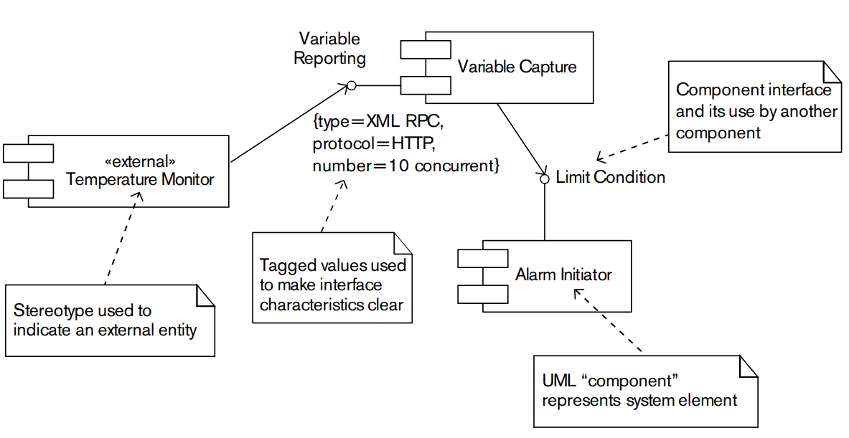
The Functional Viewpoint
Cornerstone of the architectural description.
Drives the definition of Information, Concurrency, Development, and Deployment Views.
Should offer structure to guide design without placing too many constraints.
Does not detail physical infrastructure.
Notes:
The Functional view is the cornerstone of most ADs and is often the first part of the description that stakeholders try to read. (Too often, it is also the only view of the architecture produced.) It is probably the easiest view for stakeholders to understand. The Functional view usually drives the definition of many of the other architectural views (particularly Information, Concurrency, Development, and Deployment). You will almost always create a Functional view and will
often spend a lot of time refining the structure that it defines.
A major challenge when defining the Functional view is to include an appropriate level of detail. It should Focus on what is architecturally significant—in other words, what has a visible impact on stakeholders—and leave the rest to your designers. It should Avoid documenting physical implementation details such as servers or infrastructure, as this will overcomplicate your model and confuse stakeholders

Slide 4
Key Attributes
Concerns:
Functional capabilities, external interfaces, internal structure, and functional design philosophy.
Models: Functional structure model
Problems and Pitfalls:
Poorly defined interfaces, poorly understood responsibilities, infrastructure modeled as functional elements, overloaded view, diagrams without definitions, reconciling stakeholders, wrong level of detail, and too many dependencies.
Stakeholders: All

Slide 5
Today’s (and Next) Class
Introduce the Functional Viewpoint.
How to specify and document.
Introduce the building blocks: elements, interfaces, and connectors.
The structures, what they can do, and how they interact.
Visualization using UML Context Diagrams
Pitfalls of functional architectural design.

Slide 6
Concern: Functional Capabilities
Define what the system is - and is not - required to do.
Some projects have a agreed set of requirements.
Functional View can focus on showing how the elements provide functionality.
Some projects will require a clear statement of system capabilities.
Notes:
Functional capabilities define what the system is required to do—and, explicitly or implicitly, what it is not required to do (either because this functionality is outside the scope of consideration or because it is provided elsewhere). On some projects, you will have an agreed-upon set of requirements at the start of architecture definition, and you can focus in the Functional view on showing
how your architectural elements work together to provide this functionality. However, in many projects this isn’t the case, and the onus will be on you in this case to ensure that there is a clear definition of what the system will (and won’t) be required to do.

Slide 7
Concern: External Interfaces
Define data, event, and control flow between your system and others.
Data can flow in or out.
Causing or caused by internal state change.
Events can be consumed or emitted.
Notifications for your system or issued to others.
Control can be inbound or outbound.
Requests to or made by your system.
Interface definitions must consider syntax and semantics.
Notes:
External interfaces are the data, event, and control flows between your system and others.
Data can flow inward (usually resulting in an internal change of system state) and/or outward (usually as a result of internal changes of system state).
Events can be consumed by your system (notifying your system that something has occurred) or may be emitted by your system (acting as notifications for other systems).
A control flow may be inbound (a request by an external system to yours to perform a task) or outbound (a request by your system to another to perform a task).
Interface definitions need to consider both the interface syntax (the structure of the data or request) and semantics (its meaning or effect).

Slide 8
Concern: Internal Structure
How do you construct your system?
How much code do you create yourself?
What is provided by external systems?
What middleware do you use?
What libraries do you import?
Internal structure defined by:
The elements
What they do (how do they map to requirements?)
How they interact
Choice impacts quality properties.
Notes:
In most cases, you can design a system in a number of different ways to meet its requirements. It can be built as a single monolithic entity or a collection of loosely coupled components; it can be constructed from a number of standard packages, or written from scratch; or its functional needs can be met by using existing services provided by systems external to this one or even to the organization. Your challenge is to choose among these many options in order to create an architecture that meets the requirements, exhibits the required quality properties, and is fit for purpose.
The internal structure of the system is defined by its internal elements, what they do (i.e., how they map onto the requirements), and how they interact with each
other. This internal organization can have a big impact on the system’s quality properties, such as its availability, resilience, ability to scale, and security (e.g., a complex system that crosses organizational boundaries is generally harder to secure than a simple one running on a couple of collocated machines).

Slide 9
Functional View Elements
Functional Elements
A well-defined part of the system that has responsibilities and a defined interface.
Software subsystem, cluster of classes, a package, a data store, a complete system.
Interfaces
A well-defined mechanism by which the functions of an element can be accessed by other elements.
Defined by inputs, outputs, and semantics of each operation.
Notes:
The functional structure model typically contains the following elements.
Functional elements: A functional element is a well-defined part of the system that has particular responsibilities and exposes well-defined interfaces that allow it to be connected to other elements. At its simplest level, an element is a software code module, but in other contexts it could be an application package, a data store, or even a complete system.
• Interfaces: An interface is a well-defined mechanism by which the functions of an element can be accessed by other elements. An interface is defined by
the inputs, outputs, and semantics of each operation offered and the nature of the interaction needed to invoke the operation. Common types of interfaces found in information systems are remote procedure calls (RPCs)through an API, messaging, events, and in some cases interrupts.

Slide 10
Functional View Elements
Connectors
Define the interactions between elements.
Can be simple or complex.
Simple: A calls B.
More complex: message-passing (the message could be a type of element).
External Entities
Other systems, software, hardware devices, etc. that interact with your system.
Also often have responsibilities and a defined interface.
Notes:
Connectors: Connectors are the pieces of your architecture that link the elements together to allow them to interact. A connector defines the interaction between the elements that use it and allows the nature of the interaction to be considered separately from the semantics of the operation being invoked. The nature of the interactions between elements can be intimately bound up in how they are connected.
The amount of consideration you need to give connectors depends on your circumstances. At one extreme—for example, when one element calls another via a simple procedure call—you can just note that one element connects to another. At the other extreme, such as a message-based interface, a connector can be defined as a type of element in its own right as it provides capabilities to the interactions that occur across it.
• External entities: External entities are other systems, software programs, hardware devices, or any other entity with which your system interacts. They are obtained from your system’s Context view, and each appears in the functional model at the far end of an interface, external to your system.

Slide 11
Functional View Elements
Does not define how code is packaged and executed in processes or threads.
Deployment and Concurrency Views
Does not depict underlying infrastructure.
I.e., server or networking infrastructure.
Deployment View
Might show things like message queues that are interelement connectors.
But you would omit the message broker that provides the queues - not relevant to functionality.
Notes:
The functional structure model does not define how code is packaged and executed in processes and on threads, so this view doesn’t constrain element packaging or deployment—this is the domain of the Concurrency and
Deployment views. Similarly, it is generally not a good idea to model underlying infrastructure as functional elements, unless that infrastructure performs a functionally significant task, independent of the other functional elements, without which the view doesn’t make sense. Infrastructure that simply supports the operation of the functional elements should normally not be shown in the Functional view; it is best considered in the Deployment view. For example, you might well want to show message queues, as they are important interelement connectors and so the view doesn’t make sense without them, but you probably don’t need to show the message broker that provides the
queues, which doesn’t add anything in this context. The message broker would be shown in the Deployment view.

Slide 12
Functional Design Characteristics
Coherence
Does the architecture have a logical structure with elements working together to form a whole?
Cohesion
To what extent are the functions provided by an element strongly related to each other?
Consistency
Are mechanisms and design decisions applied consistently throughout the architecture?
Notes:
(1) (2) If the architecture doesn’t look coherant, this may indicate that the element decomposition is wrong and may also make it harder for stakeholders to understand
(3-4) High cohesion is logically sensible and tends to result in simpler, less error-prone designs.
(5-6) A consistently designed and implemented system is easier to build, test, operate, and evolve than one with a lot of inconsistency.

Slide 13
Functional Design Characteristics
Coupling
How strong are the element interrelationships?
Do changes in one element affect others?
Extensibility
Will the architecture be easy to extend to allow the system to perform new functions in the future?
Functional Flexibility
How amenable is the system to supporting functional changes?
Generality
Are the mechanisms and decisions in the architecture as general as is practicable?
Notes:
1-3) Loosely coupled systems are often easier to build, support, and enhance but may suffer from poor scalability compared with a monolithic approach.
(4-5) Often the result of properties like coherance, low coupling, and high cohesion, but is worth keeping in mind explicitly while defining the functional view.
Related, (6-7) Systems that are designed to be easy to change are usually harder to build and typically don’t perform as well as systems that are less adaptable. However, there are obvious benefits to flexibility.
(8-9) If the solutions embodied in the architecture are generic, the architecture should be easier to extend and hcange. However, this must be balanced against an increase in cost and complexity

Slide 14
Functional Design Characteristics
Interdependency (Volume of Element Interactions)
What proportion of processing involves interactions between elements versus within elements?
Separation of Concerns
To what extent is each internal element responsible for a distinct part of the system’s operation?
To what extent is common processing performed in only one place?
Simplicity
Are the design solutions used within the system the simplest ones that would be suitable?
Notes:
(1-2) Communicating between elements can be an order of magnitude more expensive - in processing and elapsed time - and less reliable than performing an operation within an element. This is closely related to coupling, but is separated from the concept of change spillover and more focused on performance and reliability, quality attributes.
(3-5) High separation results in a system that is easier to build, support, and enhance but may adversely impact performance and scalability compared with a monolithic approach
(6-7). Complexity makes systems difficult and expensive to build, comprehend, operate, and evolve. On the other hand, a simplistic approach may not meet the requirements of a complex system.

Slide 15
Functional Design Characteristics
Achieving characteristics affects quality.
High cohesion, low coupling improve modifiability.
Separation of concerns, simplicity improve security.
Consistency improves performance, scalability.
However, “good” design can also negatively impact qualities.
Low coupling may degrade performance by increasing the number of communication steps.
Establish architectural principles to prioritize favored design characteristics.
Notes:
In general, these design characteristics have a positive effect on a number of system qualities, particularly those relating to evolution, such as flexibility and modifiability. They also have a positive effect performance and security (e.g., separation of concerns and simplicity can make security easier to achieve, while consistency is likely to make performance and scalability easier to achieve). In some cases, though, you
need to consider the possibility of a negative relationship between “good” design and other system qualities (e.g., very loosely coupled systems can be less performant than more tightly coupled ones by incrasing communication steps); in some cases this can mean the need to compromise over the design characteristics that can be achieved. We previously talked abotu establishing principles - this is a good technique for defining how you want the
design of the system to embody these design characteristics, as they can guide design decisions that support the characteristics that you are most interested in achieving.

Slide 16
Documenting the Functional View
Notes:
(discussion) Point is - there are a lot of different answers to this question

Slide 17
Functional View Notation
UML Component Diagram
Elements
Data Stores
Variable Capture
<<external>>
Temperature Monitor
<<infrastructure>>
Message Queue
User Data
Notes:
The typical way to visualize your functional view is to use a UML Component Diagram. Using UML for a Functional view has a number of advantages, including its widespread comprehension and its flexibility. The component diagram shows a system’s elements, interfaces, and interelement connections.
You represent each of the system’s elements and external entities with a box, annotated with its name and any stereotype needed to make the nature of the element clear. (Stereotypes are annotations used to note special types of components) One particularly useful stereotype is <<external>>, which indicates that the icon refers to an external entity, rather than an internal system element. Another is <<infrastructure>>, which indicates an infrastructure element of the system that has a distinct functional role.
Data stores are generally depicted using these little drums. These can also be marked using stereotypes like external.

Slide 18
Functional View Notation
Interfaces
Attached to an element (half-circle facing away from its element)
Named and tagged with attribute-value pairs that characterize the interface.
Alarm Initiator
LimitCondition
Variable Capture
VariableReporting
{ concurrentLimit = “10”, protocol = “HTTP”,
type = “XMLRPC” }
<<external>>
Temperature Monitor
Notes:
UML interface icons attached to a system element represent the interfaces it exposes (2). In
order to differentiate between types of interfaces, stereotypes may be defined with associated sets of tagged values that allow the characteristics of
particular interfaces to be captured (go over example). Using tagged values to capture the type of interface, the protocol used to access it (if any), and the number of concurrent users or connections allowed provides a good basis for interface classification.

Slide 19
Functional View Notation
Information Flow
Elements may exchange data outside of direct connectors.
Show flow of information (i.e., messages)
Boxes at ends are message ports (sending/receiving, based on direction)
Order Processor
Order message propagated via PUR1 EAI message endpoint to order fulfillment
<<pub/sub topic>>
Order Change Message
<<external>>
Order Fulfillment
Notes:
(1-2) An approach to depicting information flow is to use ports and information flows to model
message-oriented interactions between system elements. The notion of ports comes originally from the real-time systems community, where a port is an abstract representation of the source or destination of messages. (3)

Slide 20
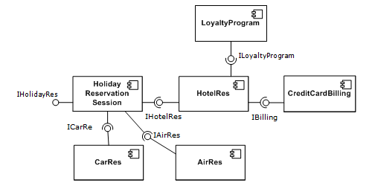
Example - Vacation Reservations
Notes:
Go over, point out interfaces

Slide 21
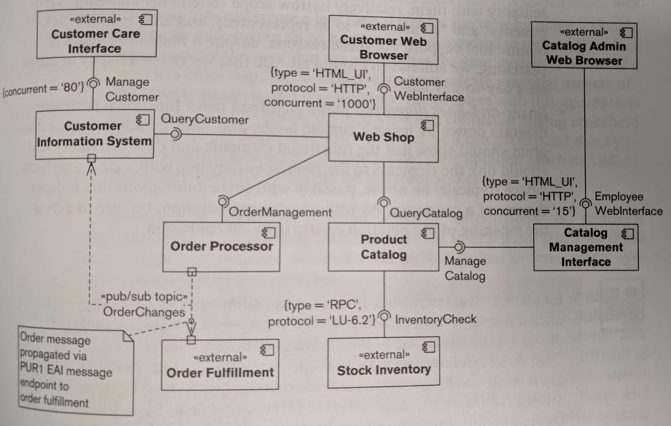
Example - Web Store
Notes:
The system under consideration provides a Web storefront
(called the Web Shop) for customers to use when purchasing items from an online catalog that fits
into an existing enterprise software environment.
The model shows that the system communicates with four external entities: the Web browsers of the three main user types (customers, customer care representatives, and catalog administrators) and an external system (the order fulfillment system). Our system is composed of five main functional components linked via a number of connector types (including HTML over HTTP and publish/subscribe messaging, with an LU 6.2 external interface).
Customers order from the Web Shop, which interacts with the Product Catalog, the Order Processor, and the Customer Information System. The catalog administrators maintain the product catalog via their Web-based interface, and the customer care representatives maintain the customer information via a dedicated interface client program (the Customer Care Interface). When the stock level of a particular item in the catalog is needed, the Product Catalog accesses this information from the Stock Inventory (which already exists).

Slide 22
Example - Web Store
What this tells us
Up to 1000 customers, 80 care reps, 15 admins may access the system at once.
Interaction between Product Catalog and Stock Inventory takes place using a specific protocol.
Unadorned communication takes place via a standard remote procedure call.
Notes:
We also have some insights into the nature of the intercomponent interactions. We know that up to 1,000 customers, 80 customer care representatives, and 15 catalog administrators may access the
system simultaneously. We also note that the interaction between the Product Catalog and the Stock Inventory components takes place using a specific protocol (presumably due to preexisting
technology). We can assume for this example that the unadorned intercomponent communication takes place via some form of standard remote procedure call (which we will assume has been clearly defined elsewhere).

Slide 23
Example - Web Store
What this model does NOT tell us
Element responsibilities are not clear.
Details of interfaces are not clear.
Details of how components interact are not clear.
No one diagram will fill in all details.
This is an overview, detail all elements, interfaces, and connectors using text descriptions.
Scenario models can fill in additional details.
Notes:
Having said this, one of the interesting points to note about this model is how much is not obvious
from the diagram. The responsibilities of the components aren’t clear, the details of their interfaces
aren’t clear, and the details of how the components interact aren’t clear. This impresses on us the
need to complete the textual descriptions that underpin the diagram and the need to understand the system via a number of models rather than just one (scenario models)

Slide 24
Elements
Notes:
(discussion) Point is - there are a lot of different answers to this question

Slide 25
Element Definition
Szyperski Definition:
An element has the following characteristic properties:
A software element is a unit of composition with contractually specified interfaces and explicit context dependencies only.
A software element can be deployed independently and is subject to composition by third party.

Slide 26
Element Definition
Szyperski definition implies that:
For an element to be deployed independently, a clear distinction from its environment and other elements is required.
An element must have clearly specified interfaces.
The implementation must be encapsulated in the element and is not directly reachable from the environment.
Notes:
What does this imply? Well, (2) - there must be a clear boundary, and (3) - a contract with its users. Further, (4) - access must be controlled and funneled through the defined interfaces.

Slide 27
Element Definition
D’Souza and Wills definition:
An element is a reusable part of software, which is independently developed, and can be brought together with other elements to build larger units.
It may be adapted but may not be modified.
An element can be compiled code without a source.
To describe an element completely, the element should consist of:
A set of interfaces provided to or required from the environment.
Executable code which can be coupled to the code of other elements through these interfaces.

Slide 28
Identifying Elements
Work through functional requirements, deriving key system-level responsibilities.
Identify the functional elements that will perform the responsibilities.
Assess against desired design criteria.
Iterate and refine until sound.
If an element is pre-defined (libraries or existing systems), understand their responsibilities and how they affect the architecture.
Notes:
You can identify the functional elements by following these steps.
1. Work through the functional requirements, deriving key system-level responsibilities.
2. Identify the functional elements that will perform those responsibilities.
3. Assess the identified set against the desirable design criteria.
4. Iterate back to refine the functional structure until you judge it to be sound.
Of course, some elements may be defined for you already (e.g., software libraries, software packages, preexisting systems or subsystems), in which case the process for these elements is one of understanding rather than identifying and designing.

Slide 29
Refining the Element Set
Generalization
Identify common responsibilities across elements, introduce new elements encapsulating those.
Allows reuse of elements across systems.
Decomposition
Break complex elements into smaller subelements.
Often needed in large systems to produce manageable subsystem-level elements.
Notes:
Refining the set of functional elements involves applying one or more refinements to the functional structure.
Generalization: identifying some common responsibilities across a number of elements and introducing a number of more general elements that can be reused across the system to perform these tasks. Generalization is particularly important as part of a larger enterprise or product-line architecture to allow reuse of software assets across similar products or systems.
• Decomposition: breaking a large, complex element into a number of smaller subelements. For large systems, you will often need to break the top-level functional elements into more manageable subsystem-level elements to allow them to be designed and built.

Slide 30
Refining the Element Set
Amalgamation
Replace small elements with a larger element that includes all functions of smaller ones.
Group similar standalone elements into one to increase cohesion.
Replication
Replicate either an element or a piece of processing.
Data validation might be repeated across multiple external interfaces.
Can bring performance benefits, but makes consistency difficult.
Notes:
• Amalgamation: replacing a number of small functional elements with a larger element that includes all of the functions of the smaller ones.
Amalgamation is typically used when a large number of small but similar functional elements have been identified. In such cases, it often makes sense from an architectural perspective to replace the smaller elements with a single large element that can factor out the commonality between the smaller ones and reduce the amount of interactions the system requires.
• Replication: replicating either a system element or a piece of processing. An example is data validation, where you identify a validation element for incoming data and then replicate it across a number of the system’s external interfaces. Replication can bring performance benefits, but care must be taken to keep the replicated components consistent.

Slide 31
Assigning Responsibility
Once elements are created, they must be assigned clear responsibilities.
Web Shop | Present customers with an HTML-based user interface they can access with a Web browser. Manage all state related to the customer interface session. Interact with other parts of the system to allow customers to view the catalog and stock levels, buy goods, and view their customer information.
Customer Information System | Manage all persistent information about customers of the system. Provide a query-only interface that can be used to retrieve information held on a particular customer that should be visible to that customer. Provide an information management programmatic interface that can be used to create customer information management applications. Provide an event-driven message-handling interface to accept details of orders placed by customers and the state changes of those orders
Notes:
Once you have identified candidate elements, your next activity is to assign clear responsibilities to them—that is, the information managed by the element, the services it offers to other parts of
the system, and the activities it initiates. Here are responsibilities assigned to two of the elements for the online shop we had in the diagram earlier (go over)

Slide 32
Interfaces and Connectors
Notes:
(discussion) Point is - there are a lot of different answers to this question

Slide 33
Interface Definition
An interface of an element can be defined as a specification of its access point, offering no direct implementation for any of its operations.
The implementation can be replaced without replacing the interface.
New interfaces can be added without changing the existing implementation.
Notes:
(1) This separation implies that (2-3)

Slide 34
Interface Definition
An interface defines a contract specifying how elements interact:
Set of participating elements
Role of each element, specified through its contractual obligations (i.e., data type).
Invariants to be maintained by elements.
Pre and post-conditions on calls to interface.
Specification of the methods that instantiate the contract.

Slide 35
Element Replacement
Substituting element Y for element X is said to be safe if all systems that work with X will also work with Y.
From a syntactic viewpoint, an element can safely be replaced if:
The new element implements at least the same interfaces as the older elements, or
The interface of the new element is a subtype of the interface of the old element.

Slide 36
Importance of Interfaces
Architectural thinking depends on interfaces!
Partitioning
Structuring
Testability
Reuse
Portability
Scalability
All depend on the interfaces that you design or that are made available.
Notes:
It cannot be emphasized enough just how important interfaces are. (1). From top to bottom, how your architecture is designed depends on the interfaces offered by elements.
(2-7). All of these depend on the interfaces that your elements surface. What the elements are, where their boundaries are, how they can be broken down, how much information is available when testing, whether you can reuse an element in a different project, how an element is accessed and how many can make use of that element. All are determined by the interfaces that you design.

Slide 37
Designing the Interfaces
The definition of an interface must include:
The operations that the interface offers
Inputs, outputs, pre-conditions, and post-conditions of each operation.
Nature of the interface
(messaging, procedure call, web service, etc.)
Computational Interfaces: Clients invoke defined functions.
Data-oriented Interfaces: Clients communicate through unidirectional data transfer.
Notes:
The services offered by your elements need to be accessed via well-defined interfaces. The definition of an interface must include the operations that the interface offers; the input, outputs, preconditions, and
effects of each operation and the nature of the interface (messaging, remote
procedure call, Web service). Two common categories of interfaces (6-7)

Slide 38
Design by Contract
Define an interface by establishing promises with the user of an element.
Pre-conditions: What the client must promise to the element in order to expect correct behavior.
(Binary Search: the input array must be sorted)
Post-conditions: What the element promises will happen on return.
(Quick Sort: the array will be sorted numerically)
Invariants: Conditions that will be met during execution of the operation.
Notes:
The appropriate type of interface depends on quality attributes, the requirements, and who needs to understand this information (considering factors such as the
likely implementation technology and the background of the development team).
A good approach to consider when developing element interfaces is Design by Contract, an interface design method created for developing interfaces in object-oriented systems. This approach involves
defining interfaces via “contracts” with the user of an element through the use of preconditions, postconditions, and invariants to precisely define operation behavior and relationships.
(2)

Slide 39
Computational Interfaces
Elements publish a set of operations that can be invoked. Clients call these operations to have the element perform them.
Can be directly defined in a program.
Simple, but ties you to use of that language.
Can be defined through interface definition languages (IDLs).
.NET IDL, CORBA IDL, Web Services Description Language (WSDL)
Programming language independent
Notes:
(1) Interfaces can be defined directly by using a programming language to define the operation signatures along with text and/or language assertions to define the operation semantics. This approach is simple but ties you to the style, assumptions, and limitations of the particular programming language. This may not be ideal, particularly if you’re using multiple technologies. This approach works particularly well for programming libraries or in other situations where the system is really a single, large programming artifact or where a single programming language is used to implement the entire system.
Specialist IDLs have also been developed to support mixed-language distributed systems technology (so there is an an IDL for .NET, WSDL for Web services, and so on). These languages are independent of implementation technology and tend to offer simpler facilities than programming languages do, more suitable for defining architectural interfaces.

Slide 40
Computational Interfaces
Responses are synchronous or asynchronous.
Synchronous
Typical approach.
Acts like a function call in a normal program.
Asynchronous
Type 1: Client provides an interface for callback when complete
Type 2: Client receives a token object (sometimes called a future) that will eventually hold output.

Slide 41
Interface Consistency
We say a two elements have consistent interfaces if:
Interface names match.
Provided and required function lists match.
Function parameter lists match.
Required: getSubQ(Natural first, Natural last, Boolean remove) returns FIFOQueue;
Provided 1: getSubQ(Index first, Index last) returns FIFOQueue;
Provided 2: getSubQ(Natural first, Natural last, Boolean remove) returns Queue;
Notes:
(1) - that is, the elements can work together, (2), if the functions they provide match what we require, and if (4). Are these two consistent with what is required?

Slide 42
Behavioral Consistency
Interfaces of interacting elements may match, but behaviors may not.
Example: subtraction
subtract(Integer x, Integer y) returns Integer;
Do we know what the subtract operation does?
Example: QueueClient and QueueServer elements
QueueClient
pre-condition q.size >= 1;
post-condition q’.size = q.size;
QueueServer
pre-condition q.size > 0;
post-condition q’.size = q.size - 1;
Pre-conditions are consistent, Post-conditions are not.
Notes:
Both take in and return a queue

Slide 43
Interfaces and Parameters
Structure depends on distribution model.
Function calls within a program are very cheap.
Calls between processes on the same machine are 100x - 1000x more expensive.
Calls between machines are (at least) 100,000x more expensive and are much more likely to fail.
Parameter passing via interfaces
Base types (bool, int, float, char, etc.): passed by value
Data structures: can be passed by reference if synchronized; must be passed by value if asynchronous.
References to other elements; get back a reference and make calls to it to get data.

Slide 44
Remote Procedure Calls
Can use the resources of multiple servers to solve a client’s goal.
Synchronous timing: Client blocks during call, so familiar computational model (function call)
Load Balancing: If interfaces are stateless, then it is possible to throttle scale RPCs through load-balancing across multiple servers
Speed: RPCs are faster than messaging for call and response operations.

Slide 45
Remote Procedure Calls
Unreliable Communication & Idempotence: RPCs are difficult to make 100% reliable. Need to ensure that operations are idempotent!
Idempotent - messages/data is retransmitted if there is a failure.
Thread management: Servers can handle many concurrent clients.

Slide 46
Data Transfer Objects
Remote calls (i.e., through web services) are expensive and failure-prone.
Majority of the cost is related to round-trip time between client and server.
DTOs carry data between processes.
Aggregate data that would be transferred over several calls, and handle it in a single call.
Offer storage, retrieval, serialization, and deserialization of data, but no other functionality.
Notes:
However, if communication is done through remote interfaces (e.g., web services), each call is an expensive operation. The majority of the cost of each call is related to the round-trip time between the client and the server, one way of reducing the number of calls is to use a data transfer object - an object that carries data between processes - to aggregate the data that would have been transferred by the several calls, but that is served by one call only. A DTO does not have any behavior except for storage, retrieval, serialization and deserialization of its own data (mutators, accessors, parsers and serializers). In other words, DTOs are simple objects that should not contain any business logic but may contain serialization and deserialization mechanisms for transferring data over the wire. So, instead of having a series of calls and returns, you can call functionality, then transfer the needed data at the end.

Slide 47
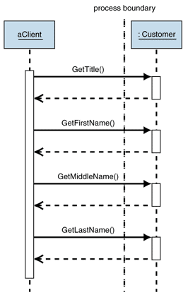
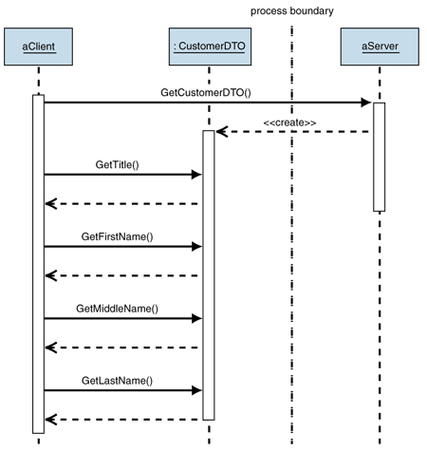
Data Transfer Objects
Without DTO
With DTO:

Slide 48
Data-Oriented Interfaces
Elements communicate through unidirectional data transfer.
Data defines the means of communication.
Messages or documents are transferred, initiating a process.
Common for elements that perform event-based actions, rather than on-command actions.
Pipe and filter, real-time architecture, message queueing systems.
Notes:
Interfaces can also be described purely in terms of messages that are exchanged, where (1). (2-3) Examples of this type of interface definition include interfaces accessed via messaging systems and interfaces defined in terms of structured document exchange (e.g., document-oriented, Web-service-based interfaces with messages defined using XML Schema). This approach works particularly well for event-based interfaces that are defined in terms of the exchange of business events rather than the invocation of operations. (5)

Slide 49
Data Interface Considerations
Message (packet) vs Stream:
Are items batched and sent as individual messages (packets), or are items processed immediately (sent through an open stream to the element)?
Are messages queued by the element?
If a job is in-process, are new requests queued or ignored?
Is data transferred using lossy or guaranteed delivery?
TCP vs UDP
UDP allows faster transfer, but lacks error checking.
TCP guarantees correct data, but transfers may fail.

Slide 50
Data Interface Advantages
Can transfer packets of data frequently, immediately, reliably, and asynchronously using customizable formats.
Variable timing
Unlike RPCs, sender and receiver can work at their own pace.
Throttling
Because receiver buffers requests, it can control rate at which they are consumed so to avoid overload.
Reliable Communication
“Store and forward” communication ensures delivery.
Notes:
Store and forward is a telecommunications technique in which information is sent to an intermediate station where it is kept and sent at a later time to the final destination or to another intermediate station. The intermediate station, or node in a networking context, verifies the integrity of the message before forwarding it.

Slide 51
Data Interface Advantages
Disconnected Operation:
Can run client applications disconnected with server and then synchronize when connection is available
Mediation
Messaging system acts as a mediator between all programs that send and receive messages. If an application becomes disconnected, it must only reconnect with messaging system, not other apps.
Thread management
Threads do not block waiting for remote server.

Slide 52
Data Interface Challenges
Complex Programming Model
Messaging requires developers work with an event-driven programming model; applications must have callbacks for events from remote applications
Sequence Issues
Message channels guarantee delivery, but not when message will be delivered. This can lead to messages being delivered out of sequence
Synchronous scenarios
Many times we want application to behave synchronously. Data interfaces tend to be asynchronous.

Slide 53
Data Interface Challenges
Performance
Messaging systems add overhead to communications for each message.
Structuring messages correctly is important to performance.
Vendor Lock-in
Many messaging systems rely on proprietary protocols.
Even specifications such as JMS do not control the physical implementation of the solution, so different messaging systems may not connect to one another, leading to yet another integration problem.

Slide 54
Connectors
Elements must communicate in order to achieve system goals.
Connectors link elements and the interfaces of elements they depend on.
How we implement a data or procedure-based interface (RPC, messaging, file transfer, etc)
Must consider:
Synchronous or asynchronous communication
Resiliency of the connector
Concurrent users
Acceptable latency of connections
Notes:
The elements of your system need to communicate in order to achieve the system’s goals, and as you identified your element responsibilities, you probably noted the need for elements to interact in order to implement their responsibilities. The interactions take place across connectors of some sort that link delegating elements to the interfaces offered by the elements to which they wish to delegate. For each required interelement
communication path in your architecture, add a connector to the model to
support it (be that RPC, messaging, file transfer, or other mechanisms).
Sometimes the type of connector required is self- evident (such as a simple procedure call), whereas in other cases you’ll need to
think carefully about whether you need synchronous or asynchronous communication, the resiliency required of the connector, the acceptable latency
of interactions across it, and so on.

Slide 55
Connectors on One Machine
Tend to be simple
Procedure call
Data interfaces:
Message queueing through a mutex-protected queue object.
“Last update” through mutex-protected shared memory.
What about when we move to multiple machines?

Slide 56
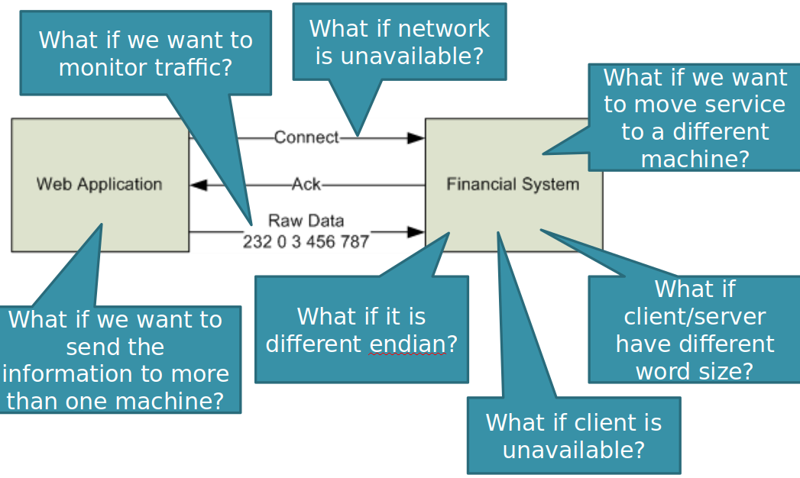
Moving to Remote Access

Slide 57
Object Request Brokers
Middleware that allows program calls to be made from one computer to another.
Allows objects from one process to be used in another process as though they were part of the same process.
Transform in-process data structures into a byte sequence, and transmit it over a network to another process (serialization).
Notes:
In distributed computing, an object request broker (ORB) is a middleware which allows program calls to be made from one computer to another via a computer network, providing location transparency through remote procedure calls. In object-oriented languages, an ORB actually provides a framework which enables remote objects to be used over the network, in the same way as if they were local and part of the same process. ORBs promote interoperability of distributed object systems, enabling such systems to be built by piecing together objects from different vendors, while different parts communicate with each other via the ORB.ORBs handle the transformation of in-process data structures to and from the raw byte sequence, which is transmitted over the network. This is called serialization.

Slide 58
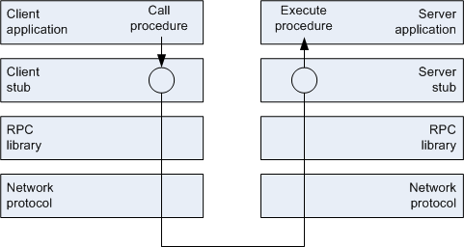
Object Request Brokers
Client creates a stub object and call a method.
Client-side ORB serializes data and transfers to server-side ORB.
Server-side ORB executes operation and returns result.
Same semantics whether or not client and server are on same computer.
Notes:
In object-oriented languages, an ORB actually provides a framework which enables remote objects to be used over the network, in the same way as if they were local and part of the same process. On the client side, so-called stub objects are created and invoked, serving as the only part visible and used inside the client application. After the stub's methods are invoked, client-side ORB performs the serialization of data, and forwards the request to the server-side ORB. On the server side, ORB locates the targeted object, executes the requested operation, and returns the results. Having the results available, client's ORB performs the demarshalling and passes the results back into the invoked stub, making them available to the client application. The whole process is transparent, resulting in remote objects appearing as if they were local

Slide 59
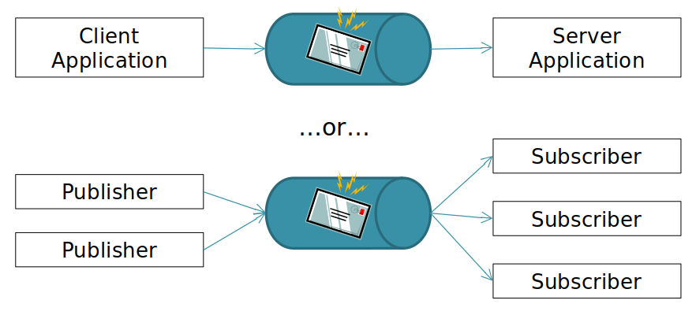
Message-Oriented Middleware
One-way message is queued and later processed (asynchronous)
Decouples sender and receiver
Message queues ensure that messages are not lost
Message relate to transaction to be executed
Example: SMTP (e-mail)

Slide 60
More Subtle Than It Looks...
Possible to implement message-oriented middleware through remote procedure calls, and vice-versa.
Possible to implement asynchronous communication over RPCs.
Pass in a “callback interface”
Once task is completed, result is returned to the client through callback.

Slide 61
Interfaces and Distribution
For distributed interfaces, should synchronous or asynchronous interaction be preferred?
Often asynchronous:
Higher availability, higher throughput, higher performance
Implement through messaging, RPCs with “callbacks”

Slide 62
Interfaces and Distribution
When communicating with a remote component or service, the chance of failure goes up dramatically. Why? How can we address it?
Idempotence (resend messages)
Statelessness (ensure we do not corrupt state when something goes wrong)
Component and service isolation
Can service continue if something happens?
Cache data, preload data, defer processing

Slide 63
Functional View Pitfalls
Notes:
(discussion) Point is - there are a lot of different answers to this question

Slide 64
Refining the Functional View
Check the functional traceability.
Ensure all functional requirements are met by the proposed functional structure.
Table relating requirements to elements.
Walk through common scenarios.
Use the functional view to illustrate how the system behaves in a scenario.
Explain how the elements would interact to implement that scenario.
Will point out weaknesses (i.e., too much interaction) or missing elements.
Notes:
Check the Functional Traceability. The requirements documentation for your system will have defined a number of functions that the system has to offer. You should carry out a traceability check to ensure that all functional requirements have been met by the proposed functional structure. Such an analysis often reveals missing or incomplete functions in the functional structure model. the traceability analysis is often presented as a table of functional requirements cross-referenced against the functional model elements with responsibilities relating to those requirements. Check marks in cells indicate that the requirement is covered by that element.
Walk through Common Scenarios. It can be extremely valuable to walk through common system usage scenarios with your stakeholders, using the Functional view to illustrate how the system will behave in each case; doing this with the testers, the development team, and the system administrators can be particularly useful. In such a walkthrough, you should explain how the system’s elements would interact in order to implement the scenario. Often, architectural weaknesses or misunderstandings as well as missing elements are identified as part of such a process.

Slide 65
Refining the Functional View
Analyze the interactions.
Analyze the chosen structure based on the number of interelement interactions taken during processing.
Reducing interactions results in better structure, efficiency, reliability.
Revised system must still be appropriately partitioned, without undesirable redundancy.
Analyze for flexibility.
Walk through “what-if” changes to see if the proposed structure can change with minimal impact.
Often conflicts with interaction analysis. Must trade efficiency for flexibility where it makes sense.
Notes:
Analyze the Interactions. Given the impact that excessive interelement interactions can have, it is useful to analyze the chosen structure from the point of view of the number of interelement interactions taken during common processing scenarios. Refining the functional structure to reduce interelement interactions to a minimum set without distorting the coherence of the functional components usually results in a well-structured system with cohesive, loosely coupled elements. It is typically an important step toward an efficient and reliable system. When performing interaction analysis, you need to make tradeoffs to ensure that reducing interelement interactions does not result in a distorted system structure with undesirable redundancy or inappropriate element partitioning.
Analyze for Flexibility. Successful systems are always under pressure to change. Given this reality, you should consider how flexible your architecture is in the face of change, as early in the project as you can. The functional structure of a system is often one of the primary factors affecting flexibility. It’s useful to work through some “what if” scenarios that reveal the impact of possible future changes on your system. A common problem at this point is that the changes implied by the change analysis conflict with those suggested by the interaction analysis. Therefore, it is important that you trade off these two factors during architectural evaluation in order to find the right balance for your system, and that you avoid burdening your design with complexity that will never be used.

Slide 66
Pitfall: Poorly Defined Interfaces
Without good interface definition, development teams will make implementation mistakes.
Leads to build errors, obviously incorrect behavior, subtle unreliability.
To reduce risk:
Define interfaces and connectors clearly and early.
Review frequently to ensure clear understanding.
Do not consider element definition complete until interfaces have been designed.
Make sure interface definitions include operations, their semantics, and examples.
Notes:
Many architects define their elements, responsibilities, and interelement relationships well, yet totally neglect their connectors and interface definitions. This is one of the most important tasks you can perform for the system.
Without good interface definitions, major misunderstandings will occur between subsystem development teams, leading to a range of problems from build errors to obviously incorrect behavior to subtle, occasional system unreliability.
Risk Reduction
• Define your interfaces and interelement connectors clearly and as early as possible.
• Review interfaces and connectors frequently to ensure that they are clearly understood.
• Do not consider element definition complete until interfaces have been designed.
• Make sure that interface definitions include the operations, their semantics, and examples where possible.

Slide 67
Pitfall: Poorly Understood Responsibilities
If you don’t define all responsibilities of the elements, confusion can remain over exactly what each element is meant to do.
Can lead to missing or duplicated functionality.
To reduce risk:
Ensure responsibilities are formally defined early.
Do not allow development to drift into element design without responsibilities being formally defined
Make sure all implementers understand where their boundaries are (and why they are there).
Make sure all requirements have been mapped to elements that implement them.
Notes:
It is easy to become very focused on a couple of key scenarios and to consider the functional elements only in this context. If you don’t define all of the responsibilities of the elements (and don’t perform traceability analysis), a lot of confusion can remain over exactly what each functional element is meant to do. This often leads to problems later: Either functionality is missing because it fell between the gaps, or functionality is duplicated because two subsystem
development teams both thought that a piece of functionality was their responsibility.
Risk Reduction
• Ensure that element responsibilities are formally defined as early as possible.
• Do not allow the development process to drift into element design without element responsibilities being formally defined and agreed upon.
• Make sure that all implementers understand where their boundaries are (and why they are there).
• Make sure that all requirements have been mapped to the elements that implement them.

Slide 68
Pitfall: Infrastructure Modeled as Functional Elements
Include infrastructure elements only if important to understanding functional view.
Include a messaging gateway that performs some functional processing, but not the application server you are using.
To reduce risk:
Avoid modeling infrastructure elements as you develop your initial model. Focus on functional elements that solve part of the problem.
Question any elements that do not have names related to the problem domain.
Address infrastructure concerns in deployment view.
Notes:
In general, you should not model underlying infrastructure as functional elements. Adding infrastructure elements to the Functional view simply makes it more confusing without adding useful information. Infrastructure can normally be hidden inside the functional elements; the Deployment view defines the infrastructure in more detail. Include infrastructure elements only if their role is important to understanding how the Functional view works (e.g., you might want
to include a messaging gateway that performs some functional processing for you, but it’s very rarely the case that including the application server you are using adds anything).
Risk Reduction
• Avoid modeling underlying infrastructure elements as you develop your initial element model. Focus on functional elements that solve part of the problem the system is going to address.
• Question the need for any elements that do not have names related to the domain of the problem being addressed.
• Address specific infrastructure concerns in another view (typically, a Deployment view).

Slide 69
Pitfall: Overloaded View
Often tempting to add deployment or concurrency information to this view.
Do not allow functional view to become overloaded. Will be harder to understand and follow.
To reduce risk:
Remove everything except for items related to the functional elements, interfaces, and connectors.
Create other views to describe the other aspects of your architecture.
Develop the other views in parallel and cross-reference between views to illustrate other aspects of the architecture.
Notes:
The Functional view is the cornerstone of the AD and is often the primary structuring device. However, don’t let it become all of the views rather than just the central view. It is often tempting to overload the Functional view with the intent to make things clearer by adding deployment or concurrency information or other aspects of the architecture to this view. Don’t allow the Functiona lview to simply creep into being an overloaded description of many aspects of the system. Such a description is very unlikely to be easy to understand and therefore is of limited use.
Risk Reduction
• Remove everything from your Functional view except for items related to the functional elements and their interfaces and connectors.
• Create other views, based on the other viewpoints we define in this book, to describe the other aspects of your architecture.
• Develop the other views in parallel and cross-reference between views to illustrate other aspects of the architecture.

Slide 70
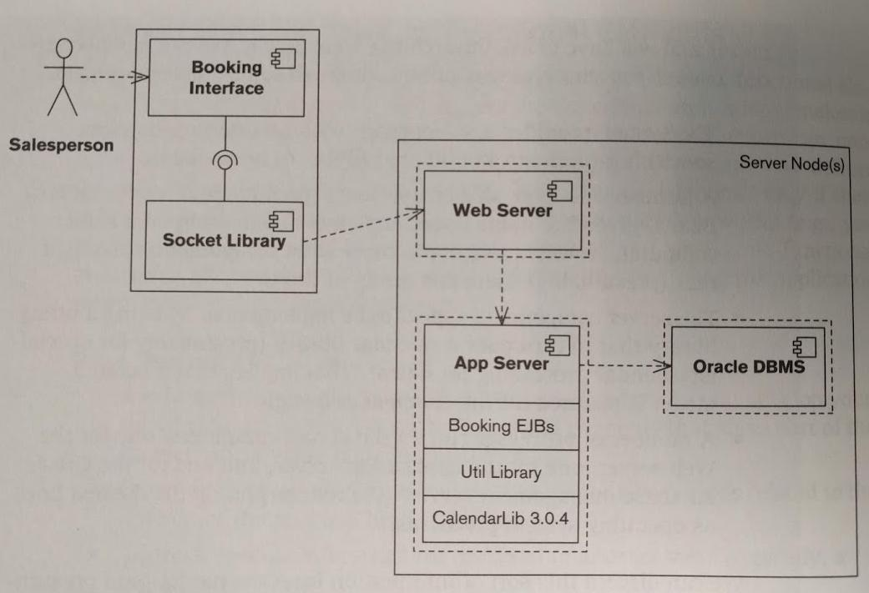
Example: Overloaded View
Notes:
What’s wrong with this?
This model has a number of problems. It’s obviously related in format to what we went over, but various bits and pieces of ad hoc notation have been added:
- the dashed line from the Socket Library box to the Web Server box, the dashed lines within the Server Node(s) box, and so on. This means that we don’t really know what the diagram means and will have to ask the architect who drew it. (We’re interpreting the dashed lines as operating system processes.)A number of processes run on the server computers: one for the Web server, one for the application server, and one for the Oracle database management server.
• A number of server-side components (presumably Enterprise Java Beans, given the name used) implement something on a server computer. However, we don’t know what components exist, just that (presumably) there is a group of them.
• The server components appear to be implemented by using a utility library that in turn uses a calendar library (presumably for specialist calendar processing for dates). Infrastructure details.
We can discern this sort of information from the model (and presumably could untangle the notation if we could talk with the architect); the real problem is the overloading of the diagram. Even in our initial understanding of it, we need to consider functional structure, deployment across machines, concurrency, software design constraints, and so on. These are separate concerns, at different abstraction levels, of interest to different stakeholders. The result is that none of the concerns are addressed very clearly, and this model probably can’t be used with any of our stakeholders apart from developers and testers (and even they will probably need more detail about each of their concerns).
The overloading of the model is probably also one of the reasons that the notation is confusing. It is very hard to overload a diagram’s function and not end up with notational confusion because of the need to represent a number of unrelated concepts together on one diagram.

Slide 71
Pitfall: Wrong Level of Detail
If too detailed, or define too many layers of elements, you are constraining design.
Can lead to mistakes on your behalf.
Too little detail risks misinterpretation.
To reduce risk:
Avoid defining more than 2-3 levels of elements, with 8-10 elements at the top level.
Avoid too many details about the internal structure of functional elements in main view.
If system is very large, model it as a group of systems.
Notes:
A common question when creating the Functional view is when to stop. If the process of functional analysis becomes too detailed and ends up defining too many layers of elements, you are starting to design all of the software, rather than just the architecturally significant parts. This can cause real problems, not least of which is the lack of input from the development team. Conversely, if you
don’t include enough detail, there is a risk that people will misinterpret your ideas and the system won’t be able to deliver the qualities that you need it to. Obviously, there is no simple solution to this problem—it depends on the context.
Risk Reduction
• if you have to define more than two or three levels of elements, assuming a limit of about eight to ten functional elements at the top level, you may have a problem. So, if possible, keep your level of detail below this limit.
• Another danger sign can be the inclusion in the Functional view’s models of details about the workings or internal structure of functional elements. If your system is very large, modeling it as a group of systems rather than working down into the elements would make the problem tractable.

Slide 72
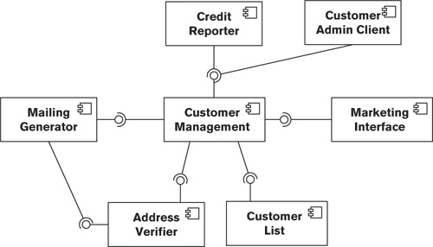
Pitfall: “God Elements”
A single huge “God Element” sits at the center of a design, with many small elements attached.
Notes:
You will often see object-oriented designs that have a single huge object in the center, with lots of small objects attached to it. This situation is often dubbed the “God object” problem.
In this situation, the Customer Management system element appears to exhibit the major
characteristic of a God element, namely, nearly all interelement interactions involve it.

Slide 73
Pitfall: “God Elements”
“God Elements” contain too much functionality and have too many dependencies.
Often, “God Element” is the entire program and the small elements are just data storage.
Often result of too much consolidation after interaction analysis.
Results in difficult maintenance.
“God Element” dominates quality properties.
To avoid, aim for even ditribution of responsibilities. If >50% of functionality is in <25% of elements, may have “God Elements”
Notes:
From this structure, it is likely that the Customer Management element contains too much of the system’s functionality and has dependencies with too many of the system’s elements.
The underlying problem in such cases isusually an inappropriate partitioning of responsibilities among design elements—the large object is really the entire program, and the small objects are often just data structures that this object uses. This often happens if you consolidate too zealously (perhaps as a result of interaction analysis).
This problem leads to a situation where the system is hard to maintain because the God element is terribly complex and difficult to understand. It also results in this one component’s characteristics dominating the quality properties that the system exhibits. It becomes difficult to solve related problems like performance,
eliability, or scalability because they all involve changing this one system element.
To avoid, Aim for a broadly even distribution of system-level responsibilities amongyour major elements. As a guideline, if you find more than 50% of your system’s responsibilities concentrated in less than 25% of your functional elements, you may be heading toward a number of large elements and your system will lack cohesion, be difficult to develop, and be resistant to change.

Slide 74
Pitfall: Too Many Dependencies
Avoid having too many small elements that depend on each other.
Will make the system harder to change, will worsen performance.
To reduce risk:
Compress related elements together.
In general, an element should be aware of the existence of only a couple of other elements in order to perform its functions.
If any elements need to services from more than 50% of the other elements, revising the structure.
Notes:
Opposite problem. The converse to the God object problem is static object diagrams that look like a number of spiders fighting for control. Complex interactions between elements make the system harder to design and build and may lead to a solution that is hard to change and performs poorly.
Risk Reduction
• This problem can often be the symptom of too many small elements in the system; practicing some judicious compression may help you resolve it.
• In general, a system element should need to be aware of the existence of only a couple of other elements in order to perform its functions. If any of your elements need to use services from more than 50% of the other elements in the system, consider revising your functional structure.

Slide 75
Checklist (Food for Thought)
Do you have fewer than 15-20 top-level elements?
Do all elements have a name, responsibilities, and clear interfaces?
Do all element interactions take place via well-defined interfaces and connectors?
Do your elements exhibit an appropriate level of cohesion?
Do your elements exhibit an appropriate level of coupling?

Slide 76
Checklist (Food for Thought)
Have you identified the important usage scenarios and used these to validate the functional structure?
Have you checked the coverage of requirements by your architecture?
Have you defined and documented architectural design principles, and does your architecture comply with these principles?

Slide 77
Checklist (Food for Thought)
Have you considered how the architecture is likely to cope with future change?
Does the presentation of the view take into account the concerns and capabilities of all interested stakeholder groups?
Will the view act as an effective communication vehicle for all groups?

Slide 78
Activity: Airport Parking
Notes:
(discussion) Point is - there are a lot of different answers to this question

Slide 79
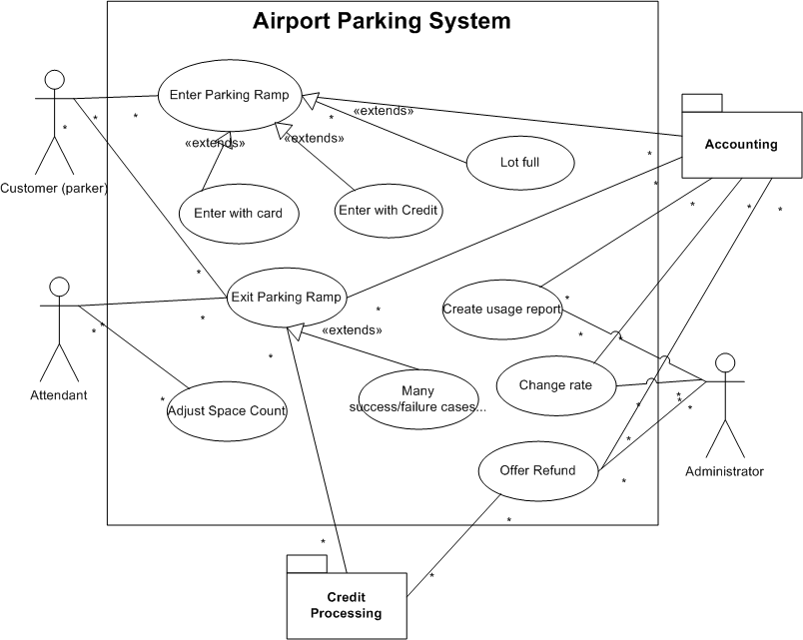
Use Cases

Slide 80
General Principles
Encapsulate components that are likely to change
Hardware
Policies (pricing, lot capacity, etc.)
Define services that individually and collectively have value
High Coherence
Low Coupling

Slide 81
Food for Thought
What do you need to track?
On entry?
On exit?
Where do you store completed transactions? In the system? Sent through interface to accounting system?
For pricing?
When performing manual overrides
Who can perform them?
How do you log them?
What do you need to control?
Physical gates for entry / exit
Entry kiosks
Credit card reader
Parking card dispenser
Exit kiosks
Automated: credit card / parking card reader
Optional: cash input
Attendant kiosks
Point of sale device: in or out of system?
Allow manual override of charges?

Slide 82
Food for Thought
How do you want to report?
Revenue?
Partitioned by pricing type?
Current? Over time?
Card stock levels per entry kiosk?
Mechanical failures?
Ramp usage? Utilization over time?

Slide 83
The Activity
From the requirements, use cases, and other provided information:
Derive elements. For each, briefly note the responsibilities and purpose of that element.
Draw a UML Context Diagram depicting the system.
You do not need to design interfaces, but think about how you would implement important ones.

Slide 84
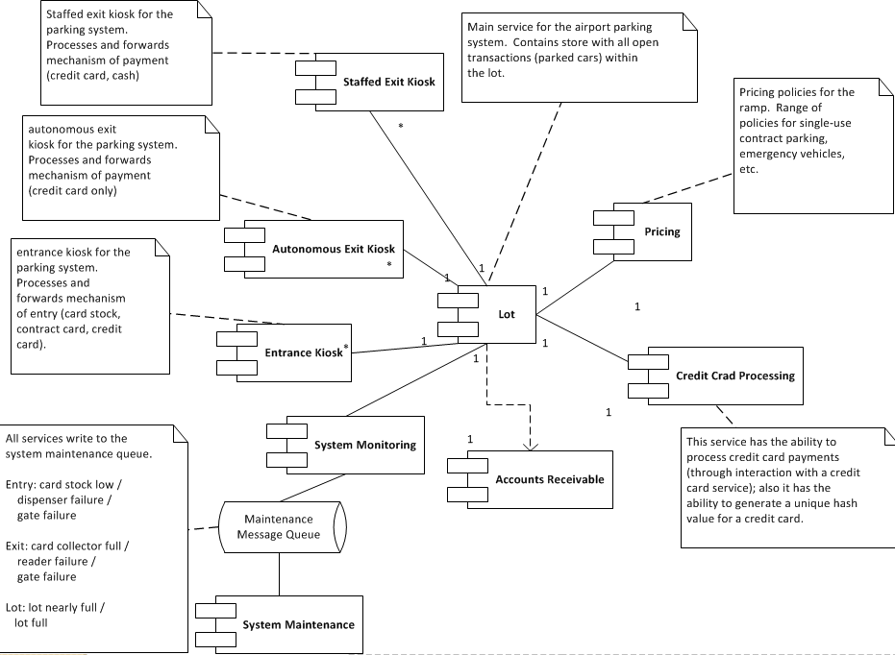
Suggested Solution

Slide 85
Key Points
The functional view of a system defines the architectural elements that deliver the functions of the system being described.
Documents the system’s functional structure:
Key functional elements and their responsibilities.
The interfaces they expose (internal/external).
The interactions between them.
This view demonstrates how the system will perform the functions required of it.
Notes:
(1) It can also help reveal omissions and errors in the requirements and is useful when it comes to testing the system. We defined two classes of scenarios: functional scenarios, which are nearly
always defined in terms of a sequence of external events the system must respond to in a particular way; and system quality scenarios, which are defined in terms of how the system should react to a change in its environment, as a
consequence of one of the quality properties it is meant to exhibit. (4)

Slide 86
Next Time
Architectural Style: REST
Source: Roy Fielding. “Architectural Styles and the Design of Network-based Software Architectures”
Homework:
Assignment 1 - due 10/02
Project Part 2 - due 10/11
Assignment 2 - due 10/25
Notes:
(read)

