Slide 1
Course Overview:
Verification and Validation
CSCE 747 - Lecture 1 - 01/12/2016

Slide 2
Today’s Goals
Introduce The Class
AKA: What the heck is going on?
Go over syllabus
What you should already know
Clarify course expectations
Assignments/grading
Answer any questions
Cover the basics of verification and validation
Gregory Gay CSCE 747 - Spring 2016 2

Slide 3
When is software ready for release?
Notes:
Just start with a question - want you to start thinking about this. (read)
This isn’t something with one answer, or even a right answer. It’s something we’ll keep returning to

Slide 4
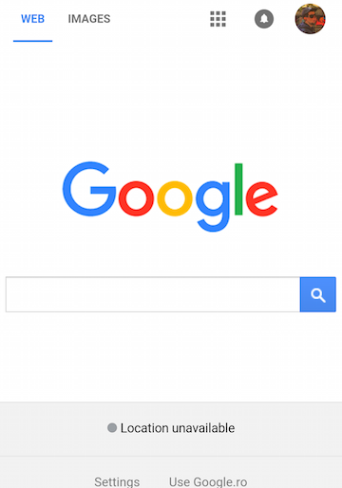
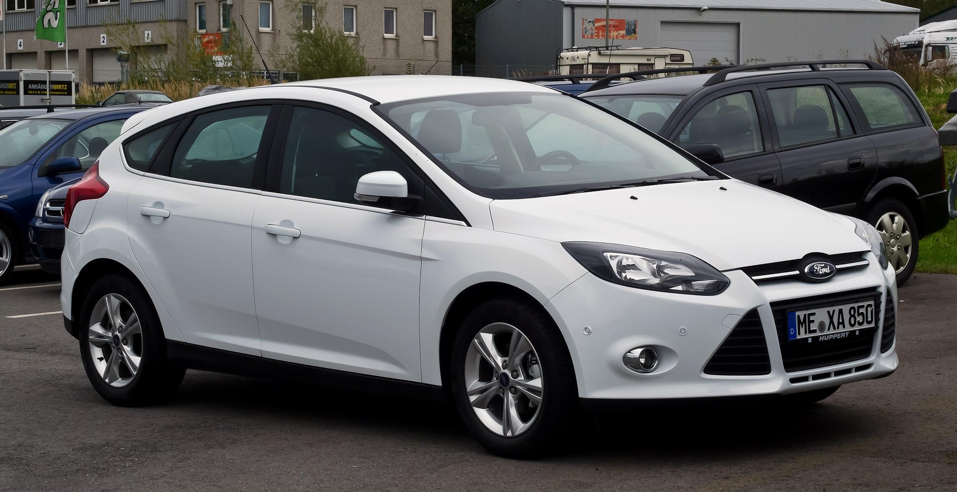

Our Society Depends on Software
This is software: So is this:
Also, this:
Gregory Gay CSCE 747 - Spring 2016 4
Notes:
Amazon, of course, is software. No one disputes that. If I ask you about software, you’d mention something like this - a web app, a video game, a word processor. That’s not all that is software though - Our society is built on software. It powers our homes, it manages our private information, it controls our cars, it automates our factories and it even regulates our bodies. Ford is one of the largest software makers in the country. It is incredibly important that we construct good software. We need robust, operational systems, especially given growing demand for features, limited development budgets and strict time constraints.

Slide 5
Flawed Software Will Hurt Profits
“Bugs cost the U.S. economy $60 billion annually… and testing would relieve one-third of the cost.”
- NIST
“Finding and ﬁxing a software problem after delivery is often 100 times more expensive than ﬁnding and ﬁxing it before.”
- Barry Boehm (TRW Emeritus Professor, USC)
Gregory Gay CSCE 747 - Spring 2016 5
Notes:
If you screw up during design, development, or testing - if you release bad software...
software bugs hurt your bottom line. They are expensive to fix, and only become more expensive the longer they remain active. The cost of fixing bugs, handling tech support, distributing the patched software, and addressing potential legal issues is not insignificant.
In 2002, a study commissioned by the US Department of Commerce' National Institute of Standards and Technology concluded that "software bugs, or errors, are so prevalent and so detrimental that they cost the US economy an estimated $59 billion annually, or about 0.6 percent of the gross domestic product"
The report estimated that minor improvements in software testing would relieve 1/3rd of that cost.

Slide 6
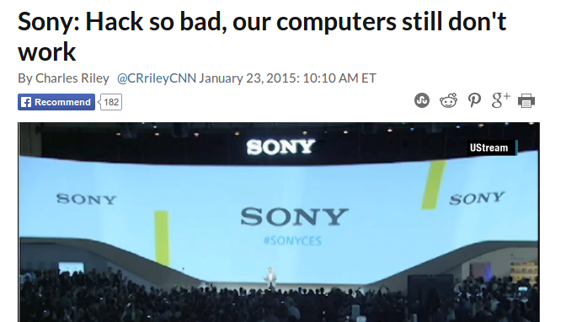
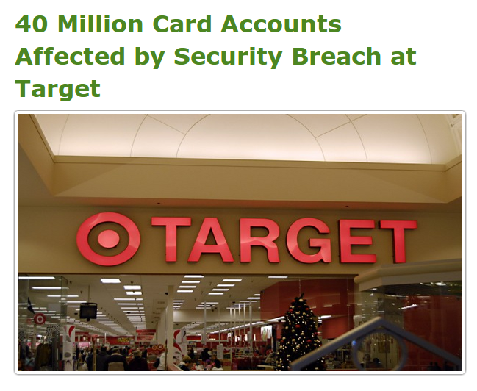
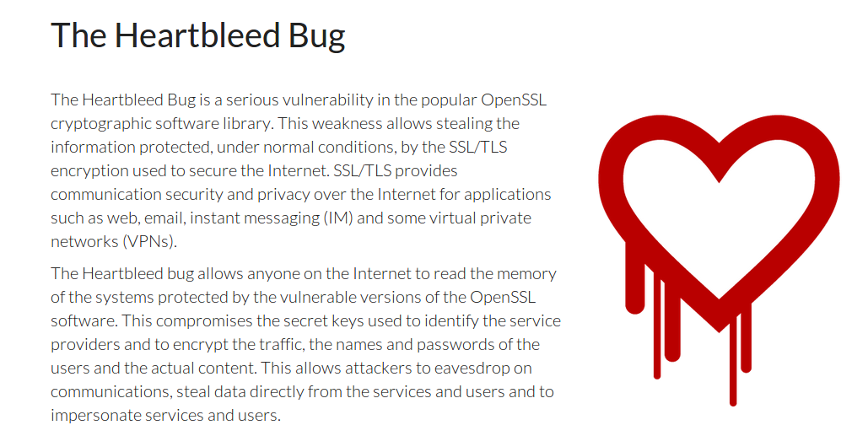
Flawed Software Will Be Exploited
Gregory Gay CSCE 747 - Spring 2016 6
Notes:
If your software is flawed, if you take short-cuts, if you don’t take security seriously, or if you don’t take the time to test your system, your flaws will be exploited. No matter how big or small you are, there are hackers working to find holes in your security, software defects they can take advantage of. You constantly see headlines about security breaches leading to leaked credit cards, or the secret documents of corporations and governments being leaked to the world. Even the software we assume is safe, the open-source code powering the modern internet, is being cracked.
Now, some of this is in the realm of security, but how you develop software matters. It may take some time, but, as a developer, improper engineering efforts will cost you. As expensive as it may be, as time consuming, to produce robust software, not taking proper engineering seriously will cost you - the loss in profit or reputation may easily outweigh the savings from releasing early.

Slide 7
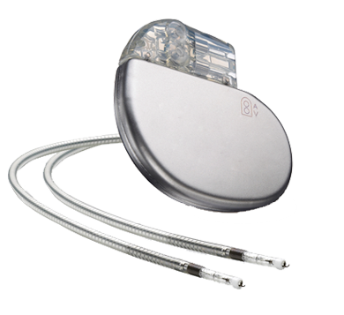
Flawed Software Will Hurt People
In 2010, software problems were responsible for 26% of medical device recalls.
“There is a reasonable probability that use of these products will cause serious adverse health consequences or death.”
US Food and Drug Administration
Gregory Gay CSCE 747 - Spring 2016 7
Notes:
Security breaches are bad - they can cripple financial instruments, they expose users to identity theft, but those are a drop in the bucket compared to the full extent of how much software can effect your life.
This little device, fits in the palm of my hand, is a pacemaker. A little block of sensors, pulse generators, and a lot of complicated software, that regulates the beating of the heart. Just one example of the growing medical device industry - little complex combinations of hardware/software that are implanted in patients and used to improve their quality of life.
In 2010, software problems were responsible for 26% of medical device recalls. These were classified by FDA as class 1 recalls, meaning (quote).
To swap one of these devices, to remove a defective one, a patient must undergo surgery - a life-threatening operation in order to fix a software issue.
This is just a single example. Software has been at fault in rocket explosions, helicopter crashes, radiation overdoses, plant failures, and more.

Slide 8
This Course
The key to good software?
Verification and Validation
Does the software do what we promised?
Does the software meet the needs of its users?
In this course, we will explore the testing and analysis activities that make up the V&V process.
Gregory Gay CSCE 747 - Spring 2016 2
Notes:
So, the key to delivering robust software is through a thorough process known as v&v - verification and validation.
This essentially asks two things (read 3-4)
In this course, we will explore the process of software verification and examine a variety of methods to test systems, prove their correctness, and make an argument that the software we build is reliable and safe to use.

Slide 9
Desired Course Outcomes
The students will be familiar with the process of verification and validation.
… will understand the process of applying tests to software and the fundamental components of a test case.
… will be able to derive test cases from software requirement specifications - including being able to partition input and output domains, form test specifications, and identify valid combinations of input.
… will understand and be able to distinguish between methods of judging test case adequacy and how to design tests that will accomplish the obligations of such methods.
… will understand how to build models of system behavior and prove that their obey required properties.
… will be able to make logical arguments that prove the correctness of program implementations.
… will be able to write code to automate test execution and analysis.
… will be familiar with methods of measuring software reliability.
Gregory Gay CSCE 747 - Spring 2016 9
Notes:
read off

Slide 10
Lecture Plan (approximate)
Introduction and Fundamentals (1 week)
Functional and Combinatorial Testing (1 week)
Test Case Adequacy/Structural Testing (1 week)
Data Flow Testing (1 week)
Testing Object-Oriented Software (1 week)
Model-Based Testing/Finite State Verification (1 week)
Proofs and Analysis (1 week)
Execution and Automation (3 weeks)
Inspections (1 week)
End-of-Testing Activities (1 week)
Presentations (2 week)
Gregory Gay CSCE 747 - Spring 2016 10
Notes:
read off

Slide 11
Contact Info
Instructor: Greg Gay (Dr, Professor, $#*%)
E-mail: greg@greggay.com
Office Hours: T/Th, 4:00-5:00 PM, 3A66 Swearingen Engineering Center
Website:
http://dropbox.cse.sc.edu/course/view.php?id=90
(Moodle - will be used for course material and assignment submission)
http://greggay.com/courses/spring16csce747/
(Static backup - somewhat behind, but useful if Moodle is down)
Gregory Gay CSCE 747 - Spring 2016 11
Notes:
read off

Slide 12
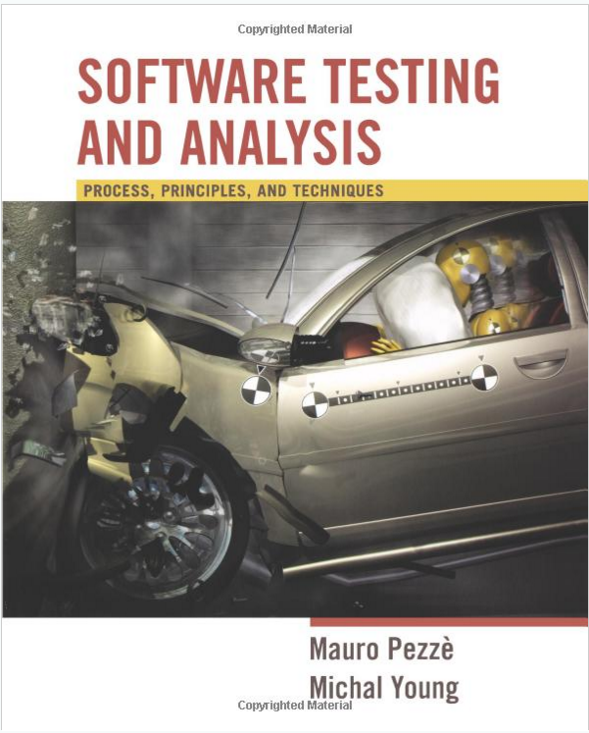
Textbook
Required:
Software Testing and Analysis, Mauro Pezze and Michal Young.
(Only one edition)
Amazon: Rental for ~$23, Used for ~$40, new for ~$50
Additional readings
4-5 over the semester
Will be made available on Moodle
Gregory Gay CSCE 747 - Spring 2016 12
Notes:
don’t buy at publisher’s price - ripoff - but you can get a rental for pretty cheap or buy it off aftermarket for cheap

Slide 13


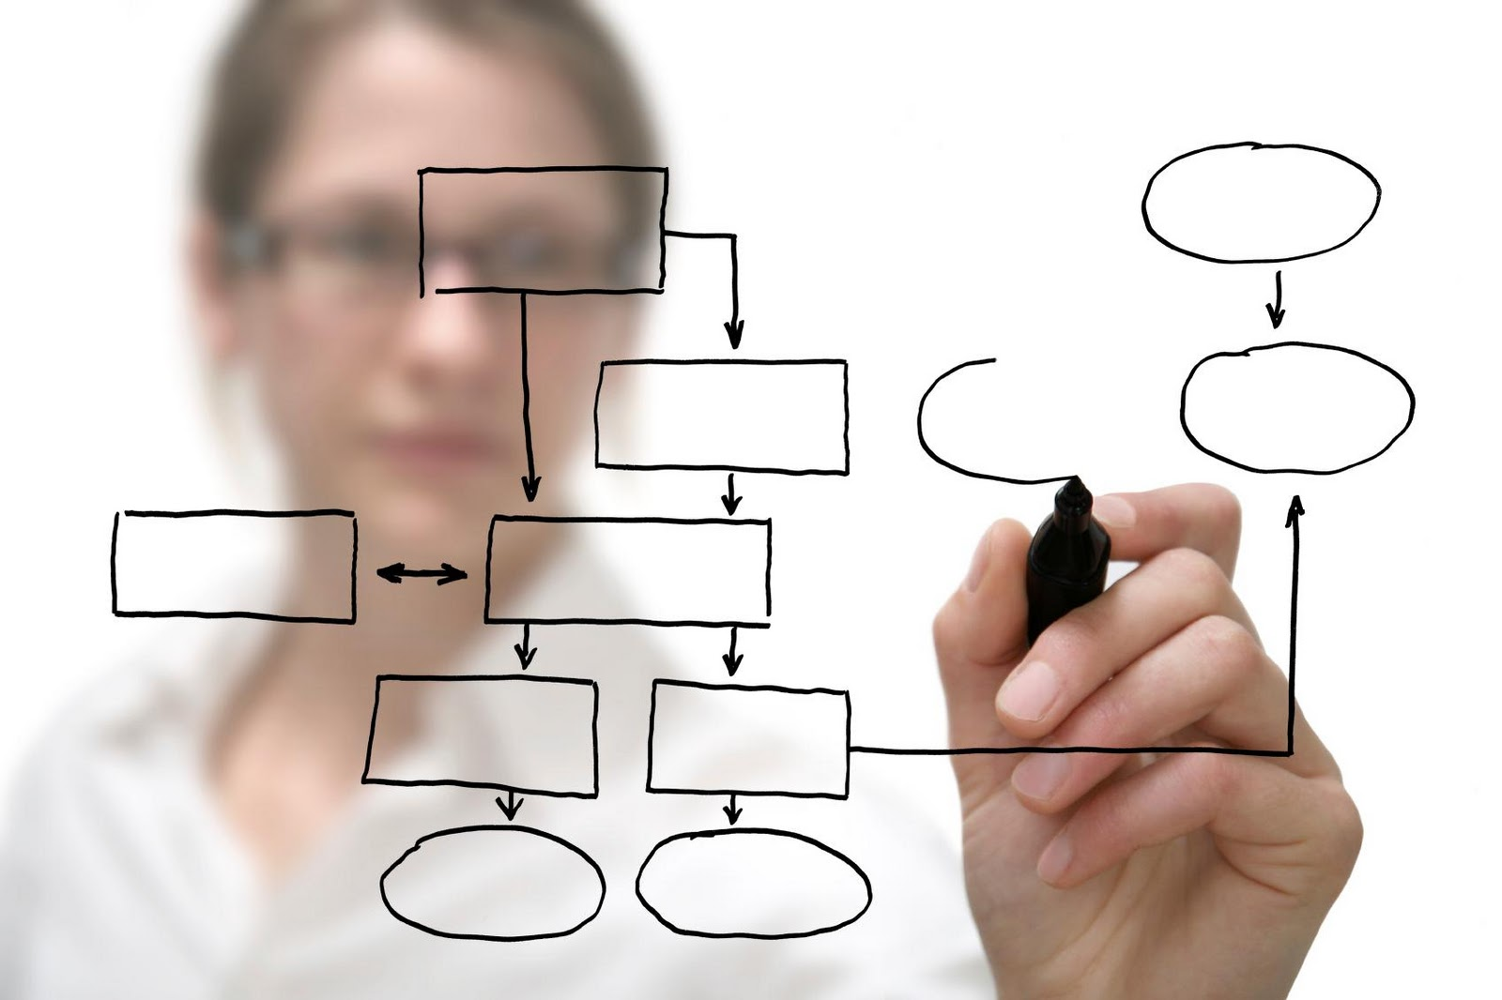
Learning Modes
Lectures/Textbook
Class Discussions
Group Project
Gregory Gay CSCE 747 - Spring 2016 13
Notes:
Most of the time, we’re in normal class mode. I will stand up here and drone at you, then toss in a joke to keep you awake
Then, because it’s boring to just listen to me talk. For me too. We’ll do a lot of group discussion. I’ll ask questions,try to get you to answer them. We’ll work through problems and examples in a group. I expect you guys to respond. I’ll stand here until someone does.
Project. Work in groups on a large-scale software project. You’ll go through each stage of development, and build a system. The idea is that you get to put the course content into practice.

Slide 14
Prerequisites
CSCE 740 - Software Engineering
Not essential, but very helpful.
You need to be proficient in Java
(and, ideally, C++)
You should be able to read and write programs without additional instruction.
This is not a programming language class.
You need a basic understanding of algorithms, logic, and sets.
Gregory Gay CSCE 747 - Spring 2016 14
Notes:
(read 1-2) - I know the MSE schedule is a little weird, but you should have taken that. If not, not a huge deal - we will recover the basics of testing (those who took it might be a little bored), but we will also go far beyond what we covered in there.
(read rest)

Slide 15
Assignments and Grading
Group Assignments (45% in total)
Groups of 3.
Frequent peer evaluations.
Individual Assignments (15%)
Reading + 1 page summary
Literature Survey (20%)/Presentation (10%)
More soon.
Participation (10%)
In-class activities.
Group participation.
Answering questions.
Gregory Gay CSCE 747 - Spring 2016 15
Notes:
1) You will work in groups of 3 students to complete assignments. Apogee students may choose to work alone or in a group. In class students must work in groups unless you have a particularly compelling reason otherwise. Now, group doesn’t mean you can slack off. There will be peer evaluations, and those will impact your grade.
2) There will also be individual reading assignments. Everyone will read the same paper and submit a one page summary.
3) There will be no exams. Instead, each person will choose a topic and prepare a literature survey, then present it at the end of the semester.
4) Finally, there is a participation component to your grade. There will be in-class exercises throughout the semester. Attending and completing those will make up most of this grade. Apogee students should e-mail those within a week of the class. Your group performance and whether you take part in in-class conversations will also make up part of this grade.

Slide 16
Literature Survey
Most of the topics we cover in this class could fill a whole semester.
You will be presented with a list of testing topics, and choose one to dive into.
You will prepare a 12 page survey (template to be provided) on this topic.
In the last two weeks, you will present a 12 minute talk on your findings.
Gregory Gay CSCE 747 - Spring 2016 16
Notes:
Throughout the course, we will introduce a number of testing topics. Many of these topics could easily fill their own courses. Therefore, part of your task for the semester will be to choose one of the topics we are covering and become an expert on it.
Early in the semester, a list of topics will be circulated. You will choose one of these topics and be responsible for writing a 12 page literature survey, summarizing trends and cutting-edge research in that area. This paper will be due at the end of the semester.
During the last week of classes, all students will present their findings in a 12-minute TED-style talk. APOGEE students will be responsible for either presenting in person, presenting live through a screen-sharing or video chat service (Skype/Google Hangouts/etc), or filming their presentation.

Slide 17
Expected Workload
This class can be time consuming.
Understanding a field takes time.
It will not be easy to write the survey.
Project work requires team coordination.
Do not underestimate the project work.
Good engineering is hard.
Planning and scheduling your time is essential.
Do NOT delay getting started.
Gregory Gay CSCE 747 - Spring 2016 17
Notes:
project -
We’re not trying to make things arbitrairly hard to justify teamworks, but good engineering is hard - it takes time adn work
planning/scheduling is essential. most issues come from people starting too late and trying to cram. That doesn’t work here. Especially given the need for teamwork. Working together takes planning.
You can’t slack off - we do use peer evaluations in grading, and if you don’t take part, you won’t get the grade.

Slide 18
Feedback
Problems with assignments, course questions, feedback?
Contact me! I like feedback!
Problem with instructor
Also contact me
Contact CS front office
Gregory Gay CSCE 747 - Spring 2016 18
Notes:
(read). I’m new. I’m going to make mistakes. I’ll forget things, try things that don’t work out, and will change things as we go along. Don’t hesitate to contact me at any time. I want your feedback. If something isn’t working, don’t wait until the end to tell me - let me know and we’ll see what we can do about it.

Slide 19
Other Policies
Integrity and Ethics:
The homework and programs you submit for this class must be entirely your own. If this policy is not absolutely clear, then please contact me. Any other collaboration of any type on any assignment is not permitted. It is your responsibility to protect your work from unauthorized access.
Classroom Climate:
All students are expected to behave as scholars at a leading institute of technology. This includes arriving on time, not talking during lecture (unless addressing the instructor), and not leaving the classroom before the end of lecture. Disruptive students will be warned and potentially dismissed from the classroom.
Gregory Gay CSCE 747 - Spring 2016 19

Slide 20
Other Policies
Make-Up and Late Homework
Make-ups for graded activities may be arranged if your absence is caused by a documented illness or personal emergency.
Homework assignments are due at the time noted on the assignment handout. Late work is not accepted without prior approval. Any assignment turned in after the due date will be considered late and will be subject to a penalty of 10% per day, including weekends and holidays.
Gregory Gay CSCE 747 - Spring 2016 20
Notes:
(read 1-3) - A written explanation (including supporting documentation) must be submitted.
Make-up arrangements should be completed prior to the scheduled activity.
(read 4)

Slide 21
Other Policies
Diversity
Students in this class are expected to respectfully work with all other students, regardless of gender, race, sexuality, religion, or any other protected criteria. There is a zero-tolerance policy for any student that discriminates against other students.
Special Needs
We will provide, on a flexible and individual basis, reasonable accommodations to students that have disabilities that may affect their ability to participate in course activities or to meet course requirements Students with disabilities should contact their instructor early in the semester to discuss their individual needs.
Gregory Gay CSCE 747 - Spring 2016 21
Notes:
Someday you will graduate, and in the real world, you will have to work with a wide variety of people. Now is the time to abandon preconceived prejudices about others. Students in this class are expected to respectfully work with all other students, regardless of gender, race, sexuality, religion, number of tentacles, whether they pick their nose, or any other possible criteria. Real talk here - we’re a bunch of nerds, and nerds have a reputation for not knowing what to do when women are in the room. Don’t be that stereotype. There is a zero-tolerance policy for any student that discriminates against other students, regardless of the reason. Be a professional adult.
(read)

Slide 22
When is software ready for release?
Notes:
Just start with a question - want you to start thinking about this. (read)
This isn’t something with one answer, or even a right answer. It’s something we’ll keep returning to

Slide 23
Basic Answer...
Software is ready for release when you can argue that it is dependable.
Correct, reliable, safe, and robust.
The primary process of making software dependable (and providing evidence of dependability) is Verification and Validation.
Gregory Gay CSCE 747 - Spring 2016 24
Notes:
So, the short answer - and you’ll see pretty soon why this is so complicated - is that (read).
This is usually measured along four dimensions (read).
(read)

Slide 24
Verification and Validation
Activities that must be performed to consider the software “done.”
Verification: The process of proving that the software conforms to its specified functional and non-functional requirements.
Validation: The process of proving that the software meets the customer’s true requirements, needs, and expectations.
Gregory Gay CSCE 747 - Spring 2016 25
Notes:
Verification and validation are two essential activities (read)
These sound similar, but they’re a little different.

Slide 25
Verification and Validation
Barry Boehm, inventor of “software engineering” describes them as:
Verification: “Are we building the product right?”
Validation: “Are we building the right product?”
Gregory Gay CSCE 747 - Spring 2016 26
Notes:
Barry Boehm - the guy who invented the term and what we think of as the practice of “software engineering” today - came up with the most succinct definitions of each. (read)

Slide 26
Verification
Is the implementation consistent with its specification?
“Specification” and “implementation” are roles.
Source code and requirement specification.
Detailed design and high-level architecture.
Test oracle and requirement specification.
Verification is an experiment.
Does the software work under the conditions we set?
We can perform trials, evaluate the software, and provide evidence for verification.
Gregory Gay CSCE 747 - Spring 2016 26
Notes:
Verification asks if (read). Usually, at the beginning of a project, we lay out a set of requirement specifications. We state the set of properties that define how the software’s functionality will work. What defines correct behavior? What equations are used? What properties must not be violated? Then, once we build the code, we want to go back and see if the code meets these properties. If it doesn’t, then the code is wrong - whether it crashes or not, it doesn’t do what it was supposed to do. So, verification is how we argue that the software meets its specification.
That said (read 2) - verification is something we do all the time in software development, because we constantly move from plan to reality, and we need to be able to step back and check whether we have remained consistent throughout the process. (read examples)
In any of these cases, verification is a check of consistency between two descriptions. It is an empirical activity - an experiment we can conduct.
(read)

Slide 27
Validation
Does the product work in the real world?
Does the software fulfill the users’ actual requirements?
Not the same as conforming to a specification.
If we specify and implement all behaviors related to two buttons, we can achieve verification.
If the user expected a third button, we have not achieved validation.
Gregory Gay CSCE 747 - Spring 2016 27
Notes:
Validation asks a broader question - (read 1-2)
(read). A specification is one view of how to solve a problem. The trouble is that solution might not actually achieve the goals that the users want fulfilled. (read 4-5) The software works, under the conditions we set. We can argue that with no problem. That said, it doesn’t do what the users actually want, so we didn’t build the right software.

Slide 28
Verification and Validation
Verification
Does the software work as intended?
Validation
Does the software meet the needs of your users?
This is much harder.
Validation shows that software is useful. Verification shows that it is dependable. Both are needed to be ready for release.
Gregory Gay CSCE 747 - Spring 2016 28
Notes:
(read 1-4) talk about people
The point of both verification and validation is ensuring that the software we’re building works. If it doesn’t, we’ve wasted our time, we’re trying to sell a product no one wants or can use.
Ultimately, the point of both is to answer the big, nebulous question of whether the software is correct and ready for release, but at two different scopes.
(read rest)

Slide 29
Verification and Validation: Motivation
Both are important.
A well-verified system might not meet the user’s needs.
A system can’t meet the user’s needs unless it is well-constructed.
This semester focuses on verification - how can we ensure that the software we build is dependable.
Testing is the primary activity of verification, and our main focus in this class.
Gregory Gay CSCE 747 - Spring 2016 29
Notes:
Both are extremely important, and they are closely linked. (read2). You could have had a misunderstanding, the customer might not have told you everything
But, (read 3). Without verification, you’re likely to have missed faults or requirements mistakes. You’ll never meet their needs to the degree that is required if you don’t start from a solid base.
You can’t build a successful, robust system without both. Verification and validation is about making an argument that you’ve built the best solution for the job. Validation is somewhat subjective, as it involves people - but being able to argue that your software meets their needs is a good start to making the validation case. Verification gives you the evidence to make that argument. Verification is not subjective. It can be conducted poorly, but you have an experimental setup with well defined operating conditions. You can prove that the implementation meets its specification, and you can use that as the basis for validation - you can offer some assurance that you didn’t screw up. Under these conditions, the system does exactly what we promised it would do. So, both come hand-in-hand in determining the success of your project.

Slide 30
Required Level of V&V
The goal of V&V is to establish confidence that the system is “fit for purpose.”
How confident do you need to be? Depends on:
Software Purpose: The more critical the software, the more important that it is reliable.
User Expectations: When a new system is installed, how willing are users to tolerate bugs because benefits outweigh cost of failure recovery.
Marketing Environment: Must take into account competing products - features and cost - and speed to market.
Gregory Gay CSCE 747 - Spring 2016 30
Notes:
The ultimate goal of verification and validation processes it to establish confidence that the software system is “fit for purpose”, it’s good enough for its intended use and ready to ship. The level of required confidence depends on the system’s purpose, the expectations of the system users, and the current marketing environment for the system
(read). This means that the V&V process is stricter the more serious the consequences of something going wrong. V&V is easy for a to-do list - bugs won’t cause trouble. It’s harder for a web store, since money can be lost. It’s even harder for a medical device, since people can be hurt.
(read) Maybe. But, they still expect the software to become more reliable as the system matures, and failure to increase reliability can be costly.
(read) Those weigh heavily into the calculation of how much time and effort to spend on V&V

Slide 31
Basic Questions
When do verification and validation start? When are they complete?
What techniques should be applied to obtain acceptable quality at an acceptable cost?
How can we assess readiness for release?
How can we control the quality of successive releases?
How can the development process be improved to make verification more effective (in cost and impact)?
Gregory Gay CSCE 747 - Spring 2016 31
Notes:
So, as an engineer who wants to build a robust piece of software, you need to sit down at the start and answer five basic questions. Those answers will guide the entire V&V process, and by the time this class is over, you will be able to answer these questions like experts.

Slide 32
When Does V&V Start?
V&V starts as soon as the project starts.
Feasibility studies must consider quality assessment.
Requirement specifications can be used to derive test cases.
Design can be verified against requirements.
Code can be verified against design and requirements.
Feedback can be sought from stakeholders at any time.
Gregory Gay CSCE 747 - Spring 2016 32
Notes:
(read all)
Quality and dependability must be part of every phase of design. Verification is not just about the running source code, but must be used to check each stage of design and development.

Slide 33
Types of Verification
Static Verification
Analysis of static system artifacts to discover problems.
Proofs: Posing hypotheses and making a logical argument for their validity using specifications, system models, etc.
Inspections: Manual “sanity check” on artifacts (such as source code) by other people or tools, searching for issues.
Gregory Gay CSCE 747 - Spring 2016 33
Notes:
Verification comes in two main forms - either static or dynamic.
Static verification is (read). So, it’s the process of inspecting the artifacts produced during development - the requirements, specifications, design documents, source code to find issues, to make formal arguments for correctness. A couple common forms of static verification include
(read), (read).
Static verification can be very effective, and more importantly, does not require working code to perform. Static verification can start from the moment you have detailed requirements or a specification document, and can continue throughout the entire development process.

Slide 34
Advantages of Static Verification
During execution, errors can hide other errors. It can be hard to find all problems or trace back to a single source. Static inspections are not impacted by program interactions.
Incomplete systems can be inspected without additional costs. If a program is incomplete, special code is needed to run the part that is to be tested.
Inspection can also assess quality attributes such as maintainability, portability, poor programming, inefficiencies, etc.
Gregory Gay CSCE 747 - Spring 2016 34
Notes:
(read) - you can read through pieces of the code in isolation and look for issues.
(read). If you need to actually execute the code, (read)
(read) - there are even automated code review techniques that inspect for known vulnerabilities or design issues.

Slide 35
Dynamic Verification
Exercising and observing the system to argue that it meets the requirements.
Testing: Formulating controlled sets of input to demonstrate requirement satisfaction.
Static verification is not good at discovering problems that arise from runtime interaction, timing problems, or performance issues.
Dynamic verification is often cheaper than static - easier to automate.
Gregory Gay CSCE 747 - Spring 2016 35
Notes:
Dynamic verification, on the other hand, involves the working code. In dynamic verification, you (read)
Dynamic verification takes many forms, but the central one is testing. When performing testing as a verification activity, you are less focused on finding bugs, and more on demonstrating compliance. You formulate sets of input in order to demonstrate that the software meets the conditions imposed on it - that it fulfills the specification of a requirement.
(read). Code reviews are limited in their use. They aren’t as useful for looking at how objects interact when the system executes. That’s where a lot of your problems are going to lie, and you need to actually run the code to see those problems emerge.
(read)

Slide 36
The Trade-Off Game
Software engineering is the process of designing, constructing and maintaining the best software possible given the available resources.
We are always trading off between what we want, what we need, and what we've got. As a NASA engineer put it,
“Better, faster, or cheaper - pick any two”
Gregory Gay CSCE 747 - Spring 2016 36
Notes:
This is what I also led 740 off with - in all of software engineering, from design, to development, to testing - there is rarely one single correct answer to the question of how you approach that activity. What testing technique do I use? What verification technique?
the honest answer is that, in general - (read).
That point - the best we can do given what we have means there is always a trade-off game. As a NASA engineer put it, “we want products to be better, faster to develop, and cheaper to develop - you aren’t getting all three. Best you can do is pick two.” It can be created on a short schedule without a big budget, but that comes at a cost to quality. It can be developed quickly and quality can be maintained, but that will cost you. This semester, you will hear me say several times that the right answer depends on your product, your budget, your resources. It depends is frustrating, but it is the honest answer. What we’ll do is prepare you to make that judgement call.

Slide 37
The Role of Software Engineers
Software engineers, therefore, aren’t just responsible for designing, constructing, and maintaining software.
They are the people we look to plan, make, and justify well-informed decisions about trade-offs throughout the development process.
Gregory Gay CSCE 747 - Spring 2016 37
Notes:
Your

Slide 38
Perfect Verification
For physical domains, verification consists of calculating proofs of correctness.
Given a precise specification and a program, we should be able to do the same… Right?
Verification is an instance of the halting problem.
For each verification technique, there is at least one program for which the technique cannot obtain an answer in finite time.
Testing - cannot exhaustively try all inputs.
We must accept some degree of inaccuracy.
Gregory Gay CSCE 747 - Spring 2016 38
Notes:
(read 1-2)
Software is, in many ways, entirely too complex. There are logical paradoxes regarding situations where programs analyze other programs. This is Turing’s halting problem - we can’t assume that there is a program that can - given another program and input - find out whether that program eventually halts. We will eventually hit something that cannot be analyzed in finite time. The same is true in verification
(read 4).
Take testing. In theory, we could prove that a program is correct by trying every possible test case. This is a proof by cases - a perfectly valid technique. But, how long would that take? How about for addition? two integers. In java, an int is 32 bits, so there are 2^32 x 2^32 inputs for addition, 10^21 test cases. At one nanosecond per test, that would take about 30000 years to solve. That’s not going to do.
So, in practice, verification techniques all display some form of inaccuracy.

Slide 39
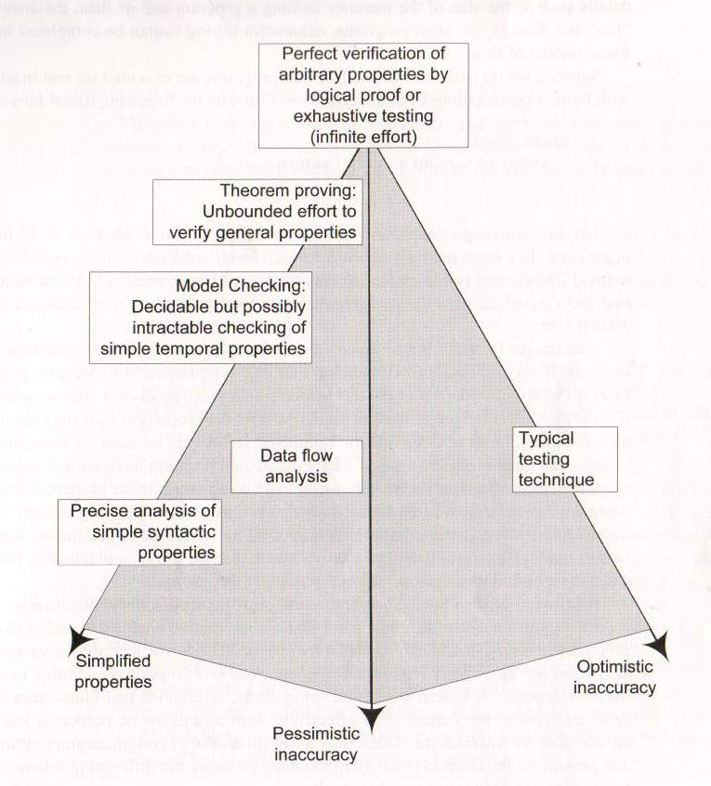
Verification Trade-Offs
Three dimensions of inaccuracy:
Pessimistic Inaccuracy - not guaranteed to accept a program even if the program possesses the property.
Optimistic Inaccuracy - may accept a program that does not possess a property.
Property Complexity - if one property is too difficult to check, substitute one that is easier to check or constrain the types of programs checked.
Gregory Gay CSCE 747 - Spring 2016 39
Notes:
So, the question of which verification technique applies involves making trade-offs across three dimensions of inaccuracy -pessimistic inaccuracy, optimistic inaccuracy, and simplicity of the property
(read 2 - 3)
Testing is the classic optimistic technique, because no finite number of tests can guarantee correctness. Instead, we aim to provide evidence that we did “good enough”.
Now, there is a third dimension to consider, which is the complexity of the property that you wish to verify. (read)
If we aren’t willing to accept the optimistic inaccuracy of testing and the only other technique is too pessimistic, well.. maybe we know of a similar property that is correlated with the one of interest. If that property is simpler, and if it is a necessary condition for your property, then analyze that property instead. We may then be able to find precise violations rather than potentially missing violations or being flooded with false rejections.
(go over examples)

Slide 40
Assessing Verification Techniques
Safe
No optimistic inaccuracy - it only accepts programs that are correct with respect to that property.
Sound
An analysis of a program with respect to property is sound if the technique returns true ONLY when the program does meet the property.
If true = correct and the technique is sound, then the technique is also safe.
If true = incorrect and the technique is sound, you allow optimistic but disallow pessimistic inaccuracy.
Gregory Gay CSCE 747 - Spring 2016 40
Notes:
So, in assessing verification techniques, there are three criteria that may be of interest - in an ideal world, you would like techniques that are safe, sound, and complete.
(read safe)
(read sound 1). That is, if our technique says the property is met, it must actually be met. We can’t get a confirmation if the program is actually not meeting that property.
Now, properties can be formulated in a couple of ways. One is that, if the property is met, the program is acting correctly - in that case, if our analysis technique is sound, and passing the property means the program is correct, then this indicates the technique is also safe.
The other way to formulate a property is to look for a violation of correctness. If this property is met, then the program is actually incorrect. This is actually a good way to generate test cases - ask the verification technique to check whether something bad is happening. In that case,(read last point)

Slide 41
Assessing Verification Techniques
Complete
An analysis of a property on a program is complete if it always returns true when the program does satisfy the program.
If true = correct, then complete admits only optimistic inaccuracy.
Often a trade-off between safe, sound, and complete.
Gregory Gay CSCE 747 - Spring 2016 41
Notes:
the third feature we would like is completeness.
(read) - that is, for all programs that do satisfy the property, you get a true back. This is like soundness. In soundness, if you get a true, that means it is true - you can’t get a true when it is actually false. Here, you can’t get a false if the property is true.if you get a false, it must be false.
(read) You can get incorrect true verdicts, but not incorrect false verdicts.
(read)

Slide 42
How Can We Assess the Readiness of a Product?
Identifying faults is useful, but finding all faults is nearly impossible.
Instead, need to decide when to stop verification and validation.
Need to establish criteria for acceptance.
How good is “good enough”?
One option is to measure dependability (availability, mean time between failures, etc) and set a “acceptability threshold”.
Gregory Gay CSCE 747 - Spring 2016 42
Notes:
Most of the things we cover in this class are done with the goal of identifying, locating, or removing faults, and that’s obviously something useful. But, finding all faults is a pipe dream. It’s nearly impossible, and definitely not cost effective. Verification can’t go on forever. So, at some point, we need to make a judgement call - is this ready to go. You need to be able to make that call, and to do so, you need a plan in place.
(read 3 -4)
Now, one option is to measure the level of dependability - there are metrics that can be used such as the availability - the uptime over the execution time - or the mean time between failues - the average amount of time that passes before something goes wrong. We will cover these more later this semester. But, you can track these dependability metrics throughout development, simulate the use of the system, take down updated figures, and declare the system ready once that threshold is met.

Slide 43
Product Readiness
Another option is to put it in the hands of human users.
Alpha/Beta Testing - invite a small group of users to start using the product, have them report feedback and faults. Use this to judge product readiness.
Can make use of dependability metrics for a quantitative judgement (metric > threshold).
Can make use of surveys as a qualitative judgement (are the users happy with the current product?)
Gregory Gay CSCE 747 - Spring 2016 43
Notes:
(read). This is almost always a good idea at some point - people will find ways to break your software that you never imagined. So, at some point, you want to start brining in those users. First, with alpha testing, where a tiny group of select people are given access to the software in a controlled environment, observed by the developers. Then in beta testing, an even larger crowd gets their hands on the product in their own operating environment, without interference or close monitoring from the developers. At both stages, you can perform quantitative studies of the software dependability, measuring those reliability metrics. You can also perform qualitative analysis by surveying the users and their opinions - asking them if they actualyl like the software.

Slide 44
Ensuring the Quality of Successive Releases
Verification and validation do not end with the release of the software.
Software evolves - new features, environmental adaptations, bug fixes.
Need to test new code, retest old code, track changes.
Faults have not always been fixed before release. Do not forget those.
Regression Testing - when code changes, rerun tests to ensure that it still works.
As faults are repaired, add tests that exposed them to the suite.
Gregory Gay CSCE 747 - Spring 2016 44
Notes:
(read)

Slide 45
Improving the Development Process
Try to learn from your mistakes in the next project.
Collect data during development.
Fault information, bug reports, project metrics (complexity, # classes, # lines of code, coverage of tests, etc.).
Classify faults into categories.
Look for common mistakes.
Learn how to avoid such mistakes.
Share information within your organization.
Gregory Gay CSCE 747 - Spring 2016 45
Notes:
Finally, that last question to keep in mind is how the development process can be improved as a result of verification and validation -aka: learn from your history and don’t make the same mistakes over again.
(read)

Slide 46
We Have Learned
Software should be dependable and useful before it is released into the world.
Verification is the process of demonstrating that an implementation meets its specification.
This is the primary means of making software dependable (and demonstrating dependability).
Testing is the most common form of verification.
Gregory Gay CSCE 747 - Spring 2016 46
Notes:
the third feature we would like is completeness.
(read) - that is, for all programs that do satisfy the property, you get a true back. This is like soundness. In soundness, if you get a true, that means it is true - you can’t get a true when it is actually false. Here, you can’t get a false if the property is true.if you get a false, it must be false.
(read) You can get incorrect true verdicts, but not incorrect false verdicts.
(read)

Slide 47
We Have Learned
Verification techniques can be static or dynamic.
Often pessimistically or optimistically inaccurate
Level of inaccuracy can be controlled by simplifying properties.
Techniques strive to be safe, sound, and complete.
But, obtaining one often involves losing another.
Gregory Gay CSCE 747 - Spring 2016 47
Notes:
(read)

Slide 48
Next Time
More introduction:
Testing fundamentals.
Principles of analysis and test.
Reading:
Chapters 1-4 of testbook.
Plan your team selection.
The earlier, the better!
Gregory Gay CSCE 747 - Spring 2016 48

