Slide 1
Automated Test Case Generation
CSCE 747 - Lecture 20 - 03/24/2016

Slide 2
Software Testing
Fundamentally: Try input, see what happens.
We do not just try any input.
We create test cases to:
Find faults
Obtain coverage over structural elements
Cover combinations of representative values
Execute DU pairs
Model important use scenarios
Establish reliability measurements
What do all of these have in common?
Gregory Gay CSCE 747 - Spring 2016 2
Notes:
We’ve spent 19 classes now talking about software testing, and what we do when we test. Let’s step back a second. Fundamentally, the act of testing is picking input to some part of the software, trying it, and seeing what happens.
But, we don’t just toss any input at the system. That would just be a waste of time. We craft test cases, regardless of the technique, to do things like (go over list)
What do all of these have in common? (discuss)

Slide 3
Testing as a Search Problem
Do you have a goal in mind when testing?
Can that goal be measured?
Then you are searching for a test suite that achieves that goal.
Out of the near-infinite set of inputs, I would like a set of inputs that…
obey those properties.
cover all branches.
try all 2-way pairs of representative values.
(etc)
Gregory Gay CSCE 747 - Spring 2016 3
Notes:
The common thread is that we have a purpose in testing. We have a goal that we want to accomplish. And, if you have a goal, and if that (2) - if we can judge whether or not we’ve achieved it, then you have a search problem.
(4-8)

Slide 4
Testing as a Search Problem
“I want to find all faults” cannot be checked.
However, almost all testing goals can.
Boolean: Property Satisfied/Not Satisfied
Numeric: % Coverage Obtained
If we can take a candidate solution and check whether it meets our goal, then computers can search for a solution.
Many search techniques for automated test case generation.
Gregory Gay CSCE 747 - Spring 2016 4
Notes:
The ultimate goal of testing, to find all faults, is not something we can check for attainment of. We don’t know what faults exist. WE can’t know what faults exist. However ,we’ve invented all of these testing techniques and practices as approximations of the idea of fault-finding effectiveness - if you do these things, you will find faults - and the vast majority of those can be checked. Many in yes/no checks (3), others we can even watch the progress of and check partial completeness (4).
As it turns out, computers are very good at search problems (4-5)

Slide 5
Search Process
Choose a solution. If it does not accomplish the goal, try another.
Keep trying new solutions until goal is achieved or all solutions are tried.
The order that solutions are tried is key to efficiently finding a solution.
A search follows some defined strategy.
Called a “heuristic”.
Heuristics are used to choose solutions and to ignore solutions known to be unviable.
Gregory Gay CSCE 747 - Spring 2016 5
Notes:
The rough idea of a search process is that you (1)
(2-6). If other solutions share properties with candidates already tried that rule them out as candidates, you can choose to ignore them in favor of other candidates. Heuristics determine the order that we explore the search space.

Slide 6
Graph Search Heuristic Examples
Arrange nodes into a hierarchy.
Breadth-first search explores a graph by trying all nodes one level deeper than the current node.
Depth-first search explores until backtracking must occur.
Naive, but easy to understand and implement.
Attempt to estimate shortest path.
A* search finds a path through a graph by
calculating the distance travelled
examining all “next moves” and estimating which will get them closest to the goal.
Requires domain-specific scoring function.
Gregory Gay CSCE 747 - Spring 2016 6
Notes:
To give you an idea of the range of heuristics available to solve problems, consider something as simple as a graph search. We want to find a particular node of interst, and we aren’t sure where it is.
One approach is to arrange nodes into a hierarchy and just search using a universal strategy (2-4), it requires no domain-specific knowledge.
Other strategies attempt to estimate the shortest path using some cost function. (6-9), but if you choose a good cost function, you can get to a solution faster than when you just try to explore everything. A* is useful approach for things like robot pathfinding - hills are harder to climb than flat ground, so you can steer around them and get to a goal with more battery life left or at a faster speed.

Slide 7
Search Budget
Default: all solutions will be attempted.
Most software has near-infinite number of inputs. We generally cannot try all solutions without constraining the problem.
Search can be bound by a search budget.
Number of attempts made.
Time allotted to the search.
Search techniques try to find a solution before the budget expires
Gregory Gay CSCE 747 - Spring 2016 7
Notes:
Now, by default (1). With any real piece of software, this just isn’t happening. (2) You can’t sit there are try everything, you need to give up at some point.
(3 - 6)

Slide 8
Search Budget
T/F goals difficult to solve under a budget.
May return “unknown” if satisfying solution not found
Or, problem must be constrained to be exhaustively solvable.
Measurable goals transform a search into an optimization problem.
Partial solutions can be returned:
“This test suite obtained the highest branch coverage.”
Search for the best solution possible given the search budget.
Gregory Gay CSCE 747 - Spring 2016 8
Notes:
t/F goals, like, does the program obey this property, or can I find a test that gets me to this state (1). You really need a third value, unknown, if operating under a budget - you must exhaustively search to answer false. What is commonly done,
in those cases, is that you limit the analysis to something that is solvable exhaustively by abstracting details and limiting the types of properties that can be explored.
(4-7).
There is no guarantee of an optimal solution - you need an exhaustive search to guarantee optimality - but (8)

Slide 9
Optimization
Search for the best solution possible given the search budget.
The search heuristic becomes important.
If time bound, time to create, execute, and evaluate a solution is important.
If attempt bound, the strategy used to choose solutions is important.
In practice, efficiency in both categories is desired.
Many search strategies are possible.
Gregory Gay CSCE 747 - Spring 2016 9
Notes:
If you have a (1), then (2)
3-6

Slide 10
Random Search
Randomly formulate a solution.
Choose a class in the system.
Generate a series of method calls to that class.
Random number of calls, range 1-(max test case size)
Methods to call chosen randomly from list of methods.
Method parameters generated randomly.
Random integer, random string, etc.
If it doesn’t work, try another solution. Keep trying until the goal is attained or budget expires.
Gregory Gay CSCE 747 - Spring 2016 10
Notes:
The simplest thing you can do is a random search.
(1-7). You get the point. Generate a unit test completely at random, try it
(8)Pretty straightforward.

Slide 11
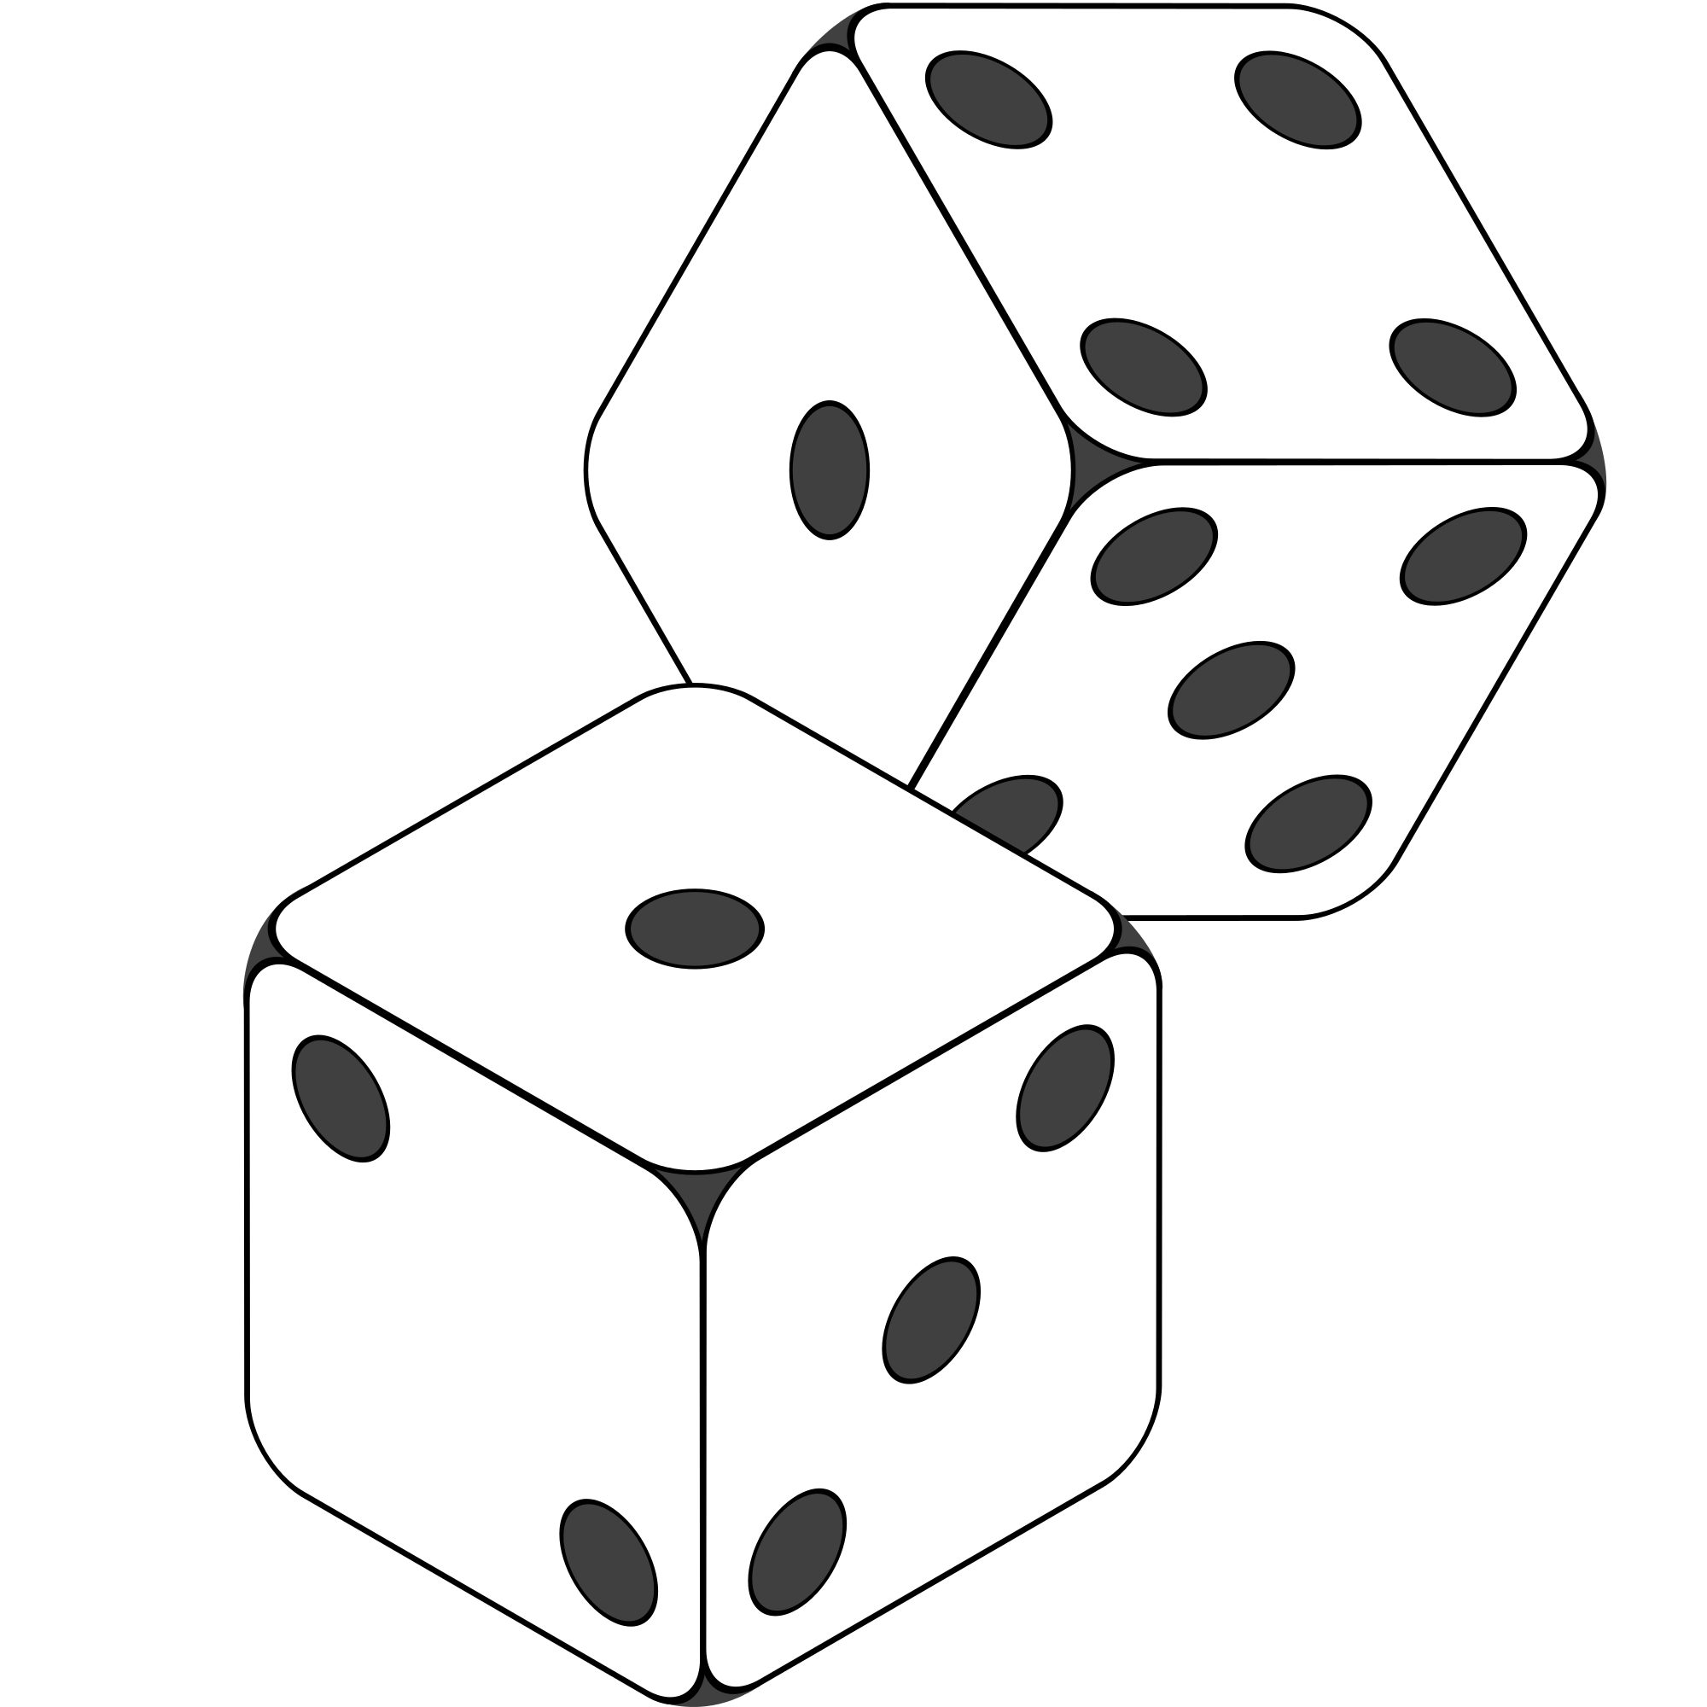
Random Testing
Very popular test generation method.
Extremely fast.
Requires no planning.
Easy to implement.
Easy to understand.
All inputs considered equal, so no designer bias.
Gregory Gay CSCE 747 - Spring 2016 11
Notes:
Random search is actually one of the more popular methods of coming up with test inputs.
(2-6)

Slide 12
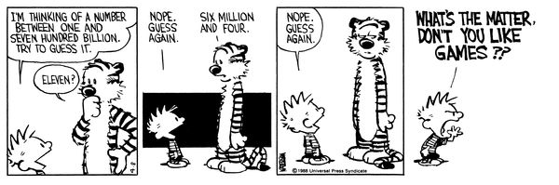
Why Not Random?
Gregory Gay CSCE 747 - Spring 2016 12
Notes:
(discuss)
*can be* useful doesn’t mean it usually is. Random testing is way too naive for the kind of input space you see in most software. You’re basically hoping to get lucky. Even if you generate thousands of random tests, you’ve only covered a tiny set of those possible inputs, and even worse, you’re likely repeating work. There’s no guarantee that you have chosen different inputs, you might have hundreds clustered in a small corner of that space. this is what you do in the absence of a plan, pray and try something. As a basic idea, it’s kind of appealing and a good starting place, but it isn’t the end of the search story either.

Slide 13
Range of Search Techniques
Adaptive Random Testing
Ensuring an even distribution of randomly-chosen inputs across the search space.
(Dynamic) Symbolic Execution
Combining targeted exhaustive search with a random search to generate test cases.
Metaheuristic Search
Using optimization techniques to intelligently converge on effective test cases.
Gregory Gay CSCE 747 - Spring 2016 13
Notes:
So, this class and next, we are going to discuss a range of search heuristics, and how they have been used in software test generation.
(go over)
These are families of techniques, and it is hard to compare them - some are better than others, but no one family is better than another. These are all different takes on the same core idea - how can we efficiently search for test cases that meet our goal.

Slide 14
Adaptive Random Testing

Slide 15
The Input Space
Some tests will pass when executed. Others will fail.
Test Input Data
Ie
Faults are sparse in the space of all inputs, but dense in some parts of the space where they appear.
Program
Test Output Results
If an input causes a failure, a similar input is likely to also cause a failure.
Oe
Gregory Gay CSCE 747 - Spring 2016 15
Notes:
When we test, we pass input into the software.
- We can think of that input space as a game of battleship. When we select input, we choose a spot. We don’t know what will happen when we run it, but there are two tesults.
- Some tests will pass.
- Others will fail.
- In truth, faults are pretty sparse in the input space as a whole - most tests are probably going to pass - but they are dense in the part of the input space in which they appear.
- So, you are likely to get these small clusters, where if input fails, and you try a similar input, that input will fail too.
- In practice, you can almost always divide the input space into partitions - into logical group of inputs based on some criteria - maybe based on the outcome they’ll trigger. The thing is, if we do a good job of partitioning, and we come up with an input that lands in a space dense with faults, then we’re in good shape.
-This goes back to something I touched on a few minutes ago. We should - a a general strategy - favor different input over similar input. That’s a key idea. Try two very different things and you’re more likely to trigger a fault than trying two very similar things. Even more so if we put some thought into where those inputs come from. if we systematically go through and try a few inputs from each of those partitions, we are more likely to hit a a larger range of different results than just randomly trying input. If a feature can result in different outcomes, we’re more likely to hit all of those by braking the input space down along the lines of which outcomes are triggered, and as a result, we’re way more likely to hit that space where faults are dense and trigger a few of them. By incorporating human knowledge, you can make sure that the tests actually cover a representative portion of that input space.
Say you can select three tests for a program that breaks a text buffer into lines of 60 characters each. We select tests with a 40 character string and a 30 character string. Then, for a final test, we use a 100 character string. We can’t prove the 100 character buffer is a better test, but we would be more suspicious of a set of tests that is biased towards lengths less than 60. That’s a start, we’re covering a wider range of the input space. You’re more likely to hit a different outcome of a function or some weird corner case that is likely to break the whole thing..

Slide 16
Choosing Tests
Failing inputs form small contiguous regions in the input space.
If a test fails, similar input is also likely to fail.
Similar effect for most test goals.
If a test covers a branch, similar input is also likely to cover that branch.
We want to find the region that meets our goal.
Gregory Gay CSCE 747 - Spring 2016 16
Notes:
(read)

Slide 17
Adaptive Random Tests
Rather than choosing tests completely at random, favor input diversity.
If a test does not meet a goal, new input should be very different from used input.
Basis of Adaptive Random Testing.
Gregory Gay CSCE 747 - Spring 2016 17
Notes:
So, to make random testing effective. We shouldn’t just spam the system with input. We should use what has happened already to shape how we choose. We should - as a general strategy - favor different input over similar input. That’s a key idea. Try two very different things and you’re more likely to solve a goal than trying two very similar things. We should favor input diversity. Say you can select three tests for a program that breaks a text buffer into lines of 60 characters each. We select tests with a 40 character string and a 30 character string. Then, for a final test, we use a 100 character string. We can’t prove the 100 character buffer is a better test, but we would be more suspicious of a set of tests that is biased towards lengths less than 60. If we try something, and it doesn’t work, we should try something that is very different rather than something similar. In doing so, we can cover a wider range of the input space. (3)

Slide 18
FSCS-ART Algorithm
Fixed Size Candidate Set algorithm.
Makes use of two sets of test cases:
Executed Set - the tests already executed that did not meet our goal.
Candidate Set - a set of random tests that have been generated, but not yet tried.
Initially, generate a test and execute it.
Then, generate N candidate tests.
Choose the test furthest from the executed test, and execute it. Add that to the set of executed tests.
Gregory Gay CSCE 747 - Spring 2016 18
Notes:
The (1) is the basis of almost all other ART approaches. It’s fairly easy to understand.
(2-3)
and the disjoint (4)
(5-7)
If there are multiple tests in the executed tests set, you calculate the distance to each and go with the one with the highest.

Slide 19
Performance vs Random Testing
FSCS-ART generates many more tests than are executed.
In RT, all tests generated are executed.
Execution is more time consuming than generation.
In theory, ART should find a solution faster than pure random testing.
ART finds solutions in 50-60% of the time of RT.
More tests generated per round, the faster goals are attained. Original authors found n=10 to offer best effectiveness vs performance ratio.
Gregory Gay CSCE 747 - Spring 2016 19
Notes:
In random testing, each round, you generate 1 test, then execute it. In ART, you might generate 10 or 100 and then you execute one of those. Now, this might make it seem like ART is far more expensive than RT, but the difference is negligible. The time cost is in test execution, not input generation.
(4-5).
(6) - now, that also increases overhead (rest of 6)

Slide 20
Choosing a Candidate Test
Executed set T = {t1,t2,...,tm}, Candidate set C = {c1,c2,...,cn}, C ∩ T = ∅
Maxi-min method: We must choose candidate ci such that for all j ∈ {1,2,...,n}, min_{i=1}^{m} dist(ci,ti) >= min_{i=1}^{m} dist(cj,ti)
Maxi-sum method: We must choose candidate ci such that for all j ∈ {1,2,...,n}, sum_{i=1}^{m} dist(ci,ti) >= sum_{i=1}^{m} dist(cj,ti)
Inputs near boundary of domain are more likely to be chosen with maxi-min.
Gregory Gay CSCE 747 - Spring 2016 20
Notes:
Given (1), (2)
that is, we want to evenly spread the tests by maximizing the minimum distance between the next test case and the already executed test cases.
(3) - in this case, we go through and sum up the differences between each candidate and the other test cases, then choose the one with the highest combined distance.
(4)

Slide 21
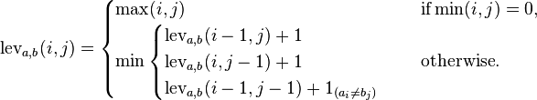
Distance Functions
Important to choose a reliable distance function for your input type.
For numeric values, Euclidean Distance
Compare two vectors of numeric variables, a = (a1, a2, ... , am), b = (b1, b2, … , bm), dist(a,b) = root( sum_{i=1}^{m} (ai - bi)²)
For strings, Levenshtein Distance
Gregory Gay CSCE 747 - Spring 2016 21
Notes:
For numeric variables, comparing distance is simple - (1-2)
the Levenshtein distance between two words is the minimum number of single-character edits ( insertions, deletions or substitutions) required to change one word into the other. For example, the Levenshtein distance between "kitten" and "sitting" is 3 - you need three edits, no fewer, to transform one word into the other.
This gets more complicated when working with more complex input, like unit tests that call multiple methods, or for complex inputs like trees or documents.

Slide 22
Exclusion Zones
Introduce exclusion zones - “bubbles” around tests that do not meet our goals.
Circular zone around that input.
No inputs may be chosen from those zones.
Does not require input to be “furthest” away, but ensures a minimum level of diversity in random choices.
Gregory Gay CSCE 747 - Spring 2016 22
Notes:
Another strategy that can be used along with distance, or instead of, is the idea of exclusion zones.
(1 -3)
By employing a circular zone, a minimum distance - the radius of the exclusion zone - between all test cases is ensured.
(4)

Slide 23
Exclusion Zones
Initially - exclusion zone is set to a user-defined size N.
All exclusion zones are of equal size.
Zones shrink as more tests are executed.
If there are m zones, each will have an area of N/m, and radius root(N/(m𝛑))
Gregory Gay CSCE 747 - Spring 2016 23
Notes:
(1-2)
- (bring in) (3)
- (4)

Slide 24
Dynamic Partitioning
Break input space into regions, and chooses a test from the largest unexplored region.
Generate a random test t.
Divide the input space into two regions, with one containing t.
Choose the largest untested region and generate a test in that region.
Each time a test is executed, shrink that region, then generate a test from the largest remaining region.
Helps ensure even spread across the input space.
Gregory Gay CSCE 747 - Spring 2016 24
Notes:
A similar idea is to, rather than excluding areas, dynamically partition the input space and select the partition most likely to lead to a test that meets your goal.
(1-3), usually with that test as the middle point.
(4-6)

Slide 25
(Dynamic) Symbolic Execution

Slide 26
Symbolic Execution
Process of building predicates that describe which execution paths will be taken and their effect on program state.
Determines the conditions under which a path can be taken.
Identifies infeasible paths and paths that can be taken when they shouldn’t.
Can be used to generate tests targeted at particular paths in the system.
Gregory Gay CSCE 747 - Spring 2016 26
Notes:
Symbolic execution builds predicates that characterize the conditions under which execution paths can be taken and the effect of the execution on the program state.
(2) This is useful for identifying both feasible and infeasilbe paths, as well as paths that can be taken when they shouldn’t be. This is actually an incredibly powerful technique in testing, as we can use symbolic execution to generate test cases targeted at particular paths in the system.

Slide 27
Symbolic Execution
Symbolic execution builds a set of path constraints.
Boolean formulas over the symbolic inputs.
Describes the constraints on the input variables that must be satisfied to arrive at a program location.
At each point, the path constraints are updated with any information that can inform the choice of input.
If a path constraint is unsatisfiable, that path is infeasible.
If it is satisfiable, any solution of that formula is a concrete test case.
Gregory Gay CSCE 747 - Spring 2016 27
Notes:
(1-2)
For each program location, the path constraint is an accumulation of the constraints that the inputs must satisfy for an execution to follow that path.
(4)

Slide 28
Symbolic Execution Example
1. void swap(int x, int y){
2. if(x > y){
3. x = x + y;
4. y = x - y;
5. x = x - y;
6. if (x - y > 0){
7. assert(false);
8. }
9. }
10. System.out.print(
x+”,”+y);
11. }
Three paths:
1,2,10
PC: X <= Y
1,2,3,4,5,6,7
PC: X > Y ^ Y - X < 0
1,2,3,4,5,6,10
PC: X > Y ^ Y - X >= 0
Test case is obtained by finding a solution that satisfies the path constraint.
Path 2: x=2, y=1
Path 3: Unsatisfiable
1
x=X, y = Y
2
x=X, y = Y, X > Y
x=X, y = Y, X <= Y
3
10
x=X+Y, y = Y,
X > Y
4
x=Y,
y = X,
X > Y
^ Y - X < 0
x=X+Y, y = X,
X > Y
5
x=Y,
y = X,
X > Y
^ Y - X >= 0
x=Y, y = X,
X > Y
7
6
Gregory Gay CSCE 747 - Spring 2016 28
Notes:
go over example
- go over paths (1-3) discuss why unsat

Slide 29
Symbolic Execution
Symbolic execution extracts a logical structure from the program.
Small, solvable mathematical model that can be exhaustively searched (in theory).
The search problem:
Choose a path constraint.
Find values for the input variables that satisfy the path constraint.
Exhaustive search, but limited in scope.
Gregory Gay CSCE 747 - Spring 2016 29
Notes:
The reason this works is that rather than worrying about the complexities of the entire program, we can extract a small, analyzable mathematical model describing conditions on the input space.
(3-5)
This is a (6- 7) - can we assign values in such a way that we can satisfy a boolean expression.

Slide 30
Symbolic Execution
Exhaustive search, but limited in scope.
Can we find input that executes this path?
Boolean outcome - yes or no. No partial solutions.
Or, “unknown” if algorithm is unable to solve.
Tends to be used to achieve coverage.
Can be tied to particular testing goals by changing how path constraint is formulated.
i.e., MC/DC obligations
Searching for a solution to a satisfiability modulo theories (SMT) problem.
Gregory Gay CSCE 747 - Spring 2016 30
Notes:
go over
(3) - this won’t tell you that you have 10% branch coverage, just whether a particular path can be covered or not. As a result (4). By targeting certain paths, we will cover combinations of structural elements along those paths.

Slide 31
Satisfiability Modulo Theories
Searching for a solution to a satisfiability modulo theories (SMT) problem.
Generalization of Boolean Satisfiability (SAT)
Express properties as conjunctive normal form expressions:
f = (!x2 || x5) && (x1 || !x3 || x4) && (x4 || ! x5) && (x1|| x2)
SAT: variables are boolean. SMT: predicates.
Can include numeric expressions, as long as a model of decidability exists.
Gregory Gay CSCE 747 - Spring 2016 31
Notes:
SMT is a generalization of SAT, in with you (3) and attempt to solve them. (5) from a variety of underlying theories
This basically means that we can feed in relatively complex expressiosn to be solved, as long as (6). This does place some strict restrictions on what can be solved, but also means that we can conduct a powerful search.

Slide 32
Search Based on SMT
Express properties as conjunctive normal form expressions:
f = (!x2 || x5) && (x1 || !x3 || x4) && (x4 || ! x5) && (x1|| x2)
Choose a variable and attempt to assign a value based on how it affects the CNF expression.
If we want x2 to be false, choose a value that imposes that change.
Continue until CNF expression is satisfied.
Gregory Gay CSCE 747 - Spring 2016 32
Notes:
SMT is a NP-complete problem ,no ploynomial time algo known that can solve all instances, but many algorithms that can solve a large set of instances.
To check these properties, (read) - a conjunction of clauses - AND statement -, where each clause is a disjunction of boolean variables - OR statements.
(read rest)

Slide 33
Branch & Bound Algorithm
Set a variable to a particular value.
true, false, a numeric value.
Apply that value to the CNF expression.
See whether that value satisfies all of the clauses that it appears in.
If so, assign a value to the next variable.
If not, backtrack (bound) and apply the other value.
Prune branches of the boolean decision tree as values are applies.
Gregory Gay CSCE 747 - Spring 2016 33
Notes:
One example of an exhaustive search algorithm is the branch-and-bound algorithm. We went over this before, but it’s worth bringing up again in the context of search algorithms.
This algorithm is conceptually simple: set a literal in the boolean formula to a particular value, apply that value to the formula, and check to see if the value satisfies all of the clauses that it appears in. If so, assign a value to the next variable. However, if setting a value unsatisfies a clause, then a backtracking step (a bound) is initiated and the other possible value is applied. This process prunes branches of the formed boolean decision tree

Slide 34
Branch & Bound Algorithm
f = (!x2 || x5) && (x1 || !x3 || x4) && (x4 || ! x5) && (x1|| x2)
Set x1 to false. f = (!x2 || x5) && (0 || !x3 || x4) && (x4 || ! x5) && (0 || x2)
Set x2 to false. f = (1 || x5) && (0 || !x3 || x4) && (x4 || ! x5) && (0 || 0)
Backtrack and set x1 to true. f = (0 || x5) && (0 || !x3 || x4) && (x4 || ! x5) && (0 || 1)
Gregory Gay CSCE 747 - Spring 2016 34
Notes:
-We first set a value of zero to x1. This inserts a zero into clauses two and four, but does not satisfy or unsatisfy either clause yet.
-Next, we insert a value of zero for x2. This satisfies the first clause, but unsatisifies the fourth clause (as both x1 and x2 are set to zero).
-Therefore, we stop and backtrack, assigning a new value of one to x2. This satisifies the fourth clause. We can continue this process with all variables until the complete formula is satisified.

Slide 35
DPLL Algorithm
Set a variable to a particular value
true, false, a numeric value
Apply that value to the CNF expression.
If the value satisfies a clause, that clause is removed from the formula.
If the variable is negated, but does not satisfy a clause, then the variable is removed from that clause.
Repeat until a solution is found.
Gregory Gay CSCE 747 - Spring 2016 35
Notes:
Another common complete method is the Davis-PutnamLogemann-Loveland, or DPLL, algorithm [13]. DPLL is conceptually similar to the branch-and-bound method, but a few key differences give it an edge on a number of SAT problems. Like with branch-and-bound, DPLL begins by selecting a variable and applying a value to it. If this value satisifies the clause, then that clause is removed from the formula. If the variable is made false due to negation, the algorithm instead remove that variable from any cause that it is negated in. This process is repeated recursively until a solution is found. This induces a domino effect—as more variables are removed from clauses, more clauses turn into unit clauses

Slide 36
DPLL Algorithm
f = (!x2 || x5) && (x1 || !x3 || x4) && (x4 || ! x5) && (x1|| x2)
Set x2 to false. f = (1 || x5) && (x1 || !x3 || x4) && (x4 || ! x5) && (x1|| 0) f = (x1 || !x3 || x4) && (x4 || ! x5) && (x1)
Set x1 to true. f = (1 || !x3 || x4) && (x4 || ! x5) && (1) f = (x4 || ! x5)
Set x4 to false, then x5 to false.
Gregory Gay CSCE 747 - Spring 2016 36
Notes:
-If we assign a value of zero to x2, the first clause is rendered true (¬x2 = ¬0 = 1). We can eliminate the first cause from the formula and x2 from clause four. This leaves the following: (read)
- As the third clause is now a unit clause, we assign x1 = 1. We can now remove both clauses one and three from the formula:(read)
- From this point, the example is trivially solved with x4 = 0 and x5 = 0 so that we have assigned everything.

Slide 37
Limitations
Path explosion - too many paths to build constraints for.
To handle infinite path situations, constraints must be discarded in favor of summaries of execution.
Path complexity
Solvers are limited in the scope of the constraints they can solve.
Cannot solve expressions with nonlinear operations such as multiplication, division, sin(x).
Cannot solve for complex data structures such as trees or pointers.
Inputs cannot be from an infinite set.
Gregory Gay CSCE 747 - Spring 2016 37
Notes:
Symbolic execution is a potentially powerful technique, but also has some key limitations.
(1). To handle situations where there are potentially an infinite number of paths, like with loops, you need a way to summarize the effect of executing the loop, so that you can discard the current path conditions in favor of the summary.
(3-5), or mathematical functions like sin. These are impossible to definitely establish proofs for. This means that many real-world systems have path constraints that cannot be solved.
Similarly( 6-7).

Slide 38
Dynamic Symbolic Execution
In parallel, execute symbolic and concrete executions.
In the concrete execution, log the results of each operation that can impact a path condition or the values of symbolic variables.
Choose random input for the initial concrete execution, and execute the program.
Symbolically re-execute the program on the path followed by the trace and generate path conditions.
Gregory Gay CSCE 747 - Spring 2016 38
Notes:
Dynamic symbolic execution techniques can, in many cases, overcome these limitations by (go over)

Slide 39
Dynamic Symbolic Execution
Negate the last constraint and solve the PC to generate new input.
If an individual predicate is unsolvable, substitute the concrete value from the trace.
If the PC is unsolvable with the negated constraint, negate the next constraint.
Continue negating one constraint at a time to explore new paths.
Refine path conditions as new paths are taken.
Gregory Gay CSCE 747 - Spring 2016 39
Notes:
(go over)

Slide 40
DSE Example
typedef struct cell{
int v;
struct cell *next;
} cell;
int f(int v){
return 2*v + 1;
}
int textme(cell *p, int x){
if(x > 0)
if (p != NULL)
if (f(x) == p->v)
if(p->next == p)
ERROR;
return 0;
}
p = P, p->v = V, p->next = N, x = X
p = P, x = X
X > 0
X > 0 ^ P = NULL
X > 0 ^ P != NULL
X > 0 ^ P != NULL
^ ((2X+1) != V)
Generate initial input: NULL, random int (236)
Takes T branch of first IF statement.
F branch of second IF statement.
Negate the last predicate, and solve the PC:
(X > 0) ^ !(P = NULL)
Generate new concrete input:
x = 236, p->v = 634, p->next = NULL
Negate the last predicate, and solve the PC:
(X > 0) ^ !(P = NULL) ^ !((2X+1) != V)
Generate new concrete input:
x = 1, p->v = 3, p->next = NULL
Gregory Gay CSCE 747 - Spring 2016 40
Notes:
Consider the function testme. This has an error that can be reached given highly specific input that hits the true branch of these four nested if conditions. Our inputs are p - a pointer to a cell struct, and x, an integer.
- First, we will generate a random integer. The other input is a bit more complex, so rather than generating it randomly, we might set it to null and see what we can discover. We then run this concretely, where we take the true branch of the first if statement, then the false branch of the second.
- The symbolic execution takes this trace in and tries to extract path constraints from it. It learns the value of X must be > 0. Simple enough.
- Then, it learns that the value of P must not be null.
- Now, to explore another path, we take this PC, (1). We then solve this to generate new concrete input. Now, as we have to generate a real instance of p instead of just null, we need to consider the variables that make up the struct, v and next. We can keep the value of x the same, we can randomly generate a value for p->v, and as p->next is a pointer - thus, a little more complex, we start by setting it to NULL.
- First two steps are the same in the new symbolic execution.
- Now, we get != null
- Then, we take the false branch here, and add constraint (go over)
- Now, again, we negate the last predicate and solve the PC. This has multiplication, but is still solvable, as it is multiplication by a constant - if this involved multiplying two variables, we would need to attempt more random generations, play with substitutions of concrete values, and learn a thory that could be used to solve this. You get the rough idea from here. We can continue this until we uncover the error. By combining the concrete and symbolic executions ,we guide exploration of paths, and can use information from the concrete execution to aid the symbolic execution.

Slide 41
We Have Learned
When we create test cases, we are usually searching for tests that fulfill a goal.
Such as code coverage.
If we have a measurable goal, algorithms can perform a search process, automating the creation of test inputs.
Searches can be exhaustive, or bound by a search budget.
Gregory Gay CSCE 747 - Spring 2016 41

Slide 42
We Have Learned
Simple strategy: randomly generate input.
Fast, easy to understand, very bad at finding faults.
Adaptive random testing applies strategies to control the distribution of random test generation.
Retains benefits of RT, more likely to find faults.
Dynamic symbolic execution extracts logical expressions describing program paths, and generates input from those expressions.
Gregory Gay CSCE 747 - Spring 2016 42

Slide 43
Next Time
Metaheuristic Search
Test Generation
Genetic Programming
Homework:
Reading assignment 4 - due tonight.
Gregory Gay CSCE 747 - Spring 2016 43

