Slide 1
A little more on structural testing...
Notes:
one thing we didn’t have time for last class

Slide 2
Where Coverage Goes Wrong...
Testing can only reveal a fault when execution of the faulty element causes a failure, but…
Execution of a line containing a fault does not guarantee a failure.
(a <= b) accidentally written as (a >= b) - the fault will not manifest as a failure if a==b in the test case.
Merely executing code does not guarantee that we will find all faults.
Gregory Gay CSCE 747 - Spring 2016 30
Notes:
(read)
How you execute code matters more than whether it was executed. This is the advantage of something like MCDC over branch coverage - we don’t just require that branches get executed, but we place constraints on how the conditions are executed. If faults are lurking in those conditional statements, or can cause issues with the evaluation of those statements, then we are more likely to catch them. That’s not enough to guarantee faults, and that’s the limitation of coverage as a proxy for effective testing, but strengthening the coverage criterion makes it more likely that we will notice faults. Still..

Slide 3
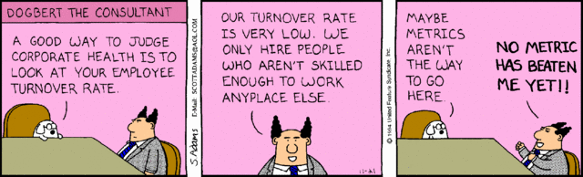
Don’t Rely on Metrics
There is a small benefit from using coverage as a stopping criterion.
But, auto-generating tests with coverage as the goal produces poor tests.
Two key problems - sensitivity to how code is written, and whether infected program state is noticed by oracle.
Gregory Gay CSCE 747 - Spring 2016 31
Notes:
Coverage metrics shouldn’t be relied on as a crutch for “good testing”. A recent study found that:
(read)
(read)
Now, other studies have found happier results - better correlations between fault finding and coverage, but Given the important role of structural coverage criteria in development, especially given that certain forms of coverage are mandated for safety certification of aircraft systems, we found these results kind of scary. These coverage metrics aren’t always a particularly great indicator of test adequacy, and we’re getting junk tests from automated generation, so what can we do? Well, we should start by figuring out what is wrong with coverage metrics, and there were two key issues that kept popping up with, even with “strong” coverage metrics like MC/DC (read)
Both of these issues relate to the idea of masking - in an expression, especially boolean expressions, the value of one variable can determine the result of the whole expression regardless of the value of the other variables. In that case, say that a fault corrupted one expression, well, we might not notice that fault if we monitor another expression where the faulty state is masked by another variable.

Slide 4
Sensitivity to Structure
expr_1 = in_1 || in_2;
out_1 = expr_1 && in_3;
out_1 = (in_1 || in_2) && in_3;
Both pieces of code do the same thing.
How code is written impacts the number and type of tests needed.
Simpler statements result in simpler tests.
Gregory Gay CSCE 747 - Spring 2016 32
Notes:
First, there is the idea of masking. Sometimes, the effect of executing code is negated by other other code - we don’t notice because one calculation overrules another for this combination of input. Due to masking, it is possible to change the number and structure of test obligations - we’ve changed how the code was written, so what the tests need to execute changes.
So, here, these two program fragments have different structures but are functionally equivalent. Version 1 is written with an intermediate variable
\texttt{expr\_1}, and Version 2 inlines this variable. To give a masking example, given a decision like {in\_1 or in\_2}, the truth value of \texttt{in\_1} is irrelevant if \texttt{in\_2} is true, so we state that \texttt{in\_1} is masked out.
Based on the form of coverage we’re working with, we will get different test goals and, as a result, different tests from these two fragments.
One of these coverage metrics is called MCDC, and it requires tests that overcome the masking effect at the expression level, so we would need a test where in_1 is not masked by in_2. \mcdc\ over the inlined version requires a test suite to take the masking effect of \texttt{in\_3} into consideration as well, so the tests are going to need to satisfy slightly more complicated test goals. Those differences can have significant ramifications when it comes to fault finding.
Restructuring the program with additional intermediate variables makes it significantly easier to achieve the desired coverage (\mcdc\ tests are easier to find
if the decisions are simple). This restructuring can significantly impact the number and quality of the tests required to satisfy the coverage goals.

Slide 5
Sensitivity to Oracle
The oracle judges test correctness.
We need to choose what results we check when writing an oracle.
Typically, we check certain output variables.
However, masking can prevent us from noticing a fault if we do not check the right variables.
We can’t monitor and check all variables.
But, we can carefully choose a small number of bottleneck points and check those.
Some techniques for choosing these, but still more research to be done.
Gregory Gay CSCE 747 - Spring 2016 33
Notes:
So, remember those testing artifacts. We had the oracle, which is what we use to check the behavior of the program, maybe some assertions we write or we take some variables and state what their values should be. Well, of course, when we write an oracle, we choose which variables to check the behavior of. Typically, we take a look at the output of a function. The problem is that, through masking, some expressions in the systems can easily be prevented from influencing the outputs. So, if we don’t check the right variables, we might not notice that there is a fault in the program.
This reduces the effectiveness of any testing process based on structural coverage, as we can easily satisfy coverage obligations without allowing resulting errors to propagate to an observed variable. This is a problem where automated test generation is concerned. We have found that test inputs generated tend to be short, kind of lazy - they only do the bare minimum to exercise the system. The longer you run the code - the more loop cycles, longer path, more statements executed - the more likely the problems reach the outputs. This is, in some sense, a problem with the test generation technique, but the blame can be shared by the coverage metric. The generation algorithm did exactly what it was told to do.
Now, of course, we can always add more variables and expected values for those to the oracle, but there are often so many options to choose from that we just can’t write an oracle for every variable. You’d get one test done a day. That’s just not going to work out. But, by being smart and choosing the right variables, we can do pretty well. We have a couple of techniques for estimating those variables -those chokepoints in control in the system, but there is still research to do in coming up with efficient ways of identifying those variables.

Slide 6
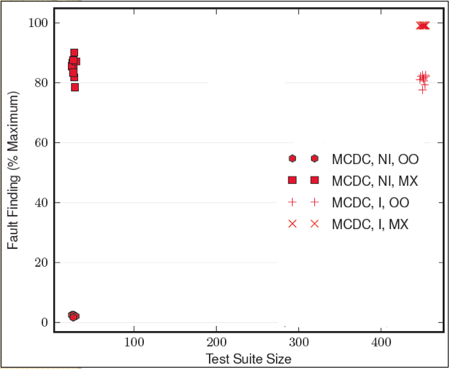
Coverage Effectiveness
Still sensitive to choice of oracle.
Sensitive to choice of oracle.
Sensitive to structuring of the system.
Gregory Gay CSCE 747 - Spring 2016 34
Notes:
How bad is it? Well, here we go. Here we plot the fault finding effectiveness against the test suite size of test suites for one system where we vary the program structure and oracle.
1) MC/DC considered strong, but has a couple of important weaknesses wrt propagation - it is formulated assuming that decisions are independent, as a result, you can actually satisfy it with only a small number of tests. However, short length/don’t propagate. effectiveness is Sensitive.
2) by simply changing the oracle so that we observe all of the internal variables, we see a massive increase in effectiveness. If oracle can monitor everything/specify behaviors for all of those variables , this propagation weakness doesn’t matter.
3) MC/DC is also sensitive to the choice of program structure. If we have an expression that uses the result of another expression, we can inline that used expression. Simple syntactic change - type of optimization compilers often make. As a result, the effectiveness of MC/DC tests jumps quite a bit - but it also requires many more tests to achieve coverage (some of benefit from better tests or more tests)
4) despite this restructuring, there are still propagation issues. Effects of faults masked out.

Slide 7
Masking
Why do we care about faults in masked expressions?
Effect of fault is only masked out for this test. It is still a fault. In another execution scenario, it might not be masked.
We just haven’t noticed it yet.
The fault isn’t gone, we just have bad tests.
One solution - ensure that there is a path from assignment to output where we will notice the fault.
Gregory Gay CSCE 747 - Spring 2016 35
Notes:
(read). If the effect of that fault is masked, then we’re still getting the right output, right?
(click)
(read). It’ll bite us in the butt eventually.
(read)

Slide 8
One Solution - Observability
Program P containing expression e is a transformer from inputs to outputs: P: I → O
P[v/e_{n}] (computed value for n^{th} instance of e is replaced by value v).
observable(e, t) = ∃v.P(t)!= P[v/e_{n}](t)
Gregory Gay CSCE 747 - Spring 2016 36
Notes:
Masking can be addressed by checking behavior of all internal variables w oracle - that’s one way to make sure we notice everything - but too expensive - monitoring all of those variables and specifying expected values for them is inconcievably expensive.
Instead, work with the oracle we have - strengthen coverage criteria with notion of observability to the oracle variables - add a path condition saying that we need to be able to observe the impact of a change to a statement without that impact being masked on the way
If you view a program as a transformer from inputs to outputs.
Observability is a measure of how well internal statements of a system can be inferred from available data
An execution of an expression in a program is observable in a test case if we can modify its value - take an instance of the expression and replace it with a particular value, leaving the rest of the program intact - and observe changes in the output of the system.

Slide 9
Observable MC/DC
MC/DC + observability = Observable MC/DC
Given test suite T, OMC/DC obligations are:
(∀c_{n} ∈ Cond(P) .
(∃t ∈ T. (P(t)!=P[true/c_{n}](t))) ⋀
(∃t ∈ T. (P(t)!=P[false/c_{n}](t))))
Given test suite T, MC/DC obligations are:
(∀c_{n} ∈ Cond(D) .
(∃t ∈ T. (D(t)!=D[true/c_{n}](t))) ⋀
(∃t ∈ T. (D(t)!=D[false/c_{n}](t))))
Idea: Lift observability from decision level to program level.
Gregory Gay CSCE 747 - Spring 2016 37
Notes:
If you remember last class, MC/DC requires that we show the independent impact of condition values at the decision level. For each condition in a decision, we observe the independent impact of setting a condition to true and false.
- We can define a variant of MCDC - called Observable MCDC - that solves the sensitivity issues we saw by lifting that definition to the program level.
For all conditions, we want a test where we can observe the independent impact of setting a condition to true and a test where we can observe the independent impact of setting a condition to false.

Slide 10
Tagging Semantics
Assign each condition a tag set:
(ID, Boolean Outcome)
Evaluation determines tag propagation:
exp1=c1 && c2;
exp2=c3 || c4;
out=if (c5) then
exp1 else exp2;
[(c1,true), (c2,false)]
[(c1,true), (c2,false)]
[(c3,true), (c4,false)]
[(c3,true), (c4,false)]
[(c5,true), <exp1>,<exp2>]
[(c5,true),(c2, false),
<exp2>]
Gregory Gay CSCE 747 - Spring 2016 38
Notes:
formal definition unwieldy for test generation and measurement, requires two versions of the program run in parallel. Instead, approximate using tagged semantics. We assign each condition a set of tags: a unique identifier and the value of that condition. Then, when we evaluate a decision, we can also determine which tags propagate by checking what is masked for that expression, given the current values of each condition. Tag propagation is determined by masking at the expression level.
- If c2 is false, then c1’s tag is masked out.
- But, the tag for c2 has a chance to continue propagation.
- Now, this is an or decision, so if c3 is true, then c4 is masked.
- Since c4 is false, c3 propagates on.
-Now, we have a variable observed by the oracle. The condition c5 will get a tag, then we look at it’s value to see what propagates from earlier expressions.
- Since c5 is true, we propagate the tags that come through the true branch and mask out any from the false branch. As this is an output variable, the tags that propagate are those for c2 and c5.
From this, the level of coverage for a test suite can be assessed by looking at how many of all possible tag pairings have reached an observation point in some test. We want to ensure that all conditions have a tag that propagates to the output in some test.

Slide 11
Benefits of Observability
OMC/DC should improve test effectiveness by accounting for program structure and oracle composition:
We select what points the oracle monitors, OMC/DC requires propagation path to those points.
No sensitivity to structure because impact must be propagated at monitoring points.
i.e., we place conditions on the path taken.
Gregory Gay CSCE 747 - Spring 2016 39

Slide 12
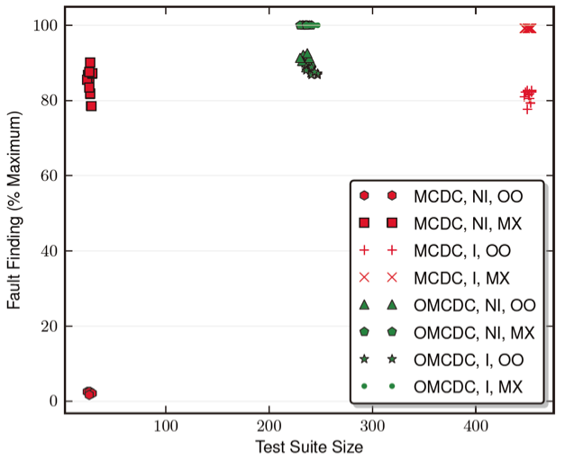
Evaluation - Results
DWM_1 System
Gregory Gay CSCE 747 - Spring 2016 40
Notes:
(explain plot - axis, suite, program structure, oracle, why many dots)
1) OMC/DC test suites outperform MC/DC test suites on all program, structure, and oracle combinations.
2) Up to an 11% improvement in the exact situations where MC/DC thrives - code is structured specifically to aid mc/dc observability and monitoring all variables
3) and at times, as much as an 88% improvement in fault finding in the far more common situation where statements are not aggressively inlined and we only monitor a small number of output variables.
4) We also see that while MC/DC is sensitive to the choice or oracle
and 5) the choice of program structuring
6) omcdc is not. Showing no improvement from code structuring, and only a small improvement from increasing the oracle size

Slide 13
Still Not a Solved Problem
OMC/DC often prescribes a large number of infeasible obligations.
Tests can be difficult to derive.
Often results in better fault-finding, but not 100% fault-finding (especially in complex systems).
New coverage metrics and structural coverage methods are being formulated.
Gregory Gay CSCE 747 - Spring 2016 41
Notes:
(read)
But, this is an interesting apporach because it leads nicely into today’s topic - the idea of choosing paths based on how information is used in expressions in the system under test.

Slide 14
Data Flow Analysis
CSCE 747 - Lecture 8 - 02/04/2016

Slide 15
Control Flow
Capture dependencies between parts of the program, based on “passing of control” between those parts.
We care about the effect of a statement when it affects the path taken.
but deemphasize the information being transmitted.
1<x
T
F
/* continue */
x--;
Gregory Gay CSCE 747 - Spring 2016 2
Notes:
We’ve been talking about structural coverage metric, and all of the ones we’ve talked about so far are based on the analysis of control flow. The idea behind control flow, as you should know by now, is to (read 1)
Usually, when working with control flow, we don’t really care what the statements in the program do - (read 2)
We (3) - we don’t care what the values of the variables are, or where they are used. The focus is on the paths that execution can take and ensuring that they are taken

Slide 16
Data Flow
Another view - program statements compute and transform data…
So, look at how that data is passed through the program.
Reason about dependence
A variable is used here - where does its value come from?
Is this value ever used?
Is this variable properly initialized?
If the expression assigned to a variable is changed what else would be affected?
Gregory Gay CSCE 747 - Spring 2016 3
Notes:
Today’s class is about another view - (read 1-2)
(3) - look at how statements interact and take advantages of the connections between those statements
(rest)

Slide 17
Data Flow
Basis of the optimization performed by compilers.
Used to derive test cases.
Have we covered the dependencies?
Used to detect faults and other anomalies.
Is this string tainted by a fault in the expression that calculates its value?
Gregory Gay CSCE 747 - Spring 2016 4
Notes:
(1) - they look at how statements interact and move them around and transform them to produce an efficient binary.
(2-5) - can identify probable faults before the code is executed.

Slide 18
Definition-Use Pairs
Data is defined.
Variables are declared and assigned values.
… and data is used.
Those variables are used to perform computations.
Associations of definitions and uses capture the flow of information through the program.
Definitions occur when variables are declared, initialized, assigned values, or received as parameters.
Uses occur in expressions, conditional statements, parameter passing, return statements.
Gregory Gay CSCE 747 - Spring 2016 5
Notes:
(1-4)
These associations - pairings of a particular definition and usage of a variable - (5)
(6), in general, at all statements that change the value of a variable
(7), in general, at all statements whose execution extracts a value from a variable

Slide 19
Example - Definition-Use Pairs
min = 1;
max = N;
mid = ((min + (max - min))/2);
while (A[mid] != x or min <= max){
mid = ((min + (max - min))/2);
if (x > A[mid]){
min = mid + 1
} else {
max = mid - 1;
}
}
def - min
def - max, use - N
def - mid, use - min, max
use - A[mid], mid, x, min, max
def - mid, use - min, max
use - x, A[mid], mid
def - min, use - mid
-
def - max, use - mid
Gregory Gay CSCE 747 - Spring 2016 6
Notes:
what are the defs? uses? (discuss, bring in)
Looking at the code alone is deceptive. This doesn’t look that complex. But, there are hidden layers of complexity that we can analyze and exploit in understanding how this system works.

Slide 20
Example - Definition-Use Pairs
def - min
def - max, use - N
def - mid, use - min, max
use - A[mid], mid, x, min, max
def - mid, use - min, max
use - x, A[mid], mid
def - min, use - mid
-
def - max, use - mid
min = 1; max = N;
mid = ((min + (max - min))/2);
A[mid] != x or min <= max
mid = ((min + (max - min))/2);
min = mid + 1;
x > A[mid]
max = mid -1;
Gregory Gay CSCE 747 - Spring 2016 7
Notes:
The control flow, of course, is one way to understand how the program works. This lets us visualize how the code can be executed, the different orderings that code can be executed in. The data flow adds another layer of complexity on to the heap. We can take any one of these variables, say, min and look at how it is defined and used in the program
- (bring in). What you begin to see is another form of path - the path that information takes rather than control.
- (bring in) Same with max - another set of paths. Each variable creates a set of targeted paths, and those are often as important, if not more important, than the generic control flow paths in detecting faults in a system.

Slide 21
Def-Use Pairs
We can say there is a def-use pair when:
There is a def (definition) of variable x at location A.
Variable x is used at location B.
A control-flow path exists from A to B.
and the path is definition-clear for x.
If a variable is redefined, the original def is killed and the pairing is between the new definition and its associated use.
Gregory Gay CSCE 747 - Spring 2016 8
Notes:
(1-3). Each def-use pair associates a definition of a vaqriable - its assignment, with a use of the same variable. A single definition can be paired with multiple usages, and vice-versa.
(4-5). A def-use pair is only formed if there is a program path where the value assigned in that definition isn’t redefined by another expression. (6).

Slide 22
Example - GCD
public int gcd(int x, int y){
int tmp;
while(y!=0){
tmp = x % y;
x = y;
y = tmp;
}
return x;
}
def: x, y
def: tmp
use: y
use: x, y def: tmp
use: y def: x
use: tmp def: y
-
use: x
Gregory Gay CSCE 747 - Spring 2016 9
Notes:
(name defs, uses)
(bring in)

Slide 23
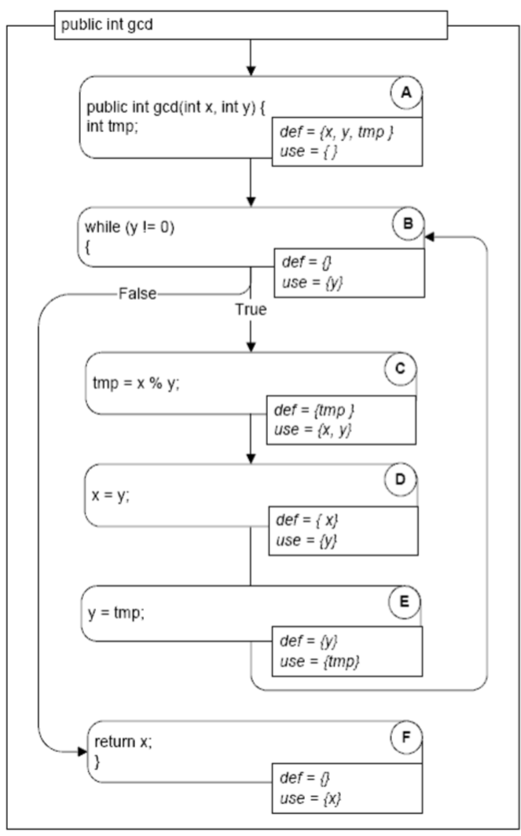
Example - GCD
public int gcd(int x, int y){
int tmp;
while(y!=0){
tmp = x % y;
x = y;
y = tmp;
}
return x;
}
1. def: x, y 2. def: tmp
3. use: y 4. use: x, y def: tmp
5. use: y def: x 6. use: tmp def: y
8. use: x
Gregory Gay CSCE 747 - Spring 2016 10
Notes:
So, to gather our pairs, it’s useful to first plot the control flow and add the def and use information to that graph.
We can now look at this info to gather our def-use pairs. Path E, B, C, D is a definition-clear path from definition of y in line 6 to its use in line 5 in the next loop iteration. Path A, B, C, D, E is not a definition-clear path with respect to tmp because of the definition in node C.

Slide 24
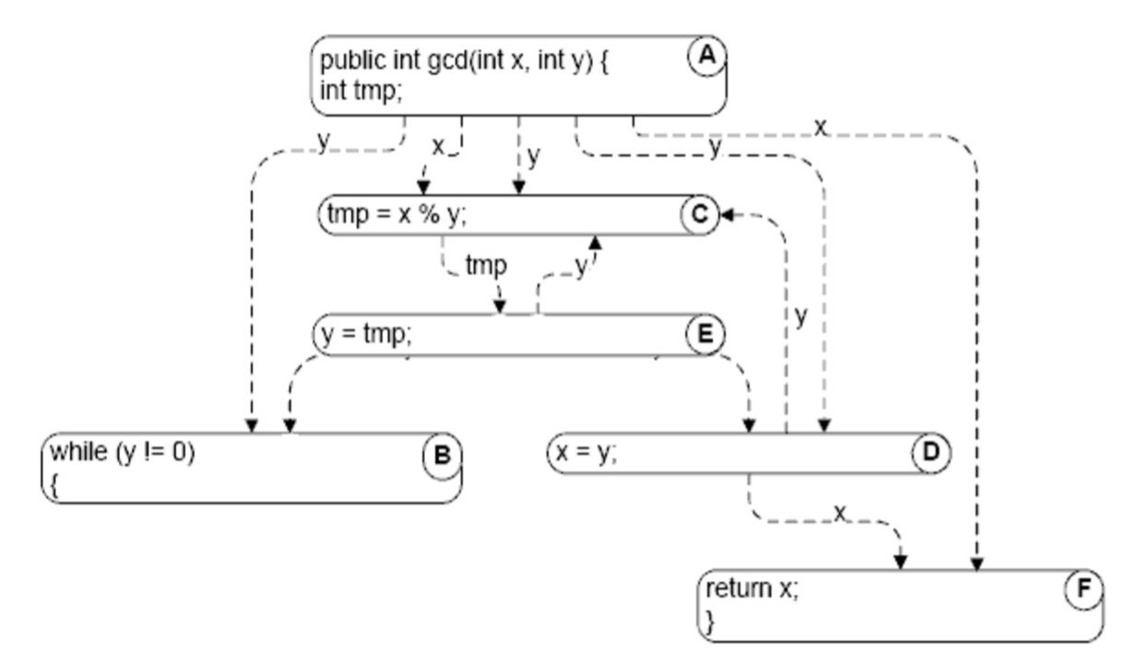
Data Dependence
If a definition is impacted by a fault, all uses of that definition will be too.
Uses are dependent on definitions.
Tests that focus on these dependencies are likely to trigger faults.
Data dependency can be visualized.
Nodes = statements
Edges = data dependence
Gregory Gay CSCE 747 - Spring 2016 11
Notes:
We care about def-use pairs because they track a form of dependence between program statements. The result of a computation is dependent on the value of a variable, and if that definition is corrupted by a fault, than the uses will be as well. By understanding and using the dependencies between statements, we can find faults in a program.
(4-6)
This is a useful visualization of how data flows through a program.

Slide 25
Control-Dependence
A node that is reached on every execution path from entry to exit is control dependent only on the entry point.
For any other node N, that is reached on some - but not all - paths, there is some branch that controls whether that node is executed.
Node M dominates node N if every path from the root of the graph to N passes through M.
Gregory Gay CSCE 747 - Spring 2016 12
Notes:
It is also useful to be able to reason about control dependency in the same way.
A node in a CFG that is reached on (1-2) It follows then, that (3).

Slide 26
Domination
Nodes typically have many dominators.
Except for the root, a node will have a unique immediate dominator.
Closest dominator of N on any path from the root and which is dominated by all other dominators of N.
Forms a dependency tree.
Domination can also be calculated in the reverse direction of control flow, using the exit node as root.
Dominators in this direction are called post-dominators.
Gregory Gay CSCE 747 - Spring 2016 13
Notes:
(2). However, (3), which is the (4).
Because each node has a unique immediate dominator, the immediate dominator relation forms a tree. This tree is quite useful for understanding how the program works
Understanding how and when a node will be executed requires both an understanding of domination leading to that node, but also domination to the end of execution.
(6-7).

Slide 27
Domination Example
To understand control-dependence, look at pre and post-dominators.
A pre-dominates all nodes
G post-dominates all nodes
F and G post-dominate E
G is the immediate post-dominator of B
C does not post-dominate B
B is the immediate pre-dominator of G
F does not pre-dominate G
A
B
C
E
D
F
G
Gregory Gay CSCE 747 - Spring 2016 14

Slide 28
Post-Dominators and Control Dependency
Node N is reached on some paths.
N is control-dependent on a node C if that node:
Has two or more successor nodes.
Is not post-dominated by N.
Has a successor that is post-dominated by N.
Gregory Gay CSCE 747 - Spring 2016 15
Notes:
Post-dominators can be used to give us a more precise understanding and definition of control dependence. Think about a node that is reached on some, but not all paths. In the CFG, then, we can figure out N’s control dependencies by looking at what it follows. There may be an earlier node C that N is control-depedent on if there is a node C then with these particular properties. (3) - it is a control decision (if, loop predicate, switch).
(4) - N isn’t inevitable, it’s reached on some but not all paths
(6) - N is reached on one of those paths.
So, analyzing from the reverse direction lets us better calculate control dependence than just looking at pre-domination.

Slide 29
Control-Dependency Example
Execution of F is not inevitable at B.
Execution of F is inevitable at E.
F is control-dependent on B - the last point at which it is not inevitable.
A
B
C
E
D
F
G
Gregory Gay CSCE 747 - Spring 2016 16
Notes:
Here’s an intuitive way of looking at that definition. The conditions for F being control-dependent on B are:
B is a decision - it has at least two successors (C and E)
B is not post-dominated by F, F is not inevitable from B
But, one of B’s sucessors - E specifically - is post-dominated by F.
In other words, whether we execute F depends on B.

Slide 30
GCD Example
B and F are inevitable, only dependent on entry (A).
C, D, and E (nodes in the loop) depend on the loop condition (B).
Gregory Gay CSCE 747 - Spring 2016 17
Notes:
(discuss one by one)
Take E - what are its dominators? C and D are post-dominated by E - so if you’re in the loop, E is inevitable. B has sucessors in and out of the loop, so it controls whether E is executed. So, E is dependent on B.
(bring in)

Slide 31
Data Flow Analysis
Notes:
These two ideas - data and control dependence are at the heart of a series of analyses and testing techniques that we can perform on a program to examine how data flows through the control paths of the system. Today, we’re going to cover some analyses that we can perform on the program - and use those to illustrate how - in general - we can design new analyses.

Slide 32
Reachability
Def-Use pairs describe paths through the program’s control flow.
There is a (d,u) pair for variable V only if at least one path exists between d and u.
If this is the case, a definition V_{d} reaches u.
V_{d} is a reaching definition at u.
If the path passes through a new definition V_{e}, then V_{e} kills V_{d}.
Gregory Gay CSCE 747 - Spring 2016 19
Notes:
Def-Use pairs can be defined (1). That is, (2) with no redefinition of the variable.
If that is the case, we can say that (3- 4).
If, on the other hand, (5) at that point

Slide 33
Computing Def-Use Pairs
One algorithm: Search the CFG for paths without redefinitions.
Not practical - remember path coverage?
Instead, summarize the reaching definitions at a node over all paths reaching that node.
x = ..
y = ..
z = ..
x = ..
z = ..
y = ..
z = ..
w = ..
Gregory Gay CSCE 747 - Spring 2016 20
Notes:
(1-2) - even if we ignore loops, the number of paths can be near-infinite. Looking for d-u pairs is essentially the path coverage problem all over again, we would need to look at all paths to compute all pairs.
However, we don’t actually have to do it that way. If, instead, we consider the reaching definitions, we can simply track and (3)

Slide 34
Computing Def-Use Pairs
If we calculate the reaching definitions of node n, and there is an edge (p, n) from an immediate predecessor node p.
If p can assign a value to variable v, then definition v_{p} reaches n.
v_{p} is generated at p.
If a definition v_{d} reaches p, and if there is no new definition, then v_{d} is propagated from p to n.
If there is a new definition, v_{p} kills v_{d} and v_{p} propagates to n.
Gregory Gay CSCE 747 - Spring 2016 21
Notes:
Suppose (1) - (reaching defs) - that is, we look at the expression in n. We look at the variables being used, and we look at where they were defined (rest of 1). We can observe:
(2-5)

Slide 35
Computing Def-Use Pairs
Reaching definitions flowing out at of a node are:
All the reaching definitions flowing in
Minus the definitions that are killed
Plus the definitions that are generated
x = ..
y = ..
z = ..
x_{a}, y_{a}, z_{a}
x = ..
z = ..
y = ..
z = ..
x_{b}, y_{a}, z_{b}
x_{a}, y_{c}, z_{c}
w = ..
x_{b}, y_{a}, z_{b}, x_{a}, y_{c}, z_{c}, w_{d}
Gregory Gay CSCE 747 - Spring 2016 22
Notes:
In other words - (read)
go through - (xa,ya,za generated)
(xa and za are killed and replaced with xb and zb, ya is propagated)
(xa still there, ya and za are killed and replaced by yc and zc)
(multiple reaching definitions from the two branches - that’s fine - still a def-use pair

Slide 36
Flow Equations
As node n may have multiple predecessors, we must merge their reaching definitions:
ReachIn(n) = ⋃_{p∈pred(n)} ReachOut(p)
The definitions that reach out are those that reach in, minus those killed, plus those generated.
ReachOut(n) = (ReachIn(n) \ kill(n)) ⋃ gen(n)
Gregory Gay CSCE 747 - Spring 2016 23
Notes:
We can formalize this computation with two equations describing how we merge together all definitions flowing in, and then produce the set that flows to all successor nodes.
So, (1) - the definitions that flow out from those predecessors
The set of definitions that reaches in is the union of the definitions reaching out from all predecessors of node n.
(3) - just remember your set notation.
(4)

Slide 37
Computing Reachability
Initialize
ReachOut is empty for every node.
Repeatedly update
Pick a node and recalculate ReachIn, ReachOut.
Stop when stable
No further changes to ReachOut for any node
Guaranteed because the flow equations define a monotonic function on the finite lattice of possible sets of reaching definition.
Gregory Gay CSCE 747 - Spring 2016 24
Notes:
The nice thing is that these reaching definitions can be calculated simply and efficiently by first initializing the reaching definitions at each node in the control-flow graph to an empty set and applying these equations repeatedly over each node until the results stabilize. The repeat part is because you may not have processed all predecessors when you have computed definitions for a node.
Stability is eventually guaranteed because these equations define a monotonic function over the finite lattice of possible sets of reaching definition - that is, the size of the set of reaching definitions will always increase until stability - you cannot lose more definitions as time goes on.

Slide 38
Iterative Worklist Algorithm
Input:
A control flow graph G = (nodes, edges)
pred(n)
succ(n)
gen(n)
kill(n)
Output:
ReachIn(n)
for(n ∈ nodes){
ReachOut(n) = {};
}
workList = nodes;
while(workList != {}){
n = a node from the workList;
workList = workList \ {n};
oldVal = ReachOut(n);
ReachIn(n) = ⋃_{p∈pred(n)} ReachOut(p);
ReachOut(n) = (ReachIn(n) \ kill(n)) ⋃ gen(n)
if(ReachOut != oldVal){
workList = workList ⋃ succ(n);
}
}
Initialize the reaching definitions flowing out to an empty set.
Keep a worklist of nodes to be processed.
At each step remove an element from the worklist and process it.
Calculate the flow equations.
If the recalculated value is different for the node add its successors to the worklist.
Gregory Gay CSCE 747 - Spring 2016 25
Notes:
We can create an iterative worklist algorithm to perform this process. (go over inputs and outputs). Let’s just step through this one item at a time.
-(read)
-Keep a worklist of nodes to be processed
-At each step remove an element from the worklist and process it.
- (read)
- If the recalculated value is different for the node add its successors to the worklist. That way, we will reprocess them as well.
This is a fairly efficient approach to identifying the def-use pairs. It does, however, depend somewhat on the order that nodes are examined. By choosing a good order in which nodes are processed, iterations can be minimized

Slide 39
Can this algorithm work for other analyses?
ReachIn/ReachOut are flow equations.
They describe passing information over a graph.
Many other program analyses follow a common pattern.
Initialize-Repeat-Until-Stable Algorithm
Would work for any set of flow equations as long as the constraints for convergence are satisfied.
Another problem - expression availability.
Gregory Gay CSCE 747 - Spring 2016 26
Notes:
Reaching definition is a classic data flow analysis that we’ve adapted from compiler construction - where it is used for program optimization - to testing and software analysis. (1 -2) As it turns out, (3).
This algorithm - initialize and repeatedly apply equations until stable- works - with minimal changes - for a variety of different program analyses. One example is expression availability.

Slide 40
Available Expressions
When can the value of a subexpression be saved and reused rather than recomputed?
Classic data-flow analysis, often used in compiler construction.
Can be defined in terms of paths in a CFG.
An expression is available if - for all paths through the CFG - the expression has been computed and not later modified.
Expression is generated when computed.
… and killed when any part of it is redefined.
Gregory Gay CSCE 747 - Spring 2016 27
Notes:
(read 1-2) - another way to optimize a program, remove redundant computations. This is something you could even apply in refactoring a program - find inefficiencies and remove them at the source code level.
(3) - sound familiar?
(4-5) - a new value is assigned to a variable used in the expression.

Slide 41
Available Expressions
Like with reaching, availability can be described using flow equations.
The expressions that become available (gen set) and cease to be available (kill set) can be computed simply.
Flow equations:
AvailIn(n) = ⋂_{p∈pred(n)} AvailOut(p)
AvailOut(n) = (AvailIn(n) \ kill(n)) ⋃ gen(n)
Gregory Gay CSCE 747 - Spring 2016 28
Notes:
Just like with reaching definitions, we can efficiently analyze expression availability by looking at flow between nodes, and calculating the available expressions coming in and going out from a node in the CFG.
(2)
(4) - note the intersection. You only want the expressions definitely available at this point - if it only comes in from one path, then you can’t assume it is available any longer.

Slide 42
Iterative Worklist Algorithm
Input:
A control flow graph G = (nodes, edges)
pred(n)
succ(n)
gen(n)
kill(n)
Output:
AvailIn(n)
for(n ∈ nodes){
AvailOut(n) = set of all expressions defined anywhere;
}
workList = nodes;
while(workList != {}){
n = a node from the workList;
workList = workList \ {n};
oldVal = AvailOut(n);
AvailIn(n) = ⋂_{p∈pred(n)} AvailOut(p)
AvailOut(n) = (AvailIn(n) \ kill(n)) ⋃ gen(n)
if(AvailOut != oldVal){
workList = workList ⋃ succ(n);
}
}
Gregory Gay CSCE 747 - Spring 2016 29
Notes:
And, we can use the same worklist algorithm again with a tiny number of changes.
Namely, AvaiOut is initialized to be all expressions defined everywhere - we will instead strip out the killed expressions as we work through. Then, we plop in the right flow equations and we’re set - we can identify the set of available expressions for each node in the CFG.

Slide 43
Analysis Types
Both reaching definitions and expression availability are calculated on the CFG in the direction of program execution.
They are forward analyses.
Definitions can reach across any path.
The in-flow equation uses a union.
This is a forward, any-path analysis.
Expressions must be available on all paths.
The in-flow equation uses an intersection.
This is a forward, all-paths analysis.
Gregory Gay CSCE 747 - Spring 2016 30
Notes:
So, these two problems - and their flow equations - are incredibly similar. These can be used to define two axes on which we can design analyses.
(1) - from entry node to exit node - (2). Of course, then, any analysis that starts from the exit node and works back to the entry is a backwards analysis
(3) - you can tell because the flow in uses the union operator - (5)
(6 - 7) - So, expression availability is a forward, all paths analysis.

Slide 44
Forward, All-Paths Analyses
Encode properties as tokens that are generated when they become true, then killed when they become false.
The tokens are “used” when evaluated.
Can evaluate properties of the form:
“G occurs on all execution paths leading to U, and there is no intervening occurrence of K between G and U.”
Variable initialization check - G = variable-is-initialized, U = variable-is-used, K = variable-is-uninitialized (kill set is empty)
Gregory Gay CSCE 747 - Spring 2016 31
Notes:
We can use expression availability as a template for other forward, all-paths analyses.
Available expressions can be thought of as tokens propagated from generation to use along paths in the CFG
(1 - 2)
So, by associating these tokens with gen and kill sets for nodes, we can evaluate other properties that fit this pattern (3)
Where G, U, and K are events that we can check and mark in the CFG. For example, if we wanted to check for variables that are not initialized, the events that we model might indicate (5)

Slide 45
Backward Analysis - Live Variables
Tokens can flow backwards as easily as forwards in a CFG.
Backward analyses are used to examine what happens after an event of interest.
“Live Variables” - analysis to determine whether the value held in a variable may be used.
A variable may be considered live if there is any possible execution path where it is used.
Gregory Gay CSCE 747 - Spring 2016 32
Notes:
(1-4). So, live analysis is a backwards, any-path analysis

Slide 46
Live Variables
A variable is live if its current value may be used before it is changed.
Can be expressed as flow equations.
LiveIn(n) = ⋃_{p∈succ(n)} LiveOut(p)
Calculated on successors, not predecessors.
LiveOut(n) = (LiveIn(n) \ kill(n)) ⋃ gen(n)
Worklist algorithm can still be used, just using successors instead of predecessors.
Gregory Gay CSCE 747 - Spring 2016 33
Notes:
(1) live at a node in the cfg if (rest)
(2) just like reach and avail - (3)
note that (4)
(5)

Slide 47
Backwards, Any-Paths Analyses
General pattern for backwards, any-path:
“After D occurs, there is at least one execution path on which G occurs with no intervening occurrence of K.”
D indicates a property of interest. G is when it becomes true. K is when it becomes false.
Useless definition check, D = variable-is-assigned, G = variable-is-used, K = variable-is-reassigned.
Gregory Gay CSCE 747 - Spring 2016 34
Notes:
So, liveness checks are a useful analysis - again, especially for program optimization - but for our purposes, it’s also useful for looking at a general pattern for many types of backwards, any-paths analyses.
(2 -3)
For example, one check of this form is for useless definitions - that is, we look for assigned values that are never used. This isn’t necessarily a fault, but could be a symptom of another mistake we’ve made. For example, languages like python and perl don’t require variables to be declared before use. So, this check often reveals when we’ve made a typo in a variable name and accidentally created a new variable when we meant to make an assignment to another variable. Well, in that case (4)

Slide 48
Backwards, All-Paths Analyses
Check for a property that must inevitably become true.
General pattern for backwards, all-path:
“After D occurs, G always occurs with no intervening occurrence of K.”
Informally, “D inevitably leads to G before K”
D indicates a property of interest. G is when it becomes true. K is when it becomes false.
Ensure interrupts are reenabled, files are closed, etc.
Gregory Gay CSCE 747 - Spring 2016 35
Notes:
Naturally, then, there must also be backwards, all-paths analyses - where we analyze the successors of a node and a property must be true along all paths.
(1)
(2-4) Again (5)
This kind of analyis can ensure that interrupts are renabled after an interrupt-handling routine is executed, that files are closed after opening them, that memory allocated is deallocated after use, and other similar types of checks.

Slide 49
Analysis Classifications
 | Any-Paths | All-Paths
Forward (pred) | Reach U may be preceded by G without an intervening K | Avail U is always preceded by G without an intervening K
Backward (succ) | Live D may lead to G before K | Inevitability D always leads to G before K
Gregory Gay CSCE 747 - Spring 2016 36
Notes:
go over

Slide 50
Crafting Our Own Analysis
We can derive a flow analysis from run-time analysis of a program.
The same data flow algorithms can be used.
Gen set is “facts that become true at that point”
Kill set is “facts that are no longer true at that point”
Flow equations describe propagation
Gregory Gay CSCE 747 - Spring 2016 37
Notes:
We can think of data flow analysis as a form of simulation of program execution. Instead of passing around the values of all variables as our state, we pass around a compact set of information - like, whether variables are initialized. All possible paths are considered, but the number of states is kept small by associating just one summary state with each node in the CFG. About any analysis of data in a system system can be mapped to these flow analyses we’ve talked about today.
(2-5)

Slide 51
Monotonicity Argument
Constraint: The outputs computed by the flow equations must be monotonic functions of their inputs.
When we recompute the set of “facts”:
The gen set can only get larger or stay the same.
The kill set can only grow smaller or stay the same.
Gregory Gay CSCE 747 - Spring 2016 38
Notes:
The constraint on this is that (6)
So, for our flow equations to be monotonic, (2) - we can’t recompute and get a gen set that is smaller than on previous computations. Similarly, (3) We can’t get a larger kill set suddenly. Basically, we can’t lose information when that was true on previous computations when we recompute a function. If we know something should be generated, it can’t sometimes claim to not be generated. When we know something should be killed, it can’t suddenly be not be killed.

Slide 52
Taint Analysis
Built into Perl. Prevents program errors from data validation by detecting and preventing use of “tainted” data in sensitive operations.
Tracks sources that variables are derived from. Looks for data derived from tainted data, and tracks corrupted program state.
String created from concatenating a tainted and a safe string is corrupted by the tainted string.
Signals an error if tainted data is used in a potentially dangerous way.
Gregory Gay CSCE 747 - Spring 2016 39
Notes:
(1) , particularly when invalidated data could result in a security hazard.
For example, if a perl script wrote to a file whose name came from scraping a web site, a malicious user could provide a path to sensitive files.
(2-4)

Slide 53
Taint Analysis Variant
Perl monitors values dynamically.
Alternative - analysis that prevents data that could be tainted from ever being used in an unsafe manner.
Forward, any-path analysis.
Tokens = tainted variables
Gen set = any variable assigned a tainted value
Kill set = variable cleansed of taintedness
Gregory Gay CSCE 747 - Spring 2016 40
Notes:
(1) , a script may run in testing just fine, but trigger an error in use when data is fed in.
Let’s consider an alternative version for something like Java where (2)
This would be a (3), where (4), (5) Sets of tainted values are propagated from node to node from its predecessors, with a set union performed over the predecessors - we want to propagate taint from any path forward. (6).

Slide 54
Taint Analysis Variant
Gen and kill sets depend on the set of tainted variables, which is not constant.
Circularity - tainted variable set also depends on gen and kill sets.
Monotonicity property ensures soundness of the analysis.
We evaluate taintedness of an expression with the set {a,b}, then again with {a,b,c}. If it is tainted the first time, it must be tainted the second time.
Gregory Gay CSCE 747 - Spring 2016 41
Notes:
A difference from the other analyses covered is that (1) - it depends on what input we have given, and variables might become cleansed or become tainted as we execute.
(2) - Such circularities are pretty common in defining flow analyses. To deal with this, we must show that the output of the flow equations increases monotonically. This is why that property is so important.
(3) - because the set of input variables is larger. That means that adding elements to the input tainted set can only add elements to the gen set or leave it the same and it can only remove elements from the kill set and leave them the same.

Slide 55
We Have Learned
Control-flow and data-flow both capture important paths in program execution.
Analysis of how variables are defined and then used and the dependencies between definitions and usages can help us reveal important faults.
Many forms of analysis can be performed using data flow information.
Gregory Gay CSCE 747 - Spring 2016 42
Notes:
(read this)

Slide 56
We Have Learned
Analyses can be backwards or forwards.
… and require properties be true on all-paths or any-path.
Reachability is forwards, any-path.
Expression availability is forwards, all-paths.
Live variables are backwards, any-path.
Inevitability is backwards, all-paths.
Many analyses can be expressed in this framework.
Gregory Gay CSCE 747 - Spring 2016 43
Notes:
(read this)

Slide 57
Next Class
Data flow test adequacy criteria
Data flow analysis with arrays and pointers.
Reading: Chapter 13
Homework 1 due tonight.
Reading assignment 2 out.
Gregory Gay CSCE 747 - Spring 2016 44
Notes:
(read this)

Slide 58
backup slides

Slide 59
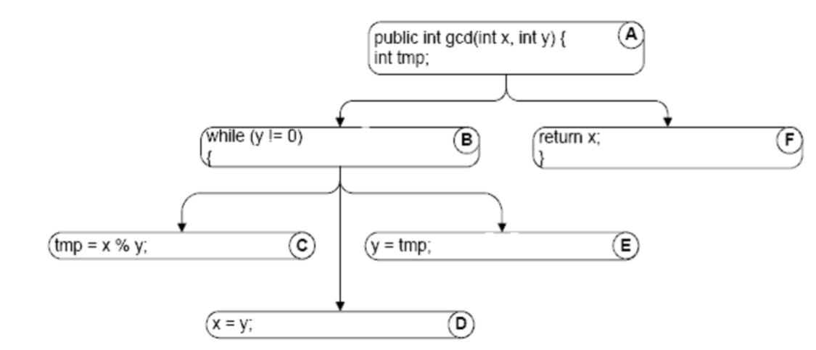
Control Dependence Graph
Which statement controls the execution of a statement of interest?
In a CFG, order is imposed whether it matters or not.
If there is dependency, then the order does matter.
CDG shows only dependencies.
Often combined with DDG.
Gregory Gay CSCE 747 - Spring 2016 19
Notes:
Once you know these dependencies, you can plot out this tree. This is called a control-dependence graph.
The control-dependence graph shows where execution of one statement controls whether the other is executed to begin with.
This is a little different from the sequencing captured in the control-flow graph. The CFG imposes a definite order on execution even when two statements are logically independent and could - really - be executed in either order with the same result. It just shows up as the code was written in the file. If a statement is control or data dependent, than ordering DOES matter, and knowing when that is important is important for being able to analyze a program. So, the point of the CDG is that it only shows those dependencies. It’s not better than a CFG in a general sense, but it gives you information relevant to understanding how some statements are affected by others. Those connections show you how faults might spread from one statement to another, corrupting the execution. You can design tests around these dependencies and may be more likely to notice faults
(read 5)

Slide 60
Data Dependence Graph
Gregory Gay CSCE 747 - Spring 2016 12
Notes:
In this graph, we have a directed edge for each def-use pair, going from the definition node to the usage node.
(go over some)
This graph leaves out control information entirely. So, we do leave out some information about control. Execution of the body of the loop depends on the loop predicate, and that can’t be represented by data dependence alone.

Slide 61
Powerset Lattice
Lattice is made up of subsets of a set.
Powerset of set A is the set of all subsets of A.
If the subset grows larger as we follow the arrows, subset y >= x.
A function is monotonically increasing if:
x >= y implies f(y) >= f(x)
{a, b, c}
{a, b}
{a, c}
{b, c}
{a}
{b}
{c}
{ }
Gregory Gay CSCE 747 - Spring 2016 39
Notes:
(1) Subset of definitions, for instance
This is called the powerset lattice because (2). Bottom element is the empty set, the top is the full set, and each layer in between represents progressively larger subsets.
(3 - 4)
the result of the function performed over that subset is greater than the function performed over the smaller subset.
All of the flow equations wev’e discussed have this property. If you design your own function, it must also follow the monotonicity property.

