Slide 1
Model-Based Testing:
State Machines
CSCE 747 - Lecture 11 - 02/14/2017

Slide 2
Creating Requirements-Based Tests
Write Testable Specifications
Produce clear, detailed, and testable requirements.
Identify Independently Testable Features
Figure out what functions can be tested in (relative) isolation.
Identify Representative Input Values
What are the outcomes of the feature, and which input classes will trigger them?
Generate Test Case Specifications
Identify abstract classes of test cases.
Instantiate concrete input/output pairs.
Generate Test Cases
Gregory Gay CSCE 747 - Spring 2017 2
Notes:
A little while back, we talked about the idea of coming up with test cases using the system’s requirement specification. We went over this process - (go over).

Slide 3
Creating Requirements-Based Tests
This process is effective for identifying the independent partitions for each input.
Leaving us with a large number of test specifications
Humans must still identify constraints on combinations of input choices and identify a subset of important test specifications.
An alternative approach - build a model from the specification, and derive tests from the structure of the model.
Gregory Gay CSCE 747 - Spring 2017 3
Notes:
The strength of this process, and the techniques based on it, is in systematically going through an informal specification, identifying features to be tested, and for each input, partitioning it into independent choices. It leaves us with a big list of potential test specifications.
(2) to turn into real tests - this is a pretty huge job. What are the possible input combinations, what constraints can be applied to certain combinations of input? What are the redundant combinations?
Today, we’ll cover (3), just as we did from the program itself.

Slide 4
Models
A model is an abstraction of the system being developed.
By abstracting away unnecessary details, extremely powerful analyses can be performed.
Can be extracted from specifications and design plans
Illustrate the intended behavior of the system.
Often take the form of state machines.
Events cause the system to react, changing its internal state.
Gregory Gay CSCE 747 - Spring 2017 4
Notes:
(1) - it takes the system and throws away all details except those explicitly needed for design. As long as the model still reflects the program, (2)
(2 )
Models can be (3), in which case they (5-7)

Slide 5
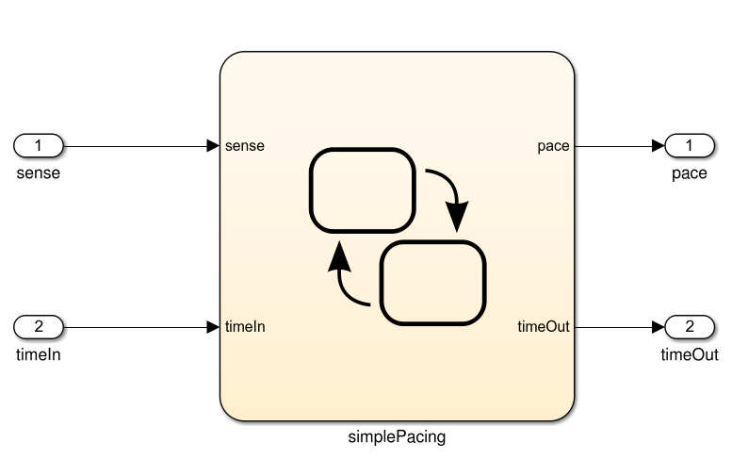
What Can We Do With This Model?
… Then we can derive test cases from the model that can be applied to the program. If the model and program do not agree, then there is a fault.
Specification
public static void Main(){
System.out.println(“Hello world!”);
}
And If the model is well-formed, consistent, and complete.
And If the model accurately represents the program.
If the model satisfies the specification...
Gregory Gay CSCE 747 - Spring 2017 5
Notes:
So, what can we do with this model? Well,
(1-4).

Slide 6
Model-Based Testing
Models describe the structure of the input space.
They identify what will happen when types of input are applied to the system.
That structure can be exploited:
Identify input partitions.
Identify constraints on inputs.
Identify significant input combinations.
Can derive and satisfy coverage metrics for certain types of models.
Gregory Gay CSCE 747 - Spring 2017 6
Notes:
(1-6). All as part of the process of verification - of using the specification to look for faults in the system.
Anytime that you have structure, you can measure coverage of that structure - just like we did with source code. Today, we’ll present some common model types and go over how to derive test cases that achieve coverage over those models.

Slide 7
Finite State Machines

Slide 8
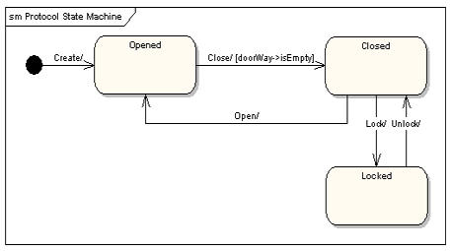
Finite State Machines
A directed graph.
Nodes represent states
An abstract description of the current value of an entity’s attributes.
Edges represent transitions between states.
Events cause the state to change.
Labeled event [guard] / activity
event: The event that triggered the transition.
guard: Conditions that must be true to choose a transition.
activity: Behavior exhibited by the object when this transition is taken.
Gregory Gay CSCE 747 - Spring 2017 8
Notes:
Models are often constructed prior to the code, or independent from it, and may serve as a specification of the allowed behavior. In that case, the most common way to model system behavior is to take the original natural language specification, choose a function, and represent the behavior of the system when performing that function as a finite state machine.
You often see this done for systems where it is crucial to ensure that the requirements are complete and non-contradictory. So, most often, this is done for embedded systems - where you see complex, highly conditional behavior. Communication protocols often can be directly represented as state machines. Menu-driven applications can also easily be modeled at state machines, as can thread behavior and communication in systems with multiple threads and processes.
These are directed graphs where nodes represent snapshots of the system - states (3)
and edges represent how the system responds to events - they represent (4).
(5), from any state, how the system can react to events is represented by transitions to all reachable states from that point, marked with a label (6-9)

Slide 9
Example: Gumball Machine
[gumballs > 0]
Waiting for Quarter
user ejects quarter
user inserts quarter
Quarter Inserted
user turns crank
[gumballs -1 > 0] / dispense gumball
Out of Gumballs
Gumball Sold
[gumballs -1 = 0] / dispense gumball
Gregory Gay CSCE 747 - Spring 2017 9
Notes:
Old school mechanical devices are dead. Today, people are building software into everything from refridgerators to cars. Now, we want to bring gumball machines into the modern day. By putting CPUs in our machine, we can increase sales, monitor inventory, and add new features. How do we do this? We start by modeling the behavior of our gumball machine as a state machine. (walk through)
initial state
point out transitions and guards
Now, this isn’t detailed enough to serve as source code directly - there are a lot of actions unaccounted for - what should happen if a person tries to eject a quarter then there isn’t one in the machine? what if they insert two quarters? Those decisions need to be made during implementation, and should have been covered in the requirements, but this gives us an abstracted overview of what happens then the system operates - how the system reacts to events and what conditions guide those actions.

Slide 10
Example: Maintenance
If the product is covered by warranty or maintenance contract, maintenance can be requested through the web site or by bringing the item to a designated maintenance station.
If the maintenance is requested by web and the customer is a US resident, the item is picked up from the customer. Otherwise, the customer will ship the item.
If the product is not covered by warranty or the warranty number is not valid, the item must be brought to a maintenance station. The station informs the customer of the estimated cost. Maintenance starts when the customer accepts the estimate. If the customer does not accept, the item is returned.
If the maintenance station cannot solve the problem, the product is sent to the regional headquarters (if in the US) or the main headquarters (otherwise). If the regional headquarters cannot solve the problem, the product is sent to main headquarters.
Maintenance is suspended if some components are not available.
Once repaired, the product is returned to the customer.
No Maintenance
Waiting for Pick Up
Request - No Warranty
Wait for Acceptance
Repair at Station
Wait for Returning
Repair at Regional HQ
Repair at Main HQ
Wait for Component
Repaired
Gregory Gay CSCE 747 - Spring 2018 10
Notes:
The maintenance function records the history of items undergoing maintenance. Read over
If we look over this closely, we can identify states
- no maintenance - nothing is going on right now
- What about waiting for shipping? Probably not - that’s not something the software is aware of. We just care about what the software does. Customers will ship items without alerting us.
- Request is made without warranty - we send out the total then, we wait for a response. If they don’t like it, we then return the item to them.
- Try repairing it at the station
- If that fails (regional/main)
- wait
- return
This is open to some interpretation, obviously - but you should be sure to cover all states that the system can exhibit. Be as detailed as possible, but remember to restrict yourself to what the software can actually do - what info it tracks and can influence. The software can’t know, for instance, that a customer has shipped an item to it unless we explicitly note that the customer could do something like log a tracking number. The next step is to link up these states with all of the transitions that we can extract from this text. What does this look like?

Slide 11
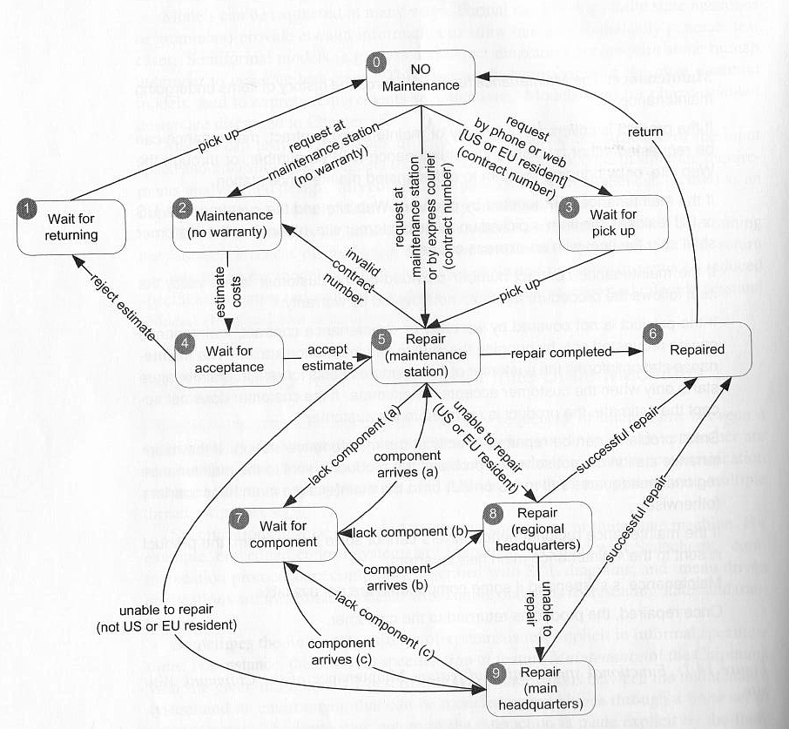
Example: Maintenance
Gregory Gay CSCE 747 - Spring 2017 11
Notes:
go over

Slide 12
Finite State Space
Most systems have an infinite number of states.
For a communication protocol, there are an infinite number of possible messages that can be passed.
To model such systems, non-finite components must be ignored or abstracted until the model is finite.
For the communication protocol, the message text doesn’t matter. How it is used does matter.
Requires an abstraction function to map back to the real system.
Gregory Gay CSCE 747 - Spring 2017 12
Notes:
(1). A state is what the current values of the system’s variables are at any given time, and most variables have a huge - if not infinite - number of variations. (2)
When you model, (3).
The thing is, we don’t need all of those variables and their values. We usually model these things before building code, so we might only know about a few variables. So, we model what we know, and we simplify down to what is important (4)
(5) - we need to know how to make comparisons to the model for this test to be run and judged on the real system.

Slide 13
State Coverage
Each state has been reached by one or more test cases.
Analog to statement coverage - unless the model has been placed in each state, all faults cannot be revealed.
Easy to understand and obtain, but low fault-revealing power.
The software takes action during the transitions, and most states can be reached through multiple transitions.
Gregory Gay CSCE 747 - Spring 2017 13
Notes:
Several coverage metrics based on covering the structure of the state machine. The first is, of course, - state coverage.
(1)
the natural analog to statement coverage - (2)
(3-4) transitions - that’s when input comes in, the next state is decided, and output is released - and (rest)

Slide 14
Transition Coverage
A transition specifies a pre/post-condition.
“If the system is in state S and sees event I, then after reacting to it, the system will be in state T.”
A faulty system could violate any of these precondition, postcondition pairs.
Coverage requires that every transition be covered by one or more test cases.
Subsumes state coverage.
Gregory Gay CSCE 747 - Spring 2017 14
Notes:
(1). A transition from state S-T on event i means that “if the system is in state S and sees event i, then after reacting to it, the system will be in state T.
State S is a precondition, T is the postcondition, and I is the input. If this input arrives and we are in S, we should be in T once the transition is over
(3), and each should be checked.
(5) - if we’ve covered all transitions, we’ve obviously hit each state.

Slide 15
Example: Maintenance
Test cases often given as a list of states or transitions to be covered.
No “final” states, could achieve transition coverage with one large test case.
Smarter to break down FSM and target sections in isolation.
Example Suite:
T1: 0-2-4-1-0
T2: 0-5-2-4-5-6-0
T3: 0-3-5-9-6-0
T4: 0-3-5-7-5-8-7-8-9-7-9-6-0
T5: 0-5-8-6-0
Gregory Gay CSCE 747 - Spring 2017 15
Notes:
(1)
(2) - final - states that we cannot transition out of after reaching them (rest of 2). However, like with code coverage, this often isn’t a good idea. It’s better to have a larger number of small tests so you can examine problems in isolation if they crop up. It makes sense to break the FSM into sections and cover those, tracking what needs to be covered.
- T1
- T2
- T3
-T4
-t5

Slide 16
History Sensitivity
Transition coverage based on assumption that transitions out of a state are independent of transitions into a state.
Many machines exhibit “history sensitivity”.
Transitions available depend on the history of previous actions.
AKA - the path to the current state.
Can be a sign of a bad model design.
“wait for component” in example.
Path-based metrics can cope with sensitivity.
Gregory Gay CSCE 747 - Spring 2017 16
Notes:
(1-4). If we’re in a state and deciding what to transition to next, we might need information on the path taken to that point to know we’ve made the right selection.
Go back to example - take “wait for component”. Once we’re in that state, we can transition to any of the repair states. Which one? if we (show mismatch), well, that should be impossible in the real system. If we use transition coverage as our guide, we’d get a test from the model that can’t be replicated and passed by the system- at least we hope. We need to know where it came from in the first place. We need that path history to know that we made the right choice. This is arguably a design flaw in the model, and a huge issue if the system can replicate it - we should not be able to take any of these transitions. Really, our model should have three different waiting states, each with their own transition. That said, sometimes it is better just to work with a flawed model, and there are some path-based coverage metrics that can cope with history sensitivity.

Slide 17
Path Coverage Metrics
Single State Path Coverage
Requires that each subpath that traverses states at most once to be included in a path that is exercised.
Single Transition Path Coverage
Requires that each subpath that traverses a transition at most once to be included in a path that is exercised.
Boundary Interior Loop Coverage
Each distinct loop must be exercised minimum, an intermediate, and a large number of times.
Gregory Gay CSCE 747 - Spring 2017 17
Notes:
(1-2). This deals with the looping issue that makes path coverage impossible. We remove cycles from paths. We need to visit all states without looping through cycles forever, as you would have to in full path coverage. - maybe draw simple example on the board
(3-4)
(5-6)
Even without looping, the number of paths can be exponentially high, so these are often impractical, but can be very powerful if they can be satisfied.

Slide 18
Single State/Transition Path Coverage
Single State/Transition Path Coverage
Requires that each subpath that traverses states/transitions at most once to be included in a path that is exercised.
Gregory Gay CSCE 747 - Spring 2017 18
Notes:
go over
Remember - each state at most once. If you have to return to a previous state, you can end the path.
(5 clicks). I am not going to go over every one, but this should give the idea. Each path that does not touch a state previouslt hit in that path must be covered. This gives a stopping criterion on subpaths, so that you do not loop forever, as you could in this case.

Slide 19
Boundary Interior Loop Coverage
Boundary Interior Loop Coverage
Each distinct loop must be exercised minimum, an intermediate, and a large number of times.
Gregory Gay CSCE 747 - Spring 2017 19
Notes:
(1-2). Let’s pick a loop. (bring in)
The minimum can vary, in some cases, any test will exercise it multiple times, but it should be at least once. Then, pick some upper bound - probably less than 10. Then, something in the middle.

Slide 20
Test Generation
Test cases created for models can be applied to programs.
Events can be translated into method input.
System output, when abstracted, should match model output.
Model coverage is one form of requirements coverage. Tests should be effective for verification.
Gregory Gay CSCE 747 - Spring 2017 20
Notes:
(go over)

Slide 21
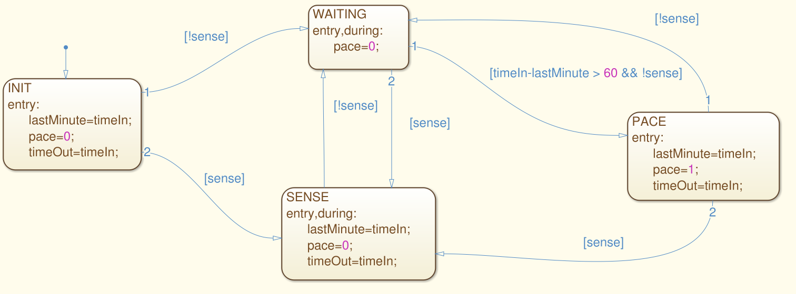
Activity
For this model, derive test suites that achieve state and transition coverage.
Gregory Gay CSCE 747 - Spring 2017 21
Notes:
(go over)

Slide 22
Activity - State Coverage
[true,1], [false,2], [false, 65]
Gregory Gay CSCE 747 - Spring 2017 22
Notes:
(go over)(3 clicks). Pretty simple.

Slide 23
Activity - Transition Coverage
[true,1], [false,2], [false, 65], [true, 66], [false, 77], [true, 78], [false, 79], [false, 140], [false, 141]
[false, 1]
Gregory Gay CSCE 747 - Spring 2017 23
Notes:
Transition coverage is a little more complicated.
Start by expanding the first test (9 clicks)
Just leaves one transition. For that, we need a second test because it is a transition out of the initial state, and there is no way back to the original state.
Not the only suite, not even the best suite. That first test is really long and may be hard to understand. May want to distribute this out over both.

Slide 24
We Have Learned
If we build models from functional specifications, those models can be used to systematically generate test cases.
Helps identify important combinations of input to the system.
Coverage metrics based on the type of model guide test selection.
Gregory Gay CSCE 747 - Spring 2017 24

Slide 25
Next Time
More Model-Based Testing
Decision Structures
Grammars
Homework:
Homework 2 - questions?
Gregory Gay CSCE 747 - Spring 2017 25

