Slide 1
Midterm Review
CSCE 747 - Lecture 15 - 02/28/2017

Slide 2
We Will Cover
You have a midterm on Thursday
75 minutes
Closed-book, closed-notes.
Covers all content to date.
There is a practice exam on the course site.
Did you try it?
Let’s go over it!
Gregory Gay CSCE 747 - Spring 2017 2

Slide 3
Question 1
A test suite that meets a stronger coverage criterion will find any defects that are detected by any test suite that meets only a weaker coverage criterion
True
False
A test suite that is known to achieve Modified Condition/Decision Coverage (MC/DC) for a given program, when executed, will exercise, at least once:
Every statement in the program.
Every branch in the program.
Every LCSAJ in the program.
Every path in the program.
Gregory Gay CSCE 747 - Spring 2017 3

Slide 4
Question 1
A test suite that meets a stronger coverage criterion will find any defects that are detected by any test suite that meets only a weaker coverage criterion
True
False
A test suite that is known to achieve Modified Condition/Decision Coverage (MC/DC) for a given program, when executed, will exercise, at least once:
Every statement in the program.
Every branch in the program.
Every LCSAJ in the program.
Every path in the program.
Gregory Gay CSCE 747 - Spring 2017 4

Slide 5
Question 1
Possible sources of information for functional testing include:
Requirements Specification
User Manuals
Program Source Code
Domain Experts
Category-Partition Testing technique requires identification of:
Parameter characteristics
Representative values
Def-Use pairs
Pairwise combinations
Gregory Gay CSCE 747 - Spring 2017 5

Slide 6
Question 1
Possible sources of information for functional testing include:
Requirements Specification
User Manuals
Program Source Code
Domain Experts
Category-Partition Testing technique requires identification of:
Parameter characteristics
Representative values
Def-Use pairs
Pairwise combinations
Gregory Gay CSCE 747 - Spring 2017 6

Slide 7
Question 1
Validation activities can only be performed once the complete system has been built.
True
False
Statement coverage criterion never requires as many test cases to satisfy as branch coverage criterion.
True
False
Requirement specifications are not needed for generating inputs to satisfy structural coverage of program code.
True
False
A system that fails to meet its user’s needs may still be:
Correct with respect to its specification.
Safe to operate.
Robust in the presence of exceptional conditions.
Considered to have passed verification.
Gregory Gay CSCE 747 - Spring 2017 7

Slide 8
Question 1
Validation activities can only be performed once the complete system has been built.
True
False
Statement coverage criterion never requires as many test cases to satisfy as branch coverage criterion.
True
False
Requirement specifications are not needed for generating inputs to satisfy structural coverage of program code.
True
False
A system that fails to meet its user’s needs may still be:
Correct with respect to its specification.
Safe to operate.
Robust in the presence of exceptional conditions.
Considered to have passed verification.
Gregory Gay CSCE 747 - Spring 2017 8

Slide 9
Question 2
Consider the following situation:
After carefully and thoroughly developing a collection of requirements-based tests and running your test suite, you determine that you have achieved only 60% statement coverage. You are surprised (and saddened), since you had done a very thorough job developing the requirements-based tests and you expected the result to be closer to 100%.
Gregory Gay CSCE 747 - Spring 2017 9

Slide 10
Question 2
Briefly describe two (2) things that might have happened to account for the fact that 40% of the code was not exercised during the requirements-based tests.
Poor job choosing test cases.
Missing requirements.
Dead or inactive code.
Error-handling.
Code used only in special cases.
Gregory Gay CSCE 747 - Spring 2017 10
Notes:
There are several reasons. The most obvious one being doing a poor job finding the black-box test cases. Since we assume we did a good job, this is not the case.
- We are missing requirements. The requirements document is incomplete and somewhere along the development of the software these missing requirements have been informally filled in by the development team, but the requirements were never added to the requirements document. Developing black-box tests from an incomplete specification to test a more complete implementation will naturally lead to poor coverage.
- We have large amounts of dead or inactivated code. The software may have gone through several major changes and code needed for an earlier version is now not used. This code will not be covered. Also, debugging code deactivated through some global variable will not be covered. Furthermore, any malicious code may not get covered. There are many reasons why unneeded or undesirable code might make it into the software—this code is likely to not be covered with your black-box tests.
- There may be valid optimizations in the code. The programmers might have done some very smart things in terms of optimizing the code, but this leads to a potentially large code base that is only used in various special cases. For example, the programmer might have used some lookup tables for various trigonometric functions (implemented as a switch statement) instead of the built in trigonometric functions. With black box testing you are unlikely to cover much of those switch statements.

Slide 11
Question 2
Should you, in general, be able to expect 100% statement coverage through thorough requirements-based testing alone (why or why not)?
No.
There are almost always special cases not covered by requirements.
Code optimizations, debug code, exception handling.
Gregory Gay CSCE 747 - Spring 2017 11
Notes:
In general there will be optimizations, debug code, exception handling, etc. in the program that the black-box testing is quite unlikely to reveal. Thus it is highly unlikely that we will get close to 100% through black-box testing alone.

Slide 12
Question 2
Some structural criteria, such as MC/DC, prescribe obligations that are impossible to satisfy. What are two reasons why a test obligation may be impossible to satisfy?
Impossible combination of conditions
Defensive programming (situations that may not happen in practice are planned for).
Other situations that result in unused code (i.e., code implemented for future use that is not currently reachable).
Gregory Gay CSCE 747 - Spring 2017 12
Notes:
Impossible combination of conditions, defensive programming, unreachable/unused code

Slide 13
Question 3
In class we discussed the importance of defining a test case for each requirement. What are the two primary benefits of defining this test case?
Helps when performing integration testing. Can build test cases early, apply to code once it is written.
Forces us to write testable requirements.
Gregory Gay CSCE 747 - Spring 2017 13
Notes:
A test case will greatly help us in the integration testing phase. Now our testing groups can start defining test cases and procedures early and be ready when the system is coming on-line.
Test cases force us to write testable (thus, pretty good) requirements. If a requirement is not testable, we simply cannot write a test case.

Slide 14
Question 4
The airport connection check is part of a travel reservation system. It checks the validity of a single connection between two flights in an itinerary.
validConnection(Flight arrivingFlight, Flight departingFlight) returns ValidityCode.
A Flight is a data structure consisting of:
A unique identifying flight code (string, three characters followed by four numbers).
The originating airport code (three character string).
The scheduled departure time (in universal time).
The destination airport code (three character string).
The scheduled arrival time (in universal time).
There is also a flight database, where each record contains:
Three-letter airport code (three character string).
Airport country (two character string).
Minimum connection time (integer, minimum number of minutes that must be allowed for flight connections).
Gregory Gay CSCE 747 - Spring 2017 14
Notes:
(read)

Slide 15
Question 4
A Flight is a data structure consisting of:
A unique identifying flight code (string, three characters followed by four numbers).
The originating airport code (three character string).
The scheduled departure time (in universal time).
The destination airport code (three character string).
The scheduled arrival time (in universal time).
There is also a flight database, where each record contains:
Three-letter airport code (three character string).
Airport country (two character string).
Minimum connection time (integer, minimum number of minutes that must be allowed for flight connections).
Identify categories and choices for the parameters of this function.
Gregory Gay CSCE 747 - Spring 2017 15
Notes:
(read) work through
departure flight, arrival flight, database
for each parameter in data structure, what are some input partitions

Slide 16
Question 4 - Solution
Parameter: Arriving flight
Flight code:
malformed
not in database
valid
Originating airport code:
malformed
not in database
valid city
Scheduled departure time:
syntactically malformed
out of legal range
legal
Destination airport (transfer airport):
malformed
not in database
valid city
Scheduled arrival time (tA):
syntactically malformed
out of legal range
legal
Parameter: Departing flight
Flight code:
malformed
not in database
valid
Originating airport code:
malformed
not in database
differs from transfer airport
same as transfer airport
Scheduled departure time:
syntactically malformed
out of legal range
before arriving flight time (tA)
between tA and tA + minimum connection time (CT)
equal to tA + CT
greater than tA + CT
Destination airport code:
malformed
not in database
valid city
Scheduled arrival time:
syntactically malformed
out of legal range
legal
Parameter: Database record
This parameter refers to the database time record corresponding to the transfer airport.
Airport code:
malformed
not found in database
valid
Airport country:
malformed
invalid
valid
Minimum connection time:
not found in database
invalid
valid
Gregory Gay CSCE 747 - Spring 2017 16
Notes:
Here are kind of the essential, could be some others - make sure destination and originating differ for the arriving flight and for the departing flight

Slide 17
Question 5
Draw the control-flow graph for this method.
Develop test input that will provide statement coverage.
Develop test input that will provide branch coverage.
Develop test input that will provide path coverage.
int findMax(int a, int b, int c) {
int temp;
if (a>b)
temp=a;
else
temp=b;
if (c>temp)
temp = c;
return temp;
}
Gregory Gay CSCE 747 - Spring 2017 17

Slide 18
Question 5 - Solution
1. int findMax(int a, int b, int c) {
2. int temp;
3. if (a>b)
4. temp=a;
5. else
6. temp=b;
7. if (c>temp)
8. temp = c;
9. return temp;
10. }
2
3
T
4
F
6
7
T
F
8
Statement:
(3,2,4), (2,3,4)
Path:
(4,2,5), (4,2,1), (2,3,4), (2,3,1)
9
Branch:
(3,2,4), (3,4,1)
Gregory Gay CSCE 747 - Spring 2017 18
Notes:
statement (discuss) - 2
branch (discuss) - 2 (one new) (TT,FF)
path ( discuss) - 4 tests (TT) (TF) (FT) (FF)

Slide 19
Question 5 - Solution
Modify the program to introduce a fault such that even path coverage could miss the fault.
int findMax(int a, int b, int c) {
int temp;
if (a>b)
temp=a;
else
temp=b;
if (c>temp)
temp = c;
return temp;
}
Use (a >b+1) instead of (a>b) and the test input from the last slide:
(4,2,5), (4,2,1), (2,3,4), (2,3,1)
will not reveal the fault.
Gregory Gay CSCE 747 - Spring 2017 19
Notes:
(read and discuss)
Point is - this depends on your test inputs. You can pass in input that achieves coverage without triggering a fault. Those are two different things. Stronger coverage can help reveal faults, but does not ensure it.

Slide 20
Question 6
Identify all DU pairs and write test cases to achieve All DU Pair Coverage.
Hint - remember that there is a loop.
1. int doSomething(int x, int y) 2. {
3. while(y > 0) {
4. if(x > 0) {
5. y = y - x;
6. }else {
7. x = x + 1;
8. }
9. }
10. return x + y;
11. }
Gregory Gay CSCE 747 - Spring 2017 20
Notes:
Now, the code in the practice midterm is too big for one slide, the answers for that will go up today. Let’s work together on a smaller example, though.

Slide 21
Question 6
1. int doSomething(int x, int y) 2. {
3. while(y > 0) {
4. if(x > 0) {
5. y = y - x;
6. }else {
7. x = x + 1;
8. }
9. }
10. return x + y;
11. }
Variable | Defs | Uses
x | 1, 7 | 4, 5, 7, 10
y | 1, 5 | 3, 5, 10
Variable | D-U Pairs
x | (1, 4), (1, 5), (1, 7), (1, 10), (7, 4), (7, 5), (7, 7), (7, 10)
y | (1, 3), (1, 5), (1, 10), (5, 3), (5, 5), (5, 10)
Gregory Gay CSCE 747 - Spring 2017 21

Slide 22
Question 6
1. int doSomething(int x, int y) 2. {
3. while(y > 0) {
4. if(x > 0) {
5. y = y - x;
6. }else {
7. x = x + 1;
8. }
9. }
10. return x + y;
11. }
Variable | D-U Pairs
x | (1, 4), (1, 5), (1, 7), (1, 10), (7, 4), (7, 5), (7, 7), (7, 10)
y | (1, 3), (1, 5), (1, 10), (5, 3), (5, 5), (5, 10)
Test 1: (x = 1, y = 2)
Covers lines 1, 3, 4, 5, 3, 4, 5, 3, 10
Test 2: (x = -1, y = 1)
Covers lines 1, 3, 4, 6, 7, 3, 4, 6, 7, 3, 4, 5, 3, 10
Test 3: (x = 1, y = 0)
Covers lines 1, 3, 8
Gregory Gay CSCE 747 - Spring 2017 22
Notes:
Click 1, 2 go over
Click 3, 4 go over
Click 5, 6 go over

Slide 23
Question 7
In a directed graph with a designated exit node, we say that a node m post-dominates another node n, if m appears on every path from n to the exit node.
Let us write m pdom n to mean that m post-dominates n, and pdom(n) to mean the set of all post-dominators of n, i.e., {m | m pdom n}.
Gregory Gay CSCE 747 - Spring 2017 23
Notes:
Look familiar?

Slide 24
Question 7
Does b pdom b hold true for all b?
Can both a pdom b and b pdom a hold true for two different nodes a and b?
Yes. Each node must appear on every path to the exit from itself.
Not if they are different nodes. If a pdom b, then b must be on all paths from a to the exit. Node a cannot appear after b at the same time.
Gregory Gay CSCE 747 - Spring 2017 24
Notes:
Yes. Trivially, the node b must appear on every path from the exit node to itself. Thus, every node is its own “trivial post-dominator”. Thus, pdom is reflexive.
No, unless a = b (or yes, only if a = b). If a = b, result follows from (a). If a and b are distinct and a pdom b, every path to the exit must pass through a after reaching b. If b pdom a is true, that implies that every path to the exit must pass through b after passing through a. Both cannot be true at once, that would imply there is some path from a to the exit that does not pass through b. Thus, pdom is anti-symmetric.

Slide 25
Question 7
3. If both c pdom b and b pdom a hold true, what can you say about the relationship between c and a?
4. If both c pdom a and b pdom a hold true, what can you say about the relationship between c and b?
3. c pdom a. Node b appears on all paths from a to the exit. Node c must appear on the subpath from b to the exit.
4. Either c pdom b or b pdom c. Both b and c must appear on all paths from a to the exit. One will pdom the other.
Gregory Gay CSCE 747 - Spring 2017 25
Notes:
c pdom a holds true. If there is a path from a to the exit, b appears on that path because b pdom a. Then, c must appear on the sub-path from b to the exit because c pdom b. Thus, pdom is transitive.
Either c pdom b or b pdom c holds true. Otherwise, b and c will be distinct nodes and there will be a path from b to the exit that does not pass through c, and a path from c to the exit that does not pass through b. Suppose there is a path from a to the exit. Now, because c pdom a and b pdom a, both c and b must appear on that path.

Slide 26
Question 8
In class, we discussed various forms of oracles – such as a model, a second implementation, properties, self-checks, a team of experts, etc.
Provide a comparative analysis of three different kinds of oracles of your choice, defining what they are and addressing their strengths and weaknesses with respect to key attributes relevant to the verification process (e.g., cost, accuracy, completeness).
Gregory Gay CSCE 747 - Spring 2017 26

Slide 27
Question 8
Expected-Value Oracle: Exact definition of the expected output given a concrete input. Most common form of oracle.
expected = 5; actual = function(x); assert(expected == actual);
Self-Check Oracle: A property that must be met by the output, regardless of the value of the output. actual = function(x); assert (actual > 0);
Model: A finite-state machine representing the abstract behavior of a function in a variety of situations.
Gregory Gay CSCE 747 - Spring 2017 27

Slide 28
Question 8
Cost (per-test) (least to greatest):
expected value, self-check, model
Expected value very cheap, but only work for one input. Models very expensive, but can handle almost any input.
Completeness (least to greatest):
expected value, self-check, model
Self-checks, models can account for more scenarios.
Accuracy (least to greatest):
self-check, model, expected value
Self-checks only catch faults related to specified properties.
Gregory Gay CSCE 747 - Spring 2017 28
Notes:
Expected-value oracles are less expensive to design (per-test) than models and self-checks, but only work for one test input at a time. Self-checks and Models can handle a wider variety of situations - potentially any input to the function. However, they may miss a fault that does not violate the property, or meets the same abstract output class as the expected result. Models are the most expensive to design, as they require development of a full model of execution. Models may be inaccurate as well, as they represent simplified versions of a program, and may not reflect enough of the details that are needed for the real execution of the program. Self-Checks may also be inaccurate, as they can only tell when a program violates the specified property - incorrect output could still meet the property.

Slide 29
Question 9
Explain the difference between verification and validation.
Which of these is considered harder? Why?
Gregory Gay CSCE 747 - Spring 2017 29
Notes:
(read)

Slide 30
Question 9
Explain the difference between verification and validation.
Validation: Does the system meet the customer’s needs? “Are we building the right product?”
Verification: Does the system meet the specifications we laid out? “Are we building the product right?”
Which of these is considered harder? Why?
Validation is harder.
It requires that we understand the customer’s actual desires. They might not have told us those, or changed their minds.
Gregory Gay CSCE 747 - Spring 2017 30
Notes:
(read)

Slide 31
Question 10
Describe the key difference between black-box testing and white-box testing.
Gregory Gay CSCE 747 - Spring 2017 31

Slide 32
Question 10
Black-box testing treats the program as a machine that accepts input and issues output, with no visibility into its internal workings.
Tests are based on requirements and specifications.
You do not know what classes or methods are in the code, and you do now know what objects exist at runtime.
White-box involves testing the independent logic paths with full knowledge of the source code. You do not have full knowledge of the intended functionality (white box tests cannot look for unimplemented code).
Gregory Gay CSCE 747 - Spring 2017 32

Slide 33
Question 11
When we discuss software testing, we refer to Faults and Failures. Please briefly describe what a Fault is and what a Failure is. Make sure to point out the difference between a Fault and a Failure.
Gregory Gay CSCE 747 - Spring 2017 33

Slide 34
Question 11
A Fault is a problem with the implementation. It is something that is missing, extra, or erroneous.
A Failure is an incorrect execution of the software; we get an output we did not expect.
A Failure is the manifestation of a Fault, if the execution executes the Fault and the corrupted state propagates to the output, we can observe it as a Failure.
Gregory Gay CSCE 747 - Spring 2017 34

Slide 35
Question 12
Why is it so important to include boundary values in your black-box test-data?
Make sure your answer includes a brief description of what a boundary value is.
Gregory Gay CSCE 747 - Spring 2017 35

Slide 36
Question 12
Boundary values are the inputs that are on or close to the boundaries between the input equivalence partitions as well as special values we know are tricky to handle correctly.
We know from experience that programmers make mistakes with boundary values.
Thus we should include test cases to see if these cases are handled correctly.
Include values such as zero, very large, very small, empty list, max long list, etc.
Gregory Gay CSCE 747 - Spring 2017 36

Slide 37
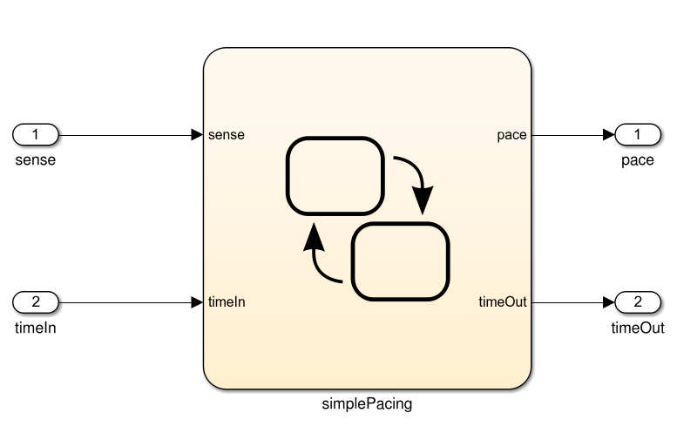
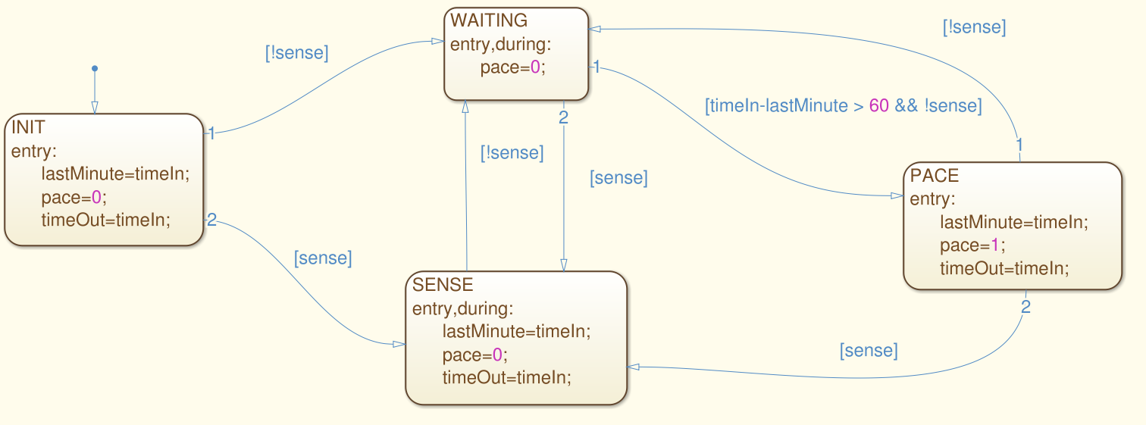
Question 13
For this model, derive test suites that achieve state and transition coverage.
Gregory Gay CSCE 747 - Spring 2017 37
Notes:
(go over)

Slide 38
Question 13
[true,1], [false,2], [false, 65]
Gregory Gay CSCE 747 - Spring 2017 38
Notes:
(go over)(3 clicks). Pretty simple.

Slide 39
Question 13
[true,1], [false,2], [false, 65], [true, 66], [false, 77], [true, 78], [false, 79], [false, 140], [false, 141]
[false, 1]
Gregory Gay CSCE 747 - Spring 2017 39
Notes:
Transition coverage is a little more complicated.
Start by expanding the first test (9 clicks)
Just leaves one transition. For that, we need a second test because it is a transition out of the initial state, and there is no way back to the original state.
Not the only suite, not even the best suite. That first test is really long and may be hard to understand. May want to distribute this out over both.

Slide 40
Question 13
What about single-state and single-transition path coverage?
2
1
4
3
Gregory Gay CSCE 747 - Spring 2017 40
Notes:
(go over)

Slide 41
Any other questions?
Next Class:
The Midterm
Next Week:
Spring Break
The Week After:
Video lectures
Writing executable unit tests
Gregory Gay CSCE 747 - Spring 2017 41
Notes:
(read) (and many more)

