Slide 1
Test Execution and Automation
CSCE 747 - Lecture 17 - 03/14/2017

Slide 2
Executing Tests
We’ve covered many techniques to derive test cases.
How do you run them on the program?
You could run the code and check results by hand.
Please don’t do this.
Humans are slow, expensive, and error-prone.
Test design requires effort and creativity.
Test execution should not.
Gregory Gay CSCE 747 - Spring 2017 2
Notes:
(1), but this has been an abstract process. I’ve never once brought up how you actually run these tests on the system.
Of course, (3) - stat up the code, enter some input, then look at the output and give it the ok or not ok.
(4) Just don’t. Don’t even think of it. It happens more than you expect, but it’s almost always a bad idea. (5) - this is especially true on the oracle side. We get bored, our mind drifts, the caffeine wears off. Eventually, we’ll make mistakes. We could make a different judgement each time we run a test case, or mess up at entering input.
Ultimately, (6), but (7).

Slide 3
Test Automation
Test Automation is the development of software to separate repetitive tasks from the creative aspects of testing.
Automation allows control over how and when tests are executed.
Control the environment and preconditions.
Automatic comparison of predicted and actual output.
Automatic hands-free reexecution of tests.
Gregory Gay CSCE 747 - Spring 2017 3
Notes:
Execution should be as mechanical as compiling the latest version of the product. We want to make testing as easy as possible for humans. Test automation is how we do this
(read 1-2)
We can (3), giving us the ability to test the system in a variety of configurations.WE can make (4) without having to judge each test case, and really importantly - (5)

Slide 4
Testing Requires Writing Code
Testing cannot wait for the system to be complete.
The component to be tested must be isolated from the rest of the system, instantiated, and driven using method invocations.
Untested dependencies must be stubbed out with reliable substitutions.
The deployment environment must be simulated by a controllable harness.
Gregory Gay CSCE 747 - Spring 2017 4
Notes:
The simple fact is that (1 -4)

Slide 5
Test Scaffolding
Test scaffolding is a set of programs written to support test automation.
Not part of the product
Often temporary
Allows for:
Testing before all components complete.
Testing independent components.
Control over testing environment.
Gregory Gay CSCE 747 - Spring 2017 5
Notes:
So, to make this happen, testing often involves writing a surprising amount of code. This code, called test scaffolding,
(read)
That said, scaffolding has been estimated to be up to half of the code written for large-scale projects
(more reading)
last point - the ability to set up the system in the state needed for running a test, to control how components are tested, and to then tear it down and prepare the system for the next test.

Slide 6
Test Scaffolding
A driver is a substitute for a main or calling program.
Test cases are drivers.
A harness is a substitute for all or part of the deployment environment.
A stub (or mock object) is a substitute for system functionality that has not been completed.
Support for recording and managing test execution.
Gregory Gay CSCE 747 - Spring 2017 6
Notes:
Some of the common pieces of code written as test scaffolding include:
(read). Called this because this is how you interact with the software and make it do something. Each test is generally a driver. It initializes objects and calls them, sets up the oracle, and initiaes the result comparison once the test runs.
(read) - This usually comes into play when testing embedded systems - you might simulate the platform it is running on and the environment it’ll be used in if it needs to work with some particular environment - for instance, a pacemaker might need a simulated heart to react to. When testing a program with a networking component, you might simulate the network and try out different connection conditions.
(read) or that we simply do not want to rely on.
You might also need to write code for additional (5)

Slide 7
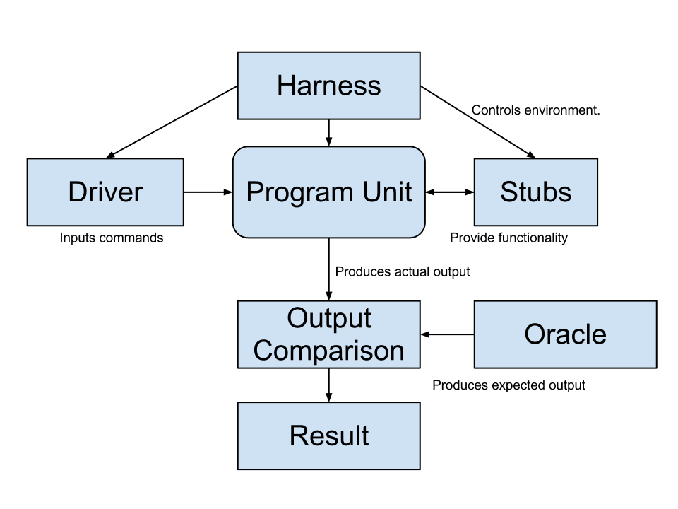
Test Scaffolding
Simulates the execution environment.
Can control network conditions, environmental factors, operating systems.
Initializes objects
Initializes parameter variables
Performs the test
Performs any necessary cleanup steps.
Templates that provide functionality and allow testing in isolation
Checks the correspondence between the produced and expected output and renders a test verdict.
Gregory Gay CSCE 747 - Spring 2017 7
Notes:
- Driver: instantiates system objects, performs setup - initializes the non-local variables, initializes parameters, activates the test, then tears everything down when done
- The harness simulates the execution environment, controlling factors such as environment simumations for embedded systems or networking conditions for systems with communication components.
- Stubs are templates that represent unimplemented system components or external entities and allow you to test part of a system in isolation from the rest.
- The oracle checks the produced output against an expected output and renders a test verdict - pass or fail.

Slide 8
Writing an Executable Test Case
Test Input
Any required input data.
Expected Output (Test Oracle)
What should happen, i.e., values or exceptions.
Initialization
Any steps that must be taken before test execution.
Test Steps
Interactions with the system (such as method calls), and output comparisons.
Tear Down
Any steps that must be taken after test execution to prepare for the next test.
Gregory Gay CSCE 747 - Spring 2017 8
Notes:
To write a driver - an executable test case - we need to address five items. These are (go over)

Slide 9
Writing a Unit Test
JUnit is a Java-based toolkit for writing executable tests.
Choose a target from the code base.
Write a “testing class” containing a series of unit tests centered around testing that target.
public class Calculator { public int evaluate (String expression) { int sum = 0; for (String summand: expression.split("\\+")) sum += Integer.valueOf(summand); return sum; } }
Gregory Gay CSCE 747 - Spring 2017 9
Notes:
So, what does a test look like? Usually, tests are code that you write, included in their own package within the project, that can be executed and perform that series of steps we just talked about - set up, execution, and checking the results, and cleaning up. Most languages have toolkits for writing these tests. In Java, the most popular is called JUnit - and IDEs like Eclipse have support for JUnit fairly well integrated into the development environment. Writing tests in JUnit is essentially as easy as just writing more Java code, you just need to learn some special syntax.
What you usually will do is choose some target - some unit from the code base. Often, this is a class from the project, or a small group of classes. Then, in the test package (3), where you write a series of test cases as methods.

Slide 10
Writing a Unit Test
public class Calculator { public int evaluate (String expression) { int sum = 0; for (String summand: expression.split("\\+")) sum += Integer.valueOf(summand); return sum; } }
import static org.junit.Assert.assertEquals; import org.junit.Test; public class CalculatorTest { @Test public void evaluatesExpression() { Calculator calculator = new Calculator(); int sum = calculator.evaluate("1+2+3"); assertEquals(6, sum);
calculator = null; } }
Convention - name the test class after the class it is testing or the functionality being tested.
Each test is denoted with keyword @test.
Initialization
Input
Test Steps
Oracle
Tear Down
Gregory Gay CSCE 747 - Spring 2017 10
Notes:
to give an example, on the left, we have some calculator code we want to test. It has an evaluate method that takes in an expression. Then, it splits that expression based on the + sign, and for each substring, it converts it to an int and adds the value to the sum, returning that at the end.
Now, we can write a test class using the capabilities offered by JUnit.
- You create classes for testing either a particular class or unit of your system or for testing a kind of functionality.The convention is to name it (read), followed by the word Test.
- each test is marked with the keyword @test.
-this is our initialization
- then, our test steps are to run the evaluate method on the initialized Calculator object, then to check the results.
- We execute evaluate with the input 1+2+3
- Our oracle then is the exact value 6 - we expect the result of evaluate with that input to be 6. To check the result, we use what is called an assertion - in this case assertEquals - which compares the equality of two values and issues a fail verdict if they don’t match.
- finally, to prepare for the next test, we set calculator to null. This is our tear down - any prep that needs to happen for the next test to ensure that this test does not corrupt another test.
(DEMO)
run, then
Modify Calculator.java in order to get a failing test. Replace the linesum += Integer.valueOf(summand);with sum -= Integer.valueOf(summand);

Slide 11
Test Fixtures - Shared Initialization
@Before annotation defines a common test
initialization method:
@Before
public void setUp() throws Exception
{
this.registration = new Registration();
this.registration.setUser(“ggay”);
}
Gregory Gay CSCE 747 - Spring 2017 11
Notes:
JUnit also offers special method annotations for special test support code - these are called test fixtures. If we have initialization steps shared by all tests, rather than repeating them in the code for each test, you can write a method that executes those steps. (read). This contains anything you want to run before each test. So, we might want to reinitialize our GRADS system, then set the user. Get that taken care of before a test.

Slide 12
Test Fixtures - Teardown Method
@After annotation defines a common test tear
down method:
@After
public void tearDown() throws Exception
{
this.registration.logout();
this.registration = null;
}
Gregory Gay CSCE 747 - Spring 2017 12
Notes:
Similarly, (read). This contains anything you want to do after a test to clean up the environment. For instance, you might want to log the user out of the system to make sure that happens without issue, then you might want to wipe out that system object entirely to leave the slate clean for the next test.

Slide 13
More Test Fixtures
@BeforeClass defines initialization to take place before any tests are run.
@AfterClass defines tear down after all tests are done.
@BeforeClass public static void setUpClass() {
myManagedResource = new ManagedResource(); } @AfterClass public static void tearDownClass() throws IOException { myManagedResource.close(); myManagedResource = null; }
Gregory Gay CSCE 747 - Spring 2017 13
Notes:
There are two other fixtures called beforeclass and after class
(go over)

Slide 14
Test Skeleton
@Test annotation defines a single test:
@Test
public void test<MethodName><TestingContext>() {
//Define Inputs
try{ //Try to get output.
}catch(Exception error){
fail("Why did it fail?");
}
//Compare expected and actual values through assertions or through if statements/fails
}
Gregory Gay CSCE 747 - Spring 2017 14
Notes:
Tests are marked with the @test keyword. They are usually named with the word test, followed by the name of the method being tested, then a description for the outcome or scenario being tested - some kind of context for why you are performing this test. You will generally then define inputs, try to run the function with those, and examine the outputs. There is a special call called fail that will declare the test a failure, parameterized with a string explaining why it failed. You can compare the expected and actual output through if statements and issue fail commands if they don’t match up, or you can make assertions about the results - declare properties that the results must follow. If an assertion fails, than the test fails.

Slide 15
Assertions
Assertions are a "language" of testing - constraints that you place on the output.
assertEquals, assertArrayEquals
assertFalse, assertTrue
assertNull, assertNotNull
assertSame,assertNotSame
assertThat
Gregory Gay CSCE 747 - Spring 2017 15
Notes:
(read) - your bread and butter in writing unit tests.
- this is where you can make a direct comparison of expected and actual output
- assert that a property evaluate to true or false - add two positive numbers, you can assert that the result is positive.
- assert that an object is null or not null
- assert that two objects are clones
- a bit of a complex one that allows for a number of checks on the contents of the output.

Slide 16
assertEquals
@Test public void testAssertEquals() { assertEquals("failure - strings are not equal", "text", "text");
}
@Test public void testAssertArrayEquals() { byte[] expected = "trial".getBytes(); byte[] actual = "trial".getBytes(); assertArrayEquals("failure - byte arrays not same", expected, actual); }
Compares two items for equality.
For user-defined classes, relies on .equals method.
Compare field-by-field
assertEquals(studentA.getName(), studentB.getName()) rather than assertEquals(studentA, studentB)
assertArrayEquals compares arrays of items.
Gregory Gay CSCE 747 - Spring 2017 16
Notes:
Our first two are assertEquals and assertArrayEquals. This is the straightforward - does the expected output match the actual output. It takes in two items, and compares their values for equality.
(2-5)
go over code examples

Slide 17
assertFalse, assertTrue
@Test public void testAssertFalse() { assertFalse("failure - should be false", (getGrade(studentA, “CSCE747”).equals(“A”)); }
@Test
public void testAssertTrue() {
assertTrue("failure - should be true", (getOwed(studentA) > 0)); }
Take in a string and a boolean expression.
Evaluates the expression and issues pass/fail based on outcome.
Used to check conformance of solution to expected properties.
Gregory Gay CSCE 747 - Spring 2017 17
Notes:
Next is assertFalse and its twin assertTrue
(go over)
This is used when, rather than checking the exact value of the result, we want to check (3)

Slide 18
assertSame, assertNotSame
@Test public void testAssertNotSame() { assertNotSame("should not be same Object", studentA, new Object()); } @Test public void testAssertSame() { Student studentB = studentA; assertSame("should be same", studentA, studentB); }
Checks whether two objects are clones.
Are these variables aliases for the same object?
assertEquals uses .equals().
assertSame uses ==
Gregory Gay CSCE 747 - Spring 2017 18
Notes:
Our next two are similar to assertEquals, but not quite the same.
(1) , that is (2). Not whether they contain the same data, but are they literally aliases for the same memory space.
(3-4)

Slide 19
assertNull, assertNotNull
@Test public void testAssertNotNull() { assertNotNull("should not be null", new Object()); } @Test
public void testAssertNull() { assertNull("should be null", null); }
Take in an object and checks whether it is null/not null.
Can be used to help diagnose and void null pointer exceptions.
Gregory Gay CSCE 747 - Spring 2017 19
Notes:
Pretty straightforward - (go over)

Slide 20
assertThat
@Test public void testAssertThat{ assertThat("albumen", both(containsString("a")).and(containsString("b"))); assertThat(Arrays.asList("one", "two", "three"), hasItems("one", "three")); assertThat(Arrays.asList(new String[] { "fun", "ban", "net" }), everyItem(containsString("n"))); assertThat("good", allOf(equalTo("good"), startsWith("good"))); assertThat("good", not(allOf(equalTo("bad"), equalTo("good")))); assertThat("good", anyOf(equalTo("bad"), equalTo("good"))); assertThat(7, not(CombinableMatcher.<Integer> either(equalTo(3)).or(equalTo(4))));
}
both - two properties must be met.
has items - a list contains an indicated subset of items, but can also contain other items.
everyItem - all items in list must match a property.
allOf - all listed properties must be true
not(allOf(...)) - if all of these properties are true, the test should fail.
anyOf - at least one of the listed properties must be true
either - pass if one of these properties is true.
Gregory Gay CSCE 747 - Spring 2017 20
Notes:
assertThat is a special construct that allows a number of specialized assertions, using matchers provided by JUnit directly and the Hamcrest library that JUnit makes use of.
If you look at JUnit’s documentation, there are a bunch of these, but to go over a few examples.
- read
- read
- read
- read
- read - so, we have a checklist of bad things, and if all of them are met, we’ll issue a failure verdict.
- read
- read

Slide 21
Testing Exceptions
When testing error handling, we expect exceptions to be thrown.
In JUnit, we can ensure that the right exception is thrown.
@Test(expected = IndexOutOfBoundsException.class) public void empty() { new ArrayList<Object>().get(0); }
Gregory Gay CSCE 747 - Spring 2017 21
Notes:
1-2
This code (method invocation) should throw an IndexOutOfBoundsException. The @Test annotation has an optional parameter "expected" that takes as values subclasses of Throwable. If we wanted to verify thatArrayList throws the correct exception, we would write (go over code)

Slide 22
Testing Exceptions - Rules
Rules can be used to encapsulate repeated test behavior.
Such as ensuring that the right exception is thrown.
In the test, state which exception is expected and examine its stack trace.
@Rule public ExpectedException thrown = ExpectedException.none(); @Test public void testExceptionMessage() throws IndexOutOfBoundsException { List<Object> list = new ArrayList<Object>(); thrown.expect (IndexOutOfBoundsException.class); thrown.expectMessage("Index: 0, Size: 0"); list.get(0); }
Gregory Gay CSCE 747 - Spring 2017 22
Notes:
The expected parameter should be used with care. The above test will pass if any code in the method throws IndexOutOfBoundsException. For longer tests, it's recommended to use the ExpectedException rule. Rules are used to add additional functionality which applies to all tests within a test class, but in a more generic way. Rather than repeatidly pasting in the same code and making minor changes to examine things like exceptions, you can use one of the special rule objects that encapsulate common testing tasks and just fill in the test-relevant details. There are several of these, but the most relevant is the ExpectedException rule.
(3) - go over code. point out none, then explicit definition later
can inspect the message and look for particular strings or location indicators.

Slide 23
Scaffolding
Stubs and drivers are code written as replacements other parts of the system.
May be required if pieces of the system do not exist.
Scaffolding allows greater control over test execution and greater observability to judge test results.
Ability to simulate dependencies and test components in isolation.
Ability to set up specialized testing scenarios.
Ability to replace part of the program with a version more suited to testing.
Gregory Gay CSCE 747 - Spring 2017 23
Notes:
(1). Sometimes stubs are needed to even make a component executable, if (2).
(3), including (4)- (5) (6) - say taking a protected component and replacing it with a version where you can freely read and check the correctness of fields.

Slide 24
Object Mocking
Components may depend on other, unfinished (or untested) components. You can mock those components.
Mock objects have the same interface as the real component, but are hand-created to simulate the real component.
Can also be used to simulate abnormal operation or rare events.
WeatherData
temperature
windSpeed
windDirection
pressure
lastReadingTime
collect()
summarize(time)
Thermometer
ther_identifier
temperature
get()
shutdown()
restart()
Mock_Thermometer
ther_identifier
temperature
get()
shutdown()
restart()
get(){
return 98;
}
Gregory Gay CSCE 747 - Spring 2017 24
Notes:
I mentioned the idea of testing units in isolation a couple of times. The thing is that objects are often tightly interconnected, and when a problem occurs, it’s often hard to figure out where exactly the problem is coming from. Especially when parts of your system are closely linked with other objects. You might even have faults in both objects, and it only gets harder to isolate issues the more dependency links you have. If you are testing a method that depends on another methods, and that method depends on another method, you can see where this is going. It’s in your interest to try to test these units in as much isolation as is possible. Now, (read). For instance, Your class might need to read from a non-existent database.
may need to mock (read). This is a form of stub.
For example, if your object calls a database, your mocked database might only contain a couple of hand-written data items. Therefore, you do not need to depend on other components that may not be finished or may not have been satisfactorily tested.
Mock objects are often used to substitute in data or results that you know are right, but they are also a cool tool for testing because - even if you do have that component working - you can create a mock object to simulate abnormal behavior or rare events, make sure you hit those boundary cases.

Slide 25
Replacing Interfaces
Scaffolding can be complex - can replace any portion of the system.
If an interface does not allow control or observability - write scaffolding to replace it.
Allow inspection of previously-private variables.
Replace a GUI with a machine-usable interface.
May be useful after testing.
Expose a command-line interface for scripting.
Gregory Gay CSCE 747 - Spring 2017 25
Notes:
Scaffolding like stubs and drivers aren’t just used as quick replacements for non-functional code, though. They can be quite complex as they can replace any portion of the system. For instance, (2) - it dosn’t allow us to go in and directly control the system, or doesn’t let us extract the information we need to judge the test case, we can write scaffolding to replace it.
(3)
Or, say we use a GUI to control the system. That’s not something a machine can typically step in and use directly. In that case, we might want to write a driver that allows direct control of the underlying functionality.
In these cases (5) - (6)

Slide 26
Generic vs Specific Scaffolding
Simplest driver - one that runs a single specific test case.
More complex:
Common scaffolding for a set of similar tests cases,
Scaffolding that can run multiple test suites for the same software (i.e., load a spreadsheet of inputs and run then).
Scaffolding that can vary a number of parameters (product family, OS, language).
Balance of quality, scope, and cost.
Gregory Gay CSCE 747 - Spring 2017 26
Notes:
Your test scaffolding can range a good bit in complexity. The most common, and most straightforward is (read) - that’ll be easy to build one at a time, but you’ll quickly notice that time adding up. There are more complex forms of scaffolding that may save you more time long-term, (read)
As usual, the trade-off game comes in…
If you’re building something like a network traffic generator to stress test a networked system = that’s essentially the same as full-blown development of a new piece of software. But, it can often be worthwhile to invest some time in building testing infrastructure that can be deployed across many future projects.

Slide 27
Activity - Unit Testing
You are testing the following method: public double max(double a, double b); Devise three executable test cases for this method in the JUnit notation. See the attached handout for a refresher on the notation.
Gregory Gay CSCE 747 - Spring 2017 27
Notes:
Your test scaffolding can range a good bit in complexity. The most common, and most straightforward is (read) - that’ll be easy to build one at a time, but you’ll quickly notice that time adding up. There are more complex forms of scaffolding that may save you more time long-term, (read)
As usual, the trade-off game comes in…
If you’re building something like a network traffic generator to stress test a networked system = that’s essentially the same as full-blown development of a new piece of software. But, it can often be worthwhile to invest some time in building testing infrastructure that can be deployed across many future projects.

Slide 28
Activity Solution
@Test public void aLarger() { double a = 16.0;
double b = 10.0;
double expected = 16.0; double actual = max(a,b);
assertTrue(“should be larger”, actual>b); assertEquals(expected, actual); } @Test public void bLarger() { double a = 10.0;
double b = 16.0;
double expected = 16.0; double actual = max(a,b);
assertThat(“b should be larger”, b>a); assertEquals(expected, actual); }
@Test public void bothEqual() { double a = 16.0;
double b = 16.0;
double expected = 16.0; double actual = max(a,b);
assertEquals(a,b); assertEquals(expected, actual); }
@Test public void bothNegative() { double a = -2.0;
double b = -1.0;
double expected = -1.0; double actual = max(a,b);
assertTrue(“should be negative”,actual<0); assertEquals(expected, actual); }
Gregory Gay CSCE 747 - Spring 2017 28
Notes:
Your test scaffolding can range a good bit in complexity. The most common, and most straightforward is (read) - that’ll be easy to build one at a time, but you’ll quickly notice that time adding up. There are more complex forms of scaffolding that may save you more time long-term, (read)
As usual, the trade-off game comes in…
If you’re building something like a network traffic generator to stress test a networked system = that’s essentially the same as full-blown development of a new piece of software. But, it can often be worthwhile to invest some time in building testing infrastructure that can be deployed across many future projects.

Slide 29
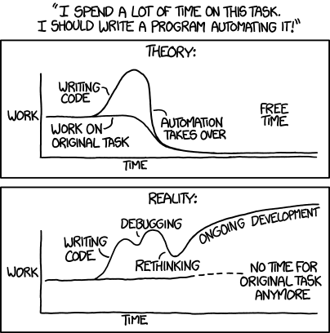
Automation Trade-Offs
Some common strategies help guide automation.
Gregory Gay CSCE 747 - Spring 2017 29
Notes:
I have to look back at this comic from time to time in my own work. It’s fun to code up automation, but it can get a little out of hand. We’ll cover some strategies to help systematically test a system.

Slide 30
Incremental Testing
T1
Test pieces of the system as they are completed. Use scaffolding (stubs, drivers) to test in isolation, then swap out for real components to test integration.
Advantages:
Easily test components in isolation.
Discover faults earlier.
Disadvantage:
Expensive to develop scaffolding.
T1
A
A
T2
T2
B
B
T3
T3
C
T4
T1
A
T2
B
T3
C
T4
D
T5
Gregory Gay CSCE 747 - Spring 2017 30
Notes:
One of the most powerful things made possible by all of this automation is the concept of incremental testing. Rather than waiting for the complete system to be built, we can start testing what we have completed. Piece by piece, we test components of the system. When we start, almost everything is stubbed out, but we can add in the real components and test their integration as we complete them.
As a result, we can easily test components in isolation, which means that not only we can more easily discover faults, we can discover faults earlier in development because we don’t need the rest of the system and fix them before they become a problem.
The downside is that it is expensive to develop all of that scaffolding. The earlier you start, or the more you want to isolate components, the more work you will have to pour into writing stubs. That can add up.

Slide 31
Top-Down Testing
Testing Sequence
Level 1
Level1
Level 2 Stubs
Level 2
Level 2
Level 2
Level 3 Stubs
Gregory Gay CSCE 747 - Spring 2017 31
Notes:
How you test can follow a style similar to how you are design your system. Earlier, we talked a little about top-down vs bottom-up development. How you incrementally test relates to how you work through building the code. In top-down testing, testing takes place from top to bottom in the system hierarchy, following the control flow dependencies. You take a higher-level component, something that calls into low level code, and you test it in isolation. To do so, lower level components or systems are substituted by stubs that fake their results. This lets you see whether the higher-level component and how it brings together those stubs can corrupt results.

Slide 32
Top-Down Testing
Start with the high levels of a system (based on control-flow, data-flow, or architecture) and work your way downwards.
Use in conjunction with top-down development.
Very good for finding architectural or integration errors.
May need system infrastructure in place before testing is possible.
Requires large effort in developing stubs.
Gregory Gay CSCE 747 - Spring 2017 32
Notes:
(read)
(read) - if the interaction between components is an issue, it’s easier to spot if the top level is already working pretty well. If there is a problem with how the architecure comes together in practice. you’ll spot that more quickly.
The trade-off is that top-down testing requires simulating the lower components. You will need to put effort into building stubs, and may need a great deal of system architecture in place before you can do much testing at all.

Slide 33
Bottom-Up Testing
Level N-1 Drivers
Testing Sequence
Level N-1
Level N-1
Level N-1
Level N Drivers
Level N
Level N
Level N
Level N
Gregory Gay CSCE 747 - Spring 2017 33
Notes:
Bottom-Up testing comes in from the opposite direction. You start at the bottom of the system hierarchy - small units that perform tasks independently of calling components. Test each individual component at that level in isolation, then work your way up the hierarchy, bringing together already-tested components. Here, you don’t need as many stubs. You have the lower components. When you develop something that brings together lower-level units, that has dependencies, most of its dependencies should already exist as they will come in at the lower level. However, most of the testing code will be in the drivers. You will need to develop more complex drivers to instantiate, set up, and test those components.

Slide 34
Bottom-Up Testing
Start with the lower levels of a system (based on control-flow, data-flow, or architecture) and work your way upwards.
Use in conjunction with bottom-up development.
Appropriate for object-oriented systems.
Necessary for testing critical infrastructure.
Does not find major design problems, but very good at testing individual components.
Requires high effort in developing drivers.
Gregory Gay CSCE 747 - Spring 2017 34
Notes:
(read)
(read 3) - the best way to test components in isolation. It won’t find architectural issues as easily, but it allows you to effectively test and find faults in those individual objects or methods.
The trade off is that it (read 5).

Slide 35
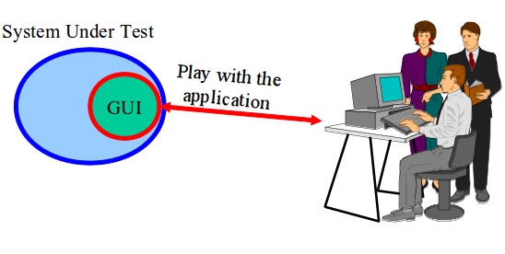
What About Graphical Interfaces?
Graphical components of projects often tested manually by real users.
Heavily tested during alpha/beta testing.
Gregory Gay CSCE 747 - Spring 2017 35
Notes:
Now, there are aspects of most programs that aren’t exactly amenable to passing in a few command line parameters and running. The graphical components of applications - GUIs, video games - take input from mouse motions and clicks. testing whether those work can be complex - dealing with overlapping visual widgets, it’s hard to define boundary regions, and every click can set off a series of under-the-surface interactions How do we test those?
Well, those are often tested by hand. First by the developers, of course, but most heavily during alpha and beta testing. Get a few hundred users clicking around and sort out the problems that crop up.

Slide 36
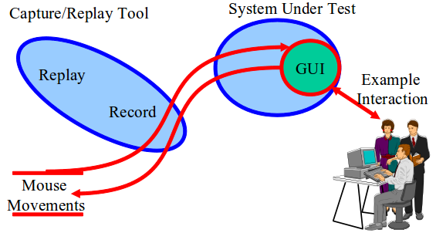
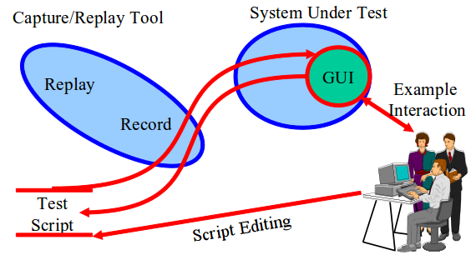
Capture and Replay
Have a human interact with the system, walking through several different scenarios.
Record their mouse motions and clicks during these scenarios.
Take these test cases and modify them to create additional tests.
Gregory Gay CSCE 747 - Spring 2017 36
Notes:
The thing is - this stinks. It’s something that should have some human involvement eventually, as graphical interactions - especially in games - need to be tuned until they feel right. But, if we’re just on the hunt for bugs, we should be able to automate interactions. How can we do that without a person? Well, a common idea in automation is the concept of taking a little bit of human feedback as a seed and building automation off of that. This is a concept that comes in to play heavily in testing GUIs. What we can do is get a human in to play with the program. We can record the actions they take during some sample scenarios - based on our different use cases. Those are called captures. We can then use those - we can replay them - to repeat the same scenarios and the same mouse motions and clicks without needing the human sitting there. These captures - these sets of actions - become an initial set of test cases. We can then edit those to turn them into new test cases - modifying the actions slightly or taking the individual actions and combining them to form entirely new tests. This lets us automate GUI testing. Cuts repetition. Capture a few manual executions, and reuse them or alter them. More productive use of human effort.

Slide 37
Capture and Replay
Common test automation method:
Have a human do something once.
Let the computer take the same actions.
Allows retesting without additional human involvement as long as interface is unchanged.
Often can be used to create additional tests:
Transform their actions into a script.
Encode a series of transformations that can be automatically invoked on the script.
Requires an oracle, but can rely on generic oracles.
Gregory Gay CSCE 747 - Spring 2017 37
Notes:
go over

Slide 38
Continuous Integration
Development practice that requires code be frequently checked into a shared repository.
Each check-in is then verified by an automated build.
The system is compiled and subjected to an automated test suite, then packaged into a new executable.
By integrating regularly, developers can detect errors quickly, and locate them more easily.
Gregory Gay CSCE 747 - Spring 2017 38
Notes:
One area where test automation is essential - and has made possible - is continuous integration.
Continuous Integration is a development practice that requires developers to integrate code into a shared repository several times a day. Each check-in is then verified by an automated build (3)
By integrating regularly, you can detect errors quickly, and locate them more easily. CI requires significantly less back-tracking to discover where things went wrong, so you can more efficiently build the system.

Slide 39
CI Practices
Maintain a code repository.
Automate the build.
Make the build self-testing.
Every commit should be built.
Keep the build fast.
Test in a clone of the production environment.
Make it easy to get the latest executable.
Everyone can see build results.
Automate deployment.
Gregory Gay CSCE 747 - Spring 2017 39
Notes:
(1) The first practice advocates the use of a revision control system for the project's source code. All artifacts required to build the project should be placed in the repository. the system should be buildable from a fresh checkout and not require additional dependencies. Everybody should be actively using source control, and committing code changes at least once - if not several times per day.
(2) A single command should have the capability of building the system. Think of something like Make in Unix - a script you write that builds the system. Maven is a more modern concept for Java that lets you define a series of actions used to compile, test, and package the code. Automation of the build should include automating the integration of program components, which often includes deployment into a production-like environment. In many cases, the build script not only compiles binaries, but also generates documentation, website pages, statistics and distribution media
(3) Once the code is built, all tests should run to confirm that it behaves as the developers expect it to behave. This requires test automation.
(4) The system should build commits to the current working version to verify that they integrate correctly. A common practice is to use Automated Continuous Integration, where a continuous integration server or daemon monitors the revision control system for changes, then automatically runs the build process.
(5) The build needs to complete rapidly, so that if there is a problem with integration, it is quickly identified.
(6) Having a test environment can lead to failures in tested systems when they deploy in the production environment, because the production environment may differ from the test environment in a significant way. The test environment should be built to be a scalable version of the actual production environment.
(7) Making builds readily available to stakeholders and testers can reduce the amount of rework necessary when rebuilding a feature that doesn't meet requirements. Additionally, early testing reduces the chances that defects survive until deployment. Finding errors earlier also, in some cases, reduces the amount of work necessary to resolve them.
All programmers should start the day by updating the project from the repository. That way, they will all stay up to date.
(8) It should be easy to find out whether the build breaks and, if so, who made the relevant change.
(9) Most CI systems allow the running of scripts after a build finishes. In most situations, it is possible to write a script to deploy the application to a live server that everyone can look at. Sometimes, the software is deployed directly into production, often with additional automation to prevent defects or regressions.

Slide 40
How Integration is Performed
Developers check out code to their machine.
Changes are committed to the repository.
The CI server:
Monitors the repository and checks out changes when they occur.
Builds the system and runs unit/integration tests.
Releases deployable artefacts for testing.
Assigns a build label to the version of the code.
Informs the team of the successful build.
Gregory Gay CSCE 747 - Spring 2017 40
Notes:
(go over)

Slide 41
How Integration is Performed
If the build or tests fail, the CI server alerts the team.
The team fixes the issue at the earliest opportunity.
Developers are expected not to check in code they know is broken.
Developers are expected to write and run tests on all code before checking it in.
No one is allowed to check in while a build is broken.
Continue to continually integrate and test throughout the project.
Gregory Gay CSCE 747 - Spring 2017 41
Notes:
(go over)

Slide 42
We Have Learned
Test automation can be used to lower the cost and improve the quality of testing.
Automation involves creating drivers, harnesses, stubs, and oracles.
Systems can be tested in a top-down or bottom-up style.
Automated testing enables continuous integration and deployment.
Gregory Gay CSCE 747 - Spring 2017 42

Slide 43
Next Time
Unit testing lab - let’s get our hands dirty.
You will need a laptop with a Java IDE installed (and jUnit).
Individual assignment - turn in by March 17, 11:59 PM.
Assignment 3
Out now. Due March 28
Complete the unit testing lab first.
Gregory Gay CSCE 747 - Spring 2017 43

