Slide 1
Model-Based Testing
CSCE 747 - Lecture 18 - 03/29/2018

Slide 2
Creating Requirements-Based Tests
Write Testable Specifications
Produce clear, detailed, and testable requirements.
Identify Independently Testable Features
Figure out what functions can be tested in (relative) isolation.
Identify Representative Input Values
What are the outcomes of the feature, and which input classes will trigger them?
Generate Test Case Specifications
Identify abstract classes of test cases.
Instantiate concrete input/output pairs.
Generate Test Cases
Notes:
A little while back, we talked about the idea of coming up with test cases using the system’s requirement specification. We went over this process - (go over).

Slide 3
Creating Requirements-Based Tests
This process is effective for identifying the independent partitions for each input.
Leaving us with a large number of test specifications
Humans must still identify constraints on combinations of input choices and identify a subset of important test specifications.
An alternative approach - build a model from the specification, and derive tests from the structure of the model.
Notes:
The strength of this process, and the techniques based on it, is in systematically going through an informal specification, identifying features to be tested, and for each input, partitioning it into independent choices. It leaves us with a big list of potential test specifications.
(2) to turn into real tests - this is a pretty huge job. What are the possible input combinations, what constraints can be applied to certain combinations of input? What are the redundant combinations?
Today, we’ll cover (3), just as we did from the program itself.

Slide 4
Models
A model is an abstraction of the system being developed.
By abstracting away unnecessary details, extremely powerful analyses can be performed.
Can be extracted from specifications and design plans
Illustrate the intended behavior of the system.
Often take the form of state machines.
Events cause the system to react, changing its internal state.
Notes:
(1) - it takes the system and throws away all details except those explicitly needed for design. As long as the model still reflects the program, (2)
(2 )
Models can be (3), in which case they (5-7)

Slide 5
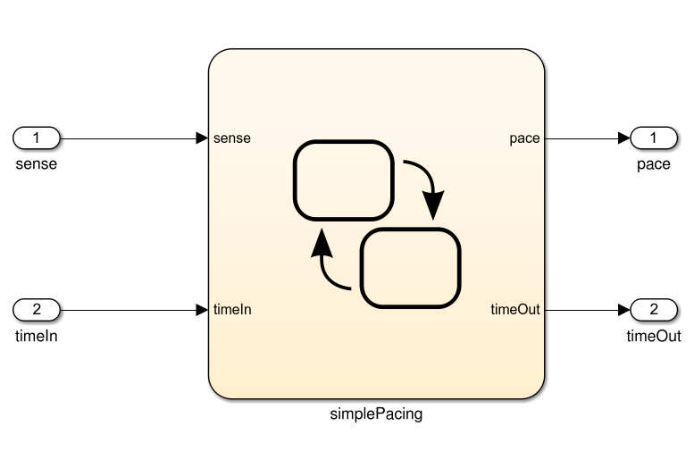
What Can We Do With This Model?
… Then we can derive test cases from the model that can be applied to the program. If the model and program do not agree, then there is a fault.
Specification
public static void Main(){
System.out.println(“Hello world!”);
}
And If the model is well-formed, consistent, and complete.
And If the model accurately represents the program.
If the model satisfies the specification...
Notes:
So, what can we do with this model? Well,
(1-4).

Slide 6
Model-Based Testing
Models describe the structure of the input space.
They identify what will happen when types of input are applied to the system.
That structure can be exploited:
Identify input partitions.
Identify constraints on inputs.
Identify significant input combinations.
Can derive and satisfy coverage metrics for certain types of models.
Notes:
(1-6). All as part of the process of verification - of using the specification to look for faults in the system.
Anytime that you have structure, you can measure coverage of that structure - just like we did with source code. Today, we’ll present some common model types and go over how to derive test cases that achieve coverage over those models.

Slide 7
Finite State Machines

Slide 8
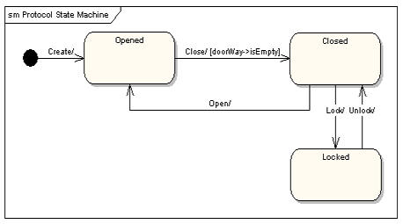
Finite State Machines
A directed graph.
Nodes represent states
An abstract description of the current value of an entity’s attributes.
Edges represent transitions between states.
Events cause the state to change.
Labeled event [guard] / activity
event: The event that triggered the transition.
guard: Conditions that must be true to choose a transition.
activity: Behavior exhibited by the object when this transition is taken.
Notes:
Models are often constructed prior to the code, or independent from it, and may serve as a specification of the allowed behavior. In that case, the most common way to model system behavior is to take the original natural language specification, choose a function, and represent the behavior of the system when performing that function as a finite state machine.
You often see this done for systems where it is crucial to ensure that the requirements are complete and non-contradictory. So, most often, this is done for embedded systems - where you see complex, highly conditional behavior. Communication protocols often can be directly represented as state machines. Menu-driven applications can also easily be modeled at state machines, as can thread behavior and communication in systems with multiple threads and processes.
These are directed graphs where nodes represent snapshots of the system - states (3)
and edges represent how the system responds to events - they represent (4).
(5), from any state, how the system can react to events is represented by transitions to all reachable states from that point, marked with a label (6-9)

Slide 9
Example: Gumball Machine
[gumballs > 0]
Waiting for Quarter
user ejects quarter
user inserts quarter
Quarter Inserted
user turns crank
[gumballs -1 > 0] / dispense gumball
Out of Gumballs
Gumball Sold
[gumballs -1 = 0] / dispense gumball
Notes:
Old school mechanical devices are dead. Today, people are building software into everything from refridgerators to cars. Now, we want to bring gumball machines into the modern day. By putting CPUs in our machine, we can increase sales, monitor inventory, and add new features. How do we do this? We start by modeling the behavior of our gumball machine as a state machine. (walk through)
initial state
point out transitions and guards
Now, this isn’t detailed enough to serve as source code directly - there are a lot of actions unaccounted for - what should happen if a person tries to eject a quarter then there isn’t one in the machine? what if they insert two quarters? Those decisions need to be made during implementation, and should have been covered in the requirements, but this gives us an abstracted overview of what happens then the system operates - how the system reacts to events and what conditions guide those actions.

Slide 10
Example: Maintenance
If the product is covered by warranty or maintenance contract, maintenance can be requested through the web site or by bringing the item to a designated maintenance station.
If the maintenance is requested by web and the customer is a US resident, the item is picked up from the customer. Otherwise, the customer will ship the item.
If the product is not covered by warranty or the warranty number is not valid, the item must be brought to a maintenance station. The station informs the customer of the estimated cost. Maintenance starts when the customer accepts the estimate. If the customer does not accept, the item is returned.
If the maintenance station cannot solve the problem, the product is sent to the regional headquarters (if in the US) or the main headquarters (otherwise). If the regional headquarters cannot solve the problem, the product is sent to main headquarters.
Maintenance is suspended if some components are not available.
Once repaired, the product is returned to the customer.
No Maintenance
Waiting for Pick Up
Request - No Warranty
Wait for Acceptance
Repair at Station
Wait for Returning
Repair at Regional HQ
Repair at Main HQ
Wait for Component
Repaired
Notes:
The maintenance function records the history of items undergoing maintenance. Read over
If we look over this closely, we can identify states
- no maintenance - nothing is going on right now
- What about waiting for shipping? Probably not - that’s not something the software is aware of. We just care about what the software does. Customers will ship items without alerting us.
- Request is made without warranty - we send out the total then, we wait for a response. If they don’t like it, we then return the item to them.
- Try repairing it at the station
- If that fails (regional/main)
- wait
- return
This is open to some interpretation, obviously - but you should be sure to cover all states that the system can exhibit. Be as detailed as possible, but remember to restrict yourself to what the software can actually do - what info it tracks and can influence. The software can’t know, for instance, that a customer has shipped an item to it unless we explicitly note that the customer could do something like log a tracking number. The next step is to link up these states with all of the transitions that we can extract from this text. What does this look like?

Slide 11
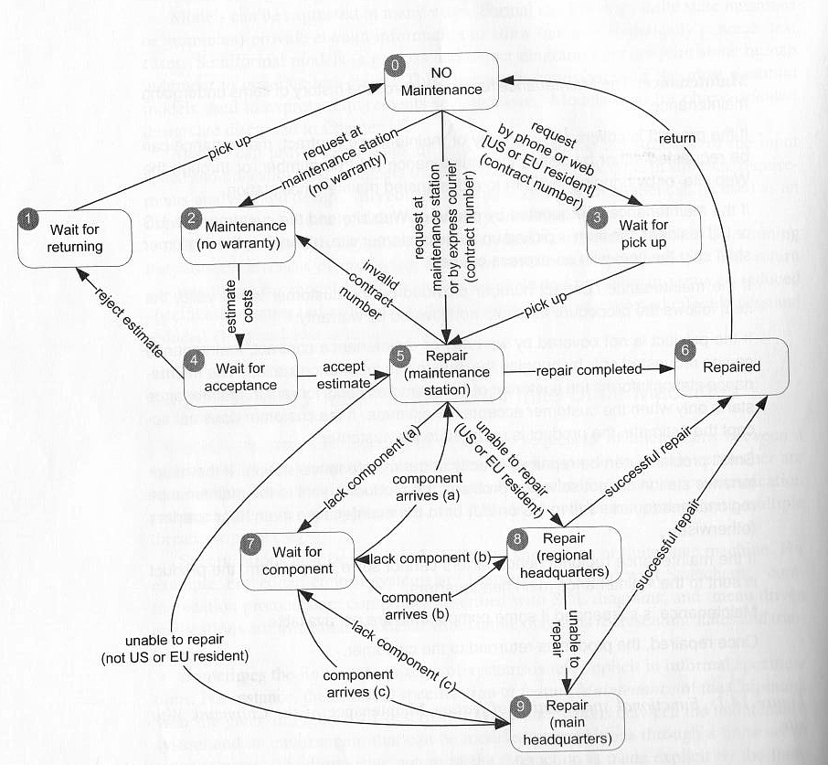
Example: Maintenance
Notes:
go over

Slide 12
Finite State Space
Most systems have an infinite number of states.
For a communication protocol, there are an infinite number of possible messages that can be passed.
To model such systems, non-finite components must be ignored or abstracted until the model is finite.
For the communication protocol, the message text doesn’t matter. How it is used does matter.
Requires an abstraction function to map back to the real system.
Notes:
(1). A state is what the current values of the system’s variables are at any given time, and most variables have a huge - if not infinite - number of variations. (2)
When you model, (3).
The thing is, we don’t need all of those variables and their values. We usually model these things before building code, so we might only know about a few variables. So, we model what we know, and we simplify down to what is important (4)
(5) - we need to know how to make comparisons to the model for this test to be run and judged on the real system.

Slide 13
State Coverage
Each state has been reached by one or more test cases.
Analog to statement coverage - unless the model has been placed in each state, all faults cannot be revealed.
Easy to understand and obtain, but low fault-revealing power.
The software takes action during the transitions, and most states can be reached through multiple transitions.
Notes:
Several coverage metrics based on covering the structure of the state machine. The first is, of course, - state coverage.
(1)
the natural analog to statement coverage - (2)
(3-4) transitions - that’s when input comes in, the next state is decided, and output is released - and (rest)

Slide 14
Transition Coverage
A transition specifies a pre/post-condition.
“If the system is in state S and sees event I, then after reacting to it, the system will be in state T.”
A faulty system could violate any of these precondition, postcondition pairs.
Coverage requires that every transition be covered by one or more test cases.
Subsumes state coverage.
Notes:
(1). A transition from state S-T on event i means that “if the system is in state S and sees event i, then after reacting to it, the system will be in state T.
State S is a precondition, T is the postcondition, and I is the input. If this input arrives and we are in S, we should be in T once the transition is over
(3), and each should be checked.
(5) - if we’ve covered all transitions, we’ve obviously hit each state.

Slide 15
Example: Maintenance
Test cases often given as a list of states or transitions to be covered.
No “final” states, could achieve transition coverage with one large test case.
Smarter to break down FSM and target sections in isolation.
Example Suite:
T1: 0-2-4-1-0
T2: 0-5-2-4-5-6-0
T3: 0-3-5-9-6-0
T4: 0-3-5-7-5-8-7-8-9-7-9-6-0
T5: 0-5-8-6-0
Notes:
(1)
(2) - final - states that we cannot transition out of after reaching them (rest of 2). However, like with code coverage, this often isn’t a good idea. It’s better to have a larger number of small tests so you can examine problems in isolation if they crop up. It makes sense to break the FSM into sections and cover those, tracking what needs to be covered.
- T1
- T2
- T3
-T4
-t5

Slide 16
History Sensitivity
Transition coverage based on assumption that transitions out of a state are independent of transitions into a state.
Many machines exhibit “history sensitivity”.
Transitions available depend on the history of previous actions.
AKA - the path to the current state.
Can be a sign of a bad model design.
“wait for component” in example.
Path-based metrics can cope with sensitivity.
Notes:
(1-4). If we’re in a state and deciding what to transition to next, we might need information on the path taken to that point to know we’ve made the right selection.
Go back to example - take “wait for component”. Once we’re in that state, we can transition to any of the repair states. Which one? if we (show mismatch), well, that should be impossible in the real system. If we use transition coverage as our guide, we’d get a test from the model that can’t be replicated and passed by the system- at least we hope. We need to know where it came from in the first place. We need that path history to know that we made the right choice. This is arguably a design flaw in the model, and a huge issue if the system can replicate it - we should not be able to take any of these transitions. Really, our model should have three different waiting states, each with their own transition. That said, sometimes it is better just to work with a flawed model, and there are some path-based coverage metrics that can cope with history sensitivity.

Slide 17
Path Coverage Metrics
Single State Path Coverage
Requires that each subpath that traverses states at most once to be included in a path that is exercised.
Single Transition Path Coverage
Requires that each subpath that traverses a transition at most once to be included in a path that is exercised.
Boundary Interior Loop Coverage
Each distinct loop must be exercised minimum, an intermediate, and a large number of times.
Notes:
(1-2). This deals with the looping issue that makes path coverage impossible. We remove cycles from paths. We need to visit all states without looping through cycles forever, as you would have to in full path coverage. - maybe draw simple example on the board
(3-4)
(5-6)
Even without looping, the number of paths can be exponentially high, so these are often impractical, but can be very powerful if they can be satisfied.

Slide 18
Single State/Transition Path Coverage
Single State/Transition Path Coverage
Requires that each subpath that traverses states/transitions at most once to be included in a path that is exercised.
Notes:
go over
Remember - each state at most once. If you have to return to a previous state, you can end the path.
(5 clicks). I am not going to go over every one, but this should give the idea. Each path that does not touch a state previouslt hit in that path must be covered. This gives a stopping criterion on subpaths, so that you do not loop forever, as you could in this case.

Slide 19
Boundary Interior Loop Coverage
Boundary Interior Loop Coverage
Each distinct loop must be exercised minimum, an intermediate, and a large number of times.
Notes:
(1-2). Let’s pick a loop. (bring in)
The minimum can vary, in some cases, any test will exercise it multiple times, but it should be at least once. Then, pick some upper bound - probably less than 10. Then, something in the middle.

Slide 20
Test Generation
Test cases created for models can be applied to programs.
Events can be translated into method input.
System output, when abstracted, should match model output.
Model coverage is one form of requirements coverage. Tests should be effective for verification.
Notes:
(go over)

Slide 21
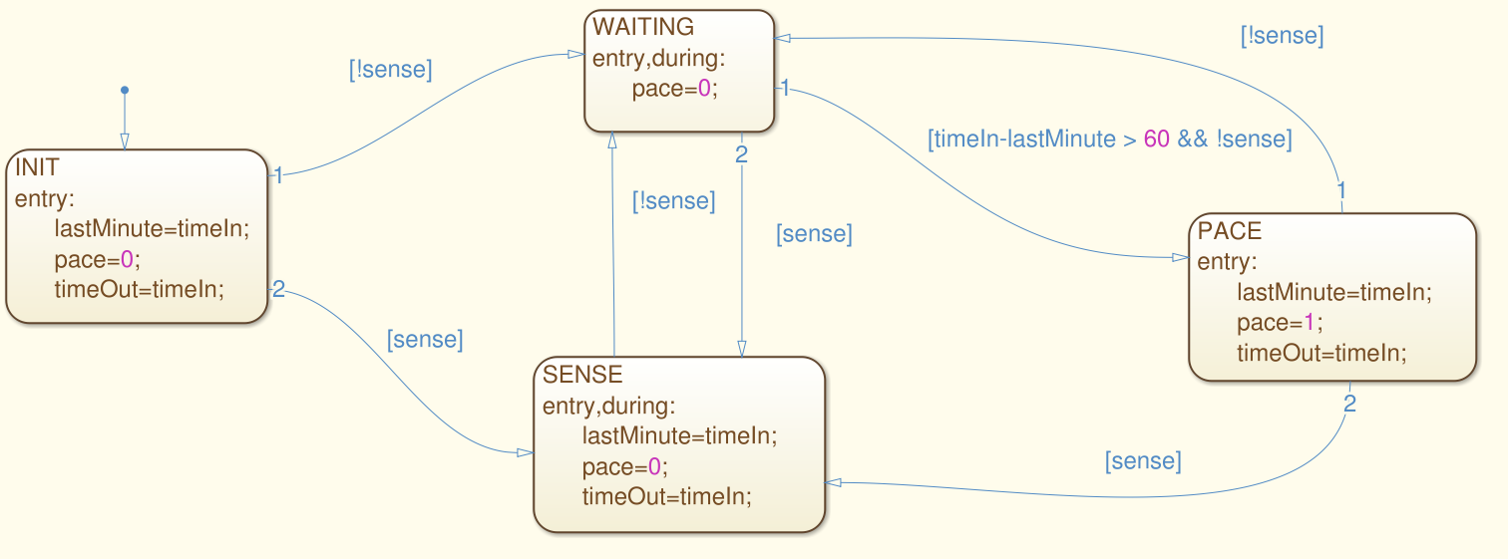
Activity
For this model, derive test suites that achieve state and transition coverage.
Notes:
(go over)

Slide 22
Activity - State Coverage
[true,1], [false,2], [false, 65]
Notes:
(go over)(3 clicks). Pretty simple.

Slide 23
Activity - Transition Coverage
[true,1], [false,2], [false, 65], [true, 66], [false, 77], [true, 78], [false, 79], [false, 140], [false, 141]
[false, 1]
Notes:
Transition coverage is a little more complicated.
Start by expanding the first test (9 clicks)
Just leaves one transition. For that, we need a second test because it is a transition out of the initial state, and there is no way back to the original state.
Not the only suite, not even the best suite. That first test is really long and may be hard to understand. May want to distribute this out over both.

Slide 24
Decision Structures

Slide 25
Logic Terminology
A predicate is a function with a boolean outcome (true/false).
When the inputs of the function are clear, they are left implicit.
We don’t care how accounts are represented. There is just a predicate “educational-customer”.
A condition is a predicate that cannot be decomposed further.
A decision, is 2+ conditions, connected with operators (and, or, xor, implication).
Notes:
(1-2). You might have an account system, where the actual representation of account types is a three letter code, but in a specification, we might not care about that representation, we just care about whether they have an educational account. In that case, educational account is a predicate that is either true or false
(4-5) - and, or, not, xor, implies

Slide 26
Decision Structures
Specifications are often expressed as decision structures.
Conditions on input values, and the corresponding actions or results.
Example:
NoDiscount = (indAcct ^ !(current > indThreshold) ^ !(offerPrice < indNormalPrice)) v (busAcct ^ !(current > busThreshold) ^ !(current > busYearlyThreshold) ^ !(offerPrice < busNormalPrice))
Decision structures can be modeled as tables, relating predicate values to outputs.
Notes:
(1-2). For example, we might have a specification describing outputs that depend on the type of account - educational, business, or ondividual - the amount of current and yearly purchases, and the availability of special prices. These can be considered as a series of boolean conditions - educational account is either true or false - and outputs can be described as expressions over these predicates. For example (3-4)
(5)

Slide 27
Decision Tables
Decision structures can be modeled as tables, relating predicate values to outputs.
Rows represent basic conditions.
Columns represent combinations of conditions, with the last row indicating the expected output for that combination.
Cells are labeled T, F, or - (don’t care).
Column is equivalent to a logical expression joining the required values.
Notes:
1-5 - where the value doesn’t matter
(6) and leaving out don’t care values.

Slide 28
Decision Tables
Can be augmented with a set of constraints that limit combinations.
Formalize the relations among basic conditions
Expressions over predicates:
(Cond1 ^ !Cond2 => Cond3)
Short-hand for common combinations:
at-most-one(C1...Cn)
exactly-one(C1...Cn)
Cond1 | T | F
Cond2 | F | -
Cond3 | T | T
Out | T | F
Notes:
(go over example)
(1-4) that are tedious to express with standard boolean connectives. (5-6)
at most one - all can be false, but at most, only one can be true
exactly one - one of these must be true, rest must be false

Slide 29
Example Decision Table
Constraints
at-most-one(EduAc,BusAc)
at-most-one(YP<=YT1, YP > YT2)
at-most-one(CP<=CT1, CP > CT2)
at-most-one(SP<=T1, SP > T2)
YP > YT2 => YP > YT1
CP > CT2 => CP > CT1
SP > T2 => SP > T1
Abbreviations
CP = current purchase
YP = yearly purchase
C(Y)T = current/yearly threshold
SP = special price
Sc = scheduled price
T1 = tier 1
T2 = tier 2
Edu = educational discount
NP = no discount
EduAc | T | T | F | F | F | F | F | F
BusAc | - | - | F | F | F | F | F | F
CP > CT1 | - | - | F | F | T | T | - | -
YP > YT1 | - | - | - | - | - | - | - | -
CP > Ct2 | - | - | - | - | F | F | T | T
YP > YT2 | - | - | - | - | - | - | - | -
SP > Sc | F | T | F | T | - | - | - | -
SP > T1 | - | - | - | - | F | T | - | -
SP > T2 | - | - | - | - | - | - | F | T
Out | Edu | SP | ND | SP | T1 | SP | T2 | SP
Notes:
go over some examples
Indicates different pricing policies, depending on a set of predicates that we can calculate.

Slide 30
Decision Table Coverage
Basic Condition Coverage
Translate each column into a test case.
Don’t care entries can be filled out arbitrarily, as long as constraints are not violated.
Compound Condition Coverage
All combinations of truth values for predicates must be covered by test cases.
Requires 2^{n} test cases for n predicates.
Can only be applied to small sets of predicates.
Notes:
The three condition-related coverage metrics from structural testing can be used here, and again, the first two represent extreme ends of the spectrum
(1-3) - this is fairly cheap and covers the basic business logic - the situations you’ve envisioned and included.
(3-6)

Slide 31
Example - Basic Condition Coverage
?
Constraints
at-most-one(EduAc,BusAc)
at-most-one(YP<=YT1, YP > YT2)
at-most-one(CP<=CT1, CP > CT2)
at-most-one(SP<=T1, SP > T2)
YP > YT2 => YP > YT1
CP > CT2 => CP > CT1
SP > T2 => SP > T1
EduAc | T | T | F | F | F | F | F | F
BusAc | - | - | F | F | F | F | F | F
CP > CT1 | - | - | F | F | T | T | - | -
YP > YT1 | - | - | - | - | - | - | - | -
CP > Ct2 | - | - | - | - | F | F | T | T
YP > YT2 | - | - | - | - | - | - | - | -
SP > Sc | F | T | F | T | - | - | - | -
SP > T1 | - | - | - | - | F | T | - | -
SP > T2 | - | - | - | - | - | - | F | T
Out | Edu | SP | ND | SP | T1 | SP | T2 | SP
Test 1: (T,-,-,-,-,-,F,-,-)
Test 2: (T,-,-,-,-,-,T,-,-)
Test 3: (F,F,F,-,-,-,F,-,-)
Test 3: (F,F,F,-,F,-,F,-,-)
Notes:
So, for Basic condition coverage, we simply take each column and design test cases that match each. Again, don’t care entries can become whatever we want as long as no constraints are violated. What you can do here is to set those “don’t care” variables in such a way that one test satisfies multiple columns.
- (go over - only one, can’t cover anything else just because of how EduAc works)
- (same deal, T, T, can’t cover anything else)
- (Go to the third column. Now, if we select carefully (CP > ct2, SP>T2), it looks like we could cover two tests with this one, but it would violate this constraint.
- We can either have CP <= Ct1 or CP > Ct 2. By having that false, we can’t have the second as true. That actually tells us what to pick for a don’t care there as well
- We can use these constraints to help fill out test cases. Unfortunately, we can’t cover multiple columns with one test here due to the constraints.

Slide 32
Example - Compound Condition Coverage
EduAc | T | T
BusAc | F | T
CP > CT1 | F | F
YP > YT1 | F | F
CP > Ct2 | F | F
YP > YT2 | F | F
SP > Sc | F | F
SP > T1 | F | F
SP > T2 | F | F
EduAc | T | T
BusAc | F | T
CP > CT1 | F | F
YP > YT1 | F | F
CP > Ct2 | F | F
YP > YT2 | F | F
SP > Sc | F | F
SP > T1 | F | F
SP > T2 | F | F
… etc
(2⁹ combinations)
Constraints
at-most-one(EduAc,BusAc)
at-most-one(YP<=YT1, YP > YT2)
at-most-one(CP<=CT1, CP > CT2)
at-most-one(SP<=T1, SP > T2)
YP > YT2 => YP > YT1
CP > CT2 => CP > CT1
SP > T2 => SP > T1
Removes 128 combinations
Removes 96 more combinations
Removes 64 more combinations
Notes:
So, in compound condition coverage, we ignore the basic truth table. Instead, we take each condition and try all legal combinations - so all combinations allowed under our constraints.
Ignoring constraints, we start with 2^9 combinations, or 512 test cases. We can’t actually run all of those, so this is where the constraints become important.
we then take the constraints and rule out illegal combos
- Right away, we see one combo that can’t happen - EduAc and BusAc can’t both be true, so that eliminates a large number of pairings - ¼, so 128. Leaving you with 384. We can pare down from there.
- Our second constraint disallows YP > YT1 = false and YP > YT2 = true, so it removes another 96 combinations, leaving us with 288
- Similar deal with our next constraint, disallows CP>CT1 = false and CP > CT2 = true. This removed another 64 combinations, down to 224.
You get the idea.

Slide 33
Decision Table Coverage
Modified Decision/Condition Coverage (MC/DC)
Each column represents a test case.
In addition, new columns are generated by modifying the cells containing T and F.
If changing a value results in a test case consistent with an existing column, the two are merged back into one.
A test suite should not just test positive combinations of values, but also negative combinations.
Notes:
The third, MCDC, again strikes a balance between the extremes - potentially exposing more faults, but requiring fewer test cases than compound condition coverage
(2-4) - consistent - they agree on all don’t care columns - we merge them back into one, prodivded no constraints are violated.
The idea here is that (5) - those combinations that differ from the ones we’ve explicitly spelled out. These combinations should produce different outcomes from those already specified - either other specified outcomes or error conditions.

Slide 34
Example Decision Table
EduAc | T | F | T | T | F | F | F | F | F | F
BusAc | - | - | - | - | F | F | F | F | F | F
CP > CT1 | - | - | - | - | F | F | T | T | - | -
YP > YT1 | - | - | - | - | - | - | - | - | - | -
CP > Ct2 | - | - | - | - | - | - | F | F | T | T
YP > YT2 | - | - | - | - | - | - | - | - | - | -
SP > Sc | F | F | T | T | F | T | - | - | - | -
SP > T1 | - | - | - | - | - | - | F | T | - | -
SP > T2 | - | - | - | - | - | - | - | - | F | T
Out | Edu | ND | SP | SP | ND | SP | T1 | SP | T2 | SP
EduAc | T | T | F | T | F | F | F | F | F | F | F | F
BusAc | - | - | F | F | T | F | F | F | F | F | F | F
CP > CT1 | - | - | F | F | F | T | F | F | T | T | - | -
YP > YT1 | - | - | - | - | - | - | - | - | - | - | - | -
CP > Ct2 | - | - | - | - | - | - | - | - | F | F | T | T
YP > YT2 | - | - | - | - | - | - | - | - | - | - | - | -
SP > Sc | F | T | F | F | F | F | T | T | - | - | - | -
SP > T1 | - | - | - | - | - | - | - | - | F | T | - | -
SP > T2 | - | - | - | - | - | - | - | - | - | - | F | T
Out | Edu | SP | ND | Edu | ND | T2 | SP | SP | T1 | SP | T2 | SP
EduAc | T | T | F | T | F | F | F | F | F | F
BusAc | - | - | - | - | F | F | F | F | F | F
CP > CT1 | - | - | - | - | F | F | T | T | - | -
YP > YT1 | - | - | - | - | - | - | - | - | - | -
CP > Ct2 | - | - | - | - | - | - | F | F | T | T
YP > YT2 | - | - | - | - | - | - | - | - | - | -
SP > Sc | F | T | T | F | F | T | - | - | - | -
SP > T1 | - | - | - | - | - | - | F | T | - | -
SP > T2 | - | - | - | - | - | - | - | - | F | T
Out | Edu | SP | SP | Edu | ND | SP | T1 | SP | T2 | SP
EduAc | T | T | F | F | F | F | F | F
BusAc | - | - | F | F | F | F | F | F
CP > CT1 | - | - | F | F | T | T | - | -
YP > YT1 | - | - | - | - | - | - | - | -
CP > Ct2 | - | - | - | - | F | F | T | T
YP > YT2 | - | - | - | - | - | - | - | -
SP > Sc | F | T | F | T | - | - | - | -
SP > T1 | - | - | - | - | F | T | - | -
SP > T2 | - | - | - | - | - | - | F | T
Out | Edu | SP | ND | SP | T1 | SP | T2 | SP
Notes:
Take this example again.
- col 1 - adds two, show flip. Both of these already exist in this table, though, so we don’t need to keep them
- col 2 - adds two, show flip - also both already here, so we don’t need to keep them.
- col 3 - adds four, show flip - three of these are new, so we keep them, the fourth exists, so we get rid of it
You get the idea. If we keep going, we will add several new columns to the table, but fewer than would be required for compound condition coverage.

Slide 35
Activity
Airline Ticket Discount Function
Read the specification and draw a decision table.
How many tests would be required for compound condition coverage?
Expand the table to form a MC/DC test suite. How many tests were added?

Slide 36
Activity - Decision Table
Infant | T | T | F | F | F | F
Child | F | F | T | T | F | F
Domestic | T | F | - | - | - | F
International | F | T | - | - | - | T
Early | - | - | T | - | T | -
Off-Season | - | - | - | - | - | T
Discount | 80 | 70 | 20 | 10 | 10 | 15
Constraints:
Infant => !Child
Child => !Infant
Domestic => !International
International => !Domestic
Domestic xor International
Notes:
Go over
How many tests for compound condition - 6 conditions, 2^6 = 64 tests. Let’s see what we can do with MCDC

Slide 37
Activity - Decision Table
Infant | T | F | T | F | T | F | F | F | F | F | T | F | F | F | F
Child | F | F | F | T | F | T | T | F | F | F | F | T | F | F | F
Domestic | T | T | F | - | - | - | - | - | - | F | F | F | T | F | F
International | F | F | T | - | - | - | - | - | - | T | T | T | T | F | T
Early | - | - | - | T | T | F | - | T | F | - | - | - | - | - | -
Off-Season | - | - | - | - | - | - | - | - | - | T | T | T | T | T | F
Discount | 80 | 0 | 70 | 20 |  |  | 10 | 10 |  | 15
Infant | T | F | T | F | T | F | F | F | F | F | T | F | F
Child | F | F | F | T | F | T | T | F | F | F | F | T | F
Domestic | T | T | F | - | - | - | - | - | - | F | F | F | F
International | F | F | T | - | - | - | - | - | - | T | T | T | T
Early | - | - | - | T | T | F | - | T | F | - | - | - | -
Off-Season | - | - | - | - | - | - | - | - | - | T | T | T | F
Discount | 80 | 0 | 70 | 20 | ?? | 10 | 10 | 10 | 0 | 15 | 70 | 15 | 0
Infant | T | F | T | F | T | F | F | F | F | F | T | F | F
Child | F | F | F | T | F | T | T | F | F | F | F | T | F
Domestic | T | T | F | - | - | - | - | - | - | F | F | F | F
International | F | F | T | - | - | - | - | - | - | T | T | T | T
Early | - | - | - | T | T | F | - | T | F | - | - | - | -
Off-Season | - | - | - | - | - | - | - | - | - | T | T | T | F
Discount | 80 | 0 | 70 | 20 | ?? | 10 | 10 | 10 | 0 | 15 | 70 | 15 | 0
Infant | T | F | T | F | T | F | F | F | T | F | F | F
Child | F | F | F | T | F | T | T | F | F | T | F | F
Domestic | T | T | F | - | - | - | - | - | - | - | - | F
International | F | F | T | - | - | - | - | - | - | - | - | T
Early | - | - | - | T | T | F | - | T | T | T | F | -
Off-Season | - | - | - | - | - | - | - | - | - | - | - | T
Discount | 80 | 0 | 70 | 20 |  |  | 10 | 10 |  |  |  | 15
Infant | T | F | T | F | T | T | T | T | F | F | F | F
Child | F | F | F | F | T | F | F | F | T | T | F | F
Domestic | T | T | F | F | F | T | F | F | - | - | - | F
International | F | F | T | F | F | F | F | T | - | - | - | T
Early | - | - | - | - | - | - | - | - | T | - | T | -
Off-Season | - | - | - | - | - | - | - | - | - | - | - | T
Discount | 80 | 0 | 70 |  |  |  |  | 70 | 20 | 10 | 10 | 15
Infant | T | F | T | F | T | F | F | F | F | -
Child | F | F | F | T | F | F | T | T | F | -
Domestic | T | T | F | - | - | - | - | - | - | -
International | F | F | T | - | - | - | - | - | - | T
Early | - | - | - | T | T | T | F | - | T | -
Off-Season | - | - | - | - | - | - | - | - | - | T
Discount | 80 | 0 | 70 | 20 |  |  |  | 10 | 10 | 15
Infant | T | F | T | F | T | F | F | T | F | F | F
Child | F | F | F | T | F | T | T | T | F | F | F
Domestic | T | T | F | - | - | - | - | - | - | - | F
International | F | F | T | - | - | - | - | - | - | - | T
Early | - | - | - | T | T | F | - | - | - | T | -
Off-Season | - | - | - | - | - | - | - | - | - | - | T
Discount | 80 | 0 | 70 | 20 |  |  | 10 |  |  | 10 | 15
Infant | T | F | T | T | T | T | F | F | F | F
Child | F | F | T | F | F | F | T | T | F | F
Domestic | T | T | T | F | T | F | - | - | - | F
International | F | F | F | F | T | T | - | - | - | T
Early | - | - | - | - | - | - | T | - | T | -
Off-Season | - | - | - | - | - | - | - | - | - | T
Discount | 80 | 0 |  |  |  | 70 | 20 | 10 | 10 | 15
Infant | T | F | F | F | F | F | T | F | F
Child | F | F | T | T | F | F | F | T | F
Domestic | T | T | - | - | - | F | F | F | F
International | F | F | - | - | - | T | T | T | T
Early | - | - | T | F | T | - | - | - | -
Off-Season | - | - | - | - | - | T | T | T | F
Discount | 80 | 0 | 20 | 10 | 10 | 15 | 70 | 15 | 0
Constraints:
Infant => !Child
Child => !Infant
Domestic => !International
International => !Domestic
(Domestic xor International)
Notes:
First col - we add four tests. Second violates rule - infant/child, so we remove it. Third says the flight is neither domestic or international, so it goes. Fourth violates constraints dom/int.
- 1/2 - contradicts constraints, 3 - already have, 4 - contradicts constraints
- first doesn’t violate constraints, so we’ll keep it for now - we’ll talk about that in a minute. Second is something we already have, so it goes. Third is ok too
- add two, both are bad, both go
- adds three - first two we already have, third is fine for now
- adds two, both ok - first, can’t leave domestic as a don’t care.
Now, we can simplify this a bit. Some of these cases can be combined by taking out don’t cares and making them explicit. First, let’s add in outcomes
- go over marked. Now, let’s merge the redundant ones.
- get rid of red, needs info about the flight type, get rid of blue on right, is redundant, green, get rid of left, purple, get rid of left
- Now, left with 9 test cases. Slightly more than our original 6, but we cover a better range of conditional cases and hit a few more outcomes.

Slide 38
Grammars

Slide 39
Grammars
Specifications for complex documents or domain-specific languages are often structured as grammars.
<search> ::== <search> <binop> <term> | not <search> | <term>
<binop> ::== and | or
<term> ::== <regexp> | (<search>)
<regexp> :== Char<regexp> | Char | {<choices>} | *
<choices> ::== <regexp> | <regexp>,<choices>
Tests can be derived from these structures.
Notes:
(1) or sets of regular expressions
grammar in BNF for a search function - go over
(2)

Slide 40
Grammar-Based Input
Grammars are useful for representing complex input of varying and unbounded size, with recursive structures and boundary conditions.
Example, XML files.
Document built from a set of standard tags.
There are rules on how those tags are formatted.
However, some tags may appear multiple times, are optional, or may appear in different orders.
Can use the grammar to derive input for a function.
Notes:
(1) (2-5). That said, we can write a grammar that defines rules over that input structure, then use that grammar to systematically derive test cases to test the function

Slide 41
Generating Input
A test case is a string generated from that grammar, then fed to the function.
A production is a grammar element:
<binop> ::== and | or
<binop> is a non-terminal symbol (it can be broken down further)
“and” is a terminal symbol (it can’t be broken down further)
Start from a non-terminal symbol and apply productions to substitute substrings from non-terminals in the current string until we get a string entirely made of terminals.
Notes:
Generating tests from grammars is a simple process - (1). (2-5). go over

Slide 42
Generating Input
At each step, we must choose productions to apply to the string.
Generation is guided by coverage criteria, defined as coverage over the grammar rather than coverage over the program.
Production Coverage - Each production must be exercised at least once by a test case.
Requires a strategy for how productions are selected.
Notes:
1-2
Simplest, then, is production coverage - 3
4

Slide 43
Selecting Productions
Test and suite size can be tuned based on the strategy.
Favor productions with more terminals.
Large number of tests, each test will be small.
Favor productions with more non-terminals.
Small number of tests, where each test is larger.
<search> ::== <search> <binop> <term> | not <search> | <term>
<binop> ::== and | or
<term> ::== <regexp> | (<search>)
<regexp> :== Char<regexp> | Char | {<choices>} | *
<choices> ::== <regexp> | <regexp>,<choices>
Notes:
You could select purely at random, of course, but one interesing property of this type of testing is that (1-5)

Slide 44
Production Coverage Example
“not Char {*,Char} and (Char or Char)”
<search>
<search> <binop> <term>
not <search> and (<search>)
<term> <search><binop><term>
<regexp> <term> or <regexp>
Char<regexp> <regexp> Char
{<choices>} Char
<regexp>, <choices>
* <regexp>
Char
<search> ::== <search> <binop> <term> | not <search> | <term>
<binop> ::== and | or
<term> ::== <regexp> | (<search>)
<regexp> :== Char<regexp> | Char | {<choices>} | *
<choices> ::== <regexp> | <regexp>,<choices>
Notes:
achieves production coverage, go over tree

Slide 45
Activity - Production Coverage
Derive a test suite that covers each production in this grammar.
expr : term | term * term | term / term
term : factor | factor + factor | factor - factor
factor : ATOM | LPAREN expr RPAREN
ATOM = 0..9
LPAREN = (
RPAREN = )
Notes:
Now, this one is a bit of a mounthful (title)
(1-4), except the loop is the repeated application of a production from the grammar

Slide 46
Activity Solution
expr : term | term * term | term / term
term : factor | factor + factor | factor - factor
factor : ATOM | LPAREN expr RPAREN
expr
term * term
factor
factor + factor
ATOM
ATOM
LPAREN expr RPAREN
ATOM * ATOM + (ATOM - ATOM / ATOM)
ex: 9 * 8 + (7 - 6 / 5)
term / term
factor - factor
factor
ATOM ATOM ATOM
Notes:
Go over
Bring in, explain
Now, production coverage is pretty simple, but is a good start for exploiting the structure of input. Another…

Slide 47
Boundary Condition Grammar-Based Coverage
BCGBC applies boundary conditions on the number of times each recursive production is applied per test.
Choose a minimum and maximum number of applications of a recursive production.
Generates tests that apply each the minimum, minimum + 1, maximum, maximum -1.
Similar to boundary interior coverage.
Notes:
Now, this one is a bit of a mounthful (title)
(1-4), except the loop is the repeated application of a production from the grammar

Slide 48
Boundary Condition Grammar-Based Coverage
Start with the grammar
<model> ::== <modelNumber> <compSequence> <optCompSequence>
<compSequence> ::== <Component> <compSequence> | empty
<optCompSequence> ::== <OptComponent> <optCompSequence> | empty
<Component> ::== <ComponentType> <ComponentValue>
<OptComponent> ::== <ComponentType>
<modelNumber> ::== string
<ComponentType> ::== string
<ComponentValue> ::== string
Split compound productions
<model> ::== <modelNumber> <compSequence> <optCompSequence>
<compSequence> ::== <Component> <compSequence>
<compSequence> ::== empty
<optCompSequence> ::== <OptComponent> <optCompSequence>
<optCompSequence> ::== empty
<Component> ::== <ComponentType> <ComponentValue>
<OptComponent> ::== <ComponentType>
<modelNumber> ::== string
<ComponentType> ::== string
<ComponentValue> ::== string
Annotate with names and limits
Model <model> ::== <modelNumber> <compSequence> <optCompSequence>
CompSeq1, limit=16 <compSequence> ::== <Component> <compSequence>
CompSeq2 <compSequence> ::== empty
OptCompSeq1, limit=16 <optCompSequence> ::== <OptComponent> <optCompSequence>
OptCompSeq2 <optCompSequence> ::== empty
Comp <Component> ::== <ComponentType> <ComponentValue>
OptComp <OptComponent> ::== <ComponentType>
ModNum <modelNumber> ::== string
CompTyp <ComponentType> ::== string
CompVal <ComponentValue> ::== string
Results in production coverage, plus:
0 required components (compSeq1 * min)
1 required component (compSeq1 * min + 1)
15 required components (compSeq1 * max -1)
16 required components (compSeq1 * max)
0 optional components (optSeq1 * min)
1 optional component (optSeq1 * min + 1)
15 optional components (optSeq1 * max -1)
16 optional components (optSeq1 * max)
Notes:
To apply BCGBC, we need a little more information. So, we start with a grammar. In this case, the input to the function is an XML fule describing a product configuration
model num, and a number of components, a comp sequence is a set of 0 or more components. Some components are also optional, can have a sequence of those as well. (go over)
-(read), point out)
-(read point out) limits on recursive
- (go over)

Slide 49
Probabilistic Grammar-Based Coverage
Selection of productions can be biased by assigning weights to each production and factoring those into test generation.
For each production, assign a weight.
10 = use 10x as often as those with weight 1
Equal weights indicate that those productions are used an equal number of times.
0 = never use this production
Multiple sets of weights can be kept to model different types of input.
Notes:
Now, this one is a bit of a mounthful (title)
(1-4), except the loop is the repeated application of a production from the grammar

Slide 50
We Have Learned
If we build models from functional specifications, those models can be used to systematically generate test cases.
Models have structure. We can exploit that structure.
Functional testing, but in a form that makes it easier to test.
Helps identify important combinations of input to the system.
Coverage metrics based on the type of model guide test selection.

Slide 51
We Have Learned
State machines model expected behavior.
Cover states, transitions, non-looping paths, loops.
Decision tables model complex combinations of conditions and their expected outcomes.
Cover basic conditions and their combinations.
Grammars allow us to verify whether complex input is handled correctly.

Slide 52
Next Time
Finite State Verification
Reading: Chapter 8
Homework:
Homework 3 due on the 3rd.
E-mail me if you have questions!

