Slide 1
Finite State Verification
CSCE 747 - Lecture 19 - 04/03/2018

Slide 2
So, You Want to Perform Verification...
You have a property that you want your program to obey.
Great! Let’s write some tests!
Does testing guarantee that the requirement is met?
Not quite…
Testing can make a statistical argument in favor of verification, but usually cannot guarantee that the requirement holds in all situations.
Notes:
(1-3). discuss
(4) (5) verification- It builds evidence that we’re doing the right thing. We can show individual situations where the property holds, but usually, we cannot guarantee that the requirement holds in all situations.

Slide 3
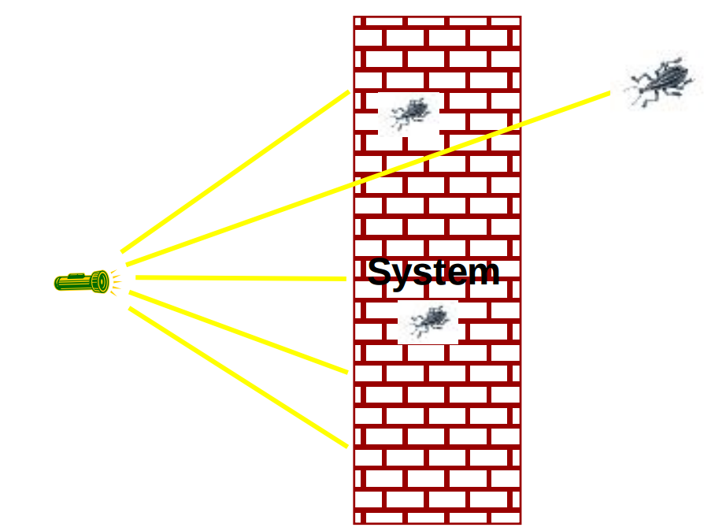
Testing
Any real system has a near-infinite number of possible inputs.
Some faults trigger failures extremely rarely, or under conditions that are hard to control and recreate through testing.
How can we prove that our system meets the property?
Notes:
Some faults, like synchronization faults in multi-threaded systems, (1)
2-4

Slide 4
What About a Model?
We have previously used models to analyze programs, and to generate test cases.
Models can be used to “tame” the complexity of the program.
Models are simpler than the real program.
By abstracting away unnecessary details, we can learn important insights.
Perhaps models can be used to verify the full programs!

Slide 5
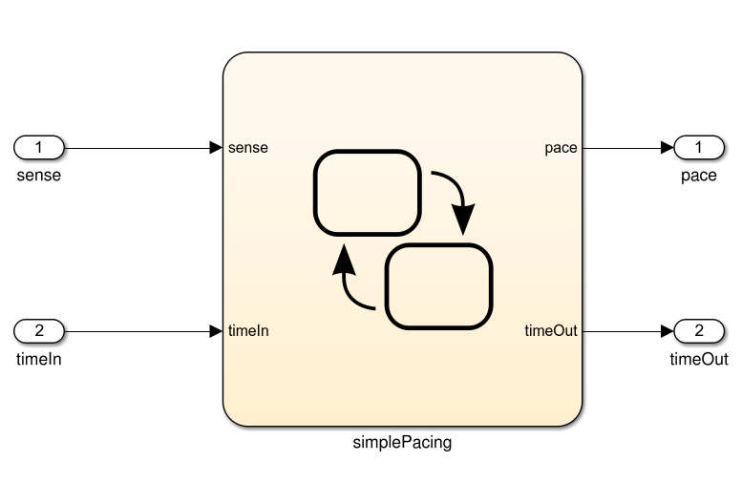
What Can We Do With This Model?
If we can show that the model satisfies the requirement, then the program should as well.
Specification
public static void Main(){
System.out.println(“Hello world!”);
}
And If the model is well-formed, consistent, and complete.
And If the model accurately represents the program.
If the model satisfies the specification...
Notes:
Ultimately, we need to make the argument that the the system we built fulfills the specification - make the argument for verification. The model represents the first step in making that argument. If we take the specification and formulate it as a series of logical properties, we can check whether those properties hold by analyzing the model. As the model comes directly from our requirements and our understanding of the system, if there are violations, there is an issue with our plans - somewhere, our requirements and specifications are wrong. They might be contradictory, incomplete, or just have a mistake. By verifying properties over the model, we can find out if there are issues and fix them. So, the train of thought is that if the model satisfies the properties, AND if the model is well-formed, consistent, and complete, AND if the model actually represents the final program, then proving properties over the model is an argument that your specifications are correct and that the final product will actually meet them.
Where do you think you can get in the most trouble here?
(discuss - last one)

Slide 6
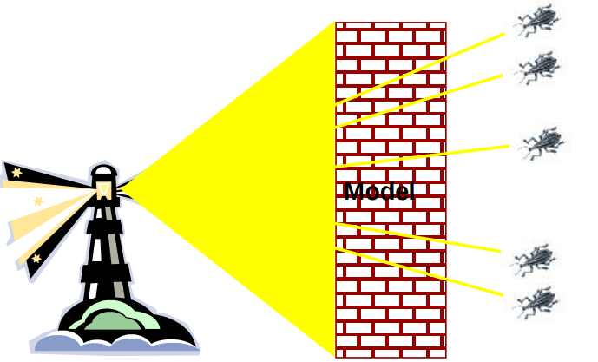
Finite-State Verification
Express specification as a set of logical properties, written as Boolean formulae.
Exhaustively search the state space of the model for violations of those properties.
If the property holds - proof that the model is correct.
Contrast with testing - no violation might just mean bad tests.
Notes:
Often, on a real program, testing is the best you can do. You can’t cover the input space, but you do enough to feel confident. In this case, however, we’ve simplified things dramatically by building a model. A model is much, much simpler than the real system. So, we can perform a more thorough analysis. This is a process called finite state verification.
(read)
(2) - state space, not the input space. We don’t need to try all inputs, but rather, examine the abstract states.

Slide 7
Today’s Goals
Formulating specification statements as formal logical expressions.
Introduction to temporal logic.
Building behavioral models in NuSMV.
Performing finite-state verification over the model.
Exhaustive search algorithms.
Notes:
(read)

Slide 8
Expressing Specification Statements as Provable Properties

Slide 9
Expressing Properties
Properties expressed in a formal logic.
Temporal logic ensures that properties hold over execution paths, not just at a single point in time.
Safety Properties
System never reaches bad state.
Always in some good state.
Liveness Properties
Eventually useful things happen.
Fairness criteria.
Notes:
To ensure that the requirements hold, we need to express them in a form that can be logically assessed, as a boolean expression written in a formal logic. Now, if we just write out a property as an if expression, we can check whether it holds at
a particular point in time - over a model, we could check whether something is always true, but that’s usually not quite expressive enough - many requirements are properties over paths of execution. So typically, we use a form of what is called temporal logic. Temporal logics contain a set of operators that can be used to express properties over execution paths, allowing you to ensure that complex properties hold over any possible execution of the system.
Typically, we can break down these properties into two forms - safety properties and liveness properties.
Safey properties divide the system into good states and bad states, where good states satisfy properties and bad states violate them. Most properties are written this way - we say that the system never will do something or that it will always do something. These can be specified over sequences of events too, where we treat the history of events preceeding a state as an attribute of that state. Think about a traffic light, we could write properties asserting that the order must always be green, then yellow, then red. If there is a situation where these could go out of order, then we’re in trouble. There is a violation of that property.
Liveness properties deal with eventualities - they say that at some point, a thing must happen. We don’t know when - that’s what differentiates liveness from safety. Safety properties are exact - this sequence must happen, this property must never
be violated. Liveness is something we want to eventually be true. A safety property says that nothing bad will ever happen- the light will always turn green within five seconds - while liveness properties say that something good will eventually happen - if the light is red, it will eventually be green. Liveness properties are used to reason over paths of unknown length.

Slide 10
Temporal Logic
Sets of rules and symbolism for representing propositions qualified over time.
Linear Time Logic (LTL)
Reason about events over a timeline.
Computation Tree Logic (CTL)
Branching logic that can reason about multiple timelines.
We need both forms of logic - each can express properties that the other cannot.
Notes:
temporal logic is any system of rules and symbolism for representing, and reasoning about, propositions qualified in terms of time. Consider the statement: "I am hungry." Though its meaning is constant in time, the truth value of the statement can vary in time. Sometimes the statement is true, and sometimes the statement is false, but the statement is never true and false simultaneously. In traditional logic, you can only discuss statements whose truth value is constant in time. We’d be limited severly in what we could
verify over the program - and many requirements actually ask for sequences of events over types of paths - there are a lot of qualifiers. We can address this in temporal logic, where statements can have a truth value which can vary in time. In a temporal logic we can then express statements like "I am always hungry", "I will eventually be hungry", or "I will be hungry until I eat something".
Typically, two types of temporal logic are used to express properties.
Linear time logic, or LTL, has the ability to reason about a time line. One can encode formulae about the future of paths, for instance, that a condition will eventually be true or that a condition will be true until another fact becomes true,
Branching logics, such as computation tree logic or CTL, however, can reason about multiple time lines. In a branching logic we may state that "there is a timeline in which that I will stay hungry forever." Or, in terms of liveness, "there is a possibility that eventually I am no longer hungry." If we do not know whether or not I will ever get fed, these statements are both true some times.
(read)

Slide 11
Linear Time Logic Formulae
Formulae written with propositional variables (boolean properties), logical operators (and, or, not, implication), and a set of modal operators:
X (next) | X hunger | In the next state, I will be hungry.
G (globally) | G hunger | In all future states, I will be hungry.
F (finally) | F hunger | Eventually, there will be a state where I am hungry.
U (until) | hunger U burger | I will be hungry until I start to eat a burger.
R (release) | hunger R burger | I will cease to be hungry after I eat a burger.
Notes:
(go over)
U and R are very similar, the difference is that U means that the first property can stop being true in the same state that the latter becomes true.
R is stronger, R requires that both be true for at least one state, then in the next state, the first property can become false. If the latter property never becomes true, then the former can never be false.

Slide 12
LTL Examples
X (next) - This operator provides a constraint on the next moment in time.
(sad && !rich) -> X(sad)
((x==0) && (add3)) -> X(x == 3)
F (finally) - At some point in the future, this property will be true.
(funny && ownCamera) -> F(famous)
sad -> F(happy)
send -> F(receive)
Notes:
read, ask them to explain formulae

Slide 13
LTL Examples
G (globally) - This property must always be true.
winLottery -> G(rich)
U (until) - One property must be true until the second becomes true.
startLecture -> (talk U endLecture)
born -> (alive U dead)
request -> (!reply U acknowledgement)
Notes:
read, ask them to explain formulae

Slide 14
More LTL Examples
G (requested -> F (received))
G (received -> X (processed))
G (processed -> F (G (done)))
If the above are true, can this be true?
G (requested) && G (!done)
Notes:
read, ask them to explain formulae
F G done = final state, once done it can’t be undone
(discuss - no )
this says (request is true and stays true on all states from then on) and (done is false and stays false on all states from now on). Might be true for a bit, but will eventually be falsified if the above hold
if it’s requested, it will eventually be received, then processed, then eventually done
note - g whole expression will become and remain true (implies makes this an if)

Slide 15
Computation Tree Logic Formulae
Combines quantifiers over all paths and path-specific quantifiers:
A (all) | A hunger | Starting from the current state, I must be hungry on all paths.
E (exists) | E hunger | There must be some path, starting from the current state, where I am hungry.
X (next) | X hunger | In the next state on this path, I will be hungry.
G (globally) | G hunger | In all future states on this path, I will be hungry.
F (finally) | F hunger | Eventually on this path, there will be a state where I am hungry.
U (until) | hunger U burger | On this path, I will be hungry until I start to eat a burger. (I must eventually eat a burger)
W (weak until) | hunger W burger | On this path, I will be hungry until I start to eat a burger. (There is no guarantee that I eat a burger)
Notes:
As computation tree logic poses properties over all possible paths, not just over a specific path, there quantifiers get a little more complex. CTL has two quantifiers over all paths, and several over specific paths
(go over)
U and W are similar - the difference is that W is a weaker property - it never guarantees that the latter property will be verified. I could always be hungry and hunger W burger would be considered true. For hunger U burger to be verified, you must eventually eat a burger and you must be hungry until then.
The path specific and all path quantifiers are alwayscombined, so that you specify properties saying things like, along all path, something will happen next, or there exists some path where this becomes true.

Slide 16
CTL Examples
chocolate = “I like chocolate.”
warm = “It is warm outside.”
AG chocolate
EF chocolate
AF (EG chocolate)
EG (AF chocolate)
AG (chocolate U warm)
EF ((EX chocolate) U (AG warm))
Notes:
read, ask them to explain formulae
AG.P "I will like chocolate from now on, no matter what happens."
EF.P"It's possible I may like chocolate some day, at least for one day."
AF.EG. "It's always possible (AF) that I will suddenly start liking chocolate for the rest of time."
EG.AF.P "This is a critical time in my life. Depending on what happens next (E), it's possible that for the rest of time (G), there will always be some time in the future (AF) when I will like chocolate. However, if the wrong thing happens next, then all bets are off and there's no guarantee about whether I'll ever like chocolate."
AG(PUQ)"From now until it's warm outside, I will like chocolate every single day. Once it's warm outside, all bets are off as to whether I'll like chocolate anymore. Oh, and it's guaranteed to be warm outside eventually, even if only for a single day."
EF((EX.P)U(AG.Q)) "It's possible that: there will eventually come a time when it will be warm forever (AG.Q) and that before that time there will always be some way to get me to like chocolate the next day (EX.P)."

Slide 17
Examples
requested: if true, a request has been made
acknowledged: if true, the request has been acknowledged.
CTL: AG (requested -> AF acknowledged)
On all paths (A) from an initial state, at every state in the path (G), if requested holds true, then (->) for all paths (A) from that state, eventually (F) at some other state, acknowledge holds true.
LTL: G (requested -> F acknowledged)
On all paths from an initial state, at every state in the path (G), if requested holds true, then (->) eventually (F) at some other state, acknowledge holds true.

Slide 18

Examples
It is always possible to reach a state where we can reset.
AG (EF reset)
Is the LTL formula G (F reset) the same expression?
Eventually, the system will reach a good state and remain there.
F (G good)
Is the CTL formula AF (AG good) the same?
Notes:
read, ask them to explain formulae
ask about LTL - what the CTL formula says that along all paths, it is always true that there is some possible continuation where we could eventually reset. The LTL formula here is not the same -it says that we MUST eventually reset, the CTL formula just allows the possibility. This is a formula that is not possible in LTL
read
ask about CTL - The CTL formula says that on all paths, at some point, it will become permanently true along all extensions that things are good. This is trickier - this statement is too strong. Consider this diagram, where p is good. F( G good) holds on this - eventually, we get to a point where good is always true, on the right. The CTL formula is not true because we have this good state closer to the front - we can’t differentiate the two p nodes. the all paths part is what kills us. We can’t swap the A to an E either, as that is too weak. The LTL statement has no equivalent CTL statement in this case - this is why we need both logics

Slide 19
Building Models

Slide 20
Building Models
Many different modeling languages.
Most verification tools use their own language.
Conceptually, most map to state machines.
Define a list of variables.
Describe how their values are calculated.
Each “time step”, recalculate the values of these variables.
The state is the current set of values for all variables.
Notes:
You have these properties you wish to prove. To do so, you’re going to need a model.

Slide 21
Building Models in NuSMV
NuSMV is a symbolic model checker.
Models written in a basic language, represented using Binary Decision Diagrams (BDDs).
BDDs translate concrete states into compact summary states.
Allows large models to be processed efficiently.
Properties may be expressed in CTL or LTL.
If a model may be falsified, it provides a concrete counterexample demonstrating how it was falsified.
Notes:
(1). It translates models written in a basic programming language into what are called binary decision diagrams (BDD). (3-end)

Slide 22
A Basic NuSMV Model
MODULE main
VAR
request: boolean;
status: {ready, busy};
ASSIGN
init(status) := ready;
next(status) :=
case
status=ready & request: busy;
status=ready & !request : ready;
TRUE: {ready, busy};
esac;
SPEC AG(request -> AF (state = bust))
Models consist of one or more modules, which execute in parallel.
The state of the model is the current value of all variables.
Expressions define how the state of each variable can change.
“request” is set non-deterministically. Models and environmental factor out of our control.
Property we wish to prove over the model.
Notes:
- (read). Each time step, their state changed according the defined variables and transitions.
- (read) VAR - the state of the model is the combination of the variables request and status.
- (read) ASSIGN - go over status,
- notice - didn’t mention request - that will be set randomly to one of the values we’ve allowed it to take on. In this case, we’re modeling status as an input coming from an external environment. We don’t control it, we just react to it.

Slide 23
A More Complicated NuSMV Model
MODULE main
VAR
traffic_light: {RED, YELLOW, GREEN}; ped_light: {WAIT, WALK, FLASH}; button: {RESET, SET};
ASSIGN
init(traffic_light) := RED;
next(traffic_light) := case
traffic_light=RED & button=RESET: GREEN;
traffic_light=RED: RED;
traffic_light=GREEN & button=SET: {GREEN,YELLOW};
traffic_light=GREEN: GREEN;
traffic_light=YELLOW: {YELLOW, RED};
TRUE: {RED};
esac;
init(ped_light) := WAIT;
next(ped_light) := case
ped_light=WAIT & traffic_light=RED: WALK;
ped_light=WAIT: WAIT;
ped_light=WALK: {WALK,FLASH};
ped_light=FLASH: {FLASH, WAIT};
TRUE: {WAIT};
esac;
next(button) := case
button=SET & ped_light=WALK: RESET;
button=SET: SET;
button=RESET & traffic_light=GREEN: {RESET,SET};
button=RESET: RESET;
TRUE: {RESET};
esac;
Notes:
(go over each variable)

Slide 24
Activity
For this model:
Briefly describe a safety-property (nothing “bad” ever happens) for this model and formulate it in CTL.
Briefly describe a liveness-property (something “good” eventually happens) for this model and formulate it in LTL.
Notes:
(1). It translates models written in a basic programming language into what are called binary decision diagrams (BDD). (3-end)

Slide 25
Activity - Potential Solutions
Safety Property
System never reaches bad state.
Always in some good state.
AG (pedestrian_light = walk -> traffic_light != green)
The pedestrian light cannot indicate that I should walk when the traffic light is green.
This is a safety property. We are saying that something should NEVER happen.
Notes:
(1). It translates models written in a basic programming language into what are called binary decision diagrams (BDD). (3-end)

Slide 26
Activity - Potential Solutions
Liveness Property
Eventually useful things happen.
Fairness criteria.
G (traffic_light = RED & button = RESET -> F (traffic_light = green))
If the light is red, and the button is reset, then eventually, the light will turn green.
This is a liveness property, as we assert that something will eventually happen.
Notes:
(1). It translates models written in a basic programming language into what are called binary decision diagrams (BDD). (3-end)

Slide 27
Proving Properties Over Models

Slide 28
Proving Properties
To perform verification, we take properties and exhaustively search the state space of the model for violations.
Violations give us counter-examples
A path that demonstrates how the property has been violated.
Implications:
Property is incorrect.
Model does not reflect expected behavior.
Real issue found in the system being designed.
Notes:
(read)
(read) - (read). This is really helpful, as we don’t just know that something is wrong, we can trace our way through the model to see exactly what is wrong.
If you get a violation, this can mean three things
(read) - you made a mistake when you translated specification to the temporal logic
(read) - the model is wrong, and needs to be fixed
or, and this is what we want to find - (read) - identified something that you left out, or that is contradictory, or that is just plain wrong. This is what we want to see, if we get violations, we can fix our specification before we design and code the system.

Slide 29
Test Generation from FS Verification
We can also take properties and negate them.
Called a “trap property” - we assert that a property can never be met.
The counter-example shows one way the property can be met.
This can be used as a test for the real system - to demonstrate that the final system meets its specification.
Notes:
Now, this same process isn’t just useful for analyzing our requirements, but is useful for verification of the final system as well. You can (read)
(read) - we can take that, extract inputs from it, then run those inputs as a test for the final system (read)

Slide 30
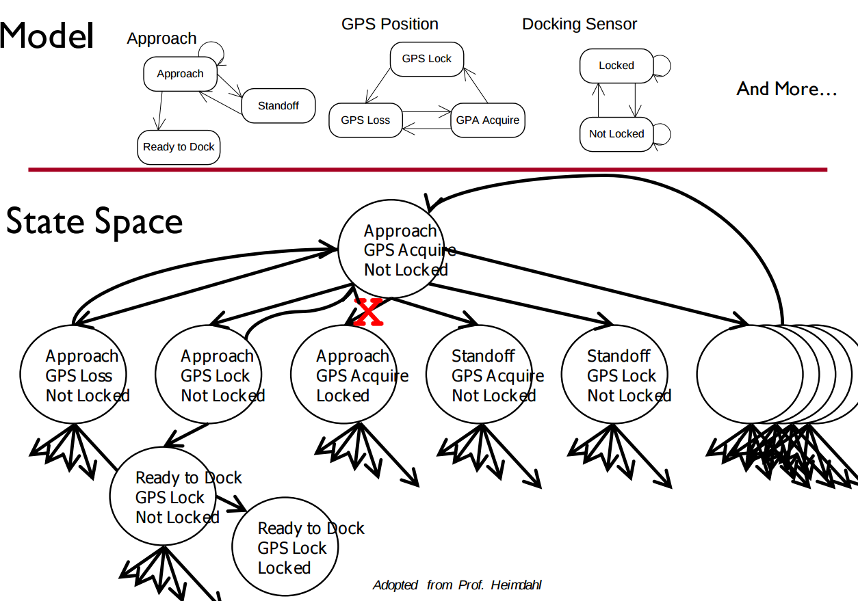
Exhaustive Search
Algorithms exhaustively comb through the possible execution paths through the model.
Major limitation - state space explosion.
Notes:
This form of verification depends on a family of techniques that exhaustively search the state space - the set of all possible paths of execution over the model - at each state, examining all reachable states, then from there, examine all possible reachable states, and so on.
very quickly, the problem that we run into is that the number of possible states and paths through those states explodes. Let’s say we define three variables - approach, GPS position, and Docking Sensor - and we define how those variables can
change values. The state of the system describes the combination of assignments to those three variables. Even if the number of possible values is small, the number of possible states is massive, and the number of reachable states at any given time can be quite large. Quickly, an exhaustive search of the state space becomes extremely difficult.

Slide 31
Exhaustive Search - Dining Philosophers
Problem - X philosophers sit at a table with Y forks between them. Philosophers may think or eat. When they eat, they need two forks.
Goal is to avoid deadlock - a state where no progress is possible.
5 philosophers/forks - deadlock after exploring 145 states
10 philosophers/forks - deadlock after exploring 18,313 states
15 philosophers/forks - deadlock after exploring 148,897 states
9 philosophers/10 forks - deadlock found after exploring 404,796 states
Notes:
To give an example, say we built a model of the dining philosophers problem (read)
(read)
What we can see from this is that the limits of verification are reached pretty quickly as the complexity of the model grows. All of these algorithms have tricks to prune the state space, but even still, models cannot be too complex - if so, they must be simplified further to be verified in this way. This is why we can’t just use these techniques on real code. Real code almost always has a massive state space.

Slide 32
Search Based on SAT
Express properties as conjunctive normal form expressions:
f = (!x2 || x5) && (x1 || !x3 || x4) && (x4 || ! x5) && (x1|| x2)
Examine reachable states and choose a transition based on how it affects the CNF expression.
If we want x2 to be false, choose a transition that imposes that change.
Continue until CNF expression is satisfied.
Notes:
This search is based on satisfaction of what is called a SAT problem - or boolean satisfiability - the problem of determining if there exists a solution that satisfies a boolean formula. To check these properties, (read) - a conjunction of clauses - AND statement -, where each clause is a disjunction of boolean variables - OR statements.
(read rest)

Slide 33
Branch & Bound Algorithm
Set a variable to a particular value (true/false).
Apply that value to the CNF expression.
See whether that value satisfies all of the clauses that it appears in.
If so, assign a value to the next variable.
If not, backtrack (bound) and apply the other value.
Prune branches of the boolean decision tree as values are applies.
Notes:
One example of an exhaustive search algorithm is the branch-and-bound algorithm. This algorithm is conceptually simple: set a literal in the boolean formula to a particular value, apply that value to the formula, and check to see if the value satisfies all of the clauses that it appears in. If so, assign a value to the next variable. However, if setting a value unsatisfies a clause, then a backtracking step (a bound) is initiated and the other possible value is applied. This process prunes branches of the formed boolean decision tree

Slide 34
Branch & Bound Algorithm
f = (!x2 || x5) && (x1 || !x3 || x4) && (x4 || ! x5) && (x1|| x2)
Set x1 to false. f = (!x2 || x5) && (0 || !x3 || x4) && (x4 || ! x5) && (0 || x2)
Set x2 to false. f = (1 || x5) && (0 || !x3 || x4) && (x4 || ! x5) && (0 || 0)
Backtrack and set x1 to true. f = (0 || x5) && (0 || !x3 || x4) && (x4 || ! x5) && (0 || 1)
Notes:
-We first set a value of zero to x1. This inserts a zero into clauses two and four, but does not satisfy or unsatisfy either clause yet.
-Next, we insert a value of zero for x2. This satisfies the first clause, but unsatisifies the fourth clause (as both x1 and x2 are set to zero).
-Therefore, we stop and backtrack, assigning a new value of one to x2. This satisifies the fourth clause. We can continue this process with all variables until the complete formula is satisified.

Slide 35
DPLL Algorithm
Set a variable to a particular value (true/false).
Apply that value to the CNF expression.
If the value satisfies a clause, that clause is removed from the formula.
If the variable is negated, but does not satisfy a clause, then the variable is removed from that clause.
Repeat until a solution is found.
Notes:
Another common complete method is the Davis-PutnamLogemann-Loveland, or DPLL, algorithm [13]. DPLL is conceptually similar to the branch-and-bound method, but a few key differences give it an edge on a number of SAT problems. Like with branch-and-bound, DPLL begins by selecting a variable and applying a value to it. If this value satisifies the clause, then that clause is removed from the formula. If the variable is made false due to negation, the algorithm instead remove that variable from any cause that it is negated in. This process is repeated recursively until a solution is found. This induces a domino effect—as more variables are removed from clauses, more clauses turn into unit clauses

Slide 36
DPLL Algorithm
f = (!x2 || x5) && (x1 || !x3 || x4) && (x4 || ! x5) && (x1|| x2)
Set x2 to false. f = (1 || x5) && (x1 || !x3 || x4) && (x4 || ! x5) && (x1|| 0) f = (x1 || !x3 || x4) && (x4 || ! x5) && (x1)
Set x1 to true. f = (1 || !x3 || x4) && (x4 || ! x5) && (1) f = (x4 || ! x5)
Set x4 to false, then x5 to false.
Notes:
-If we assign a value of zero to x2, the first clause is rendered true (¬x2 = ¬0 = 1). We can eliminate the first cause from the formula and x2 from clause four. This leaves the following: (read)
- As the third clause is now a unit clause, we assign x1 = 1. We can now remove both clauses one and three from the formula:(read)
- From this point, the example is trivially solved with x4 = 0 and x5 = 0 so that we have assigned everything.

Slide 37
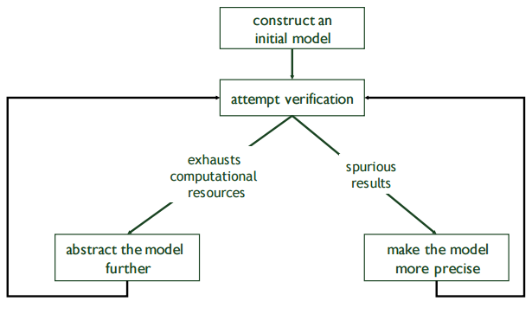
Model Refinement
Models have to balance precision with efficiency.
Abstractions that are too simple may introduce spurious failure paths that may not be in the real system.
Models that are too complex may render model checking infeasible due to resource exhaustion.
Notes:
(read all).
So, you often find that your first attempt at a model is not good enough. You need to get into a loop of iterative refinement. If it’s too complex, simplify it. It it’s too simple, add detail. Continue until you are able to perform verification.

Slide 38
We Have Learned
We can perform verification by creating models of the system and proving that the specification properties hold over the model.
To do so, we must express specifications as sets of logical formulae written in a temporal logic.
Finite state verification exhaustively searches the state space for violations of properties.

Slide 39
We Have Learned
By performing this process, we can gain confidence that the system will meet the specifications.
We can even generate test cases from the model to help demonstrate that properties still hold over the final system.

Slide 40
Next Time
Symbolic execution and proof of properties
Reading: Chapter 7
Homework:
Reading assignment 3 is out.
Steven P. Miller, Alan C. Tribble, Michael W. Whalen, and Mats P.E. Heimdahl. Proving the Shalls: Early Validation of Requirements Through Formal Methods
Due April 10th.
Assignment 3 due tonight.

Slide 41
Backup Slides

Slide 42
Intensional Models
State space can be limited by replacing extensional representations with intensional representations
A positive even integer < 20:
Extensional: {2, 4, 6, 8, 10, 12, 14, 16, 18}
(All concrete values)
Intensional: {x ∈ N | x mod 2 =0 ^ 0 < x < 20}
(Symbolic representation)
Equation called the characteristic function
A predicate true for all elements in the set of values and false otherwise.
Notes:
The computational cost of exploring all states is a limiting factor in finite state verification. (1) extensional - all concrete values of the variable, intensional - a symbolic representation describing what we are dealing with
(3-9)
The thing here, is that the symbolic representation does not necessarily grow if the number of concrete states grows. Here, you have one representation instead of 9 concrete representations. If we changed 20 to 80, we add many more concrete states, but do not grow the number of symbolic states.

Slide 43
Ordered Binary Decision Diagrams
We can represent whether or not there is a transition between two states using a characteristic function.
f(m,n) = true if there is a transition from m to n.
OBDDs are a data structure representing the calculation of a binary function.
Such as a characteristic function.
Can be used to represent a subset of the state space.
Notes:
However, even more powerful than trying to take all of the variables and describe them in this way, is applying this concept to the state machine itself. (1) - a binary equation that returns true if (2). (3-5)

Slide 44
OBDD Example
!a v (b ^ c)
Can be thought of as a function: f(a,b,c)
Returns true if the property is satisfied, false if not.
A
0
1
B
0
1
C
0
1
F
T
Notes:
go over
Essentially, this is a decision tree turned into an acyclic graph by getting rid of nodes leading to identical subtrees - it’s a compact representation of how we calculate the result of an expression by ordering the decisions in the same way on all paths from the root of the tree to the leaves, which represent the outcomes. First we check A, then B, then C

Slide 45
Ordered Binary Decision Diagrams
Built by iteratively expanding the set of states reachable in k+1 steps.
Stabilizes when the number of transitions that can occur in the next step are already included.
Most basic form - what states can we reach from the current state in n transitions?
Often, merged with specification properties:
The set of transitions leading to a violation of the property.
If that set if empty, the property is verified.
Symbolic model checking.
Notes:
OBDDS can be used to represent a subset of the state space. In the most basic form, we can enumerate what states are reachable in k+1 steps. - so, if we know the reachable states in k steps, we then build out from there - with a breadth first expansion of the state space - the set of states reachable in one more transition. (2)
We don’t just use these to represent the state space. Rather, we have properties that we want to check. Well, OBDDs represent binary functions. These properties are either met or not met. So, OBDDS are often built at representations of the set of transitions leading to a violation of a property. As we iterate over the original model, if this set remains empty, the property is verified. If not, we have a counterexample to give to the user. This is a process called symbolic model checking.

Slide 46
Building OBDDs
Assign each state and symbol a boolean label.
Encode transitions as tuples (sym, from, to)
X0
0
1
S0 (00)
S1 (01)
S2 (10)
X1
X1
b(x0 == 1)
b(x0 == 1)
0
1
0
1
b(x0 == 0)
X2
X2
0
1
0
1
X3
X3
X3
X0 | X1X2 | X3X4
0 | 00 | 00
1 | 00 | 01
1 | 01 | 10
sym | from state | to state
0
1
0
1
0
1
X4
X4
0
1
0
1
F
T
Notes:
Representing transitions in a OBDD is not straightforward. One way:
- assign each state and symbol a boolean label (shorthand, two bit for each state)
- encode
- transition tuples correspond to paths leading to the true leaf in the OBDD, while all other paths lead to false.

Slide 47
Benefits of OBDDs
OBDDS allow us to represent sets of states symbolically.
Rather than reasoning over the entire state space, we can reason over a small representation of a set of states (the boolean characteristic function).
Allows verification of much larger models than explicit model checking.
As long as we can represent states with such a function.
Best when there is a large degree of regularity in the state space.

