Slide 1
Lecture 2: Quality Attributes and Measurement
Gregory Gay
DIT636/DAT560 - January 21, 2026

Slide 2
When is Software Ready for Release?
When you can argue that it shows sufficient quality.
Requires choosing quality attributes.
  … specifying measurements and thresholds.
  … different measurements and thresholds for different functionality and execution scenarios.
Assessed through Verification and Validation.
Notes:
Last time I posed a question is (title). And the basic, but not really simple answer, is that (go over)

Slide 3
Today’s Goals
Discuss quality attributes
  Dependability, availability, performance, scalability.
Discuss measurement of these attributes
  How we build evidence that the system is “good enough”.
  How to assess whether each attribute is met.

Slide 4
Software Quality
We all want high-quality software.
  We don’t all agree on the definition of quality.
Quality encompasses what and how.
  How dependable it is.
  But also…
    How quickly it runs.
    How available its services are.
    How easily it scales to more users.
Hard to measure and assess objectively.
Notes:
We all want high-quality software, we all agree that quality is necessary. However, we don’t all agree on what quality means. Ask ten people, and they may describe ten things. Why? (3) what a system does and how it does it. what a system does is only part of the story and that how the system provides its services often has a huge impact on the perceptions that stakeholders have of it. (rest)

Slide 5
Quality Attributes
Describe desired properties of the system.
Developers prioritize attributes and design system that meets chosen thresholds.
Most relevant for this course: dependability
  Ability to consistently offer correct functionality, even under unforeseen or unsafe conditions.
Notes:
Quality attributes describe desired properties of the system under development. Developers must prioritize quality attributes and design a system that meets chosen thresholds.
Most relevant for this course: dependability. Ability of the system to consistently offer correct functionality, even under unforeseen or unsafe conditions.

Slide 6
Quality Attributes
Availability
  Ability to carry out a task when needed, to minimize “downtime”, and to recover from failures.
Performance
  Ability to meet timing requirements. When events occur, the system must respond quickly.
Scalability
  Ability to maintain dependability and performance as the number of concurrent requests grows.
Notes:
availability, related to dependability, how systems recover
scalability, related to performance, how the system is designed to scale its resource usage to maointan performance at a consistent level as the userbase increases
there are others, but these are the four we will focus on - dependability, availability, performance, scalability

Slide 7
Quality Measurement
Quality is always measured situationally.
  Not quality of the whole system, but of one “aspect”
    A class, sub-system, API endpoint, user-facing function, …
  Relative to a usage profile.
    Expected interaction patterns.
Notes:
Before we talk about these attributes, it’s important to establish one crucial common point. Quality is measured situationally.Y ou cannot establish a general level of quality, or present one number for the whole system. Each “part” of the system may have its own quality requirements. That can be a class, a service, an API endpoint, whatever. Generally, you start by talking about user-facing functionality, and establish quality goals for each function. As we get into testing, we may talk about lower-level code segments. Still, we always talk about quality of part of the system. In addition to that segmentation, we also often look at different usage profiles. That can be a number of concurrent users (heavy versus normal load) or types of users (experienced versus new users) as those situations also may differ and may have different experiences or expectations. Some users might never trigger a crash, while some might see crashes all the time, based on how they work with the system.

Slide 8
Improving Quality
Improved when faults in the most frequently-used parts of the software are removed.
  X% of faults != X% improvement
  in quality.
    “Removing 60% of faults led to
    3% reliability improvement.”
  Removing faults with serious consequences is top priority.
Input Causing Failure
User 1
User 3
User 2
Notes:
Quality is improved when software faults that occur in the most frequently-used parts of the software are removed. Not all faults impact quality equally - some faults are rarer than others, and Removing X% of faults will not necessarily lead to an X% improvement in quality (3). Not all faults are equal and often don’t affect the system in the same way. Unfortunately, quality depends on how users work with the system. Different users access different functions, have different settings, and use the system in different environments. So, quality depends on the user. We can’t actually check and improve this for everyone, but we can think about representative types of users and situations and focus on those.(4), as those have the biggest impact on perceived quality.

Slide 9
Quality Economics
May be cheaper to accept a certain leave of quality and pay for failure costs.
Depends on social/political factors and risks.
  Reputation versus cost.
  Risks of failure.
    Health risks or equipment failure risk requires high quality.
    Minor annoyances can be tolerated.
Notes:
(Raising quality is expensive. It may be cheaper to accept unreliability and pay for failure costs.) - this is an optimization problem. How do we balance quality improvement over accepting liability. We should improve quality but there is a tipping point.The balancing point depends on social and political factors and the system type. A reputation for unreliable products may hurt more than the cost of improving reliability. Cost of failure depends on risks of failure. (last points)
Minor annoyances (crashes, occasional data loss) (rest)

Slide 10
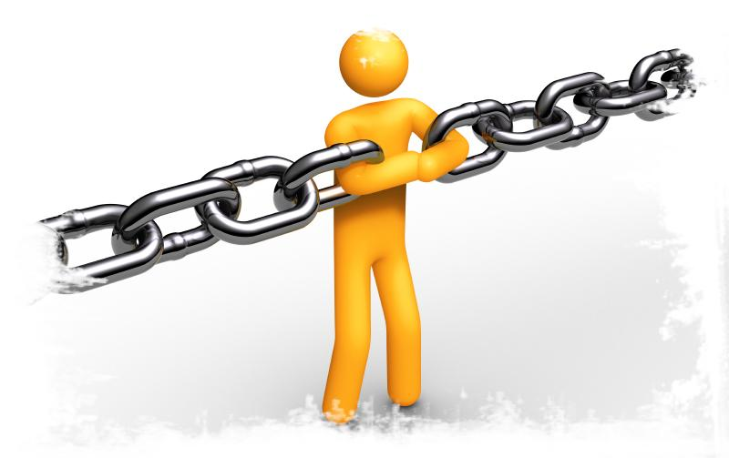
Quality Attribute:
Dependability
Notes:
Just start with a question - want you to start thinking about this. (read)
This isn’t something with one answer, or even a right answer. It’s something we’ll keep returning to

Slide 11
Dimensions of Dependability
The goal of dependability is to establish four things about the system:
  That it is correct.
  That it is reliable.
  That it is safe.
  That is is robust.
Reliable
Correct
Safe
Robust
Notes:
Dependability is the primary factor that we use to determine quality. However, when we talk about dependability, Dependability is a sort of meta-quality attribute. It actiually encompasses four dimensions. We don’t typically achieve all four, but all four are important (go over)

Slide 12
Correctness
A program is correct if it is always consistent with its specification.
  Depends on “completeness” of requirements.
    Easy to show with a weak specification.
    Often impossible with a detailed specification.
  Rarely provably achieved.
Notes:
The simplest of these properties in definition, if not in use, is correctness - A program is correct if it is consistent with its specifications. By definition, a specification divides all system behaviors into two classes - successful or correct executions - those that match what was specified in the requirements - and failures, or incorrect executions - all of those that are inconsistent. All possible behaviors of a correct system result in successful executions that are consistent with the specifications. A program cannot be 30% correct. It is either correct or not correct. The difficulty and utility of showing correctness depend on the completeness of your requirements.
A program can easily be shown to be correct with respect to a weak specification. However, it is often impossible to prove correctness with a good, detailed specification, as that would require showing every possible behavior of the program. Correctness is a goal to aim for, but is rarely provably achieved.

Slide 13
Reliability
Statistical approximation of correctness.
  The likelihood of correct behavior from some period of observed behavior.
    Time period, number of executions
  Even if we cannot prove correctness, we can show that the system almost always works.
Notes:
Instead, we often aim for reliability as a specific quality goal, as it is an approximation of acceptable correctness. (go over)Testing can demonstrate reliability, but not correctness.

Slide 14
Dependence on Specifications
Correctness and reliability:
  Success relative to complexity of the specification.
    Hard to meaningfully prove anything for full spec.
  Severity of a failure is not considered.
    Some failures are worse than others.
Safety focuses on a hazard specification.
Robustness focuses on unspecified behaviors.
Notes:
Those definitions of correctness and reliability have two properties that lead into the concepts of safety and correctness - first, success or failure is relative to a specification, they are only as strong as the specification. If you have an incomplete spec, lacking detail, then it’s easy to say the system is correct or reliable. If the specification is detailed, we cannot show correctness and only can build some evidence for reliability. Second, those two qualities make no distinction between failures that are minorly annoying and failures that are life-threatening. Not all failures are equally annoying.. For some kinds of systems, it is really important to consider the severity of a fault. Our last two properties - safety and robustness - help deal with both of these issues. Safety revolves around a limited specificaition of a set of major safety hazards that we must avoid above all else. Robustness revolves around everything we haven’t thought of specifying. Of course, we don’t need to be psychics, we don’t need to handle everything possible, but robustness tasks us with putting safeguards in place to prevent these unforeseen risks from causing catastrophic errors.

Slide 15
Safety
Safety is the ability to correctly handle hazards.
  Known undesirable situations.
  Generally serious problems.
Relies on a specification of hazards.
  Defines each hazard, how it will be avoided or handled.
  Prove that the hazard is avoided.
    Subset of correctness, easier to prove.
Notes:
(1), where, by hazard, I mean a known, defined undesirable situation, generally prioritized by the severity of the problem. It might be annoying any time your word processor crashes, but it it corrupts your document - preventing recovery - then that is a hazard you want to avoid. If there is a brief graphical glitch on your aircraft display, that’s fine. If a software bug prevents the altitude from ever being displayed to the screen, then that is a serious hazard to avoid. Demonstrating safety (4). Rather than fosucsing on the full specification, we create a small ,focused hazard specification that defines what each hazard is and imposes requirements on how it will be avoided. We then, ideally, prove that the software does avoid the hazard by doing what we promised. If proofs are not possible, we at least will gather observations and build evidence, like in reliability.
By ignoring other elements of correctness, a safety specification is often easier to analyze than the full specification. And, by looking at hazards in isolation, you can better think through what those hazards are and how to avoid them. Because we have this small, focused specification, we can often prove safety, unlike correctness.

Slide 16
Robustness
Software that is “correct” may fail when the assumptions of its design are violated.
  How it fails matters.
Software that “gracefully” fails is robust.
  Design the software to counteract unforeseen issues or perform graceful degradation of services.
    Look at how a program could fail and handle those situations.
  Cannot be proved, but is a goal to aspire to.
Notes:
Correctness, reliability, and safety are contingent on normal operating conditions. They depend on specifications to define what “normal” is - what conditions we expect to use the system under, and how behavior occurs in those situations. All specifications make assumptions, implicit or explicit. What happens when those assumptions are violated? What happens when we land outside of the specification? that is where robustness comes in. (1) it’s not reasonable to expect file changes to save when there’s no harddrive space, or money to be dispensed by an atm when there is none in the machine, or a sale to take place when there’s no network connection or too many server connections. Software that is “correct” might still fail. When you design software ,when you write a specification, you make assumptions on how the software will operate and be used. When those assumptions are violated, the software will fail. In those situations, how it fails becomes important. (read 3) This is not something you prove or can even demonstrate in a meaningful way. Instead, this is something you aspire to in the software design. When designing software to be robust, you accept that failure might occur. and you try to control how it fails. (4) You can design software to be able to recover some portion of a document if something that happens that causes a crash, or use redundancy to recover if part of an app crashes or if there is some data loss, or design a webpage that will turn away users when load is too high. You design the software to recover from or prevent issues that could come up if there is a problem. You don’t know what will happen - but you may know how many problems would manifest - crashes, slowdown, inability to connect to a service - and you design the software to react to those problems.

Slide 17
Examples - ATM
We verify different situations where money is withdrawn ($ > balance, $ < balance, $ = balance, 0, …)
  Reliability
A thief may attach a “skimmer” to steal bank card details. We added a sensor and code to detect this.
  Safety
If the network connection is lost, we display an error screen and prevent any further actions from being taken.
  Robustness

Slide 18
Dependability Property Relations
Reliable, but not correct. Catastrophic failures can occur.
Robust, but not safe. Catastrophic failures could occur, but measures have been put in place to potentially prevent issues.
Reliable
Correct
Safe
Robust
Correct, but not safe. Specification is inadequate
Safe, but not correct. Hazards avoided, but other failures can occur.
Notes:
We ideally would have all four. Software that is correct is also reliable, but not vice-versa (top-left). Software that is safe is also robust, but not vice-versa (top-right). Software can be correct but not safe (bottom left). It can also be safe, but not correct (bottom right).

Slide 19
Assessing Dependability
When is the system dependable enough?
  Correctness hard to prove.
  Robustness/Safety important, but do not demonstrate normal dependability.
Reliability is the basis for arguing dependability.
  Can be measured.
  Can be demonstrated through testing.
  Can reflect normal and abnormal usage.
Notes:
we need to establish criteria for when we are done - when we can claim to be dependable enough. Correctness is not a good basis for this, your software is either correct or not, and it’s unlikely to ever be provably correct if your specification is complex. That’s an aim, but not realistically 100% achieveable.
Robustness and Safety are important, but hard to measure, and not necessarily the best grounds to base your release on - you could be safe, but the rest of your software could be an mess, putting out the wrong output constantly. It doesn’t show dependability under normal circumstances. Reliability is the best basis for establishing the level of dependability of your software. (last three points). Next, we will talk about how you measure reliability.

Slide 20
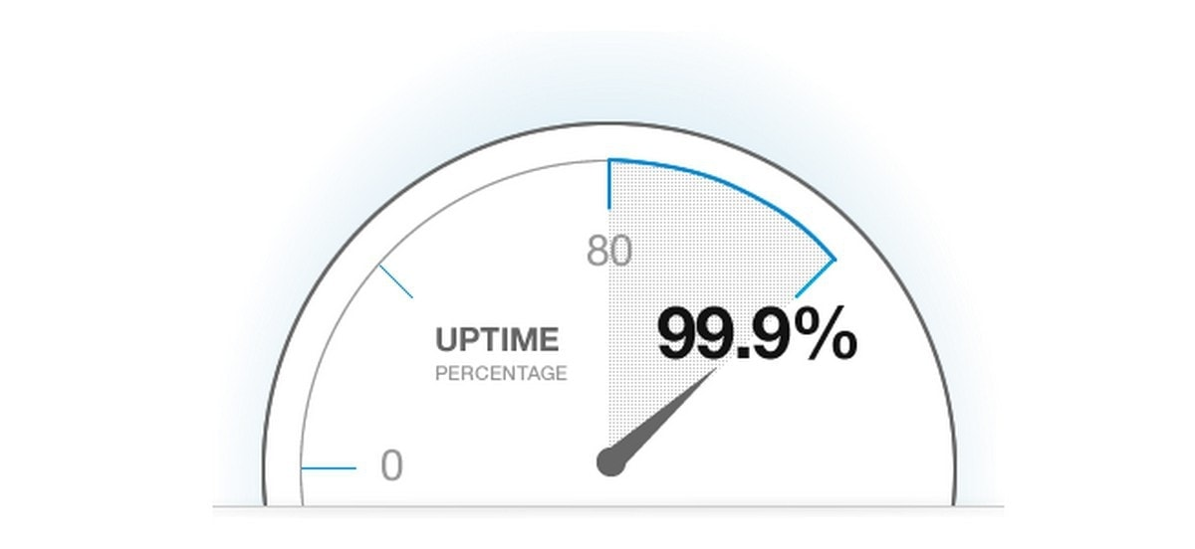
Quality Attribute: Availability
Notes:
Just start with a question - want you to start thinking about this. (read)
This isn’t something with one answer, or even a right answer. It’s something we’ll keep returning to

Slide 21
Availability
Ability to recover from - or work around - failures.
  After a failure occurs, ensure the system can recover.
  System is seen as more reliable if failures can be corrected or masked before they affect the user.
Notes:
Availability is both a part of reliability and a standalone quality attribute on its own. Availability essentially asks whether the software can carry out a task when it is needed, and when it fails, its ability to cover up and work around the fault or recover fully from the fault. Essentially, when something happens, how fast does the system return to normal operation. As part of reliability, high availability helps ensure that the reliability is seen as good - if the system does fail, perhaps that failure can be stopped, recovered from, or at least worked around before the user notives it. as a standalone quality attribute, availability shows that - when something bad happenes - the system can recover quickly and get back to operation.

Slide 22
Availability
Failures can be prevented, tolerated, or repaired.
  How are failures detected?
  How frequently do failures occur?
  What happens when a failure occurs?
  How long can the system be out of operation?
  When can failures occur safely?
  Can failures be prevented?
  What notifications are required when failure occurs?
Notes:
(1). One of the most demanding tasks in building a high-availability, fault-tolerant system is to understand the nature of the failures that can arise during operation. Once those are understood, mitigation strategies can be designed into the software. Faults can be prevented, tolerated, or recovered from. In this way a system becomes “resilient” to faults. Among the areas with which we are concerned are how system faults are detected, how frequently failures may occur, what happens when a failure occurs, how long a system is allowed to be out of operation, when faults or failures may occur safely, how faults or failures can be prevented, and what kinds of notifications are required when a failure occurs

Slide 23
Availability Considerations
System has “recovered” when the failure is no longer observable.
  Hard to define.
    Stuxnet caused problems for months.
    How does that impact availability?
Software can remain partially available more easily than hardware.
  If code containing fault is executed, but system is able to recover, there was no failure.
Notes:
Because a system failure is observable by users, the time to repair is the time until the failure is no longer observable. This may be a brief delay in the response time or it may be the time it takes someone to fly to a remote location in the Andes to repair a piece of mining machinery (as was recounted to us by a person responsible for repairing the software in a mining machine engine). The notion of “observability” can be a tricky one: the Stuxnet virus, as an example, went unobserved for a very long time even though it was doing damage. In addition, unlike hardware, we are often concerned with the level of capability that remains when a failure has occurred—a degraded operating mode.
The distinction between faults and failures allows discussion of automatic repair strategies. That is, if code containing a fault is executed but the system is able to recover from the fault without any deviation from specified behavior being observable, there is no failure.

Slide 24
Measuring Reliability and Availability
Notes:
How do we measure these? We group reliability and availability, as they have common measurements.

Slide 25
How to Measure Reliability
Hardware metrics often aren’t suitable for software.
  Based on component failures and the need to repair or replace a component once it has failed.
  Design is assumed to be correct.
Software failures are generally design failures.
  System often available despite failure.
  Metrics consider failure rates, uptime, and time between failures.
Notes:
Measuring reliability is normal when building hardware, but hardware metrics often aren’t suitable for software. (2) once the hardware fails, it has failed until you replace the part. How it failed didn’t really matter. It’s working or not. Software isn’t quite so binary. In software, failure can be more easily recovered from, and may only be partial. You can fail in degrees. - the thing is, with hardware, the design is assumed to be correct - you just had a component wear out or go bad. in software, parts don’t fail - there’s no hardware degradation. (read 4-6)

Slide 26
Measurement 1: Time Available
(uptime) / (total time observed)
  Takes repair and restart time into account.
  Does not consider incorrect computations.
    Only crashes.
  Keep an eye on digits of precision:
    0.9 = down for 144 minutes a day.
    0.99 =14.4 minutes
    0.999 = 84 seconds
    0.9999 = 8.4 seconds
Notes:
Our first metric is the “time available” - the percentage of the time that the system is up and running. As a measurement of reliability, (1) (2)), and gives us a clear indicator of when the system is able to respond. now, this is important, but not perfect on its own, as Does not tend to take incorrect computations (partial failures) into account. If the system doesn’y crash, it doesn’t affect the availability. be careful when looking at availability figures, keep an eye on the number of digits. One decimal point makes a huge difference. (go over last bit)

Slide 27
Metric 2: Probability of Failure on Demand (POFOD)
(# failures) / (# requests)
  Likelihood that a request will fail
  POFOD = 0.001 means that 1 out of 1000 requests fail.
Used when every failure is serious.
  Independent of frequency of requests.
  1/1000 sounds risky, but if only one failure in whole lifetime, may be good.
Notes:
(read 1-3)- This is measured independently of the frequency of requests, which is something you should consider. Often, a system that monitors a chemical reactor and shuts down the reaction if it is overheating should have reliability measured using POFOD. Generally, requests will be infrequent - will be a last line of defense - but any failures on that request would result in terrible consequences. (read 5)

Slide 28
Metric 3: Rate of Occurrence of Fault (ROCOF)
(# failures) / (chosen period of time)
  Frequency of failures.
  Often given as “X failures per Y seconds/minutes/hours”
    You choose Y.
    Often normalized to failures per minute, hour, day.
Appropriate when requests are made on a regular basis (such as a shop).
Notes:
Another factor to consider is how often failures occur, which you can do through ROCOF. (read 1-4). So, in a online store, you might want to set a ROCOF of 10 transactions per day that fail. You’re willing to accept 10 failed transactions per day. As opposed to POFOD, where you might seta threshold of 10 failed transactions out of every 1000.

Slide 29
Metric 4: Mean Time Between Failures (MTBF)
Average time between failures.
  Only considers time where system operating.
  Requires time of each failure and time when system resumed service.
Used for systems with long user sessions, where crashes can cause major issues.
  E.g., saving requires resource consumption.
Notes:
(read 1-3) This is important in situations where the time in operation is crucially important, like when users have long sessions where crashes can cause problems. For instance, in a CAD system, an architect might spend the whole day on a design. Saving work takes rendering time and might take up a lot of storage space, so you might not save often. So, you want a MTBF that is higher than the average time a user spends working on their design model. You want it to be unlikely that they lose their work before saving and rendering, especially if you can’t consume the resources needed to save regularly or you can’t save partial results.

Slide 30
Measuring Availability
How you avoid, ignore, or recover from failures.
  Avoid:
    Measure reliability when that failure could occur.
  Ignore:
    Induce failure, then measure subsequent reliability.
    Compare to reliability when the failure did not occur.
  Recover:
    Measure time that it takes to return to normal operation.
    Measure effects of failure on operation (e.g., like in “ignore”)
Notes:
The goal of availability, as a quality attribute, is to show that the system can avoid, handle or recover from failures. Your measurements come from exactly what you are trying to show. First, if your goal is to show that your system can avoid or work around certain kinds of failures, then you can use reliability measurements. If showing that the system can avoid that failure, put the system in situations where that failure could occur, and see if it does. If you can show high reliability, despite the conditions, then you have evidence that that failure has been avoided. Second, if you want to show that the system can ignore a certain failure, you can measure reliability. You would ensure the failure occurs, then assess the effects that this failure has on subsequent reliability afterwards, and compare to situations where the failure did not occur. The reliability should be similar. Finally, if showing that the system can recover, then you generally use time. How long did the system take to return to normal. You also might look at the effects of the failure, similar to the “ignore” path.

Slide 31
Let’s take a break!
Notes:
10 min break, will take more later

Slide 32
Reliability Metrics
Time Available: (uptime) / (total time observed)
POFOD: (# failures) / (# requests)
ROCOF: (# failures) / (period of time)
MTBF: Average time between failures

Slide 33
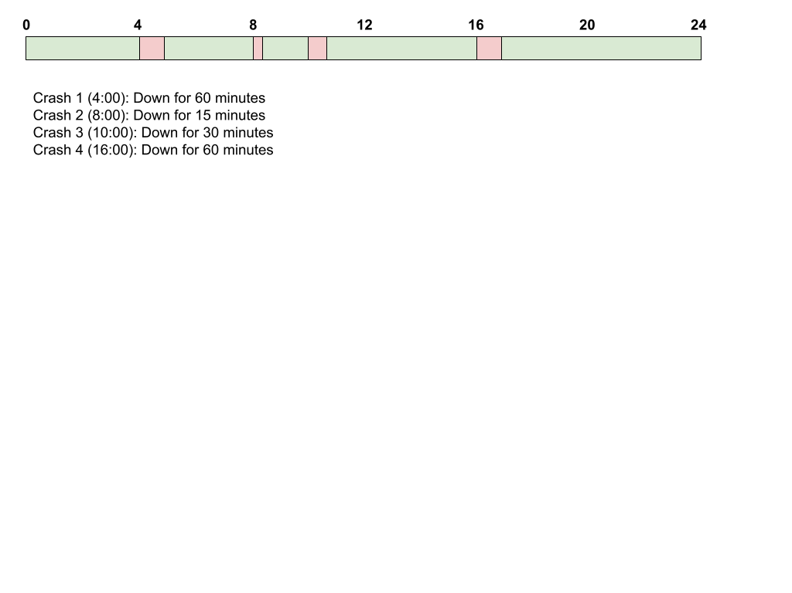
Activity
Recorded the following data:
There were 1200 requests.
  60 of those requests resulted in failures.
  56 failures resulted in incorrect computations.
  4 failures resulted in crashes.
  Uptime and downtime (caused by crashes):

Slide 34
Activity
What is the Time Available?
  Total Time Observed =
  24 * 60 =
  1440 minutes
  Uptime =
  Total Time Obverved - Downtime
  1440 - (60 + 15 + 30 + 60) =
  1275 minutes
  Time Available = Uptime / Total Time Observed =
  1275 / 1440 =
  88.54%

Slide 35
Activity
What is the POFOD?
  POFOD = (# failures) / (# requests) =
  60 / 1200 =
  0.05
What is the ROCOF in failures per hour?
  ROCOF = (# failures) / (number of hours) =
  60 / 24 =
  2.5 failures per hour

Slide 36
Activity
What is the MTBF (only crashes)?
  We need the uptime between each crash.
  1 (0:00 - 4:00): 240 minutes
  2 (5:00 - 8:00): 180 minutes
  3 (8:15 - 10:00): 105 minutes
  4 (10:30 - 16:00): 330 minutes
  Take the average: (240 + 180 + 105 + 330) / 4 = 213.75 minutes

Slide 37
Activity
If we were interested in assessing availability, what are some ways that we could do so?
  Pick failures we are interested in, show that they are avoided, ignored, recovered from.
    Avoid: See if failure occurred.
    Ignored: After failure occurs, is it likely to recur? Are other failures more likely to occur?
    Recovered: How long was system down? Afterwards, is there an effect on reliability?

Slide 38
Activity
If we were interested in assessing availability, what are some ways that we could do so?
  Are crash 1 and 4 caused by the same failure?
  Did crash 2 lead to crash 3?

Slide 39
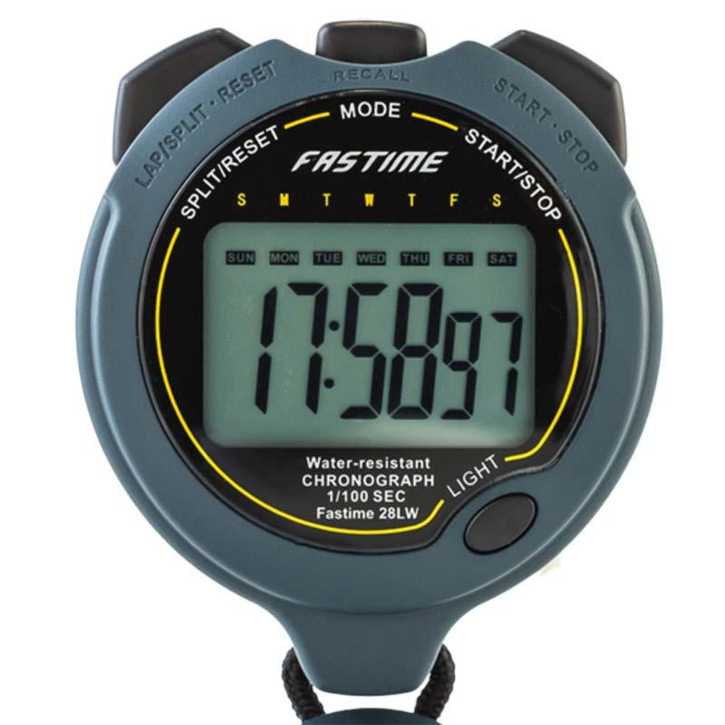
Quality Attributes:
Performance and
Scalability
Notes:
Just start with a question - want you to start thinking about this. (read)
This isn’t something with one answer, or even a right answer. It’s something we’ll keep returning to

Slide 40
Performance
Ability to meet timing requirements.
  When events occur, how fast does the system respond?
  Captures performance-per-user and across-users.
  Captures variance in performance.
Driving factor in software design.
  Often at expense of other quality attributes.
  All systems have performance requirements.
Notes:
Performance is about the software system’s ability to meet timing requirements. When events occur the system must respond to them in time. When we discuss performance, we Characterize the events that can occur (and when they can occur) and the system’s response to those events. In a web system, those events might be requests (numbering in the tens or tens of millions) via web browsers or through APIs. In a control system for an engine, events come from the operator’s controls and the passage of time; the system must control both the firing of the ignition when a cylinder is in the correct position and the mixture of the fuel to maximize efficiency. For a web-based system, the desired response might be expressed as number of transactions that can be processed in a minute. For the engine control system, the response might be the allowable variation in the firing time. In each case, the pattern of events arriving and the pattern of responses can be characterized, and this characterization is used to assess performance. Performance has been the driving factor in how we design systems, over all other qualities.All systems have performance requirements, even if not expressed. A word processer may not have explicit performance requirement, but you would agree that waiting an hour (or a minute, or a second) before seeing a typed character appear on the screen is too long. Performance continues to be a fundamentally important quality attribute for all software.

Slide 41
Scalability
Ability to maintain performance or reliability despite increasing number of requests.
  Horizontal scalability (“scaling out”)
    Adding more resources to logical units.
      Adding another server to a cluster.
  Vertical scalability (“scaling up”)
    Adding more resources to a physical unit.
      Adding memory to a single computer.
Notes:
Performance is often linked to scalability—that is, increasing your system’s capacity for work (1 , while still performing well and meeting performance and reliability requirements. Two kinds of scalability are horizontal scalability and vertical scalability. Horizontal scalability (scaling out) refers to adding more resources to logical units, such as adding another server to a cluster of servers. In cloud environments, horizontal scalability is called elasticity. Elasticity is a property that enables a customer to add or remove virtual machines from the resource pool. These virtual machines are hosted on a large collection of upwards of 10,000 physical machines that are managed by the cloud provider. Vertical scalability (scaling up) refers to adding more resources to a physical unit, such as adding more memory to a single computer.

Slide 42
Scalability
How can we effectively utilize additional resources?
Requires that additional resources:
  Result in performance improvement.
  Did not require undue effort to add.
  Did not lower reliability.
The system must be designed to scale
  (i.e., designed for concurrency).
Notes:
The problem that arises with either type of scaling is how to effectively utilize the additional resources. Being effective means that the additional resources result in a measurable improvement of some system quality, did not require undue effort to add, and did not disrupt operations. Technically, scalability is making your system easy to change in a particular way, and so is a kind of modifiability. The problem with achieving scalability by adding hardware (particularly when scaling out) is that it usually isn’t very effective unless the system has been designed to take advantage of the new hardware. If your system’s scalability is limited by a single threaded process at its core, adding more CPUs or machines isn’t going to help, and increasing the speed of the single CPU on which it runs will be of limited help. Similarly, if you can’t partition your workload into many cooperating processes, you won’t be able to take advantage of scaling out. You can certainly be lucky, and in certain situations adding some more hardware can save the day, but it is a dangerous tactic to rely on unless the system has been built from the outset with good scalability characteristics.

Slide 43
Measuring Performance and Scalability
Notes:
Just start with a question - want you to start thinking about this. (read)
This isn’t something with one answer, or even a right answer. It’s something we’ll keep returning to

Slide 44
Performance Measurements
Latency: The time between the arrival of the stimulus and the system’s response to it.
Response Jitter: The allowable variation in latency.
Throughput: Usually number of transactions the system can process in a unit of time.
Processing Deadlines: Points where processing must have reached a particular stage.
Number of events not processed because the system was too busy to respond.
Notes:
The response of the system to an event can be measured by the following: (go over)
(6) In the engine controller, for example, the fuel should ignite when the cylinder is in a particular position, thus introducing a processing deadline.

Slide 45
Measurements - Latency
Time it takes to complete an interaction.
  Affected by the the system and its environment.
    The user’s hardware, the network, system’s hardware.
  Measured probabilistically (“... 95% of the time”)
    “Under load of 350 updates per minute, 90% of ‘open account’ requests should complete within 10 seconds. 99% should complete within 12 seconds”
Notes:
LAtency is one of the most common ways to assess performance. LAtency is the length of time it takes for an interaction to complete. For a human-oriented system, this could be the length of time between the user initiating the request and the response being available for their use (e.g., from clicking a button to seeing the screen populated with data). this could be the time between invoking a service and the service returning a response, e.g., query to a database. The two aspects of latency that usually need to be considered are the responsiveness of the system itself (e.g., how long it takes the system to respond to a request when a button is clicked) but also how the environment around the system affects the performance- such as the responsiveness of the user’s device (e.g., how long it takes for a keypress or mouse click to be recognized) or the network connection. The system is usually the focus, but the environment can be important to consider in very resource-limited clients, or when users are accessing the ystem remotely .(last two points)

Slide 46
Measurements - Response Jitter
Response time is non-deterministic.
  If controlled, this is OK.
    10s +- 1s, great!
    10s +- 10 minutes, bad!
Jitter defines how much variation is allowed.
  Ex: “All writes to the database must be completed within an interval of 120 to 150 ms.”
Notes:
(1) If you run a task multiple times, it will not always take an identical amount of time to finish. (2) - if a task generally takes 10 seconds, plus or minus a small amount, great. If it sometimes takes 10 minutes, that isn’t good. (5) Places boundaries on when task can be completed. If boundaries violated, quality is compromised. (last)

Slide 47
Measurements - Throughput
The workload a system can handle in a time period.
  Measures performance across all users.
  Shorter the processing time, higher the throughput.
  As load increases (and throughput rises), response time for individual transactions tends to increase.
    With 10 concurrent users, request takes 2s.
    With 100 users, request takes 4s.
Notes:
Throughput is defined as the amount of workload the system is capable of handling in a unit time period. (2)Throughput and response time have a complex interrelationship in most systems. In general, the shorter your transaction processing time, the higher the throughput your system can achieve. However, as the load on the system increases (and throughput rises), the response time for individual transactions tends to increase (5-6).

Slide 48
Measurements - Throughput
Throughput goals can conflict with latency goals.
  For example:
    When there are 10 users, each user can perform 20 requests per minute (throughput: 200/m).
    When there are 100 users, each can perform 12 per minute
    (throughput is 1200/m but at a cost for individual user).
      i.e., performance is worse with more concurrent users.
Notes:
Therefore, it is quite possible to end up with a situation where throughput goals can be met only at the expense of latency goals, or vice versa. (2-4)
As an engineer, you need to make sure that you and your stakeholders understand these interrelationships and that you have balanced your stakeholders’ different performance goals.

Slide 49
Measurements - Event Deadlines
Some tasks must take place as scheduled.
If times are missed, the system will fail.
Can place deadlines on event completion.
Notes:
(1). In the engine controller, for example, the fuel should ignite when the cylinder is in a particular position.Places a deadline on when the fuel must ignite.

Slide 50
Which response measure should we use?
We want every user’s transaction on the shop to complete quickly.
  Latency
Can our shop handle Black Friday traffic?
  Throughput - make sure all requests are handled in a short period of time.
  May prioritize completing the batch over individual users in this situation.

Slide 51
Which response measure should we use?
The user must sign with BankID and confirmation must be returned within 60 seconds.
  Deadline - there is an absolute deadline for BankID processing to complete.
Ensure that inventory database updates are properly synchronized.
  Jitter - Imposes minimum and maximum timeframe on updates.

Slide 52
Assessing Scalability
Scalability measures impact of adding or removing resources on performance or reliability.
Response measures reflect:
  Changes to performance.
  Changes to reliability or availability.
  Load assigned to existing and new resources.

Slide 53
Key Points
Dependability is one of the most important software characteristics.
  Aim for correctness, reliability, safety, robustness.
  Often assessed using reliability.
Reliability depends on the pattern of usage of the software. Different users will interact differently.
Reliability measured using ROCOF, POFOD, Time Available, MTBF
Notes:
(read)

Slide 54
Key Points
Availability is the ability of the system to avoid, ignore, or recover from a failure.
Performance is about management of resources in the face of demand to achieve acceptable timing.
  Usually measured in terms of throughput and latency.
Scalability is the ability to “grow” the system to process an increasing number of requests.
  While still meeting performance requirements.
Notes:
Availability refers to the ability of the system to be available for use, especially after a fault occurs. The fault must be recognized (or prevented) and then the system must respond in some fashion. The response desired will depend on the criticality of the application and the type of fault and can range from “ignore it” to “keep on going as if it didn’t occur.”

Slide 55
Next Time
Quality Scenarios
No exercise session this week.
Form your teams!
  Deadline: January 25
  Assignment 0 on Canvas

