Slide 1
Lecture 14: Course Summary
Gregory Gay
TDA 594/DIT 593 - December 16, 2021

Slide 2
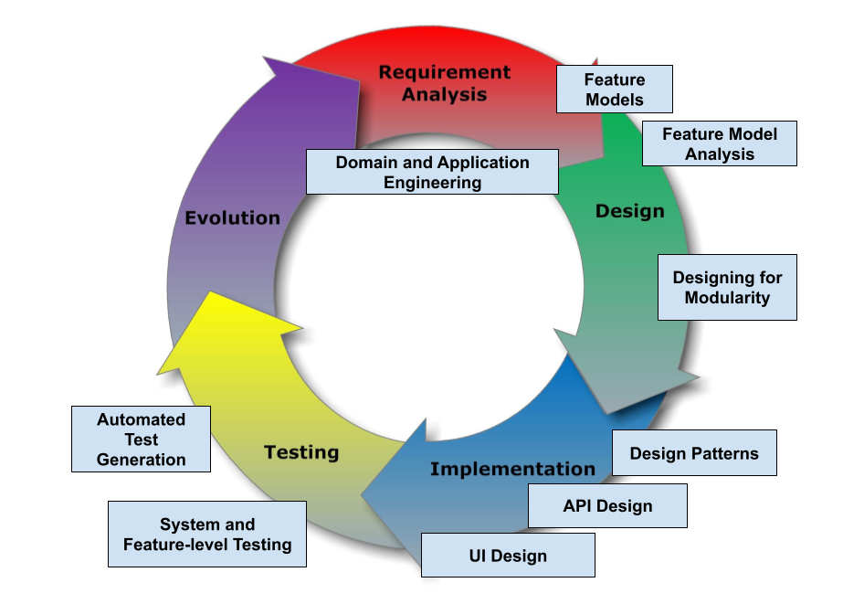
SE Principles for Complex Systems
Notes:
Today is our last lecture, and today, we’re going to use the class to recap what we have covered. The goal of this course wasto present advanced techniques aimed at creating complex systems with many interacting features and variable configurations. We examined the design, implementation, and verification of complex systems, focusing on managing complexity at different stages of the system development life cycle. We will also examine how the development process must be organized to deliver such systems. (go over core topics). Mainly, today, we will be summarizing the material we covered, presenting some of the highlights. This is a great chance to ask questions and get clarification. We will be watching the chat as we present, and will be happy to spend a few minutes handling anything that is still confusing that we glossed over before.

Slide 3
Individual Assignment - Jan 10-14
Take home exam, 10ish open-ended questions.
Will require reading one research paper.
Will be made available on Canvas at 9:00 on January 10th and due January 14, 23:59.
Based on topics covered in lectures, more theory-based than group assignments.
Practice Assignment: https://bit.ly/3oxH3Yc
Notes:
Of course, this leads into the individual assignment, which we have talked about here and there. (go over) There are practice problems on Canvas. Today, we’re going to go over those as a way to revisit some of the topics we have covered.

Slide 4
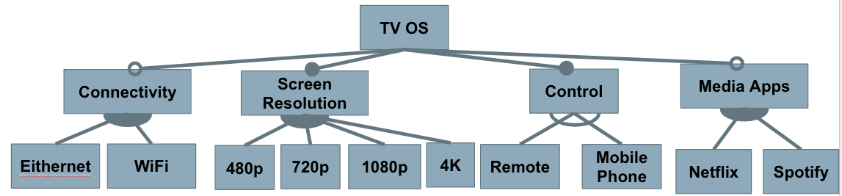
Question 1 - Domain/Application
Your company has developed SPL for smart TVs, according to the following feature diagram:
For each request, decide if you will extend the platform, add the feature to a single application, or decline the request.
Notes:
Your company has developed a product line platform for smart TVs. Your current platform was developed according to the following feature diagram:
You receive the following requests from customers. For each, decide if you will: Extend the platform to accommodate the request as a new feature that can be reused in future products. Add the feature to a single concrete application, but not develop it for future reuse. Decline the request and continue to use your existing platform.
Note that many arguments can be “correct” here. In each case, you should consider the trade-offs involved. Developing for the platform is more difficult and time consuming than developing for a single product. It requires matching specialized interfaces and carefully testing feature interactions, for example, which may not be required for a single product (where the new functionality will only be used in one feature selection). If the feature would be useful in many products, it is good to develop it for the platform. If it will be used rarely, then it is more efficient to focus on one product. If few customers will care, then it is often better to decline the request entirely. Consider these factors (and others that come to mind) in justifying your answer.

Slide 5
Question 1 - Domain/Application
2K resolution for video games (offering good balance between image sharpness and game speed).
Extend the Platform: Easy to support. Few hardware incompatibilities. Gamers would appreciate the option.
One Product: Limited customer base. Potential hardware incompatibility. Performance will change in the future.
Notes:
A game studio has requested you develop a new TV optimized to support 2K resolution (between 1080p and 4K) because that resolution offers a good balance between image sharpness and the speed the game can operate at.
Extend the platform OR add to one product: This would be relatively easy to support, so you shouldn’t ignore it entirely. However, there are arguments for either of the others.
Platform: It would likely be easy to support, as you already support several other screen resolution options. Most 4K displays can handle this resolution without issues. Many gamers would appreciate the option, so there is a customer base.
One Product: Only some customers will care (gamers who want to get the optimal performance), so may not be worth extra effort. There could be hardware incompatibility (not all displays can show 2K content). In the near future, games will perform well at 4K and higher resolutions, so the performance optimization only matters in the short-term.

Slide 6
Question 1 - Domain/Application
App Store where developers can publish their own media apps, and customers can select the ones they want.
Extend the Platform or Ignore: Would require extensive effort to create and manage. Would need to work on all hardware. Could earn a lot of additional revenue - so may be worth the effort, but can argue either way.
Notes:
Your current TVs come with a small selection of pre-installed apps (Netflix and Spotify currently). Customers have requested the addition of an app store where developers can publish their own apps and customers can download the apps that they want to use.
(click)Ignore OR extend the platform: This would require extensive effort to add, as the current platform is designed for only certain hand-selected apps. This would require the creation and management of a store, an interface for apps may need to be created (and followed by apps), apps would need to work on all TVs, etc. This could be enough work to ignore the request entirely. On the other hand, this could be of interest to a lot of customers and you could potentially earn revenue from the app developers as well. The investment may be worthwhile - IF the app store can appear on all future TVs and not just a single product.

Slide 7
Question 1 - Domain/Application
TVs for a restaurant chain that display a special app, and have a remote with simplified button layout.
Single Product: Relatively little development work, and may sell a lot of TVs to that restaurant.
Remote could be added to platform and sold with future products (or as an add-on).
Notes:
A restaurant chain has requested a special version of your TV that is locked to a single display for use in their stores for displaying menus, advertisements, and special videos. To extend your platform for their use, they ask for two features:A special app for that restaurant. A special remote containing only the power and volume buttons.
Single Product: This is clearly a product for a single buyer. You could reasonably argue for ignoring this as well, but this could be a way to sell a lot of these TVs for relatively little work, so it’s likely worth producing a TV for this restaurant with the special app and the simplified remote. The remote could be potentially added to the platform and sold as a separate add-on or used in future models as well (e.g., to other restaurants or as a child-friendly remote).

Slide 8
Question 2 - Feature Modelling
You are developing a word processor as a software product line, so that you can easily provide different feature sets for different types of customers.
Analyze the domain and identify a set of features.
Model the domain with a feature diagram.
Notes:
You work at a company that is developing a word processor. You have decided to develop this as a software product line, so that you can easily provide different feature sets for different types of customers.
Analyze the domain and identify a set of features.
Model the domain with a feature diagram, capturing the hierarchy and constraints between these features.

Slide 9
Question 2 - Feature Modelling
Some items to consider:
Which features will be requested by many customers?
Which features will be requested only by a few customers?
Which features could distinguish your products from others?
Pay attention to feature dependencies and make sure you capture cross-tree constraints and model structures.
Notes:
Some items to consider:
Which features are likely to be requested by many customers?
Which features are likely to be requested only by a few customers?
Which features could distinguish your products from the products of your competitors in this market segment?
Do not go crazy trying to identify all features. Try to capture an interesting set of important features (15 - 25, including all options for choices).
Pay attention to feature dependencies and make sure you capture relevant cross-tree constraints and model structures (mandatory, optional, alternative, or).

Slide 10
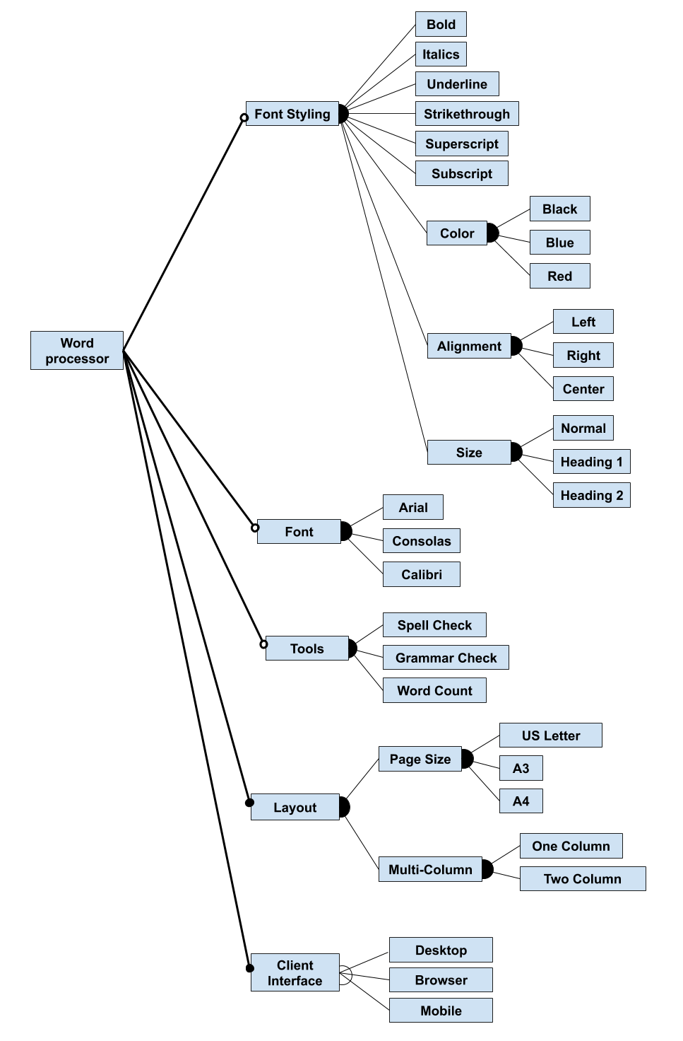
Question 2
Notes:
We do not expect an exhaustive feature model, but you should capture an interesting set of features and variation points. Above, we recommended 15-25 features, but this is not an exact rule as many answers will differ. It is more important to demonstrate your knowledge. You are recommended to add some explanation and not just present the diagram. Features should be arranged in a reasonable hierarchy, with appropriate cross tree constraints

Slide 11
Question 2
Notes:
We do not expect an exhaustive feature model, but you should capture an interesting set of features and variation points. Above, we recommended 15-25 features, but this is not an exact rule as many answers will differ. It is more important to demonstrate your knowledge. You are recommended to add some explanation and not just present the diagram. Features should be arranged in a reasonable hierarchy, with appropriate cross tree constraints

Slide 12
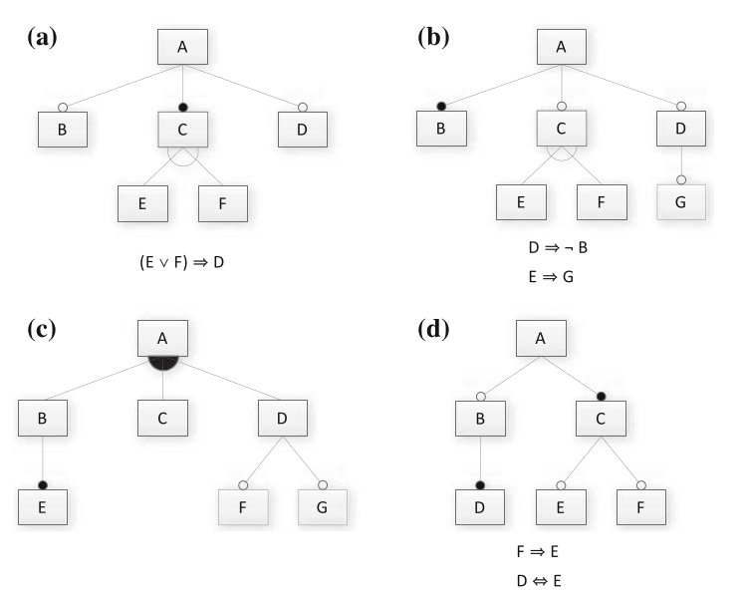
Question 3
Translate model into propositional logic formula.
Provide two valid and two invalid features.
Is it consistent? If not, why not?
Notes:
(reminder on model structures) Consider the following Feature Models.Translate the feature model into a propositional logic formula. Note that the logical expressions next to models A, B, and D are cross-tree constraints that must be incorporated as well.
Provide two valid and two invalid feature selections (if possible).
Determine whether the feature model is consistent (are there any valid configurations?). If it is not consistent, identify one reason why.

Slide 13
Question 3 (A)
Translate model into propositional logic formula.
Provide two valid and two invalid features.
Is it consistent? If not, why not?
A ∧ (B ⇒ A) ∧ (C ⇔ A) ∧ (D ⇒ A) ∧ ((C ⇔ (E ∨ F)) ∧ ￢(E ∧ F)) ∧ ((E ∨ F) ⇒ D))
Valid: A, B, C, D, F ; A, C, D, E
Invalid: A, B, C, D, E, F ; A, B, C, E
Is it consistent: Yes

Slide 14
Question 3 (B)
Translate model into propositional logic formula.
Provide two valid and two invalid features.
Is it consistent? If not, why not?
A ∧ (B ⇔ A)∧ (C ⇒ A) ∧ (D ⇒ A) ∧ ((C ⇔ (E ∨ F)) ∧ ￢(E ∧ F)) ∧ (G ⇒ D) ∧ (D ⇒ ￢B) ∧ (E ⇒ G)
Valid: A, B ; A, B, C, F
Invalid: A, B, D, G ; A, B, C, E
It is consistent: Yes, but D, E, and G are dead features (because B is mandatory).
Notes:
Consider the following Feature Models. Start with Models A and B. If you have time, also try Models C and D.
Translate the feature model into a propositional logic formula. Note that the logical expressions next to models A, B, and D are cross-tree constraints that must be incorporated as well.
Provide two valid and two invalid feature selections (if possible).
Determine whether the feature model is consistent (are there any valid configurations?). If it is not consistent, identify one reason why.

Slide 15
Question 3 (C)
A ∧ ((B ∨ C ∨ D) ⇔ A) ∧ (E ⇔ B) ∧ (F ⇒ D) ∧ (G ⇒ D)
Valid: A, C ; A, B, C, D, E, F, G
Invalid: A, B, C; A, C, E
It is consistent: Yes (just remember that B and E need to come as a pair)
Translate model into propositional logic formula.
Provide two valid and two invalid features.
Is it consistent? If not, why not?
Notes:
Consider the following Feature Models. Start with Models A and B. If you have time, also try Models C and D.
Translate the feature model into a propositional logic formula. Note that the logical expressions next to models A, B, and D are cross-tree constraints that must be incorporated as well.
Provide two valid and two invalid feature selections (if possible).
Determine whether the feature model is consistent (are there any valid configurations?). If it is not consistent, identify one reason why.

Slide 16
Question 3 (D)
A ∧ (B ⇒ A) ∧ (C ⇔ A) ∧ (D ⇔ B) ∧ (E ⇒ C) ∧ (F ⇒ C) ∧ (F ⇒ E) ∧ (D ⇔ E)
Valid: A, C ; A, B, C, D, E
Invalid: A, B, C, D ; A, C, F
It is consistent: Yes, but remember that if you have F, you need E, D, and B as well.
Translate model into propositional logic formula.
Provide two valid and two invalid features.
Is it consistent? If not, why not?
Notes:
Consider the following Feature Models. Start with Models A and B. If you have time, also try Models C and D.
Translate the feature model into a propositional logic formula. Note that the logical expressions next to models A, B, and D are cross-tree constraints that must be incorporated as well.
Provide two valid and two invalid feature selections (if possible).
Determine whether the feature model is consistent (are there any valid configurations?). If it is not consistent, identify one reason why.

Slide 17
Question 4 - Implementation
Consider compile-time and load-time binding of variability decisions.
Define each and note how they differ.
Explain potential advantages and disadvantages.
Notes:
Consider compile-time and load-time binding of variability decisions.
Define each and note how they differ from each other.
Explain potential advantages and disadvantages of each.

Slide 18
Question 4 - Implementation
Compile-time Binding:
Features selected when code is compiled.
Preprocessors.
Unselected features removed from code.
Faster code, lower system requirements, more secure.
Notes:
Compile-time binding is when variability decisions are made when the code is compiled. Preprocessors are the most common form of this style of binding. Unselected features are removed from the compiled binary, resulting in a smaller, simpler compiled unit. This results in faster code, with less overhead and lighter requirements in terms of disc space and memory consumed. It may also result in more secure code. The negative side of this style is that the user loses any control of reconfiguration and can make no further customizations without requesting a new compiled binary. This is a common style in embedded development, where the additional efficiency is beneficial and reconfiguration is not needed.

Slide 19
Question 4 - Implementation
Load-time Binding:
Features selected when program executed.
Parameters, design patterns, frameworks, components can do this (or run-time).
Configuration file, command line
Flexible, user can change settings.
Slower, insecure.
Notes:
Load-time binding is when variability decisions are made when the program is executed, usually by providing flags through the command line or setting them in a configuration file. The decisions are read in and set as the program starts to run. All features remain in the compiled binary and are accessible. However, to change the configuration, the program must be re-executed with new settings. This form is often implemented using design patterns or parameters. This form of binding is less efficient than compile-time binding and can lead to slow or insecure code. However, it offers far more flexibility to the user, who is free to customize the program to their specific needs.

Slide 20
Question 4 - Implementation
Discuss best binding times are suitable for:
Multiple alternative localization features for the GUI of a satellite navigation system.
(language selection, metric versus imperial units, etc.)
Run-time:
User may want to change preferences without a reboot. Multiple users may share same device, could customize options for each profile.
Notes:
Discuss which binding times (compile, load, run-time) are suitable (or ideal, or necessary) for the following features:
Multiple alternative localization features (language selection, metric versus imperial units, and so forth) for the graphical user interface of a satellite navigation system.
(click)Run-time. The user may wish to change their preferences without a full reboot. Multiple users may share the same device, and you could even customize the options for each profile.

Slide 21
Question 4 - Implementation
Discuss best binding times are suitable for:
Two alternative sorting features in a database:
Very fast or power- efficient sorting algorithm.
Load or Run-time:
Switch based on current needs.
If run-time, can switch based on battery state (but could be issues if switched at runtime)
Notes:
Discuss which binding times (compile, load, run-time) are suitable (or ideal, or necessary) for the following features:
Two alternative sorting features in a database system: a very fast and a power- efficient sorting algorithm.
(click) Load-time or run-time. We may want to switch based on current needs (performance when plugged-in, power-efficient when on battery). Run-time is likely ideal, as we could switch based on battery state. However, we also should consider the potential issues of switching algorithms during run-time. If there would be issues with elements of the system working with that data that could result from changing algorithms, we might want to wait until reloading the program.

Slide 22
Question 4 - Implementation
Discuss best binding times are suitable for:
Two alternative features in an operating system:
Single-processor support and multi-processor support.
Compile or Load-time:
Hardware can’t change without reboot.
Could change hardware and reboot (load-time), but this is often compile-time (company sells different products).
Notes:
Discuss which binding times (compile, load, run-time) are suitable (or ideal, or necessary) for the following features:
Two alternative features in an operating system: single-processor support and multi-processor support.
(click) Compile-time or load-time. At minimum, you will not change the hardware configuration without a reboot. You may want this as load-time, as you could conceivably change the CPU and then boot the computer again. However, this scenario, in the real world, is usually a compile-time decision. You would select the feature, then generate the right executable. This is because companies often sell multiple products for different scenarios (e.g., a server version of the OS optimized for many-processors).

Slide 23
Question 4 - Implementation
Discuss best binding times are suitable for:
Two alternative features for edge representations in a library of graph algorithms:
directed and undirected edges.
Compile or Load-time:
Other features depend on edge type, so issues at run-time. Compile-time could be efficient if changes infrequent.
Notes:
Discuss which binding times (compile, load, run-time) are suitable (or ideal, or necessary) for the following features:
Two alternative features for edge representations in a library of graph algorithms: directed and undirected edges.
(click) This could reasonably be compile or load-time. The other features in this system may depend on one graph type, so changing at run-time could cause issues (and render your current graph useless). At minimum, you would restart the program before changing. Given feature dependencies, a compile-time version could be very efficient (by removing all unselected features). Therefore, that may be the ideal version if you do not switch graph types regularly (you could even have two different lean executables - undirected and directed). Of course, a compile-time version would lose the flexibility of a load-time version.

Slide 24
Question 4 - Implementation
Discuss best binding times are suitable for:
Multiple optional features for supported file formats in printer firmware.
Compile-time:
The file types are unlikely to change often.
Embedded system benefits from simple/fast executable.
Notes:
Discuss which binding times (compile, load, run-time) are suitable (or ideal, or necessary) for the following features:
Multiple optional features for supported file formats in printer firmware.
(click) Compile-time. The supported file types are unlikely to change often (if at all), as that may be determined by other hardware or software limitations. Additionally, as an embedded system, a printer will benefit from a simpler executable created by only including the supported features;.

Slide 25
Question 5 - Design Patterns
Choose one of: strategy, decorator, factory, facade, adapter, and template method pattern.
Describe the goal of the pattern and how it is applied to a system.
Describe how the pattern would help enable controlled variability.
Give an example of a system that would benefit from the application of this pattern.
Notes:
In class, we discussed the following design patterns - strategy, decorator, factory, facade, adapter, and template method. Choose one of these patterns and:
Describe - in your own words - the goal of the pattern and how it is applied to a system.
Describe how this pattern would help enable controlled variability in an effective and efficient manner.
Give an example (not one that we covered in class) of a concrete system that would benefit from the application of this pattern. Draw a partial class diagram to help explain this example.

Slide 26
Let’s Take a Break
Notes:
Just start with a question - want you to start thinking about this. (read)
This isn’t something with one answer, or even a right answer. It’s something we’ll keep returning to

Slide 27
Question 5 - Design Patterns
Factory Pattern
Performs object creation based on selected options
Returns an object (Product) on request.
All Products implement a common interface.
New Products can be added, or existing ones changed.
Client does not need to know details of object creation or which object it is interacting with.
Notes:
The Factory Pattern is used to perform object creation in a decoupled manner. A Factory object takes requests and returns the object (called a Product) that was requested. All Products of a particular type implement an interface representing that product, thus they all have the same data type and core set of methods. That means that client code can be developed around generic product types rather than specific products. The Factory contains all code needed to create and initialize Products. This means that new Products can be added and existing Products can be changed or removed at any time, without the client needing to change to accommodate the product changes.
Because of these features, the Factory Pattern enables the seamless initialization of related-but-varying objects without client code needing to know how the different concrete objects vary. These Products can be treated equivalently. Creation code exists in one location and only needs to evolve in that one location. This pattern enables loose coupling to concrete (varying) code and enables efficient evolution of the product portfolio.

Slide 28
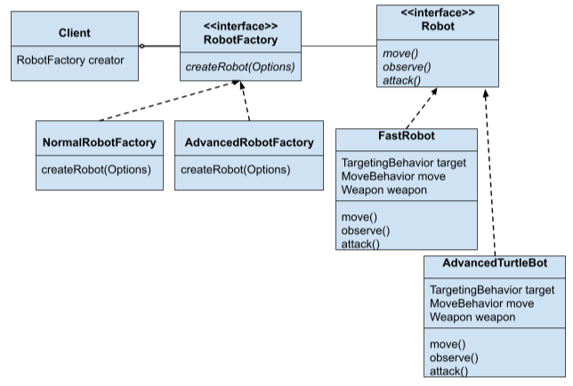
Question 5 - Design Patterns
Notes:
In class, we focused on the example of a pizza shop that enables ordering of different types of pizza. These products vary, but the client code can treat them all equivalently (based on the operations defined by a Pizza interface). The Factory takes in a parameter (a string, representing the ID of the requested pizza type), and returns the correct Pizza object. Many other situations would map similarly to this exact situation. For example, we could imagine a factory responsible for instantiating robots based on a set of options chosen, such as a movement pattern, targeting behavior, and weapon type. The Factory could take these options as parameters to a creation method, instantiate the correct Robot object, and return it to the client code. You could even have different factories to manage different subsets of robots.

Slide 29
Question 6 - Modularity/APIs
“Let’s Make a Deal” is a game where contestants are presented with three doors.
One leads to a prize, the others lead to nothing.
Users select one door.
Host opens one of the other doors.
Users can then choose to open their door or the remaining unopened door.
Notes:
“Let’s Make a Deal” is a game where contestants are presented with three doors.
One leads to a great prize, the other leads to nothing.
Users select one door.
Host opens one of the other doors.
Users can then choose to open their door or the remaining unopened door.

Slide 30
Question 6 - Modularity/APIs
Implement Let’s Make a Deal as a web service:
Creation of games.
User selection of a door.
The game will open one of the other doors.
User opening of a door.
Querying of the current state of the game and outcome (if complete) by user.
Deletion of a game.
Notes:
You have been asked to implement Let’s Make a Deal as a web service. You must support:
Creation of games.
User selection of a door.
The game will open one of the other doors.
User opening of a door.
Querying of the current state of the game and outcome (if complete) by user.
Deletion of a game.

Slide 31
Question 6 - Modularity/APIs
Create a REST API for this game.
Determine the appropriate resources and verbs, and explain your API.
Extend your API into a generic, reusable API that could be used as the interface for additional games.
Redesign your interface as a generic “game” interface.
Explain why your new design could be reused for a different game.

Slide 32
Question 6 - Modularity/APIs
Once game is over, only GET is allowed for {gid}
Resource | Verb
/games | get – status of games server post – create new game
/games/{gid} | get – status of game (in_play, won, lost) delete – delete the game resource
/games/{gid}/doors | get – status of all doors
/games/{gid}/doors/{1..3} | get – door status {closed, selected, opened} put – update door status

Slide 33
Question 6 - Modularity/APIs
Resource | Verb
/games | get – status of games server post – create new game
/games/{gid} | get – status of game {results based on game} delete – delete the game resource
/games/{gid}/items | get – status of any in-game item post - create a new item (requires authentication)
/games/{gid}/items/{iid} | get – item status {results based on game} put – update item status delete - delete the item resource (requires authentication)
Notes:
Redesign as a more generic API that could serve as an interface for other games. The first two resources and their verbs could remain the same, although we could potentially allow a wider range of results for the game status. The remaining two can be made more generic. Rather than reasoning over doors, we can reason over “items” - a notion that can include doors, laser guns, mushrooms, or any other object that a player can interact with in a game. We can add a post action to even allow the creation and addition of new items easily, but we may want to require authentication to enable this action. For each item, we can get a status still - like with the door - but the results may be determined by the game behind the interface. We can still use PUT to interact with the item. We may also add a DELETE to allow removal of the item if it has been “used” by a player. Perhaps this also should require authentication to prevent misuse.

Slide 34
Question 7 - Testing
find(pattern,file)
Finds instances of a pattern in a file
find(“john”,myFile)
Finds all instances of john in the file
find(“john smith”,myFile)
Finds all instances of john smith in the file
find(““john” smith”,myFile)
Finds all instances of “john” smith in the file
Notes:
You have created a utility intended to find all instances of a pattern in a file.

Slide 35
Question 7 - System Testing
Parameters: pattern, file
What can we vary for each?
What can we control about the pattern? Or the file?
What values can we choose for each choice?
File name:
File exists with that name
File does not exist with that name
What constraints can we apply between choice values? (if, single, error)
Notes:
(go over) Give time to work on

Slide 36
Question 7 - System Testing
Pattern size:
Empty
single character
many characters
longer than any line in the file
Quoting:
pattern has no quotes
pattern has proper quotes
pattern has improper quotes (only one “)
Embedded spaces:
No spaces
One space
Several spaces
(2²*3³*4¹) = 108 test specifications
File name:
Existing file name
no file with this name
Number of occurrence of pattern in file:
None
exactly one
more than one
Pattern occurrences on any single line line:
One
more than one
Notes:
Go over
How many combinations - test specifications - 108 (two variables with two options, three with three, one with four. Niot too horrible, but still a lot for one function. Let’s constraint it.

Slide 37
ERROR and SINGLE Constraints
File name:
Existing file name
no file with this name
Number of occurrence of pattern in file:
None
exactly one
more than one
Pattern occurrences on target line:
One
more than one
Pattern size:
Empty
single character
many character
longer than any line in the file
Quoting:
pattern has no quotes
pattern has proper quotes
pattern has improper quotes (only one “)
Embedded spaces:
No spaces
One space
Several spaces
4 (error) + 2 (single) + (1²*2³*3¹) = 30
[error]
[error]
[error]
[single]
[error]
[single]
Notes:
Let’s narrow further. Can we apply any error constraints?
- go over. Now, anything we can try just once and leave out after?
- go over. How many tests now? 30! Much better shape, and down from our starting point of 108

Slide 38
IF Constraints
File name:
Existing file name
no file with this name
Number of occurrence of pattern in file:
None
exactly one
more than one
Pattern occurrences on target line:
One
more than one
Pattern size:
Empty
single character
many character
longer than any line in the file
Quoting:
pattern has no quotes
pattern has proper quotes
pattern has improper quotes (only one “)
Embedded spaces:
No spaces
One space
Several spaces
4 (error) + 2 (single) + (1³*2³) (quoted = true) + (1⁴*2²) (quoted = false) = 18
[error]
[error]
[error]
[single]
[property quoted]
[error]
[single]
[if quoted]
[if quoted]
Notes:
let’s add a constraint. (go over quoted) Maybe you had others. There are a lot of different things you could try here. Any questions?

Slide 39
Question 8 - Combinatorial Testing
Allow Content to Load | Notify About Pop-Ups | Allow Cookies | Warn About Add-Ons | Warn About Attack Sites | Warn About Forgeries
Allow | Yes | Allow | Yes | Yes | Yes
Restrict | No | Restrict | No | No | No
Block |  | Block
Full set of test specifications = 144
Create set covering all pairwise value combinations.
Hint: Start with two variables with most values. Add one variable at a time.
Notes:
let’s do one more example interactively. You are designing system-level tests for a web browser with multiple configuration options. You have extracted the following choices, with the following representative values for each: (go over) The full set of possible test specifications contains 144 options. Create a covering array of specifications that covers all pairwise value combinations in fewer test specifications. (hint: start with two variables with the most values and add additional variables one at a time)

Slide 40
Question 8 - Combinatorial Testing
Allow Content | Allow Cookies
Allow | Allow
Allow | Restrict
Allow | Block
Restrict | Allow
Restrict | Restrict
Restrict | Block
Block | Allow
Block | Restrict
Block | Block
Add-Ons
Yes
No
-
No
-
Yes
-
Yes
No
Forgeries
Yes
No
Yes
No
Yes
No
Yes
-
No
Pop-Ups
Yes
No
-
-
Yes
No
No
-
Yes
Attacks
Yes
Yes
No
No
-
Yes
-
No
Yes
No
No
Yes
Notes:
start with the two variables with three values (click) now add any of the two value ones , pop-ups (go over) (click) add-ons(click) attachs - need to fill in some of those values (click) forgeries, can do without filling anything (ask questions?)
From 144 to 9 test cases. Yours might look a little different

Slide 41
Question 9 - Automation
Metaheuristic search techniques can be divided into local and global search techniques.
Define “local” search and “global” search.
Local search: formulate a solution, and improve by making small changes.
Global search: more than one solution at a time, and freely change those solutions.
Notes:
Metaheuristic search techniques can be divided into local and global search techniques.
Define what a “local” search and a “global” search is.
Local search techniques formulate a solution, and attempt to improve that solution by making small changes (looking for a better solution in the “local neighborhood” - the possible solutions formed by making one small change). Global searches typically form more than one solution at a time, and freely change those solutions (moving to any spot in the search space).

Slide 42
Question 9 - Automation
Metaheuristic search techniques can be divided into local and global search techniques.
Contrast the two approaches. What are the strengths and weaknesses of each?
Local search: Fast, easy to understand. Depend on initial guess to not get stuck.
Global search: Do not get stuck easily, but are slower.
Notes:
Metaheuristic search techniques can be divided into local and global search techniques.
Contrast the two approaches. What are the strengths and weaknesses of each?
Local searches are often very fast, easy to implement, and easy to understand conceptually. However, they depend strongly on the choice of initial guess. They can easily get stuck in local optima - where they find the best solution possible given the neighborhood, but not the best for the whole search space. This weakness can be partially overcome by allowing restarts. Global searches are harder to implement and are often slower, but have no problems with becoming stuck, as they try more than one solution at once. However, because they are slower, they may not find as good of a solution given the same time budget.

Slide 43
Question 9 - Automation
Choose and explain an algorithm.
Simulated Annealing:
Generate random initial solution.
Each round, pick a neighbor.
If better, make it new solution.
If worse, make it solution based on result of a probability.
Probability of accepting worse solution decreases over time - allows rapid early exploration.
Notes:
Metaheuristic search techniques can be divided into local and global search techniques.
Choose one search algorithm and briefly explain how it works. State whether it is a global or local search, and explain why it belongs to that category.
An example of a local search is Simulated Annealing. Initially, a solution is generated at random. Then, during each round of the search, a random neighboring solution is picked (created by making a small change to the current solution). If that neighbor is better, it becomes the new solution. If it is worse or identically good, at a certain probability, that solution will become the new solution anyways. This probability is based partially on how many rounds the search has progressed through. At earlier rounds, the search is more likely to accept a worse solution to avoid getting stuck in a local maxima. Over time, it will be more likely to reject worse solutions. This is a local search because it manipulates one solution at a time and focuses on the local neighborhood when making changes.

Slide 44
Question 10 - Research in SPLs
Read the following research paper: “Variability Management With The Virtual Platform”
What problem are the authors attempting to address?
Why is this problem important to address?
What did the authors do to address this problem?
What conclusions did they come to?
What is one thing you think could be done to extend this work in the future?
Notes:
Wardah Mahmood, Daniel Strüber, Thorsten Berger, Ralf Lämmel, Mukelabai Mukelabai. Seamless Variability Management With The Virtual Platform. Available at https://arxiv.org/abs/2103.00437.
After reading this paper, explain (in your own words) the following:
What problem are the authors attempting to address?
Why is this problem important to address?
What did the authors do to address this problem?
What conclusions did they come to?
If you were the authors of this study, what is one thing you would do to extend this work in the future?

Slide 45
Question 10 - Research in SPLs
What problem are the authors addressing?
Clone & Own: New variant created by cloning existing code and making changes.
Flexible, inexpensive to start, but hard to maintain and does not scale to large number of variants.
Product line development: Asset platform, compose new products from platform
Expensive upfront effort, but scales well.
Authors want to ease transition.
Notes:
Two common strategies for development of customizable software are clone & own and platforms (software product lines). In the former, a developer creates a new branch or clone of the code repository, makes changes, and maintains their separate branch. This is inexpensive, flexible, enables developer independence, and allows fast innovation. However, it does not scale as the number of variants increases and creates a large maintenance burden, as it is difficult to incorporate new changes to the original system. In platform development, a set of reusable assets are developed and composed into new concrete products based on a feature selection. This strategy is scalable, but requires substantial up-front investment. Many companies start with clone & own, and migrate to product line development. This transition is risky and expensive. The authors seek a way to make the transition easier and less risky, enabling developers to more easily transition to a product line development approach.

Slide 46
Question 10 - Research in SPLs
Why is this problem important to address?
Very expensive to start with a platform.
Many developers cannot start with SPL.
Transition is difficult and failure has high consequences (bad or cancelled products).
Simple, incremental transition methods can reduce that risk.
Notes:
This problem is important to address because of the cost and effort required to develop a software product line. Many developers cannot start with a platform, and must transition from a single product to a product line. This transition is risky, and could result in poor products, cancelled products, failed contracts, and other problems if it fails or is conducted poorly. A simple and incremental way to transition to a platform is very important to reduce this risk.

Slide 47
Question 10 - Research in SPLs
What did the authors do to address this problem?
Virtual platform collects metadata (features, feature locations, clone traces).
Metadata used in operators available to developers
Clone and feature creation/evolution/management.
Operators allow management of clones, transition to platform.
Notes:
The authors propose that the two approaches can be bridges using a virtual platform. This is a framework that supports both clone & own and platform development. Based on the number of variants, organizations can decide to use only a subset of all the variability concepts typically required for a full platform, starting with clone & own and incrementally scaling the development. They facilitate this by recording relevant metadata (e.g., features, feature locations, and clone traces) automatically for the developers. The virtual platform exploits this metadata for the transition, providing operators that developers can use to handle variability. For example, operators allow developers to add, change, or remove assets, to change the location of an attribute, to clone an asset, to link an asset to a feature, to merge code from one asset into its clone, to create features, to link a feature model to an asset, to remove or move features, to mark a feature as optional, to clone a feature, or to merge the code of one feature into another. These operators maintain traceability between project clones and the original code, ease management of clones, and allow the transition from a clone & own model to a platform over time using this metadata and the operators.

Slide 48
Question 10 - Research in SPLs
What conclusions did they come to?
Costs - maintaining features, dealing with omissions during feature maintenance.
Benefits - reduced manual feature location, clone detection and maintenance.
Benefits far outweigh costs.
Reduced effort from pure clone & own.
Notes:
The authors evaluate their virtual platform in terms of costs and benefits. Costs are in terms of additional developer effort using the virtual platform. Costs arise from maintaining features, and dealing with omissions during feature maintenance. Benefits relate to saved costs from feature location and clone detection/propagation. Most costs relate to feature creation and adding an asset to a feature, with the cost-per-invocation being low each time this is done. Much larger effort savings are attained from avoiding the need for manual clone detection. Their platform is able to save developers significant effort that would be required through a pure clone & own approach.

Slide 49
Question 10 - Research in SPLs
What is one thing you think could be done to extend this work in the future?
Use metadata to train a prediction model.
Could predict feature-to-asset mappings.
Could suggest operators to the developer that they may want to apply.
(You are moving code - perhaps you should use the “move asset” operator?)
You do NOT need to be an expert - just think a little and try to be creative!
Notes:
(Do not state one of the ideas for future work that the authors proposed themselves, but come up with your own idea. Justify why it makes sense as an extension. You donät need to be an expert! Just think creatively a little and propose something that you think is interesting)
The existing metadata and, potentially, other data that could be recorded could be used to train a prediction model that can automatically propose potential feature mappings to the user by comparing different clones. Alternatively, this data could be used to suggest operators to the developer when it appears that they could make use of one. For example, if a user is moving code manually, the platform might suggest that an asset is being moved or changed, and suggest the use of the operator to accomplish the task.

Slide 50
Wrap-Up
Thank you for making this a great course!
Any remaining questions?

