Slide 1
Lecture 2: Domain and Application Engineering
Gregory Gay
TDA 594/DIT 593 - November 4, 2021

Slide 2
Today’s Goals
Introduce Domain Engineering
Domain and Application Engineering
Platform vs Specific Application
Design FOR and WITH reuse
Principles of SPLE
BAPO: Business, Architecture, Process, Organization
Notes:
This class is, to some extent, structured like a software development process, We will talk about requirements and design, then testing, for software product lines and other complex reuse or modularity-driven systems. So, as a starting point, we’re going to begin with the development process itself. Not the basics, agile vs waterfall vs spiral, etc, but some considerations and planning and adaptation of traditional development phases that need to take place to create SPLs or similar systems. We will (1)(a process of developing Software Product Lines and other complex systems) (rest) BAPO model

Slide 3


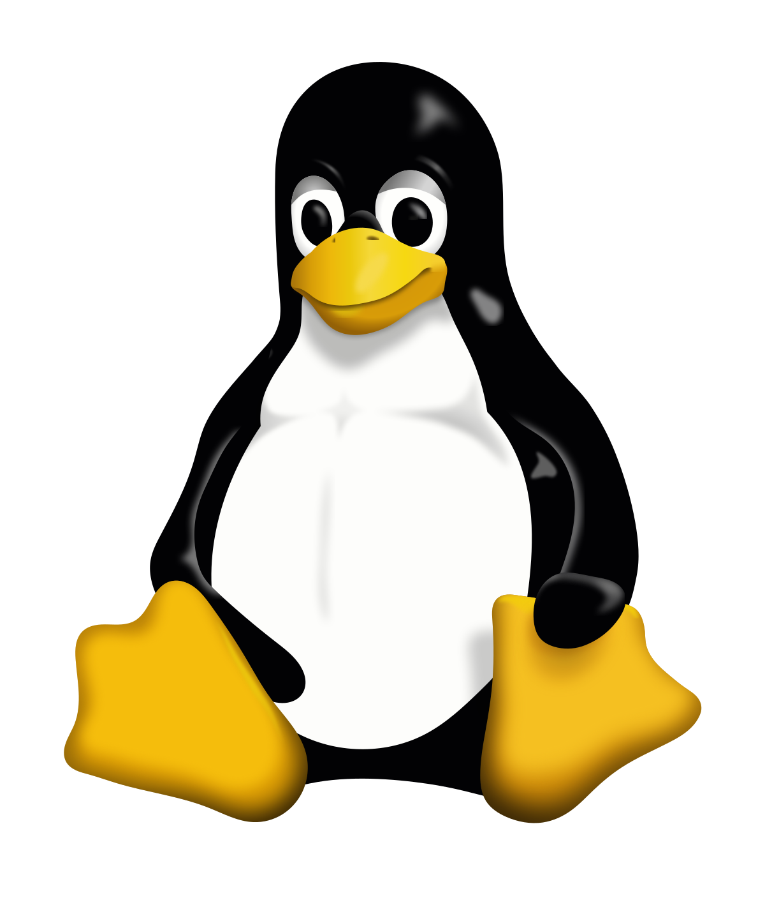
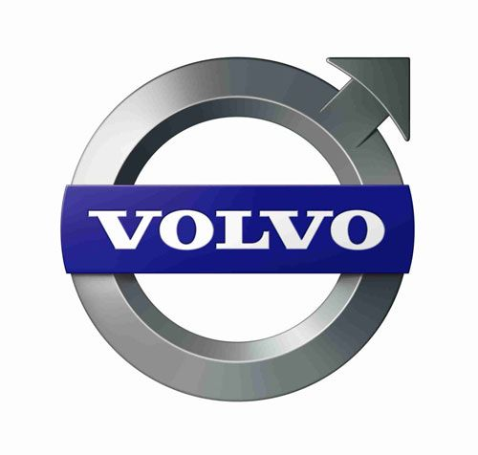
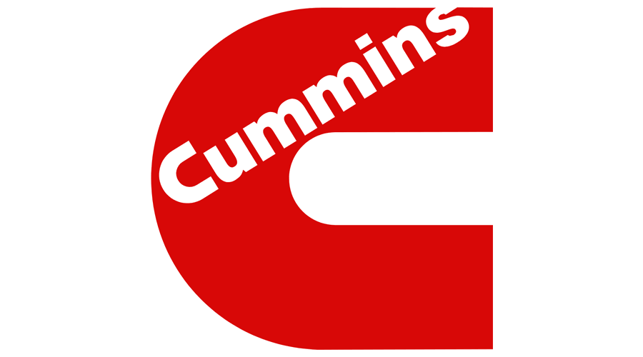
Software Product Lines
Highly configurable families of systems.
Built around common, modularized features.
Common set of core assets.
Allows efficient development, customization.
Examples:
Notes:
as a reminder, software product lines (SPLs) are highly configurable families of systems built around common, modularized features. Together, SPLs address the needs of a particular market segment or mission. They are developed from a common set of core, reusable assets in a planned way. By developing large software systems in this way, companies can produce a set of products more economically, since the development effort put into the shared assets does not need to be duplicated. SPLs can also help companies to better address product customization tasks to meet specific needs of individual customers. This allows sustaining a high rate of product innovation, while keeping guaranteed levels of overall system performance and quality. SPLs are seen in many domains, and are highly challenging to develop as they have technical, process, organization, and business-related aspects. We will talk much more about these, but to give two examples: the Android OS provides a set of core libraries and components that can be tuned by phone manufacurers to particular devices. A Samsung Galaxy S20 and the new Motorola RAZR look nothing alike - have different hardware, different user interfaces, but are largely powered by the same software underneath the surface, customized to its particular operating circumstances. And within that ecosystem, you can plug in an endless set of different apps to perform common tasks, like for sharing a file or opening a video. A second comes from Cummins, the world’s largest manufacturer of diesel engines - their core software covers 9 basic engine types ranging over 4-18 cylinders and 4-164 liters of displacement, with 12 kinds of electronic control modules, 5 kinds of processors, and 10 kinds of fuel systems. The core software - 20 basic software builds - have been deployed into over 1000 separate products. These stories are common, and SPLs are built at Volvo or Boeing, in Linux, and in many other circumstances. Most systems today are SPLs in some form whether or not the term is used - components are designed for reuse, systems are designed to be highly configurable, and designed to adapt and change over time to meet the needs of evolving markets by easily swapping out elements with standardized interfaces. All of these circumstances require similar design techniques and tactics to enable variation and change over time

Slide 4
Domain and Application Engineering
Notes:
So, let’s talk about the design process for such systems.

Slide 5
SPLE Principles
Variability Management
Variability must be planned for.
Business-Centric Development
Connect to long-term business strategy.
Architecture-Centric Development
Take advantage of system similarities.
Two-Life-Cycles
Domain Engineering, then Application Engineering.
Notes:
Four principles govern successful product line engineering. Variability management: individual systems are considered as variations of a common theme. This variability must be made explicit and must be systematically managed. Business-centric: software product line engineering aims at thoroughly connecting the engineering of the product line with the long-term strategy of the business. Architecture-centric: the technical side of the software must be developed in a way that allows taking advantage of similarities among the individual systems. Two-life-cycle approach: the individual systems are developed based on a software platform. These products – as well as the platform itself – must be engineered and have their individual life-cycles. Development FOR reuse comes before development WITH reuse, so we perform development based on whether it is development of assets that are part of the platform ,which takes place during domain engineering, then the development of single products that use those assets, and we refer to that lifecycle as application engineering

Slide 6
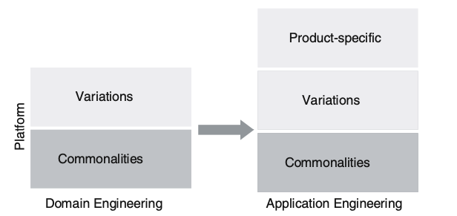
Variability Management
Commonality
Shared between all products.
Implemented in core platform.
Variability
Shared by subset of products.
Implemented in core platform, enabled in subset.
Product-specific
Unique to a single product.
Platform must support unique adaptations.
Notes:
Software product line engineering aims at supporting a range of products customized to different, individual customers or usage types. As a result, variability is a key concept. Instead of understanding each individual system all by itself, software product line engineering looks at the product line as a whole and the variation among the individual systems. This variability must be defined, represented, exploited, implemented, evolved, etc. – in one word managed – throughout software product line engineering. When managing variability in a product line, we need to distinguish three main types: Commonality: a characteristic (functionality or non-functional) can be common to all products in the product line. We call this a commonality. This can be requirements, code blocks (methods, to classes, to services and subsystems, any asset. This is then implemented as part of the platform. 2) Variability: a characteristic or asset may be common to some products in the line, but not to all. It must then be explicitly modelled as a possible variability and must be implemented in a way that allows having it in selected products only. 3. Product-specific: a characteristic may be part of only one product – at least for the foreseeable future. While these variabilities will not be integrated into the platform, the platform must be able to support them.
During the life-cycle of the product line, a specific characteristic may change in type. For example, a product-specific characteristic may become a variability, if it looks like a piece of code or some other asset we might want to reuse in the future in a different product. On the other hand, a commonality may become a variability as well – for example, if over time the decision is made to support alternatives to that asset (e.g. extending the platform beyond the initial operating system which provided the starting basis, so some versions now are on iOS while others are on Android - now we have options that we choose form based on the OS). Commonalities and variabilities are handled mostly in domain engineering, when we develop the assets of the platform, and product-specific parts are handled exclusively in application engineering because they are tied to one product.

Slide 7
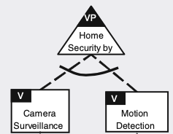
Reasoning about Variability
Variation Point
Where one product can differ from another.
Ex: Which features are supported by this security alarm?
Feature
Options that can be chosen at each variation point.
Ex: Motion detection, camera
Notes:
Variability management covers the whole life-cycle. It starts with the early steps of scoping and requirements, covering all the way to implementation and testing and finally going into maintenance and evolution. variability is relevant to all assets throughout software development. So, it is something we will return to and discuss often. This means that there are some terms to introduce that we can use to reason about variability. Variation point: the variation point describes where differences exist in the final systems (e.g. systems may differ with respect to the operating systems they rely on, with respect to whether they support a particular feature or not, which algorithm a feature uses, etc.) For example, we may have a security alarm product line that can perform different types of detection. Which are supported by a concrete alarm? This is essentially where you make a choice between the different possibilities that exist to satisfy a variation point , what we call features or sometimes variants.

Slide 8
Constraints on Variability
Variability Dependencies
Dependencies between features at one variation point.
How many features can we choose for this point?
Which are mandatory? Optional?
Feature Dependencies
Dependencies between features at same or different variation points.
Choosing one feature requires choosing or excluding another feature.
Notes:
We also need to discuss the dependencies introduced by a variation point. Not all feature selections are valid and specify meaningful products, and two types of dependencies are used to decide what is a legal selection. First, Variability dependencies are how we denote the different choices (features) that are possible to fill a single variation point. This generally refers to the number of features that can be selected simultaneously (e.g. a program may support e-mail, text, phone for delivering a notification). We also note which features are mandatory and which are optional add-ons. In the last slide, we had that security alarm. You might require that all models have a camera, while making the motion detection feature optional.
Feature dependencies describe dependencies among certain feature selections. the selection of a specific feature may require the selection of another feature (perhaps for a different variation point, but somewhere in the concrete system, choosing one feature requires also choosing another). Or the selection of a specific feature may prohibit the selection of another feature (perhaps for a different variation point). We talked about that security alarm earlier. We have different concrete products that have different selections of detection features. One has a camera, another has a camera and motion detecter, and another has a motion detecter and microphone. Maybe we can’t get one with a microphone and camera. That is an invalid selection. Feature dependencies are modeled explicitly in product lines as part of feature modeling, which we discuss next class.

Slide 9
Features and Products
Any end-user-visible characteristic or behavior of a system is a feature.
(often, functionality a user can directly interact with)
A concrete product is a valid feature selection.
Fulfills all variability and feature dependencies.
Notes:
Features are the concerns of primary interest in product-line engineering. A feature is a end-user-visible - that’s key - characteristic or behavior of the system (2). Features are used in product-line engineering to specify and communicate commonalities and variabilities, the differences, of the products between stakeholders and designers, and to guide structure, reuse, and variation across all phases of the development life cycle. The product portfolio of a product line is defined by its features and their relations. A specific product is identified by a subset of features, called a feature selection. A product of a product line is specified by a valid feature selection (a subset of the features of the product line). A feature selection is valid if and only if it fulfills all variability and feature dependencies.

Slide 10
Application Engineering
Should requirements for a concrete application become part of the product line platform?
If supported by the platform, add it to the platform.
(can be added as an asset or tied to a variation point)
Else:
1) Drop it.
2) Add a new variation point to the platform.
3) Develop it as a unique part of one application.
Notes:
Setting up the product line infrastructure is not a goal in itself. The ultimate aim is its exploitation during application engineering. This is also called the instantiation of the variability. As new requirements are captured during application engineering, each requirement must be considered and a decision must be made about its future: should it be a requirement of the platform instead and become a variable part there – or should it just be part of this concrete application? The simplest case is when the product line infrastructure already supports this requirement. Maybe this new featue can be chosen at an existing variation point. In that case, we just need to incorporate it appropriately, so it can be bound at compile-time, run-time, wherever it needs to be incorporated into the concrete application. If the requirement is not supported by the product line infrastructure - maybe it is an entirely new feature, there are three different possibilities: 1) we could drop or replace it. this may sound strange from a customer-satisfaction perspective, but it needs to be decided. the more variabilities we must support, the more difficult the evolution of the infrastructure gets. 2) The new requirement should be integrated with the product line infrastructure - maybe adding a new variation point where we can choose between options to be expanded on in the future. or 3) this is truly something application specific, and not to be part of any future instantiations of this product line. In Case 2, we step back into the role of domain engineering - implementing this requirement as part of our overall asset portfolio and product line infrastrucute. In the third case, we remain in the application engineering role, developing it as part of this particularp roducrt. Typically, all three cases occur for different requirements in the same system development

Slide 11

Business-Centric Development
Up-front planning and investment required.
Long-term return on investment?
Implement requirement as part of platform or in a product?
3+ concrete products: make it part of platform.
Notes:
While traditional software development focuses on the individual system, product line engineering must need to focus the market as a whole. Because of the long-term investment and planning required to create the underlying asset platform, Product line engineering can only be successful if the product line infrastructure is in the long term an reasonable instrument to bring new products onto the market very efficiently. As a consequence, development decisions for the individual product are always linked to the product line as a whole. Because of this strong linkage, it is important that the major business goals for the product line initiative are well understood. The typical business goals are effort- (and as a result cost-) reduction, as well as time-to-market reduction. Major goals might also be quality-related - reliability improvement or usability improvement. The goal of usability improvement is inherantly supported as product line engineering inherently supports user interface consistency.
The specific set of goals that provides the basis of a product line engineering effort is going to influences decisions about when a requirement should be implemented and whether it should be implemented for the product line as a whole or only for a specific product. As a rule of thumb, the break-even from a cost-point of view is typically about three concrete implementations of the system. When three or more concrete ealisations of a requirement are required, it is usually more cost-effective to implement it once as part of domain engineering - as part of the product line platform.

Slide 12
Scoping
Product Portfolio Planning
Which products are we going to make?
How do they differ?
Domain Potential Analysis
Will we get ROI on platform creation?
How complex should the platform be?
Asset Scoping
Which specific components will be part of the platform?
Notes:
A business-centric approach to product line engineering means that decisions about which functionality to include in the product line or a concrete product is based on a economic decisions. This is what we call scoping, and there are three main steps scoping we perform. Together, these determine whether we will develop a product line, and then, what becomes part of that platform. First, Product portfolio planning aims at determining the specific prod- ucts and their functionalities that shall be supported by the product line infrastructure. Here we aim at capturing the products that shall be part of the product line and identifying their main requirements. At this stage, we come up with a first overview of commonalities and variabilities of the products we plan to build. This is the first step at which an optimisation can (and should) occur. This activity is mostly performed from a marketing point of view, but technical aspects come into account as they strongly impact the production cost. This is an overall picture - what products are we going to build, how do they differ from each other?
Domain potential analysis aims at analysing the potential of the product line domain or specific sub-domains to identify whether a promising case for product line engineering exists. Here, we focus on the systematic analysis of an area of functionality to determine whether investing in software product line engineering makes sense. This is sometimes done on the level of the product line as a whole, while other approaches focus on individual areas within the product line. The key issue of this step is always to get a systematic answer to the question of where reuse investments should be focused. In the first place, would we get that return on investment from building a platform. Then, what are the key things we should engineer as part of the product line, and what can be left to the individual products? Finally, asset scoping aims at defining the individual components that shall be built for reuse. In order to adequately define these components, two view- points must be brought together. These are the viewpoints of business and of architecture. The business-centric viewpoint can be addressed by an economic analysis, while the architectural viewpoint looks at this from a technical angle - what makes sense implementation-wise?

Slide 13
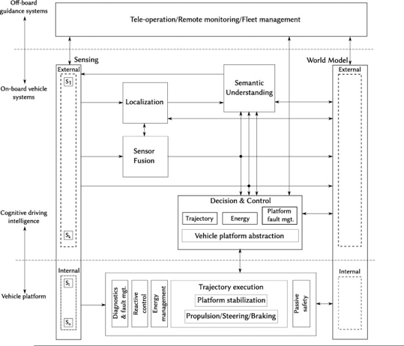
Architecture-Centric Development
Product lines use reference architectures.
Common architecture for all products.
Features follow the same interface standards to make them swappable.
Used to create a specific product architecture.
Notes:
Software product line engineering relies on a common product line architecture (also called reference architecture). The central role of a common architecture is a major ingredient of the success of product line engineering compared to other reuse approaches. The reference architecture is designed during domain engineering, in order to provide a coherent picture of the different components that must be developed and to make sure they all follow compatible generic interfaces that can be used throughout the different products. That way, the variants can be swapped at a variation point because they follow the same interface. A common architecture defines a single environment for all components that are used in the individual products . This ensures that there is no need to develop multiple components that address similar functionality, and differ only with respect to the environment they work in.
In each application engineering cycle - each time we create a new concrete product- the reference architecture provides the basis for the derivation of the specific product architecture. this product architecture is mainly derived by instantiation of the generic assets. The architectural decomposition provides the basis for work assignment in the development process and for determining how to modify assets to support product-specific requirements. Referenece architectures are the key for the overall success of product line engineering. They make it easy to support and control variability and give you the clear means to control the complexity of the product.

Slide 14
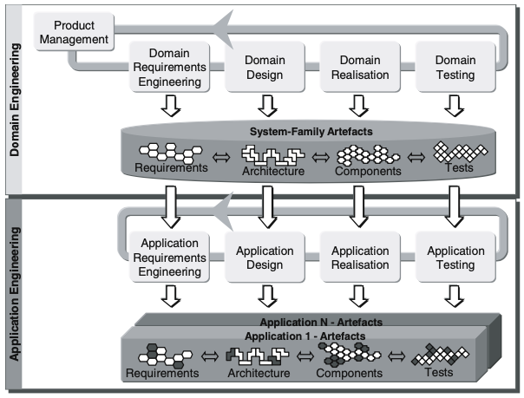
Domain and Application Engineering
Domain Engineering
Enables reuse.
Basis for creating individual products.
Requirements, design, code, etc. all planned for variability.
Notes:
The key difference between traditional single system development and software product line engineering is a fundamental shift of focus: from the individual system and project to the product line. This shift especially implies a shift in development strategy. It relies on a fundamental distinction of development for reuse - preparing code with the intention of using it in multiple circumstances - and development with reuse - simply making use of assets. Development FOR reuse follows a process we call domain engineering, with provides a basis for the development of the individual products, the creation of a platform and its assets. This is followed by application engineering - development WITH reuse - which makes use of those assets.
As opposed to traditional reuse approaches, the product line infrastructure encompasses all assets that are relevant throughout the development life-cycle. The assets cover the whole range from the requirements to architecture and implementation to testing. This range of assets together defines the product line infrastructure. A key distinction of product line engineering from other reuse approaches is that the various assets themselves contain explicit variability - we plan for the start for variability and customization of assets. For example, the requirements may contain an explicit description of specific requirements that apply only for a certain subset of the products, and we make that clear in the requirements. The individual assets in the product line infrastructure are linked together just like assets in software development. For example, traceability is defined among the individual assets, ideally enabling one to take a requirement and identify all related implementation code and test cases.

Slide 15
Domain and Application Engineering
Application Engineering
Development based on reuse.
Builds product on top of platform.
<= 90% of product built from assets.
Notes:
Application engineering (development with reuse) builds the final products on top of the product line infrastructure. Application engineering is strongly driven by the product line infrastructure, which usually contains most of the functionality required for a new product. The variability explicitly modelled in that infrastructue provides the basis for deriving the individual products. Basically, when a new product is developed, an accompanying project is set up. Then requirements are gathered and directly categorised as being either part of the product line or product-specific. Then the various assets (e.g. architecture, implementation, etc.) may be instantiated right away, leading to an initial product version. At this stage in the development, up to 90% of the product may be available from reuse; only the remaining 10% must be developed in further steps. Now, something to keep in mind here is that, with adaptation and careful planning, that asset portfolio can include assets you built yourself, or increasingly, microservices built to be adaptable from the start, with well-defiend APIs, generally RESTful APIs

Slide 16
What is a Domain?
An area of knowledge.
Scoped to maximize requirement satisfaction.
Encompases distinct concepts
Defines how to build systems in this area.
High-Level Domains: databases, social networks, deep learning
Deep learning subdomains: classification, language processing, decision support, ...
Notes:
Most processes of traditional software engineering cover the life cycle of a single software system. we specify requirements, and design and implement the system, then we verify its correctness. For software product lines, we must change our way of thinking about software development. In contrast to analyzing and implementing a single system, we have to look at a variety of desired systems that are similar but not identical. This is where domain engineering comes into play. A key success factor of product-line development is to set a proper focus on a particular, well-defined and well-scoped domain. Broadly, a domain is an area of knowledge that: is scoped to maximize the satisfaction of the requirements of its stakeholders, encompasses a distinct set of concepts and terminology understood by practitioners in that area, and includes and defines the knowledge of how to build software systems (or parts of software systems) in that area.
More concretely, what does that mean? Essentially, a domain is a set of systems that have something in common. At a high level, we might consider databases to be a domain, social netowkrs, deep learning, classifiers, network management, etc. However, you can dive futher from there. The broader the domain, the smaller is the set of similarities among products. Although there are similarities that could be exploited in deep learning, for example, the applications of these programs are broad - classification of images, processing of text, understanding of factors leading to decisions, and so on - individual systems have substantial differences, which decrease potential for reuse of assets between them. Focusing on the (sub)domains within deep learning, increases the reuse potential, while keeping maintenance effort acceptable, so if our domain is face identification in images, we might be able to develop multiple specialized products that share lower-level assets like model training, classification algorithms, neural network architecture. The bottom-line is that a proper scoping of the target domain is essential. But, broadly, we start by deciding on, scoping, and examining the domain we are interested in.

Slide 17
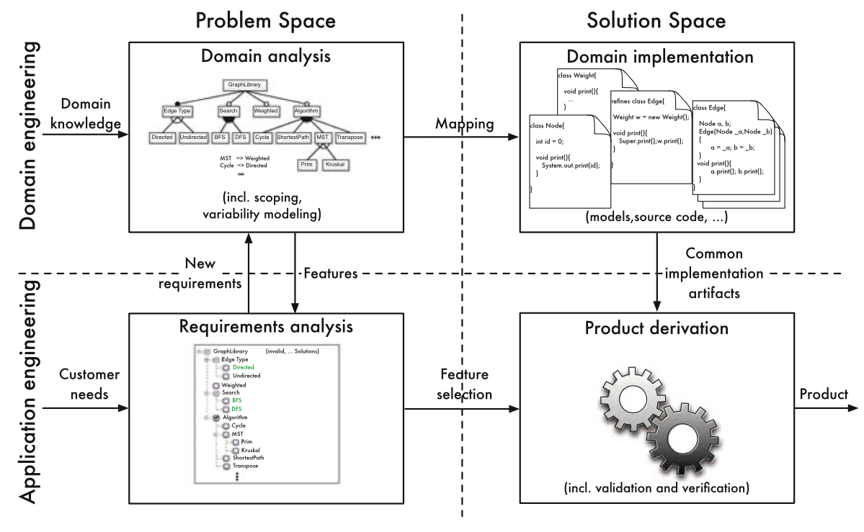
Problem and Solution Space
Problem Space
Stakeholder view
Characterized by features
Solution Space
Developer view
Characterized by code structure
Implementation of features.
Notes:
A development process for software product lines has to take the idea of a domain - a set of related, but differing systems - into account. Two issues play a crucial role: the explicit handling of variability and the systematic reuse of implementation artifacts. For both, it is important to have an appropriate structuring of process and software artifacts. The specific characteristics of software product lines lead to a separation between domain engineering and application engineering and between problem space and solution space. Again, Domain engineering is the process of analyzing the domain of a product line and developing reusable artifacts. Domain engineering does not result in one specific product, but prepares artifacts to be used in multiple products - development for reuse. application engineering develops a specific product. It reuses artifacts from domain engineering where possible- development with reuse. Application engineering is repeated for every concrete product of the product line that is to be derived. The distinction between the problem space and solution space highlights two different perspectives. The problem space takes the perspective of stakeholders and their problems, requirements, and views of the entire domain and individual products. Features characterize the problem space. The stakeholders are interested in what externally-visible functionality they can interact with. In contrast, the solution space represents the developers perspective. It is characterized by the code structure - the functions, classes, and program parameters. The solution space covers the design, implementation, and verification of features and their combinations in suitable ways to facilitate systematic reuse.

Slide 18
Key Task Clusters
Develop reusable assets.
Requirements for the entire product line (scope, features)
Assets combined to form new concrete product.
Map requirements to feature selection, assess new requirements
Notes:
The distinctions between domain and application engineering as well as problem and solution space give us four clusters of tasks in product-line engineering: 1) (click) Domain analysis is a form of requirements engineering for the entire product line. Here, we need to decide the scope of the domain, that is, decide which products should be covered by the product line and, as a result, which features are relevant and should be implemented as reusable artifacts. The results of domain analysis are usually documented in a feature model. 2) (click) Requirements analysis investigates the needs of a specific customer as part of application engineering. In the simplest case, a customer’s requirements are mapped to a feature selection, based on the features identified during domain analysis. If additional requirements are discovered, they can be fed back into domain analysis, which may modify our feature model (and, eventually, the reusable artifacts in our asset portfolio). 3) (click) Domain implementation is the process of developing reusable assets that correspond to the features identified in domain analysis, including source code and test cases. 4) (click) Product derivation is the implementation step of application engineering, where reusable assets are combined to form a new concrete product. Domain engineering is performed once for the entire product line, whereas application engineering is performed for every individual product. A goal of product-line engineering, in general, is to move development effort as much as possible from application engineering to domain engineering. For example, if quality assurance (such as code inspections, testing) can be done in domain engineering instead of looking at individual products, costs can be dramatically reduced. A major goal of feature-oriented product lines is to fully automate product derivation, although some customization effort is almost always needed.

Slide 19
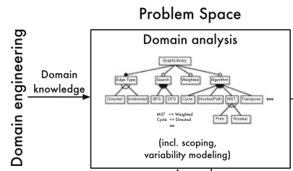
Domain Analysis
Domain Scoping
Deciding on extent of product line
Features to support.
Trade-off between effort and customer range.
Ex: Embedded Database Domain
Definite Features: Transactions, Recovery, Encryption, Queries, Aggregation, Multi-OS (eCos, TinyOS, Linux),
Out-of-Scope: Cloud Storage
Consider: Multi-User Support
Notes:
Domain analysis is a form of requirements engineering for the whole product line. It is concerned with the problem space. It contains two primary tasks: domain scoping and domain modeling. Domain scoping is deciding on a product line’s extent and range. We decides which of all possible requirements arising in a domain should be considered. The scope describes desired features or specific products that should be supported. For example, if our domain is embedded database systems, we might decide which hardware architectures to support from all embedded architecture out there - ARM, RISC, etc. During domain scoping, domain experts collect information about the target domain, for example, by analyzing existing systems or interviewing domain experts and potential customers. We then decide on the limits of our product line. product lines with a small scope are easier to develop and maintain, as they target a well-defined domain of very similar products with few variations and much reuse. However, the broader the scope and the more features the product line has, the more possible customers can be satisfied. So, there is a trade-off between implementation effort and potential use cases of the product line. The trade-off requires careful consideration, including looking at prospective revenue, potential customers, and imeplementation costs of each additional feature.
For example, In the domain of data management for embedded systems, a product line should cover basic data management functionalities targeting operating systems for embedded devices.What features do we need to cover? transactions, recovery, encryption, and basic queries, also support for multiple OSes (eCos, TinyOS, Linux, Android). By focusing on embedded systems, several features are o outside the scope of the product line: for instance, remote storage outside the device (for example, cloud storage) may not be viable. Other features are not obvious. For example, we might consider whether to include security (user and access management) as an optional feature. It might open up multi- user support, but the number of customers interested in that might not be huge. After interviewing potential customers, we might decide to exclude the feature from the product line’s scope, as the potential revenue does not cover the required implementation and maintenance costs.

Slide 20
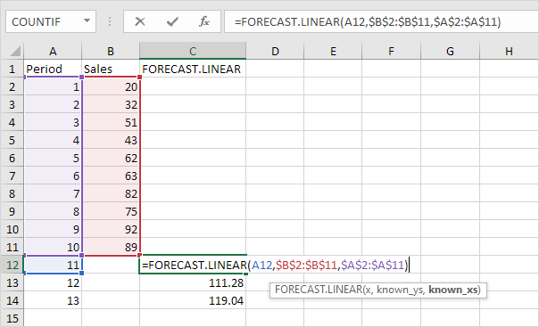
Example: Spreadsheets
Look at existing products: Excel, Google Sheets, …
What are some features a user would expect?
Notes:
(1-2) discuss in chat
formulas, conditional formatting (numbers, dates), text formatting (colors, bold), chart creation, summation, sorting of data, input/output of file formats (CSV, open office, excel, pdf), data backup to prevent corruption
Some of these have options we could choose from (text formatting options, may support some but not others - same for I/O formats) or different ways to perform calculations

Slide 21
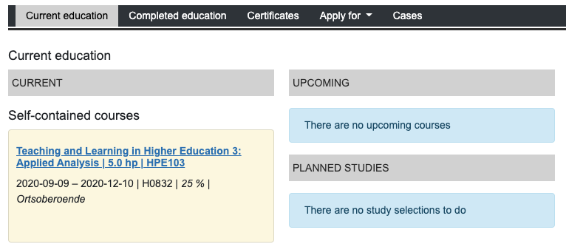
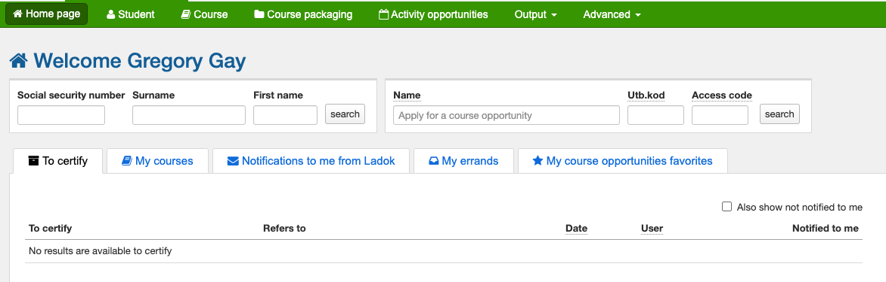
Example: Student Data Management (Ladok)
Product Line: Student App, Teacher App
Notes:
As a second domain, consider management of student course and grade data, like what you’d see on Ladok. What features does a product line for this domain need to offer?
Here, we need to consider two stakeholder perspectives - students and teachers. Our product line could serve both using a common platform, with a different interface and certain features enabled
Student functionality - see grades (shared), see completed courses, see upcoming courses, apply for degrees or certificates, add degrees/ceritifcates/credentials
Teacher functionality - see grades for a student (shared), enter grades, certify grades, see past courses taught (could be shared with seeing past courses taken - we could associate course records with a profile in a flexible manner)

Slide 22
Domain Analysis
Domain Modeling
Document commonalities and differences between products in terms of features and dependencies.
Ex: Embedded Database
Features: Storage, Transactions, OS (Android, Linux), Encryption
Storage, OS are mandatory.
Only one OS selection supported per product.
Notes:
Domain modeling captures and documents the commonalities and variabilities of the scoped domain. As a first step,we might give examples for possible products, as well as counter examples documenting which products are and are not in the scope of the product line. Then, commonalities and differences between desired products are identified and documented in terms of features and their mutual dependencies, this is the feature modeling we will talk about next class. For example, in the domain of embedded data management, we identify Storage, Transactions, OperatingSystem, Encryption as features to support. Only Storage and OperatingSystem are mandatory, all other features are optional. An example for restricting the possible products is that we cannot select more than one supported operating system at the same time.

Slide 23
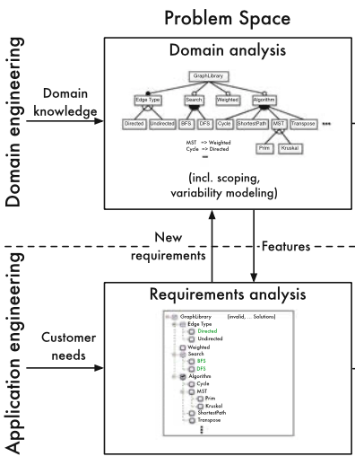
Requirements Analysis
Map customer requirements to domain requirements.
If requirements do not map to existing features:
1) Out of scope
2) Do much as possible with features, customize rest
3) Extend platform with new features, variation points.
Notes:
Requirements analysis in product-line engineering is similar to requirements analysis in traditional engineering. We solicit the customer’s requirements through interviews and document analysis. But, in product-line engineering, we can build on the knowledge gathered during domain analysis. There, we already identified possible requirements arising in the domain, so we try to map the customer’s requirements to those identified earlier during domain analysis. Ideally, requirements analysis can be reduced to the selection of existing features, such that a product can be assembled using reusable assets associated with these features. If a customer’s requirement cannot be mapped to one or more existing features, e can do one of three things. We can decide that the requirement is out of scope of the product line,so we simply cannot provide a corresponding feature or product. Not our job. 2) We can assemble the next best product without this feature and manually extend the resulting product with custom extensions. This way, we invest additional implementation effort during application engineering, which is not integrated back into the product line. Or Finally, 3) we can decide to change the scope of our product line and include the additional requirements. We go back to domain engineering and implement a new feature or even add a new variation point, or modify exiting ones. Subsequently, we can map the customer’s requirement to these features, of which also other customers can benefit. which path to take is a business decision that must be weighed. Additional application engineering is certainly cheaper in the short term than developing a new feature available for all products, but other products of the product line cannot benefit from that development. So, it may be of benefit in the long term to instead add it to the product line. In our embedded database example, Suppose we have a database product line with features for query processing and transaction support. If, during requirements analysis, we learn that a customer wants an SQL-based, multi-user, client- server environment, we can map these requirements directly to the existing features for query processing and transaction support and their respective implementations in our product line. However, we might have earlier decided that multi-user was out of scope. We could add that solely to this one implementation, or we could revisit our domain analysis and now decide to add multi-user support as a feature for the whole product line.

Slide 24
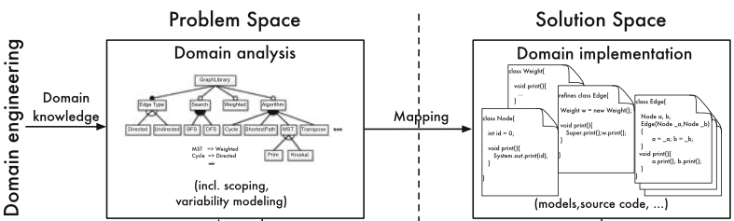
Domain Implementation
Implement reusable assets from domain requirements.
Strategy for combining modules.
Compile-time: only include requested code
Run-time: include all code, bind when executed
Interfaces for “attaching” variable features.
Notes:
After identifying features, we want to implement them in the form of reusable artifacts. Domain ( or feature) implementation targets the solution space, as we are now working in technical terms - code structures, architecture, concrete classes and modules - to implement solutions to a domain requirements. The implementation process requiores several considerations beyond just writing code. First, we need to select a general implementation strategy, also known as a reuse framework. For example, we could use C/C++ preprocessors to include or exclude variable code conditionally or build a framework with a number of plug-ins that can be combined on demand - classes or micro-services bound at run-time. Second, depending on the implementation strategy, we might need to prepare the design and code such that we can hook feature implementations. For example, we design how to structure common parts of the implementation - how to design interfaces - and where to leave variation points and how to enable or disable variations for features

Slide 25
Product Derivation
Build the final concrete product from reusable assets.
Add any necessary customization.
Ideally, can be done automatically.
Often requires some manual “glue” code.
Notes:
Finally, we build the concrete product from reusable assets, adding any additional custom implementation necessary. Depending on the choice of the implementation strategy, a product for a given feature selection can be composed using the assets developed in domain implementation. In some cases, we can even perform fully automated generation based on feature selection and reusable artifacts. For example, we select the artifacts that correspond to selected features and call a composition engine to combine them into an executable, without further manual intervention. In most cases, however, we assemble the product manually from reusable artifacts. Many parts of the implementation have been prepared during domain implementation and can be reused, but the combination of the artifacts requires some manual work, in which developers still have to write glue code to connect the artifacts and to patch up the gaps for which no reusable artifacts exist. In both cases (automatic and manual), the resulting product usually has to be verified before being delivered to a customer by running tests derived from artifacts during domain engineering.

Slide 26
Two-Life-Cycle Approach
Domain Engineering
Develop reusable assets
Designed for long-term, complex development.
Application Engineering
Develop products.
Designed for current customer, rapid changes.
Notes:
These two types of engineering are – in the ideal case – only loosely coupled and synchronised by platform releases. As a consequence, they can be conducted based on two completely different life-cycle models. Domain engineering focuses on the development of reusable assets that provide the necessary range of variability. As domain engineering continues as long as the product line exists, the underlying software development approach must be able to cope with long-term, highly complex system development. As a result domain engineering sets up the common product line infrastructure, including all required variability. Application engineering focuses on the development of the individual systems on top of the platform. As a large part of development effort and complexity is moved to domain engineering, this activity – and its underlying life-cycle model – will usually be profoundly different as it won’t need to cope with so much complexity and the development will not span so much time as in domain engineering. On the other hand, application engineering is directly involved with the customer and thus will often need to deal with much more rapid changes than in domain engineering. As a consequence, a life-cycle model that is able to cope rapidly with changes is required.

Slide 27
Domain Engineering Activities
Product Management
Portfolio planning, economic analysis.
Creates product roadmap.
Requirements Engineering
Requirements for the platform, identification of variation points/features.
Notes:
The activities within domain engineering are : 1) Product management defines the products that will constitute the product line as a whole. In particular, it aims at identifying the major commonalities and variabilities among the products. This realises product portfolio planning, as we mentioned a minute ago. It also encompasses major economic analysis of the products in the product line. The major output of this activity is the product roadmap. 2) Domain requirements engineering: this activity starts with the product roadmap and aims at a comprehensive analysis of the requirements for the products in the product line. It captures these requirements, identifies commonalities and variabilities and constructs an initial variability model - including specification of the variation points and features - which supports the further development steps.

Slide 28
Domain Engineering Activities
Domain Design
Create reference architecture.
Domain Realization
Design and implement reusable assets.
Domain Testing
Test assets in isolation, generate test input for concrete products.
Notes:
3) Domain design: starting from the requirements model, this activity aims at developing the product line architecture (the reference architecture). It provides the basis for all future realisation work within the product line. 4) Domain realisation: this activity encompasses detailed design and implementation of the reusable software components. At this stage the planned variability which has been expressed as a requirement must be realised with adequate implementation mechanisms. 5) Domain testing: this aims at verifying the generic, reusable components that were implemented as a result of the previous activity. Domain testing is much more difficult than testing in a single system context, mainly for two reasons: the implemented variability must be taken into account and there is no specific product which provides an integration context - wwe focus on testing the assets in isolation. In addition, domain testing also generates reusable test assets that can be reused in application testing. We must be careful to verify these assets again in the context of the concrete application

Slide 29
Application Engineering Activities
Requirements Engineering
Requirements for the specific product, starting from existing variabilities.
Application Design
Instantiates reference architecture, adds specific adaptations.
Notes:
Application engineering, then, consists of the following activities: 1) Application Requirements Engineering: This aims at identifying the spe- cific requirements for an individual product. As opposed to single system requirements engineering, this starts from the existing commonalities and variabilities. It is thus the goal of this activity to stay as close as possible to the existing product line infrastructure. 2) Application Design: This activity derives an instance of the reference ar- chitecture, which conforms to the requirements identified in the previous step. On top of this product-specific adaptations are built. Then, as far as reusable components are concerned, the architecture is consistent with the reference architecture, enabling plug-and-play reuse.

Slide 30
Application Engineering Activities
Application Realization
Reuse and configure existing assets, build new components.
Application Testing
Test new components and integration of reused assets.
Notes:
3) Application Realisation: Based on the available requirements and architec- ture, the final implementation of the product is designed and developed. This includes reuse and configuration of existing components as well as building new components corresponding to product-specific functionality. 4) Application Testing: In this step, the final product is verfiied against the application requirements. Similar to the previous steps, this builds on reusable assets from the corresponding domain activity. So, we integrate reused components into the new system, test new components, and test the integration of all components.

Slide 31
Let’s take a break!
Notes:
Just start with a question - want you to start thinking about this. (read)
This isn’t something with one answer, or even a right answer. It’s something we’ll keep returning to

Slide 32
Additional SPLE Concerns
Notes:
Just start with a question - want you to start thinking about this. (read)
This isn’t something with one answer, or even a right answer. It’s something we’ll keep returning to

Slide 33
BAPO Model
B
Business
O
Organization
Hosting and Assignment of Responsibility
Strategy and Planning
A
Architecture
Technical Implementation
P
Process
Roles, Responsibilities, and Relationships
Notes:
in developing product lines, four concerns need to be addressed, in order: Business, Architecture, Process and Organisation (BAPO). These prioritize the decisions we make during development. Business: the costs and profits of the software, the strategy of applying it and the planning of producing it. Architecture: the technical means to build the software. Process: the roles, responsibilities and relationships within software development. and Organisation: the people and organisational structures that execute the software development. These four concerns are interrelated. Applying changes in one concern induces changes in the others. Business is the most influential factor. This is not something we think of a lot as developers, but is crucially important. This has to be set up right in the first place. Architecture reflects these business concerns in software structure and rules. Processes enable the development of the software, based on the architecture. Finally, Organisation hosts this process, assigning units and people who are responsible for business, architecture and process responsibilities

Slide 34
Business Concerns
Requires significant up-front planning. However…
Reduction to < 50% time to market.
> 70% smaller code size
> 20% reduction in maintenance costs
> 20% cheaper to operate
Common look and feel = happier customers
Features propagate to new products quickly
Many more fixed bugs
Notes:
First, consider business concerns. SPLE requires signficant up-front effort, and will never pay off if you do not need reuse. However, implementing it can be worth the trouble. Case studies have shown that some of the business advantages that can be obtained from product line engineering are: Reduction to less than 50% time to market. Reduction of code size by more than 70%. Reduction of calibration and maintenance efforts (up to 20%) Reduction of resource consumption (20–30%) and a Common look-and-feel.This eases the use of the systems by the clients, since the products act like other systems in the product line that they are familiar with. This considerably increases customer satisfaction. In addition, A feature can be developed for a single product and, when it is satisfactory, it can quickly be added to other systems in the product line. Finally, the quality of systems in a product line can be better guaranteed. Reuse implies many users, which leads to more environments in which the soft- ware is tested, and more reported and fixed bugs. For instance, product defect density can be reduced to 50% or less of what it was before.

Slide 35
Architecture Concerns
Domain architects design the reference architecture
Enables reuse of code, tests, other artifacts.
Important to control variability.
Ensure requirements do not conflict.
Ensure architecture can be changed over time.
Application architects specialize the architecture to match application requirements.
Decide what to promote to the platform.
Notes:
Next consider architecture concerns. Software product line engineering makes use of a reference architecture for all products. It needs continuous updates and maintenance, since in practice the platform is growing and improving throughout its lifetime. Variability is traced from requirements over architecture and design to testing, enabling reuse not only for the software assets, but also for requirements and test artifacts. Software product line engineering enables reuse of test cases by more than 50%. This reduces the test effort significantly. The domain architects use the commonality and variability in requirements and their priorities to determine the commonality and variability of the reference architecture. Specific variability mechanisms have to be selected to enable resolving variability easily. It has to provide solutions for requirements interaction, including requirements that are in conflict with each other, and that are applicable to distinct systems. An important concern of the domain architects is to deal with qualities like flexibility, adaptability, maintainability and evolvability, that all need to be supported to keep the reference architecture stable. The application architects specialise the reference architecture to the specific requirements of the application. This involves the selection and instantiation of reusable domain assets. For those requirements that are not covered, application-specific variants have to be determined, and placed in the configuration. Such application-specific variants may be candidates for promotion to the platform, and therefore a close co-operation between domain and application architects is important.

Slide 36
Process and Organization Concerns
Coordination needed between domain and application engineering.
Often separate domain and application engineers.
Domain engineers develop and maintain assets.
Application engineers quickly combine assets.
Specialists coordinate between domain and application.
Notes:
Next consider process concerns. We already discussed that product line engineering approach relies on a two-life-cycle model,domain engineering and application engineering. Besides these fundamental development processes, additional coordination processes are needed to effectively communicate between these two lifecycles. Finally consider organisation concerns. The impact of software product line engineering on the organisation is often underestimated. We often see a single domain engineering group and several separate application engineering groups. This typically leads to a diversification of jobs. Domain engineerings develop these reusable software components, and maintain them afterwards. In large organisations, the reference architecture is maintained by a group of people, each of them is responsible for a specific aspect of the architecture, often a quality issue, like performance or safety. Of course, knowledge of variability mechanisms is crucial for domain engineers. Application engineers are able to build applications fast, based on a given platform. They need to know how to use the variability mechanisms to configure systems. Finally, specialists are needed with good communication skills that relate between domain and application engineering. In many cases, cross-functional teams are active. These are groups of specialists both in domain and application engineering groups. Together they decide on the introduction of the evolution of specific aspects that they are responsi- ble for.

Slide 37
Transitioning to a Product Line
Proactive
Develop full SPL from scratch.
Extractive
Start from existing products and refactor into a SPL.
Reactive
Build a small SPL and extend it over time.
Notes:
So, you want to develop a product line? How should one start the development of a software product line in the first place? In most cases, a company moving to product-line technology has already some products of the target domain in its portfolio. In these cases, we are looking at a transition to a product line. There are three paths that you can take. 1) The proactive approach develops a product line from scratch by carefully using domain and application engineering 2) The extractive approach starts with a collection of existing products and incre- mentally refactors them to form a product line. 3) The reactive approach begins with a small, easy to handle product line (possibly consisting only of a single product) and is extended incrementally with new features and implemented assets, extending the product line’s scope over time.

Slide 38

Proactive Approach
Build from scratch.
Existing products halt development, are re-implemented.
High quality products, reduced long-term costs.
Requires SIGNIFICANT up-front investment.
Notes:
The proactive approach is to develop a product line from scratch. We model the domain and implement all relevant features before the first product is generated. We perform domain analysis and scoping and we implement the entire product line. Using the proactive approach, developers can plan the product line’s variability perfectly. As a result, we can reach a high level of code quality and maintainability. However, its drawback is a high upfront investment and a lot of risks before the first product arrives at the market. With existing products, essentially we have to stop production for a significant period of time for restructuring or even rewriting the code entirely. The proactive approach is a clean-slate approach and the domain and application engineering process we discussed earlier follows this idealized model, where we start from scratch and build a perfect product line. This can be nice. This can pay off, adn we have real-world success stories of this. However, it is debatable how applicable this process is in general. especially since, some products are often already in productiom use and a long delay to transit to product-line technology is not acceptable. The proactive approach is often seen as idealistic, which, in practice, has to be combined partly with ideas from the other two adoption strategies.

Slide 39
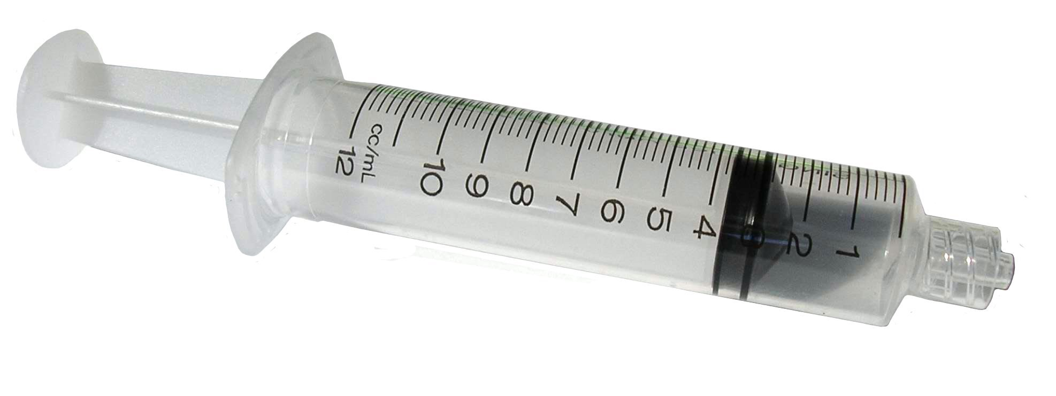
Extractive Approach
Transition from existing products to product line.
Extract functionality as reusable assets.
Implement variation points to attach assets.
Done over time, while products remain in-service.
Requires much less up-front cost.
Code quality may suffer.
Notes:
The extractive approach is useful when a company already has a portfolio of related products that target a common domain, but those projects are not engineered in a systematic way yet. Often companies start with a clone-and-own approach, where variations of a system are created by copying/branching the source code and modifying the branch. The more copies need to be maintained and evolved separately, the more expensive maintenance tasks become and the more developers run into maintenance problems, such as inconsistent evolution of different copies. Typically, at some point, the pressure on developers grows so strong that they are forced to adopt a more disciplined product-line approach. The aim of the extractive approach is to make a transition from one or multiple existing products to a more structured product line. We identify commonalities and differences of existing products, based on domain knowledge and stakeholder requirements, we extract or reimplement the core functionality in the form of reusable domain artifacts, and we re-implement variation in an extendable manner. This advocates for incremental adoption of product-line technology. Common parts are extracted, and some cloning is eliminated step by step. Due to its incremental nature, risks and upfront investment are much lower compared to the proactive approach. During the adoption process, all products remain in production - we steadily refacter them. However, the resulting code basis may be hard to maintain and quality might suffer as we break things during reimplementation. This is typical in practice, as it lets us move to a product line steadily over time.

Slide 40
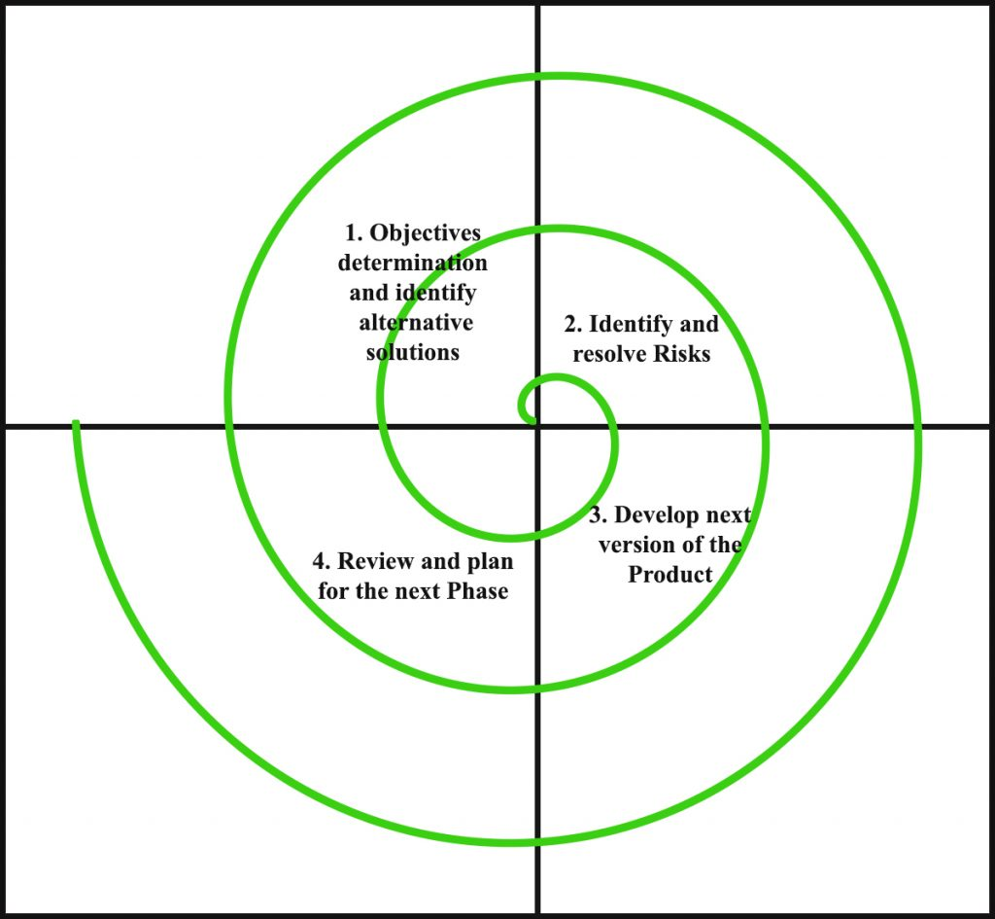
Reactive Approach
Implement initial SPL.
In increments, identify and implement new features.
Less upfront planning than proactive.
Adding unplanned features more difficult.
More structured than extractive.
Notes:
The reactive approach is an agile method to adopt a product-line approach. Developers start with a small initial software product line which realizes an initial version of the envisioned final software product line. In incremental steps, the product line progressively grows toward its ideal. We explore and characterize the requirements leading to a new product currently not covered by the product line, we describe the delta - the difference - leading to the improved product, and we implement the delta in a suitable way. Then, we do this again, until we eventually have a fully-formed product line. reactive adoption falls somewhere between the proactive and the extrac- tive approach. It requires less upfront planning than the proactive approach, but including a feature may require invasive and expensive changes to the product line, because it has not been designed with that feature in mind. At the same time, the reactive approach is typically considered to be more structured than the extractive approach, because each iteration follows clear planning steps.

Slide 41
We Have Learned
Domain Engineering
Development FOR reuse. Creates asset portfolio.
Provides basis for creating individual products.
Requirements, design, code, etc. planned for variability.
Application Engineering
Development WITH reuse.
Builds product on top of asset infrastructure.
Up to 90% of new product may be built from assets.
Notes:
(read)

Slide 42
Next Time
Feature Modelling
Models that define and constrain variability.
Basis for planning a SPL.
Team Selection Due Tonight!
6-7 people, one email per team to ggay@chalmers.se
Complete assignment in Canvas
(include either team number given to you, or if you want to be assigned to a team)
Assignment 1 out now!

Slide 43
Assignment 1 - Case Study
Due November 14, 11:59 PM
Case study examining development of a SPL or other reuse-driven system.
Choose a system:
Van der Linden, F. J.,Schmid, K., & Rommes, E. (2007). Software product lines in action: the best industrial practice in product line engineering. Springer Science & Business Media.
You may also choose any system with sufficient public information available.
Notes:
In this assignment, you will create a case study examining the development of a Software Product Line (or another complex system that makes extensive use of reusable assets or external libraries, where alternative options could be chosen and configured). Many examples of SPL development are included in the following book: Van der Linden, F. J.,Schmid, K., & Rommes, E. (2007). Software product lines in action: the best industrial practicein product line engineering. Springer Science & Business Media. This book is freely available indigital form from the Chalmers library.However, you are not restricted to this book (which is somewhat old). You may also feel free tofind other SPLs or complex systems that make extensive use of reusable assets and externallibraries, and create a case study on the development of those systems. We recommend that you search specifically for companies that produce software product lines, but you may focus on any system that was clearly engineered to manage variability of some kind (e.g., a system that can be customized by a user or for a particular customer, a system where there are many configuration options, or a system designed to be plugged into an existing framework)
For example, manycompanies blog extensively about their products (i.e., Netflix - ​https://netflixtechblog.com/​ -Facebook - ​https://engineering.fb.com/​ - or Spotify - ​https://engineering.atspotify.com/​). Others have written white papers and participated in research studies (Danfoss, for example - https://dl.acm.org/doi/10.1145/2934466.2934491 - as well as Bosch and pure::variants). You are encouraged to do some preliminary research before you choose a system and may choose any company and system as long as sufficient information exists to analyze the engineering choices made in the development of that system.

Slide 44
Assignment 1 - Case Study
Must get approval from your supervisor!
Document:
Context: What kind of organization/market?
Motivation: Why a SPL or reuse-driven approach?
Type of System
Approach: What engineering practices?
Challenges: Key technical and process challenges.
Results: What happened?
Conclusions: What did they learn?
Notes:
You must ensure that sufficient information is available on the chosen system to write this report before you begin the project.Before beginning your case study, you ​must​ obtain approval from your supervisor on yourchoice of system to study. A supervisor will be assigned following completion of Assignment 0(Team Formation), so it is in your interest to form a team as quickly as possible.When requesting approval, include your primary sources of information on the chosen system. If you are unsure whether enough information is publicly available on a system you are interested in, discuss this with your supervisor.
You will create a case study on the system of your choice. To guide your analysis, we present the following aspects regarding the system that you should consider●Context: ​What kind of organization adopted/applied SPL or reuse-driven engineering?●Motivation:​ What motivated the transition to or adoption of a product line or reuse-driven approach?●System Type:​ For what kind of system did they apply SPL or reuse-driven engineering?
●Approach:​ How did they adopt SPL or reuse-driven engineering? What practices were employed? What processes were affected, and how?●Challenges:​ What were the key technical or process challenges encountered when implementing SPL or reuse-driven engineering?●Results:​ What are the important results with regard to business, architecture, process,and organization?●Conclusions:​ What did they learn from implementing SPL or reuse-driven engineering?You may also write about other aspects of the system that you feel are relevant.
In addition to documenting information found about these systems, you should reflect on the choices made by the engineers building these systems and provide your own commentary and opinions on those choices. Do you feel these were reasonable decisions? Do you see potential weaknesses in the decisions made? Are there alternatives you feel should have been considered? We do not expect you to design a perfect system, but you should discuss the work performed by these companies in the context of your own experiences or in the context of other systems that you have read about.There is not a minimum page length for this document. Quality is more important than quantity.It is important that you cover the criteria in detail, and provide your own reflections on the development of the chosen system. Any questions? Again, this is due Nov 14, but don’t wait to get started. This will take a bit of research and thought to get right.

