Slide 1
Lecture 8: Modularity
Gregory Gay
TDA 594/DIT 593 - November 25, 2021

Slide 2
Annotation-Based Representation
Code in common code base.
Code related to a feature is marked.
Preprocessor annotations, if-statements.
Code belonging to deselected features:
ignored (load-time, run-time)
removed (compile-time).
Notes:
A major goal of product line engineering is to derive a product automatically from variable code, based on a user’s feature selection. So, product derivation involves product generation, statically or dynamically. There are two main ways to represent variability and variation points, and how products can be generated: annotation-based and composition-based approaches. We have talked about examples of both, of course. As a reminder, in annotation-based approaches, the code of all features is merged in a single code base, and annotations mark which code belongs to which feature. Preprocessors are our major example of this approach. Depending on the implementation technique selected, During product derivation, all code that belongs to deselected features or invalid feature combinations is removed (at compile time) or ignored (at run time) to form the final product.

Slide 3
Composition-based Representation
Feature code in dedicated location.
Class, file, package, service
Selected units combined to form product.
Requires clear mapping between features and units
Notes:
On the other hand, composition-based approaches locate code belonging to a feature or feature com- bination in a unit of some kind - a dedicated file, pacakge, class, service, or module. During product deriva- tion, all units of all selected features and valid feature combinations are com- posed to form the final product. A classic example is a framework that can be extended with plug-ins, ideally one plug-in per feature; different products can be generated by integrating different plug-ins. The key challenge of composition-based approaches is to keep the mapping between features (problem space) and composition units (solution space) simple, ideally one-to-one. If each feature has its own imple- mentation in the form of a composition unit, a generator can simply include the corresponding unit in the composition when a feature is selected.

Slide 4
Today’s Goals
Frameworks
Libraries of extendable base implementations.
Subclass a template class (white box), implement objects following an interface and register them (black box).
Components/Services
Standalone units with explicit interfaces.
Can be reused in other systems.
Form a system as part of a broader architecture.
Notes:
We have discussed several implementation strategies so far. We discussed preprocessors and parameters, which both are based on annotations - we mark in the code when something should be used. Design patterns can be based on annotations, or based on composition - where we attach the correct object to another. Today, we are going to focus on two more forms of composition-based implementation - frameworks and components. (go over)

Slide 5
Frameworks and Libraries

Slide 6
Frameworks
A collection of classes that represent solutions to related problems.
Base implementation that can be extended with new custom use cases.
Provides extension points (“hot spots”)
Framework is responsible for main control flow, asks extensions for custom behavior.
Notes:
A framework is an incomplete set of collaborating classes that represent some kind of abstract idea and a set of solutions for a family of related problems, and that can be extended and tailored for a specific use case. It represents a reusable base implementation for a related set of problems, and thus perfectly fits the needs of product-line development, and supports reuse at a larger granularity than classes. A framework provides explicit points for extensions, called hot spots or hooks, at which developers can extend the framework. Often, extensions are called plug-ins. In the same manner as the strategy design pattern, a framework is responsible for the main control flow and asks its extensions for custom behavior, on demand.

Slide 7
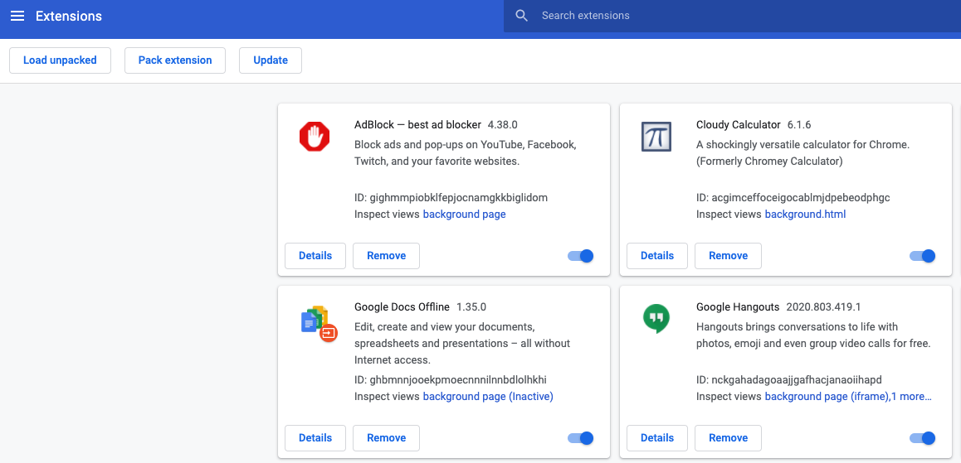
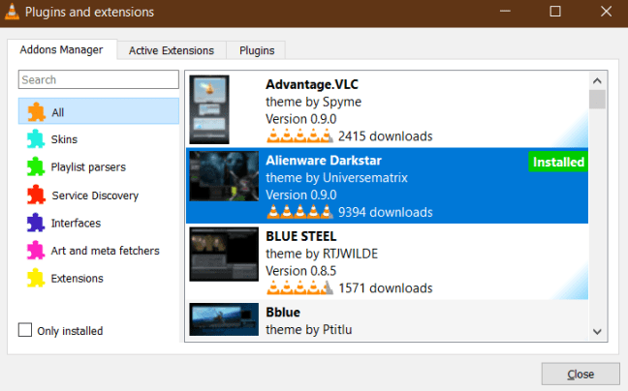
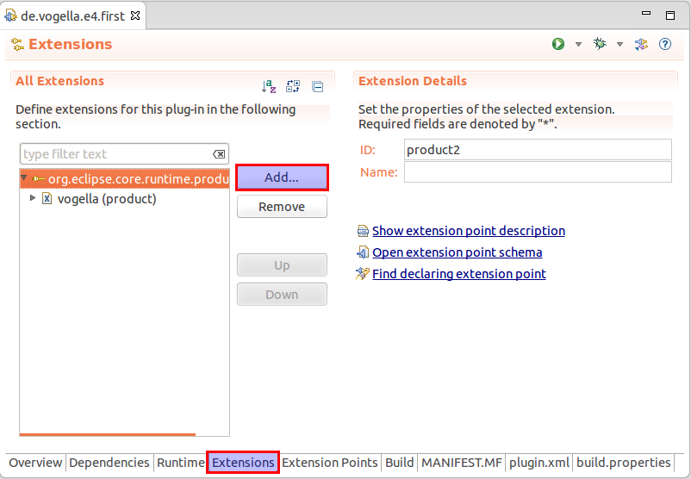
Frameworks
Used in web browsers, graphics editing, media players, IDEs.
In product line, a feature developed as a plug-in.
Select plug-ins based on feature selection.
Notes:
Frameworks with plug-ins are popular in end-user software, including web browsers - think of Chrome extensions- graphics-editing software - in Gimp, you can install image filters as plug-ings - media players - VLC can be extended with video codecs and other features, and integrated development environments (IDEs). For example, the Eclipse IDE is a framework (actually a set of many frameworks) that can be tailored with thousands of plug-ins for tasks from code formatting to generating documentation, running tests, taking measurements, debugging, and so on. In Eclipse and all other frameworks, the basic application is extensible with specific plug-ins. Furthermore, plug-ins are often developed and compiled independently by third-party developers. In product-line development, ideally, we develop one plug-in per feature and configure the application by assembling and activating plug-ins corresponding to the feature selection—a composition process.

Slide 8
White-Box Frameworks
Abstract class with concrete subclasses.
Defines default behaviors (template methods).
Extensions implemented as new concrete classes that override these methods.
Directly implemented in existing codebase.
Requires access to source code.
Free to interact with existing code, access base implementation.
Notes:
Frameworks typically come in two forms: white-box and black-box, with plug-ins more closely associated with black-box frameworks. White-box frameworks consist of a set of concrete and abstract classes. To customize their behavior, developers extend white-box frameworks by overriding and adding methods through subclassing. By adding more code to the existing framrwork. A white-box framework can be best thought of as a class containing one or more methods that act as templates for behaviors that developers implement or overwrite in a subclass. The “white-box” in white-box framework comes from the fact that developers need to understand the framework’s internal code and class structure. Developers need to identify these template methods and can additionally override all other accessible methods. Extensions in white-box frameworks can usually directly access the state of superclasses. All non-private fields and methods can be regarded as hot spots of the framework. Extensions in white-box frameworks are usually compiled together with the framework code. Basically, we extend the code itself of the project, requrirng access to its source code and build system.

Slide 9
White-Box Frameworks
Overriding existing behavior allows flexibility.
… But requires detailed understanding of low-level implementation.
Fails to protect existing code from extensions.
Often used for libraries
GUI elements, data structures
Features implemented as subclasses.
Best for alternative features (choose-one).
Template
function()
Feature A
function()
Feature B
function()
Notes:
On the one hand, the ability to override existing behavior provides additional flexibility to implement unforeseen extensions. On the other, white-box frameworks require detailed understanding of internal code functionality and do not clearly encapsulate extensions from the framework. They are harmful for protecting the existing code from misuse or unintended behavioral changes. A Typical example of white-box frameworks are libraries. For example, of graphical user interface elements, such as Swing in Java, or data structures like Google Guava. When using white-box frameworks for product-line variability, we can add a subclass to a given class for each feature that we can select from for that variation point. So, white-box frameworks are best suited for implementing alternative features, where we choose one out of several options.

Slide 10
Black-Box Frameworks
Separate code and extensions through interfaces.
Each feature is a separate plug-in.
Plug-ins registered at hot spots.
E.g., Observers, strategies.
One or more plug-ins can be attached.
Feature A
callback()
Hot Spot
register()
Feature B
callback()
Notes:
Black-box frameworks separate framework code and extensions through interfaces. An extension of a black-box framework can be separately compiled and deployed and is typically called a plug-in. In product-line development, ideally, each feature is implemented by a separate plug-in. Whereas white-box frameworks can be understood in terms of the template- method pattern, where subclasses override methods of a parent class, black-box frameworks areconceptually similar to the strategy and observer patterns we talked about last time. The framework exposes explicit hot spots - interface hooks - at which plug-ins can be registered, for example as observers and strategies. That is, instead of subclassing, black-box frame- works register objects and callback functions. While white-box frameworks work well for cases where we choose one out of several options, It is possible to provide hot spots that can be extended with multiple plug-ins (choose one or more out of a set of options).

Slide 11
Black-Box Frameworks
Developers only need to understand interfaces.
Easier to understand framework.
Internal functions, information protected.
Can only extend designated hot-spots.
Limits flexibility, but decouples framework/extensions.
Can independently develop/distribute extensions.
Notes:
Black-box frameworks are called “black-box” because, ideally, developers need to understand merely the interfaces, but not the internal implementation of the framework. In contrast to a white-box framework, the interface (set of hot spots) of a black-box framework is explicit. Extensions can access only state of the framework that is exposed by the interface. The internal implementation and stored information is protected. Developers can add extensions only to hot spots foreseen (or preplanned) by the framework developer. Although restricting extensions to an interface may limit flexibility, it enables a strict decoupling of framework code and extension code. Furthermore, it can make the framework easier to understand and use, because only a comparably small amount of interface code must be understood. The decoupling of extensions encourages separate development and independent deployment of plug-in. If you develop a Chrome extension or an Eclipse plug-in, you can do that without the knowledge or approval of the Chrome or Eclipse developers, except for the possible exception of being listed on an official store or plug-in site. As long as the plug-in inter- faces remain unchanged, framework and plug-ins can evolve independently of each other.

Slide 12
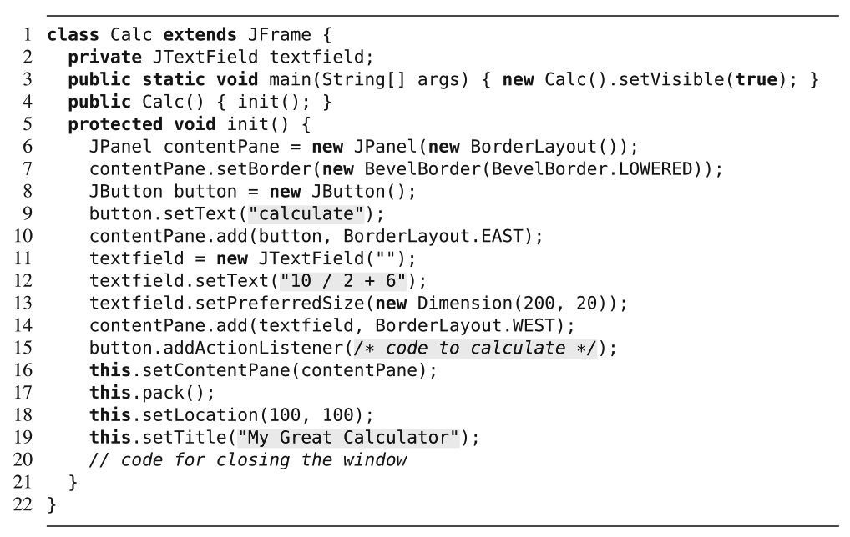
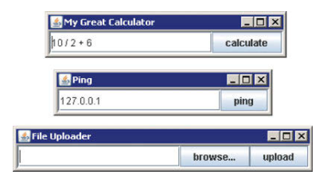
Implementation Example
Notes:
We illustrate the implementation of white-box and black-box frameworks in Java with a small example. Here, we have screenshots of three applications that perform different tasks (calculator, ping an IP address, and file loader), but have a similar user interface. They clearly draw from the same UI framework, and clearly share a relatively large amount of source code for initializing the user interface (fields, buttons, and layout), for starting and stopping the application, and so forth. the code of the calculator application is shown here, and only the highlighted code fragments differ between the applications, the rest is shared code. This is not yet implemented with a framework. As is, if we want to evolve these applications, they need to be changed and managed separately. Let’s look at how to implement the common behavior in a framework and extend it with specific plug-ins, for example, to get the three applications.

Slide 13
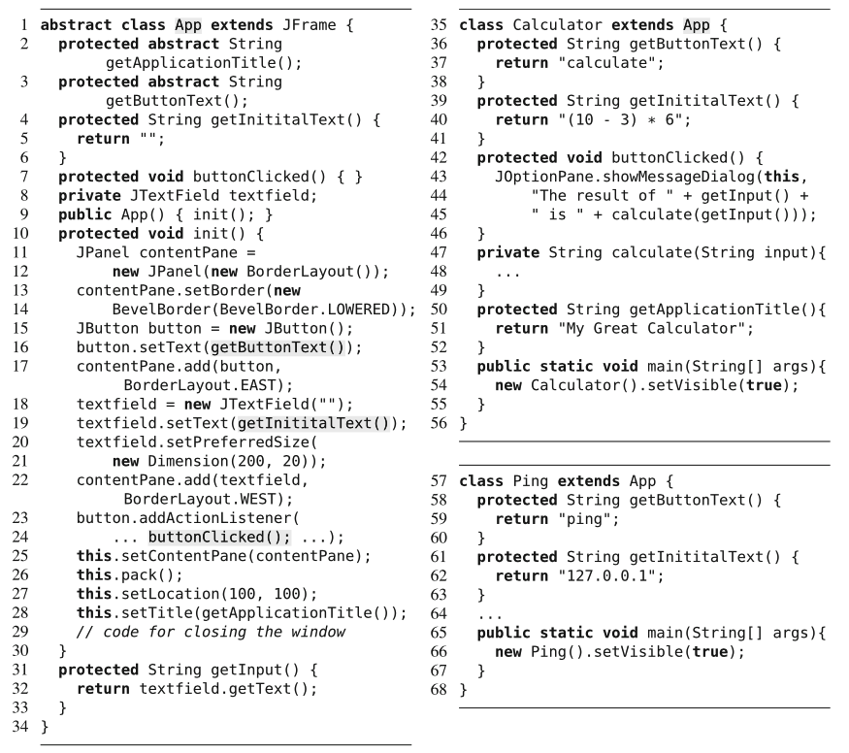
White-Box
Abstract class implements base behavior.
Defines abstract or default methods that will be extended.
Subclasses override those methods.
Notes:
A white-box framework is shown on the right: We replace variable code frag-ments by abstract methods (or overridable methods with default implementations) in a parent class called App. This class defines a set of abstract methods that will be implemented by the concrete application subclasses - (click) like getApplicationTitle, getButtonText. It also has methods with default behavior that can be overridden, like buttonClicked (click) - which does nothing, getInitialText, which returns an empty string. For each extension, we create a subclass and implement the abstract methods to specify custom behavior. For example, in Calculator, we provide the button text and initial text by implementing the previously-abstract methods. (click)We also override buttonClicked to implement the correct behavir - we take the input from the interface and pass it to the calculate method that is unique to this subclass. The extensions can directly access protected and public methods of the framework, such as getInput in Line 44. Same in the Ping subclass.

Slide 14
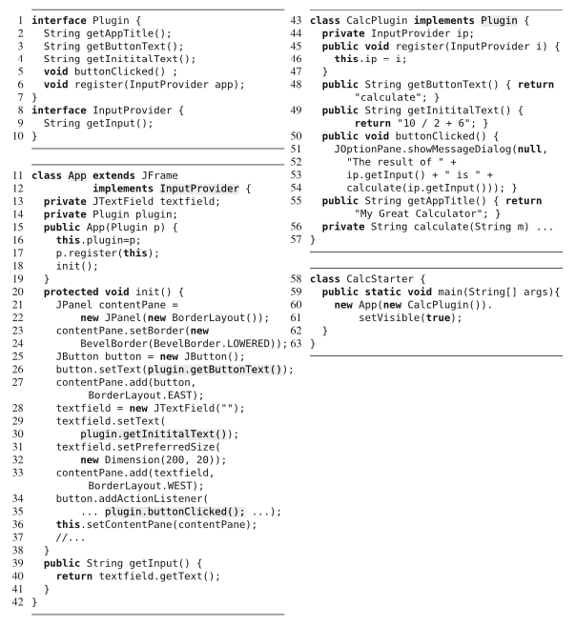
Black-Box
Extensions implement a defined interface.
Register with the framework to provide needed functionality.
Can also use interface to surface information from framework in app (InputProvider)
Notes:
A black-box framework of the same design is shown here. Here, we decouple framework and extensions (plug-ins) with (click) an interface called Plugin. The extension does not subclass the framework, but implements only the interface. Note the similarity to the strategy pattern: The interface Plugin represents a strategy interface called from the context in class App, whereas class CalcPlugin is a concrete strategy that fulfills that interface. Remember, in a black-box framework, the extension cannot access the internals of the framework. To allow extensions accessing information from the framework, we need to provide a callback mechanism. In our example, the framework registers itself to the extension (click,Line 17), such that the extension can access methods from the framework (Line 53). We even decouple the callback with an additional interface InputProvider to protect what information the framework exposes (click). We only expose the method getInput(). Such a callback is not always needed and must not necessarily be implemented with an additional interface as in our example, but it gives a way to access framework functionality within the extension.

Slide 15
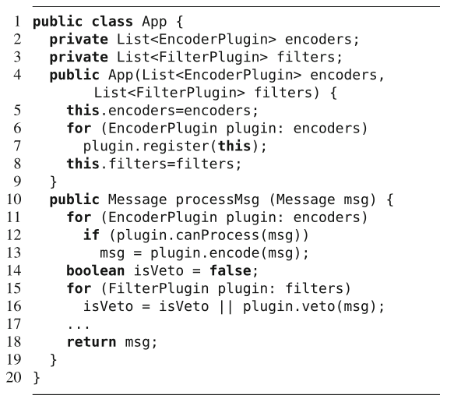
Black-Box
Can register multiple extensions in a list.
Can extend with multiple types of extensions at same point.
Notes:
To provide a hot spot that can be extended with multiple plug-ins, we can store a list of plug-ins instead of a single plug-in (similar to the observer pattern, where we can register multiple observers). Further, instead of providing a single plug-in interface for all variability, we provide multiple specialized plug-in interfaces. We can see that in the code on this slide: (click) Encoders and filters have different plug-in interfaces and the frame- work accepts a list of both plug-ins; then (click) all plug-ins work together to encode and filter messages. We iterate over the list of encoders and apply each that can process the message. The framework controls the execution and only calls the extension when it requires information or functionality from it.

Slide 16
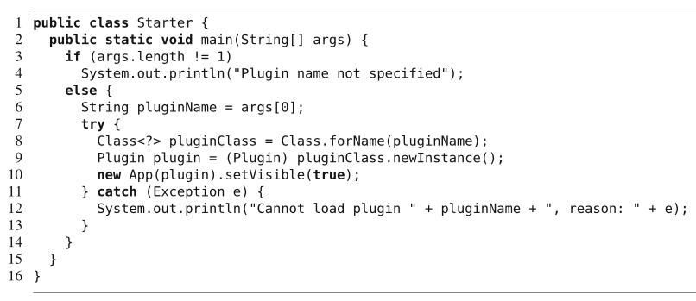
Loading Plug-Ins
Often loaded when application is executed.
Command-line parameter, config file, directory.
Sets up framework with detected plug-ins.
Can check whether plug-in implements correct interface, check dependencies, check constraints between plug-ings.
May use a built-in extension manager (Chrome)
Notes:
One more question is how to load extensions, especially, plug-ins in black-box frameworks. In white-box frameworks, we simply pass the desired subclass or invoke its main method. In our black-box framework example, we passed the desired plug- in as constructor parameters to the framework from a separate starter class, shown here. In practice, separate plug-in loaders are common. here, we illustrate a simple plug-in loader for our black-box framework. The loader expects a command-line parameter naming the plug-in class. The loader then uses Java’s reflection mechanism to dynamically load the class and instantiate the framework with it. This is an example of load-time binding - as opposed to compile-time or run-time binding. Beyond this simple example, a plug-in loader typically searches for plug-ins in a certain directory or loads plug-ins listed in a configuration file. Subsequently, the plug-in loader sets up the framework with the corresponding loaded plug-ins. The loader decouples framework and plug-ins even further, since the loader identifies and loads plug-ins during startup. No further code must be written to activate a plug- in, in the simplest case it is just copied to a directory. Plug-in loaders can also check that the plug-in implements required interfaces and check dependencies or ordering constraints between plug-ins. That way, invalid plug-in combinations can be rejected at load-time. End-user applications also often provide mechanisms to install, update, deactivate, or configure plug-ins, often with graphical front-ends, like the extension store in Chrome or Eclipse.

Slide 17
Discussion
Composition-based, often load-time, approach.
Uniform: Can be implemented similarly across many languages, technologies.
Traceable: Direct correspondence from feature to code (one plug-in = one feature)
Black-box frameworks can encode alternative and optional features easily and systematically.
White-box can encode alternative features, but harder to blend features.
Notes:
Frameworks, especially, black-box frameworks, are a suitable way to implement variability in product lines. Using typical plug-in loaders, individual products are created by composing plug-ins at load-time, but in principle run-time changes are also possible. Much like design patterns, frameworks are general in that they can be implemented in most programming languages, but not in noncode languages. This means that they embody the principle of uniformity well - we can implement them in the same conceptual manner across many technologies. When features are implemented as plug-ins, we can trace them directly between feature and implementation. With plug-ins in black-box frameworks, we can encode alternative (making a choice) as well as optional features in a disciplined way. We can even combine multiple optional features. Developing one plug-in per feature allows us to flexibly select other features and load the corresponding plug-ins. The entire process from a feature selection to a tailored program can be automated. Plug-ins for deselected features do not need to be deployed, so we can potentially reduce binary size. white-box frameworks can also be used to implement alternative features or a single optional feature, but combining multiple optional features is problematic due to the limitations of subclassing.

Slide 18
Discussion
Separation of Concerns:
Interfaces encapsulate framework from plug-ins.
Plug-ins developed separately from framework, as long as interface is followed.
Information Hiding: Can understand feature by only looking at plug-in code.
Modularity: Independent developers can develop their own extensions.
Notes:
In contrast to the parameter approach and ad-hoc use of design patterns, black-box frameworks facilitate modularity by following well- defined conventions (supporting separation of concerns). We can implement features one at a time, following the interface design. Plug-ins are encapsulated from the framework implementation through clear interfaces. Ideally, an interface is designed not only for a specific extension in mind, but for a whole set of potential extensions, different options. Framework and plug-ins can be changed independently as long as they still adhere to the common interface. In the best case, all code related to a feature is encapsulated in a single plug-in, and it is possible to understand and maintain the feature by looking only at this plug-in’s code (enabling information hiding). Modularity allows developers to provide third-party plug-ins that can be compiled and deployed independently. This is especially important for software ecosystems, in which a community of specialized companies or independent developers provides additional features, like the eclipse example I keep mentioning. Users of Eclipse can select from many independently developed open source and commercial plug-ins.

Slide 19
Discussion
Pre-planning Effort: Must anticipate hot-spots and design interfaces and templates.
If needed information not exposed to extensions, framework must be refactored.
Interfaces cannot change without changing all plug-ins.
Changing a framework can be inflexible.
Notes:
However, frameworks are not without difficulties. Creating and maintaining frameworks is a challenging task. The framework designer must anticipate (or pre- plan) where hot spots are needed and design corresponding template methods or plug- in interfaces. They must design for change, which requires an preplanning effort. If a framework designer chooses not to expose information that extensions need, these extensions are difficult or impossible to build without refactoring the framework. Once hot spots and interfaces have been fixed, they are hard to evolve: Although developers can add new hot spots to the framework, it is not possible to change the plug-in interface without invasively changing all existing plug-ins (some of which might be provided by third parties and not available with source code or not even known). The inflexibility to change a framework may slow down future evolution of the product line.

Slide 20
Discussion
Plug-ins can be reused in versions of the same framework, but not in other frameworks.
Tied closely to implementation.
Introduce development and run-time overhead.
Must write additional code.
Can lead to over-complex design.
More code must be executed, slowing the system.
Limit to few well-defined extension points in code.
Notes:
Plug-ins may be reused in different instantiations of one framework, but, in contrast to components, they are not intended to be reused across different frameworks. It is highly unlikely that plug-ins for one framework can be plug-ins for other frameworks. The reason is simple: every framework encodes structures, architectural conventions, and implementation details that are specific to it, and that are unlikely to be shared exactly by any other framework. Furthermore, frameworks induce both development and run-time overhead. Developers need to write additional code to decouple extensions from the framework, such as interfaces. Even if a hot spot is not extended, additional code for the extension point is required. As a result, frameworks often require more source code, result in a larger binary size, and perform slower due to additional indirections. Often the overhead is acceptable, but not always: In embedded scenarios, for instance, unnecessary overhead can not be tolerated. When a framework exhibits too many hot spots for potential extensions that are never used, artificial overhead can become problematic. Extensions can lead to overly complex design if you are not careful, which makes evolusiotn and debugging hard. Overall, frameworks are better suited for coarse extensions that extend few well- defined points in the control flow

Slide 21
Components and Services
Notes:
As a last classic language-based implementation approach, we will discuss components and services (including the notion of web services, which are a major factor of many systems now).

Slide 22
Components
A component is a standalone unit with specified interfaces and explicit dependencies.
Can be deployed independently.
Can be reused in many systems.
Can vary from one class to many.
Developers can choose to implement their own components or work with existing ones.
Requires compatible interfaces and data.
Notes:
A component is a unit of composition with specified interfaces and explicit context dependencies only. Basically, a component stands alone, and only interacts with other parts of the same system through its interfaces. A component can be deployed independently and can be used by third parties in different systems. The key idea of a component is to form a modular, reusable unit. A component provides its functionality through an interface, whereas its internal implementation is encapsulated and hidden. A single class can be seen as a small component that can be reused in many applications, but a component can also encapsulate many classes. You might use the oauth library to handle username and password authentication. That is a component, interacted with through its interfaces, that is used in many many web applications, that internally contains a number of classes. A key idea here is that components can stand alone from the broader systems they are used in. Developers can implement and deploy components independently, and select components from different sources. As a consequence, developers can decide whether to implement their own components or whether to find and reuse third-party components. This can be great - it can sharply reduce development effort, and can enable code reuse from project to project. the challenge here is that components are compatible only if they and their interfaces are designed to existing standards. Reusing components is often hard, because their architectural assumptions may not match the requirements of your project. If so, components require engineering effort to use, and require awkward interface matching ,or adaptation of returned results.

Slide 23
Services
A form of component focused on standardization, interoperability, and distribution.
Reachable over standard protocols.
HTTP
Can often look up services from a registry.
NPM for JavaScript
Communication standardized so underlying language does not matter.
REST API
Notes:
Services are a form of software component. A service encapsulates functionality behind an interface, just like a component, with the main potential difference being an emphasis on standardization, interoperability, and distribution. Especially as web services, a service is reachable over a standardized Internet protocol. In the vast majority of cases, this is a REST API - a API designed based on the HTTP protocol. Web services may run on remote servers, so it is not necessary to install and integrate a service locally. Even the lookup of a service can occur at run-time, through the use of service registries, which index and provide metadata on services. For example, the npm (node package manager) registry is an utterly massive registry of Javascript components. It provides a uniform means of finding, downloading, and linking to these components. In addition, com- munication between services is standardized, so services written in different lan- guages can exchange messages. Again, with a REST api, you can use almost any underlying language. Communication uses the same interface and data formats. To connect services, called service orchestration, several specialized tools and languages exist, which simplify the compo- sition process.

Slide 24
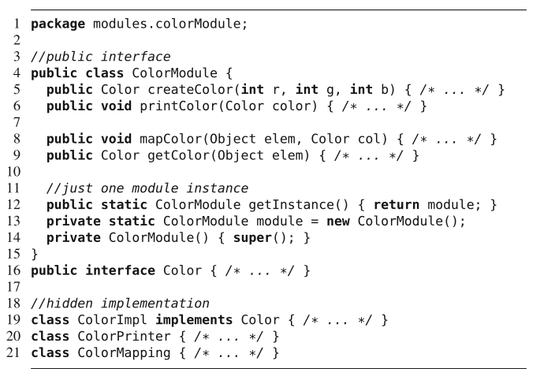
Simple Example
Define public interface (class ColorModule, interface Color)
Hide implementation (private/package-level visibility)
Can integrate into code or as JAR file.
Notes:
For example, we might have code in a project to store and print color information for a UI element. Assume that storing and printing colors is nontrivial and might be reused in another project outside of our existing code. We could extract color management into a reusable component (or package). The component’s interface (click) exposes a class ColorModule with several public methods and a Java interface called Color, whereas all of the other implementa- tion details are hidden. Here, We use Java’s scoping and package mechanism to enforce encapsulation. That is, to ensure that other components may not access private imple- mentation details, we use package-level visibility. (click) The Classes ColorImpl, ColorPrinter, and Col- orMapping are not public and visible only inside the package, so other components in other packages can only interact with the public classes and methods. A component is independent of a specific application or product line. Develop- ers can reuse it when implementing this color management feature not just in their currentp product line, but in future compatible product lines or standalone applications as well. Note that developers need to write custom code to connect the implementation with the component, for example, extra code to call the component’s interface-surfaced methods or to process data returned from those methods. To reuse the component, only the public interface is of interest; implementation details are not accessible and we don;t need to understand them. In Java, we can deploy the component separately as class or standalone jar files.

Slide 25
Components vs Plug-Ins
Both result in encapsulated modules.
Enabling traceability, information hiding.
Difference in automation potential and reuse.
Plug-ins tailored to one framework.
Product can be generated by loading only the needed plug-ins.
Plug-ins designed for that framework.
Hard to reuse.
Components can be reused.
But require glue code to integrate.
Notes:
Components and plug-ins share many similarities. They both pursue a modular implementation (ideally a module per feature) and hide implementation details behind an interface. So, they both enable traceability and information hiding, and require similar preplanning effort. Their main difference lies in the automation potential and in reuse beyond a product line: A plug-in is always tailored for a specific framework, and has very specific requirements on its context. In contrast, components can be intended to be reused even outside a product line. At the same time, the tight integration of plug-ins into a framework allows loading plug-ins automatically without additional per-product development. Deriving a product for a feature selection in a framework requires only assembling the corresponding plug-ins, not writing additional glue code, which is necessary for components. Of course, components can be used within frameworks. We can write glue code that adapts a general-purpose component to the plug-in interface of a framework (see the adapter design pattern). This way, we can reuse components within a framework and automate their integration based on a feature selection, while we can still reuse the component in different contexts outside the framework.

Slide 26
Components vs Plug-Ins
Components can be encoded in many languages.
Both allow compile-time product derivation.
Interfaces for both are difficult to evolve once designed.
Others may depend on current interface definition.
Both add overhead from interfacing/communication.
Notes:
Components can be encoded in many languages. Ideally, the language should provide some encapsulation mechanism that can hide internals of the component behind an interface, and that enforces the interface mechanically. Apart from automation, reuse, and uniformity, as components and plug-ins use similar modularity mechanisms, they share similar benefits and limitations. They modularize features and allow compile-time product derivation, deploying only selected functionality in the binary. At the same time, both components interfaces and plug-in interfaces are difficult to evolve once they are fixed and other (potentially third-party) implementations rely on them. Both may also add overhead due to additional indirections and boilerplate code that has to run to make use of them.

Slide 27
Sizing Components
A component can contain a lot of functionality or only offer a single, small function.
A complex component is easier to use in the project it was developed for, but hard to reuse elsewhere.
Small components are easy to reuse in many projects, but add communication overhead and glue code.
Trade-off between use and reuse.
Notes:
Deciding when to build a component and what to include in that component is a difficult design decision. There is a well-known trade-off between reuse and use: A large component that provides a lot of functionality is easy to integrate and use in the initial project, but there might be only few applications in which the component can be reused. In contrast, one might be tempted to build many small reusable components that can be combined flexibly (in an extreme case, every method is a component), but, then, the overhead of using a component becomes hard to justify. let’s say that you are searching the web for component. Suppose you find two choices: One that is less than 1000 lines of code with only some of the functionality that you want; and one that is 100000 lines of code with many extra functions that are highly intertwined with desired functionality. Which one should be selected? Just on intimidation alone, many developers would select the small one as its easier to understand what it does, while the rest could still be added manually. The big one likely makes incompatible architectural assumptions. It would require considerable integration effort and pose considerable risks. Most developers would reuse less and implement more themselves. But, the smaller the component, the more programming is left to the user that has to connect the components with the base code and with each other; in extreme cases, components are so small that little remains to reuse and to hide behind their interfaces. In addition, if these are remote components the communication overhead from calling many services can be overwhelming. Uber actually got in a little bit of trouble with this. Their app connected, at once point, almost 7000 remote microservices. This created a lot of development headaches for them and led to performance issues and problems in debugging code when something went wrong, plus issues when individual services were updated.

Slide 28
Sizing Components
Non-trivial to size components.
Domain analysis helps in SPL development.
Which functionality will be reused in different products?
If functions are always used together, package them together as a component.
If a function is only used in a subset of products, it can be packages as a separate component.
Notes:
In the tension between reuse and use, developers need to strive for a balance of a component that is large enough to provide useful functionality but small enough to be reused in many contexts. Unfortunately, without knowing when and how a component will be reused, this is hard to guess at and plan for. In product-line development, the domain analysis planning phase is the key to solving this dilemma and guides us in how to size a component to balance reuse and use.During domain analysis, a domain expert investigates potential products within the domain and decides which products are in the scope of the product line. With this information, we can decide upfront which functionality will be reused within different products in the product line; thus, we can size components accordingly and coordinate their architectural assumptions. That is, in product-line development, developers solve the sizing problem by preplanning reuse systematically. For example, when we know that certain function- ality is always used together, we can combine it in the same component and make it easier to use; in contrast, when we know that functionality is only used in few products, it should be separated into its own component. In short, domain analysis helps us to decide how to divide code into components.

Slide 29
Let’s take a break!
Notes:
Just start with a question - want you to start thinking about this. (read)
This isn’t something with one answer, or even a right answer. It’s something we’ll keep returning to

Slide 30
Composing Components into a Software Architecture
Notes:
Now, we have components, how do they work together? Unlike plug-ins, components require some care and some code to integrate into a product, and we have to combine them to form a broader system with some care. Let’s look at some common patterns for creating an architecture from individual components.

Slide 31
Static Structures
Static structures define system’s internal components and their arrangement.
Software: services, classes, packages.
Data: Database entries/tables, data files.
Hardware: Servers, CPUs, disks, networking.
Static arrangement defines associations, relationships, or connectivity between components.
Notes:
There are two types of system structure of interest to the software architect: static structures, which matter at design-time, and dynamic, which matter at runtime. The static structures of a system tell you what the design-time form of a system is—that is, what its components are and how they fit together. These might be (2). Any self-contained code unit. Internal data components include relational (3). (4) - such as cables, routers, hubs, and how the network is arranged. The static arrangement of these componentss defines—depending on the context—the associations, relationships, or connectivity between these elements.

Slide 32
Static Structure Arrangement
Software:
Relationships define hierarchy (inheritance) or dependency (use of variables or methods).
Data:
Relationships define how data items are linked.
Hardware:
Relationships define physical interconnections between hardware components.
Notes:
(1) between modules. Flesh out hierarchy/dependency.(2) - ie., elements from a database may collectively define an entry in a relational database, or two tables may be part of the same overall database. (3) In a networked environment, for instance, we would define how the machines are connected together - are they in the same datacenter or office? What network topology are we using?

Slide 33
Dynamic Structures
Dynamic structures define system’s runtime elements and their interactions.
Flow of information
A sends messages to B
Flow of control
A.action() invokes B.action()
Effect an action has on data.
Entry E is created, updated, and destroyed.
Notes:
(1) The system’s dynamic structures show how the system actually works— that is, what happens at runtime and what the system does in response to external (or internal) stimulus. (2-7)

Slide 34
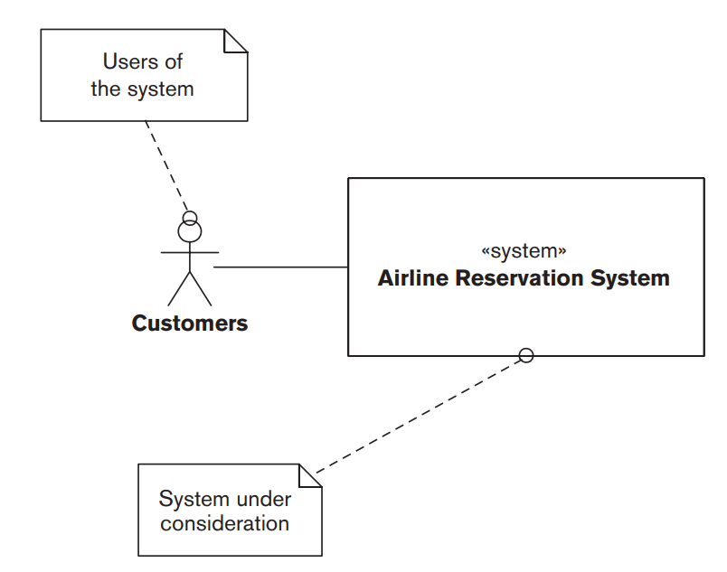
Airline Reservation System
Allows seat booking, updating, cancellation, upgrading, transferring.
Externally visible behavior:
How it responds to submitted transactions.
Quality properties of interest:
Average response time, max throughput, availability
Notes:
Let’s sat that We have to design the architecture for an airline reservation system that supports a number of different transactions to book airline seats, update or cancel them, transfer them, upgrade them, and so forth. To design the architecture of this system, we need to look at what it does and how it does it. The externally visible behavior of the system (what it does) is its response to the transactions that can be submitted by customers, such as booking a seat, updating a reservation, or canceling a booking. The quality properties of interest of the system (how it does it) include the average response time for a transaction, the maximum throughput the system can support, and its uptime. How would we want to architec this internally?

Slide 35
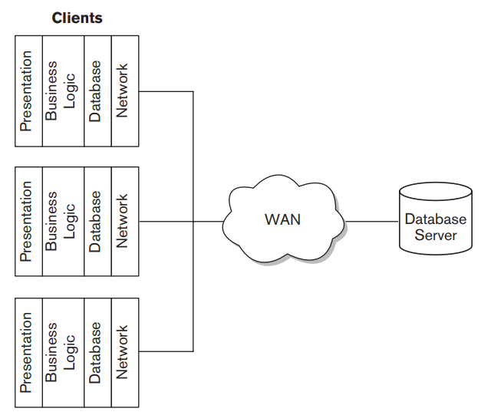
Option 1: Client/Server Architecture
Clients communicate with a central server (with a database) over a network.
Static Structure: Client programs, broken into layered elements, a server, and connections.
Dynamic Structure: Request/response model.
Notes:
Faced with these requirements, there are a number of ways that an architect could design a system for it. Let’s talk about two. First, we could approach this through what is a basic Client/Server Architecture - which we’ll talk over more today. In this approach, a number of clients (which present information to customers and accept their input) communicate with a central server (which stores the data in a relational database) via a wide-area network (WAN). The static structure (design-time organization) for this client/server architecture consists of the client programs -Three different clients shown here, all subsystems that serve different purposes in the overall system - (which in this example are further broken down into presentation, business logic, database, and network layers - what we call a layered architecture), the server, and the connections between them. The dynamic structure (runtime organization) is based on a request/response model: Requests are submitted by a client to the server over the WAN, and responses are returned by the server to the client

Slide 36
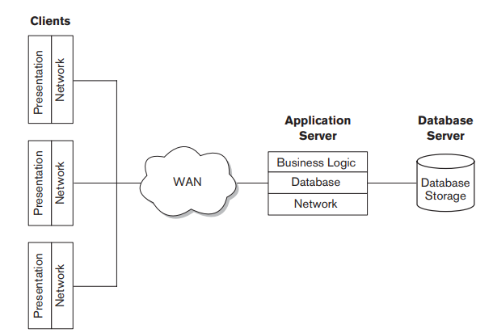
Option 2: “Thin Client” Architecture
Clients communicate with a central server (with a database) over a network.
Static Structure: Client only perform presentation. Server performs logic computation.
Dynamic Structure: Request/response model. Requests submitted to application server, then database server.
Notes:
Our second option is a three-tier or thin-client approach - still a client/server architecture, but architected a little differently), where only the presentation processing is performed on the clients, with the business logic and database access performed in a new application server. The static structure for this architecture consists of the client programs still (which are further broken down into presentation and network layers), the application server (here, business logic, database, and network layers), the database server, and the connections between them. The dynamic structure is based on a three-tier request/response model: Requests are submitted by a client to the application server over the WAN, the application server submits requests to the database server if necessary, and responses are returned by the application server to the client. So, which would you prefer? Why?

Slide 37
Which Would You Choose?
Same external behavior, may differ in performance.
First is simpler.
Second might be more scalable or more secure.
Must select a candidate architecture that satisfies all requirements and meets quality goals.
Extent that a architecture exhibits behaviors and performance must be studied further.
Notes:
Although the candidate architectures have different static and dynamic structures, each must be able to meet the system’s overall requirements. Each of these should share the same externally visible behaviors (responses to booking transactions) and general quality properties (acceptable response time, throughput, availability), they are likely to differ in the specific performance that each exhibits. The architect might identify the two-tier approach as appropriate for the architecture because of its relative operational simplicity, because it can be developed quickly by the organization’s software developers, because it can be delivered at lower cost than other options, or for a range of other reasons. Alternatively, the architect may consider the three-tier approach to be right for the architecture because it provides better options for scalability as workload increases, because less powerful client hardware is needed, because it may offer better security, or for other reasons. Whichever approach the architect considers to be most appropriate, you chooses because it provides the best match between the favored quality properties and the requirements of the system. In each case, the extent to which the candidate actually exhibits these behaviors and properties must be determined by further analysis of its structures. the client/server model might meet the functional requirements better because it supports functionally richer clients; the three-tier model might deliver better throughput and response time because it is more loosely coupled. It is part of the architect’s role to derive the static and dynamic structures for a candidate architectures, understand the extent to which they exhibit the required behaviors and quality properties, and select the best.

Slide 38
Static Structuring
Decompose the system into components.
Visualized as structured blocks.
Vision System
Arm Controller
Gripper Controller
Packaging Selection System
Object Database
Object ID System
Conveyor Controller
Packing System
Notes:
This leads us to the first major part of the architecture design process - static structuring. Breaking down the system into several principal components and identifying how they communicate.
this is normally expressed as a block diagram presenting a high-level overview of the system structure - not very detailed yet, but a good start for brainstorming and explaining how the system is constructed. So, pretty straightforward - each block is a element., lines mark channels of communication and control. Sometimes, we group components together into a single subsystem. This is fairly informal right now, but gives you an idea of where the components of the final system will go and how they relate/communicate/and work together (go over packaging robot control system)

Slide 39
Basic Architectural Styles
Common styles: layered, shared repository, client/server, pipe & filter
The style used affects performance, robustness, maintainability, etc.
Complex systems might not follow a single model - mix and match for subsystems.
Notes:
We’re going to cover four common models - (read),
In practice, the style of architecture you cover will dictate many of the characteristics of your system. (read). Your task is to choose the right style for the job - you wouldn’t grab the blueprints for a skyscraper when building a castle. Same for software.
That said, as many of these qualities conflict, and as real-world projects are complex - you generally don’t just apply one of these models and call it a day. These should be taken as advice, patterns that can help you design a robust project, but can’t guarantee anything. You usually will adapt multiple patterns, or steal lessons from several, and merge them into different parts of your project where they will be helpful.

Slide 40
Layered Model
Components organized into layers
Each layer only dependent on the previous layer.
May be multiple components in a single layer.
Allows components to change independently.
Supports incremental development.
User Interface
Interface Management, Authentication, Authorization
Core Business Logic (Functionality)
System Support (OS interface, Databases, etc.)
Notes:
- In the layered architecture, (read). Each layer provides services to the layer immediately above it. The lowest layers represent core services likely to be used throughout the system and the higher layers represent user-facing functionality or security features such as authetnication.
- The big idea here is to separate functionality into logical layers where each layer can change independently of the others - if we want to swap out the user interface, we can do so without impacting all of the back-end functionality. This can be a big boon to maintenance - keeping software alive long past where we would be able to otherwise.
- This also (read). As a layer is developed, some of the services provided by that layer can be made available to users. We can slot in new functionality as it is completed.

Slide 41
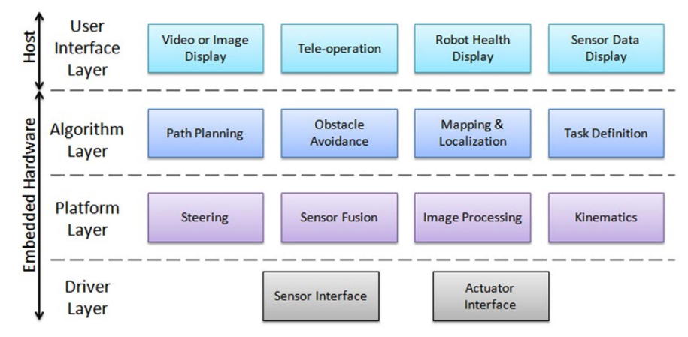
Robot Example
Notes:
Here is an example of the layered architecture for a copyright management system in a university librar
(walk through, relate layers) these might be seperate components, but conceptually grouped at the same layer.

Slide 42
Layered Model Characteristics
Advantages
Allows replacement of entire layers as long as interface is maintained.
Changes only impact the adjacent layer.
Redundant features (authentication) in each layer can enhance security and dependability.
Disadvantages
Clean separation between layers is difficult.
Performance can be a problem because of multiple layers of processing between call and return.
Notes:
(discussion - advantages?)
(read). The architecture is changeable and portable. Like I mentioned, as layers are done, those features can be made available to users, with more features added as other layers are complete. As long as the interface is unchanged, a layer can be replaced by another at any time, adding features or chaging how they work without requiring that the rest of the system be changed. This can be incredibly powerful.
When interfaces or features do change, only the adjacent layer is impacted. And, since the machine dependencies are restricted to lower layers, it is easier to port these systems to other OSes. Only the lowest layers need to be recoded for a new OS or to adapt to database changes.
(read), this is a powerful way to protect important data.
(disadvantages)
(read). In practice, a high-level layer may have to interact with a low-level layer through multiple levels of access. That adds communication overhead.
(read).

Slide 43
The Repository Model
Components often exchange and work with the same data. This can be done in two ways:
Each component maintains its own data and passes it to other components.
Shared data held in central repository and accessed by all components.
Repository model is structured around the latter.
Notes:
One big factor to consider in deciding on architecture is what data your system works with. In the layered architecture, we can bundle data and subsystem in the same layer, but if you have a bunch of subsystems across the entire system that work with the same data, you can get in trouble and increase dependency across multiple layers. If (1,2,3)
Each has its pros and cons. At the local level, the former is often a good idea - we talked about that last time, local data decreases coupling. Still, this doesn’t always work or make sense.
If several subsystems need the same data, it can be hard to figure out where to stash parts of it and it can be inefficient - results in a lot of communication.
The repository model is structured around the latter - many structured around large amounts of data, used by many different system function, are organized around a central database.

Slide 44
IDE Example
Model Editor
Code Generator
Java Editor
Project Information and Code Repository
Suggested Refactorings
Python Editor
Design Analyzer
Report Generator
Notes:
This kind of model is useful when data is produced by one component and used by another. This is useful when components don’t need to interact directly, but rather through the manipulation of information.
(describe example)
Consider an IDE - the central data is our source code, the project we’re building. The data repository is the code.
walk through components

Slide 45
Repository Model Characteristics
Advantages
Efficient way to share data.
Components can be independent.
May be more secure.
All data can be managed consistently (centralized backup, security, etc)
Disadvantages
Single point of failure.
Components must agree on data model
(inevitably a compromise).
Data evolution difficult.
Communication may be inefficient.
Notes:
(discussion - advantages?)
(read).
(read). They do not need to be aware of the existence of other components. They are just concerned with the data. This can be pretty secure - you can completely wall off each of those systems.
(read). Data can be controlled centrally, we don’t need to synchronize all subsystems. We can centralize backups, we can use a single security policy to manage data.
(disadvantages)
(read). Problems with the repository affect the whole system. If you can get in there and corrupt that data, then you wreck everything.
Everybody needs to work with the same data, not their own interpretation of that data. (read).
(read) - say we want to change that central data and how it works, how it is stored - that requires changes to all subsystems, not just one subsystem that stores data locally.
Since components communicate through the central repository, rather than with each other (read) - more overhead is needed

Slide 46
Client-Server Model
Functionality organized into distributed services:
Servers that offer services.
Print server, file server, code compilation server, etc..
Clients that call on these services.
Through locally-installed front-end.
Network allows clients to access services.
Distributed systems connected across the internet.
Notes:
can just read this
That said, while this is usually the architecture used for distributed systems across the internet, this can also be a logical model used a system on a single local machine. An important benefit is separation and independence. Services and servers can be changed without affecting the other parts of the system.

Slide 47
Film Library Example
...
iOS
Android
Browser
Catalog Server
Video Server
Search Server
HTML Server
Notes:
something like Netflix might use this architecture.
Each local system operates lightweight client software that calls the appropriate servers - an html server when it needs to serve a webpage to the interface, the video server when a video needs to be streamed, and so on.
Multiple clients can be connected at once, and when pinged, a server provides the service is was written for.

Slide 48
Client-Server Model Characteristics
Advantages
Distributed architecture.
Failure in one server does not impact others.
Effective use of networked systems and their CPUs. May allow cheaper hardware.
Easy to add new servers or upgrade existing servers.
Disadvantages
Performance unpredictable
(depends on system/network)
Each service is a point of failure.
Data exchange may be inefficient
(server -> client -> server)
Management problems if servers owned by others.
Notes:
(discussion - advantages?)
read these
(disadvantages)
read these

Slide 49
Pipe and Filter Model
Input is taken in by one component, processed, and the output serves as input to the next component.
Each processing step transforms data.
Transformations execute sequentially or in parallel.
Data processed as items or batches.
Similar to Unix command line:
cat file.txt | cut -d, -f 2 | sort -n | uniq -c
Notes:
(read) In the repository model, we had a bunch of subsystems that needed to work with the same data, here, we have a sequence of steps where we take data, transform it, and pass it to the next system.
read rest

Slide 50
Customer Invoicing Example
Receipt Generation
Receipts
Invoice Processing
Payment Identification
Payment Management
Payment Reminders
Reminders
Invoices
Payments
Notes:
Application that issues invoices to customers. Once a week, payments made are checked and invoices are adjusted. If invoices have been paid, a receipt is issued. If not, a reminder is issued.
(walk through)

Slide 51
Pipe and Filter Characteristics
Advantages
Easy to understand communication.
Supports reuse.
Add features by adding new components to sequence.
Disadvantages
Communication format must be agreed on.
Each transformation needs to accept and output right format.
Increases overhead.
Can hurt reuse if code doesn’t accept structure.
Notes:
(discussion - advantages?)
- read, we have a pretty clear idea of who needs to communicate with whom.
- (read) - since communication progresses in a line, we don’t tend to have many dependencies between multiple components
- (read) - similarly, we can just slot in new subsystems without much integration work
(disadvantages)
-read
- read, there is some performance overhead since subsystems aren’t well connected
- read

Slide 52
Dynamic Structuring
Model control relationships between components.
During execution, how do components work together to respond to requests?
Centralized Control:
One component has overall responsibility and stops/starts others.
Event-Based Control:
Each component can respond to events generated by others or the environment.
Notes:
(read). This is distinct from system decomposition - that is more of a static idea, what are the components? Control modeling looks at runtime - when the system executes - when a command comes in or an event occurs - (read). Where are requests routed, and when?
The control model typically takes on two forms:
(read, read)

Slide 53
Centralized Control: Call-Return
Central controller takes responsibility for managing the execution of other subsystems.
Call-Return Model
Applicable to sequential systems.
Top-down model: control starts at the top of hierarchy and moves downwards.
Controller
Component 1
Component 2
Class 1.1
Class 1.2
Class 2.1
Class 2.2
Notes:
When control is centralized, one piece of the system - usually just your Main in the program - takes responsibility for managing the execution of all of the components. The most common form of this for sequential programs is the call-return model:
(read, read).
So, a request comes in to the control module, and it calls the appropriate component interface, which calls methods in its classes, stepping down into the system hierarchy and returning the result up that tree until it reaches the control subsystem again. Like I said, kind of your default contro lstructure.

Slide 54
Centralized Control: Manager Model
Applicable to concurrent systems.
One process controls stopping, starting, and coordination of other processes.
Sensor Processes
Actuator Processes
Sensor Processes
Actuator Processes
Sensor Processes
Actuator Processes
System Controller Process
Computation Processes
Fault Handler Processes
Control Processes
Fault Handler
Control Processes
Fault Handler
User Interface Process
Notes:
In a concurrent system, with many parallel components, the manager model is common, where (read)
(walk through system)

Slide 55
Decentralized Control: Event-Driven
Control driven by external events where timing is out of control of components that process the event.
Broadcast Model
An event is broadcast to all components.
Any that needs to respond to the event does so.
Interrupt-Driven Model
Events processed by interrupt handler and passed to proper component for processing.
Notes:
Many embedded systems and systems distributed over networks follow more of a decentralized control style - driven instead by input events. (read)
Tends to either be a broadcast model, where (read)
or more of a centralized interrupt-driven model where (read)

Slide 56
Broadcast Model
Event broadcast to all components, any that can handle it respond.
Components register interest in specific events.
When these occur, control is transferred to registered components.
Effective for distributed systems.
When component fails, others can potentially respond.
Components don’t know when or if event will be handled.
Notes:
(read).
a publisher-subscriber model (read).
This can be very effective because it doesn’t need a central authority. On a network, any live computers can listen, and the ones that see the event and can respond do so. Even if failures occur, the working components can react.
The downside is that (read). There is no guarantee that the system will respond to an event.

Slide 57
Interrupt-Driven Model
Events processed by interrupt handler and passed to components for processing.
For each type of interrupt, handler listens for the event and coordinates response.
Each interrupt type associated with a memory location. Handlers watch that address.
Ensures fast response to event.
Complex to program, hard to validate.
Notes:
(read).
- So, how this works is that you (read). In centralized control, you had a unit - maybe your main - that would interpret input and call the appropriate subsystem. Here, you have a set of managers, each tuned to a particular event type
- You attach listeners to a particular input port, and when that memory location fires up with information, it notifies the appropriate subsystem.
- (read)
- The downside is that (read)

Slide 58
Nuclear Plant Interrupt Example
Interrupt Array
Temperature Event Handler
Radiation Event Handler
Fire Alarm Event Handler
Fuel Event Handler
Process 1
Process 2
Process 3
Process 4
Notes:
Say we have a nuclear plant controller, where we regulate temperature and other factors with our plutonium rods.
We have a bunch of events that we need to watch for, tied to certain sensors.
We define a handler for each event type, and they watch that memory location for events. When something hits that channel, they scramble a response
(name specifics)

Slide 59
We Have Learned
Frameworks
Composition-based, load-time.
White Box: Subclass an abstract parent, override template methods with specific functionality.
Black Box: Register plug-in objects that provide specific functionality.
Provides clear modularity, but requires extensive up-front design effort.
Notes:
go over
annotation (mark notes in the code to denote feature boundaries), compositon (feature code is separate and plugged in from a the correct class.

Slide 60
We Have Learned
Components
Standalone functionality with explicit interface and dependencies.
Interfaces often standardized (REST).
Can be reused in many projects.
Integrated as part of a broader architectural design.

Slide 61
We Have Learned
The architecture must consider static structure, dynamic structure, externally-visible behaviors, and performance.
Architectural models help organize a system.
Layered, repository, client-server, and pipe and filter models - also many others.
Control models include centralized control and event-driven models.
Notes:
(read)

Slide 62
Next Time
API Design
REST APIs
API design principles
Designing reusable APIs
Assignment 3 - Preprocessors - Due Sunday
Assignment 4 - Design Patterns/Modularity
Due December 12

