Slide 1
Software Engineering Principles
for Complex Systems
- Robocode introduction -
Tobias Schwarz, Mazen Mohamad, Thorsten Berger, Wardah Mahmood
Notes:
Hello everyone and welcome to this introduction session.
In this session I will introduce RoboCode and give a basic tutorial on how to get started to creating robots
Please feel free to ask questions in the chat at any time of the presentation.

Slide 2
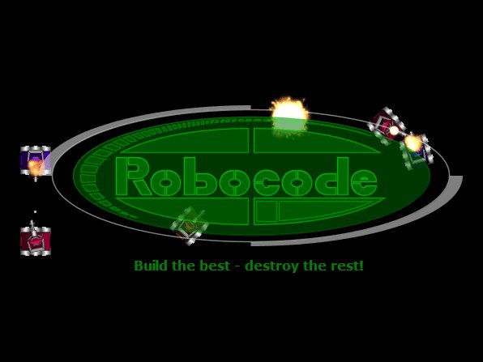
Robocode
Notes:
The reason for this introduction is that there are assignments of this course are based on the robocode framework. (already starting from assignment 2)
(1) https://a.fsdn.com/con/app/proj/robocode/screenshots/Robocode%20Logo.PNG

Slide 3
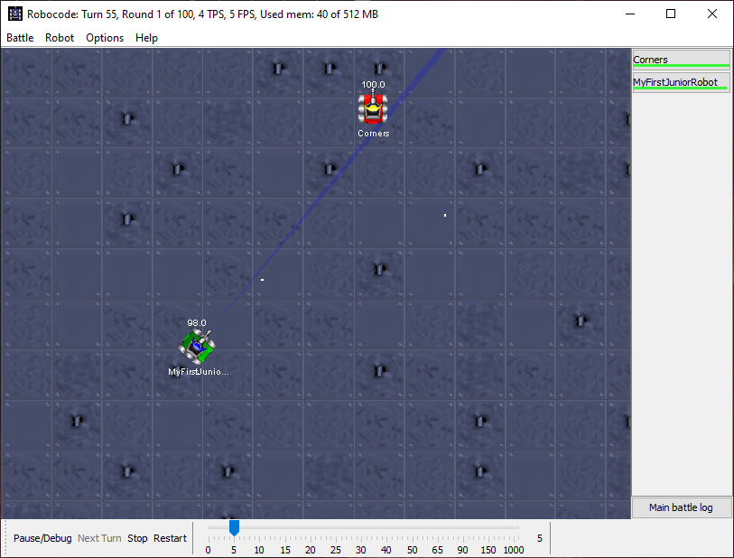
What is Robocode?
Robocode is a programming game
Provides a game engine to simulate robot competitions (battles)
You’re not directly controlling the robot, but programming it to manage the battle by its own
Implement one or many Java classes how the robot behaves and reacts to its environment
Robot competitions takes places
on a simulated battlefield
Purpose of assignment:
Learn creating an SPL in a fun
and interactive environment
Notes:
So what is Robocode??
Robocode is a programming game, where the goal is to develop a robot battle tank to battle against other tanks in Java or .NET.
In this course, we will use Java.
The robot battles are running in real-time and on-screen. The motto of Robocode is: Build the best, destroy the rest!
You pay the game not by directly controlling a robot, but rather by implementing the way you want it to behave, when it comes for example to movement, firing, and responding to different events.
You do this by implementing one or more Java classes.
The actual game then takes place in real-time and on-screen, in a simulated battlefield, as you can see in the picture. I’ll show you later a demo of a battle.
Our purpose of the assignment is for you learn how to create an SPL in this (hopefully fun) and interactive environment. ( not to create the best or most competitive bots)

Slide 4
Robocode Important Websites
RoboWiki
Main source of information
Over 200 OS robots available
Robocode website
Download Robocode.
Robocode API.
Notes:
I would like here to introduce some important websites:
The RoboWiki is a very important site, from which, you can find the information you need about robocode, and different implemented robots. You will specially need this for the domain analysis assignment which you will soon get (or maybe already did).
It includes information about over 200 robots, as well as external links to other important websites, such as the robocode website
You can download robocode from the robocode website, and there you can also find valuable information, for example on the tobocode API.
RoboRumble

Slide 5
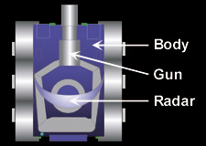
Robot Anatomy
Body ‒ Carries the gun with the radar on top. The body is used for moving the robot ahead and back, as well as turning left or right.
Gun ‒ Mounted on the body and is used for firing energy bullets. The gun can turn left or right. Carries the radar on top.
Radar ‒ Mounted on the gun and is used to scan for other robots when moved. The radar can turn left or right.
Each component has a set of associated strategies
Notes:
The body Carries the gun with the radar on top. It is used for moving the robot ahead and back, as well as turning left or right.
Gun ‒ Mounted on the body and is used for firing bullets. The gun can turn left or right. Carries the radar on top.
Radar ‒ Mounted on the gun and is used to scan for other robots when moved. The radar can turn left or right.
If you do not move the Radar and gun independently, the radar will move together with the gun, but they can move independently
The information of this slide is taken (as is) from the robowiki, so I’m stealing them, but without not telling you I’m doing that ☺
The strategies we are referring to here are behavioural strategies for example for the movement of the robot.

Slide 6
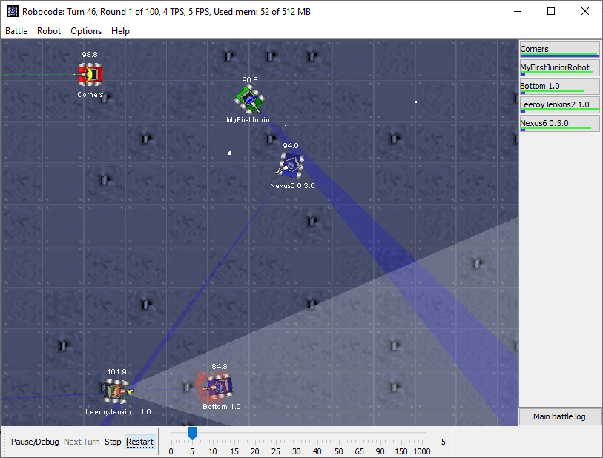
The battlefield
Notes:
This is how a battlefield looks like in robocode. It is two dimensional, and you can adjust the size of the battlefield before starting the battle (I’ll show that in the demo)
Red dots on the bot are also analytical data (debug)

Slide 7

The battlefield
Simulated battle
Different robots
Radar
Bullets
Hit by bullet
Individual robot
Health points (=98.8)
Name (=Corners)
Notes:
On the simulated battle, you see the robots.. Each robot has a name and health points printed on the screen.
You can also configure the radar to visualize the scanning. The bullets are also visible, and they have different shapes based on the power of them.
You can also see when a robot gets hit (a small explosion is painted)

Slide 8
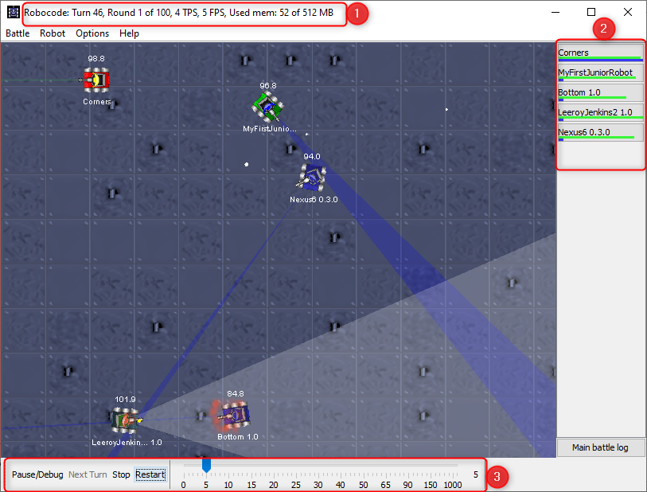
The battlefield
Simulator information
Turns/Ticks (time measure)
Round
FPS (1Tick per FPS)
Memory
Robot information
Name and health
Simulation settings
Pause/stop/restart
FPS setting
Notes:
A tick is the time measure used in robocode. Each robot gets one turn by tick
The green/yellow/red bar represent energy: >50 = green; 20-50 = yellow; <20 = red (IIRC). Another blue bar is the 'score' it gains that round. Full bar means that you have the highest score in that rounds. The score bar can't tell you the real score since the length is the factor ratio against bot with the highest score.

Slide 9
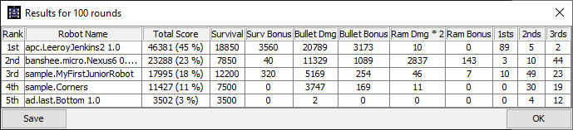
The battlefield
Rank
Robot Name
Total Score
Points for
Survival
Survival Bonus
Bullet Damage
Bullet Bonus
Ram Damage
Ram Bonus
Times won on position X
Notes:
More about how points are calculated: https://www.slideshare.net/alsfurlan/robocode-66626596 - P.21
Multiple ways to win: e.g., aggressive vs defensive. Last man standing in the end. Stay out of fights or shoot each robot you see
X=1,2,3

Slide 10
Constrains
Robots health (100points)
Lose health points for: Getting hit, shooting, hitting a wall or other robots
Gain health points for: Hitting other robot
Actions per tick
E.g. gun turns max 20 degrees and radar turns max 45 degrees
Robot’s velocity influences body turn rate
Bullet power and speed. Shooting cooldown phase
Body, gun, and radar influence each other
More details: Robowiki - Game physics
Notes:
There are some constraints on the robots’ behavior, and here are some examples
Actions per tick
E.g. gun turns max 20 degrees and radar turns max 45 degrees
Robot’s velocity influences body turn rate (when you move faster the curves are wider)
Bullet power and speed. Shooting cooldown phase (between consecutive shootings, the gun needs to cool down, time is implicit with bullet power. bullet power has certain range, the stronger the bullet, longer cool down time. A bot can shoot bullets of all powers)
Body, gun, and radar influence each other

Slide 11
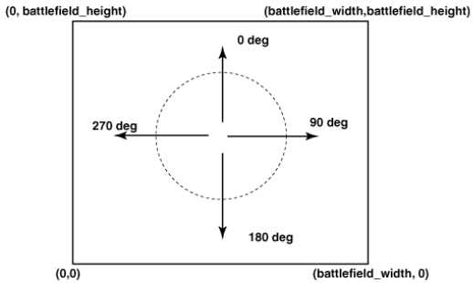
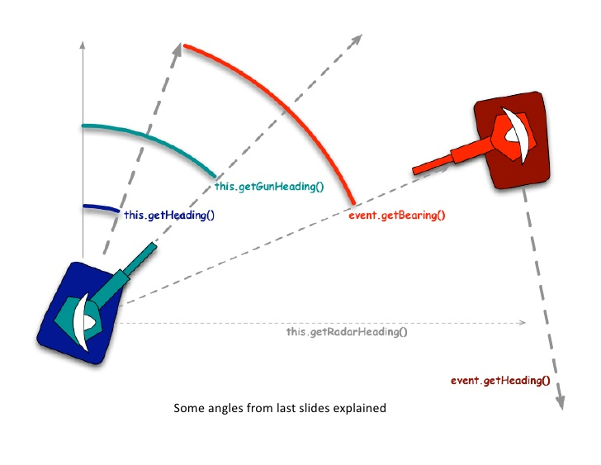
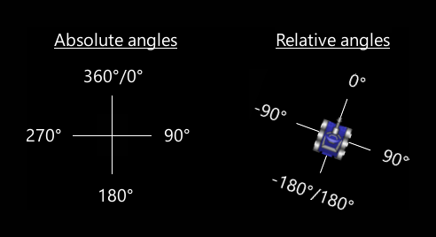
Battlefield and Robot Positioning
Trigonometric: https://www.ibm.com/developerworks/java/library/j-robocode2/sidefile-robo2.html
Notes:
Robocode coordinates system
Cartesian coordinate system
So if we look at the getHeading() method, it will return the absolute angle, whereas the getBearing() method is a relative angle in degrees to your robot's direction.
- http://www.cse.chalmers.se/~bergert/robowiki-mirror/RoboWiki/i.imgur.com/7Pkqy65.gif
Absolut/Relative Angles - http://www.cse.chalmers.se/~bergert/robowiki-mirror/RoboWiki/robowiki.net/w/images/b/b1/AbsoluteRelativeAngles.png
Robot bearing - https://image.slidesharecdn.com/robocodebasics-100720111911-phpapp02/95/robocode-basics-9-728.jpg?cb=1279624788

Slide 12
Live Demo
With robots
Sample.MyFirstRobot
Sample.Corners
Sample.RamFire
Sample.Crazy

Slide 13
MyFirstRobot - Code explained
package pkg;
import robocode.*;
public class MyFirstRobot extends Robot {
public void run() {
while (true) {
ahead(100);
turnGunRight(360);
back(100);
turnGunRight(360);
}
}
public void onScannedRobot(ScannedRobotEvent e) {
fire(1);
}
}
“Package” for organizational purposes of robots in RoboCode Simulator
Import RoboCode library to receive access to its functions

Slide 14
MyFirstRobot - Code explained
package pkg;
import robocode.*;
public class MyFirstRobot extends Robot {
public void run() {
while (true) {
ahead(100);
turnGunRight(360);
back(100);
turnGunRight(360);
}
}
public void onScannedRobot(ScannedRobotEvent e) {
fire(1);
}
}
“Main” class of your robot
Extends Robot / AdvancedRobot
Robot = blocking calls
Ad.Robot = non-blocking calls
Notes:
The three key new features provided by AdvancedRobot are the ability to:
• Carry out multiple movements simultaneously
• Decide on the robot's action or strategy at every clock tick
• Define and handle custom events
From https://www.ibm.com/developerworks/java/library/j-robocode2/j-robocode2-pdf.pdf, P.6
advanced robot can shoot while turning. code is more complex
Robot can do one thing at a time.

Slide 15
MyFirstRobot - Code explained
package pkg;
import robocode.*;
public class MyFirstRobot extends Robot {
public void run() {
while (true) {
ahead(100);
turnGunRight(360);
back(100);
turnGunRight(360);
}
}
public void onScannedRobot(ScannedRobotEvent e) {
fire(1);
}
}
Run() for robot configuration
While-loop contains basic behavior; always executed when no on-events, e.g. onScannedRobot
In this example:
Continue loop until health points run out or onScannedRobot is called

Slide 16
MyFirstRobot - Code explained
package pkg;
import robocode.*;
public class MyFirstRobot extends Robot {
public void run() {
while (true) {
ahead(100);
turnGunRight(360);
back(100);
turnGunRight(360);
}
}
public void onScannedRobot(ScannedRobotEvent e) {
fire(1);
}
}
Ahead – Pixels to move
turnGunRight – Degree to turn gun attached radar
In this example:
Move ahead 100 pixels.
Turn the gun right by 360 degrees.
Move back 100 pixels.
Turn the gun right by 360 degrees again.

Slide 17
MyFirstRobot - Code explained
package pkg;
import robocode.*;
public class MyFirstRobot extends Robot {
public void run() {
while (true) {
ahead(100);
turnGunRight(360);
back(100);
turnGunRight(360);
}
}
public void onScannedRobot(ScannedRobotEvent e) {
fire(1);
}
}
Event handling code on certain event and implementation about action to take
onScannedRobot()
onHitByBullet()
onHitWall()
…
Callout contains information about event, such as scanned enemy robot

Slide 18
Next steps
Download and install required software
Build your first own robot
Run a competition with your own robot
Learn more about movement, targeting and firing
Highly recommended:
https://www.ibm.com/developerworks/java/library/j-robocode/
https://robocode.sourceforge.io/docs/robocode/
Recommended:
https://www.ibm.com/developerworks/java/library/j-robocode2/j-robocode2-pdf.pdf
http://robowiki.net/ (Chalmers Mirror ) -> Radar, Targeting, Movement, Tutorials

Slide 19
Further reading
RoboCode FAQ
Basic knowledge in trigonometry (used to targeting, movement and avoid getting hit): https://www2.clarku.edu/faculty/djoyce/trig/
Secrets from the Robocode masters https://robocode.sourceforge.io/developerWorks.php
http://mark.random-article.com/robocode/
Interests of research
Applying Machine Learning to Robocode
Deep Q-Learning for Robocode

Slide 20

If you have something to discuss or ask,
use CANVAS discussion section.

