Slide 1
Lecture 5: Test Case Design
Gregory Gay
DIT636/DAT560 - February 3, 2025

Slide 2
Sources of Test Input
Functional Testing (Black Box)
Structural Testing (White Box)
The sort function should yield an array of integers, sorted in ascending order from smallest to largest.
public int[] sort (int[] unsorted){
…
if (unsorted[x] <= unsorted[y]) {
…
}
…
}
True
False
Test Cases
Test Cases
Test Cases
Test Cases
Test Cases
Test Cases
Test Cases
Test Cases
Test Cases
Test Cases
Notes:
First, some preliminaries. As mentioned last time, When we design test cases, we want to show that the program either operates correctly, or that it meets some other desired aspect of quality - such as meeting a performance goal. To do that, we need to interact with the program - make it perform an action that will show it meets our goals. There are two fundamental sources of information that we use, what we call functional, or black box, testing and structural, or white box testing. In functional testing, we use the requirements, design documents, code comments, or other sources of program information to design test cases - that is, we use information that describes how the code should act, and we design test cases to show that it does exactly that. In structural testing, we use the code itself as a source of information. We take checklists - called coverage criteria - and they tell us to take the code and make sure it is run in specific ways, like getting a true and false outcome for each if statement - and we make sure we do so in our test cases.

Slide 3
Sources of Input
Functional (Black Box) Test Design
Use documentation of system behavior to design tests.
Requirements, comments, user manuals, intuition.
Reflects what code should do, not what it currently does.
Treated as a “black box”: input -> code -> output
Normal form of test design.
Complemented by structural testing.
Tests can be designed before code is written.
(test-driven development)
Notes:
Functional testing is the standard mode for test design. We use these requirements, documentation, bug reports, and so on to design tests based on this knowledge of what the code should do. If the tests pass, then the code is working as it should, based on our ideas of how it should function. In this mode, we treat the program itself as a box that input goes into and output comes from. We try not to be biased by what the code actually does. Again, this is how we generally design tests, and structural testing serves as a complimentary source of information to flesh out the test suite. Since we often have requirements before a line of code has been written, we can start using that information to design tests before we even begin to write code. This leads to test-driven design, a major philosophy of agile processes, where we create tests for our code before we write that code - and know we did a good job if those tests pass.

Slide 4
Sources of Input
Structural (White Box) Test Design
Input chosen to exercise code in specific way.
Oracles still based on requirements.
Usually based on adequacy criteria:
Checklists based on program elements.
Branch Coverage - All conditional statements evaluate to true/false.
Fill in the gaps in functional test design.
Notes:
Structural, or White box, methods are based the structure of the source code that we wrote, and we design tests to deliberately execute the code in a particular way. Rather than looking at the requirements and saying that, well, this type of input should lead to this type of outcome - where we don’t really look into the code - we instead look at the if-statement on line 10 and say that we want input that makes this if-statement evaluate to true. Typically, white box testing is based on coverage of some part of the source code as prescribed by different checklists of goals. These checklists - called adequacy criteria - suggest that you will increase your likelihood of detecting faults if you ensure that the code itself is exercised in a particular manner. The most common of these are statement coverage - which says that all lines of code need to be executed at least once, and branch coverage - that says that all conditional expresions need to evaluate to all possible outcomes. All if-statements need to evaluate to true and false, all switch statements need to hit each case, and all loops need to run at least one cycle and exit. When we do this, the oracles - the expected output - are stil based on the requirements. So, if the code does the wrong thing, we still detect it. This is important for filling in the gaps left by functional test design, which may not have forced all of the code in place to run in the first place - e.g., we may lack requirements for some code. These adequacy criteria suggest weaknesses in our test suite that we can plug by adding more test cases. These criteria also can generally be measured by tools, give a good stopping place for testing, and can serve as the basis for automated input generation.

Slide 5
Today’s Goals
Introduce API testing, using Postman
Process for functional test case design.
Identify testing targets.
For each testing target, identify choices.
For each choice, identify representative values.
Generate test specifications.
Instantiate concrete test cases.
Notes:
Today, we are going to start talking about functional test creation, then later in the study period, we will look at structural test design. We’re going to first introduce our first testing framework, because I want to have something concrete to illustrate test cases. For that purpose, we’re going to use Postman, which is a framework for interacting with - and testing - REST APIs. We will then talk about a process for designing test cases. This five step process is a brainstorming activity that we can use to create tests at all levels - unit, integration, and full system testing - and is the basis of all testing activities.

Slide 6
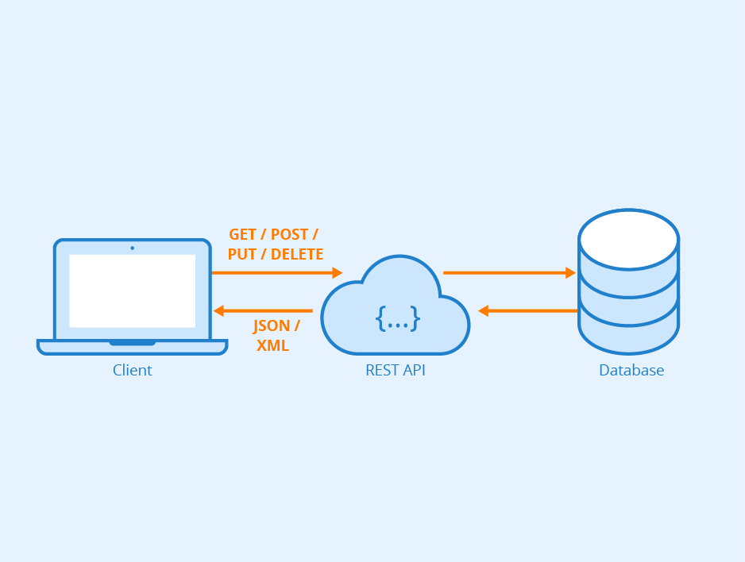
Creating AI Tests
with Postman
Notes:
What do these tests look like? how you write concrete test cases is is very depedent on technology - which language are you working in? What product domain? what interface type? Let’s give one concrete scenario and we’ll show some test cases for that scenario. Let’s focus on one specific domain - web apps. Most of you have taken mobile and web development already, so we will look at REST APIs and use the Postman framework for writing test cases. this is a domain AND a tool most of you have already used, or at least heard of. So, I won’t go into every detail on the tool, but we can use it to make some of these theoretical concepts a bit more concrete.

Slide 7
Postman
Testing framework for systems with a REST API.
REST: interface with endpoints we can interact with.
At an endpoint, we can send HTTPS request to:
GET information
DELETE information
POST information into a new resource (i.e., create a new entry)
PUT information in a resource (i.e., update an existing entry)
Can create requests and tests using Postman.
Notes:
A REST API is (2), where endpoints are URLs we can access. At an endpoint, we can use, typically, one of four actions. We can get information we are interested in that is provided by that endpoint, we can delete the current information stored, we can send it new information to PUT into what is already there, or we can POST information - for example, updating a record that already exists). What happens when we make these requests depends on how the program is written, but we have this core set of VERBS we apply to these endpoints. Using Postman, we can create requests and test cases for those requests - system-level test cases that interact through these endpoints using HTTP requests

Slide 8
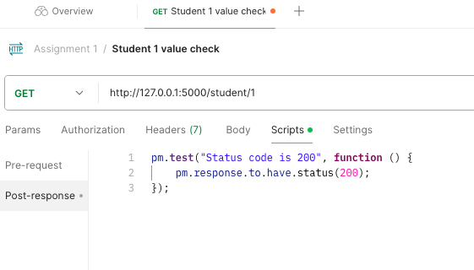
Writing Tests in Postman
Test Input
Each tab is a request.
The request defines test input.
GET/POST/PUT/DELETE
Resource acted upon
Params, Authorization, Headers, Body
Post-response scripts tab defines test oracles.
Write small JavaScript methods to check correctness of output.
Test Oracle
Notes:
Postman has a GUI where you create requests to the endpoints of a REST API. This GUI seperates our test input from our test oracles - where we specify what the expected behavior is and how the system should respond. The GUI presents you with tabs and a + button you can press to create a new tab. Each tab is a request. This is, esentailly, our test input. Here, we have a GET Request to to a specific endpoint. In this case, it gets information on a specific student. Then, there are many tabs where we set information about the request, like authorization information, headers, and the request body - the information you pass to it. Then, there is the tab for scripts. Pre-request scripts enable setup - any actions that need to take place before executing the test input. The second is post-response. Here, we define our test oracles - expectations on the output and some code we use to check that output against the expectations. Test oracles are written in Javascript and we have a lot of different expressions we can use to write test cases. In this simple case, we pull the response, and state that it must have status 200. We don’t care what information is returned here. We just expect the GET request to be accepted by the endpoint. Status 200 indicates that it ran without crashing or returning a pre-defined error. We can get far more complex, checking for specific information being returned, but this is a starting point - we made a valid acceptable request for information on a student.

Slide 9
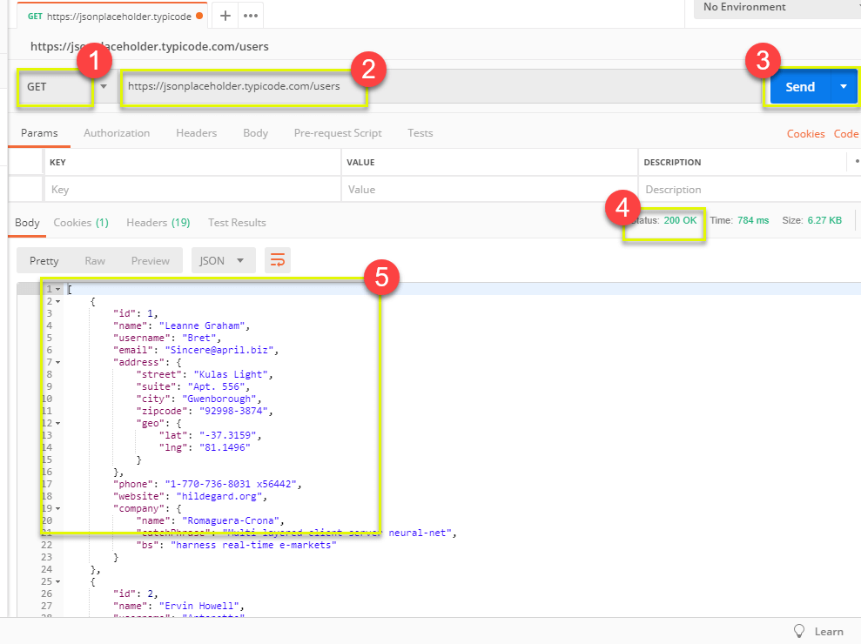
Input - GET
Select GET as the request type.
Set the resource URL.
Click “Send”
The response status is indicated.
The body contains the returned information.
Adapted from https://www.guru99.com/postman-tutorial.html
Notes:
Get requests are used to retrieve information from the given URL. There will be no changes done to the endpoint. To run a GET request, you (1) Set your HTTP request to GET.
(2) In the request URL field, input the endpoint link (3) Click Send. After that, (4) You will see a response status. In this case, it is - 200 OK Message. The endpoint accepted the request and sent a response. (5) Then, we can see the actual information returned in the body. In this case, it is a JSON file with information on the users. We don’t know yet if this information is correct - we need to add a test oracle for that. However, this is how we provide test input for a GET request.

Slide 10
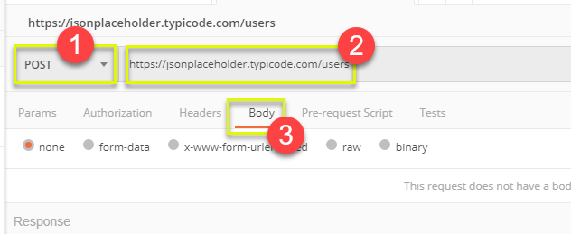
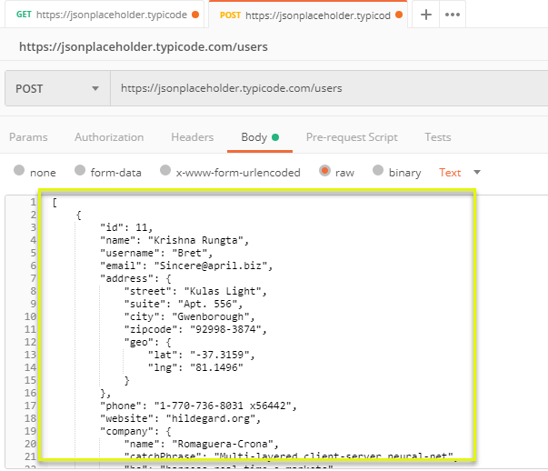
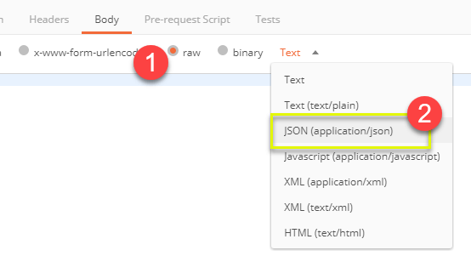
Input - POST
Set request to POST.
Set the endpoint URL.
Select the “Body” tab.
Click “raw” (raw text), “binary” (file/executable), etc.
Select data format (JSON, XML, etc.)
Add user data in proper JSON format.
Adapted from https://www.guru99.com/postman-tutorial.html
Notes:
Post requests are different from Get request as there is data manipulation with the user adding data to the endpoint. Using the same data from the previous Get request, let's now add our own user to this set. To do this time, we (1) set the request to POST instead of GET, we use the same endpoint URL, then we click the Body tab to input the information we want to pass to the interface. Now, in the body tab, we (1) click raw to send raw text. We could also click, for example, binary to send a PDF file or some other compiled executable object. We then select the data format. In our case, we are going to provide data to this endpoint as JSON. This JSON will contain information on the users we want to add to this list. We then add JSON data in the format that the interface expects. This is also where we can try to do things like enter malformed data, embed attacks, and so on to test the reilience of the system under test.

Slide 11
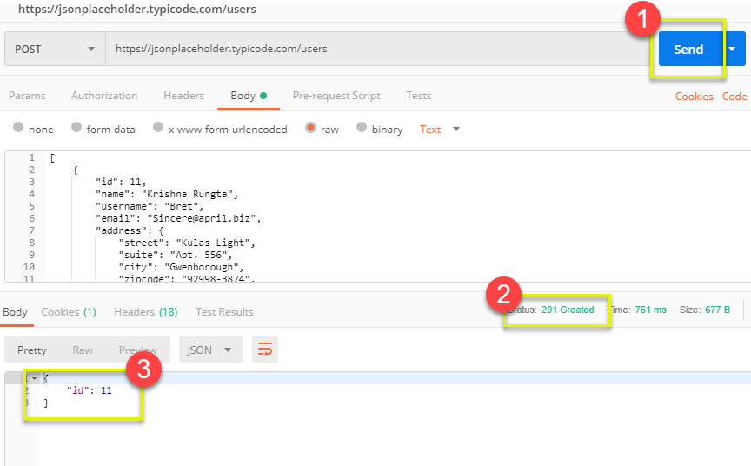
Output - POST
Click Send to send request.
Response status is indicated (201, data created)
Body indicates record “11” was created.
Adapted from https://www.guru99.com/postman-tutorial.html
Notes:
When we run this, what happens? We click send to send the request to the endpoint, then we get back the status 201, which normally indicates that something was created at the endpoint in response to the request. This is the repsonse we would probably want to see. The body also contains a small snippet of JSON indicating that the created item has the ID 11. Before, there were 10 records, now this is the 11th record. Another good sign that this POST request worked.

Slide 12
Creating Test Oracles
Post-response scripts tab allows creation of JavaScript blocks used to verify results.
These are test oracles.
Embed expectations on results and code to compare expected and actual values.
Use pm.test library to create assertions on output.
https://learning.postman.com/docs/writing-scripts/script-references/test-examples/ (many example scripts!)
Notes:
Postman Tests are little blocks of JavaScript added to requests that help you verify results. As I said, these are done in the post-response scripts tab
In the language we specified before, these are our “test oracles” - in these, we embed our expectations on correct behavior, and then code to compare those expectations to the results we see. This can be as simple as checking the response status. It can also be more complex, where we inspect the JSON returned and make explicit comparisons. The best starting point for building these is to use the PostMan test Javascript library, called pm.test. This offers you commands that you can use to make assertions and verify results. I’ll show a couple of examples, but the best place to see a full list of example scripts is at https://learning.postman.com/docs/writing-scripts/script-references/test-examples/

Slide 13
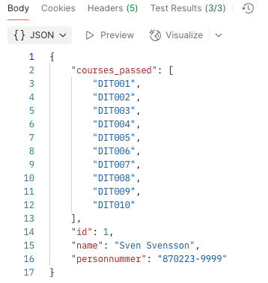
Oracle Example - Status Check
Create test in post-response scripts tab.
Snippets offer pre-built test oracles.
Example - “status code must be 200”
Adapted from https://www.guru99.com/postman-tutorial.html

Slide 14
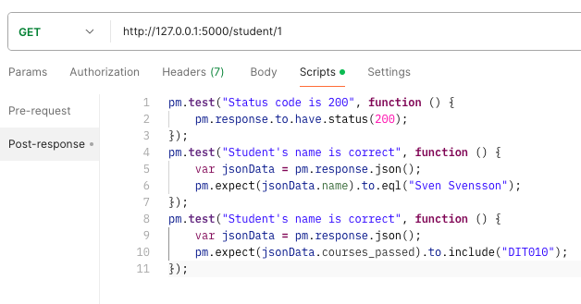
Example - Expected Value
Snippets “JSON value check”, “Contains String”
Both insert generic test body.
Change test name, variable to check (name), value to check (check for name “Sven Svensson”, specific course “DIT010”).
Adapted from https://www.guru99.com/postman-tutorial.html
Notes:
Next, let’s look at checking some expected values. Go back to the script tab and let's add two more tests. This time we will compare the expected result to the actual result. From the snippets section, click on "Response body:JSON value check" and “response body contains string”. In our tests, we want to check that the student’s name is Sven Svensson and that he has passed the course DIT010. The snippet inserted is generic, so we need to adapt it to our needs. Next, we then replace "Your Test Name" from the code with actual test names. Replace jsonData.value with jsonData.name. In the second test, we replace the generic “value” with “courses_passed” and note the course that should be contained within that array. We can see what was actually returned on the right, and the tests pass.

Slide 15
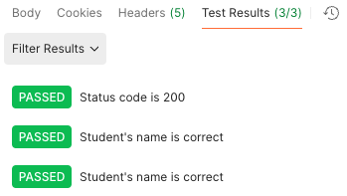
Test Execution Results
All three tests should pass.
Status and test names indicated in GUI.
Notes:
Click send. There should now be two passed test results for your request. You can see the names of the test and the status of each in the GUI

Slide 16
Creating Functional Test Cases
Notes:
So, that gives you an idea of what a concrete test case looks like. Of course, we need to actually design those test cases. Let’s talk about a process for coming up with those.

Slide 17
Creating Functional Tests
Identify Testing Targets
Identify function(s) that can be tested in (relative) isolation.
Identify Choices
Identify controllable aspects of the input and environment that determine the outcome of that function.
Identify Representative Input Values
Identify options for each choice that lead to different function outcomes.
Generate Test Case Specifications
Select a value for all choices to form abstract test case “recipe”.
Generate Test Cases
Replace representative values with concrete values.
Notes:
Creating functional tests can be boiled down to a five stage process.
You need to figure out what you want to test - typically we talk about these in terms of independently testable features of your system. What features or functions are surfaced by an interface and can be tested in relative isolationfrom other parts of the system? Or, in some cases, you might discuss a set of functions that are tested together
For each of those targets, we look at the inputs, configuration options, and execution environment. What can you control when you test this function that would influence the outcome of executing it? This includes both the actual input parameters - what you can pass to the functionality - and any other important aspects you can contorl and that might change the outcome, like database contents or the existence of a file.
For each of those choices, what types of input will trigger each possible outcome. What types of input should we try?
We then combine these representative values to form recipes for test cases, abstract test specifications that state the type of input we will provide. These can lead to many different concrete test cases when we
instantiate the specifications by replacing the abstract representative values with concrete values.

Slide 18
Independently Testable Functionality
Identify Testing Targets
Well-defined function(s) that can be tested in (relative) isolation.
Based on the “verbs” - what can we do with this system?
Functionality offered by an interface.
Depends on the level of testing.
Web Forum: Sorted user list can be accessed.
System testing: Test through the web interface, examine the complete page loaded by the function (member list, page layout, etc.).
Unit testing: Test functions of a class (e.g., sorting function alone).
Notes:
The first step is to identify what to test. We typically try to focus on one aspect of the systems at a time, that can be a single function or a small group of functions intended to be used together. An independently testable feature or function is a well-defined function that can be tested in (relative) isolation from other functionality. This is often pretty clear in system or subsystem-level testing. You look at the “verbs” - the actions you can perform with the software. If you are working with an interface, it is the high-level functionality you can access through that interface. In your API, it might be each defined endpoint. It can be much fuzzier in a GUI, but we can look at what functionality a user can perform through the graphical interface. In general, for a n interface, look at what the user would see as a distinct, independent function. It also depends on the level of testing. For example, a web forum might be able to bring up a list of members. When it does so, it sorts them into alphabetical order. When doing system-level testing, “list members” might be an independently testable feature, where we focus on activating that function, through the website in a browser. We might look at the page that appears, the content of the list, the graphical layout of hte page, and so on when we test that feature. During unit testing, we might dive deep into the codebase. At that level, we might test a function in an individual class in the code, for example, at that level, we might test the sorting function itself directly. At the unit testing stage for that class, the sorting function might be its own independently testable feature. And, again, we might look at functions intended to be used together. For example, for a bank account, we might test combinations of adding and removing money from an account, even those are two functions.

Slide 19
Identify Choices
Identify Choices
What choices do we make when invoking target?
Anything we control that can change the outcome.
What are the input parameters to that feature?
What configuration choices can we make?
Are there environmental factors we can vary?
Networking environment, file existence, file content, database connection, database contents, disk utilization, …
Notes:
The outcome of a function depends on the choices we make when we test it. What do I mean by choices? This is anything important that we can control when we test. The parameters, variable choices, and environmental factors that influence the execution of a feature. The obvious choices are the input parameters of the function. We choose values for those. Of course, we might even drill in further and look at the aspects of the input that we can vary.However,, explicitly defined parameters might not be the only thing that determines the output you get from a function. You might have configuration options you chose for the software - flags at start-up, an account we log into. Third, what other environmental factors could lead to a different outcome? There may be many of these and these and configuration options are implicit parameters, as they can have a big impact on the outcome of executing this function. Things like your network connection - number of concurrent users - whether a file exists or not, what is in that file, whether we can connect to the database, what is in that database - does it already have the record we want to insert? - is the hard disk full. We want to consider any important factors that could change the outcome of this function. These are the choices we will decide on when we test.

Slide 20
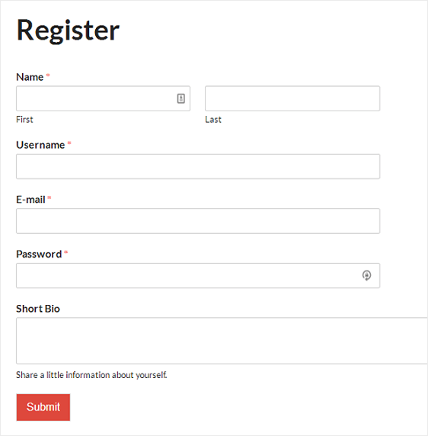
Ex: Register for Website
Identify Choices
From the input parameters:
First Name, Last Name, Username, E-Mail Address, Password, Short Bio
Other environmental factors:
Is there a database connection?
Is this user already in the database?
Notes:
Say we have a user registration feature on a website. What choices do we make? First, consider the inputs to the function and what you can vary about them. Each input parameter could be one or more choices. Right away, we have several choices: (2) Now, the explicitly defined parameters might not be the only factors that you can control and that affect the outcome of the function. If you’re registering users, what else might influence the outcome? How about a database to store those users? That database is going to influence execution. In this case, we might want to consider whether we can connect to the database and whether is has this user already in it or not - those have an effect on how the test executes. So, we need to take that into account. This means that for the function “register for website”, we make 8 choices already, and there could be even more.

Slide 21
Parameter Characteristics
Identify Choices
Identify choices by understanding how parameters are used by the function.
Type information is helpful.
firstName is string, database contains UserRecords.
… but context is important.
Reject registration if in database.
… or database is full.
… or database connection down.
Notes:
The key to identifying more choices is in understanding how the input parameters are used by the function. (2-3) But, any context for how those are used in practice and how they impact execution is invaluable for coming up with tests. If the database already contains an entry for that combination of fields, registration should be rejected. or (last two)

Slide 22
Parameter Context
Identify Choices
Input parameter can be split into multiple “choices” based on context.
A database affects User Registration, but there is more than one choice.
Choice: Is there a database connection?
Choice: Is there already a record for the user?
Choice: How full is the database storage?
Notes:
An input for a function might be split into multiple “choices” based on contextual use. The database may or may not contain a record for that user. In either case, issues may emerge based on the size of the database. The program may also have issues if a database connection cannot be established. This means that “database” - even though it is an implicit parameter to the User Registration function - is not one choice. Rather, you have three “choices” for this function based on the database, three things we can vary when testing. So, when thinking about choices, it is less important to capture just the literal input that would be passed to the function, and more important to capture each thing we can vary when testing the function. (3-5)

Slide 23
Ex: Binary Search
Identify Choices
Boolean binarySearch(String[] array, String toFind)
Choice: How many items are in the array?
(Empty array might behave differently than one with several items)
(Could also provide a null pointer instead of a real array)
Choice: Is the array sorted?
(Binary search assumes the array is sorted)
Choice: Is the string in the array?
(Different function outcomes)
Notes:
(ask them for suggestions on choices) (two click, talk over)
Already you can also see some relations emerge between these choices. In the end, an empty array couldn’t have the string in it). We will talk about filling out options for choices in a moment.

Slide 24
Example
Identify Testing Targets
Class Registration System
What are some independently testable functions?
Register for class
Drop class
Transfer credits from another university
Apply for degree
Notes:
(discussion)
if low on time, skip

Slide 25
Example - Register for a Class
Identify Choices
Input: Route: /registrations/, Method: POST,
Input: { “studentID”: VALUE, “courseID”: VALUE }
Output: Status Code: (201 if registration OK, 200 for input-based errors, others for other errors), JSON message: { “result”: VALUE } (“OK”, error messages)
Example Oracle: pm.test(“Normal Case”, function() {
pm.response.to.have.status(201);
var jsonData = pm.response.json();
pm.expect(jsonData.result).to.eql(“OK”);
});
Notes:
Ok, let’s start to set up a test case. We have a registration function. It accepts POST requests. The request body must contain a student and course ID. the function returns a status code - 201 if the registration was completed, 200 for an error based on the input, like a student registering for an illegal course, others for other errors - 503 for server errors, etc. It also returns a JSON message with more information on the result. We can then use an assertion to determine whether the result was what we expected. For example, we could check the status code and the result message for particular values (go over)

Slide 26
Identify Choices
What are the choices we make when we design a test case?
Input: Route: /registrations/, Method: POST,
Input: { “studentID”: VALUE, “courseID”: VALUE }
Example Oracle: pm.test(“Normal Case”, function() {
pm.response.to.have.status(201);
var jsonData = pm.response.json();
pm.expect(jsonData.result).to.eql(“OK”);
});
Does student meet prerequisites?
Does the course exist?
What else influences the outcome?
Notes:
(title) (click) The literal value of the student ID and course ID, of course. What else do we control? (discuss) (click) What could we do with the set up to change the outcome? (click) (go over box and discuss)

Slide 27
Example - Register for a Class
Identify Choices
During setup, we can influence a student’s record and the course records.
These are “inputs” to consider.
How are they used?
Has a student already taken the course?
Do they meet the prerequisites?
Does a course exist?
What are the prerequisites of a course.
Notes:
(discussion)

Slide 28
Example - Register for a Class
Identify Choices
Parameter: studentID
Choice: Validity of Student ID
Choice: Courses Student Has Taken Previously
Parameter: courseID
Choice: Validity of Course ID
Choice: Prerequisites of Course ID
Notes:
(go over).

Slide 29
Let’s take a break.
Notes:
15 minute break

Slide 30
Identifying Representative Values
Identify Representative Input Values
Test Input Data
We know the functions.
We have choices for each.
Representative values are the options for each choice.
Program
Test Output Results
Notes:
(1-2) The next step, obviously, is to come up with the input to those parameters. We do this based on the choices. What we need to do is identify the options for each choice. These are called the representative values for reasons we will see more clearly in a moment.

Slide 31
Ex: Binary Search
Identify Choices
Boolean binarySearch(String[] array, String toFind)
Choice: How many items are in the array?
Choice: Is the array sorted?
Yes
No
Choice: Is the string in the array?
Yes
No
Choice: How many items are in the array?
Null pointer
0
1
2
3
4
5
…
1000000000000
Notes:
In some cases, this is easy. In others, it is much harder. LEt’s look at this example. Two of these three choices are easy to identify representative values for. (point out). These are just yes or no values. (click) What about this choice?

Slide 32
Ex: Register for Website
Identify Choices
“Value of X” are choices.
X = first name, username, etc.
What are the representative values for each choice?
First name could be any string!
Notes:
What about on our user registration? (go over). Do we want to try all of those?

Slide 33
Exhaustive Testing
Identify Representative Input Values
2³² possible integer values for each parameter.
= 2³² x 2³² = 2⁶⁴ combinations = 10¹³ tests.
Take the arithmetic function for the calculator:
add(int a, int b)
How long would it take to exhaustively test this function?
Test Input Data
Program
1 test per nanosecond
= 10⁵ tests per second
= 10¹⁰ seconds
Test Output Results
or… about 600 years!
Notes:
Let’s take a calculator and just look at addition. Let’s just restrict the numbers to 32 bit integers. If we wanted to exhaustively test adding two numbers, how long would it take? How many inputs are we talking about?
- (read) That’s a lot right, how long we talking about time wise?
- let’s be generous and say we can run a test per nanosecond. That works out to about 10^5 tests per second, or 10^10 seconds overall. That doesn’t sound bad in seconds, but how long is that?
- (read). That’s for something as simple as addition of two integers. That’s insane, right?

Slide 34
Not all Inputs are Created Equal
Identify Representative Input Values
Many inputs lead to same outcome.
Some inputs better at revealing faults.
We can’t know which in advance.
Tests with different input better than tests with similar input.
Test Input Data
I
Program
Test Output Results
O
Notes:
We can’t exhaustively test any real program. You just can’t. Addition is the bottom of the barrel in terms of complexity. Most individual features will have quadrillions of inputs at least. Exhaustive testing just isn’t going to work out. Fortunately, you don’t need to. The fact is that not all inputs are as useful as others. Purely from the verification perspective, there are only so many outcomes of a function, and you’ll have a lot of inputs that lead to the same outcomes. Why use all of them? We can cut that down some. Then, fundamentally, testing is really something we do to find problems, and some inputs are going to be better than others and revealing those problems. We want those inputs. Sadly, we don’t know which tests will reveal faults until we run them. But, as a start, we know that two tests with inputs that are very different from each other are more likely to reveal faults than two tests with very similar input. Say you can select three tests for a program that breaks a text buffer into lines of 60 characters each. We select tests with a 40 character string and a 30 character string. Then, for a final test, we use a 100 character string. We can’t prove the 100 character buffer is a better test, but we would be more suspicious of a set of tests that is biased towards lengths less than 60. That’s a start, we’re covering a wider range of the input space. You’re more likely to hit a different outcome of a function or some weird corner case that is likely to break the whole thing..

Slide 35
Input Partitioning
Identify Representative Input Values
Consider possible values for a variable.
Faults sparse in space of all inputs, but dense in parts where they appear.
Similar input to failing input also likely to fail.
Try input from partitions, hit dense fault space.
Notes:
The next step is to take a good, long look at that input space for a variable. This is the space of all possible inputs values for a variable (click) In truth, faults are pretty sparse in the input space as a whole, but they are dense in the part of the input space in which they appear. If we try an input, and it fails, there’s a good chance that a highly similar value will also fail. (click) In practice, you can almost always divide the space into partitions - into logical group of inputs based on some criteria - maybe based on the outcome they’ll trigger. The thing is, if we do a good job of partitioning, and we come up with an input that lands in a space dense with faults, then we’re in good shape. This goes back to something I touched on a few minutes ago. We should - a a general strategy - favor different input over similar input. That’s a key idea. Try two very different things and you’re more likely to trigger a fault than trying two very similar things. Even more so if we put some thought into where those inputs come from. if we systematically go through and try a few inputs from each of those partitions, we are more likely to hit a larger range of different results than just randomly trying input. If a feature can result in different outcomes, we’re more likely to hit all of those by breaking the input space down along different line, and as a result, we’re way more likely to hit that space where faults are dense and trigger a few of them. By incorporating domain knowledge and experience, you can make sure that the tests actually cover a representative portion of that input space.

Slide 36
Equivalence Class
Identify Representative Input Values
Divide the input domain into equivalence classes.
Inputs from a group interchangeable (trigger same outcome, result in the same behavior, etc.).
If one input reveals a fault, others in this class (probably) will too. In one input does not reveal a fault, the other ones (probably) will not either.
Partitioning based on intuition, experience, and common sense.
Notes:
So, by partitioning the input domain, we can then form a set of equivalence classes - input that is essentially interchangeable. An equivalence class of tests essentially test the same scenario - they give you the same outcome, they trigger the same behavioral pattern, same usage of a feature, they do the same thing according to come criterion we define. (2-3)
Perfect partitioning of tests is hard, but we try our best with a combination of intuition, experience, and common sense.

Slide 37
Choosing Input Partitions
Identify Representative Input Values
What are the function outcomes?
Ranges of numbers or values.
Membership in a logical group.
Time-dependent equivalence classes.
Equivalent operating environments.
Data structures.
Partition boundary conditions.
Notes:
A few of these include:
- (read) Can you group based on the output event that occurs?
-Look for ranges of numbers or values - what are the different discrete ranges of input values that can be provided that might give us different outcomes based on context?
-Look for membership in a logical group - Can we group these inputs based on how their used, what context the method uses them in, do member of this group trigger similar behavior?
-Look for time-dependent classes - does the timing of input matter to particular groupings?
- (read) the operating environment might influence system behavior
- (read) - some data structures, such as arrays, can be broken down into common groupings of input.
-(read)

Slide 38
Function Outcomes
Identify Representative Input Values
Look at the outcomes and group input by the outcomes they trigger.
Boolean binarySearch(String[] array, String toFind)
Choice: How many items are in the array?
Null pointer
0
1
2
3
4
5
…
1000000000000
Choice: How many items are in the array?
Null pointer (could lead to exception)
0 (could lead to exception/warning)
1+ (normal outcomes)
Notes:
First thing to do is start from the output, divide the output into the different outcomes I can get - then try to come up with input that produces those outcomes. This is a good first step, then we might break down further from there.It is often easier to find good tests by looking at the outputs and working backwards. For example, we have this how many items are in the array. We don’t need to try all possible array sizes. We can start by just selecting representative values that could lead to different outcomes (click,go over). We then might break these representative values down further later on, but this is a good start.

Slide 39
Data Type
Identify Representative Input Values
Try values commonly misused, based on data type.
Ex: Integer
Basic Split: < 0, 0, >0
If conversions take place from String -> Integer, use a non-numeric string.
Also split based on how variable is used.
Integer intended to be 5-digit:
< 10000, 10000-99999, >= 100000
Notes:
When dividing input into input partitions, it is also natural to look for how you could split the parameter’s values into discrete ranges, informed by both the variable type and the context of how it is used in the function. For example, If we have a numeric input parameter. We, at least, should try negative, 0, and positive values. If conversions take place, like String to Int, we should try non-numeric values to see if we properly protect against them. We might then further divide it based on how it is used. For example, if it is intended to be a 5-digit integer between 10000 and 99999, but you just inter an integer, you mgiht first divide this into: less than five digits, more than five digits, and the expected five digit. Then think a little more about other special numbers that might do something weird.

Slide 40
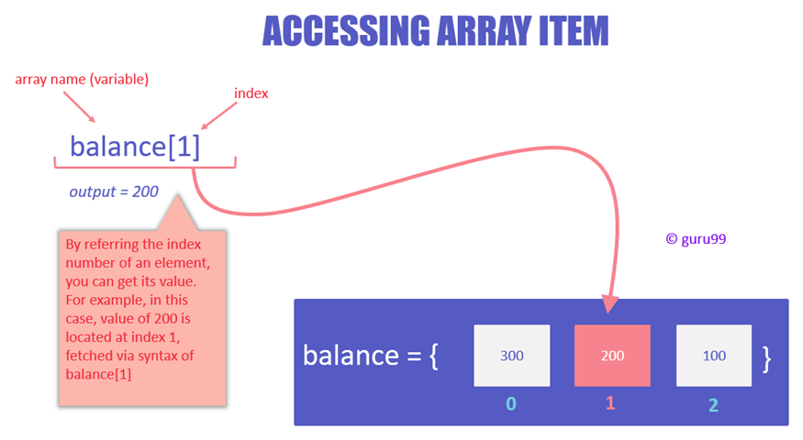
Data Type
Identify Representative Input Values
Data structures prone to certain types of errors.
For arrays or lists:
Only a single value.
Different sizes and number filled.
Order of elements: access first, middle, and last elements.
Notes:
(1) So, use experience with those to suggest values to try
(read) Programmers naturally think of sequences as made of up several values and it’s common to embed this assumption into the program. If presented with a single-value sequence,the program might fail.
(read) Decreases the chances that a bad program will accidentally give you a good output because of a particular input choice.
(read) This will reveal problems at partition boundaries.

Slide 41
Data Type
Identify Representative Input Values
Boolean binarySearch(String[] array, String toFind)
Choice: How many items are in the array?
Null pointer (could lead to exception)
0 (could lead to exception/warning)
1 (single item collections often misused)
2+, # items == array size (normal outcomes)
2+, # items < array size (could be issues if array is not full)
Notes:
Now, we have added some items (go over)

Slide 42
Operating Environments
Identify Representative Input Values
Environment may affect behavior of the program.
Environmental factors can be partitioned.
Available memory may affect the program.
Processor speed and architecture.
Client-Server Environment
No clients, some clients, many clients
Network latency
Communication protocols (SSH vs HTTPS)
Notes:
the environment that the program operates or timing of actions can also easily impact the behavior of the program. Thus, the environment can also be considered when forming value partitions. Consider the environment you’re operating in, how it can influence the input or output of the system, and how the combination of both explicit program inputs and implicit environmental variation can be partitioned.
Memory may cause problems. What if you don’t have enough? What if you have enough physical memory, but not enough free (or not enough birtual memory)
Same for processor speed or architecture. Could see race conditions, deadlock between processes, unexpected slowdown.
Try using different machine specs and vary both the processor and memory. Those choices suggest different partitionings.
Client-server environment can have huge impacts on the operation of the system.
try with different numbers of connections to clients - none, some, many (DDOS conditions)
network latency - can vary network equipment or speed
communication protocols - many options for a file upload, try each that you support

Slide 43
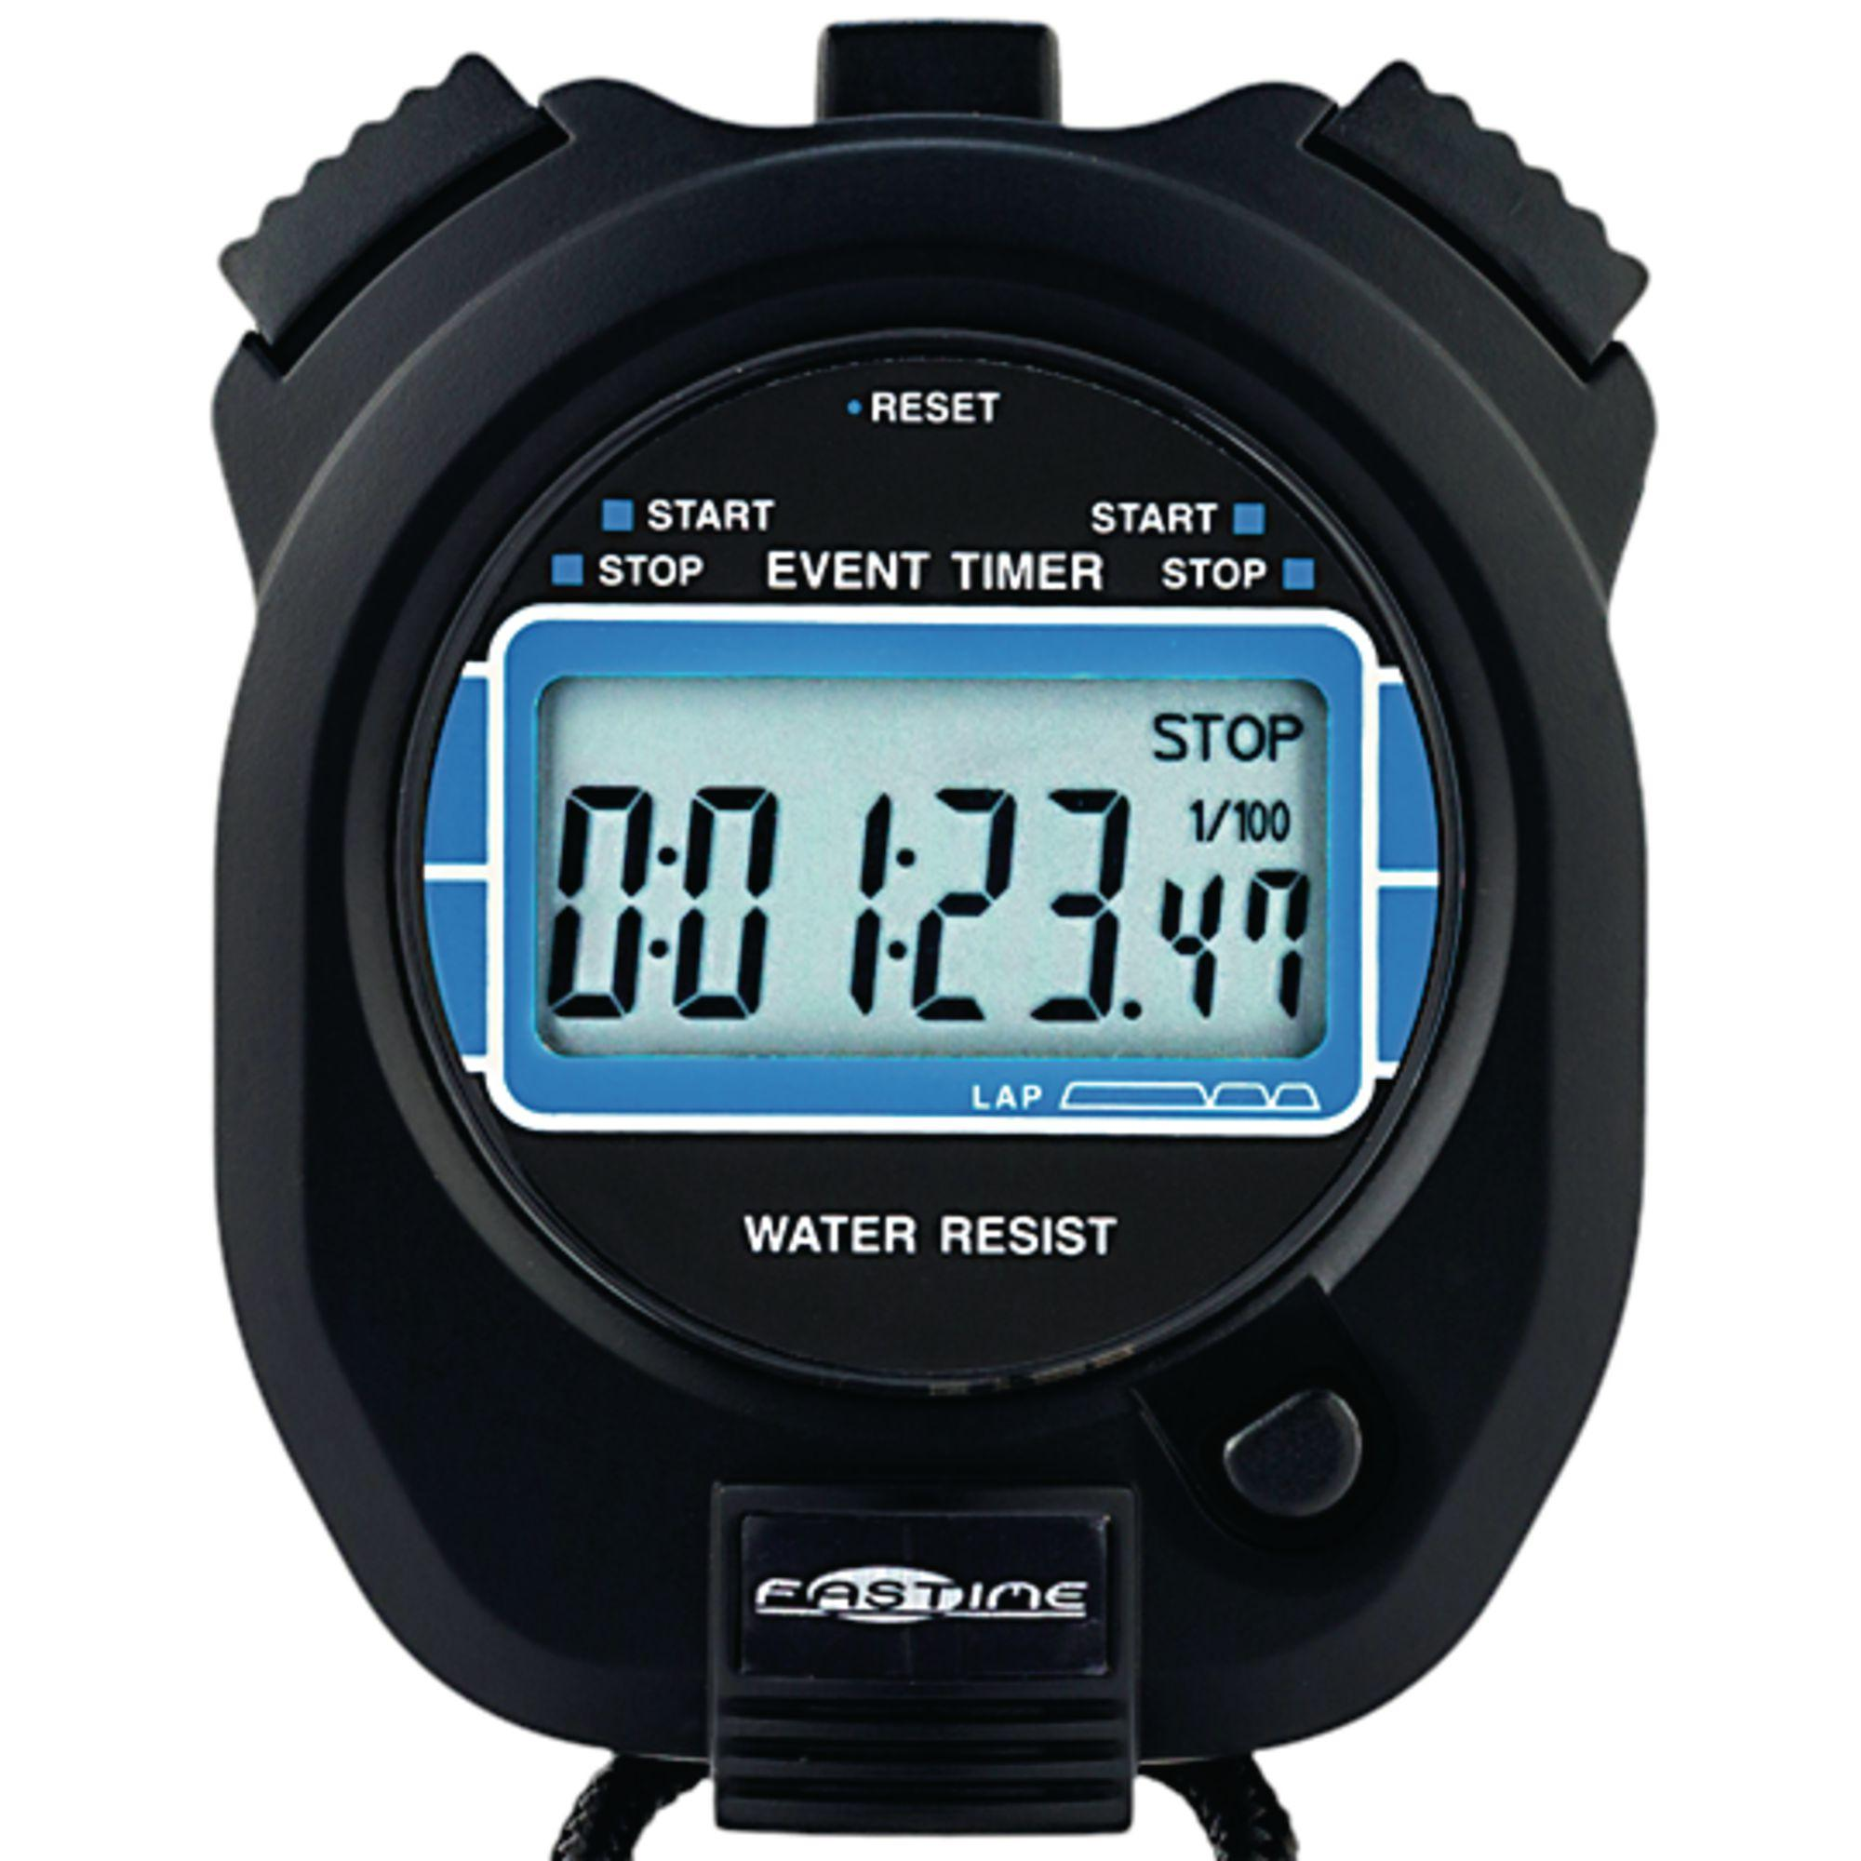
Timing Partitions
Identify Representative Input Values
Timing and duration of input can be as important as value.
Timing often implicit input.
Trigger an electrical pulse 5ms before a deadline, 1ms before the deadline, exactly at the deadline, and 1ms after the deadline.
Close program before, during, and after the program is writing to (or reading from) a disc.
Notes:
(1) Very hard and very crucial to get right. but also something that can be very important. For many systems, the timing of an input is an unstated, implicit input. If timing matters, you need to remember that it is part of the input, and partition it accordingly. For example, consider a pacemaker - looking for electrical impulses from the heart. (read)
Or, strange behaviors can happen when reading from a file or writing out to a file, try (read) Timing can be partitioned.

Slide 44
Quality Considerations
Input partitions likely to affect quality goals.
Performance: Input likely to lead to performance issues.
Ex: Remove resources, large input that will take awhile to process
Security: Input that attacker could apply.
Ex: Code injection in XML input.

Slide 45
Quality Considerations
Identify Representative Input Values
Boolean binarySearch(String[] array, String toFind)
Choice: How many items are in the array?
Null pointer (could lead to exception)
0 (could lead to exception/warning)
1 (single item collections often misused)
2+, # items == array size (normal outcomes)
2+, # items < array size (could be issues if array is not full)
10000 (could lead to performance issues)
Notes:
Now, we have added some items (go over)

Slide 46
Input Partition Example
Identify Representative Input Values
What are the input partitions for:
max(int a, int b) returns (int c)
We could consider a or b in isolation:
a < 0, a = 0, a > 0
Consider combinations of a and b that change outcome:
a > b, a < b, a = b
Notes:
In addition, we need to consider the interaction between the parameters. (go over)

Slide 47
Example - Register for a Class
Identify Representative Input Values
Parameter: studentID
Validity of Student ID
Active Student
Inactive Student
Non-Existent Student
Courses Student Has Taken Previously
Matches Prerequisites
Does Not Match Prerequisites
Parameter: courseID
Validity of Course ID
Existing Course
Non-Existent Course
Prerequisites of Course ID
Only Courses Taken By Student
Only Courses Not Taken By Student
Some Courses Taken by Student
Notes:
(go over).

Slide 48
Revisit the Roadmap
For each choice:
Partition options into representative values.
Choose a value for each choice to form a test specification.
Assign concrete values to create test cases.
Identify Representative Values
Generate Test Case Specifications
Generate Test Cases
Notes:
So, for each independently testable function and its choices, we want to:
identify the representative values for each choice. For each input choice, we want to be able to chop up the input space into different groupings.
So, we have each individual choice partitioned. For tests, we feed in a combination of decisions for each of those choices. Not just a value for one, but a value for all explicit and implicit inputs of the function. So, you create a set of abstract tests where each abstract test specification has a partition selected for each choice.
Then, we can turn those specifications into one or more concrete test cases by choosing actual concrete values for each partition selected.

Slide 49
Basic Test Specification
Generate Test Case Specifications
// Set Up
POST /studentRecords/VALUE, { … “status”: VALUE, “coursesTaken”: [VALUES]}
POST /courses/VALUE, { … “prerequisites”: [VALUES] }
// Attempt to register for a course
POST /registrations/, { “studentID”: VALUE, “courseID”: VALUE }
// Check the result of registration
pm.test(“Normal Case”, function() {
pm.response.to.have.status(VALUE);
var jsonData = pm.response.json();
pm.expect(jsonData.result).to.eql(VALUE);
});
Notes:
So, to test this registration function, we can add two setup steps to put the system in the right state, We have endpoints containing student records for a particular student, and information on particular courses. Relevant to our test choices, we can set the student’s status and the courses they have taken and the prerequisites of a course. This lets us set up the system to run our actual tests of the registration function. then we can submit a POST request to register with the right student and course ID. We can then use a postman test to verify the result. This can’t be run in full yet, but gives us a recipe to set up where we fill in all of these red VALUEs. We need to start filling this in based on our selected representative values.

Slide 50
Forming Specification
Generate Test Case Specifications
Parameter: studentID
Validity of Student ID
Active Student
Inactive Student
Non-Existent Student
Courses Student Has Taken Previously
Matches Prerequisites
Does Not Match Prerequisites
Test Specifications:
Active, Matches, Existing, Only Taken
Active, Does Not Match, Existing, Only Not Taken
Active, Does Not Match, Existing, Some Taken
Active, - , Non-Existing, -
Inactive, Matches, Existing, Only Taken
Inactive, Does Not Match, Existing, Only Not Taken
Inactive, Does Not Match, Existing Some Taken
Inactive, - , Non-Existing, -
Non-Existing, -, Existing, -
Non-Existing, -, Non-Existing, -
…
Parameter: courseID
Validity of Course ID
Existing Course
Non-Existent Course
Prerequisites of Course ID
Only Courses Taken By Student
Only Courses Not Taken By Student
Some Courses Taken by Student
# Specifications: 3 * 2 * 2 * 3 = 36 - Illegal Combinations
Notes:
To fill this in, we need to identify all test specifications to cover. We don’t just pass in values to a single input. We pass in values to all inputs at once. To form our test specifications, our list of test types, we need to list out all of the possible legal combinations of representative values partitions for all choices. For example,
(go over, emphasize legal)
then, we can create concrete test cases by assigning values to each abstract specification
(go over number of abstract specifications, real test cases)
Next time, we will talk more about identifying and removing illegal combinations.

Slide 51
Generate Test Cases
Generate Test Cases
Specification:
Active, Matches, Existing, Only Taken
// Set Up
POST /studentRecords/ggay, {“status”: active, “coursesTaken”: [“DIT050”, “DIT360”]}
POST /courses/DIT636, { … “prerequisites”: [“DIT360”] }
// Attempt to register for a course
POST /registrations/, { “studentID”: ggay, “courseID”: DIT636}
// Check the result of registration
pm.test(“Normal Case”, function() {
pm.response.to.have.status(201);
var jsonData = pm.response.json();
pm.expect(jsonData.result).to.eql(“OK”);
});
// Attempt to register for a course
Boolean outcome = registerForCourse(ggay, TDA594);
Fill in concrete values that match the representative values classes.
Can create MANY concrete tests for each specification.
Notes:
Now, we have our set of test case specifications. We have all these abstract combinations of input types we want to try. Now, we need to transition to concrete test cases, where we feed in actual values. This is a simple instantiation of these test specifications (go over). Keep in mind, at this stage, you can create potentially many concrete test cases from any one of these specifications. Depending on your resources, you may want to try several test cases for each specification, especially if there are corner cases you can cover.

Slide 52
Boundary Values
Generate Test Cases
Errors tend to occur at the boundary of a partition.
Remember to select inputs from those boundaries.
Notes:
Now, no matter how you chop up the input partitions, the most errors tend to occur at the boundaries of those divisions. So, in choosing concrete values, don’t forget to try out those wrird corner cases.

Slide 53
Boundary Values
Generate Test Cases
Choose test case values at the boundary (and typical) values for each partition.
If an input is intended to be a 5-digit integer between 10000 and 99999, you want partitions:
<10000, 10000-99999, >100000
0
5000
9999
100000
150000
max int
10000
50000
99999
Notes:
(read)

Slide 54
Example - Message Board Creation
createBoard (String name, String description, Boolean public)
Returns true if board created, false otherwise.
User requesting must be an admin, board must not exist, name and description must not contain banned words.
Exception can be thrown if error.
Connects to user database, JSON of existing boards, JSON of banned words.
Notes:
switch to drawing to do together.. web-based discussion forum. Administrators can create “Discussion Boards”, which are areas where discussion topics can be created. For example, they might create a “Movies” board, where discussion topics about movies should be posted.
Discussion boards have the following attributes: A name, A description, and Boards can be public or private (only accessible to administrators). The function returns TRUE if the user successfully created the discussion board. It returns FALSE if not. An exception can also be thrown if there is an error.
A board will be registered under the following conditions: The user requesting board creation is an administrator. The board does not already exist. The board name and description do not contain any banned words.
This function connects to a user database and a JSON file containing a list of existing boards.

Slide 55
Example - Message Board Creation
Choice: User
Admin
Not an Admin
Choice: Board Name
Valid, does not exist
Exists already
Contains banned word
Blank string
Null
Choice: Description
Contains banned word
Does not contain banned word
Blank string
Null
Choice: Public
Public
Private
Null
Notes:
(switch to drawing to do together, then show this)

Slide 56
We Have Learned
Process to create functional tests:
Identify testing targets.
Identify choices that influence function outcome.
Partition choices into representative values.
Form specifications by choosing a value for each choice.
Turn specifications into concrete test cases.
Notes:
(read)

Slide 57
Next Time
Next Time: Test Case Design and Unit Testing
Exercise Session: Test Case Design
Assignment 1 - Due Feb 6
Based on Lectures 1-3
Assignment 2 - Due Feb 16
Lectures 4-6

