Slide 1
Lecture 13: Model-Based Testing
Gregory Gay
DIT635 - March 4, 2020

Slide 2
Models and Software Analysis
Before and while building products, engineers analyze models to address design questions.
Software is no different.
Software models capture different ways that the software behaves during execution.
Notes:
Whether you’re designing a skyscraper, or a bridge, or a rocket, from wind-tunnels and little prototype models, to navier-stokes equations, to circuit diagrams, engineers construct and analyze models to analyze what they are doing - to determine whether their solution will work.
Software is no different in this regard, and it too can be modeled.
(3) - from how its state changes when methods are called, to how particular functions should operate to how data or control are passed through the system.

Slide 3
Behavior Modeling
Abstraction - simplify a problem by identifying and focusing on important aspects while ignoring all other details.
Key to solving many computing problems.
Solve a simpler version, then apply to the big problem.
A model is a simplified representation of an artifact, focusing on one facet of that artifact.
The model ignores all other elements of that artifact.
Notes:
One of the key principles of all computer science disciplines is that of abstraction - (read).
This idea has been the key to solving many, many, MANY computing problems over the years. Start cutting away at unnecessary complexity. Find a simpler, related problem to solve, figure it out, then see if your solution holds on the big problem. We often want to answer questions about the things we build - that’s the key to verification, asking questions of the software and using the answers to address that big question of “is this ready to ship?”
But, the real software is big, and scary, and complex. There are a lot of details that are not going to be relevant to the question you want to answer. Sometimes, the code isn’t even there yet to analyze. In either case, what you really want to do is to just focus on the details you need to answer that question, and that is when you’re going to build a model.
If you haven’t built the code yet, if you don’t even have a design laid out, but you just want to analyze your functional requirements - you want to know if some piece of functionality is going to work and fulfill those requirements, then those details - the code and design- don’t matter just yet. Ignore them and focus on that core behavior of the software. Focus on its functionality. Build a model. Then see if you can prove that it meets those requirements.

Slide 4
Software Models
A model is an abstraction of the system being developed.
By abstracting away unnecessary details, extremely powerful analyses can be performed.
Can be extracted from specifications and design plans
Illustrate the intended behavior of the system.
Often take the form of state machines.
Events cause the system to react, changing its internal state.
Notes:
(1) - it takes the system and throws away all details except those explicitly needed for design. As long as the model still reflects the program, (2)
(2 )
Models can be (3), in which case they (5-7)

Slide 5
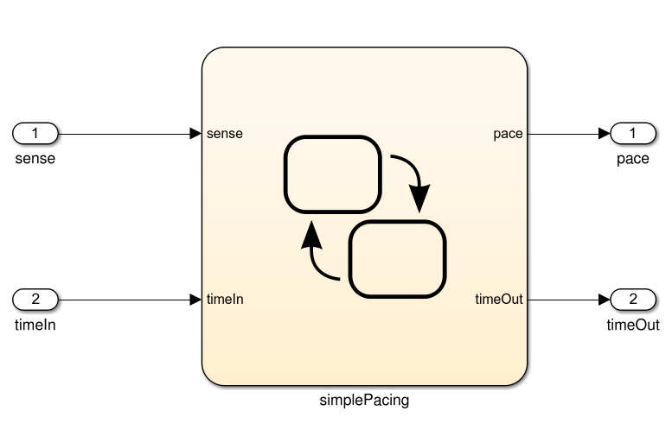
What Can We Do With This Model?
… Then we can derive test cases from the model that can be applied to the program. If the model and program do not agree, then there is a fault.
Specification
public static void Main(){
System.out.println(“Hello world!”);
}
And If the model is well-formed, consistent, and complete.
And If the model accurately represents the program.
If the model satisfies the specification...
Notes:
So, what can we do with this model? Well,
(1-4).

Slide 6
Model-Based Testing
Models describe the structure of the input space.
They identify what will happen when types of input are applied to the system.
That structure can be exploited:
Identify input partitions.
Identify constraints on inputs.
Identify significant input combinations.
Can derive and satisfy coverage metrics for certain types of models.
Notes:
(1-6). All as part of the process of verification - of using the specification to look for faults in the system.
Anytime that you have structure, you can measure coverage of that structure - just like we did with source code. Today, we’ll present some common model types and go over how to derive test cases that achieve coverage over those models.

Slide 7
Model Properties
To be useful, a model must be:
Compact
Models must be simplified enough to be analyzed.
“How simple” depends on how it will be used.
Predictive
Represent the real system well enough to distinguish between good and bad outcomes of analyses.
No single model usually represents all characteristics of the system well enough for all types of analysis.
Notes:
To be useful for analysis, there are four properties that we want to see out of a model.
(read) - this depends on how it will be used. For human inspection, a model must be relatively simple. Otherwise, you’ll get lost. For automated verification, it can be more complex, but must not fall prey to state space explosion. it needs to still be small enough to be analyzed computationally.
(read6)
You need to be able to run this analysis and link it back to the real system. (read7)
For instance, you’d build seperate models to analyze airflow over an aircraft fusulage and to analyze the internal layout for efficient passenger loading.

Slide 8
Model Properties
To be useful, a model must be:
Meaningful
Must provide more information than success and failure. Must allow diagnoses of the causes of failure.
Sufficiently General
Models must be practical for use in the domain of interest.
An analysis of C programs is not useful if it only works for programs without pointers.
Notes:
(read, read) If a property is violated, we must be able to tell why it was violated. If we model a building design, and it tells us that it collapses when there is an earthquake, we need to be able to go through the analysis and figure out what we can change to prevent a collapse in the next simulation.
(read) - don’t adapt them to be so specific to a simplified version of your problem that they fail to be useful for use on the un-abstracted problem. There are limitations to what a lot of these verification techniques can analyze, but still, there is a difference between working within limitations and still getting some meaning out of the analysis and performing a pointless analysis just for the sake of looking smart. (read).

Slide 9
Finite State Machines
Notes:
15 minute break

Slide 10
Finite Abstraction
A program execution can be viewed as a sequence of states alternating with actions.
Software “behavior” is a sequence of state-action-state transitions.
The set of all possible behaviors is often infinite.
Called the “state space” of the program.
Models of execution are finite abstractions (simplifications) of the full program’s state space.
Notes:
(read) performed by the program. A computation is performed, leaving the program in a new state, then another computation is performed - based on the input - and the program enters another state.
So, (read 2).
If we abstract away the physical limits of a piece of computing hardware, (read 3). We call the whole set of states and transitions the “state space” of the program.
(read 5)

Slide 11
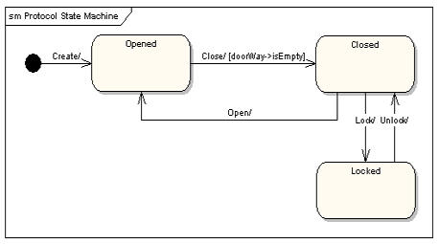
Finite State Machines
A directed graph.
Nodes represent states
An abstract description of the current value of an entity’s attributes.
Edges represent transitions between states.
Events cause the state to change.
Labeled event [guard] / activity
event: The event that triggered the transition.
guard: Conditions that must be true to choose a transition.
activity: Behavior exhibited by the object when this transition is taken.
Notes:
Models are often constructed prior to the code, or independent from it, and may serve as a specification of the allowed behavior. In that case, the most common way to model system behavior is to take the original natural language specification, choose a function, and represent the behavior of the system when performing that function as a finite state machine.
You often see this done for systems where it is crucial to ensure that the requirements are complete and non-contradictory. So, most often, this is done for embedded systems - where you see complex, highly conditional behavior. Communication protocols often can be directly represented as state machines. Menu-driven applications can also easily be modeled at state machines, as can thread behavior and communication in systems with multiple threads and processes.
These are directed graphs where nodes represent snapshots of the system - states (3)
and edges represent how the system responds to events - they represent (4).
(5), from any state, how the system can react to events is represented by transitions to all reachable states from that point, marked with a label (6-9)

Slide 12
Some Terminology
Event - Something that happens at a point in time.
Operator presses a self-test button on the device.
The alarm goes off.
Condition - Describes a property that can be true or false and has duration.
The fuel level is high.
The alarm is on.
Notes:
First, let’s cover some terminology. We commonly talk about the behavior of software in terms of events and conditions, then reflect on the state of the software. What does that actually mean, though?
(read) - things that occur that trigger a response from the software. Something went wrong, an alarm is raised. A human starts the self-test, which causes the software to enter a self-test mode. These are interactions that occur at some point in time.
(read). Describe the environment or software over a period of time. An event happens and it is over, a condition is something that is true over a period of time. It can be triggered by an event, but is not an event.

Slide 13
Some Terminology
State - An abstract description of the current value of an entity’s attributes.
The controller is in the “self-test” state after the self-test button has been pressed, and leaves it when the rest button has been pressed.
The tank is in the “too-low” state when the fuel level is below the set threshold for N seconds.
Notes:
(read). The state of an object or of the software is some description of what it is currently doing. What mode is it in? What is guiding its behavior?

Slide 14
States, Transitions, and Guards
States change in response to events.
A state change is called a transition.
When multiple responses to an event (transitions triggered by that event) are possible, the choice is guided by the current conditions.
These conditions are also called the guards on a transition.
Notes:
(read)

Slide 15
State Transitions
Transitions are labeled in the form:
event [guard] / activity
event: The event that triggered the transition.
guard: Conditions that must be true to choose this transition.
activity: Behavior exhibited by the object when this transition is taken.
Notes:
(read)

Slide 16
State Transitions
Transitions are labeled in the form:
event [guard] / activity
All three are optional.
Missing Activity: No output from this transition.
Missing Guard: Always take this transition if the event occurs.
Missing Event: Take this transition immediately.
Notes:
(read)

Slide 17
State Transition Examples
Transitions are labeled in the form:
event [guard] / activity
The controller is in the “self-test” mode after the test button is pressed, and leaves it when the rest button is pressed.
Pressing self-test button is an event.
Pressing the rest button is an event.
The tank is in the “too-low” state when fuel level is below the threshold for N seconds.
Fuel level below threshold for N seconds is a guard.
Notes:
(read)

Slide 18
Example: Gumball Machine
[gumballs > 0]
Waiting for Quarter
user ejects quarter
user inserts quarter
Quarter Inserted
user turns crank
[gumballs -1 > 0] / dispense gumball
Out of Gumballs
Gumball Sold
[gumballs -1 = 0] / dispense gumball
Notes:
Old school mechanical devices are dead. Today, people are building software into everything from refridgerators to cars. Now, we want to bring gumball machines into the modern day. By putting CPUs in our machine, we can increase sales, monitor inventory, and add new features. How do we do this? We start by modeling the behavior of our gumball machine as a state machine. (walk through)
initial state
point out transitions and guards
Now, this isn’t detailed enough to serve as source code directly - there are a lot of actions unaccounted for - what should happen if a person tries to eject a quarter then there isn’t one in the machine? what if they insert two quarters? Those decisions need to be made during implementation, and should have been covered in the requirements, but this gives us an abstracted overview of what happens then the system operates - how the system reacts to events and what conditions guide those actions.

Slide 19
More on Transitions
Guards must be mutually exclusive
If an event occurs and no transition is valid, then the event is ignored.
last bill ejected [balance > 0 && balance >= needed]
Able to Purchase
last bill ejected
[balance = 0]
last bill ejected
[balance > 0 && balance < needed]
Waiting for Money
More Money Needed
Notes:
- (read) When events occur, you can only take one transition, so if multiple transitions are activated by the same event, they must have guards that decide which to take. This is a good way to tell if you’ve made a mistake in your specification - can you take more than one transiiton at once? then something is wrong, and that’ll be a bug in your code if not fixed.
-(read) for instance, what if you ejected a bill, but still had greater than the needed balance? then no transition is taken

Slide 20
Internal Activities
Special events: entry and exit.
Other activities occur until a transition occurs.
On each “time step”.
Entry and exit not re-triggered without a self-transition.
States can react to events and conditions without transitioning using internal activities.
Typing
entry / highlight all
exit / update field
character entered / add to field
help requested [verbose] / open help page
help requested [minimal] / update status bar
Notes:
(read) (walk through state example_
(read entry and exit and explain)
A similar thing you could do in a state diagram is use a self-transition, have an arrow pointing from a state back to itself. The point of a self-transition is if you want to remain in a state, but want to trigger an action in response to a particular event. These internal activities fo the same thing - allow you to respond to events without a state transition - but with one difference. A self-transiiton will trigger the exit and enter actions each time it is taken. Internal activities will not retrigger entry and exit unless you take transitions away from and back to the state.

Slide 21
Example: Maintenance
If the product is covered by warranty or maintenance contract, maintenance can be requested through the web site or by bringing the item to a designated maintenance station.
If the maintenance is requested by web and the customer is a US resident, the item is picked up from the customer. Otherwise, the customer will ship the item.
If the product is not covered by warranty or the warranty number is not valid, the item must be brought to a maintenance station. The station informs the customer of the estimated cost. Maintenance starts when the customer accepts the estimate. If the customer does not accept, the item is returned.
No Maintenance
Waiting for Pick Up
Request - No Warranty
Wait for Acceptance
Wait for Returning
Notes:
The maintenance function records the history of items undergoing maintenance. Read over
If we look over this closely, we can identify states
- no maintenance - nothing is going on right now
- What about waiting for shipping? Probably not - that’s not something the software is aware of. We just care about what the software is handling. Customers will ship items without alerting us.
- Request is made without warranty - we send out the total then, we wait for a response. If they don’t like it, we then return the item to them.

Slide 22
Example: Maintenance
Repair at Station
If the maintenance station cannot solve the problem, the product is sent to the regional headquarters (if in the US) or the main headquarters (otherwise). If the regional headquarters cannot solve the problem, the product is sent to main headquarters.
Maintenance is suspended if some components are not available.
Once repaired, the product is returned to the customer.
Repair at Regional HQ
Repair at Main HQ
Wait for Component
Repaired
Notes:
- Try repairing it at the station
- If that fails (regional/main)
- wait
- return
This is open to some interpretation, obviously - but you should be sure to cover all states that the system can exhibit. Be as detailed as possible, but remember to restrict yourself to what the software can actually do - what info it tracks and can influence. The software can’t know, for instance, that a customer has shipped an item to it unless we explicitly note that the customer could do something like log a tracking number. The next step is to link up these states with all of the transitions that we can extract from this text. What does this look like?

Slide 23
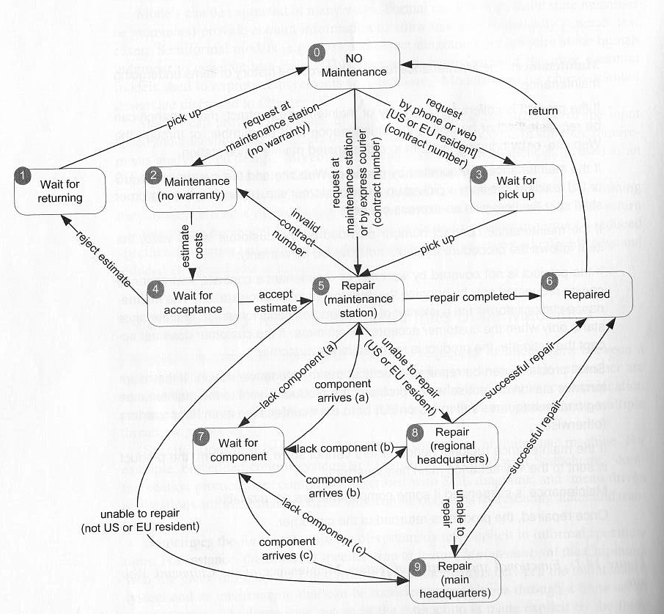
Example: Maintenance
Notes:
go over

Slide 24
Finite State Space
Most systems have an infinite number of states.
For a communication protocol, there are an infinite number of possible messages that can be passed.
Non-finite components must be ignored or abstracted until the model is finite.
For the communication protocol, the message text doesn’t matter. How it is used does matter.
Requires an abstraction function to map back to the real system.
Notes:
(1). A state is what the current values of the system’s variables are at any given time, and most variables have a huge - if not infinite - number of variations. (2)
When you model, (3).
The thing is, we don’t need all of those variables and their values. We usually model these things before building code, so we might only know about a few variables. So, we model what we know, and we simplify down to what is important (4)
(5) - we need to know how to make comparisons to the model for this test to be run and judged on the real system.

Slide 25
Abstraction Functions
We can link a concrete state to a model state through an abstraction function.
Translates the real program to a model by stripping away details.
Groups states that only differ through details abstracted from the model.
This has two effects:
Sequences of transitions are collapsed into fewer execution steps.
Nondeterminism can be introduced.
Notes:
(read) concrete in real space of execution - this is a translation function that strips away details from the real program to produce the simplified model. (read 3) So, if two states in the real program only differ in a way that the model doesn’t care about, we combine them in the model. This means the model has fewer states than the real program. This has two effects.
Because states are removed, (read 4). As a result (read 5). Normally, you know exactly what transition to take - the details are there. Now, because we’ve removed details, we might get into situations where multiple transitions are possible, and the details differentiating their transitions have been removed for the model. This is a bad thing - we aren’t sure if the right transition will be taken, because we can’t tell them apart - we need to just choose at random.

Slide 26
Abstraction Functions
This has two effects:
Sequences of transitions are collapsed into fewer execution steps.
Nondeterminism can be introduced.
x = 0;
y = 0;
z = 0;
x = 0;
y = 0;
z = 1;
x = 0;
y = 1;
z = 0;
x = 0;
y = 1;
z = 1;
Program:
x = 0;
y = 0;
x = 0;
y = 1;
Model:
x = 0;
y = 0;
z = 0;
x = 0;
y = 1;
z = 0;
Program:
Model:
x = 0;
y = 0;
x = 0;
y = 0;
z = 1;
x = 1;
y = 1;
z = 1;
x = 0;
y = 1;
x = 1;
y = 1;
Notes:
(explain examples) only care about x and y
Models are inevitably imperfect - collapsing the potentially infinite state space into something that can be analyzed requires leaving out some information. While we hope those omissions are irrelevant to the properties we want to analyze, that isn’t always the case. By introducing non-determinism, we make the models imprecise, we have some guesswork involved in analyzing them, and we risk producing a model that does not correlate to the real program.

Slide 27
Activity - Secret Panel Controller
You must design a state machine for the controller of a secret panel in Dracula’s castle.
Dracula wants to keep his valuables in a safe that’s hard to find. So, to reveal the lock to the safe, Dracula must remove a strategic candle from its holder. This will reveal the lock only if the door is closed. Once Dracula can see the lock, he can insert his key to open the safe. For extra safety, the safe can only be opened if he replaces the candle first. If someone attempts to open the safe without replacing the candle, a monster is unleashed.
Notes:
(include 5 minute break)

Slide 28
Activity Solution
Open
safe closed / close panel
key turned [candle in] / open safe
candle removed [door closed] / reveal lock
Wait
Lock Revealed
key turned [candle out] / release monster
Monster Unleashed
Notes:
walk through

Slide 29
State Coverage
Each state reached by one or more test cases.
Like statement coverage - unless model has been placed in each state, faults cannot be revealed.
Easy to understand and obtain, but low fault-revealing power.
The software takes action during the transitions, and most states can be reached through multiple transitions.
Notes:
Several coverage metrics based on covering the structure of the state machine. The first is, of course, - state coverage.
(1)
the natural analog to statement coverage - (2)
(3-4) transitions - that’s when input comes in, the next state is decided, and output is released - and (rest)

Slide 30
Transition Coverage
A transition specifies a pre/post-condition.
“If the system is in state S and sees event I, then after reacting to it, the system will be in state T.”
A faulty system could violate any of these precondition, postcondition pairs.
Coverage requires that every transition be covered by one or more test cases.
Subsumes state coverage.
Notes:
(1). A transition from state S-T on event i means that “if the system is in state S and sees event i, then after reacting to it, the system will be in state T.
State S is a precondition, T is the postcondition, and I is the input. If this input arrives and we are in S, we should be in T once the transition is over
(3), and each should be checked.
(5) - if we’ve covered all transitions, we’ve obviously hit each state.

Slide 31
Example: Maintenance
If no “final” states, we could achieve transition coverage with one large test case.
Smarter to break down FSM and target sections in isolation.
Example Suite:
T1: request w/ no warranty (0->2) - estimate costs (2->4) - reject (4->1) - pick up (1->0)
T2: 0->5->2->4->5->6->0
T3: 0->3->5->9->6->0
T4: 0->3->5->7->5->8->7->8->9->7->9->6->0
T5: 0->5->8->6->0
Notes:
(1) - final - states that we cannot transition out of after reaching them (rest of 2). However, like with code coverage, this often isn’t a good idea. It’s better to have a larger number of small tests so you can examine problems in isolation if they crop up. It makes sense to break the FSM into sections and cover those, tracking what needs to be covered.
- T1
- T2
- T3
-T4
-t5

Slide 32
History Sensitivity
Transition coverage based on assumption that transitions out of a state are independent of transitions into a state.
Many machines exhibit “history sensitivity”.
Transitions available depend on the history of previous actions.
AKA - the path to the current state.
Can be a sign of a bad model design.
“wait for component” in example.
Path-based metrics can cope with sensitivity.
Notes:
(1-4). If we’re in a state and deciding what to transition to next, we might need information on the path taken to that point to know we’ve made the right selection.
Go back to example - take “wait for component”. Once we’re in that state, we can transition to any of the repair states. Which one? if we (show mismatch), well, that should be impossible in the real system. If we use transition coverage as our guide, we’d get a test from the model that can’t be replicated and passed by the system- at least we hope. We need to know where it came from in the first place. We need that path history to know that we made the right choice. This is arguably a design flaw in the model, and a huge issue if the system can replicate it - we should not be able to take any of these transitions. Really, our model should have three different waiting states, each with their own transition. That said, sometimes it is better just to work with a flawed model, and there are some path-based coverage metrics that can cope with history sensitivity.

Slide 33
Path Coverage Metrics
Single State Path Coverage
Requires that each subpath that traverses states at most once to be included in a path that is exercised.
Single Transition Path Coverage
Requires that each subpath that traverses a transition at most once to be included in a path that is exercised.
Boundary Interior Loop Coverage
Each distinct loop must be exercised minimum, an intermediate, and a large number of times.
Notes:
(1-2). This deals with the looping issue that makes path coverage impossible. We remove cycles from paths. We need to visit all states without looping through cycles forever, as you would have to in full path coverage. - maybe draw simple example on the board
(3-4)
(5-6)
Even without looping, the number of paths can be exponentially high, so these are often impractical, but can be very powerful if they can be satisfied.

Slide 34
Single State/Transition Path Coverage
Single State/Transition Path Coverage
Requires that each subpath that traverses states/transitions at most once to be included in a path that is exercised.
Notes:
go over
Remember - each state at most once. If you have to return to a previous state, you can end the path.
(5 clicks). I am not going to go over every one, but this should give the idea. Each path that does not touch a state previouslt hit in that path must be covered. This gives a stopping criterion on subpaths, so that you do not loop forever, as you could in this case.

Slide 35
Boundary Interior Loop Coverage
Boundary Interior Loop Coverage
Each distinct loop must be exercised minimum, an intermediate, and a large number of times.
Notes:
(1-2). Let’s pick a loop. (bring in)
The minimum can vary, in some cases, any test will exercise it multiple times, but it should be at least once. Then, pick some upper bound - probably less than 10. Then, something in the middle.

Slide 36
Test Generation
Test cases created for models can be applied to programs.
Events can be translated into method input.
System output, when abstracted, should match model output.
Model coverage is one form of requirements coverage. Tests should be effective for verification.
Notes:
(go over)

Slide 37
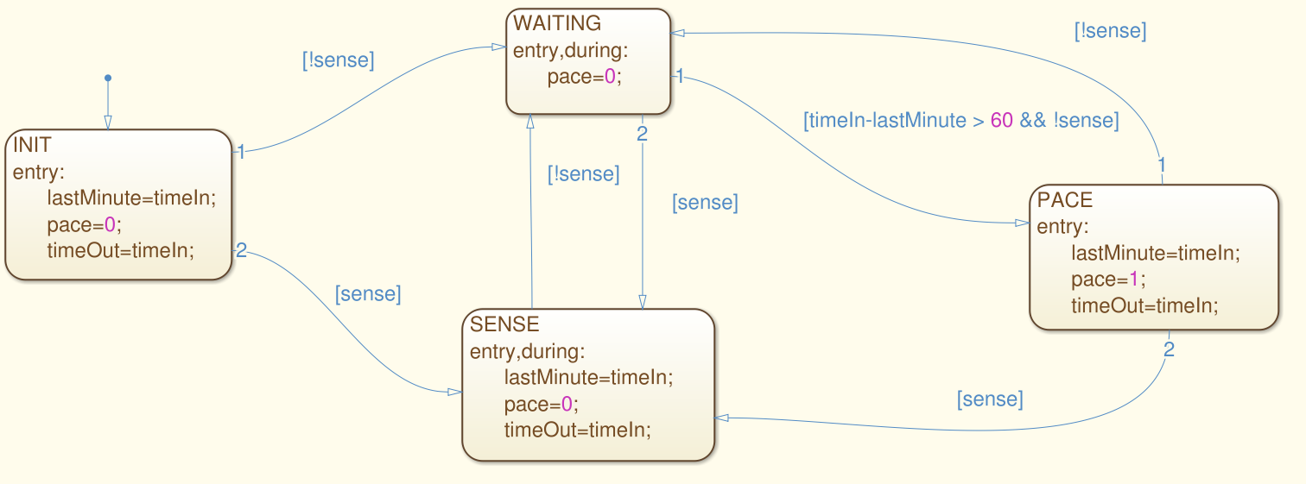
Activity
For this model, derive test suites that achieve state and transition coverage.
Notes:
(go over)

Slide 38
Activity - State Coverage
[true,1], [false,2], [false, 65]
Notes:
(go over)(3 clicks). Pretty simple.

Slide 39
Activity - Transition Coverage
[true,1], [false,2], [false, 65], [true, 66], [false, 77], [true, 78], [false, 79], [false, 140], [false, 141]
[false, 1]
Notes:
Transition coverage is a little more complicated.
Start by expanding the first test (9 clicks)
Just leaves one transition. For that, we need a second test because it is a transition out of the initial state, and there is no way back to the original state.
Not the only suite, not even the best suite. That first test is really long and may be hard to understand. May want to distribute this out over both.

Slide 40
Let’s take a break.
Notes:
10 minute break

Slide 41
Decision Structures
Notes:
10 minute break

Slide 42
Logic Terminology
A predicate is a function with a boolean outcome.
If inputs of the function are clear, they are left implicit.
We don’t care how accounts are represented. There are just predicates “is-a-educational-customer”, “is-a-corporate-customer”
A condition is a predicate that cannot be decomposed further.
A decision, is 2+ conditions, connected with operators (and, or, xor, implication).
Notes:
(1-2). You might have an account system, where the actual representation of account types is a three letter code, but in a specification, we might not care about that representation, we just care about whether they have an educational account. In that case, educational account is a predicate that is either true or false
(4-5) - and, or, not, xor, implies

Slide 43
Decision Structures
Specifications often expressed as decision structures
Conditions on input values, and corresponding results.
Example:
NoDiscount = (indAcct ^ !(current > indThreshold) ^ !(offerPrice < indNormalPrice)) v (busAcct ^ !(current > busThreshold) ^ !(current > busYearlyThreshold) ^ !(offerPrice < busNormalPrice))
Decision structures can be modeled as tables, relating predicate values to outputs.
Notes:
(1-2). For example, we might have a specification describing outputs that depend on the type of account - educational, business, or ondividual - the amount of current and yearly purchases, and the availability of special prices. These can be considered as a series of boolean conditions - educational account is either true or false - and outputs can be described as expressions over these predicates. For example (3-4)
(5)

Slide 44
Decision Tables
Decision structures can be modeled as tables, relating predicate values to outputs.
Rows represent basic conditions.
Columns represent combinations of conditions, with the last row indicating the expected output for that combination.
Cells are labeled T, F, or - (don’t care).
Column is equivalent to a logical expression joining the required values.
Notes:
1-5 - where the value doesn’t matter
(6) and leaving out don’t care values.

Slide 45
Decision Tables
Can be augmented with a set of constraints that limit combinations.
Formalize the relations among basic conditions
Expressions over predicates:
(Cond1 ^ !Cond2 => Cond3)
Short-hand for common combinations:
at-most-one(C1...Cn)
exactly-one(C1...Cn)
Cond1 | T | F
Cond2 | F | -
Cond3 | T | T
Out | T | F
Notes:
(go over example)
(1-4) that are tedious to express with standard boolean connectives. (5-6)
at most one - all can be false, but at most, only one can be true
exactly one - one of these must be true, rest must be false

Slide 46
Example Decision Table
Constraints
at-most-one(EduAc,BusAc)
at-most-one(YP<=YT1, YP > YT2)
at-most-one(CP<=CT1, CP > CT2)
at-most-one(SP<=T1, SP > T2)
YP > YT2 => YP > YT1
CP > CT2 => CP > CT1
Special > Tier 2 => Special > Tier 1
Abbreviations
CP = current purchase
YP = yearly purchase
C(Y)T = current/yearly threshold
EduAc | T | T | F | F | F | F | F | F
BusAc | - | - | F | F | F | F | F | F
CP > CT1 | - | - | F | F | T | T | - | -
YP > YT1 | - | - | - | - | - | - | - | -
CP > Ct2 | - | - | - | - | F | F | T | T
YP > YT2 | - | - | - | - | - | - | - | -
Special > Normal | F | T | F | T | - | - | - | -
Special > Tier 1 | - | - | - | - | F | T | - | -
Special > Tier 2 | - | - | - | - | - | - | F | T
Out (Price Type) | Edu | Special | None | Special | Tier 1 | Special | Tier 2 | Special
Notes:
go over some examples
Indicates different pricing policies, depending on a set of predicates that we can calculate.

Slide 47
Decision Table Coverage
Basic Condition Coverage
Translate each column into a test case.
Don’t care entries can be filled out arbitrarily, as long as constraints are not violated.
Compound Condition Coverage
All combinations of truth values for predicates must be covered by test cases.
Requires 2^{n} test cases for n predicates.
Can only be applied to small sets of predicates.
Notes:
The three condition-related coverage metrics from structural testing can be used here, and again, the first two represent extreme ends of the spectrum
(1-3) - this is fairly cheap and covers the basic business logic - the situations you’ve envisioned and included.
(3-6)

Slide 48
Example - Basic Condition Coverage
?
Constraints
at-most-one(EduAc,BusAc)
at-most-one(YP<=YT1, YP > YT2)
at-most-one(CP<=CT1, CP > CT2)
at-most-one(SP<=T1, SP > T2)
YP > YT2 => YP > YT1
CP > CT2 => CP > CT1
SP > T2 => SP > T1
EduAc | T | T | F | F | F | F | F | F
BusAc | - | - | F | F | F | F | F | F
CP > CT1 | - | - | F | F | T | T | - | -
YP > YT1 | - | - | - | - | - | - | - | -
CP > Ct2 | - | - | - | - | F | F | T | T
YP > YT2 | - | - | - | - | - | - | - | -
SP > Sc | F | T | F | T | - | - | - | -
SP > T1 | - | - | - | - | F | T | - | -
SP > T2 | - | - | - | - | - | - | F | T
Out | Edu | SP | ND | SP | T1 | SP | T2 | SP
Test 1: (T,-,-,-,-,-,F,-,-)
Test 2: (T,-,-,-,-,-,T,-,-)
Test 3: (F,F,F,-,-,-,F,-,-)
Test 3: (F,F,F,-,F,-,F,-,-)
Notes:
So, for Basic condition coverage, we simply take each column and design test cases that match each. Again, don’t care entries can become whatever we want as long as no constraints are violated. What you can do here is to set those “don’t care” variables in such a way that one test satisfies multiple columns.
- (go over - only one, can’t cover anything else just because of how EduAc works)
- (same deal, T, T, can’t cover anything else)
- (Go to the third column. Now, if we select carefully (CP > ct2, SP>T2), it looks like we could cover two tests with this one, but it would violate this constraint.
- We can either have CP <= Ct1 or CP > Ct 2. By having that false, we can’t have the second as true. That actually tells us what to pick for a don’t care there as well
- We can use these constraints to help fill out test cases. Unfortunately, we can’t cover multiple columns with one test here due to the constraints.

Slide 49
Example - Compound Condition Coverage
EduAc | T | T
BusAc | F | T
CP > CT1 | F | F
YP > YT1 | F | F
CP > Ct2 | F | F
YP > YT2 | F | F
SP > Sc | F | F
SP > T1 | F | F
SP > T2 | F | F
EduAc | T | T
BusAc | F | T
CP > CT1 | F | F
YP > YT1 | F | F
CP > Ct2 | F | F
YP > YT2 | F | F
SP > Sc | F | F
SP > T1 | F | F
SP > T2 | F | F
… etc
(2⁹ combinations)
Constraints
at-most-one(EduAc,BusAc)
at-most-one(YP<=YT1, YP > YT2)
at-most-one(CP<=CT1, CP > CT2)
at-most-one(SP<=T1, SP > T2)
YP > YT2 => YP > YT1
CP > CT2 => CP > CT1
SP > T2 => SP > T1
Removes 128 combinations
Removes 96 more combinations
Removes 64 more combinations
Notes:
So, in compound condition coverage, we ignore the basic truth table. Instead, we take each condition and try all legal combinations - so all combinations allowed under our constraints.
Ignoring constraints, we start with 2^9 combinations, or 512 test cases. We can’t actually run all of those, so this is where the constraints become important.
we then take the constraints and rule out illegal combos
- Right away, we see one combo that can’t happen - EduAc and BusAc can’t both be true, so that eliminates a large number of pairings - ¼, so 128. Leaving you with 384. We can pare down from there.
- Our second constraint disallows YP > YT1 = false and YP > YT2 = true, so it removes another 96 combinations, leaving us with 288
- Similar deal with our next constraint, disallows CP>CT1 = false and CP > CT2 = true. This removed another 64 combinations, down to 224.
You get the idea.

Slide 50
Decision Table Coverage
Modified Decision/Condition Coverage (MC/DC)
Each column represents a test case.
In addition, new columns are generated by modifying the cells containing T and F.
If changing a value results in a test case consistent with an existing column, the two are merged back into one.
A test suite should not just test positive combinations of values, but also negative combinations.
Notes:
The third, MCDC, again strikes a balance between the extremes - potentially exposing more faults, but requiring fewer test cases than compound condition coverage
(2-4) - consistent - they agree on all don’t care columns - we merge them back into one, prodivded no constraints are violated.
The idea here is that (5) - those combinations that differ from the ones we’ve explicitly spelled out. These combinations should produce different outcomes from those already specified - either other specified outcomes or error conditions.

Slide 51
Example Decision Table
EduAc | T | F | T | T | F | F | F | F | F | F
BusAc | - | - | - | - | F | F | F | F | F | F
CP > CT1 | - | - | - | - | F | F | T | T | - | -
YP > YT1 | - | - | - | - | - | - | - | - | - | -
CP > Ct2 | - | - | - | - | - | - | F | F | T | T
YP > YT2 | - | - | - | - | - | - | - | - | - | -
SP > Sc | F | F | T | T | F | T | - | - | - | -
SP > T1 | - | - | - | - | - | - | F | T | - | -
SP > T2 | - | - | - | - | - | - | - | - | F | T
Out | Edu | ND | SP | SP | ND | SP | T1 | SP | T2 | SP
EduAc | T | T | F | T | F | F | F | F | F | F | F | F
BusAc | - | - | F | F | T | F | F | F | F | F | F | F
CP > CT1 | - | - | F | F | F | T | F | F | T | T | - | -
YP > YT1 | - | - | - | - | - | - | - | - | - | - | - | -
CP > Ct2 | - | - | - | - | - | - | - | - | F | F | T | T
YP > YT2 | - | - | - | - | - | - | - | - | - | - | - | -
SP > Sc | F | T | F | F | F | F | T | T | - | - | - | -
SP > T1 | - | - | - | - | - | - | - | - | F | T | - | -
SP > T2 | - | - | - | - | - | - | - | - | - | - | F | T
Out | Edu | SP | ND | Edu | ND | T2 | SP | SP | T1 | SP | T2 | SP
EduAc | T | T | F | T | F | F | F | F | F | F
BusAc | - | - | - | - | F | F | F | F | F | F
CP > CT1 | - | - | - | - | F | F | T | T | - | -
YP > YT1 | - | - | - | - | - | - | - | - | - | -
CP > Ct2 | - | - | - | - | - | - | F | F | T | T
YP > YT2 | - | - | - | - | - | - | - | - | - | -
SP > Sc | F | T | T | F | F | T | - | - | - | -
SP > T1 | - | - | - | - | - | - | F | T | - | -
SP > T2 | - | - | - | - | - | - | - | - | F | T
Out | Edu | SP | SP | Edu | ND | SP | T1 | SP | T2 | SP
EduAc | T | T | F | F | F | F | F | F
BusAc | - | - | F | F | F | F | F | F
CP > CT1 | - | - | F | F | T | T | - | -
YP > YT1 | - | - | - | - | - | - | - | -
CP > Ct2 | - | - | - | - | F | F | T | T
YP > YT2 | - | - | - | - | - | - | - | -
SP > Sc | F | T | F | T | - | - | - | -
SP > T1 | - | - | - | - | F | T | - | -
SP > T2 | - | - | - | - | - | - | F | T
Out | Edu | SP | ND | SP | T1 | SP | T2 | SP
Notes:
Take this example again.
- col 1 - adds two, show flip. Both of these already exist in this table, though, so we don’t need to keep them
- col 2 - adds two, show flip - also both already here, so we don’t need to keep them.
- col 3 - adds four, show flip - three of these are new, so we keep them, the fourth exists, so we get rid of it
You get the idea. If we keep going, we will add several new columns to the table, but fewer than would be required for compound condition coverage.

Slide 52
Activity
Airline Ticket Discount Function
Read the specification and draw a decision table.
How many tests would be required for compound condition coverage?
Expand the table to form a MC/DC test suite. How many tests were added?

Slide 53
Activity - Decision Table
Infant | T | T | F | F | F | F
Child | F | F | T | T | F | F
Domestic | T | F | - | - | - | F
International | F | T | - | - | - | T
Early | - | - | T | - | T | -
Off-Season | - | - | - | - | - | T
Discount | 80 | 70 | 20 | 10 | 10 | 15
Constraints:
Infant => !Child
Child => !Infant
Domestic => !International
International => !Domestic
Domestic xor International
Notes:
Go over
How many tests for compound condition - 6 conditions, 2^6 = 64 tests. Let’s see what we can do with MCDC

Slide 54
Activity - Decision Table
Infant | T | F | T | F | T | F | F | F | F | F | T | F | F | F | F
Child | F | F | F | T | F | T | T | F | F | F | F | T | F | F | F
Domestic | T | T | F | - | - | - | - | - | - | F | F | F | T | F | F
International | F | F | T | - | - | - | - | - | - | T | T | T | T | F | T
Early | - | - | - | T | T | F | - | T | F | - | - | - | - | - | -
Off-Season | - | - | - | - | - | - | - | - | - | T | T | T | T | T | F
Discount | 80 | 0 | 70 | 20 |  |  | 10 | 10 |  | 15
Infant | T | F | T | F | T | F | F | F | F | F | T | F | F
Child | F | F | F | T | F | T | T | F | F | F | F | T | F
Domestic | T | T | F | - | - | - | - | - | - | F | F | F | F
International | F | F | T | - | - | - | - | - | - | T | T | T | T
Early | - | - | - | T | T | F | - | T | F | - | - | - | -
Off-Season | - | - | - | - | - | - | - | - | - | T | T | T | F
Discount | 80 | 0 | 70 | 20 | ?? | 10 | 10 | 10 | 0 | 15 | 70 | 15 | 0
Infant | T | F | T | F | T | F | F | F | F | F | T | F | F
Child | F | F | F | T | F | T | T | F | F | F | F | T | F
Domestic | T | T | F | - | - | - | - | - | - | F | F | F | F
International | F | F | T | - | - | - | - | - | - | T | T | T | T
Early | - | - | - | T | T | F | - | T | F | - | - | - | -
Off-Season | - | - | - | - | - | - | - | - | - | T | T | T | F
Discount | 80 | 0 | 70 | 20 | ?? | 10 | 10 | 10 | 0 | 15 | 70 | 15 | 0
Infant | T | F | T | F | T | F | F | F | T | F | F | F
Child | F | F | F | T | F | T | T | F | F | T | F | F
Domestic | T | T | F | - | - | - | - | - | - | - | - | F
International | F | F | T | - | - | - | - | - | - | - | - | T
Early | - | - | - | T | T | F | - | T | T | T | F | -
Off-Season | - | - | - | - | - | - | - | - | - | - | - | T
Discount | 80 | 0 | 70 | 20 |  |  | 10 | 10 |  |  |  | 15
Infant | T | F | T | F | T | T | T | T | F | F | F | F
Child | F | F | F | F | T | F | F | F | T | T | F | F
Domestic | T | T | F | F | F | T | F | F | - | - | - | F
International | F | F | T | F | F | F | F | T | - | - | - | T
Early | - | - | - | - | - | - | - | - | T | - | T | -
Off-Season | - | - | - | - | - | - | - | - | - | - | - | T
Discount | 80 | 0 | 70 |  |  |  |  | 70 | 20 | 10 | 10 | 15
Infant | T | F | T | F | T | F | F | F | F | -
Child | F | F | F | T | F | F | T | T | F | -
Domestic | T | T | F | - | - | - | - | - | - | -
International | F | F | T | - | - | - | - | - | - | T
Early | - | - | - | T | T | T | F | - | T | -
Off-Season | - | - | - | - | - | - | - | - | - | T
Discount | 80 | 0 | 70 | 20 |  |  |  | 10 | 10 | 15
Infant | T | F | T | F | T | F | F | T | F | F | F
Child | F | F | F | T | F | T | T | T | F | F | F
Domestic | T | T | F | - | - | - | - | - | - | - | F
International | F | F | T | - | - | - | - | - | - | - | T
Early | - | - | - | T | T | F | - | - | - | T | -
Off-Season | - | - | - | - | - | - | - | - | - | - | T
Discount | 80 | 0 | 70 | 20 |  |  | 10 |  |  | 10 | 15
Infant | T | F | T | T | T | T | F | F | F | F
Child | F | F | T | F | F | F | T | T | F | F
Domestic | T | T | T | F | T | F | - | - | - | F
International | F | F | F | F | T | T | - | - | - | T
Early | - | - | - | - | - | - | T | - | T | -
Off-Season | - | - | - | - | - | - | - | - | - | T
Discount | 80 | 0 |  |  |  | 70 | 20 | 10 | 10 | 15
Infant | T | F | F | F | F | F | T | F | F
Child | F | F | T | T | F | F | F | T | F
Domestic | T | T | - | - | - | F | F | F | F
International | F | F | - | - | - | T | T | T | T
Early | - | - | T | F | T | - | - | - | -
Off-Season | - | - | - | - | - | T | T | T | F
Discount | 80 | 0 | 20 | 10 | 10 | 15 | 70 | 15 | 0
Constraints:
Infant => !Child
Child => !Infant
Domestic => !International
International => !Domestic
(Domestic xor International)
Notes:
First col - we add four tests. Second violates rule - infant/child, so we remove it. Third says the flight is neither domestic or international, so it goes. Fourth violates constraints dom/int.
- 1/2 - contradicts constraints, 3 - already have, 4 - contradicts constraints
- first doesn’t violate constraints, so we’ll keep it for now - we’ll talk about that in a minute. Second is something we already have, so it goes. Third is ok too
- add two, both are bad, both go
- adds three - first two we already have, third is fine for now
- adds two, both ok - first, can’t leave domestic as a don’t care.
Now, we can simplify this a bit. Some of these cases can be combined by taking out don’t cares and making them explicit. First, let’s add in outcomes
- go over marked. Now, let’s merge the redundant ones.
- get rid of red, needs info about the flight type, get rid of blue on right, is redundant, green, get rid of left, purple, get rid of left
- Now, left with 9 test cases. Slightly more than our original 6, but we cover a better range of conditional cases and hit a few more outcomes.

Slide 55
We Have Learned
If we build models from functional specifications, those models can be used to systematically generate test cases.
Models have structure. We can exploit that structure.
A form of functional testing.
Helps identify important input.
Coverage metrics based on the type of model guide test selection.

Slide 56
We Have Learned
State machines model expected behavior.
Cover states, transitions, non-looping paths, loops.
Can also be used in finite state verification (next class)
Decision tables model complex combinations of conditions and their expected outcomes.
Cover basic conditions and their combinations.

Slide 57
Next Time
Finite State Verification
Optional Reading - Pezze and Young, Chapter 8
Homework 3
Due Friday, March 13
Questions?

