Slide 1
Project Support: Version Control and Issue Tracking
CSCE 247 - Lecture 5 - 02/04/2019
Notes:
open pdf of withdrawal example

Slide 2
Managing Change
We now have requirements.
Are they set in stone?
What needs to happen when they change?
Next is design, then implementation.
What happens when those change?
These artifacts evolve throughout development, and after release.
Effective engineers can control the impact of change, and ensure that all artifacts evolve when any change.
Today - Version Control and Issue Tracking
Notes:
(1-5) Back in the first lecture, I said that evolution is a constant - code will change, requirements will change, design will change. Handling change in an elegant manner is a fundamental principle guiding software engineering. What happens when a project artifact changes or needs to change? How do we ensure we deliver a good product. (7) Today, we’re going to look at that question, and focus on two fundamental tools of modern development - version or source control and issue tracking.

Slide 3
Code Evolution
I want to add a feature to MyAwesomeApp.
Open in my IDE, edit the code, save.
Done, right?
Let’s test it out…
MyAwesomeApp
MyAwesomeApp
Version 2.0
Notes:
Let’s focus on code. Let’s say you have a project. It’s working well. But, you want to add a feature. Well, we just open the code, make changes, save it, and try it out. We now have beautiful, sparkly version 2 of our code. Great, right? Well… If it work, yes. But, there are a few complicating factors.

Slide 4
Complicating Factors
What if the changes don’t work?
Can we go back to what we had before?
Especially hard if we’ve made a series of changes.
When do we overwrite a backup?
MyAwesomeApp
?
MyAwesomeApp
Version 2.0
Notes:
First, what if the changes don’t work? Well, maybe we could keep patching, but what if it was a fundamentally bad idea? It just isn’t going to work, no matter what we do? Or, what if we made a series of changes and found that our new feature makes the rest of the system too slow? (2) Not if we didn’t keep a backup somewhere, and restoring a backup gets harder as we make more changes to that code. When do you overwrite your backup?

Slide 5
Complicating Factors
What if I want to work on my code on two computers?
Did you copy over all files?
Did you remember to sync changes?
What if you forgot to sync and edited files on both?
Desktop
Laptop
MyAwesomeApp
MyAwesomeApp
MyAwesomeApp
Version 2.0?
?
MyAwesomeApp
Version 2.0?
Notes:
Slightly different question - (1). Well, just copy and send them over to the other machine, right? Well.. (2), did you forget anything? Ok, you’re fine - we changed some files on one machine. Did you send the changed files back to the other machine? What if we forget to sync and change files on both machines? How do we reconcile those changes?

Slide 6
Complicating Factors
What if multiple people are working on the project?
What happens if multiple people edit the same file?
When do you synchronize?
How do you reconcile conflicting changes?
MyAwesomeApp
Notes:
(go over)

Slide 7
Version Control
A version control system (VCS) tracks and manages changes to a filesystem.
Tracks addition, deletion, and modification of files.
Allows users to share and integrate these filesystem changes to other VCS users.
Enables work to progress on multiple machines.
Allows backup rollback to previous versions.
VCS allows collaboration.
Each person edits their own copies of files and chooses when to share those changes.
Integrates work done simultaneously by team members. Edits to the same file can be combined.
Notes:
Well, the solution is obviously version control. A version control system or VCS, also know as revision control or source control system, is a software utility that tracks and manages changes to a filesystem in a controlled manner. When operating at the filesystem level, a VCS will track the addition, deletion, and modification actions applied to files and directories. A VCS also offers collaborative utilities to share and integrate these filesystem changes to other VCS users. Version control also enables one person you to use multiple computers to work on a project. Version control gives access to historical versions of your project. This is insurance against computer crashes or data lossage. If you make a mistake, you can roll back to a previous version. You can reproduce and understand a bug report on a past version of your software. You can also undo specific edits without losing all the work that was done in the meanwhile. For any part of a file, you can determine when, why, and by whom it was ever edited.
Version control enables multiple people to simultaneously work on a single project. Each person edits his or her own copy of the files and chooses when to share those changes with the rest of the team. Thus, temporary or partial edits by one person do not interfere with another person's work. Version control integrates work done simultaneously by different team members. In most cases, edits to different files or even the same file can be combined without losing any work. In rare cases, when two people make conflicting edits to the same line of a file, then the version control system requests human assistance in deciding what to do.

Slide 8
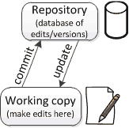
Repositories and Working Copies
The repository is a database of changes made to files.
The working copy is your copy of all of the files in the project.
This is where you do your work.
The repository tracks edits over time, and dictates what the “official” version of the filesystem contains.
You update that version by committing local changes to the repository.
Incorporate changes by updating the working copy.
Notes:
Version control uses a repository ( which is a database of changes made to the files) and a working copy where you do your work. Your working copy (sometimes called a checkout) is your personal copy of all the files in the project. You make arbitrary edits to this copy, without affecting your teammates. When you are happy with your edits, you commit your changes to a repository. A repository is a database of all the edits to, and/or historical versions (snapshots) of, your project. It is your source of truth - the repository dictates what the current version of that file system contains. (5)
It is possible for the repository to contain edits that have not yet been applied to your working copy. You can update your working copy to incorporate any new edits or versions that have been added to the repository since the last time you updated.

Slide 9
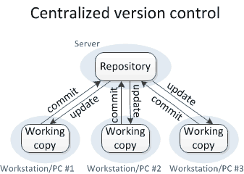
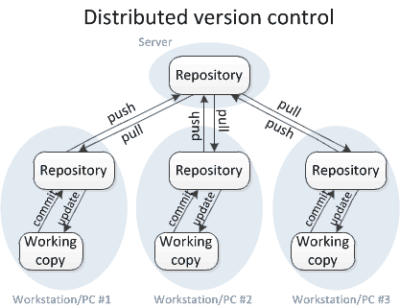
Centralized and Distributed VCS
In centralized VCS, the repository is stored on a central server.
In decentralized VCS, all working copies are paired with a copy of the repository.
A central repository is used to coordinate and synchronize the local repositories.
Notes:
VCS tools come in two primary types of remote architecture. These architecture types are centralized and distributed. The main difference between centralized and distributed version control is the number of repositories. In centralized version control, there is just one repository, and in distributed version control, there are multiple repositories. (1-3)

Slide 10
Centralized and Distributed VCS
Decentralized VCS has become standard.
Centralized CVS has a single point of failure.
If the central server is lost, we could lose data.
If it is unavailable, developers cannot push changes, merge updates, or roll back code.
Decentralized avoids this by keeping a copy of the repository in each working copy.
If the central server is lost, any copy could become the “central” source of truth.
Notes:
(1) A centralized VCS has a single point of failure, which is the remote central VCS instance. If this instance is lost, it can cause productivity and data loss, and it will need to be replaced with another copy of the source code. If it temporarily becomes unavailable, it will prevent developers from pushing, merging or rolling-back code.A distributed model architecture avoids these pitfalls by keeping a full copy of the source code at each VCS instance. If any of the previously mentioned centralized failure scenarios happen within the distributed model, a new VCS instance can be swapped in to lead development mitigating any serious drop in productivity. (last point)

Slide 11
Basic Workflow
To establish a working copy, you checkout or clone the repository.
This downloads the current version of all files to your local machine.
git clone https://github.com/User/Project.git
Make changes to files.
You must tell the VCS what you have changed or plan to change.
This is called staging.
git add MyFile.java
Notes:
Using a VCS requires following a certain workflow. This starts by getting the files onto your current machine. (1) - this tells the repository that you want the current version of the project, and the repository then tells you what those files look like. (2-3).
Great - we now have files. Let’s make some changes. You can do this however you like - in an IDE, in a text editor, whatever you want. From here, our source control system knows that we have a repository set up, but it needs a little guidance to automatically start saving all the changes you make to your files. The first thing we have to do is tell our source control system about the files within the repository we created or changed. This is known as staging a file. (last point)

Slide 12
Committing Changes
A commit takes a snapshot of the project in its current state.
The commit command takes the set of changes and writes them to the repository.
git commit -m “Message”
Commits form a history of snapshots that can be revisited at any time.
In decentralized systems, the commit must also be pushed to all other copies of the repository.
git push origin master
Notes:
Now that our source control system is keeping track of changes being made, the final piece is the famed commit. The simplest way to think of a commit is imagining taking a snapshot of your project at its current state. This snapshot represents a certain point in your application that you want to save. (2-3)
As you make commits throughout the life of your project, you form a history of snapshots that can be traversed to see any changes made. It also allows you to revert to an early commit if you encounter problems with your application.
The commit command writes to the repository. In a decentralized system, this is just your local repsitory. You then need to push the changes to the other copies of the repository. (last point)

Slide 13
Commit Best Practices
Commits are accompanied by an explanatory message.
git commit -m “Fixes issue #1337 by adding a configuration flag”
Use descriptive commit messages.
These messages indicate the purpose of the change and are used to find the right commit.
If the commit relates to a known issue, refer to that issue ID.
Describe what the commit does - use verbs.
Notes:
(1-3) It only takes a moment to write a good commit message. This is useful when someone is examining the change, because it indicates the purpose of the change.This is useful when someone is looking for changes related to a given concept, because they can search through the commit messages. (last two points)

Slide 14
Commit Best Practices
Make each commit a logical unit.
Each commit should have a single purpose and should completely implement that purpose.
One feature change, bug fix, redesigned class.
Makes it easier to locate changes related to a particular feature or bug fix.
Allows isolated analysis of changes.
Don’t try to fix a fault at the same time you introduce new functionality.
What if you want to fix an issue before finishing a change?
git commit can selectively commit files.
Notes:
(1-3) This makes it easier to locate the changes related to some particular feature or bug fix, (5-6) The utility of the version control history is compromised if one commit contains code that serves multiple purposes, or if code for a particular purpose is spread across multiple different commits. During the course of one task, you may notice another issue and want to fix it too. You can choose to commit only a subset of the changed files at a time — the commit command of every version control system supports this.If a single file contains changes that serve multiple purposes, you may need to save your all your edits, then re-introduce them in logical chunks, committing as you go.

Slide 15
Commit Best Practices
Avoid indiscriminate commits.
Specify specific files to commit (either when adding or committing changes).
Do not commit all changed files unless you intend to.
Do not include temporary debugging changes.
To avoid committing more than intended:
git status lists all modified files.
git diff shows specific changes made.
git commit file1 file2 -m “Message” only commits the named files.
Notes:
(1)As a rule, I do not run git commit without supplying specific files to commit (2). If you supply no file names, then these commands commit every changed file. You may have changes you did not intend to make permanent (such as temporary debugging changes); even if not, this can create a single commit with multiple purposes. When I want to commit my changes, to avoid accidentally committing more than I intended, I always run the following commands: (last three)

Slide 16
Commit Best Practices
VCS is intended for the files people edit.
Do not commit generated files.
.class, .o files. Temporary or compiled artifacts (.pdf).
Generated files are not needed in version control. Users can regenerate them.
Generated files are prone to conflict.
Generated files tend to be binary files. Version control cannot identify differences between two versions of a binary file.
A .gitignore file lists filenames to ignore.
Notes:
Version control is intended for files that people edit. Generated files should not be committed to version control. For example, do not commit binary files that result from compilation, such as .o files or .class files. Also do not commit .pdf files that are generated from a text formatting application; as a rule, you should only commit the source files from which the .pdf or .class files are generated. Generated files are not necessary in version control; each user can re-generate them (typically by running a build program such as make or ant). Generated files are prone to conflicts. They may contain a timestamp or in some other way depend on the system configuration. It is a waste of time to resolve such uninteresting conflicts. This is a particular problem when the generated file is binary. Version control systems can concisely record the differences between two versions of a textual file (usually the differences are much smaller than the file itself). However, version control systems have to store each version of a binary file in its entirety. To tell your version control system to ignore given files, create a top-level .gitignore file

Slide 17
Incorporating Changes
An update operation applies the changes made in all commits since your last update.
You commit, they update.
In decentralized VCS, you must first pull updates into your repository, then update your working directory.
You commit, you push, they pull, they update.
Commit and update move changes between working copy and local repository. Push and pull move changes between local and central repositories.
git pull performs both pull and update.
Notes:
That tells us how to save our changes. What if we’re working with others and they’ve made a change? Or you’ve worked on a different machine and want to bring in your work to your normal machine? (1-4) Notice that the commit and update commands only move changes between the working copy and the local repository, without affecting any other repository. By contrast, the push and pull commands move changes between the local repository and the central repository, without affecting your working copy.

Slide 18
Update Best Practices
Incorporate changes frequently.
Run git pull before making any changes.
If someone has made a change before you start to edit, it is a waste of time to make changes then have to resolve conflicts.
Run git pull before git push.
This allows you to resolve conflicts quickly.
Also push changes frequently!
Once you have completed work, share those changes with all copies of the repository.
Do not hold changes on your machine.
Notes:
(1) Work with the most up-to-date version of the files as possible. That means that you should run git pull very frequently. (2) When two people make conflicting edits simultaneously, then manual intervention is required to resolve the conflict. But if someone else has already completed a change before you even start to edit, it is a huge waste of time to create, then manually resolve, conflicts. You would have avoided the conflicts if your working copy had already contained the other person's changes before you started to edit. (4-6)
Once you have committed the changes for a complete, logical unit of work, you should share those changes with your colleagues as soon as possible (by doing git push). So long as your changes do not destabilize the system, do not hold the changes locally while you make unrelated changes. The reason is the same as the reason for incorporating others' changes frequently.

Slide 19
Conflicts
A conflict occurs if two users make simultaneous, different changes to the same line of a file.
Manual intervention is needed to resolve a conflict.
Changes 1 & 2 are simultaneous if:
User A makes Change 1 before performing the update that brings in Change 2.
User B makes Change 2 before performing the update that brings in Change 1.
Frequent push and pull help avoid conflicts.
Notes:
A version control system lets multiple users simultaneously edit their own copies of a project. Usually, the version control system is able to merge simultaneous changes by two different users: for each line, the final version is the original version if neither user edited it, or is the edited version if one of the users edited it. A conflict occurs when two different users make simultaneous, different changes to the same line of a file. In this case, the version control system cannot automatically decide which of the two edits to use (or a combination of them, or neither!). Manual intervention is required to resolve the conflict. “Simultaneous” changes do not necessarily happen at the exact same moment of time. Change 1 and Change 2 are considered simultaneous if: User A makes Change 1 before User A does an update that brings Change 2 into User A's working copy, and User B makes Change 2 before User B does an update that brings Change 1 into User B's working copy. It is better to avoid a conflict than to resolve it later. (3), but do not rule them out entirely.

Slide 20
Conflicts
Remember that VCS tools are line-based.
Be careful with adjusting indentation.
Do it if you need to, but check for accidental indentation changes.
Avoid excessively long lines.
80-character lines are often recommended.
Longer lines are more likely to cause conflicts.
More people will edit that line.
The more characters, the harder it is to determine the exact changes when viewing VCS history.
Shorter lines are easier to read when viewing or editing a source file.
Notes:
(1) Version control tools record changes and determine conflicts on a line-by-line basis. (2-3), as imposed by the text editor you’re using.
Do not write excessively long lines; as a general rule, keep each line to 80 characters. The more characters are on a line, the larger the chance that multiple edits will fall on the same line and thus will conflict. Also, the more characters, the harder it is to determine the exact changes when viewing the version control history. As another benefit, 80-character lines are also easier to read when viewing/editing the source file.

Slide 21
Summarizing Basic Workflow
git clone (on initialization)
git pull (on new change)
Make local edits.
Examine local edits:
git diff, git status
git add
git commit
git pull
git push
Notes:
Go over

Slide 22
Not Just for Source Code
VCS should always be used for source code, but can also be used for requirements, design, and other documentation.
Update and commit workflow can be used for any type of file.
Binary files (.pdf, .doc, images) are complicated as there is no way to identify specific changes to files.
No way to merge elements from versions of conflicting files. VCS simply stores newest version.
However, machine-readable files can be used without issue (.txt, .csv).
Notes:
(1)

Slide 23
Branches
The history of commits forms a tree.
The core version of the system is called the master branch.
The master branch should be relatively stable, tested, and free of faults (as far as we know).
How can we add new features or redesign elements of the system while keeping the master branch stable?
VCS allows the creation of new branches.
Notes:
(go over)

Slide 24
Branches
Creating a branch takes the current commit of an existing branch (usually master) as the starting point for a new timeline.
This can be the current commit to any existing branch.
Commits to the new branch are not applied to the original branch.
Commits to the original branch are not applied to the new branch.
When finished, the branch can be merged into the original branch.
May require handling conflicts.
Notes:
In the context of software development, when we create a new branch we are essentially branching away from the master branch so we can work on a new feature or bug fix without the risk of breaking something in our master branch. (1-4)
Once we’ve finished, tested it, and made sure it works, we can merge it back into the master branch.

Slide 25
Branches
These are known as feature branches.
Insulated from master branch, so we can make changes without impacting stability for other developers.
Once complete, we can merge the working change into the master branch
Allows experimentation without breaking anything or impeding others.
Many projects have a stable master branch, a development branch, and feature branches stemming from that.
Enables control over development.
Notes:
Commonly,these branched are referred to as feature branches. Within the feature branch, we are insulated from the master branch, so we can make changes, stage files and make commits separately without impacting the stability of the core system for the other developers, who might be working on their own changes. Once the feature or bug fix is complete we can merge in the changes made in the feature branch back into the master branch. The benefits of having separate branches for our features is that it allows us to further develop our project without breaking the working version of the application along the way. When implementing a source control system in this way, we end up with a beautiful development tree that gives us access to previous commits, branches that show the different features added on and, of course, a backup of our entire project.

Slide 26
Branches
To create or switch to a branch:
git checkout -b <new branch name> [<base branch name>]
[<brase branch name>] is optional, default value is master.
To push changes:
git push origin <new branch name>
Git push origin master commits changes to the master branch.
git pull incorporates changes to all branches.
git commit commits to the currently “checked out” branch.

Slide 27
Forks
A fork is a copy of a complete repository.
Contains all past commits and branches.
New commits to the original repository are not applied to a fork.
New commits to a fork are not applied to the original repository.
Commits can be selectively merged into the original.
Used when a team wants to take the project in an independent direction and does not plan to merge their work.
Often used in open-source by amateurs to extend a project they are not part of.
Notes:
(go over)

Slide 28
Merging Branches or Forks
Pull requests are used to tell others about changes you would like to merge into a branch.
Once sent, interested parties can review changes, discuss them, and push additional follow-up commits before agreeing to merge.
Performed through the web interface (i.e., Github).
Once conflicts are resolved, the target branch will be updated by applying all commits to the source branch.
Notes:
Now, say we have been working on a branch, and it’s ready. We want to bring those changes into master. What do we do? Pull requests are the favored mechanism for performing a merge. (1-3), not the command line. It is possible to merge branches through the command line, but not recommended. This mechanism uses the features of the web interface to allow discussion, review, and follow up changes. (last point)

Slide 29
Pull Requests
Common tool in open-source development.
Fork the project to create a “personal copy” or create a branch in the core repository.
Incorporate your changes.
Issue a pull request to the core repository.
Same mechanism is used for both fork-to-original and branch-to-branch (i.e., new branch-to-master) merging.
Project maintainers discuss the pull request and assess whether it fits the project (and does not break anything).
Project maintainers agree to incorporate changes.

Slide 30

Pull Request
To create a pull request, you must have changes committed to the your new branch.
Go to the core repository page on Github, click the “Pull requests” tab, and click "New pull request" button.
Pick the source branch using the "head repository” and “compare” dropdowns. Pick the target branch using the “base repository” and “base” dropdowns.
Notes:
Go over dropdowns

Slide 31
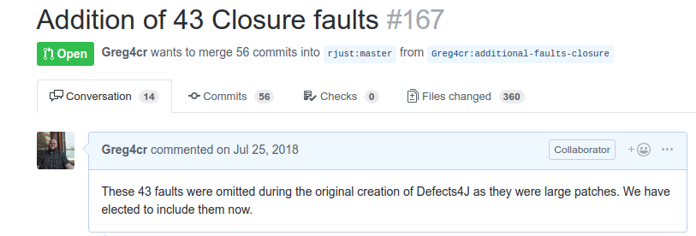
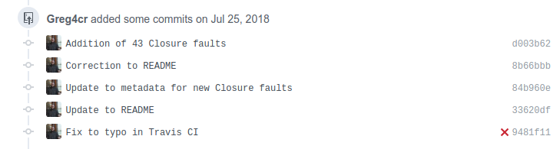
Pull Requests
Fill out a title and description of the changes.
Commits that will be applied to the target are listed.
Notes:
(1) - go over screenshot. 56 commits, target, source, files changed, title/dscription

Slide 32
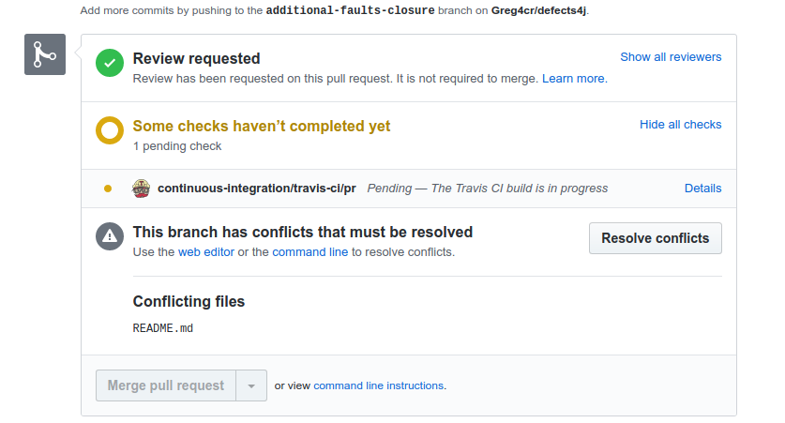
Pull Requests
Contributors may discuss or review the request.
Conflicts may need to be resolved.
When ready, click the “Merge pull request” button.

Slide 33
Issue Tracking
Issue tracking systems allow developers to track reported software issues.
Used to record information about the issue and the status of fixing that issue.
Also often used to request new features and track progress on implementation of these features.
Often available as part of project management software (i.e., Github).
Issues can be reported by developers and end-users of the system.

Slide 34
Issue Tracking
Commonly tracked details:
What happened: The erroneous behavior.
How to reproduce the issue: Steps (and often test cases) that will demonstrate the behavior.
The severity of the issue: A rating of how badly this affects users (and how widespread it is).
When the issue was reported: Allows tracking of age of issues, and measuring fix time.
Responsibility: Who reported the issue and who has been tasked with fixing the issue.
Notes:
2-3, good bug reports MUST have both of these. Not just that I saw something, but what I was doing when I saw it. This is essential to fixing issues.

Slide 35
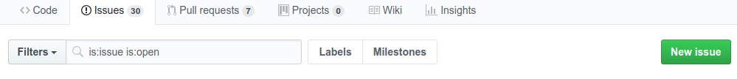
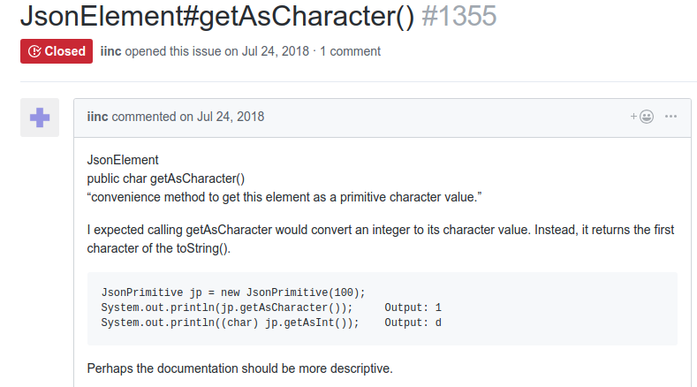
Filing an Issue
Go to the “Issues” tab on the project page, and click “New issue.”
Fill out a title and description.
Be sure to include both what happened and steps to reproduce.
Notes:
Point out issue ID, title, description of what happened, reproduction, suggestions

Slide 36

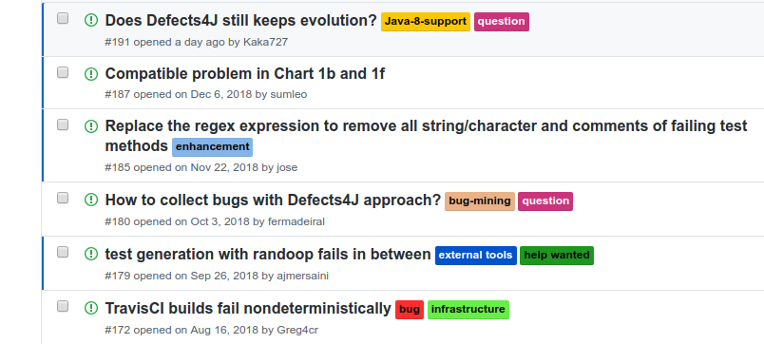

Filing an Issue
Issues can be labeled.
Common: “bug”, “enhancement”
Users can be assigned to fix the issue.

Slide 37
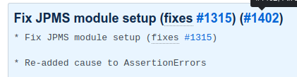


Filing an Issue
Refer to report IDs in commit messages and pull requests addressing such issues.
Allows traceability, showing progress in addressing issues.
Notes:
Top: commit, middle: pull request, bottom: bug report

Slide 38
Issue Reporting Advice
Only include one bug per issue.
If an issue covers multiple bugs, it is harder to track progress and ensure all bugs are fixed.
Allows flexible assigning of priority and responsibility.
If existing issues cover multiple bugs, split them into unique issues.
If linked, refer to their issue IDs in each report.
Use descriptive subjects.
Issue title is used to get an idea of the contents at a glance. Very important to convey what exactly is wrong in the title.
Tracker might have hundreds of issues. Important to let developers search information efficiently.
Notes:
Each issue ultimately needs to be resolved and closed. But if an issue covers multiple bugs, it becomes that much harder for developers to keep track of the moving parts as they try to fix each piece—because instead of perhaps three bugs, it now only looks like a single bug—and that’s how bugs can fall through the cracks. It’s also not uncommon for team members to be responsible for distinct areas of an application, so by filing separate issues instead of a mega-issue, you also gain the flexibility to give each issue a unique assignee and priority. If any of your existing issues cover multiple bugs, you should split them into separate issues so they can be addressed individually. But since splitting issues leaves room for mistakes, confusion, or other misunderstandings, you’re better off filing them as individual issues right from the start. If you need to convey a relationship among a set of issues, include references from each issue to its related issues.
(6) When someone looks through a list of issues, the issues’ subjects are the most important identifying information they see. Think of each issue’s subject as its name. In real life, for instance, you wouldn’t refer to your best friend as “the person” since that could refer to anyone—you’d use your friend’s name instead. The same goes with issues. A subject of “Broken Login” doesn’t convey what part of the login screen is broken or at which point it failed. But a subject like “Can’t log in because I’m missing a user account” wipes out that ambiguity. Clear and accurate subjects make it easier to locate specific issues and quickly understand what they’re about. They’ll make your team more efficient and help them resolve issues more quickly.

Slide 39
Issue Reporting Advice
Focus on the facts.
Do not speculate on the cause of an issue if you can avoid it. Give exact facts rather than guessing.
If you have an educated guess, you can provide it. Just be careful, as these often are wrong.
Describe your expectations.
Describe what you expected to happen when you used the system. Some issues are subjective.
Describe what actually happened. Include output text, a screenshot, a URL if you can.
“I can’t log in” versus “I’m at (URL) and I’m trying to log in using my username, (username). But the system is saying that my username can’t be found, and it’s taking me to (URL).”
Notes:
(1) It might be tempting to speculate on what you think might be causing a problem, and there are occasions now and again where that can be helpful. But more often than not, those hunches can end up being a red herring that can send a developer down the wrong path, making it more difficult for them to get to the bottom of things. It’s generally better to stick to the facts about a bug rather than trying to guess what might be causing the problem. That’s not to say that you shouldn’t ever speculate, but do so sparingly and only when your guess is more of an educated guess gleaned from observable behavior
(4) What did you expect to happen? Some bugs may be subjective. And if you’re reporting an issue without clarifying what you expected to happen, you might get a response like “working as designed” or “this looks fine to me.” So when you’re filing an issue, include a sentence or two on what you’re expecting to happen, and that’ll make it easier for developers to understand what you’re looking for. What actually happened? So you came across a bug. Did you see any errors along the way? Or did you have a chance to grab a URL or screenshot for the page you were taken to? When an issue is hard to reproduce, sometimes a screenshot or an error message can be the key to solving the problem. For instance, an issue that just said “I can’t log in” or “login is broken” would leave a lot to the imagination, and the developer working on it would probably need some clarification. Adding a little more detail in your initial reports can help reduce the chances that developers will have to ask follow-up questions later. Instead, “I’m at (URL) and I’m trying to log in using my username, (username). But the system is saying that my username can’t be found, and it’s taking me to (URL).” That report would take only a moment longer to write, but it eliminates any gray areas, so there’s no question in the developer’s mind what’s wrong. Providing information like screenshots, URLs, and specific error messages can potentially shave hours off the time it takes to fix an issue.

Slide 40
Issue Reporting Advice
Document each problem as soon as you encounter it.
Then try to reproduce the problem based on the steps you just wrote down.
Even if you can’t reproduce the problem, it’s still worth reporting.
Sometimes multiple reports of an issue are the only way a developer can track it down.
If you can reproduce, try to reduce the sequence of steps down to the simplest sequence that still triggers the issue.
Notes:
While many bugs are easy to reproduce, that’s not always the case. It’s safer to assume that the developers trying to fix a bug won’t be able to reproduce the problem on their end. There are a couple of tricks you can use to help you capture most (if not all) of the steps to reproduce an issue: (1-4) If you can consistently reproduce a problem, take your steps to reproduce the issue and whittle them down to the simplest sequence that still triggers the issue. And if you can include screenshots or video to help illustrate the steps you’re going through, that can really help.

Slide 41
Issue Reporting Advice
Before reporting an issue, check whether it was already reported.
Include platform information.
What OS are you using? Which version?
What hardware is in your machine?
Describe the severity of the issue.
Blocker: No further testing work can be done.
Critical: Application crash, Loss of data.
Major: Major loss of function.
Minor: Minor loss of function.
Trivial: Some UI enhancements.
Notes:
A duplicate bug is a burden in the testing cycle. Check the whole list of known bugs. At times, the developers might have known the issue and ignored for a future release. Tools often automatically search for duplicate bugs when you fill out a report.However, it is best to manually search for any duplicate bug.
(3-5), CPU, amount of RAM, graphics card - those can impact behavior.

Slide 42
Issue Reporting Advice
Report issues immediately.
This ensures detailed and reproducible reports.
Reproduce the bug three times before writing the report.
Make sure your steps are robust enough to reproduce the bug without ambiguity.
See if the issue occurs in similar modules.
If code is repeated or used, see if you can corrupt the dependent modules.
May allow identification of most severe appearance of fault.
Notes:
1) Report the problem immediately: If you find any bug while testing, then need not wait to write a detail bug report later. Instead write the bug report immediately. This will ensure a good and reproducible bug report. If you decide to write the bug report later on then there are high chances to miss the important steps in your report. 2) Reproduce the bug three times before writing a bug report: Your bug should be reproducible. Make sure that your steps are robust enough to reproduce the bug without any ambiguity. If your bug is not reproducible every time you can still file a bug mentioning the periodic nature of the bug. 3) Test the same bug occurrence on other similar modules: Sometimes the developer uses the same code for different similar modules. So there are higher chances for the bug in one module to occur in other similar modules as well. You can even try to find the more severe version of the bug you found.

Slide 43
We Have Learned
Your project will evolve over time. Tool support can ensure that this process is smooth.
Version control can be used to control how code and other artifacts evolve.
A history of snapshots is maintained and can be revisited.
Mistakes can be easily resolved by rolling back to a snapshot.
Allows multiple developers to collaborate.
Branches and forks allow experimental development while maintaining a stable version.
Notes:
read these

Slide 44
We Have Learned
Issue trackers allow developers and end-users to report bugs.
Reports should detail the user’s expectations, what actually happened, and steps or tests that allow reproduction of the issue.
System can be used to track whether issues are fixed, what issues affected the system in the past, and who is responsible for fixing issues.
Can also be used to manage feature requests and progress towards implementing them.
Issue IDs can be references in code commit messages and pull requests.

Slide 45
Next Time
Testing Fundamentals
What is testing?
What are the stages of testing?
Sommerville, Chapter 8
Homework 1
Due February 10th
Ask questions online!
Notes:
read these

