Slide 1
Lecture 3: Quality Scenarios
Gregory Gay
DIT636/DAT560 - January 24, 2023

Slide 2
Today’s Goals
Examine quality attributes.
Reliability: Ability to minimize number of visible failures.
Availability: Ability to mask or repair failures so cumulative service outage is not excessive.
Performance: Ability to meet timing requirements.
Scalability: Ability to “grow” the system to process increasing number of requests.
Security: Ability to protect data and information from unauthorized access
How to assess each using scenarios.

Slide 3
Scenarios
Description of interaction between external entity and system. Defines:
Event that triggers the scenario.
Interaction initiated by the external entity.
Response required (in terms of quality attribute).
Similar to use cases or user stories, but examines both quality and functionality.
Notes:
the most important goal of any developer is that the project meets the needs of your stakeholders. In practical terms, this means that the system built must be able to perform certain tasks while exhibiting the specific quality attributes - performance and such - that are important to the stakeholders. A good way to stay grounded when developing your system is to continually consider how the ideas you are developing will actually work in practice. We can do this by defining and applying scenarios to your system, both as a brainstorming exercise during design and in practice - as our first quality assurance practice - when building it.A scenario is a well-defined description of an interaction between an external entity and the system. It defines the event that triggers the scenario, the interaction initiated by the external entity, and the response required of the system, defined in terms of a measurement based on an appropriate quality attribute - for instance, if we are interested in performance, we might define a task and the current load, and measure the performance of the system against a threshold - number of jobs completed in a time frame, average speed of a job, and so on. Similar to use cases or user stories, but examines both quality and functionality. A sort of “high-level” test case of the system. These often get translated later into detailed test cases to apply while testing the system.

Slide 4
Scenarios
Capture a range of requirements:
A set of interactions with users to which a system must respond.
Processing in response to timed events.
Peak load situations that could occur.
Regulator demands.
Failure response.
A change that a maintainer might make.
Any situation that the design must handle.
Notes:
Scenarios can be used to capture a wide range of requirements, such as:
• A particular set of interactions with its users to which the system must be
able to respond
• The processing that must happen automatically at a particular point in time,
such as month end
• A particular peak load situation that could occur
• A demand that an external regulator might make of a system
• How the system must respond to a particular type of failure
• A change that a maintainer might need to be made to the system
• Any other situation with which the design of the system must be able to cope

Slide 5
Scenario Usage
Provide input to architecture definition.
Help flesh out and find missing requirements.
Evaluate system architecture.
Force description of execution paths through system
Find missing/incompatible interfaces.
Communicate with stakeholders.
Concrete, easy to understand.
Drive the testing process.
Help prioritize testing efforts.
Notes:
You can use scenarios in a number of ways within the development process.
(1) Scenarios can provide part of this input and keep the process grounded in reality by challenging you to design solutions to specific problems the scenarios pose. it is common for scope and requirements to be ill defined in the early stages of development, and scenarios (2) Considering how the system behaves in one scenario often leads stakeholders to realize that another situation they hadn’t previously considered was omitted from the requirements analysis.
(3) Scenarios are a primary input into almost any process of architectural evaluation, which can range from simple credibility checks to heavyweight reviews using a formal process like the Architecture Tradeoff Analysis Method (ATAM). Scenarios force you to consider how well the system can respond to a specific situation, (4-5)
(6) Scenarios are (7). Discussion of a scenario, and how the system will respond to the situation described in it, is a very useful vehicle for communicating with stakeholders and is often much more effective than using traditional design documentation, particularly for less technical stakeholders. Indeed, for nontechnical stakeholders, scenarios may be the only way to communicate the implications of the proposed architecture in a way that they really understand.
(8) Scenarios help highlight the things that are important to your stakeholders, providing a useful guide for where to focus testing activity. After identifying your scenarios, use them to plan the sort of testing you will require, and make sure that the system’s testers have a copy of the scenarios as a basis for their initial test plans.

Slide 6
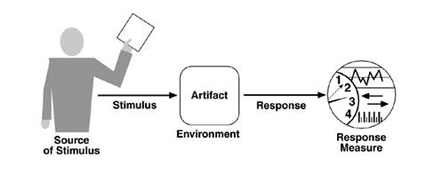
Scenario Format
Overview:
Brief description of the scenario.
External Stimulus:
Input or environmental factors that initiate the scenario.
(e.g., user request, infrastructure changes or failures, security attacks)
Notes:
When creating a scenario, you define six pieces of information. (click) First, you give a brief overview, desribing the goal of the scenario. What do you hope to show about the system using a scenario? (click) then, we define the stimulus. All scenarios start with a stimulus. This includes either one or more input events. This can be a request made to the system by a user or exernal system, or some change in the system’s environment that forces it to act, like a timer going off or a sensor getting a reading. This is some kind of interaction with the system that causes the scenario to occur. This could be a user request, infrastructure changes or failures, changes in external system behavior, security attacks, required modifications, or any of the other factor that requires the system to act and to possess a particular quality property in order to deal with the stimulus successfully.

Slide 7
Scenario Format
System State:
Aspects of internal state that affect quality (e,g., information stored in the system or database, current load)
System Environment:
Significant observations about the external environment (e.g., network connection, external system availability).
Notes:
Next (click) the internal state of the system when the stimulus occurs (if significant). What internal factors could influence the result. This may revolve around information stored in the system, current number of concurrent users, number of waiting tasks in a queue, contents of a database, remaining storage space, and such that could influence the resulting quality with regard to the attribute we care about. (click) we then look at the relevant factors in the system’s external environment - any significant observations about the environment that the system is running in, related to other pieces of software, infrastructure, even the physical world - such as the unavailability of external systems, current network conditions, particular infrastructure behavior, whether we can access a piece of hardware, if there is a fire in a room, and so on. Is there any special external factor that might influence system quality beyond the direct stimulus.

Slide 8
Scenario Format
Required System Response:
How does the system respond and meet the quality goal?
(e.g., how should it handle a defined increase in requests?)
Response Measure:
How we judge whether the system meets the quality goal.
(e.g., throughput, timing, availability)
Notes:
Finally, the last two items. (click) The required system response is a definition of how the system must behave in response to the stimulus. This is the functional response - what does it do when faced with this stimulus in this environment and state? This should include specifically how the system meets the quality goal - for instance, how does the system respond, from a functional point of view, to a defined increase in the number of requests arriving per minute (click) the response measure - this is how we judge whether the sysgtem met the quality goal. This should include a measurement - throuhput, timing, availability, mean time to repair, time to detect an intruder, etc - and a threshold that must be met. This is how we prove the system met our quality goal successfullly.

Slide 9
Response Measures
Most quality measurements are non-deterministic.
Time-based measures should be probabilistic.
95% of the time, the response should be N. (common case)
99% of the time, the response should be M. (worst case)
For real-time systems (e.g., embedded devices), time measurements should give a worst-case deadline.
For other measures, can give an absolute threshold.
Notes:
(1) - Performance, availability, scalability especially- Due to a variety of factors, you won’t always get the same exact measurement back. This is especially true with time bounds, like those you see in performance measurements. If you have a time measurement - you will do something within 2 seconds, you can complete 10 jobs in 10 minutes, etc., you should present the response measure probabilistically. Give a standard case, then give a worst-case scenario - (3-4). Now, if working with a real-time system like an embedded device, where you have stricter time requirements, you instead want to present absolute deadlines - the worst case you will accept. (last point). Security, reliability measures like POFOD or ROCOF, those you can give as absolute. I will accept a ROCOF of 2 per hour.

Slide 10
Example - Daily Data Update Increases in Size
Overview: How the system’s end-of-day processing behaves when regular data volumes are suddenly greatly exceeded.
System state: The system has stored summary statistics in its database for data that has been processed, and the system’s processing elements are lightly loaded at the current rate of system load (1,000 to 1,500 data items per hour).
System environment: The deployment environment is working correctly. The network connection is adequate.
External Stimulus: The data update rate suddenly increases to 4,000 items/hour.
Required system behavior: When end-of-day processing starts, the system should process the data set until processing time exceeds a system-configurable limit. At that point, the system should stop, leave the summary statistics in place, and log a diagnostic message.
Response measure: Availability should remain at 99.999%.
Notes:
Let’s do a couple of examples so you can see what these look like, then we can break down by quality attrbitute

Slide 11
Example - Failed Webpage Transmission
Overview: Client-facing web service fails during transmission of page update.
System State: System is working correctly under normal load (10,000 concurrent users).
Environment State: Deployment environment is operating normally. All services have adequate network connection.
External Stimulus: Customer has generated a “add item to cart” post request, which was routed to Server <X> in transaction pool. <X> crashes during response generation.
Notes:
Let’s go over an example. We’ll talk more about availability specifically later, but as a quick example. (go over)

Slide 12
Example - Failed Webpage Transmission
Required system behavior: The response page may be corrupted on client-side. Load balancer no longer receives heartbeat message from service and removes it from service pool after 2s of missed messages, or on next request sent to the service. A page reload will be routed to alternate service by load balancer and page will be correctly displayed on client-side.
Response measure: On client-side page refresh, client state and display contains state after last transaction. Time for re-routed refresh is equivalent to “standard” refresh (<1 second 95% of the time, <3 seconds 99% of the time).
Notes:
Why is this a good examples? specific and has a reasonable and testable response measure.

Slide 13



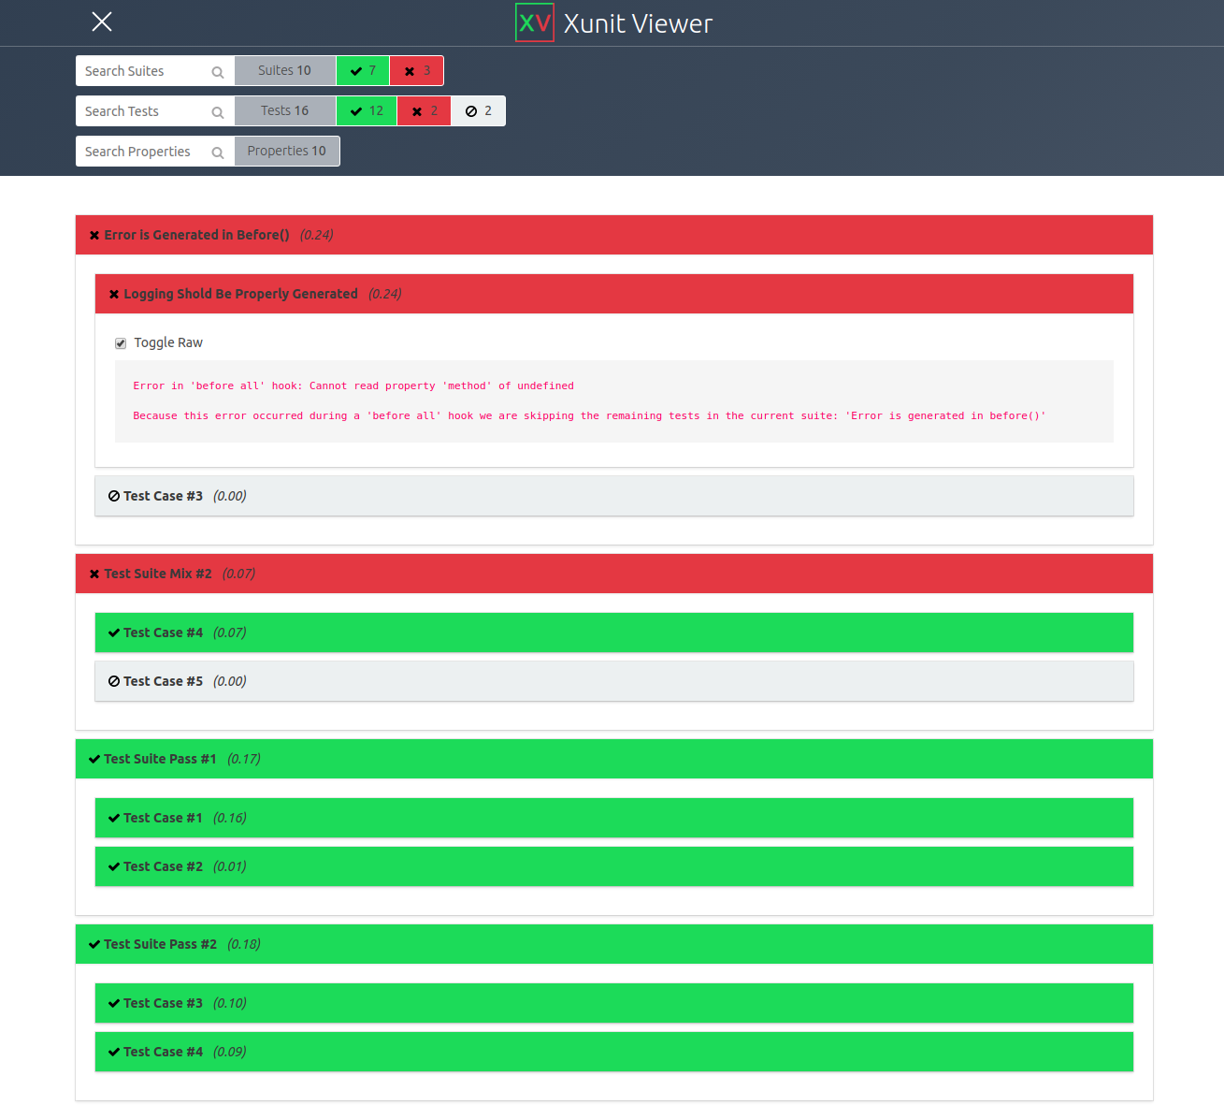
What do we do with Scenarios?
System Design
Stakeholder Negotiation
Exploratory Testing
Human experiments with app.
Formal Test Cases
Assign specific input and check response.
Notes:
So, (title). They are used at multiple stages of development. Often, these are used as a design brainstorming tool. We design them when we design the system architecture and perform mental exercises to see if we think the designed the system will meet our goals. This often leads to architecture redesign and additional requirements - both functional and non-functional. They are also used to communicate and negotiate with stakeholders. We can persent them and see if the stakeholders have feedback - do they agree with your views on quality? will they accept a system behavior that reduces attainment of one quality for gains in another - for example, performance and security are often at odds with each other. Third, we can assess them during exploratory testing - when human users interact with the system - either internal or an alpha/beta test. We can execute these scenarios in multiple ways and see if the quality goals are met. Foruth, we can translate these into one or more formal test cases by assigning specific input and including calculations of the response measure.

Slide 14
“Good” Scenarios
Credible
Describes a realistic scenario.
Valuable
Can be directly used during architectural definition.
Specific
Addresses a single, concrete situation.
Precise
Intended user of scenario should be clear about the described situation and response.
Comprehensible
Writing should be unambiguous and free of jargon.
Notes:
What Makes a Good Scenario? what qualities should we aim for? Key ones are
Credible: A scenario should describe a realistic situation that could credibly occur, and it should include enough realistic detail for the reader to accept the scenario as a valid situation that the system could encounter.
• Valuable: While it seems self-evident, a scenario should be of direct use somewhere in the architectural process, whether that is explaining the architecture to a stakeholder, convincing an assessor that the architecture is sound, or illustrating how the architecture works to a development team. It is easy to get carried away with defining scenarios that don’t really address the concerns of any stakeholder, so consider this when creating new scenarios.
• Specific: A good scenario describes a particular situation accurately, rather than trying to generalize the system’s behavior over a whole class of situations. The danger in trying to generalize scenarios is that it becomes difficult to describe them succinctly, so they are difficult to use since they address so many different concrete situations, each with its own variations.
• Precise: The definition of the scenario should be precise enough for the intended user of the scenario to be quite clear about what situation the scenario is describing and the required response of the system.
• Comprehensible: Like all architectural deliverables, scenarios should be comprehensible by those stakeholders who need to use them. This means writing them clearly, using widely understood terms, and avoiding acronyms and jargon that stakeholders are likely to misunderstand or find confusing.

Slide 15
Effective Scenario Use
Identify a focused scenario set
Too many scenarios can be distracting.
Prioritize no more than 15-20.
Use distinct scenarios
Avoid having multiple scenarios centered around near-identical events. They are redundant.
Consider demands placed on the system.
Use scenarios early
Most impactful early in development to focus design activities on most important aspects of the system.
Notes:
Scenarios are a straightforward technique. However, here are a few general practices that are helpful in applying scenarios effectively.
(1) Although scenarios are very effective, it isn’t often useful to end up with dozens and dozens of them. If you consider too many at once, the net result is a lack of focus that prevents them from providing guidance. It is difficult to be prescriptive about the precise number of scenarios you need because it depends on the scale and complexity of the system. However, more than 15 or 20 important scenarios across ALL quality attributes, not just one, is likely to be too many to use effectively for most systems, so work with your stakeholders to prioritize the set you end up with and focus on the riskiest and most important ones to guide decision making.
(4) It is easy to create a number of scenarios that, although they seem different initially, are really very similar in terms of the requirements they place on the
system. This leads to a situation where the cost of applying the technique increases (due to the number of scenarios that need to be created and considered) with only a marginal increase in benefits. In order to avoid this situation, revisit the scenarios you identify and consider what demands each places on the system. Where you find duplicates, remove them; they are unlikely to provide additional significant insights into your architecture.
(7) scenarios can be used throughout the software development lifecycle, but they have the most impact when applied early, when the design of the system is taking shape. If you don’t consider scenarios at an early stage but leave them until, say, they are needed for system testing, much of their potential benefit is likely to be lost. Of course, you may identify additional scenarios as development progresses ( for testing purposes). Still, the biggest role these have to play is to help you focus design activities on the most important aspects of the system. Later, we will use these as the basis for creating test cases

Slide 16

Reliability
Scenarios
Notes:
How do we assess quality? One popular way is to use what we call scenarios.

Slide 17
Reliability Scenarios
The ability to minimize the number of observed failures (AKA: a statistical approximation of correctness).
Scenarios revolve around one function (or a small set) accessed through an interface.
Give context on type of user if it impacts system execution or perceived reliability.
Notes:
Reliability is a statistical approximation of correctness. Over an observed period, how likely is the system to fail in an observable manner. As a quality, reliability is the ability of the system to function correctly. This is something that cannot be stated universally, but is instead dependent on the functionality accessed or the type of user, and that context must be given when we write scenarios. We must specify a specific user-level function of the system or small set of functions, and if we can, may even want to give context about the type of user - what frequency and ordering of functions do they use. Functionlity is accessede by an user or external system through a defined interface.

Slide 18
Reliability Metrics
POFOD: (failures/ requests over period)
ROCOF: (failures / total time observed)
Availability: (uptime / total time observed)
MTBF: Average time between observed failures.

Slide 19
Reliability Scenarios
Overview: Highlight the function(s) being used and the context used in. Explain the type of user, if relevant.
System state: Data stored in system or past events may impact reliability (multiple failures may leave system vulnerable)
Environment state: Available resources may impact reliability (resources, networking).
Notes:
(1-2). You might want to examine reliability in specific scenarios, like following a specific type of failure, and the impact that leaves on reliability after the face. Same for environment state (3) - available disc space, memory, CPU capacity, networking environment - all of these can have a major impact on the reliability. If the network connection is flaky, requests to certain services might fail, leading to a visible system failure. Likewise, if the disc can’t be written to, we might see additional failures. These factors can be examined when we write scenarios, noting the expected outcome in resource-restricted environments.

Slide 20
Reliability Scenarios
External Stimulus:
User or external software performs one or more input interactions.
State specific interaction or sequence of interactions performed.
If relevant, explain the type of user and reason they would perceive reliability differently.
Notes:
(1) through a system interface. The user or external system wants to use your system to perform some functionality. (2) In general, we do NOT state reliability universally, but focus on a specific functionality of the system we are examining. When we use this function in this scenario, we expect this reliability. Not availability is 99.999999% no matter what we do. This is because we have to actually be able to run a scenario, and for that, we need to look at specific situation and not state some universal truth. (3)

Slide 21
Reliability Scenarios
Required Response:
The functional response of the system.
Generally, the normal operation of that function.
Reliability Measure:
ROCOF, POFOD, Availability, MTBF
Can be either absolute or average.
“ROCOF must be < 2 failures/day.”
“The average ROCOF must be < 2 failures/day.”
Notes:
(go over all). The first is absolute - never violate this - the second allows exceptions if there is a bad day or two. It’s a little more relaxed.

Slide 22
Example Reliability Scenario
Overview: A user adds an item to the shopping cart.
System State: The system is operating normally, under normal load (500 concurrent users). The shopping cart is empty.
Environment State: The environment is operating normally, with standard network connectivity.
External Stimulus: A user selects the “add to cart button” with the quantity set to “1”.
Required Response: The item is successfully added to the shopping cart. The number of items displayed on the cart icon is incremented by one.
Response Measure: The average ROCOF is 0.015 (15/1000 requests).
Notes:
fairly basic, we’ll do more complicated, but gives you a good starting place.

Slide 23
Example Reliability Scenario 2
Overview: A “power user” requests summary statistics for data in the spreadsheet.
System State: The system is operating under normal load (100 concurrent users).
Environment State: The environment is operating normally, with adequate network connection.
External Stimulus: A “power user” clicks the data summary button.
A power user manages a large volume of data (> 20000 rows), and accesses this function at least once per hour.
Notes:
Give a spefiic user type. Give their MTBF
power user - large data quantity can decrease reliability potentially. On the other hand, if they use this function often, we may be able to use past data to improve the efficiency of the operation or to recover from partial failure.

Slide 24
Example Reliability Scenario 2
Required Response:
The summary statistics are calculated and displayed to the screen. The statistics are also written to a CSV file (appended to the file if it already exists).
Response Measure:
The MTBF for this function must be at least 8 hours.
Power uses expect long, uninterrupted sessions, and expect accurate results on a regular basis.
Notes:
Give a spefiic user type. Give their MTBF
power user - large data quantity can decrease reliability potentially. On the other hand, if they use this function often, we may be able to use past data to improve the efficiency of the operation or to recover from partial failure.

Slide 25
Availability Scenarios
Notes:
How do we assess quality? One popular way is to use what we call scenarios.

Slide 26
Availability Scenarios
Ability of the system to mask or repair failures such that the outage period does not exceed a required value over a time period.
Measure how the system responds to failure.
What does the system do to return to normal?
How long does it take?
Stimuli should always be a failure.
Notes:
As a reminder, availability is (1). Availability scenarios (rest)

Slide 27
Availability vs Reliability
Reliability scenarios:
How a function operates normally.
Response measures show how often it is allowed to fail.
Availability scenarios:
What happens when the function fails.
How system avoids failing or recovers from failure.
Response measures based on successful avoidance or recovery time.
Notes:
Reliability scenarios show how the system should operate under normal usage. In a normal situation, what does this function do? As a result, the response measures show how often it is allowed to fail. Availability scenarios focus on what happens when it fails. The scenarios show how the failure is avoided, or how the system recovers when it does fail. As a result, the response measures are based on how the system handles the failure. (last point)

Slide 28
Availability Scenarios
Response measures should always include a measure of availability:
availability threshold
(“Availability must be at least 0.9999”)
time to detect or repair fault
(“95% of the time, the failure is detected within 5ms”)
time system in degraded mode
(“95% of the time, must be back online within 10 minutes”)
Notes:
As a result, (1). If we are trying to show that the system avoids failing or comes back quickly - (2-3). Or, we can use other measurements to show that it recovers quickly when it fails (rest)

Slide 29
Availability Scenarios
Distinguish between failures and software’s perception of the failure.
Do not assume software is omniscient.
Scenarios tend to deal with:
Failure of internal component or external system.
Reconfiguration of physical system.
Maintenance or reconfiguration of software.
Notes:
(1). This can be failures internally in the software or in the environment. For example, given a network connection failure, if there is no traffic from the system over the link, then the software may not perceive the network failure until it attempts to use the network. Do not assume the software is omniscient, that is, all-knowing; there must be a mechanism in the architecture to perceive failures before the system can respond to them.
The kinds of scenarios that are managed by availability fall into three types: failure of a component of the software itself (code or hardware) or failure in an external system that is used by the software, reconfiguration of the physical system (e.g., adding or removing additional hardware resources), or maintenance or reconfiguration of the software: for example, patching the running software, especially if it requires restarting different processes that are part of the system, or entering a “maintenance mode” that requires that the software is offline or functions in a reduced capacity.

Slide 30
Availability Scenarios
Overview: Be clear about what needs to be available.
System/environment state: The state of the system when failure occurs may affect the response.
If this is the first failure, degradation of response time or functionality.
If the system has already failed and is not in normal mode, shut it down.
Notes:
■ We need to specify the resource or element of the system that is required to be highly available, such as a subsystem, a processor, acommunication channel, process, or storage.
■ State and Environment. The state of the system when the fault or failure occurs may also affect the desired system response. For example, if the system has already seen some faults and is operating in other than normal mode, it may be desirable to shut it down totally. However, if this is the first fault observed, some degradation of response time or function may be preferred.

Slide 31
Availability Scenarios
External Stimulus: Differentiate internal/external failure - desired response may differ.
Stimuli is:
An omission (a component fails to respond to an input),
A crash (component repeatedly suffers omission faults)
timing (component responds but response is early/late)
response (component responds with incorrect value).
Notes:
Source of stimulus. We differentiate between internal and external origins of faults or failure because the desired system response may be different.
■ Stimulus. A fault of one of the following classes occurs: ■ Omission. A component fails to respond to an input. ■ Crash. The component repeatedly suffers omission faults. ■ Timing. A component responds but the response is early or late. ■ Response. A component responds with an incorrect value.

Slide 32
Availability Scenarios
Required Response: Failure must be detected and isolated before recovery. Can:
Logging the failure
Notifying users or systems
Taking actions to limit the damage
Switching to a degraded mode
Shutting down external systems
Becoming unavailable during repair.
Notes:
■ Response. There are a number of possible reactions to a system fault. First, the failure must be detected and isolated (correlated) before any other response is possible. (One exception to this is when the failure is prevented before it occurs.) After the failureis detected, the system must recover from it. Actions associated with these possibilities include logging the failure, notifying selected users or other systems, taking actions to limit the damage caused by the failure, switching to a degraded mode with either less capacity or less function, shutting down external systems, or becoming unavailable during repair.

Slide 33
Availability Scenarios
Response measure:
Can specify an availability percentage
Can specify a time:
to detect the fault
to repair the fault
times where system must be available
duration system must be available
Notes:
■ Response measure. The response measure can specify an availability percentage, or it can specify a time to detect the fault, time to repair the fault, times or time intervals during which the system must be available, or the duration for which the system must be available.

Slide 34
Example Availability Scenario
Overview: Additional beer taps added to the dispensing system.
System State: System is available.
Environment state: Environment operating normally. Four taps exist. No beer is currently being dispensed.
External Stimulus: A new board is activated with six additional taps.
Required system behavior: The board send init messages to the central server. The server interrogates the boards and adds the additional taps to the inventory. Existing taps still serviced without interruption.
Response measure: There is no interruption of service to existing taps. Within 1 second, the new board is added to the administrative interface on the web server for administration configuration.
Notes:
(from a beer inventory management system)
Why are these good examples? They are specific and have a reasonable and testable response measure.
A possible critique is that both scenarios have aspects of both availability and performance, but occurs
fairly often. Note that we have combined the system state and environment; for both of these “good”
examples, they are essentially stating that everything is normal.

Slide 35
Example Availability Scenario 2
Overview: How the server-side components handle non-response from external payment system.
System state: System is operating under heavy load (>10000 concurrent users).
Environment state: External payment processing system has exceeded load limits.
External Stimulus: Multiple (5+) queries to the external system have gone without response without any successful responses between.
Notes:
how we stay available, when an external dependency goes down

Slide 36
Availability Scenario 2
Required system behavior: The system will cease to allow any further orders until the external system responds to a heartbeat message. An error page will be displayed to all clients to prevent further order attempts. Once the external system has returned for sufficient time (100 responses over at least a five minute period), normal operations will be resumed.
Response measure: Following detection of the failure, all order attempts will be stopped within one minute (90% of the time) and two minutes (99% of the time). Once the failure is resolved, normal operations will be resumed within one minute (following the five minutes of successful responses) 90% of the time and three minutes 99% of the time.
Notes:
point out probabilistic

Slide 37
Let’s take a break.
Notes:
8 min break

Slide 38
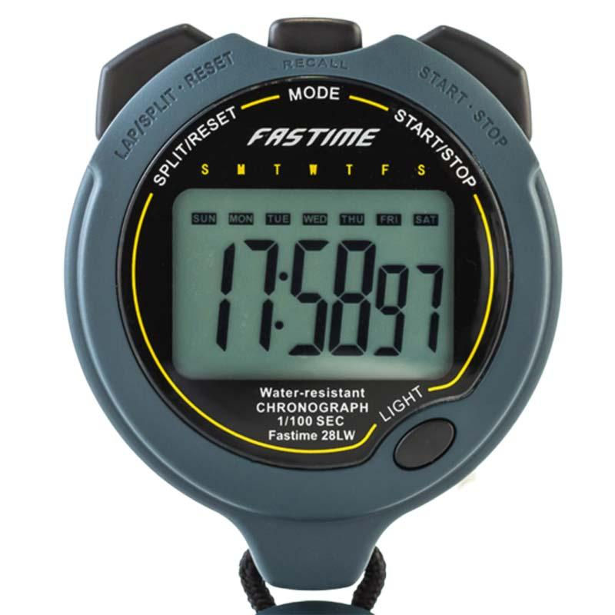
Performance and
Scalability Scenarios
Notes:
How do we assess quality? One popular way is to use what we call scenarios.

Slide 39
Performance Scenarios
Begin with events arriving at the system.
Responding requires resources to be consumed.
Arrival pattern for events can be:
Periodic (at regular time intervals)
Stochastic (events arrive according to a distribution)
Sporadic (unknown timing, but known properties)
“No more than 600 per minute”
“At least 200 ms between arrival of two events”
Notes:
A performance scenario begins with one or more events arriving that the system must respond to. Responding correctly to the event requires resources (including time) to be consumed. While this is happening, the system may be simultaneously servicing other events. Events can arrive in predictable patterns or mathematical distributions, or be unpredictable. An arrival pattern for events is characterized as periodic, stochastic, or sporadic:
Periodic events arrive predictably at regular time intervals. For instance, an event may arrive every 10 milliseconds. Periodic event arrival is most often seen in real-time systems.
Stochastic arrival means that events arrive according to some probabilistic distribution.
Sporadic events arrive according to a pattern that is neither periodic nor stochastic. Even these can be characterized, however, in certain circumstances. For example, we might know that at most 600 events will occur in a minute, or that there will be at least 200 milliseconds between the arrival of any two events. (This might describe a system in which events correspond to keyboard strokes from a human user.) These are helpful characterizations, even though we don’t know when any single event will arrive.

Slide 40
Performance Measurements
Latency: The time between the arrival of the stimulus and the system’s response to it.
Response Jitter: The allowable variation in latency.
Throughput: Number of transactions system can process in a unit of time.
Deadlines in processing: Points where processing must have reached a particular stage.
Number of events not processed because the system was too busy to respond.
Notes:
The response of the system to a stimulus can be measured by the following - we went over these last class, but to reiterate: (go over)
(6) In the engine controller, for example, the fuel should ignite when the cylinder is in a particular position, thus introducing a processing deadline.

Slide 41
Specifying Response Time
Response time targets require a defined load.
One transaction in 3s is easy if that is the only request.
Can you still hit 3s if there are 500 transactions per second?
Specify a clearly-defined response time goal.
Define when a transaction starts and ends.
Not all requests take the same amount of time, even with constant load.
Notes:
Response time targets are meaningful only in the context of a defined load. It may be easy for a computer system to process a single transaction in 3 seconds but much harder to achieve this target when it is receiving 500 transactions a second. This means that response time requirements need to specify the context as well as a clearly defined response time goal (which also defines when a transaction starts and ends). In most systems, response time under constant load will vary according to some sort of distribution curve. Most transactions will complete at or near the average response time, but some will take longer, and a few will complete more quickly. In most cases, it isn’t reasonable to expect every transaction to complete within the target response time. It is more realistic to require a certain proportion (such as 90% or 95%) of transactions to meet the target. This is why it is so important to specify these probabilitiies - 95% 99% etc.

Slide 42
Performance Scenarios
Overview: Description of the scenario.
System State: System can be in various levels of load (normal, emergency, peak load, or overload).
Environment State: Be clear on conditions that can impact performance.
Limited resources (disc, memory, CPU)
Networking conditions
Notes:
(1) be clear about what aspect of performance you care about and what elements of the system you are focusing on

Slide 43
Performance Scenarios
External Stimulus: Stimuli arrive from external or internal sources.
The stimuli are event arrivals.
Arrival pattern can be periodic, stochastic, or sporadic, characterized by numeric parameters.
Be clear on number, duration, concurrency of stimuli.

Slide 44
Performance Scenarios
Required system behavior:
System must process arriving events.
May cause change in system
(e.g., shift from normal to overload mode).
May cause change in environment
(e.g., reduction of available memory)

Slide 45
Performance Scenarios
Response measure:
Time to process arriving events (latency or a deadline)
Variation in latency time (jitter)
Number of events that can be processed within a time interval (throughput)
Characterization of the events that cannot be processed (miss rate).

Slide 46
Example Performance Scenario
Overview: Check system responsiveness for adding items to shopping cart under normal conditions.
System State: Normal load (less than 20 customer requests per second).
Environment State: Good internet connection to client. External dependencies are functioning.
External Stimulus: Customer adds product to cart.
Notes:
(go over - discuss. Why good?)
It is specific; it talks about response under a specific user action. It gives enough context
information to be reasonable (granted, some of it is defined elsewhere in a glossary). Also, it gives a
probabilistic guarantee, which is usually the correct way to talk about performance for non-real-
time systems, and provides a testable bound for the scenario

Slide 47
Example Performance Scenario
Required system behavior: Web page refreshes. Icon on right side of web page displays last item added to cart. If item is out of stock, cart icon has exclamation point overlay on top of cart icon.
Response measure: In 95% of requests, web page is loaded and displayed to user within 1 second. In 99.9% of requests, web page is loaded and displayed to user within 5 seconds.
Notes:
(go over - discuss. Why good?)
It is specific; it talks about response under a specific user action. It gives enough context
information to be reasonable (granted, some of it is defined elsewhere in a glossary). Also, it gives a
probabilistic guarantee, which is usually the correct way to talk about performance for non-real-
time systems, and provides a testable bound for the scenario

Slide 48
Example Performance Scenario 2
Overview: Ensure that credit card processing can still meet throughput targets when many users are competing for resources.
System state: System is operating under heavy load (10000 concurrent users are logged in).
Environment state: Load balancer distributes user requests approximately evenly between 100 servers.
External stimulus: A large number of credit card processing requests come within a short window (8500 requests within a one minute window).
Notes:
thnroughput focus

Slide 49
Example Performance Scenario 2
Required system behavior: Each server maintains a queue of requests and processes requests as resources become available. The load balancer distributes requests to servers, favoring servers with shorter queues. All requests are completed successfully.
Response measure: All 8500 requests are completed within two minutes, 85% of the time. All requests are completed within three minutes 99% of the time.
Notes:
thnroughput focus

Slide 50
Scalability Scenarios
The ability to efficiently use available resources.
Scenarios assessing scalability directly deal with impact of adding or removing resources.
Performance measures to reflect:
Changes to performance.
Changes to availability.
Load assigned to existing and new resources.
Notes:
Ability to address more and more requests are often part of performance scenarios. Scenarios assessing scalability directly (the ability to adjust available resources to the system) deal with the impact of adding or removing resources and what that does to the system.
Response measures reflect: Changes to performance after you add more resources to one unit or add more logical units to a pool - more servers to a server pool. Look at performance before and after and either quantify the improvement that should happen from adding resources or the worst allowable decrease in performance as you remove resources
Changes to availability after adding or removing resources. Look at availablility before and after
Load assigned to existing and new resources - look at how evenly load is spread among units.

Slide 51
Example Scalability Scenario
Overview: Addition of new hardware improves credit card transaction speed.
System State: Before addition of new hardware, 95% of credit card transactions were completed within 10 seconds, 99.9% within 15s. System is under normal load (1500 users).
Environment State: An additional server has doubled threads available for processing requests. Environment is operating normally, with adequate connectivity.
Notes:
note that change in resources is part of environment state.

Slide 52
Example Scalability Scenario
External Stimulus: Customer completes a purchase.
Required system behavior: Order confirmation is displayed, with a list of items purchased, expected arrival date, and total cost of items.
Response measure: In 95% of requests, web page is loaded and displayed to user within 5 second. In 99.9% of requests, web page is loaded and displayed to user within 7.5 seconds.
Notes:
this is looking at change in performance

Slide 53
Example Scalability Scenario 2
Overview: Addition of additional VMs improves availability of account authorization service.
System State: The average availability of the authorization service was previously 97.35% per week. System is under normal load (15,000 users).
Environment State: The VM pool has now been increased by 150%. Environment is operating normally, with adequate connection.
External stimulus: A user submits their username and password for authentication. The password is correct.
Notes:
look at change in availability

Slide 54
Example Scalability Scenario 2
Required system behavior:
Authentication completes successfully.
A session is established, and the user’s customized homepage is displayed on the client browser.
Response measure:
The average availability of the authorization service is increased to at least 99% per week.
Notes:
look at change in availability

Slide 55

Security
Scenarios
Notes:
How do we assess quality? One popular way is to use what we call scenarios.

Slide 56
Security Scenarios
Ability to protect data from unauthorized access while still providing service to authorized users.
Stimuli are attacks from external systems/users or demonstrations of policies (log-in, authorization).
Responses:
Auditing, logging, reporting, analyzing.
Measures:
time to detect/stop attack; time to identify attacker; impact of breach
Notes:
(1) An attack is an attempt to break CIA - confidentiality, integrity, or availability. The response to the attack is to preserve CIA or deter attackers through monitoring of their activities.Scenarios assess response to attack.
(rest)

Slide 57
Assessing Security
No universal metrics for measuring “security”.
Present specific attack types and specify response.
Response assessed by appropriate metrics.
Time to identify attacker.
Amount of data protected.
Time to stop attack.
Number of accounts compromised.
Availability during attack.

Slide 58
Security Scenarios
Overview: Description of the scenario.
Be clear about goal (examine attack response, demonstrate policy)
System/environment state:
The attack can come when the system is online or offline
Connected to or disconnected from a network
Behind a firewall or open to a network
Fully operational, partially operational, or not operational.
Notes:
(1-2) - what is the goal of this scenario?
Environment. The attack can come when the system is either online or offline, either connected to or disconnected from a network, either behind a firewall or open to a network, fully operational, partially operational, or not operational.

Slide 59
Security Scenarios
External Stimulus:
Source may be either a human or external system.
May have been previously identified or may be unknown.
Attacker may be from outside or inside organization.
The stimulus is an attack
Unauthorized attempt to display data
Change or delete data
Access services
Change system’s behavior, or reduce availability.
Notes:
Source of stimulus. The source of the attack may be either a human or another system. It may have been previously identified (either correctly or incorrectly) or may be currently unknown. A human attacker may be from outside the organization or from inside the organization.
■ Stimulus. The stimulus is an attack. We characterize this as an unauthorized attempt to display data, change or delete data, access system services, change the system’s behavior, or reduce availability

Slide 60
Security Scenarios
Required response:
Should ensure that:
Data/services protected from unauthorized access.
Data/services not manipulated without authorization.
Parties identified and cannot repudiate involvement.
Data/resources/services available for legitimate use.
Notes:
Response. The system should ensure that transactions are carried out in a fashion such that data or services are protected from unauthorized access; data or services are not being manipulated without authorization; parties to a transaction are identified with assurance; the parties to the transaction cannot repudiate their involvements; and the data, resources, and system services will be available for legitimate use.

Slide 61
Security Scenarios
Required response:
The system should track activities by:
Recording attempts to access or modify data, resources, or services.
Notifying appropriate entities (people or systems) when attack is occurring.
Notes:
The system should also track activities within it by recording access or modification; attempts to access data, resources, or services; and notifying appropriate entities (people or systems) when an apparent attack is occurring.

Slide 62
Security Scenarios
Response Measure:
How much of system is compromised when particular component or data compromised.
How much time passed before attack was detected.
How many attacks were resisted.
How long it took to recover from a successful attack.
How much data was vulnerable to a particular attack.
How long it takes to identify attacker.
Notes:
Response measure. Measures of a system’s response include how much of a system is compromised when a particular component or data value is compromised, how much time passed before an attack was detected, how many attacks were resisted, how long it took to recover from a successful attack, and how much data was vulnerable to a particular attack. (last)

Slide 63
Example Security Scenario
Overview: A disgruntled employee at a remote location attempts to change their pay rate.
System state: System is operating normally. 100 active users are logged in.
Environment state: Environment is operating normally with good network connection.
External stimulus: An employee has discovered location of configuration file storing employee pay rates. They log in (using their credentials) and use a stolen passkey to open the locked file. They modify the file and save changes.

Slide 64
Example Security Scenario
Required system behavior: The system maintains an audit trail. The user is able to modify the file, as they have the passkey. However, the log records the date, time, identify of user, and modification made. System administrators are informed of the modification.
Response measure: The correct data is restored within a day and the source of tampering has been identified and reported.

Slide 65
Example Security Scenario 2
Overview: A user attempts to authenticate with the beer dispensing system (to purchase beer) but the authentication fails due to unrecognized authorization token.
System state: System is operating normally, without problems.
Environment state: There is a valve installed on the tap. There is a flow meter installed on the tap. There is a buzzer installed on the board. Authentication hardware (RFID or one-wire) is installed on the board. There is no pour in progress.
External stimulus: A user presents an authorization token to the authentication sensor on the board.
Notes:
demonstration of policy, ratehr than an active attack

Slide 66
Example Security Scenario 2
Required system behavior: The authorization token is unrecognized, and the valve is not opened. An audible sound is played from the buzzer, indicating authentication failure.
Response measure: Authorization fails within 2 seconds 95% of the time (within 5 seconds 99% of the time). Buzzer sounds within 5 seconds 95% of the time (7 seconds, 99%). No beer is dispensed.
Notes:
Why are these good examples?
They are specific and they describe both reasonable system responses and reasonable measures that
can determine whether the system is behaving as intended.

Slide 67
Key Points
Defining and applying scenarios ensures that desired quality attributes are shown.
Scenarios define how the system responds to factors that affect quality properties.
Should include the initial system state and environment state, external stimulus, required system response, and how to assess response.
Notes:
(1) It can also help reveal omissions and errors in the requirements and is useful when it comes to testing the system. We defined two classes of scenarios: functional scenarios, which are nearly
always defined in terms of a sequence of external events the system must respond to in a particular way; and system quality scenarios, which are defined in terms of how the system should react to a change in its environment, as a
consequence of one of the quality properties it is meant to exhibit. (4)

Slide 68
Next Time
Testing Fundamentals
Terminology, phases and types of testing
Optional reading: Pezze & Young, Ch 1-4
Scenario practice during exercise session.
Assignment 1 out soon. Due Feb 12.

