Slide 1
Lecture 9: API Design
Gregory Gay
TDA 594/DIT 593 - November 30, 2021

Slide 2
Implementing Features
Features often implemented a standalone services.
Services can be accessed through an API.
e.g., web APIs generally use REST interfaces.
Good API design is crucial to creating a feature reusable in many clients.
Notes:
We’ve been talking about kmany different ways to implement variability in code - and reusing code - by segmenting the code into features. There are many ways to do this - separating feature code using preprocessors, using design patterns to separate variable code from non-variable code. Designing extendable libraries and frameworks. And by implementing a feature as a standalone component. The latter is very common today, when we can design a standalone service that can be reused in a new project. A service can operate on its own, and we communicate with it through its API. The API is a machine-based interface. While we might access a program though a graphical interface, our code can access this standalone service through an API that defines functionality that can be accessed and the means to invoke that functionality. Today, we are going to examine API design and principles for creating an API that is easy to make use of in a variety of clients, and that can be compatible with other services implementing a similar API.

Slide 3
REST
REST is a web-based API format.
Services provide resources (through URLs) designed to be consumed by programs rather than by people.
Design Principles:
Stateless
Resource-Based (URI)
Uniform Interface (GET, PUT, POST, DELETE)
Links describe relationships
Cacheable and monitorable using standard internet tools
Notes:
REST is short for Representational State Transfer (1). Systems based on REST, what we call RESTful services, provide resources (through URLs) designed to be consumed by programs rather than by people. Design Principles:
Stateless
Resource-Based (URI)
Uniform Interface (GET, PUT, POST, DELETE)
Links describe relationships
Cacheable and monitorable using standard internet tools

Slide 4
Today’s Goals
Creating REST APIs.
Web services with common invocation methods.
REST API design practices.
Designing Reusable APIs.
Features that can be substituted for other features.
Notes:
So, tday, we will start by discussing the creation of web APIs using the REST format. We will discuss practices for creating a good API, then we will discuss additional principles for creating APIs that are reusable and that can be substituted for other compatible APIs.

Slide 5
Hypertext Transfer Protocol (HTTP)

Slide 6
HTTP
Communication protocol for networked systems.
Defines how to exchange or transfer hypertext between nodes in a network.
How your computer accesses a webpage.
Defines an API based on requests.
Requests performed using verbs.
I get a page, post an update, delete a photo, put up information.
Notes:
Much of the internet, as we know it today, is built on the HTTP - the hypertext transfer protocol. Communication protocol used for distributed networked systems. Defines how to exchange or transfer hypertext between nodes in a network. AKA, how your computer can access a webpage. Now, HTTP defines all aspects of how information is moved around the web, but importantly, it defined a simple API based on requests. Requests are performed using verbs.
I get a page, I post an update, I delete a photo, I put up my information.

Slide 7
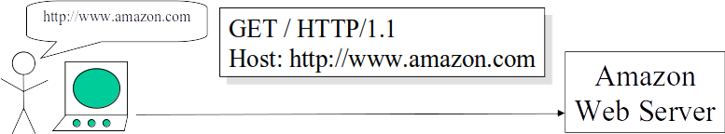
Retrieving Information (GET)
User types into the browser: http://www.amazon.com
The browser creates an HTTP request (no body)
The HTTP request identifies:
The desired action: GET ("get me resource")
The target machine (www.amazon.com)
Slide from: REST by Roger Costello and Timothy Kehoe http://www.xfront.com/REST-full.ppt
Notes:
User types into the browser: http://www.amazon.com
The browser creates an HTTP request (no body)
The HTTP request identifies:
The desired action: GET ("get me resource")
The target machine (www.amazon.com)

Slide 8
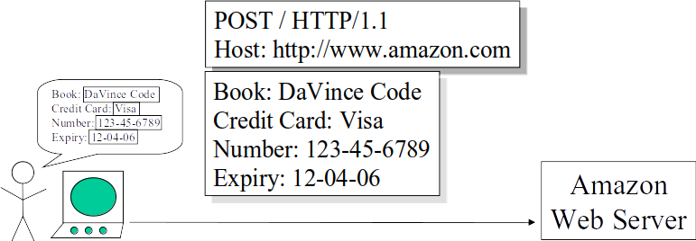
Updating Information (POST)
The user fills in a form on a webpage.
The browser creates an HTTP request with a body containing form data.
HTTP request identifies:
The action: POST ("here is some updated info")
The target machine (amazon.com)
The body contains data being POSTed (form data)
Slide from: REST by Roger Costello and Timothy Kehoe http://www.xfront.com/REST-full.ppt
Notes:
The user fills in a form on a webpage.
The browser creates an HTTP request with a body containing form data. This is generally in JSON, a structured format for sending data.
The HTTP request identifies:
The action: POST ("here is some updated info"), The target machine (amazon.com)
The body contains: The data being POSTed (the form data)

Slide 9
The HTTP API
HTTP provides a simple set of operations.
Based on the idea of CRUD (Create, Retrieve, Update, and Delete)
PUT: “Here is some new info” (Create)
GET: “Give me some info” (Retrieve)
POST: “Here is some updated info” (Update)
DELETE: “Get rid of this info” (Delete)
Slide from: REST by Roger Costello and Timothy Kehoe http://www.xfront.com/REST-full.ppt
Notes:
HTTP provides a simple set of operations. Amazingly, almost all Web exchanges are done using this simple HTTP API. Based on the idea of CRUD (Create, Retrieve, Update, and Delete). PUT: “Here is some new info” (Create) The PUT method requests that the enclosed entity be stored under the supplied URI. If the URI refers to an already existing resource, it is modified; if the URI does not point to an existing resource, then the server can create the resource with that URI. GET: “Give me some info” (Retrieve)
The GET method requests a representation of the specified resource. Requests using GET should only retrieve data and should have no other effect. POST: “Here is some updated info” (Update) The POST method requests that the server accept the entity enclosed in the request as a new subordinate of the web resource identified by the URI. The data POSTed might be, for example, an annotation for existing resources; a message for a bulletin board, newsgroup, mailing list, or comment thread; a block of data that is the result of submitting a web form to a data-handling process; or an item to add to a database. DELETE: “Get rid of this info” (Delete)

Slide 10
Additional Verbs
HEAD
“Give me the metadata”
TRACE
“Show me what changes have been made”
OPTIONS
“What verbs have you implemented for this resource?”
PATCH
“Apply partial resource modification”
Notes:
Also some (title)
(1-2) The HEAD method asks for a response identical to that of a GET request, but without the response body. This is useful for retrieving meta-information written in response headers, without having to transport the entire content.
(3-4) The TRACE method echoes the received request so that a client can see what (if any) changes or additions have been made by intermediate servers.
(5-6) The OPTIONS method returns the HTTP methods that the server supports for the specified URL. This can be used to check the functionality of a web server by requesting '*' instead of a specific resource.
(7-8)The existing PUT method only allows a complete replacement of a document. PATCH can partially modify an existing HTTP resource.

Slide 11
Anatomy of an HTTP Request
VERB
URI
HTTP Version
Request Header
Request Body
<VERB> is one of the HTTP verbs, <URI> is the resource location
<Request Header> contains metadata
Collection of key-value pairs of headers and their values.
Information about the message and its sender like client type, the formats client supports, format type of the message body, cache settings for the response, and more.
<Request Body> is the actual message content (JSON, XML).

Slide 12
HTTP Request Examples
VERB
URI
HTTP Version
GET:
POST:
Request Header
Request Body
GET http://www.w3.org/Protocols/rfc2616/rfc2616.html HTTP/1.1
Host: www.w3.org, Accept: text/html,application/xhtml+xml,application/xml; …, User-Agent: Mozilla/5.0 (Windows NT 6.3; WOW64) AppleWebKit/537.36 …, Accept-Encoding: gzip,deflate,sdch, Accept-Language: en-US,en;q=0.8,hi;q=0.6
POST http://MyService/Person/ HTTP/1.1
Host: MyService, Content-Type: text/xml; charset=utf-8, Content-Length: 123
<?xml version="1.0" encoding="utf-8"?>
<Person><ID>1</ID><Name>M Vaqqas</Name> <Email>m.vaqqas@gmail.com</Email><Country>India</Country></Person>
Notes:
Go over, point out that GET has no body but POST does, go over key/value pairings in header

Slide 13
Anatomy of an HTTP Response
HTTP Version
Response Code
Response Header
Response Body
<Response code> contains request status. 3-digit HTTP status code from a pre-defined list.
<Response Header> contains metadata and settings about the response message.
<Response Body> contains the representation if the request was successful.
Notes:
Requests are followed by replies - HTTP responses - in a similar packet format.

Slide 14
HTTP Response Example
HTTP Version
Response Code
Response Header
Response Body
HTTP/1.1 200 OK
Date: Sat, 23 Aug 2014 18:31:04 GMT, Server: Apache/2, Last-Modified: Wed, 01 Sep 2004 13:24:52 GMT, Accept-Ranges: bytes, Content-Length: 32859, Cache-Control: max-age=21600, must-revalidate, Expires: Sun, 24 Aug 2014 00:31:04 GMT, Content-Type: text/html; charset=iso-8859-1
<!DOCTYPE html PUBLIC "-//W3C//DTD XHTML 1.0 Strict//EN" "http://www.w3.org/TR/xhtml1/DTD/xhtml1-strict.dtd"> <html xmlns='http://www.w3.org/1999/xhtml'> <head><title>Hypertext Transfer Protocol -- HTTP/1.1</title></head> <body> …
Notes:
GET response

Slide 15
HTTP Status Codes
Common Responses:
200 Ok (succeeded)
201 Created (a new resource)
202 Accepted (not completed)
204 No Content (fulfilled request, nothing to return)
205 Reset content (reload page)
301 Redirection: moved permanently
400 Bad request
401 Unauthorized
404 Not found
Notes:
HTTP status code is primarily divided into five groups for better explanation of request and responses between client and server as named:
Informational 1XX
Successful 2XX
Redirection 3XX
Client Error 4XX
Server Error 5XX

Slide 16
Representational State Transfer (REST)

Slide 17
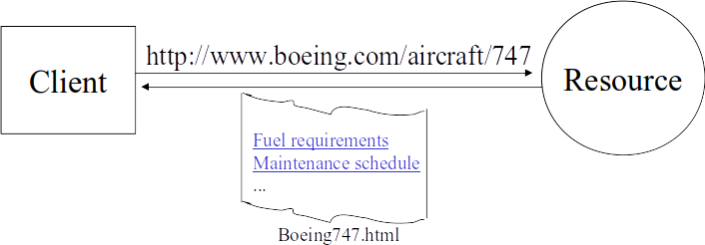
Representational State Transfer
A Client references a resource using a URI.
A representation of the resource is returned.
Receiving the representation places the client in a new state.
When user selects a link in Boeing747.html, it accesses another resource. New representation places client into another state.
Client application transfers state with each resource access.
Slide from: REST by Roger Costello and Timothy Kehoe http://www.xfront.com/REST-full.ppt
Notes:
REST, short for representational state transfer, is an architectural pattern for implementing networked systems. In this architecture, A Client references a resource using a URI. A representation of the resource is returned. (in this case as an HTML document). Receiving the representation (Boeing747.html) Receiving the representation places the client in a new state. When the client selects a hyperlink in Boeing747.html, it accesses another resource. The new representation places the client into yet another state. Thus, the client application transfers state with each resource representation.

Slide 18
The Core Idea
REST modeled after natural workflow of the net.
Design pattern for web services.
A well-designed web app behaves as a network of web pages (a virtual state-machine).
User progresses through application by selecting links (state transitions).
Resulting in next page (the next state) being transferred to the user and rendered.
Notes:
REST modeled after natural workflow of the internet net.- and was developed alongside HTTP version 1.1 itself. Motivation: Create a design pattern for how the web should work, such that it could serve as a guiding framework for designing web services. A well-designed web application behaves as a network of web pages (a virtual state-machine). The user progresses through an application by selecting links (state transitions). Resulting in the next page (the next state of the application) being transferred to the user and rendered for their use.

Slide 19
REST - Not a Standard
Not a standard, but an architectural pattern.
You can't bottle up a pattern.
You can only understand it and design your web services based on it.
REST does prescribe the use of standards (reuse):
HTTP, URL
XML/HTML/JPEG/etc. (Resource Representations)
Frameworks like Hydra offer advice for designing generic, reusable REST interfaces.
Slide from: REST by Roger Costello and Timothy Kehoe http://www.xfront.com/REST-full.ppt
Notes:
REST is not a standard. W3C will not put out a REST specification. Microsoft does not sell a REST developer's toolkit.
REST is just an architectural pattern. You can't bottle up a pattern. You can only understand it and design your web services based on it.
However, REST does prescribe the use of standards: HTTP, URL, JSON/XML/HTML/JPEG/etc. (Resource Representations)
text/xml, text/html, image/gif, image/jpeg, etc. (Resource Types, MIME Types) (last point). This means that REST offers us a blueprint for designing services that have an interchangeable means of invocation in their interface, that follow common patterns, and that use common data formats. This greatly increases the ability to develop reusable code as small, standalone services.

Slide 20
Verbs in REST
Verbs describe actions that are applicable to nouns
Using different verbs for every noun would make widespread communication impossible.
Some verbs only apply to a few nouns.
In REST, we use universal verbs.
All RESTful services offer the same interface.
Based on HTTP requests and responses.
Notes:
In a language, Verbs (loosely) describe actions that are applicable to nouns. One from an earlier slide - “I get a page”. The verb is “get”, the noun it is applied to is “the page”. If we had to come up with unique verbs. Using different verbs for every noun would make widespread communication impossible.
Some verbs only apply to a few nouns. In programming we call this “polymorphism” In REST, we use universal verbs. All RESTful services offer the same interface. Based on HTTP requests and responses.

Slide 21
REST Fundamentals
Services offer resources.
All resources have a unique URI.
URIs tell a client that there's a concept somewhere.
Clients request a specific representation of the concept from the representations the server makes available.
HTTP verbs are used to retrieve or manipulate resources in a clear, universal manner.
Notes:
Services offer resources that can be interacted with. All resources have a unique URI. Often web addresses (blah.com/form.html) Not necessarily HTML - resources are just concepts. A web page is a representation of a resource. (rest)

Slide 22
Representation Formats
Client and server should be able to comprehend data.
Structured content often JSON or XML
Representation should completely represent resource.
If partial representation needed, break into subresources.
Smaller representation = easier to transfer = less time required to create representation = faster services.
Representation should be capable of linking resources to each other via URIs.
Notes:
Both client and server should be able to comprehend the format. Structured content is often JSON or XML (JSON = Javascript Object Notation)
A representation should completely represent a resource. If there is a need to partially represent a resource, break the resource into child resources.
Smaller representation = easier to transfer = less time required to create representation = faster services. The representation should be capable of linking resources to each other via URIs.

Slide 23
Verb Guarantees
GET, OPTIONS, TRACE, and HEAD are safe.
Should not change the resource in any way.
Be careful - no technical limitations ensuring safety.
PUT and DELETE are idempotent.
Repeated requests have same effect as a single request.
Safe operations are also idempotent.
POST is not idempotent.
Notes:
Some of the methods (for example, HEAD, GET, OPTIONS and TRACE) are defined as safe, which means they are intended only for information retrieval and should not change the state of the server. They should not have side effects, beyond harmless effects such as logging, caching, serving advertisements or incrementing a counter. Making arbitrary GET requests should therefore be considered safe. By contrast, POST, PUT, DELETE and PATCH are intended for actions that may cause side effects either on the server, or external side effects such as financial transactions or transmission of email. Despite the prescribed safety of GET requests, in practice their handling by the server is not technically limited in any way, just limited by convention. For example, a website might allow deletion of a resource through a URL such as http://example.com/article/1234/delete, which, if arbitrarily fetched, even using GET, would delete the article.One example of this occurring was during the Google Web Accelerator beta, which prefetched arbitrary URLs on the page a user was viewing, causing records to be automatically altered or deleted. Methods PUT and DELETE are defined to be idempotent, meaning that multiple identical requests should have the same effect as a single request. This allows us to redeliver a request in event of a failure. GET, HEAD, OPTIONS and TRACE, being prescribed as safe, should also be idempotent, as HTTP is a stateless protocol In contrast, the POST method is not necessarily idempotent, and sending an identical POST request multiple times may further affect state or cause further side effects (such as financial transactions). In some cases this may be desirable, but in other cases this could be due to an accident, such as when a user does not realize that their action will result in sending another request, or they did not receive adequate feedback that their first request was successful.

Slide 24
Elements of Web Architecture
Firewalls decide which HTTP messages get out, and which get in.
These components enforce web security.
Routers decide where to send HTTP messages.
These components manage web scalability.
Caches decide if saved copy of resource used.
These components increase web performance.
Slide from: REST by Roger Costello and Timothy Kehoe http://www.xfront.com/REST-full.ppt
Notes:
A major reason for the use of HTTP requests is not just that they offer a universal interface, but also because three fundamental components of all web architectures are already built around the exchange of HTTP messages and collectively determine many of the quality attributes of a web-based system. (go over=

Slide 25
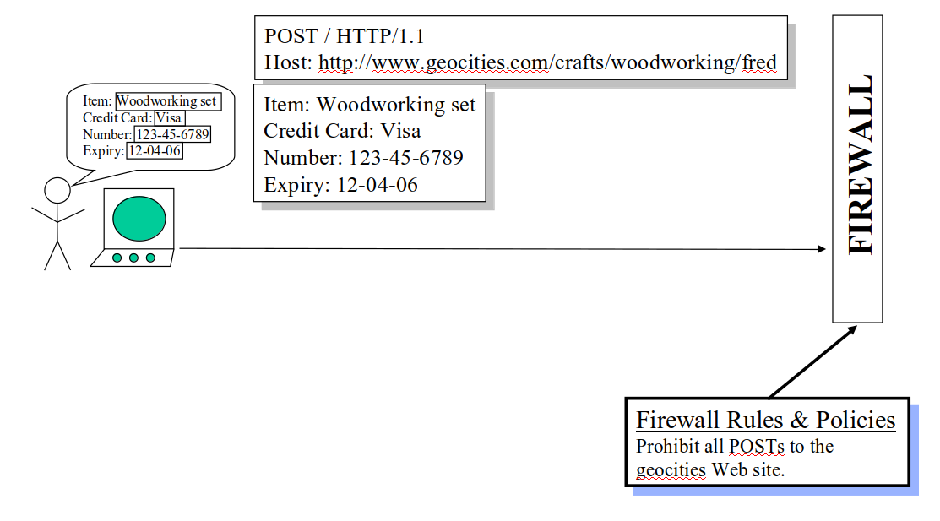
Firewalls
Firewall decides whether HTTP message passes through.
All decisions based purely on the HTTP header. The firewall never looks in the payload.
This is fundamental!
This message is rejected.
Slide from: REST by Roger Costello and Timothy Kehoe http://www.xfront.com/REST-full.ppt
Notes:
Firewalls play a fundamental role in determining the outcome of requests by establishing rules and policies for services.

Slide 26
Privacy of Content
Firewalls, routers, caches base decisions only on HTTP header.
Should never examine the request body.
Letter analogy: Postal service doesn’t look inside your letter (this is illegal), they just act based on addressing on the outside.
The content should not matter, just the metadata.
Protects privacy of data.
Notes:
All three components (firewalls, routers, caches) base decisions and actions purely upon information in the HTTP header.
They should never examine the request body.
Letter analogy: The postal service doesn’t look inside your letter (this is illegal), they just act based on addressing on the outside.
REST enforces a similar idea - the content should not matter, just the metadata.Protects privacy of data.

Slide 27
The Parts Depot Web Store
Parts Depot, Inc wants to deploy a web service to enable its customers to:
Get a list of parts.
Get detailed information about a particular part.
Submit a Purchase Order (PO).
How would you architect this?
Let’s discuss the RESTful way to design this.
Notes:
(go over, discuss)

Slide 28
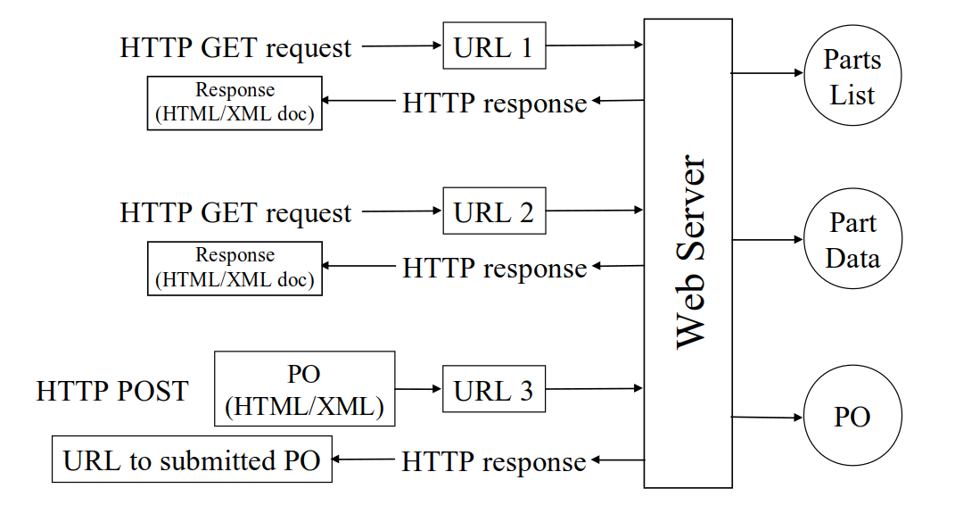
The RESTful Way
Slide from: REST by Roger Costello and Timothy Kehoe http://www.xfront.com/REST-full.ppt
Notes:
Through HTTP requests and responses

Slide 29
Retrieving a List of Parts
Service: Get a list of parts
Web service offers a URL to parts list resource.
Client posts GET request to URL to get parts list:
http://www.parts-depot.com/parts
How the web service generates parts list is completely transparent to the client.
Enforces loose coupling.
Slide from: REST by Roger Costello and Timothy Kehoe http://www.xfront.com/REST-full.ppt
Notes:
(go over)

Slide 30
REST Fundamentals:
Create a resource for every service.
Identify each resource using a URI.
Notes:
Two fundamentals of REST are reflected here: Create a resource for every service. Identify each resource using a URL.

Slide 31
Data Returned: Parts List
<?xml version="1.0"?> <Parts> <Part id="00345" href="http://www.parts-depot.com/parts/00345"/> <Part id="00346" href="http://www.parts-depot.com/parts/00346"/> <Part id="00347" href="http://www.parts-depot.com/parts/00347"/> <Part id="00348" href="http://www.parts-depot.com/parts/00348"/> </Parts>
Contains links to detailed information about parts.
Client transfers state by choosing among alternative URLs in a response.
Slide from: REST by Roger Costello and Timothy Kehoe http://www.xfront.com/REST-full.ppt
Notes:
1, This is a key feature of REST. Client transfers from one state to the next by examining and choosing from among the alternative URLs in the response document.

Slide 32
REST Fundamental:
Data that a service returns should link to other data.
Design data as network of information
Contrast with OO design, which says to encapsulate information.
Notes:
one more fundamentals of REST is reflected here:

Slide 33
Retrieving Details on a Part
Service: Get detailed information about a particular part
Web service makes available a URL to each part resource.
A client can request information on a specific part by posting GET request to http://www.parts-depot.com/parts/00345
Slide from: REST by Roger Costello and Timothy Kehoe http://www.xfront.com/REST-full.ppt

Slide 34
Data Returned: Part 00345
<?xml version="1.0"?> <Part>
<Part-ID>00345</Part-ID> <Name>Widget-A</Name>
<Description>This part is used within the frap assembly</Description>
<Specification href="http://www.parts-depot.com/parts/00345/specification"/>
<UnitCost currency="USD">0.10</UnitCost>
<Quantity>10</Quantity>
</Part>
Data is linked to still more data. Part specification may be found by traversing the link.
Response allows client to get more detailed information.
Notes:
Again, data is linked to still more data
The specification for this part may be found by traversing the hyperlink.
Each response document allows the client to drill down to get more detailed information.

Slide 35
Let’s take a break!
Notes:
Just start with a question - want you to start thinking about this. (read)
This isn’t something with one answer, or even a right answer. It’s something we’ll keep returning to

Slide 36
Designing Services with REST
Notes:
Just start with a question - want you to start thinking about this. (read)
This isn’t something with one answer, or even a right answer. It’s something we’ll keep returning to

Slide 37
Designing Services With REST
Destination URL placed in HTTP header.
Firewalls, routers, caches make decisions based on information in the HTTP Header.
Infrastructure will not work if destination not in URL!
HTTP header should identify final destination, not intermediate destination.
Notes:
Destination URL must be placed in the HTTP header for Web components to operate effectively.
Web components (firewalls, routers, caches) make their decisions based upon information in the HTTP Header.
Infrastructure will not work correctly if destination not in URL!
It is anti-REST if the HTTP header just identifies an intermediate destination and the payload identifies the final destination.

Slide 38
Designing Services With REST
Client requests should be idempotent – multiple calls should lead to the “same” response.
Server responses are “idempotent”, but only in terms of the meaning of information and not necessarily the content.
Think of a URL that always returns the current time…
Notes:
(1) This allows the client to retry if something goes wrong during transmission, which is VERY common

Slide 39
PUT and POST
PUT is idempotent, POST is not.
Multiple POSTs may create multiple resources.
PUT requires a full resource ID path.
Client creates resource.
POST does not require full resource ID path.
Server notifies client of resource location.
Post can still be used for resource updates.
Notes:
Which brings us back to POST. PUT is idempotent, POST is not.
No matter how many times PUT request is made (>=1), server state will be the same.
Multiple POSTs may create multiple resources.
PUT requires a full resource ID path.
Client creates resource.
POST does not require full resource ID path.
Server notifies client of resource location.
Post can still be used for resource updates.

Slide 40
PUT and POST
PUT http://MyService/Persons/
Won't work. PUT requires a complete URI.
PUT http://MyService/Persons/1
Insert a new person, PersonID=1, if it does not already exist or update existing resource with the payload.
POST http://MyService/Persons/
Insert new person (using the payload), generate new ID.
POST http://MyService/Persons/1
Update the existing person where PersonID=1

Slide 41
Handling POSTs
Other methods are idempotent, but POST creates new resources.
Multiple POSTs of same data must be harmless.
Put message ID in a header or in the message body.
This renders multiple posts harmless.
Prevents “multiple charge” issue with web stores.

Slide 42
Handling POSTs
Many ways to do this:
Exact: client or server-side unique transaction ID.
Heuristic: check and remove “likely duplicates”.
Wasted IDs are irrelevant.
Duplicated POSTs are not acted on by the server
Server must send back same response original POST got, in case the application is retrying because it lost the response.

Slide 43
Idempotence
What does this mean, strictly speaking?
Call to server must return the same thing each time?
No side effects?
What about changing data?
Time-of-day service.
Each GET call returns a new time. Is this RESTful?
As long as the resource is constant.
The value does not need to be constant, just how we access it.

Slide 44
Statelessness
Each request contains all information needed to service the request.
No client state is held on the server.
Benefits in scalability and availability.
Performance may be worse (multiple requests may be needed to get information).
Notes:
REST is considered to be a stateless style, in the sense that The client–server communication is constrained by no client context being stored on the server between requests. Each request from any client contains all the information necessary to service the request, and session state is held in the client.No client state is held on the server.
Benefits in terms of scale and availability.
Negatives: Development is harder. Performance may be worse (multiple requests may be needed to get information).

Slide 45
Well-Structured URIs
Avoid using spaces. Use _ (underscore) or – (hyphen) instead.
Remember that URIs are case insensitive.
Stay consistent with naming conventions.
URIs are long lasting.
If you change the location of a resource, keep old URI.
Use status code 300 and redirect the client.
Notes:
Avoid using spaces. Use _ (underscore) or – (hyphen) instead.
Remember that URIs are case insensitive.
Stay consistent with naming conventions throughout the service.
URIs are long lasting. think before naming them
If you need to change the location of a resource, do not discard the old URI. If a request comes for the old URI, use status code 300 and redirect the client to the new location.

Slide 46
Well-Structured URIs
Avoid verbs for resource names unless resource is actually an operation or a process.
Bad URIs:
http://MyService/FetchPerson/Mike
http://MyService/DeletePerson?id=Mike
Good URI:
http://MyService/Persons/Mike
You can apply verbs to this resource.

Slide 47
Food For Thought
What if Parts Depot has a million parts, will there be a million static pages?
http://www.parts-depot/parts/000000
http://www.parts-depot/parts/000001
...
http://www.parts-depot/parts/999999
Slide from: REST by Roger Costello and Timothy Kehoe http://www.xfront.com/REST-full.ppt

Slide 48
Food For Thought
URLs are logical.
Express what resource is desired, not physical object.
Changes to the implementation of the resource will be transparent to clients (loose coupling!).
All parts stored in a database. Web service will receive URL request, parse it for ID, query the database, and generate the response document at runtime.
Slide from: REST by Roger Costello and Timothy Kehoe http://www.xfront.com/REST-full.ppt
Notes:
Distinguish between logical and physical entities.
The URLs are logical.
They express what resource is desired.
They do not identify a physical object.
The advantage of using a logical identifier (URL) is that changes to the implementation of the resource will be transparent to clients (loose coupling!).
Parts Depot will store all parts data in a database. Code at the Parts Depot website will receive each logical URL request, parse it to determine which part is being requested, query the database, and generate the part response document to return to the client.

Slide 49
Food For Thought
Physical URLs
http://www.parts-depot/parts/000000.html
http://www.parts-depot/parts/000001.html
...
http://www.parts-depot/parts/999999.html
Logical URLs
http://www.parts-depot/parts/000000
http://www.parts-depot/parts/000001
...
http://www.parts-depot/parts/999999
Physical URLs point to HTML pages.
If there are a million parts,we don’t want a million HTML pages.
Changes to how these parts data is represented will effect all clients that were using the old representation.
Slide from: REST by Roger Costello and Timothy Kehoe http://www.xfront.com/REST-full.ppt
Notes:
Contrast (go over). Instead, you use logical URLs that do not represent actual HTML pages, but are parsed by the server and elicit a response inside of an HTTP packet
Physical URLs are pointing to HTML pages.
If there are a million parts, it will not be very attractive to have a million static pages.
Furthermore, changes to how these parts data is represented will effect all clients that were using the old representation.

Slide 50
Designing Reusable APIs
Adapted from Verborgh, R. and Dumontier, M. (2018), “A Web API ecosystem through feature-based reuse”, Internet Computing, IEEE, Vol. 22 No. 3, pp. 29–37.

Slide 51

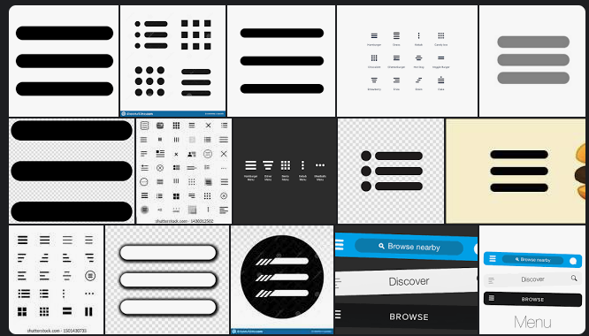

Human-based Interaction
Well-designed websites base user interaction on common interaction patterns.
Interaction patterns are reused across the web.
Notes:
Why can people easily navigate websites they’ve never encountered before? The answer is fairly simple: because interactions patterns are reused across websites. If you are designing the graphical appearance of a new website, the best advice you can follow is that users spend most of their time on other websites, reminding interaction designers to compose websites from shared interaction patterns rather than custom ones. For example, the user interfaces to update a status message on Facebook, Twitter, and Instagram are all highly similar. The strength of the concept of reuse is given more evidence by the survival of visually less obvious patterns, such as a site’s logo doubling as a homepage link, or three parallel lines (the hamburger button) forming a menu button on mobile devices. From a technical perspective, we could say people are loosely coupled to well-designed websites, because those websites bind to generic interaction patterns rather than specific interfaces. The human-based Web maintains usability by learning how to design websites from an evolving ecosystem of interaction patterns, only inventing new interfaces as a last resort.

Slide 52
Code-based Interaction
API reuse is difficult, as similar APIs often have very different interfaces.
Different number of HTTP requests to perform a task.
Different JSON bodies.
A client can’t easily swap an API that posts a photo to Facebook for one that posts to Twitter.
Notes:
In contrast, the machine-based Web - under the interface, where code talks to code - is characterized by a near-total lack of interface-level reuse, as even Web APIs with highly similar functionality often expose very different interfaces. This results in a lack of any ability to substitute with non-native services: clients programmed for a specific API task (such as posting a photo on Facebook) can’t perform that same task with another Web API (posting that same photo on Twitter or Flickr). Switching API providers is difficult as clients are forced to bind to a provider-specific interface rather than a provider-independent, abstract interface. Case in point: whereas Facebook and Twitter show a near-identical user interface for updating a status (a textbox with an encouraging question and a camera icon), the corresponding interactions with their Web APIs require a different number of HTTP requests with entirely different JSON bodies. If the human Web were designed in such a way, information consumption would slow down significantly, as accessing any new website would involve studying its documentation first—as is the case with Web APIs.

Slide 53
Designing Reusable APIs
APIs should be reusable in many applications.
However, they often require custom code, and rarely share interaction patterns.
Result: # of APIs grows rapidly.
API design should center around common interaction patterns.
Like human-based interaction.
Notes:
The absence of an ecosystem of Web API interaction patterns - like we have with human interaction patterns - means that every client needs custom manual programming for each external service they make use of—even if they had already been equipped with support for functionally similar or identical APIs. Since new integrations cannot build upon earlier ones, developers need to selectively pick the APIs they can support. As a result, as the number of Web APIs continues to grow at a rapid pace, each application only gives users access to an increasingly smaller fraction of APIs with relevant functionality. Web APIs were intended to facilitate reuse, but we still often have to either write code ourselves or pick and specifically design around chosen APIs. If we want our applications to access similar Web APIs with the same flexibility as people browse similar webpages, then we need to focus API design around repeating interaction designs. This allows a new generation of clients that are compatible with Web APIs beyond those for which they were explicitly programmed. Imagine a world where we could swap one external service for another in our application. There are certain design principles that can enable this.

Slide 54
Designing Reusable APIs
Individual APIs are reusable.
We can use one to post a photo to Facebook.
However, APIs are often not substitutable.
If we want to post photos to Facebook or Twitter, the APIs can’t be swapped.
We should be able to choose and swap APIs that perform the same kind of functionality.
Notes:
It might seem contradictory to discuss a lack of reuse in the context of Web APIs: APIs are designed to enable reuse. A Web API enables the reuse of an implementation offered by an external developer. We can take a small service developed by someone else and make use of it in our application. However, Web APIs are different in that the question is not whether to reuse or reimplement: we have already decided we need this external functionality, we aren’t going to develop it ourselves. For example, when providing sharing functionality, users will not be satisfied if their photos appear on our website; instead, they want to post those on their existing social networks. That means we need to work with those - with Facebook, Instagram, Twitter. Another difference is the scale of reuse: with the ever growing number of Web APIs, new providers for existing functionality appear every day. While integrating a single API is non-trivial but manageable, integrating the same functionality from multiple APIs—offering sharing to Facebook and Twitter and not just one of them, or switching between them—is far more difficult. While the interface might loosely couple clients to the server’s underlying implementation of functionality, that same interface in practice tightly couples clients to one specific provider of that type of functionality. We can’t just swap out one photo sharing service for another without work. In many situations, no coupling is loose enough to enable switching providers without changing client code.

Slide 55
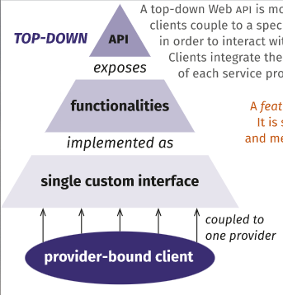
Top-Down API Design
API is monolithic.
Clients couple to specific interface to interact with lower-level parts.
Only clear invocation mechanisms are parameter names and types.
Notes:
Why does this happen, and what can we do about it? The coupling between clients and provider-specific interfaces follows from the fact that Web APIs are often constructed and consumed like monoliths. Clients approach APIs in a top-down manner: they consider the interface as a single custom entity with its own principles and design conventions. Clients couple to a specific interface to interact with any of its parts. While several APIs incorporate similar or identical functionalities, these are exposed through totally different interfaces. Clients integrate the functionality of each provider separately. As a result, clients can’t easily verify semantic compatibility between seemingly-similar APIs, or discover invocation mechanics beyond parameter names and types. This contrasts with interfaces on the human Web: people recognize smaller interface components across websites (search bars, share buttons, address forms, …), and these parts guide us through the entire functionality of the interface.

Slide 56
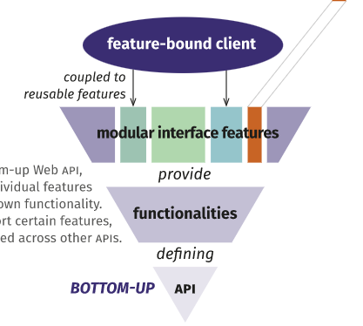
Bottom-Up API Design
A feature offers interface to a common function type.
Search text, upload file, update status, etc.
Should be simple, self-describing.
Clients couple to select features, not entire API.
APIs reuse features.
Whole API may not be identical.
Notes:
Instead, we could design Web interfaces for machines in a bottom-up manner, by composing them of reusable features. In this case, a feature is a part of an interface that identifies, describes, and enables interaction across Web APIs. A feature odders a reusable interface to certain functionality. It should be self-describing, so clients can identify and interpret it and measurable so API designers can understand its impact. Examples of such features include separate interfaces to perform full-text search, autocompletion, file uploads, status updates, etc - types of interaction that are common across the internet, even if specific results differ - piosting a photo to facebook instead of twitter. Clients couple to one or more features instead of the entire API, and use the feature’s interface to determine compatibility between different services and invocation mechanics for that functionality. Multiple APIs can reuse features, without requiring entire APIs to be identical. As an additional benefit, clients and servers can reuse feature implementations.

Slide 57
1: Web APIs Consist of Features with Common Interfaces
A web service should be split into features with their own interfaces.
Accessing/updating/sorting list of items, pagination, updating a status, uploading a photo, search.
Features can be optionally selected by client or enabled/disabled by server.
Clients only affected by changes to selected features.
Clients can make use of only what they need.
Notes:
How do we realize bottom-up design. There are four principles that can guide this. First, Web APIs should consist of features that implement a common interface to other features offering the same kind of functionality. This principle breaks up a monolithic custom interface into clearly delineated interface parts that can be reused across different APIs. The input and output of features should reuse specific subsets/profiles of common media types such as JSON to achieve interoperability. Features can be compared to visual components that coexist on the same page but are interacted with separately, such as a search form, upload form, or order button. Some examples of features include: accessing and updating a list of items, obtaining a sorted view of items, pagination, updating a status message, uploading a photograph, search and auto-completion, viewing and managing collections. Additionally, features can be switched on or off, depending on factors such as authentication, selected plan or payment options, and the version of the API. Clients can bind to individual features to access functionality, so they are unaffected by changes in other features. Server-side code related to the feature’s interface and implementation can be reused in a granular way, as reusers are not required to copy the entire interface. This can be achieved by implementing features as separate microservices that are offered. This principle is based on the observation that many clients only use a fraction of a service’s functionality. A commonly stated principle is the idea that clients should not depend on methods they do not use. By separating one monolithic interface into a set of smaller feature interfaces that are part of the same broader service, we allow clients to make use of only parts of our service that they actually need. We still offer one web service, but with a set of features surfaced. Features might be realized as microservices internally or in some other form, but clients do not need to know whether this is the case.

Slide 58

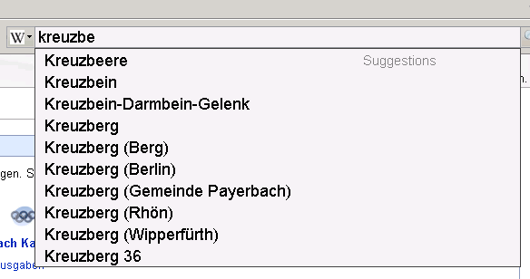
1: Web APIs Consist of Features with Common Interfaces
OpenSearch specifies a common format for performing search and publishing the results.
Also specifies a format for auto-completion of partial search terms.
Notes:
An example of how this is done is the OpenSearch specification for search and autocompletion. OpenSearch is a standard for publishing of search results in a form for syndication and aggregation. A web service can return search results in a standard and accessible format. It includes a specification for how to return auto-completion suggestions as well.

Slide 59
2: Partition Interface for Feature Reuse
If a feature is available elsewhere, reuse it in your API instead of implementing it yourself.
Clients could perform task with any API offering feature.
If designing a new feature, make it available separately for reuse.
Feature-specific repository, documentation.
Prioritize reuse when possible, make new functionality available as features.
Notes:
Second, Web APIs should partition their interface to maximize feature reuse. While each Web API is different, similar functionality appears in many of them. This second principle encourages architects to first check whether a part of the API is already available as a feature elsewhere, before implementing their own feature. If it is, they should design their API to use the common implementation. Since features could be reused across APIs, clients that are compatible with a set of features should be able to perform their task with any API that offers these features, regardless of provider. Client- and server-side documentation, tooling, and libraries for certain features could be reused across implementations. This can be realized through repositories for features (instead of full APIs) and feature-specific SDKs - documentation, code examples, and such- (instead of provider-specific SDKs). If you are developing a new feature, make it available separately so it can be reused. You could implement code for a generic status update feature instead of a provider specific one. Assuming that every Web API can be cleanly separated into existing features would of course be unrealistic, so this principle does not demand that. Instead, architects should prioritize reuse of features where applicable, and package the remaining provider-specific functionality as separate features. Features can have a dependency on each other, for instance, sorting a list can depend on browsing a list. However, they do not directly interact with each other: the client should decide whether or not to use multiple features in combination.

Slide 60
2: Partition Interface for Feature Reuse
Atom defines XML format for representing collection of items.
E.g., blog posts
Could create feature for “post a blog entry” that uses Atom as a generic representation.
“Post to Facebook”, “Post to Twitter” could use same shared input format.
<?xml version="1.0" encoding="utf-8"?>
<feed xmlns="http://www.w3.org/2005/Atom">
<title>Example Feed</title>
<link href="http://example.org/"/>
<updated>2003-12-13T18:30:02Z</updated>
<author>
<name>John Doe</name>
</author>
<entry>
<title>Atom-Powered Robots Run Amok</title>
<link href= "http://example.org/2003/12/13/atom03"/>
<updated>2003-12-13T18:30:02Z</updated>
<summary>Some text.</summary>
</entry>
</feed>
Notes:
For an idea of how to realize features in a generic manner, we can look at Atom. Atom is a XML-based web content and metadata syndication format. It gives a way to publish and edit web resources represented in a generic manner. It defines an XML format representing a feed - a collection- of web content of any kind. This feed consists of entries. An entry has a title, link, ID, date, and a summary. We can use this format to represent blog posts in a generic form, enabling posting a blog entry to a variety of different providers. WE could have a feature centered around “post a blog entry” that uses Atom to accept and disseminate content in a reusable format. This could then have its own functionality for posting to specific providers - post to Tumblr, post to Medium, and so on - or could hook into other features out there for those specific providers that accept this generic format.

Slide 61
3: API Responses Should Advertise Relevant Features
Server should include or link to supported features.
Support indicated in header of HTTP response or inside response body.
Can indicate which optional parts are implemented.
Clients can determine whether API offers needed features at runtime.
Notes:
Third, Web API responses should advertise the presence of each relevant feature. When servers include or link to the list of features they support, clients can able to automatically verify their compatibility with the Web API. Support should be explicitly indicated inside of the HTTP response, either through headers or inside of the response body. For example, the Link HTTP reader includes a profile relationship. Inside the response body, hypermedia-based media types and vocabularies can describe the features available. Rather than clients being hard-coded with the knowledge of what an API supports, clients should be able to determine whether a given API offers the features they require. If feature support varies dynamically (based on authentication or other factors), clients can find out at runtime. In case of incompatibility, clients can explain what features are missing. Clients can ignore the presence of non-supported features. In addition to signaling the presence of the features themselves, the server might indicate to what extent they are supported, for instance, which optional parts are implemented.

Slide 62
3: API Responses Should Advertise Relevant Features
GET /
{
"version": "1.2.3",
"description": "Example API to manage orders",
"links": [
{ "rel": "orders", "href": "/orders" },
{ "rel": "customers", "href": "/customers"},
{ "rel": "customer-by-id", "href": "/customer/{id}"},
{ "rel": "customer-by-email", "href": "/customer{?email}"},
...
]
}
Hypermedia: Embed links to resources within JSON body of HTTP response.
Ex: GET call to entry point returns links to accessible resources.
GitHub API uses hypermedia to broadcast functionality.
Notes:
One means to do this is through the use of hypermedia. Hypermedia APIs provide discoverability for services - a human discovers the web by clicking links. Hypermedia does the same for APIs, creating links between resources in an API. Rather than returning a customer ID, we might return a link directly to a resource that is associated with that customer. One thing this lets us do is broadcast that can be done through our API. For example, a GET call to the entry point for an API might return a JSON object containing a set of links to resources. This exposes information on how to access resources. The “rel” entry describes what the resource represents, and the “href” entry describes where the resource is located. This lets users of the API discover how the API can be used. We can do the same thing to expose features, and a good example of this is the GitHub API, which uses hypermedia to broadcast available resources and actions.

Slide 63
4: Features Describe their Functionality and Invocation
When queried, a feature should describe its functionality and how it is accessed in a standard form (e.g., hypermedia, JSON schema).
Reduces need to find documentation on an API.
APIs implementing a feature do not need to use same URL structure/parameter names.
Client can query feature for details at runtime.
Notes:
Building on this, fourth, Each feature should describe its own invocation mechanics and functionality. Describing invocation mechanics and functionality might seem redundant, given that the third principle already mandates the identification of features. However, this fourth principle decouples features from specific URL or request body templates, since these details are now communicated at runtime. Descriptions can be provided in the response body or, if the identifier is a URL, by dereferencing the identifier. Through descriptions of functionality new kinds of features can be discovered at runtime. If Clients only receive a feature’s identifier, they are coupled to outside details that have to be known beforehand about how to access that identified. In this form, all APIs would have to implement a feature with the exact same URL structure and parameter names. Instead, if a feature can broadcast its functionality and invocation method, Clients are coupled only to an abstract interface of a feature, the details of which are communicated at runtime. At runtime, we can query the feature for this information. Servers are free to choose their own URLs and names, as they explicitly indicate their mapping to the feature. This can also be implemented through hypermedia, or through a JSON schema. This principle provides an explicit way for customizing and extending features by describing optional or additional parameters. Cross-API integration of features is facilitated by allowing each API to describe its own URI and form templates, authentication, content types and profiles, etc. Beyond the substitutability this brings current clients, new possibilities for future clients arise. For instance, interactive clients can automatically generate forms for features they have not encountered before. By additionally describing functionality, clients can gain an understanding of what a feature does and, depending on the capabilities of the client, potentially access features for which they have not been explicitly designed.

Slide 64
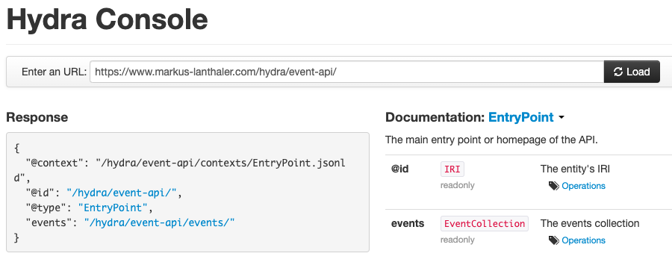
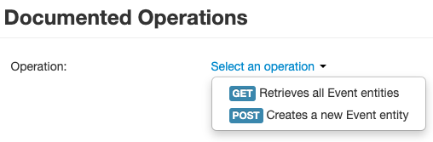
4: Features Describe their Functionality and Invocation
Hydra is a standard for generic APIs.
Includes ways to describe functionality and invocation.
Hydra Console infers details from Hydra APIs and renders documentation.
Notes:
This principle is realised already by APIs that broadcast their capabilities through hypermedia, like the GitHub API, Amazon AppStream API which streams desktop apps to users, or the PayPal API. Another example is the Hydra console. Hydra defines a vocabulary for creating hypermedia-driven web apis in a standard format. By specifying a number of commonly used concepts it renders the creation of generic API clients possible. The goal of the Hydra project is to embed information like functionality and invocation details within he API itself in a machine-readable manner so that we can create reusable APIs. The Hydra console is an example of a generic client in the form of a single-page web application. Given a URL of a Hydra-based API, it access the API, gets information from it, and then uses that information to generate documentation in a human-readable format. Here, given the URL we entered, we got back a response that defines the ID of the resource we accessed, the type of resource this is, and the features it surfaces. The feature is called “events”, and we can access it to determine what we can do with it. The Events feature can be invoked through a GET and a POST method. By using the Hydra standard, we can get information on how to access it and what happens when we do.

Slide 65
We Have Learned
REST is a web-based API format.
Services provide resources (through URLs) designed to be consumed by programs rather than by people.
Design Principles:
Stateless
Resource-Based (URI)
Uniform Interface (GET, PUT, POST, DELETE)
Links describe relationships
Cacheable and monitorable using standard internet tools
Notes:
Today’s class is centered around Representational State Transfer, or REST, (1). Systems based on REST, what we call RESTful services, (2 - rest)

Slide 66
We Have Learned
APIs should be designed to be reusable.
APIs should be split into features.
Features should have a common interface with compatible features with separate implementations.
The overall API should be partitioned into these separate features with their own interfaces.
APIs should advertise available features.
Features should broadcast their functionality and invocation details.

Slide 67
Next Time
System-Level Test Design
Assignment 3 - due tonight
Assignment 4 - December 12
Modularization and design patterns
Any questions?

