Slide 1
Lecture 8: Exploratory Testing
Gregory Gay
DIT636/DAT560 - February 12, 2025

Slide 2
Today’s Goals
Introduce Exploratory Testing
Human-driven testing of the project, to gain familiarity with the system and conduct high-level testing.
Often focused on “tours” of the software features.

Slide 3
Exploratory Testing
Testers check the system on-the-fly.
Guided by scenarios.
Often based on ideas noted before beginning.
Testing as a thinking idea.
About discovery, investigation, and role-playing.
Tests end-to-end journeys through app.
Test design and execution done concurrently.
Notes:
EXPLORATORY TESTING is a type of software testing where Test cases are not created in advance but testers check system on the fly. They may note down ideas or come up with goals about what to test before test execution. The focus of exploratory testing is more on testing as a "thinking" activity. Exploratory Testing is widely used in Agile models and is all about discovery, investigation, and learning. You can try out different roles and user types. It emphasizes personal freedom and responsibility of the individual tester.
Last week, we talked about system testing, this is a form of scripted testing where you design test cases first and later proceed with test execution. On the contrary, exploratory testing is a simultaneous process of test design and test execution all done at the same time. (last point)

Slide 4
Exploratory Testing
Tester write down ideas to give direction, then create tests “live”.
Tester chooses next action based on results seen.
Can find subtle faults missed by formal testing.
Allows tester to better learn system functionality, and identify new ways of using features.
Notes:
The tester will create or write down a test idea to give direction, and explore the system while testing to further create critical, practical and useful tests for the successful testing of an application. This requires minimal planning. Testers continuously make a decision on her next step of action. It completely depends upon the tester's thought process.
Sometimes this testing can be more beneficial than the formal testing approach for finding some subtle defects which go missing in formal testing.
A learner will learn better through hands-on experience rather than cramming the theory. Likewise, a tester will know the application better only while exploring and learning about all the functionality it provides by itself. It is always good to have a customer and business perspective while testing to ensure successful testing of an application.
For Example, if you open a shopping website, you have a general idea that this shopping website will let you shop by selecting a product of your choice and then paying for the same.
During this process, you might learn that you can order a number of products for home trial or that you can make payment through rewards points of some banks, etc. You can extend your testing to try these featurs.
As a tester, you not only need to verify whether a system is working as expected but also check if that system is not behaving in a way which is not expected. Exploratory testing can help find these gaps.

Slide 5
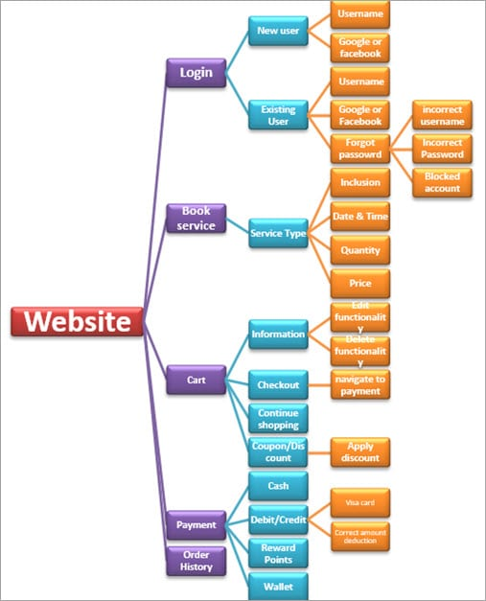
Example
Start with functionality you know well (Login)
Examine possible options and list them.
Use your findings to plan the next steps.
As you learn and observe, more test cases will emerge.
Some slides derived from https://www.softwaretestinghelp.com/what-is-exploratory-testing/
Notes:
A home care service provider website with the following components: Login, Services, Cart, Payment, Order History, Technician allotment. A general idea to start exploratory testing will be to Login or book a service.the idea is to start with functionality based on your knowledge. As you learn and observe more about the application, you can govern your next set of test cases. (go over diagram - > start with login feature, then what are our options? well, we could try creating a new user or we could log in as an existing user. As a new use, you can enter a username or use Google/Facebook integrated login to create an account using your Google or Facebook account. If we are existing user, can login using username (... go down chart)

Slide 6
Session-Based Exploratory Testing
Time-based method to structure exploratory testing.
No e-mail, phone, messaging.
Short (60min), Normal (90m), Long (120m)
Primary components:
Mission
The purpose of the session, provides focus.
Charter
Individual testing goals to be completed in this session.
A list of features or scenarios.
Notes:
While doing exploratory testing, it’s very difficult for testers to put into words on how much he has tested and on what basis. it’s difficult to quantify the work and the time spent. Session-based testing is a time based approach to perform this testing which helps in managing, tracking, and keeping exploratory testing on track. It includes a dedicated time-boxed testing session with no interruption from email, phone, messages etc. Each session can have the following duration: “Short” (60min) “Normal” (90min) “Long” (120 min). Primary components: Mission: Mission shout out the purpose of the session and in a way provide the focus for the tester. It will also include a session time duration. Charter: Includes the scope of the testing. Basically, an agenda detailing the goals that need to be completed during the session.

Slide 7
Session Report Items
Mission: Overall goal
“Analyze Login Feature on Website”
Charter: Features and scenarios to focus on.
“Login as existing user with username and password”
“Login as existing user with Google account”
“Login as existing user with Facebook account”
“Enter incorrect username and password to verify validation message”
“Block your username and verify the validation message”
“Use Forgot Password link to reset password”
Notes:
This process produces a session report that Include notes to provide metrics to the leaders and managers. It gives details about the charter sessions remaining or done, session setup time, scenarios tested, information about the testing process, a list of bugs and the issues found and other information. (go over items)

Slide 8
Session Report Items
Start and end time of session
Duration of session
Notes on actions taken
Opened login page
Verified default screen.
Verified that existing and new user account links exist.
Opened existing user login
Verified successful login with username, Google, and Facebook.
Verified validation messages.

Slide 9
Session Report Items
Failure Information: Describe each failure. File a bug report, include tracker ID.
Issues Information: If an issue prevents or complicates testing, describe it.
Include data files (screenshots, recordings, files).
Set-up Time: % of time required to set-up.
Test Design and Execution Time: % of time spent purely on testing
Notes:
Fault Information: Describe each fault found. File a bug report for each, include tracker ID in report.
Issues Information: If an issue prevents or complicates testing, describe it in the report.
For any fault or issue, Include data files (screenshots, recordings, files), especially if a bug is found. Then, that data can aid in reproducing the bug.
In addiiton, you can also note things that are not traditional bugs, but are interesting observations about the software or a suggestion on how to improve it. Exploratory testing is not justa fault-finding activity, but a way to generally improve the app.
Set-up Time: % of time required to set-up.
Test Design and Execution Time: % of time spent purely on testing

Slide 10
Session Debrief
Short meeting between tester and manager to review the findings.
Track time spent testing, number of faults reported, time spent on set-up, time spent on testing, time spent analyzing issues, features covered.
Allows time management and process observability.
Notes:
Finishes with (title). A short meeting or stand-up between the tester and Test Lead/Manager to review the test session findings. Session-based testing allows tracking of time spent testing, number of faults reported, time spent on set-up, time spent on testing, time spent analyzing issues, and the features covered. This allows for accountability in exploratory testing and offers better management of time spent on testing. It also increases productivity and provides a better grasp on fault detection. It is a great way to provide team leads and managers with metrics to check the project progress, giving observability into the testing process. This lets you tune the testing process, to either end testing if the improvements are dwindling, or increase personell or time spent on testing if you are finding a lot of issues still.

Slide 11
Tips for Exploratory Testing
Divide the application into modules or features, then try to further divide.
Make a checklist of all the features and put a check mark when each is covered.
Start with a basic scenario and then gradually enhance it to add more features to test it.
Notes:
(1) Start ET from the smallest subdivisions. This will give greater coverage. (2), to give you an idea of where you stand in this process and what remains. (3) Login works. What if the password is wrong? What if the username is wrong? What if there is no account? Can we log in using all methods - username, google, facebook.

Slide 12
Tips for Exploratory Testing
Test all input fields.
Check for all possible error messages.
Test all negative scenarios.
Invalid input, mistakes in usage.
Check the GUI against standards.
Check integration with external applications.
Check for complex business logic.
Try to do the ethical hacking of the application.

Slide 13
Pair-Based Exploratory Testing
Two people test together.
One uses the computer, the other suggests actions and takes notes.
Can train new developers/testers.
Benefits
Increases focus.
Leads to more constructive ideas.
Avoids biased input selection.
Notes:
Pair Testing is an approach in which two people test the same thing/feature of the application at the same time by sharing a PC. They continuously share their thoughts and ideas. During this testing, one person takes charge of the keyboard whereas the other person suggests test cases or actions and takes note. It is always helpful to have a good communication between the partners so that both are aware of what is being done and why. This approach can be powerful because the strengths of each tester can mutually complement their weaknessses. This pairing benefits both the parties and each can learn something from their partner. It is also a good way to train new resources - new developers or testers - by pairing them with experienced testers. They can quickly learn the system they will be working with.
Benefits: Helps a tester to focus on the task at hand. Brainstorming between paired testers usually, lead to more constructive ideas. Avoid tunnel vision and biasing.

Slide 14
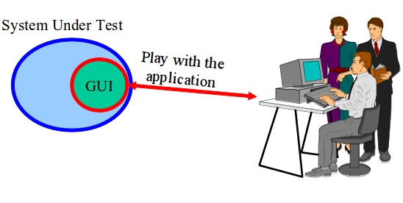
Automating Exploratory Testing
Use tools to streamline bug reporting and reproduction, snapshots, preparation of executable test suites for future use.
A tool captures and records the activities performed by the tester.
Called capture and replay tools.
Notes:
We can use (1). We still conduct exploratory testing as a human, but we use tools to help improve our efficiency and to improve reproducability of the results. In this methodology, usually, a tool, which captures and records every single activity performed by a tester and is installed on the resource’s PC.there is no change in the way the tests are executed apart from crafting the test result based on the captured session. These test results can be used for reporting and reenacting recorded actions later in time. (last point)

Slide 15
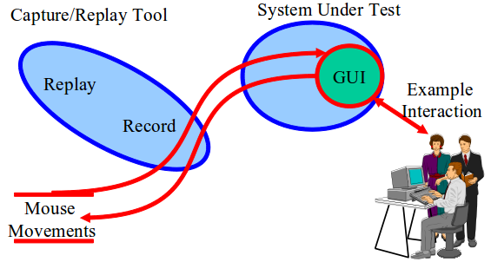
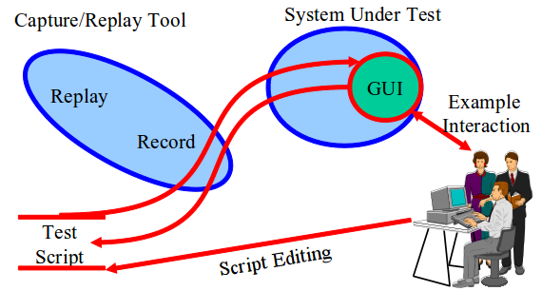
Capture and Replay Tools
Record input during exploratory testing.
The “Capture”
Capture can be replayed to reproduce outcomes.
Capture scripts can be extended and altered to form new test cases.
Notes:
What we can do is get a human in to play with the program. We can record the actions they during exploratory testing. Those are called captures. We can then use those - we can replay them - to repeat the same scenarios and the same mouse motions and clicks without needing the human sitting there again. This aids reproduction of events. If there is a bug, we can see if the same actions trigger it again. These captures - these sets of actions - can also be used as the basis for creating more tests as well. The actions taken during exploratory testing become an initial set of test cases. We can then edit those to turn them into new test cases - modifying the actions slightly or taking the individual actions and combining them to form entirely new tests. This lets us automate GUI testing to some extent as well and fill in some gaps from exploratory testing. Capture a few manual executions, and reuse them or alter them. slightly More productive use of human effort.

Slide 16
Automating Exploratory Testing
Provides clear steps to reproduce failure.
Can also judge performance.
Often used in pair exploratory testing.
Second tester watches replay and extends the tests.
First tester watches that replay and extends.
Exchange again to confirm results.
Notes:
It also has few other benefits like: Provides clear steps to reproduce the failures. Reproducing failuress is easier even when the reporter is not available. Also Helps in performance testing by getting the system response time at the specific point in time. It is advisable to use capture/replay tools with Pair Testing. In this approach,one tester creates a capture and the second tester executes the captures created by the first tester. Then, they look for ways to extend the existing work with new actions or improvements. Testers involved swap roles again at the end so that the tester who created the test script has a chance to re-execute the scripts to confirm the reliability & robustness of the final extended suite.

Slide 17
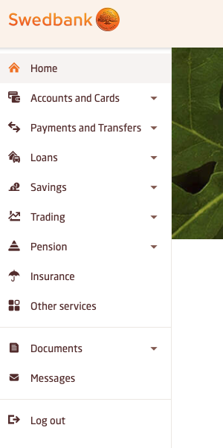
Example - Banking App
How would you perform exploratory testing?
Scenarios you would try?
Features you would focus on?

Slide 18

Example - Meeting Planner
Offers the following high-level features:
Booking a meeting
Booking vacation time
Checking availability for a room
Checking availability for a person
Printing the agenda for a room
Printing the agenda for a person
Notes:
Go over, then give demo of Driver

Slide 19
Example - Meeting Planner
Mission: Explore the booking features.
Charter:
Book a meeting
Book vacation time
Check that bookings have been made.
Notes:
Go over, then do session with them.
- book meeting on bad date, double book a meeting/person, book a meeting during vacation time, book vacation time during a meeting
Can see that we achieve a lot of coverage that way

Slide 20
Tours in Exploratory Testing
Notes:
10 minute break

Slide 21
Using “Tours” in Exploratory Testing
A tourist visits as many districts of a city as possible within the time budget.
In software, the “city” is the system, and the “districts” are aspects of the system.
A tour give guidelines for exploratory testing.
Includes suggestions, based on visiting different “districts”, to focus exploration.
Notes:
While performing exploratory testing, testers resemble tourists who arrive in the place where they have never been before. Suppose you are visiting a large city like London for the very first time. It’s a big, busy, confusing place for new tourists, with lots of things to see and do. Even the most time-unconstrained tourist would have a hard time seeing everything London has to offer. The same can be said of testers trying to explore complex software. Each city or town has several districts, for Example, business or historical one, and the tourists choose one or several districts to visit based on their schedule. In terms of software testing, The city or town where the tourists come is a software product to test. Districts are aspects of the software, themes in a way for testing. For instance, the business district represents core money-making functionality, while the seedy district represents security of the system. A tour gives guidance for the type of exploratory testing activities you pursue in a session. Tourism benefits from a mix of structure and freedom, and so does exploratory testing. A testing tour includes guidelines and examples of tasks to focus exploratory testing.

Slide 22

Business District
Most important features.
Functionality that will get users to buy software.
Tours focus on features that are used most often.
Guidebook Tour: Common user journeys, covered in user manuals and tutorials.
Fed-Ex Tour: How data is passed and transformed between these features.
Notes:
Business districts for cities are where work gets done. They contain banks, office buildings. For software, the business district is also “where the business gets done” and is centered around the functionality customers use the software for. These are the features that would appear in a commercial or sales demo. Business District tours focus on these important features and guide testers through the paths of the software where these features are used. For example, the guidebook tour focuses on following the step-by-step tutorials offered in user manuals and guides to the software, while the Fed-Ex tour looks at how data is passed from function to function in the software and verified the results of data transformation as it takes different paths through the system.

Slide 23

Guidebook Tour
Cities advertise top attractions, and ensure they are clean and safe.
Software offers user manuals and tutorials, illustrating step-by-step use of features.
Follow tutorials and execute each step.
Tests both functionality and accuracy of tutorials.
If software and tutorial do not match, report an issue.
Notes:
Guidebooks for tourists often boil down the sights to see to a select (and manageable) few. They identify the best hotels and the top attractions, without going into too much detail or overwhelming a tourist with too many options. The attractions in the guidebook have been visited by experts who tell the tourist exactly how to enjoy them and get the most out of a visit. Cities must ensure that such attraction areas are clean, safe, and welcoming so that tourists will spend their money and return often. From a testing standpoint, hitting such hotspots is just as important. Like cities, we want users to enjoy their experience, and so the major features - the ones we use to sell the product - need to be usable, reliable, and work as advertised. The analogous artifact for exploratory testing to a guidebook is the user manual/tutorials. The guidebook tour is performed by reading the user manual (or other tutorials) and following its advice. When the manual describes features and how they are used, the tester follows the same directions. If there is a step-by-step guide, we perform each step in sequence. The goal is to try and execute each scenario described in the user manual as faithfully as possible. This tour tests not only the software’s ability to deliver the functionality as described but also the accuracy of the user manual. It’s a straightforward test, and you should be alert for deviations from the manual and report those as bugs. It may end up that the fix is to update the manual, but in any event you have done a service for your users. The guidebook tour forces you to string together features of the software much the same way as a user would string them together and forces those features to interact. Any failures found during this tour tend to be important ones.

Slide 24
Guidebook Variants
“Blogger’s Tour”
Follow guides and scenarios from StackOverflow, blogs, books, other tutorials.
“Pundit’s Tour”
Create tests based on complaints.
Try to reproduce their issues.
“Competitor’s Tour”
Perform tour on competing products and their guides.
Identify potential improvements to your system.
Notes:
There are Variations of this tour, where we step past our own material, and look at what others have written. In the Blogger’s tour, you follow third-party advice. You’ll find descriptions of the software, advice, and tutorials found on stack overflow, in online forums, beta communities, blogs, or if your application is big and widely distributed like Microsoft Office, in actual books. Follow third-party tutorials and scenarios and see if they are accurate and the software can be used problem-free. In the Pundit’s tour, you create test cases that describe the complaints of unhappy reviewers. See if you can either reproduce their issue or understand their complaint, perhaps leading to proposed changes to the software. Another useful variant is the Competitor’s tour, where you follow any of the above artifacts’ advice for competing systems. In this case, you are not looking for bugs exactly, but are looking for ways you can improve your own product, like ways the competitor is more usable, works more smoothly, or has a better version of a feature you also offer.

Slide 25

Fed-Ex Tour
When a package is sent, it is handled by many people and passes through many locations.
In software, data is passed, transformed, and passed again before output appears.
Examine how data is manipulated.
Validate data after operations.
Look at serialization/deserialization.
(ex: how does shopping site handle mailing addresses?)
Notes:
FedEx is a company that does package-delivery. They pick up packages, move them around their various distribution centers, and send them to their final destination. For this tour, instead of packages moving around the planet through the FedEx system, think of data moving through the software. The data starts its life as input and gets stored internally in variables and data structures where it is manipulated, modified, and used in computation. Finally, much of this data is finally “delivered” as output to some user or destination - some other part of the system or an external system. During this tour, a tester must concentrate on this data. Try to identify inputs that are stored and “follow” them around the software. For example, when a mailing address is entered into a shopping site, how is that address used? What features consume this address? If it is used as a billing address, make sure you exercise that feature. If it is used as a shipping address, make sure you use that feature. If can be updated, update it. Does it ever get printed or purged or processed? Try to find every feature that touches the data so that, just as FedEx handles their packages, you are involved in every stage of the data’s life cycle.

Slide 26
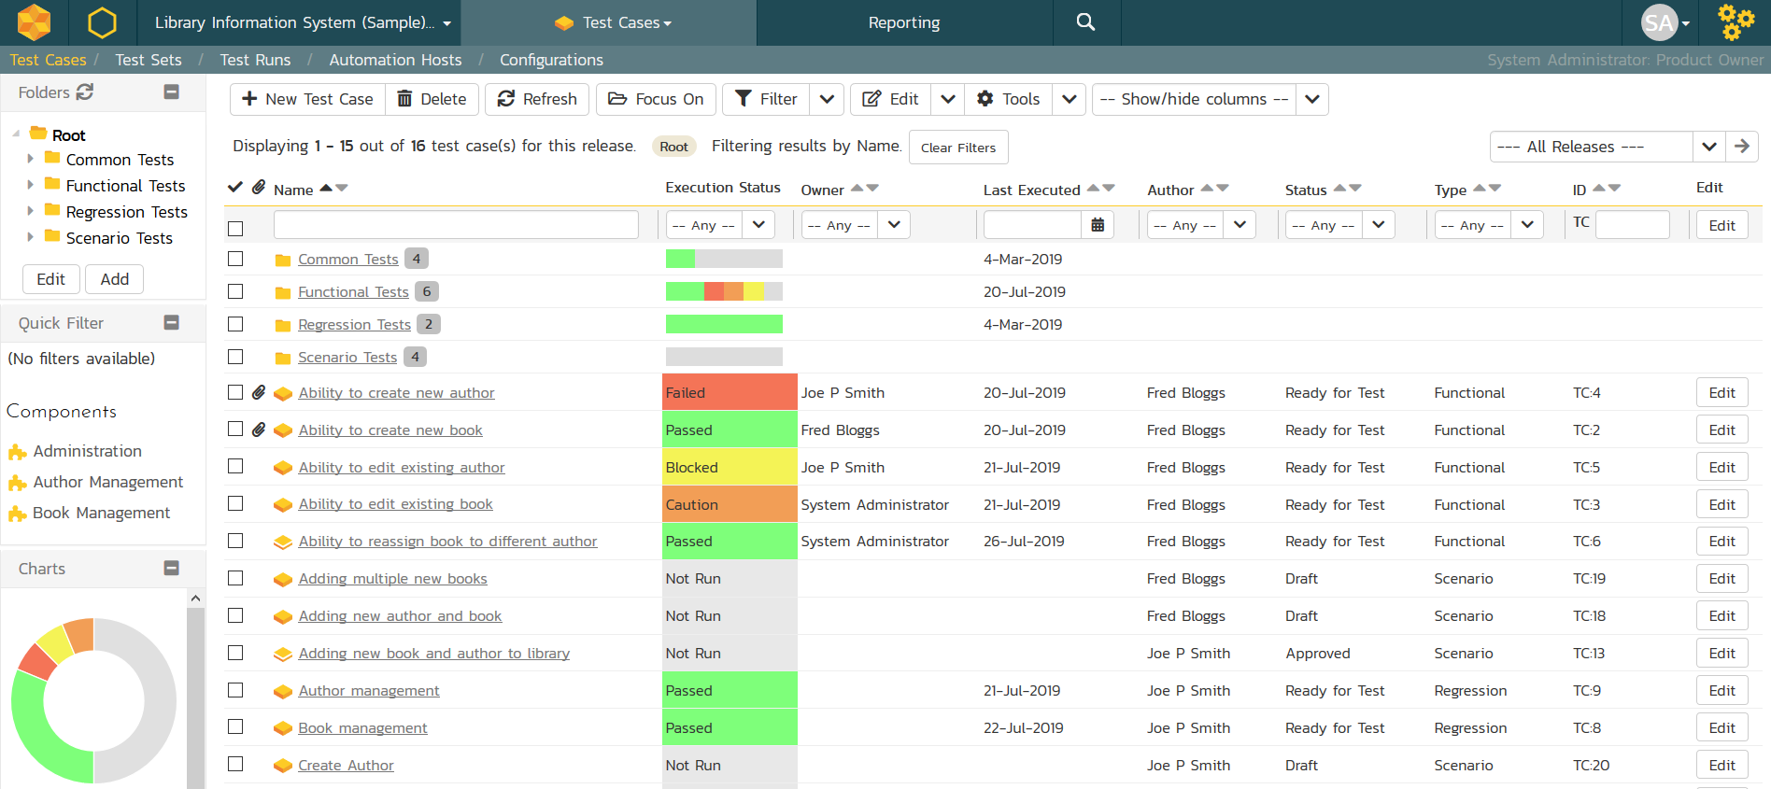
Fed-Ex Tour Example
Test Case Management System
Client app pulls “work items” from a server and displays it in GUI.
Test cases, bug reports
Relies on server connection.
Many clients can modify same work items concurrently.
Notes:
I will be using a lot of examples from Microsoft. They have written a lot about exploratory testing and mostly are the ones who invented these tour. Here is a test case management system, where they used exploratory tours heavily. The test case management client works with a server, from which it pulls “work items”; things such as test cases, issue reports, test plans, to display for a user to manipulate in the GUI. Without the server, the client can basically do nothing. Just by using this piece of information yielded a lot of failures. Imagine canceling an operation involving client server communication halfway through its completion, or just cutting the connection to the server. in addition, a work item (or anything on the server) can be modified at the same time by more than one client. So, that can lead to many failures, as well - situations where data is out of sync between clients. Updates are happening all the time throughout the application, so the FedEx tour is one to target, as it looks at information passing through a system.

Slide 27
Fed-Ex Tour Example
Test Case Management System
Must keep data items in sync between clients.
Failure 1: Modify name of test case, go back to view the plan. Must manually refresh to see the updated name.
Failure 2: Modifying the name of a test plan while a second client had it open would crash the app.
Failure 3: If a test plan is linked to a deleted CI build, the app will crash when the plan is opened.
Notes:
the test case management system processes data that flows freely between the client and the server. All this information has to be refreshed to remain in sync, and this is not easy for an application where multiple clients work with the same artifacts simultaneously. The FedEx tour is intended to help a tester think through such scenarios. To give some examples of actual bugs found in this tour: 1) After modifying a test case, they returned to the test plan. In the test plan, the updated items, like the name, were not automatically updated in the plan itself. They had to perform a manual refresh. 2) You can open multiple client windows on one computer. They found that if you open an item on one client, and modify it in a second, then the first client would crash. The program could not cope with displaying an item while a modification took place. 3) Test plans could be bound to CI builds. If they deleted a build that a test plan was linked to, however, the program would crash anytime that test plan was opened.
In all three cases, the point of the FedEx tour is helping us identify those types of data dependencies and guiding us through thinking about such associations between data elements in a system in a methodical manner.

Slide 28
Let’s take a break.
Notes:
15 minute break

Slide 29

Historic District
Historic districts contain important old buildings.
In software: older features still in use.
Tours verify that they still work and are fault-free.
Bad Neighborhood Tour: Ensure that faulty code now works, and that fixes did not introduce new faults.
Museum Tour: Ensure that unchanged code still works as intended.
Notes:
Historical districts within cities are areas that contain old buildings. Tourists love the mystery and legacy of the past For software, history is determined by its legacy code and history of faults. The historical district represents areas of legacy code still in use, features that debuted in earlier versions, and fixes. The latter is particularly important because when it comes to faults, history does repeat itself, and it is important to retest previously faulty sections of code. legacy code is often poorly understood, and many assumptions are made when legacy code is included, modified, or used. Tours through the historical district are designed to test legacy functionality and verify bug fixes. For example, the bad neighborhood tour is focused on fragments of the software where faults were previously discovered, and ensures that those faultss are solved and gone and looks for new faults exposed by fixing that code. The Museum tour, on the other hand, looks at parts of the program that have not changed in some time and that may not work properly given recent changes to the rest of the system and may not have been retested. It focuses on verifying that those parts of the system still work.

Slide 30

Bad Neighborhood Tour
Complex features may have had many faults fixed over time.
Focus on those features and ensure that:
Reported faults have actually been fixed.
New faults have not been introduced or uncovered.
Also check related features for introduced faults.
Notes:
Every city worth visiting has bad neighborhoods that a tourist is advised to avoid. Software also has bad neighborhoods—those sections of the code populated by faults. The difference between real tourists and exploratory testers, however, is that the former try to avoid bad neighborhoods, and the testers are advised to spend as much time in them as possible. Clearly, we do not know in advance which features are likely to represent bad neighborhoods. But as faults are found and reported, we can connect certain features with bug counts and can track where faults are occurring on our product. A tester should check such these faulty areas precisely, ensuring that older issues are actually solved and looking for mistakes uncovered by fixing known faults. Because faults tend to congregate around complex features, revisiting faulty sections of the product is worth taking. once a faulty section of code is identified, it is recommended to take a tour through nearby features as well to verify that the fixes didn’t introduce any new faults in those either.

Slide 31
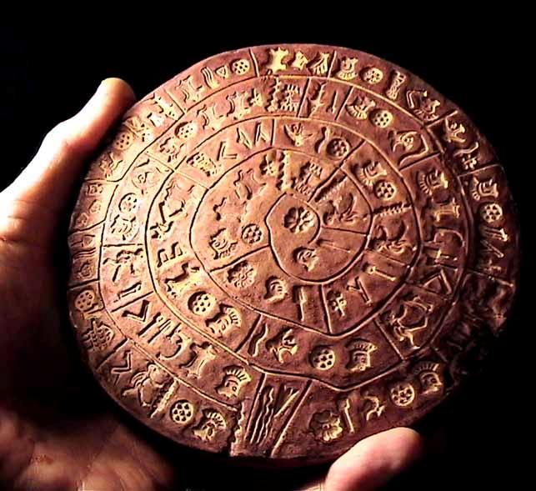
Museum Tour
Older features may not have been modified or retested recently.
Verify that old code still works in the current system.
Check modification dates, and ensure oldest elements are retested.
Such elements often lack tests, are hard to modify, not tested up to current standards.
Notes:
Famous museums draw many thousands of visitors on a daily basis. Antiquities within a code base deserve the same kind of attention from testers. Features or aspects of this code may not work in a new environment. For Example, an Android version of the application might have operated properly in 13, but some features cause crashes in Android 14 even if everything seems to compile. In this case, software’s antiquities are legacy code - older features that we continue to use, but have not been modified or retested in some time. Untouched legacy code is easy to identify by checking time stamps in the repository. Source repositories also maintain a modification record, so testers can do a little research to see what older code may contain some recent modifications. Older code files that undergo revision or that are put into a new environment tend to be failure prone. With the original developers potentially long gone and documentation often poor, legacy code is hard to modify, hard to review, and evades the unit testing net of developers (who usually write such tests only for new code). During this tour, testers should identify older code and executable artifacts and ensure they receive a fair share of testing attention.

Slide 32
Entertainment District
Entertainment districts fill in the gaps in a vacation.
In software: supporting features that aren’t critical.
Word processor: Making document look nice.
Tours visit supporting features and ensures they are properly intertwined with core features.
Supporting Actor: Features on-screen with core features
All-Nighter Tour: Run the software for a long time.
Notes:
On every vacation, tourists will need a break. Visiting the entertainment district, taking in a show, or having a long quiet dinner out is a common way of doing this. Entertainment districts aren’t about seeing sites, they fill in the gaps of a vacation. Most software has features that serve these purposes. For example, the business district for a word processor is the set of features to construct the document, write text, and insert graphics, tables, and artwork. The entertainment district, on the other hand, is the filler features for laying out pages, formatting text, and modifying backgrounds and templates. In other words, the work is in making the document and the “fun” part is making it look nice. Tours through the entertainment district will visit supporting rather than mainline features and ensure that the two are intertwined in useful and meaningful ways. These tours complement the tours through other districts. For example, the supporting actor tour focuses on features that are connected with core features, but aren’t those core features. Their proximity to core features means they will be used often as well. Whereas the all nighter tour examines what happens to the system when it has been running for a long time. Bad things happen over time, memory leaks, data c orruption, race conditions. This tour looks on what happens when you have been using the system continuously for a long period of time.

Slide 33

Supporting Actor Tour
Many features linked to a core feature.
When we search for a product (core feature), we see “reviews” and “similar items” (non-core features).
Focus on linked features.
Will be used often.
Make sure they can be accessed from the core feature.
Notes:
At times in a city, your attention might be drawn to the buildings that the guide was not pointing out. Next to a famous church, you mgiht find yourself drawn to a cute little house. The Supporting Actor tour encourages testers to focus on those features that share the screen with the features we expect most users to exercise. Simply their proximity to the core features increases their visibility, and we must not make the mistake of giving those features less attention than they deserve. For instance, when we search for an item, we might see items that were purchased along with the top result, along with a review feature. Make sure both of those work properly, as those searching for products - our core feature - might end up looking at or writing reviews as well, or might look at the “similar items” - those supporting features. If a menu of items is presented and the second item is the most popular, choose the third. Whereever other testers are looking, look a few degrees left or right to make sure the supporting actors get the attention they deserve. In particular, make sure that they can be accessed from the core feature and that this transition works - thatwe don’t have issues accessing these features, as they will likely most often be accessed via the core feature they are linked to.

Slide 34

Tourist District
Visit functions quickly and focus on making a good first impression.
Souvenir Tour: Run quick tests on functions, examine actions and identify gaps, plan round 2.
Supermodel Tour: Test the GUI thoroughly, look for GUI errors, inconsistencies, usability errors.
Notes:
Every city that focuses on tourism has a section of town where tourists congregate. It’s full of souvenir shops, restaurants. It’s important to make a good first impression. Tours through the tourist district focus on this first impression. for example, the souvenir tour is based on the idea of buying souviniers. We try a bunch of major features quickly, and try them each a little bit - just as we collect something from a place we visit. The idea is to quickly build some bredth. Then, we look over what we have done and the output of it and plan round 2 - identify some ideas on what we missed and would like to hit. Then, we do round 2 based on those ideas of what we missed. Then, we look over the results and plan round 3 to flesh out what we saw. This creates an iterative process of exploration where we brainstorm based on what we uncovered so far. Then we have the supermodel tour, wehre we focus specifically on the user interface alone and assess it in detail -we look for rendering errors, inconsistent UI elements, and usability issues.

Slide 35
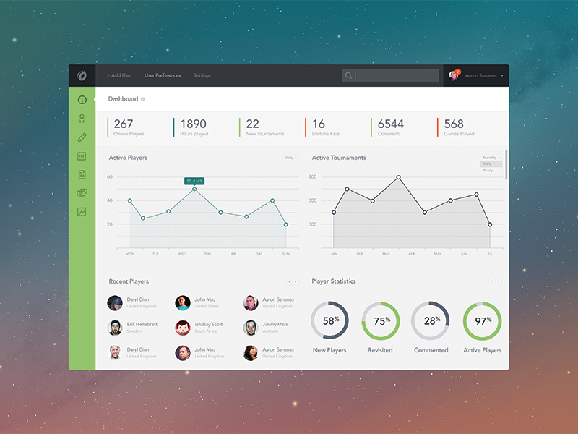
Supermodel Tour
Focus on the GUI.
As you try different functions:
Does GUI render properly and quickly?
Are transitions clean?
Are colors and styles used consistently?
Is GUI usable and accessible by those with dyslexia or colorblindness?
Notes:
For this tour, I want you to think superficially. This tour is about looks and impressions. During the Supermodel tour, the focus is on the graphical interface. Interact with features and inspect the interface elements. Do they look good? Do they render properly, and is the performance good? As you make changes, does the GUI refresh properly? Does it do so correctly or are there unsightly artifacts left on the screen? If the software is using color in a way to convey some meaning, is this done consistently? Are the GUI panels internally consistent with buttons and controls where you would expect them to be? As we go to different screens, do we use elements of the GUI in a consistent manner? Does the interface violate any conventions or standards? Is it accessible to people who are colorblind or have dyslexia issues - especially important with new legal directives in EU? Software that passes this test may still be faulty in many other ways, but it is going to look really good. The Supermodel tour is used extensively, and is one of the three tours used on every project at Microsoft.

Slide 36
Supermodel Tour Example
Dynamics AX Client
Resource planning system.
Shift from APIs to GUI development.
Led to take-up of exploratory testing.
Found MANY bugs missed by API tests.
Many new scenarios and interactions not considered before.
Testers learned that they knew very little about their own app.
Now: exploratory testing before new features merged.
Notes:
To give an example of how this tour was used in practice, we can look at Dynamics AX. This is an enterprise resource planning, or ERP, system that was implemented more than 20 years ago and was acquired by Microsoft. After the acquisition, development shifted heavily towards improvements of the graphical interface - providing forms, controls, and shells over the underlying functionality. The team shifted from testing APIs to testing through a GUI. This led to heavy use of exploratory testing. When they made this transition, Many new failures were found that were not being caught by the API test cases. Testing through the GUI introduced a seemingly infinite number of scenarios and complex user interactions that were not easily captured using automated tests.

Slide 37
Supermodel Tour Example
Actions that exposed DynamicAX issues:
Modify brightness/contrast/resolution.
Look for flickering or bad rendering.
Multiple monitors.
Appearance faults often impact user perception.
Notes:
The Supermodel tour was crucial for Dynamics AX, since they added this GUI to an existing application. With respect to a GUI, it’s important to verify how features of the external environment affect the appearance of an application. Here are a few examples: • Modify the OS display settings, such as to high contrast or different resolution, and verify that all controls, icons, and text display properly. • Move the window and switch between full screen and windows mode to ensure that there are no painting or flickering issues as windows in the application are drawn.For instance, they found a bug where they opened a pop-up window on a form and the title bar became grayed-out, thereby making it appear as though the entire form had lost focus. • Run the application with dual monitors and verify that menus and windows display in the correct monitor. Because most first impressions are based on looks alone, bugs involving the appearance of an application can lead to perceptions of an unprofessional, poorly engineered product. Unfortunately, these types of bugs are often deemed as low priority to fix. A handful of appearance-related bugs in an application may seem harmless, but together they often have a cumulative effect on usability and therefore should not be ignored.

Slide 38
Supermodel Tour Example
Windows Phone
Set to an uncommon screen resolution.
Navigated to different calendar views.
When selecting a month, the month “view” was centered when it should have been top-justified.
Missing flag for screen resolution in this view.
Usability of Maps application.
Device knows current location, but does not use it as default when “Location A” field left blank.
Not a “fault”, but fixing would improve user experience.
Notes:
Here are two examples of when they used the Supermodel tour on a Windows Phone device and explored UI centering and anchor points using different resolutions. After booting in a screen resolution that they knew was not used a lot, they navigated around the device performing simple user tasks (for example, creating contacts, checking email, and checking calendar events). However, After they changed which month to view in the calendar, the repainting of the month that was selected was centered in the middle of the screen, instead of being top justified like every other view. This incorrect centering occurred because of a missing resolution flag. A second example coupled with focus on usability and intuitiveness. While testing the map app, they decided to see how easy it was to get directions from their current location to another location. They launched the application, the device found my current location, and then they decided to select the option to get Directions from A to B from the menu. In this UI, there was no intuitive way to select the current location as their starting point. Given that they did not know the address where they currently were, they just then decided to enter the point B location and hit Go. An error appeared stating it needed to know where they were starting from. Interesting, because upon entering the application, it made it a point to tell them where they were. This lack of completeness can cause a lot of pain when using the application, and a simple addition to prepopulate this field could be the difference between someone using this application all of the time versus it getting bad reviews.

Slide 39
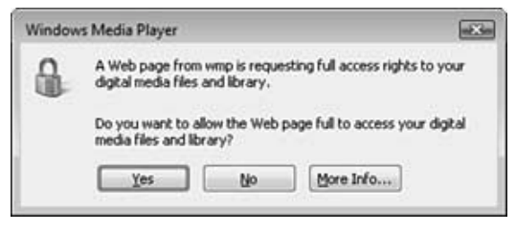
Supermodel Tour Example
Windows Media Player
Many typographical mistakes found early in development.
Look at text and read slowly.
(count to two before going to the next word)
Not *serious*, but can harm your reputation.
Notes:
They also found the supermodel tour very useful in testing Windows Media Player, and noted that it was their top for quantity of failures found quickly. The first things they found with supermodel tour were typographical errors. Early on in the product cycle is when this category of faults is more common. To effectively spot text faults, one should read each word and then count to two before reading the next word. Spot the bug here? It’s hard to read, I know. So, It is in the second paragraph. “Do you want to allow the Web page full to access your….” (click) This should be, “Do you want to allow the Web page full access to your….” It is easy to read too fast and correct the sentence in your head while not seeing the error in front of your eyes - so that’s where that read slowly trick comes in

Slide 40
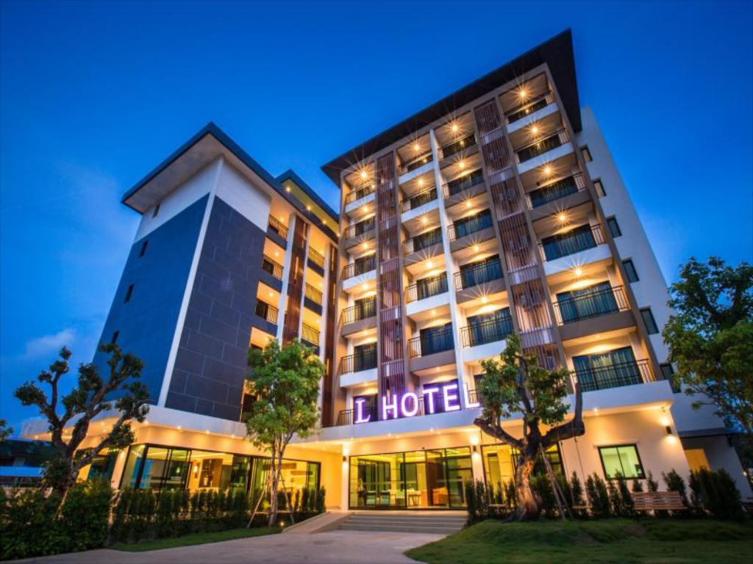
Hotel District
Return to hotel to take a break.
Focuses on doing very little and stopping operations.
Software “at rest” can be very busy.
Rained Out Tour: Cancel running operations and see if problems are caused.
Couch Potato Tour: Leave fields blank and use default values to assess ability to process partial information.
Notes:
The hotel is a place to get awayfor a little rest and relaxation, to recover from their day or wait out bad weather. This is a place for the software tester to get away from the primary functionality and focus on taking a break - stopping operations, trying to do very little work with the running system. software is actually quite busy when it is “at rest,” and these tours seek to test those features. For example, the rained-out tour looks for features that can be cancellend once started, and examines what happens when we cut a long-running operation in progress. The couch potato tour looks at what happens when the tester does the least interaction possibel - Leave default values in place, leave input fields blank. Ensures the software must execute code for processing blank or partial information, must handle defaults properly.

Slide 41

Rained-Out Tour
Look for operations that can be cancelled.
Cancel midway through, see if everything still works.
Good for finding failures related to the program’s inability to clean up after itself.
Open files, corrupted memory or state.
Even if there is no cancel button, can click back button or close entirely.
Notes:
The idea behind the Rained-Out tour is to start operations and stop them before they complete. We may enter information to search for flights on a travel website only to cancel them after the search begins. We will do the same thing for any feature that provides a cancel option or that takes longer than a few seconds to complete. Seek out the time-consuming operations that their application possesses to use this attack to its fullest. Search capabilities are a common example, and using queries that require a lot of processing is a tactic that will make this tour a little easier. every time a cancel button appears, click it. If there is no cancel button, try the back button for apps that run in a browser or on Android. You can even close the application completely. And try this, too: Start an operation, and then start it again without stopping the first. The failures you will see on this tour are mostly related to the inability of the application to clean up after itself. There are often files left open, data left clogging up internal variables, and a state of the system that is no longer tenable for the software to do much else. So after you hit cancel (etc.), take some time to poke around the application to make sure it is still working properly. At the very least, you want to make sure that whatever action you canceled should be able to be exercised again and complete successfully. After all, one would expect a user to occasionally cancel something and then try again See what happens - can you cause negative side effects when operations are killed in-progress?

Slide 42
Rained-Out Tour Example
DynamicsAX
Change the state of the software before cancelling.
Opened a pop-up within a form, then closed the form while pop-up was open.
App crashed because pop-up was still open.
After opening “User Setup” form, they left it open and switched to a different module.
Crash when they clicked Setup form’s cancel button.
Notes:
The RainedOut tour was also used to find faults in the DynamicAX client software. There are two tips. First, it is important to change the state of the object under test before canceling out of it. Let’s use a form as an example: Do not just open a form and immediately close it. Instead, alter the form’s fields before closing it. To demonstrate this, here are some failutes that they have found in Dynamics AX using this technique: • They opened a form and then opened a pop-up window that was parented by the form. With the pop-up window still open, they clicked the form’s X button to close it. As a result, the application crashed because the form failed to properly close the pop-up window before closing itself. • After opening the User Setup form,they left the form open and switched to a different module in the application. Next, they clicked the User Setup form’s Cancel button, which caused the application to crash.

Slide 43
Rained-Out Tour Example
DynamicsAX
Reattempt scenario after cancelling.
New feature ensures that creates/updates/deletes for joined data occur within a single operation.
Cancel changes by clicking “Restore” button on toolbar.
Changes discarded and replaced by values in database.
Reattempted to update same record, leading to crash.
Notes:
Second, it is imperative to reattempt the same scenario after canceling out of an operation. They used this technique for a new feature. This new feature ensures that creates, updates, and deletes for inner/outer joined data sources occur within a single transaction. While testing updates, they decided to cancel (discard) these changes by clicking the Restore button on the form’s toolbar. As a result of clicking Restore,their changes were discarded and replaced by values in the database table. They then reattempted to update the same record again and Dynamics AX crashed. So, explore what happens when you cancel operations and continue using the software.

Slide 44
Rained-Out Tour Example
Test Case Management System
Interrupted server requests and refresh actions can lead to issues.
Failure 1: Canceled initial connection to project. No longer able to manually connect to it.
Failure 2: Switching test suites during loading does not stop loading of the original suite.
Failure 3: Clicking refresh button several times causes slowdown, as each refresh is handled (not just the latest).
Notes:
(1) When you’re working with a client application that works closely with a server, you can assume that any unexpected server activity can cause weird things to happen (both on the server and on the client). If you open a page that starts loading information from a server, and you immediately click Refresh, one action is canceled, and a new one starts immediately. The software on both sides of such a transaction needs to handle this. That’s why this tour finds tons of failures in client-server applications. For example, •Whenever the test case management system is launched, it remembers the previous serverthat the user was connected to and initiates an automatic connection to it. If users want to connect to a different server, they have to cancel this operation. It turns out that the developers didn’t think through the cancellation scenario well and caused an environment variable to be deleted under certain circumstances; so when they loaded a new version of the test data, the connection to the server was lost. • 2: It turns out that whenever they chose a test repository, the application would start loading the test cases that were associated with it. The tour led a tester to think that there had to be an implicit cancel action whenever they quickly chose a different repository, and if not, there would be performance issues. It turned out to be true; they were not canceling the action properly, and performance was really bad. It continued to load the contents of the old repository, even when it should have stopped and switched immediately. (3) Time to refresh starts growing exponentially as we try to refresh several times. Knowing that a refresh action should basically cancel any in-progress activity, they decided to click that Refresh button many times (quickly), and this actually caused horrible performance issues in the product.

Slide 45

Couch Potato Tour
Do least interaction possible.
Leave default values in place
Leave fields blank
Move forward without offering data.
Ensures software processes partial, default values.
We often try complicated scenarios and miss defaults.
Notes:
There’s always one person on a group tour who just doesn’t participate. Couch potatoes can make very effective testers! The reason is simple, even if it is not intuitive: Just because the tester isn’t doing much does not mean that the software follows suit. It’s often the case that nonactivity forces software to work very hard because it is busy executing the “else” clauses in IF-THEN-ELSE conditions and figuring out what to do when the user leaves data fields blank. A great deal of “default logic” executes when a user declines to take the initiative. A Coach Potato tour means doing as little actual work as possible. This means accepting all default values (values prepopulated by the application), leaving input fields blank, filling in as little form data as possible, never clicking on an advertisement, paging through screens without clicking any buttons or entering any data, and so forth. If there is any choice to go one way in the application or another, the coach potato always takes the path of least resistance. As lazy as this sounds, and granted the tester does little real interaction, this does not mean the software is not working. Software must process default values, and it must run the code that handles blank input. That code doesn’t execute itself, and missing default cases are far too common and very embarrassing in released products because testers are too focused on specific cases.

Slide 46

Seedy District
Focused on attacking and breaking the system.
Saboteur Tour: Directly attack software via malformed input or resource manipulation.
Antisocial Tour: Try unlikely input or perform actions in the wrong order.
(add 10000 songs, try to play empty playlist, order 10000000 pairs of shoes)
Notes:
Finally, we have the Seedy District. Seedy districts are those unsavory places that few guidebooks or visitors bureaus will document. They are full of people doing bad and illegal things and are better off left alone. Yet they attract a certain class of tourist anyway. Seedy tours are a must for testers because they find places of vulnerability that may be very unsavory to users should they remain in the product. This is the bad part of town, where we have input meant to break the software, meant to cause trouble for the legitimate users. In the Saboteur Tour, we attempt to break the software by feeding in malformed input, removing or restricting resources, or thinking of other ways to creatively disrupt operations. In the Antisocial Tour, we try unlikely input - legal, but unlikely. We add 10000 songs to a playlist, or play an empty playlist, or we try to order 1000000000 pairs of shoes. Or we use legal input, but try to perform actions in the wrong order.

Slide 47
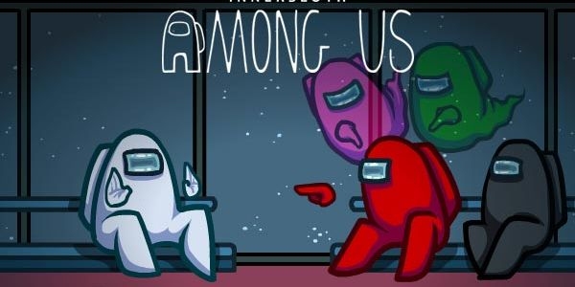
Saboteur Tour
Force the software to act.
Understand the resources it requires to successfully act.
Remove of restrict those resources.
Use corrupt input data, limit network connectivity, allow too little RAM, run many other apps at the same time.
Think of ways to creatively disrupt operations and try them out.
Notes:
During the Saboteur Tour we will attempt to undermine the application at every possible opportunity. We will ask the application to read from the disk (by opening a file or using some disk resource), but then sabotage its attempt to do so by rigging the file operations to fail (perhaps by corrupting the file in question). We will also ask it to do some memory-intensive operation when the application is either on a machine with too little memory or when other applications are operating in the background and consuming most of the memory resources. We try to hide injected code in xml or cut off the internet connection mid-operation. This tour is simple to conceptualize: • Force the software to take some action. • Understand the resources it requires to successfully complete that action. • Remove or restrict those resources in varying degrees. During this tour, a tester will find that there are many ways to rig environments by adding or deleting files, changing file permissions, unplugging network connections, running other applications in the background, deploying the application under test on a machine that has known problems, and so forth.

Slide 48
Saboteur Tour Example
Test Case Management System
Change or remove necessary resources.
Failure 1: System crashes if connection to server is closed at different points.
Failure 2: System crashes, restarts, crashes again, etc. if the config file is corrupted.
Failure 3: System crashes if config file is too large.
(also try making it read-only, changing file type, deleting)
Notes:
The Saboteur forces you to think though the application’s use of resources so that you can vary the amount of resources available, and potentially find scenarios that will cause it to fail, for example: • Bug: System crashes when trying to view a test configuration when there is no connection to the server used to store test cases and test data. The Saboteur causes you to think through many scenarios where availability of a server was crucial and where good error-handling routines need to be in place. Making the server unavailable at the right time sometimes will lead to serious crashes, and the resulting fixes will make your product more robust. In this next bug, the strategy was the same one: looking for a resource that the application uses. • Bug 2: system crashes at startup time if the config settings file becomes corrupt. The system continually fails until the config file is corrected. • Bug 3: System crashes when config file is really large. Finding this particular bug consisted of playing around with the configuration file and creating variants of it and modifying its properties. The Saboteur suggests making it read-only, deleting it, changing its type, and so forth. But the property that worked in this case was its size. When they created a very large config file, the application was simply not able to cope with it.

Slide 49
Banking, Meeting Planner Examples
Anything else you would try?
Additional scenarios?
Additional focus on certain features?
Particular tours?
Notes:
(discuss)
Talk through supermodel, fedex (modify data, see if modifications stick), couch potato (fields in bankgiro or other forms), saboteur (strange malformed data values)

Slide 50
We Have Learned
Exploratory Testing
Tests are not created in advance.
Testers check the system on-the-fly,
Often based on ideas noted before beginning.
Testing as a thinking idea.
About discovery, investigation, and role-playing.
Test design and execution done concurrently.
Often by directly using the software and its user interfaces.
Notes:
EXPLORATORY TESTING is a type of software testing where Test cases are not created in advance but testers check system on the fly. They may note down ideas or come up with goals about what to test before test execution. The focus of exploratory testing is more on testing as a "thinking" activity. Exploratory Testing is widely used in Agile models and is all about discovery, investigation, and learning. You can try out different roles and user types. It emphasizes personal freedom and responsibility of the individual tester.
Last class, we talked about uni testing, this is a form of scripted testing where you design test cases first and later proceed with test execution. On the contrary, exploratory testing is a simultaneous process of test design and test execution all done at the same time. (last point)

Slide 51
We Have Learned
Tours apply different focus areas to exploration
Business District: Core features
Historic District: Legacy code and old software versions
Entertainment District: Supporting functionality, long execution sessions
Tourist District: Looks for gaps in the experience, iterative fast rounds of exploration.
Hotel District: Focuses on supporting functionality
Seedy District: Attacks and misuse of software

Slide 52
Next Time
Structural Testing
Before Exercise Session:
Install an IDE (IntelliJ, Eclipse) and ensure that JUnit is installed and usable.
Assignment 2 due February 16
Questions?

