Slide 1


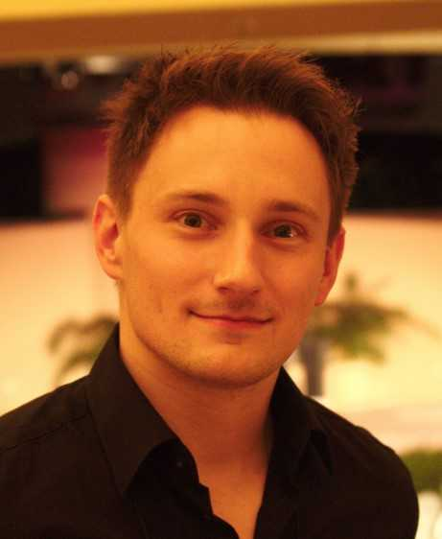


Promote-pl: A Round-Trip Engineering Process Model for Adopting and Evolving Product Lines
Jacob Krüger, Wardah Mahmood, Thorsten Berger
International Systems and Software Product Lines Conference
October 2020

Slide 2

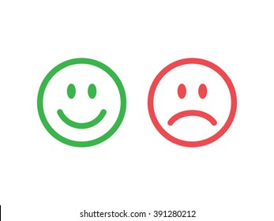
Traditional Software Development
Analysis
Design
Development
Testing
Deployment
Maintenance
customer
requirements
variant 1
Maintenance
Convenience
new
requirements
variant 2
Agility
Familiarity
new
requirements
Maintenance
variant 3
Reuse: Which variant to clone to create a new one?
Maintenance: How to maintain multiple variants?
new
requirements
Maintenance
How to ensure quality and consistency?
variant n

Slide 3
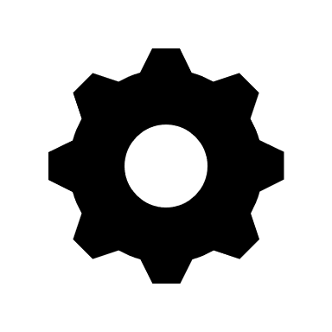
Software Product-Line Engineering (SPLE)
Build once, reuse n times
Variant 1
Platform
orange, green, yellow, crimson
Variant 2
blue, red, white, violet
Configurator
crimson, white, brown, aqua
Variant 3
Efficient reuse
Single-point maintenance
Allows experimentation via configuration
Better consistency and quality

Slide 4
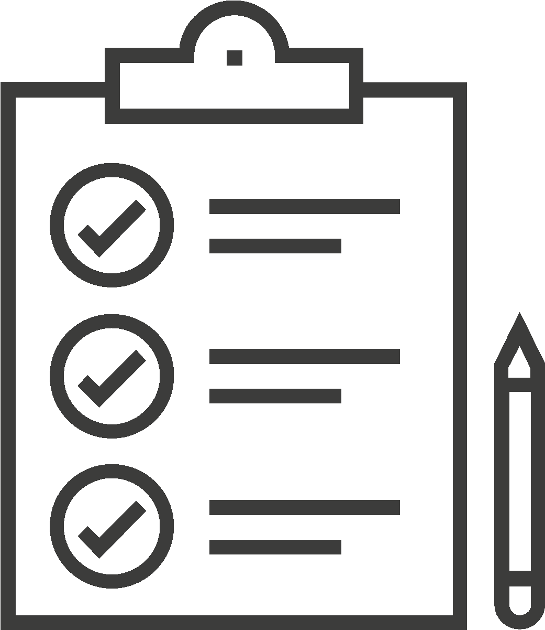
Process Models for SPL adoption
Process model: An abstraction of the software development process.
Examples: Waterfall, agile etc.
SPLE process models steer the adoption of SPL architecture in industry.
Pohl et al. [1], Northrop [2], Kang et al. [3], Czarnecki [4], and Apel et al. [5].

Slide 5
A Typical SPL Process Model
develop core assets for reuse
proactive adoption
Write application-specific code
Clear distinction between the phases (sequence)
Platform-based evolution
1. Klaus Pohl, Günter Böckle, and Frank J. van der Linden. 2005. Software Product Line Engineering. Springer

Slide 6
Proactive adoption
Reactive adoption
Extractive adoption
Start with a platform from the get-go (process models assume this)
Start with one variant as the platform. Merge every subsequent variant into the platform one by one
Start with n variants, do a diff, integrate them, and make one big platform
Platform
Variant 2
Variant 1
Variant 2
Variant n
Variant 3
Variant 1
…………
Platform
Variant 1
Variant 2
Variant 3
Sounds familiar? ;)

Slide 7
SPL adoption in reality:
Organizations capitalize on existing variants to create new variants.
Domain engineering and application engineering go hand in hand.
Product lines also evolve through their variants.
Proactive adoption
Reactive adoption
Extractive adoption
Start with a platform from the get-go (process models assume this)
Start with one variant as the platform. Merge every subsequent variant into the platform one by one
Start with n variants, do a diff, integrate them, and make one big platform
Platform
Variant 2
Variant 1
Variant 2
Variant n
Variant 3
Variant 1
…………
Platform
Variant 1
Variant 2
Variant 3
Sounds familiar? ;)

Slide 8
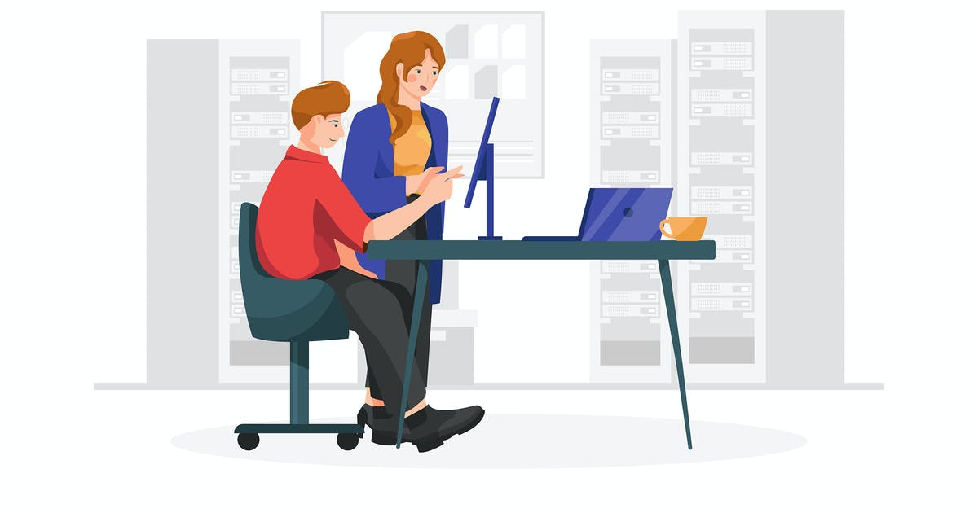
Objectives
RO1: Do contemporary practices reflect those prescribed in the process models?
RO2: Do process models need to be updated? What would an updated process model look like?
Research
Industry
RO3: Does the updated process model align with contemporary practices?
Motivation: A more “realistic” process model would facilitate organizations in planning SPL adoption in different ways.
Bonus: Can be used for teaching SPLE to students!

Slide 9

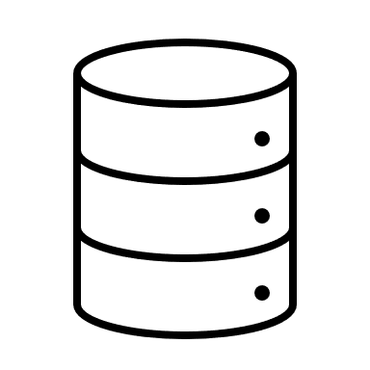

Step 1: Elicit Empirical Data about Contemporary PLE Processes
12 venues*
Last five years
Written in English
Peer-reviewed
Used a process model
Experience reports
32 publications
* SPLC, VaMoS, ICSE, ESEC/FSE, ASE, EMSE etc

Slide 10
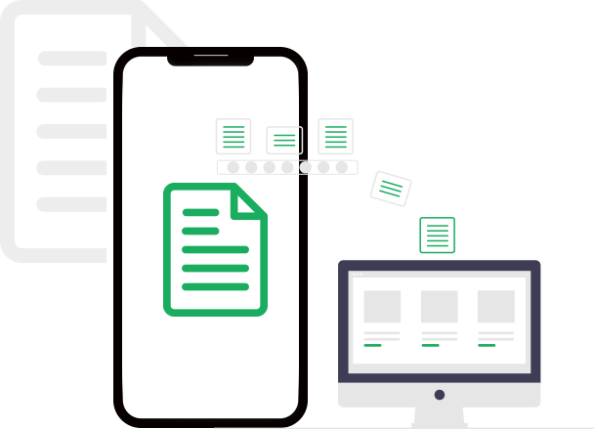
Data Extraction
Metadata (title, authors, venue, year published etc.)
Partial order of activities
E.g., Analyze Commonality & Variability [Locate Features] ≺ Model Variability ≺ Re-Engineer Artifacts
Scope (proactive, reactive, extractive)
Findings:
Reactive (8 instances) and extractive (12 instances) adoption are almost as common as proactive adoption (12 instances)
SPLs also evolve via variants (8 instances)

Slide 11
Step 2: Synthesize a Common Process Model
Obtain an initial understanding of the existing process models.
Created a list of unique activity names (150+).
Extract partial orders of activities from publications.
Unify terminology.
Merge partial orders to create partitions of the process model.
Resolve unclear orders by discussion first and last author.

Slide 12
Result: Promote-pl
(PROcess MOdel for round-Trip Engineering
of Product Lines)

Slide 13
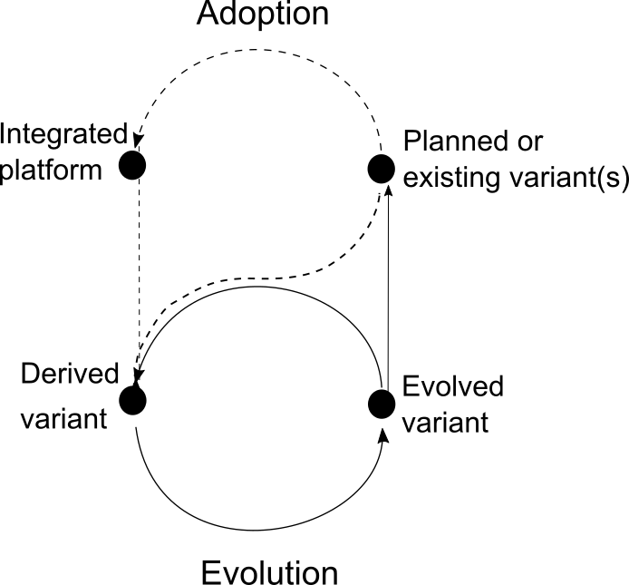
Simplified Process Model
Focus on adoption and evolution rather than domain and application engineering
Caters for different adoption approaches
Round-trip

Slide 14
Dynamic Configuration and Adaptive Systems.
Continuous Software Engineering.
Contemporary practices
Clone Management and Incremental Adoption of Platforms.
Agile Practices.

Slide 15
Conclusion
Updated process model: promote-pl
Switch in primary decomposition towards adoption and evolution.
Covers all adoption strategies.
Caters for variant-based PL evolution.
Based on empirical evidence and experience.
Activities of different granularity levels.
Connects SPLE to modern SE practices.

Slide 16
Paper Reference
Krüger, Jacob, Wardah Mahmood, and Thorsten Berger. "Promote-pl: a round-trip engineering process model for adopting and evolving product lines." Proceedings of the 24th ACM Conference on Systems and Software Product Line: Volume A-Volume A. 2020.

Slide 17
References
Klaus Pohl, Günter Böckle, and Frank J. van der Linden. 2005. Software Product Line Engineering. Springer
Linda M Northrop. 2002. SEI’s Software Product Line Tenets. IEEE Software 19, 4 (2002).
Kyo C. Kang, Jaejoon Lee, and Patrick Donohoe. 2002. Feature-Oriented Product Line Engineering. IEEE Software 19, 4 (2002).
Krzysztof Czarnecki. 2004. Overview of Generative Software Development. In UPP. Springer.
Sven Apel, Don Batory, Christian Kästner, and Gunter Saake. 2013. Feature-Oriented Software Product Lines. Springer.

Slide 18


