Slide 1
Lecture 2: Quality Attributes and Measurement
Gregory Gay
DIT635 - January 22, 2021

Slide 2
Today’s Goals
Discuss software quality in more detail.
Quality attributes
Dependability, availability, performance, scalability, and security.
How we build evidence that the system is good enough to release.
How to assess whether each attribute is met.

Slide 3
Software Quality
We all want high-quality software.
We don’t all agree on the definition of quality.
Quality encompasses both what the system does and how it does it.
How quickly it runs.
How secure it is.
How available its services are.
How easily it scales to more users.
Quality is hard to measure and assess objectively.
Notes:
As stated last class. We all want high-quality software, we all agree that quality is necessary. However, we don’t all agree on what quality means. Ask ten people, and they may describe ten things. Why? (3) what a system does is only part of the story and that how the system provides its services often has a huge impact on the perceptions that stakeholders have of it. (rest)

Slide 4
Quality Attributes
Describe desired properties of the system.
Developers prioritize attributes and design system that meets chosen thresholds.
Most relevant for this course: dependability
Ability to consistently offer correct functionality, even under unforeseen or unsafe conditions.
Notes:
Quality attributes describe desired properties of the system under development. Developers must prioritize quality attributes and design a system that meets chosen thresholds.
Most relevant for this course: dependability. Ability of the system to consistently offer correct functionality, even under unforeseen or unsafe conditions.

Slide 5
Quality Attributes
Performance
Ability to meet timing requirements. When events occur, the system must respond quickly.
Security
Ability to protect information from unauthorized access while providing service to authorized users.
Scalability
Ability to “grow” the system to process more concurrent requests.
Notes:
Here are other ways we assess quality
- (2) How components are structured and communicate influences performance. One of your biggest bottlenecks is often in communication between subsystems, especially over a network. So, performance can often be improved by localizing critical operations into fewer, but larger, components. Install more of your system locally, rather than on a remote server, so that computation doesn’t depend on network latency. Consider how to execute components of the system in parallel, for more efficiency.
- (4) If security is a concern, you might want to layer the architecture, with the critical components protected in innermost layers , with a high level of security validation applied to the higher layers. Architect the system to trap attackers with multiple layers of gates between them and critical assets.
- (5)

Slide 6
Quality Attributes
Availability
Ability to carry out a task when needed, to minimize “downtime”, and to recover from failures.
Modifiability
Ability to enhance software by fixing issues, adding features, and adapting to new environments.
Testability
Ability to easily identify faults in a system.
Probability that a fault will result in a visible failure.
Notes:
- (2) If availability is a critical requirement, the architecture should be designed with redundancy in mind - always make it possible to replace components in case of trouble and update components without stopping the system. This is called a “fault-tolerant” system. You’ll see terms like triple reudndancy, where things like spacecraft systems will have three copies of software or hardware running at once, and makre sure they agree, or ensure that there is always a backup if something goes wrong.
- (4) If you want a high degree of maintainability, you need a larger number of small, self-contained components. That’s the idea of high cohesion and low coupling. Keep related functions together, and as independent as possible - separate data from consumers, avoid shared data structures - then you can more easily fix bugs and add features to these little independent subsystems.
- (6) a well-designed system is able to amplify a failure - ensuring that you notice problems, rather than getting subtlely wrong answers or missing issues until it is too late. For instance, the system design can determine what information is visible for inspection when testing, and a system could be designed to surface information to a special testing interface designed to provide data that would not otherwise be visible to the world.

Slide 7
Quality Attributes
Interoperability
Ability to exchange information with and provide functionality to other systems.
Usability
Ability to enable users to perform tasks and provide support to users.
How easy it is to use the system, learn features, adapt to meet user needs, and increase confidence and satisfaction in usage.
Notes:
- (2) This is not useful in isolation, but is defined by context - by identifying with whom, what, and under what circumstances the system is supposed to communicate and work with .The idea here, however, is that the architecture is designed to provide the right data and functionality to external sources in a controlled manner.
(4-5) Naturally, this most centrally relates to user interfaces, but impacts the entire architecture and how users work with it.

Slide 8
Other Quality Attributes
Resilience
Supportability
Portability
Development Efficiency
Time to Deliver
Tool Support
Geographic Distribution

Slide 9
Quality Attributes
These qualities often conflict.
Fewer subsystems improves performance, but hurts modifiability.
Redundant data helps availability, but lessens security.
Localizing safety-critical features ensures safety, but degrades performance.
Important to decide what is important, and set a threshold on when it is “good enough”.
Notes:
Now, unfortuantely, emphasizing one of these qualities tends to lessen another quality. They conflict with each other. It is hard to achieve multiple qualities at once.
Using a small number of complex subsystems components improves performance because there are fewer bottlenecks, but hurts maintainability, as it’s harder to add features or make changes to complex subsystems.
(read) - you need to protect all of that data equally, and that’s infinitely harder than protecting data in one place.
Localizing safety-critcical features to one module on a local machine introduces more communication between subsystems, possibly in remote locations, degrading performance, but does improve safety
(last point), we’ll talk more about that over the next three classes

Slide 10
Our Focus
Dependability
Availability
Performance
Scalability
Security
(Others important - but not enough time for all!)
Notes:
(availability is part of dependability, but also its own attribute)

Slide 11
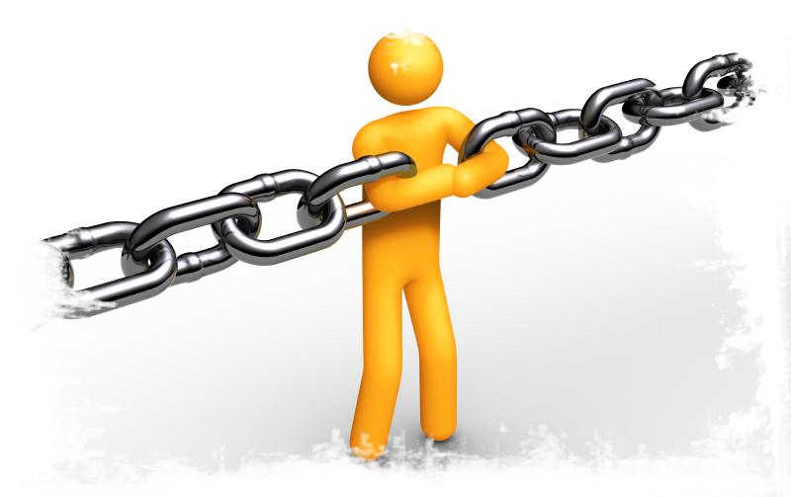
Dependability
Notes:
Just start with a question - want you to start thinking about this. (read)
This isn’t something with one answer, or even a right answer. It’s something we’ll keep returning to

Slide 12
When is Software Ready for Release?
Provide evidence that the system is dependable.
The goal of dependability is to establish four things about the system:
That it is correct.
That it is reliable.
That it is safe.
That is is robust.
Reliable
Correct
Safe
Robust
Notes:
(title) The answer - we need evidence. Can we can argue that we’ve done enough? Often, this actually boils down to (1). Dependability is a sort of meta-quality attribute. It actiually means four things - (go over 2-end)

Slide 13
Correctness
A program is correct if it is always consistent with its specification.
Depends on quality and detail of requirements.
Easy to show with respect to a weak specification.
Often impossible to prove with a detailed specification.
Correctness is rarely provably achieved.
Notes:
The simplest of these properties in definition, if not in use, is correctness - A program is correct if it is consistent with its specifications. By definition, a specification divides all system behaviors into two classes - successful or correct executions - those that match what was specified in the requirements - and failures, or incorrect executions - all of those that are inconsistent. All possible behaviors of a correct system result in successful executions that are consistent with the specifications. A program cannot be 30% correct. It is either correct or not correct. The difficulty of utility of showing correctness depend on the quality and thoroughness of your requirements.
A program can easily be shown to be correct with respect to a weak specification. However, it is often impossible to prove correctness with a good, detailed specification, as that would require showing every possible behavior of the program. Correctness is a goal to aim for, but is rarely provably achieved.

Slide 14
Reliability
Statistical approximation of correctness.
The likelihood of correct behavior from some period of observed behavior.
Time period, number of system executions
Measured relative to a specification and usage profile (expected pattern of interaction).
Dependent on how the system is used by a type of user.
Notes:
Instead, we often aim for reliability as a specific quality goal, as it is an approximation of acceptable correctness. (read 2-5)
Some users might never trigger a crash, while some might see crashes all the time. That’s why it’s important to consider how the system is interacted with in measuring reliability. You cannot establish a general level of reliability, but you can establish reliability levels for certain types of users and use that as an approximation of correctness.

Slide 15
Dependence on Specifications
Correctness and reliability:
Success relative to the strength of the specification.
Hard to meaningfully prove anything for strong spec.
Severity of a failure is not considered.
Some failures are worse than others.
Safety revolves around a restricted specification.
Robustness revolves around everything not specified.
Notes:
Those definitions of correctness and reliability have two weaknesses - first, success or failure is relative to a specification, they are only as strong as the specification. If you have a weak spec, lacking detail, then it’s easy to say the system is correct or reliable. It’s all relative. If the specification is detailed, we cannot show correctness and only can build some evidence for reliability. Second, those two qualities make no distinction between failures that are minorly annoying and failures that are life-threatening. Not all faults are equal in the effect they have when a failure occurs. For some kinds of systems, it is really important to consider the severity of a fault. Our last two properties - safety and robustness - help deal with both of these issues. Safety revolves around a limited specificaition of a set of major safety hazards that we must avoid above all else. Robustness revolves around everything we haven’t thought of specifying. Of course, we don’t need to be psychics, we don’t need to handle everything possible, but robustness tasks us with putting safeguards in place to prevent these unforeseen risks from causing catastrophic errors.

Slide 16
Safety
Safety is the ability to avoid hazards.
Hazard = defined undesirable situation.
Generally serious problems.
Relies on a specification of hazards.
Defines what the hazard is, how it will be avoided in the software.
We prove or show evidence that the hazard is avoided.
Only concerned with hazards, so proofs often possible.
Notes:
(1), where, by hazard, I mean a known, defined undesirable situation, generally prioritized by the severity of the problem. It might be annoying any time your word processor crashes, but it it corrupts your document - preventing recovery - then that is a hazard you want to avoid. If there is a brief graphical glitch on your aircraft display, that’s fine. If a software bug prevents the altitude from ever being displayed to the screen, then that is a serious hazard to avoid. Demonstrating safety (4). Rather than fosucsing on the full specification, we create a small ,focused hazard specification that defines what each hazard is and imposes requirements on how it will be avoided. We then, ideally, prove that the software does avoid the hazard by doing what we promised. If proofs are not possible, we at least will gather observations and build evidence, like in reliability.
By ignoring other elements of correctness, a safety specification is often easier to analyze than the full specification. And, by looking at hazards in isolation, you can better think through what those hazards are and how to avoid them. Because we have this small, focused specification, we can often prove safety, unlike correctness.

Slide 17
Robustness
Software that is “correct” may fail when the assumptions of its design are violated.
How it fails matters.
Software that “gracefully” fails is robust.
Design the software to counteract unforeseen issues or perform graceful degradation of services.
Look at how a program could fail and handle those situations.
Cannot be proved, but is a goal to aspire to.
Notes:
Correctness, reliability, and safety are contingent on normal operating conditions. They depend on specifications to define what “normal” is - what conditions we expect to use the system under, and how behavior occurs in those situations. All specifications make assumptions, implicit or explicit. What happens when those assumptions are violated? What happens when we land outside of the specification? that is where robustness comes in. (1)
it’s not reasonable to expect file changes to save when there’s no harddrive space, or money to be dispensed by an atm when there is none in the machine, or a sale to take place when there’s no network connection or too many server connections. Software that is “correct” might still fail. When you design software ,when you write a specification, you make assumptions on how the software will operate and be used. When those assumptions are violated, the software will fail. In those situations, how it fails becomes important.
(read 3) This is not something you prove or can even demonstrate in a meaningful way. Instead, this is something you aspire to in the software design.
When designing software to be robust, you accept that failure might occur. and you try to control how it fails. (4) You can design software to be able to recover some portion of a document if something that happens that causes a crash, or use redundancy to recover if part of an app crashes or if there is some data loss, or design a webpage that will turn away users when load is too high. You design the software to recover from or prevent issues that could come up if there is a problem. You don’t know what will happen - but you may know how many problems would manifest - crashes, slowdown, inability to connect to a service - and you design the software to react to those problems.

Slide 18
Dependability Property Relations
Reliable, but not correct. Catastrophic failures can occur.
Robust, but not safe. Catastrophic failures can occur.
Reliable
Correct
Safe
Robust
Correct, but not safe. Specification is inadequate
Safe, but not correct. Annoying failures can occur.
Notes:
We ideally would have all four. Software that is correct is also reliable, but not vice-versa (top-left). Software that is safe is also robust, but not vice-versa (top-right). Software can be correct but not safe (bottom left). It can also be safe, but not correct (bottom right).

Slide 19
Measuring Dependability
Must establish criteria for when the system is dependable enough to release.
Correctness hard to prove conclusively.
Robustness/Safety important, but do not demonstrate functional correctness.
Reliability is the basis for arguing dependability.
Can be measured.
Can be demonstrated through sufficient volume of testing.
Notes:
Testing is there to reveal faults so they can be removed. Identifying and removing as many faults as possible is a useful goal, but finding all faults is nearly impossible in any complex system, and is definitely not cost-effective. We can always test more. However, Testing cannot go on forever. Products must be delivered at some point, and to do so, we need to establish criteria for when we are done - when we can claim to be dependable enough.
Correctness is not a good basis for this, your software is either correct or not, and it’s unlikely to ever be provably correct if your specification is any goof. That’s an aim, but not realistically 100% achieveable.
Robustness and Safety are important, but hard to measure, and not necessarily the best grounds to base your release on - you could be safe, but the rest of your software could be an mess, putting out the wrong output constantly.
Reliability is the best basis for establishing the level of dependability of your software. (last two points). Next, we will talk about how you measure reliability.

Slide 20
Let’s take a break!
Notes:
10 min break, will take more later

Slide 21
Measuring Reliability
Notes:
Just start with a question - want you to start thinking about this. (read)
This isn’t something with one answer, or even a right answer. It’s something we’ll keep returning to

Slide 22
What is Reliability?
Probability of failure-free operation for a specified time in a specified environment for a given purpose.
Depends on system and type of user.
How well users think the system provides services they require.
Notes:
I know we already defined it, but what is reliability, really? Reliability is the probability of failure-free operation for a specified time in a specified environment for a given purpose. now, notice the qualifiers there. That’s because
This means different things depending on the system and the users of that system. Informally, reliability is a measure of how well users think the system provides the services they require.

Slide 23
Improving Reliability
Improved when faults in the most frequently-used parts of the software are removed.
Removing X% of faults != X% improvement in reliability.
In one study, removing 60% of faults led to 3% improvement.
Removing faults with serious consequences is the top priority.
Input Causing Failure
User 1
User 3
User 2
Notes:
Reliability is improved when software faults that occur in the most frequently-used parts of the software are removed. We find and fix faults, and as we do so, we track the improvement in reliability.
That said, not all faults impact reliability equally - some faults are rarer than others, and Removing X% of faults will not necessarily lead to an X% improvement in reliability (3). Not all faults are equal and often don’t affect the system in the same way. So, (read), as those have the biggest impact on perceived reliability. Unfortunately, reliability depends on how users work with the system. Not all users will see a particular fault. Each user will use the system in all sorts of different ways. Different users access different functions, have different security settings, and use the system in different environments. So, reliability depends on the user. Some of them might experience all sorts of faults. Others may never trigger a single fault. So, measuring reliability requires setting the context. It requires all of those qualifications we mentioned earlier. You want to establish different operating scenarios, different profiles of the users you think will interact with the system and the actions they will take, so that you can measure reliability for the different types of users.

Slide 24
Reliability is Measurable
Reliability can be defined and measured.
Reliability requirements can be specified:
Non-functional requirements define number of failures that are acceptable during normal use or time in which system is allowed to be unavailable.
Functional requirements define how the software avoids, detects, and tolerates failures.
Notes:
Reliability is fundamentally something that can be measured, unlike correctness or robustness. We can set conditions, and measure reliability for those scenarios. Reliability -once defined -is something you can measure and argue for. It can be divided into levels, and you can specify a level of required reliability. This starts with the system requirements. Non-functional requirements can define the number of failures that are acceptable during normal use of the system, or the time in which the system is allowed to be unavailable for use. Functional requirements can define how the software avoids, detects, and tolerates failures and corrects for them. The non-functional requirements can define how we judge reliability, and functional requirements determine what the system does to be more reliable. We can check these requirements to make sure they are met. We can make measurements and establish a level of reliability. The functional requirements then can be tested and verified.

Slide 25
How to Measure Reliability
Hardware metrics often aren’t suitable for software.
Based on component failures and the need to repair or replace a component once it has failed.
In hardware, the design is assumed to be correct.
Software failures are always design failures.
Often, the system is available even though a failure has occurred.
Metrics consider failure rates, uptime, and time between failures.
Notes:
So, that said, given an operational profile, how do we measure reliability?
- Measuring reliability is normal when building hardware, but hardware metrics often aren’t suitable for software. (2) once the hardware fails, it has failed until you replace the part. How it failed didn’t really matter. It’s working or not. Software isn’t quite so binary. In software, failure can be more easily recovered from, and may only be partial. You can fail in degrees.
- the thing is, with hardware, the design is assumed to be correct - you just had a component wear out or go bad. in software, parts don’t fail - there’s no hardware degradation. (read 4-6)

Slide 26
Metric 1: Availability
Can the software carry out a task when needed?
Encompasses reliability and repair.
Does the system tend to show correct behavior?
Can the system recover from an error?
The ability to mask or repair faults such that cumulative outages do not exceed a required value over a time interval.
Both a reliability measurement AND an independent quality attribute.
Notes:
One measurement that originated from hardware is still works as a good starting place to talk about how you measure reliability in software is the availability. Availability refers to a property of software that it is there and ready to carry out its task when you need it to be. This encompasses what is normally called reliability (4) (although it may encompass additional considerations such as downtime due to periodic maintenance). In fact, availability builds upon the concept of reliability by adding the notion of recovery—that is, when the system breaks, it repairs itself. To define it formally: “Availability refers to the ability of a system to mask or repair faults such that the cumulative service outage period does not exceed a required value over a specified time interval.” This is both a way to measure reliability AND a quality attribute on its own that is often examined.

Slide 27
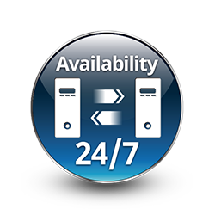
Metric 1: Availability
Measured as (uptime) / (total time observed)
Takes repair and restart time into account.
Does not consider incorrect computations.
Only considers crashes/freezing.
0.9 = down for 144 minutes a day.
0.99 =14.4 minutes
0.999 = 84 seconds
0.9999 = 8.4 seconds
Notes:
(1) (2)), and gives us a clear indicator of when the system is able to respond. now, this is important, but not perfect on its own, as Does not tend to take incorrect computations (partial failures) into account. If the system doesn’y crash, it doesn’t affect the availability. be careful when looking at availability figures. One decimal point makes a huge difference. (go over last bit)

Slide 28
Availability
Improvement requires understanding nature of failures that arise.
Failures can be prevented, tolerated, removed, or forecasted.
How are failures detected?
How frequently do failures occur?
What happens when a failure occurs?
How long can the system be out of operation?
When can failures occur safely?
Can failures be prevented?
What notifications are required when failure occurs?
Notes:
One of the most demanding tasks in building a high-availability, fault-tolerant system is to understand the nature of the failures that can arise during operation. Once those are understood, mitigation strategies can be designed into the software.Faults can be prevented, tolerated, removed, or forecast. In this way a system becomes “resilient” to faults. Among the areas with which we are concerned are how system faults are detected, how frequently failures may occur, what happens when a failure occurs, how long a system is allowed to be out of operation, when faults or failures may occur safely, how faults or failures can be prevented, and what kinds of notifications are required when a failure occurs

Slide 29
Availability Considerations
Time to repair is the time until the failure is no longer observable.
Can be hard to define. Stuxnet caused problems for months. How does that impact availability?
Software can remain partially available more easily than hardware.
If code containing fault is executed, but system is able to recover, there was no failure.
Notes:
Because a system failure is observable by users, the time to repair is the time until the failure is no longer observable. This may be a brief delay in the response time or it may be the time it takes someone to fly to a remote location in the Andes to repair a piece of mining machinery (as was recounted to us by a person responsible for repairing the software in a mining machine engine). The notion of “observability” can be a tricky one: the Stuxnet virus, as an example, went unobserved for a very long time even though it was doing damage. In addition, unlike hardware, we are often concerned with the level of capability that remains when a failure has occurred—a degraded operating mode.
The distinction between faults and failures allows discussion of automatic repair strategies. That is, if code containing a fault is executed but the system is able to recover from the fault without any deviation from specified behavior being observable, there is no failure.

Slide 30
Metric 2: Probability of Failure on Demand (POFOD)
Likelihood that a request will result in a failure
(failures/requests over observed period)
POFOD = 0.001 means that 1 out of 1000 requests fail.
Used in situations where a failure is serious.
Independent of frequency of requests.
1/1000 failure rate sounds risky, but if one failure per lifetime, may be good.
Notes:
(read 1-3)
- This is measured independently of the frequency of requests, which is something you should consider. Often, a system that monitors a chemical reactor and shuts down the reaction if it is overheating should have reliability measured using POFOD. Generally, requests will be infrequent - will be a last line of defense - but any failures on that request would result in terrible consequences.
(read 5)

Slide 31
Metric 3: Rate of Occurrence of Fault (ROCOF)
Frequency of occurrence of unexpected behavior.
(number of failures / total time observed)
ROCOF of 0.02 means 2 failures per 100 time units.
Often given as “N failures per M seconds/minutes/hours”
Most appropriate metric when requests are made on a regular basis (such as a shop).
Notes:
Another factor to consider is how often failures occur, which you can do through ROCOF. (read 1-5).
So, in a online store, you might want to set a ROCOF of 10 transactions per day that fail. You’re willing to accept 10 failed transactions per day. As opposed to POFOD, where you might seta threshold of 10 failed transactions out of every 1000.

Slide 32
Metric 4: Mean Time Between Failures (MTBF)
Average length of time between observed failures.
Only considers time where system operating.
Requires the timestamp of each failure and the timestamp of when the system resumed service.
Used for systems with long user sessions, where crashes can cause major issues.
E.g., saving requires resource (disc/CPU/memory) consumption.
Notes:
(read 1-3) This is important in situations where the time in operation is crucially important, like when users have long sessions where crashes can cause problems. For instance, in a CAD system, an architect might spend the whole day on a design. Saving work takes rendering time and might take up a lot of storage space, so you might not save often. So, you want a MTBF that is higher than the average time a user spends working on their design model. You want it to be unlikely that they lose their work before saving and rendering, especially if you can’t consume the resources needed to save regularly or you can’t save partial results.

Slide 33
Probabilistic Availability
(alternate definition)
Probability that system will provide a service within required bounds over a specified time interval.
Availability = MTBF / (MTBF + MTTR)
MTBF: Mean time between failures.
MTTR: Mean time to repair
Notes:
The availability of a system can also be calculated as the probability that it will provide the specified services within required bounds over a specified time interval. (2-5)

Slide 34
Reliability Metrics
Availability: (uptime) / (total time observed)
POFOD: (failures/ requests over period)
ROCOF: (failures / total time observed)
MTBF: Average time between observed failures.
MTTR: Average time to recover from failure.

Slide 35
Reliability Examples
Provide software with 10000 requests.
Wrong result on 35 requests, crash on 5 requests.
What is the POFOD?
40 / 10000 = 0.0004
Run the software for 144 hours
(6 million requests). Software failed on 6 requests.
What is the ROCOF? The POFOD?
ROCOF = 6/144 = 1/24 = 0.04
POFOD = 6/6000000 = (10⁻⁶)
Notes:
ask
answer
ask
answer

Slide 36
Reliability Examples
You advertise a piece of software with a ROCOF of 0.001 failures per hour.
However, it takes 3 hours (on average) to get the system up again after a failure.
What is availability per year?
Failures per year:
approximately 8760 hours per year (24*365)
0.001 * 8760 = 8.76 failures per year
Availability
8.76 * 3 = 26.28 hours of downtime per year.
Availability = 0.997 ((8760 - 26.28)/8760)
Notes:
ask, so, how would we go about figuring this out. Availability is uptime over a period of time. So, we need a period of time. How about a year. Figure out failure per year. WE can use that to calculate the uptime.
answer

Slide 37
Additional Examples
Want availability of at least 99%, POFOD of less than 0.1, and ROCOF of less than 2 failures per 8 hours.
After 7 full days, 972 requests were made.
Product failed 64 times (37 crashes, 27 bad output).
Average of 2 minutes to restart after each failure.
What is the availability, POFOD, and ROCOF?
Can we calculate MTBF?
Is the product ready to ship? If not, why not?
Notes:
(5 min break + activity time)

Slide 38
Additional Examples
Want availability of at least 99%, POFOD of less than 0.1, and ROCOF of less than 2 failures per 8 hours.
After 7 full days, 972 requests were made.
Product failed 64 times (37 crashes, 27 bad output).
Average of 2 minutes to restart after each failure.
ROCOF: 64/168 hours
= 0.38/hour
= 3.04/8 hour work day
Notes:
(5 min break + activity time)

Slide 39
Additional Examples
Want availability of at least 99%, POFOD of less than 0.1, and ROCOF of less than 2 failures per 8 hours.
After 7 full days, 972 requests were made.
Product failed 64 times (37 crashes, 27 bad output).
Average of 2 minutes to restart after each failure.
POFOD: 64/972 = 0.066
Availability: Down for (37*2) = 74 minutes / 168 hrs
= 74/10089 minutes = 0.7% of the time = 99.3%
Notes:
(5 min break + activity time)

Slide 40
Additional Examples
Can we calculate MTBF?
No - need timestamps. We know how long they were down (on average), but not when each crash occurred.
Is the product ready to ship?
No. Availability/POFOD are good, but ROCOF is too low.
Notes:
(read)
check my math on this

Slide 41
Reliability Economics
May be cheaper to accept unreliability and pay for failure costs.
Depends on social/political factors and system.
Reputation for unreliability may hurt more than cost of improving reliability.
Cost of failure depends on risks of failure.
Health risks or equipment failure risk requires high reliability.
Minor annoyances can be tolerated.
Notes:
(Raising reliability is expensive. It may be cheaper to accept unreliability and pay for failure costs.) - this is an optimization problem. How do we balance reliability improvement over accepting liability. We should improve reliability, but there is a tipping point.The balancing point depends on social and political factors and the system type. A reputation for unreliable products may hurt more than the cost of improving reliability. Cost of failure depends on risks of failure. (last points)
Minor annoyances (crashes, occasional data loss) (rest)

Slide 42
Let’s take a break!
Notes:
5 minutes

Slide 43
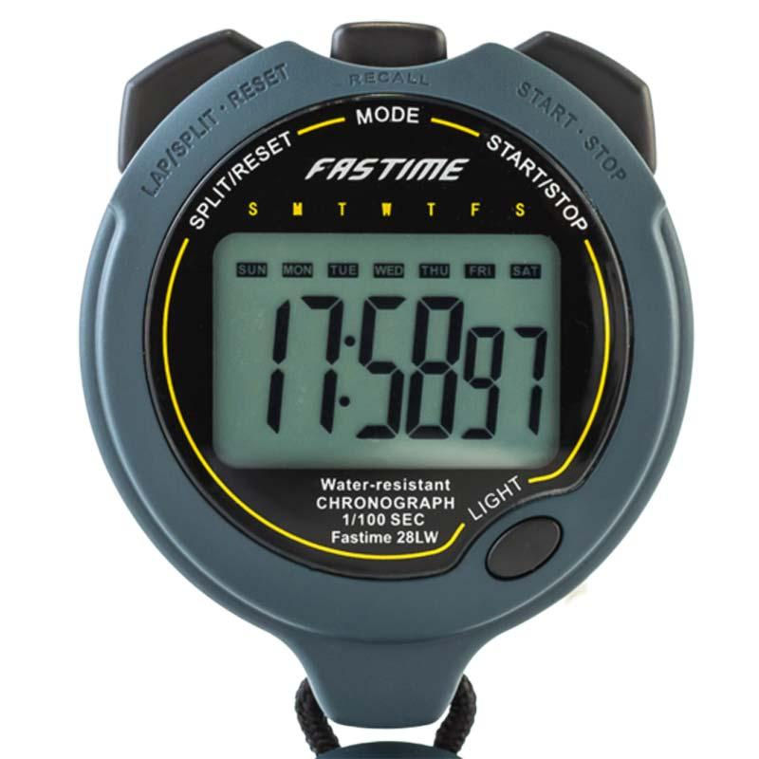
Quality Attributes: Performance and Scalability
Notes:
Just start with a question - want you to start thinking about this. (read)
This isn’t something with one answer, or even a right answer. It’s something we’ll keep returning to

Slide 44
Performance
Ability to meet timing requirements.
Characterize pattern of input events and responses
Requests served per minute.
Variation in output time.
Driving factor in software design.
Often at expense of other quality attributes.
All systems have performance requirements.
Notes:
Performance is about time and the software system’s ability to meet timing requirements. When events occur—interrupts, messages, requests from users or other systems, or clock events marking the passage of time—the system, or some element of the system, must respond to them in time. Characterizing the events that can occur (and when they can occur) and the system’s time-based response to those events is the essence is discussing performance.
Web-based system events come in the form of requests from users (numbering in the tens or tens of millions) via their clients such as web browsers. In a control system for an internal combustion engine, events come from the operator’s controls and the passage of time; the system must control both the firing of the ignition when a cylinder is in the correct position and the mixture of the fuel to maximize power and efficiency and minimize pollution. For a web-based system, the desired response might be expressed as number of transactions that can be processed in a minute. For the engine control system, the response might be the allowable variation in the firing time. In each case, the pattern of events arriving and the pattern of responses can be characterized, and this characterization forms the language with which to construct performance scenarios.
For much of the history of software engineering, performance has been the driving factor in how we design systems. It has frequently compromised the achievement of all other qualities. As the price/performance ratio of hardware continues to plummet and the cost of developing software continues to rise, other qualities have risen in importance. Still, all systems have performance requirements, even if they are not expressed. A word processer may not have explicit performance requirement, but no doubt everyone would agree that waiting an hour (or a minute, or a second) before seeing a typed character appear on the screen is too long. Performance continues to be a fundamentally important quality attribute for all software.

Slide 45
Performance Measurements
Latency: The time between the arrival of the stimulus and the system’s response to it.
Response Jitter: The allowable variation in latency.
Throughput: Usually number of transactions the system can process in a unit of time.
Deadlines in processing: Points where processing must have reached a particular stage.
Number of events not processed because the system was too busy to respond.
Notes:
The response of the system to a stimulus can be measured by the following: (go over)
(6) In the engine controller, for example, the fuel should ignite when the cylinder is in a particular position, thus introducing a processing deadline.

Slide 46
Measurements - Latency
Time it takes to complete an interaction.
Responsiveness - how quickly system responds to routine tasks.
Key consideration: user productivity.
How responsive is the user’s device? The system?
Measured probabilistically (... 95% of the time)
Under a load of 350 update transactions per minute, 90% of “open account” requests should return a reply to the calling program within 10 seconds.
Notes:
LAtency is one of the most common ways to assess performance. LAtency is the length of time it takes for a specified interaction with the system to complete. For a human-oriented system, this could be the length of time between the user initiating the request and the response being available for their use (e.g., the time from clicking a user interface button to seeing the response screen populated with data). For an infrastructure-oriented system such as a database, this could be the time between invoking a service and the service returning a response (e.g., the time from calling a query application programming interface to obtaining the query results).
We define two ways of looking at latency measurements you may want to consider separately.
1. Responsiveness considers how quickly the system responds to routine workloads such as interactive user requests. The response time for such operations is typically on the order of a few seconds. The key consideration
for such workloads is user productivity, ensuring that the system does not slow down its users. The two aspects of responsiveness that usually need to be considered are the responsiveness of the user’s device (e.g., how long it
takes for a keypress or mouse click to be recognized) and the responsiveness of the system itself (e.g., how long it takes the system to respond to a request when a button is clicked). The latter is usually the focus of our attention, but the former can be important to consider in circumstances very resource-limited clients, or when users are accessing their devices remotely (such as with remote desktop technology).
(last two points)

Slide 47
Measurements - Latency
Turnaround time = time to complete larger tasks.
Can task be completed in available time?
Impact on system while running?
Can partial results be produced?
Ex: Assuming a daily throughput of 850,000 requests, the process should take no longer than 4 hours, including writing results to a database.
Ex: It must be possible to resynchronize monitoring stations and reset database within 5 minutes.
Notes:
2. Turnaround time is the time taken to complete (turn around) larger tasks. This is typically measured in minutes or hours, and the key considerations are whether the task can be completed in the time available to it and the
impact the task has on the system responsiveness while it is running. It may also be important to consider how quickly partial results can be produced as part of a long-running task, for example, to provide partial or summary information earlier than the full results.
(last two points)

Slide 48
Measurements - Response Jitter
Response time is non-deterministic.
If non-determinism can be controlled, this is OK.
10s +- 1s, great!
10s +- 10 minutes, bad!
Defines how much variation is allowed.
Places boundaries on when task can be completed.
If boundaries violated, quality is compromised.
Ex: “All writes to the database must be completed within 120 to 150 ms.”
Notes:
(1) If you run a task multiple times, it will not always take an identical amount of time to finish. (2) - if a task generally takes 10 seconds, plus or minus a small amount, great. If it sometimes takes 10 minutes, that isn’t good. (4-end)

Slide 49
Measurements - Throughput
The workload a system can handle in a time period.
Shorter the processing time, higher the throughput.
As load increases (and throughput rises), response time for individual transactions tends to increase.
With 10 concurrent users, request takes 2s.
With 100 users, request takes 4s.
Notes:
Throughput is defined as the amount of workload the system is capable of handling in a unit time period. Throughput and response time have a complex interrelationship in most systems. In general, the shorter your transaction
processing time, the higher the throughput your system can achieve. However, as the load on the system increases (and throughput rises), the response time for individual transactions tends to increase (4-5).

Slide 50
Measurements - Throughput
Possible to end up in situation where throughput goals conflict with response time goals.
With 10 users, each can perform 20 request per minute (throughput: 200/m).
With 100 users, each can perform 12 per minute (throughput: 1200/m - but at cost to response time).
Notes:
Therefore, it is quite possible to end up with a situation where throughput goals can be met only at the expense of response time goals, or vice versa. (7-8)
As an engineer, you need to make sure that you and your stakeholders understand these interrelationships and that you have balanced your stakeholders’ different performance goals.

Slide 51
Measurements - Deadlines
Some tasks must take place as scheduled.
If times are missed, the system will fail.
In a car, fuel must ignite when cylinder is in position.
Places a deadline on when the fuel must ignite.
Deadlines can be used to place boundaries on when events must complete.
Notes:
(1). In the engine controller, for example, the fuel should ignite when the cylinder is in a particular position. (3-4)

Slide 52
Measurements - Missed Events
If the system is busy, input may be ignored.
Or, queued until too late to matter.
Can track how many input events are ignored because the system is too slow to respond.
Set upper bound on how many events can be missed in a defined timeframe.

Slide 53
Scalability
Ability to process increasing number of requests.
While meeting performance requirements.
Horizontal scalability (“scaling out”)
Adding more resources to logical units.
Adding another server to a cluster.
“elasticity” (add or remove VMs from a pool)
Vertical scalability (“scaling up”)
Adding more resources to a physical unit.
Adding memory to a single computer.
Notes:
Performance is often linked to scalability—that is, increasing your system’s capacity for work (1) , while still performing well. Two kinds of scalability are horizontal scalability and vertical scalability. Horizontal scalability (scaling out) refers to adding more resources to logical units, such as adding another server to a cluster of servers. In cloud environments, horizontal scalability is called elasticity. Elasticity is a property that enables a customer to add or remove virtual machines from the resource pool. These virtual machines are hosted on a large collection of upwards of 10,000 physical machines that are managed by the cloud provider. Vertical scalability (scaling up) refers to adding more resources to a physical unit, such as adding more memory to a single computer.

Slide 54
Scalability
How can we effectively utilize additional resources?
Requires that additional resources:
Result in performance improvement.
Did not require undue effort to add.
Did not disrupt operations.
The system must be designed to scale
(i.e., designed for concurrency).
Notes:
The problem that arises with either type of scaling is how to effectively utilize the additional resources.
Being effective means that the additional resources result in a measurable improvement of some system quality, did not require undue effort to add, and did not disrupt operations.
Technically, scalability is making your system easy to change in a particular way, and so is a kind of modifiability.
The problem with achieving scalability by adding hardware (particularly when scaling out) is that it usually isn’t very effective unless the system has been designed to take advantage of the new hardware. If your system’s scalability is limited by a single threaded process at its core, adding more CPUs or machines isn’t going to help, and increasing the speed of the single CPU on which it runs will be of limited help. Similarly, if you can’t partition your workload into many cooperating processes, you won’t be able to take advantage of scaling out. You can certainly be lucky, and in certain situations adding some more hardware can save the day, but it is a dangerous tactic to rely on unless the system has been built from the outset with good scalability characteristics.

Slide 55
Assessing Scalability
Ability to address more requests is often part of performance assessment.
Assessing scalability directly measures impact of adding or removing resources.
Response measures reflect:
Changes to performance.
Changes to availability.
Load assigned to existing and new resources.

Slide 56

Quality Attribute:
Security
Notes:
Just start with a question - want you to start thinking about this. (read)
This isn’t something with one answer, or even a right answer. It’s something we’ll keep returning to

Slide 57
Security
Ability to protect data and information from unauthorized access...
… while still providing access to people and systems that are authorized.
Can we protect software from attacks?
Unauthorized access attempts.
Attempts to deny service to legitimate users.
Notes:
Security is a measure of the system’s ability to protect data and information from unauthorized access while still providing access to people and systems that are authorized. (3) An action taken against a computer system with the intention of doing harm is called an attack and can take a number of forms. It may be an unauthorized attempt to access data or services or to modify data, or it may be intended to deny services to legitimate users.

Slide 58
Security
Processes that allow owners of resources to control access.
Who: Actors (systems or users).
Resources are sensitive elements, operations, and data of the system.
Policies define legitimate access to resourced.
Enforced by security mechanisms used by actors to gain access to resources.
Actors
Mechanisms
Policies
Resources
Notes:
We define security as the set of processes and technologies that allow the owners of resources in the system to reliably control who can access which resources.
The “who” refers to the people, pieces of software, and so on that form the set of actors in the system who have a security identity; security specialists normally refer to such actors as principals.
The resources are the parts of the system considered sensitive (i.e., those to which access must be controlled) such as subsystems, data elements, and operations. The access to the resources refers to the operations that the principals in the system will want to legitimately perform on the resources (e.g., read them, change them, execute them, and so on), and the fact that access must be limited to principals known to the system.
Resources are at the core of the system’s security. Policies define the legitimate access allowed to them, which is enforced by security mechanisms, which are used by the principals of the system to gain access to the resources that they need.
The resources, principals, and policies that need to be considered are often very specific to the system. An Internet service provider is likely to have a totally different set of security concerns from those of a military intelligence organization, which will be different again from those of an enterprise implementing an internal information system that allows remote access to its employees. However, in all of these cases, security is still the business of allowing the right levels of access to the right resources to the right people.

Slide 59
Security Characterization (CIA)
Confidentiality
Data and services protected from unauthorized access.
A hacker cannot access your tax returns on an IRS server.
Integrity
Data/services not subject to unauthorized manipulation.
Your grade has not changed since assigned.
Availability
The system will be available for legitimate use.
A DDOS attack will not prevent your purchase.
Notes:
The simplest approach to characterizing security has three characteristics: confidentiality, integrity, and availability (CIA): 1. Confidentiality is the property that data or services are protected from unauthorized access. For example, a hacker cannot access your income tax returns on a government computer. 2. Integrity is the property that data or services are not subject to unauthorized manipulation. For example, your grade has not been changed since your instructor assigned it. 3. Availability is the property that the system will be available for legitimate use. For example, a denial-of-service attack won’t prevent you from ordering book from Amazon

Slide 60





Supporting CIA
Authentication - Verifies identities of all parties.
Nonrepudiation - Guarantees that sender cannot deny sending, and recipient cannot deny receiving.
Authorization - Grants privilege of performing a task.
Notes:
characteristics that are used to support CIA are these: 4. Authentication verifies the identities of the parties to a transaction and checks if they are truly who they claim to be. For example, when you get an email purporting to come from a bank, authentication guarantees that it actually comes from the bank. 5. Nonrepudiation guarantees that the sender of a message cannot later deny having sent the message, and that the recipient cannot deny having received the message. For example, you cannot deny ordering something from the Internet, or the merchant cannot disclaim getting your order. 6. Authorization grants a user the privileges to perform a task. For example, an online banking system authorizes a legitimate user to access his account. We will use these characteristics in our general scenarios for security.

Slide 61
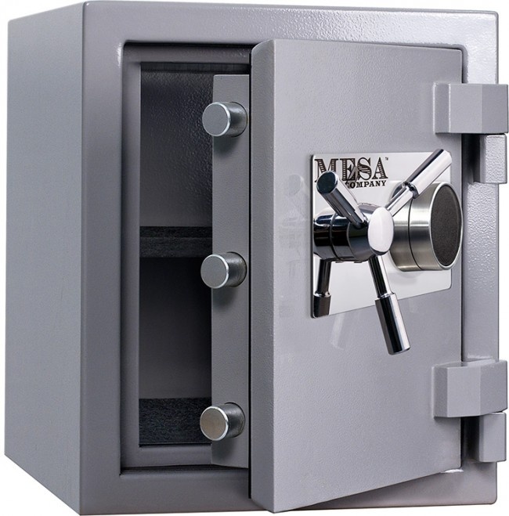
Security Approaches
Achieving security relies on:
Detecting attacks.
Resisting attacks.
Reacting to attacks.
Recovering from attacks.
Objects being protected are:
Data at rest.
Data in transit.
Computational processes.
Notes:
Approaches to achieving security can be characterized as those that detect attacks, those that resist attacks, those that react to attacks, and those that recover from successful attacks. The objects that are being protected from attacks are data at rest, data in transit, and computational processes.

Slide 62
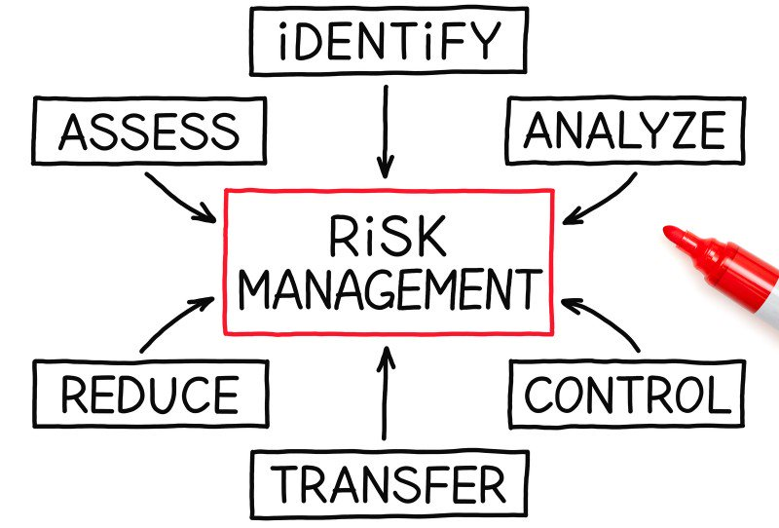
Security is Risk Management
Not simply secure/not secure.
All systems will be compromised.
Try to avoid attack, prevent damage, and quickly recover.
Balance risks against cost of guarding against them.
Set realistic expectations!
Notes:
It is also important to recognize that security is not a simple process of “being secure” or not. Rather than being a binary state, security is really a process of
risk management. (2-3)
Balance likely security risks against the costs of guarding against them. Bear this in mind to help you set realistic expectations in the minds of your stakeholders and to make intelligent tradeoffs that address the realsecurity risks your system faces.

Slide 63
Assessing Security
Measure of system’s ability to protect data from unauthorized access while still providing service to authorized users.
Assess how well system responds to attack.
Stimuli are attacks from external systems/users or demonstrations of policies (log-in, authorization).
Responses: auditing, logging, reporting, analyzing.
Notes:
Security is (1) An attack is an attempt to break CIA. The response to the attack is to preserve CIA or deter attackers through monitoring of their activities. So, we don’t measure security in a universal way. Instead, (2 - end)

Slide 64
Assessing Security
No universal metrics for measuring “security”.
Present specific attack types and specify how system responds.
Response assessed by appropriate metrics.
Time to identify attacker.
Amount of data protected.
Time to stop attack.

Slide 65
Key Points
Dependability is one of the most important software characteristics.
Aim for correctness, reliability, safety, robustness.
Often assessed using reliability.
Reliability depends on the pattern of usage of the software. Different users will interact differently.
Reliability measured using ROCOF, POFOD, Availability, MTBF
Notes:
(read)

Slide 66
Key Points
Availability is the ability of the system to be available for use, especially after a failure.
Performance is about management of resources in the face of demand to achieve acceptable timing.
Usually measured in terms of throughput and latency.
Scalability is the ability to “grow” the system to process an increasing number of requests.
While still meeting performance requirements.
Notes:
Availability refers to the ability of the system to be available for use, especially after a fault occurs. The fault must be recognized (or prevented) and then the system must respond in some fashion. The response desired will depend on the criticality of the application and the type of fault and can range from “ignore it” to “keep on going as if it didn’t occur.”

Slide 67
Key Points
Security is the ability to protect data and information from unauthorized access…
… while still providing access to people and systems that are authorized.
Security is not “measured”, but requires defining attacks and actions to prevent or reduce impact of risk, then assessing those actions.
Notes:
Attacks against a system can be characterized as attacks against the confidentiality, integrity, or availability of a system or its data. Confidentiality means keeping data away from those who should not have access while granting access to those who should. Integrity means that there are no unauthorized modifications to or deletion of data, and availability means that the system is accessible to those who are entitled to use it.

Slide 68
Next Time
Quality Scenarios
Assessing whether quality thresholds are met.
No exercise session today!
Form your teams!
Deadline: January 26
E-mail me (ggay@chalmers.se) with list of team members.
Or e-mail if you want to be assigned to a team

