Slide 1
Exercise Session 3: Unit Testing
Gregory Gay
DIT636/DAT560 - February 12, 2025

Slide 2

Enter… The Planning System
Everybody likes meetings.
Not true - but we need to book them.
We don’t want to double-book rooms or employees for meetings.
System to manage schedules and meetings.
Notes:
(read)

Slide 3
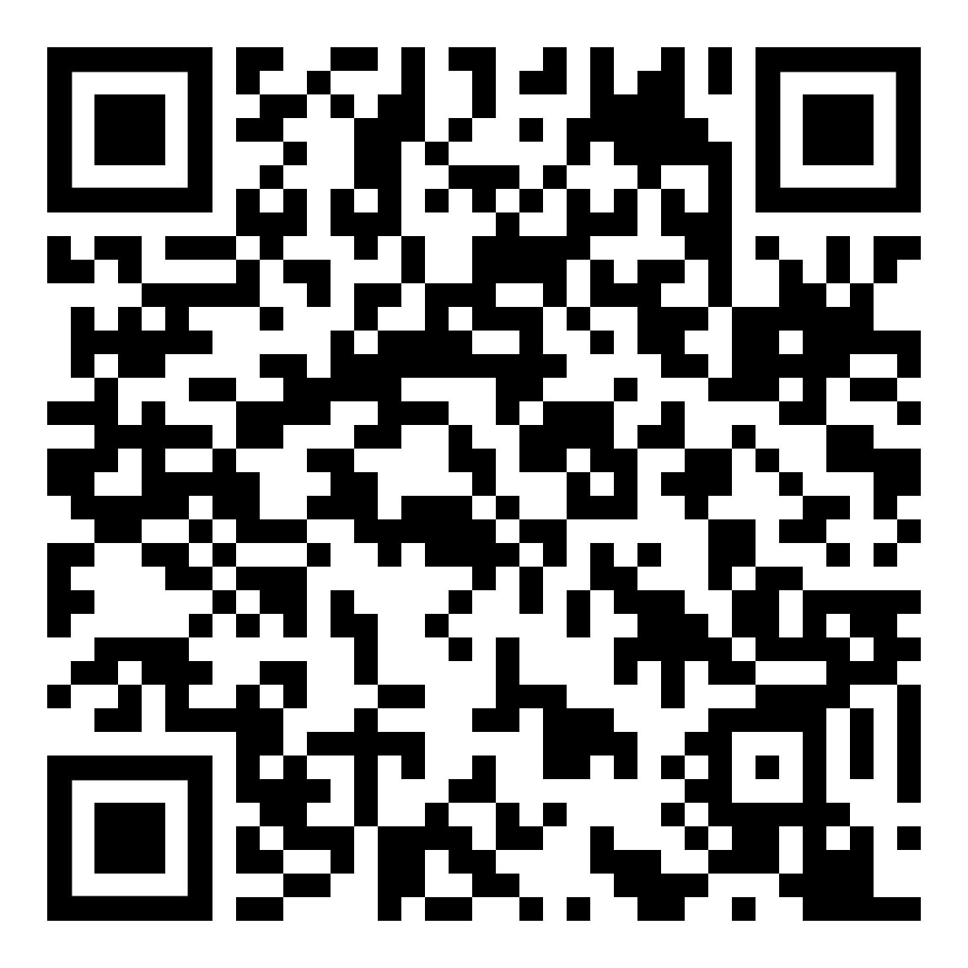
The Planning System
Offers the following high-level features:
Booking a meeting
Booking vacation time
Checking availability for a room
Checking availability for a person
Printing the agenda for a room
Printing the agenda for a person
Notes:
Go over, then give demo of Driver

Slide 4
Develop a Test Plan
In groups, come up with an informal test plan.
Given the features and the code documentation, plan unit tests to ensure that these features can be performed without error.
Notes:
Go over,

Slide 5
Food for Thought
Try running the code!
Perform exploratory testing to test it at the system level.
Think about normal and erroneous inputs/actions.
How many things can go wrong?
You will probably be able to add a normal meeting, but can you add a meeting for February 35th?
Try it out - you have the code.
Notes:
Go over,
GET thumb drives for each team, pass out with code.
(10-15 minutes, then talk over)

Slide 6
Develop Unit Tests
If a test is supposed to cause an exception to be thrown, make sure you check for that exception.
Make sure that expected output is detailed enough to ensure that - if something is supposed to fail - that it fails for the correct reasons.
Use proper assertions.
Notes:
Sample test in Calendar class, bring it up, then come back

Slide 7
Example - Adding Midsommar
@Test
public void testAddMeeting_holiday() {
Calendar calendar = new Calendar();
try {
Meeting midsommar = new Meeting(6, 26, "Midsommar"); // Create holiday
calendar.addMeeting(midsommar); // Add to calendar object.
Boolean added = calendar.isBusy(6, 26, 0, 23); // Verify that it was added.
assertTrue(added,"Midsommar should be marked as busy on the calendar");
} catch(TimeConflictException e) {
fail("Should not throw exception: " + e.getMessage());
}
}
Setup
Test Steps
Input
Oracle
Oracle

Slide 8
Can you expose the faults?
Notes:
(discuss)

Slide 9
Can you expose the faults?
1: getMeeting and removeMeeting perform no error checking on dates.
public Meeting getMeeting(int month, int day, int index){
return occupied.get(month).get(day).get(index);
}
public void removeMeeting(int month, int day, int index){
occupied.get(month).get(day).remove(index);
}
Notes:
Go over,
(give them time to program)

Slide 10
Can you expose the faults?
2: Calendar has a 13th month.
public Calendar(){
occupied = new ArrayList<ArrayList<ArrayList<Meeting>>>();
for(int i=0;i<=13;i++){
// Initialize month
occupied.add(new ArrayList<ArrayList<Meeting>>());
for(int j=0;j<32;j++){
// Initialize days
occupied.get(i).add(new ArrayList<Meeting>());
}
}
}
Notes:
Go over,
(give them time to program)

Slide 11
Can you expose the faults?
3: November has 30 days.
Oh - and we just added a meeting to a day with a date that does not match that date.
occupied.get(11).get(30).add(new Meeting(11,31,"Day does not exist"));
Notes:
Go over,
(give them time to program)

Slide 12
Can you expose the faults?
4: Used a >= in checking for illegal times. December no longer exists.
if(mMonth < 1 || mMonth >= 12){
throw new TimeConflictException("Month does not exist.");
}
Notes:
Go over,
(give them time to program)

Slide 13
Can you expose the faults?
5: We should be able to start and end a meeting in the same hour.
if(mStart >= mEnd){
throw new TimeConflictException("Meeting starts before it ends.");
}
Notes:
Go over,
(give them time to program)

Slide 14
What Other Faults Can You Find?
Notes:
(pull in their tests, run them, see what happens)

