Slide 1
Lecture 6: Exploratory Testing
Gregory Gay
DIT635 - February 7, 2020

Slide 2
How do you come up with tests?
Notes:
We’ve talked about what tests are, and how to write them. Now, how do we come up with them?

Slide 3
Today’s Goals
Test Plans
Document describing testing process and scope.
Exploratory Testing
Human-driven testing of the project, to gain familiarity with the system and conduct high-level testing.
Often focused on “tours” of the software features.

Slide 4
Test Plans
Notes:
We’ve talked about what tests are, and how to write them. Now, how do we come up with them?

Slide 5
Test Plans
Plan for how we will test the system.
What is being tested (units of code, features).
When it will be tested (required stage of completion).
How it will be tested (what scenarios do we run?).
Where we are testing it (types of environments).
Why we are testing it (what purpose do tests serve?).
Who will be responsible for writing test cases (assign responsibility to team members).
Notes:
Test plans are the cornerstone of the testing process. They range in length and formality from quick thought exercises to extensively-planned blueprints for the entire testing cycle. Regardless, they are what structures the process of testing a system, and coming up with a plan should be your first step in testing. This plan needs to cover the who,what,when,where, how, and why of testing. (read)

Slide 6
Where Does a Test Plan Come From?
Most test plans are derived from requirement specifications.
The specification defines “correct” behavior.
The specification exists in some form before code is written, and guides development.
Test plans and cases can be developed and refined as the code is built.
Functional Testing: The process of deriving tests from the requirement specifications.
Notes:
(1) - after all - (2). This is verification - the process of comparing any implementation to its corresponding specification, it is most often used to find out if there are any discrepancies between what the program does and what we intend for it to do. (3). This means we can start early - wd can even design test cases before we have code, and we can continue to evolve our collection of plans and tests with the code.
This is also a process known as functional testing (5)

Slide 7
Why Make a Test Plan?
Guides the development team.
Rulebook for planning test cases.
Helps people outside the team understand the testing process.
Documents rationale for scope of testing, how we judge results, why we chose a strategy.
Can be reused when making decisions in future projects.
Notes:
Making Test Plan has multiple benefits: Test Plan guides our thinking as we create detailed test cases. It is like a rule book, which needs to be followed.
Help people outside the test team such as developers, business managers, customers understand the details of testing.
Important aspects like test estimation, test scope, Test Strategy are documented in Test Plan. This is where we discuss WHY we test a certain way. This is important for understanding the outcome of a project, and can be reviewed by Management Team and re-used for other projects.

Slide 8
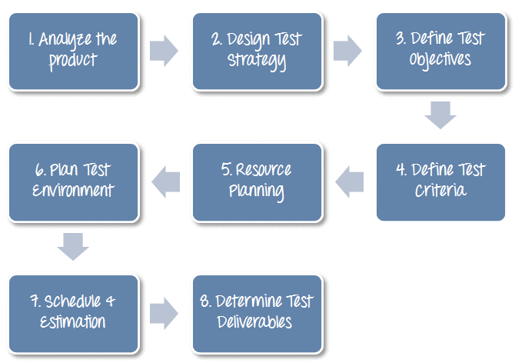
Writing a Test Plan
Slides derived from https://www.guru99.com/what-everybody-ought-to-know-about-test-planing.html
Notes:
go over process

Slide 9
Analyze the Product
You must understand the product being built before you can test it.
What are the needs of the users?
Who will use the product?
What will it be used for?
What are the dependencies of the product?
Review requirements and documentation.
Interview stakeholders and developers.
Perform a product walkthrough (if code is running).
Slides derived from https://www.guru99.com/what-everybody-ought-to-know-about-test-planing.html
Notes:
How can you test a product without any information about it? You can’t. You must learn a product thoroughly before testing it. You should research clients and the end users to know their needs and expectations from the applicationWho will use the product? What is it used for? How will it work? What are the software/ hardware dependencies of the product?
You can use the following approach to analyze the product before building a test plan: (last three points) review of product documentation helps you to understand all the features of the website as well as how to use it. If you are unclear on any items, you might interview customer, developer, designer to get more information.

Slide 10
Analyze the Product
Banking Website
What features do we want to see?
Account creation, deletion, manipulation.
Fund transfers
Fund withdrawal
Check deposit
…?
Slides derived from https://www.guru99.com/what-everybody-ought-to-know-about-test-planing.html
Notes:
Think about what the functionality is of the product we are building

Slide 11
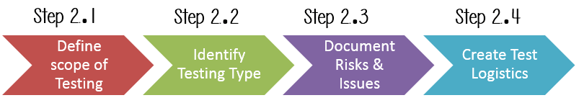
Develop the Test Strategy
Document defining:
Test Objectives (and how to achieve them)
Testing Effort and Cost
Slides derived from https://www.guru99.com/what-everybody-ought-to-know-about-test-planing.html
Notes:
Test Strategy is a critical step in making a Test Plan. A Test Strategy document, is a high-level document, which is usually developed by Test Manager. This document defines:
The project’s testing objectives and the means to achieve them. Determines testing effort and costs. Follows this process

Slide 12
Testing Scope
What are you planning to test?
Software, hardware, middleware, ...
… AND… What are you NOT going to test?
Gives project members a clear understanding about what you are responsible for.
Must take into account:
Requirements
Budget
Skills of your testing team
Slides derived from https://www.guru99.com/what-everybody-ought-to-know-about-test-planing.html
Notes:
Before the start of any test activity, you need to know what is your responsibility to test. What is the scope? The extent of what you plan to test, and - importatnly - what we plan to NOT test. You must think hard about it.
The components of the system to be tested (hardware, software, middleware, etc.) are defined as "in scope" The components of the system that will not be tested also need to be clearly defined as being "out of scope."
A precise scope helps you Give everyone confidence & accurate information on the testing you are doing. All project members will have a clear understanding about what is tested and what is not
How do you determine scope your project? To determine scope, you must take into account– Precise requirements, Project Budget,, Skills & talent of your test team

Slide 13

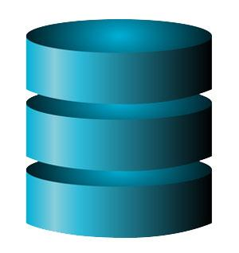
Testing Scope
Banking website
Requirements specified only for functionality and the external interface.
These are in-scope.
No requirements for database or client hardware.
No quality requirements (performance, availability).
These are out-of-scope.
Slides derived from https://www.guru99.com/what-everybody-ought-to-know-about-test-planing.html

Slide 14
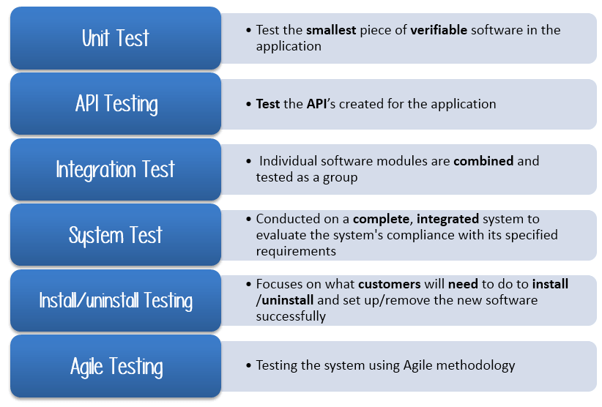
Identify Testing Types
For the banking site:
API Testing
Focus on verifying access points and interfaces.
Integration Testing
System Testing
Functionality likely spread over multiple classes, many features interact
Acceptance Testing
Could limit:
Unit Testing (final product matters more than individual classes)
Can skip:
Install/Uninstall (web app)
Which should we apply?
Consider the project domain.
Which can we skip or limit to save money?
Slides derived from https://www.guru99.com/what-everybody-ought-to-know-about-test-planing.html
Notes:
The next step is to decide what kind of tests you plan to apply. We’ve talked about a lot of these already, but some review (go over)Which Testing Types should be focused on for testing this project?
Which Testing Types should be ignored to save costs? What about for the banking site? (talk about, click)

Slide 15
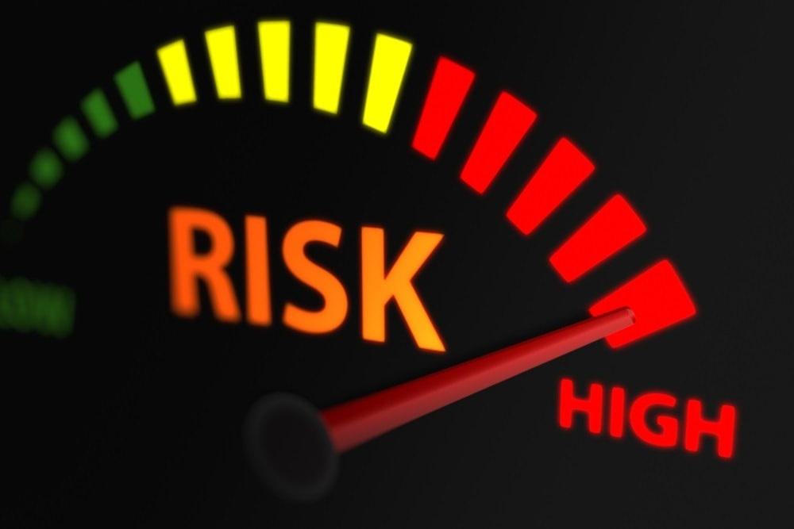
Document Risks and Issues
Risks - events that could prevent the success of testing. Have probability of occurrence and effect.
Issues are risks that have already impacted project.
Document risks and how to avoid them or reduce their impact.
Slides derived from https://www.guru99.com/what-everybody-ought-to-know-about-test-planing.html
Notes:
We want to next consider what could derail this process -what can stop us from testing this system? We need to identify risks. A risk is an uncertain event, which has a probability of occurence and a potential for loss. If a risk occurs, it becomes an issue. (2) In your test plan, you document risks and how to mitigate them.

Slide 16
Document Risks and Issues
Risk | Mitigation
Team lacks required skills for website testing | Plan training course on web testing
The project schedule is too tight | Prioritize each testing activity
New security vulnerabilities may appear | Review attack reports on competing websites and update practices at regular intervals
A lack of cooperation negatively affects your employees' productivity | Encourage each team member, and inspire them to greater efforts
Wrong budget estimate and cost overruns | Establish the scope before beginning work, pay a lot of attention to project planning and constantly track and measure the progress
Slides derived from https://www.guru99.com/what-everybody-ought-to-know-about-test-planing.html
Notes:
for the banking site. Any others you can think of?

Slide 17
Create Test Logistics
Who will write and execute test cases?
What types of testers do you need?
Skills needed for the targeted domain
What is the budget for testing?
How many people can you hire to test?
When will each testing activity occur?
When to design and when to execute tests.
Pair with appropriate stage of development.
Unit development -> unit testing -> system testing -> ...
Slides derived from https://www.guru99.com/what-everybody-ought-to-know-about-test-planing.html
Notes:
In Test Logistics, the Test Manager should answer the following questions: Who will test? When will the test occur?
Who will test? You may not know exact names of the tester who will test, but the type of tester can be defined. To select the right member for specified task, you have to consider if her skills are the right ones for the task or not, also you need to estimate the project budget to figure out how many people you need. or, more importantly, how many you CAN hire.
When will the testing occur? Test activities must be matched with associated development activities. We showed a diagram last Friday with common pairings (talk about), you need to decide roughly when to design tests and when to execute tests.

Slide 18
Define Test Objectives
What are the goals of the testing process?
What features need to be tested?
What system elements need to be tested?
What quality attributes do we need to demonstrate?
For each feature or quality, what scenarios do we want to walk through?
Does not include a list of specific tests
But, at a high level, should detail scenarios we plan to examine by writing one or more test cases.
Notes:
The test objectives, essentially, are (1) - 2-3) and what can we show about those featurs through the process of testing (rest)

Slide 19
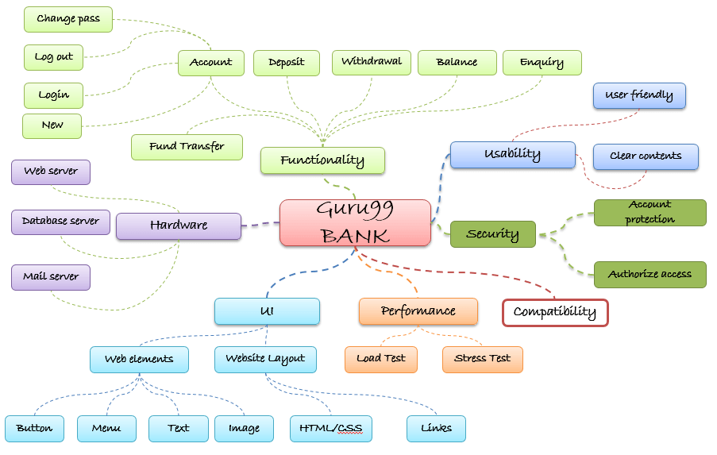
Define Test Objectives
Slides derived from https://www.guru99.com/what-everybody-ought-to-know-about-test-planing.html
Notes:
For the bank (go over)
Check that whether website Guru99 functionality(Account, Deposit…) is working as expected without any error or bugs in real business environment
Check that the external interface of the website such as UI is working as expected and & meet the customer need
Verify the usability of the website. Are those functionalities convenient for user or not?

Slide 20
Define Test Criteria
When have we completed our testing objectives?
For qualities, set appropriate thresholds.
Availability, ROCOF, throughput, etc.
For functionality, commonly defined using:
Run Rate: Number of Tests Executed / Number Specified
Pass Rate: Number of Passing Tests / Number Executed
Often aim for 100% run rate and a high pass rate (> 95%)
Slides derived from https://www.guru99.com/what-everybody-ought-to-know-about-test-planing.html
Notes:
The next step is to (title) - how do we know when we are done and have met our goals? (2) - availability, time limits for performance, etc - (3)
Some methods of defining exit criteria are by specifying a targeted run rate and pass rate. Run rate is ratio between number test cases executed/total test cases of test specification. For example, the test specification has total 120 TCs, but the tester only executed 100 TCs, So the run rate is 100/120 = 0.83 (83%) Pass rate is ratio between numbers test cases passed / test cases executed. For example, in above 100 TCs executed, there’re 80 TCs that passed, so the pass rate is 80/100 = 0.8 (80%) Run rate is mandatory to be 100% unless a clear reason is given. Pass rate is dependent on project scope, but achieving high pass rate is a goal. You might ship a product where some tests fail - there could be non-deteminism you plan to ignore, or bugs you don’t have the resources to fix, there are multiple reasons, but you generally aim for a very high pass rate still.

Slide 21
Resource Planning
Summarize all resources that you have to complete the testing.
Allows estimation and adjustment of testing scope, objectives, and exit criteria.
Human Resources: Managers, testers, developers who assist in testing, system administration.
System Resources: Servers, testing tools, network resources, physical hardware.
Slides derived from https://www.guru99.com/what-everybody-ought-to-know-about-test-planing.html
Notes:
The Resource plan is a detailed summary of all types of resources required to complete project task. Resource could be human, equipment and materials needed to complete a project. Resource planning is important factor of the test planning because it helps in determining the what you need to acheive the level of testing you seek, and what you can actually afford to accompish. This lets you make estimates, and alter the scope, objectives, and exit criteria accordingly. (rest)

Slide 22
Plan Test Environment
Where will you execute test cases?
Software and hardware execution environment
Often defined as part of continuous integration.
Need to account for:
Requirements on both server and client-side.
Different networking conditions (bandwidth, load).
Different client or server-side hardware.
Different numbers of concurrent users.
Notes:
A testing environment is the software and hardware setup on which the testing team is going to execute test cases. The test environment consists of a user environment, as well as physical environments, such as server, and front end running machines. (3)You should ask the developer some questions to understand the application under test clearly. Ask things like - What is the maximum user connection which this website can handle at the same time? What are hardware/software requirements run this website? Does the user's computer need any particular settings or software to browse the website?

Slide 23
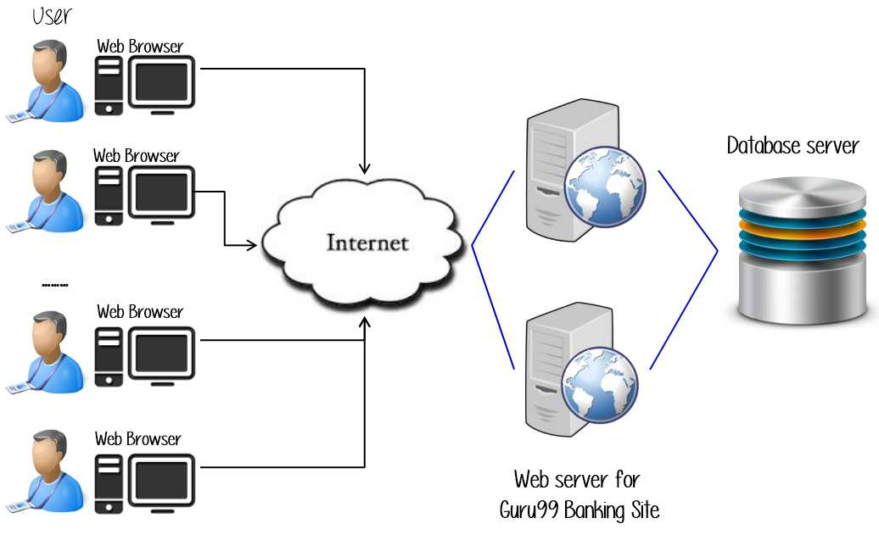
Plan Test Environment
When testing, we might vary:
Number of clients, servers
Networking conditions
Contents of database server.
Connection to database server.
Slides derived from https://www.guru99.com/what-everybody-ought-to-know-about-test-planing.html
Notes:
Here is the environment overview for the banking site. We have clients and servers - often multiple of each. Clients connect over the internet to the servers. Server connects to a database server as well. Now, when testing, we might not use the actual internet, but might use a simulated networking environment where we apply differing numbers of concurrent requests, and different speeds and loads on the connection. We might vary number of servers and clients. We might swap out different test databases.

Slide 24
Schedule Estimation
Break testing plans into individual tasks, each with an effort estimation (in person-hours)
Create test specification, 170 person-hours
Write unit tests, 80 person-hours
Write API tests, 50 person-hours
Perform test execution, 1 person-hour (per suite execution)
Write test report, 10 person-hours
…
Slides derived from https://www.guru99.com/what-everybody-ought-to-know-about-test-planing.html
Notes:
( go over, then create a schedule with rough dates, or sprint estimates, for when you will take care of each task.

Slide 25
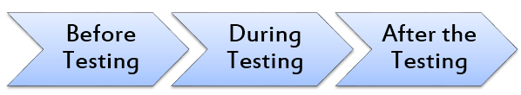
Plan Test Deliverables
Before: Test plan document, test specifications
During: Executable tests, simulators, test input data, traceability matrix, error and execution logs.
After: Test report, fault reports, installation and test procedure guidelines, release notes
Slides derived from https://www.guru99.com/what-everybody-ought-to-know-about-test-planing.html
Notes:
Finally, you will come up with a list of all the documents, tools and other components that has to be developed and maintained in support of the testing effort.
There are different test deliverables at every phase of the software development lifecycle. For example (go over)

Slide 26
Let’s take a break.
Notes:
10 minute break

Slide 27
Exploratory Testing
Notes:
We’ve talked about what tests are, and how to write them. Now, how do we come up with them?

Slide 28
Exploratory Testing
Tests are not created in advance.
Testers check the system on-the-fly,
Often based on ideas noted before beginning.
Testing as a thinking idea.
About discovery, investigation, and role-playing.
Test design and execution done concurrently.
Often by directly using the software and its user interfaces.
Notes:
EXPLORATORY TESTING is a type of software testing where Test cases are not created in advance but testers check system on the fly. They may note down ideas or come up with goals about what to test before test execution. The focus of exploratory testing is more on testing as a "thinking" activity. Exploratory Testing is widely used in Agile models and is all about discovery, investigation, and learning. You can try out different roles and user types. It emphasizes personal freedom and responsibility of the individual tester.
Last class, we talked about uni testing, this is a form of scripted testing where you design test cases first and later proceed with test execution. On the contrary, exploratory testing is a simultaneous process of test design and test execution all done at the same time. (last point)

Slide 29
Exploratory Testing
Tester will write down an idea to give direction, then explore the system to create critical, practical, and userful tests.
Requires minimal planning. Tester chooses next action based on result of current action.
Can find subtle faults missed by formal testing.
Allows tester to better learn system functionality, and identify new ways of using features.
Notes:
The tester will create or write down a test idea to give direction, and explore the system while testing to further create critical, practical and useful tests for the successful testing of an application. This requires minimal planning. Testers continuously make a decision on her next step of action. It completely depends upon the tester's thought process.
Sometimes this testing can be more beneficial than the formal testing approach for finding some subtle defects which go missing in formal testing.
A learner will learn better through hands-on experience rather than cramming the theory. Likewise, a tester will know the application better only while exploring and learning about all the functionality it provides by itself. It is always good to have a customer and business perspective while testing to ensure successful testing of an application.
For Example, if you open a shopping website, you have a general idea that this shopping website will let you shop by selecting a product of your choice and then paying for the same.
During this process, you might learn that you can order a number of products for home trial or that you can make payment through rewards points of some banks, etc. You can extend your testing to try these featurs.
As a tester, you not only need to verify whether a system is working as expected but also check if that system is not behaving in a way which is not expected. Exploratory testing can help find these gaps.

Slide 30
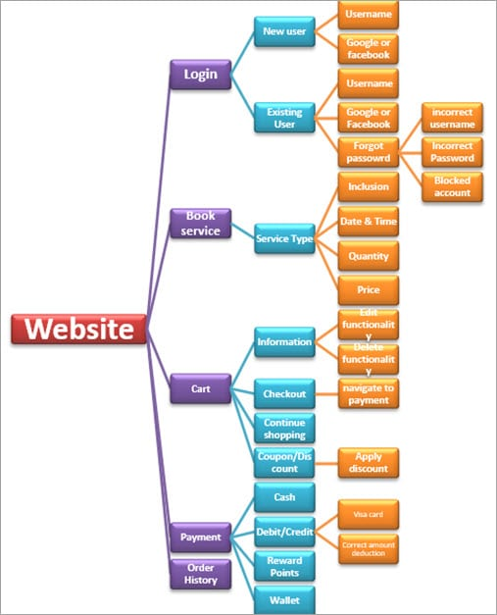
Example
Start with functionality you know well (Login)
Examine possible options and list them.
Use your findings to plan the next steps.
As you learn and observe, more test cases will emerge.
Slides derived from https://www.softwaretestinghelp.com/what-is-exploratory-testing/
Notes:
A home care service provider website with the following components: Login, Services, Cart, Payment, Order History, Technician allotment. A general idea to start exploratory testing will be to Login or book a service.the idea is to start with functionality based on your knowledge. As you learn and observe more about the application, you can govern your next set of test cases.

Slide 31
Session-Based Exploratory Testing
Time-based method to structure exploratory testing.
Conducted with no e-mail, phone, messaging.
Short (60min), Normal (90m), Long (120m)
Primary components:
Mission
The purpose of the session.
Provides focus for the tester.
Charter
Individual testing goals to be completed in this session.
Could be a list of features or scenarios.
Notes:
While doing exploratory testing, it’s very difficult for testers to put into words on how much he has tested and on what basis. it’s difficult to quantify the work and the time spent. Session-based testing is a time based approach to perform this testing which helps in managing, tracking, and keeping exploratory testing on track. It includes a dedicated time-boxed testing session with no interruption from email, phone, messages etc. Each session can have the following duration: “Short” (60min) “Normal” (90min) “Long” (120 min). Primary components: Mission: Mission shout out the purpose of the session and in a way provide the focus for the tester. It will also include a session time duration. Charter: Includes the scope of the testing. Basically, an agenda detailing the goals that need to be completed during the session.

Slide 32
Session Report Items
Mission: Overall goal
“Analyze Login Feature on Website”
Charter: Features and scenarios to focus on.
“Login as existing user with username and password”
“Login as existing user with Google account”
“Login as existing user with Facebook account”
“Enter incorrect username and password to verify validation message”
“Block your username and verify the validation message”
“Use Forgot Password link to reset password”
Notes:
This process produces a session report that Include notes to provide metrics to the leaders and managers. It gives details about the charter sessions remaining or done, session setup time, scenarios tested, information about the testing process, a list of bugs and the issues found and other information. (go over items)

Slide 33
Session Report Items
Start and end time of session
Duration of session
Testing notes: journal of actions taken
Opened login page
Verified default screen.
Verified that existing and new user account links exist.
Opened existing user login
Verified successful login with username, Google, and Facebook.
Verified validation messages.

Slide 34
Session Report Items
Include data files (screenshots, recordings, files), especially if a bug is found.
Fault Information: Describe each fault found. File a bug report for each, include tracker ID in report.
Issues Information: If an issue prevents or complicates testing, describe it in the report.
Set-up Time: % of time required to set-up.
Test Design and Execution Time: % of time spent purely on testing

Slide 35
Session Debrief
Short meeting between tester and manager to review the findings.
Session-based testing allows tracking of time spent testing, number of bugs reported, time spent on set-up, time spent on testing, time spent analyzing issues, features covered.
Allows management of the time spent on exploratory testing and process observability.
Notes:
Finishes with (title). A short meeting or stand-up between the tester and Test Lead/Manager to review the test session findings. (2, elaborate)SBT allows for accountability is exploratory testing and offers better management of time spent on testing. It also increases productivity and provides a better grasp on bug detection. It is a great way to provide team leads and managers with metrics to check the project progress, giving observability into the testing process

Slide 36
Tips for Exploratory Testing
Divide the application into modules or features, then try to further divide.
Start ET from the smallest subdivisions.
This will give greater coverage.
Make a checklist of all the features and put a check mark when each is covered.
Start with a basic scenario and then gradually enhance it to add more features to test it.
Notes:
(after last) Login works. What if the password is wrong? What if the username is wrong? What if there is no account?

Slide 37
Tips for Exploratory Testing
Test all input fields.
Check for all possible error messages.
Test all the negative scenarios.
Invalid input, mistakes in usage.
Check the GUI against standards.
Check the integration of the application with other external applications.
Check for complex business logic.
Try to do the ethical hacking of the application.

Slide 38
Pair-Based Exploratory Testing
Two people share a computer and test together.
One person uses the computer, the other suggests actions and takes notes.
Each brings their own strengths.
Can be used to train new developers or testers.
Benefits of pair testing:
Increases focus.
Leads to more constructive ideas.
Avoids biased input selection.
Notes:
Pair Testing is an approach in which two people test the same thing/feature of the application at the same time by sharing a PC. They continuously share their thoughts and ideas. During this testing, one person takes charge of the keyboard whereas the other person suggests test cases or actions and takes note. It is always helpful to have a good communication between the partners so that both are aware of what is being done and why. This approach can be powerful because the strengths of each tester can mutually complement their weaknessses. This pairing benefits both the parties and each can learn something from their partner. It is also a good way to train new resources - new developers or testers - by pairing them with experienced testers. They can quickly learn the system they will be working with.
Benefits: Helps a tester to focus on the task at hand. Brainstorming between paired testers usually, lead to more constructive ideas. Avoid tunnel vision and biasing.

Slide 39
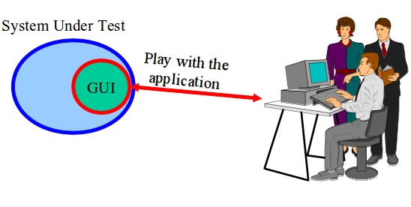
Automating Exploratory Testing
Use tools to streamline bug reporting and reproduction, snapshots, preparation of executable test suites for future use.
A tool captures and records the activities performed by the tester.
Called capture and replay tools.
Notes:
We can use (1). We still conduct exploratory testing as a human, but we use tools to help improve our efficiency and to improve reproducability of the results. In this methodology, usually, a tool, which captures and records every single activity performed by a tester and is installed on the resource’s PC.there is no change in the way the tests are executed apart from crafting the test result based on the captured session. These test results can be used for reporting and reenacting recorded actions later in time. (last point)

Slide 40
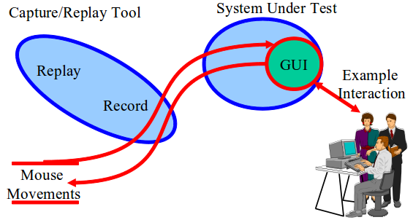
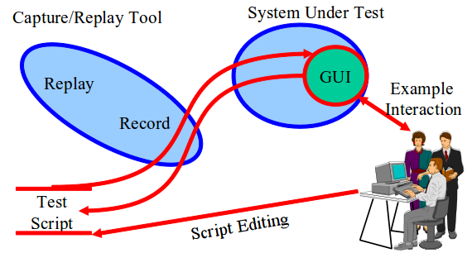
Capture and Replay Tools
Tool records input (key presses, mouse clicks, touches, etc.) during exploratory testing.
The “Capture”
Capture can be replayed to reproduce outcomes and crashes.
Capture scripts can be extended and altered to form new test cases.
Notes:
What we can do is get a human in to play with the program. We can record the actions they during exploratory testing. Those are called captures. We can then use those - we can replay them - to repeat the same scenarios and the same mouse motions and clicks without needing the human sitting there again. This aids reproduction of events. If there is a bug, we can see if the same actions trigger it again. These captures - these sets of actions - can also be used as the basis for creating more tests as well. The actions taken during exploratory testing become an initial set of test cases. We can then edit those to turn them into new test cases - modifying the actions slightly or taking the individual actions and combining them to form entirely new tests. This lets us automate GUI testing to some extent as well and fill in some gaps from exploratory testing. Capture a few manual executions, and reuse them or alter them. slightly More productive use of human effort.

Slide 41
Automating Exploratory Testing
Provides clear steps to reproduce bug.
Can also be used to judge performance.
Often used in pair exploratory testing.
Second tester watches replay from first tester.
Second tester looks for ways to extend the tests.
The first tester does the same with the second tester’s replay.
Exchange again at the end to confirm results.
Notes:
It also has few other benefits like: Provides clear steps to reproduce the bugs. Reproducing defects is easier even when the defect reporter is not available. Also Helps in performance testing by getting the system response time at the specific point in time. It is advisable to use capture/replay tools with Pair Testing. In this approach,one tester creates a capture and the second tester executes the captures created by the first tester. Then, they look for ways to extend the existing work with new actions or improvements. Testers involved swap roles again at the end so that the tester who created the test script has a chance to re-execute the scripts to confirm the reliability & robustness of the final extended suite.

Slide 42
Let’s take a break.
Notes:
10 minute break

Slide 43
Using “Tours” in Exploratory Testing
A tourist seeks to visit as many districts of a city as possible within the time budget.
In software, the “city” is the system, and the “districts” are aspects of the system.
Business district = core features, entertainment district = supporting features
A tour is a plan for exploratory testing.
Includes a set of objectives, based on visiting different “districts”, to focus on during testing.
A typical tour should take less than four hours.
Notes:
While performing exploratory testing, test engineers resemble tourists who arrive in the place where they have never been before. Tourists would wish to visit and see as many places as possible within a limited timeframe. Each city or town has several districts, for Example, business or historical one, and the tourists choose one or several districts to visit based on their schedule. In terms of software testing, The city or town where the tourists come is a software product to test. Districts are aspects of the software. For instance, the business district represents core money-making functionality, while the entertainment district represents customizable elements. A tour is a plan of exploratory testing activities. It includes the objectives and tasks to focus on during exploratory testing. Usually, the duration of each tour is limited and should not exceed 4 hours.

Slide 44
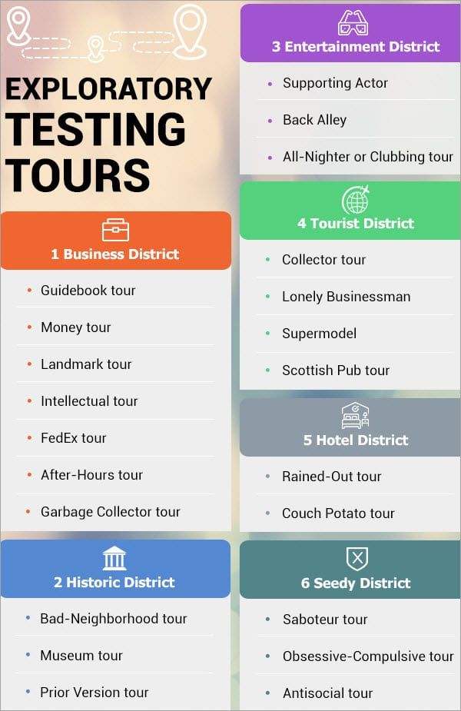
Exploratory Tours
Software split into aspects (districts)
Several “tours” related to each district.
Each prescribes a way of exploring the software.

Slide 45
Business District
Focused on the features designed to increase sales
Tours vary in focus, but all are intended to give a good impression of the software (to attract sales).
Guidebook Tour
Focused on users that strictly follow the steps in support information, instructions, and user manuals.
Walk through all guides to the software.
Look for unclear or incorrect instructions, steps that do not correspond to actual workflow, uninformative prompts
Notes:
A business district is a place where people make money. A software product also has its own “business district” features that are designed to increase sales. Promo material informs about the features that differentiate a software product from the similar ones available at the market and attract more users. (2). The first is the (3). Some tourists travel only according to the guidebook and never visit places that are not included or mentioned in the guide. This situation is relevant to the users who strictly follow each and every step specified in the support information, instructions, and user manuals. (5)
Users may face unclear/improper instructions, steps to follow that do not correspond the actual workflow of software, or inconclusive prompts. When conducting this tour, you look for these items. If they exist, you need to correct them. By doing this, you ensure that support documentation is accurate.

Slide 46
Business District
Money Tour
Advertising material should be accurate.
Compare advertising to the real software.
Look for outdated screenshots or lists of features, grammar mistakes, logical mistakes.
Landmark Tour
Cities have famous “highlights”.
Define a list of “core” software features and execute each step-by-step.
Try all critical functionality, and detect blocking faults.
Notes:
Cities use advetising material to attract tourists. If it is outdated or showed something not in the city, tourists will be disapoointed. In software testing, the advertising materials should correspond to the actual features of the system. Otherwise, after purchasing it, the users will be disappointed, might leave a negative feedback, and never recommend your app to others. The money tour is focused on ensuring that advertising material is accurate. You want to compare it to the software, and look for outdated screenshots or list of features, improper grammar, and logical mistakes in the advertising.
Landmark tour: A tourist might selecs famous places to visit beforehand, often without detailed planning. A test engineer likewise can define a list of core software features and execute testing based on that list in a step by step manner.Thus, the tester does not miss the critical functionality and may detect bugs that block the system operability.

Slide 47
Business District
Intellectual Tour
Try to “outsmart” the program.
Enter long filenames, huge number of products to shopping card, invalid form data.
FedEx Tour
Packages get passed around and handled by many people. Likewise, you can examine how data is passed around the software.
Validate data after operations that manipulate it.
Look at results of serialization/deserialization.
Notes:
Intellectual Tour - Every tourist group will include a person who would have read tons of books about the city, its history, cultural traditions and try to show his/ her brilliance all the time. A tester also can execute rare user scenarios to detect bugs, those that only an expert might try to prove how able to break your software they are. For Example, enter a very long name for a file, add a huge number of products to the shopping cart, enter invalid data to the form fields, etc.
FedEx Tour - Before reaching an addressee, an international parcel gets passed around, inspected, and gets additional marks and ticks.A software product also utilizes data that can be stored, modified, or even lost. A tester should follow the ways data is processed and validate it after all the operations. For Example, data that gets serialized and deserialized or transformed in other ways.

Slide 48
Business District
After-Hours Tour
When the user closes a program, that does not mean it stops working.
System can backup, archive data, apply updates, etc.
Tester verifies the success of background tasks.
Monitor background operations, looking for irregular traffic, memory leaks.
Notes:
After-Hours Tour - At the end of the working day, people go home. But when a user closes an application, that does not mean that it stops working totally. The application can backup or archive data, receive updates, etc. (4), checking that they are successful. They also monitor the application in the background mode, looking for irregular usage of traffic, memory leaks and so on.

Slide 49
Historic District
Towns have historic areas with older buildings.
Software often relies on legacy code, previous product versions, older dependencies.
Bad-Neighborhood Tour
Focus on fragments of the software where bugs have been previously discovered.
Ensure that older bugs are solved.
Look for new bugs exposed by fixing that code.
Notes:
A typical town has old districts full of ancient buildings and places of historical value. In testing, a historic district means the features connected with the previous product versions, legacy code or functionality, or older dependencies.
Bad-Neighborhood Tour - There are places that tourists should try to avoid. A bad-neighborhood tour focuses on code fragments that have historically contained a lot of bugs. A tester should check such buggy areas precisely, ensuring that older issues are actually solved and looking for mistakes uncovered by fixing known bugs.

Slide 50
Historic District
Museum Tour
Museums are parts of the program that have not been changed in some time.
May not work properly given changes to the rest of the system, and may not have been retested.
Focus on verifying that they still work.
Prior Version Tour
Software updates intended to make UI/functionality better
Compare old and new version to ensure positive changes
Notes:
Museum Tour - Every traditional tour includes visiting of museums. In testing, a museum is a code that developers have not changed for a long time. The code may not work in a new environment. For Example, an Android version of the application might have operated properly in Honeycomb, but not in a newer version like Android Pie or when ported over to IOS - even if everything seems to compile. Tester should examine portions of the program that have not been altered in some time, as they have likely not been retested either at a recent point.
Prior Version Tour - The restoration of buildings is similar to software updates. Users should easily adapt to the updated UI and functionality that can change the user experience. A tester should take all the modifications into account. Compare the new version to the old version and make sure that changes are positive - that the new version is actually better.

Slide 51
Entertainment District
Entertainment districts fill in the gaps in a vacation when you want to relax.
In software, this represents supporting features that aren’t part of critical functionality.
Word processor
Business District: Constructing a document (inserting text, images), Entertainment District: Make it look nice (format layout)
Tours visit supporting features and ensures they are properly intertwined with core features.
Notes:
After a long walk, the tourists wish to have some fun and relax. Entertainment distruicts aren’t about seeing the sights, but are about filling in the gaps and giving some local flavor. (2) For example, the “business district” for a word processor involves constructing documents, writing text, inserting graphics. The entertainment district might include text formatting, or page layouts. In other words, the business is constructing a document, and the fun is making it look good. (last point)

Slide 52
Entertainment District
Supporting Actor Tour
Focus on features that share screen with core features.
Proximity to core features mean they will be used.
Ex: product search shows reviews and similar items. Make sure those features work as well, as they might get used following a search.
Back Alley Tour
Focus on the least commonly-used features.
Don’t devote much time to these, but they should still be tested. Somebody will depend on them.
Mixed Destination tour combines common/uncommon.
Notes:
(1-2) that we expect most users to exercise. Their proximiity to the main event increases their visibility, and we need to make sure they don’t get less attention - users are more likely to click on them given that proximity, and they will be expected to work well. For instance, when we search for an item, we might see items that were purchased along with the top result, along with a review feature. Make sure both of those work properly, as those searching for products might end up looking at or writing reviews as well, or might look at the “similar items”. Whereever other testers are looking, look a few degrees left or right to make sure the supporting actors get the attention they deserve.
(4) In testing terms, this is a tour of the least likely features to be used, the ones that are least attractive to users. You might not devote much of your time or budget to these, but they should still be touched at some point. If you are Google or MS, your user base is so huge that somebody will depend on these features. They deserve a reasonable experience. But, be wise in how you proportion your budget (last) - intertwine the landmarks and the back alleys to find features that interact in ways that developers didn’t anticipate when they are combined into a single scenario.

Slide 53
Entertainment District
All-Nighter Tour
How long can the system run before collapsing?
Bad things tend to happen over time - memory leaks, data corruption, race conditions.
Closing and reopening program resets the slate.
Try to run it without restarting for as long as possible, to see how robust the system is over time.
Often uses dedicated machines that never get turned off, running replays over and over.
Notes:
(1) Also known as the clubbing tour. This is for the people that stay out all night dancing. The key here is “all night. There is always one more bar, one more club. Will you last? The question is the same in software. How long can the system run and process data before it collapses? This is a real challenge for software. Because of buildup in memory and constant reading/writing of variables, bad things cna happen - memory leaks, data corruption, race conditions. Closing and reopening an application resets the clock and cleans the slate. What if we don’t do that? This tour has us use the app without restarting for as long as we can. Use features continuously, keep the app open continuously. (last point)

Slide 54
Tourist District
Capture the experience of being a tourist - based on collected souvenirs, guided tours, etc.
Collector’s Tour:
Try each piece of functionality/scenario.
Collect the output.
Look at the output to see if you can come up with more scenarios.
Repeat the process until you can’t think of anything else.
Notes:
Every city that attracts tourist has a section full of souvenir shops, restauants, and places to maximize spending and ensure the profits of the local merchants. In software, the Tourist district captures a similar feeling, though the tours vary from short trips to buy souvenirs to tours that hit a bunch of destinations quickly. Collector’s Tour - buying souvinirs. We collect something from each place we visit, then assess the collection to see if we’re missing something - something we could collect on the second round (go over points)

Slide 55
Tourist District
TOGOF Tour (Test-One-Get-One-Free):
Run multiple copies of the program at once.
Try to open the same file in each, or cause them to work with memory/disk IO.
See if having multiple copies open can cause issues.
Scottish Pub Tour:
Try to find out-of-the-way features or locations that only an expert would ever have stumbled into.
Look at Stack Overflow, forums, blogs for stories about weird cases with the software. Recreate those, and look for other obscure features that are undertested.
Notes:
TOGOF, this tour is a play on the phrase “buy one get one free”. This is a simple tour designed to test for the effect of having multiple copies of the same application running on one machine. Start the tour by launching the program multiple times, then try actions in each. Use features that cause the program to do something in memory or drive, make them open multiple copies of the same file or all transmist data at the same time. See if they can stumble over each other in some way - maybe somethign bad will happen when they all try to read from or write to the same file?
Scottish Pub Tour - the expereince of a guided tour. The guy who came up with these had a friend who visited Amsterdam, ran into a bunch of Scottish guys, and they led him to every Scottish pub in the city. These are places he never would have gone on his own, but was led to by the drunken scottsmen. Simiulalrly, there are always places you will only find through word of mouth or meeting the right guide. This tour applies to large, complex programs. Programs where there are features or locations you’d be unlikely to hit. The trick is in finding them. Your goal is to dive deeply into the application, into submenus, bouncing from location to location. The idea is that you can get information on oddities by looking at discussion forums, stackoverflow, reading industry blogs. Look for stories about people using the program in unconventional ways and try to recreate them yourself - and see where this journey leads you.

Slide 56
Hotel District
Focuses on secondary or supporting functionality.
Rained-Out Tour:
Look for operations that can be cancelled.
Feed them input that will cause a long operation.
Cancel midway through, and see if everything still works.
Good for finding failures related to the program’s inability to clean up after itself.
Open files, corrupted memory or state.
Even if there is no cancel button, can always ctrl-c, alt-f4, click the “x” in the corner, etc.
Notes:
Hotels are a sanctuary for a tourist, where you can get a little rest and relaxation. Here, the software tester gets away from primary functionality and tests secondary or supporting functionality that have been ignored or underrepresented before. Rained-out tour - We’ve all gone places and had it start raining, right? Then you have to decide whether to press on or cancel. For software, this tour is about starting and stopping operations. We enter information into a search bar, then cancel. We send a document to the printer, then cancel it before completion. We go through the software, find any feature with a cancel button ,and try it out. When doing this, you want to try input that will cause the operation to take as long as possible, to make sure you can cancel midway through. If there’s a cancel button, click it. Even if there isn’t, look for ctrl-c, alt-f4, etc. See what happens - can you cause negative side effects when operations are killed in-progress? You will see failures related to the program’s inability to clean up after itself. Files left open, corrupted internal variables or system state. After you cancel, poke around the program to make sure it is still working properly.

Slide 57
Hotel District
Couch Potato Tour:
Tester does the least interaction possible when executing the code.
Leave default values in place, leave input fields blank, try to move forward without offering much data and without doing much work.
Ensures the software must execute code for processing blank or partial information, must handle defaults.
We try so many complicated scenarios that we can miss or forget the defaults.
Notes:
There’s alwasy one person on a gorup tour who just doesn’t seem that interested. He’s bored, doesn’t talk much, and the tour guide has to draw them in. He is the couch potato. In this tour, the tester acts like this guy. Couch potatos can make very effective testers. The reason is simple, even if it’s not necessarily intuitive. Justb ecause a tester is minimially interacting doesn’t mean thr software isn’t doing much work either .It’s often the case that inactivity forces the software to work very hard because it’s busy executing the “else” clauses in if-then-else constructs and figuring out what to do if the tester left a field blank.
The couch potato tour means doing as little work as possilbe. Accepting default values prepopulated by the application, leaving input fields blank, filling in as little data as possible, never clicking on ads, paging through screens without clicking buttons and entering data, etc. UIf there is any choice of one way or the other, take the path of least resistance.
As lazy as this sounds, this doesn’t mean the software isn’t working. Software must process default values, and run code that handles blank input. That code doresn’t execute itself, and we might have been so busy with complex, detailed scenarios that we never tried leaving things blank before.

Slide 58
Seedy District
Focused on attacking and breaking the system.
Saboteur Tour:
Force the software to act.
Understand the resources it requires to successfully act.
Remove of restrict those resources.
Use corrupt input data, limit network connectivity, allow too little RAM, run many other apps at the same time.
Think of ways to creatively disrupt operations and try them out.
Notes:
Finally, we have the Seedy District. This is the bad part of town, where we have input meant to break the software, meant to cause trouble for the legitimate users. Saboteur Tour - During it, we attempt to undermind the application at all possible opportunities. We will ask it to read corrupted files, try to hide injected code in xml, perform memory-intensive operations when there’s too little RAM, cut off the internet connection. Basically, we will force the software to take an action, understand the resources it requires to successfully complete the action, then remove or restrict those resources. During this tour, a tester will find that there are many ways to rig environments by adding or deleting files, changing permissions, killing the network connection, running other apps in the background, deplotying acpplications on machines with known issues or limitations, and so on.

Slide 59
Seedy District
Antisocial Tour:
Opposite Subtour:
Try the least likely input, or actions that make almost no sense.
Add 10000 songs to a playlist, or play an empty playlist.
Try to order 100000000 pairs of shoes.
Crime Spree Subtour:
Enter illegal data (SQL injections)
Wrong Turn Subtour:
Use legal input, but try to perform actions in the wrong order.
Notes:
And, of course, sometimes the couch potato becomes outright hostile. Someone who just does not want to be on the tour. Likewise, as a tester, we can be inspired by antisocial behavior. Testing requires an attitude of creative destruction. We don’t have to be nice to the software. The antisocial tour requires entering the least likely inputs, or known bad inputs. If a real user would do A, then never do that - do the polar opposite. There are three ways to accomplish this, subtours:
Opposite - do the action that is the most unlikely at any given time. Do things that are stupid or nonsensiscal. How many items in your shopping cart? Add 14963. How many pages to print? 75? Add 10000 songs to your playlist, or try to play an empty playlist.
Crime spree - enter data you know to be illegal. Try SQL or ZML injections. Enter data that should make the program crash. Just attack that sucker.
Wrong turn - here we perform normal actions, but try to do them in the wrong order.

Slide 60
We Have Learned
Test Plans form the basis for testing.
What is being tested (units of code, features).
When it will be tested (required stage of completion).
How it will be tested (what scenarios do we run?).
Where we are testing it (types of environments).
Why we are testing it (what purpose do tests serve?).
Who will be responsible for writing test cases (assign responsibility to team members).

Slide 61
We Have Learned
Exploratory Testing
Tests are not created in advance.
Testers check the system on-the-fly,
Often based on ideas noted before beginning.
Testing as a thinking idea.
About discovery, investigation, and role-playing.
Test design and execution done concurrently.
Often by directly using the software and its user interfaces.
Notes:
EXPLORATORY TESTING is a type of software testing where Test cases are not created in advance but testers check system on the fly. They may note down ideas or come up with goals about what to test before test execution. The focus of exploratory testing is more on testing as a "thinking" activity. Exploratory Testing is widely used in Agile models and is all about discovery, investigation, and learning. You can try out different roles and user types. It emphasizes personal freedom and responsibility of the individual tester.
Last class, we talked about uni testing, this is a form of scripted testing where you design test cases first and later proceed with test execution. On the contrary, exploratory testing is a simultaneous process of test design and test execution all done at the same time. (last point)

Slide 62
We Have Learned
Tours apply different focus areas to exploration
Business District: Core features
Historic District: Legacy code and old software versions
Entertainment District: Supporting functionality, long execution sessions
Tourist District: Looks for gaps in the experience, rarely seen scenarios
Hotel District: Focuses on supporting functionality
Seedy District: Attacks and misuse of software

Slide 63
Next Time
Exercise Session: Unit Testing
Next class: Functional Testing
Pezze and Young, Chapters 10-11
Assignment 1 due February 16

