Slide 1
Lecture 7: Functional Testing
Gregory Gay
DIT635 - February 12, 2020

Slide 2
Where Do Tests Come From?
Many are derived from requirement specifications.
The specification defines “correct” behavior.
The specification exists in some form before code is written, and guides development.
Test plans and cases can be developed and refined as the code is built.
Functional Testing: The process of deriving tests from the requirement specifications.
Notes:
(title-1) - after all - (2). This is verification - the process of comparing any implementation to its corresponding specification, it is most often used to find out if there are any discrepancies between what the program does and what we intend for it to do. (3). This means we can start early - wd can even design test cases before we have code, and we can continue to evolve our collection of plans and tests with the code.
This is also a process known as functional testing (5)

Slide 3
Functional Testing
Deriving tests from the requirement specifications.
Typically the baseline technique for designing test cases. Can begin as part of requirements specification, and continue through each level of design and implementation.
Basis of verification - builds evidence that the implementation conforms to its specification.
Effective at finding some classes of faults that elude code-based techniques.
i.e., incorrect outcomes and missing functionality
Notes:
Functional testing, aka black box testing, is (read 1)
is typically the base-line technique for designing test cases. Functional test case design can (and should) begin as part of the requirements specification process, and continue through each level of design and interface specification. It is the only test design technique with such wide and early applicability.
Some of the other techniques we’ll cover in this class are great for finding big faults - things that crash the system, make it lock up, cause memory leaks and buffer overruns, but functional testing is effective in finding some classes of faults that typically elude structural techniques. That of course includes cases where features don’t crash the system, but give you the wrong outcome. The second are cases of missing functionality. Code-based techniques can only test the code that is there - requirements-based testing can show that a feature or even an outcome of an if statement or some error-handing code is missing completely.

Slide 4
Partitioning
Functional testing is based on the idea of partitioning.
You can’t test individual requirements in isolation.
Instead, we need to partition the specification and software into features that can be tested.
Requirement Specification
?
Test Cases
Notes:
Ultimately, we need to arrive at are concrete test cases that we can execute on the software. So, to arrive at test cases, we need to solve two problems, which we do through the idea of partitioning the option space.
The first is that (read). A requirement isn’t necessarily a function you can call - it’s just something the software needs to do while operating. So, our test cases need to actually be expressed in terms of features of the software.
We need to identify what features of the software we can test in isolation and in combination, link those features back to the requirements, and assign inputs and formulate expected outputs.

Slide 5
Partitioning
Not all inputs have the same effect.
Partition the outputs of a feature into the possible outcomes.
… and the inputs, by what outcomes they cause (or other potential groupings).
Requirement Specification
?
Test Cases
Notes:
That leads to the second problem- not all inputs have the same effect. Some might draw out faults, others won’t. Some will lead to different outcomes than others. So, that’s the second layer of partitioning.
(read 2-3)

Slide 6
Creating Requirements-Based Tests
Write Testable Specifications
Produce clear, detailed, and testable requirements.
Identify Independently Testable Features
Figure out what functions can be tested in (relative) isolation.
Identify Representative Input Values
What are the outcomes of the feature, and which input classes will trigger them?
Generate Test Case Specifications
Identify abstract classes of test cases.
Instantiate concrete input/output pairs.
Generate Test Cases
Notes:
So, this is what our roadmap looks like.
You need to write and refine your requirements until they are testable.
Then, you need to figure out what the independently testable features of your system are. What features or functions can be tested in isolation. What can we push and observe in the software?
For each of those features, what are the possible outcomes - good, alternative, and exception paths - and what kind of input will trigger them.
Usually, requirements-based testing techniques produce abstract test case specifications that identify classes of test cases.
Then, instantiate the specifications to produce individual test cases with concrete input and expected output pairings.

Slide 7
Specification Verifiability
“The system should be easy to use by experienced engineers and should be organized in such a way that user errors are minimized.”
Problem is the use of vague terms such as “errors shall be minimized.”
The error rate must be quantified
Notes:
Is this an acceptable requirement?
What’s wrong? How would you fix it?
-read
-we need to quantify the error rate. (read examples)
-There are two big problems with requirements such as these. The first is that this is too vague - we could implement the original requirement in the software in a million ways, all up to the interpretation of whatever developer was reading the requirement. There is no control over the resulting product. That’s not going to cut it. You might get a buggier product, you might not, but the real issue is that you don’t know what you’ll get. With requirements this vague, there is no way to ensure that the product works as intended, that it does what we claimed it would do or what the customer actually wants it to do.
- So, this won’t cut it. We need to control how the final product acts. We can’t go in blind. To fix this, we need to make this requirement testable.

Slide 8
Example Specifications
After a high temperature is detected, an alarm must be raised quickly.
Novice users should be able to learn the interface with little training.
How in the world do you make these specifications verifiable?
Notes:
Let’s just start by taking a couple of typical requirements. (read them)
These aren’t good - they’re clearly vague - but how can we make them verifiable? The obvious answer is to quantify them. Start thinking about how you would show that the software meets these requirements. A good way to do so is to come up with some test cases, so can anybody give me a test case for the first one that we can use to go back and refine the requirement:
(discussion - input, procedure, and expected output)

Slide 9
Test the Requirement
After a high temperature is detected, an alarm must be raised quickly.
Test Case 1:
Input:
Artificially raise the temperature above the high temperature threshold.
Procedure:
Measure the time it takes for the alarm to come on.
Expected Output:
The alarm shall be on within 2 seconds.
Notes:
So, what we need for a test is input, expected output, and a testing procedure.
(walk though)
Input, you should define what a high temperature is, if that isn’t established already.
Procedure (read)
(read) - you need to quantify the output, make sure that “quickly” is defined.

Slide 10
Test the Requirement
Novice users should be able to learn the interface with little training.
Test Case 2:
Input:
Identify 10 new users and put them through the training course (maximum length of 6 hours)
Procedure:
Monitor the work of the users for 10 days after the training has been completed
Expected Output:
The average error rate over the 10 days shall be less than 3 entry errors per 8 hours of work.
Notes:
This requirement has all sorts of problems, but coming up with a test lets us work through them. First,
Input, we need to define what a novice user is and what “little training” means. Both are vague. We can take a strict definition of “novice” to mean absolutely new, no prior experience. Then, put them through a course with a definined maximum length. That 6 hours tells us what we consider “little” training to be.
Procedure - we watch them for a set length of time and check their work
(read) - to quantify the output, we need to define what it means to learn the interface - we can do this by setting an error rate that we can use to check the users’ work.

Slide 11
“Fixed” Specifications
Original: After a high temperature is detected, an alarm must be raised quickly.
New: When the temperature rises over the threshold, the alarm must activate within 2 seconds.
Original: Novice users should be able to learn the interface with little training.
New: New users of the system shall make less than 2 entry mistakes per 8 hours of operation after 6 hours of training.
Notes:
Now that we have tests, we can take them and use them to go back and refine the original specifications.
(read)
These are more like what we want to see. We can form concrete scenarios that we use to state, objectively, that the software meets the specification. This gives us that evidence for verification.

Slide 12
Detailed is Not Always Testable
Number of invalid attempts to enter the PIN before a user is suspended.
This count is reset when a successful PIN entry is completed for the user.
The default is that the user will never be suspended.
The valid range is from 0 to 10 attempts.
Problem: “never” is not testable.
(same for “always”)
Notes:
This requirement looks pretty good. It is detailed, exact. Are there any problems with this?
The problem is the use of the word “never”. “Never” is not testable, no matter how many other parts of the requirement are. The same goes for words like “always”. You can never prove that something is always or never true. You see this all the time in safety requirements. The nuclear rods should never exceed 1000 celsius. You can’t demonstrate that this is true. For a requirement to be testable, you need to find a way to express this such that is is testable.
This is not always possible, but avoid absolute phrases such as never and always whenever you can. Instead, looks for something that you can demonstrate. You can set up the software to not lock out users who enter incorrect pins - that’s ok - but you need some way to prove that actually works. So, think about how you would demonstrate that the specification is being met.

Slide 13
How Many Tests Do You Need?
Testing a single requirement specification does not mean writing a single test.
You normally have to write several tests to ensure that the requirement holds.
What are the different conditions that the requirement must hold under?
Maintain links from tests to the requirements they cover.

Slide 14
Independently Testable Feature
Requirements are difficult to test in isolation. However, the system can usually be decomposed into the functions it provides.
An independently testable feature is a well-defined function that can be tested in (relative) isolation.
Identified to “divide and conquer” the complexity of functionality.
Notes:
Requirements specifications can be large and complex. You want specifications to be testable - it’s nice to start by coming up with tests for each specification to help you refine the specification - but when it comes down to testing the system itself, it’s hard to test requirements in isolation. A requirement is not usually the same thing as a piece of code - it’s more like conditions that need to hold when the software is in use. So, we need to express tests in terms of what we can make the software do- then make sure those requirements hold when we use the software.
Fortunately, the reason we write requirements is to come up with those functions and define how they work. So, specifications can be decomposed into a set of functions and we can use those as the basis for testing
(read2)
- We identify the functional behaviors as perceived by users of the system, what functionality is externally visible and can be interacted with.
For example, a web forum might be able to bring up a list of members. When it does so, it sorts them into alphabetical order. When testing this site, “list members” might be an independently testable feature. You can try that out and make sure it gives you the right outcome. Register for the forum would be another independently testable feature -you can fill out the provided form and see if your account is created. Sort member list is NOT a independently testable feature, as the user can’t cause a sort without everything else that comes up when you click on the member list link. However, you are still verifying the requirements related to the sort during this process.
- We identify the testable features to divide and conquer the complexity of the requirements specification and the produced system. We can list out the functions that we can independently test, and use these to verify that the system meets the requirement specifications.

Slide 15
Units and Features
Executable tests are typically written in terms of “units” of code.
Usually a class or method.
Until we have a design, we do not have units.
An independently testable feature is a capability of the software.
May not correspond to unit(s).
Can be at the class, subsystem, or system level.
Notes:
(read 1-3) - a verb - what does the software do? What actions can it perform?
(read 4)
Rather, the testable features depend on the level of granularity and how detailed your design efforts have been. At the beginning, you tend to look at the software as a big black box - you don’t know what the code looks like, but the software has an interface, and that interface will define certain high-level features that you know you can access. But, each subsystem offers an interface as well, and has responsibilities it can perform. Same at the class level - a class has methods, thus it has testable features. So, as you refine the design of the system, you can define testable features at different levels of granularity. But, for the start, we want to look at this from the high level - what are the capabilities that we know the software will have.

Slide 16
Features and Parameters
Tests for features must be described in terms of parameters and environmental factors that influence its execution.
What are the inputs to that feature?
User registration on a website might take in:
(firstName, lastName, dateOfBirth, eMail)
Consider implicit environmental factors.
Registration also requires a user database.
Contents of that database influence execution.
Notes:
- (read).
- Say we have a user registration feature on a website, it obviously has a set of parameters - (read)
- Now, the explicitly defined parameters might not be the only ones you have to deal with. If you’re registering users, what else might you need? How about a database to store those users? That is going to influence execution - whether or not the database exists, whether is has this user already in it or not - those have an effect on how the test executes. So, we need to take that into account. Now, our goal is not to test one particular configuration of this registration system with a fixed database, but rather - we want to test the system with regard to any execution scenario - so, we need to know how the database can influence execution and consider that as a parameter of our tests.

Slide 17
Parameter Characteristics
The key to identifying tests is in understanding how the parameters are used by the feature.
Type information is helpful.
firstName is string, database contains UserRecords.
… but context is important.
If the database already contains an entry for that combination of fields, registration should be rejected.
dateOfBirth is a collection of three integers, but those integers are not used for any arithmetic operations.
Notes:
(read, read)
But, any context for how those are used in practice and how they impact execution is invaluable for coming up with tests.
(read)

Slide 18
Parameter Context
An input for a feature might be split into multiple “variables” based on contextual use.
The database may or may not contain a record for that user.
In either case, issues may emerge based on the size of the database.
The program may also have issues if a database connection cannot be established.
This is three “parameters” for a feature.
Notes:
(1-4) (5), three things we can vary when testing. So, when thinking about parameters, it is less important to capture the literal input that would be passed to the function, and more important to capture each thing we can vary when testing the high-level feature.

Slide 19
Examples
Class Registration System
What are some independently testable features?
Add class
Drop class
Modify grading scale
Change number of credits
Graphical interface of registration page
Notes:
(discussion)
if low on time, skip

Slide 20
Examples
Adding a class
What are the parameters?
Course number to add
Grading basis
Student record
What about a course database? Student record database?
Notes:
(discussion)

Slide 21
Examples
Student Record
Context - how is it used?
Have you already taken the course?
Are there holds on your record?
Do you meet the prerequisites?
…
Each of these can be varied when testing.
Notes:
(discussion)

Slide 22
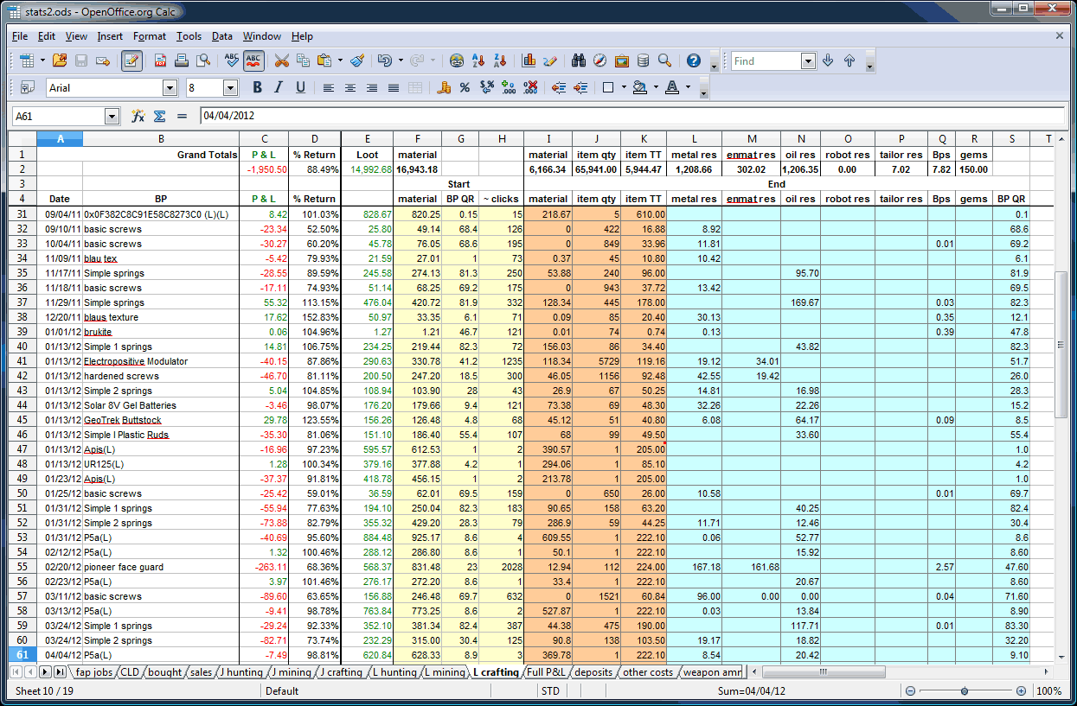
Independently Testable Features
What are three independently testable features of a spreadsheet?
Notes:
Let’s try a slightly less obvious one. Take a spreadsheet. What are three independently testable features of a spreadsheet? (discuss)

Slide 23
Identifying Representative Values
We know the features. We know their parameters.
What input values should we pick?
What about exhaustively trying all inputs?
Test Input Data
Program
Test Output Results
Notes:
(read) The next step, obviously, is to come up with the input to those parameters. If we want to test the software, we should prod the system so we can see what it does.
What values should we pass in? What would you do? (discussion)
How about we try every input? (discuss)

Slide 24
Exhaustive Testing
2³² possible integer values for each parameter.
= 2³² x 2³² = 2⁶⁴ combinations = 10¹³ tests.
Take the arithmetic function for the calculator:
add(int a, int b)
How long would it take to exhaustively test this function?
Test Input Data
Program
1 test per nanosecond
= 10⁵ tests per second
= 10¹⁰ seconds
Test Output Results
or… about 600 years!
Notes:
Let’s take that calculator again and just look at addition. Let’s just restrict the numbers to integers. If we wanted to exhaustively test this, how long would it take? How many inputs are we talking about?
- (read) That’s a lot right, how long we talking about time wise?
- let’s be generous and say we can run a test per nanosecond. That works out to about 10^5 tests per second, or 10^10 seconds overall. That doesn’t sound bad in seconds, but how long is that?
- (read). That’s for something as simple as addition of two integers. That’s insane, right?

Slide 25
Not all Inputs are Created Equal
We can’t exhaustively test any real program.
We don’t need to!
Some inputs are better than others at revealing faults, but we can’t know which in advance.
Tests with different input than others are better than tests with similar input.
Test Input Data
Ie
Program
Test Output Results
Oe
Notes:
We can’t exhaustively test any real program. You just can’t. Addition is the bottom of the barrel in terms of complexity. Most individual features will have quadrillions of inputs at least. Exhaustive testing just isn’t going to work out. Fortunately, you don’t need to. The fact is that not all inputs are as useful as others.
Purely from the verification perspective, there are only so many outcomes of a function, and you’ll have a lot of inputs that lead to the same outcomes. Why use all of them? We can cut that down some.
Then, fundamentally, testing is really something we do to find problems, and some inputs are going to be better than others and revealing those problems. We want those inputs.
Sadly, we don’t know which tests will reveal faults until we run them. At this point, we may not even have code, just our requirements if we start coming up with tests early. But, as a start, we know that two tests with inputs that are very different from each other are more likely to reveal faults than two tests with very similar input.
- Say you can select three tests for a program that breaks a text buffer into lines of 60 characters each. We select tests with a 40 character string and a 30 character string. Then, for a final test, we use a 100 character string. We can’t prove the 100 character buffer is a better test, but we would be more suspicious of a set of tests that is biased towards lengths less than 60. That’s a start, we’re covering a wider range of the input space. You’re more likely to hit a different outcome of a function or some weird corner case that is likely to break the whole thing..

Slide 26
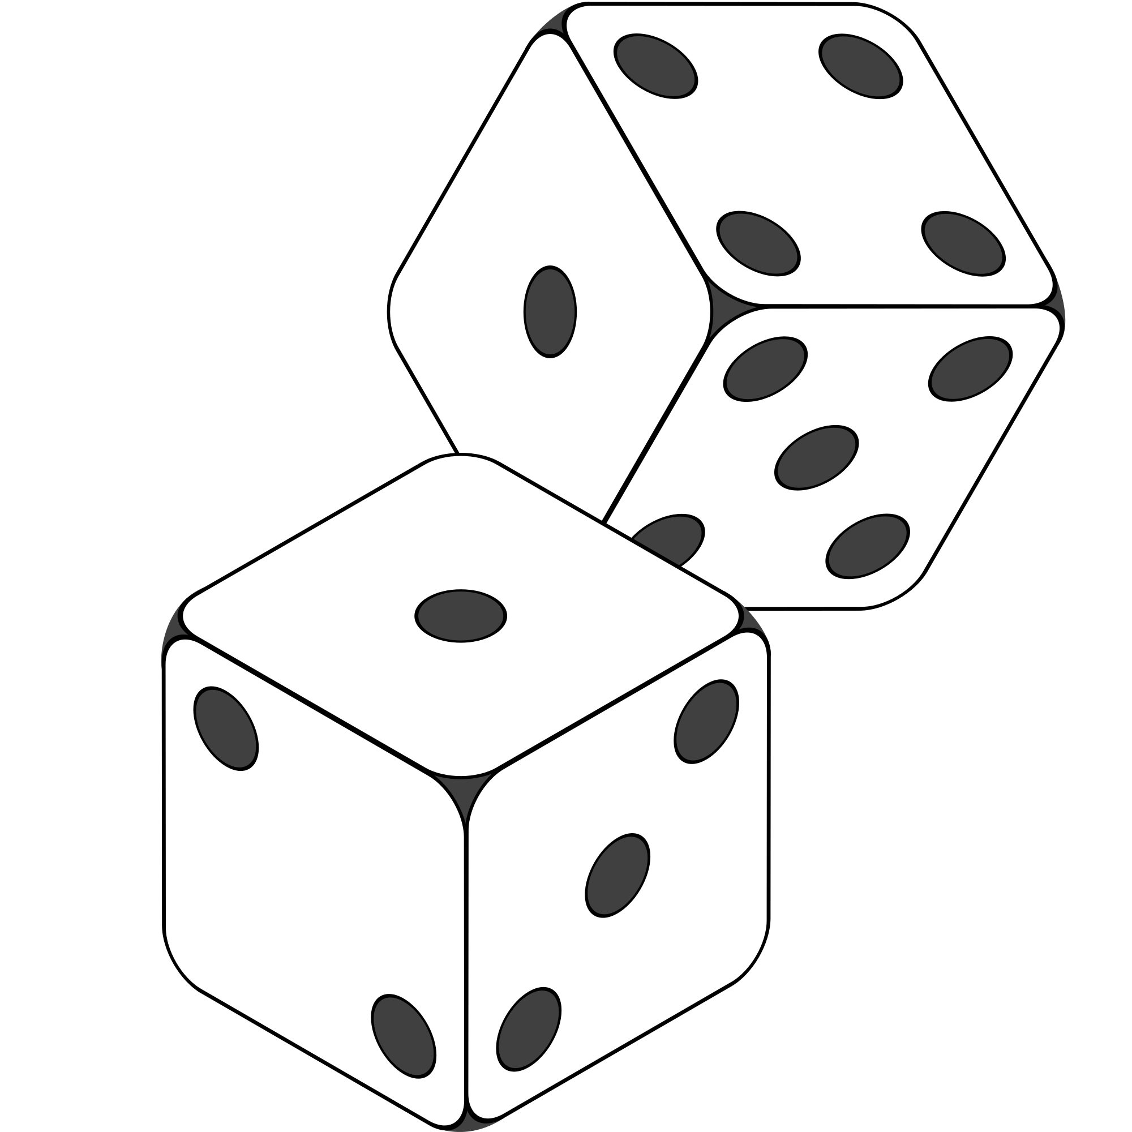
Random Testing
Pick inputs uniformly from the distribution of all inputs.
All inputs considered equal.
Keep trying until out of time.
No designer bias.
Removes manual tedium.
Notes:
- So, we don’t want to test exhaustively, but we do want to hit a good span of the input space. How about we try a random sampling?
- Let’s just consider all inputs equal and try different ones until we run our of time. This avoids bias, and is cheap - we don’t need to spend all of this time coming up with tests by hand - just spam the system with input. If it’s cheap to run tests, than we can just keep trying until we uncover bugs or run out of time.

Slide 27
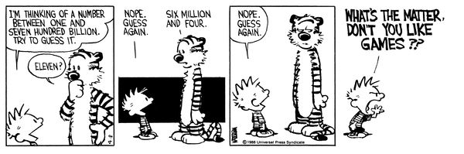
Why Not Random?
Notes:
(discuss)
*can be* useful doesn’t mean it usually is. Random testing is way too naive for the kind of input space you see in most software. You’re basically hoping to get lucky. Even if you generate thousands of random tests, you’ve only covered a tiny set of those possible inputs, and even worse, you’re likely repeating work. There’s no guarantee that you have chosen different inputs, you mgiht have hundreds clustered in a small corner of that space. Best case scenario is that we have a decent randomization strategy. If we can ensure enough diversity in input, we can at least try a lot of different things. But, still. this is what you do in the absence of a plan, pray and try something.
So, how do we find those faults, those needles in the haystack?

Slide 28
Input Partitioning
Faults are sparse in the space of all inputs, but dense in some parts of the space where they appear.
Test Input Data
Ie
Program
By systematically trying input from each partition, we will hit the dense fault space.
Test Output Results
Oe
Notes:
-The next step is to take a good, long look at that input space.
- In truth, faults are pretty sparse in the input space as a whole, but they are dense in the part of the input space in which they appear.
- In practice, you can almost always divide the input space into partitions - into logical group of inputs based on some criteria - maybe based on the outcome they’ll trigger. The thing is, if we do a good job of partitioning, and we come up with an input that lands in a space dense with faults, then we’re in good shape.
-This goes back to something I touched on a few minutes ago. We should - a a general strategy - favor different input over similar input. That’s a key idea. Try two very different things and you’re more likely to trigger a fault than trying two very similar things. Even more so if we put some thought into where those inputs come from. if we systematically go through and try a few inputs from each of those partitions, we are more likely to hit a a larger range of different results than just randomly trying input. If a feature can result in different outcomes, we’re more likely to hit all of those by braking the input space down along the lines of which outcomes are triggered, and as a result, we’re way more likely to hit that space where faults are dense and trigger a few of them. By incorporating human knowledge, you can make sure that the tests actually cover a representative portion of that input space.

Slide 29
Equivalence Class
We want to divide the input domain into equivalence classes.
Inputs from a group can be treated as the same thing (trigger same outcome, result in the same behavior, etc.).
If one test reveals a fault, others in this class (probably) will too. In one test does not reveal a fault, the other ones (probably) will not either.
Perfect partitioning is difficult, so grouping based on intuition, experience, and common sense.
Notes:
So, by partitioning the input domain, we can then form a set of equivalence classes - tests that are essentially interchangeable. An equivalence class of tests essentially test the same scenario - they give you the same outcome, they trigger the same behavioral pattern, same usage of a feature.
-(read reveal)
-So, we want to come up with tests from each of the possible classes. Perfect partitioning of tests is hard, but we try our best with a combination of intuition, experience, and common sense.

Slide 30
Example
substr(string str, int index)
What are some possible partitions?
index < 0
index = 0
index > 0
str with length < index
str with length = index
str with length > index
...
Notes:
(discuss), both variables
think about the outcomes, and how the variables work together to influence the outcome.
-bring in and walk through
Let’s go over some strategies.

Slide 31
Choosing Input Partitions
Look for equivalent output events.
Look for ranges of numbers or values.
Look for membership in a logical group.
Look for time-dependent equivalence classes.
Look for equivalent operating environments.
Look at the data structures involved.
Remember invalid inputs and boundary conditions.
Notes:
A few of these include:
-Look for ranges of numbers or values - what are the different discrete ranges of input values that can be provided?
-Look for membership in a logical group - Can we group these inputs based on how their used, what context the method uses them in, do member of this group trigger similar behavior?
-Look for time-dependent classes - does the timing of input matter to particular groupings?
- (read) - some data structures, such as arrays, can be broken down into common groupings of input.
- (read) Can you group based on the output event that occurs?
- (read) the operating environment might influence system behavior
-(read)

Slide 32
Look for Equivalent Outcomes
It is often easier to find good tests by looking at the outputs and working backwards.
Look at the outcomes of a feature and group input by the outcomes they trigger.
Example: getEmployeeStatus(employee ID)
Manager, Developer, Marketer, Lawyer
Employee Does Not Exist
Malformed Employee ID
Notes:
First thing to do is start from the output, divide the output into the different outcomes I can get - then try to come up with input that produces those outcomes.
(read rest)

Slide 33
Look for Ranges of Values
If an input is intended to be a 5-digit integer between 10000 and 99999, you want partitions:
<10000, 10000-99999, >100000
Other options: < 0, max int, real-valued numbers
You may want to consider non-numeric values as a special partition.
Notes:
When dividing input into input partitions, it is natural to look for how you could split the values of inputs into discrete ranges. Any value from a particular input range should have the same effect.
(read)
You want to hit a typical value, something from the expected range, then hit cases that fall outside of the expected range
(read partitions)
Some other options to consider include those weird corner cases likely to trigger issues - a negative value - those can have strange effects, the maximum sized integer, or a real-valued number. Something with a decimal in it. See how that gets rounded (or if it breaks something, or if error handling code kicks in)
May also want to consider non-numeric values as a special partition. Can you pass in a string, character, array, pointer? What happens when you do?

Slide 34
Look for Membership in a Group
Consider the following inputs to a program:
The name of a valid Java data type.
A floor layout
A country name.
All can be partitioned into groups.
Numeric vs Other data types, Apartment vs Business, Europe vs Asia, etc.
All groups can be subdivided further.
Look for context that an input is used in.
Notes:
(read) - idea is that there is context behind how a program uses inputs. Often ,you have different logical groups in mind when you come up with a feature. Why not break up inputs into these logical groupings?
(read rest - these groupings are often too broad at first, but can we break those into smaller subgroups?
data type - what about into numeric primitives and text-based ones? ints, float, double, etc and character, string.
alphabet - letter a-f, g-p, q-z.. or usage frequency in the english language
country name - groupings of countries - by continent or membership in US/EU/other political bodies.
(Depends on the needs of your program, but you can almost always break an input or output into logical groupings based on what it represents)

Slide 35
Timing Partitions
The timing and duration of an input may be as important as the value of the input.
Very hard and very crucial to get right.
Trigger an electrical pulse 5ms before a deadline, 1ms before the deadline, exactly at the deadline, and 1ms after the deadline.
Push the “Esc” key before, during, and after the program is writing to (or reading from) a disc.
Notes:
(read)
(read) very hard, but also something that can be very important. For many systems, the timing of an input is an unstated input. If timing matters, you need to remember that it is part of the input, and partition it accordingly.
For example, consider a pacemaker - looking for electrical impulses from the heart. (read)
Or, in a more common scenario, even on a personal computer, strange behaviors can happen when reading from a file or writing out to a file, try (read)

Slide 36
Equivalent Operating Environments
Environment may affect behavior of the program.
Environmental factors can be partitioned.
Memory may affect the program.
Processor speed and architecture.
Try with different machine specs.
Client-Server Environment
No clients, some clients, many clients
Network latency
Communication protocols (SSH, FTP, Telnet)
Notes:
Similar to timing, the environment that the program operates in can easily impact the behavior of the program. Thus, the environment can also be considered when forming behavior partitions. Consider the environment you’re operating in, how it can influence the input or output of the system, and how the combination of both program inputs and environmental variation can be partitioned.
Memory may cause problems. What if you don’t have enough? What if you have enough physical memory, but not enough free (or not enough birtual memory)
Same for processor speed or architecture. Could see race conditions, deadlock between processes, unexpected slowdown.
Try using different machine specs and vary both the processor and memory. Those choices suggest different partitionings.
Client-server environment can have huge impacts on the operation of the system.
try with different numbers of connections to clients - none, some, many (DDOS conditions)
network latency - can vary network equipment or speed
communication protocols - many options for a file upload, try each that you support

Slide 37
Data Structures
Certain data structures are prone to certain types of errors. Use those to suggest equivalence classes.
For sequences, arrays, or lists:
Sequences that have only a single value.
Different sequences of different sizes.
Derive tests so the first, middle, and last elements of the sequence are accessed.
Notes:
(read)
(read) Programmers naturally think of sequences as made of up several values and it’s common to embed this assumption into the program. If presented with a single-value sequence,the program might fail.
(read) Decreases the chances that a bad program will accidentally give you a good output because of a particular input choice.
(read) This will reveal problems at partition boundaries.

Slide 38
Do Not Forget Invalid Inputs!
Likely to cause problems. Do not forget to incorporate them as input partitions.
Exception handling is a well-known problem area.
People tend to think about what the program should do, not what it should protect itself against.
Take these into account with all of the other selection criteria already discussed.
Notes:
(read)
read, even if you’ve included some error-handling code, test all possibilities - you’ve probably forgot some corner case
(read). We try to nail the functionality - it must perform this function, if everything goes to plan. We don’t spend as much time on the exceptional cases - on protecting the program from bad input.
so, in addition to the other criteria - group membership, timing, operating environment, take invalid input into account. Make sure you pass in malformed input when testing, and consider different types of bad input as additional equivalence classes on top of your partitioning of the valid input domain.

Slide 39
Input Partition Example
What are the input partitions for:
max(int a, int b) returns (int c)
We could consider a or b in isolation:
a < 0, a = 0, a > 0
We should also consider the combinations of a and b that influence the outcome of c:
a > b, a < b, a = b
Notes:
(discussion) (read)

Slide 40
Creating Requirements-Based Tests
For each independently testable feature, we want to:
Identify the representative value partitions for each input or output.
Use the partitions to form abstract test specifications for the combination of inputs.
Then, create concrete test cases by assigning concrete values from the set of input partitions chosen for each possible test specification.
Identify Representative Values
Generate Test Case Specifications
Generate Test Cases
Notes:
So, for each independently testable feature, we want to:
identify the representative values for each input. For each input, we want to be able to chop up the input space into different groupings.
So, we have each individual input partitioned. For tests, we feed in a combination of inputs. Not just a value for one, but a value for all inputs of a function. So, you form all of the possible combinations of partitions for the set of inputs to get your set of abstract test specifications.
(read)

Slide 41
Equivalence Partitioning
Feature insert(int N, list A).
Partition inputs into equivalence classes.
int N is a 5-digit integer between 10000 and 99999. Possible partitions:
<10000, 10000-99999, >100000
list A is a list of length 1-10. Possible partitions:
Empty List, List of Length 1, List of Length 2-10,
List of Length > 10
Notes:
So, in coming up with equivalence partitions for inputs or outputs, you need to think about what exemplifies the space of inputs. You want to make sure you hit the types of input that can be passed in.
For example (read)

Slide 42
From Partition to Test Case
Choose concrete values for each combination of input partitions: insert(int N, list A)
int N
list A
Test Specifications:
insert(< 10000, Empty List)
insert(10000 - 99999, list[1])
insert(> 99999, list[2-10])
etc
Test Cases:
insert(5000, {})
insert(96521, {11123})
insert(150000, {11123, 98765})
etc
< 10000
10000 - 99999
> 99999
Empty List
List[1]
List[2-10]
List[>10]
Notes:
Now, we have the representative values for the individual inputs. For our test, we want to combine those. We don’t just pass in values to a single input. We pass in values to all inputs at once. To form our test specifications, our list of test types, we need to list out all of the possible combinations of input partitions for all inputs. For example,
(read)
then, we can create concrete test cases by assigning values to each abstract specification
(read)

Slide 43
Generate Test Cases
substr(string str, int index)
Specification:
str: length >=2, contains special characters
index: value > 0
Test Case:
str = “ABCC!\n\t7”
index= 5
Generate Test Case Specifications
Generate Test Cases
Notes:
Now, we have our set of test case specifications. We have all these abstract combinations of input types we want to try. Now, we need to transition to concrete test cases, where we feed in actual values. This is a simple instantiation of these test specifications. There are still a few things to keep in mind, though. For one - there is a reason we do both the specifications and concrete cases, which is that if you feed in multiple tests with the same specification, only one of them might still actually trigger a fault in the code.

Slide 44
Boundary Values
Basic Idea:
Errors tend to occur at the boundary of a partition.
Remember to select inputs from those boundaries.
Notes:
Now, no matter how you chop up the input partitions, the most errors tend to occur at the boundaries of those divisions. So, in choosing concrete values, don’t forget to try out those wrird corner cases.

Slide 45
Choosing Test Case Values
Choose test case values at the boundary (and typical) values for each partition.
If an input is intended to be a 5-digit integer between 10000 and 99999, you want partitions:
<10000, 10000-99999, >100000
0
5000
9999
100000
150000
max int
10000
50000
99999
Notes:
(read)

Slide 46
Let’s take a break.
Notes:
15 minute break + activity

Slide 47
Activity - Functional Testing
You are asked to develop a simple C++ container class SetOfE containing elements of type E with the following methods:
void insert(E e)
Bool find(E e)
void delete(E e)
Using domain partitioning, develop functional test cases for the methods. You can define your test cases as input/output pairs.
For example, to test insert(E e), one test case could be:
Input: Empty Container/any e Expected output: e in Container.
Notes:
Go over

Slide 48
Activity Solution
Insert | Empty/ any e | e in container
 | E with one element / any e | e in container
 | E with multiple elements / any e | e in container
 | Very large E/ any e | e in container
 | E containing e/ e | Error or no change
 | Any E/ malformed e | Error
Exists | E containing e/ e | True
 | E not containing e/ e | False
 | Very large E containing e/ e | True
 | E with only element e/ e | True
 | Any E / malformed e | Error
 | Empty / e | False
Delete | E containing e/ e | e no longer in list
 | E not containing e/ e | no change (or error)
 | Any E / malformed e | error
 | Very large E containing e/ e | e no longer in list
 | Empty / e | no change
Notes:
go over

Slide 49
Building a Test Suite
Smarter process than random testing, but still comes down to brute force:
May still be an infeasibly high number of test specifications.
Each specification can be transformed into MANY concrete test cases. How many should be tried?
How do we arrive at an effective, reasonably-sized test suite?
Identify Representative Values
Generate Test Case Specifications
Generate Test Cases
Notes:
So, for each independently testable feature, we want to:
identify the representative values for each input. For each input, we want to be able to chop up the input space into different groupings.
So, we have each individual input partitioned. For tests, we feed in a combination of inputs. Not just a value for one, but a value for all inputs of a function. So, you form all of the possible combinations of partitions for the set of inputs to get your set of abstract test specifications.
(read)
Now, this is - of course- smarter than trying to exhaustively try everything or feed in random values, but it still boils down to an inefficient brute force approach: (read 2, 3)
So, the question we still have is how we can arrive at an effective, reasonably sized test suite.

Slide 50
Category-Partition Method
Notes:
15 minute break + activity

Slide 51
Category-Partition Method
A method of generating test specifications from requirement specifications.
Adds a small number of additional steps on the process discussed today.
Requires identifying categories, choices, and constraints.
Once identified, these can be used to automatically generate a list of test specifications to cover.
Notes:
(read 1 -3) We’ll talk more about those.
But, once you have these categories, choices, and constraints, you can use them to estimate the number of test cases that you’ll need to generate, and (read 4). This lets you determine the number of cases that you’ll need to create before spending human effort creating them. That’s a powerful concept - if you end up with too many test cases that need to be formed, you can apply more constraints until you get a reasonably sized test suite. This is obviously a better apporach than building a bunch of tests and then realizing that you’re out of time

Slide 52
Identify Independently Testable Features and Parameter Characteristics
Identify features and their parameters.
Identify characteristics of each parameter.
What are the controllable attributes?
What are their possible values?
May be defined partially by other parameters and their characteristics.
May not correspond to variables in the code.
Parameter characteristics are called categories.
Notes:
So, we start, as before, by (read title). So, just like before, you’ll (read 1). Remember environmental inputs as well, like databases.
Then, we should think about what defines each parameter (read 2 - 5). Remember that (6). You may have multiple attributes - each representing something you have control over when testing. They may not reflect something that can be set in the code, but rather may be something test or outcome specific that you can control and that influences several of the variables in the code
(read 7)

Slide 53
Example: Computer Configurations
Your company sells custom computers.
A configuration is a set of options for a model.
Some combinations are invalid (i.e., VGA monitor with HDMI video output).
Testing feature:
checkConfiguration(model,components)
What are the parameters?
Next - what are the choices to be made for each parameter?
Notes:
read
Not just model and components. We need some information on what defines a valid configuration - there might be a database of models and components that lists the options available. Even though that isn’t a direct input to the function, it’s something we need to consider as well. It’s required for the code to function and its contents impact execution.

Slide 54
Parameter Characteristics
Turn to the requirements specifications.
Model: A model identifies a specific product and determines a set of constraints on available components. Models are identified by a model number. Models are characterized by logical slots on a bug. Slots may be required (must be filled) or optional (may be left empty).
Set of Components: A set of <slot, component> pairs, which must correspond to the required and optional slots associated with the model. A component is a choice that can be varied within a model. Available components and a default for each slot is determined by the model. The special value “empty” is allowed and may be the default for optional slots. In addition to being compatible or incompatible with a model, components may be compatible or incompatible with each other.
Notes:
read
What defines a model - what are the categories or characteristics of a model?
(id, req slots, optional slots)
think about how model influences the allowed components - number of slots, what form are those slots, and are the selected components compatible with those slots?
(does the selection correspond to the model slots?, required components with non-empty selections, optional components with non-empty selections, what components have you selected for the required slots, what components have ou selected for the optional slots)

Slide 55
Categories
Model
Model number
Number of required slots (must have a selection)
Number of optional slots (may or may not have a selection)
Components
Selected component valid for model
Number of required/optional slots with non-empty selections
Selected components for required/optional slots OK/not OK
Product Database
Number of models in database
Number of components in database
Notes:
read
for now, keep product database simple

Slide 56
Identify Representative Values
For each category, many values that can be selected for concrete test cases.
We need to identify classes of values, called choices, for each category.
A test specification is a combination of choices for all categories.
Consider all outcomes of a feature.
Consider boundary values.
Notes:
Again, just like last time, we now want to form test specifications
(read 1) - now, the only thing to keep in mind is that - last class -we were pretty strictly talking about the actual inputs of a method and partioning those into classes of value that are grouped in some logical manner, such as by what outcome they produce. Here, the only difference is that we might actually be talking about choices that don’t correspond to a single variable, but rather shape the actual variables being passed into the method. For example, on the component input, one of the choices was the number of optional components with non-empty selections. That’s not a literal variable you set, but rather, an aspect of the set of components - the actual variable - you pass in. Make sense? So, keeping that in mind, we need to look at each categor and (read 2).
Then, (read 3)
The same advice applies - start by considering the different outcomes of a feature. Especially the error-handling cases, and make sure you try all of those variations out to make sure nothing bad sneaks through. Remember boundary values - extreme values within each class, those at the edges between two classes. Those often trigger weird off-by-one conditions, so try them.

Slide 57
Choices for Each Category
Model
Model number
malformed
not in database
valid
Number of required slots
0
1
many
Number of optional slots
0
1
many
Product Database
Number of models in database
0
1
many
Number of components in database
0
1
many
Components
Correspondence of selection with model slots
omitted slots
extra slots
mismatched slots
complete correspondence
Number of required (or optional) components with non-empty selections
0
< number required (or optional)
= number required (or optional)
Selected components for required (or optional) slots
some default
all valid
>= 1 incompatible with slot
>= 1 incompatible with another component
>= 1 not in database
Notes:
(walk throught)
combined required/optional on right for readability
NOT ALL POSSIBLE VALUES, think - it’s easy to capture the normal, everyday behavior, but think about what can go wrong and make sure you test that. Make sure you really capture the essence of the specification. If it is mentioned in the specification, you NEED a test showing that it happens as was stated in the spec. In thinking, you might even identify situations not covered yet in the specification that you can go back and add.

Slide 58
Generate Test Case Specifications
Test specifications are formed by combining choices for all categories.
Number of possible combinations may be impractically large, so:
Eliminate impossible pairings.
Identify constraints to remove unnecessary options.
From the remainder, choose a subset of specifications to turn into concrete tests.
Notes:
-(read). So, at the base level, the number of possible test specifications is the cartesian product of representative values - the choices - for all categories.
-Now, the number of combinations grows exponentially as the number of variables and equivalence classes grows. For a simple system with five inputs and six value classes for each, the raw number of test specifications is 6^5, or 7776. Which, is an insane number of tests for a simple system. That’s still not going to happen.
- That said, we still don’t need all of those. Many of those combinations may not even be possible, so you want to eliminate any combinations that are impossible
- identify constraints that can be used to remove unnecessary combinations
- and from the remainder, choose a practical subset to examine the system.
- (read)

Slide 59
Choices for Each Category
Model
Model number
malformed
not in database
valid
Number of required slots
0
1
many
Number of optional slots
0
1
many
Product Database
Number of models in database
0
1
many
Number of components in database
0
1
many
Components
Correspondence of selection with model slots
omitted slots
extra slots
mismatched slots
complete correspondence
Number of required (or optional) components with non-empty selections
0
< number required (or optional)
= number required (or optional)
Selected components for required (or optional) slots
some default
all valid
>= 1 incompatible with slot
>= 1 incompatible with another component
>= 1 not in database
Seven categories with three choices.
Two categories with 6 choices.
One category with 4 choices.
Results in 3⁷ x 6² x 4 = 314928 test specifications
However… not all combinations correspond to reasonable specifications.
Notes:
(bring in)
(read 1-5)
For example, it isn’t reasonable to have a test with a valid model from the database where the database has no entries. So, we can eliminate some of these pairings.

Slide 60
Identify Constraints Among Choices
Three types of constraint:
IF
This partition only needs to be considered if another property is true.
ERROR
This partition should cause a problem no matter what value the other input variables have.
SINGLE
Only a single test with this partition is needed.
Notes:
There are three types of constraints that we can define to reduce the number of pairings.
-read - for instance, you might inlcude input from one partition only if a particular partition is used for another input variable.
-read, so we don’t need every combination of other partition for the other variables with this one. Just one test with this error-inducing partition should do for us.
- Single is similar to error, but more general purpose. A partition is special, unusual, or irrelevant, so we only want to bother with it once. We don’t need every combination of other inputs with this partition. We just need one test that uses this particular partition and we can move on.

Slide 61
Applying Constraints
substr(string str, int index)
Str length Input index
length 0 value <0
length 1 value = 0
length >= 2 value = 1
Str contents value > 1
contains special characters value = MAXINT
contains lower case only
contains mixed case
empty
PROPERTY zeroLen
ERROR
if !zeroLen
SINGLE
if !zeroLen
if !zeroLen
if zeroLen
Notes:
Let’s take substr (go over), and for each input, we have some partitions (read through). str - combine from the length constraints and contents choices.
What are some of the constraints we can try applying? (discuss)
- prop/if read
- error
- single - this one is unusual, but shouldn’t result in an error. We only really need to try it out once. It should execute and work, maybe slowly, but it should still work out. So, let’s jsut try it once

Slide 62
Applying Constraints
Model
Model number
malformed [error]
not in database [error]
valid
Number of required slots
0 [single]
1 [property RS] [single]
many [property RS] [property RSMANY]
Number of optional slots
0 [single]
1 [single] [property OS]
many [property OS] [property OSMANY]
Product Database
Number of models in database
0 [error]
1 [single]
many
Number of components in database
0 [error]
1 [single]
many
Components
Correspondence of selection with model slots
omitted slots [error]
extra slots [error]
mismatched slots [error]
complete correspondence
Number of required (or optional) components with non-empty selections
0 [error] [if RS]
< number required (or optional) [error] [if RS] / [if OS]
= number required (or optional) [if RSMANY] / [if OSMANY]
Selected components for required (or optional) slots
some default [single]
all valid
>= 1 incompatible with slot
>= 1 incompatible with another component
>= 1 not in database [error]
Notes:
let’s walk through these
- So, the label error means that this is a value that only needs to be tried once when combined with the other non-error values of other parameters. No matter the combination, if you have this choice set, you get an error - so that right off the bat wipes out a lot of combinations. (walk through these). With these error labels, we get down to 2711 test specifications from 314928. Huge impact right there. This still leaves a large number of test specifications to try, more than we may need or have budget for, so let’s see if we can get this down further. Some combinations might not be erroneous, but might only be useful or valid in combination with certain other choices. For example, the number of non-empty choices of required components > 0 doesn’t make sense if the number of required components is 0.
-So, that’s where properties and if-constraints come in. The property identifies a constraint. In this case, RSNE indicates that there is one or more required slots. Any situation where 0 isn’t the number of required slots fits this property. Similarly, we can mark properties on the number of optional slots.
- Now, the if-property contraints state that if a choice is only valid if that property is true. So, the choice of having fewer non-empty required slots than is required is only valid if there are 1 or more required slots. That just makes sense. These if-properties can be used to eliminate invalid combinations (point at rest). These if-properties reduce us again down to 1811 possible test specifications.
- Then, the single constraint acts like the error constraint. This is a situation that isn’t meant to be an error case, but is something rare that doesn’t need to be tried in every configuration - you just want to cover it once to make sure nothing is weird with it. This is how you normally treat boundary value conditions - they shuldn’t fail, but you need to try them - like a database with a single model in it or 0 required slots or a configuration that mixes default and non-default components. You want to try them, but don’t need to try every combination, so any one test will do. These single constraints take us from 1811 tests down to 67 - a very reasonable number to create. Our next technique can drop that even further.

Slide 63
Example - Find Command
Bash command: find
find <pattern> <file>
Finds instances of a pattern in a file
find john myFile
Finds all instances of john in the file
find “john smith” myFile
Finds all instances of john smith in the file
find ““john” smith” myFile
Finds all instances of john” smith in the file

Slide 64
Example - Find Command
Parameters: pattern, file
What can we vary for each?
Our categories.
What can we control about the pattern? Or the file?
What choices can we make for each category?
Our categories
File name:
Name of an existing file provided
File does not exist

Slide 65
Example - Find Command
Pattern size:
Empty
single character
many character
longer than any line in the file
Quoting:
pattern is quoted
not quoated
improperly quoated
Embedded spaces:
No spaces
One space
Several spaces
1944 tests if we consider all combinations.
Embedded quotes:
no quotes
one quote
several quotes
File name:
Existing file name
no file with this name
Number of occurrence of pattern in file:
None
exactly one
more than one
Pattern occurrences on target line:
One
more than one
Notes:
Go over
How many combinations - test cases - do you think we can make for this one function?
- 1944! We don’t have time for that. Let’s narrow it down by applying constraints.

Slide 66
IF Constraints
678 Tests
Pattern size:
Empty
single character
many character
longer than any line in the file
Quoting:
pattern is quoted
not quoted
improperly quoted
Embedded spaces:
No spaces
One space
Several spaces
Embedded quotes:
no quotes
one quote
several quotes
File name:
Existing file name
no file with this name
Number of occurrence of pattern in file:
None
exactly one
more than one
Pattern occurrences on target line:
One
more than one
[not empty]
[if not empty]
[not empty]
[if not empty and quoted]
[not empty]
[quoted]
[if not empty]
[if not empty]
[if not empty]
[if not empty]
[match]
[if not empty]
[match]
[if not empty]
[if match]
[if not empty and quoted]
[if match]
[if not empty and quoted]
Notes:
Let’s apply some constraints. First, we need to define properties. What properties can we define?
- not empty, quoted,match - go over
- Now, where can we apply those properties? Go over each
How many tests now?
- Down to 678

Slide 67
ERROR and SINGLE Constraints
Embedded quotes:
no quotes
one quote
several quotes
File name:
Existing file name
no file with this name
Number of occurrence of pattern in file:
None
exactly one
more than one
Pattern occurrences on target line:
One
more than one
Pattern size:
Empty
single character
many character
longer than any line in the file
Quoting:
pattern is quoted
not quoted
improperly quoted
Embedded spaces:
No spaces
One space
Several spaces
40 Tests!
[single]
[error]
[error]
[single]
[error]
[single]
Notes:
Let’s narrow further. Can we apply any error constraints?
- go over. Now, anything we can try just once and leave out after?
- go over. How many tests now?
- 40! Much better shape, and down from our starting point of 1944

Slide 68
We Have Learned
Requirements-based tests are derived by
identifying independently testable features
partitioning their input/output to identify equivalence partitions
combining inputs into test specifications
and removing impossible combinations
then choosing concrete test values for each specification
Notes:
(discussion) (read)

Slide 69
Key Points
The requirement specifications define the correct behavior of the system.
Therefore, the first step in testing should be to derive tests from the specifications.
If the specification cannot be tested, you most likely have a bad requirement.
Rewrite it so it is testable.
Remove the requirement if it can’t be rewritten.
Tests must be written in terms of independently testable features.

Slide 70
Key Points
Not all inputs will have the same outcome, so the inputs should be partitioned and test cases should be derived that try values from each partition.
Input partitions can be used to form abstract test specifications that can be turned into 1+ concrete test cases.
IF/ERROR/SINGLE constraints can remove unnecessary combinations of input.

Slide 71
Next Time
Structural Testing
Optional Reading: Pezze and Young, Chapters 5.3 and 12
Homework
Assignment 1 Due Sunday, February 16
Any questions?

