Slide 1
Exercise 4: Structural Testing
Gregory Gay
DIT636/DAT560 - February 16, 2026

Slide 2
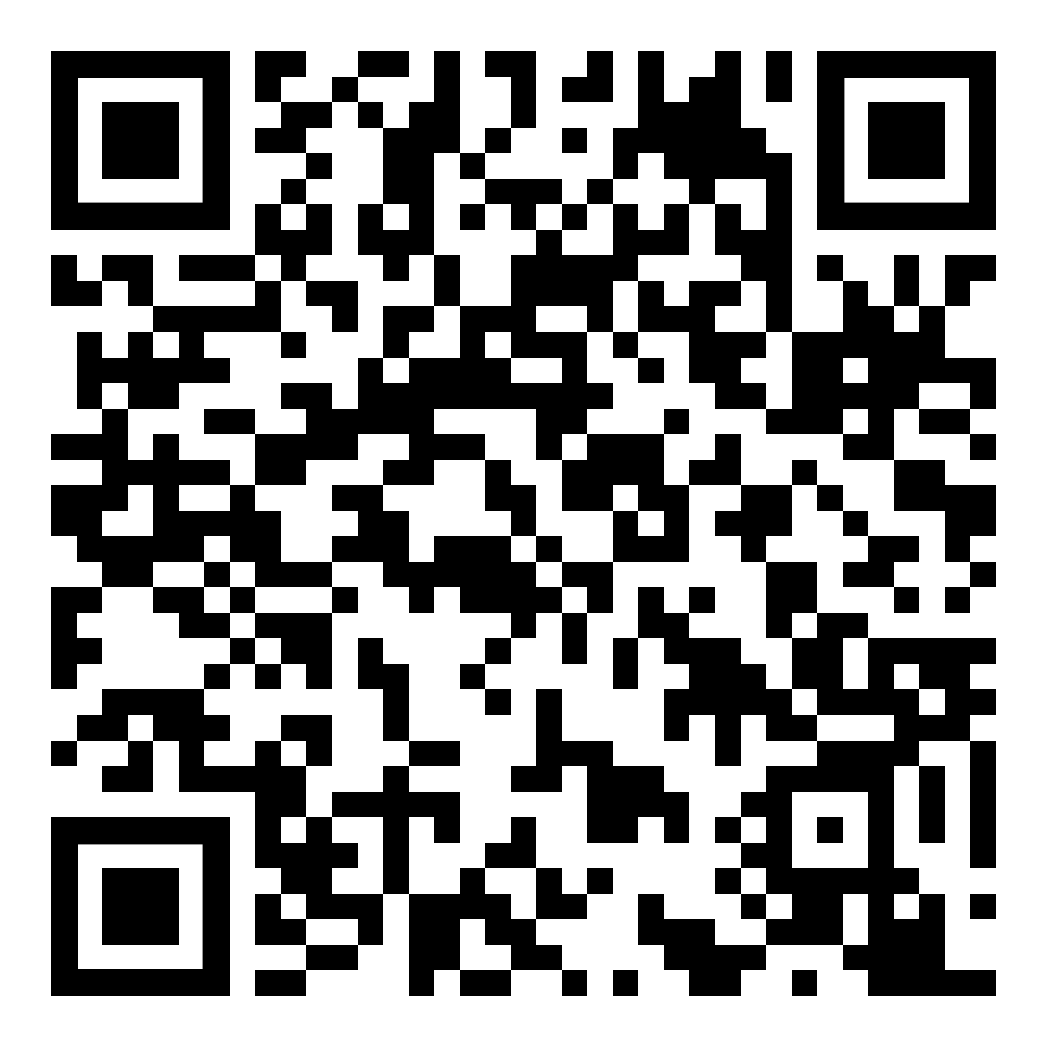
The Planning System Returns
Everybody likes meetings.
  Not true - but we need to book them.
We don’t want to double-book rooms or employees for meetings.
System to manage schedules and meetings.
Notes:
(read)

Slide 3
Structural Testing
You already tested this system based on the functionality. Now we want to fill in the gaps.
Goal: 100% Statement Coverage (Line Coverage) of all classes except Main and the exceptions.
  First, measure coverage of your existing tests
  Then, fill in any gaps with additional tests targeting the missed code.

Slide 4
Measuring Coverage
The easiest way: use an IDE plug-in.
  IntelliJ: IntelliJ IDEA code coverage runner: https://www.jetbrains.com/help/idea/code-coverage.html
  VSCode: https://code.visualstudio.com/docs/debugtest/testing#_test-coverage
Command line:
  Cobertura
  JaCoCo available as a Maven plug-in: https://medium.com/capital-one-tech/improve-java-code-with-unit-tests-and-jacoco-b342643736ed
Notes:
org.blah.blah.MyCode
src/org/blah/blah/MyCode.java
org.blah.blah.MyCodeTest
test/org/blah/blah/MyCodeTest.java

Slide 5
Activity
If tests from last week don’t get 100% line coverage.
Target methods from each class using one of the coverage criteria from class.
  Recommendation: Target Branch Coverage
  Skip PlannerInferface and exception.
If you find code that cannot be covered, explain why.
If you feel some code doesn’t need covered, explain.

Slide 6
Example
From Calendar:
public boolean isBusy(int month, int day, int start, int end){
boolean busy = false;
checkTimes(month,day,start,end);
for(Meeting toCheck : occupied.get(month).get(day)){
if(start >= toCheck.getStartTime() && start <= toCheck.getEndTime()){
busy=true;
}else if(end >= toCheck.getStartTime() && end <= toCheck.getEndTime()){
busy=true;
}
}
return busy;
}
1
T, F
2
3
1
Loop Condition: Set up Calendar with 1+ meetings on the date that we provide as input.
Will enter and exit the loop, providing coverage.
Notes:
To get you started, let’s pull a method from the system and look at how we would write tests to cover it. This is the method isBusy from class Calendar. Now, if we want to achieve Branch Coverage of this, that means we need to identify the branches, then design input that will cause each to resolve to true and false. (click) here are our branches. We have three branching points. The loop condition, an if-statement, and and else-if. We want to cover each of these. (click) The loop is easy enough. We need to have one or more meetings on the date indicated. The loop will iterate over each. Then, within that loop, we need to interact with the if and the else-if.

Slide 7
Example
From Calendar:
public boolean isBusy(int month, int day, int start, int end){
boolean busy = false;
checkTimes(month,day,start,end);
for(Meeting toCheck : occupied.get(month).get(day)){
if(start >= toCheck.getStartTime() && start <= toCheck.getEndTime()){
busy=true;
}else if(end >= toCheck.getStartTime() && end <= toCheck.getEndTime()){
busy=true;
}
}
return busy;
}
1
T, F
2
F
3
F
2
3
Set up Calendar with 1+ meetings on the date that we provide as input.
Meeting does not conflict with start or end provided.
Covers False for 2 and 3.
Notes:
Now, let’s say that the meeting on that date does not conflict with the start and end times we provided. That would give us the False for 2 and 3

Slide 8
Example
From Calendar:
public boolean isBusy(int month, int day, int start, int end){
boolean busy = false;
checkTimes(month,day,start,end);
for(Meeting toCheck : occupied.get(month).get(day)){
if(start >= toCheck.getStartTime() && start <= toCheck.getEndTime()){
busy=true;
}else if(end >= toCheck.getStartTime() && end <= toCheck.getEndTime()){
busy=true;
}
}
return busy;
}
1
T, F
2
T
3
2
Set up Calendar with 1+ meetings on the date that we provide as input.
Input start time falls after the meeting start time, before the meeting end time.
Notes:
That just leaves us with the True result for 2 and 3. We can’t cover those in one pass - the meeting being examined must either cause a conflict in branch 2 or 3. So, let’s start with 2. The start time we provide as input then must begin afterh the start time of the meeting we insert in the calendar and before the end time of that meeting. That gives us a True for branch point 2. That just leave a true for point 3.

Slide 9
Example
From Calendar:
public boolean isBusy(int month, int day, int start, int end){
boolean busy = false;
checkTimes(month,day,start,end);
for(Meeting toCheck : occupied.get(month).get(day)){
if(start >= toCheck.getStartTime() && start <= toCheck.getEndTime()){
busy=true;
}else if(end >= toCheck.getStartTime() && end <= toCheck.getEndTime()){
busy=true;
}
}
return busy;
}
1
T, F
2
3
T
3
Set up Calendar with 1+ meetings on the date that we provide as input.
Input start time is BEFORE meeting start time.
Input end time falls after the meeting start time, before the meeting end time.
Notes:
Finally, we again can have a meeting in the calendar, and when we examin it, the start time we input must be before the start time and the input end time must fall between the start and end of the meeting, meaning we overlap with part of the meeting on the front end.

Slide 10
@Test
public void testIsBusyCoverage_1TF_2F_3F() {
// Meeting with no conflict with our dates.
Meeting noConflict = new Meeting(1,13,1,3);
Calendar calendar = new Calendar();
// Add meeting to calendar
try {
calendar.addMeeting(noConflict);
// Enter a time that has no conflict.
// Covers branches 1TF, 2F, 3F
boolean result = calendar.isBusy(1, 13, 14, 16);
assertFalse(result, "Should cause no conflict");
} catch(TimeConflictException e) {
fail("Should not throw exception: " + e.getMessage());
}
}
Set up Calendar with 1+ meetings on the date that we provide as input.
Meeting does not conflict with start or end provided.
Notes:
Now, we could do this all in one test case, but I highlighted three scenarios, so I’ll write three tests. There are many ways you can attain coverage, but this will just highlight one way you could approach this.
Here, we Set up Calendar with 1+ meetings on the date that we provide as input.
Meeting does not conflict with start or end provided.
Covers False for 2 and 3.
go over code

Slide 11
@Test
public void testIsBusyCoverage_1TF_2T() {
Meeting noConflict = new Meeting(1,13,1,3);
Calendar calendar = new Calendar();
// Add meeting to calendar
try {
calendar.addMeeting(noConflict);
// Start time will fall after meeting start time
// and before meeting end time
// Covers branches 1TF, 2T
boolean result = calendar.isBusy(1, 13, 2, 3);
assertTrue(result, “Should be a conflict with start time");
} catch(TimeConflictException e) {
fail("Should not throw exception: " + e.getMessage());
}
}
Set up Calendar with 1+ meetings on the date that we provide as input.
Input start time falls after the meeting start time, before the meeting end time.
Notes:
go over

Slide 12
@Test
public void testIsBusyCoverage_1TF_2F_3T() {
Meeting noConflict = new Meeting(1,13,2,4);
Calendar calendar = new Calendar();
// Add meeting to calendar
try {
calendar.addMeeting(noConflict);
// Start time will fall before meeting start time
// End time will fall after meeting start time, before end time
// Covers branches 1TF, 2F, 3T
boolean result = calendar.isBusy(1, 13, 1, 3);
assertTrue(result, "Should be a conflict with end time");
} catch(TimeConflictException e) {
fail("Should not throw exception: " + e.getMessage());
}
}
Set up Calendar with 1+ meetings on the date that we provide as input.
Input start time is BEFORE meeting start time.
Input end time falls after the meeting start time, before the meeting end time.
Notes:
go over

