Slide 1
Lecture 5: System Testing
Gregory Gay
DIT635 - February 3, 2021

Slide 2
Testing Stages
API
GUI
CLI
We interact with systems through interfaces.
APIs, GUIs, CLIs
Systems built from subsystems.
With their own interfaces.
Subsystems built from units.
Communication via method calls.
Set of methods is an interface.
API
API
Notes:
We can break testing into independent stages that we stagger throughout the development process. These stages are largely built around different levels of granularity within the system under test. If we look at the system from the outside, it looks like this box. It has interfaces - maybe a GUI, maybe an API, maybe some kind of command line interface. However, there is also a lot going on inside. (click). The system as a whole tends to be architected, as we saw, as a set of larger indepedendent subsystems. Each of these has their own interface, and the subsystems communicate with each other through those interfaces. (click) then, within those, we have a bunch of individual, standalone UNITS (classes), all working together to produce the functionality offered by that subsystem, by calling methods in the other classes when needed - with methods forming another kind of interface. We need to test at all of these levels - class (or unit), subsystems, and the system as a whole.

Slide 3
Testing Stages
API
GUI
CLI
Unit Testing
Do the methods of a class work?
System-level Testing
System (Integration) Testing
(Subsystem-level) Do the collected units work?
(System-level) Does high-level interaction through APIs/UIs work?
Exploratory Testing
Does interaction through GUIs work?
API
API
Notes:
Broadly, then, when we talk about testing, we talk about either unit-level testing or system-level testing, with a couple of distinct types of testing in there. (1) is where we tend to spend most of our testing time - we take small pieces of the system - units - the smallest chunk of system we can work with. Generally one class or a small cluster of classes. And we test those in isolation from the rest of the system. We take a class, and come up with tests for each of its methods. We try to isolate these units as much as possible - even faking the results passed from pieces of the system that we aren’t currently testing. Then we move up the ladder to what we collectively call system testing, which encomapsses three things. (click) Subsystem Integration Testing: We bring these units together - which have now been tested independently and we test their integration with each other - can they work together without breaking everything. Even if we’ve tested the individual units, faults can emerge from their combination, so we integrate the units together and test their combination and whether the subsystem as a whole can perform the functions that we stated in the specification. (click) Then we can test the system as a whole, through its high-level interfaces, to test the integration of the combined system to ensure that therre aren’t integration errors and that the product as a whole meets the requirements. This is System Integration Testing. (click) The third element of system testing is what we call exploratory or GUI testing - where we test from the direct perspective of a user, generally through a GUI, performing end-to-end journies through the system from the user perspective. System Integration Testing and exploratory testing tend to have a blurry line between them, and more come down to whether tests are executed through a GUI or a program-level interface like a REST API or through the command line. There are also other specialized forms of testing within each of these distinct levels, but these are our main focus in this class

Slide 4
Today’s Goals
Discuss testing at the system level.
System (Integration) Testing versus Unit Testing.
Introduce process for creating System Tests.
Identify a Independently Testable Function
Identify Choices
Identify Representative Values
Generate Test Case Specifications
Generate Concrete Test Cases
Notes:
Today, we are going to start talking about test creation starting from the top down. We will talk about system testing, specifically what is known as system integration testing - testing at a high level - through defined interfaces - versus at the individual class or unit level. We will also introduce a five step process for creating system tests.

Slide 5
Unit Testing
Testing the smallest “unit” that can be tested.
Often, a class and its methods.
Tested in isolation from all other units.
Mock the results from other classes.
Test input = method calls.
Test oracle = assertions on output/class variables.
Notes:
Unit testing is the process of testing the smallest isolated “unit” that can be tested. Often, a class and its methods or a small set of dependent classes that can’t be separated. There is a big emphasis here on isolation. Classes are often tightly interconnected, and when a problem occurs, it’s often hard to figure out where exactly the problem is coming from. You might even have faults in your class or a class that your class calls, and it only gets harder to isolate issues the more dependencies you have. It’s in your interest to try to test these units in as much isolation as is possible. So, what you do is you fake the results of method calls to other classes. This is called mocking, where you just return a pre-set value instead of actually calling another class. Test input for unit tests should be calls to methods with different input parameters. Our oracle then is made of assertions on either method output or the class variables that we can read the state of.

Slide 6
Unit Testing
For a unit, tests should:
Test all “jobs” associated with the unit.
Individual methods belonging to a class.
Sequences of methods that can interact.
Set and check value of all class variables.
Examine how variables change after method calls.
Put the variables into all possible states (types of values).
Notes:
If writing unit tests for classes, your Tests should:
(2)) - so try every method offered by the class. Then, if methods are meant to interact with each other, try those sequences of calls and make sure you get the expected results. If the sequence can be called in different orders, do that as well. (5) Look at different ways those variables change in response to method calls. Call those methods and try to corrupt the values of the class variables. Put the variables into all possible states (broad types of values).

Slide 7
System Testing
After testing units, test their integration.
Integrate units in one subsystem.
Then integrate the subsystems.
Test through a defined interface.
Focus on showing that functionality accessed through interfaces is correct.
Subsystems: “Top-Level” Class, API
System: API, GUI, CLI, …
Notes:
That’s the gist of unit testing, now we move up the hierarchy to integration testing. Most software works by combining multiple, interacting units, within multiple interacting subsystems. In addition to testing units independently, we must test their integration. Then, when the individual subsystems work in isolation, we bring them together again and test the integration of the subsystems. Functionality performed across units is accessed through a defined interface. So, our tests tend to be through the interface of the subsystem or the interfaces of the system as a whole.Therefore, integration testing focuses on showing that functionality accessed through this interface behaves according to the specifications. Interfaces come in many forms. At the subsystem level, we may still be talking about method calls. or we might have an actual API - especially if we are integrating a 3rd party microservice. It mighti nteract through its own REST API, for example. Then, of course, at the system level, we may not be calling methods, though it is possible. We might be calling an API, a command line interace, some kind of messaging queue, a command line interface, or any number of other ways we can interact with a whole system.

Slide 8
System Testing
Subsystem made up classes of A, B, and C. We have performed unit testing...
Classes work together to perform subsystem functions.
Tests applied to the interface of the subsystem they form.
Errors in combined behavior not caught by unit testing.
Test Cases
A
B
C
Notes:
(1), However, (2). Therefore, we apply test cases not to the classes, but to the interface of the subsystem they form.
Errors in their combined behavior - errors in the interface these combined objects form - are not caught by unit testing because they only emerge when you combine these objects together, when they interact at runtime.

Slide 9
Unit vs System Testing
Unit tests focus on a single class.
Simple functionality, more freedom.
Few method calls.
System tests bring many classes together.
Focus on testing through an interface.
One interface call triggers many internal calls.
Slower test execution.
May have complex input and setup.
Notes:
Unit tests focus on a single class. This is very important and hard to get right, but still There is a limit to how complex one class can be, so as a result, unit tests tend the be small, and you can quickly write a lot of them. You will write a lot of them, as you can access a class and prod it in ways that you can’t when working through an interface - you can easily set variable values, for example. Unit tests, because they are simple, execute quickly. System tests, of course, focus on the system as a whole, or at least a large subsystem - a large set of classes accessed through an interface. System tests bring many underlying classes togehther. The interface constrains how you test, but testing is done on high-level functions that require the interaction of many low-level components. The tests often require more complex input, more complex setup procedures, and complex series of events. They trigger many internal system calls and interactions, so they also are much slower to execute and it may be harder to debug when something goes wrong as oyu need to trade the source of the failure to any number of places.

Slide 10
System Testing and Requirements
Tests can be written early in the project.
Requirements discuss high-level functionality.
Can create tests using the requirements.
Creating tests supports requirement refinement.
Tests can be made concrete once code is built.
Notes:
System testing is done through an interface, which means that you do not need a detailed knowledge of the internal system class and method structure to create test cases. From the requirments phase, you form an idea of the functionalityo ffered through a top-level interface. This means that system testing is often planned from near the start of a project, often as part of or right after requirements specification. Test cases are formed based on our knowledge of the high-level functiionality and how it should work gleaned from the requirements, and they are a tool to help us refine our requirements. If we create a test case, we can think about the requirements that informed that test case, we can look for missing outcomes or contradictions or other missing information that, in turn, will help us produce better requirements from the start. We can then execute the tests later in the project when we have code and the concrete interface.

Slide 11
Interface Types
Parameter Interfaces
Data passed from through method parameters.
Subsystem may have interface class that calls into underlying classes.
Procedural Interfaces
Interface surfaces a set of functions that can be called by other components or users (API, CLI, GUI).
Integrates lower-level components and controls access.
Notes:
When I say interface, I mean that we have some clearly defined way to access the functionality offered by the code at the level of granularity we are testing at - a class, a subsystem, or the system as a whole.
How this code can accessed from the outside. There are four main types of interfaces that we are concerned with. First are parameter interfaces. This is a code-level construct. A set of methods that are public, and that are appropriate for accessing the code we are interested in testing. A parameter interface is a set of one or more methods called by code, where we pass information through the method arguments. All classes have a parameter interface. Many times, a “subsystem” is not an indepedent executable, but just a set of classes we have roped off, that are accessed through a specially designated class that we call. This is a parameter interface to that subsystem, and we should test that subsystem through different parameter combinations to those methods. Second is a procedural interface, where one component encapsulates a set of functions that can be called by other components. That is, it offers an API, CLI, or other dedicated interface surfacing a few high-level functions. This interface controls access to subsystem functionality. Thus, is important to test rigorously, as these high-level functions will integrate several underlying components - classes or subsystems togetehr.

Slide 12
Interface Types
Shared Memory Interfaces
A block of memory is shared between (sub)systems.
Data placed by one (sub)system and retrieved by another.
Common if system architected around data repository.
Message-Passing Interfaces
One (sub)system requests a service by passing a message to another.
A return message indicates the results.
Common in parallel systems, client-server systems.
Notes:
In a shared memory interface, A block of memory is shared between components. the different subsystems don’t talk directly, but instead make changes to and read from a central data source or block of dedicated memory.Data is placed in this memory by one subsystem and retrieved by another. The different elements may not communicate directly, but their behavior is influenced by the state of the data. Common if system is architected around a central data repository. This is a form of interface that must be tested by manupulating this data. Finally, we might have Message-Passing Interfaces where one component requests a service by passing a message to another component. A return message indicates the results of executing the service. Common in parallel systems, client-server systems. Common when you have multiple processes that need to synchronize from time to time, but mostly run independently and can’t be expected to immediately respond to a method call.

Slide 13
Interface Errors
Interface Misuse
Malformed data, order, number of parameters.
Interface Misunderstanding
Incorrect assumptions made about called component.
A binary search called with an unordered array.
Timing Errors
Producer of data and consumer of data access data in the wrong order.
Notes:
Interface errors are one of the most common forms of error in complex systems. These usually fall into three types. (1) A calling component calls another component and makes an error in the use of its interface, in how it is called. This might be wrong type or malformed data passed to a parameter, parameters passed in the wrong order, wrong number of parameters input. (3) Incorrect assumptions made about the called component. So, as a result, the behavior returned from the called component was not what was expected, causing the wrong outcome from the calling component. An example of this might be if you called a binary search from a component and fed it an unordered array. Well, binary search assumes you’ve already sorted the array, so it will return the wrong result. Timing errors. Producer of data and consumer of data may operate at different speeds, and may access out of data information as a result. You need to watch out for all three of these, and write tests to account for them.

Slide 14
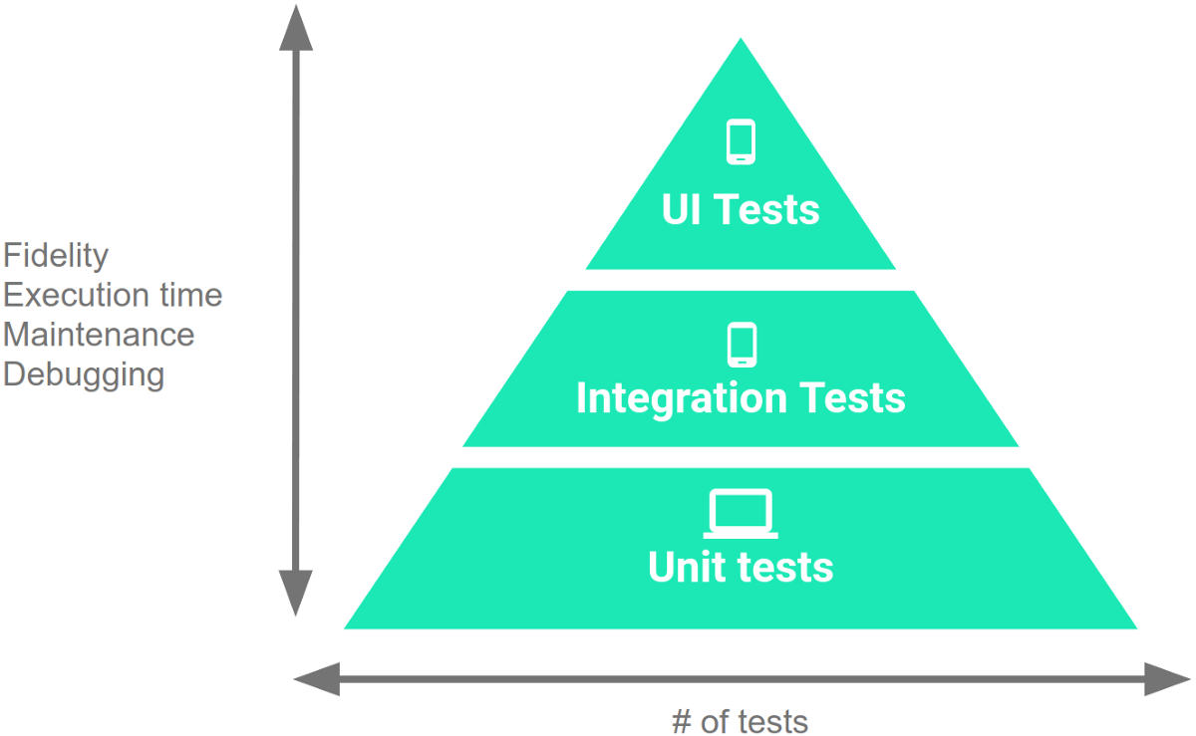
Testing Percentages
Unit tests verify behavior of a single class.
70% of your tests.
System tests verify class interactions.
20% of your tests.
GUI tests verify end-to-end journeys.
10% of your tests.
Notes:
These testing types are not equal in number that you write. Unit tests validate your app's behavior one class at a time. These are about 70% of your tests in a project. It is important to verify that the classes work as expected before we combine them. Then, system Integration tests validate either interactions between levels of the stack within a subsystem - a cluster of classes-, or interactions between related subsystems at the system level. These tend to be about 20% of your tests. Finally, End-to-end tests or GUI tests and exploratory tests validate user journeys spanning multiple subsytems of your app. These tend to make up the remaining 10% of your number of tests.

Slide 15
Testing
70/20/10 recommended.
Unit tests execute quickly, relatively simple.
System tests more complex, require more setup, slower to execute.
UI tests very slow, may require humans.
Well-tested units reduce likelihood of integration issues, making high levels of testing easier.
Notes:
This 70/20/10 split is what Google recommends. Thus is not set in stone, but has a logical underpinning. The reason for this is that as you work up the pyramid, from small unit tests to large complex UI tests, each test increases in fidelity but also increases in execution time and effort to create, maintain, and debug. Therefore, you should write more unit tests than system integration tests, and more system tests than GUI tests. Unit tests run through the command line, on the machine you use to develop the app. They run quickly, in milliseconds. They are small and simple. Integration tests require more setup, more communication, tend to include more actions and method calls. They take more time to run. GUI tests require running the full system, may require special hardware - if testing an Android app, you run the test on the phone itself. You should run GUI tests on multiple devices too in any case, to make sure they work in different hardware, OS, and software configurations. You may also need humans in the loop. This dramatically increases the required execution time. GUI tests are also often more complex, so they require more maintenance effort too. The good news is that this split also works out even without the speed factor. Units are tested in isolation. Well-tested units should integrate more cleanly - if there are issues, they are due to the integration itself and not a problem solely in one unit. Creating more unit tests makes the other levels easier as well. Cheaper and easier.

Slide 16
Creating System-Level Test Cases
Notes:
10 minute break

Slide 17
Creating System-Level Tests
Identify an Independently Testable Function
Identify a function that can be tested in (relative) isolation.
Identify Choices
Identify controllable aspects of the input and environment that determine the outcome of the function.
Identify Representative Input Values
Identify types of values for each choice that lead to different function outcomes.
Generate Test Case Specifications
Combine values to form “recipes” for test cases.
Generate Test Cases
Replace representative values with concrete values.
Notes:
Last time, we discussed the process of creating System-level tests. As a reminder, this is a five stage process.
You need to figure out what the independently testable functionality of your system or subsystem is. What features or functions are surfaced by an interface and can be tested in isolation. What can we push and observe in the software?
For each of those features, we look at the inputs, configuration options, and execution environment. What can you control when you test this function that would influence the outcome of executing it? This includes both the actual input parameters - what you can pass to the functionality - and any other important aspects you can contorl and that might change the outcome, like database contents or the existence of a file.
For each of those choices, what types of input will trigger each possible outcome. What types of input should we try?
We then combine these representative values to form recipes for test cases, abstract test specifications that state the type of input we will provide. These can lead to many different concrete test cases when we
instantiate the specifications by replacing the abstract representative values with concrete values.

Slide 18
Independently Testable Functionality
Identify an Independently Testable Function
A well-defined function that can be tested in (relative) isolation.
Based on the “verbs” - what can we do with this system?
The high-level functionality offered by an interface.
UI - look for user-visible functions.
Web Forum: Sorted user list can be accessed.
Accessing the list is a testable functionality.
Sorting the list is not (low-level, unit testing target)
Notes:
An independently testable feature is a well-defined function that can be tested in (relative) isolation from other functionality. This is often pretty clear in system or subsystem-level testing. You look at the “verbs” - the actions you can perform with the software. If you are working with an interface, it is the high-level functionality you can access through that interface. So, if our target is a subsystem, and even if we can access its underlying classes, we wouldn’t target those, as those are likely not operating in isolation at the time we have integrated them. We look to the interface and see what it tells us we can do. It can be much fuzzier in a GUI, when testing end-to-end journeys from a user perspective. There, you want to look at use cases or user stories if you have them. Those illustrate different paths through the system. In general, for a UI, look at what the user would see as a distinct, independent function.
For example, a web forum might be able to bring up a list of members. When it does so, it sorts them into alphabetical order. When testing this site, “list members” might be an independently testable feature. You can try that out and make sure it gives you the right outcome. Register for the forum would be another independently testable feature -you can fill out the provided form and see if your account is created. Sort member list is NOT a independently testable feature, as the user can’t cause a sort without everything else that comes up when you click on the member list link. This is a low-level functionalithy that you’ve probably already covered in unit testing.

Slide 19

Units and “Functionality”
Identify an Independently Testable Function
Many tests written in terms of “units” of code.
An independently testable function is a capability of the software.
Can be at class, subsystem, or system level.
Defined by an interface.
Notes:
Executable tests are typically written in terms of “units” of code.Usually a class or method. (2) a verb - what does the software do? What actions can it perform? May not correspond to unit(s). (3). This is a principle we can apply to dervie test cases at any level of granularity. However, this is usually defined by an interface, and that is really what the purpose of an interface is - to define what the system can do. A system has interfaces. Look to those. Each subsystem offers an interface as well, and has responsibilities it can perform. When we perform integration testing at the subsystem level, look to that interface. Even at the class level - a class has methods, thus it has testable functionality. You can define testable functionality at different levels of granularity. But, we want to look at this from the outside. Look for an interface. That defines the verbs, the capabilities that we know the software will have, the actions we can perform with it.

Slide 20
Identify Input Choices
Identify Choices
What choices do we make when using a function?
Anything we control that can change the outcome.
What are the inputs to that feature?
What configuration choices can we make?
Are there environmental factors we can vary?
Networking environment, file existence, file content, database connection, database contents, disk utilization, …
Notes:
The outcome of a function depends on the choices we make when we test it. What do I mean by choices? This is anything we can control when we test. The parameters, variable choices, and environmental factors that influence the execution of a feature. The obvious choices are the input parameters of the function. We choose values for those. Of course, we might even drill in further and look at the aspects of the input that we can vary.However,, explicitly defined parameters might not be the only thing that determines the output you get from a function. You might have configuration options you chose for the software - flags at start-up, an account we log into. Third, what other environmental factors could lead to a different outcome? There may be many of these and these and configuration options are implicit parameters, as they can have a big impact on the outcome of executing this function. Things like your network connection - number of concurrent users - whether a file exists or not, what is in that file, whether we can connect to the database, what is in that database - does it already have the record we want to insert? - is the hard disk full. We want to consider any important factors that could change the outcome of this function. These are the choices we will decide on when we test.

Slide 21
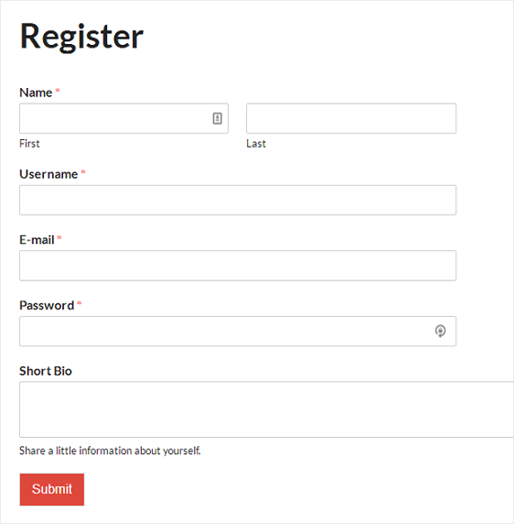
Ex: Register for Website
Identify Choices
What are the inputs to that feature?
(first name, last name, date of birth, e-mail)
Website is part of product line with different database options.
(database type)
Consider implicit environmental factors.
(database connection, user already in database)
Notes:
Say we have a user registration feature on a website. What choices do we make? First (1). It might take in (2). Now, the explicitly defined parameters might not be the only ones you have to deal with. If you’re registering users, what else might influence the outcome? How about a database to store those users? That is going to influence execution. Lets say this website is part of a product line, where we can attach different databases. This adds one more choice - which type of database are we using? Now, we should consider how that database can influence execution. Those are also choice we make when testing. What matters here? This adds more choices. In this case, we might want to consider whether we can connect to the database and whether is has this user already in it or not - those have an effect on how the test executes. So, we need to take that into account. This means that for the function “register for website”, we make 7 choices when we test (2,4,6)

Slide 22
Parameter Characteristics
Identify Choices
Identify choices by understanding how parameters are used by the function.
Type information is helpful.
firstName is string, database contains UserRecords.
… but context is important.
Reject registration if in database.
… or database is full.
… or database connection down.
Notes:
The key to identifying more choices is in understanding how the input parameters are used by the function. (2-3) But, any context for how those are used in practice and how they impact execution is invaluable for coming up with tests. If the database already contains an entry for that combination of fields, registration should be rejected. or (last two)

Slide 23
Parameter Context
Identify Choices
Input parameter split into multiple “choices” based on contextual use.
“Database” is an implicit input for User Registration, but it leads to more than one choice.
“Database Connection Status”, “User Record in Database”, “Percent of Database Filled” influence function outcome.
The Database “input” results in three input choices when we design test cases.
Notes:
An input for a function might be split into multiple “choices” based on contextual use. The database may or may not contain a record for that user. In either case, issues may emerge based on the size of the database. The program may also have issues if a database connection cannot be established. This means that “database” - even though it is an implicit parameter to the User Registration function - is not a choice. Rather, you have three “choices” for this function based on the database, three things we can vary when testing. So, when thinking about choices, it is less important to capture just the literal input that would be passed to the function, and more important to capture each thing we can vary when testing the function. (3-5)

Slide 24
Examples
Identify an Independently Testable Function
Class Registration System
What are some independently testable functions?
Register for class
Drop class
Transfer credits from another university
Apply for degree
Notes:
(discussion)
if low on time, skip

Slide 25
Example - Register for a Class
Identify Choices
What are the choices we make when we design a test case?
Course number to add
Student record
What about a course database? Student record database?
What else influences the outcome?
Notes:
(discussion)

Slide 26
Example - Register for a Class
Identify Choices
Student Record is an implicit input choice.
How is it used?
Have you already taken the course?
Do you meet the prerequisites?
What university are you registered at?
Can you take classes at the university the course is offered at?
Notes:
(discussion)

Slide 27
Example - Register for a Class
Identify Choices
Potential Test Choices:
Course to Add
Does course exist?
Does student record exist?
Has student taken the course?
Which university is student registered at?
Is course at a valid university for the student?
Can student record be retrieved from database?
Does the course exist?
Does student meet the prerequisites?
Notes:
(go over). This looks like a lot, but you do want to try to capture all the factors that can influence the outcome of the function. When we create tests, we will not necessarily combine every combination of choices. Many of these we will try once. But, we first need to capture the full space of possibiltiies.

Slide 28
Identifying Representative Values
Identify Representative Input Values
We know the functions.
We have a set of choices.
What values should we try?
For some choices, finite set.
For many, near-infinite set.
What about exhaustively trying all options?
Test Input Data
Program
Test Output Results
Notes:
(1-2) The next step, obviously, is to come up with the input to those parameters and choices. If we want to test the software, we need to provide input and choose between the values for those choices. For some, this is easy. On that last slide, we had a lot of yes/no choices. For most cases ,we do not have exactly two options. What if an input is a number? What numbers do we choose?
What values should we pass in? How about we try every input? (discuss)

Slide 29
Exhaustive Testing
Identify Representative Input Values
2³² possible integer values for each parameter.
= 2³² x 2³² = 2⁶⁴ combinations = 10¹³ tests.
Take the arithmetic function for the calculator:
add(int a, int b)
How long would it take to exhaustively test this function?
Test Input Data
Program
1 test per nanosecond
= 10⁵ tests per second
= 10¹⁰ seconds
Test Output Results
or… about 600 years!
Notes:
Let’s take a calculator and just look at addition. Let’s just restrict the numbers to 32 bit integers. If we wanted to exhaustively test adding two numbers, how long would it take? How many inputs are we talking about?
- (read) That’s a lot right, how long we talking about time wise?
- let’s be generous and say we can run a test per nanosecond. That works out to about 10^5 tests per second, or 10^10 seconds overall. That doesn’t sound bad in seconds, but how long is that?
- (read). That’s for something as simple as addition of two integers. That’s insane, right?

Slide 30
Not all Inputs are Created Equal
Identify Representative Input Values
Many inputs lead to same outcome.
Some inputs better at revealing faults.
We can’t know which in advance.
Tests with different input better than tests with similar input.
Test Input Data
I
Program
Test Output Results
O
Notes:
We can’t exhaustively test any real program. You just can’t. Addition is the bottom of the barrel in terms of complexity. Most individual features will have quadrillions of inputs at least. Exhaustive testing just isn’t going to work out. Fortunately, you don’t need to. The fact is that not all inputs are as useful as others. Purely from the verification perspective, there are only so many outcomes of a function, and you’ll have a lot of inputs that lead to the same outcomes. Why use all of them? We can cut that down some. Then, fundamentally, testing is really something we do to find problems, and some inputs are going to be better than others and revealing those problems. We want those inputs. Sadly, we don’t know which tests will reveal faults until we run them. But, as a start, we know that two tests with inputs that are very different from each other are more likely to reveal faults than two tests with very similar input. Say you can select three tests for a program that breaks a text buffer into lines of 60 characters each. We select tests with a 40 character string and a 30 character string. Then, for a final test, we use a 100 character string. We can’t prove the 100 character buffer is a better test, but we would be more suspicious of a set of tests that is biased towards lengths less than 60. That’s a start, we’re covering a wider range of the input space. You’re more likely to hit a different outcome of a function or some weird corner case that is likely to break the whole thing..

Slide 31
Let’s take a break.
Notes:
15 minute break

Slide 32
Input Partitioning
Identify Representative Input Values
Consider possible values for a variable.
Faults sparse in space of all inputs, but dense in parts where they appear.
Similar input to failing input also likely to fail.
Try input from partitions, hit dense fault space.
Notes:
The next step is to take a good, long look at that input space for a variable. This is the space of all possible inputs values for a variable (click) In truth, faults are pretty sparse in the input space as a whole, but they are dense in the part of the input space in which they appear. If we try an input, and it fails, there’s a good chance that a highly similar value will also fail. (click) In practice, you can almost always divide the space into partitions - into logical group of inputs based on some criteria - maybe based on the outcome they’ll trigger. The thing is, if we do a good job of partitioning, and we come up with an input that lands in a space dense with faults, then we’re in good shape. This goes back to something I touched on a few minutes ago. We should - a a general strategy - favor different input over similar input. That’s a key idea. Try two very different things and you’re more likely to trigger a fault than trying two very similar things. Even more so if we put some thought into where those inputs come from. if we systematically go through and try a few inputs from each of those partitions, we are more likely to hit a larger range of different results than just randomly trying input. If a feature can result in different outcomes, we’re more likely to hit all of those by breaking the input space down along different line, and as a result, we’re way more likely to hit that space where faults are dense and trigger a few of them. By incorporating domain knowledge and experience, you can make sure that the tests actually cover a representative portion of that input space.

Slide 33
Equivalence Class
Identify Representative Input Values
Divide the input domain into equivalence classes.
Inputs from a group interchangeable (trigger same outcome, result in the same behavior, etc.).
If one input reveals a fault, others in this class (probably) will too. In one input does not reveal a fault, the other ones (probably) will not either.
Partitioning based on intuition, experience, and common sense.
Notes:
So, by partitioning the input domain, we can then form a set of equivalence classes - input that is essentially interchangeable. An equivalence class of tests essentially test the same scenario - they give you the same outcome, they trigger the same behavioral pattern, same usage of a feature, they do the same thing according to come criterion we define. (2-3)
Perfect partitioning of tests is hard, but we try our best with a combination of intuition, experience, and common sense.

Slide 34
Example
Identify Representative Input Values
substr(string str, int index)
What are some possible partitions?
index < 0
index = 0
index > 0
str with length < index
str with length = index
str with length > index
...
Notes:
(discuss), both variables
think about the outcomes, and how the variables work together to influence the outcome.
-bring in and walk through
Let’s go over some strategies.

Slide 35
Choosing Input Partitions
Identify Representative Input Values
Equivalent output events.
Ranges of numbers or values.
Membership in a logical group.
Time-dependent equivalence classes.
Equivalent operating environments.
Data structures.
Partition boundary conditions.
Notes:
A few of these include:
- (read) Can you group based on the output event that occurs?
-Look for ranges of numbers or values - what are the different discrete ranges of input values that can be provided that might give us different outcomes based on context?
-Look for membership in a logical group - Can we group these inputs based on how their used, what context the method uses them in, do member of this group trigger similar behavior?
-Look for time-dependent classes - does the timing of input matter to particular groupings?
- (read) the operating environment might influence system behavior
- (read) - some data structures, such as arrays, can be broken down into common groupings of input.
-(read)

Slide 36
Look for Equivalent Outcomes
Identify Representative Input Values
Look at the outcomes and group input by the outcomes they trigger.
Example: getEmployeeStatus(employeeID)
Outcomes include: Manager, Developer, Marketer, Lawyer, Employee Does Not Exist, Malformed ID
Abstract values for choice employeeID.
Can potentially break down further.
Notes:
First thing to do is start from the output, divide the output into the different outcomes I can get - then try to come up with input that produces those outcomes. This is a good first step, then we might break down further from there.It is often easier to find good tests by looking at the outputs and working backwards. Fior example, (2). The outcomes of this function include (3). Well, this is a good initial set of options for the choice employee ID. These are abstract values, and when we create a concrete test, we would then choose actual input for employee ID from each abstract category. We then might break these abstract values down further into ranges of IDs within those categories.

Slide 37
Look for Ranges of Values
Identify Representative Input Values
Divide based on data type and how variable used.
Ex: Integer input. Intended to be 5-digit:
< 10000, 10000-99999, >= 100000
Other options: < 0, 0, max int
Can you pass it something non-numeric? Null pointer?
Try “expected” values and potential error cases.
Notes:
When dividing input into input partitions, it is natural to look for how you could split the values of inputs into discrete ranges. (1) Any value from a particular input range should have a similar effect. For example, If input is intended to be a 5-digit integer between 10000 and 99999, but you just inter an integer, you mgiht first divide this into: (3) Then think a little more about other special numbers that might do something weird. For example (4) . In general, You want to hit a typical value, something from the expected range, then hit cases that fall outside of the expected range. Then consider those weird corner cases likely to trigger issues - a negative value, exactly 0, the maximum sized integer. see if those break something, or if error handling code kicks in. Then, can you pass it something non-numeric? String, some other data type that might be cast in a weird way or cause a problem? A null pointer?

Slide 38
Look for Membership in a Group
Identify Representative Input Values
Consider the following inputs to a program:
A floor layout
A country name.
All can be partitioned into groups.
Apartment vs Business, Europe vs Asia, etc.
Many groups can be subdivided further.
Look for context that an input is used in.
Notes:
(title) - idea is that there is context behind how a program uses inputs. Often ,you have different logical groups in mind when you come up with a feature. Why not break up inputs into these logical groupings? (1-3) Look at how the input is used in the program. These can likely be broken into logical groupings. (4) Often these groupings are often too broad at first, but can we break those into smaller subgroups? Apartment types. EU and non-EU members, etc. (Depends on the needs of your program, the idea is that you can look at how a variable is used and break it into logical groupings based on what it represents)

Slide 39
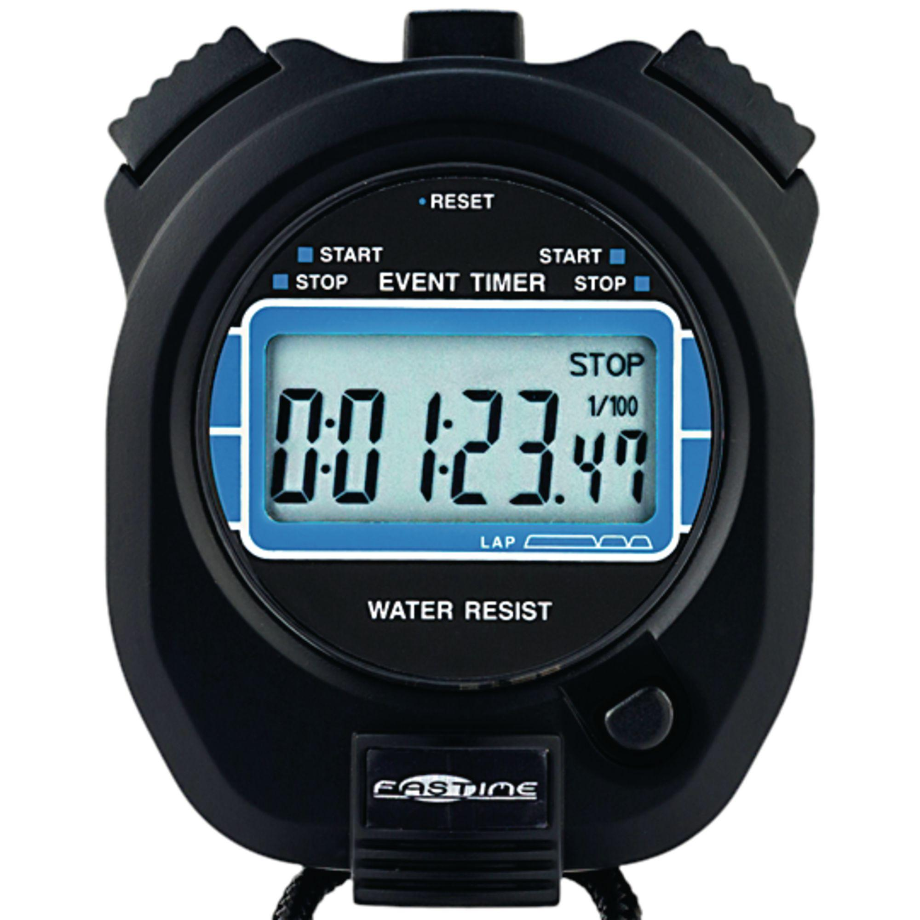
Timing Partitions
Identify Representative Input Values
Timing and duration of an input may be as important as the value.
Timing often implicit input.
Trigger an electrical pulse 5ms before a deadline, 1ms before the deadline, exactly at the deadline, and 1ms after the deadline.
Close program before, during, and after the program is writing to (or reading from) a disc.
Notes:
(1) Very hard and very crucial to get right. but also something that can be very important. For many systems, the timing of an input is an unstated, implicit input. If timing matters, you need to remember that it is part of the input, and partition it accordingly. For example, consider a pacemaker - looking for electrical impulses from the heart. (read)
Or, strange behaviors can happen when reading from a file or writing out to a file, try (read) Timing can be partitioned.

Slide 40
Operating Environments
Identify Representative Input Values
Environment may affect behavior of the program.
Environmental factors can be partitioned.
Memory may affect the program.
Processor speed and architecture.
Client-Server Environment
No clients, some clients, many clients
Network latency
Communication protocols (SSH vs HTTPS)
Notes:
Similar to timing, the environment that the program operates in can easily impact the behavior of the program. Thus, the environment can also be considered when forming value partitions. Consider the environment you’re operating in, how it can influence the input or output of the system, and how the combination of both explicit program inputs and implicit environmental variation can be partitioned.
Memory may cause problems. What if you don’t have enough? What if you have enough physical memory, but not enough free (or not enough birtual memory)
Same for processor speed or architecture. Could see race conditions, deadlock between processes, unexpected slowdown.
Try using different machine specs and vary both the processor and memory. Those choices suggest different partitionings.
Client-server environment can have huge impacts on the operation of the system.
try with different numbers of connections to clients - none, some, many (DDOS conditions)
network latency - can vary network equipment or speed
communication protocols - many options for a file upload, try each that you support

Slide 41
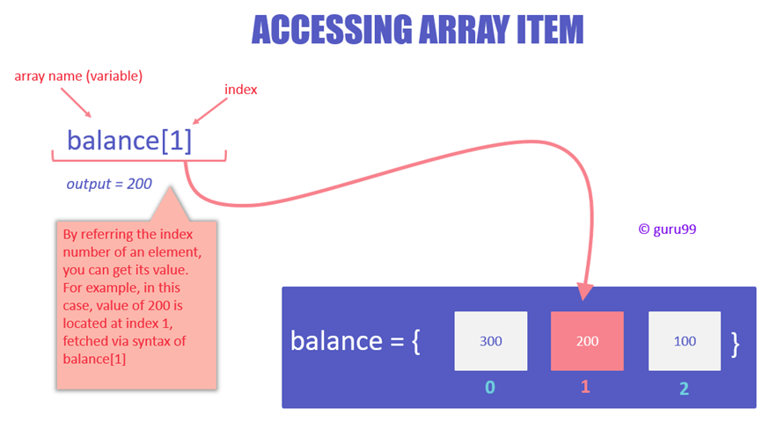
Data Structures
Identify Representative Input Values
Data structures are prone to certain types of errors.
For arrays or lists:
Only a single value.
Different sizes and number filled.
Order of elements: access first, middle, and last elements.
Notes:
(1) So, use experience with those to suggest values to try
(read) Programmers naturally think of sequences as made of up several values and it’s common to embed this assumption into the program. If presented with a single-value sequence,the program might fail.
(read) Decreases the chances that a bad program will accidentally give you a good output because of a particular input choice.
(read) This will reveal problems at partition boundaries.

Slide 42
Input Partition Example
Identify Representative Input Values
What are the input partitions for:
max(int a, int b) returns (int c)
We could consider a or b in isolation:
a < 0, a = 0, a > 0
Consider combinations of a and b that change outcome:
a > b, a < b, a = b
Notes:
(discussion) (read)

Slide 43
Revisit the Roadmap
For each testing choice for a function, we want to:
Partition each choice into representative values.
Choose a value for each choice to form a test specification.
Assigning concrete values from each partition.
Identify Representative Values
Generate Test Case Specifications
Generate Test Cases
Notes:
So, for each independently testable function and its choices, we want to:
identify the representative values for each choice. For each input choice, we want to be able to chop up the input space into different groupings.
So, we have each individual choice partitioned. For tests, we feed in a combination of decisions for each of those choices. Not just a value for one, but a value for all explicit and implicit inputs of the function. So, you create a set of abstract tests where each abstract test specification has a partition selected for each choice.
Then, we can turn those specifications into one or more concrete test cases by choosing actual concrete values for each partition selected.

Slide 44
Forming Specification
Generate Test Case Specifications
Function insertPostalCode(int N, list A).
Choice: int N
5-digit integer between 10000 and 99999
Representative Values: <10000, 10000-99999, >100000
Choice: list A
list of length 1-10
Representative Values: Empty List, List of Length 1, List Length 2-10, List of Length > 10
Notes:
So, in coming up with equivalence partitions for these choices, you need to think about what exemplifies the space of input values. You want to make sure you hit the types of input that can be passed in. For example (go over)

Slide 45
Forming Specifications
Generate Test Case Specifications
Choose concrete values for each combination of input partitions: insertPostalCode(int N, list A)
int N
list A
(3 * 4 = 12 abstract specifications)
Test Specifications:
insert(< 10000, Empty List)
insert(10000 - 99999, list[1])
insert(> 99999, list[2-10])
...
Concrete Test Cases:
insert(5000, {})
insert(96521, {11123})
insert(150000, {11123, 98765})
...
< 10000
10000 - 99999
> 99999
Empty List
(Each specification = 1000s of potential test cases)
List[1]
List[2-10]
List[>10]
Notes:
Now, we have the representative values for the individual inputs. For our test, we want to combine those. We don’t just pass in values to a single input. We pass in values to all inputs at once. To form our test specifications, our list of test types, we need to list out all of the possible combinations of input partitions for all inputs. For example,
(read)
then, we can create concrete test cases by assigning values to each abstract specification
(read)
(go over number of abstract specifications, real test cases)

Slide 46
Generate Test Cases
Generate Test Cases
substr(string str, int index)
Specification:
str: length >=2, contains special characters
index: value > 0
Test Case:
str = “ABCC!\n\t7”
index= 5
Generate Test Case Specifications
Generate Test Cases
Notes:
Now, we have our set of test case specifications. We have all these abstract combinations of input types we want to try. Now, we need to transition to concrete test cases, where we feed in actual values. This is a simple instantiation of these test specifications. There are still a few things to keep in mind, though. For one - there is a reason we do both the specifications and concrete cases, which is that if you feed in multiple tests with the same specification, only one of them might still actually trigger a fault in the code.

Slide 47
Boundary Values
Generate Test Cases
Errors tend to occur at the boundary of a partition.
Remember to select inputs from those boundaries.
Notes:
Now, no matter how you chop up the input partitions, the most errors tend to occur at the boundaries of those divisions. So, in choosing concrete values, don’t forget to try out those wrird corner cases.

Slide 48
Boundary Values
Generate Test Cases
Choose test case values at the boundary (and typical) values for each partition.
If an input is intended to be a 5-digit integer between 10000 and 99999, you want partitions:
<10000, 10000-99999, >100000
0
5000
9999
100000
150000
max int
10000
50000
99999
Notes:
(read)

Slide 49
Example - Set Microservice
Microservice related to Sets:
void insert(Set set, Object obj)
Boolean find(Set set, Object obj)
void delete(Set set, Object obj)
For each function, identify choices.
For each choice, identify representative values.
Create test specifications with expected outcomes.
Notes:
You have developed a microservice that safely inserts, finds, and deletes elements from a Set structure (i.e., a list where no duplicates can exist). The interface for this microservice offers the following independently testable functions:
void insert(Set set, Object obj) Boolean find(Set set, Object obj) void delete(Set set, Object obj)
For each function, identify the input choices you can make when testing.
For each choice, identify a set of representative values.
For each function, create four test specifications from those values. For each, state the expected program output.

Slide 50
Example - Set Microservice
void insert(Set set, Object obj)
What are our choices?
Identify an Independently Testable Function
Identify Choices
Parameter: set
Choice 1: Number of items in the set
Parameter: obj
Choice 2: Is obj already in the set?
Choice 3: Type of obj (e.g., valid, invalid, null)
Notes:
insert is one of our indepedently testable functions. (click to bring in choices

Slide 51
Example - Set Microservice
void insert(Set set, Object obj)
Parameter: set
Choice: Number of items in the set
Representative Values:
Empty Set
Set with 1 item
Set with 10 items
Set with 10000 items
Identify Representative Input Values
Parameter: obj
Choice: Is obj already in the set?
Representative Values:
obj already in set
obj not in set
Choice: Type of obj
Representative Values:
Valid obj
Null obj
Notes:
go over representative values

Slide 52
Example - Set Microservice
Generate Test Case Specifications
void insert(Set set, Object obj)
(4 * 2 * 2) = 16 specifications
Some are invalid (null in set). Can remove/ignore those.
Each can become 1+ test cases.
(1 item, Yes, Valid) becomes:
insert({“Bob”}, “Bob”);
Set Size | Obj in Set | Obj Status | Outcome
Empty | No | Valid | Obj added to Set
Empty | No | Null | Error or no change
1 item | Yes | Valid | Error or no change
1 item | No | Valid | Obj added to Set
1 item | No | Null | Error or no Change
10 items | Yes | Valid | Error or no change
10 items | No | Valid | Obj added to Set
10 items | No | Null | Error or no Change
10000 | Yes | Valid | Error or no change (may be slowdown)
10000 | No | Valid | Obj added to Set(may be slowdown)
10000 | No | Null | Error or no Change (may be slowdown)
Generate Test Cases
Notes:
From this, we can form 16 test specifications by choosing values for each choice. now, of course, many of these are redundant, so we can eliminate ones that we don’t really expect to learn anything new from. Some are also impossible, and we can get rid of those right away, like cases where a null object is already in the set - that can’t happen, so we wipe those out. Here is our set of test specifications, our recipes for test cases.

Slide 53
Creating System Tests for a REST API with Postman
Notes:
Let’s give a slightly more concrete scenario.

Slide 54
Postman
Testing and development framework for systems with a REST API.
A system interface with endpoints we can interact with.
At an endpoint, we can send HTTPS request to:
GET information that you are interested in.
DELETE the information stored.
PUT information into what is stored (ex: create a new entry)
POST information (ex: update an existing record)
Create requests and test cases using Postman.
Notes:
how you write concrete test cases is is very depedent on technology - which language are you working in? What product domain? what interface type? Let’s focus on one specific domain - web apps. You’ve taken mobile and web development already, so this is a domain AND a tool you’ve already used, or at least heard of. So, I won’t go into every detail on the tool, but we can use it to make some of these theoretical concepts a bit more concrete. A REST API is (2), where endpoints are URLs we can access. At an endpoint, we can use, typically, one of four actions. We can get information we are interested in that is provided by that endpoint, we can delete the current information stored, we can send it new information to PUT into what is already there, or we can POST information - for example, updating a record that already exists). What happens when we make these requests depends on how the program is written, but we have this core set of VERBS we apply to these endpoints. Using Postman, we can create requests and test cases for those requests - system-level test cases that interact through these endpoints using HTTP requests

Slide 55
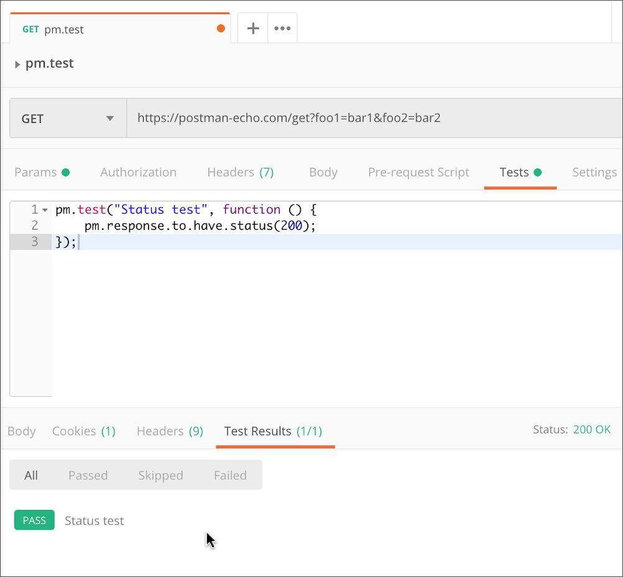
Writing Tests in Postman
Test Input
Each tab is a request.
The request is the test input.
(GET/POST/PUT/DELETE) to an endpoint.
Can specify body, header, authorization, etc. for the request.
Tests tab allows creation of test oracles.
Write small JavaScript methods to check correctness of output.
Test Oracle
Notes:
Postman has a GUI where you create requests to a REST API. This GUI seperates our test input from our test oracles - where we specify what the expected behavior is and how the system should respond. The GUI presents you with tabs and a + button you can press to create a new tab. Each tab is a request. This is, esentailly, our test input. Here, we have a GET Request to this endpoint. Then, there are many tabs where we set information about the request, like the request body - the information you pass to it - the header, authentication ,adn so on. One tab is called tests. This is esstentially our test oracle- expectations on the output and some code we use to check that output against the expectations. Test oracles are written in Javascript and we have a lot of different expressions we can use to write test cases. In this simple case, we pull the response, and state that it must have status 200. We don’t care what information is returned here. We just expect the GET request to be accepted by the endpoint. Status 200 just indicates that everything is great. We can get far more complex, checking for specific information being returned..

Slide 56
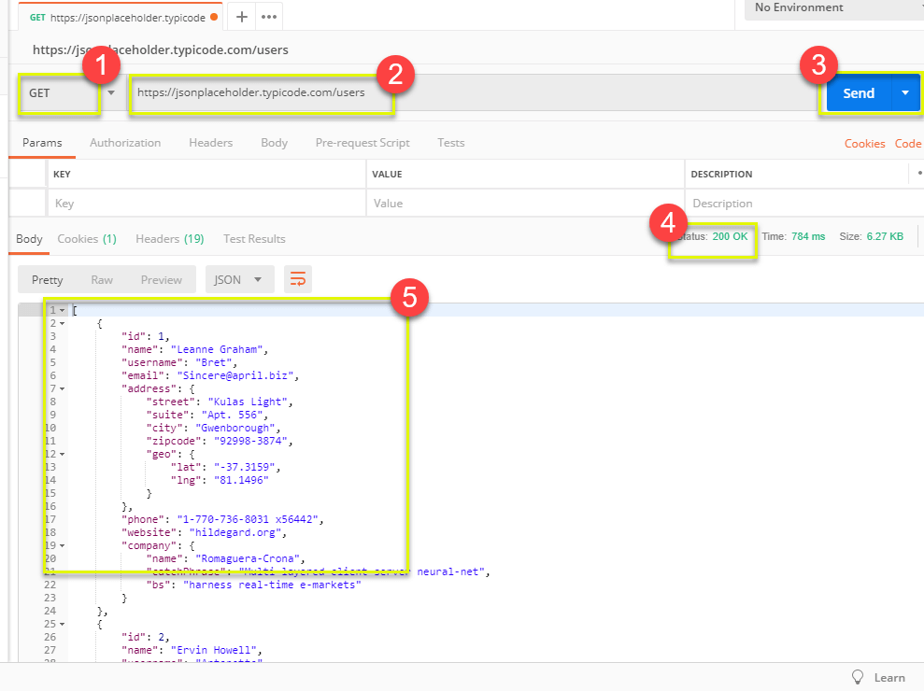
Input - GET
Select GET as the request type.
Set the endpoint URL.
Click “Send”
The response status is indicated.
The body contains the returned information.
Adapted from https://www.guru99.com/postman-tutorial.html
Notes:
Get requests are used to retrieve information from the given URL. There will be no changes done to the endpoint. To run a GET request, you (1) Set your HTTP request to GET.
(2) In the request URL field, input the endpoint link (3) Click Send. After that, (4) You will see a response status. In this case, it is - 200 OK Message. The endpoint accepted the request and sent a response. (5) Then, we can see the actual information returned in the body. In this case, it is a JSON file with information on the users. We don’t know yet if this information is correct - we need to add a test oracle for that. However, this is how we provide test input for a GET request.

Slide 57
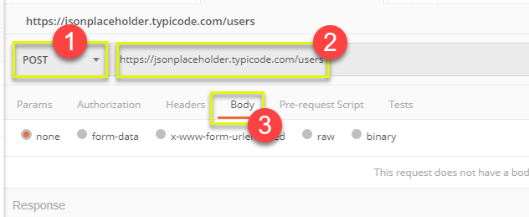
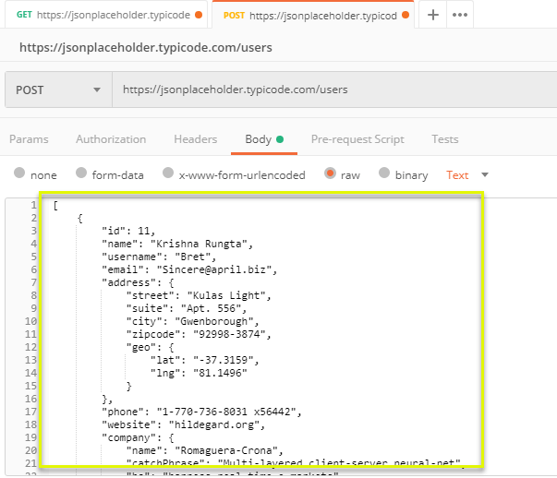
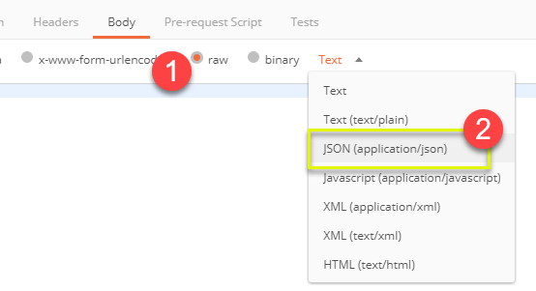
Input - POST
Set request to POST.
Set the endpoint URL.
Select the “Body” tab.
Click “raw” (raw text), “binary” (file/executable), etc.
Select data format (JSON, XML, etc.)
Add user data in proper JSON format.
Adapted from https://www.guru99.com/postman-tutorial.html
Notes:
Post requests are different from Get request as there is data manipulation with the user adding data to the endpoint. Using the same data from the previous Get request, let's now add our own user to this set. To do this time, we (1) set the request to POST instead of GET, we use the same endpoint URL, then we click the Body tab to input the information we want to pass to the interface. Now, in the body tab, we (1) click raw to send raw text. We could also click, for example, binary to send a PDF file or some other compiled executable object. We then select the data format. In our case, we are going to provide data to this endpoint as JSON. This JSON will contain information on the users we want to add to this list. We then add JSON data in the format that the interface expects. This is also where we can try to do things like enter malformed data, embed attacks, and so on to test the reilience of the system under test.

Slide 58
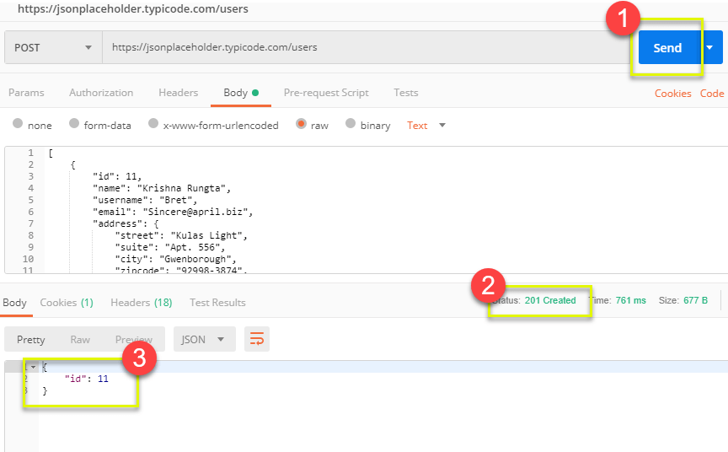
Output - POST
Click Send to send request.
Response status is indicated (201, data created)
Body indicates record “11” was created.
Adapted from https://www.guru99.com/postman-tutorial.html
Notes:
When we run this, what happens? We click send to send the request to the endpoint, then we get back the status 201, which normally indicates that something was created at the endpoint in response to the request. This is the repsonse we would probably want to see. The body also contains a small snippet of JSON indicating that the created item has the ID 11. Before, there were 10 records, now this is the 11th record. Another good sign that this POST request worked.

Slide 59
Creating Test Oracles
Tests tab allows creation of JavaScript blocks used to verify results.
These are “test oracles”.
Embed expectations on results and code to compare expected and actual values.
pm.test library gives variety of commands to make assertions on output.
https://learning.postman.com/docs/writing-scripts/script-references/test-examples/ (many example scripts!)
Notes:
Postman Tests are little blocks of JavaScript added to requests that help you verify results. In the language we specified before, these are our “test oracles” - in these, we embed our expectations on correct behavior, and then code to compare those expectations to the results we see. This can be as simple as checking the response status. It can also be more complex, where we inspect the JSON returned and make explicit comparisons. The best starting point for building these is to use the PostMan test Javascript library, called pm.test. This offers you commands that you can use to make assertions and verify results. I’ll show a couple of examples, but the best place to see a full list of example scripts is at https://learning.postman.com/docs/writing-scripts/script-references/test-examples/

Slide 60
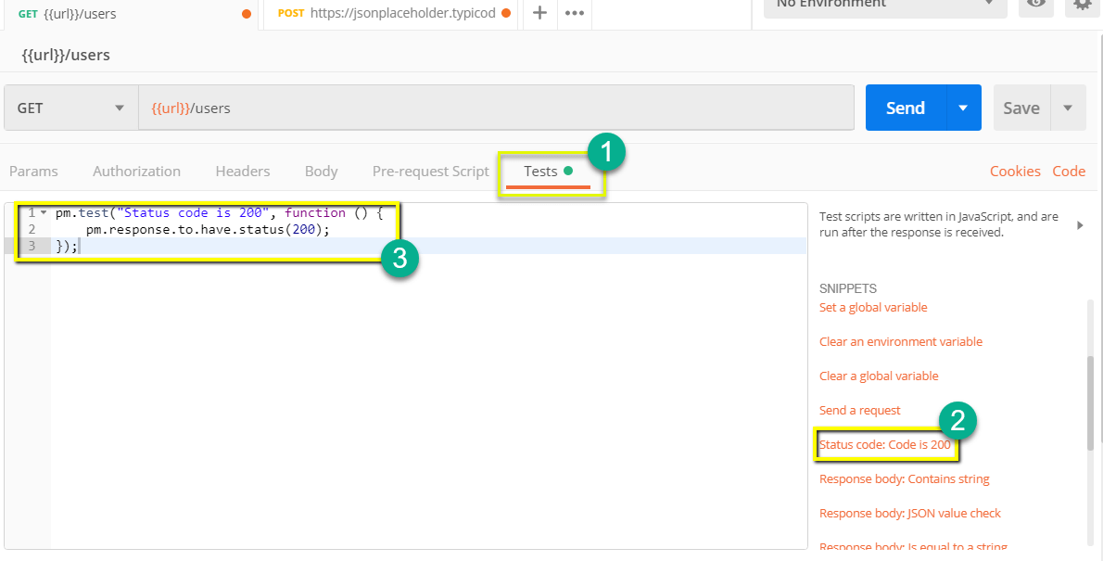
Oracle Example - Status Check
Create test in “tests tab”
Snippets offer pre-built test oracles.
Example - “status code must be 200”
Adapted from https://www.guru99.com/postman-tutorial.html

Slide 61
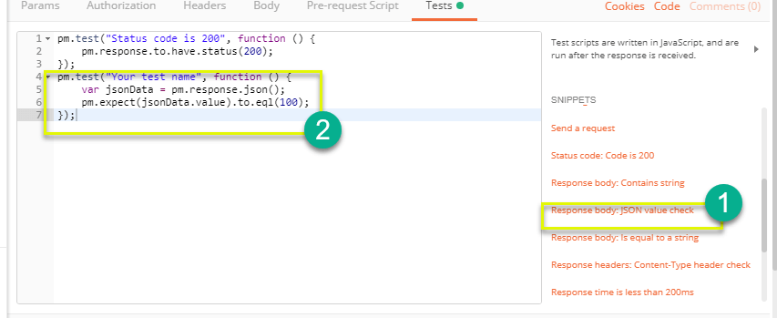
Oracle Example - Expected Value
Choose snippet “JSON value check”
This inserts generic test body.
Change test name, variable to check (name of the first user), value to check (check for name “Leanne Graham”).
3
pm.test("Check if user with id1 is Leanne Graham", function () {
var jsonData = pm.response.json(); pm.expect(jsonData[0].name).to.eql("Leanne Graham");
});
Adapted from https://www.guru99.com/postman-tutorial.html
Notes:
Next, let’s look at checking the expected value. Go back to the test tab and let's add another test. This time we will compare the expected result to the actual result. From the snippets section, click on "Response body:JSON value check". We will be checking if Leanne Graham has the userid 1. The snippet inserted is generic, so we need to adapt it to our needs. Next, we then replace "Your Test Name" from the code with "Check if user with id1 is Leanne Graham" so that the test name specifies exactly what we want to test. Replace jsonData.value with jsonData[0].name. To get the path, check the body in Get result earlier. Since Leanne Graham is userid 1, jsonData is in the first result which should start with 0. If you want to get the second result, use jsonData[1] and so on for succeeding results. In to eql, input "Leanne Graham"

Slide 62
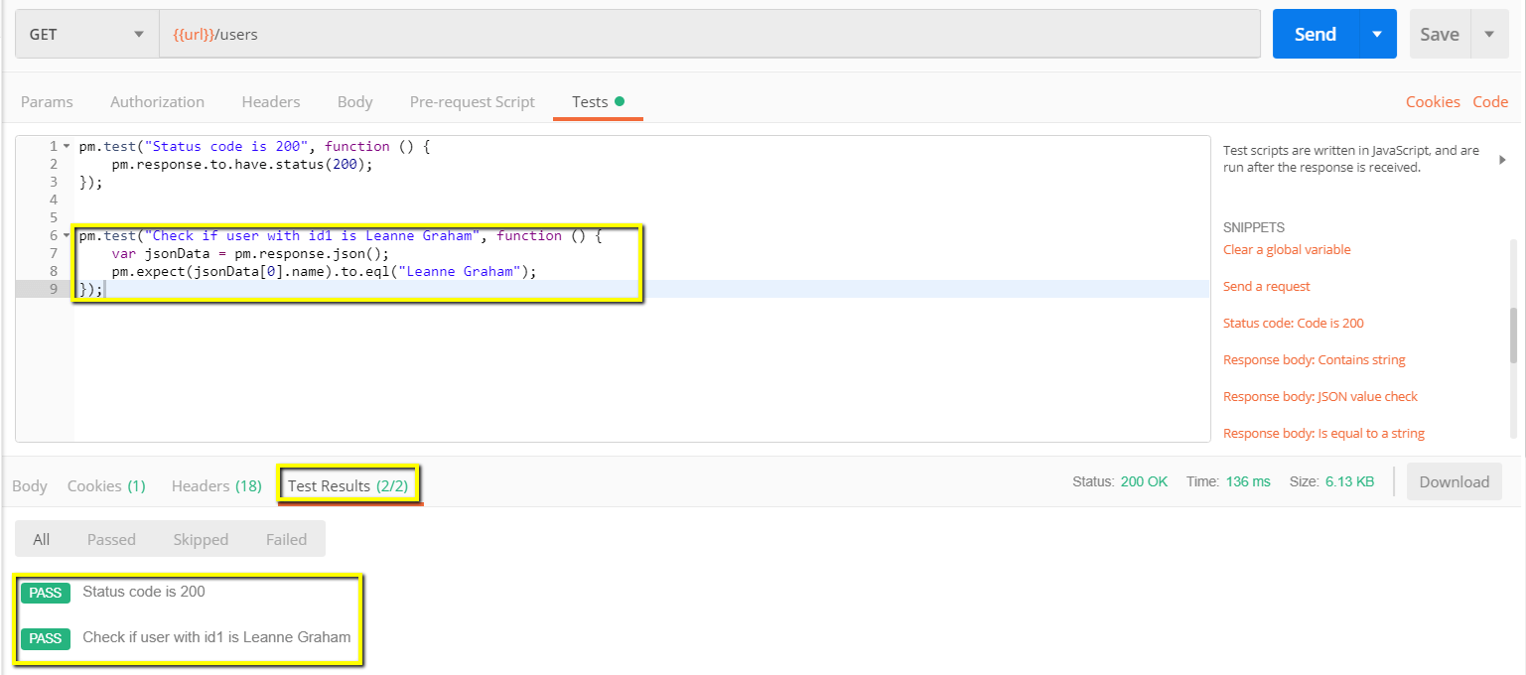
Test Execution Results
Both tests should pass. Status and test names indicated in GUI.
Notes:
Click send. There should now be two passed test results for your request. You can see the names of the test and the status of each in the GUI

Slide 63
We Have Learned
Unit testing focus on a single class.
System tests focus on high-level functionality, integrating low-level components through a UI/API.
Identify an independently testable function.
Identify choices that influence function outcome.
Partition choices into representative values.
Form specifications by choosing a value for each choice.
Turn specifications into concrete test cases.
Notes:
(read)

Slide 64
Next Time
Choosing system test cases.
Handling infeasible combinations.
Selecting an interesting subset of specifications.
Assignment 1 - Due Feb 14
Based on Lectures 1-6

